Slide 1
To easily follow these notes, log on to our Wifi
Wifi: mycci01 p/w: ancientquail060
Go to OrHaOlam.com
Click on downloads, messages, 2017

Slide 2
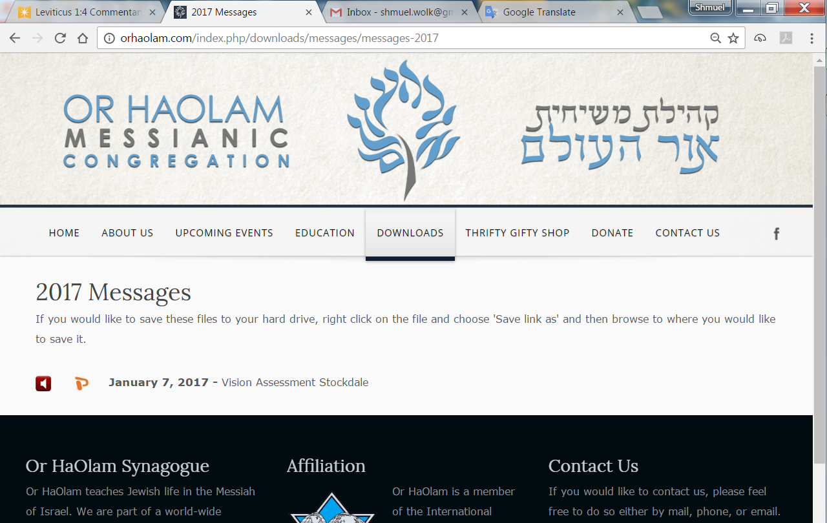

Slide 3
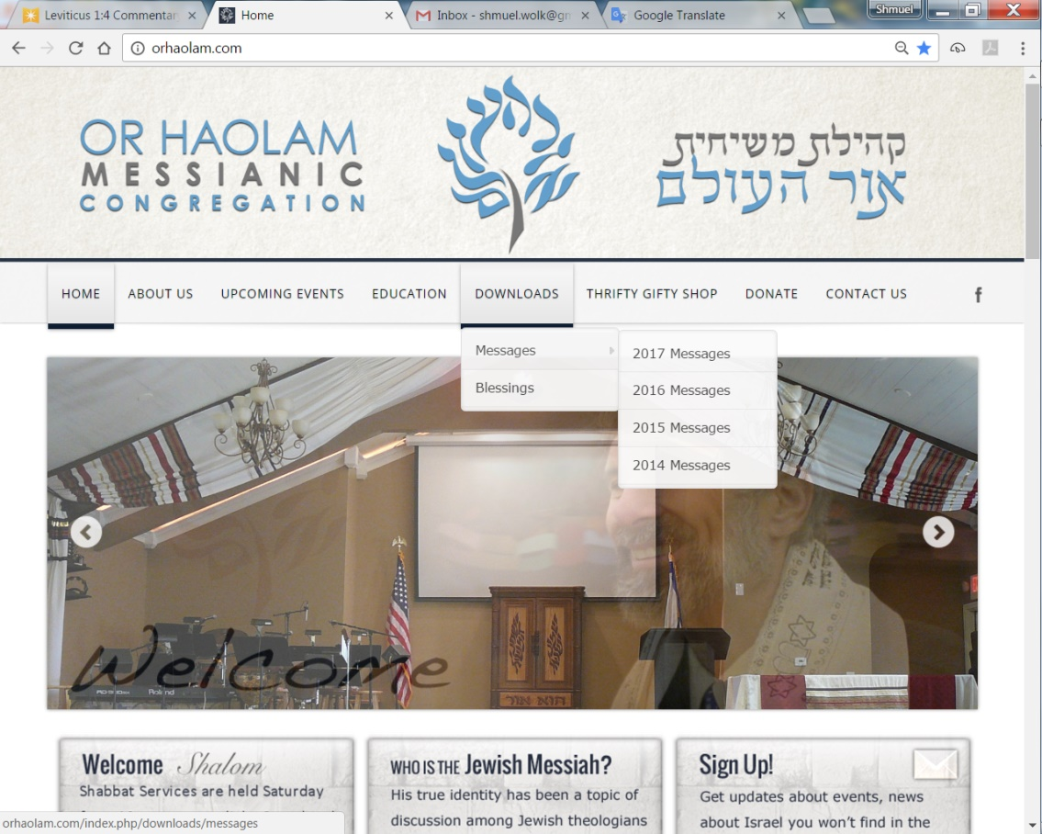
Downloads\messages\
2017 Messages

Slide 4
Israel trip with March of the Nations, May 6-16, 2018
Go to
OrHaOlam.com

Slide 5
OrHaOlam.com
Notes:
We really need enrollment to start, if this trip is going to happen!
Israel got a sort of early Hanukkah present. Hanukkah represents commemoration of the liberation and dedication/Hanukkah of the Temple in Jerusalem. [Next week’s theme] This year in diplomatic thinking, Jerusalem was liberated again. However, there is a big balagan = commotion over it.

Slide 6
News behind the news!
Pres. Trump is moving
the US Embassy to land
that is NOT disputed!
This move changes nothing
except to cancel a fantasy!
Notes:
The embassy is NOT going into land that has ever been said to be negotiable!!

Slide 7
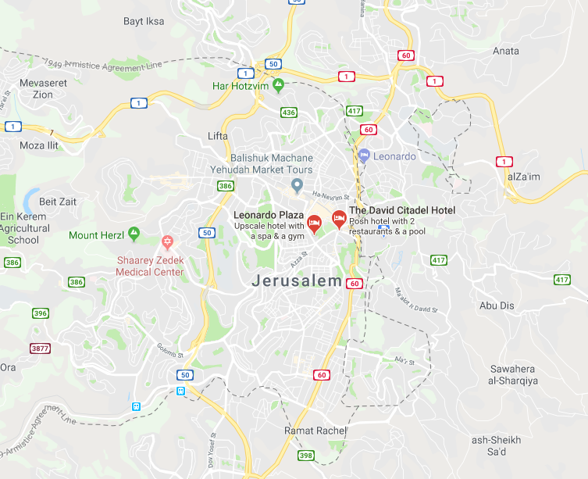
Green line
Knesset
Notes:
Green Line = 1967 border that is NOT subject to negotiation. Note, well into the west side of the 1967 “Greeen Line”
Note Knesset location. The embassy is NOT going into land that has ever been said to be negotiable!!
The Czech Republic announced Wed. evening 6 Dec. 2017 that it recognizes west Jerusalem as Israel's capital, [only state to sell weapons to Israel ~1947]. Russia did so last April. There were also numerous media reports that the Philippines has also expressed interested in granting Jerusalem recognition as Israel's capital. (J.Post)

Slide 8
News behind the news!
#2
How to solve the
Lebanon Crisis

Slide 9
United Nations Security Council Resolution 1701, 12 August 2006
A long term solution based on (OP8)
Disarmament of all armed groups in Lebanon (implying Hezbollah)
No armed forces other than UNIFIL and Lebanese (implying Hezbollah and Israeli forces) will be south of the Litani River.
Notes:
https://en.wikipedia.org/wiki/United_Nations_Security_Council_Resolution_1701

Slide 10
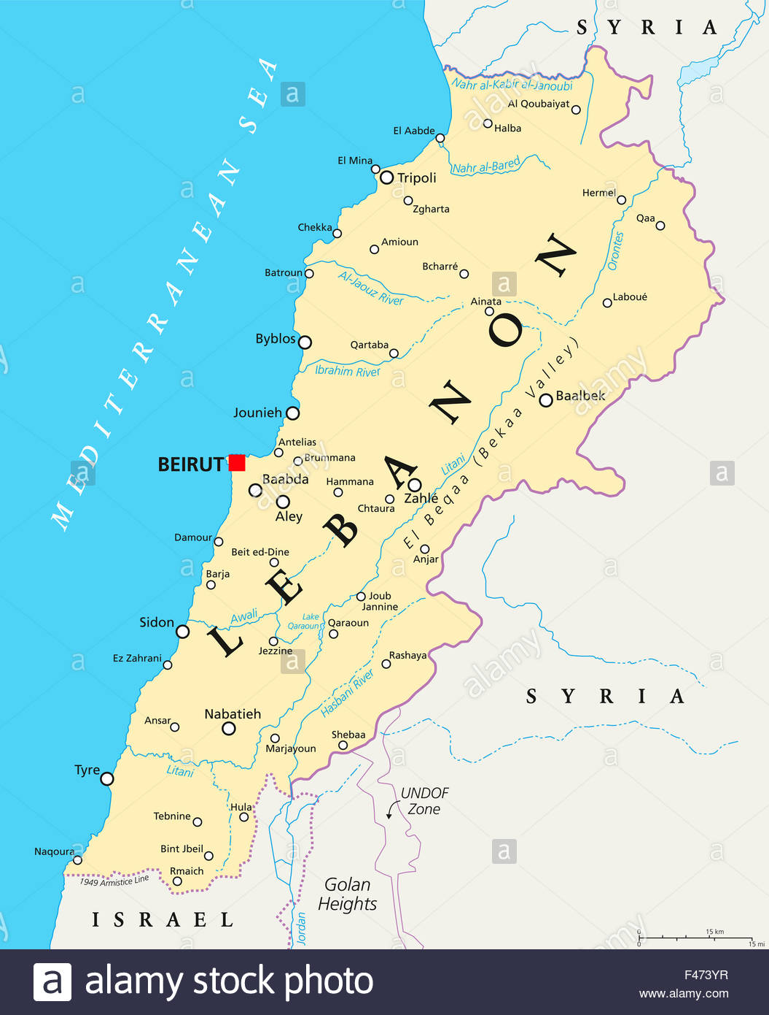
Inset enlarged
On next slide
Litani R

Slide 11
Notes:
http://www.jpost.com/Arab-Israeli-Conflict/Israel-warns-UN-Hezbollah-has-120000-missiles-aimed-at-Israel-460184
Colored points are mostly weapons caches.

Slide 12
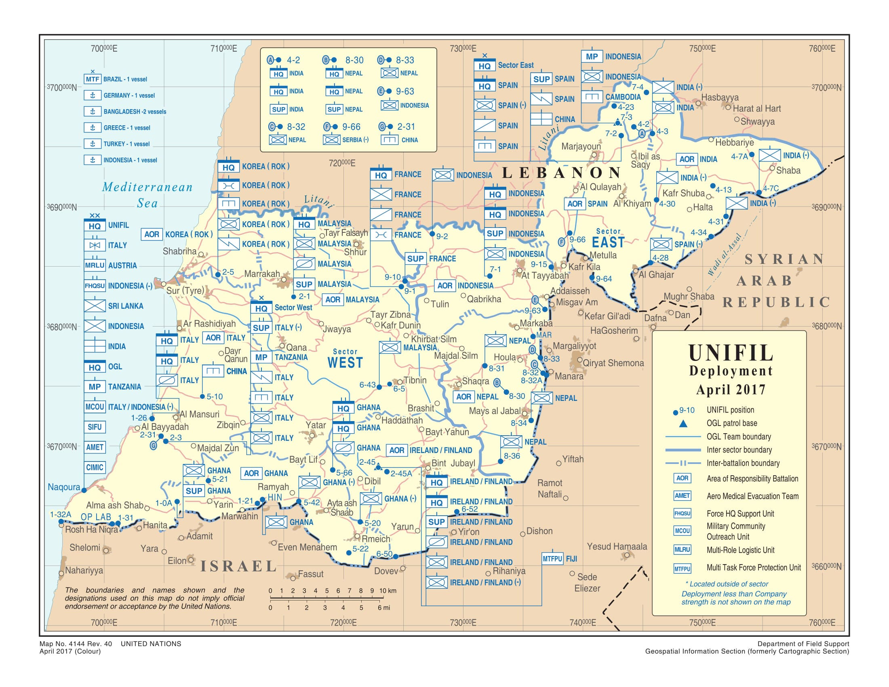
Litani R.
Notes:
Troops of various nations positioned in S. Lebanon
Here’s why it’s news.

Slide 13
Amb. Ron Prosor is the former Israeli Ambassador to the UN. He currently heads the Abba Eban Institute for International Diplomacy at the IDC Herzilya. He writes:
Yesterday, [Nov. 30, 2017] the United Nations Security Council debated a report recently published by UNIFIL, the United Nations Interim Force in Lebanon.
Notes:
http://unitycoalitionforisrael.org/?p=15704192

Slide 14
It is common knowledge in the intelligence communities…that Hezbollah has amassed over 150,000 missiles directed towards Israeli cities. Instead of detailing the locations of weapon stockpiles and asking the UN Security council to strengthen its mandate so they are able to raid them,
Notes:
http://unitycoalitionforisrael.org/?p=15704192

Slide 15
the report goes into incredible detail of the amount of Lebanese shepherds spotted near the border area. 420 if anyone is interested. Maj. Gen. Michael Beary, has said he sees no evidence of weapons being illegally transferred and stockpiled in the area.
Notes:
http://unitycoalitionforisrael.org/?p=15704192

Slide 16
“If there was a large cache of weapons,” he said last summer, “we would know about it.” As the US Ambassador to the UN, Nikki Haley, has said, Beary “seems to be the only person in south Lebanon who is blind to what Hezbollah is doing.”
Notes:
http://unitycoalitionforisrael.org/?p=15704192
The USA is paying to finance this absurd peace force!!
Petition your congressmen to make the UN enforce Res 1701
Now, for what gives us real hope…

Slide 17
מַתִּתְיָהוּ Mattityahu
(Matthew) 22:1-3
Notes:
Yeshua is telling a story / illustration of spiritual truth!

Slide 18
Mattityahu (Matthew) 22:1
יֵשׁוּעַ הוֹסִיף לְדַבֵּר אֲלֵיהֶם בִּמְשָׁלִים וְאָמַר:
Yeshua again used parables in speaking to them:
Notes:
This one is in very much the format of a standard rabbinic parable about a wedding with some extreme typical rabbinic repercussions.
Explains some of the extremes in Yeshua’s story.

Slide 19
Mattityahu (Matthew) 22:2
"דּוֹמָה מַלְכוּת הַשָּׁמַיִם לְמֶלֶךְ בָּשָׂר וָדָם שֶׁעָשָׂה חֲתֻנָּה לִבְנוֹ.
"The Kingdom of Heaven is like a king who prepared a wedding feast for his son,
Notes:
G-d had been preparing such an invitation to Israel for Millenia! General format of this invitation was given to Israel over centuries. Feast and freedom, hope and victory.

Slide 20
^{Yeshayahu/Isaiah 25.6-9} On this mountain Adoni-Tzva’ot will make for all peoples a feast of rich food and superb wines, delicious, rich food and superb, elegant wines. On this mountain he will destroy the veil which covers the face of all peoples

Slide 21
^{Yeshayahu/Isaiah 25.6-9} the veil enshrouding all the nations. He will swallow up death forever. Adonai Elohim will wipe away the tears from every face, and he will remove from all the earth the disgrace his people suffer.

Slide 22
^{Yeshayahu/Isaiah 25.6-9} For Adoni has spoken. On that day they will say, “See! This is our God! We waited for him to save us. This is Adoni ; we put our hope in him. We are full of joy, so glad he saved us.
Notes:
This is picked up in Messianic terminology for the end of time!

Slide 23
^{Rev. 19.6-8} Then I heard what sounded like the roar of a huge crowd, like the sound of rushing waters, like loud peals of thunder, saying, “Halleluyah! Adonai, God of heaven’s armies, has begun his reign! “Let us rejoice and be glad! Let us give him the glory!

Slide 24
^{Rev. 19.6-8} For the time has come for the wedding of the Lamb, and his Bride has prepared herself — fine linen, bright and clean has been given her to wear.” (“Fine linen” means the righteous deeds of God’s people.)
Notes:
G-d in Messiah LOVES a party: food, joy, people, conversation

Slide 25
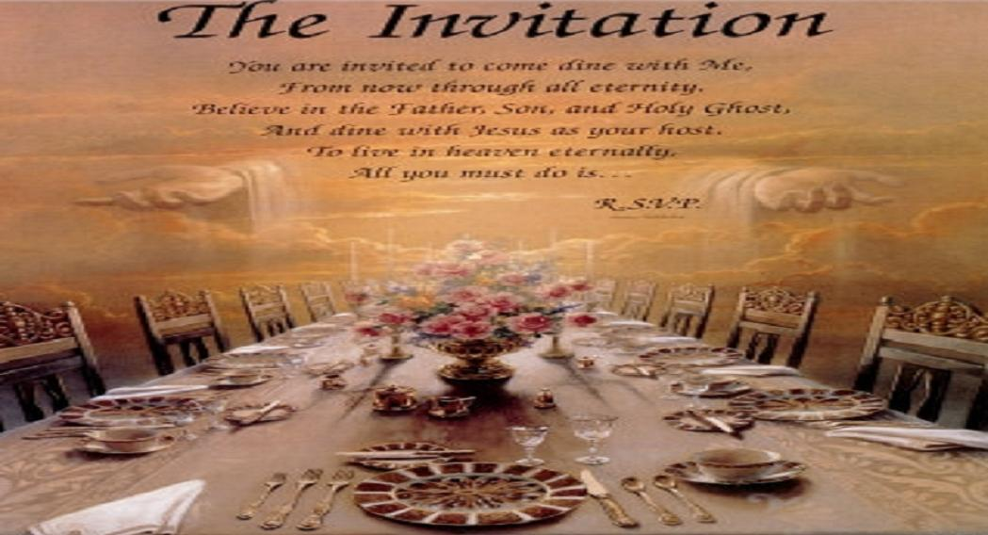
Notes:
Early days of Or HaOlam one of our teens asked me, “Is this a service or a party?”

Slide 26
Mattityahu (Matthew) 22:3
שָׁלַח אֶת עֲבָדָיו לִקְרֹא אֶת הַמֻּזְמָנִים אֶל הַחֲתֻנָּה
but when he sent his slaves to summon the invited guests to the wedding, [second event notice]
Notes:
Keener p 591
Weddings required major preparation, exact time of the completion of prep was difficult to pre-determine. A second invitation at the appropriate hour was standard procedure.
Ancient commentary…

Slide 27
^{Midrash on Lament iv 2} “among the inhabitants of Jerusalem… none of them went to a feast till the invitation has been given and repeated.
Notes:
Edersheim Life and Times 2.427
Took time to prepare all the food, decorations, not known exactly when complete

Slide 28
Mattityahu (Matthew) 22:3
שָׁלַח אֶת עֲבָדָיו לִקְרֹא אֶת הַמֻּזְמָנִים אֶל הַחֲתֻנָּה וְלֹא רָצוּ לָבוֹא.
but when he sent his slaves to summon the invited guests to the wedding, they refused to come. [second event notice]
Notes:
Hebrew: I don’t want to.

Slide 29
I will, wish, desire, am willing,
intend, design
Notes:
http://biblehub.com/interlinear/matthew/22-3.htm
Just not important. Previously had RSVPed to invitation. Now just blew it off, just dismissed.
Attendance at a patron’s banquet was incumbent on social dependents throughout the Ro. Empire.
Keener 519
Refusing to come insults the dignity of the kings who counted on their attendance and graciously prepared food.
It gets worse.

Slide 30
Genesis Rabba בְּרֵאשִׁית רַבָּה‎,
B'reshith Rabba is a religious text from Judaism's classical period, probably written between 300 and 500 CE with some later additions. It is a collection of ancient rabbinical homiletical interpretations of the Book of Genesis, Beresheet
Notes:
https://en.wikipedia.org/wiki/Genesis_Rabbah
A bit rambling ancient language.

Slide 31
﻿Midrash Rabbah - Genesis IX:10 R. Samuel b. R. Isaac said: BEHOLD, IT WAS VERY GOOD alludes to the angel of life; AND BEHOLD, IT WAS VERY GOOD, to the angel of death. Is then the angel of death very good? Imagine a king who made a feast, invited the guests,
Notes:
The Soncino Talmud (©1973 Judaica Press, Inc. and ©1965, 1967, 1977, 1983, 1984, 1987, 1988, & 1990 Soncino Press, Ltd.) is a product of Judaica Press, Inc. Brooklyn, NY, and, if included, is incorporated herein pursuant to exclusive license.

Slide 32
﻿Midrash Rabbah - Genesis IX:10 and set a dish filled with all good things before them: ' Whoever will eat and bless the king, said he, ' let him eat and enjoy it; but he who would eat and not bless the king, let him be decapitated with a sword.
Notes:
The Soncino Talmud (©1973 Judaica Press, Inc. and ©1965, 1967, 1977, 1983, 1984, 1987, 1988, & 1990 Soncino Press, Ltd.) is a product of Judaica Press, Inc. Brooklyn, NY, and, if included, is incorporated herein pursuant to exclusive license.
That was the culture and expectation of Yeshua’s hearers

Slide 33
^{Matityahu 22.4-10} So he sent some more slaves, instructing them to tell the guests, ‘Look, I’ve prepared my banquet, I’ve slaughtered my bulls and my fattened cattle, and everything is ready. Come to the wedding!’ But they weren’t interested
Notes:
Third call! Apparently to same invited guests.

Slide 34
Weren’t interested: ameléō from
A "not" [like apathy, atheist] and
mélō, "have concern, be affected") – properly, without concern,
unaffected, viewing something as being without significance, i.e. without perceived value ("of no moment").
Notes:
http://biblehub.com/greek/272.htm

Slide 35
Made light of it.
Amy Jill Levine: a gross insult to the host
Notes:
http://biblehub.com/greek/272.htm

Slide 36
^{Matityahu 22.4-10} But they weren’t interested and went off, one to his farm, another to his business; and the rest grabbed his slaves, mistreated them and killed them. The king was furious and sent his soldiers, who killed those murderers and burned down their city.
Notes:
Not just for refusal to attend, as in midrash, but attack on the messengers! Evidently a reference to the impending disaster on Jerusalem.
Literary expectation in such circumstances of rejection.
Was Yeshua rejecting Israel, being anti-Semitic, to make such statements? Actually, such statements of judgement not new to Israel’s ears from her prophets!

Slide 37
^{Yermiyahu 4.5-7} “Announce in Y’hudah, proclaim in Yerushalayim; say: ‘Blow the shofar in the land!’ Shout the message aloud: ‘Assemble! Let us go to the fortified cities!’ Set up a signal toward Tziyon, head for cover without delay.

Slide 38
^{Yermiyahu 4.5-7} For I will bring disaster from the north, yes, dire destruction. A lion has risen from his lair, a destroyer of nations has set out, left his own place to ruin your land, to demolish and depopulate your cities.”
Notes:
Returning to the narrative about the Messiah

Slide 39
^{Matityahu 22.4-10} “Then he said to his slaves, ‘Well, the wedding feast is ready; but the ones who were invited didn’t deserve it. So go out to the street-corners and invite to the banquet as many as you find.’

Slide 40
^{Matityahu 22.4-10} The slaves went out into the streets, gathered all the people they could find, the bad along with the good; and the wedding hall was filled with guests.
Application to us??

Slide 41
It so important to fill the celebration hall.
Recovers the King’s honor.
^{Lk 19.9-10} Then Yeshua said to him, “Today salvation has come to this home…for the Son of Man came to seek and to save the lost.”
Notes:
Do WE receive with joy and prioritization His wedding invitation?
It’s His passion to gather the lost. Those that reject are headed for GREAT disaster!

Slide 42
^{Matityahu/Mt. 23.37-39} “O Jerusalem, Jerusalem who kills the prophets and stones those sent to her! How often I longed to gather your children together, as a hen gathers her chicks under her wings…
Notes:
He longed, He atoned by death and resurrection, and gives us the Ruakh, the Spirit!

Slide 43
Yeshua longs to fill His house with people finding eternal shalom and forgiveness.
He seeks to bring His resources to marriages, individuals, young families.
This building is relatively new to us, for access, outreach.
Fill the house, expand the house!
Notes:
Jewish people first, not minimized or excluded, then all.
Not always so immediately successful, as we saw in the story.

Slide 44
Remember we spoke about a moving of G-d’s spirit in Sarasota, FL last year.
20, 30, 40 or more new believers in the next few months or year

Slide 45
There are hazards to growth, and having new people here.
Challenges us to be spiritual givers, nurturers, disciplers.
Challenges us to be givers socially, financially.
Opens our doors to surprises…

Slide 46
Outreach is always risky…
So easy to lack wisdom for the most effective invitation.
Possible to get rejection.
Not directly associated with outreach, but part of life in contact with the outside world…
Notes:
Safety committee, headed ably by Blaine Robison, have wanted me to present this. So, it’s a bit of a shocking transition, but related, indirectly to connecting with, reaching out to the world around us. Brace yourself for a sort of relevant diversion.

Slide 47
Notes:
This will teach you how to respond to and welcome newcomers!
Maybe not.

Slide 48
Transitioning/ returning to the positive side of outreach, from Stewart Winograd…
Notes:
Many of you know Stewart, who serves on our external Board of Directors, and has be used of G-d fruitfully in E. Europe, Himalaya’s in India, Israel to win people.

Slide 49
Remember we spoke about a moving of G-d’s spirit in Sarasota, FL last year.
20, 30, 40 or more new believers in the next few months or year

Slide 50
From Stewart Winograd re prep for repetition of recent Florida outreach with dozens of Ruakh born new believers:
Have a clear Strategy and Structure to create a Culture of Evangelism, Discipleship and Equipping volunteer ministers.
Notes:
Let’s say we invited people, and dozens came, hungry for truth

Slide 51
Choose an effective discipleship course or Road to Maturity; including foundations of the faith, T’vilah, inner healing and deliverance, baptism in the Ruakh Ha Kodesh and preparation for ministry.

Slide 52
Have the whole congregation go through the discipleship program, so that everyone is on the same page.
Establish a Kingdom of God culture where everyone is a minister and there is no one that feels good about being audience only.
Notes:
Leadership will be developing these. But…
So, application to us:
Do we have a desire to fill His house
Do we have a plan or an attempt to fill His house, or His kingdom?
Have you brought someone to the Kingdom in the last year, 2017? Have you tried?
It’s risky. Rejection. Not know arguments. But passion?

Slide 53
^{Lk 19.9-10} Then Yeshua said to him, “Today salvation has come to this home…for the Son of Man came to seek and to save the lost.”
Notes:
Are we the lost?
Are we seeking to save?

Slide 54
^{Matityahu/Mt. 23.37-39} “O Jerusalem, Jerusalem who kills the prophets and stones those sent to her! How often I longed to gather your children together, as a hen gathers her chicks under her wings…

Slide 55
^{Matityahu/Mt. 23.37-39} but you were not willing! Look, your house is left to you desolate! For I tell you, you will never see Me again until you say, ‘Barukh ha-ba b’shem Adonai. ברוך השם יי
Blessed is He who comes in the name of the Lord!’”

Slide 56
How many
Learned the active shooter response: three modes?
Are praying for G-d to give you a plan and an opportunity to fill His house, His Kingdom?
Notes:
Love you to
pray about this now
Email me your passion and thoughts for outreach, fill His house.

