Slide 1
To easily follow these notes, log on to our Wifi
Wifi: mycci01 p/w: ancientquail060
Go to OrHaOlam.com
Click on downloads, messages, 2017

Slide 2
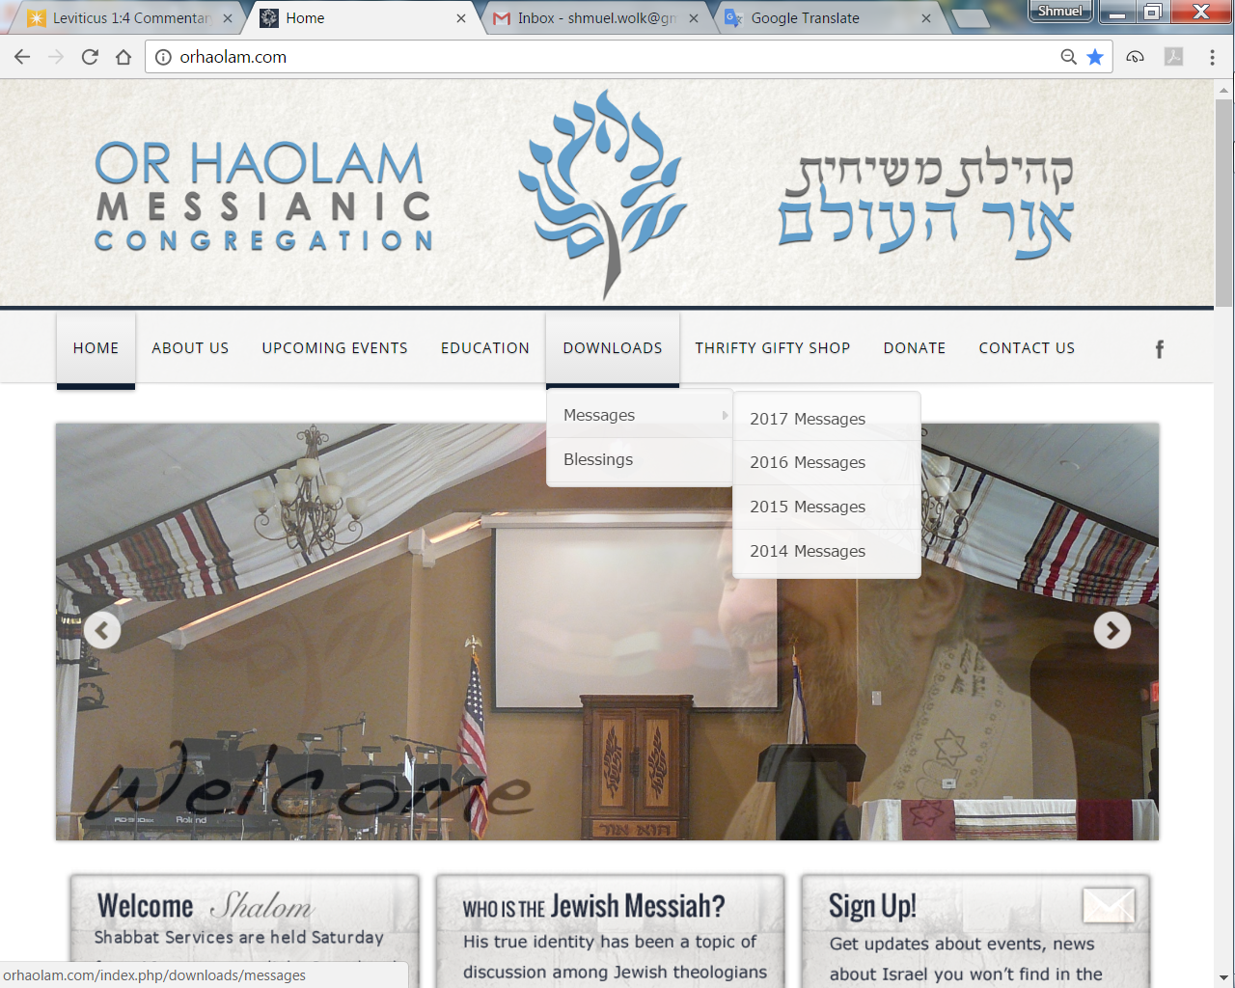
Downloads\messages\
2017 Messages

Slide 3
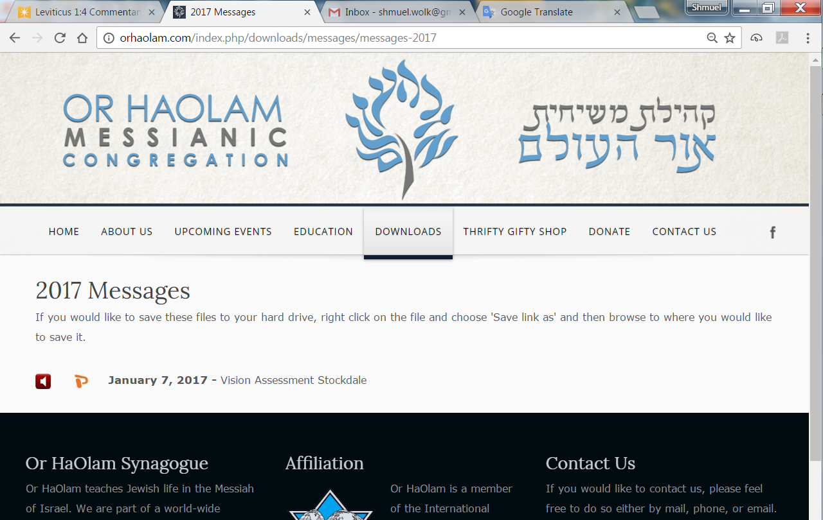

Slide 4
Notes:
I only have one thing to say about the inauguration. It’s the first time I heard the words, ‘Extreme Islamic terrorism.’ Not all Islam, but ‘We will exterminate extreme Islamic terrorism.’

Slide 6
מַתִּתְיָהוּ Mattityahu
(Matthew) 16:2-4
Notes:
Feel that I need to continue a theme that I left off two weeks ago, so highly risky question. Anyone remember anything about this guy?

Slide 7
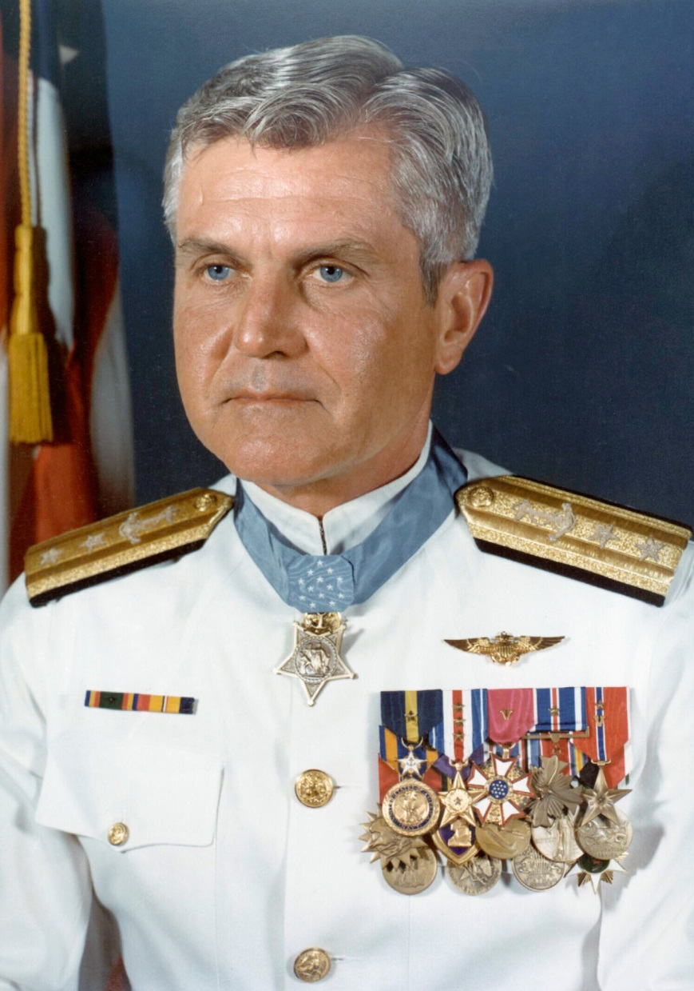

Slide 8
Rear Admiral
James Stockdale in
full dress white
uniform
Dec. 23, 1923 – July 5, 2005

Slide 9
Stockdale was held as a prisoner of war in the Hoa Lo prison (the infamous "Hanoi Hilton") for seven and a half years. Tortured routinely and denied medical attention.
Notes:
https://en.wikipedia.org/wiki/James_Stockdale
Great paradox in his overcoming survival 7.5 years?

Slide 10
In a business book by James C. Collins called Good to Great, there is a conversation with Stockdale.
“I never doubted not only that I would get out, but also that I would prevail in the end and turn the experience into the defining event of my life, which, in retrospect, I would not trade.”
Notes:
http://ndoherty.com/stockdale-paradox/
Never doubted his future. Faith? Not in G-d, but in his cause of democracy and freedom.

Slide 11
Stockdale Paradox
When Collins asked who didn't make it out of Vietnam, Stockdale replied:
Oh, that's easy, the optimists. Oh, they were the ones who said, 'We're going to be out by Christmas.' And Christmas would come, and Christmas would go.
Notes:
http://ndoherty.com/stockdale-paradox/
The greatest danger to a life of faith is optimism. Not tough faith. Maybe analogous to tough love.

Slide 12
So, it’s all about faith, not optimism, in the face of brutal reality.
Notes:
How does this apply to our current text in Matityahu?

Slide 13
Mattityahu (Matthew) 16:1
Then some P’rushim and Tz’dukim came to trap Yeshua by asking him to show them a miraculous sign from Heaven.

Slide 14
Mattityahu (Matthew) 16:2
הֵשִׁיב וְאָמַר לָהֶם: "לְעֵת עֶרֶב אַתֶּם אוֹמְרִים, 'מֶזֶג אֲוִיר נָאֶה, כִּי הַשָּׁמַיִם אֲדֻמִּים';
But his response was, "When it is evening, you say, 'Fair weather ahead,' because the sky is red;

Slide 15
Mattityahu (Matthew) 16:3
וּבַבֹּקֶר, 'סַגְרִיר הַיּוֹם, כִּי אֲדֻמִּים וְקוֹדְרִים הַשָּׁמַיִם'.
and in the morning you say, 'Storm today!' because the sky is red and overcast.

Slide 16
Mattityahu (Matthew) 16:3
אֶת פְּנֵי הַשָּׁמַיִם אַתֶּם יוֹדְעִים לְפָרֵשׁ, אַךְ אֶת אוֹתוֹת הַזְּמַנִּים אֵינְכֶם יְכוֹלִים?
You know how to read the appearance of the sky, but you can't read the signs of the times!
Notes:
Yeshua is rebuking them for asking for signs, yet He says that they already have signs. Bit of a paradox. Good signs bad signs.

Slide 17
Mattityahu (Matthew) 16:4
דּוֹר רַע וּמְנָאֵף מְבַקֵּשׁ לוֹ אוֹת, וְאוֹת לֹא יִנָּתֵן לוֹ
A wicked and adulterous generation is asking for a sign? It will certainly not be given a sign —

Slide 18
Mattityahu (Matthew) 16:4
מִלְּבַד אוֹת יוֹנָה הַנָּבִיא". הוּא עָזַב אוֹתָם וְהָלַךְ.
except the sign of Yonah!" With that he left them and went off.
Notes:
Here’s a good sign. These signs as requested were sought with wrong motives. “A wicked and adulterous generation is asking for a sign?”
Evidently NOT appropriate faith builders.
Going back to the lesson from Adm. Stockdale...

Slide 19
It’s all about faith, not optimism, in the face of brutal reality. Apparently, these men were seeking to reinforce their faith in an unacceptable way. ~Optimism?
How do we properly reinforce faith, walk in faith?
Notes:
How does this apply to our current text in Matityahu?

Slide 20
Simplified Summary of Salvation Sequence
Bliss in Gan Eden → gratefulness/trust → bliss
Trust in Yeshua →gratefulness → Ruakh → trust in difficulties → worship → trust in Yeshua

Slide 21
Bliss
Grate-fulness
Trust
In Eden
Notes:
Adam and Hava didn’t thank G for creation, did trust G for regulations

Slide 22
Notes:
Entitlement = ‘I don’t have what I deserve.’
Now, we see our sinful, debauched, darkened condition →

Slide 23
Trust in Yeshua
Grateful-ness
Ruakh
Trust despite difficulties
Worship
Now
Notes:
Gratefulness is the key!
How does this apply to our current text in Matityahu?
Difficulties will stretch you. There are events and signs to encourage you, but not all. Sickness, financial dearth, relational conflicts [probably the worst]. Marriage, kids, siblings, parents.
Optimisim = easy fix for all.

Slide 24
OK in scripture to request evidence to build our trust.

Slide 25
Mattityahu (Matthew) 16:4
מִלְּבַד אוֹת יוֹנָה הַנָּבִיא". הוּא עָזַב אוֹתָם וְהָלַךְ.
[This generation] will certainly not be given a sign — except the sign of Yonah!
Notes:
Expanded a few chapters earlier. This Mt 16...Mt 12

Slide 26
^{Matthew 12:39-41} He replied, “A wicked and adulterous generation asks for a sign? No! None will be given to it but the sign of the prophet Yonah. For just as Yonah was three days and three nights in the belly of the sea-monster,

Slide 27
^{Matthew 12:39-41} so will the Son of Man be three days and three nights in the depths of the earth.

Slide 28
What? Resurrection. Resurrection is the sign and evidence for Yeshua!
Notes:
Good sign

Slide 29
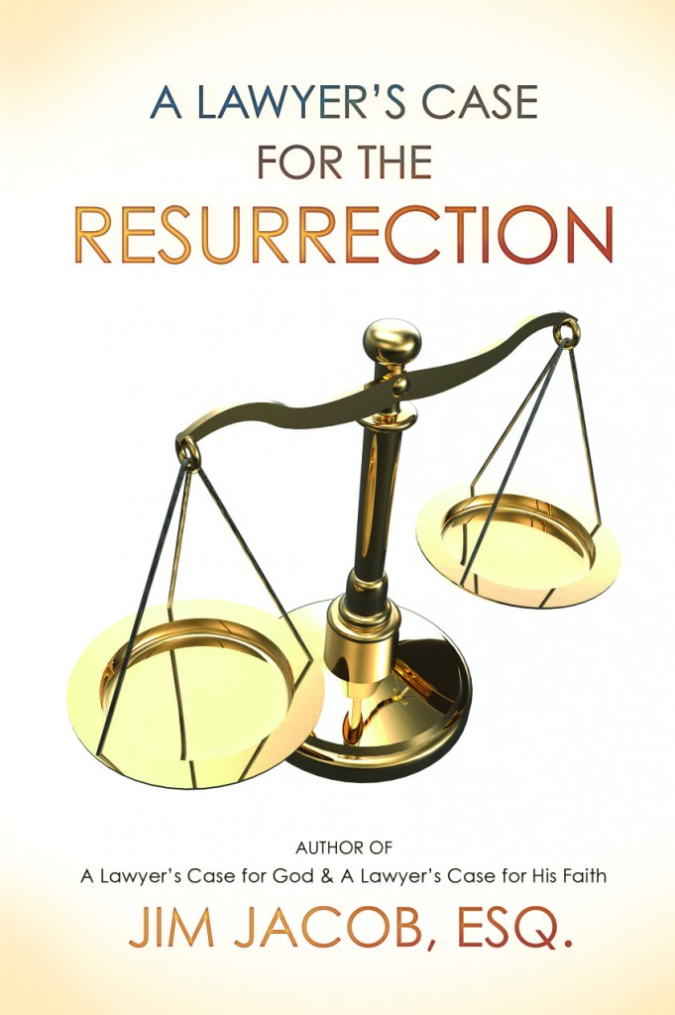
discover the
astounding
HISTORICAL
evidence
for the resurrection.
Notes:
http://www.jimjacobbooks.com/

Slide 30
What about other signs?
Faith builders or
Faith breakers?

Slide 31
OK in scripture to request evidence to build our trust.
^{Ju 6.16-17} Adoni said to him, “Because I will be with you, you will strike down Midyan as easily as if they were just one man.” Gid‘on replied, “If indeed you favor me, would you mind giving me a sign that it is really you talking with me?
Notes:
Gideon to face Midianite armies. ~facing Russia.
Exactly led to worship.

Slide 32
^{Shoftim/Ju 6.20-22} The angel of God said to him, “Take the meat and matzot, lay them on this rock, and pour out the broth.” Gid‘on did so. Then the angel of Adonai reached out with the stick he was holding, touched the meat and matzot,

Slide 33
^{Shoftim/Ju 6.20-22} and fire shot up out of the rock and burned up the meat and matzot. Then the angel of Adoni disappeared before his eyes. Gid‘on realized that he was the angel of Adoni.
Notes:
Then another…

Slide 34
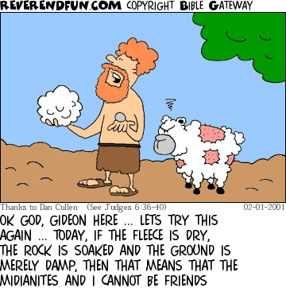
Notes:
Then a spied out discussion on a Midianite enemy soldier’s dream. 4 dramatic signs!
Gideon to face Midianite armies. ~facing Russia.
Exactly led to worship

Slide 35
^{2 K 20.8} Hizkiyahu said to Yesha‘yahu, “What sign will there be that Adoni will heal me and that I will be able to go up to the house of Adoni on the third day?”
Notes:
After great deadly sickness. Exactly led to worship then trust in G changed to trust in himself = arrogance.

Slide 36
OK in scripture to request evidence to build our trust.
In fact, Yeshua had done that as recounted in the previous chapter.
Notes:
Good, g-dly signs.

Slide 37
^{Mtt 15.21-28} Tyrian woman trusted Yeshua → healed daughter → “great trust”
^{Mtt. 15.29-31} Great crowds trusted Him for healing → gratefulness → b’rakah [blessing]
^{Mtt 15.32-39} Feeding
Notes:
#1. ^{Mtt. 15.4} He said, “I was sent only to the lost sheep of the house of Isra’el.”
#3…always great gratefulness, or should be, after eating. We may come back to this.
These could all be viewed as faith building signs to Israel then, and to us today.

Slide 38
After miraculous signs of last chapter [Tyrian daughter, multitudes healed, feeding],
These guys were still requesting a sign!
Yeshua saw their motive.

Slide 39
OK in scripture to request evidence to build our trust.
NOT
OK in scripture to request evidence to build our distrust.

Slide 40
Mattityahu (Matthew) 16:1
Then some P’rushim and Tz’dukim came to trap Yeshua by asking him to show them a miraculous sign from Heaven.

Slide 41
Similar examples:
^{Shmot/Ex 17.2} The people quarreled with Moshe, demanding, “Give us water to drink!” [reasonable?]

Slide 42
^{Shmot/Ex 17.7} The place was named Massah [testing] and M’rivah [quarreling] because of the quarreling of the people of Isra’el and because they tested Adoni by asking, “Is Adoni with us or not?”
Attitude with which requested!
Notes:
NOT gratefulness.
This story recounted in T’hillim/Psalms...

Slide 43
^{Ps 78.17-19} Yet they sinned still more against him, rebelling in the wilderness against the Most High; in their hearts they tested God by demanding food that would satisfy their cravings. Yes, they spoke against God by asking, “Can God spread a table in the desert?

Slide 44
^{Bamidbar/Nu 14.22-23} None of the people who saw my glory and the signs I did in Egypt and in the desert, yet tested me these ten times and did not listen to my voice, will see the land I swore to their ancestors! None of those who treated me with contempt will see it.
Notes:
OK signs, not OK signs

Slide 45
Mattityahu (Matthew) 16:1
Further, consider their wording
Then some P’rushim and Tz’dukim came to trap Yeshua by asking him to show them a miraculous sign from Heaven.

Slide 46
By Yeshua’s day, it was well established in Israel NOT to pronounce the Sacred Name. YHVH. Rather, circumlocution.
Yeshua followed and endorsed that practice, so therefore we don’t either. “from Heaven”
Notes:
So, ‘Kingdom of heaven’ is a synonym for ‘Kingdom of G-d’
Ro 1.18 ‘wrath of G-d from heaven’, lots of apocryphal ref. circumlocution. Keener p 421
alternatively
“from Heaven” epochal sign like manna, Eliyahu with prophets of Baal, sun and moon apparent motion stop [earth rotation] as for Yehoshua/Joshua.

Slide 47
Mattityahu (Matthew) 16:4
דּוֹר רַע וּמְנָאֵף מְבַקֵּשׁ לוֹ אוֹת, וְאוֹת לֹא יִנָּתֵן לוֹ
A wicked and adulterous generation is asking for a sign? It will certainly not be given a sign —
Notes:
Wickedness of Messiah’s generation a sign in itself, according to Talmudic reference. Keener 421

Slide 48
Mattityahu (Matthew) 16:4
מִלְּבַד אוֹת יוֹנָה הַנָּבִיא". הוּא עָזַב אוֹתָם וְהָלַךְ.
[This generation] will certainly not be given a sign — except the sign of Yonah!

Slide 49
Application to us?
If your optimistically waiting for signs and events, answers to prayer…you’ll fail.
If we cling to our vision, work the vision, wait for the vision, G-d will send LOTS of evidence, eventually.
Notes:
Actually, according to this teaching, you’re rebelling. You want G on your terms.
Torah lesson, Yokheved, Moshe’s mother optimistic about Pharaoh’s daughter? Just trust in brutal reality.

Slide 50
Trust in Yeshua
Grateful-ness
Ruakh
Trust despite difficulties
Worship
Now
Notes:
Gratefulness is the key!
Difficulties will stretch you. Sickness, financial dearth, relational conflicts [probably the worst]. Marriage, kids, siblings, parents, friends, cong. Kingdom conflicts.
So, to review our vision, and apply this to good signs, bad signs.

Slide 51
Working to bring Jewish people, and those grafted in, to their covenantal identity in Messiah.
One of the signs Mtt 15 was feeding the 4000 households.
Notes:
This is where my face is set. Not just cerebral affirmation, but personal.
To bring this sign of blessing to Israel and the Nations here in Overland Park...

Slide 52
Notes:
Food is a sign, indication of blessing.

Slide 53
Oneg means "delight," and to keep the Shabbat a delight, our plan is that we all work together so we can enjoy fellowship. In Acts 2, the first Spirit filled followers of Messiah “shared their food with joy and

Slide 54
sincere hearts.” As a welcoming community working together we can share a delightful and fun meal that is restful, hospitable and Biblically kosher and also will accommodate our outreach and growth.

Slide 55
Three sections:
Restful
Hospitable
Biblically Kosher

Slide 56
In the previous chapter of signs and miracles, Yeshua showed special attention to the needs of Jewish people. Apparently rude: ^{Mtt. 15.4} He said, “I was sent only to the lost sheep of the house of Isra’el.”

Slide 57
March of Remembrance 2016 was the biggest event we’ve ever done for the safety and welfare of the Jewish community.
This year, May 7, 2017.
Review, for encouragement those who were there or weren’t

Slide 58
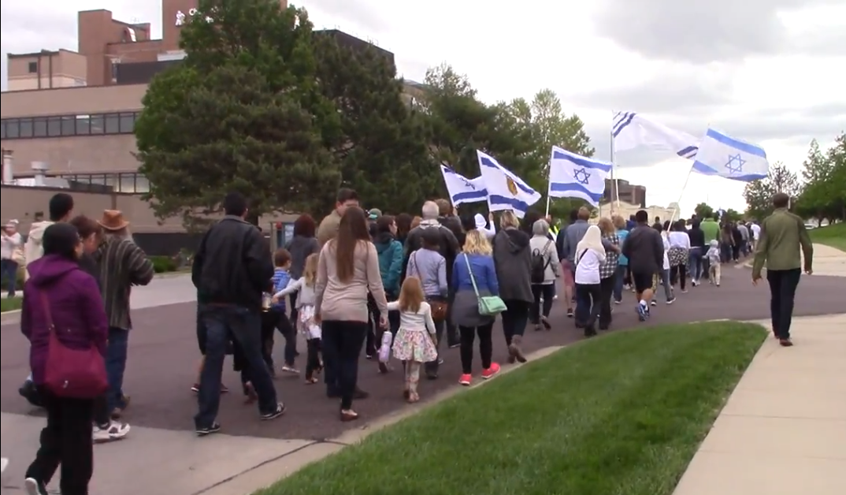

Slide 60
Elhanan Glazer, former Knesset member

Slide 61
Notes:
The redemption/restoration to Israel, that had the whole house in tears of celebration. This restoration of the people of Israel to the Land of Israel was indeed a sign, but NOT the fruit of optimistic faith. The fruit of faith in the faith of brutal fact.

Slide 62
This year…building a supportive community of pastors.

Slide 63
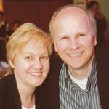
Jobst &
Charlotte Bittner
have tentatively reserved our
date and we’re
working to have
him as keynote
Speaker.
Notes:
a brief bio on Jobst [pronounced Yobst]
http://www.tos-ministries.org/en/about-us/jobst-charlotte-bittner/ The website of the origin of the March in Europe.
http://www.marchoflife.org/v2/footer/ueber-mdl/

Slide 64
^{Daniel 11.32} Those who do wickedly against the covenant he shall corrupt with flattery; but the people who know their God shall be strong, and carry out great exploits.
Notes:
Good signs! Know Him. Tough faith. Do exploits.

Slide 65
Professor Zahava Solomon of Tel Aviv University adds that the culture of conflict has made Israelis constantly aware of their potential demise. On the other hand, it makes them virtually fearless. They have a lot to fear, therefore they fear nothing.
Notes:
http://www.maozisrael.org/site/News2?abbr=maoz_&page=NewsArticle&id=11171&news_iv_ctrl=-1
So, in a secular sense, faith in the face of brutal reality.

Slide 66
Being raised in Israel, he says, lends a unique mental capacity for overcoming hardship unlike any other Western country in the world. When you’re living in a place where people regularly threaten to wipe you off the map,
Notes:
http://www.maozisrael.org/site/News2?abbr=maoz_&page=NewsArticle&id=11171&news_iv_ctrl=-1

Slide 67
you cultivate a mindset that slugs through lesser difficulties like finding that job or paying your rent.
Notes:
http://www.maozisrael.org/site/News2?abbr=maoz_&page=NewsArticle&id=11171&news_iv_ctrl=-1
So, what are your faith battles. Health, financial, relational, kingdom?

Slide 68
By experiencing more anxiety on a daily basis, they’ve become inoculated against bad things when they do occur, and recover quickly. A study published in the Journal of the American Medical Association suggests (www.thedailybeast.com)
Notes:
http://www.maozisrael.org/site/News2?abbr=maoz_&page=NewsArticle&id=11171&news_iv_ctrl=-1

Slide 69
that Israelis recover from post-traumatic stress disorder (PTSD) more quickly than people of other Western nations. (www.thedailybeast.com)
Notes:
http://www.maozisrael.org/site/News2?abbr=maoz_&page=NewsArticle&id=11171&news_iv_ctrl=-1

Slide 70
Trust in Yeshua
Grateful-ness
Ruakh
Trust despite difficulties
Worship
Now
Notes:
Difficulties will stretch you. Sickness, financial dearth, relational conflicts [probably the worst]. Marriage, kids, siblings, parents.
The KEY to real faith is gratefulness. Gratefulness for what has been received, what will be received. Good signs relate to blessing
Bad signs relate to demanding.
Repent of demanding. Go to faith and gratefulness in the resurrection reality and Presence and Power of Yeshua.

