Slide 1
To easily follow these notes, log on to our Wifi
Wifi: mycci01 p/w: ancientquail060
Go to OrHaOlam.com
Click on downloads, messages, 2017

Slide 2
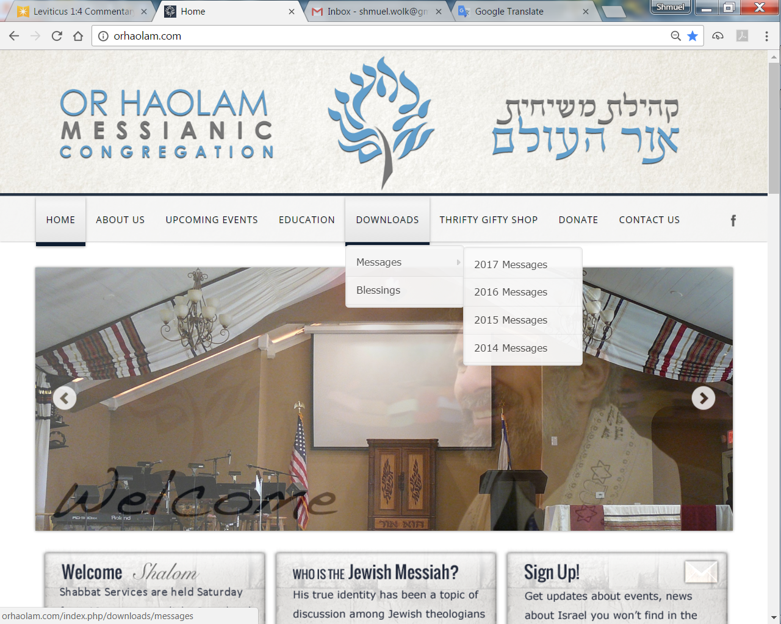
Downloads\messages\
2017 Messages

Slide 3
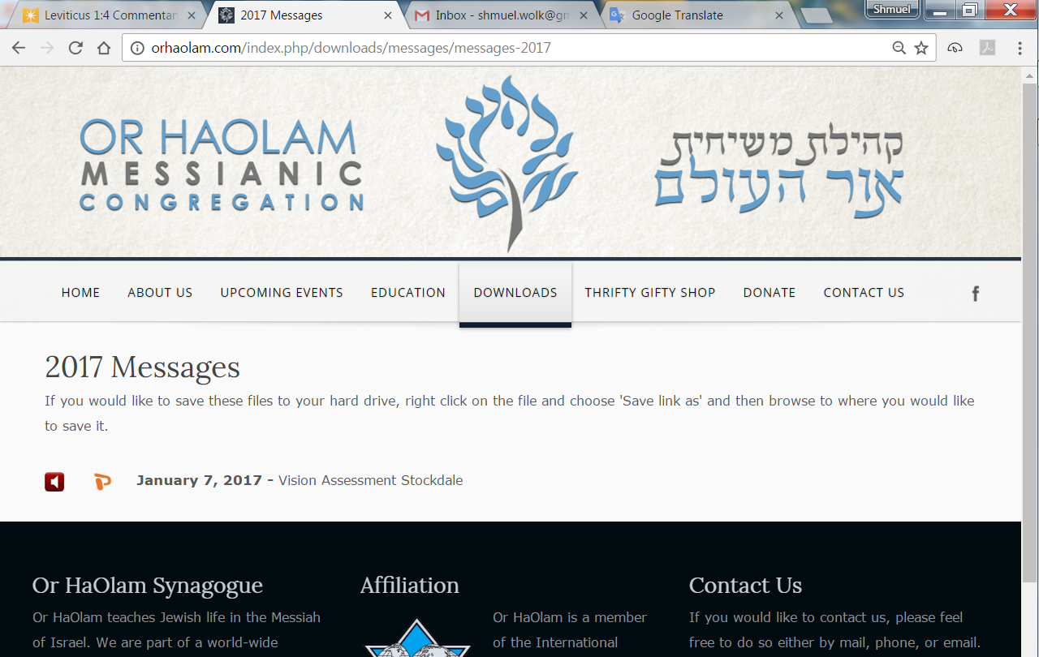

Slide 4
There is a two-letter word that perhaps has more meanings than any other two-letter word, and that is 'UP.'
It's easy to understand UP, meaning toward the sky or at the top of the list, but when we awaken in the morning, why do we wake UP?

Slide 5
At a meeting, why does a topic come UP?
Why do we speak UP
Why are the officers UP for election
Why is it UP to the secretary to write UP a report?
We call UP our friends.

Slide 6
And we use it to brighten UP a room,
polish UP the silver;
we warm UP the leftovers
and clean UP the kitchen.
We lock UP the house and some guys fix UP the old car.
People stir UP trouble
Notes:
There’s more, that that will wrap it UP for now.

Slide 7
מַתִּתְיָהוּ Mattityahu
(Matthew) 16:11-12

Slide 8
Now when the disciples came to the other side of the sea, they had forgotten to take bread. “Watch out,” Yeshua said to them, “and beware of the hametz of the Pharisees and Sadducees.”
Mattityahu (Matthew) 16:6-10
Notes:
http://www.chabad.org/holidays/passover/pesach_cdo/aid/1742/jewish/What-Is-Chametz.htm

Slide 9
What is Hametz? חמץ

Slide 10
Hametz [leaven] is any food product made from wheat, barley, rye, oats or spelt that has come into contact with water and been allowed to ferment and “rise.”
[other fermented products are OK: wine, kefir, etc.]
Passover prohibitions!
Notes:
http://www.chabad.org/holidays/passover/pesach_cdo/aid/1742/jewish/What-Is-Chametz.htm

Slide 11
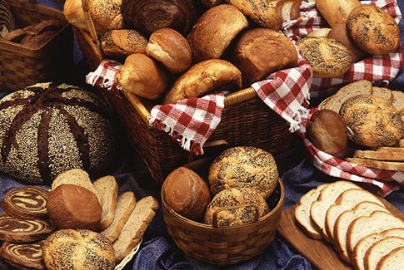

Slide 12
^{Shmot/Ex 12.14-15} “It shall be for you a remembrance . . . seven days you shall eat matzah, and on the first day you should remove all se’or (sourdough, a leavening agent) from your homes. Anyone who eats hametz (leaven) from the first day to the seventh day shall be cut off from Israel.”

Slide 13
^{Shmot/Ex 12.19} For seven days no hametz is to be found in your houses, for whoever eats hametz, that soul will be cut off from the congregation of Israel, whether he is an outsider or one who is born in the land.
Notes:
Serious issue. Cut off not well defined: excommunicated/exiled, die prematurely?
So, leaven, hametz is to be burned before Pesakh/Passover

Slide 14
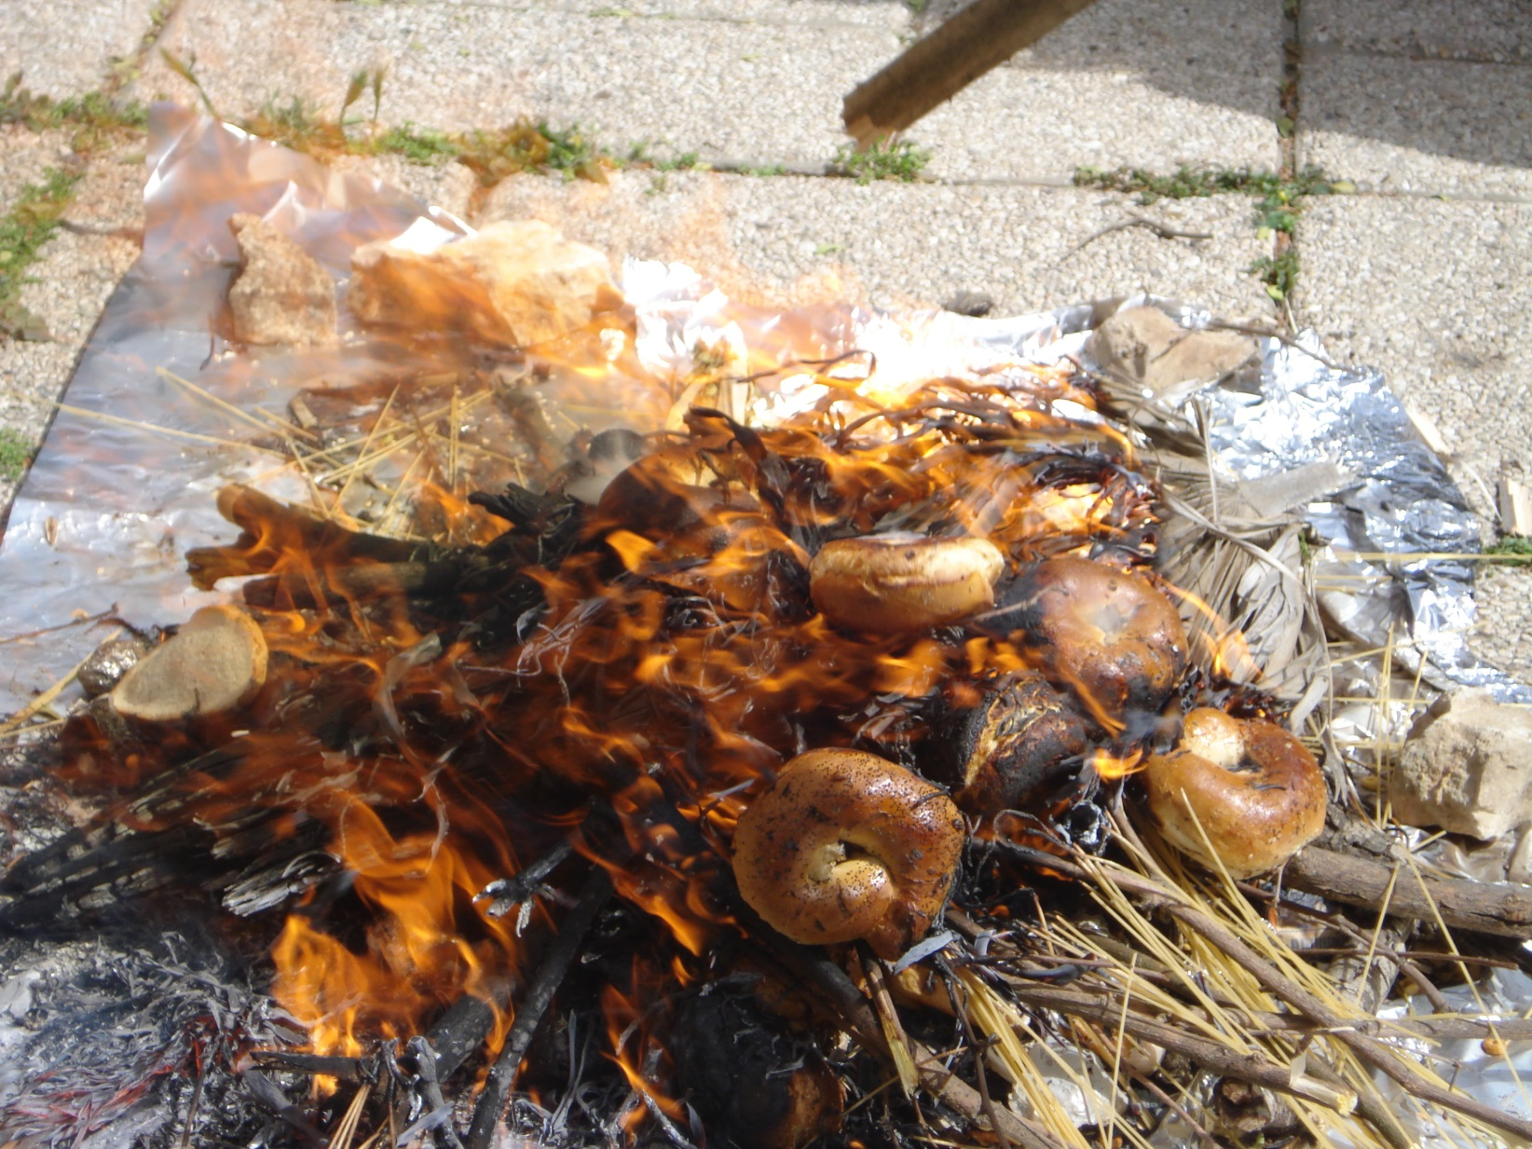
Notes:
We have a little bonfire, previously at my house. This year, burn barrel from Sukkot left out for Hametz burning ceremony. Only a very few have come in the past…

Slide 15
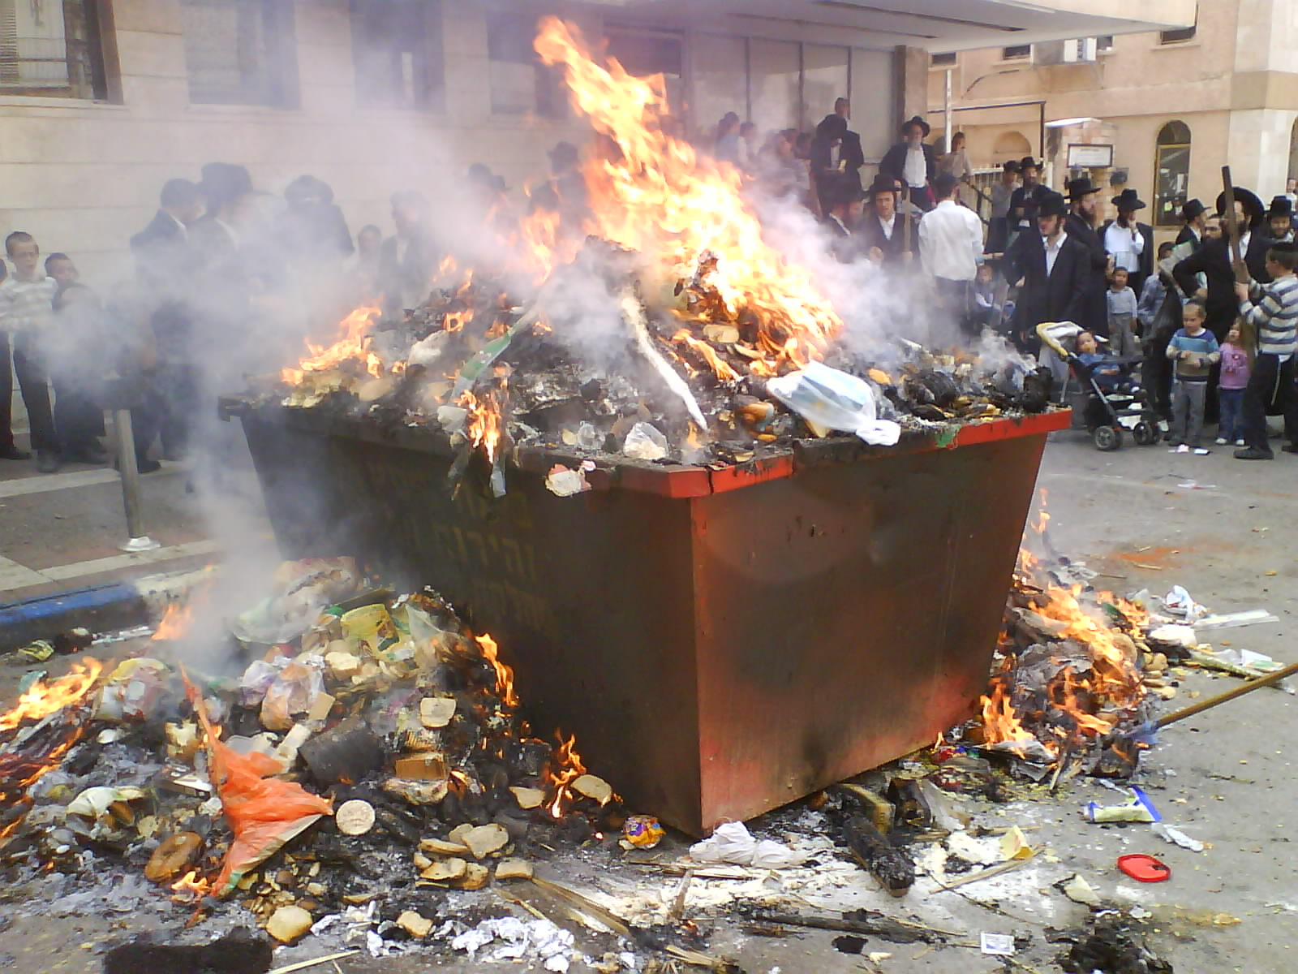

Slide 16
Fine to eat Hametz the rest of the year. So what was the deal?

Slide 17
And they began to discuss among themselves, saying, “We didn’t bring any bread.” But knowing this, Yeshua said, “O you of little faith, why do you discuss among yourselves that you have no bread?
Mattityahu (Matthew) 16:6-10
Notes:
Note: faith is part of this.

Slide 18
You still don’t get it? Don’t you remember the five loaves for the five thousand, and how many baskets of leftovers you gathered? Or how about the seven loaves for the four thousand and all the baskets of leftovers you gathered?
Mattityahu (Matthew) 16:6-10

Slide 19
Mattityahu (Matthew) 16:11
אֵיךְ זֶה אֵינְכֶם מְבִינִים שֶׁלֹּא עַל כִּכְּרוֹת הַלֶּחֶם דִּבַּרְתִּי אֲלֵיכֶם? הִזָּהֲרוּ מִשְּׂאוֹר הַפְּרוּשִׁים וְהַצְּדוֹקִים!"
How can you possibly think I was talking to you about bread? Guard yourselves from the hametz of the P'rushim and Tz'dukim!"

Slide 20
Mattityahu (Matthew) 16:12
אָז הֵבִינוּ כִּי לֹא אָמַר לָהֶם לְהִזָּהֵר מִשְּׂאוֹר הַלֶּחֶם אֶלָּא מִתּוֹרַת הַפְּרוּשִׁים וְהַצְּדוֹקִים.
Then they understood — they were to guard themselves not from yeast for bread but from the teaching of the P'rushim and Tz'dukim.

Slide 21
What teaching? Yeshua MOSTLY agreed with P’rushim.
^{Mtt. 23.1-3} Then Yeshua addressed the crowds and his talmidim: “The Torah-teachers and the P’rushim,” he said, “sit in the seat of Moshe. So whatever they tell you, take care to do it.
Notes:
What teaching was sooooo troubling? Similar issue with Shaul/Paul:

Slide 22
So, what was Shaul so upset about in Gal. 5.12?
As for those agitators, I wish they would go the whole way and emasculate themselves! NIV
I wish that those who are troubling you would even mutilate themselves. ^{NASU}

Slide 23
I would that they that unsettle you would even go beyond circumcision. ^{ASV}
I only wish these teachers who want you to cut yourselves by being circumcised would cut themselves off from you and leave you alone! TLB

Slide 24
I wish the people who are bothering you would go the whole way and castrate themselves! CJB
What???
Notes:
Not very nice talk!!

Slide 25
Teaching / hametz of the P'rushim and Tz'dukim =
^{Ro. 10.3} They are unaware of God’s way of making people righteous and instead seek to set up their own.
Notes:
I’ve taught this verse previously, but different slant today.

Slide 26
Some people do righteousness VERY well.
Some people are nicer by nature than others are by grace.
GREATEST mystery to me is the deep flaws in the ‘righteousness’ of people with Messiah’s grace.

Slide 27
What I am about to share is the MOST important, life impacting teaching I’ve ever shared. Compared to this, I’ve never preached anything significant before. What makes us who we are. Essence of freedom from hametz.

Slide 28
^{Eph. 3.14-21} For this reason, I fall on my knees before the Father, from whom every family in heaven and on earth receives its character.

Slide 29
John Bradshaw, a family-systems therapy advocate and family dynamics expert, cites research that found 96 percent of all families to be to some degree ‘dysfunctional’ — that is, distorted by addictions and compulsions... so, ignores the needs of each individual.
Notes:
http://www.thebiganswer.info/Family-Dysfunction.php

Slide 30
96 percent of all families are to some degree emotionally impaired.
Notes:
http://www.thebiganswer.info/Family-Dysfunction.php

Slide 31
Notes:
Given to me by my sister.

Slide 32
“Most adult children of toxic parents grow up feeling tremendous confusion about what love means and how it’s supposed to feel. Their parents did extremely unloving things to them in the name of love― Susan Forward, Toxic Parents: Overcoming Their Hurtful Legacy and Reclaiming Your Life

Slide 33
Love doesn’t hurt, it feels good. Loving behavior nourishes your emotional well-being...Genuine love creates feelings of warmth, pleasure, safety, stability, and inner peace.” ― Susan Forward, Toxic Parents: Overcoming Their Hurtful Legacy and Reclaiming Your Life

Slide 34
Classical nuclear family
Notes:
Smiling, eye contact, affirming, body language leaning in 6x/sec exchange of affirmation → oxytocin
Most of us don’t understand father allusion, since no experience in healthy families.
Father hunger

Slide 35
^{Eph. 3.14-21} For this reason, I fall on my knees before the Father, from whom every family in heaven and on earth receives its character.
Notes:
Verse is opaque, except for revelation following.
Need the following to have healthy families, source of all.

Slide 36
^{Eph. 3.14-21} I pray that from the treasures of his glory he will empower you with inner strength by his Spirit,
Notes:
Treasures: most treasuries in the world are bankrupt.
Next slide too small to read, but if get notes, for comparison. Treasuries of the nations of the world. US is 20th wealthy.

Slide 37
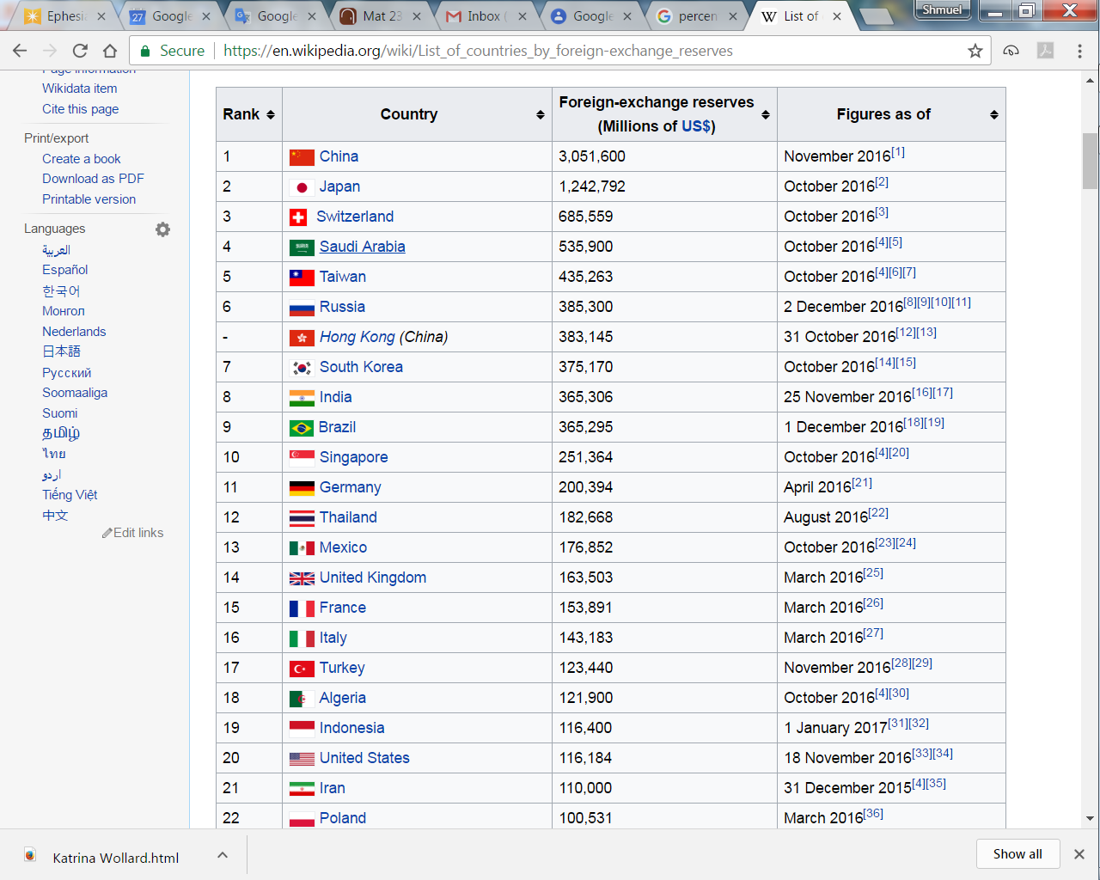
Notes:
https://en.wikipedia.org/wiki/List_of_countries_by_foreign-exchange_reserves
Twenty countries wiht the most treasure = reserves
US 116,184,000,000 dollars in reserves. $116 billion

Slide 38
Notes:
https://en.wikipedia.org/wiki/List_of_countries_by_foreign-exchange_reserves
China has $3 trillion treasure = reserves
Next slide is the debt of the countries of the world

Slide 39
Notes:
https://en.wikipedia.org/wiki/List_of_countries_by_external_debt

Slide 40
United States of America
$20 trillion debt, $116 billion reserves [hard to visualize, so proportionally:]
Like $20 thousand debt, $116 reserves
USA has no treasure, no reserves

Slide 41
^{Eph. 3.14-21} I pray that from the treasures of his glory he will empower you with inner strength by his Spirit,
^{NIV} I pray that out of his glorious riches he may strengthen you with power through his Spirit in your inner being,
Notes:
1. Treasures: most treasuries in the world are bankrupt. US $20 trillion debt, $116 billion reserves
$20 thousand debt, $116 reserves
2. Of His glory: made of??, no lien: pearls, Au, Ag, ²³⁵U fissile, and it’s empowering!!

Slide 42
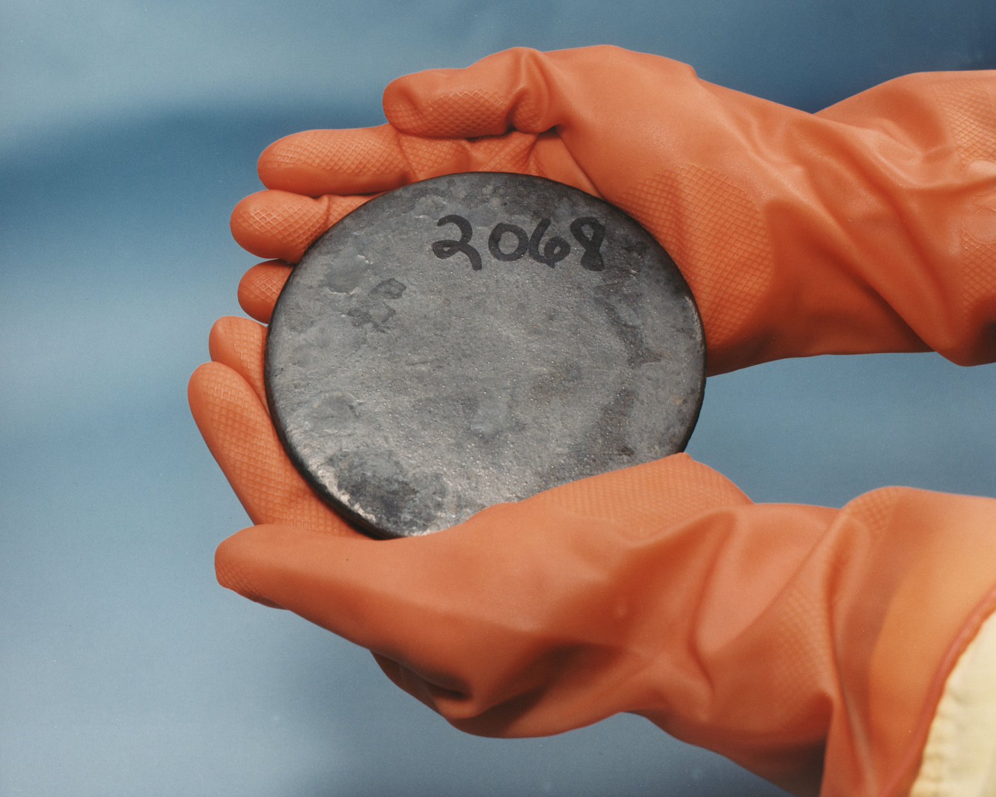
Uranium metal highly
enriched in uranium-235
2.5 million
times more
than the
energy
released
from
burning
coal
Notes:
https://en.wikipedia.org/wiki/Uranium-235
Heavy gloves

Slide 43
^{Eph. 3.14-21} I pray that from the treasures of his glory he will empower you with inner strength by his Spirit,
^{NIV} I pray that out of his glorious riches he may strengthen you with power through his Spirit in your inner being,
Notes:
3. Empower you: give, grant, bestow
4. Inner strength: dunamis: (miraculous) power, might, strength, physical power, force, might, ability, efficacy, energy, meaning
Why strength: wealth like that easy to waste.
5. By the Spirit of Him: not impersonal
Yn 16.15 Everything that the Father has is Mine. For this reason I said the Ruach will take from what is Mine and declare it to you.”
Accumulation of descriptions: treasure, empower, inner strength, Spirit

Slide 44
^{Eph. 3.14-21} so that the Messiah may live in your hearts through your trusting.
Notes:
Again, not impersonal strength, but Messiah, whom we love, whom we know, who bore our sins, has no malice, ‘Meek and lowly in heart’ Direct His love, humilty, patience to those we deal with.
Yeshua said, ‘You of little faith.’
In our hearts Conscious partnership
Thru trusting: decision of our mind, will, emotions, continuous
Continuous treasured empowering of inner strength by the Ruakh/Spirit
Next illustration some may think irreverent, but hang on...

Slide 45
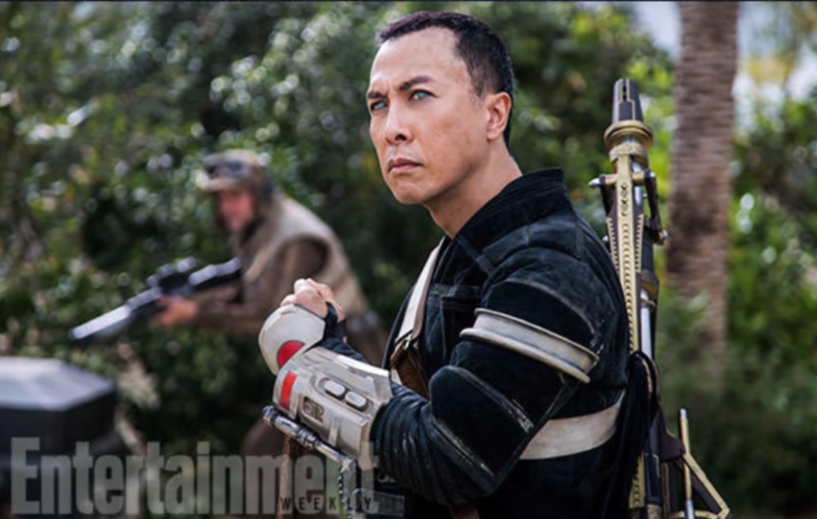
Rogue One
Notes:
Chirrut Inwe. Blind warrior: ‘I am with the force, and the force is with me.’
We can say:
‘I am with Yeshua, and Yeshua is with/in me.’

Slide 46
^{Eph. 3.14-21} so that the Messiah may live in your hearts through your trusting. Also I pray that you will be rooted and founded in love,
Notes:
Not just some mystical presence, but LOVE
Rooted: cause to take root; met: I plant, fix firmly, establish

Slide 47
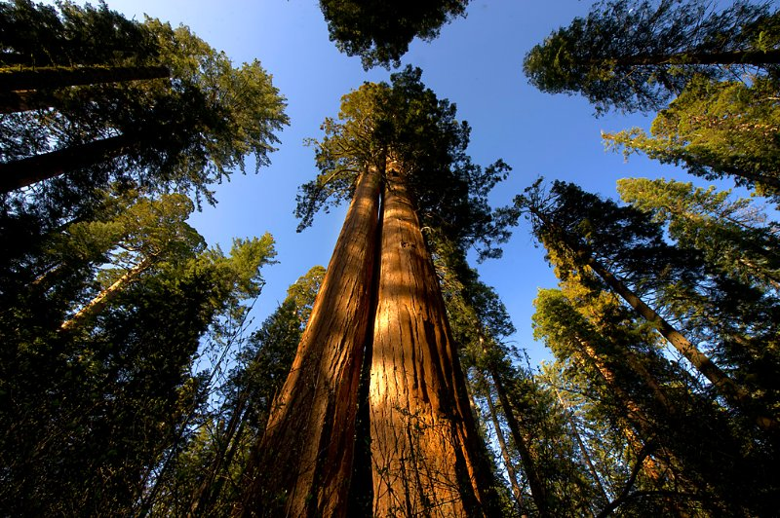

Slide 48
The sequoias have a matting, shallow, and wide spreading root system. There is no taproot. They only root to 12 to 14 feet deep even at maturity. A mature sequoia's roots can occupy over 1 acre of earth and contain over 90,000 cubic feet of soil
Notes:
https://www.giant-sequoia.com/faqs/giant-sequoia-questions/

Slide 49
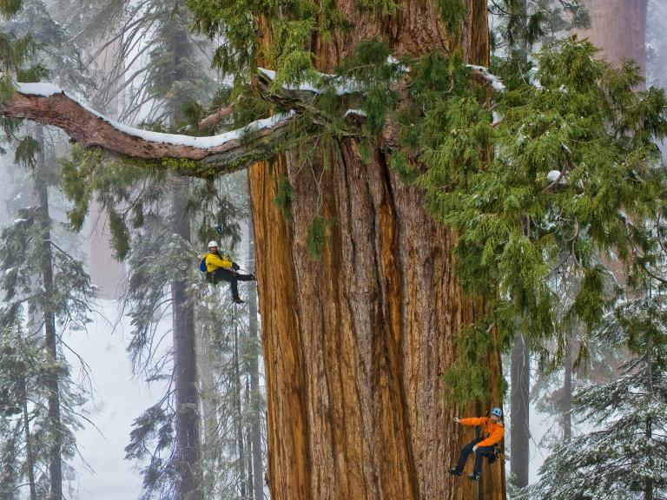
Notes:
https://www.linkedin.com/pulse/sequoia-tree-dr-tohid-nooralvandi
Wide root system: interdependent with other trees

Slide 50
That mass of matted roots and soil has to maintain the equilibrium of a tree that is nearly 300 feet tall and weighs nearly 2 million pounds
Notes:
https://www.giant-sequoia.com/faqs/giant-sequoia-questions/

Slide 51
^{Eph. 3.14-21} so that the Messiah may live in your hearts through your trusting. Also I pray that you will be rooted and founded in love,
Notes:
Rooted: cause to take root; met: I plant, fix firmly, establish
Founded: found, lay the foundation building, structure, World Trade Center.

Slide 52
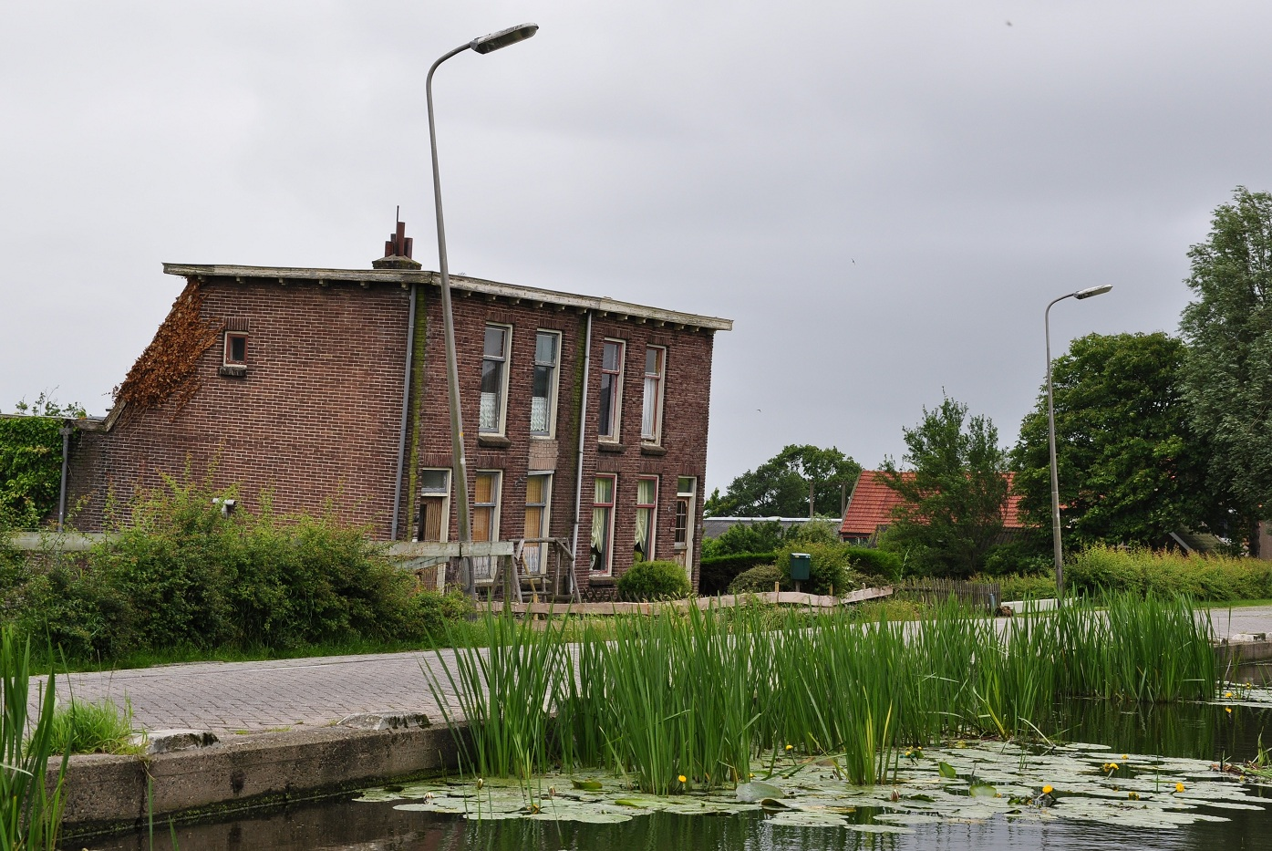
Notes:
Inadequate foundations in muddy soils below sea level caused these houses in the Netherlands to subside
https://en.wikipedia.org/wiki/Foundation_(engineering)#/media/File:Stompwijkseweg_68-70,_Stompwijk,_Netherlands.JPG

Slide 53
The foundation of the Twin Towers rested directly on the rock at a depth of more than 70' below the ground surface. A slurry wall (or diaphragm wall), 3' thick and about 80' deep, was constructed to support the soils surrounding the basements.
Notes:
http://www.columbia.edu/cu/civileng/ling/wtc/

Slide 54
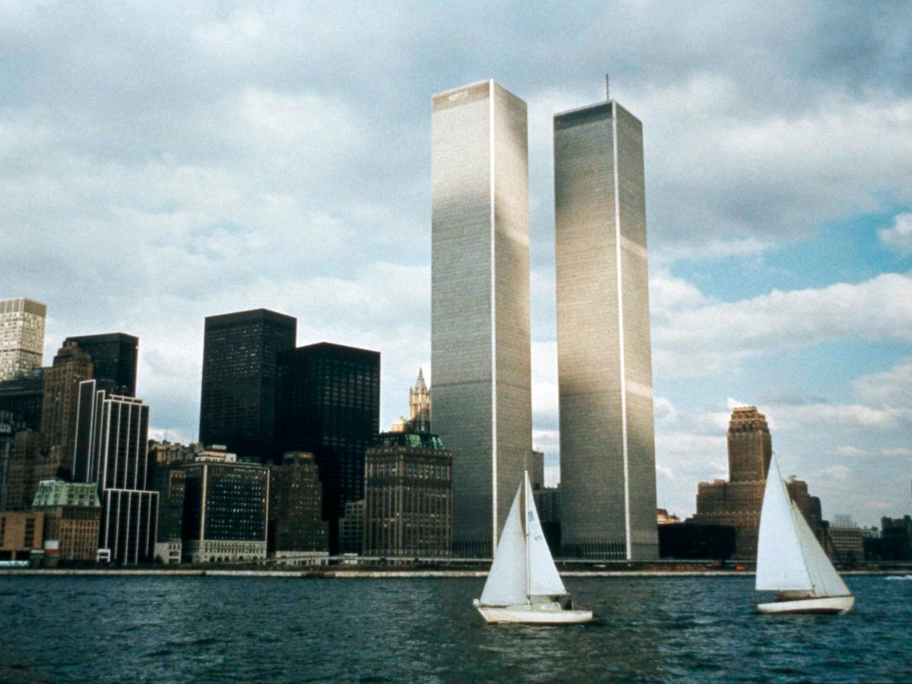

Slide 55
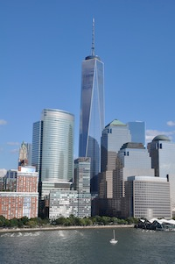
Notes:
On the Rock

Slide 56
^{Eph. 3.14-21} so that you, with all God's people, will be given strength to grasp the breadth, length, height and depth of the Messiah's love, yes, to know it,
[not only private knowledge, community knowledge, ~mat root system of sequoias]
Notes:
Love in community: dance together, eat together, home groups, social intimacy ‘with all G-d’s people’
Strength: ‘have strength for (a difficult task), to be perfectly able.’ Why need strength? Easier to NOT dwell in love. Grumble, complain, see my needs, unfulfilled aspirations, social deficits, family, fanancial, career disappointments. I’m not honored enough. I’m criticized. Love is selfless, outward!
Breadth: inclusive ^{T’hillim/Ps 10312} As far as the east is from the west, so far has He removed our transgressions from us. [north/south 12k miles. E/W unlimited. ]
Length: ∞ Height: to the very presence of G
Depth: No matter how perverted, debauched, vile, His blood atonement covers!!

Slide 57
^{Eph. 3.14-21} even though it is beyond all knowing, so that you will be filled with all the fullness of God.
Now to him who by his power working in us is able to do far beyond anything we can ask
Notes:
^{2 Cor 12.3} And I know that such a man — whether in the body or apart from the body I don’t know, God knows — was snatched into Gan-‘Eden and heard things that cannot be put into words, things unlawful for a human being to utter. Bit like quasars, black holes, pulsars, worm holes: unimaginable. Love of King Messiah Yeshua
^{Yn 14.23} Yeshua answered him, “If someone loves me, he will keep my word; and my Father will love him, and we will come to him and make our home with him.
~jar filled with all the fullness of the ocean: salts, bacteria, seaweed, but only a bit

Slide 58
^{Eph. 3.14-21} or imagine, to him be glory in the Messianic Community and in the Messiah Yeshua from generation to generation forever. Amen.
Notes:
In the community: you and me
In the Messiah: KING
Generation to Generation: Lador vador.

Slide 59
Teaching / hametz of the P'rushim and Tz'dukim =
^{Ro. 10.3} They are unaware of God’s way of making people righteous and instead seek to set up their own.
So, we need to receive His righteousness, in excellence!

Slide 60
Application:
^{2 Kefa/Peter 3.11-14} Since everything is going to be destroyed like this, what kind of people should you be? You should lead holy and godly lives, as you wait for the Day of God and work to hasten its coming.

Slide 61
Application:
^{2 Kefa/Peter 3.11-14} That Day will bring on the destruction of the heavens by fire, and the elements will melt from the heat; but we, following along with his promise, wait for new heavens and a new earth,

Slide 62
Application:
^{2 Kefa/Peter 3.11-14} in which righteousness will be at home. Therefore, dear friends, as you look for these things, do everything you can to be found by him without spot or defect and at peace.

Slide 63
Some people do righteousness VERY well.
Some people are nicer by nature than others are by grace.
GREATEST mystery to me is the deep flaws in some of G-d’s best people.

Slide 64
Dr. Tal Ben Shahar, nicknamed “Professor Happiness,” taught a course at Harvard on positive psychology - known as the most popular course on campus. (He has since returned to Israel where, perhaps, he is happier.)
Notes:
http://www.maozisrael.org/site/News2?abbr=maoz_&page=NewsArticle&id=11171&news_iv_ctrl=-1#top

Slide 65
Dr. Shahar believes the top predictor of happiness is spending time with people we care about and who care about us. In Israel, Friday night Shabbat dinners with extended family are a matter of course, even for the young and hip. After all, isolation is known to be a leading cause of unhappiness.
Notes:
http://www.maozisrael.org/site/News2?abbr=maoz_&page=NewsArticle&id=11171&news_iv_ctrl=-1#top
[RTF the key to all dysfunction and pain is abandonment/isolation, physical or emotional.]

Slide 66
“It’s because of our focus on relationships,” the professor notes. “Friends and family are very high up on our value scale, and quality time with them is given a priority. Time we spend with people we care about and who care about us is the number one predictor of happiness.” (www.israel21c.org)
Notes:
http://www.maozisrael.org/site/News2?abbr=maoz_&page=NewsArticle&id=11171&news_iv_ctrl=-1#top

Slide 67
Let’s open our lives, hearts, will power/choice, purpose to RECEIVE:
from the treasures of his glory he will empower you with inner strength by his Spirit, so that the Messiah may live in your hearts through your trusting, that you will be rooted and founded in love.

