Slide 1
Total Solar Eclipse
Aug 21, 2017
Notes:
Penumbra → partial eclipse
umbra = totality, small shadow
Every 400 years given location

Slide 2
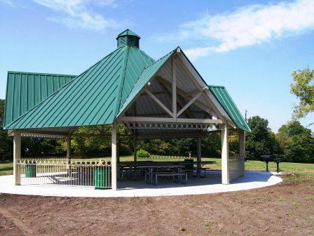
Shelter #20 at Claybrook
21211 Jesse James Farm Rd.,
Kearney, MO 64060

Slide 3
9 picnic tables
1 large grill and 2 small grills
20 amp service
Water hydrant 25 yards from shelter
Restroom with flush toilets 120 yards from shelter.
Close to Jesse James Farm Museum
21211 Jesse James Farm Rd.,
Kearney, MO 64060
Notes:
Time for a picnic. Haven’t done one for several years. And an immersion service, if you’ve never expressed your faith in “T’vilah”

Slide 4
מַתִּתְיָהוּ Mattityahu
(Matthew) 18:5-7

Slide 5
Last week
become childlike → exchanging joy smiles and dopamine brain release 6x / sec
Kindness elicits joy smiles!
Omer counting time fasting from unkindness

Slide 6
Mattityahu (Matthew) 18:5
כָּל הַמְקַבֵּל יֶלֶד אֶחָד כָּזֶה בִּשְׁמִי, אוֹתִי הוּא מְקַבֵּל."
Whoever welcomes one such child in my name welcomes me;
Notes:
Why “Such a child?”
A child of joy, of integrity, of trust in people → dopamine release
Physical child or spiritual child, His followers.
Children are messy, disorganized, immature.
In My Name, for my sake. [Not pronunciation], My redemptive spirit.
Repeat: Children are messy, disorganized, immature. Believers are messy, imperfect.
Messianics are messy. Mike Bickle says of prayer movement, “Building a ship at sea.” We are building a plane in the air! Under fire! Lots of sources opposition, disagreement, divergence!

Slide 7
^{Ro 15.7 NIV} Accept one another, then, just as Messiah accepted you, in order to bring praise to God.
^{NKJV} Therefore receive one another, just as Messiah also received us, to the glory of God.
Notes:
In essentials unity, in all else charity. Read our statement of faith for essentials. Membership class soon.

Slide 8
Mattityahu (Matthew) 18:6
"אַךְ כָּל הַמַּכְשִׁיל אֶחָד מִן הַקְּטַנִּים הָאֵלֶּה הַמַּאֲמִינִים בִּי
and whoever ensnares one of these little ones who trust me
Hebrew: Makhshil

Slide 9
מַכְשִׁיל תואר makhshil
hindering, obstructive,
causing failure

Slide 10
Notes:
Yeshua described, few chapters previous, those who fall away…

Slide 11
^{Matityahu 13.20-21} The seed sown on rocky ground is like a person who hears the message and accepts it with joy at once, but has no root in himself. So he stays on for a while; but as soon as some trouble or persecution arises on

Slide 12
^{Matityahu 13.20-21} account of the message, he immediately falls away.
But, what about the troubler, persecutor? Accountable?

Slide 13
^{Mishlei/Prov 28.10} Whoever causes the honest to pursue evil ways
will himself fall into his own pit,
but the pure-hearted will inherit good.

Slide 14
^{Matityahu 13.41} The Son of Man will send forth his angels, and they will collect out of his Kingdom all the things that cause people to sin and all the people who are far from Torah;

Slide 15
^{Matityahu 16.23} But Yeshua turned his back on Kefa, saying, “Get behind me, Satan! You are an obstacle in my path, because your thinking is from a human perspective, not from God’s perspective!”
Notes:
Considered Kefa = Satan since didn’t grasp big picture!

Slide 16
^{Vayikra 19.14} Do not speak a curse against a deaf person or place an obstacle in the way of a blind person; rather, fear your God; I am Adoni.
Notes:
G-d requires GREAT care regarding those who could fall, physically or spiritually!

Slide 17
^{Yekhez/Ezek 14.1-3} Then certain of Isra’el’s leaders came to me; and while they were sitting with me, the word of Adoni came to me: “Human being, these men have taken their idols into their hearts, thus setting in front of themselves the stumblingblock that leads to sin. Should I let them consult me at all?

Slide 18
^{Yekhez/Ezek 18.30} Therefore, house of Isra’el, I will judge each of you according to his ways,” says Adoni Elohim. “Repent, and turn yourselves away from all your transgressions, so that they will not be a stumblingblock that brings guilt upon you.

Slide 19
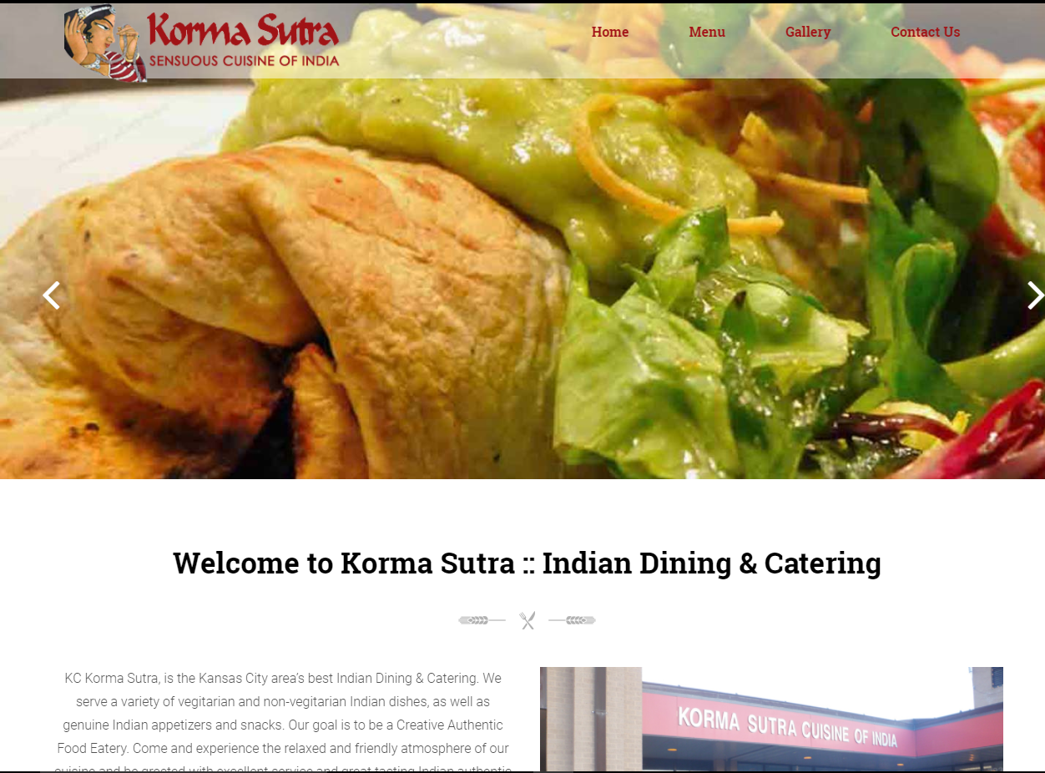
A practical application

Slide 20
What if a restaurant has halal food?
In Sunni Islam, animals slaughtered by Christians or Jews is halal only if the slaughter is carried out by using a well-sharpened knife to make a swift, deep incision that cuts the front of the throat,
Notes:
https://en.wikipedia.org/wiki/Halal

Slide 21
and the slaughter is carried out following the name of God (indicating that you are grateful for God's blessings), unless explicitly prohibited, like pork. The requirement to invoke Allah's name is a must.
Notes:
https://en.wikipedia.org/wiki/Halal
So, what do you do with such food?

Slide 22
^{1 Cor 8.4, 7-9} So, as for eating food sacrificed to idols, we “know” that, as you say, “An idol has no real existence in the world, and there is only one God.”…But not everyone has this knowledge. Moreover, some people are still

Slide 23
^{1 Cor 8.4, 7-9} so accustomed to idols that when they eat food which has been sacrificed to them, they think of it as really affected by the idol; and their consciences, being weak, are thus defiled. Now food will not improve our relationship with God —

Slide 24
^{1 Cor 8.4, 7-9} we will be neither poorer if we abstain nor richer if we eat. However watch out that your mastery of the situation does not become a stumbling block to the weak.

Slide 25
^{NIV 1 Cor 8.13} Therefore, if what I eat causes my brother or sister to fall into sin, I will never eat meat again, so that I will not cause them to fall.

Slide 26
^{Ro 15.7 NIV} Accept one another, then, just as Messiah accepted you, in order to bring praise to God.
^{NKJV} Therefore receive one another, just as Messiah also received us, to the glory of God.
Notes:
It’s all about attitude.

Slide 27
Mattityahu (Matthew) 18:6
"אַךְ כָּל הַמַּכְשִׁיל אֶחָד מִן הַקְּטַנִּים הָאֵלֶּה הַמַּאֲמִינִים בִּי
and whoever ensnares one of these little ones who trust me

Slide 28
Mattityahu (Matthew) 18:6
מוּטָב לוֹ שֶׁתִּתָּלֶה אֶבֶן רֵחַיִם עַל צַוָּארוֹ וִיטֻבַּע בִּמְצוּלוֹת יָם.
it would be better for him to have a millstone hung around his neck and be drowned in the open sea!
Image!!
Notes:
The four capital punishments inflicted by the Jews were stoning, burning, slaying with the sword, and strangling. Misn. Sanhedrim. c. 7. sect. 1

Slide 29
This describes a Roman form of execution MORE horrific than crucifixion!
Not unique in history to Roman.

Slide 30
Cement shoes or Chicago overcoat is a [largely fictional] method of execution and/or body disposal, usually associated with criminals such as the Mafia or gangs. It involves weighting down the victim
Notes:
https://en.wikipedia.org/wiki/Cement_shoes

Slide 31
who may be dead or alive, with concrete and throwing them into the water in the hope the body will never be found. In the US, the term has become tongue-in-cheek for a threat of death by criminals.
Notes:
https://en.wikipedia.org/wiki/Cement_shoes

Slide 32
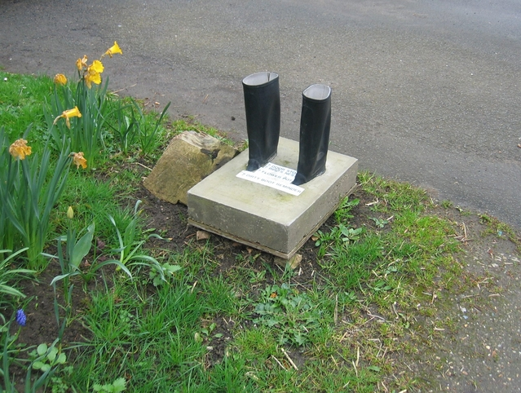
Cement shoes [concrete]

Slide 33
In three different locations in Florida two fat men wearing cement shoes can be seen underwater. The men are stripped of their clothes, except for their underwear…They have their feet inside of dried cement and have been dumped into the ocean,
Notes:
http://gta-myths.wikia.com/wiki/Cement_Shoe_Men

Slide 34
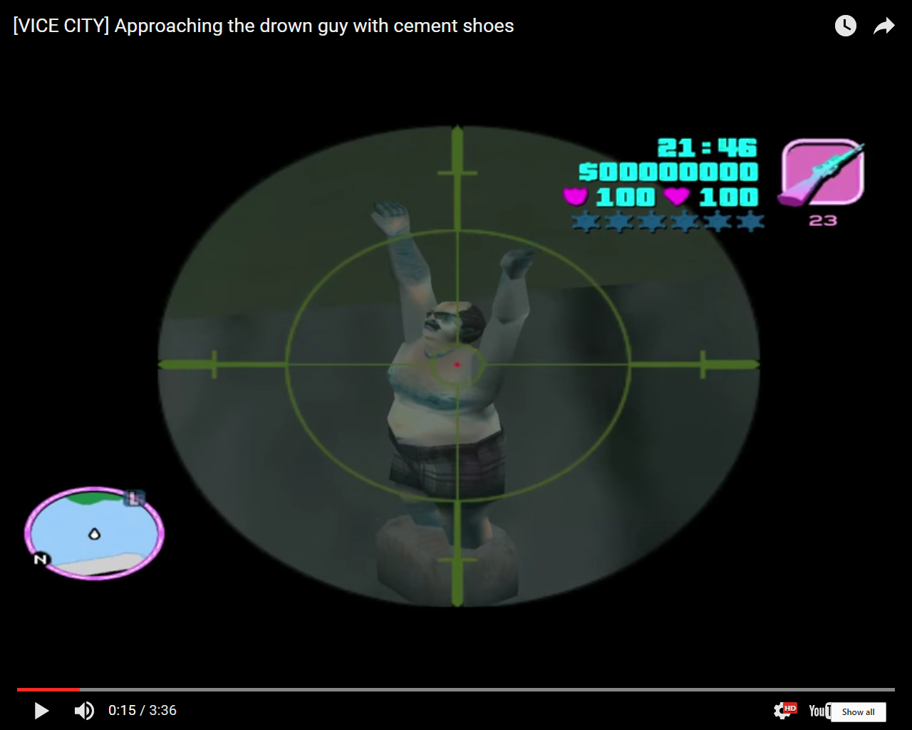
Notes:
http://gta-myths.wikia.com/wiki/Cement_Shoe_Men?file=-VICE_CITY-_Approaching_the_drown_guy_with_cement_shoes
These are apparently mockups, commemorating FL Mafia history

Slide 35
which was a notorious method of torturing and killing people that the Mafia used in the 80s.
During one movie, a person mentions that the Forelli Family are coming to fit him with some cement shoes.
Notes:
http://gta-myths.wikia.com/wiki/Cement_Shoe_Men

Slide 36
Mattityahu (Matthew) 18:6
"אַךְ כָּל הַמַּכְשִׁיל אֶחָד מִן הַקְּטַנִּים הָאֵלֶּה הַמַּאֲמִינִים בִּי
and whoever ensnares one of these little ones who trust me

Slide 37
Mattityahu (Matthew) 18:6
מוּטָב לוֹ שֶׁתִּתָּלֶה אֶבֶן רֵחַיִם עַל צַוָּארוֹ וִיטֻבַּע בִּמְצוּלוֹת יָם.
it would be better for him to have a millstone hung around his neck and be drowned in the open sea!
Notes:
The four capital punishments inflicted by the Jews were stoning, burning, slaying with the sword, and strangling. Misn. Sanhedrim. c. 7. sect. 1

Slide 38
How to cause little ones to stumble?
physically little
or spiritually little “believe on me”
Notes:
Kindness Challenge p 1, 11

Slide 39
^{Eph 4.28-32} The thief must stop stealing; instead, he should make an honest living by his own efforts. This way he will be able to share with those in need. Let no harmful language come from your mouth, only good words that are helpful in meeting the need,

Slide 40
^{Eph 4.28-32} words that will benefit those who hear them. Don’t cause grief to God’s Ruakh HaKodesh, for he has stamped you as his property until the day of final redemption. Get rid of all bitterness, rage, anger

Slide 41
^{Eph 4.28-32} violent assertiveness and slander, along with all spitefulness. Instead, be kind to each other, tenderhearted; and forgive each other, just as in the Messiah God has also forgiven you.

Slide 42
Unkindness is the khamsin of relationships, the east wind of death, abetting [not causing] depression, anger, withdrawal.
Notes:
We cause our own sins and misery, but we get help in the downward spiral!
During Omer count, s’firah, reverse the khamsin of death by fasting from unkindness.

Slide 43
A S’firah/ Omer counting time 30+ day fast from unkindness
Notes:
“You preached on this last week.” Only 50% constituency any service. And this one is a marriage saver, congregation unifier, urgent.

Slide 44
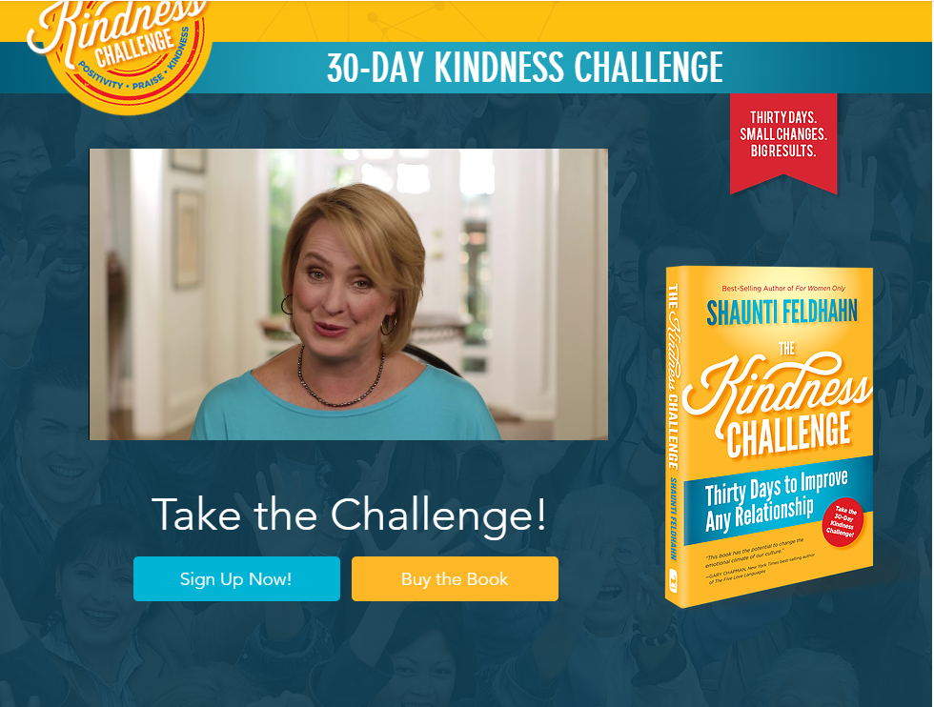
Notes:
http://www.jointhekindnesschallenge.com/

Slide 45
Say nothing negative/negatively about your person—either to them or about them to somebody else. (If you must provide honest, negative feedback to or about a colleague or child for vital reasons, be constructive, helpful and encouraging, without a negative tone.)
Notes:
Shaunti Feldhahn: Kindness Challenge

Slide 46
Every day (or as often as possible), find one thing positive that you can sincerely praise or affirm about your person and tell them, and tell someone else. (i.e. Tell your mother-in-law, "Thanks for being willing to watch the kids last night
Notes:
Shaunti Feldhahn: Kindness Challenge p 40, 41

Slide 47
while we were at that meeting," and then tell your husband the same thing. Without bringing up that she let the kids stay up way too late again.)
Notes:
Shaunti Feldhahn: Kindness Challenge

Slide 48
Every day (or as often as possible), do one small act of kindness or generosity for your person.
Notes:
Shaunti Feldhahn: Kindness Challenge

Slide 49
Is this really that important?

Slide 50
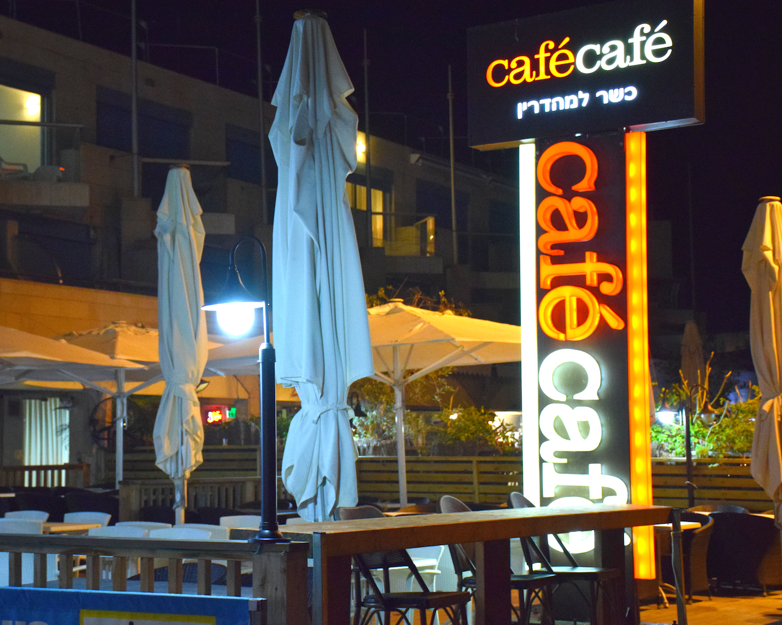

Slide 51
Israeli Coffee Shop Grants Discount For Being Polite: In Israel, being polite to your barista might not only earn you a smile - it could also save you money. Café Café, one of the country’s largest coffeehouse chains, is now offering a 25 percent discount to

Slide 52
customers at its 157 branches who say “please” and “thank you” when ordering a regular size cup of coffee, Globes reported on 3 May 2017. A cup of coffee will cost well-behaved patrons only 6 shekels, or $1.66, rather than 8 shekels, or $2.20.)

Slide 53
Café Café CEO Noam Zimerman told Globes that he hopes the initiative will “encourage more respectful conversation in Israel society.” He also expects it will benefit his company financially:

Slide 54
The chain saw a 30 to 40% increase in new customers when the price of a cup of coffee was slashed to 8 shekels several years ago from 11 or 12. Zimerman anticipates a similar increase this time. (INN Barry & Batya Segal)
Notes:
Underlying unkindness is abandonment RTF p 26

Slide 55
What causes abandonment issues?
The issues that cause a person to have abandonment fears run the gamut however, a few of the major reasons can include but are not limited to:
If your parents divorced
Notes:
http://www.couplescounselingchicago.net/7-signs-you-have-abandonment-issues-you-cant-ignore/

Slide 56
What causes abandonment issues?
If you were adopted [regardless of the kindness of the adoptive parents]
Alcoholic parents
If you lost a parent or sibling
Abuse during your childhood
Notes:
http://www.couplescounselingchicago.net/7-signs-you-have-abandonment-issues-you-cant-ignore/

Slide 57
What causes abandonment issues?
Emotionally unavailable caretakers
Narcissistic caretakers
History of low self-esteem
Verbal abuse by ex, by anyone
Notes:
http://www.couplescounselingchicago.net/7-signs-you-have-abandonment-issues-you-cant-ignore/

Slide 58
Mattityahu (Matthew) 18:7
אוֹי לָעוֹלָם מִן הַמִּכְשׁוֹלִים, כִּי מִן הַהֶכְרֵחַ שֶׁיָּבוֹאוּ מִכְשׁוֹלִים, אֲבָל אוֹי לָאִישׁ שֶׁהַמִּכְשׁוֹל יָבוֹא דַּרְכּוֹ.
Oy to the world because of snares! For there must be snares, but oy to the person who sets the snare!

Slide 59
jointhekindnesschallenge.com/
Notes:
Repent in general.

