Slide 1
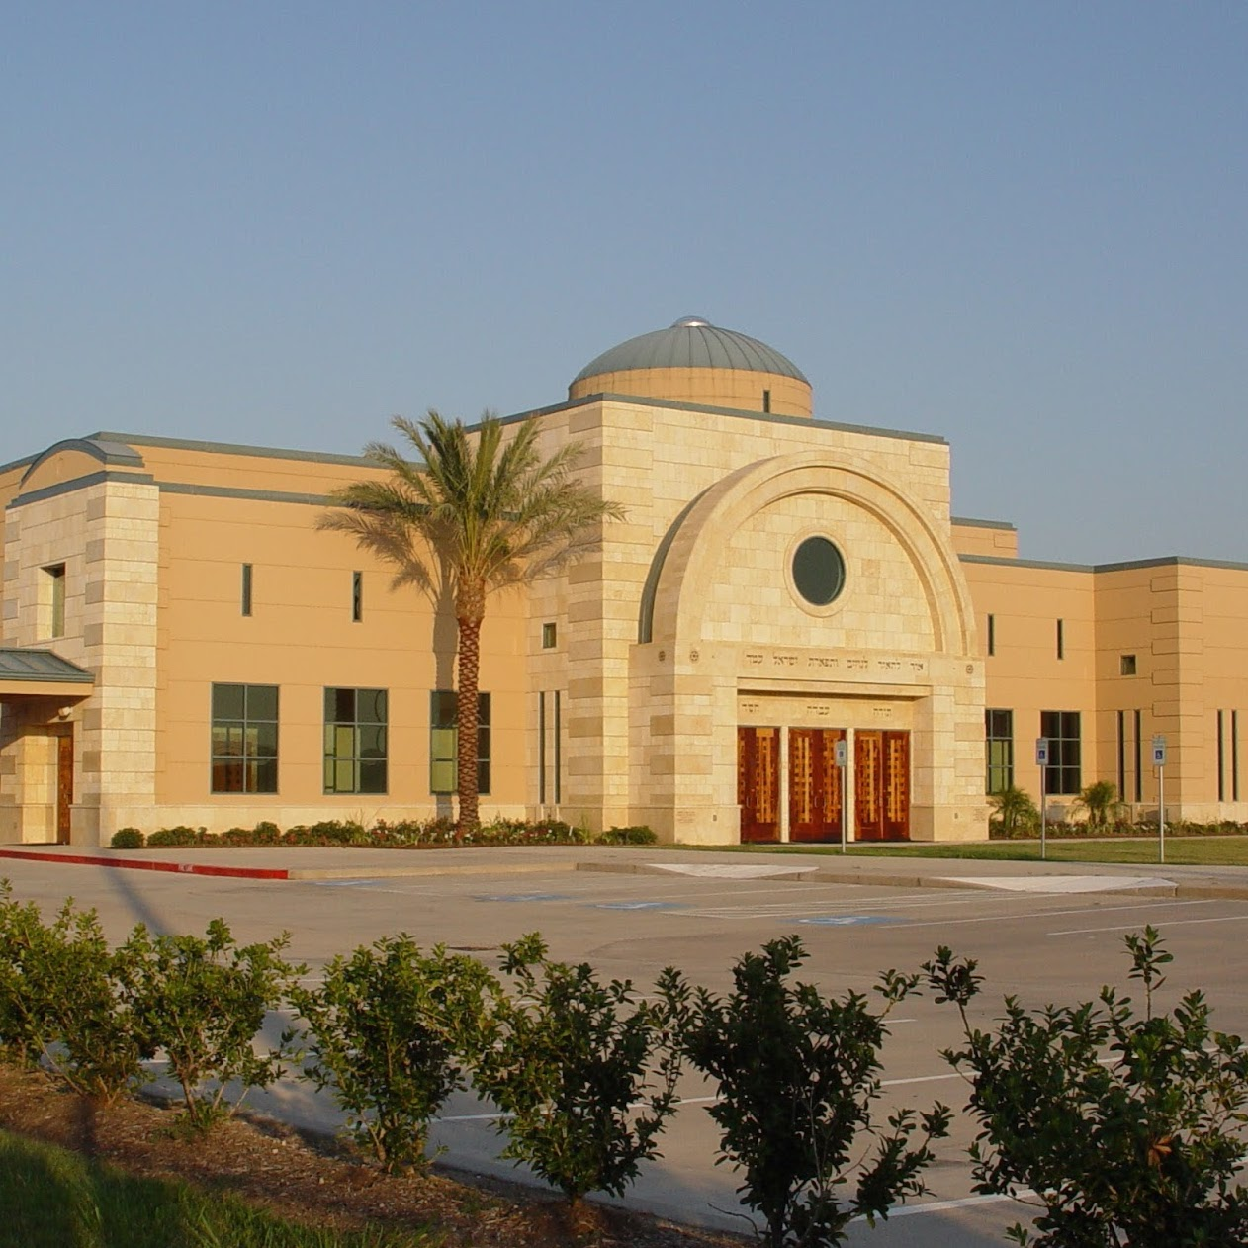
Beth Messiah Houston

Slide 2
Beth Messiah is setting up a hub or people can sign up or give donations to help hurricane victims 100% of the donations will go to families from Beth Messiah or to the greater Jewish community in Houston, Texas.
I cannot express to you how grateful we are for all of your prayer support. The devastation down here is almost undescribable and is absolutely catastrophic.
Serving Messiah, Michael Vowell | Senior Rabbi Office: 713.271.5757 cbmhouston.org

Slide 3
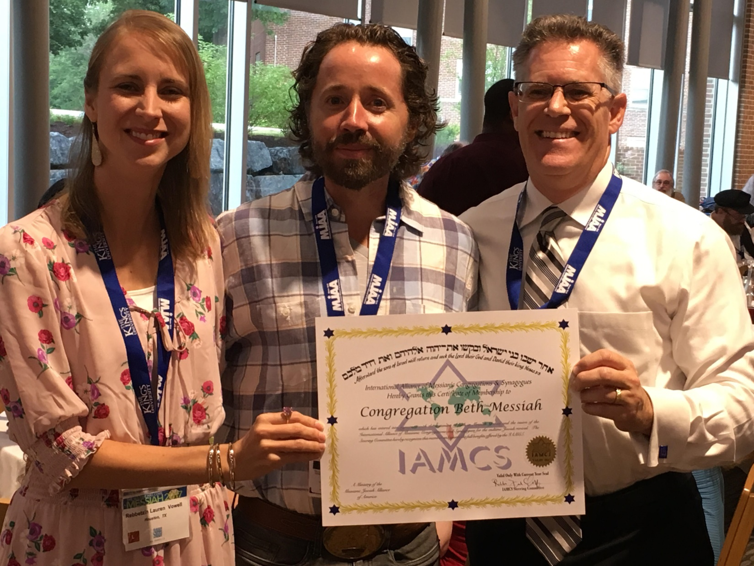
Rabbi Michael and Lauren Vowell
Notes:
Announce something in the works since we bought this building. Our logo has been ordered.

Slide 5
But stainless steel sheet and
colored, backlit logo and words

Slide 6
To easily follow these notes, log on to our Wifi
Wifi: mycci01 p/w: ancientquail060
Go to OrHaOlam.com
Click on downloads, messages, 2017

Slide 7
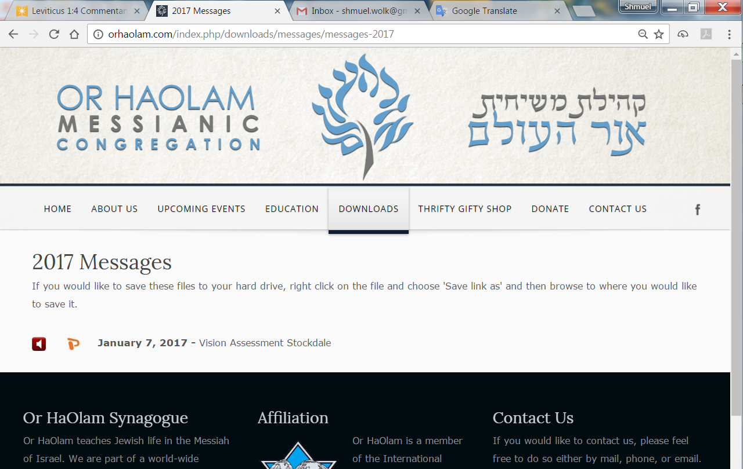

Slide 8
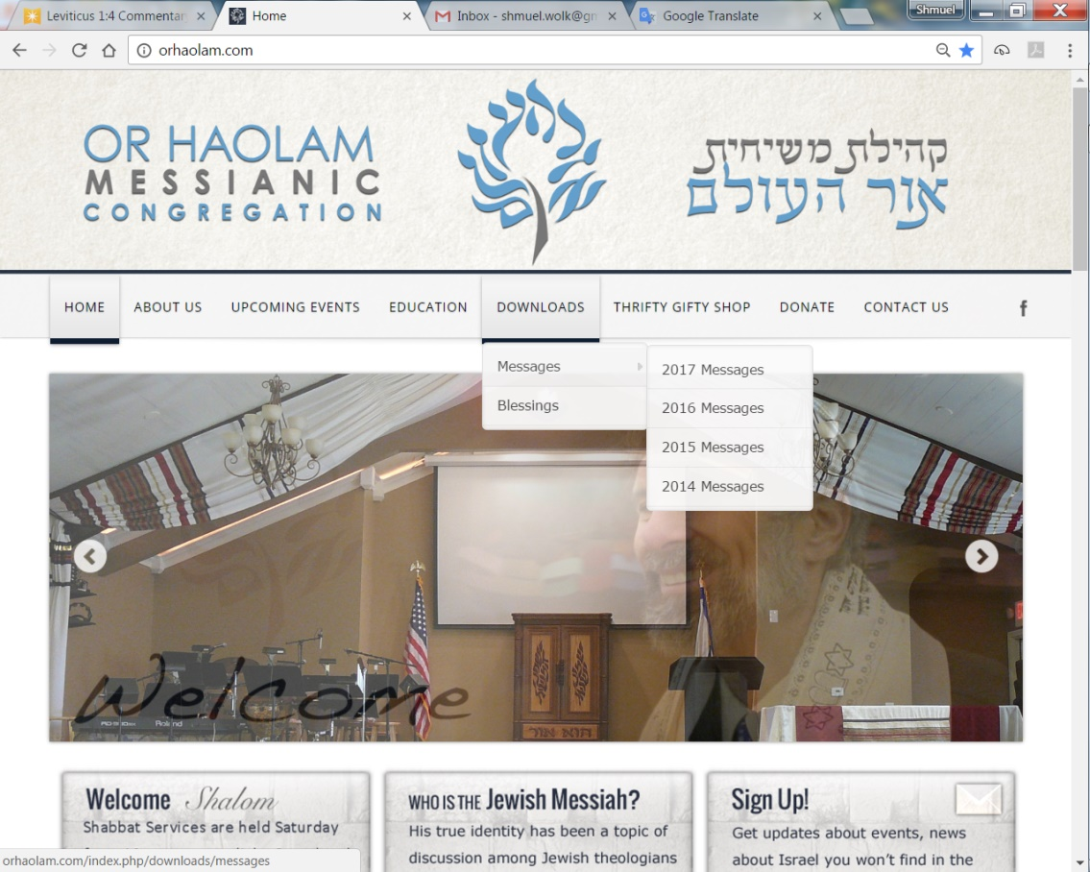
Downloads\messages\
2017 Messages

Slide 9
How is an apple like a train [in Spanish]?
Notes:
Shay Weber

Slide 10
How is an apple like a train [in Spanish]?
El tren no espera,
La manzana no es pera.
[the train won’t wait,
an apple is not a pear]
Notes:
Shay Weber

Slide 11
How is ISIS like wild blueberries?
Notes:
Shay Weber

Slide 12
How is ISIS like wild blueberries?
Wild blueberries have antioxidants,
and ISIS has anti-Occidents.
Notes:
Shay Weber

Slide 13
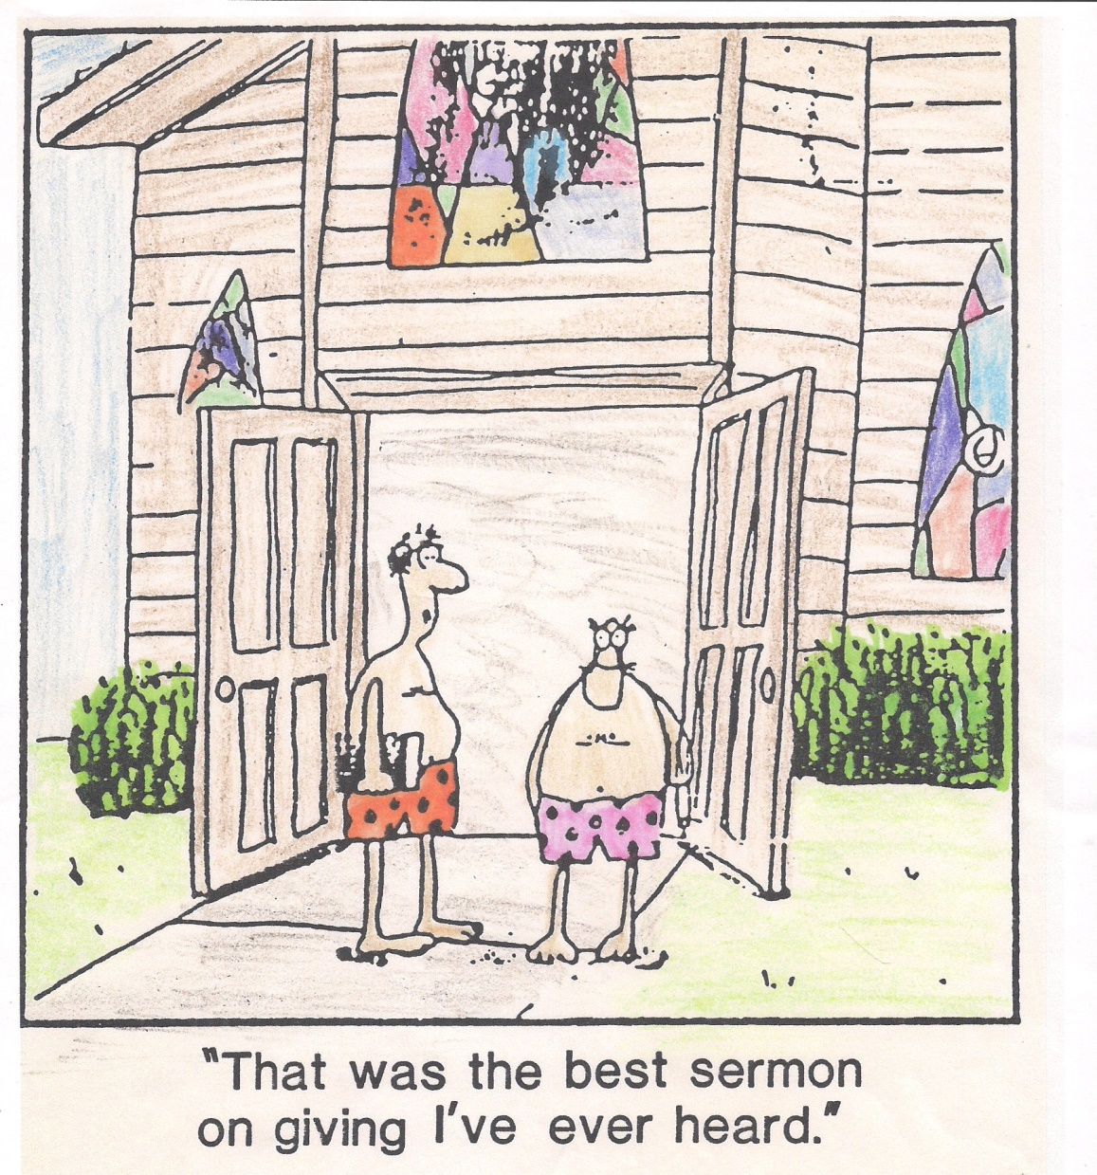
Notes:
From Bonnie Anderson

Slide 14
מַתִּתְיָהוּ Mattityahu
(Matthew) 20:20-22
Notes:
Context: we just finished discussing surprising nature of Kingdom rewards, last shall be first, the 12 over 12 tribes, immediately followed by reasserting the vision of the execution stake atonement, and the resurrection.

Slide 15
Mattityahu (Matthew) 20:20
אַחֲרֵי כֵן נִגְּשָׁה אֵלָיו הָאֵם שֶׁל בְּנֵי זַבְדַּי עִם בָּנֶיהָ וְהִשְׁתַּחַוְתָה לוֹ לְבַקֵּשׁ מִמֶּנּוּ דָּבָר.
Then Zavdai's sons came to Yeshua with their mother. She bowed down, begging a favor from him.
Notes:
She is said to be the sister of Joseph, the husband of Miriam, mother of Yeshua, so step uncle of Yeshua

Slide 16
Mattityahu (Matthew) 20:21
שָׁאַל אוֹתָהּ: "מַה בַּקָּשָׁתֵךְ?" הֵשִׁיבָה לוֹ: "אֱמֹר נָא "
He said to her, "What do you want?" She replied, "Promise that

Slide 17
Mattityahu (Matthew) 20:21
שֶׁיֵּשְׁבוּ שְׁנֵי בָּנַי אֵלֶּה אֶחָד לִימִינְךָ וְאֶחָד לִשְׂמֹאלְךָ בְּמַלְכוּתְךָ."
when you become king, these two sons of mine may sit, one on your right and the other on your left."
Notes:
Yeshua had just described the 12 sitting on 12 thrones, judging / ruling Israel, so by implication, inner circle of inner circle?
She was asking for a very large thing!!!

Slide 18
^{T’hillim/Ps 110.1} Adoni declares to my Lord: “Sit at My right hand until I make your enemies a footstool for Your feet.”
Notes:
There is something in the world of American Jewish humor culture that needs to be addressed. Begging for attention.

Slide 19
[American Ashkenaz]
Jewish Mother Stereotype: generally involves a nagging, loud, highly-talkative, overprotective, smothering, and overbearing mother or wife, who persists in interfering in her children's lives long after they have become adults and
Notes:
https://en.wikipedia.org/wiki/Stereotypes_of_Jews#Jewish_mother

Slide 20
Jewish Mother Stereotype:
who is excellent at making her children feel guilty for actions that may have caused her to suffer.
Notes:
https://en.wikipedia.org/wiki/Stereotypes_of_Jews#Jewish_mother
I had one such mother.
This lady was definitely promoting, pushy approach.
I want to go on record that I’m not there anymore. I’ve had to work a lot of forgiveness, and don’t work this theme anymore. In fact…

Slide 21
Scriptural view of Jewish motherhood:
^{Judges 5.6-7} “In the days of Shamgar the son of ‘Anat, in the days of Ya‘el, the main roads were deserted; travelers walked the byways.

Slide 22
Scriptural view of Jewish motherhood:
^{Judges 5.6-7} The rulers ceased in Isra’el, they ceased, until you arose, D’vorah, arose a mother in Isra’el.
Notes:
A warrior mother!

Slide 23
^{2 Sam. 20.15-17} All the people with Yo’av battered the wall in order to bring it down. Then a wise woman in the city shouted, “Listen! Listen! Please tell Yo’av, ‘Come over here, so that I can speak with you.’” He approached her, and the woman asked,

Slide 24
^{2 Sam. 20.15-17,19-20} “Are you Yo’av?” He answered, “I am.” She said to him, “Listen to what your servant has to say.” He answered, “I’m listening.”… “Why are you destroying a city and a mother in Isra’el?

Slide 25
^{2 Sam. 20.15-17,19-20} Why swallow up the inheritance of Adoni?” Yo’av answered, “Heaven forbid! Heaven forbid that I should swallow or destroy anything!”
Notes:
Then she gave her advice, which Joav and the townspeople accepted. She was the חכמה the Khakhama, the wise woman, presiding over the situation!

Slide 26
^{Lk 18.2-5} “In a certain town, there was a judge who neither feared God nor respected other people. There was also in that town a widow who kept coming to him and saying, ‘Give me a judgment against the man who is trying to ruin me.’ For a long time he refused;

Slide 27
^{Lk 18.2-5} but after awhile, he said to himself, ‘I don’t fear God, and I don’t respect other people; but because this widow is so persistent, I will see to it that she gets justice — otherwise, she’ll keep coming and pestering me till she wears me out!’”

Slide 28
^{1 K 2.16-18} Now I ask one favor of you; don’t deny me.” “Go on,” she said. He said, “Please speak to Shlomo the king — for he won’t say ‘No’ to you — and ask him to give me Avishag the Shunamit as my wife.” Bat-Sheva said, “All right, I will speak to the king on your behalf.”

Slide 29
^{Mt 15.1-28} Yeshua left that place and went off to the region of Tzor and Tzidon. A woman from Kena‘an who was living there came to him, pleading, “Sir, have pity on me. Son of David! My daughter is cruelly held under the power of demons!” …Then Yeshua answered her, “Lady, you are a person of great trust. Let your desire be granted.”

Slide 30
So the stereotype of Jewish motherhood is debunked in scripture, replaced by the Eshet Khiyil, the Woman of Warfare, the Wonder Woman.
Nevertheless, this request…
Notes:
Ladies, go for it. Stand for truth and love!

Slide 31
Mattityahu (Matthew) 20:22
עָנָה יֵשׁוּעַ וְאָמַר: "אֵינְכֶם יוֹדְעִים מַה שֶּׁאַתֶּם מְבַקְשִׁים. הַאִם יְכוֹלִים אַתֶּם לִשְׁתּוֹת
But Yeshua answered, "You people don't know what you are asking. Can you drink

Slide 32
Mattityahu (Matthew) 20:22
אֶת הַכּוֹס אֲשֶׁר אֲנִי עָתִיד לִשְׁתּוֹת?" הֵשִׁיבוּ לוֹ: "יְכוֹלִים אָנוּ."
the cup that I am about to drink?" They said to him, "We can."
Notes:
What does that mean, “the cup?”

Slide 33
Drink His Cup?
^{Col 1.24} Now I rejoice in my sufferings for you, and in my physical body—for the sake of His body, Messiah’s community —I fill up what is lacking in the afflictions of Messiah.
Notes:
His cup is intercessory suffering?
“for you”

Slide 34
^{Ro. 8.15-17} You received the Spirit of adoption, by whom we cry, “Abba! Father!” The Ruach Himself bears witness with our spirit that we are children of God. And if children, also heirs—heirs of God and

Slide 35
^{Ro. 8.15-17} joint-heirs with Messiah—if indeed we suffer with Him so that we may also be glorified with Him.

Slide 36
^{2 Thes.1.4-5} Therefore, we boast about you in the congregations of God because of your perseverance and trust in all the persecutions and troubles you are going through. This is clear evidence that God’s

Slide 37
^{2 Thes.1.4-5} judgment is just; and as a result, you will be counted worthy of the Kingdom of God for which you are suffering.

Slide 38
So the “cup” of Yeshua is that of suffering, sacrifice, for the betterment of others.
Shaul/Paul puts it:
Notes:
Want to be in ministry? We’re ALL in ministry!

Slide 39
^{2 Cor 6.4-10} We try to commend ourselves in every way as workers for God by continually enduring troubles, hardships, calamities, beatings, imprisonments, riots, overwork, lack of sleep and food.

Slide 40
^{2 Cor 6.4-10} We commend ourselves by our purity, knowledge, patience and kindness; by the Ruakh HaKodesh; by genuineness of love and truthfulness of speech; and by God’s power. We commend ourselves through our use of righteous weapons,

Slide 41
^{2 Cor 6.4-10} whether for pressing our cause or defending it; through being honored and dishonored, praised and blamed, considered deceptive and sincere, unknown and famous. And we commend ourselves as God’s

Slide 42
^{2 Cor 6.4-10} workers headed for death, yet look! we’re alive! as punished, yet not killed; as having reason to be sad, yet always filled with joy; as poor, yet making many people rich; as having nothing, yet having everything!
Notes:
Oy. What credentials!

Slide 43
^{2 Tim 2.11-12} Here is a statement you can trust: If we have died with him, we will also live with him. If we persevere, we will also rule with him.

Slide 44
^{Rev 1.9} I, Yochanan, am a brother of yours and a fellow-sharer in the suffering, kingship and perseverance that come from being united with Yeshua. I had been exiled to the island called Patmos for having proclaimed the message of God and borne witness to Yeshua.
Notes:
Suffering and kingship adjacent descriptions!
So, I believe G-d loves to bless us. But the blanket statement of the prosperity gospel seems a little off!

Slide 45
^{Rev. 20.4} And I saw the souls of those who had been beheaded for testifying about Yeshua and proclaiming the Word of God, also those who had not worshipped the beast or its image and had

Slide 46
^{Rev. 20.4} not worshipped the beast or its image and had not received the mark on their foreheads and on their hands. They came to life and ruled with the Messiah for a thousand years.

Slide 47
So the “cup” of Yeshua is that of suffering for the betterment of others.
As Rabbi Menachem Mendel Schneerson puts it
Notes:
Head of Chabad, legendary spiritual leader of the greatest outreach movement in [non-Messianic] Judaism.

Slide 48
Rebbe Schneerson: “It is clear that ‘no evil descends from Above,’ and buried within torment and suffering is a core of exalted spiritual good. Not all human beings are able to perceive it, but it is very much there. So it is not impossible for the physical
Notes:
https://en.wikipedia.org/wiki/Holocaust_theology

Slide 49
destruction of the Holocaust to be spiritually beneficial. On the contrary, it is quite possible that physical affliction is good for the spirit.” The Rebbe is also quoted as saying: “Hitler was a messenger of God in the same sense that Nebuchadnezzar
Notes:
https://en.wikipedia.org/wiki/Holocaust_theology

Slide 50
is called ‘God’s servant’ in the Book of Jeremiah ^{(Chapter 25)}.” As the Rebbe explained in his letter to Grossman, it is because we have no understanding why the Holocaust had to happen that we must believe, as a matter of faith or trust in God (emunah),
Notes:
https://en.wikipedia.org/wiki/Holocaust_theology

Slide 51
that it is ultimately for the benefit for those who perished as well as Jews and humanity at large. The Rebbe does not attempt to explain what the benefit is. But it is evidently eschatological-messianic.
Notes:
https://en.wikipedia.org/wiki/Holocaust_theology
I would NEVER say this, but Scheerson, in his deep moment of evaluating emunah, faith, had to say it.

Slide 52
So the “cup” of the righteous, of Yeshua, is that of suffering, sacrifice, for the betterment of others.
But it’s not all gloom and doom:

Slide 53
^{2 Cor 6.4-10} …yet look! we’re alive! as punished, yet not killed; as having reason to be sad, yet always filled with joy; as poor, yet making many people rich; as having nothing, yet having everything!
Notes:
Give thanks in all things!!

Slide 54
^{Acts 16.1-2} Sha’ul came down to Derbe and went on to Lystra, where there lived a talmid named Timothy. He was the son of a Jewish woman who had come to trust, and a Greek father. All the brothers in Lystra and Iconium spoke well of Timothy.

Slide 55
^{Luke 2.51-52} So he went with them to Natzeret and was obedient to them. But his mother stored up all these things in her heart. And Yeshua grew both in wisdom and in stature, gaining favor both with other people and with God.

Slide 56
Mattityahu (Matthew) 20:23
He said to them, "Yes, you will drink my cup. But to sit on my right and on my left is not mine to give, it is for those for whom my Father has prepared it."

Slide 57
So the “cup” of Yeshua is that of suffering AND JOY in truth for the betterment of others
Notes:
So plan on it, with joy!! Supernatural, in the Ruakh. I teach this lots, because He teaches it lots, and because I’ve noticed that there are some discouraged people here and there. Sometimes I’m one of them. Your sufferings are NOT for nothing. They are all intercessory. Thank G-d in Yeshua for redemptive purpose.
But, maybe sometimes, cup can be mitigated.
Even avoided.

Slide 58
Two examples of G-d’s people drinking the cup.
Israel it seems has always been hated. Predicted at the beginning of our people.

Slide 59
^{Beresheet/Gen 24.57-60} They said, “We will call the girl and see what she says.” They called Rivkah and asked her, “Will you go with this man?” and she replied, “I will.”
So they sent their sister Rivkah away,

Slide 60
^{Beresheet/Gen 24.57-60} with her nurse, Avraham’s servant and his men. They blessed Rivkah with these words: “Our sister, may you be the mother of millions, and may your descendants possess the cities of those who hate them.”
Notes:
Why refer to cities that hate her descendants at the very beginning of the Jewish people? Abe’s son Yitzkhak?
There is a cup of suffering that Jews and those allied with us drink MUCH. I think I should address it. We have to drink it, but maybe this will help mitigate it.

Slide 61
Big unreasonable lie about Israel, ‘justification’ of hatred → terrorism, by most Arabs:
“They stole our land.”
Much suffering: wars, bus bombings, propaganda, BDS
Few minutes of truth.
Notes:
May diminish the cup of suffering if you can understand and ANSWER accusations.

Slide 62
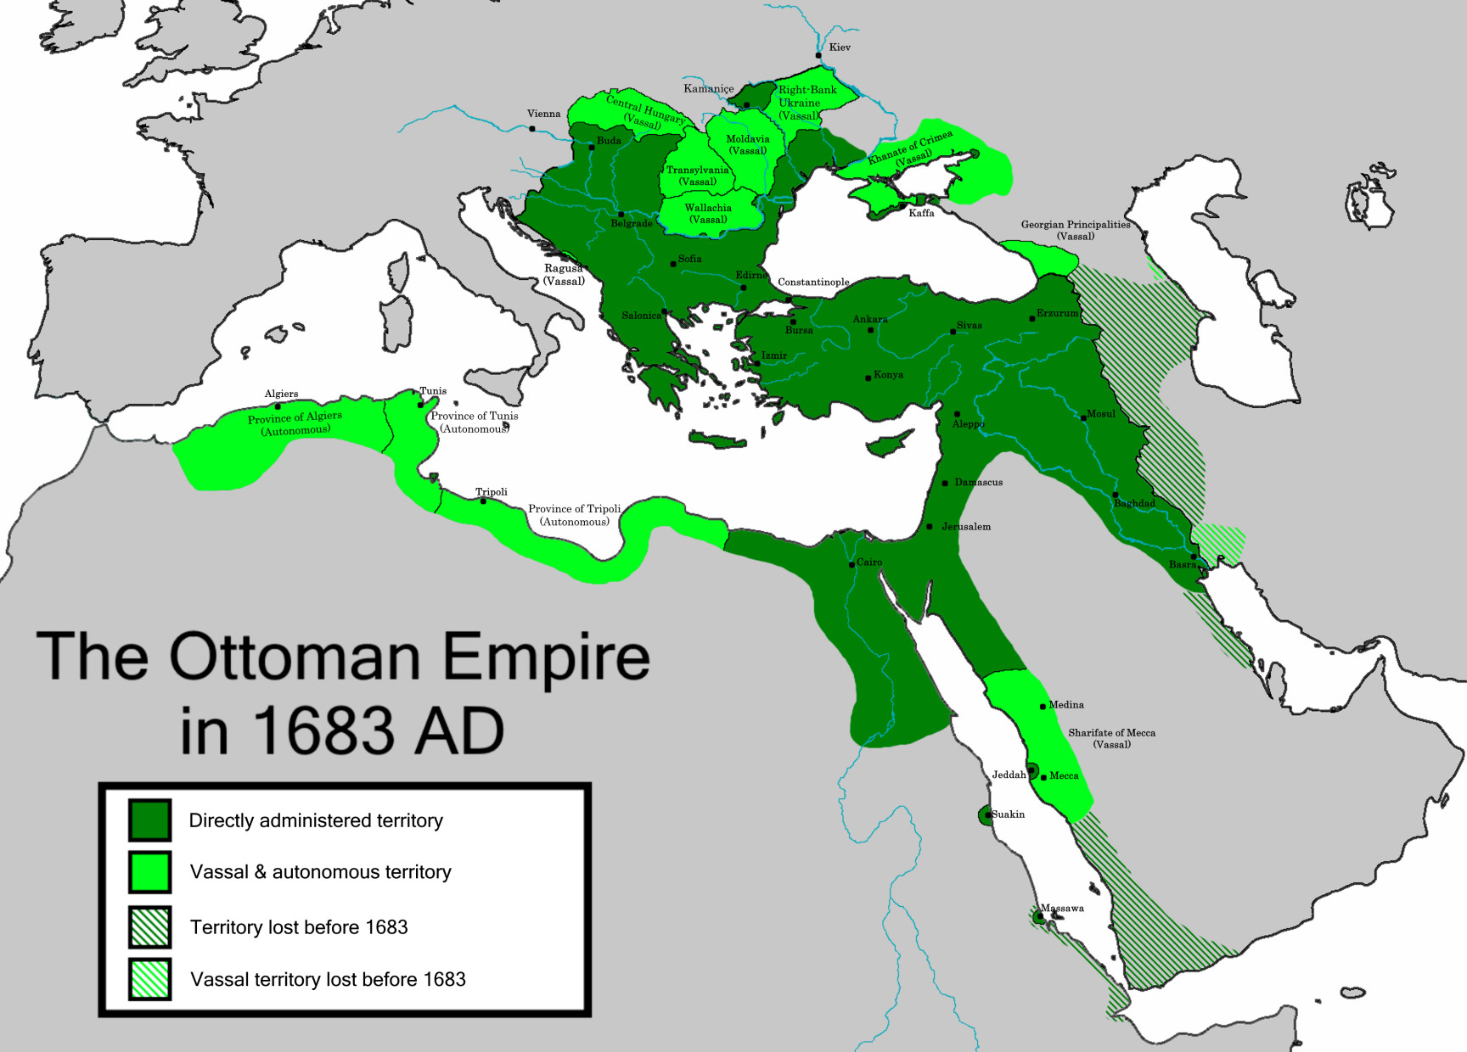
Notes:
https://en.wikipedia.org/wiki/Ottoman_Empire

Slide 63
At the close of WW I

Slide 64
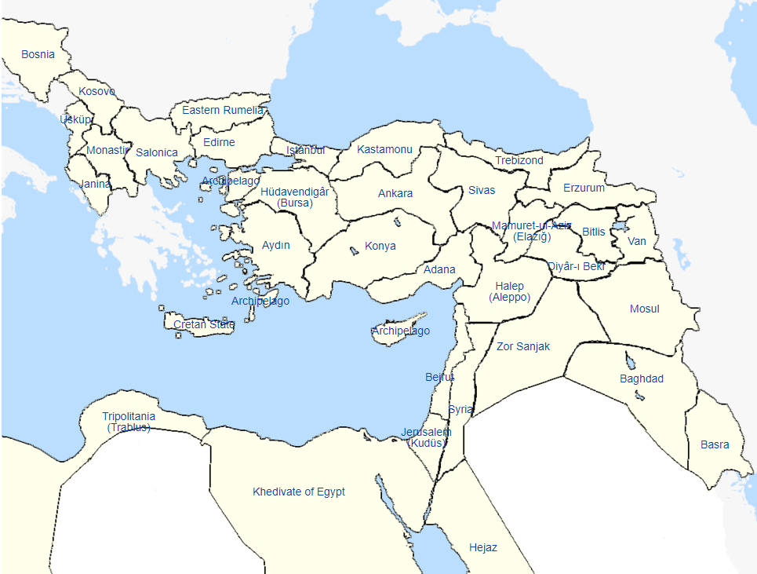
Ottoman Turkish provinces
and autonomies, c. 1876
Notes:
https://en.wikipedia.org/wiki/Vilayet
As WW 1 progressed, hope for defeat of Turks, and break up of Ottoman/Turkish Empire. No such countries as Lebanon, Iraq, Syria, Palestine. Just conquered provinces by Ottomans
We need to know a bit of history to rebut the lies, mitigate a bit one common cup of affliction.
Following is how the conquerors of the Turks decided to deal with the fallen Ottoman Empire. THERE WAS NO COLONIAL CONQUEST OF INDIGENOUS NATIONS. REALLY LIBERATION FROM THE OTTOMAN TURKS.

Slide 65
Sykes Picot Agreement 1916
Balfour Declaration Nov. 2, 1917
Paris Peace Accords 1919
San Remo Res. Apr. 25, 1920
League of Nations Jan. 10, 1920
British Mandate for Palestine – Dec. 29, 1923.
Notes:
http://unitycoalitionforisrael.org/?project=san-remos-mandate-israels-magna-carta
https://unitycoalitionforisrael.org/?page_id=13768
I don’t have time to look at all these. San Remo is the most significant. Remember, NOT colonial conquest of nationals, but break up of an oppressive Turkish empire.

Slide 66
San Remo International Law
Notes:
http://unitycoalitionforisrael.org/?project=san-remos-mandate-israels-magna-carta
Some underlying spiritual dynamics going on, also not well known!!

Slide 67
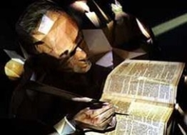
Professor George Bush
1796 - 1859

Slide 68
George Bush was an ordained Presbyterian minister and professor of Hebrew and Oriental Literature at New York University. He was convinced of the truths of the Biblical prophecies of Israel’s return to their land and became a national voice calling for the restoration of the Jewish people:
Notes:
https://www.fozmuseum.com/exhibits/dreamers/bush/

Slide 69
“The dispersed and downcast remnant shall, one after another, turn their faces to Zion … find their way to the land of their fathers….This will not only benefit the Jews, but all mankind, forming a link of communication between humanity and God.”
Notes:
https://www.fozmuseum.com/exhibits/dreamers/bush/

Slide 70
In 1844 he published his views in a landmark book entitled “The Valley of Vision; or, The Dry Bones of Israel Revived,” based on the prophecies of Ezekiel in the Bible. “The Valley of Vision” sold more than a million copies, unheard of
Notes:
https://www.fozmuseum.com/exhibits/dreamers/bush/

Slide 71
in the era before the Civil War.
It turned Bush into a national voice calling for the restoration of the Jewish people to their historic homeland.
Notes:
https://www.fozmuseum.com/exhibits/dreamers/bush/

Slide 72
An Ancestor of Two Presidents
His writings had a profound impact in shaping their views of the Jews and their homeland, including men of influence like Mark Twain, Abraham Lincoln, Woodrow Wilson and Teddy Roosevelt. Indeed, Bush himself was a distant ancestor of two US presidents named George Bush many decades later.
Notes:
https://www.fozmuseum.com/exhibits/dreamers/bush/

Slide 73
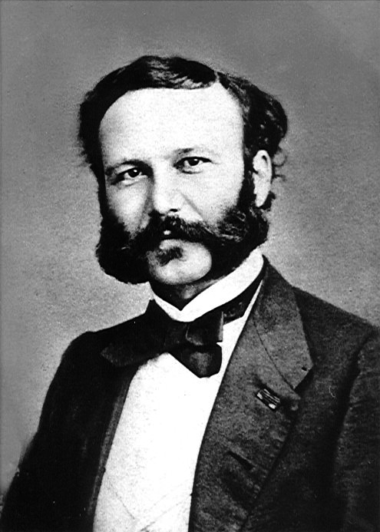
John Henry
Dunant
1828-1910

Slide 74
John Henry Dunant was a man of ideas and ideals whose strong humanitarian beliefs led to his founding of the International Red Cross and an inspiration for the framing of the First Geneva Convention on the rules of war. He was named a co-laureate of the first Nobel Peace Prize in 1901.
Notes:
https://www.fozmuseum.com/exhibits/dreamers/dunant/

Slide 75
Less known generally than his other endeavors, it was said that Dunant was the first to be labeled a “Christian Zionist,” so designated by Theodor Herzl, the founder of the international Zionist movement.
Notes:
https://www.fozmuseum.com/exhibits/dreamers/dunant/

Slide 76
Indeed, it was in 1866, long before Herzl began to push for a Jewish homeland, that Dunant appealed for the founding of the International Society for the Renewal of the Orient.
Notes:
https://www.fozmuseum.com/exhibits/dreamers/dunant/

Slide 77
Sykes Picot Agreement 1916
Balfour Declaration Nov. 2, 1917
Paris Peace Accords 1919
San Remo Res. Apr. 25, 1920
League of Nations Jan. 10, 1920
British Mandate for Palestine – Dec. 29, 1923.
Notes:
http://unitycoalitionforisrael.org/?project=san-remos-mandate-israels-magna-carta
https://unitycoalitionforisrael.org/?page_id=13768

Slide 78
The Sykes–Picot Agreement was a secret 1916 agreement between the United Kingdom and France, to which the Russian Empire assented. The agreement defined their mutually agreed spheres of influence
Notes:
https://en.wikipedia.org/wiki/Sykes%E2%80%93Picot_Agreement

Slide 79
and control in Southwestern Asia. The agreement was based on the premise that the Triple Entente would succeed in defeating the Ottoman Empire during World War I.
Notes:
https://en.wikipedia.org/wiki/Sykes%E2%80%93Picot_Agreement

Slide 80
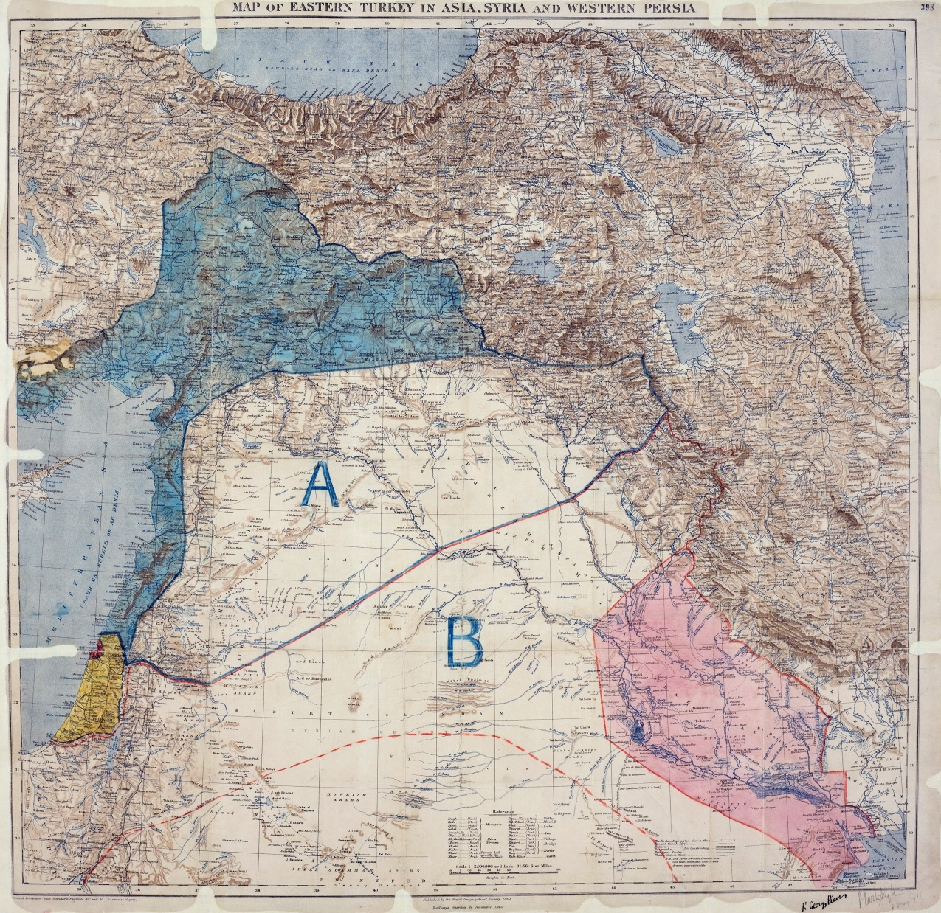

Slide 81
Sykes Picot Agreement 1916
Balfour Declaration Nov. 2, 1917
Paris Peace Accords 1919
San Remo Res. Apr. 25, 1920
League of Nations Jan. 10, 1920
British Mandate for Palestine – Dec. 29, 1923.
Notes:
http://unitycoalitionforisrael.org/?project=san-remos-mandate-israels-magna-carta
https://unitycoalitionforisrael.org/?page_id=13768

Slide 82
The Balfour Declaration was a British government public statement made during World War I, to announce their support for the establishment of a "national home" for the Jewish people in Palestine, then part of the Ottoman Empire.
Notes:
https://en.wikipedia.org/wiki/Balfour_Declaration

Slide 83
The declaration was contained in a letter dated 2 November 1917 from the United Kingdom's Foreign Secretary Arthur Balfour to Lord Walter Rothschild, a leader of the British Jewish community, for transmission to the Zionist Federation of Great Britain and Ireland. The text of the declaration was published in the press on 9 November 1917.
Notes:
https://en.wikipedia.org/wiki/Balfour_Declaration

Slide 84
His Majesty's government view with favour the establishment in Palestine of a national home for the Jewish people, and will use their best endeavours to facilitate the achievement of this object
Notes:
https://en.wikipedia.org/wiki/Balfour_Declaration
Originally “of Palestine as a national home”

Slide 85
it being clearly understood that nothing shall be done which may prejudice the civil and religious rights of existing non-Jewish communities in Palestine, or the rights and political status enjoyed by Jews in any other country
Notes:
https://en.wikipedia.org/wiki/Balfour_Declaration

Slide 86
Sykes Picot Agreement 1916
Balfour Declaration Nov. 2, 1917
Paris Peace Accords 1919
San Remo Res. Apr. 25, 1920
League of Nations Jan. 10, 1920
British Mandate for Palestine – Dec. 29, 1923.
Notes:
http://unitycoalitionforisrael.org/?project=san-remos-mandate-israels-magna-carta
https://unitycoalitionforisrael.org/?page_id=13768

Slide 87
The Paris Peace Conference, also known as Versailles Peace Conference, was the meeting of the Allied victors, following the end of World War I to set the peace terms for the defeated Central Powers diplomats from more than 32 countries and nationalities.
Notes:
https://en.wikipedia.org/wiki/Paris_Peace_Conference,_1919

Slide 88
The major decisions were the
creation of the League of Nations;
the five peace treaties with the defeated states, including the Treaty of Versailles with Germany;
the awarding of German and Ottoman overseas possessions as "mandates", chiefly to Britain and France;
Notes:
https://en.wikipedia.org/wiki/Paris_Peace_Conference,_1919

Slide 89
The conference heard statements from competing Zionist and Arab claimants. President Woodrow Wilson then recommended an international commission of inquiry to ascertain the wishes of the local inhabitants. Eventually it became the purely American King–Crane Commission,
Notes:
https://en.wikipedia.org/wiki/Paris_Peace_Conference,_1919

Slide 90
which toured all Syria and Palestine during the summer of 1919, taking statements and sampling opinion. A pro-Zionist joint resolution on Palestine was passed by Congress in September 1922.
Notes:
https://en.wikipedia.org/wiki/Paris_Peace_Conference,_1919

Slide 91
Sykes Picot Agreement 1916
Balfour Declaration Nov. 2, 1917
Paris Peace Accords 1919
San Remo Res. Apr. 25, 1920
League of Nations Jan. 10, 1920
British Mandate for Palestine – Dec. 29, 1923.
Notes:
http://unitycoalitionforisrael.org/?project=san-remos-mandate-israels-magna-carta
https://unitycoalitionforisrael.org/?page_id=13768

Slide 92
The San Remo conference was an international meeting of the post-World War I Allied Supreme Council as an outgrowth of the Paris Peace Conference, held at Villa Devachan in Sanremo, Italy, from 19 to 26 April 1920
Notes:
https://en.wikipedia.org/wiki/San_Remo_conference

Slide 93
It was attended by the four Principal Allied Powers of World War I who were represented by the prime ministers of Britain (David Lloyd George), France (Alexandre Millerand), Italy (Francesco Nitti) and by Japan's Ambassador Keishirō Matsui.
Notes:
https://en.wikipedia.org/wiki/San_Remo_conference
America was going isolationist by this point.

Slide 94
Resolutions passed at this conference determined the allocation of Class "A" League of Nations mandates for the administration of former Ottoman three territories in the Middle East: Palestine, Syria and Mesopotamia.
Notes:
https://en.wikipedia.org/wiki/San_Remo_conference

Slide 95
The San Remo Resolution adopted on 25 April 1920 incorporated the Balfour Declaration of 1917. It and Article 22 of the Covenant of the League of Nations were the basic documents upon which the British Mandate for Palestine was constructed.

Slide 96
Israel, Stand Firm on International Law! Israel has legal rights to Judea, Samaria and all of Jerusalem based on “Res Judicada” International Law (matters already judged).
Notes:
http://unitycoalitionforisrael.org/?project=san-remos-mandate-israels-magna-carta
https://unitycoalitionforisrael.org/?page_id=13768

Slide 97
Sykes Picot Agreement 1916
Balfour Declaration Nov. 2, 1917
Paris Peace Accords 1919
San Remo Res. Apr. 25, 1920
League of Nations Jan. 10, 1920
British Mandate for Palestine – Dec. 29, 1923.
Notes:
http://unitycoalitionforisrael.org/?project=san-remos-mandate-israels-magna-carta
https://unitycoalitionforisrael.org/?page_id=13768

Slide 98
So the “cup” of Yeshua is that of suffering AND JOY in truth for the betterment of others
The cup of the hatred of Israel will continue, but the lie that “colonial conquerors stole our land” is false. British liberation from the Turks/Ottomans then International legal decisions.
Notes:
I said two examples of people drinking the cup of lies and hatred. Next one more controversial. I believe, me, SW, not official Or HaOlam, but I believe our current president has made some painful mistakes: not moving embassy, cutting off funds to free Syrian army, response to Charlottesville, etc. Yet the hatred to him is somewhat out of proportion. He drinks the cup of hatred because he has some righteous principles.

Slide 99
NOW, THEREFORE, I, DONALD J. TRUMP, President of the United States of America, do hereby proclaim September 3, 2017, as a National Day of Prayer for the Victims of Hurricane Harvey and for our National Response and Recovery Efforts.
Notes:
https://www.whitehouse.gov/the-press-office/2017/09/01/president-donald-j-trump-proclaims-september-3-2017-national-day-prayer

Slide 100
We give thanks for the generosity and goodness of all those who have responded to the needs of their fellow Americans.
Notes:
https://www.whitehouse.gov/the-press-office/2017/09/01/president-donald-j-trump-proclaims-september-3-2017-national-day-prayer

Slide 101
Mattityahu (Matthew) 20:23
He said to them, "Yes, you will drink my cup. But to sit on my right and on my left is not mine to give, it is for those for whom my Father has prepared it."
LET’S RECEIVE HIS CUP WITH JOY, but mitigate it if we can.

