Slide 1
If you saw our livestream YouTube last week, it was MUCH better audio, but not quite HD video or audio.
Working on it! Adjusted settings, changed provider to Spectrum 200x15, from 100x5!

Slide 2
To easily follow these notes,
Go to OrHaOlam.com
WITHOUT WIFI
Click on downloads, messages,

Slide 3
Tour is on!!
Be a part of history and prophecy! 70 years after the founding of the State is the year of Release!
Just go to OrHaOlam.com
To register.
Notes:
Some insights from Kathleen Eltrich

Slide 4
You do not need a parachute to skydive. You only need a parachute to skydive twice.
I used to be indecisive. Now I'm not so sure.
I didn't say it was your fault, I said I was blaming you.
I'm supposed to respect my elders, but its getting harder and harder for me to find one.
Notes:
Some insights from Kathleen Eltrich

Slide 5
מַתִּתְיָהוּ Mattityahu
(Matthew) 23:5-8
Notes:
Yeshua continuing His last major teaching to the Jewish people. First one ch 5-7 Midrash on the Mountain seven blessings. This one seven woes. Today consider Yeshua’s critique of three things about the P’rushim, who sit in Moshe’s seat: tfillin, tsitsit, titles.

Slide 6
Mattityahu (Matthew) 23:5
וְעוֹשִׂים אֶת כָּל מַעֲשֵׂיהֶם כְּדֵי לְהֵרָאוֹת לִבְנֵי אָדָם, בְּהַרְחִיבָם אֶת תְּפִלֵּיהֶם וּבְהַאֲרִיכָם אֶת צִיצִיּוֹתֵיהֶם.
Everything they do is done to be seen by others; for they make their t’fillin broad and their tzitziyot long,
Notes:
So, let’s define terms. T’fillin and tsitsiyot, pl of tsitsit. Hard to pronounce. Most people say “teestsee” Like tsetse fly. Word ‘t’fillin’ not in Scripture. Jewish descriptive term.

Slide 7
their t’fillin תְּפִלֵּיהֶם
The first texts to use "tefillin" are the Targumim [Aramaic paraphrase 35–120 CE] and Peshitta [Syriac translation]. "Tefillin" may have derived from the Aramaic palal, "to plead, pray," a word closely related to the Hebrew tefillah, "prayer."
Notes:
From the scripture…

Slide 8
^{Dvarim/Dt 6.6-8} These words, which I am commanding you today, are to be on your heart. You are to… bind them as a sign on your hand, wear them on your foreheads as a reminder between your eyes.
וְהָיוּ לְטֹטָפֹת, בֵּין עֵינֶיךָ.
V’ha-yu l’totafot bayn eh-neh-kha
Notes:
There is NOT an exact explanation of what the totafot are, except…

Slide 9
^{Dvarim/Dt. 11.18} Therefore you are to set these words of Mine in your heart and in your soul. You are to bind them as a sign on your hand, and as at the front of a headband between your eyes.
לְטֹטָפֹת totafot
Notes:
Let’s explore the Hebrew word totafot

Slide 10
וְטוֹטָפֹת
totafot
טֹוטָף totaf carrier pigeon’s ring [to attach message]
טוֹטֶפֶת totefet band, front band, prayer band
Notes:
Not an exact image, but over the millennia this is what the Jewish people figured out…

Slide 11
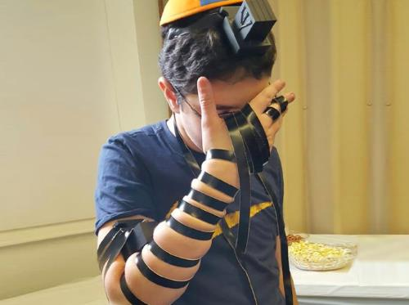
Notes:
http://www.chabad.org/library/article_cdo/aid/1918251/jewish/What-Are-Tefillin.htm
I was given this set at my Bar Mitzvah by my grandparents. I remember thinking that I will never, ever, ever wear these. As the cantor explained how to put them on, I just politely [if impatiently] nodded.
Later, as a believer, I found them and now use them about once/month, at our Shakharit service. Maybe not exactly what G intended by the command, but close enough. There is a wonderful sense of intimacy, bridal choreography.
Yeshua was condemning misuse, not use.

Slide 12
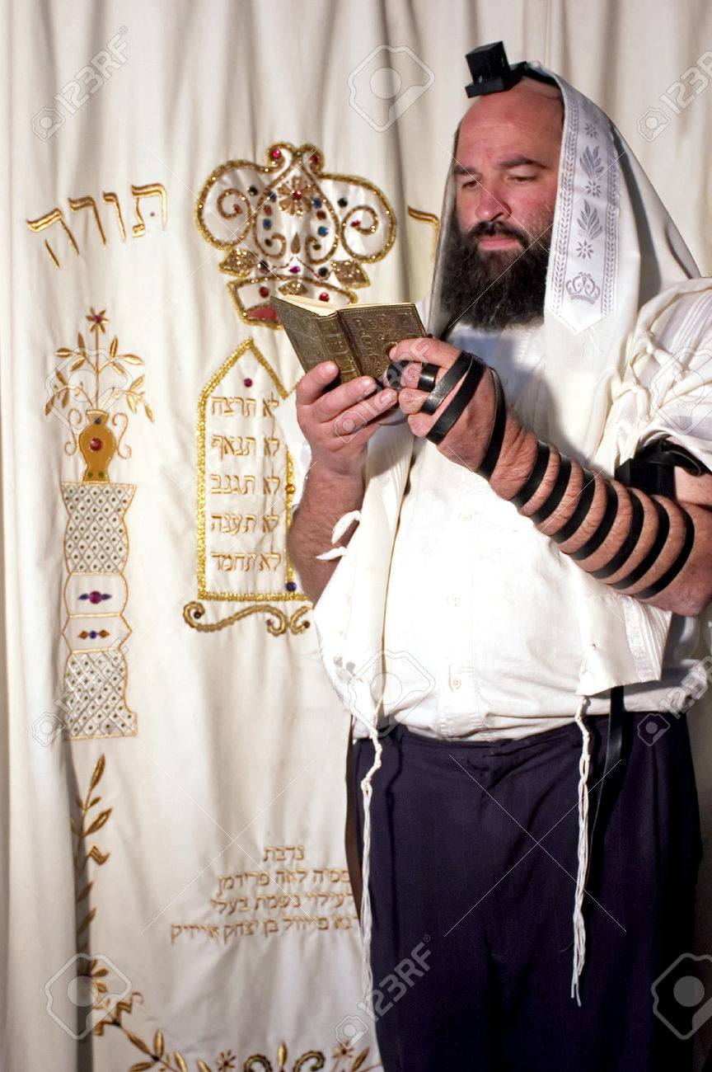

Slide 13
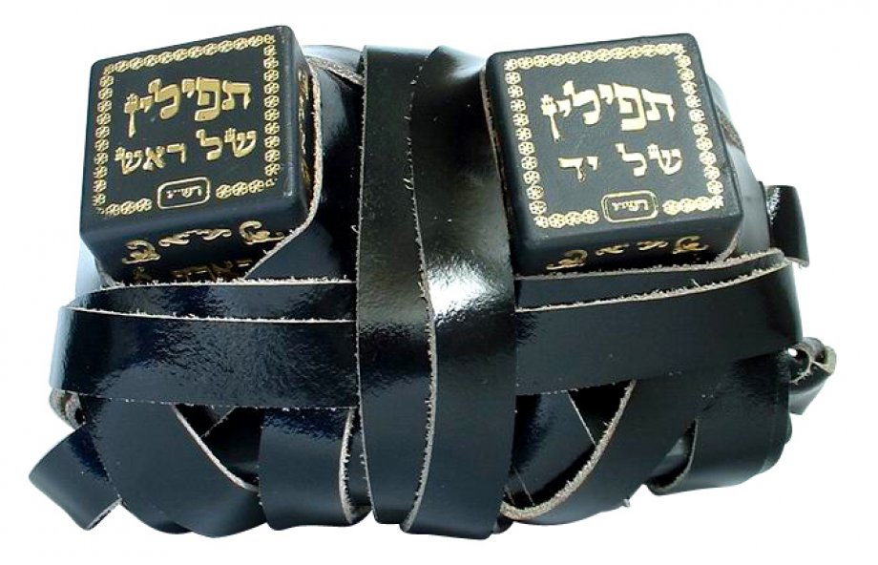

Slide 14
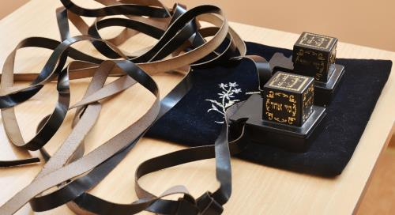
Notes:
http://www.chabad.org/library/article_cdo/aid/1918251/jewish/What-Are-Tefillin.htm

Slide 15
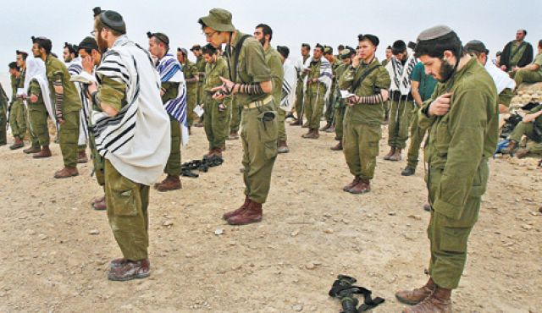
Notes:
http://www.lchaimcenter.org/prayers-for-our-idf-brothers-and-sisters/
When you put them on, the verse in Hoshea/Hosea is sung:

Slide 16
^{Hoshea 2.21-22} I will betroth you to Myself forever.
I will betroth you to Myself in Righteousness.
In justice, love, and in compassion,
And you shall know Me.

Slide 17
וְאֵֽרַשְֹתִּיךְ לִי בֶּאֱמוּנָה
V'eresteekh lee beh-ehmunah
I will betroth you to Myself in faithfulness.
וְיָדַעַתְּ אֶת־יְיָ:
Va-ya-da-at et HaShem
And you shall know Me

Slide 18
[Stern] Other English versions of the New Testament have here the word "phylacteries"; this transliterates the Greek word used in the text, "phulakterion," which means "safeguard, amulet, charm," and thus does not reflect the purpose of t'fillin.
Notes:
https://kifa.kz/eng/bible/stern/stern_matfey_23.php
When researching for the message, I found an amazing bit of Six Day War history relative to t’fillin.

Slide 19
The Rebbe’s Tefillin Campaign
We read in the Talmud that that once a Jewish male wears tefillin on his head—even one time in his life—he falls into a different category as a Jew.
Notes:
http://www.chabad.org/library/article_cdo/aid/1918251/jewish/What-Are-Tefillin.htm
Like I said, wearing them has a certain choreographic bridal effect.

Slide 20
Just before the outbreak of the Six-Day War in 1967, the Rebbe—Rabbi Menachem M. Schneerson, of righteous memory — began a campaign to encourage Jewish men and boys to put on tefillin.
Notes:
http://www.chabad.org/library/article_cdo/aid/1918251/jewish/What-Are-Tefillin.htm
Israel was in mortal danger, facing 100k Egyptian troops and 1000 tanks and advanced Russian MiG fighter planes.

Slide 21
Notes:
blob:http://www.chabad.org/aeed56ca-ec6b-421d-9d9d-297f45840470
We will drive the Jews into the sea.
Egyptian propaganda from the day…

Slide 22
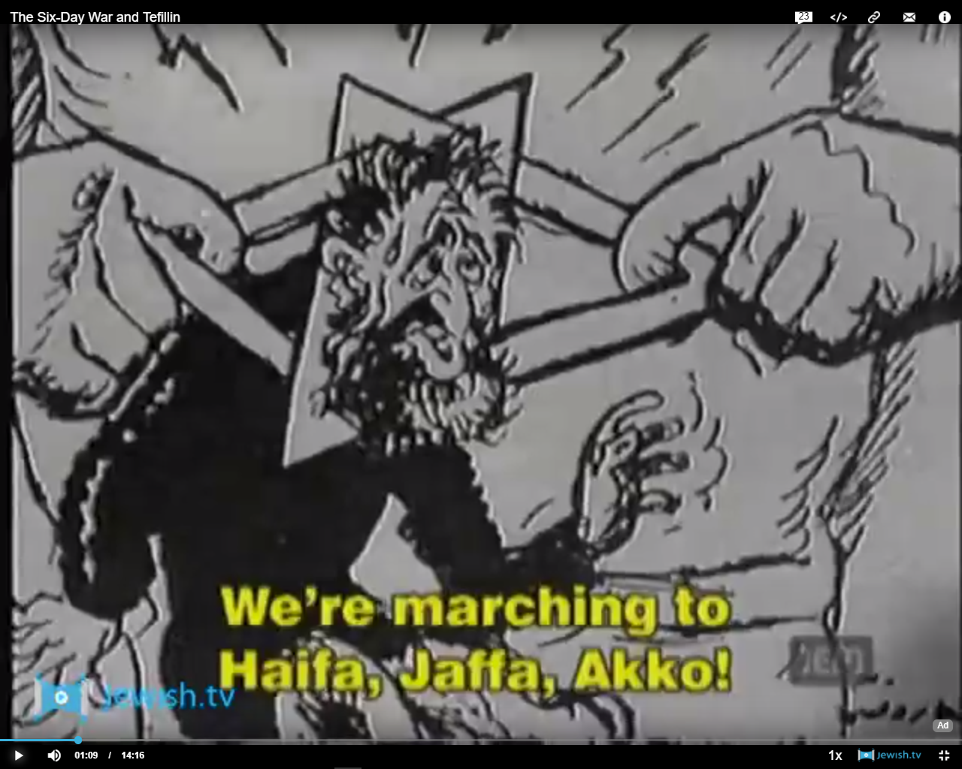
Notes:
blob:http://www.chabad.org/aeed56ca-ec6b-421d-9d9d-297f45840470

Slide 23
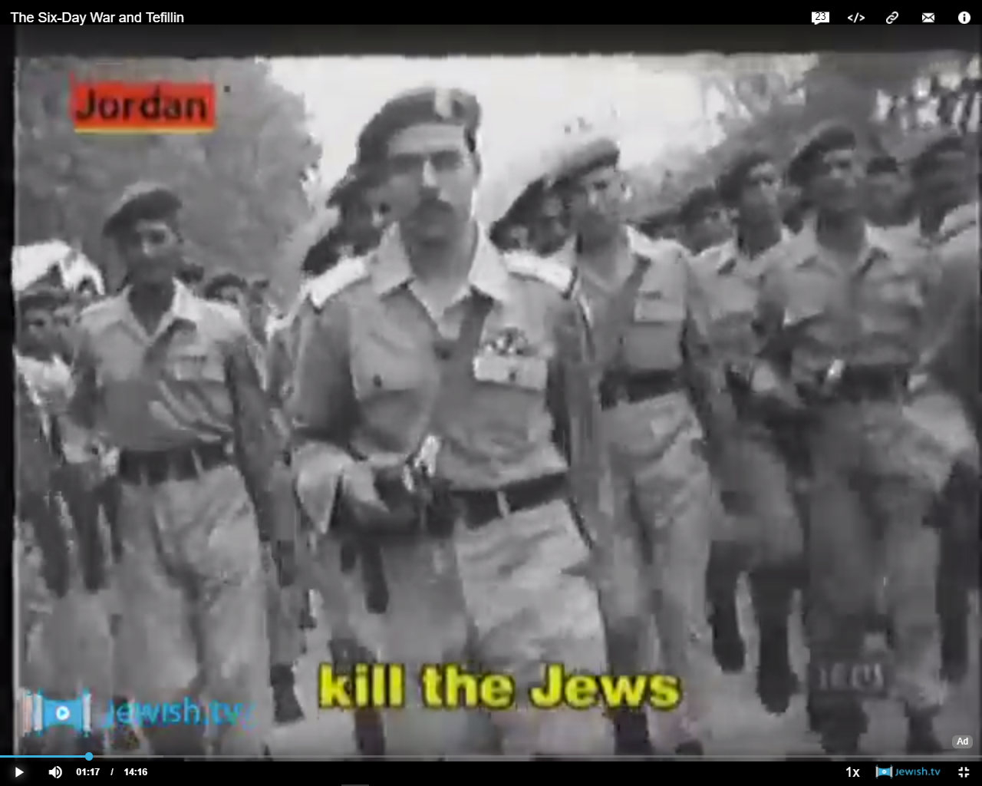
Notes:
blob:http://www.chabad.org/aeed56ca-ec6b-421d-9d9d-297f45840470

Slide 24
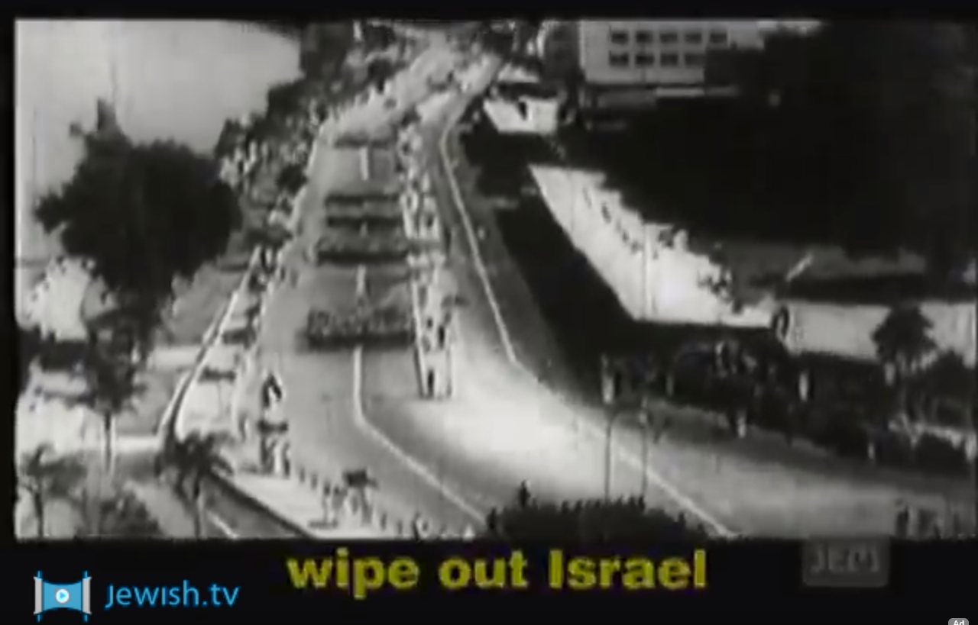
Notes:
blob:http://www.chabad.org/aeed56ca-ec6b-421d-9d9d-297f45840470

Slide 25
The Israelis were in dire expectations
10,000 dead expected
Parks were being evaluated to be huge cemeteries
Headlights of cars painted black
May 28, 1967 PM Levi Eshkol gave a vacillating address.
Notes:
I remember in my 12th grade HS classes, and the concern we had. “Will Israel survive?”
That same day, May 28, 1967, in Brooklyn, Rabbi Menachem M. Schneerson gave an address to 20,000 followers. This is a large part of what made him appear to be Messiah.

Slide 26
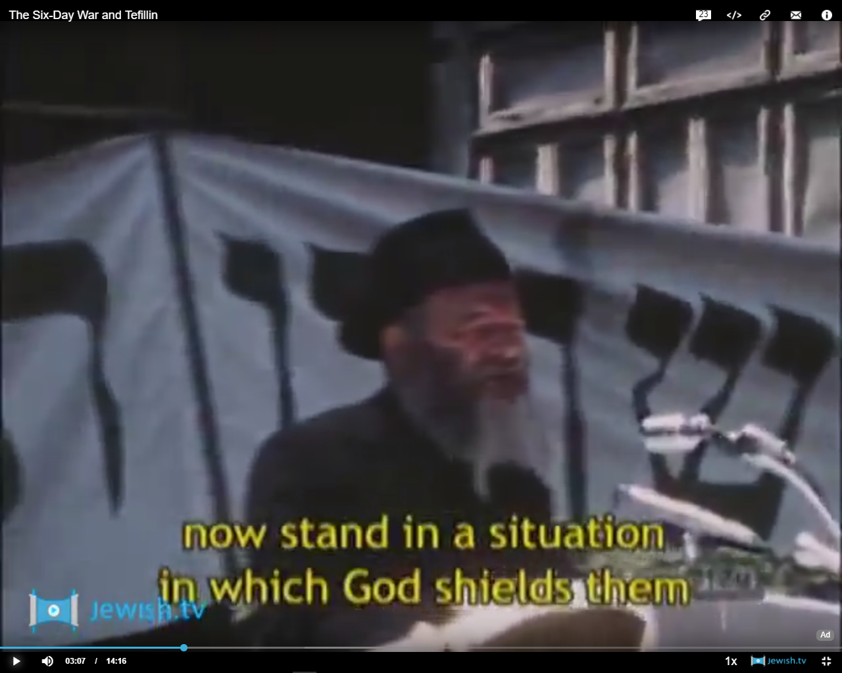
Notes:
blob:http://www.chabad.org/aeed56ca-ec6b-421d-9d9d-297f45840470

Slide 27
May 28, 1967 R. Menachem Mendel Schneerson addressed 20,000 followers in Brooklyn
Jews in Israel and diaspora must pray, do mitsvahs, love each other
G-d will protect Israel
Don’t leave Israel [panic]
He guaranteed survival, safety!!
Notes:
blob:http://www.chabad.org/aeed56ca-ec6b-421d-9d9d-297f45840470

Slide 28
Commenting on the verse ^{Deut. 28:10} “All the nations of the land will see that the name of G‑d is called upon you,” the sages declare that this refers to the head-tefillin.
“Wearing tefillin is important not just for you; it brings protection to the Jewish people.”
Notes:
http://www.chabad.org/library/article_cdo/aid/1918251/jewish/What-Are-Tefillin.htm

Slide 29
^{Dvarim/Dt.28.9-10} Then all the peoples on earth will see that Adoni’s name, his presence, is with you; so that they will be afraid of you.
וְרָאוּ כָּל-עַמֵּי הָאָרֶץ כִּי שֵׁם יְיָ נִקְרָא עָלֶיךָ; וְיָרְאוּ, מִמֶּךָּ.

Slide 30
^{Dvarim/Dt.28.9} Adoni will establish you as a people separated out for himself, as he has sworn to you — if you will observe the mitzvot of Adoni your God and follow his ways.

Slide 31
^{Dvarim/Dt.28.7} Adoni will cause your enemies attacking you to be defeated before you; they will advance on you one way and flee before you seven ways.

Slide 32
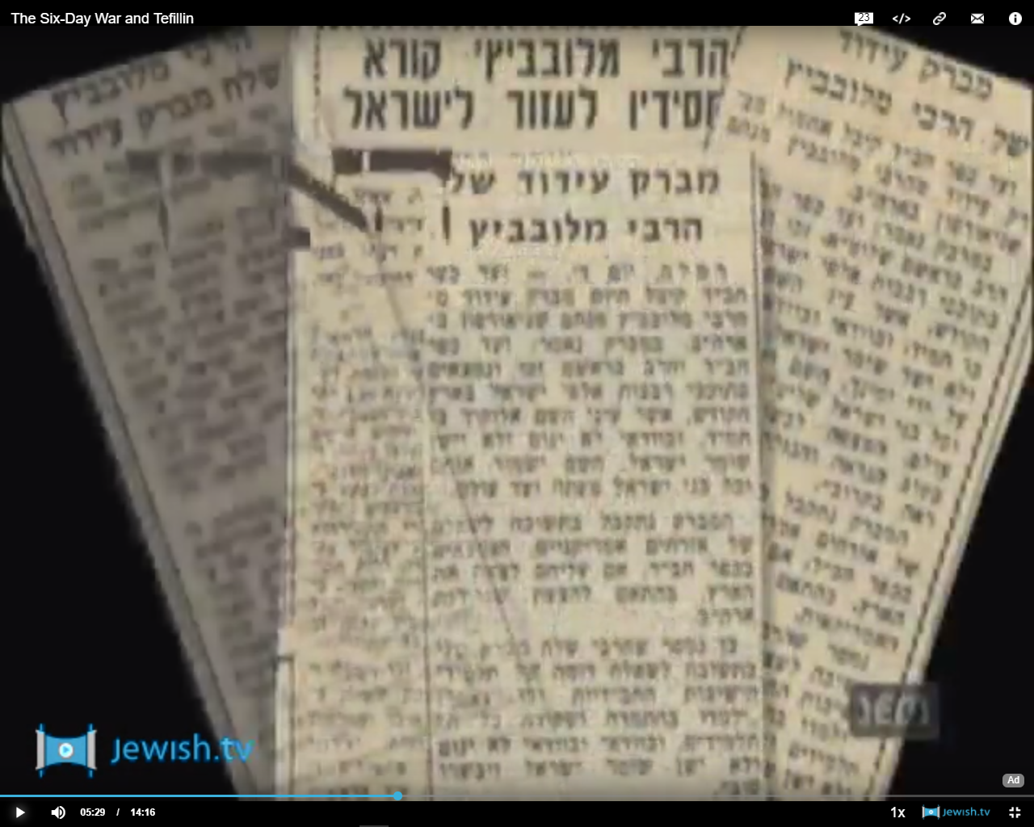
Notes:
blob:http://www.chabad.org/aeed56ca-ec6b-421d-9d9d-297f45840470
Published widely in Israeli press
Jewish men responded.
Mass panicked exodus from Israel assuaged…

Slide 33
June 5, 1967 7:45 a.m. 183 Israeli planes [almost all, no reserves] took off for Egypt and destroyed almost the entire Egyptian Air Force.
80% Egyptian tanks destroyed in 48 hours.
Notes:
blob:http://www.chabad.org/aeed56ca-ec6b-421d-9d9d-297f45840470
June 10 attacked Golan, Syrians been gunning Jewish farms from the heights for decades. 10 hours heavy fighting, then Syrian troops panicked.

Slide 34
^{Dvarim/Dt.28.7} Adoni will cause your enemies attacking you to be defeated before you; they will advance on you one way and flee before you seven ways.

Slide 35
Did tefillin save them?
No, however:
entering into G-d’s presence and having His Name on them, the best they knew
G-d’s prophetic timing for Jerusalem
G-d’s purpose in King Messiah
Notes:
His Name: NOT by pronunciation!!
That is a great part of what established R. Schneerson as the spokesman of G-d.

Slide 36
Having said all that, Yeshua is rebuking the wrong use of t’fillin and tsitsit.

Slide 37
Mattityahu (Matthew) 23:5
וְעוֹשִׂים אֶת כָּל מַעֲשֵׂיהֶם כְּדֵי לְהֵרָאוֹת לִבְנֵי אָדָם, בְּהַרְחִיבָם אֶת תְּפִלֵּיהֶם וּבְהַאֲרִיכָם אֶת צִיצִיּוֹתֵיהֶם.
Everything they do is done to be seen by others; for they make their t’fillin broad and their tzitziyot long,
Notes:
None of the commentaries had any history of wide tefillin. Keener: maybe wide straps, excessively frequent wearing. In any case, drew attention to themselves.
We explained t’fillin at length, as for tsitsit…

Slide 38
^{Bamidbar/Nu 15.37-41} Adoni said to Moshe, “Speak to the people of Isra’el, instructing them to make, through all their generations, tzitziyot on the corners of their garments, and to put with the tzitzit on each corner a blue thread.

Slide 39
^{Bamidbar/Nu 15.37-41} It is to be a tzitzit for you to look at and thereby remember all of Adoni’s mitzvot and obey them, so that you won’t go around wherever your own heart and eyes lead you to prostitute yourselves; .”

Slide 40
^{Bamidbar/Nu 15.37-41} but it will help you remember and obey all my mitzvot and be holy for your God. I am Adoni your God, who brought you out of the land of Egypt in order to be your God. I am Adoni your God.”

Slide 41
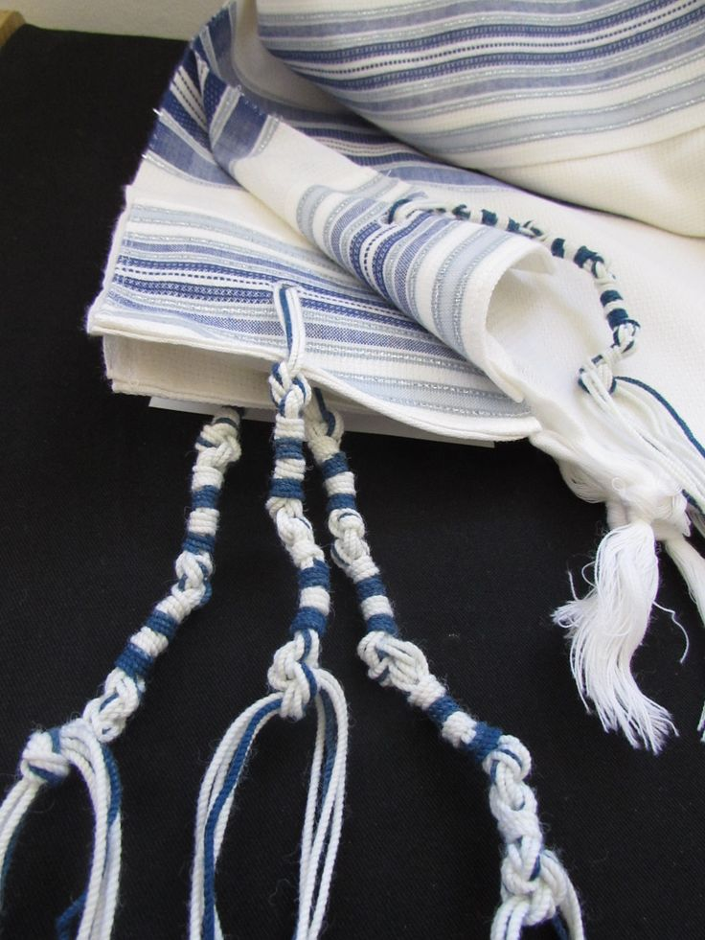
Notes:
Apparently, Yeshua had tsitsit on when approached by the woman in Mtt 9.20 with the extended hemorrhage.

Slide 42
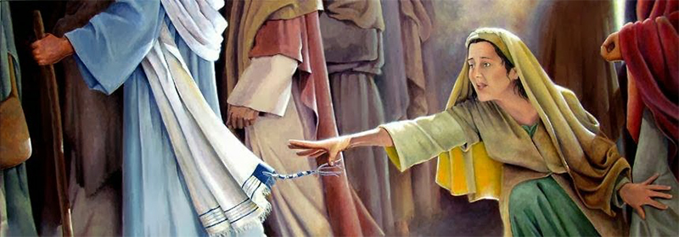

Slide 43
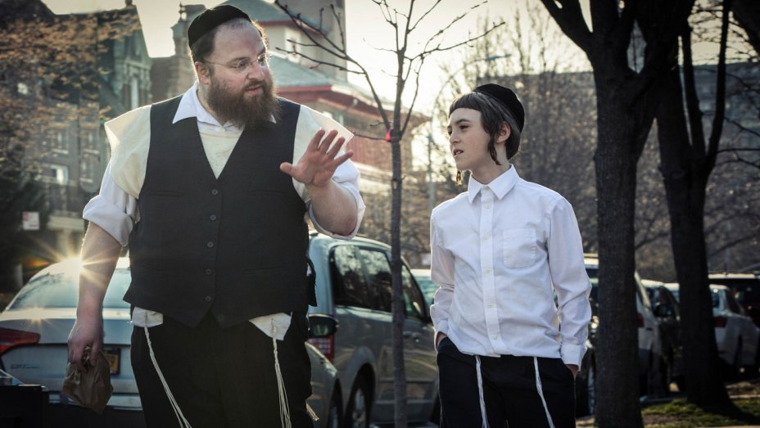

Slide 44
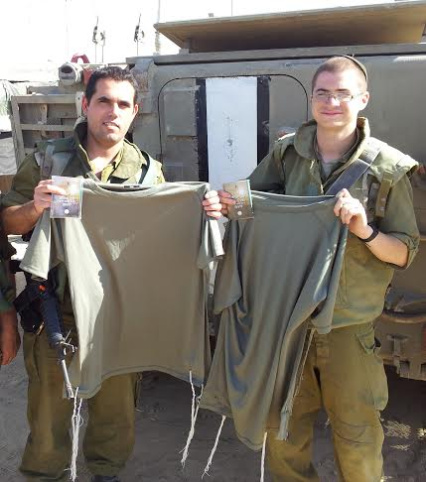
Notes:
So, when do we wear tsitsit? When we have four cornered garments. Talit is not the scriptural fringe garment, it’s just a hanger. In Biblical times every man had a four cornered over-shirt, not really a shirt. Just square. Today, talit katan.
Above are t-shirt tsitsit. Not really on corners, but good enough.

Slide 45
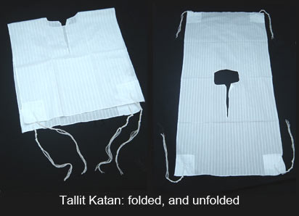
Notes:
So, it can be worn over your shirt, or under, and tsitsit sticking out or tucked in.
It’s prophesied that ten men of the nations are going to grab the tsitsit of a Jewish man, and say, we will go with you, better to wear them out. Anyhow, many Jews and Gentiles here wear the tallit gadol on Shabbat, with the tsitsit. To fulfill mitzvah? Too mechanical. To my heart, I do it to dress for worship. It feels good in the Ruakh. Not restricted to Jewish people. Women? IF it’s specifically feminine looking, seems OK by me.

Slide 46
Yeshua addressed
T’fillin
Tsitsit
Titles

Slide 47
Mattityahu (Matthew) 23:6
אוֹהֲבִים הֵם אֶת מוֹשַׁב הָרֺאשׁ בַּסְּעוּדוֹת וְאֶת הַמּוֹשָׁבִים הָרִאשׁוֹנִים בְּבָתֵּי הַכְּנֶסֶת
they love the place of honor at banquets and the best seats in the synagogues,

Slide 48
Mattityahu (Matthew) 23:7
וּבִרְכוֹת שָׁלוֹם בַּשְּׁוָקִים וּלְהִקָּרֵא 'רַבִּי' עַל־יְדֵי אֲנָשִׁים
and they love being greeted deferentially in the marketplaces and being called ‘Rabbi.’

Slide 49
Mattityahu (Matthew) 23:8
אַךְ אַתֶּם אַל יִקָּרֵא לָכֶם 'רַבִּי', כִּי אֶחָד הוּא רַבְּכֶם וְאַתֶּם אַחִים כֻּלְּכֶם.
“But you are not to let yourselves be called ‘Rabbi’; because you have one Rabbi, and you are all each other’s brothers.”

Slide 50
^{Matityahu/Mat 23.9-12} And do not call anyone on earth ‘Father.’ because you have one Father, and he is in heaven. Nor are you to let yourselves be called ‘leaders,’ because you have one Leader, and he is the Messiah!

Slide 51
^{Matityahu/Mat 23.9-12} The greatest among you must be your servant, for whoever promotes himself will be humbled, and whoever humbles himself will be promoted.

Slide 52
Three titles prohibited
Rabbi
Father
Leader

Slide 53
Rabbi renders Greek rabbi, which transliterates the Hebrew (compare 8:19N). The word means, literally, "my great one," and, less literally, "my master," "my teacher." It became a title of respect used for Torah scholars by everyone, even those of the same or higher rank.
Notes:
https://kifa.kz/eng/bible/stern/stern_matfey_23.php

Slide 54
The Hebrew Christian scholar Arnold G. Fruchtenbaum holds that this passage prohibits Messianic Jewish congregations from calling their leaders "rabbis"
Notes:
("The Quest for a Messianic Theology: Statement," in Mishkan #2 (Winter 1985), pp. 1-19; with "Response" by myself in the same issue, pp. 20-23; and "A Comment" by him in Mishkan #3, pp. 67-68).
https://kifa.kz/eng/bible/stern/stern_matfey_23.php
For about twenty years in the 1970’s, 1980’s, the Messianic Movement was paralyzed over this use or not of the word rabbi.
David Stern expressed what seems to be the definitive resolution.

Slide 55
David Stern [translator of the CJB]: My view is that a literalistic approach here is inappropriate, since Yeshua also warns against being called "father" or "leader," terms everyone uses. The context leads me to believe that Yeshua here is prohibiting believers from accepting unearned honors, rather than outlawing three titles.
Notes:
https://kifa.kz/eng/bible/stern/stern_matfey_23.php

Slide 56
A Messianic Jewish congregational leader who accepts the title "rabbi" without having training adequate to qualify him as a rabbi in a non-Messianic Jewish setting is accepting honor which he has not earned and to which he is not entitled; and this does violate Yeshua's injunction.
Notes:
https://kifa.kz/eng/bible/stern/stern_matfey_23.php

Slide 57
A leader is to be humble, a servant (20:25-28); if he is given any title at all, he is not to become puffed up. My own objection to the use of the title "rabbi" today is not theological but ideological and practical.
Notes:
https://kifa.kz/eng/bible/stern/stern_matfey_23.php

Slide 58
What should a "Messianic rabbi" be? A pastor under another name? I think the term "rabbi" sets up Jewish expectations which ought to be fulfilled.
Notes:
https://kifa.kz/eng/bible/stern/stern_matfey_23.php
So fyi for me: Th.B in theology. BA in Judaic studies Heb U Jerusalem summer studies, ordination from IAMCS after sev courses. Ordained 2001 by IAMCS.
Many of you are aware of a similar conversation I had with two of the then leading rabbis in KC, Herb Mandl of Kehilath Israel and Alan Cohen of Beth Shalom.
They challenged my use of the term ‘rabbi’ since I didn’t have smikha/ordination with them. One of my comments to them, that they really had no objection to, was…

Slide 59
Concerning the title of ‘rabbi,’ there really isn’t any other title that works. ‘Pastor’ doesn’t fit, ‘priest’ certainly doesn’t work. ‘Congregational leader’ we tried for a while, but it’s just too clumsy. We had our own hesitations at using the term ‘rabbi’ because of the words of the Messiah,
Notes:
[Log of my conversation in a Visit with the Rabbinic council reps Wednesday, December 02, 2009 10 a.m. with Herb Mandl [senior rabbi of Kehilath Israel Synagogue, http://www.kisyn.org/home/ and Alan Cohen Jewish Community Relations Bureau Am Jewish Committee, former senior rabbi of Beth Shalom.
They didn’t like me using the term “rabbi.”]

Slide 60
but His injunction was really based on the fact that we shouldn’t take the title without adequate preparation and qualification.

Slide 61
HM: What about ‘spiritual leader?’
שמואל: It’s also just too clumsy to use in conversation. My smikha is not from any Christian organization. It’s from the Internatl Alliance of Messianic Congregations and Synagogues.
HM: probably all Jews. I don’t know if that makes it better or worse.

Slide 62
So, Messianic Jewish leaders use the term “rabbi” but with caution.
Returning to the subject of warfare..

Slide 63
In our own nation, we are mourning ANOTHER school shooting.
The deadly gun rampage at a Florida high school on Wednesday took to 18 the number of school shootings across the United States so far this year - an average of one school shooting every 60 hours.
Notes:
http://www.telegraph.co.uk/news/2018/02/15/new-normal-school-shooting-every-60-hours-us-accepts-grim-reality/
The FBI apparently knew about this unstable young man, but didn’t get to him.
What’s happening to America? A spirit of rage, of loneliness, of outcast, disconnect, unaccountability.
Justify? Describing what it is.

Slide 64
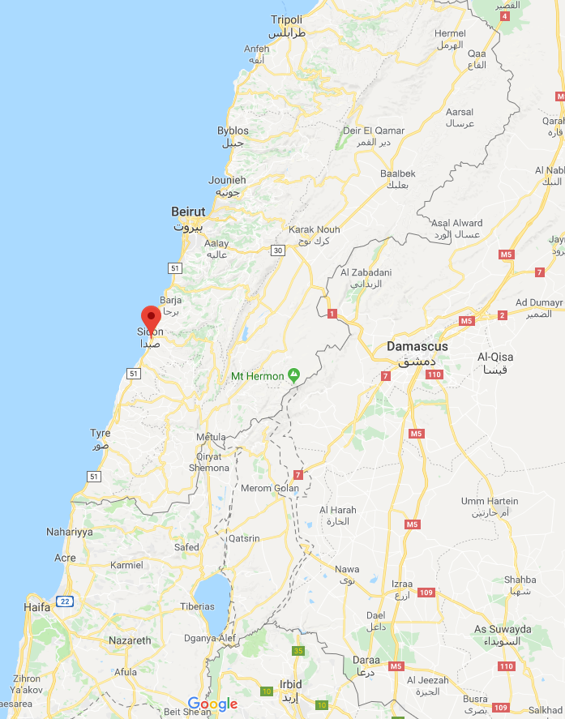
Notes:
Note: Hermel in the north, and also between Tyre and Sidon in the south of Lebanon.

Slide 65
Orit Perlov, a social media analyst for the Institute for National Security Studies, told reporters just days before an Israeli F16-I was downed over the country by Syrian air defenses. “We have [intel on] a factory for advanced weapons in the north of Lebanon,
Notes:
Barry & Batya Segal news@visionforisrael.com via mail235.atl61.mcsv.net
First lost aircraft since 1983

Slide 66
in Sunni areas,” she said referring to an Iranian-built factory near the town of Hermel in the eastern Bekaa Valley in northern Lebanon. It can produce the fairly accurate Fateh-110 missile with a range of close to 300 km. with a half-ton warhead.
Notes:
Barry & Batya Segal news@visionforisrael.com via mail235.atl61.mcsv.net

Slide 67
According French intelligence sources, another factory is located between the towns of Sidon and Tyre in southern Lebanon, which is capable of producing surface-to air and anti-tank missiles as well as unmanned aerial vehicles [drones] able to carry explosives.
Notes:
Barry & Batya Segal news@visionforisrael.com via mail235.atl61.mcsv.net

Slide 68
Defense Minister Avigdor Liberman has made it clear that while Israel does not want to start a third Lebanon war, the Jewish state is determined to prevent Iran from using Lebanon to produce precision missiles
Notes:
Barry & Batya Segal news@visionforisrael.com via mail235.atl61.mcsv.net

Slide 69
for Hezbollah that will hit deep inside the Israeli home front. And if Israel does try to prevent that, Hezbollah is expected to respond by firing tens of thousands of missiles at the country.
Notes:
Barry & Batya Segal news@visionforisrael.com via mail235.atl61.mcsv.net

Slide 70
Notes:
Note: Hermel in the north,
and also between Tyre and Sidon in the south of Lebanon.

Slide 71
The U.S. Senate has failed to pass the Pain-Capable Unborn Child Protection Act in a 51-46 vote, striking a blow to pro-life activists who plan to keep fighting.
Notes:
https://www.onenewsnow.com/pro-life/2018/01/30/sba-voters-wont-forget-pro-abortion-senators?utm_source=OneNewsNow&utm_medium=email&utm_term=16789397&utm_content=323193037843968512&utm_campaign=32697

Slide 72
The bill, which bans abortions after 20 weeks of pregnancy, failed in the closely divided senate after Republicans fell short of the 60 votes needed to bring the bill out of debate to a final floor vote.
Notes:
https://www.onenewsnow.com/pro-life/2018/01/30/sba-voters-wont-forget-pro-abortion-senators?utm_source=OneNewsNow&utm_medium=email&utm_term=16789397&utm_content=323193037843968512&utm_campaign=32697

Slide 73
"We're one of only seven nations on the whole planet to allow abortion on demand after five months," says Mallory Quigley of the Susan B. Anthony List. "That's more than halfway through pregnancy and a point by which the research shows that babies can feel pain."
Notes:
https://www.onenewsnow.com/pro-life/2018/01/30/sba-voters-wont-forget-pro-abortion-senators?utm_source=OneNewsNow&utm_medium=email&utm_term=16789397&utm_content=323193037843968512&utm_campaign=32697

Slide 74
Planned Parenthood kept aborted babies alive to harvest heart, brain, says ex-technician.
We have blood on our hands from rage and murder.
Notes:
Barry and Batya Segal newletter Feb 2018 James Dobson Feb. newsletter

Slide 75
Movies: Dunkirk, Darkest Hour
In late May of 1940, a half million British soldiers huddled hopelessly at Dunkirk, waiting for inevitable death or imprisonment.
James Dobson pointed out a grave omission in the movies.
Notes:
Barry and Batya Segal newletter Feb 2018 James Dobson Feb. newsletter

Slide 76
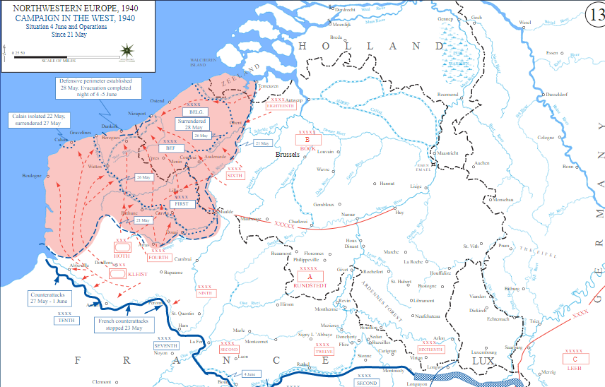

Slide 77
On May 23rd, numerous political leaders and newspaper editors joined King George and issued a call for a National Day of Prayer to be held on Sunday, May 26th, 1940. Just 24 hours after the call for prayer, Adolf Hitler inexplicably ordered his armies to halt, to the surprise and dismay of even his own generals.
Notes:
James Dobson Feb Newsletter

Slide 78
Former Prime Minister, Neville Chamberlain, wrote this in his diary: "May 26. Blackest day of all.” At seven o'clock that evening, an order was issued to attempt a desperate evacuation of Dunkirk. Every tiny vessel and privately owned craft was sent across the treacherous waters of the English Channel with

Slide 79
orders to rescue as many men as possible before the arrival of the Germans. Hitler's armies remained stationary, not only on the 24th, 25th and 26th, but incredibly, until early June! To this day, no one knows exactly why.
Notes:
G-d’s response to prayer??

Slide 80
I am calling for prayer, like R. Schneerson called for t’fillin!
Each of our hearts right with G-d and each other.
Intercession today, third hour
Tuesday, Teerosh 7 to 8:30 p.m.
Tuesday, Feb. 27, Fast of Ester extended prayer, 7 p.m. till 10:30 or…

