Slide 1
If you saw our livestream YouTube last week, it still wasn’t nearly HD video and audio.
Working on it! Adjusted settings.

Slide 2
Notes:
4.64 mbps Should be ok, although minimal. Best possible with Cu wires, not fiber optic.

Slide 3
We have changed the Wifi name and password till our live stream is acceptable.

Slide 4
To easily follow these notes,
Go to OrHaOlam.com
WITHOUT WIFI
Click on downloads, messages,

Slide 5
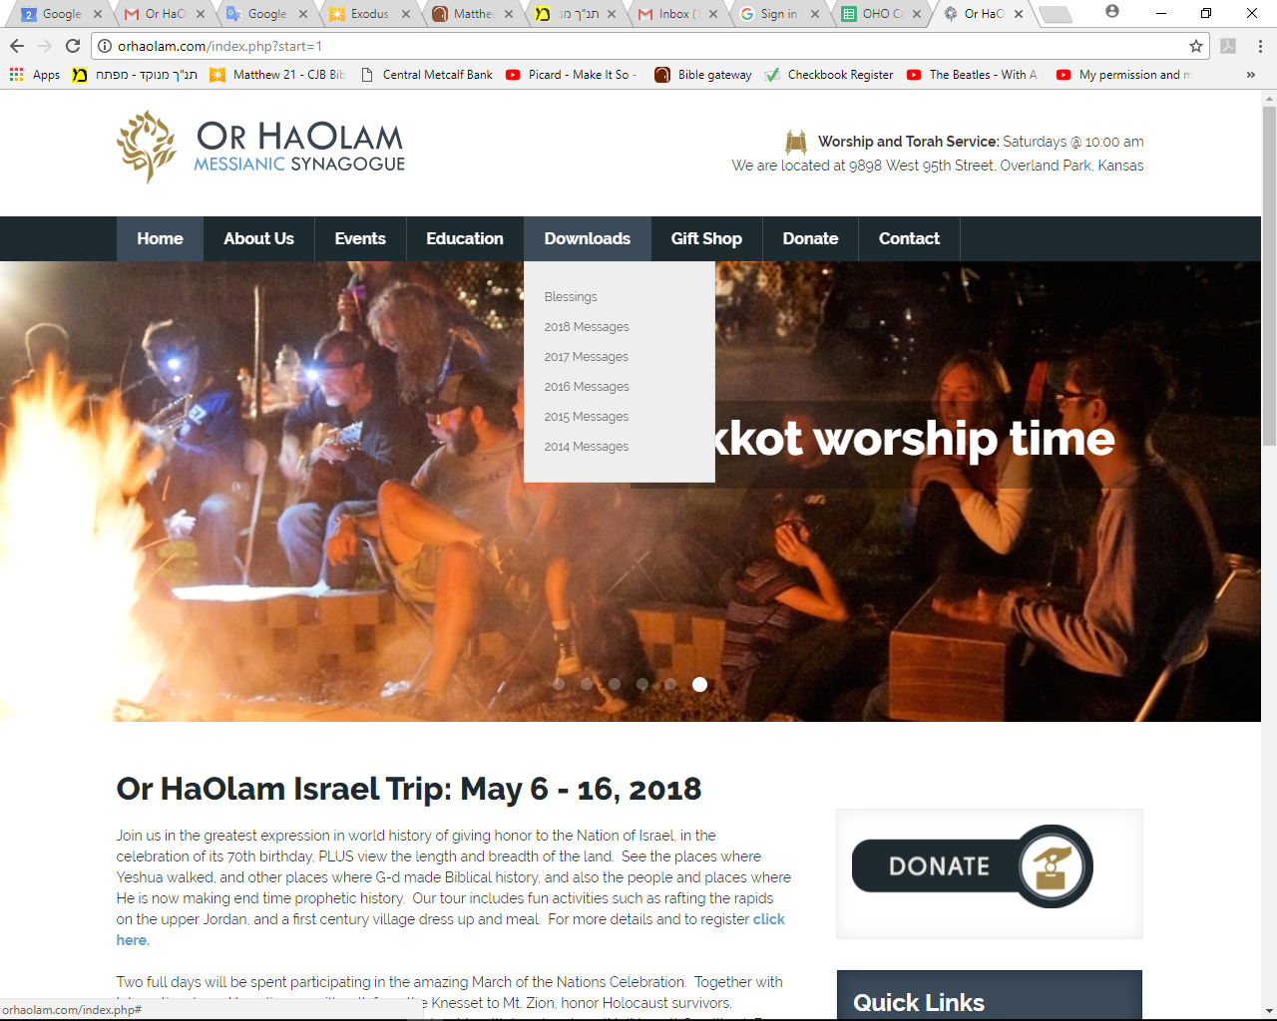

Slide 6
Notes:
YouTube https://youtu.be/Lb5EozgOs2g
also Better Josh Aaron at https://www.facebook.com/marchoflife/videos/1744828825812790/

Slide 7
Be a part of history and prophecy! 70 years after the founding of the State is the year of Release!
Except don’t register there, just go to OrHaOlam.com
Deadline Feb. 12 before price increase! If no enrollment by then tour dropped! Full refund!
Notes:
Some insights from Brian Kaufman

Slide 8
Extremely nerdy humor,
for chemistry people.
Notes:
From Brian Kaufman

Slide 9
Notes:
From Brian Kaufman

Slide 10
Notes:
From Brian Kaufman

Slide 11
Notes:
From Brian Kaufman

Slide 12
Notes:
From Brian Kaufman

Slide 13
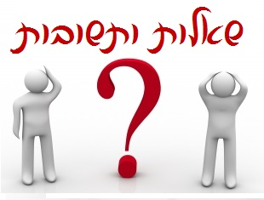
Notes:
Hebrew students: script and block will become seamless. Eventually
Hebrew for Questions and Answers, Q&A

Slide 14
In rabbinic literature, the Responsa are known as
She'elot u-Teshuvot
שאלות ותשובות
(questions and answers)
and comprise the body of written decisions and rulings.

Slide 15
We have been exploring how Yeshua has been subject to questions for the last three messages.

Slide 16
Prophetic significance?
Yeshua was being examined, like the Pesakh Lamb.
Now it was His turn to question.

Slide 17
First: ^{Mtt. 22.15-16} Then the P’rushim went away and put together a plan to trap Yeshua with his own words. They sent him some of their talmidim and some members of Herod’s party.
Taxation loyalty question
Notes:
Few weeks ago

Slide 18
Second:
^{Mtt. 22.23} That same day, some Tz’dukim came to him.
Apparent resurrection absurdity challenge.
Notes:
Last week: Resurrection power of G-d

Slide 19
Third:
^{Mtt. 22.35} One of them who was a Torah expert asked a sh’eilah to trap him: “Rabbi, which of the mitzvot in the Torah is the most important?”

Slide 20
^{Mark 12.32-34} The Torah-teacher said to him, “Well said, Rabbi; you speak the truth when you say that he is one, and that there is no other besides him; and that loving him with all one’s heart, understanding and strength, and loving one’s neighbor as oneself,

Slide 21
^{Mark 12.32-34} mean more than all the burnt offerings and sacrifices.” When Yeshua saw that he responded sensibly, he said to him, “You are not far from the Kingdom of God.” And after that, no one dared put to him another sh’eilah.

Slide 22
Now it was Yeshua’s
turn to question.

Slide 23
מַתִּתְיָהוּ Mattityahu
(Matthew) 22:42-44

Slide 24
Then, turning to the assembled P’rushim [Pharisees], Yeshua put a sh’eilah [formal question] to them:
Mattityahu (Matthew) 22:41

Slide 25
Mattityahu (Matthew) 22:42
"מַה דַּעְתְּכֶם עַל הַמָּשִׁיחַ? בֶּן מִי הוּא?"
הֵשִׁיבוּ לוֹ: "בֶּן־דָּוִד."
"Tell me your view concerning the Messiah: whose son is he?" They said to him, "David's."

Slide 26
There are plenty of scriptures about the Davidic King to come.
Notes:
First, the announcement to David by Natan the prophet.

Slide 27
^{Divrei Yamim/Chron 17.3-4} But that same night the word of God came to Nathan, saying: “Go and tell David My servant, thus says Adoni, ‘You are not to build Me a house in which to dwell.

Slide 28
^{Divrei Yamim/Chron 17.10-11} “‘Moreover, I declare to you that Adonai will build you a house. It will be that when your days are fulfilled to go with your fathers, I will raise up your offspring after you, one of your own sons,

Slide 29
^{Divrei Yamim/Chron 17.10} and I will establish his kingdom…I will appoint him over My House and My kingdom forever, and his throne [David’s] will be established forever.’”
Notes:
Next, from the Psalms…

Slide 30
^{T’hillim/Ps 89.4-5,27} “I have made a covenant with My chosen one. I have sworn to David My servant: ‘Forever I will establish your seed, and will build your throne from generation to eneration.’”… He will call to me, ‘You are my father, my God, the Rock of my salvation.’
Notes:
Then the prophet Yeshayahu/Isaiah

Slide 31
^{Yeshayahu/Is 9.5-6} For to us a child is born, a son will be given to us, and the government will be upon His shoulder. His Name will be called Wonderful Counselor, Mighty God, My Father of Eternity, Prince of Peace. Of the increase of His government and shalom there will be

Slide 32
^{Yeshayahu/Is 9.5-6} no end, on the throne of David and over His kingdom— to establish it and uphold it through justice and righteousness from now until forevermore. The zeal of Adonai-Tzva’ot will accomplish this.

Slide 33
^{Yeshayahu/Is 11.1-2} Then a shoot will come forth out of the stem of Jesse, [Who?] and a branch will bear fruit out of His roots. he Ruakh of Adoni will rest upon Him, the Spirit of wisdom and insight, the Spirit of counsel and might, the Spirit of knowledge and of the fear of Adonai.
Notes:
Two places in Yeshayahu/Isaiah. Also Yermiyahu/Jeremiah

Slide 34
^{Yirmiyahu/Jer. 23.5-6} “The days are coming,” says Adoni when I will raise a righteous Branch for David. He will reign as king and succeed, he will do what is just and right in the land.

Slide 35
^{Yirmiyahu/Jer. 23.5-6} In his days Y’hudah will be saved, Isra’el will live in safety, and the name given to him will be Adoni Tzidkenu [Adoni our righteousness].
Notes:
Note: divine Davidic king.

Slide 36
It was well established that David, Daveed HaMelekh, is the
pre-eminent Messiah King figure for Israel.

Slide 37
Mattityahu (Matthew) 22:43
אָמַר לָהֶם: "אִם כֵּן כֵּיצַד, בְּהַשְׁרָאַת הָרוּחַ, קוֹרֵא לוֹ דָּוִד 'אָדוֹן' בְּאָמְרוֹ:
"Then how is it," he asked them, "that David, inspired by the Spirit, calls him 'Lord,' when he says,
Notes:
Yeshua cites the psalms…

Slide 38
Mattityahu (Matthew) 22:44
נְאֻם יְיָ לַאדֺנִי: שֵׁב לִימִינִי עַד־אָשִׁית אֺיְבֶיךָ הֲדֺם לְרַגְלֶיךָ'?
'Adoni said to my Lord, "Sit here at my right hand until I put your enemies under your feet" '?

Slide 39
If David thus calls him, Messiah, ‘Lord,’ how is Messiah David’s son?”
That is, Messiah is
younger / descendant,
yet superior / Lord?
Mattityahu (Matthew) 22:45-46
Notes:
Dilemma in Jewish theology about Messiah ben David.
Avraham Avinu. Patriarchs, Matriarchs. Nobody contests their pre-eminence.

Slide 40
When King David received and wrote this psalm, he heard in the Spirit that G-d was calling someone to sit in the place of divine authority.

Slide 41
לְדָוִד מִזְמוֹר נְאֻם יְיָ | לַֽאדֹנִי שֵׁב לִֽימִינִי עַד־אָשִׁית אֹיְבֶיךָ הֲדֹם לְרַגְלֶֽיךָ:
There is no way G-d could be talking to Himself, to sit by his own right hand.

Slide 42
There is some form of very graphical duality in the nature of G-d depicted in this phrase. G-d is asking Someone to sit at His right hand, Someone who is David refers to as “Lord.”
Dan Juster: “Uni-plurality”

Slide 43
Focusing here on the right hand seating preeminence of the Messiah, while all his enemies are vanquished, certainly fits the story of Yeshua, whose enemies seemed to prevail over Him at the close of His life.

Slide 44
Thus, there is somewhat of an implication of the death of the Messiah, that he was later promoted to a place of divine honor.

Slide 45
It is reminiscent of the verse in Daniel 7.14, where the Messiah, called the Son of Man, comes to the Ancient of Days. There are two individuals, invested with divine power, in both these word pictures.

Slide 46
^{Daniel 7.13-14} I saw in the night visions, and, behold, one like a son of man came with the clouds of heaven, and came to the ancient of days, and they brought him near before him. And there he was given dominion, and glory,

Slide 47
^{Daniel 7.13-14} and a kingdom, that all people, nations, and languages, should serve him; his dominion is an everlasting dominion, which shall not pass away, and his kingdom one that shall not be destroyed.

Slide 48
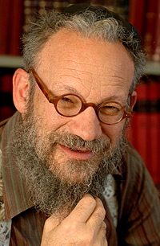
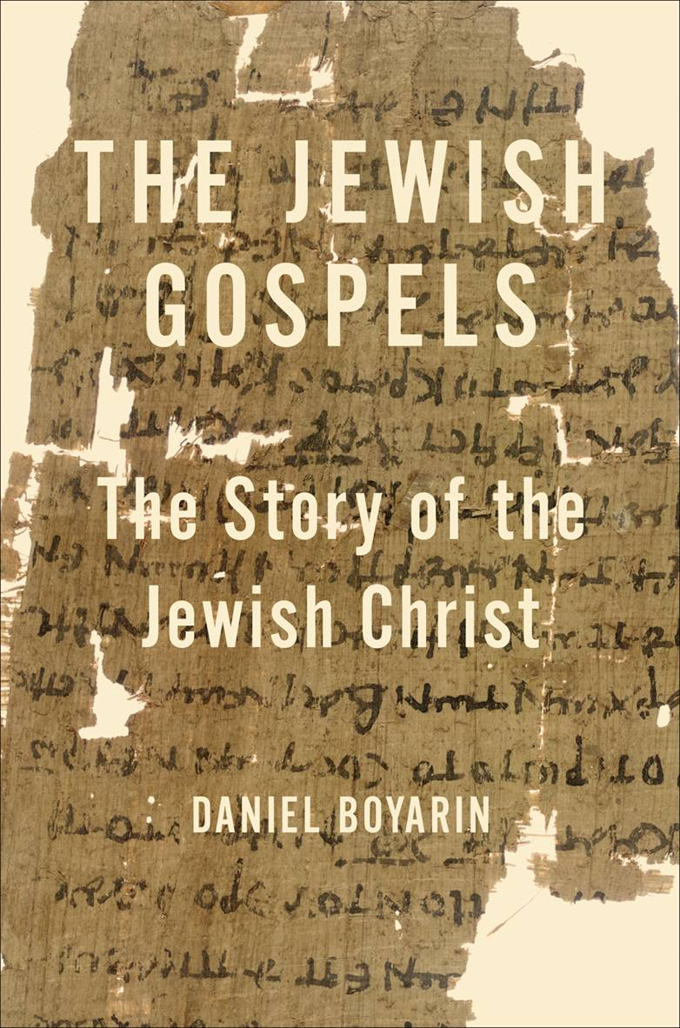
Daniel Boyarin

Slide 49
Daniel Boyarin (born 1946) is a historian of religion. Born in Asbury Park, New Jersey, he holds dual United States and Israeli citizenship. Trained as a Talmudic scholar, in 1990 he was appointed Professor of Talmudic Culture,

Slide 50
Departments of Near Eastern Studies and Rhetoric, University of California, Berkeley, a post which he still holds

Slide 51
Daniel Boyarin, professor of Talmudic Culture at the University of California Berkeley, may be the most influential scholar of ancient Judaism today.

Slide 52
This phrase, "at the right hand of G-d" or one of its variants, is referred to 22 times in the Messianic Scriptures.

Slide 53
No one could think of anything to say in reply; and from that day on, no one dared put to him another sh’eilah.
Mattityahu (Matthew) 22:45-46
Notes:
Realized a profound new thing…Messiah is greater than David. Messiah is G-d!! G-d with us!

Slide 54
Three points of application
Dan Juster: “uni-plurality”
Sacred Name
Daveed warrior worshiper
Notes:
Two points of teaching, one of preaching. Most important preaching I’ve ever done!!

Slide 55
Mattityahu (Matthew) 22:44
נְאֻם יְיָ לַאדֺנִי: שֵׁב לִימִינִי עַד־אָשִׁית אֺיְבֶיךָ הֲדֺם לְרַגְלֶיךָ'?
'Adoni said to my Lord, "Sit here at my right hand until I put your enemies under your feet" '?
Notes:
Note Sacred Name. Yeshua says “Adoni” Lord. Other places He says “power.”

Slide 56
Yeshua never spoke the Sacred Name as recorded in the B’sorot / Good News. Nor did Paul nor Yokhanan.
Notes:
Nor is the Sacred Name in the Greek texts…

Slide 58
Nehemia Gordan is a Karaite scholar.
Karaite from Kara קורא, Written Torah,
not Oral Torah= Talmud, other rabbinics.
Not a believer in Messiah
Strong promoter of using the Sacred Name.
Notes:
Nehemia has many followers among Hebrew roots people. Need to address.

Slide 59
Nehemia makes a strong case as to what the proper pronunciation of the Sacred Name is. He may be right.
Notes:
However, in this text in Matityahu/Mat,

Slide 60
1. Yeshua never used the Name nor any writer of the whole Mes Scrip/New Testament. If anyone had authority to do so, you would think He would, but He didn't. When He quoted scripture with the Name, He used circumloction, as it's called, substituting attributes.

Slide 61
2. The scriptures talk about "glorifying the Name of G-d." That doesn't mean by a certain pronunciation. The Hebraic understanding of Name = character, person. So behaving in ways that bring honor to Him.

Slide 62
3. Rev 19:12 His eyes were like a fiery flame, and on his head were many royal crowns. And he had a name written which no one knew but himself.

Slide 63
4. In the Dead Sea Scrolls, where the Name appears, they resort to the Phoenician script, instead of the Babylonian Hebrew characters that we are used to. This implies something...likely that the name was not to be accessible to the readers, but a bit mysterious, and NOT pronounced.

Slide 64
5. In the prototype prayer in Mt 6, Yeshua explains the meaning of "May your Name be kept holy." He uses the common Hebrew poetic device of parallelism, and says the same thing in different words.

Slide 65
5. "May your Kingdom come, your will be done on earth as in heaven." That, sanctifying the Name has nothing to do with pronunciation, but rather He wants us to pray for transformation of people or of life circumstances.

Slide 66
6. The B'sorah [Gospel] of Matityahu, Matthew uses the phrase "Kingdom of Heaven" as opposed to "Kingdom of G-d." Yeshua was following the common practice of reverence for the Name. Particularly in Matityahu/Matthew’s account, many scholars feel was written for Jewish readers, who had the practice of NOT saying the name, but using circumlocutions.

Slide 67
7. When addressing our earthly fathers, we would never call them by their name if we are being respectful. Rather the title "Dad," "Papa", "Father", etc. would be appropriate. Similarly with G-d the Father.

Slide 68
8. There's also an outreach dimension. Unsaved Jewish people if they are used to synagogue prayer, would think we are totally out of touch. Not feel at home.

Slide 69
According to the Hebrew usage then and now, the name of G-d is replaced by Yeshua with a substitute as גְדוּלָה, greatness, or גְבוּרָה, power. Sitting at the right hand of G-d is a place of dignity that implies that Messiah is divine.

Slide 70
So the Jewish practice is to say Adoni or Gibor (Power). That's what Yeshua said when quoting Ps 110. So that's what I urge people to do.

Slide 71
Three points of application
Dan Juster: “uni-plurality”
Sacred Name
Daveed warrior worshiper

Slide 72
Mattityahu (Matthew) 22:44
נְאֻם יְיָ לַאדֺנִי: שֵׁב לִימִינִי עַד־אָשִׁית אֺיְבֶיךָ הֲדֺם לְרַגְלֶיךָ'?
‘Adoni said to my Lord, “Sit here at my right hand until I put your enemies under your feet.”’
How did Daveed Hamelekh do that?
Notes:
Best presented by showing a sort of memorial to King David, entryway to the modern city of Jerusalem…

Slide 73
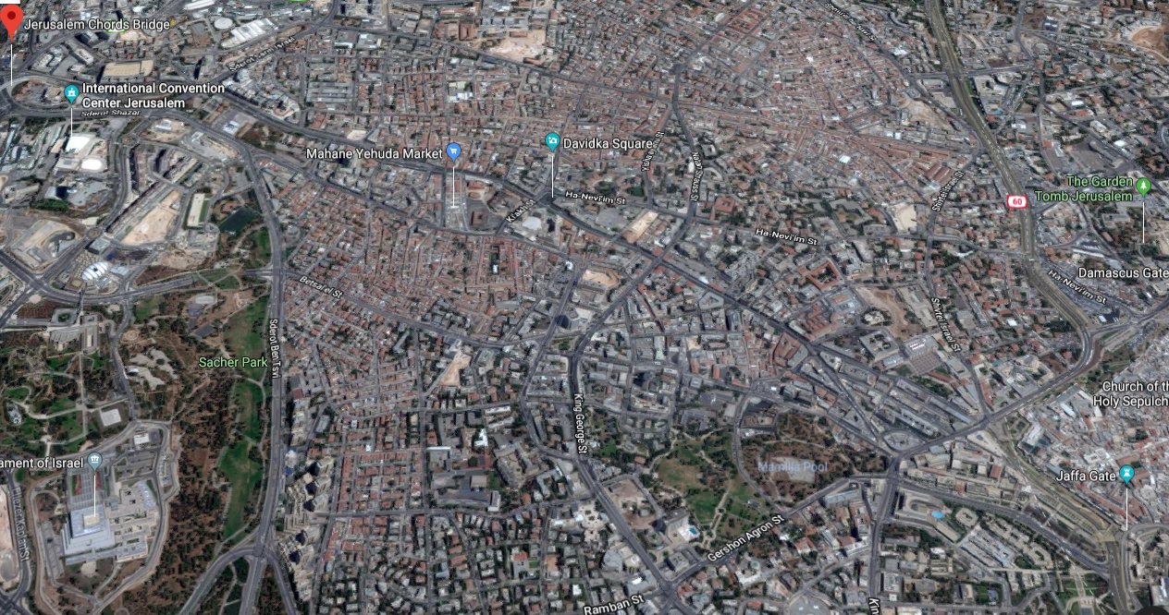
Entryway to Jerusalem
Notes:
Note Old city, Jaffa Rd., Mahane Yehuda where Evan Levine is, Convention Center, Chords bridge.

Slide 74
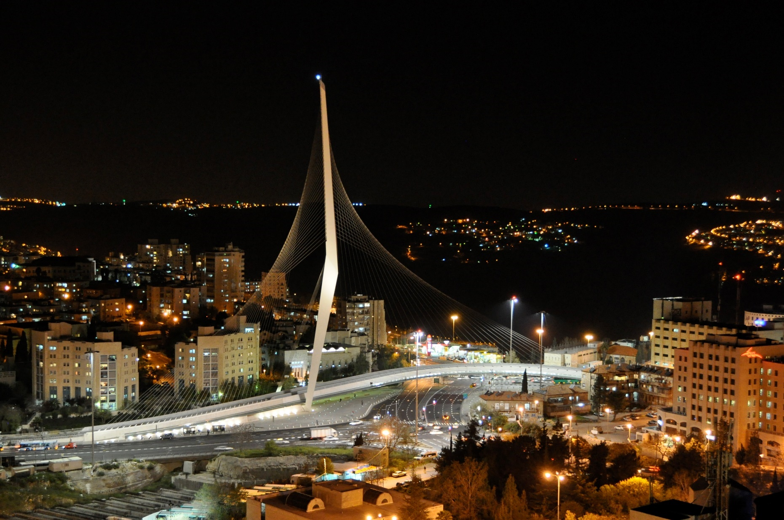
Chords Bridge גשר המיתרים
Notes:
The form of the bridge resembles a tent in the desert or a harp, with the cables as the strings, symbolizing King David's harp, according to Spanish architect and engineer Santiago Calatrava
https://en.wikipedia.org/wiki/Chords_Bridge

Slide 75
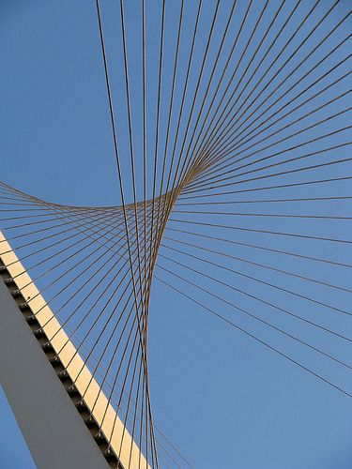

Slide 76
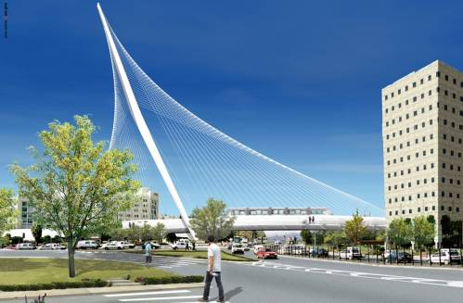
Chords Bridge, Gesher Metarim,
גשר מֵיתָרים

Slide 77
Daveed is remembered MOST in this memorial as the harp player.

Slide 78
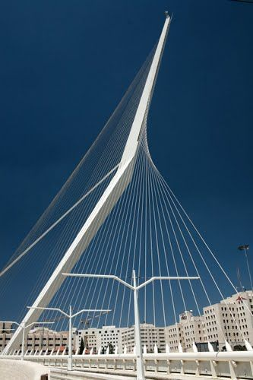

Slide 79
^{1 Shmuel 16.16,18} a skillful player on the harp…knows how to play. He’s a brave soldier, he can fight, he chooses his words carefully and he’s pleasant-looking. Besides, Adoni is with him.”
אִישׁ יֹדֵעַ מְנַגֵּן בַּכִּנּוֹר… יֹדֵעַ נַגֵּן וְגִבּוֹר חַיִל וְאִישׁ מִלְחָמָה וּנְבוֹן דָּבָר, וְאִישׁ תֹּאַר; וַיהוָה, עִמּוֹ.

Slide 80
Warfare and worship are related.
^{Luke 12.51} Do you think that I have come to bring peace in the Land? Not peace, I tell you, but division!
^{Mislei/Prov 4.23} Above everything else, guard your heart; for it is the source of life’s consequences.

Slide 81
Mattityahu (Matthew) 22:44
נְאֻם יְיָ לַאדֺנִי: שֵׁב לִימִינִי עַד־אָשִׁית אֺיְבֶיךָ הֲדֺם לְרַגְלֶיךָ'?
‘Adoni said to my Lord, “Sit here at my right hand until I put your enemies under your feet.”’

Slide 82
Focusing here on the right hand seating preeminence of the Messiah, while all his enemies are vanquished, certainly fits the story of Yeshua, whose enemies seemed to prevail over Him at the close of His life.

Slide 83
Three points of application
Dan Juster: “uni-plurality”
Sacred Name
Daveed warrior worshiper

Slide 84
Everything we do, everything we face, every situation of finances, health, conflict with people is an expression of G-d’s redemptive love for us.
Must be understood in the context of spiritual warfare/worship! ~David!

Slide 85
New first counseling question:
Have you worshipped Messiah in this?
Have you seen the death to self and power of resurrection in this?

Slide 86
Then fix the situation.
We don’t fix it by fixing it. We fix it, as Yeshua followers, by first asking for Him: death to self and resurrection power.
Worship = warfare.

Slide 87
Many of you have heard me speak on Tikkun/soul correction.
This is Tikkun on steroids. Worship death of Messiah and yourself, and power of resurrection in EVERY situation first.

Slide 88
^{Yermiyahu 29.4-14} "For here is what ADONI says: For I know what plans I have in mind for you,' says ADONI, 'plans for well-being, not for bad things; so that you can have hope and a future.
Notes:
Transition…

Slide 89
^{Yermiyahu 29.4-14} When you call to me and pray to me, I will listen to you. When you seek me, you will find me, provided you seek for me wholeheartedly; and I will let you find me,' says ADONI.

Slide 90
Mattityahu (Matthew) 22:44
נְאֻם יְיָ לַאדֺנִי: שֵׁב לִימִינִי עַד־אָשִׁית אֺיְבֶיךָ הֲדֺם לְרַגְלֶיךָ'?
‘Adoni said to my Lord, “Sit here at my right hand until I put your enemies under your feet.”’

Slide 91
Three points of application
Dan Juster: “uni-plurality”
Sacred Name
Daveed warrior worshiper
Notes:
Takeaway: find a situation to worship Yeshua in. Death to self, trust in Resurrection power. Write me, tell me. Home groups!

