Slide 1
If you want to have notes without taking notes,
Go to OrHaOlam.com
WITHOUT WIFI
Click on downloads, messages, 2018 messages
Today’s should be on the top.

Slide 2
Be a part of history and prophecy! 70 years after the founding of the State is the year of Release!
Just go to OrHaOlam.com

Slide 3
Good news from Israel

Slide 4
A truffle is the fruiting body of a subterranean fungus. Truffles are usually found in close association with tree roots.
Notes:
https://en.wikipedia.org/wiki/Truffle

Slide 5
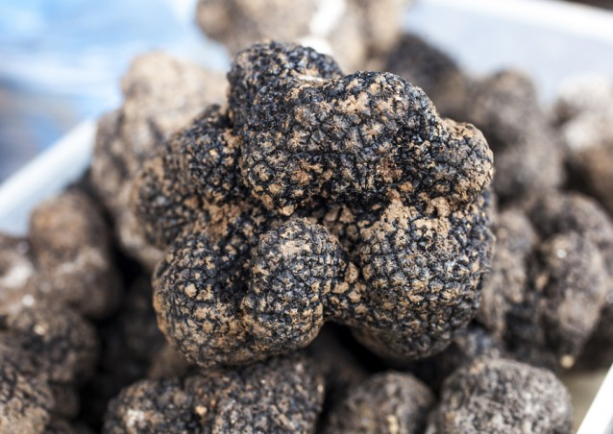
Notes:
https://www.google.com/search?q=TRUFFLES&safe=active&source=lnms&tbm=isch&sa=X&ved=0ahUKEwjbnNGw_-_ZAhXKyVMKHWrvAoMQ_AUICygC&biw=1282&bih=886#imgdii=kB9RsyuDxx0sMM:&imgrc=7X7o8KsHGa-2JM:

Slide 6
Some of the truffle species are highly prized as food, called “the diamond of the kitchen.” Edible truffles are held in high esteem in French, Croatian, Georgian, Bulgarian, Greek, Italian, Middle Eastern, and Spanish cuisine, as well as in international haute cuisine.
Notes:
https://en.wikipedia.org/wiki/Truffle
To be totally distinguished from chocolate truffles, which are the same shape, but NOT a fungus.

Slide 7
Israeli Researchers Discover New Cash Crop: Researchers in Israel said they have succeeded in cultivating commercially desert truffles whose market price reaches $120 per pound — slightly less than the cost of silver and four times that of uranium.
Notes:
http://www.netmail411.com/mail/vfi/JOLmar1618.html?mc_cid=db965ede34&mc_eid=5c6cdd3ee6

Slide 8
The researchers from the Ramat Hanegev Desert Agriculture Center in Israel’s south made a breakthrough in stimulating a symbiosis between the fungus Terfezia leonis, which occurs rarely and unpredictably in nature, and the common desert shrub Helianthemum sessiliflorum.
Notes:
http://www.netmail411.com/mail/vfi/JOLmar1618.html?mc_cid=db965ede34&mc_eid=5c6cdd3ee6

Slide 9
Both the fungus and its host shrub require little water and no fertilizer, making the cultivation of Terfezia leonis potentially Israel’s most cost-effective agricultural crop. Commercial cultivation by Israeli farmers may begin as early as next year. (Arutz-7)
Notes:
http://www.netmail411.com/mail/vfi/JOLmar1618.html?mc_cid=db965ede34&mc_eid=5c6cdd3ee6

Slide 11
Last Wednesday was
March 14,
3.14
π day

Slide 12
π = $\frac{circumference of a circle}{diameter}$
Notes:
ratio

Slide 13
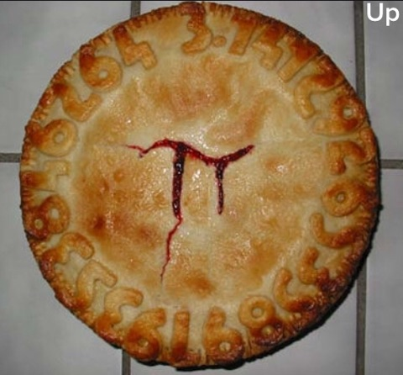
π = 3.1415
9265358
97932384
62643383
279502…
Notes:
From Jeanette Ramos
A clearer explanation…

Slide 14
Notes:
From Jim Adler

Slide 15
Speaking of math…
Recently deceased

Slide 16
Brilliant mathematician & physicist Stephen Hawking was interviewed recently about the "Big Bang," the theory that the universe exploded suddenly from a single point of origin billions of years ago.
“Nothing was around before the Big, Big Bang,” Hawking said.
Notes:
https://www.onenewsnow.com/science-tech/2018/03/08/a-brilliant-mind-fails-to-trace-nothing-to-a-creator?utm_source=OneNewsNow&utm_medium=email&utm_term=16789693&utm_content=323193037843968512&utm_campaign=33119
Sounds like “ex nihilo” to me. Heb 11

Slide 17
^{Mes.Jews/Heb. 11.3} By trusting, we understand that the universe was created through a spoken word of God, so that what is seen did not come into being out of existing phenomena.
Notes:
So be encouraged in the reality of your faith,
rejoice in G-d’s faithfulness to Jewish survival and prosperity through Israeli ingenuity,
and enjoy pie!

Slide 18
מַתִּתְיָהוּ Mattityahu
(Matthew) 23:23-24
Notes:
Continuing in Yeshua’s last message to Israel…

Slide 19
Mattityahu (Matthew) 23:23
אוֹי לָכֶם סוֹפְרִים וּפְרוּשִׁים צְבוּעִים, כִּי נוֹתְנִים אַתֶּם מַעַשְֹׂרוֹת מִמִּנְתָּה וְשֶׁבֶת וְכַמּוֹן,
“Oy to you hypocritical Torah-teachers and P’rushim! You pay your tithes of mint, dill and cumin;

Slide 20
Mattityahu (Matthew) 23:23
וּמַזְנִיחִים אֶת הַדְּבָרִים הַחֲשׁוּבִים יוֹתֵר שֶׁבַּתּוֹרָה
but you have neglected the weightier matters of the Torah --

Slide 21
Mattityahu (Matthew) 23:23
אֶת הַמִּשְׁפָּט, אֶת הַחֶסֶד וְאֶת הָאֱמוּנָה. צָרִיךְ הָיָה לַעֲשׂוֹת אֶת אֵלֶּה הָאַחֲרוֹנִים וְאֵין לַעֲזֹב אֶת הַדְּבָרִים הָאֲחֵרִים.
justice, mercy, trust. These are the things you should have attended to — without neglecting the others!

Slide 22
Mattityahu (Matthew) 23:24
‏ מוֹרֵי דֶרֶךְ עִוְרִים הָעוֹצְרִים אֶת הַיַּתּוּשׁ בְּמִסְנֶנֶת וּבוֹלְעִים אֶת הַגָּמָל.
“ Blind guides! — straining out a gnat, meanwhile swallowing a camel!”

Slide 23
Yeshua was NOT denigrating or denouncing tithing per se, any more than He had denounced the showy misuse of tefillin and tsitsit in Ch. 23 vs 5.
Notes:
A few weeks ago
Re-examine text

Slide 24
Mattityahu (Matthew) 23:23
אוֹי לָכֶם סוֹפְרִים וּפְרוּשִׁים צְבוּעִים, כִּי נוֹתְנִים אַתֶּם מַעַשְֹׂרוֹת מִמִּנְתָּה וְשֶׁבֶת וְכַמּוֹן,
“Woe to you hypocritical Torah-teachers and P’rushim! You pay your tithes of mint, dill and cumin;

Slide 25
Mattityahu (Matthew) 23:23
צָרִיךְ הָיָה לַעֲשׂוֹת אֶת אֵלֶּה הָאַחֲרוֹנִים וְאֵין לַעֲזֹב אֶת הַדְּבָרִים הָאֲחֵרִים.
These are the things you should have attended to — without neglecting the others!
Notes:
Stern: Yeshua clearly upholds keeping even the minutiae of the Law. Those who encourage Messianic Jews, and grafted in Gentiles, to stop observing the Torah are ignoring his advice.

Slide 26
Context
History of the tithe
= 10%

Slide 27
^{B’raysheet/Gen 14.18-20} Malki-Tzedek king of Shalem brought out bread and wine. He was cohen of El 'Elyon [God Most High], so he blessed him with these words: "Blessed be Avram by El 'Elyon, maker of heaven of earth, and blessed be El 'Elyon, who handed your enemies over to you." Avram gave him a tenth of all.
Notes:
Where did Abe get that idea? Seems like it wasn’t a brilliant innovation. Described as if expected.
Abraham was the first in the world that began to offer tithes; according to Pirke Eliezer, c. 27.
Maybe. Maybe understood from beginning of time in Gan Eden. What did G-d communicate in Eden?

Slide 28
Below are some specific instances of the Mesopotamian tithe,
taken from The Assyrian Dictionary of the Oriental Institute of the University of Chicago, Vol. 4 "E":
[Referring to a ten per cent tax levied on garments by the local ruler:] "the palace has taken eight garments as your tithe (on 85 garments)"

Slide 29
"...eleven garments as tithe
(on 112 garments)"
"...(the sun-god) Shamash demands the tithe..."

Slide 30
"four minas of silver, the tithe of [the gods] Bel, Nabu, and Nergal..."
"...he has paid, in addition to the tithe for Ninurta, the tax of the gardiner"

Slide 31
"...the tithe of the chief accountant, he has delivered it to [the sun-god] Shamash"
"...why do you not pay the tithe to the Lady-of-Uruk?"
Notes:
Pagan sources above.
Next Biblical source: Yaakov, when fleeing from the wrath of his brother Esav/Esau...

Slide 32
^{Ber./Gen2820-22} Ya'akov took this vow: "If God will be with me and will guard me on this road that I am traveling, giving me bread to eat and clothes to wear, so that I return to my father's house in peace,

Slide 33
^{Ber./Gen2820-22} then ADONI will be my God; and this stone, which I have set up as a standing-stone, will be God's house; and of everything you give me, I will faithfully return one-tenth to you."
Notes:
That was his vow, and again, didn’t seem to be couched as an innovation. Normal godliness.
Torah commands to Israel next.

Slide 34
^{Vayikra/Lev 27.30-34} All the tenth given from the land, whether from planted seed or fruit from trees, belongs to ADONI; it is holy to ADONI. If someone wants to redeem any of his tenth, he must add to it one-fifth. All the tenth from the herd or the flock, whatever passes under the shepherd's crook,
Notes:
From deliberate farming. Yeshua addressing treatment of herbs, weeds?
It’s not really my tithe. Holy: separate, pure, bright. We don’t GIVE tithe. We just get an opportunity to manage money that isn’t ours!
We aren’t GIVING to G-d unless it’s money above our tithe amount!
Faithfulness in this qualifies us to administer more.

Slide 35
^{Vayikra/Lev 27.31-34} the tenth one will be holy to ADONI. The owner is not to inquire whether the animal is good or bad, and he cannot exchange it; if he does exchange it, both it and the one he substituted for it will be holy; it cannot be redeemed. These are the mitzvot which ADONI gave to Moshe.
Notes:
Animals by counting every tenth one, grain by firstfuits guess

Slide 36
^{Bamidbar/Nu 18.20-21} ADONI said to Aharon, "You are not to have any inheritance or portion in their land; I am your portion and inheritance among the people of Isra'el.

Slide 37
^{Bamidbar/Nu 18.20-21} "To the descendants of Levi I have given the entire tenth of the produce collected in Isra'el. It is their inheritance in payment for the service they render in the tent of meeting.
Notes:
Source of life for Levi-im, and they tithed to subdivision of tribe of Levi: Priests/Cohenim

Slide 38
Second tithe
^{Dvarim 14.22-26} "Every year you must take one tenth of everything your seed produces in the field, and eat it in the presence of ADONI your God. In the place where he chooses to have his name live

Slide 39
^{Dvarim 14.22-26} you will eat the tenth of your grain, new wine and olive oil, and the firstborn of your cattle and sheep, so that you will learn to fear ADONI your God always.
Notes:
the second tithe could be brought to Jerusalem any time of the year and there was no specific obligation to bring the second tithe to Jerusalem for the Festival of Sukkot. The only time restriction was a commandment to remove all the tithes from one's house in the end of the third year. Deuteronomy 14:28

Slide 40
^{Dvarim 14.22-26} "But if the distance is too great for you, so that you are unable to transport it, because the place where ADONI chooses to put his name is too far away from you; then, when ADONI your God prospers you

Slide 41
^{Dvarim 14.22-26} you are to convert it into money, take the money with you, go to the place which ADONI your God will choose, and exchange the money for anything you want -

Slide 42
^{Dvarim 14.22-26} - cattle, sheep, wine, other intoxicating liquor, or anything you please - and you are to eat there in the presence of ADONI your God, and enjoy yourselves, you and your household.
Notes:
Intoxicating liquor!??

Slide 43
^{Dvarim 26.12} "After you have separated a tenth of the crops yielded in the third year, the year of separating a tenth, and have given it to the Levi, the foreigner, the orphan and the widow, so that they can have enough food to satisfy them while staying with you;
Notes:
Every year a tithe was paid to the Levites; and besides that a second tithe, which was carried to Jerusalem and eaten there; and every third year it was eaten at home, in their towns and cities in the country instead of it, with the Levite, poor and stranger, and was called the poor's tithe; and hence the Targum of Jonathan here calls this year the year of the poor's tithe, as was also the sixth year, and was reckoned not complete till the passover in the following year, as the Jewish writers Misn. ib. & Maimon. & Bartenora in ib.

Slide 44
First tithe to the Leviim, Cohenim
Second tithe for family celebration in Yerushaliyim except third and sixth year given to poor
Notes:
Tithes. The cohanim and L'vi 'im were debarred from owning hereditary land but were to be given a tithe (tenth) of all produce (Leviticus 27:30-33, Numbers 18:21); a second tithe was to be consumed by the owner in Jerusalem (Deuteronomy 14:22-27); and a tithe for the poor replaced the second tithe in the third and sixth year of the seven-year cycle that culminated in the year of sh 'mittah, in which the land was allowed to lie fallow. The rabbinic elaboration of the law of tithes is found in Talmud tractates Ma 'aserot and Ma 'aser Sheni.
So, what about the Mes. Scriptures…New Testament?

Slide 45
^{1 Cor. 9.13-14} Those who work in the Temple get their food from the Temple, and those who serve at the altar get a share of the sacrifices offered there? In the same way, the Lord directed that those who proclaim the Good News should get their living from the Good News.
Even so ^{NKJV} Along the same lines
Notes:
This is a חידוש khiddush, an innovation by Shaul. Applied specific Temple regulation to ministers of B’sorah/Good News of Yeshua.
So tithing still is relevant and in force for the age of the Messiah!

Slide 46
So, tithing of the food grains, herds, flocks, well understood.

Slide 47
Mattityahu (Matthew) 23:23
אוֹי לָכֶם סוֹפְרִים וּפְרוּשִׁים צְבוּעִים, כִּי נוֹתְנִים אַתֶּם מַעַשְֹׂרוֹת מִמִּנְתָּה וְשֶׁבֶת וְכַמּוֹן,
“Woe to you hypocritical Torah-teachers and P’rushim! You pay your tithes of mint, dill and cumin;
Notes:
These were neither grains nor flocks.

Slide 48
What about medicinal herbs?
Keener: Cummin and dill were both spices and medicinal herbs, about 1’ to 2’ in height.
Notes:
John Gill: Cummin is a sort of anise; its seed is much like fennel seed.
Shammaites doubted that black cummin need to be tithed. Hillelites said yes.
Common saying or maxim of the Jews, that the tithing of corn is from the law, but מעשר ירק דרבנין, "the tithing of herbs is from the Rabbins" : It is a constitution of theirs, and not of Moses.
T. Bab. Yoma, fol. 83. 2. & T. Hieros. Challah, fol. 60. 2. & Maaserot, fol. 48. 3.
However, dill and cummin were known crops in the Tanakh.

Slide 49
^{Yeshayahu/Is 28.23-27} Listen and hear my voice; pay attention…Does a farmer sowing keep plowing forever?... No — when he finishes levelling it, he scatters his dill-seed, sows his cumin, puts wheat in rows, barley where it belongs…

Slide 50
^{Yeshayahu/Is 28.23-27} because his God has taught him this, has given him instruction. Dill must not be threshed with a sledge or cartwheels driven over cumin; rather, dill one beats with a stick and cumin with a flail.
Notes:
Dill and Cummin known

Slide 51
Mint never mentioned as a food herb, spice, for tithing. [Amy Jill Levine]
Mint is an herb well known, and has its name in the Greek from its sweet smell; on account of which the Jews used to spread it on the floors of their synagogues. Jarchi in Misn. Oketzim, c. 1. sect. 2
Notes:
The Ethiopic version, instead of mint reads "hyssop"; and which also was an herb that was obliged to be tithed. ^{Misn. Maaserot, c. 3. sect. 9.}
But these Perushim tithed it all.
Yeshua commends them but...

Slide 52
Mattityahu (Matthew) 23:23
וּמַזְנִיחִים אֶת הַדְּבָרִים הַחֲשׁוּבִים יוֹתֵר שֶׁבַּתּוֹרָה
but you have neglected the weightier matters of the Torah --

Slide 53
Mattityahu (Matthew) 23:23
אֶת הַמִּשְׁפָּט, אֶת הַחֶסֶד וְאֶת הָאֱמוּנָה. צָרִיךְ הָיָה לַעֲשׂוֹת אֶת אֵלֶּה הָאַחֲרוֹנִים וְאֵין לַעֲזֹב אֶת הַדְּבָרִים הָאֲחֵרִים.
justice, mercy, trust. These are the things you should have attended to — without neglecting the others!
Notes:
Similar to the words of the prophet …that were written on the subway walls, tenement halls…
What?
Yeshua’s words similar to the words of the prophet…

Slide 54
^{Mikha/Mic 6.6-8} With what shall I come before Adoni? With what shall I bow myself before God on high? Shall I present Him with burnt offerings, with year-old calves? Will Adoni be pleased with thousands of rams, with hordes of rivers of oil?
Notes:
King Shlomo/Solomon gave just that…

Slide 55
^{Mikha/Mic 6.6-8} Shall I offer my firstborn for my transgression, the fruit of my belly for the sin of my soul? He has told you, humanity, what is good, and what Adoni is seeking from you: Only to practice justice, to love mercy, and to walk humbly with your God. [justice, mercy, trust]

Slide 56
Mattityahu (Matthew) 23:24
‏ מוֹרֵי דֶרֶךְ עִוְרִים הָעוֹצְרִים אֶת הַיַּתּוּשׁ בְּמִסְנֶנֶת וּבוֹלְעִים אֶת הַגָּמָל.
“ Blind guides! — straining out a gnat, meanwhile swallowing a camel!”
Notes:
Context of straining out a gnat…

Slide 57
^{Viyikra/Lev 11.31-32} Among all that creep these are the ones that are unclean to you. Whoever touches them when they are dead, will be unclean until the evening. Whatever falls on them when they are dead will become unclean, whether it is any vessel of wood,

Slide 58
^{Viyikra/Lev 11.31-32} or clothing, or skin, or sackcloth… If one of them falls into a clay pot, whatever is in it will become unclean, and you are to break the pot. Any food permitted to be eaten that water from such a vessel gets on will become unclean, and any permitted liquid in such a vessel will become unclean.
Notes:
It’s a DEAD bug that will defile their drink. If it’s alive they can strain it out and save the drink and the container.

Slide 59
So, tithing, giving 10% of our gross increase [before government taxes] is still a mitzvah, a commandment for us.
But it can be a source of self-congratulatory prideful precision.

Slide 60
How to we attend to the regulation of tithing so that it doesn’t become a matter of legalistic and self congratulatory scruples? Tithe so as to build us up in justice, love of mercy, and humility before God. [justice, mercy, trust]

Slide 61
Do Justice precise obedience required of ourselves, highest standard הַמִּשְׁפָּט hamishpat
love of mercy: We give everyone else the benefit of every doubt. הַחֶסֶד hakhesed
A humble with God. [trust] G-d undergirds ALL הָאֱמוּנָה Ha-emunah
Notes:
Some life principles from Craig Hill. Similar to Dave Ramsey…

Slide 62
2,084 vss in Mes Scrip/NT re money
10x as many as on faith and salvation
16 of Yeshua’s 38 parables re $
^{Mtt 6.21} The place where your treasure is, is the place you will most want to be, and end up being.
Notes:
Ancient Paths/Craig Hill. So, it’s all supernatural, and starts with the receiving of LIFE that is eternal, in quality and in duration, from the Messiah, by repentance and faith. Don’t want to skip this perspective.

Slide 63
^{Matt. 6.25-27} “Therefore, I tell you, don’t worry about your life — what you will eat or drink; or about your body — what you will wear. Isn’t life more than food and the body more than clothing? Look at the birds flying about! [Sparrow faith!]

Slide 64
^{Matt. 6.25-27} They neither plant nor harvest, nor do they gather food into barns; yet your heavenly Father feeds them. Aren’t you worth more than they are? Can any of you by worrying add a single hour to his life?

Slide 65
^{Dvarim/Dt. 8.17-18} You will think to yourself, ‘My own power and the strength of my own hand have gotten me this wealth.’ No, you are to remember Adoni your God

Slide 66
^{Dvarim/Dt. 8.17-18} because it is he who is giving you the power to get wealth, in order to confirm his covenant, which he swore to your ancestors, as is happening even today.

Slide 67
The enemy wants us to LOVE money
^{1 Tim.6.10} For the love of money is a root of all the evils; because of this craving, some people have wandered away from the faith and pierced themselves to the heart with many pains.

Slide 68
The enemy wants us to TRUST money
^{1 Tim. 6.17} Command those who are rich in this present age not…to trust in uncertain riches but in the living God, who gives us richly all things to enjoy.

Slide 69
Money, gold, silver, bitcoins
are NOT wealth, have no intrinsic value, only the promise of trade for goods and services.
Notes:
If there is a real meltdown, your paper cash, Au coins, credit card will be of little or no value. Even Au, cannot eat it, heat with it, drive with it. As Y2K approached, one woman stashed freeze dried food.

Slide 70
Never enough.
^{Phil 4.11-13} I have learned to be content regardless of circumstances. I know what it is to be in want, and I know what it is to have more than enough — in everything and in every way

Slide 71
Never enough.
^{Phil 4.11-13} I have learned the secret of being full and being hungry, of having abundance and being in need. I can do all things through [Messiah] who gives me power.
Notes:
Bit of wisdom, not directly relating to tithing, but to G-dly money management…

Slide 72
^{U.S. Dept of Labor} Of every 100 people who reach age 65
2 are financially independent
23 must continue working
75 must depend on friends relatives, or charity
96 of the 100 are flat broke!

Slide 73
1929 2% of American homes mortgaged
1962 2% of American homes not mortgaged
Follow Dave Ramsey’s advice.
Emergency fund: $1000
Debt elimination snowball
https://www.daveramsey.com/baby-steps

Slide 74
^{3 Yokhanan/Jn 1.2} Dear friend, I am praying that everything prosper with you and that you be in good health, as I know you are prospering spiritually.
Notes:
An Israeli example of G-d’s faithfulness to a business

Slide 75
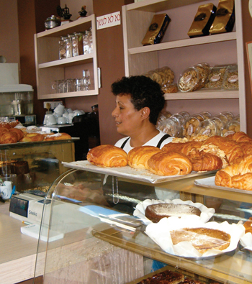
Pnina Comforti
Owner of
Penina Pie
Bakery in
Ashdod,
Messianic
Yemenite Jew.
Notes:
Lost her kosher license ONLY because Yad L’Achim, the radical Orthodox Jewish group, protested her Messianic faith.

Slide 76
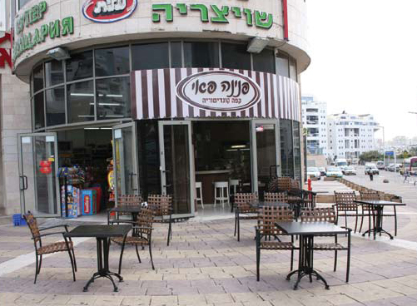

Slide 77
Pnina Comforti, one of the persecuted believers. Pnina owns Pnina Pie, a bakery being discriminated against by ultra-Orthodox Jews. A couple of weeks ago she finally received a verdict
Notes:
http://maoz.convio.net/site/MessageViewer?dlv_id=53462&em_id=31392.0

Slide 78
after almost ten years of fighting injustice ... she was awarded almost half a million shekels as a restitution for unlawful discrimination. In addition, the ultra-Orthodox organization Yad L'Achim
Notes:
http://maoz.convio.net/site/MessageViewer?dlv_id=53462&em_id=31392.0

Slide 79
known for their active persecution of believers, was fined 80,000 shekels. This is a great victory, and we are so grateful to the Lord, who is faithful and just!
Notes:
http://maoz.convio.net/site/MessageViewer?dlv_id=53462&em_id=31392.0

Slide 80
^{Matityahu 6. 33-34} Seek first the kingdom of God and His righteousness, and all these things shall be added to you. Therefore do not worry about tomorrow, for tomorrow will worry about itself. Each day has enough trouble of its own.”

Slide 81
Mattityahu (Matthew) 23:23
אֶת הַמִּשְׁפָּט, אֶת הַחֶסֶד וְאֶת הָאֱמוּנָה. צָרִיךְ הָיָה לַעֲשׂוֹת אֶת אֵלֶּה הָאַחֲרוֹנִים וְאֵין לַעֲזֹב אֶת הַדְּבָרִים הָאֲחֵרִים.
Justice, mercy, trust. These are the things you should have attended to — without neglecting the others!
Notes:
Last slide, Clyde.

