Slide 1
If you want to have notes without taking notes,
Go to OrHaOlam.com
WITHOUT WIFI
Click on downloads, messages, 2018 messages
Today’s should be on the top.

Slide 2
Tourism To Israel Has Never Been Higher: The Central Bureau of Statistics claimed over 3.7 million tourists visited Israel in 2017, a 25% increase from 2016. Tourism in 2018 has increased expectations,
Notes:
http://www.netmail411.com/mail/vfi/JOLmar1918.html?mc_cid=e18d77998d&mc_eid=5c6cdd3ee6

Slide 3
with a reported $817 million into Israel’s tourism industry this year alone. Over 556,000 tourists were reported to have visited Israel in January and February of this year, a 25% increase from last year and 56% increase from 2016. (Kehila News)
Notes:
http://www.netmail411.com/mail/vfi/JOLmar1918.html?mc_cid=e18d77998d&mc_eid=5c6cdd3ee6
So people ask if it’s safe.

Slide 4
Be a part of history and prophecy! 70 years after the founding of the State is the year of Release!
Join the March of the Nations tour, embassy opening time!
Go to OrHaOlam.com
Notes:
Meeting with travelers during Oneg. Mirror room.
Importance of unambiguous, clear communication…

Slide 5
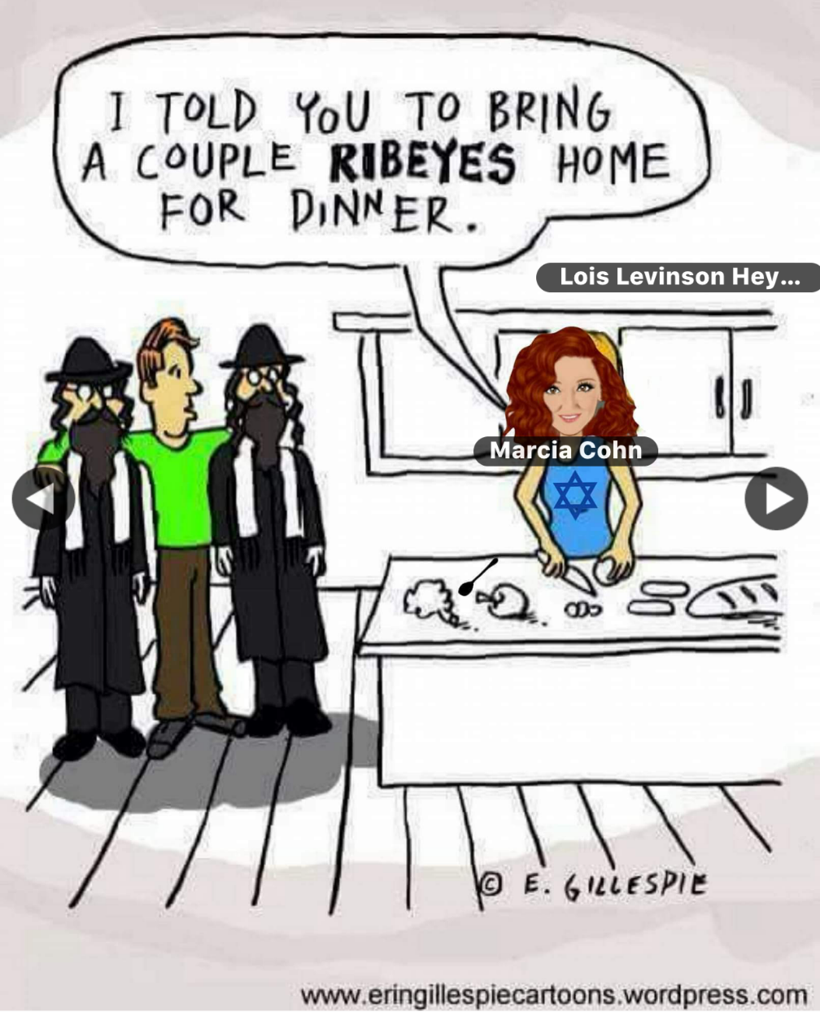
Notes:
From Jim Adler

Slide 6
מַתִּתְיָהוּ Mattityahu
(Matthew) 23:25-26
Notes:
Continuing in series. Why Matityahu? Ruakh.

Slide 8
Mattityahu (Matthew) 23:25
אוֹי לָכֶם סוֹפְרִים וּפְרוּשִׁים צְבוּעִים, כִּיּ מְטַהֲרִים אַתֶּם אֶת הַכּוֹס וְאֶת הַקְּעָרָה מִבַּחוּץ
Woe to you hypocritical Torah teachers and P’rushim! You clean the outside of the cup and the dish,

Slide 9
This is not
really about the best method to cut the grease.

Slide 10
Yeshua was talking in the context of Torah teaching on Temple purity:
טָהוֹר tahor;
pure, clean unblemished, untarnished ; unalloyed, unadulterated ; (flowery) clear, limpid

Slide 11
טמֵא Tameh
impure (usu. in a religious sense); (Jewish law) unfit to eat, to be defiled, to be contaminated, to be rendered impure ; to be declared impure
Notes:
Can you go up to the Temple, G-d’s Presence and Atonement, or are you excluded?

Slide 12
^{Vayikra/Lev. 15.1-2,12} ADONI said to Moshe and Aharon, “Tell the people of Isra'el, 'When any man has a discharge from his body, the discharge is unclean… If the person with the discharge touches a clay pot, it must be broken; if he touches a wooden utensil, it must be rinsed in water.

Slide 13
^{Vayikra/Lev. 11.29, 32-33} The following are unclean for you among the small creatures that swarm on the ground…Anything on which one of them falls when dead will become unclean — wooden utensil, article of clothing, leather, sackcloth —

Slide 14
^{Vayikra/Lev. 11.29, 32-33} any utensil used for work; it must be put in water, and it will be unclean until evening; then it will be clean. If one of them falls into a clay pot, whatever is in it will become unclean, and you are to break the pot.
Notes:
Metal and wooden vessels can be cleansed by washing and immersion. Clay cannot be cleansed. But what if you don’t that a vessel has been defiled. Precautionary washing.

Slide 15
Dispute at this time between followers of Hillel and Shammai.
Hillel P’rushim taught to wash the inside first. Outside likely defiled anyway.
Shammai P’rushim no priority.
Notes:
Shammai predominated till 70 CE, Afterward, Hillel
Whole tractate in the Talmud, called "Mikvaot", which gives rules about the places where they washed, the things to be washed, and the manner of washing them.

Slide 16
^{Bamidbar/Nu.19.14-15} This is the Torah for whenever a person dies in a tent. Anyone entering the tent or anyone inside the tent will be unclean seven days. Any open container not having a lid fastened on it will also be unclean.

Slide 17
^{Bamidbar/Nu.19.18} A clean person is to take a bunch of hyssop leaves, dip it in the water and sprinkle it on the tent, on all the containers.

Slide 18
This is not just Temple cleanliness. Some things still in force. This time of year, ritual and physical cleanliness of our homes has a consuming meaning…

Slide 19
^{Shmot/Ex 12.18-20} From the evening of the fourteenth day of the first month until the evening of the twenty-first day, you are to eat matzah. During those seven days, no leaven is to be found in your houses.

Slide 20
^{Shmot/Ex 12.18-20} Whoever eats food with hametz [leaven] in it is to be cut off from the community of Isra’el — it doesn’t matter whether he is a foreigner or a citizen of the land. Eat nothing with hametz in it. Wherever you live, eat matzah.
Notes:
No one is absolutely sure what that means. Cut off: premature death, excommunication, loss of status, death by stoning? Never been done.
But there is a spiritual meaning to this removal of hametz.
Messianic scriptures…

Slide 21
^{1 Cor. 5.6-8} “It takes only a little hametz to leaven a whole batch of dough?” Get rid of the old hametz, so that you can be a new batch of dough, because in reality you are unleavened.

Slide 22
Clean out the khametz—negative side.
Positive side…

Slide 23
^{1 Cor. 5.6-8} For our Pesakh lamb, the Messiah, has been sacrificed. So let us celebrate the Seder not with leftover hametz, the hametz of wickedness and evil, but with the matzah of purity and truth.
Notes:
Do the negative and the positive. The Corinthians were told to celebrate the Seder, and in the right spirit.
Wait a minute. Passover is only for Jews. Really? Look at the reference…Corinthians.

Slide 24
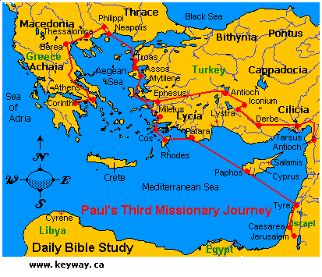
Notes:
https://www.google.com/search?q=corinth+greece+map&safe=active&tbm=isch&source=iu&ictx=1&fir=msYKT9XjR5kD8M%253A%252Cv6pLRl1FzqxmBM%252C_&usg=__XeGf2BPOGqzBGByE3FG17GPVah0%3D&sa=X&ved=0ahUKEwiuup3B94PaAhWKulMKHfq8DBEQ9QEILTAB#imgdii=72Sq4EaxYRRjIM:&imgrc=z21IFcu5hYHIQM:

Slide 25
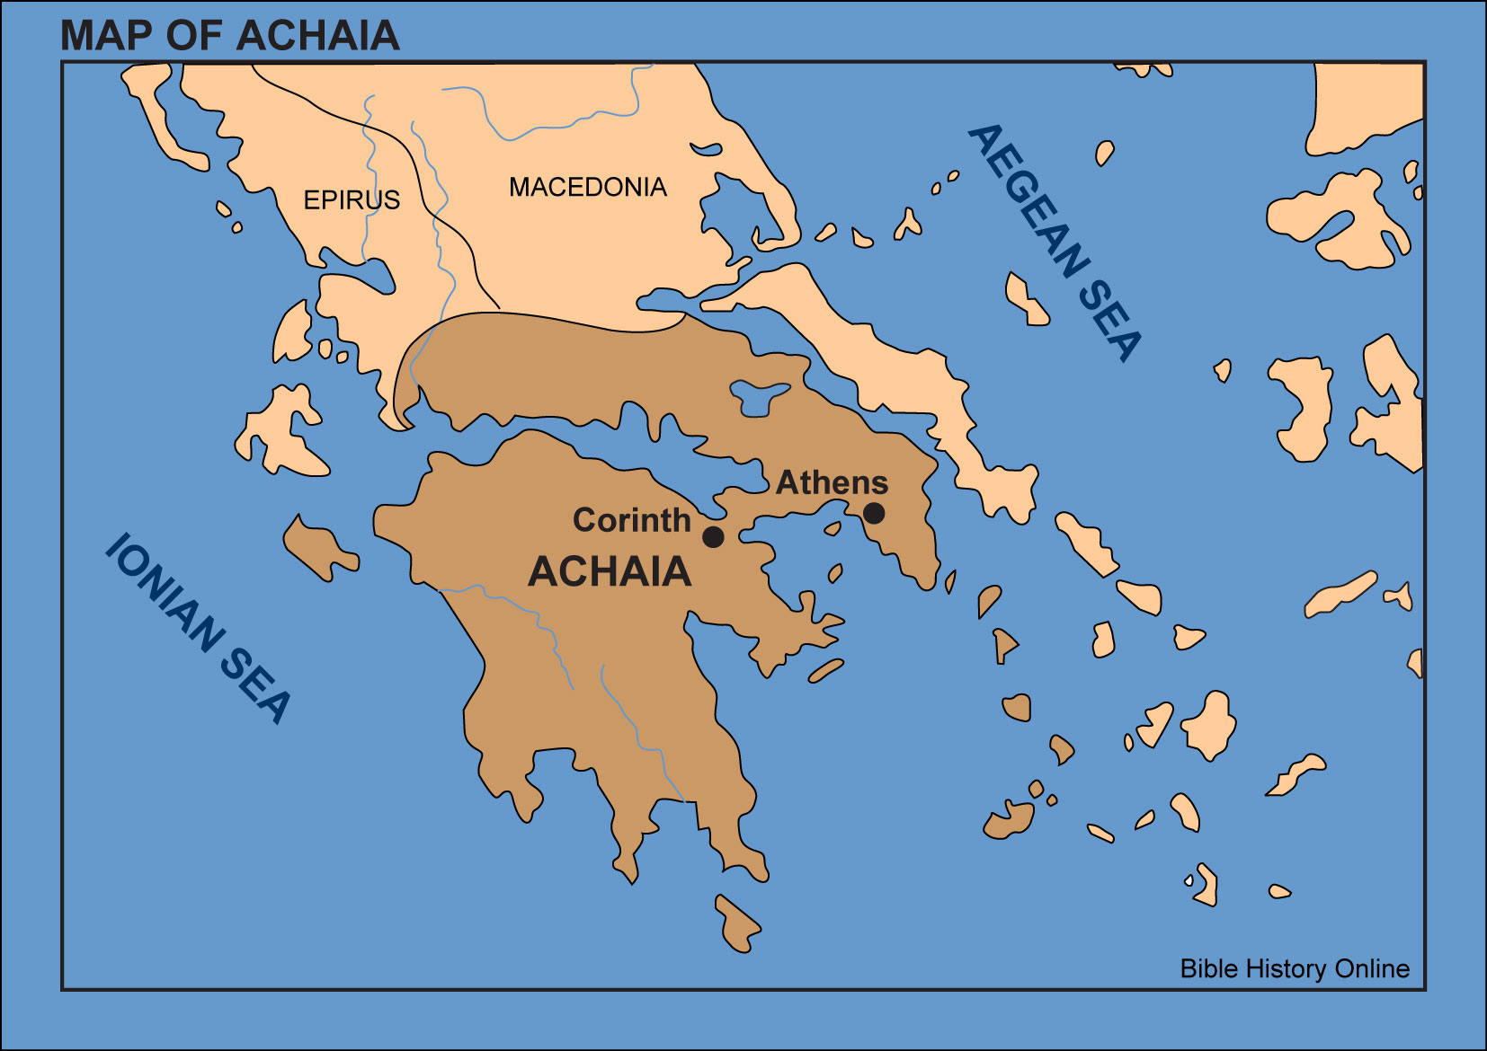
Notes:
https://www.google.com/search?q=corinth+greece+map&safe=active&tbm=isch&source=iu&ictx=1&fir=msYKT9XjR5kD8M%253A%252Cv6pLRl1FzqxmBM%252C_&usg=__XeGf2BPOGqzBGByE3FG17GPVah0%3D&sa=X&ved=0ahUKEwiuup3B94PaAhWKulMKHfq8DBEQ9QEILTAB#imgrc=msYKT9XjR5kD8M:
What nationality in Corinth? Some Jews, MOSTLY Greeks!

Slide 26
Passover cleansing particulars…
Notes:
Leaven, leavened food, confusing. Need the Hebrew…

Slide 27
שְׂאֹר leavening agents s’or
חָמֵץ leavened food khametz
Khametz is a product that is both made from one of five types of grain and has been combined with water and left to stand raw for longer than eighteen minutes and becomes leavened.
Notes:
https://en.wikipedia.org/wiki/Chametz

Slide 28
חִטָּה Wheat Ḥittim,
כֻּסְמִין Spelt Kusmin,
שְׂעוֹרָה barley Se’orah,
שִׁבֹּלֶת שׁוּעָל oats Shibbolet shual,
שִׁיפוֹן rye shifon
Notes:
https://en.wikipedia.org/wiki/Chametz
fox = שׁוּעָל

Slide 29
Leavening agents, such as yeast or baking soda, are not themselves khametz. Rather, it is the fermented grains. Thus yeast may be used in making wine, and kefir.
Notes:
https://en.wikipedia.org/wiki/Chametz
Also Kefir

Slide 30
Similarly, baking soda may be used in Passover baked goods made with matzoh meal and in matzoh balls. Since the matzoh meal used in those foods is already baked, the grain will not ferment.
Notes:
https://en.wikipedia.org/wiki/Chametz
Also Kefir

Slide 31
This applies to next week’s Oneg. Please, no khametz: leavened grain products.
No: Bread, crackers [except matzah], pasta, cakes, cookies.

Slide 32
What about rice, corn, lentils, beans, and peanuts?
They don’t leaven, but may appear to. So, Ashkenazic Jews forbid, called kitnayot.
Sephardic Jewish communities they are OK.
Or HaOlam follows the Sephardi.
Notes:
https://www.thoughtco.com/passover-forbidden-foods-2076548
Sephardi more Biblical, less add ons. Great music too.

Slide 33
Torah's description of Matza as "Lekhem Oni" – לחם עוני
the bread of affliction, poverty.
Alternatively, it could mean the bread over which a person answers.
Notes:
https://www.ulpanor.com/category/newletter/
But personally, I like matzah, the bread of affliction.

Slide 34
So it’s a practice in observant Jewish homes to do a THOROUGH Spring cleaning! Get ALL the khametz out of every corner.
Burn the crumbs
And then a prayer of covering.

Slide 35
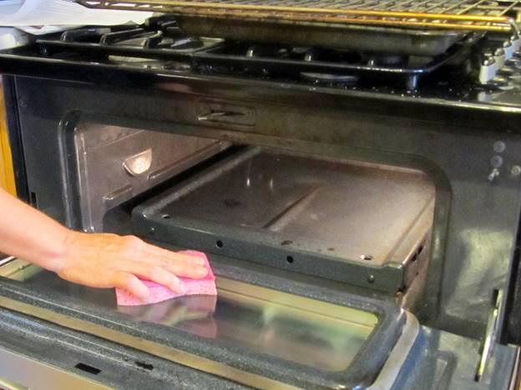

Slide 36
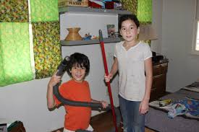

Slide 37
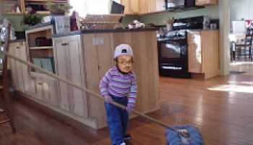
Notes:
https://www.google.com/search?q=chametz+burning&safe=active&tbm=isch&tbs=rimg:CXGR7-dDLk5BIjg1IMGltlriQnD5c6B2s6UdbVpRCvMgvCD5eE9MM8tiLT6XdlbuvnKoOO-5WSZnkZtz2ub3eWX4TyoSCTUgwaW2WuJCEWAR8_1Sg2G0sKhIJcPlzoHazpR0RiWrzQiq97U8qEgltWlEK8yC8IBEIpVnCqYqZzSoSCfl4T0wzy2ItET70tzS7UCuxKhIJPpd2Vu6-cqgRoFDs8WYCBXEqEgk477lZJmeRmxGgUOzxZgIFcSoSCXPa5vd5ZfhPEaBQ7PFmAgVx&tbo=u&sa=X&ved=2ahUKEwjFwo7F3YPaAhWKqlMKHVlIAzMQ9C96BAgAEBs&biw=1282&bih=884&dpr=1#imgrc=yXlZZUKJdFanwM:
A new Israeli military version, getting out the impurities, corruptions..

Slide 38
Notes:
From Checho Rojas’ Facebook.
After we’ve cleaned all, we burn the leftovers.

Slide 39
BTW, we have a number of serving dishes left behind. Please take yours.
Please also take any bread or pie of pasta you brought, or else…

Slide 40
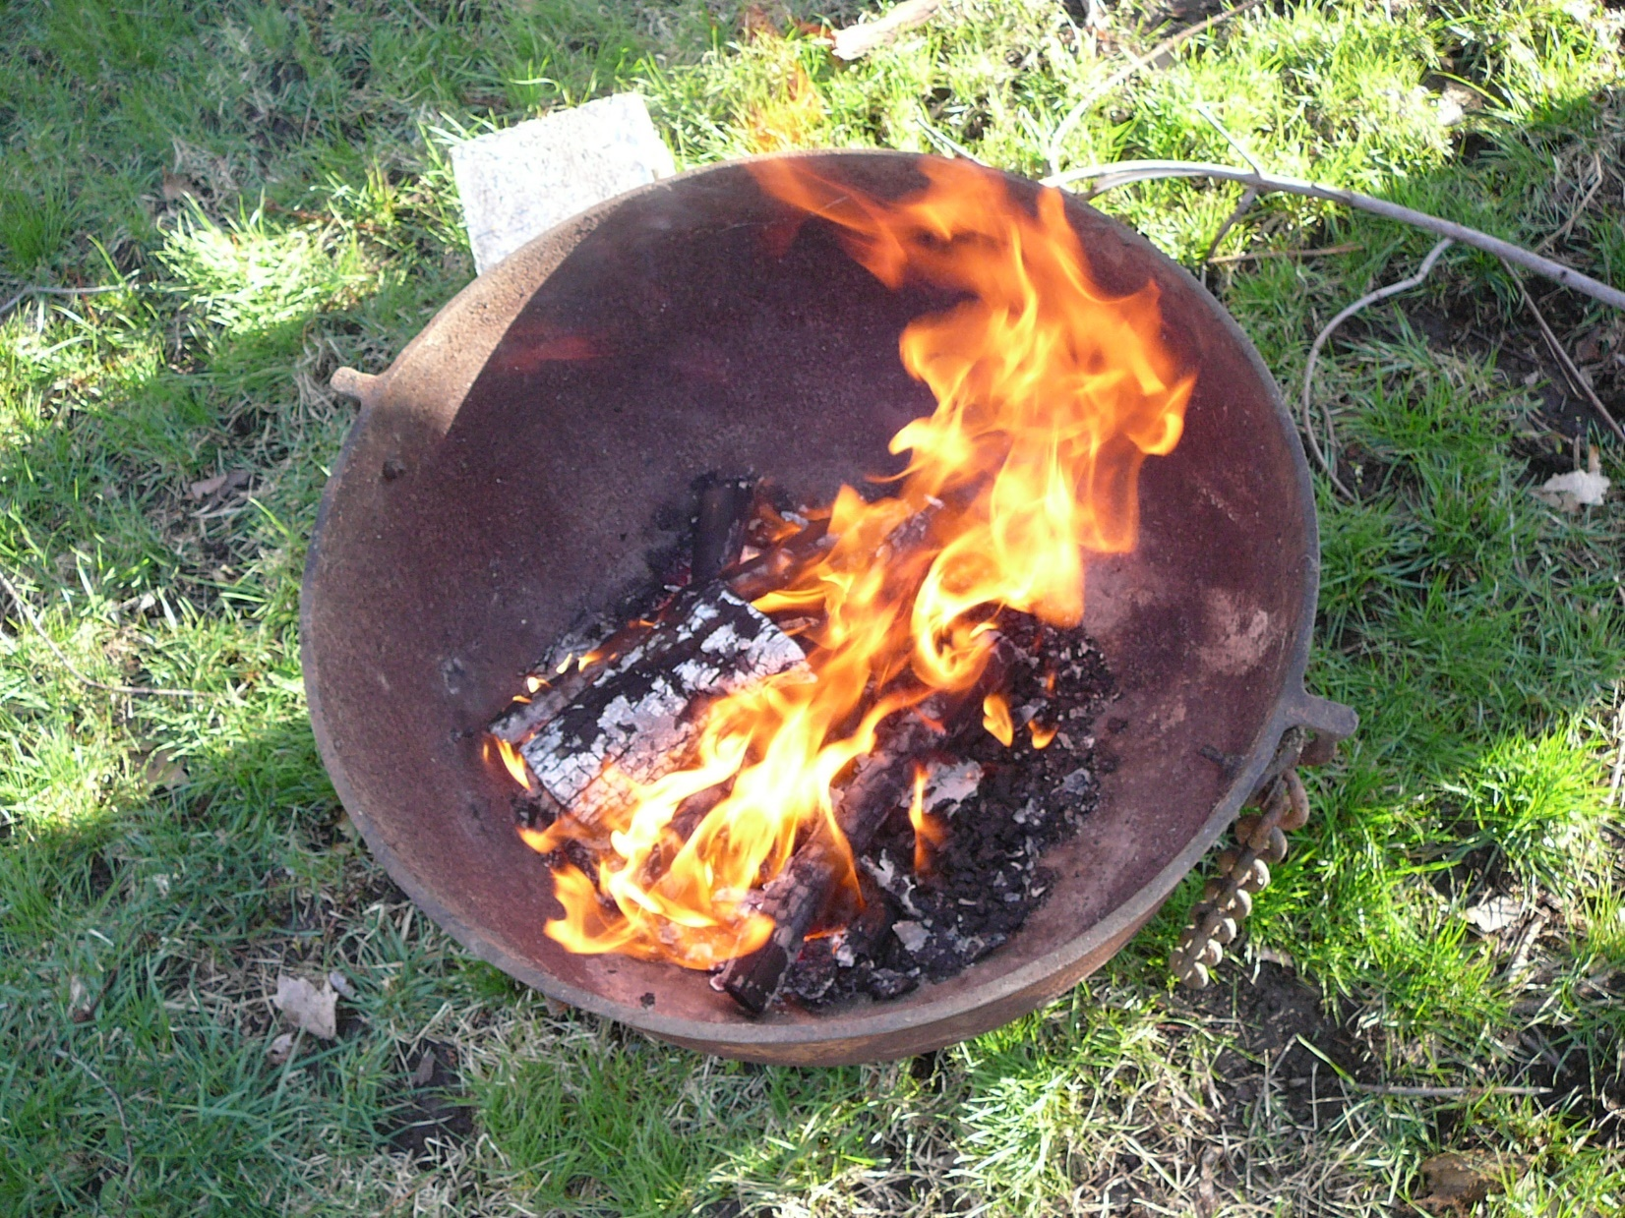
Noon this Friday, here

Slide 41
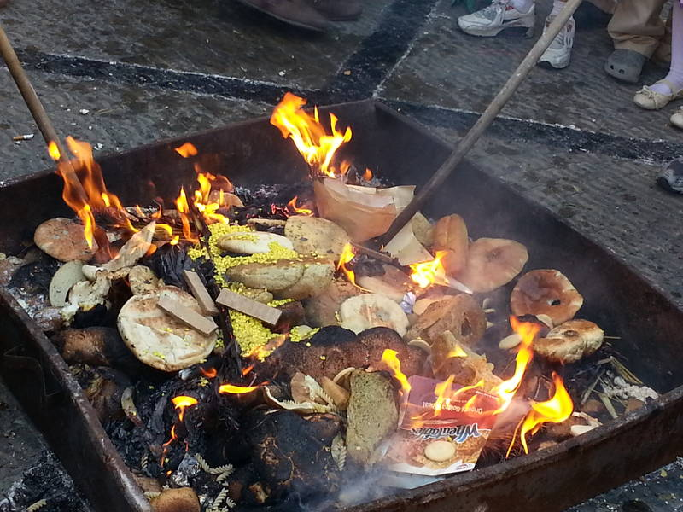
Notes:
https://www.google.com/search?q=chametz+burning&safe=active&tbm=isch&tbs=rimg:CXxcf9e-VinSIjg-F_1Fdd5SDX-FeUir7gXWLsdW6VByDOHI1E_1MGNW--dPaCWbEvh98bcZHv50MuTkHFe5xxiTRSZioSCT4X8V13lINfEZ8zH6iIIFLIKhIJ4V5SKvuBdYsR0aLZx3tPwjoqEgmx1bpUHIM4chF7cPTNuVAr9yoSCTUT8wY1b750EVtkSaEm9p5GKhIJ9oJZsS-H3xsRe3D0zblQK_1cqEglxke_1nQy5OQRGJlu5x6Q1DCyoSCcV7nHGJNFJmEdbUCgtTibsO&tbo=u&sa=X&ved=2ahUKEwjpydua3YPaAhUHv1MKHVFBDzsQ9C96BAgAEBs&biw=1282&bih=884&dpr=1#imgdii=Sjv_ENVJI0lCKM:&imgrc=xXuccYk0UmaDWM:

Slide 42
At the Ritz Charles, 2015

Slide 43
The Messiah speaks about hypocritical cleaning, pretended purity…

Slide 44
Mattityahu (Matthew) 23:25
אוֹי לָכֶם סוֹפְרִים וּפְרוּשִׁים צְבוּעִים, כִּיּ מְטַהֲרִים אַתֶּם אֶת הַכּוֹס וְאֶת הַקְּעָרָה מִבַּחוּץ
Woe to you hypocritical Torah teachers and P’rushim! You clean the outside of the cup and the dish,

Slide 45
Mattityahu (Matthew) 23:25
וְתוֹכָן מָלֵא גֶּזֶל וְתַאַוְתָנוּת.
but inside they are full of robbery and self-indulgence.
Yeshua’s choice of two words as the key representation of hypocrisy.

Slide 46
ἁρπαγῆς (harpagēs)
the act of plundering; plunder, spoil, robbery.

Slide 47
ἀκρασίας (akrasias) the inability to maintain control; (figuratively) without self-control and hence mastered by personal appetites (urges).

Slide 48
The inside of the cup is NOT immediately obvious. Hidden uncleanness, impurity, sin.
Or HaOlam first proto service Purim 1995. What I’ve seen in 23+ years ministry, hidden sin that destroys faith, relationships.
Notes:
Approaching silver anniversary, Purim 2020. Celebration!?

Slide 49
ἁρπαγῆς (harpagēs)
the act of plundering; plunder, spoil, robbery.

Slide 50
Integrity
Tax time: do we report all income? [and take all deductions.] Render unto Ceasar what is Ceasar’s
But not a penny more!

Slide 51
Yeshua
^{Mt 18.16} Take one or two others with you so that every accusation can be supported by the testimony of two or three witnesses

Slide 52
Shaul
^{2 Cor 13.1} This will be the third time that I have come to visit you. Any charge must be established by the testimony of two or three witnesses.

Slide 53
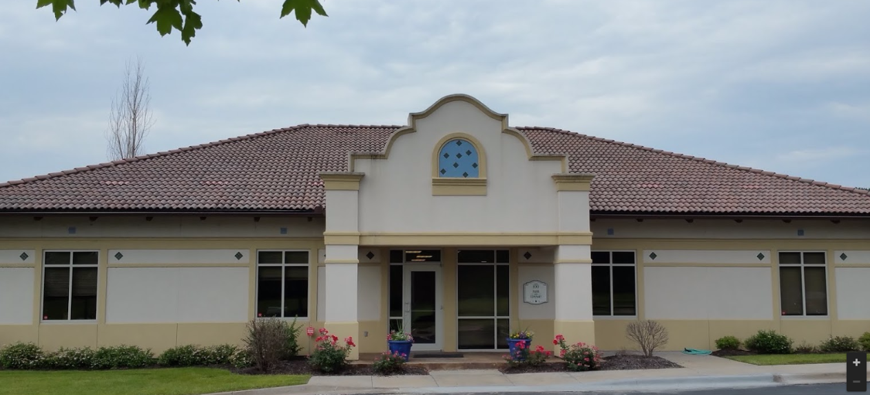
Marr and Company, P.C.
Certified Public Accountants
Notes:
In about July 2013, Yisraela, Suzanne, and I visited Marr and Co., 1401 E 104th St #100, Kansas City, MO 64131, to have our financial procedures analyzed for accountability. Not an audit כי too expensive. But procedural analysis. Always two people count our offering, etc. Feel free to ask if curious. Some have asked about Cong. Finances, and I sent them full monthly reports. Complete reports with every check or debit or cc expense distributed to leaders. Background checks on all who handle money.

Slide 54
Steal honor and reputation
Evil speaking
Unforgiveness [wounded → wounder]. Steals & steels others of your open heart.
Notes:
Shaunti p 102
Time Mag Dec 28, 2015

Slide 55
Steal honor and reputation
Joylessness: steals G-d’s honor. ^{D’varim/Dt.28.47} serving Adoni your God with joy and goodness of heart, out of the abundance of everything
Communication: touch, talk, time. Steals blessing others.
Notes:
Opposite of Emunah, trust in Resurrection power. Gevaltism.
^{Acts 20.28} Take care of yourselves and all the flock of which the Ruach ha-Kodesh has made you overseers, to shepherd the community of God—which He obtained with the blood of His own.
^{Mes Jews/Heb 10.24-25} And let us consider how to stir up one another to love and good deeds. And do not neglect our own meetings, as is the habit of some, but encourage one another—and all the more so as you see the Day approaching.
Time Mag on loneliness

Slide 56
Steal honor and reputation
Cheerleader or jeerleader. Steals strength from others.
Prayerlessness. Readinglessness[?] Source of all our strength and joy.
Outreach
Notes:
5. Especially parents, spouse. David Jeremiah: chief job is encourager.
6. ^{Song 2.14} My dove, hiding in holes in the rock, in the secret recesses of the cliff, let me see your face and hear your voice; for your voice is sweet, and your face is lovely.
Above, all the secret ways to steal. What about the other word for hypocritical practice Yeshua used?

Slide 57
ἀκρασίας (akrasias) the inability
to maintain control; (figuratively)
without self-control and hence
mastered by personal appetites
(urges).

Slide 58
Secret mental life of imagination, image watching.
PIED
Notes:
KC Star clip

Slide 59
Mattityahu (Matthew) 23:26
פָּרוּשׁ עִוֵּר, טַהֵר תְּחִלָּה אֶת תּוֹךְ הַכּוֹס כְּדֵי שֶׁתִּהְיֶה טְהוֹרָה גַּם מִבַּחוּץ.
“Blind Parush! First clean the inside of the cup, so that the outside may be clean too.”

Slide 60
Let us do a real khamets cleaning of our hearts and lives
Devotionally
Ethically
Relationally

