Slide 1
e-handout
To have these notes
without taking notes
Go to OrHaOlam.com
Click on downloads,
messages, 2018
Notes:
.

Slide 2
What's the most terrifying word in thermo-nuclear physics?
OOPS!
Three fish are in a tank. One asks the others,
"How do you drive this thing?"
Notes:
Andrea Robinson

Slide 3
Which one of Sir Arthur’s knights collected taxes?
Sir Charge.
Notes:
Daniel Wolkenfeld

Slide 4
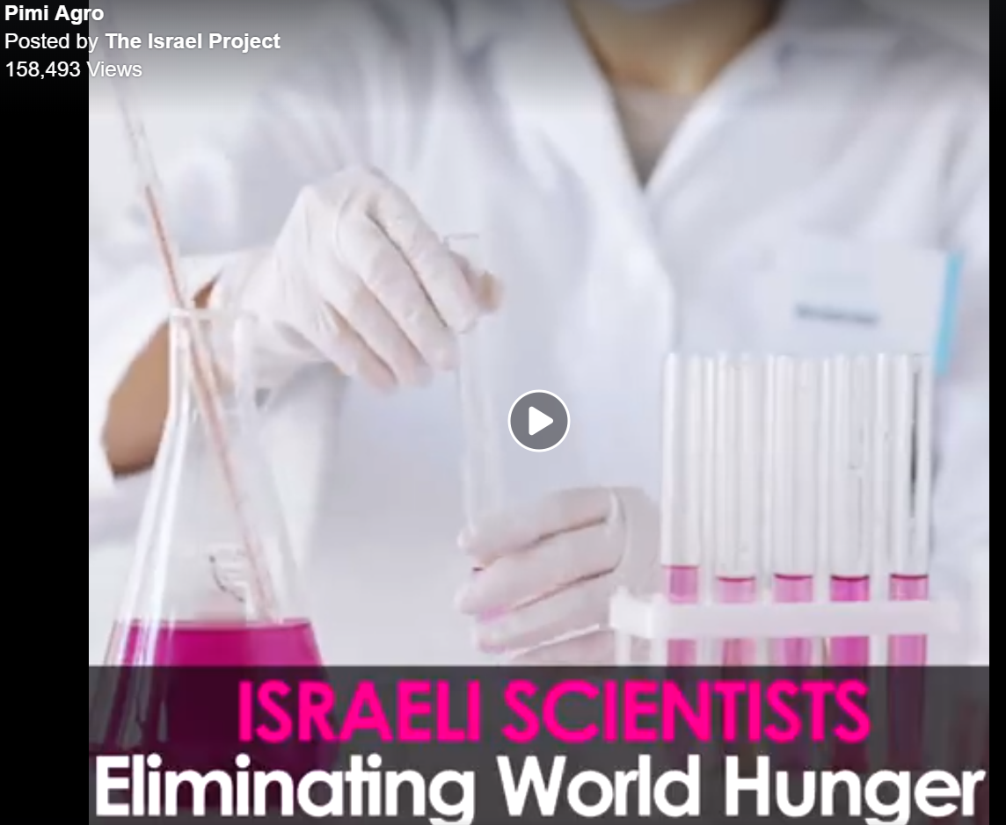
https://www.facebook.com/theisraelproject/videos/1855871591159586/

Slide 5
מַתִּתְיָהוּ Mattityahu
(Matthew) 24:32-33

Slide 6
Mattityahu (Matthew) 24:32
לִמְדוּ אֶת הַמָּשָׁל מִן הַתְּאֵנָה: כַּאֲשֶׁר עֲנָפֶיהָ מִתְרַכְּכִים
“Now let the fig tree teach you its lesson: when its branches begin to sprout

Slide 7
Mattityahu (Matthew) 24:32
וְהֶעָלִים צָצִים יוֹדְעִים אַתֶּם שֶׁהַקַּיִץ קָרוֹב.
“And leaves appear, you know that summer is approaching.
Notes:
Yeshua and talmidim may have been sitting under a fig tree as He was talking!

Slide 8
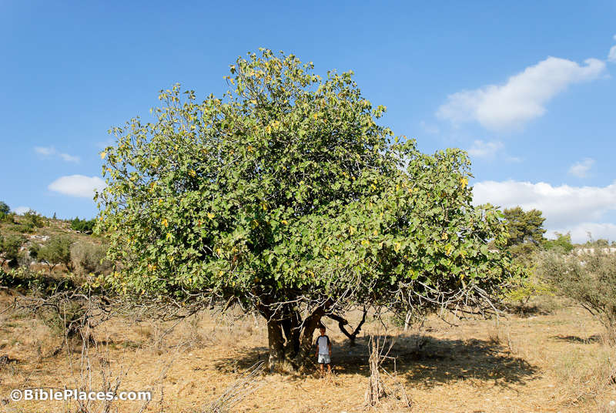
Notes:
https://www.google.com/search?q=israel+fig+tree+end+times&safe=active&source=lnms&tbm=isch&sa=X&ved=0ahUKEwiPw97I4szdAhUj7IMKHUvNDJAQ_AUIDygC&biw=1165&bih=822#imgdii=1AIrAuWPTptVFM:&imgrc=dPquD32MPKqa0M:

Slide 9
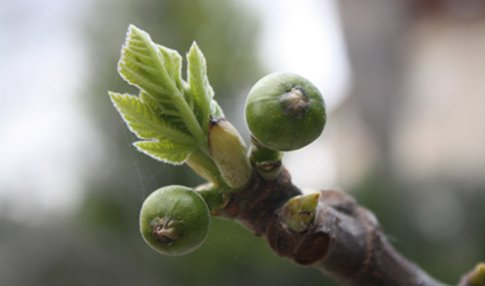
Notes:
https://www.google.com/url?sa=i&rct=j&q=&esrc=s&source=images&cd=&cad=rja&uact=8&ved=2ahUKEwjSo4bv5MzdAhVJ6oMKHenTD7AQjRx6BAgBEAU&url=http%3A%2F%2Fwww.jerusalemcornerstone.org%2Fresources%2Farticles_main-page%2Fisrael-s-seven-species-fig&psig=AOvVaw3VB99iGf9J9Dbu6GkadZYQ&ust=1537642488004402

Slide 10
Literal, agricultural
facts of
Fig Trees blossoming

Slide 11
The fig tree grows plentifully in Israel as a wild and cultivated tree. The fig tree bears bountiful figs. The fig tree was one of the blessings promised to Israel in the Land ^{Deut 8:8} It is a land of wheat and barley, grapevines, fig trees and pomegranates; a land of olive oil and honey…
Notes:
http://www.blainerobison.com/bible2-matt/mattnotes24.htm
7 fruits of Canaan. One reason for Shabbat kiddush, can include 5 or more of the above.

Slide 12
The common fig in Israel yields two crops annually, the first one, ripe about June, growing from the midsummer sprouts of the previous year. The second crop is ripe about August that grows on the Spring shoots. The leaves that announce the nearness of summer also presage the coming harvest.
Notes:
http://www.blainerobison.com/bible2-matt/mattnotes24.htm

Slide 13
Figs were eaten fresh (2Kgs 18:31), pressed into cakes (2Sam 25:18), and used as a poultice (Isa 38:21).
Notes:
http://www.blainerobison.com/bible2-matt/mattnotes24.htm

Slide 14
Fig trees are one of the few deciduous trees in Israel: lose their leaves seasonally.
Also, figs produce leaves before the vines do.

Slide 15
By December, fig-trees in the mountainous regions of Israel have shed all their leaves, and they remain bare until about the end of March, when they commence putting forth their tender leaf buds.
Notes:
http://www.blainerobison.com/bible2-matt/mattnotes24.htm

Slide 16
Literal, agricultural
facts of
Fig Trees blossoming
And some spiritual interpretations

Slide 17
Just as there are two crops of figs so there are two comings of the Messiah.

Slide 18
The fig tree is used in the Tanakh as symbolic of someone's home
In Rabbinic writings the shade of a fig tree was used as a place for prayer, meditation and study ^{(Ber. 16a)}. Of interest is that Yeshua first saw Nathanael under a fig tree ^{(John 1:48)}.
Notes:
http://www.blainerobison.com/bible2-matt/mattnotes24.htm
(cf. 2Kgs 4:25; 2Kgs 18:31; Isa 36:16; Mic 4:4; Zech 3:10)

Slide 19
"If one sees a fig tree in a dream, his learning will be preserved within him, as it says: Whoso keeps the fig tree shall eat the fruit thereof" ^{(Prov 27:18; Ber. 57a)}. In addition, "gathering figs" was an expression in later sources
Notes:
http://www.blainerobison.com/bible2-matt/mattnotes24.htm

Slide 20
that meant "studying," apparently because rabbinic scholars believed the tree of knowledge in Genesis 3 was a fig tree ^{(Ber. 40a)}
Notes:
http://www.blainerobison.com/bible2-matt/mattnotes24.htm

Slide 22
Mattityahu (Matthew) 24:33
כֵּן גַם אַתֶּם, כִּרְאוֹתְכֶם אֶת כָּל אֵלֶּה דְּעוּ כִּי קָרוֹב הוּא בַּפֶּתַח.
“In the same way, when you see all these things, you are to know that the time is near, right at the door.”

Slide 23
The Scripture divides the whole year only into two parts, summer and winter; so the fig blossom meant
the redemption and deliverance of the people of God was at hand OR.
that the son of man was come, was in the gates, displaying his power and his glory in judgement.
Notes:
John Gill
Could be for good or ill, depending on your spiritual state!

Slide 24
Redemptive fig blossoming

Slide 25
^{Song of Songs 2.10-13} My darling דוֹדִי Dodi speaks; he is saying to me, “Get up, my love! My beauty! Come away! For you see that the winter has passed, the rain is finished and gone, the flowers are appearing in the countryside, the time has come for [the birds] to sing,

Slide 26
^{Song of Songs 2.10-13} and the cooing of doves can be heard in the land. The fig trees are forming their unripe figs, and the grapevines in bloom give out their perfume. Get up, my love, my beauty! Come away!”
Notes:
David Flusser comments that it was a common interpretation that the whole passage above is about the redemption of Israel.

Slide 27
^{Hoshea 9.10} “When I found Isra’el, it was like finding grapes in the desert; when I saw your ancestors, it was like seeing a fig tree’s first figs in its first season.
That is, Israel is G-d’s delight!

Slide 28
Judgemental fig blossoming

Slide 29
^{Amos 8.1-2} Here is what Adonai Elohim showed me: there in front of me was a basket of summer fruit. He asked, “‘Amos, what do you see?” I answered, “A basket of summer [kayets קַיִץ] fruit.” Then Adonai said to me, “The end [kets קֵץ] has come for my people, I will never again overlook their offenses.

Slide 30
^{Hab. 3.17-19} Though the fig tree does not blossom, and there is no yield on the vines, Though the olive crop fail, and the fields produce no food…Yet will I triumph in Adoni, I will rejoice in the God of my salvation! Adoni my Lord, is my strength. He has made my feet like a deer’s, and will make me walk on my high places.

Slide 31
^{Yoel 1.6-7} For a mighty and numberless nation has invaded my land. His teeth are lion’s teeth; his fangs are those of a lioness. He has reduced my vines to waste, my fig trees to splinters — he plucked them bare, stripped their bark and left their branches white.”

Slide 32
Israel is blossoming
The fig tree in symbolism is
Physically being restored
Spiritually being restoring

Slide 33
^{Yekhez/Ezek 37.14} I will put my Ruakh in you and you will live. I will place you in your own land. Then you will know that I, Adoni, have spoken and that I have done it.” It is a declaration of Adoni.
Notes:
In these verses, spiritual redemption precedes physical.

Slide 34
^{Yekhez/Ezek 36.24-28} “‘For I will take you from the nations, gather you out of all the countries and bring you back to your own land. Then I will sprinkle clean water on you and you will be clean from all your uncleanness and from all your idols. Moreover I will give you a new heart. I will put a new spirit within you.
Notes:
In these verses, physical redemption precedes spiritual redemption.

Slide 35
^{Yekhez/Ezek 36.24-28} I will remove the stony heart from your flesh and give you a heart of flesh. I will put My Ruakh within you. Then I will cause you to walk in My laws, so you will keep My rulings and do them. Then you will live in the land that I gave to your fathers. You will be My people and I will be your God.
Notes:
So, Jewish people coming back to the Land, and coming to faith in the love of G-d, the reality of His only Son in Messiah, Messiah’s atoning death and resurrection, and receiving spiritual LIFE by repenting and trusting Messiah! Halleluyah!

Slide 36
Israel is blossoming
Physically being restored
Spiritually being restoring
Which comes first?
Yes!
Notes:
Consider a bit of history. The Messianic Jewish movement was huge in the first few centuries, then almost disappeared. Jews who wanted to believe in Messiah Yeshua had to renounce Judaism. Liberman book, p 47.

Slide 37
The London Society for Promoting Christianity Amongst the Jews is an Anglican missionary society founded in 1809. Later called The Church's Ministry Among Jewish People (CMJ).
Notes:
https://en.wikipedia.org/wiki/Church%27s_Ministry_Among_Jewish_People
Weslayan Revival, Salvation Army,

Slide 38
Early formal organizations run by believing Jews include:
the Anglican London Society for promoting Christianity among the Jews, which published the first Yiddish New Testament in 1821; by Joseph Samuel Frey (born Joseph Levi) (1771–1850)
Notes:
https://en.wikipedia.org/wiki/Messianic_Judaism

Slide 39
The first identifiable congregation made up exclusively of Jews who had come to faith in Messiah was established in the United Kingdom in 1813; a group of 41 Jewish believers established an association called "Beni Abraham", and started meeting at Jews' Chapel in London for prayers Friday night and Sunday morning.
Notes:
https://en.wikipedia.org/wiki/Hebrew_Christian_movement

Slide 40
The September 1813 meeting of Frey's "Beni Abraham" congregation at the rented "Jews' Chapel" in Spitalfields is sometimes pointed to as the birth of the semi-autonomous Hebrew Christian movement within Anglican and other established churches in Britain.
Notes:
https://en.wikipedia.org/wiki/Messianic_Judaism

Slide 41
During the 1800’s there is evidence of 224,000 immersions proclaiming faith in Messiah by Jewish people. [Where are they?]
The London Hebrew Christian Alliance of Great Britain was founded by Dr. Carl Schwartz in 1866. American HCAA 1915
Notes:
Dr. Ruth Fleischer So Great a Cloud of Witnesses

Slide 42
From 2003 to 2007, the movement grew from 150 Messianic houses of worship in the United States to as many as 438, with over 100 in Israel and more worldwide; congregations are often affiliated with larger Messianic organizations or alliances. As of 2012,
Notes:
https://en.wikipedia.org/wiki/Messianic_Judaism

Slide 43
population estimates for the United States were between 175,000 and 250,000 members, between 10,000 and 20,000 members for Israel, and an estimated total worldwide membership of 350,000.
Notes:
https://en.wikipedia.org/wiki/Messianic_Judaism
Those are the facts and events. Here is the back story, the driving force to the fulfilling of scripture!

Slide 44
Israel is blossoming
Physically being restored
Spiritually being restoring
All such is fulfillment is only wrought in prayer…

Slide 46
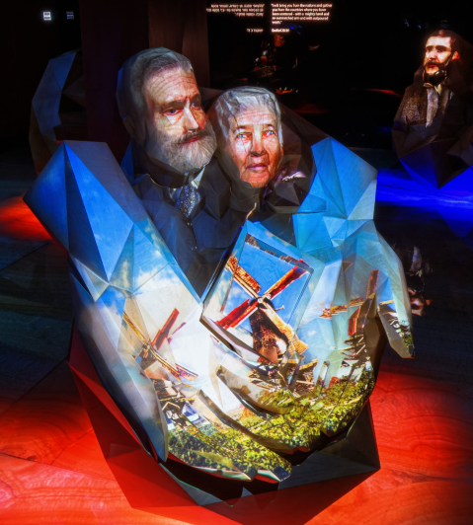
Willem and
Elizabeth Ten
Boom
Notes:
http://fozhc.net/?message=success
You’ve heard of Corrie ten Boom?

Slide 47
Willem and Elizabeth Ten Boom were devout Dutch Christians. The Ten Booms opened a clock shop in Haarlem, just outside Amsterdam in 1837, and lived with their family in the small apartment above the shop. Their apartment became the setting for one of the most powerful events in history— that is, if you believe in the power of prayer.
Notes:
http://www.fozhc.net/tour.php

Slide 48
Believing the ancient prophecies of the Bible, and moved by the injunction of Psalm 122:6 that reads, "Pray for the Peace of Jerusalem, May those who love you be secure", in 1844, the Ten Boom’s opened their humble home every week to lead a group of Christians in prayer for the Holy City, its’ inhabitants, and for the Jews now scattered around the world.
Notes:
http://www.fozhc.net/tour.php
For physical and spiritual redemption!

Slide 49
Their son Casper and his young wife Cornelia continued the tradition, joined by their children, Betsie, Corrie, Nollie and Willem. By then, the Ten Boom Prayer Meeting was an established part of the Christian community life in Haarlem. The last weekly Ten Boom Jerusalem prayer meeting took place on February 28, 1944, one hundred years to the day
Notes:
http://www.fozhc.net/tour.php
Ann Frank’s family was arrested by the Gestapo in August 1944

Slide 50
when Willem and Elizabeth had started them. No Ten Boom may show up in any history book of the Twentieth Century. But in those 100 years of faithful weekly gatherings, the Ten Boom’s led 5,200 intercessory prayer meetings on behalf of the city of Jerusalem and the people of the Promise.
Notes:
http://www.fozhc.net/tour.php

Slide 51
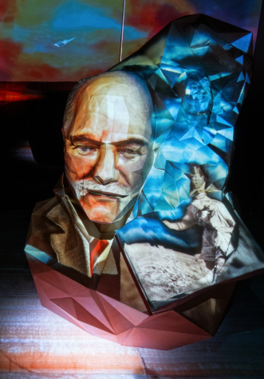
Born in 1841
William
Blackstone
Notes:
http://www.fozhc.net/tour.php

Slide 52
Born in 1841, William Blackstone was a devout Christian. One night, young William experienced an all night soulsearching. The next morning, he renounced all material pursuit, and devoted his life to advancing his faith. Soon afterward, his study of prophetic scriptures led him to a deep conviction of the Jewish people’s
Notes:
http://www.fozhc.net/tour.php

Slide 53
divinely ordained right to their biblical homeland. In 1878, he authored a best selling book that sold millions of copies worldwide. In it, he spoke of Israel’s survival in exile... “Their wonderful preservation as a distinct people... is a standing miracle, attesting the truth of God’s Word, and assuring us of His purposes in their future history...
Notes:
http://www.fozhc.net/tour.php

Slide 54
I could fill a book with comments about how Israel WILL be restored, but all I have desired to do [is] to show that it is an INCONTROVERTIBLE fact of history.” In 1891, he crafted a petition to be privately presented to the world’s leaders.
Notes:
http://www.fozhc.net/tour.php

Slide 55
It called for support of a Jewish homeland in ancient Palestine. The petition was signed by 413 prominent leaders. It came to be called “The Blackstone Memorial” and gave a powerful voice to the Zionist cause.
Notes:
http://www.fozhc.net/tour.php

Slide 56
“Why shall not the powers which gave Bulgaria to the Bulgarians and Serbia to the Serbians, now give Palestine back to the Jews? These provinces... were wrested from the Turks and given to their natural owners. Does not Palestine as rightfully belong to the Jews?”
Notes:
http://www.fozhc.net/tour.php

Slide 57
When Theodor Herzl and other Jewish Zionist leaders were considering an offer from the British government to establish a Jewish homeland in Uganda, Blackstone marked up his personal Bible with all of the prophetic passages underlined
Notes:
http://www.fozhc.net/tour.php

Slide 58
which called for the return of the Children of Israel to the Promised land. He sent the Bible to Herzl who is said to have kept it on his desk for most of his life. William Blackstone died in 1935, thirteen years before his dream came true
Notes:
http://www.fozhc.net/tour.php

Slide 59
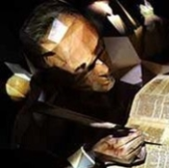
Professor
George
Bush

Slide 60
Professor George Bush began his career as an ordained Presbyterian minister, but his influence was not to be from the pulpit but with his pen. As Professor of Hebrew and Oriental Literature at New York University, the more he studied the ancient languages of the Bible,
Notes:
http://www.fozhc.net/tour.php

Slide 61
the more he became convinced of the Biblical prophecies of Israel's return to their land. He became a national voice calling for the restoration of the Jewish people to their historic homeland. In 1844, he published his views in a landmark book entitled “The Valley of Vision; or,
Notes:
http://www.fozhc.net/tour.php

Slide 62
The Dry Bones of Israel Revived” based on the prophecies of Ezekiel in the Bible. Professor Bush wrote... “The dispersed and downcast remnant shall, one after another, turn their faces to Zion, and in sparse and scattered bands find their way to the land of their fathers...
Notes:
http://www.fozhc.net/tour.php

Slide 63
This will not only benefit the Jews, but all mankind, forming a link of communication between humanity and God... It will flash a splendid demonstration upon all kindreds and tongues... "The Valley of Vision” sold more than a million copies, unheard of in the era before the Civil War.
Notes:
We thought the Bushies were just oil tycoons, but apparently a bit of wealth from writing g-dly books!!

Slide 64
His writings had a profound impact in shaping their view of the Jews and their homeland. Professor George Bush and other courageous voices set the stage for America, a century later, to be the first country to embrace the reborn State of Israel
Notes:
http://www.fozhc.net/tour.php

Slide 65
and to remain its strongest friend in the decades since. Two of his direct descendants would someday be President of the United States, both deeply committed to a strong Israel in the family of nations.
Notes:
http://www.fozhc.net/tour.php

Slide 66
John Henry
Dunant, a Swiss
born businessman,
humanitarian,
and a devout
Christian.
Notes:
http://www.fozhc.net/tour.php

Slide 67
Few men in modern history have done more to promote care for the suffering than John Henry Dunant, a Swiss born businessman, humanitarian, and a devout Christian. As a young man of 27 he helped found the YMCA as a worldwide movement. In Italy he witnessed firsthand the horrors of war.
Notes:
http://www.fozhc.net/tour.php

Slide 68
Appalled at the indifference of those in power, Dunant organized local citizens to aid the suffering and dying men. Thousands were saved! He returned home and led a campaign that resulted in the creation of the International Red Cross to serve without prejudice the wounded of all sides in any war.

Slide 69
A year later Dunant helped sponsor the Geneva Convention that established humanitarian rules of conduct for war still followed today. Dunant campaigned vigorously for the establishment of a Jewish homeland. In 1867,
Notes:
http://www.fozhc.net/tour.php

Slide 70
he founded the Association For The Resettlement of Palestine. He said... “...the moment could not be better for commencing the resettlement of Palestine.” Theodor Herzl, the founder of the Zionist movement,
Notes:
http://www.fozhc.net/tour.php

Slide 71
is said to have first coined the phrase “Christian Zionist” in reference to his friend, John Henri Dunant, one of only a handful of non-Jews invited to the First Zionist Congress in Basel, Switzerland. Dunant died in poverty, but not without honor. In 1901, he was awarded the first Nobel Prize for Peace.
Notes:
http://www.fozhc.net/tour.php

Slide 72
John Henry
Dunant:
YMCA,
Red Cross
Geneva Conventions
first Christian Zionist.
Notes:
http://www.fozhc.net/tour.php

Slide 73
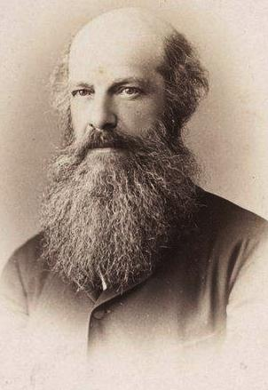
Laurence
Oliphant (1829 –
1888) S African-
born British
author, traveler,
diplomat and
Christian mystic.
Notes:
By Abdullah brothers - Bibliothèque nationale de France, Public Domain, https://commons.wikimedia.org/w/index.php?curid=17552930

Slide 74
Notes:
http://www.fozhc.net/tour.php

Slide 75
Notes:
http://www.fozhc.net/tour.php

Slide 76
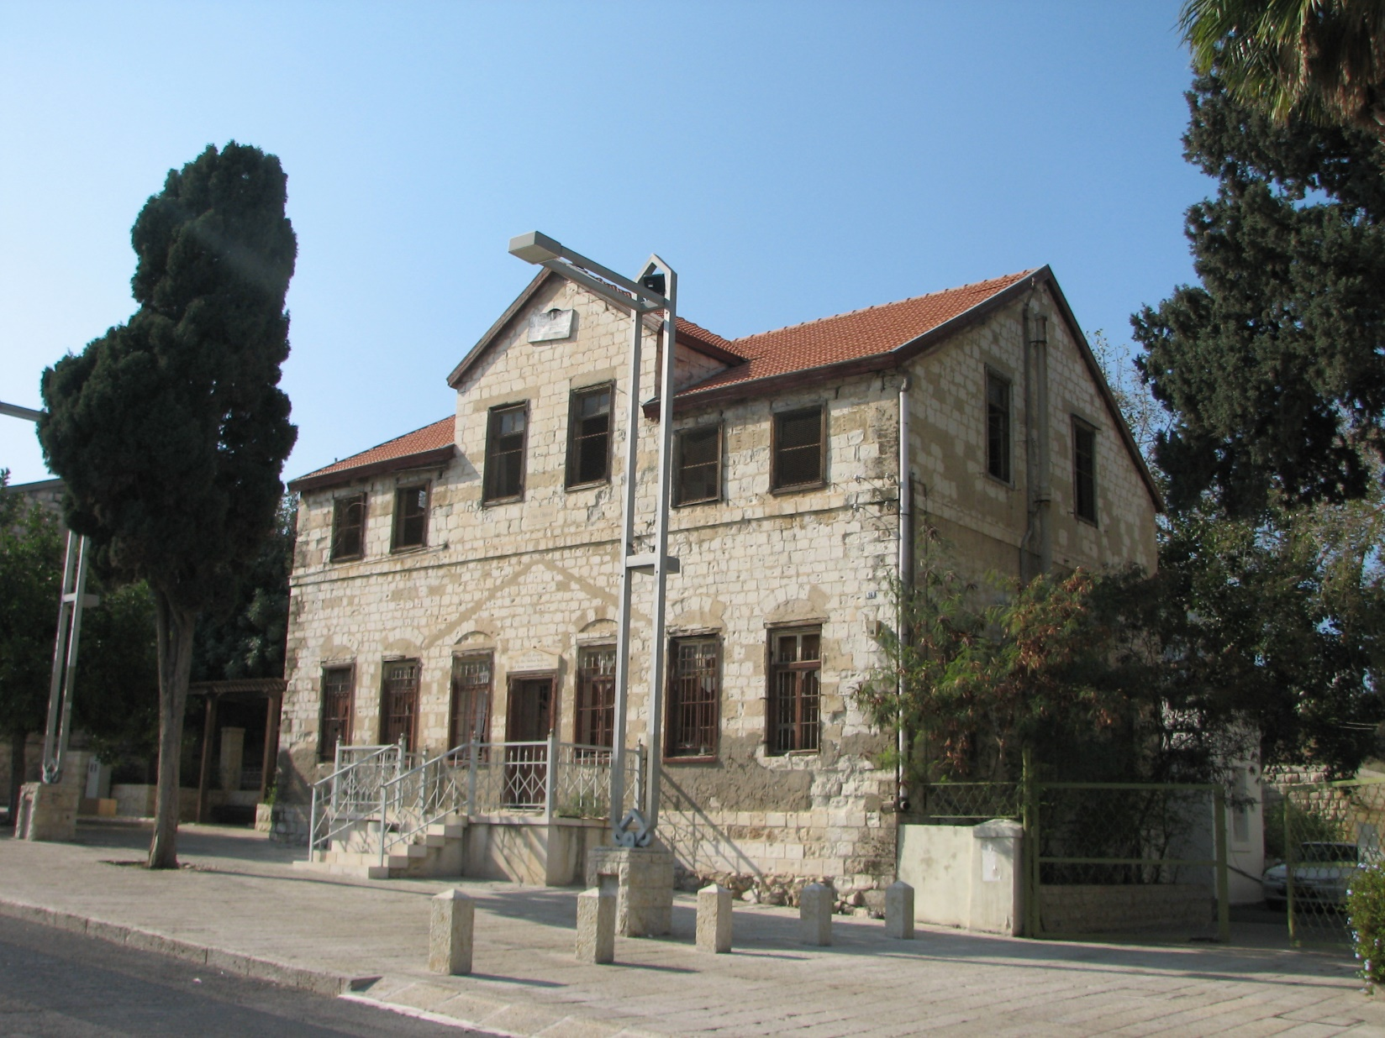
Beit Oliphant, Haifa. The house
of Laurence Oliphant
Notes:
https://commons.wikimedia.org/wiki/File:Bet_Oliphant_-_Haifa_(7).JPG

Slide 77
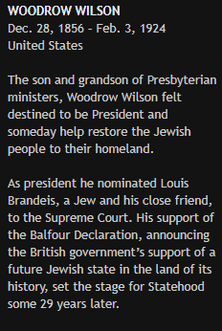
Notes:
http://www.fozhc.net/tour.php

Slide 78
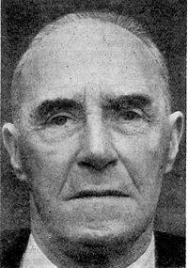
Josiah Wedge-
wood IV 1st Baron
of Wedgewood
Notes:
http://www.fozhc.net/tour.php

Slide 79
Josiah Wedgewood IV 1st Baron of Wedgewood 1872-1943. Descendant of the famous Wedgwood Pottery family, was an outspoken advocate for the Jewish cause in Palestine in parliament. He opposed the British reversal of its earlier support of founding a Jewish state in its' Biblical homeland
Notes:
http://www.fozhc.net/tour.php

Slide 80
and argued against the 1939 White Paper which strictly limited Jewish immigration to the Holy land. He supported Ze'ev Jabotinski that “Ultimately Jews will have to fight for their land and they should arm and train for that inevitability.”
Notes:
http://www.fozhc.net/tour.php

Slide 81
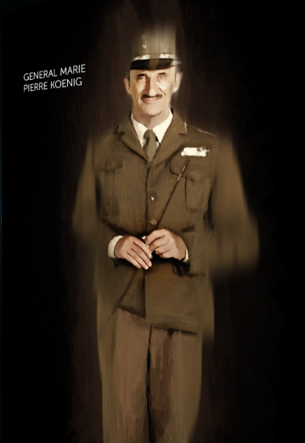
Notes:
http://www.fozhc.net/tour.php

Slide 83
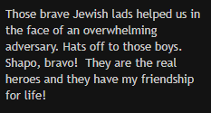
Notes:
http://www.fozhc.net/tour.php

Slide 84
Mattityahu (Matthew) 24:33
כֵּן גַם אַתֶּם, כִּרְאוֹתְכֶם אֶת כָּל אֵלֶּה דְּעוּ כִּי קָרוֹב הוּא בַּפֶּתַח.
“In the same way, when you see all these things, you are to know that the time is near, right at the door.”

Slide 85
That DOESN’T mean relax and observe. It means pray prophetic scripture to pass. Similar to Acts 4.24-31:
They raised their voices to God with singleness of heart. “Master,” they prayed, “You made heaven, earth, the sea and everything in them.

Slide 86
^{Acts 4.24-31} By the Ruakh HaKodesh, through the mouth of our father David, your servant, you said, ^{[Ps 2]} ‘Why did the ¹nations rage and the ²peoples devise useless plans? The ³kings of the earth took their stand; and the ⁴rulers assembled together against Adoni and against his Messiah.’

Slide 87
^{Acts 4.24-31} “This has come true in this city, since ³Herod and ⁴Pontius Pilate, with ¹Goyim and the ²peoples of Isra’el, all assembled against your holy servant Yeshua, whom you made Messiah, to do what your power and plan had already determined beforehand should happen.
Notes:
David Flusser observed this in my HUJ class. Early believers seeing themselves.

Slide 88
^{Acts 4.24-31} “So now, Lord, take note of their threats; and enable your slaves to speak your message with boldness! Stretch out your hand to heal and to do signs and miracles through the name of your holy servant Yeshua!”

Slide 89
^{Acts 4.24-31} While they were still praying, the place where they were gathered was shaken. They were all filled with the Ruakh HaKodesh, and they spoke God’s message with boldness.

Slide 90
Israel is blossoming
As G-d’s Fig tree prophecy
Physically being restored
Spiritually being restoring

Slide 91
Conclusion/application to our lives.
Encourage, strengthen your faith that scripture is being fulfilled. Rejoice!!
Live and give and love and pray so as to further that process!

