Slide 1
e-handout
To have these notes
without taking notes
Go to OrHaOlam.com
Click on downloads,
messages, 2019
Notes:
.

Slide 2
A new kind of pie…
Grammatical rule that singular form of the noun is octopus,
plural…

Slide 3
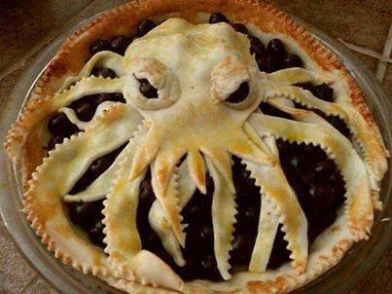
Many octopi
Notes:
Jai Cohen

Slide 4
There are some in my family that wanted me to stop with the thanksgiving jokes, but I told them I couldn’t stop
cold turkey!
Notes:
Jai Cohen
Big transition

Slide 5
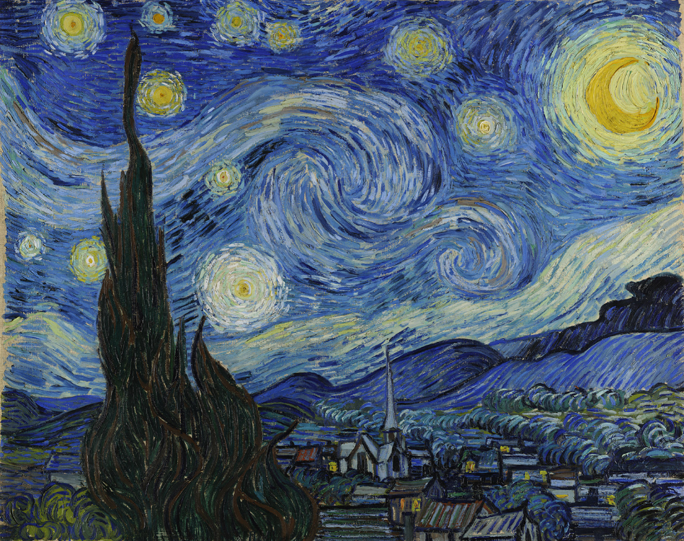
The Starry Night
Vincent van Gogh 1889
Notes:
Van Gogh's night sky is a field of roiling energy. Below the exploding stars, the village is a place of quiet order. Connecting earth and sky is the flamelike cypress, a tree traditionally associated with graveyards and mourning.
Consider Vincent van Gogh’s relatives…

Slide 6
His dizzy aunt --- Verti Gogh
The brother who ate prunes---Gotta Gogh
The brother who worked at a convenience store ---- Stop N Gogh
Notes:
Suzanne Alongi

Slide 7
His magician uncle--- Where-diddy Gogh
His Mexican cousin--- A MeeGogh
The Mexican cousin's American half-brother --- Gring Gogh
The nephew who drove a stage coach ---- Wells-far Gogh
Notes:
Suzanne Alongi credit

Slide 8
Does G-d ever confront us with His raw energy, like this?
Notes:
Do we want His revelational power?

Slide 9
מַתִּתְיָהוּ Mattityahu
(Matthew) 28:9-10
Notes:
Three weeks ago, women went to the tomb with no hint of Resurrection expected, for no supernatural reason, just simple, hopeless faith. Duty. Mechanical faith. They were DOING THE WORK. The right thing to do for a deceased rabbi.
We look back…
Then…EARTHQUAKE. Sudden, raw power…of G-d.

Slide 10
^{Matt. 28.4-8} The guards were so terrified at him that they trembled and became like dead men.
But the angel said to the women, “Don’t be afraid.”
Notes:
Power of G-d, in raw form. Guards, seasoned soldiers: Roman or Temple, more fearstruck than the non-military women.
In a good terror. No matter how secular Star Wars, Black Hole, “My G-d!!” Read of guys under bombardment, in Nam. These hardened soldiers, faced with a bizarre earthquake.
“Don’t be afraid” seemingly uncompassionate words, amazing words.
Other cases similar, in Torah…

Slide 11
Other times G-d promised His power, seemingly uncompassionately

Slide 12
^{Ber/Gen 15.1} After these things the word of Adoni came to Avram in a vision saying, “Do not fear, Avram. I am your shield, your very great reward.”
Notes:
How can we hear such words in the middle of much distress: Abe surrounded by often hostile peoples, no heir, no fulfillment of his destiny that he’d trekked across much known world.
Then G-d appeared in smoking fire pot and a flaming torch appeared, which passed between these animal parts, and gave him a son.
G-d has authority to say, “Do not fear” in light of chaos. Still today.

Slide 13
^{Lk. 7.11-13} Yeshua…approached the town gate, a dead man was being carried out for burial. His mother was a widow, this had been her only son, and a sizeable crowd from the town was with her. When the Lord saw her, he felt compassion for her and said to her, “Don’t cry.”
Notes:
Widow means destitute of normal income, now only son sustenance gone…alone, impoverished.
How can we bear such words? Unless, the speaker know something…
All met with revelation of G-d’s POWER. Sometimes in the suffering.
What is it that we fear…we are hopeless about?

Slide 15
^{Matt. 28.4-8} I know you are looking for Yeshua, who was executed on the stake. He is not here, because he has been raised — just as he said!
Notes:
They were looking hopelessly, but dutifully, but nevertheless looked!
You who are plodding on, dutifully, maybe not much apparent hope…children, health, marriage, finances, friendships, career…
Here is the reason not to fear…

Slide 16
^{Matt. 28.4-8} Come and look at the place where he lay. Then go quickly and tell the talmidim, ‘He has been raised from the dead, and now he is going to the Galil ahead of you. You will see him there.’
Notes:
Note connection: see resurrection, then go.
RAISED FROM THE DEAD, the hope of the Jewish people for thousands of years…

Slide 17
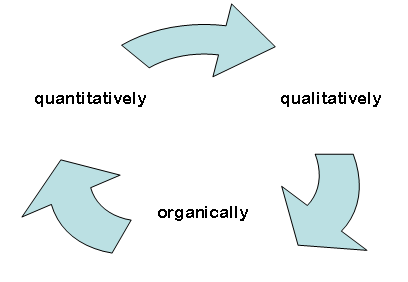
Seek and find
Resurrection
Reality, Power
Go tell
More Seek
Notes:
Objective reality → communicated reality → increased perception → seek objective

Slide 18
^{Iyob/Job 19.25-26} “Yet I know that my Redeemer lives, and in the end, He will stand on earth. Even after my skin has been destroyed, yet in my flesh I will see God.
Notes:
In the synagogue prayed daily, and the morning, Shakharit prayer.

Slide 19
Who is like you
The Master of Power
And who resembles You
O King who controls death
And gives life
And causes salvation
to spring forth
Notes:
daily prayer…

Slide 20
And you are faithful
To resurrect the dead
Blessed are You, ADONI
Who resurrects the dead

Slide 21
מִי כָמֽוֹךָ בַּעַל גְּבוּרוֹת
Mee kha-mokha ba-al g'vu-rot
וּמִי דּֽוֹמֶה לָּךְ מֶלֶךְ מֵמִית
U-mee do-meh lakhMelekh ma-meet
וּמְחַיֶּה וּמַצְמִֽיחַ יְשׁוּעָה
U-m'kha-yeh u-mats-mee-akh Y'shu-ah

Slide 22
וְנֶאֱמָן אַתָּה לְהַחֲיוֹת מֵתִים
V’neh-eh-mahn a-tah
L’ha-khay-oht meh-teem

Slide 23
בָּרוּךְ אַתָּה יְיָ
[בָּרוּךְ הוּא וּבָּרוּךְ שְּׁמוֹ]
Ba-rukh a-tah Ah-do-ni
[Ba-rukh hu u-ba-rukh sh'mo]
מְחַיֶּה הַמֵּתִים
M’kha-yeh ha-meh-teem
Notes:
They HAD it. מחיה מתים m’kha-yeh ha-meh-teem. Resurrection of the dead!!!

Slide 24
^{Matt. 28.4-8} Now I have told you.” So they left the tomb quickly, frightened yet filled with joy; and they ran to give the news to his talmidim.
Notes:
Seems a contradiction: Frightened yet joy. ~Birth of a son or daughter!!

Slide 25
Saw the Resurrection →
GO and tell

Slide 26
Mattityahu (Matthew) 28:9
פִּתְאוֹם פָּגַשׁ אוֹתָן יֵשׁוּעַ וְאָמַר: ”שָׁלוֹם לָכֶן.“ הֵן נִגְּשׁוּ אֵלָיו, אָחֲזוּ בְּרַגְלָיו וְהִשְׁתַּחֲווּ לוֹ.‏
Suddenly Yeshua met them and said, “Shalom!” They came up and took hold of his feet as they fell down in front of him.
Notes:
Another Suddenly, raw display of G-d’s power.

Slide 27
^{Yn 20.17} Yeshua says to her, “Stop clinging to Me, for I have not yet gone up to the Father. Go to My brothers and tell them, ‘I am going up to My Father and your Father, to My God and your God.’”
Notes:
Some say, like the Cohen HaGadol, High Priest

Slide 28
^{Viyikra/Lev 16.17} No one is to be in the Tent of Meeting when he enters to make atonement in the Holy Place until he comes out, and has made atonement for himself and for his household, and for all the assembly of Israel.
Notes:
To present the Atoning Blood

Slide 29
Mattityahu (Matthew) 28:10
אָמַר לָהֶן יֵשׁוּעַ: ”אַל תִּפְחַדְנָה, לֵכְנָה וְהַגֵּדְנָה לְאַחַי שֶׁיֵּלְכוּ לַגָּלִיל וְשָׁם יִרְאוּנִי.“
Then Yeshua said to them, “Don’t be afraid! Go and tell my brothers to go to the Galil, and they will see me there.”

Slide 30
Seek and find
Resurrection
Reality, Power
Go tell
More Seek
Notes:
Objective reality → communicated reality → increased perception → seek objective

Slide 31
Surprisingly, what makes the story all the more credible to Jewish scholars is the unlikely choice of women as the first witnesses.
Your unlikely success, all the more possible with G-d!
Notes:
A little substantiation of this

Slide 32
Women Discovered the Empty Tomb
Mark 16:1-8
Matthew 28:1-10
Luke 24:1-9
John 20:1-2
Notes:
Jonathan Mann at Messiah Conf 2019
Multiple Attestation and Embarrassing Testimony used car salesman – admitting the car got into a wreck and telling someone they should buy it

Slide 33
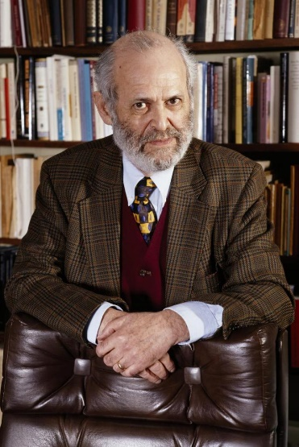
Dr. Geza Vermes
“The evidence furnished by female witnesses had no standing in a male-dominated Jewish society.”
- The Resurrection: History and Myth, pg. 148
Notes:
Late Dr. Geza Vermes – Professor of Jewish Studies at Oxford

Slide 34
b. Rosh Ha-Shanah 22a
“The following are unfit to give testimony...a woman is unfit... Although in certain cases a woman’s testimony is accepted, e.g., to testify to the death of someone’s husband, in the majority of cases her testimony is not valid.”

Slide 35
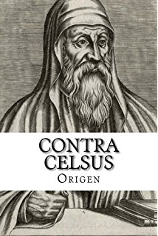
A Jewish response
“[Yeshua] showed the marks of his punishment, and how his hands were pierced with nails: who beheld this? A half-frantic woman . . .”
- Contra Celsus 2.55

Slide 36
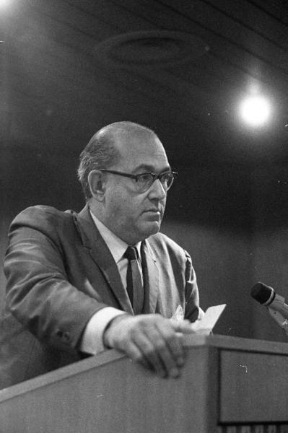
Dr. Pinchas Lapide
“In a purely fictional narrative one would have avoided making women the crown witnesses of the resurrection since they were considered in rabbinic Judaism as incapable of giving valid testimony.”
- The Resurrection of Jesus: A Jewish Perspective, pg. 95
Notes:
Israeli Orthodox rabbi and historian

Slide 37
Surprisingly, what makes the story all the more credible to Jewish scholars is the unlikely choice of women as the first witnesses.
Your unlikely success, all the more possible with G-d!

Slide 38
Tell of the Resurrection, [raw] power of G-d, so more can → GO
^{2 Cor 4.6} For it is the God who once said, “Let light shine out of darkness,” who has made his light shine in our hearts, the light of the knowledge of God’s glory shining in the face of the Messiah Yeshua.
Notes:
Me since 1969

Slide 39
Seek and find
Resurrection
Reality, Power
Go tell
More Seek
Notes:
Objective reality → communicated reality → increased perception → seek objective

Slide 40
^{1 Cor 1.17} For the Messiah did not send me to immerse but to proclaim the Good News — and to do it without relying on “wisdom” that consists of mere rhetoric, so as not to rob the Messiah’s execution-stake of its power. [And resurrection]

Slide 41
We HAVE hope, based on the Resurrection power of G-d, still manifesting in our day.
Sean Steckbeck story.

Slide 42
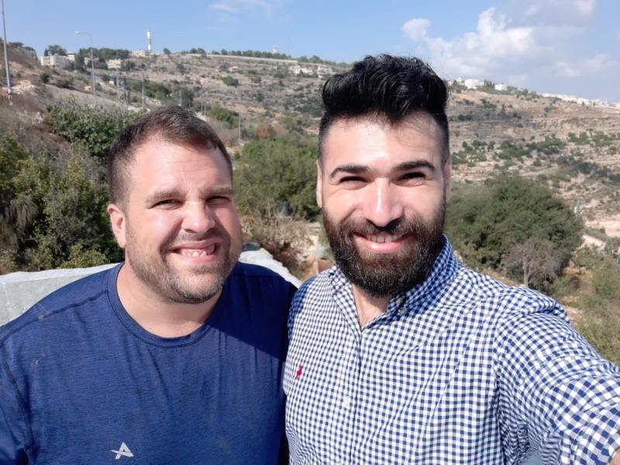
Sean Steckbeck and “Amitai”

Slide 43
Amitai , not his real name, is the son of a "Litvisher" rabbi in Jerusalem. He grew up in a very strict form of ultra Orthodox Judaism that did not allow him to do much outside of his community. From a very young age Amitai had an interest in games on his cell phone and even a career in music outside of his community, but was reprimanded harshly for his interest.
Notes:
Litvisher = Lithuanian

Slide 44
Amitai decided to explore the outside world by moving to the north of Israel far away from his parents and community. Amitai was not able to survive living on his own in Israeli society because he lacked the basic tools to do so

Slide 45
so he moved back into his parents home in Jerusalem and returned to dress like an Orthodox while there. Amitai met Sean, Chaim and Hallel at a concert event at a center led by Orthodox Jews in Jerusalem.

Slide 46
Chaim introduced me to Amitai and I spent three hours discussing with him his story, my story, and Yeshua's story. Amitai needed to breathe and be away from his parents house. I was taking care of a house of friends of ours in Jerusalem and so I invited him to stay with me for a week.

Slide 47
During our stay we had daily Discovery Bible Studies about Yeshua and intense times of prayer and healing from his past wounds. Amitai is still in the process of discovering who Yeshua and God is, but his hunger to know more about Yeshua grows and grows and has even invited a friend to join him in the process.

Slide 48
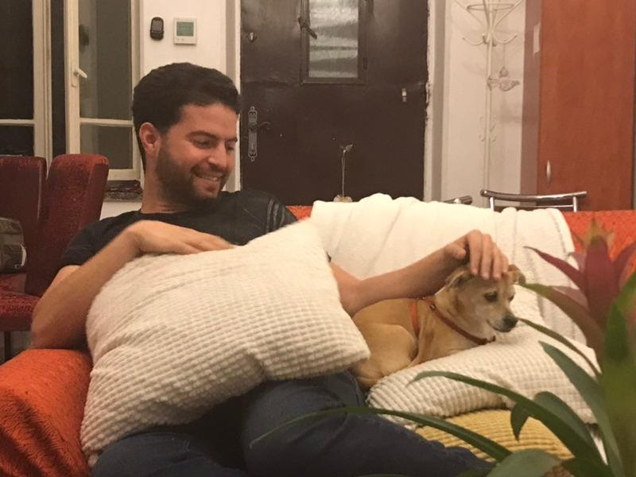
Amitai and the dog.
Notes:
One day I was not able to return to the house in time to walk the dog, so I called Amitai and asked him if he could walk the dog for me. He said he wanted to do it, but asked, "What do I do?" I said, "What do you mean what do I do?" He said, " I have never walked a dog before nor had a pet, in our Orthodox world it is forbidden and unclean." So I explained him how to walk the dog. An hour later he calls me very excited and lets me know how much dogs are amazing creatures!

Slide 49
Seek and find
Resurrection
Reality, Power
Go tell
More Seek
Notes:
Objective reality → communicated reality → increased perception → seek objective

Slide 50
It’s Thanksgiving Weekend.
The basis of all thanksgiving:

Slide 51
^{Phil. 4.6} Don’t worry about anything; on the contrary, make your requests known to God by prayer and petition, with thanksgiving.
Notes:
Resurrection power!

Slide 52
All the Matriarchs, even Leah, were barren before being empowered to have children. (We know Leah was barren because in Gen 29 we read, ”When Adoni saw that Leah was unloved, He opened her womb.”

Slide 53
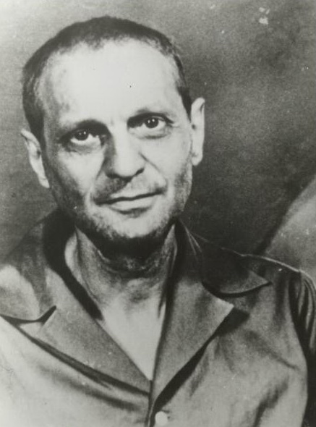
A Richard Wurmbrand story
Notes:
Faced with minimal food, space to sleep, air/ventilation, beatings, torture

Slide 54
There was a brigade in Romania which was only for priests, bishops, pastors, rabbis, and laymen - whoever was in prison for his faith. One day a political officer came to inspect that brigade. Everybody stood at attention, and at random he called out a young minister (whose name was Coceanga) and asked him, "What have you been in your civilian life?"
Notes:
https://www.helpforrefugees.com/

Slide 55
And he replied, "Sir, what I have been in my civilian life, I will be forever. I am a minister of God." "Aha, a minister! And do you still love Messiah?" The minister was silent for a few seconds - seconds as long as eternity, because he knew that his eternal destiny would be decided in those seconds. The Lord said, "Whoever confesses Me before men, him I will also confess before My Father who is in heaven.
Notes:
https://www.helpforrefugees.com/
Michael Wurmbrand

Slide 56
But whoever denies Me before men, him I will also deny before My Father who is in heaven" ^{(Matt 10:32, 33).} And then after a little meditation, his face began to shine - I have seen so many shining faces - and with a very humble but very decided voice he said, "Captain, when I became a minister, I knew that during history thousands had been killed for their faith.
Notes:
https://www.helpforrefugees.com/
Michael Wurmbrand

Slide 57
And as often as I ascended to the front dressed in those beautiful, ornate robes, surrounded by the respect and love of the congregation, I promised to God that if ever I had to suffer, if ever I wore the uniform of the prisoner, I would still love Messiah." "Captain," he went on to say, "I so pity you. We have the truth, and you have whips. We have love, and you have iron bars on prison cells.
Notes:
https://www.helpforrefugees.com/
Michael Wurmbrand

Slide 58
Violence and hatred is a very poor argument against truth and love. If you were to hang all the professors of mathematics, if all the mathematicians were hanged, how much would four plus four be then? It would still be eight. And eight plus eight would still be sixteen. "You can't change the truth by hanging those who speak the truth.
Notes:
https://www.helpforrefugees.com/
Michael Wurmbrand

Slide 59
If all the believers were hanged, it would still remain so that there is a God, and He is love. And there is a Savior, and by confessing Him a man can be saved. And there exists a Holy Spirit, and a host of angels around the earth. And there exists a beautiful paradise - you can't change the truth." I wish there was a way to convey the tone with which he said those words.
Notes:
https://www.helpforrefugees.com/
Michael Wurmbrand

Slide 60
In light of the Resurrection of Messiah, this imprisoned man, subject to torture, spoke with boldness, urgency.

Slide 61
Mattityahu (Matthew) 28:10
אָמַר לָהֶן יֵשׁוּעַ: "אַל תִּפְחַדְנָה, לֵכְנָה וְהַגֵּדְנָה"
Then Yeshua said to them, “Don’t be afraid! Go and tell…”

Slide 62
Seek and find
Resurrection
Reality, Power
Go tell
More Seek
Notes:
Objective reality → communicated reality → increased perception → seek objective

Slide 63
Current Outreach strategies
Live our lives in the light, power, presence of His resurrection! [seek Him]
After lunch 12:45 p.m.: Rivka Hare will report about outreach to the Himalayas

Slide 64
Current Outreach strategies
Friday night Shabbat dinners.
Welcoming spirit
Hanukkah outreach on the Plaza? we will discuss after Rivka’s presentation
Notes:
Human Menorah

Slide 65
Mattityahu (Matthew) 28:10
אָמַר לָהֶן יֵשׁוּעַ: "אַל תִּפְחַדְנָה, לֵכְנָה וְהַגֵּדְנָה"
Then Yeshua said to them, “Don’t be afraid! Go and tell…”

