Slide 1
e-handout
To have these notes
without taking notes
Go to OrHaOlam.com
Click on downloads,
messages, 2019
Notes:
.

Slide 2
last week Shabbat,
Jan. 19, 2019, 8:45 a.m.
Notes:
I drove over to see. No accumulation, but crusted. Could’ve called in a salt truck for $175. Thought of un-cancelling, and delaying service till 11 a.m.
But, roads icy. One snow plow skidded off road and driver killed.
Safe > sorry.

Slide 3
Last week I spoke about selfies.

Slide 4
Danger of
Perfection
obsession
Notes:
https://curiousmindmagazine.com/selfies-ad-mental-illness/
Taking selfies is fun, but it’s important not to obsess yourself about it. You don’t need approval for anything and you don’t have to be perfect – because nobody is
But for some perspective…

Slide 5
In 1957 the Soviet Union launched the world's first artificial satellite, Sputnik 1. Since then, about 8,100 satellites from more than 40 countries have been launched.
1900 still operational.
Notes:
https://en.wikipedia.org/wiki/Satellite
According to a 2018 estimate, some 4,900 remain in orbit, of those about 1,900 were operational; while the rest have lived out their useful lives and become space debris

Slide 6
https://upload.wikimedia.org/wikipedia/commons/transcoded/e/ee/NASA_Earth-observing_Fleet_June_2012.ogv/NASA_Earth-observing_Fleet_June_2012.ogv.360p.vp9.webm

Slide 7
1900
operational
satellites
Notes:
Above from Brian Kaufman
Anyone seen the movie, The Life of Pi?
Yehudit Schlosman

Slide 8
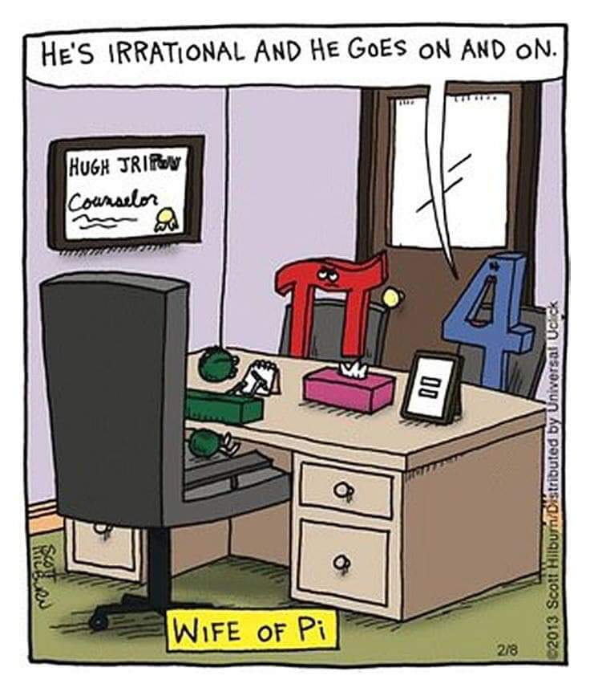
Wife of Pi
Notes:
Seems like a really old joke…I’ve been preparing it three times!
Last Monday, Jan. 21: two holidays:
Martin Luther King Jr. day [great friend of the Jews and Israel]
Tu b’Shvat: new year of trees.

Slide 9
Notes:
https://unitedwithisrael.org/plant-fruit-trees-for-israels-new-year-for-trees/?a=eh_011719&utm_source=MadMimi&utm_medium=email&utm_content=%5B3+Days+Left%5D+Plant+Fruit+Trees+for+Tu+B%27Shvat+-+Israel%27s+New+Year+for+Trees%21&utm_campaign=20190114_m149234008_%5B3+Days+Left%5D+Plant+Fruit+Trees+for+Tu+B%27Shvat+-+Israel%27s+New+Year+for+Trees%21&utm_term=button_png

Slide 11
Last Shabbat, in which we had a service, we considered value to ourselves of extravagant worship, getting beyond the selfie mentality. Loving G-d, loving others.
Notes:
How many, anyone, made a point to focus on someone else, even in time of stress? Focus on G, in time of stress?

Slide 12
מַתִּתְיָהוּ Mattityahu
(Matthew) 26:10-13

Slide 13
^{Mtt. 26.6-9} Yeshua was in Beit-Anyah, at the home of Shim‘on, the man who had had tzara’at. A woman who had an alabaster jar filled with very expensive perfume approached Yeshua while he was eating and began pouring it on his head.

Slide 14
^{Mtt. 26.6-9} When the talmidim saw it, they became very angry. “Why this waste?” they asked. “This could have been sold for a lot of money and given to the poor.”
Notes:
Passover was a time of giving to the poor.
Why impractical worship??

Slide 15
This Shabbat consider value to G-d of extravagant worship, getting beyond the selfie mentality. Loving G-d, loving others. What does G-d think of extravagant worship?
Notes:
Last week: value to ourselves of extravagant worship.

Slide 16
Mattityahu (Matthew) 26:10
כְּשֶׁהִבְחִין בָּזֶה יֵשׁוּעַ, אָמַר לָהֶם: ”מַדּוּעַ תָּצִיקוּ לָאִשָּׁה? הֲרֵי מַעֲשֶׂה טוֹב עָשְׂתָה לִי.
But Yeshua, aware of what was going on, said to them, “Why are you bothering this woman? She has done a beautiful thing for me.

Slide 17
Mattityahu (Matthew) 26:11
הָעֲנִיִּים אִתְּכֶם תָּמִיד, אֲבָל אֲנִי, לֹא תָּמִיד אֲנִי אִתְּכֶם.
“The poor you will always have with you, but you will not always have me.

Slide 18
Mattityahu (Matthew) 26:12
וְהִיא כְּשֶׁיָּצְקָה אֶת שֶׁמֶן הַבֹּשֶׂם הַזֶּה עַל גּוּפִי עָשְׂתָה זֹאת בִּשְׁבִיל קְבוּרָתִי.
“She poured this perfume on me to prepare my body for burial.

Slide 19
Mattityahu (Matthew) 26:13
אָמֵן. אוֹמֵר אֲנִי לָכֶם, בְּכָל מָקוֹם שֶׁתֻּכְרַז הַבְּשׂוֹרָה הַזֹּאת, בְּכָל הָעוֹלָם, יְסֻפַּר גַּם מַה שֶּׁעָשְׂתָה הִיא, וְזֶה לְזִכְרָהּ.“
“Yes! I tell you that throughout the whole world, wherever this Good News is proclaimed, what she has done will be told in her memory.”
Notes:
Whole world celebrity? Oscars, Golden Globes, Emmys?

Slide 20
Worldwide fame
World Series
World cup
ATP World Tour [tennis]
Miss World
World Boxing [WBA], Wrestling

Slide 21
This woman has been a world celebrity for 2000 years!
Why? Because she worshipped extravagantly!
Notes:
Ever feel forgotten? Is my life, are my struggles to live for G-d significant at all?

Slide 22
The Psalmist, and extravagant, desperate worship:
^{T’hillim/Ps 31.23} As for me, in my alarm I said, “I have been cut off from your sight!” Nevertheless, you heard my pleas when I cried out to you.

Slide 23
Iyov/Job’s extravagant, desperate worship:
^{Iyov/Job 19.21-27} “Pity me, friends of mine, pity me! For the hand of God has struck me! Must you pursue me as God does, never satisfied with my flesh?

Slide 24
^{Iyov/Job 19.21-27} I wish my words were written down, that they were inscribed in a scroll, that, engraved with iron and filled with lead, they were cut into rock forever!
Notes:
They exactly were.

Slide 25
Why was his story in fact get inscribed in a scroll, that you are reading at this moment?
Next verse:

Slide 26
^{Iyov/Job 19.21-27} “But I know that my Redeemer lives, that in the end he will rise on the dust; so that after my skin has been thus destroyed, then even without my flesh, I will see God. I will see him for myself, my eyes, not someone else’s, will behold him. My heart grows weak inside me!
Notes:
Your life, and your devotion to G-d IS significant, and has eternal consequences. Every time you praise G-d, thank Messiah, worship Him in apparent darkness and hopeless difficulty, do something for others when you don’t feel like it, you are compiling a record that will be played in eternity.
Instant replay of amazing touchdown…

Slide 27
Most amazing touchdown ever!
Notes:
https://www.youtube.com/watch?v=BjDbemCmCT8
16 lateral tosses in one play!!!
Thought it would be of particular interest in the day before the Chiefs and the Patriots game. I am NOT a follower of sports, but I was at my son’s home for that one. Real nailbiter.

Slide 28
Every time you praise G-d, thank Messiah, worship Him, serve Him in apparent darkness and hopeless difficulty, you are compiling a record that will be played in eternity. A world record!

Slide 29
^{Mtt. 10.42} Indeed, if someone gives just a cup of cold water to one of these little ones because he is my talmid, yes! — I tell you, he will certainly not lose his reward!”

Slide 30
Value of a life of praise, extravagant worship…

Slide 31
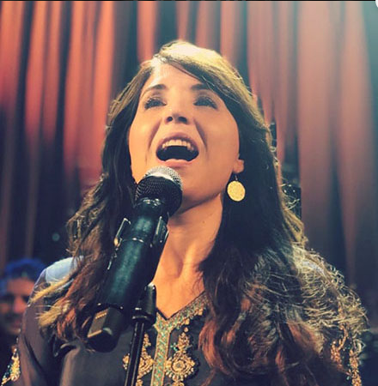
Sarah
Liberman
Israeli
vocalist at
the Rabbi’s
Conference
2019
Notes:
Describes her life having a radical transformation based on worship.
We’ve inquired of having her for a worship concert next Fall.

Slide 32
Sarah grew up in Israel, to Messianic parents. She wrote, “In fact, to be perfectly honest, I spent years of my life disliking those “super spiritual” people who just passively go through life saying “God will provide”, and spending hours of their time in “Spiritualville”. “
Notes:
http://sarahliberman.com/2018/08/14/defending-Martha/
I’m not saying that irresponsibility is good. I am the universal back up for much here.

Slide 33
Even worse, have you met the kind that never plans, nor once properly manages whatever they are doing and yet, miraculously, everything somehow falls into place for them?
Notes:
http://sarahliberman.com/2018/08/14/defending-Martha/

Slide 34
They are always so happy. I want to say: “Yeah, you know why it all works out in the end? It’s because people like me see what needs to be done to save the situation, swing into gear and get it done!”
Notes:
http://sarahliberman.com/2018/08/14/defending-Martha/

Slide 35
Now if you are one of those blissful people, I apologize. But if you’re getting frustrated right now, and feeling Marta’s pain, I’m with you. It took me years to accept the reason Yeshua acted the way He did with Marta.
Notes:
http://sarahliberman.com/2018/08/14/defending-Martha/

Slide 36
Yeshua said that Miriam chose the better part. Has it occurred to you that Marta not only missed out on spending precious time listening to Yeshua’s life-giving teaching, but she also might have missed out on an awesome miracle.
Notes:
http://sarahliberman.com/2018/08/14/defending-Martha/

Slide 37
Yeshua had no problem multiplying food; we read of several occasions when He did just that. How incredible it would have been for Marta, if at the end of listening to Yeshua, she had brought him whatever she had on a humble tray and said,
Notes:
http://sarahliberman.com/2018/08/14/defending-Martha/

Slide 38
“Lord this is what I have, may it be a blessing to feed Your people” and Yeshua taking the food and blessing it would have told her “Marta, now pass it out to all who are hungry”.
Notes:
http://sarahliberman.com/2018/08/14/defending-Martha/

Slide 39
Our community springs from a movement of young, passionate [Israeli] believers, who pursue worshipping God in spirit and in truth, interceding for the spiritual revival of Israel and the nations.
Notes:
http://sarahliberman.com/music-ascend/

Slide 40
We are passionate about seeing the transformation in individual lives through encounters with the Living God. Our team…believes that worship brings about change, which releases people to further walk in their destiny.
Notes:
http://sarahliberman.com/music-ascend/

Slide 41
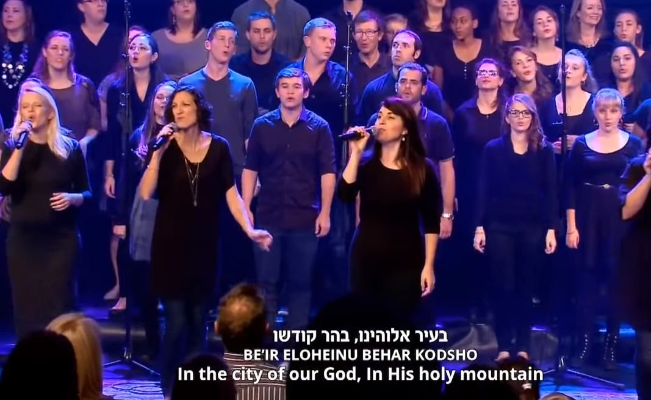
Notes:
http://abc.action.news/watch?v=p5jX2G1hHtY
Worship engages Millennials…All young adults in the King of Kings מלך המלכים worship team. Mix of older and young really BEST…

Slide 42
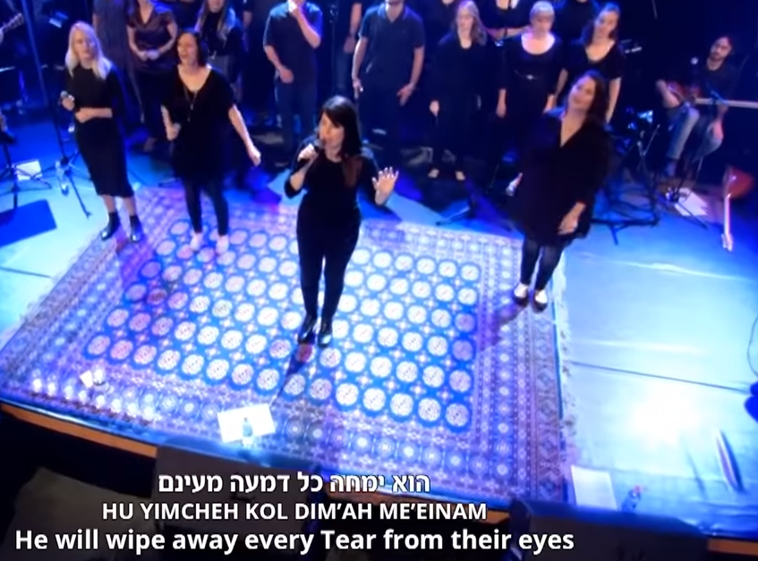

Slide 43
Notes:
https://www.pinterest.com/pin/687080486876236335/
The value of rest and worship, as expressed in Shabbat…

Slide 44
Why Israelis Live Longer: Israel is among the top countries in longevity with an average lifespan of 82.5 years as of 2016. Other countries on the longevity list - Canada, Sweden, Italy, and Japan - are tranquil, wealthy and at peace. But for Israel, confronted over its 70-year history with war and perpetual conflict,
Notes:
Segal newsletter

Slide 45
and a seven-fold increase in its population including a large and diverse immigrant base, these findings may come as a surprise. One answer is a "Mediterranean diet" high in fruit, vegetables and fish. Another is low alcohol consumption. Another quite important reason is the close family structure in Israel.
Notes:
Segal newsletter
But probably the single most important factor is the Israeli health care system. All its citizens receive health care services regardless of income or pre-existing health conditions.
Close family structure as expressed on Shabbat…

Slide 46
Shabbat is one of Judaism's greatest contributions to mankind, sanctifying the seventh day for rest. It is a day when we do not work, do not earn a living, do not conduct business or add to our wealth. A day devoted to family, to community, to leisure, culture, learning, and the spirit. Shabbat does not only belong to observant Jews but to all of us.
Notes:
http://www.israelhayom.com/opinions/why-secular-jews-need-shabbat/

Slide 47
Ahad Haam, one of the greatest Jewish thinkers of recent centuries, and father of the cultural and spiritual school of Zionism, defined himself as an atheist, and did not follow Orthodox Jewish law.
Notes:
http://www.israelhayom.com/opinions/why-secular-jews-need-shabbat/

Slide 48
But Shabbat was very dear to him. "There is no need to be a punctilious observer of commandments," he wrote, "in order to recognize the value of Shabbat.
Notes:
http://www.israelhayom.com/opinions/why-secular-jews-need-shabbat/

Slide 49
Those who in their heart feel a real connection with the life of the nation throughout the generations, cannot in any way depict the reality of the people of Israel without the Sabbath queen. It can be said without exaggeration that more than Israel has kept the Sabbath, the Sabbath has kept Israel.
Notes:
http://www.israelhayom.com/opinions/why-secular-jews-need-shabbat/

Slide 50
Without it, which restored their souls and reinvigorated their spirits each week, the hardships of the days of creation would pull them further and further downward until they hit the lowest level of materialism and moral and mental debasement.“ In other words, what makes human beings higher than animals? Shabbat. [rest, worship]
Notes:
http://www.israelhayom.com/opinions/why-secular-jews-need-shabbat/

Slide 51
Commu-
nity in
worship
Notes:
https://www.google.com/url?sa=i&source=images&cd=&ved=2ahUKEwjh5qKZgeffAhVFSK0KHX09A8MQjRx6BAgBEAQ&url=https%3A%2F%2Fwww.pinterest.com%2Fpin%2F784963410021662938%2F&psig=AOvVaw3rK9K-3GpWf4KGoEUgv2YI&ust=1547340009781313

Slide 52
Mike & Diane Bickle: When you are fathering a vision, you are focused on the end objective of impact: getting the right people lined up in the right roles…However, fathering a family demands a slower pace, where we slow down and focus on getting our heart connected, first to the L-rd and second to each other.
Notes:
Extravagant worship…rest…community!

Slide 53
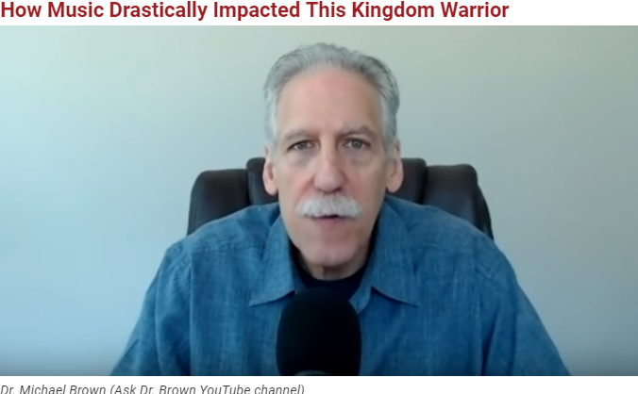

Slide 54
When the Beatles came to America in 1964, a 9-year-old Michael Brown was fascinated. He started playing the drums and saw his first rock concert at age 13. At that point, his life took a negative turn.

Slide 55
"That opened up my life to drugs and rebellion, and that shaped my life between the ages 14 and 16," he said. "I went to one rock concert after another. My life was going to school, getting high, playing in a rock band, practicing and going to rock concerts."

Slide 56
But then…it was in a little Italian Pentecostal church, and the pastor's wife [was] playing piano. It was something about those joyous hymns; the Lord really touched me. I was supernaturally overcome. I experienced and encountered the love of God in this little church.

Slide 57
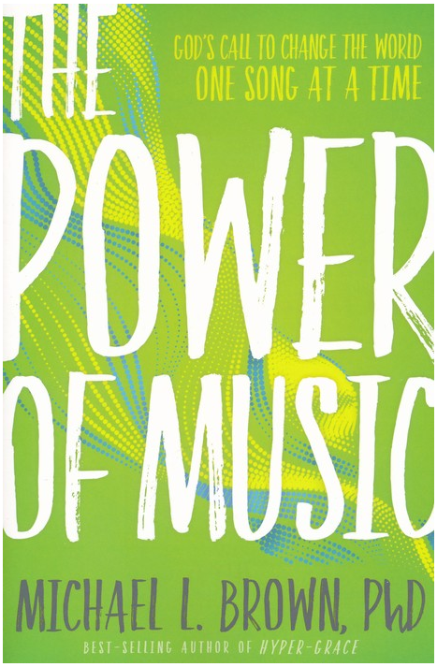

Slide 58
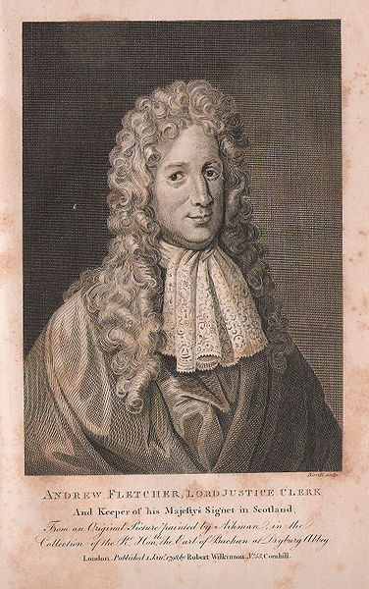
Andrew Fletcher
(1653 –1716)
was a Scottish
writer, politician,
and patriot.

Slide 59
He believed if a man were permitted to make all the ballads he need not care who should make the laws of a nation, and we find that most of the ancient legislators thought that they could not well reform the manners of any city without the help of a lyric, and sometimes of a dramatic poet.
Notes:
https://mail.google.com/mail/u/0/#inbox/KtbxLwGkKGlGHkVrGNxHCNLmFtWpkfjKbq
I said I knew a very wise man so much of Sir Christopher's sentiment, that

Slide 60
Let me make the songs of a nation, and I care not who makes its laws.
Notes:
https://mail.google.com/mail/u/0/#inbox/KtbxLwGkKGlGHkVrGNxHCNLmFtWpkfjKbq

Slide 61
Unto all generations
we will declare your greatness,
And to all eternity we will proclaim your holiness,
And thy praise, O our G-d,
shall not depart
from our mouth for ever

Slide 62
לְדוֹר וָדוֹר,
Older: L'dor va dor.
לְדוֹר וָדוֹר,
Younger: L'dor va dor.
[Repeat]
לְדוֹר וָדוֹר נַגִּיד גָּדְלֶֽךָ,
[All] L'dor va-dor na-geed gad-le-kha
[repeat from the top]

Slide 63
וּלְנֵצַח נְצָחִים קְדֻשָּׁתְךָ נַקְדִּישׁ, קְדֻשָּׁתְךָ נַקְדִּישׁ,
Oo-l'nay-tzakh n'tza-kheem
k'doo-shat-kha nak-deesh, [repeat line]
וְשִׁבְחֲךָ, אֱלֹהֵֽינוּ, מִפִּֽינוּ לֹא יָמוּשׁ לְעוֹלָם לְעוֹלָם וָעֶד,
V-sheev-kha-kha Eh-lo-hay-noo,
mee-pee-noo lo ya-moosh l'olam l'olam va-ed.

Slide 64
Testimonies of OneThing attenders:

Slide 66
Mattityahu (Matthew) 26:12
וְהִיא כְּשֶׁיָּצְקָה אֶת שֶׁמֶן הַבֹּשֶׂם הַזֶּה עַל גּוּפִי עָשְׂתָה זֹאת בִּשְׁבִיל קְבוּרָתִי.
“She poured this perfume on me to prepare my body for burial.

