Slide 1
e-handout
To have these notes
without taking notes
Go to OrHaOlam.com
Click on downloads,
messages, 2019
Notes:
.

Slide 2
IDF: Next year will be incredible
https://twitter.com/twitter/statuses/1080160510010671104

Slide 3
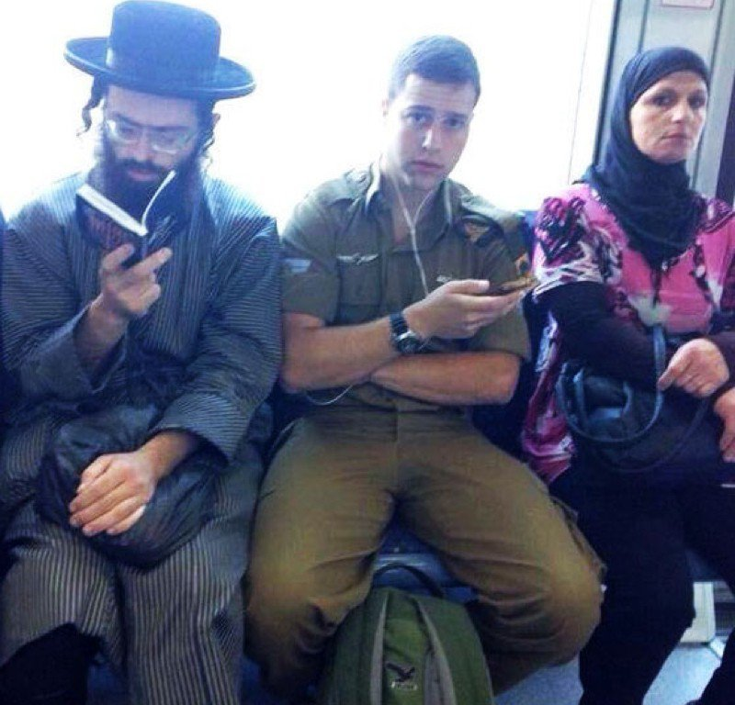
Only in
Israel:
Diversity
Notes:
.

Slide 4
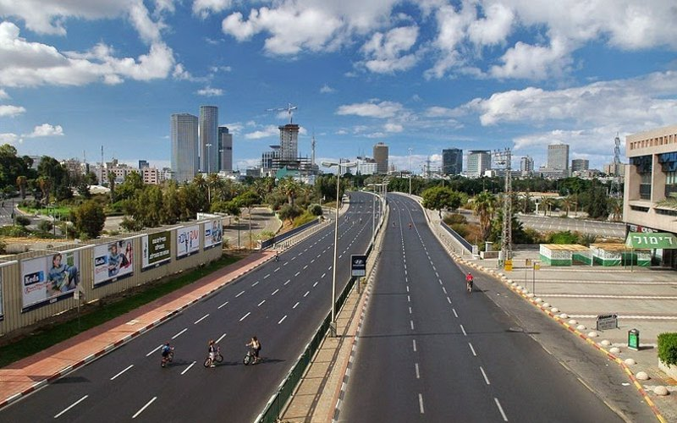
Only in
Israel
Only in Israel: Yom Kippur
observance
Notes:
.

Slide 5
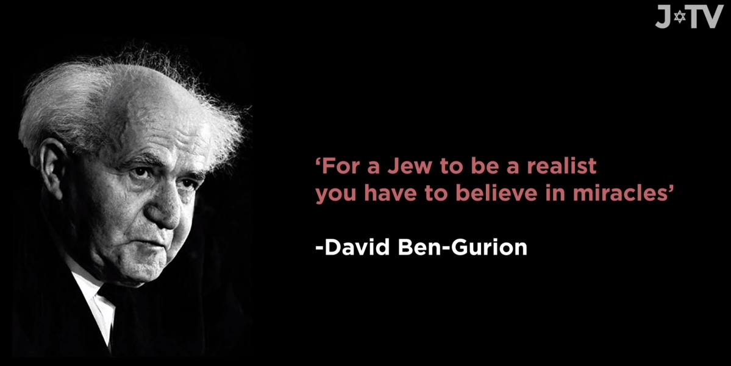
Notes:
https://unitedwithisrael.org/watch-for-a-jew-being-a-realist-means-believing-in-miracles/?utm_source=MadMimi&utm_medium=email&utm_content=%E2%80%98Israel+Proud+of+IDF%27s+Christian+Soldiers%27%21+Israel+%27Played+Major+Role%27+in+ISIS+Defeat%3B+Netanyahu+Predicts+Election+Victory&utm_campaign=20181224_m148923056_%E2%80%98Israel+Proud+of+IDF%27s+Christian+Soldiers%27%21+Israel+%27Played+Major+Role%27+in+ISIS+Defeat%3B+Netanyahu+Predicts+Election+Victory&utm_term=watch_btn_dark_png

Slide 6
Harvard Business School Prof.
Notes:
From Kathleen Eltrich

Slide 7
Marxist economist studying at Harvard:
“I learned how critical religion is to the function of democracy. Democracy works because most people, most of the time, choose to obey the law.”

Slide 8
מַתִּתְיָהוּ Mattityahu
(Matthew) 26:3-5

Slide 9
Mattityahu (Matthew) 26:3
בְּאוֹתָהּ עֵת נִקְהֲלוּ רָאשֵׁי הַכֹּהֲנִים וְזִקְנֵי הָעָם אֶל חֲצַר הַכֹּהֵן הַגָּדוֹל, קַיָּפָא שְׁמוֹ
Then the head cohanim and the elders of the people gathered in the palace of Kayafa the cohen hagadol.

Slide 10
Mattityahu (Matthew) 26:4
וְהֶחְלִיטוּ לִתְפֹּס אֶת יֵשׁוּעַ בְּעָרְמָה וּלְהָמִית אוֹתוֹ,
They made plans to arrest Yeshua surreptitiously and have him put to death;

Slide 11
Mattityahu (Matthew) 26:5
ואַךְ אָמְרוּ: ”לֹא בֶּחָג, שֶׁמָּא תִּהְיֶה מְהוּמָה בָּעָם.“
but they said, “Not during the [Passover] festival, or the people will riot.”
Notes:
Leaders responsible to the Romans for crowd control Cohanim served at appointment of the Romans. Jerusalem ~50,00 5x, for Pesakh.
Y engaged a LOT of people. Charismatic…more than that. Was a heart bond.
How do you know? His words: ^{Mt 11} “Come to me, all of you who are struggling and burdened, and I will give you rest. Take my yoke upon you and learn from me, because I am gentle and humble in heart, and you will find rest for your souls. For my yoke is easy, and my burden is light.”
First words I ever understood. 1969, my first reading.
Continuing text in Matityahu…

Slide 12
^{Mtt. 26.6-9} Yeshua was in Beit-Anyah, at the home of Shim‘on, the man who had had tzara’at. A woman who had an alabaster jar filled with very expensive perfume approached Yeshua while he was eating and began pouring it on his head.
Notes:
being anointed with the oil of gladness above his fellows; of his having the holy Spirit, and his gifts and graces without measure; which, like the ointment poured on Aaron's head, that ran down to his beard, and the skirts of his garments
^{Kohelet/Ecclesiastes 9:8} So go, eat your bread with joy, and drink your wine with a happy heart, for God has already accepted your deeds. Let your clothing always be white, and never fail to perfume your head.
^{Ps 23.5} You prepare a table for me, even as my enemies watch; you anoint my head with oil from an overflowing cup.
,

Slide 13
Alabaster… properties…usually lightly colored, translucent, and soft stones. They have been used throughout history primarily for carving decorative artifacts.

Slide 14
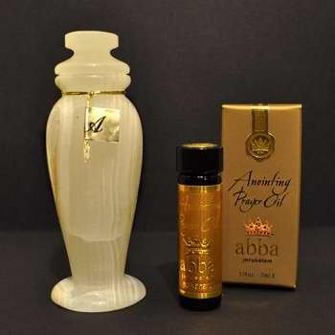
Alabaster jar
Notes:
https://www.google.com/url?sa=i&source=images&cd=&cad=rja&uact=8&ved=2ahUKEwji6biJoNXfAhVO2qwKHXZjDqUQjRx6BAgBEAU&url=https%3A%2F%2Fwww.amazon.com%2FAlabaster-Jar-Gift-Box-Spikenard%2Fdp%2FB00KFAOHF4&psig=AOvVaw2WEOjkYwZS13RFHLzranB8&ust=1546729905051046

Slide 15
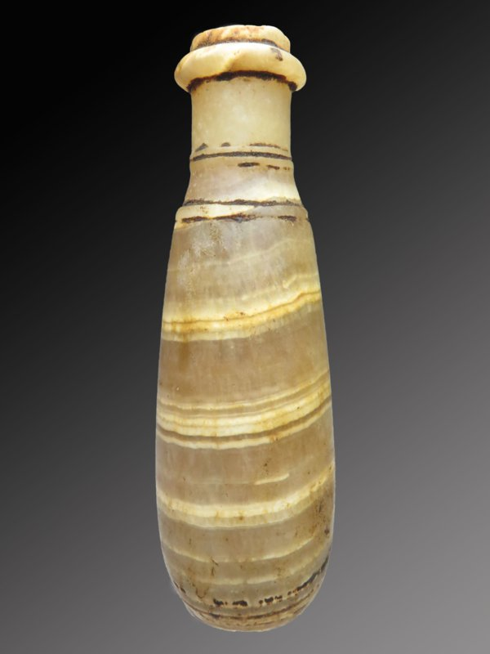
Ancient Egyptian
Alabaster jar
Notes:
https://www.google.com/url?sa=i&source=images&cd=&cad=rja&uact=8&ved=2ahUKEwipv5zXoNXfAhVHhq0KHWxRDTAQjRx6BAgBEAU&url=https%3A%2F%2Fwww.jaspersantiques.com%2Fa-48117780%2Fegyptian%2Fegyptian-alabaster-ointment-bottle%2F&psig=AOvVaw2WEOjkYwZS13RFHLzranB8&ust=1546729905051046

Slide 16
^{Mtt. 26.6-9} When the talmidim saw it, they became very angry. “Why this waste?” they asked. “This could have been sold for a lot of money and given to the poor.”
Impractical?
Notes:
Passover was a time of giving to the poor.
Why impractical worship??

Slide 17
Wasteful ministry?
^{Mk. 12.28-31} One of the Torah scholars came and…he asked Him, “Which commandment is first of all?” Yeshua answered,

Slide 18
Wasteful ministry?
^{Mk. 12.28-31} “The first is, ‘Shema Yisrael, Adoni Eloheinu, Adoni ekhad. Hear, O Israel, the Lord our God, the Lord is One. And you shall love Adoni your God with all your heart,

Slide 19
^{Mk. 12.28-31} and with all your soul, and with all your mind, and with all your strength.’
The second is this, ‘You shall love your neighbor as yourself.’ There is no other commandment greater than these.”
Notes:
Yeshua is quoting the Tanakh, but there is more there on the subject…

Slide 20
^{Dvarim 10.12-13} So now, O Israel, what does Adoni your God require of you, but to fear Adoni your God, to walk in all His ways and love Him, and to serve Adoni your God with all your heart and with all your soul, to keep the mitzvot of Adoni and His statutes that I am commanding you today, for your own good?
Notes:
Subjective
and
Objective

Slide 21
^{Dvarim 10.16} Circumcise the foreskin of your heart therefore, and do not be stiff-necked anymore.
Notes:
Metaphor of difficulty to whole hearted love

Slide 22
Similar theme in the story of Miriam and Marta…

Slide 23
^{Luke 10.38-42} On their way Yeshua and his talmidim came to a village where a woman named Marta welcomed him into her home. She had a sister called Miryam who also sat at the Lord’s feet and heard what he had to say. But Marta was busy

Slide 24
^{Luke 10.38-42} with all the work to be done; so, going up to him, she said, “Sir, don’t you care that my sister has been leaving me to do all the work by myself?” However, the Lord answered her, “Marta, Marta, you are fretting and worrying about so many things!

Slide 25
^{Luke 10.38-42} But there is only one thing that is essential. Miryam has chosen the right thing, and it won’t be taken away from her.”

Slide 26
G-d seems to encourage whole hearted, limitless, passionate devotion to Him. Give King Messiah and Redeemer
Our time – only 24 hours
Our strength – depletes
Our youth – only have once
Notes:
Is it worth it?
Ever feel defrauded?

Slide 27
Our money – tithe + offerings
Our emotional center
Our intellectual center
Our social grid
What does He give us?
Notes:
Forgiveness, joy, shalom, light, hope, salvation
We love Him, because He first loved us. GOSPEL.

Slide 28
An illustration

Slide 29
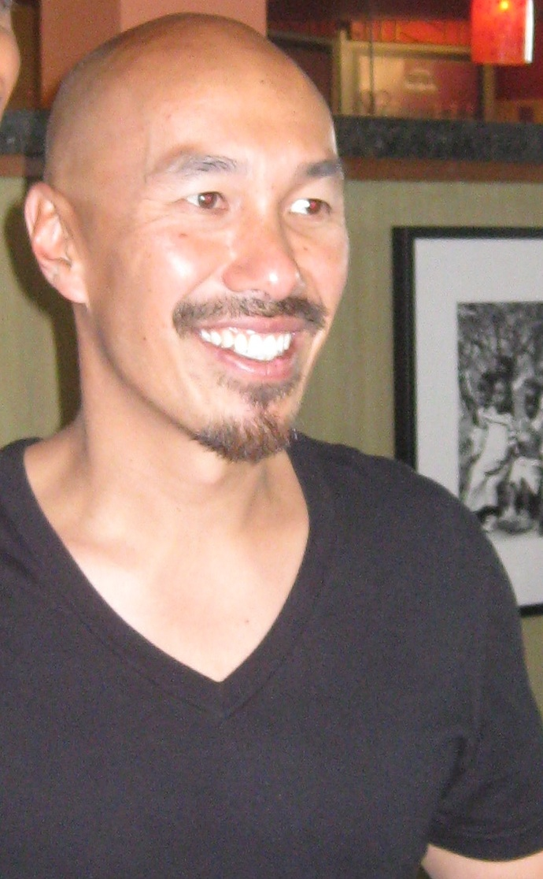
Francis
Chan

Slide 30
Chan was born in San Francisco, California to native Chinese parents. His mother tongue is Cantonese. ₁Francis Chan's mother died giving birth to him in San Francisco. ₂His father sent him away as a baby to Hong Kong to be taken care of by his grandmother.
Notes:
https://en.wikipedia.org/wiki/Francis_Chan
Subscript are tragedies, life losses.

Slide 31
The family moved back to the U.S. when Francis Chan was 5 years old. Chan's father remarried when Chan was one year old. ₃Then, his stepmother died in a car accident when he was 9 years old.
Notes:
https://en.wikipedia.org/wiki/Francis_Chan

Slide 32
His father remarried again when he was 10. ₄His father then died of cancer when Chan was 13 years old. These deaths helped Francis Chan understand at an early age the importance of knowing God.
Notes:
https://en.wikipedia.org/wiki/Francis_Chan

Slide 33
Chan and his wife, Lisa, founded Cornerstone in 1994 with only 30 people. Within two months, the congregation had grown to 100 people, and by the year 2000, Chan was leading a million-dollar project to provide for the 1,600-member congregation.
Notes:
https://en.wikipedia.org/wiki/Francis_Chan

Slide 34
Chan gives away about 50 percent of his income, doesn't take a salary from his congregation, and has donated most of his book royalties, which have totaled about $2,000,000, to various charities.
Notes:
https://en.wikipedia.org/wiki/Francis_Chan

Slide 35
All of it goes to organizations which rescue sex slaves in foreign countries. Furthermore, in 2008 it was reported that Cornerstone would give away 55% of its income to charitable causes.
Notes:
https://en.wikipedia.org/wiki/Francis_Chan

Slide 36
Francis Chan made the observation that we are a selfie culture. We go to see Niagara Falls, and take a selfie.
For thousands of years, there were no mirrors. People didn’t know what they looked like.

Slide 37
People probably first started to look at their reflections in pools of water, streams and rivers which were the first mirrors. The earliest man made mirrors were from polished stone and mirrors made form black volcanic glass obsidian.
Notes:
http://www.mirrorhistory.com/

Slide 38
Some examples of this kind of mirrors have been found in Turkey dating back at least 6000 years. The Ancient Egyptians used polished copper to produce mirrors,
Notes:
http://www.mirrorhistory.com/

Slide 39
The invention of the first modern mirror is credited to German chemist Justus von Liebig. In 1835, he perfected the technique of applying a layer of metallic silver to the back of a pane of glass through the chemical reduction of silver nature.
Notes:
http://www.mirrorhistory.com/mirror-history/who-invented-mirror/
There is a story in Greek mythology about the power of one’s reflected image...

Slide 40
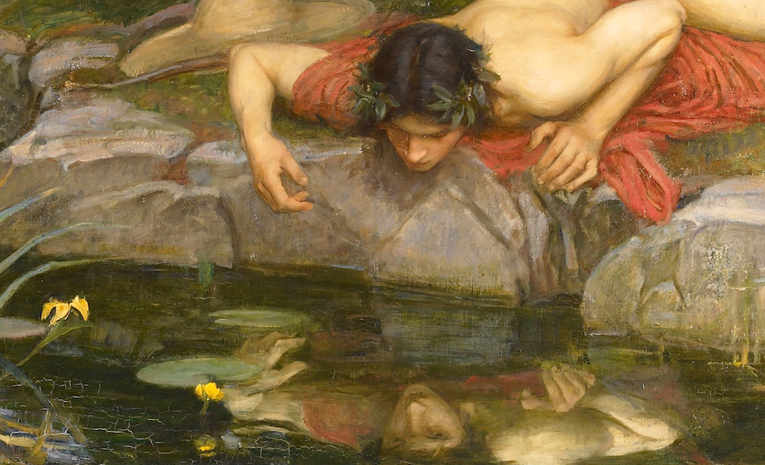
Greek
mythological
figure
Narcissus
Notes:
Narcissus saw his reflection in the water and fell in love with it. Self love ruined him.
https://www.greekmythology.com/Myths/Mortals/Narcissus/narcissus.html
Although he did not realize in the beginning that it was just a reflection, when he understood it, he fell in despair that his love could not materialize and committed suicide.
I’m NOT against selfies, but some perspective here…

Slide 42
1,000 selfies are posted to Instagram every 10 seconds.
There are 93 million selfies each day, which would represent 2,583,333 rolls of film.
19 out of 20 teens have taken selfies.
Notes:
https://www.adweek.com/digital/rawhide-selfies-infographic/
2016 data

Slide 43
More people died from taking selfies in 2015 than from shark attacks.
74 percent of all images shared on Snapchat are selfies.
Notes:
https://www.adweek.com/digital/rawhide-selfies-infographic/
A Japanese tourist reportedly died of a heart attack after falling down a staircase at the Taj Mahal’s Royal Gate while attempting to take a selfie, the BBC reports
Another man recently shot himself while posing for a selfie, and
in 2014, a couple fell off a cliff while trying to snap a picture of themselves. https://www.usatoday.com/story/news/nation-now/2015/09/23/people-died-selfies-shark-attacks/72682068/
I’m not against selfies! I perspective of extravagant love…

Slide 44
Francis Chan suggestion at OneThing: let’s focus on others.
Turn your camera on “forward” and take someone’s photo.
As a memory jogger to love OTHERS.

Slide 45
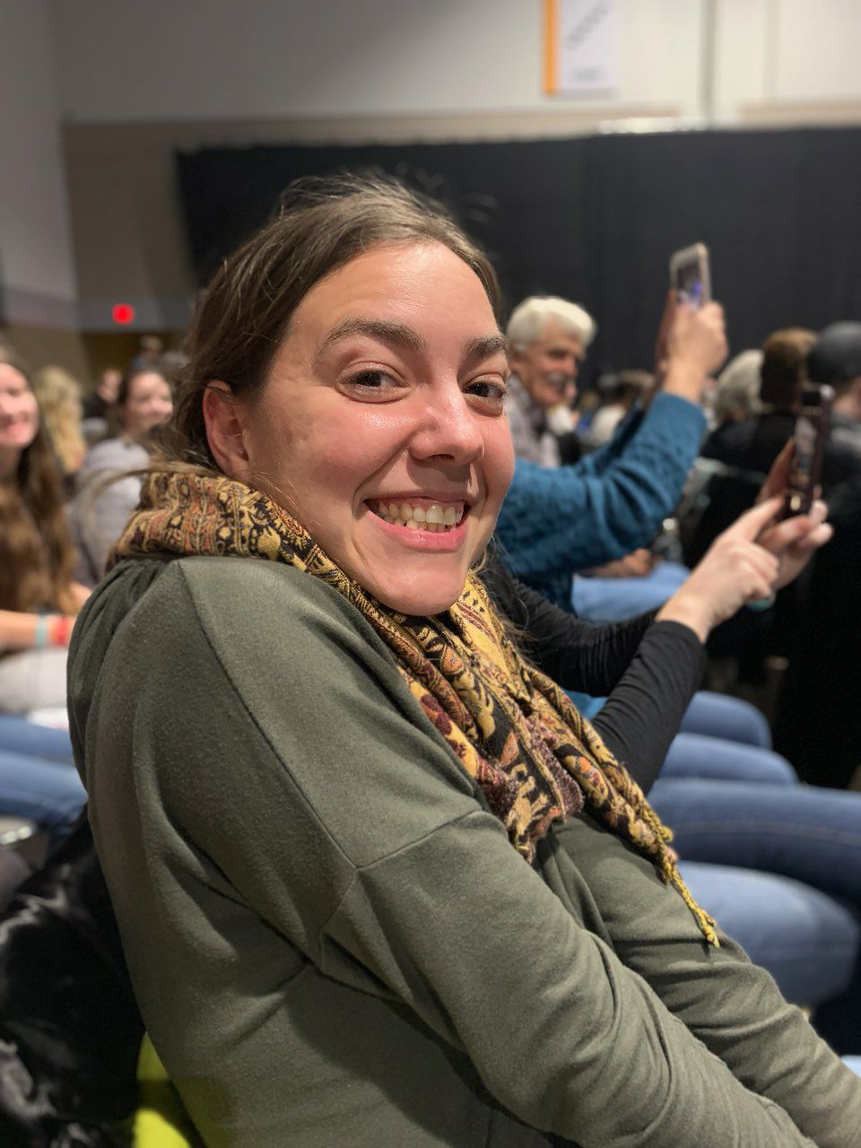
OneThing
Bartle Hall
2018
Rivka

Slide 46
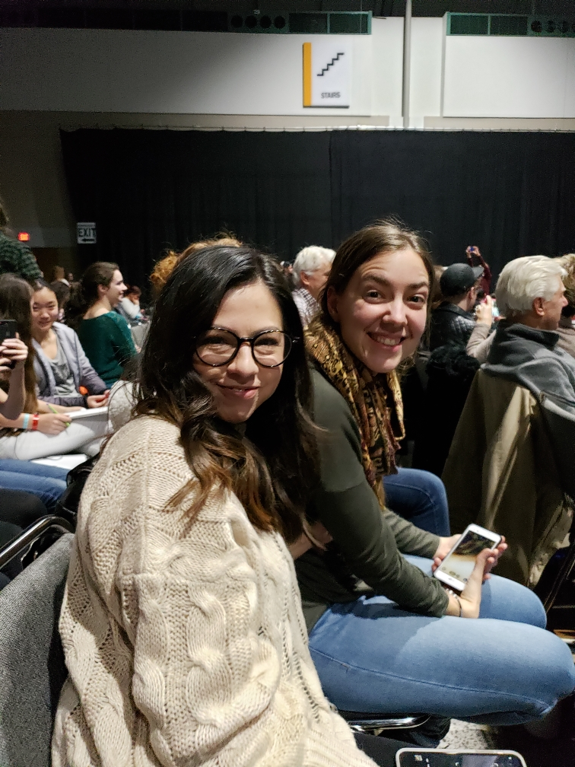
OneThing
Bartle Hall
2018
Denise

Slide 47
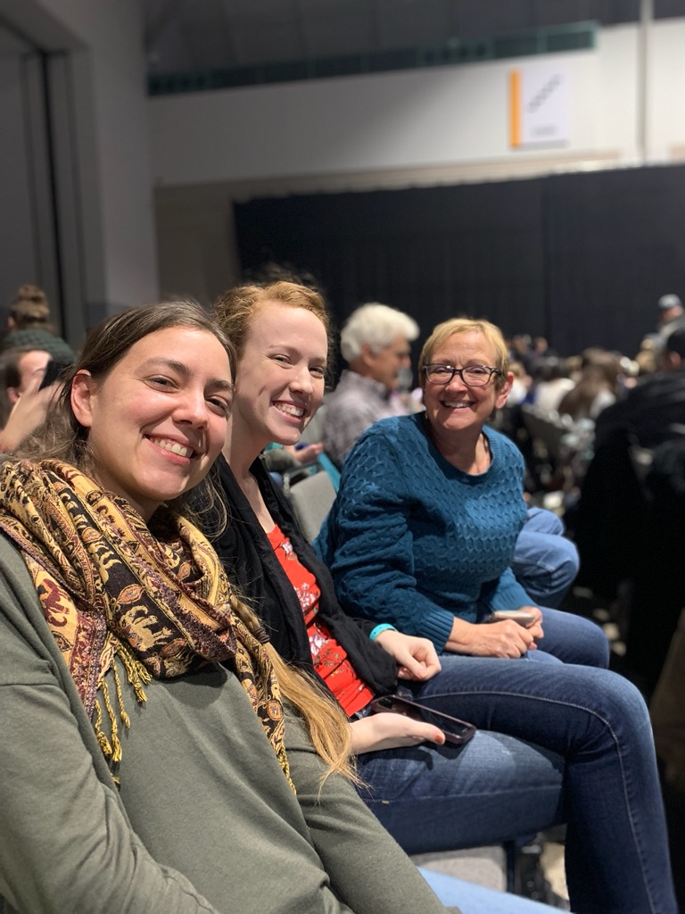
OneThing
Bartle Hall
2018
Kayla?

Slide 48
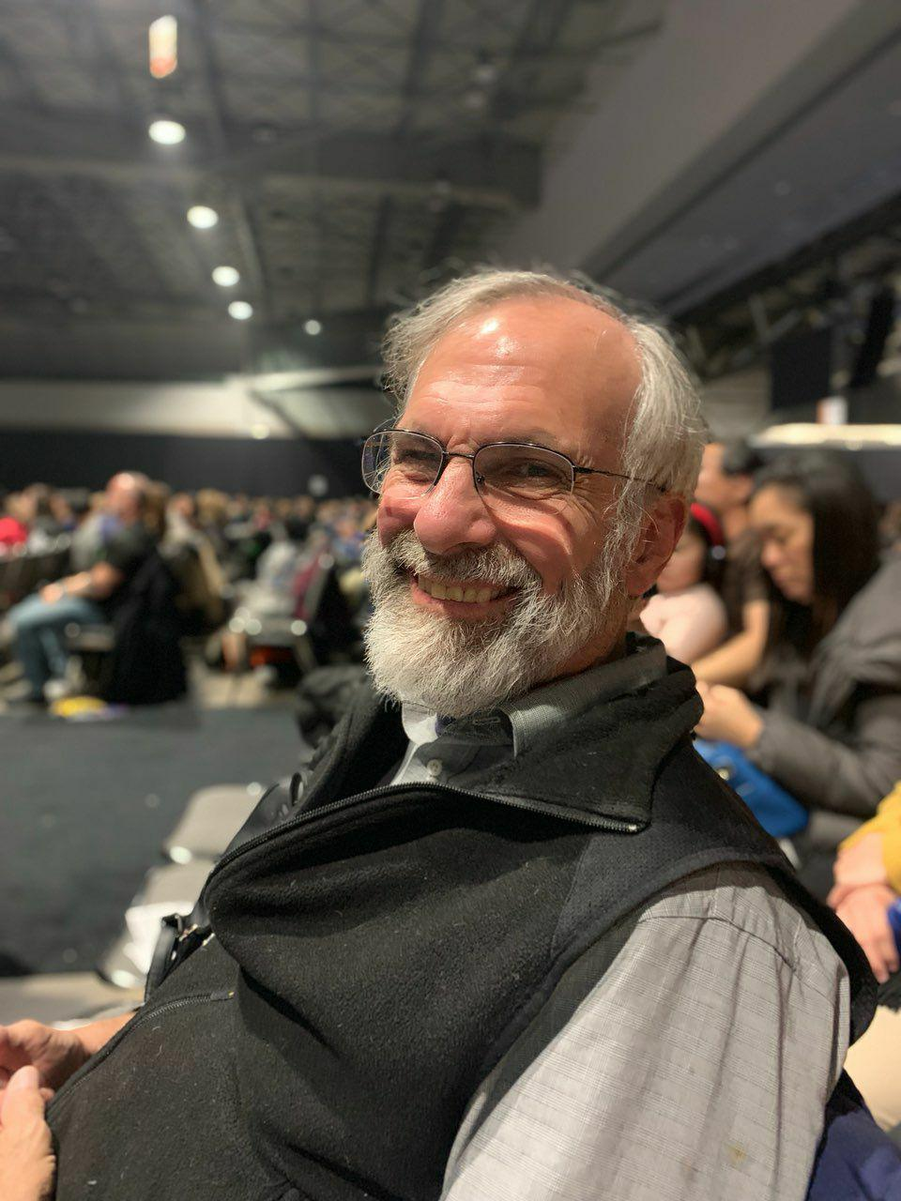
OneThing
Bartle Hall
2018
me

Slide 49
Turn your camera on “forward” and take someone’s photo.
Now.

Slide 50
How can I serve YOU?
^{Mes Jews/Heb 10.24} And let us keep paying attention to one another, in order to spur each other on to love and good deeds.
How can I serve YOU to help you become more in love with Messiah, and works of joyful service?
Notes:
Consider hindrances…

Slide 51
Hindrances to love service
Fear: This person may hurt me. Protection, defenses.
Offense: This person did hurt me. I will fix it; protect myself.
Criticism: This person is hurtful and wrong, must be corrected.
Notes:
Department of Defense is where all the weapons are, the nukes.
Defensiveness → offensiveness.

Slide 52
^{1 Cor. 13.7} Love…bears all things, it believes all things, it hopes all things, it endures all things.
John Wesley’s comments:

Slide 53
John Wesley’s commentary on 1 Cor.13.7 Whatever evil the lover of mankind sees, hears, or knows of any one, he mentions it to none; it never goes out of his lips, unless where absolute duty constrains to speak. Believes all things - Puts the most favourable construction on everything,
Notes:
https://www.biblestudytools.com/commentaries/wesleys-explanatory-notes/1-corinthians/1-corinthians-13.html

Slide 54
and is ever ready to believe whatever may tend to the advantage of any one character. And when it can no longer believe well, it hopes whatever may excuse or extenuate the fault which cannot be denied. Where it cannot even excuse,
Notes:
https://www.biblestudytools.com/commentaries/wesleys-explanatory-notes/1-corinthians/1-corinthians-13.html

Slide 55
it hopes God will at length give repentance unto life. Meantime it endures all things - Whatever the injustice, the malice, the cruelty of men can inflict. He can not only do, but likewise suffer, all things, through Messiah who strengthens him.
Notes:
https://www.biblestudytools.com/commentaries/wesleys-explanatory-notes/1-corinthians/1-corinthians-13.html
Another insight into a love breaker:

Slide 56
^{Yaakov 4.1-3} What is causing all the quarrels and fights among you? Isn’t it your passions battling inside you? You desire things and don’t have them. You kill [anger], and you are jealous, and you still can’t get them. So you fight and quarrel.
Notes:
Love one another!!

Slide 57
Second suggestion:
Look up, focus on G-d!

Slide 58
Ceiling of
Bartle Hall

Slide 59
Turn your camera on “forward” and take a photo of the ceiling, to remind you to look up!
Now!
Yeshua, how can I love you better, more joyfully, wisely, consistently, servant-heartedly?

Slide 60
Do we want to be people who pour out our alabaster jar of value on King Messiah?
Is He worth it?
Is doing so a wise use of our resources?
Notes:
https://www.google.com/url?sa=i&source=images&cd=&cad=rja&uact=8&ved=2ahUKEwji6biJoNXfAhVO2qwKHXZjDqUQjRx6BAgBEAU&url=https%3A%2F%2Fwww.amazon.com%2FAlabaster-Jar-Gift-Box-Spikenard%2Fdp%2FB00KFAOHF4&psig=AOvVaw2WEOjkYwZS13RFHLzranB8&ust=1546729905051046

Slide 61
My vision was that Or HaOlam would be a place of wholeness in joyful service to the King, of healing for wounded Jewish people and all people, and therefore an end to our wounding people.
Giving all to Him is key to wholeness.

Slide 62
Healing ministries:
Sozo sessions, ongoing as needed
Tramua healing sessions for groups
Nov. 2007 Ancient Paths Empowering Relationships
Feb. 2009 Ancient Paths Overcoming Anger

Slide 63
June 23, 2012 Neil Campbell Ancient Paths: Blessing Generations
Mar. 8-9, 2013 Ancient Paths Financial Foundations
Oct 19, 2013 Chris Coursey: Joy Starts Here
Feb 20-23, 2014 RTF w Brawers

Slide 64
Healing ministries:
Oct, 2015 Darrell Brazell: Power of Joy
Dec. 10, 2016 Jeanne Nigro
Oct 6-7, 2018 Father Son campout
Nov 10-11, 2018 RTF Brawers
March 9, 2019 Chris Coursey: Thrive: 19 Relational Brains Skills https://thrivetoday.org/

Slide 65
Wholeness, joy, celebration
Emotionally / Spiritually
Relationally
Financially
Physically
Notes:
Here is where this message preaches…

Slide 66
Every effective hospital has a maternity ward!
Only reasonably healthy people can reproduce! “Wounded healer”
We crave HEALTH at Or HaOlam: loving G-d, loving each other.
Therefore, lots of pregnancies!

Slide 67
Considerations:
Every department is a department of evangelism / outreach, in some measure.
Think about your gifting ministry and pray for Ruakh insight as to if and how you can do outreach.
Notes:
Consider Stewart’s message on Shabbat and to leadership.

Slide 68
If we succeed in new births, where do we fit them in our community meeting and facility?
Expand parking lot, at least.
Two services?
Expanded sanctuary?
Expanded home groups?
Notes:
Or HaOlam has mostly grown by legitimate transfer…bless those that want to connect with the Jewish people and the Torah!
22 new births. Need births, salvations!

Slide 69
Every effective hospital has a maternity ward!
Only reasonably healthy people can reproduce! “Wounded healer”
We crave HEALTH at Or HaOlam: loving G-d, loving each other.
Therefore, lots of pregnancies!

Slide 71
Oureach
We bought an ad in our local paper for years.
We are on a semi-major road, so our sign gets lots of drive-by attention.

Slide 72
We also have city signs on the road with arrows pointing to turn at the next intersection.
I have a radio show that airs two to three times a week and has the potential to reach 50,000 homes, vehicles, radios, etc.

Slide 73
We encourage our people to participate in events at the JCC for Yom HaShoah, Purim, etc. We are involved with the local Holocaust Center for Humanity in Seattle.
We have an annual food drive for Jewish Family Services.

Slide 74
6.5 We could host a Blood Drive

Slide 76
We update our website all the time and people find us online. We average 5-10 visitors every week.
Twice a year we offer a Getting To Know You luncheon where we invite all those who filled out visitor slips to a catered lunch where we explain our vision, mission, history, identity and destiny. We average 15-20 each time.

Slide 77
We do an annual concert in the park where we have a congregational picnic and our worship team performs on the big stage (we rent a professional sound system) and do some local advertising.
We printed beautiful, full-color welcome cards that we pass out at these community events.

Slide 78
I occasionally preach in churches, since I’m free on Sundays, which attracts those wishing to learn more about their Jewish roots.
We are members of the Newcastle Chamber of Commerce, and I attend the monthly luncheons and special meetings affecting our community.

Slide 79
We let local groups use our parking lot, which fosters good will.
We are also on the City of Newcastle list of emergency shelters. We support numerous local homeless ministries, which in turn tell their “clients” about us.

Slide 80
We print thousands of Invitation Cards and make them available in our foyer for our people to take and pass out wherever they go.
We have volunteered in the local elementary school in August to help teachers prepare their classrooms for the fall semester. https://www.citywideprayerkc.com/index.php?option=com_content&view=article&id=83&Itemid=480
Notes:
Local “Caring for Kids” by City Wide Prayer Movement.

Slide 81
Apology of the generations:
Parents apologizing to [adult] children for imposing their vision on them
Children apologizing for rejecting impartation

Slide 82
Edward Byrd, a former member of the LGBT community, opens up his heart in "Ran Into You," which he defines as his testimony in a song. Byrd, who previously identified as a gender-fluid or androgynous person, says he was giving himself away until he ran into God. "Nothing could make me whole," he belts in the song.
Notes:
https://www.charismanews.com/video/74495-androgynous-gender-fluid-person-exchanges-emptiness-for-holiness?utm_source=Charisma%20News%20Daily&utm_medium=email&utm_content=subscriber_id:5160390&utm_campaign=CNO%20daily%20-%202018-12-21

Slide 83
"Until I ran into You.“ Byrd's mother was 15 years old when she had him. Byrd was raped, abused and then abandoned by his father. Broken, confused and devastated, Byrd turned to the LGBT community for acceptance. Yet he knew something was missing.
Notes:
https://www.charismanews.com/video/74495-androgynous-gender-fluid-person-exchanges-emptiness-for-holiness?utm_source=Charisma%20News%20Daily&utm_medium=email&utm_content=subscriber_id:5160390&utm_campaign=CNO%20daily%20-%202018-12-21

Slide 84
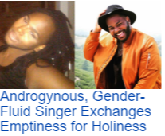
Notes:
https://www.charismanews.com/video/74495-androgynous-gender-fluid-person-exchanges-emptiness-for-holiness?utm_source=Charisma%20News%20Daily&utm_medium=email&utm_content=subscriber_id:5160390&utm_campaign=CNO%20daily%20-%202018-12-21

Slide 85
“God met me right in my sin and loved me into a personal relationship with him. This year actually marks my seventh year of being free!” Byrd tells Charisma.
Notes:
https://www.charismanews.com/video/74495-androgynous-gender-fluid-person-exchanges-emptiness-for-holiness?utm_source=Charisma%20News%20Daily&utm_medium=email&utm_content=subscriber_id:5160390&utm_campaign=CNO%20daily%20-%202018-12-21

Slide 86
Every effective hospital has a maternity ward!
Only reasonably healthy people can reproduce! “Wounded healer”
We crave HEALTH at Or HaOlam: loving G-d, loving each other.
Therefore, lots of pregnancies!

