Slide 1
e-handout
To have these notes
without taking notes
Go to OrHaOlam.com
Click on downloads,
messages, 2019
Notes:
.

Slide 2
News from Israel

Slide 3
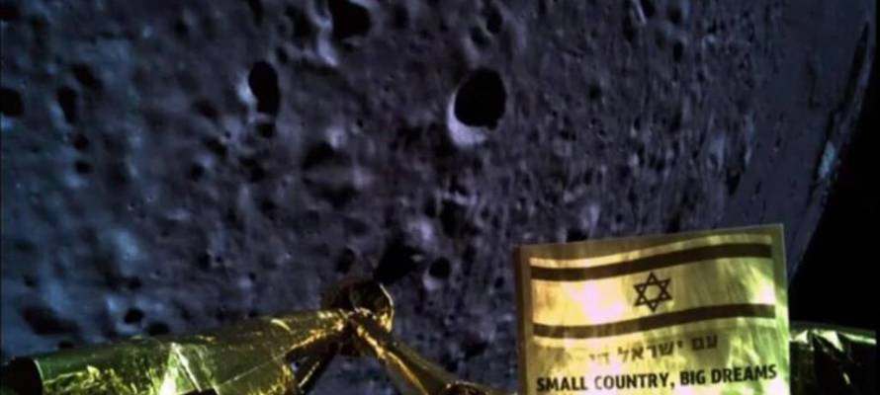
Israeli Team Awarded Million Dollar Prize for Historical Space Mission
Notes:
A sensor failure a few miles above the moon's surface resulted in the main engine cutting out. Control room engineers were hampered in their effort to quickly restart the engine by a temporary loss of communication with the craft. By the time they were able to restart the main engine, Beresheet was only 150 meters from the surface and falling too fast. Photo less than a half mile off the surface. The craft had a “kinetic disassembly.” Still, an Israeli flag is on the moon!
The man who nearly funded the entire one hundred-million-dollar space project announced yesterday that work on Beresheet 2 begins today. Sunday, April 14. 2019. SpaceIL chief and billionaire Morris Kahn said.

Slide 4
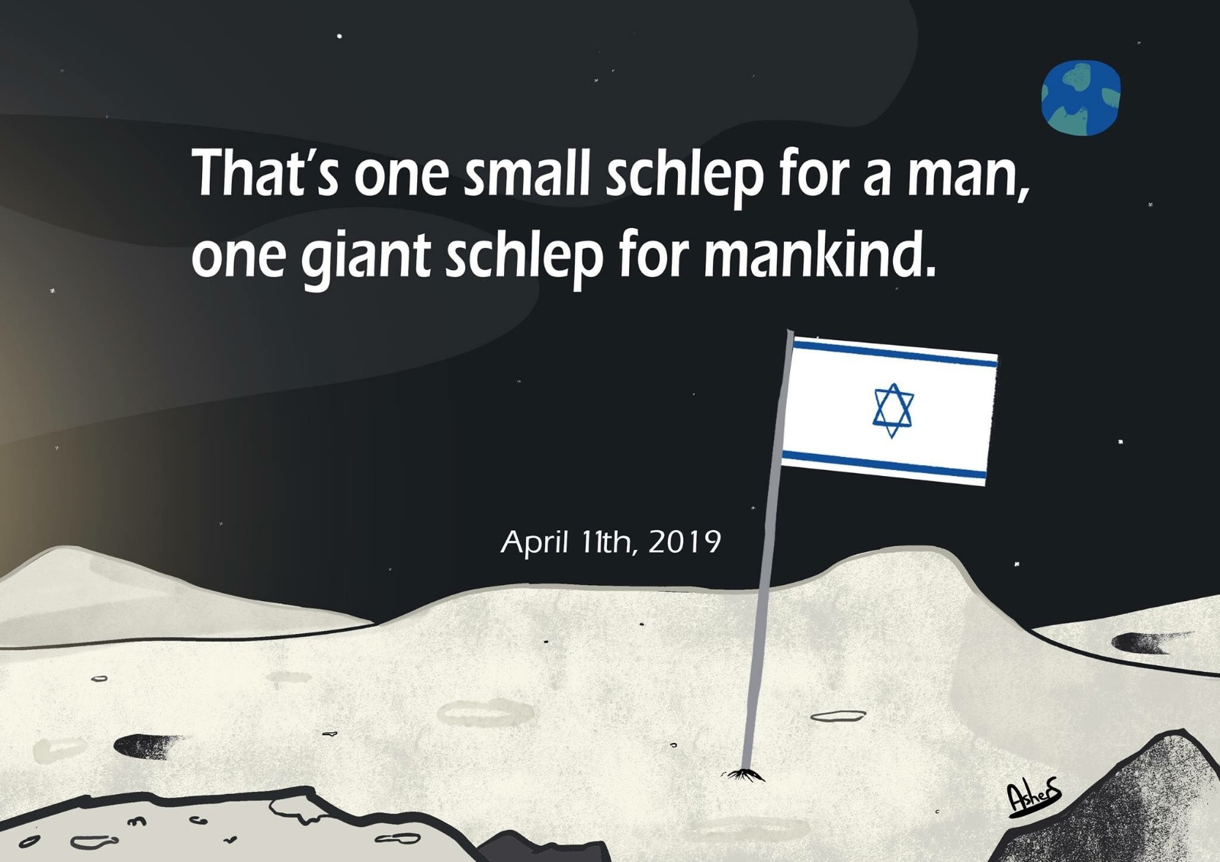
Notes:
Next three from Hiatt’s Facebook

Slide 5
Notes:
Classic intergenerational miscommunication…

Slide 6
Notes:
Seems clear enough?

Slide 7
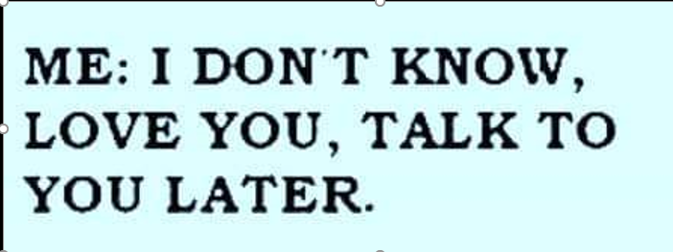
Notes:
Read the following slowly:

Slide 8
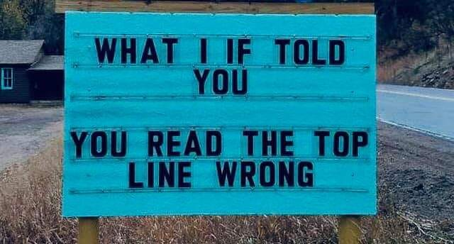
Notes:
Hiatts

Slide 9
Notes:
How many here just feel the melody?

Slide 10
How many know a melody for that?

Slide 11
מַתִּתְיָהוּ Mattityahu
(Matthew) 26:40-43
Notes:
I have five themes to expound today: Matityahu sequence, Pesakh/Passover, Resurrection, Counting the Omer, a very practical application. [Possibly should have just broken Matityahu sequence, but usually it turns out to fit and establish the special events.]

Slide 12
Mattityahu (Matthew) 26:40
לְאַחַר מִכֵּן בָּא אֶל הַתַּלְמִידִים וּמְצָאָם יְשֵׁנִים. אָמַר אֶל כֵּיפָא: ”וּבְכֵן לֹא יְכָלְתֶּם לְהִשָּׁאֵר עֵרִים אִתִּי שָׁעָה אַחַת?
He returned to the talmidim and found them sleeping. He said to Kefa, “Were you so weak that you couldn’t ₁stay awake with me for even an hour?
Notes:
Glorious, delicious seder meal was done, and they were urged to stay awake and support Him in His anguish.
Note subscript 1. Theme of this passage. Sleeping when He needed them!

Slide 14
Mattityahu (Matthew) 26:41
הֱיוּ עֵרִים וְהִתְפַּלְּלוּ כְּדֵי שֶׁלֹּא תָּבוֹאוּ לִידֵי נִסָּיוֹן. אָמְנָם הָרוּחַ חֲפֵצָה, אֲבָל הַבָּשָׂר חָלָשׁ.“
“₂Stay awake, and pray that you will not be put to the test — the spirit indeed is eager, but human nature is weak.”
Notes:
What test? Of denying Him! “Satan has desired to have you…” Helping Him in His hour of weakness…sweating blood…Hematadrosis.

Slide 15
Mattityahu (Matthew) 26:42
הָלַךְ שֵׁנִית וְהִתְפַּלֵּל בְּאָמְרוֹ: ”אָבִי, אִם אִי אֶפְשָׁר שֶׁהַכּוֹס תַּעֲבֹר מִבְּלִי שֶׁאֶשְׁתֶּה אוֹתָהּ, יְהִי נָא כִּרְצוֹנְךָ.“‏
A second time he went off and prayed. “My Father, if this cup cannot pass away unless I drink it, let what you want be done.”

Slide 16
Mattityahu (Matthew) 26:43
הוּא חָזַר וְשׁוּב מָצָא אוֹתָם יְשֵׁנִים, כִּי עֵינֵיהֶם הָיוּ כְּבֵדוֹת ‏
Again he returned and ₃found them sleeping, their eyes were so heavy.
Notes:
Why did he come back to them to check?
Why was their companionship sooooo important??

Slide 17
^{Mtt. 26.44-46} Leaving them again, he went off and prayed a third time, saying the same words.

Slide 18
^{Lk 22. 42-44} “Father, if you are willing, take this cup away from me; still, let not my will but yours be done.”

Slide 19
^{Lk 22. 42-44} There appeared to him an angel from heaven giving him strength…
He made it, without their help and support and comfort.

Slide 20
^{Mtt. 26.44-46} Then he came to the talmidim and said, “For now, ₄go on sleeping, take your rest… Look! The time has come for the Son of Man to be betrayed into the hands of sinners. Get up! Let’s go! Here comes my betrayer!”

Slide 21
How all this warfare watching relate to Pesakh?

Slide 22
Sleep is good:

Slide 23
They just had a BIG Pesakh meal.
Post-meal, the body streams more blood to the digestive system to better digest foods in massive amounts. This causes a temporary blood and nutrients shortage in the brain.
Notes:
https://www.thejakartapost.com/life/2016/10/04/why-do-we-feel-sleepy-after-eating-a-meal.html

Slide 24
Post-eating, the body releases hormones…These hormones increase blood sugar levels…At the same time, the brain releases serotonin…which then turns into melatonin. [The sleep hormone.]
Notes:
https://www.thejakartapost.com/life/2016/10/04/why-do-we-feel-sleepy-after-eating-a-meal.html

Slide 25
^{T’hillim/Ps 3.6-7} I lie down and sleep, then wake up again, because Adoni sustains me. I am not afraid of the tens of thousands set against me on every side.
^{Kohelet/Ec 5.11} The sleep of the laborer is sweet, whether he eats little or much.

Slide 26
^{T’hillim/Ps 127.2} In vain do you get up early and put off going to bed, working hard to earn a living; for he provides for his beloved [even when they ] sleep.
כֵּן יִתֵּן לִידִידוֹ שֵׁנָא.

Slide 27
https://www.verywellhealth.com/sleep-duration-and-longevity-2224291 Research suggests that regularly sleeping for less than seven hours a night can have negative effects on the cardiovascular, endocrine, immune and nervous systems. Side effects of sleep deprivation can include obesity, diabetes, heart disease, and hypertension, anxiety, depression, and alcohol abuse.
Notes:
What about the military, at war?

Slide 28
https://www.sleep.org/articles/how-soldiers-deal-with-sleep-deprivation/ Just like everyone else, most soldiers should, ideally, get seven to nine hours of sleep every night. Previously, Army guidelines had suggested only half that amount, but Army doctors revised it in 2010 because of concerns about sleep-deprived soldiers in combat.

Slide 29
Sleep is good.
On the other hand:

Slide 30
^{Mishlei /Prov 6.9-11} How long will you lie there, you sluggard? When will you get up from your sleep? A little sleep, a little slumber, a little folding of the hands to rest — and poverty will come on you like a thief, and scarcity like an armed man.

Slide 31
Ideal woman:
^{Mishlei /Prov 31.15} She rises while it is still night and provides food for her household and portions for her servant girls.

Slide 32
Ideal woman:
^{Mishlei /Prov 31.17-18} She gathers her strength around her and throws herself into her work. She sees that her business affairs go well; her lamp stays lit at night.

Slide 33
^{1 Thes 5.4-7} But you, brothers, are not in the dark, so that the Day should take you by surprise like a thief; for you are all people who belong to the light, who belong to the day. We don’t belong to the night or to darkness, so let’s not be asleep,

Slide 34
^{1 Thes 5.4-7} like the rest are; on the contrary, let us stay alert and sober. People who sleep, sleep at night; and people who get drunk, get drunk at night.

Slide 35
^{Kohelet/Eccles 3.1} For everything there is a season and a time for every activity under heaven:
There is a time for alertness, and warfare!

Slide 36
How all this warfare watching relate to Pesakh?

Slide 37
The original Passover Exodus story
^{Shmot Ex 12.42} This was a night when Adoni kept vigil to bring them out of the land of Egypt, and this same night continues to be a night when Adoni keeps vigil for all the people of Isra’el through all their generations.

Slide 38
לֵיל שִׁמֻּרִים הוּא לַייָ, לְהוֹצִיאָם מֵאֶרֶץ מִצְרָיִם: הוּא-הַלַּיְלָה הַזֶּה לַייָ שִׁמֻּרִים לְכָל-בְּנֵי יִשְׂרָאֵל לְדֹרֹתָם.
Shimurim l’khawl b’nai Yisrael l’dorotam
keeps vigil [guard] for all the people of Isra’el through all their generations.
Notes:
NOTE: G-d is always watching us, alert of our situation and needs. But THIS night is different from all other nights…this season is. G-d is watching the accomplishment of REDEMPTION!

Slide 39
Apparently that’s why Yeshua was wanting them to “Stay awake, and pray” for the “birth pangs of Messiah” were coming.
Kingdom warfare to accomplish redemption!

Slide 40
This scripture [G-d keeps vigil on this night] is why the custom developed to see if Eliyahu [and Messiah] were coming to the Seder evening!

Slide 41
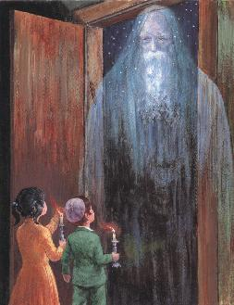
Children sent to see if Eliyahu is coming, preceding the Messiah

Slide 42
Many of you have had a Seder, others tonight, some through the next several nights.
[There is scripture to delay a whole month depending on contingencies.]

Slide 43
Pesakh is a time of
celebrating the past: looking back
Looking at and building the present by cleansing Khametz
anticipating the future and building the future.

Slide 44
Passover cleansing particulars…
Notes:
Leaven, leavened food, confusing. Need the Hebrew…

Slide 45
שְׂאֹר leavening agents s’or
חָמֵץ leavened food khametz
Khametz is a product that is both made from one of five types of grain and has been combined with water and left to stand raw for longer than eighteen minutes and becomes leavened.
Notes:
https://en.wikipedia.org/wiki/Chametz
Khametz is what is prohibited. Not yeast per se, but “yeasted 5 grains”

Slide 46
The five grains of Israel
חִטָּה wheat Ḥittim
כֻּסְמִין spelt Kusmin
שְׂעוֹרָה barley Se’orah
שִׁבֹּלֶת שׁוּעָל oats Shibbolet shual
שִׁיפוֹן rye shifon
Notes:
https://en.wikipedia.org/wiki/Chametz
fox = שׁוּעָל

Slide 47
What about rice, corn, lentils, beans, and peanuts?
They don’t leaven, but may appear to. So, Ashkenazic Jews forbid, called kitnayot.
Sephardic Jewish communities they are OK.
Or HaOlam follows Sephardim.
Notes:
https://www.thoughtco.com/passover-forbidden-foods-2076548
Sephardi more Biblical, less add ons. Great music too.

Slide 48
Leavening agents, such as yeast or baking soda, are not themselves khametz. Rather, it is the fermented grains. Thus yeast may be used in making wine, and kefir.
Notes:
https://en.wikipedia.org/wiki/Chametz
Also Kefir

Slide 49
Similarly, baking soda may be used in Passover baked goods.
Since matzoh meal is already baked, the grain will not ferment. It’s OK to use.
Notes:
https://en.wikipedia.org/wiki/Chametz
Also Kefir

Slide 50
So it’s a practice in observant Jewish homes to do a THOROUGH Spring cleaning! Get ALL the khametz out of every corner.
Burn the crumbs
And then a prayer of covering.

Slide 51
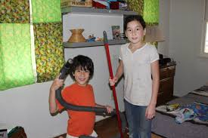

Slide 52
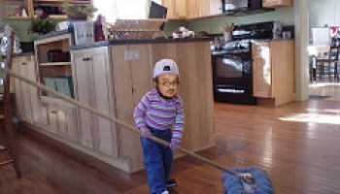
Notes:
https://www.google.com/search?q=chametz+burning&safe=active&tbm=isch&tbs=rimg:CXGR7-dDLk5BIjg1IMGltlriQnD5c6B2s6UdbVpRCvMgvCD5eE9MM8tiLT6XdlbuvnKoOO-5WSZnkZtz2ub3eWX4TyoSCTUgwaW2WuJCEWAR8_1Sg2G0sKhIJcPlzoHazpR0RiWrzQiq97U8qEgltWlEK8yC8IBEIpVnCqYqZzSoSCfl4T0wzy2ItET70tzS7UCuxKhIJPpd2Vu6-cqgRoFDs8WYCBXEqEgk477lZJmeRmxGgUOzxZgIFcSoSCXPa5vd5ZfhPEaBQ7PFmAgVx&tbo=u&sa=X&ved=2ahUKEwjFwo7F3YPaAhWKqlMKHVlIAzMQ9C96BAgAEBs&biw=1282&bih=884&dpr=1#imgrc=yXlZZUKJdFanwM:
A new Israeli military version, getting out the impurities, corruptions..

Slide 53
Notes:
From Checho Rojas’ Facebook.
After we’ve cleaned all, we burn the leftovers.

Slide 54
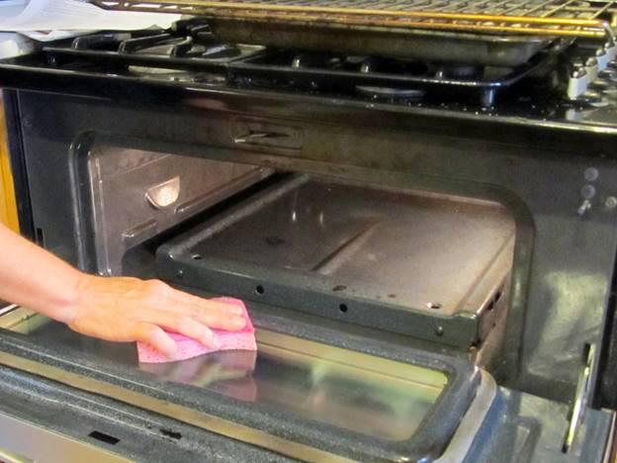

Slide 55
Next week’s Oneg is the eighth day of Passover.
Bread is OK.
Season of unleavened bread is over Friday sunset for Sephardim and Messianics.
One more day for Ashkenazim.

Slide 56
Passover is a time of vigil, of watching, of anticipating.
The very first redemption from Egypt G-d watch then.
The ultimate redemption from sin by the atoning death of Messiah then.
The resurrection following…

Slide 57
Shortly after Passover is the other aspect of the atonement.

Slide 58
^{Vayikra/Lev 23.10-11} “Tell the people of Isra’el, ‘After you enter the land I am giving you and harvest its ripe crops, you are to bring a sheaf of the firstfruits of your harvest to the cohen. He is to wave the sheaf before Adoni, so that you will be accepted; the cohen is to wave it on the day after the Shabbat.
Notes:
Wave the barley!

Slide 59
^{1 Cor. 15.20} The fact is that the Messiah has been raised from the dead, the firstfruits of those who have died.
Barley waving celebration of resurrection!

Slide 60
^{Ro. 1.4} He was powerfully demonstrated to be Son of God spiritually, set apart by his having been resurrected from the dead; he is Yeshua the Messiah, our Lord.

Slide 61
^{Vayikra/Lev 23.15-16} “‘From the day after the day of rest — that is, from the day you bring the sheaf for waving — you are to count seven full weeks, until the day after the seventh week; you are to count fifty days.

Slide 62
Tomorrow we begin counting the Omer. Daily blessings and count. Why? Commanded to.
Count: assess, examine, vigil. Great time for extended fasting!
Script sheets on the literature table.
Relative to counting and cleansing leaven…

Slide 63
We just finished the Dave Ramsey course, and learned that debt is a curse.
^{Mishlei/Prov 27.7} “The rich rule over the poor, the borrower is a slave to the lender.”

Slide 64
^{Ro 13.8} Let no debt remain outstanding, except the continuing debt to love one another, for whoever loves others has fulfilled the law.
Notes:
What does that mean, “No debt remain outstanding?”
Maybe it means, “No debt remain outstanding”
No debt.

Slide 65
We purchased this building for $650,000
$130,000 down
mortgaged $520,000
Mar 31, 2019 owing $431,271⁵³

Slide 66
We started our building fund in 2003, in the old location. It grew incrementally but consistently, then G-d expedited everything with an eviction notice. If we are faithful with what we have, G-d will expedite growth in surprising ways.

Slide 67
Significant rabbi trail…

Slide 68
Sylvia Cohn was 81 when we met her in 1994.
Member of Beth Shalom
Introduced to Yeshua and Messianic Judaism in 1994.
Faithful to attend and worship and dance till she was ~88.
Notes:
By Lori Ginson. Sweet Jewish believer who had bi-polar disorder and passed away.

Slide 69
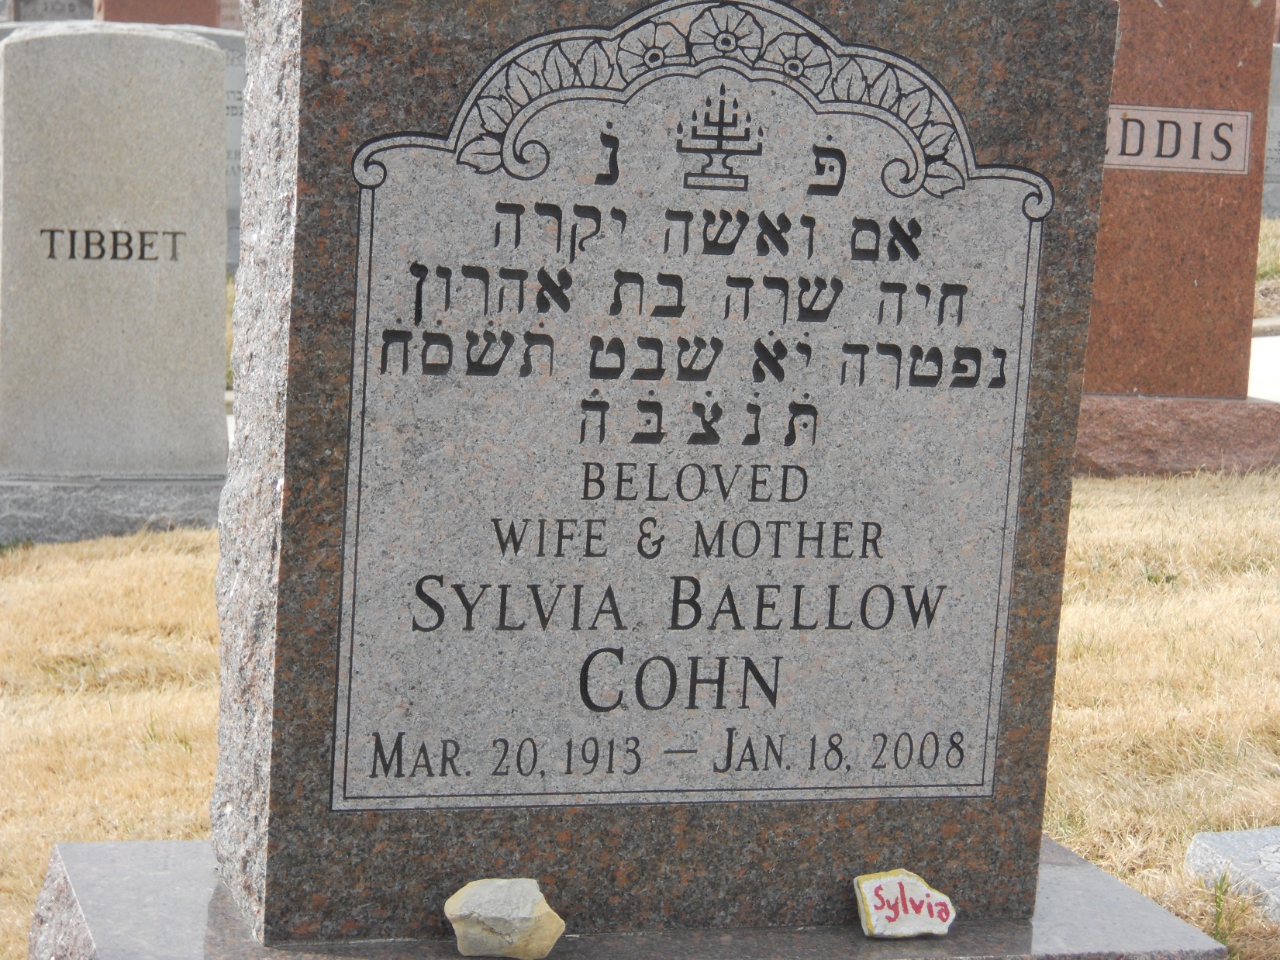

Slide 70
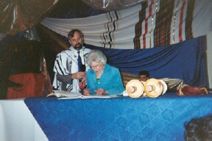

Slide 71
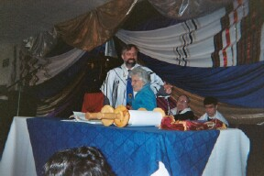
Notes:
Adam Adler, Jim Cotten in background.

Slide 72
Sylvia would sit towards the front and pay GREAT attention, and when I was intensely on a Messiahship of Yeshua topic, she would emphatically shake her head “No!” and I would say, “It’s still true, even though Sylvia disagrees.”

Slide 73
We used to have a really simplistic membership enrollment. Just sign the Statement of Faith, no commitment to attend, serve, tithe.
Sylvia wanted to join.
“Cross it out.” “Cross it out.”
“What are you joining?”
“I’m joining YOU!”
Notes:
Messiahship and Deity of Yeshua, I have received Him as my Atonement, trust Him for eternal life.
She was 83 then. My grandmother, who could deny her?

Slide 74
MY VERY SPECIAL PRAYER TO G-D
BY SYLVIA COHN

Slide 75
I understand that the span of a persons life is 70 years. After that they are donated years. Since I’m a member of that group, we need to be reminded about certain things. So I have a prayer that I want to share with you, for my later years.

Slide 76
DEAR G-D, You know that I am growing older. Keep me from becoming too talkative and particularly keep me from falling into the tiresome habit of expressing an opinion on every subject. Release me from the craving to straighten out everybody’s affairs. Keep my mind free from the ridicule of endless details.

Slide 77
Give me wings to get to the point. Give me grace, dear God, to listen to others describe their aches and pains. Help me endure the boredom with patience and to keep my lips sealed of my own aches and pains. They increase as time goes on. The pleasure of discussing them becomes sweeter as time goes by.

Slide 78
Teach me the glorious lesson that occasionally I might be mistaken. Keep me reasonably sweet. I don’t wish to be a saint. Saints are so hard to live with. A sour old person is the work of the devil.

Slide 79
Make me thoughtful but not nosey. Helpful but not moody. Helpful but not pushy. Independent yet able to accept with graciousness favors that others wish to bestow on me. Free me of the notion that simply because I have lived a long time I’m wiser than those who haven’t lived so long.

Slide 80
If I do not approve of some of the changes that have taken place in the recent years give me the wisdom to keep my mouth shut. G-d, you know that when the end comes I would like to have a few friends left. All I am telling you is that you are very precious to me.

Slide 81
Sylvia Cohn came to faith in Messiah Yeshua in ~2005, when Rose Price was our guest speaker.
Rose was a Polish born Holocaust survivor of 5 years in concentration camps.
They spoke in Polish, fervently.
Notes:
http://rosepriceministries.org/aboutRose.php
During the horror of World War II, Rose spent five years in concentration camps, narrowly escaping death time after time from the hand of her tormentors. Her entire family except for her sister and aunt, never came out of the death camps. But out of the smoldering ruins of Europe, God brought forth smoldering remnants of human life, and one of these firebrands was Rose.
After immigrating to the United States, Rose met and married Charlie Price and settled in Philadelphia to raise a family of four children -- two daughters and two sons. Rose was president of her neighborhood synagogue in spite of the fact that she did not believe in God. The horrors of the war had made her angry at God and she turned her unforgiving heart from Him completely. Yet she did want her children to know of their Jewish heritage and because of this became very involved in temple service.

Slide 82
Sylvia’s first dollar donation for our building:
Notes:
1995 dollar

Slide 83
On average, U.S. consumers own three credit cards. Total revolving debt stands at $1.04 trillion - that's up from $857 billion in 2013. The average interest Americans pay on their cards stands at 16.46%.Feb 14, 2019
Notes:
https://www.google.com/search?q=household+debt&oq=household+dept&aqs=chrome.1.69i57j0l5.9646j0j7&sourceid=chrome&ie=UTF-8

Slide 84
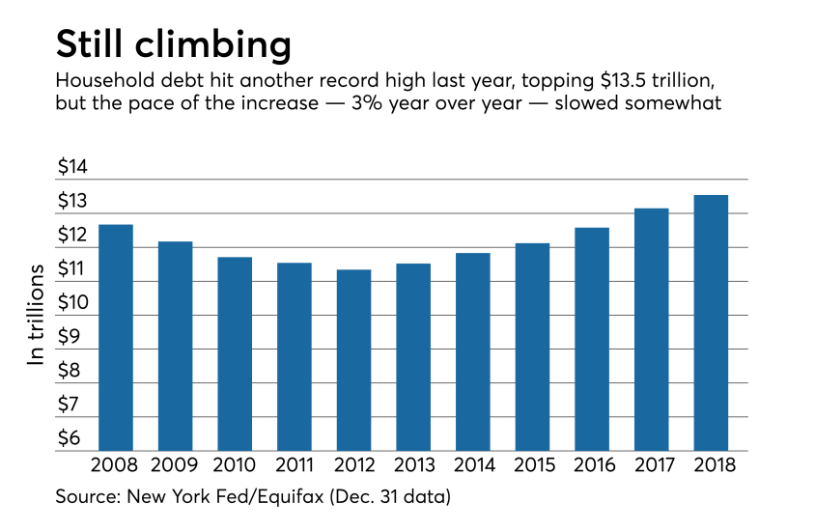
Notes:
https://www.google.com/search?q=household+debt&safe=active&tbm=isch&source=iu&ictx=1&fir=aWYqDb4FuR5FcM%253A%252CuQMhNESvuFdlzM%252C%252Fm%252F0h3wys3&vet=1&usg=AI4_-kSJcZBENqLu0_9_163tOZA-voE3Uw&sa=X&ved=2ahUKEwj5soCA0N3hAhUGA6wKHT8FBUYQ_B0wF3oECAwQBg#imgrc=0eP2dYKg7elJ3M:&vet=1

Slide 85
Notes:
https://www.cnbc.com/2018/08/20/how-much-debt-americans-have-at-every-age.html

Slide 86
https://www.cnbc.com/video/2018/05/22/kevin-oleary-age-by-which-you-should-have-your-debt-paid-off.html

Slide 87
Household debt is defined as the combined debt of all people in a household. It includes consumer debt and mortgage loans. A significant rise in the level of this debt coincides historically with many severe economic crises
Notes:
https://en.wikipedia.org/wiki/Household_debt

Slide 88
and was a cause of the U.S. and subsequent European economic crises of 2007–2012. Several economists have argued that lowering this debt is essential to economic recovery in the U.S. and selected Eurozone countries.
Notes:
https://en.wikipedia.org/wiki/Household_debt

Slide 89
You may say, “I have a lot of debt, but I can always go bankrupt.”
Following is EXTREMELY politically incorrect and possibly offensive. I’m not talking about your past. I’m talk about the future. Here is the scripture on bankruptcy:

Slide 90
^{T’hillim 37.21} The wicked borrows and does not repay, but the righteous is a gracious giver.
Notes:
Why is it so wicked?? Because it’s stealing. Not planned deliberate bank robbery, but the same concept.

Slide 91
We just finished the Dave Ramsey course, and learned that debt is a curse.
^{Mishlei/Prov 27.7} “The rich rule over the poor, the borrower is a slave to the lender.”

Slide 92
^{Ro 13.8} Let no debt remain outstanding, except the continuing debt to love one another, for whoever loves others has fulfilled the law.
Notes:
What does that mean, “No debt remain outstanding?”
Maybe it means, “No debt remain outstanding”
No debt.

Slide 93
We purchased this building for $650,000
$130,000 down
mortgaged $520,000
Mar 31, 2019 owing $431,271⁵³

Slide 94
Or HaOlam will have its Silver Anniversary on Purim, 2020.
IF we grow more, we have no where to accommodate new people, except to go to a second service.

Slide 95
The Elders Z’kenim and I would like to propose we RETIRE, pay off, the current mortgage of $431,271 by Purim 2020.
We have $9976 left in our building fund. We can apply.
Dawn and I will pledge $500 now, to start.

Slide 96
Next week, we will have pledge forms for you to fill out.
Can we do it??
Then we can save to GROW!!
“Sylvia Cohn Memorial Mortgage Retirement Campaign”?
SCMMRC
Notes:
Matt Hershey story…one million!!

Slide 97
Tomorrow is Firstfruits of the Resurrection, then the counting of the Omer up to Shavuot.
Let’s commit to watch and pray and give!

Slide 99
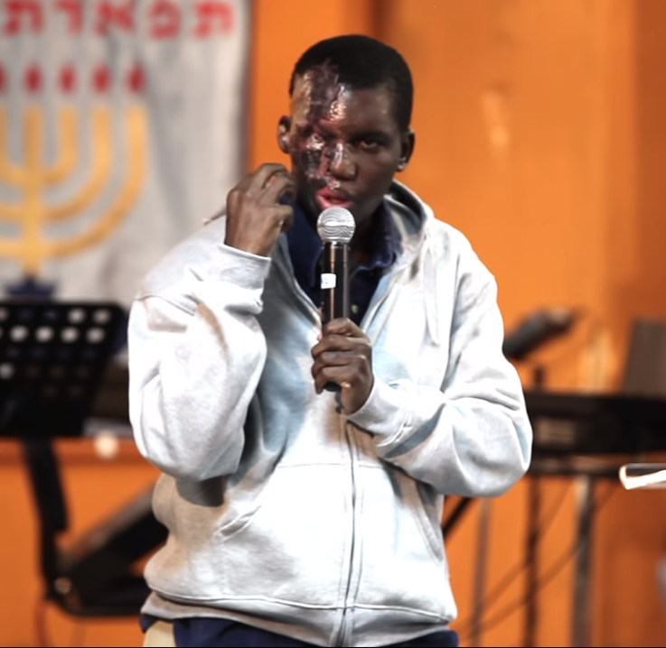
https://youtu.be/YMWd7QnXY8E

