Slide 1
e-handout
To have these notes
without taking notes
Go to OrHaOlam.com
Click on downloads,
messages, 2019
Notes:
.

Slide 2
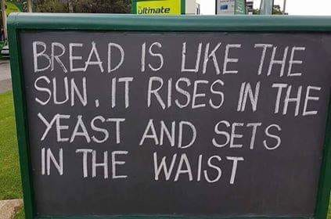
Notes:
Mordekhi Hiatt’s Facebook

Slide 3
Notes:
Hiatt’s Facebook

Slide 4
Notes:
Hiatt’s Facebook

Slide 5
Notes:
Hiatt’s Facebook

Slide 6
מַתִּתְיָהוּ Mattityahu
(Matthew) 26:47-49
Notes:
Continuing the story of Yeshua, and His talmidim sleeping when He needed them.

Slide 7
This is the time of year of counting the days till Shavuot.
Called counting the עֹמֶרOmer = bundles of wheat.
Counting gives each item value.
Counted people [Bk Numbers, new believers, fish, OH ~25 in 23 years]

Slide 8
Counting means all the little steps matter.
Counting to Shavuot/Pentecost.
Count attendance: look to left and right: treasure!
Yeshua had 12, wanted help from three…
Notes:
Note the frequency of counted quantities in this story…Each significant

Slide 9
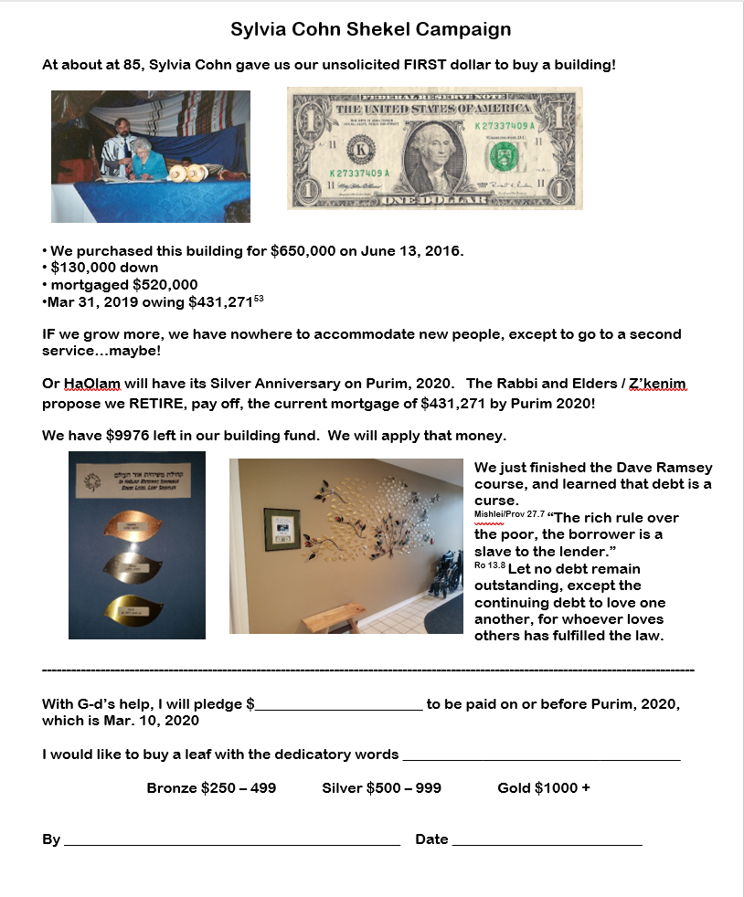

Slide 10
Yeshua had made it through the hematadrosis [stress causing bloody sweat], without their help and support and comfort.
^{Lk 22. 42-44} There appeared to him an angel from heaven giving him strength…
Notes:
Takotsubo heart stress disease
If we deny Him, He is yet faithful.

Slide 11
^{Mtt. 26.44-46} Then he came to the talmidim and said, “For now, go on sleeping, take your rest…
How long? 20 minutes?
Look! The time has come for the Son of Man to be betrayed into the hands of sinners. Get up! Let’s go! Here comes my betrayer!”

Slide 12
Mattityahu (Matthew) 26:47
עוֹדֶנּוּ מְדַבֵּר וְהִנֵּה בָּא יְהוּדָה, אֶחָד מִן הַשְּׁנֵים־עָשָׂר, וְאִתּוֹ הָמוֹן רַב,
While Yeshua was still speaking, Y’hudah (one of the Twelve!) came, and with him a large crowd

Slide 13
Mattityahu (Matthew) 26:47
מֵאֵת רָאשֵׁי הַכֹּהֲנִים וְזִקְנֵי הָעָם, בַּחֲרָבוֹת וּבְמַקְלוֹת.
carrying swords and clubs, from the head cohanim and elders of the people.

Slide 14
Backstory…

Slide 15
^{Mt 26.14-16} Then one of the Twelve, the one called Y’hudah from K’riot, went to the head cohanim and said, “What are you willing to give me if I turn Yeshua over to you?” They counted out thirty silver coins and gave them to Y’hudah. From then on he looked for a good opportunity to betray him.

Slide 16
How can we understand Yehuda’s [Judas] betrayal?
What can we learn, apply to our lives?

Slide 17
^{Lk 9.1-2} Calling together the Twelve [including Yehuda], Yeshua gave them power and authority to expel all the demons and to cure diseases; and he sent them out to proclaim the Kingdom of God and to heal.
Yehuda had Messiah’s power!
Notes:
Maybe not grateful? Not enough?

Slide 18
However, Yehuda always addresses Yeshua as “Rabbi,” but never as “Lord”
Notes:
How do we address Him?

Slide 19
"Iscariot" may be a conflation of the Hebrew Ish Kerioth, or “man from Kerioth,” קְרִיּוֹת איש a town in the southern part of Judea. If so, it has been speculated, Yehuda was the only non-Galilean.
Isolation, unresolved loneliness?

Slide 20
"Iscariot" also closely resembles a Greek word meaning "dagger-bearer. “Sicarii” Terrorist assassins.
Early warning…
Notes:
https://en.wikipedia.org/wiki/Sicarii
https://www.osv.com/OSVNewsweekly/ByIssue/Article/TabId/735/ArtMID/13636/ArticleID/10524/Why-Did-Judas-Betray-Jesus.aspx

Slide 21
^{Yn 6.67-71} Yeshua said to the Twelve, “Don’t you want to leave too?” Shim‘on Kefa answered him, “Lord, to whom would we go? You have the word of eternal life. We have trusted, and we know that you are the Holy One of God.”
Notes:
https://en.wikipedia.org/wiki/Judas_Iscariot

Slide 22
^{Yn 6.67-71} Yeshua answered them, “Didn’t I choose you, the Twelve? Yet one of you is an adversary.” (He was speaking of Y’hudah Ben-Shim‘on, from K’riot; for this man — one of the Twelve! — was soon to betray him.)
Notes:
Early warning?
Another incident…
https://en.wikipedia.org/wiki/Judas_Iscariot

Slide 23
^{Yn 12.4-6} But one of the talmidim, Y’hudah from K’riot, the one who was about to betray him, said, “This perfume is worth a year’s wages! Why wasn’t it sold and the money given to the poor?”

Slide 24
^{Yn 12.4-6} Now he said this not out of concern for the poor, but because he was a thief — he was in charge of the money box and used to steal from it.

Slide 25
Yehuda carried the disciples' money bag or box γλωσσόκομον, glōssokomon
Notes:
https://en.wikipedia.org/wiki/Judas_Iscariot

Slide 26
Possible betrayal motives:
Ingratitude for power
Not submitting to lordship
Isolation, unresolved loneliness
Political purposes
Progressive purloining

Slide 27
No matter how close you are to Yeshua’s physical presence, ie His Seder table in Yerushalayim, you are not nearly as close as
^{Yn 14.23} Yeshua answered him, “If someone loves me, he will keep my word; and my Father will love him, and we will come to him and make our home with him.

Slide 28
When we commit to evil, there are frequently a lot of steps to it. But finally we are on a headlong rush… ^{Yaakov 1.14-16} Each person is being tempted whenever he is being dragged off and enticed by the bait of his own desire.

Slide 29
^{Yaakov 1.14-16} Then, having conceived, the desire gives birth to sin; and when sin is fully grown, it gives birth to death. Don’t delude yourselves, my dear brothers.
Notes:
Illustration from Canada, where we lived for 8 years, 6 of them in Winnipeg, Manitoba.

Slide 30
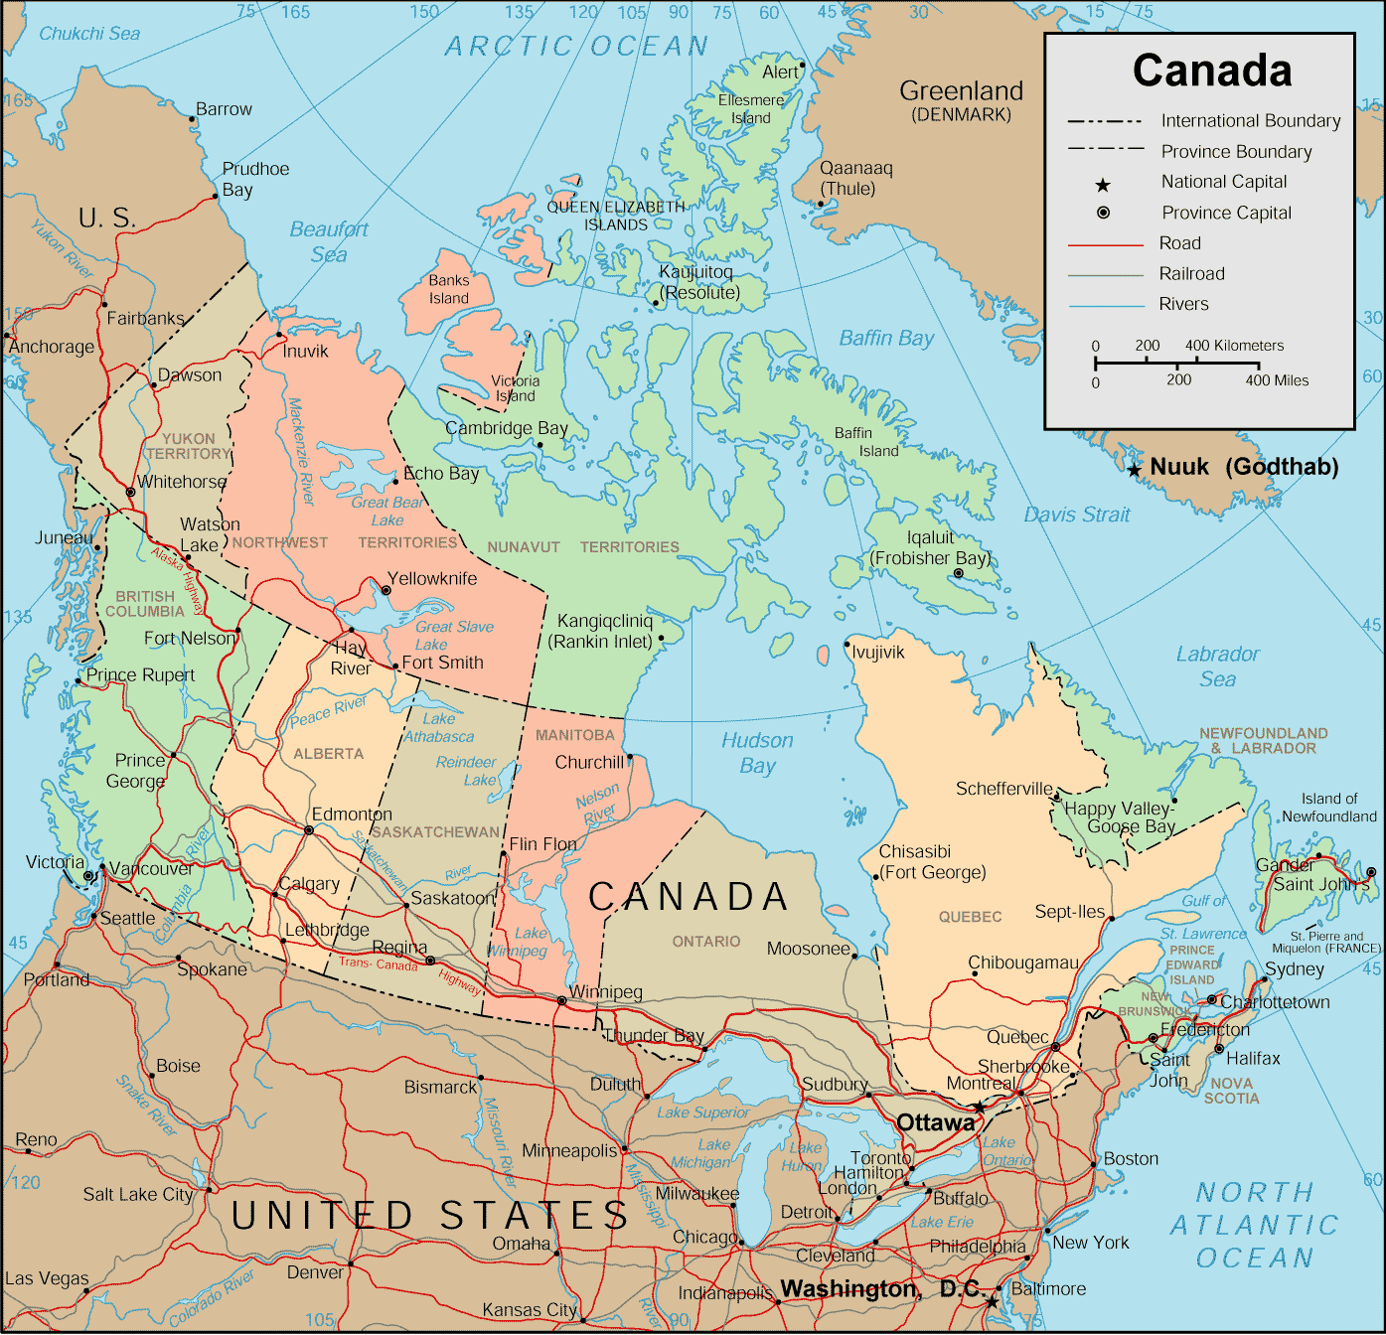
Notes:
Gets to be -40° F [F and C come together that cold]
Nevertheless, large city.

Slide 31
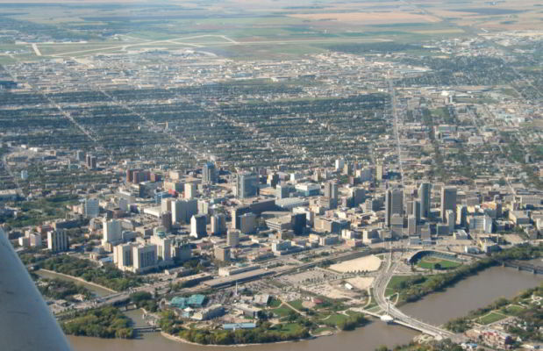
Winnipeg, Manitoba, Canada
Notes:
Canada 2011 Census there were approximately 730,018 living in the Winnipeg Metropolitan Area
Missionaries to the Native Canadians/ Indians 6 years.

Slide 32
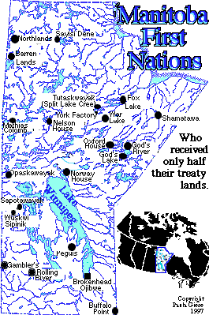
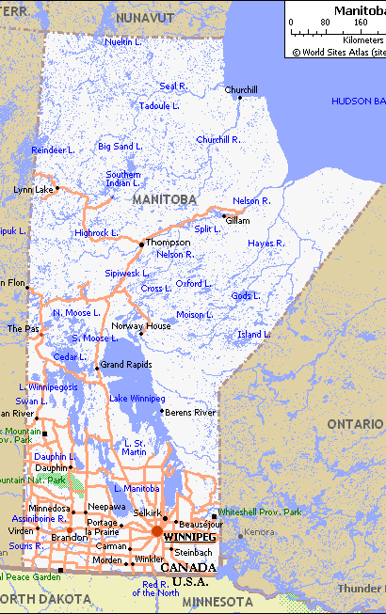
Notes:
Mostly city ministry, some trips to reserves
without road access, no RR, fly-in or winter roads marked out across the frozen lakes. Most homes with outhouses, no running water. People born “on the trap line.”
Winnipeg had plumbing. “Up north” primitive.

Slide 33
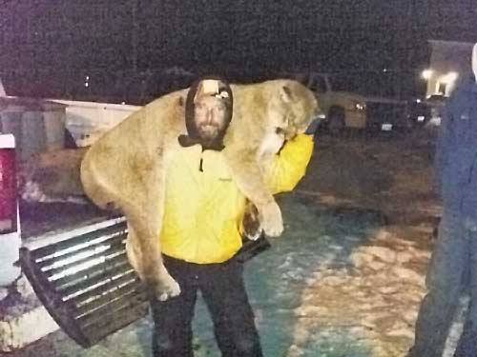
Notes:
Me at age 30. Well, maybe not.

Slide 34
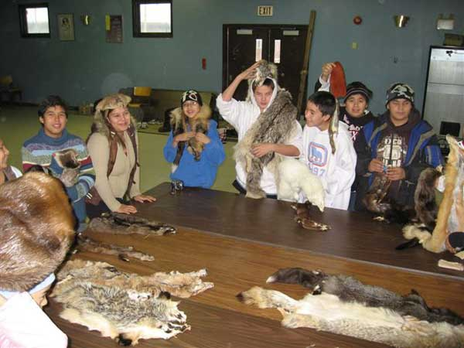
Notes:
Trapping still big business. People trapped animals for their pelts and traded them at the Hudson Bay Store, still in business. Founded 2 May 1670
Red fox in 1980’s $60. Trading pelts at the Bay Store for merchandise: 1980’s, so traded pelts for satellite dishes, VCR’s, canned goods, tools.
Satellite dish and an outhouse!

Slide 35
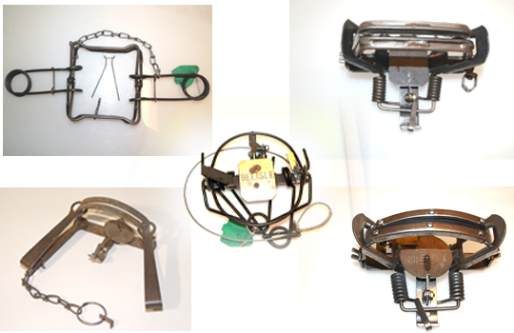
Humane Trapping

Slide 36
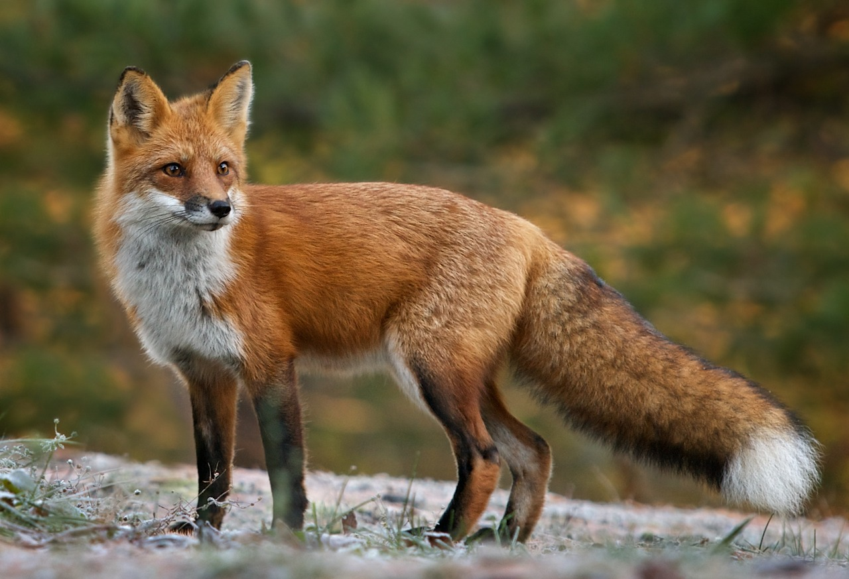
Red fox
Traps are set 10 or 15 ft off the path.
Notes:
There are paths in the forest. Trail bicyclists use them. Picture the fox above, on the path, and he smells something…something…
Traps are set 10 or 15 feet off the path.

Slide 37
Genealogy of temptation
^{Yaakov/James 1.13-16} God himself tempts no one. Rather, each person is being tempted whenever he is being dragged off and enticed by the bait of his own desire.
Notes:
Enticed
All real joys G’s CS Lewis Screwtape wrote to Wormwood, his trainee in seduction, “Despite all our research, we can’t come up with a single pleasure…All from the Enemy.” Yehuda’s temptations:
Ingratitude for power
Not submitting to lordship
Isolation, unresolved loneliness
Political purposes
Progressive purloining
Your temptation? I’m not prophetic enough, but fill in…

Slide 38
of his own desire.
Notes:
Desires NOT sinful, normal natural
There’s that enticing picture on the side of the news article, Foxnews, CNN, Jerusalem Online. I’m just curious...
Ripe opportunity to say that really cutting remark at him, her.
Alluring chance to show people who I AM.
Rather serve, bless, build up others, communicate JOY.
Enticed:

Slide 39
Enticed
^{Luke 22:40 NAS} When He arrived at the place, He said to them, "Pray that you may not enter into temptation."
Notes:
Roll in around in your mouth, imagine what it tastes like.
Cherry centered chocolate?
How long can one contemplate sin, without ENTERING into temptation?

Slide 40
^{Mishlei/Prov 4.18} But the path of the righteous is like the light of dawn, shining ever brighter until full daylight.
^{T’hillim/Ps 25.10} All ADONI's paths are grace and truth to those who keep his covenant and instructions.
Keep, guard, נֹצְרֵי בְרִיתוֹ (literary) to guard, to save ; (weaponry) to lock ; to keep, to maintain
Notes:
I particularly am blessed with the light of Dawn.
Stay on the path of light and joy!
Trigger finger on weapon: mixed metaphor, but sword of the Word. Sapper, alert for landmines of temptation.

Slide 41
Genealogy of temptation
^{Yaakov/James 1.13-16} Then, having conceived, the desire gives birth to sin; and when sin is fully grown, it gives birth to death.
Therefore Yeshua ישוע says [above]: “Pray that you may not enter into temptation.” Prayerlessnes like O₂ deprivation in smog.
Notes:
Roll in around in your mouth: contemplate evil, build that male female [outside marriage] friendship/warmth…CONCEIVED → sin
Heard Micah and Abby Mahoney, Jude’s firstborn son, first kiss on the lips at wedding. Stayed on the path of purity. Saw Facebook, seemed to have figured it out.]
Matzah lesson: flee Egypt.
Fox goes over to bait and toys with it.
Certain point of pressure on bait, snap and jaws of trap spring → guilt
Usually think, once, just look, get a whiff, not again. Off path, onto bait.
Boots of hunter, shoot, skin
Vs 16, don’t delude yourselves re temptation

Slide 42
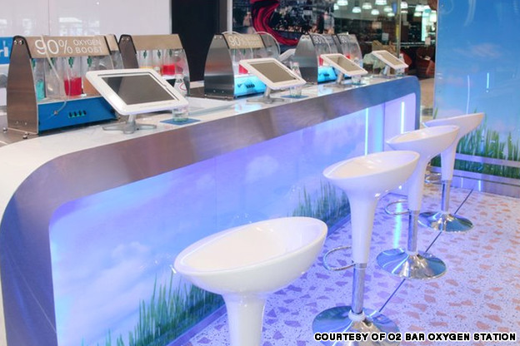
The oxygen bar in Darling Harbour
that promises 90-percent oxygen
Notes:
Darling Harbour, Sydney, Australia

Slide 43
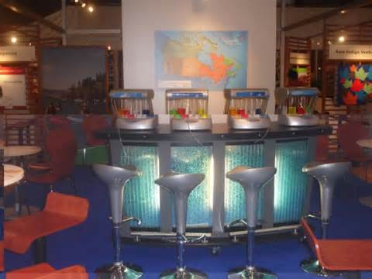

Slide 44
^{Yaakov 1.15} when sin is fully grown, it gives birth to death.
Notes:
GUILT
Death and Hell, eternal loss
Or scandal
John Edwards w videographer, wife w cancer,
Tiger Woods multiple women,
South Carolina Gov. Mark Sanford woman in Argentina
You and porn? Flee, confess, find accountability

Slide 45
Genealogy of temptation
^{Yaakov/James 1.13-16} Don't delude yourselves, my dear brothers.
Notes:
Easy to say, I’m strong, can get away with it…

Slide 46
Scripture never says
“Resist temptation.”
Only “Resist HaSatan”
“Flee temptation”
^{Yaakov 4.7} Therefore, submit to God. Moreover, take a stand against the Adversary, and he will flee from you.
Notes:
Resist HaSatan
Sitting at your desk, driving, minding own business and evil thoughts, resist

Slide 47
^{Yn13.30} As soon as he had taken the piece of matzah, Y’hudah went out, and it was night.
Notes:
Is there any issue that you are contemplating leaving the path?
Any festering wound, unsatisfied desire, frustrated ambition?
Don’t toy with it. Let it go early!!

Slide 48
Yehuda had yielded to evil, and had NOT been asleep, he had been with the chief priests, and acquainted them with the opportunity he had of making good his agreement with him: he had got the band of soldiers, and other persons together, in order to make sure work of it.
Notes:
John Gill

Slide 49
The enemy, and wicked men are diligent in the accomplishment of their evil designs, while sometimes good men are asleep and indifferent to godly exercises and spiritual warfare.
Notes:
John Gill

Slide 50
^{Yn 18.3} Y’hudah went there [to Gat Shemeni], taking with him a detachment of Roman soldiers and some Temple guards provided by the head cohanim and the P’rushim; they carried weapons, lanterns and torches.
Notes:
He was familiar with the place, and it was a full moon. How do we know the phase of the moon?

Slide 51
The ones with the swords were Roman soldiers and the ones with staves [clubs] were Jewish representatives of the Temple leaders.
Notes:
http://www.blainerobison.com/bible2/marknotes14.htm

Slide 52
polýs – many (high in number); multitudinous, plenteous, "much"; "great" in amount (extent).
Notes:
https://biblehub.com/greek/4183.htm

Slide 53
"band" of soldiers, if it was complete, consisted of a thousand men itself.
Notes:
https://www.biblestudytools.com/commentaries/gills-exposition-of-the-bible/matthew-26-47.html

Slide 54
ספר תולדות ישו The Book of the
Generations/History/Life of Yeshu), often abbreviated as Toledot Yeshu, is an early Jewish text taken to be an alternative biography of Yeshua. None of the versions are considered either canonical within rabbinic literature.

Slide 55
Toledot Yeshu reports that Yeshua had two thousand men with him: and who came also "with swords and staves, or clubs.”
Notes:
https://www.biblestudytools.com/commentaries/gills-exposition-of-the-bible/matthew-26-47.html

Slide 56
The tower of Antonia served as an official residence for the Roman procurators and had sufficient space to accommodate a Roman cohort (500-600 men).
Notes:
http://www.blainerobison.com/bible2/marknotes14.htm

Slide 57
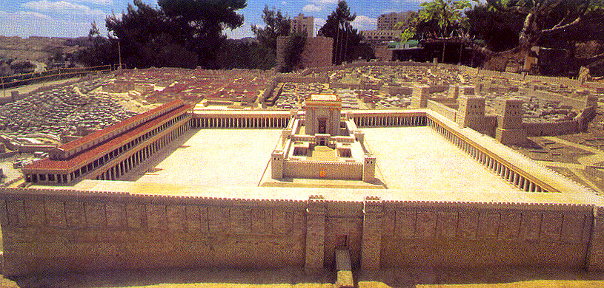
Temple model, looking west, Antonia on right
Notes:
https://emp.byui.edu/SATTERFIELDB/Rel211/jerusalem.htm

Slide 58
John's narrative records some important elements in the arrest account that occurs before Yehuda speaks: "Then Yeshua, knowing all the things coming upon Him, went forward. He said to them, "Who are you looking for?" "Yeshua ha-Natzrati," they answered Him. Yeshua tells them, "I am." Now Yehuda, the one betraying Him, was also standing with them.
Notes:
http://www.blainerobison.com/bible2/marknotes14.htm

Slide 59
So when Yeshua said to them, "I am," they drew back and fell to the ground. So again He asked them, "Who are you looking for?" And they said, "Yeshua ha-Natzrati." Yeshua answered, "I told you, I am! If you're looking for Me, let these men go their way. This was so the word would be fulfilled that He spoke, "I did not lose one of those You have given Me." ^{(John 18:4-7 TLV)}
Notes:
http://www.blainerobison.com/bible2/marknotes14.htm

Slide 60
Yeshua replies, saying "I am" (Grk. egō eimi). The best rendering is that what Yeshua said in Hebrew was the self-revelation of God אני הוא ani-hu, the One, G-d.
Notes:
http://www.blainerobison.com/bible2/marknotes14.htm

Slide 61
^{Lk 22.52-53} Then Yeshua said to the ₁head cohanim, ₂the officers of the Temple guard ₃and the elders who had come to seize him,

Slide 62
^{Lk 22.52-53} “So you came out just as you would to the leader of a rebellion, with swords and clubs? Every day I was there with you in the Temple court, yet you didn’t arrest me. But this is your hour — the hour when darkness rules.”
Notes:
Roman method of dealing with guerilla Revolutionaries, execute ringleader.

Slide 63
Mattityahu (Matthew) 26:48
הַמַּסְגִּיר אוֹתוֹ הִקְדִּים לָתֵת סִימָן בְּאָמְרוֹ: ”מִי שֶׁאֶתֵּן לוֹ נְשִׁיקָה זֶה הוּא: תִּפְסוּ אוֹתוֹ.“
The betrayer had arranged to give them a signal: “The man I kiss is the one you want — grab him!”

Slide 64
Mattityahu (Matthew) 26:49
מִיָּד נִגַּשׁ אֶל יֵשׁוּעַ וְאָמַר: ”שָׁלוֹם, רַבִּי“, וְנִשֵּׁק אוֹתוֹ.‏
He went straight up to Yeshua, said, “Shalom, Rabbi!” and kissed him.

Slide 65
kataphiléō (katá, “down,” intensifying philéō, “to kiss”) – properly, kiss down,
i.e.
kiss passionately and fervently
kiss repeatedly
kiss affectionately
Notes:
Keener p 642: as one who brought great joy
https://biblehub.com/greek/2705.htm

Slide 66
^{Ro 16.16} Greet one another with a holy kiss.
^{1 Cor. 16.20} All the brothers and sisters greet you. Greet one another with a holy kiss.
Expression of affection is good, but…

Slide 67
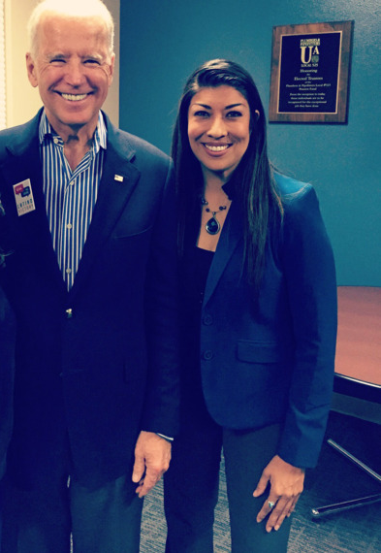
Vice Pres. Joe Biden with Lucy Flores in 2014, just before the uncomfortable kiss on her head.

Slide 68
Lucy Flores wrote on Mar. 29, 2019
“Pictures started to surface of Vice-President Biden getting uncomfortably close with women and young girls. Biden nuzzling the neck of the Defense secretary’s wife;
Notes:
https://www.thecut.com/2019/03/an-awkward-kiss-changed-how-i-saw-joe-biden.html

Slide 69
Biden kissing a senator’s wife on the lips; Biden whispering in women’s ears; Biden snuggling female constituents. I saw obvious discomfort in the women’s faces, and Biden, I’m sure, never thought twice about how it made them feel.”
Notes:
Expression of affection is good, but be respectful,
https://www.thecut.com/2019/03/an-awkward-kiss-changed-how-i-saw-joe-biden.html

Slide 70
^{2 Shmuel 20.9} Yo’av said to ‘Amasa, “Is it going well with you, my brother? Then, with his right hand, Yo’av took ‘Amasa by the beard to kiss him. ¹⁰ ‘Amasa took no notice of the sword in Yo’av’s hand, so Yo’av stabbed him in the groin.

Slide 71
Expressions of affection are good, hazardous.
Side hugs or neck hugs.
Culturally varying.

Slide 72
^{Mattityahu (Matthew) 26:49} Yeshua said to him, “Friend, do what you came to do.”
Wording of Yeshua here implication of last appeal for Yehuda to reconsider…

Slide 73
^{Mt 20.13} “But answering, he said to one of them, ‘Friend, I’m doing you no wrong. Didn’t you agree with me on a denarius?
^{Mt 22.12} ‘Friend,’ he said to him, ‘how did you get in here without wedding clothes?’ But the man was silent.

Slide 74
^{T’hillim/Ps 41.10} Even my close friend, on whom I relied, who shared my table, has turned against me.

Slide 75
^{T’hillim/Ps 55.13-15} For it was not an enemy who insulted me; if it had been, I could have borne it. It was not my adversary who treated me with scorn; if it had been, I could have hidden myself. But it was you, a man of my own kind, my friend, whom I knew well.

Slide 76
^{T’hillim/Ps 55.13-15} We used to share our hearts with each other; in the house of God we walked with the crowd.
Notes:
Is there anyone who really knows the secrets of your heart? Need just one. Usually spouse. Not always.

Slide 77
^{Zekh 13.6} Then someone will ask him, “What are these wounds between your hands?”— and he will answer, “Those that I received in the house of my friends.”
Notes:
No one can hurt you like those closest

Slide 78
^{Mattityahu (Matthew) 26:49} Yeshua said to him, “Friend, do what you came to do.” Then they moved forward, laid hold of Yeshua and arrested him.

Slide 79
Yehuda had yielded to evil, and had NOT been asleep, he had been with the chief priests, and acquainted them with the opportunity he had of making good his agreement with him: he had got the band of soldiers, and other persons together, in order to make sure work of it.
Notes:
John Gill

Slide 80
Wicked men are diligent in the accomplishment of their evil designs, while sometimes good men are asleep and indifferent to godly exercises and spiritual warfare.
Notes:
John Gill

Slide 81
^{Ro 13.11-14} Besides this, you know the time—that it is already the hour for you to awaken from sleep; for now our salvation is nearer than when we first came to trust. The night is almost gone and the day is near, so let us put off the works of darkness and put on the armor of light.

Slide 82
^{Ro 13.11-14} Let us walk properly as in the day—not in carousing and drunkenness, not in sexual promiscuity and sensuality, not in strife and envy. Instead, put on the Lord Messiah Yeshua, and stop making provision for the flesh—for its cravings.

Slide 83
Apr. 24, 2019 Last week, Justice Francesca Marzari of the Supreme Court of British Columbia, Canada, declared a father guilty of “family violence” against his 14-year-old daughter on the sole basis that he had engaged in “expressions of rejection of [her] gender identity.”
Notes:
https://thefederalist.com/2019/04/24/father-gagged-found-guilty-family-violence-calling-trans-daughter/

Slide 84
These “expressions” revolved entirely around his polite refusal to refer to his daughter as a boy in private, and his steady choice to affirm that she is a girl in public.
Notes:
https://thefederalist.com/2019/04/24/father-gagged-found-guilty-family-violence-calling-trans-daughter/

Slide 85
As previously reported, the BC Supreme Court ordered in February that 14-year-old Maxine* receive testosterone injections without parental consent. Accordingly, Maxine began regular injections at British Columbia (BC) Children’s Hospital over the course of the last two months.
Notes:
https://thefederalist.com/2019/04/24/father-gagged-found-guilty-family-violence-calling-trans-daughter/

Slide 87
So,
sign petitions to the government
Vote!
Serve to advance the Kingdom
Above all: Pray much and fervently.
A good thing next Shabbat afternoon…

Slide 89
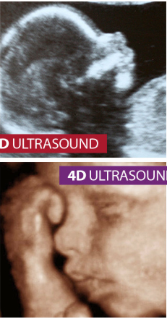
on Saturday, May 4, afternoon, 2:30 EST that we're calling ALIVE FROM NEW YORK. It will feature LIVE 4D ultrasounds displayed on the massive digital screens in Times Square, powerfully showing the world that a baby inside the womb is fully human and deserving of life.
Notes:
https://store.focusonthefamily.com/singleitem/checkout/donation/item/don-declaration-of-life#refcd=730404?utm_source=focusonthefamily.com/pro-life&utm_medium=referral&utm_campaign=SeeLifeClearly2019&utm_content=

Slide 90
“Alive from New York” is a Focus on the Family event designed to celebrate the sanctity of human life; marvel at the wonder of human development in the womb; and encourage advocacy for women facing unplanned pregnancies and the preborn.
Notes:
https://events.focusonthefamily.com/events/alive-from-new-york-live-stream/?utm_source=enewsletter&utm_medium=pro_life_church&utm_campaign=alive_from_new_york_livestream&refcd=749902&utm_campaign=749902&utm_medium=email&utm_source=nl_thrivingpastor

Slide 91
The event will feature live music and inspirational speeches from special guests, as well as abortion survivors. The culminating moment of the event will be a live 4D ultrasound broadcast on massive digital screens in Times Square.
Notes:
https://events.focusonthefamily.com/events/alive-from-new-york-live-stream/?utm_source=enewsletter&utm_medium=pro_life_church&utm_campaign=alive_from_new_york_livestream&refcd=749902&utm_campaign=749902&utm_medium=email&utm_source=nl_thrivingpastor
“Alive

Slide 92
Go to https://www.focusonthefamily.com/
To register
We’ll show some of it here.
Invite friend to next week…

Slide 94
^{Ro 13.11-14} Let us walk properly as in the day—not in carousing and drunkenness, not in sexual promiscuity and sensuality, not in strife and envy. Instead, put on the Lord Messiah Yeshua, and stop making provision for the flesh—for its cravings.

