Slide 1
e-handout
To have these notes
without taking notes
Go to OrHaOlam.com
Click on downloads,
messages, 2019
Notes:
.

Slide 2
Notes:
Morekhi Hiatt Facebook, I think

Slide 3
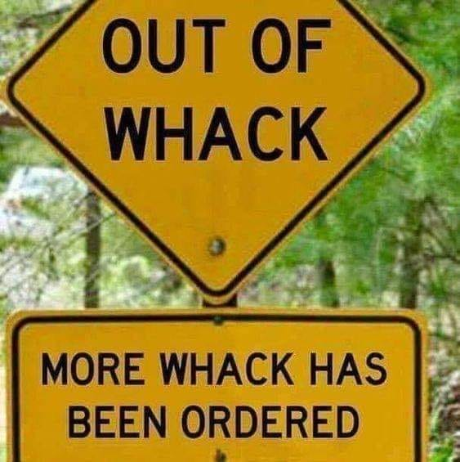
Notes:
Morekhi Hiatt Facebook, I think

Slide 4
Notes:
Morekhi Hiatt Facebook, I think

Slide 5
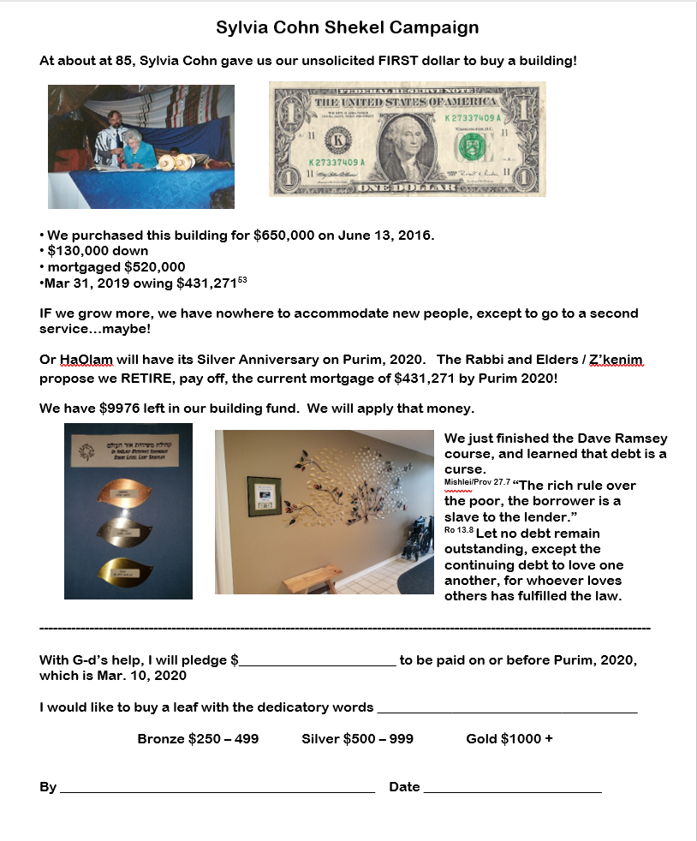
Pray about
making a Mortgage retirement pledge by next week Shavuot, June 8, 2019
paid by Purim, Mar. 9, 2020.
Notes:
All that good Dave Ramsey material on Debt Free.
Next week is the last time I’ll be showing this.

Slide 6
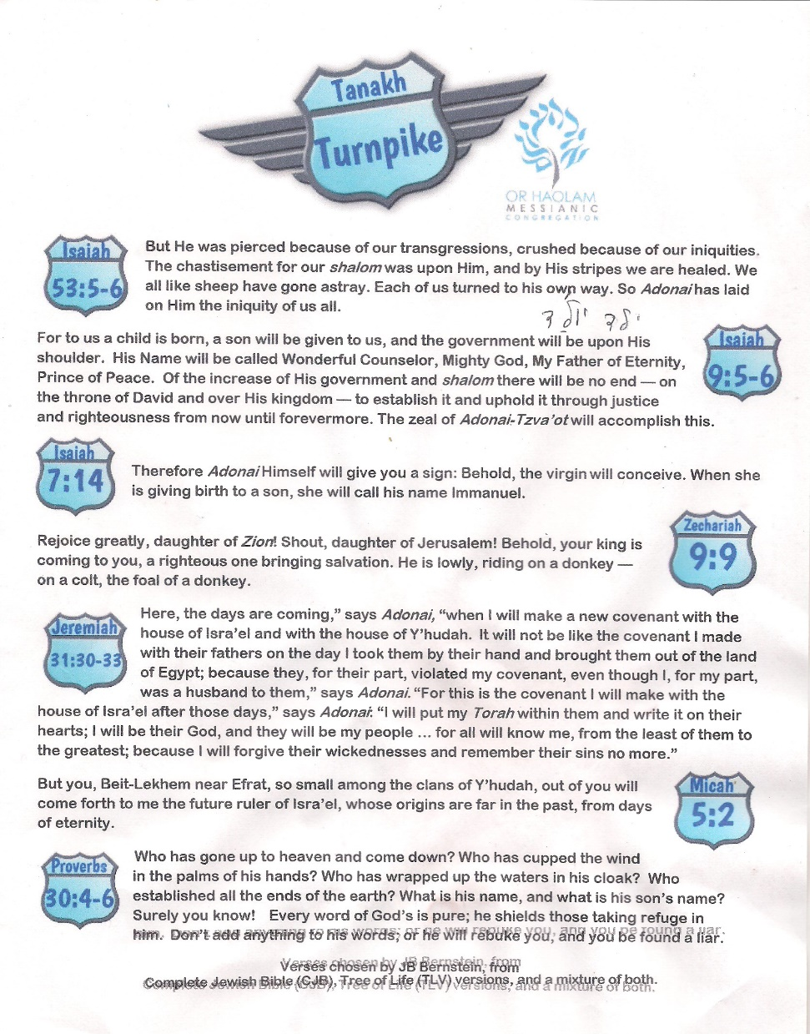
available as handout
We are challenged to memorize three per week, prep for July outreach.

Slide 7
A way to fast track memorization by music: singing the scriptures.
Singing the scriptures in Hebrew.

Slide 8
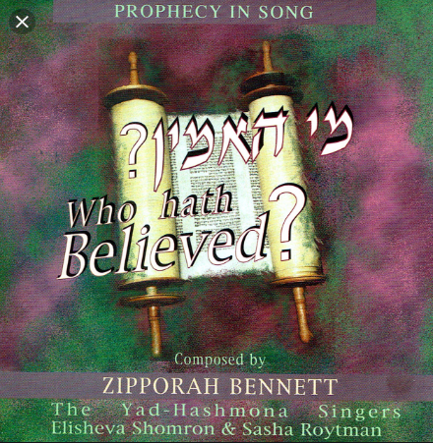
Or HaOlam has hosted Zipporah Bennett in concert about 15 years ago.

Slide 9
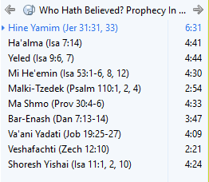

Slide 10
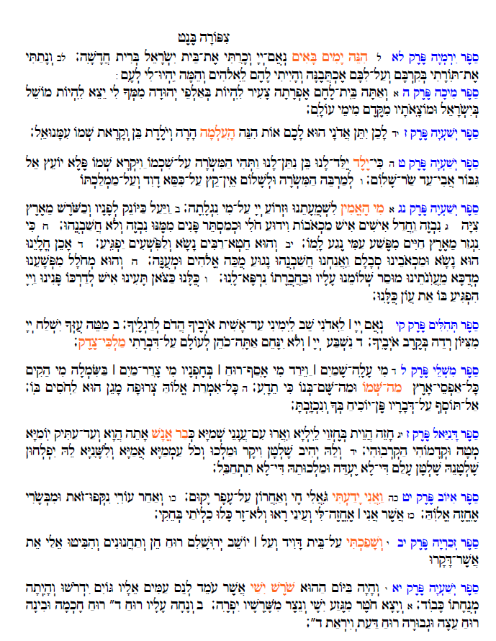
Notes:
I will demo 3 verses, as promised.
How many have you memorized?

Slide 11
Pastor Umar Mulinde
The congregations exist for one major reason - To draw people to Messiah and disciple them until they are like Messiah. We can not over emphasize the second coming of Messiah when half of the world has not heard of His first coming.

Slide 12
Pastor Umar Mulinde
Tell some one about Messiah today. Be thirsty to Win souls for Messiah. Be a soul winner forever. Have a blessed Shabbat. 🙏
Pastor Umar Mulinde.Shalom.

Slide 13
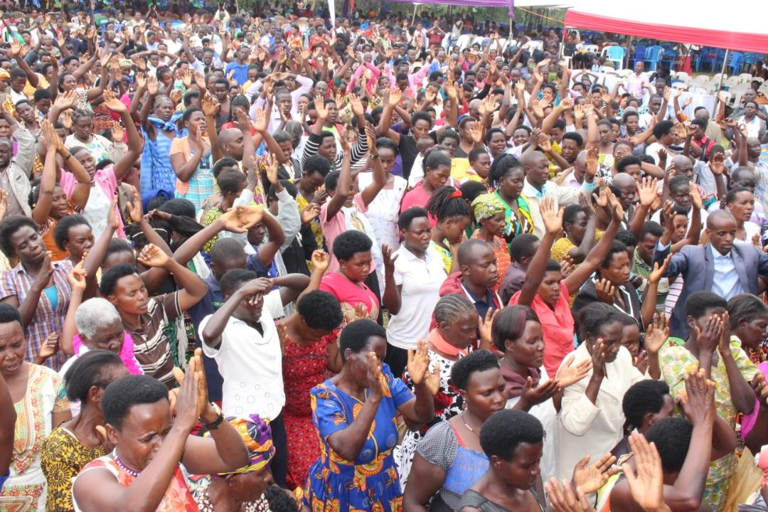

Slide 14
מַתִּתְיָהוּ Mattityahu
(Matthew) 26:59-62
Notes:
So, Yeshua
had His last Seder with his men and families,
prayed through the bloody hematadrosis stress sweat till angelic strength and shalom.
Then the soldiers came.
His men rallied and cut off an attackers ear. Yeshua healed the ear.
Soldiers seized Him.
Kefa followed vacillating.
Yokhanan followed assertively.

Slide 15
Theme today:
Accusations
Yeshua received accusations.
We receive accusations.
We give accusations.

Slide 16
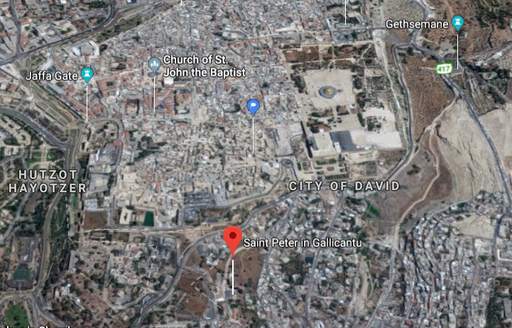

Slide 17
Mattityahu (Matthew) 26:59
אָז חִפְּשׂוּ רָאשֵׁי הַכֹּהֲנִים וְכָל הַסַּנְהֶדְרִין עֵדוּת שֶׁקֶר עַל יֵשׁוּעַ כְּדֵי לְהָמִית אוֹתוֹ,
The head cohanim and the whole Sanhedrin looked for some false evidence against Yeshua, so that they might put him to death.

Slide 18
Mattityahu (Matthew) 26:60
אַךְ לֹא מָצְאוּ, אַף שֶׁבָּאוּ לְשָׁם עֵדֵי שֶׁקֶר רַבִּים. אַחֲרֵי כֵן נִגְּשׁוּ שְׁנֵי עֵדֵי שֶׁקֶר וְאָמְרוּ,
But they didn’t find any, even though many liars came forward to give testimony. At last, however, two people came forward and said,

Slide 19
Mattityahu (Matthew) 26:61
”זֶה אָמַר, ’אֲנִי יָכוֹל לַהֲרֹס אֶת הֵיכַל הָאֱלֹהִים וּבִשְׁלוֹשָׁה יָמִים לִבְנוֹת אוֹתוֹ‘.“
“This man said, ‘I can tear down G-d’s Temple and build it again in three days.’”

Slide 20
Did Yeshua say that? When?
Did Yeshua say anything like that? [half truth?]
3 years previously…

Slide 21
^{Yn 2.18-22} “What miraculous sign can you show us to prove you have the right to do all this?” Yeshua answered them, “Destroy this temple, and in three days I will raise it up again.” The Judeans said, “It took 46 years to build this Temple, and you’re going to raise it in three days?”
Notes:
Cf accusation: ‘I can tear down G-d’s Temple and build it again in three days.’
Not what He was accused of saying.
Moreover, He really had another meaning altogether.

Slide 22
^{Yn 2.18-22} But the “temple” he had spoken of was his body. Therefore, when he was raised from the dead, his talmidim remembered that he had said this, and they trusted in the Tanakh and in what Yeshua had said.

Slide 23
About 2 years later,
similarly, Stephen was accused of following this dangerous Man…

Slide 24
^{Acts 6.10-15} They set up false witnesses who said, “This man [Stephen] never stops speaking against this holy place and against the Torah; for we have heard him say that Yeshua from Natzeret

Slide 25
^{Acts 6.10-15} will destroy this place and will change the customs Moshe handed down to us.” Everyone sitting in the Sanhedrin stared at Stephen and saw that his face looked like the face of an angel.
Notes:
How we are perceived when accused. Yes? Attitude is everything, the His Kingdom..
Then in Ch 7, Stephen gave his magnificent brief presentation of the history of Israel, and our need for redemption, which was met with him being stoned to death.
But, one of the participants was Shaul, who had his own revelation of Yeshua in the following chapter 8.
Parallel passage in Mark gives a bit more insight on accusations against Yeshua:

Slide 26
^{Mark 14.55-59} Now the ruling cohanim and all the Sanhedrin kept trying to get evidence against Yeshua so they could put Him to death, but they weren’t finding any. Many were giving false testimony against Him, but their testimony wasn’t consistent.

Slide 27
^{Mark 14.55-59} Some stood up and began to give false testimony against Him, saying, “We heard Him say, ‘I will destroy this Temple made with hands, and in three days I will build another made without hands.’” Yet even then, their testimony didn’t agree.
Notes:
Not what He really said.

Slide 28
The Cohen HaGadol [High Priest] and the Sanhedrin had a great legal problem in condemning Yeshua.
The Torah and ancient commentaries had a detailed system of justice for the accused, especially if it was a capital crime = worthy of death.

Slide 29
^{Dvarim/Dt 19.15-21} “One witness alone will not be sufficient to convict a person of any offense or sin of any kind; the matter will be established only if there are two or three witnesses testifying against him.

Slide 30
^{Dvarim/Dt 19.15-21} “If a malicious witness comes forward and gives false testimony against someone, then both the men involved in the controversy are to stand before Adonai, before the cohanim and the judges in office at the time. The judges are to investigate carefully. [cross examine]

Slide 31
^{Dvarim/Dt 19.15-21} If they find that the witness is lying and has given false testimony against his brother, you are to do to him what he intended to do to his brother. In this way, you will put an end to such wickedness among you.

Slide 32
^{Dvarim/Dt 19.15-21} Those who remain will hear about it, be afraid and no longer commit such wickedness among you. Show no pity [with lying witnesses]: life for life, eye for eye, tooth for tooth, hand for hand, foot for foot.

Slide 33
Avodah Zarah עֲבוֹדָה זַרָה
Foreign worship = idolatry
^{Dt. 17.6} The death sentence is to be carried out only if there was testimony from two or three witnesses; he may not be sentenced to death on the testimony of only one witness.

Slide 34
^{Bamidbar/Nu 35.30} “‘If anyone kills someone, the murderer is to be put to death upon the testimony of witnesses; but the testimony of only one witness will not suffice to cause a person to be put to death.

Slide 35
^{Vayikra/Lev 24.13-14} Adoni said to Moshe, “Take the man who cursed outside the camp, have everyone who heard him lay their hands on his head, and have the entire community stone him.

Slide 36
^{Vayikra/Lev 24.16} Whoever blasphemes the name of Adoni must be put to death; the entire community must stone him. The foreigner as well as the citizen is to be put to death if he blasphemes the Name.

Slide 37
Summary of Torah on accusations:
Two or three accusers needed
Accusers to be cross examined
Malicious false witness gets same punishment as crime.
All witnesses “hands on” to execution.

Slide 38
Interpretation of Torah in Yeshua’s day was in orally transmitted concepts

Slide 39
The Mishna מִשְׁנָה is the first major written collection of the Jewish oral traditions known as the “Oral Torah.” It is also the first major work of Rabbinic literature. The Mishnah was redacted [assembled] by Judah the Prince at the beginning of the third century CE.
Notes:
So about the year 200, but compiled from older literature that was transmitted by memory only. Hence “Oral Law” though now written down. So, the concepts from the Mishna were likely common knowledge among leaders in Yeshua’s time.
Here is the usefulness of the Talmud.
Torah truth on accusations, witnesses, made considerably more complex:

Slide 40
^{Mishna Sanhedrin 4:1} ₁Both non-capital and capital cases require examination and inquiry [of the witnesses], as it says, “You shall have one manner of law” (Lev. 24:22). How do non-capital cases differ from capital cases?
Notes:
https://www.sefaria.org/Mishnah_Sanhedrin.4.1?lang=bi&with=all&lang2=en

Slide 41
^{Mishna Sanhedrin 4:1} Non-capital cases [are decided] by three and ₂capital cases by twenty three. Non-capital cases may begin either with reasons for acquittal or for conviction; ₃capital cases begin with reasons for acquittal and do not begin with reasons for conviction.
Notes:
https://www.sefaria.org/Mishnah_Sanhedrin.4.1?lang=bi&with=all&lang2=en

Slide 42
^{Mishna Sanhedrin 4:1} In non-capital cases they may reach a verdict of either acquittal or conviction by the decision of a majority of one; in capital cases they may reach an acquittal by the majority of one but ₄a verdict of conviction only by the decision of a majority of two.
Notes:
https://www.sefaria.org/Mishnah_Sanhedrin.4.1?lang=bi&with=all&lang2=en

Slide 43
^{Mishna Sanhedrin 4:1} In non-capital cases they may reverse a verdict either [from conviction] to acquittal or [from acquittal] to conviction; in ₅capital cases they may reverse a verdict [from conviction] to acquittal but not [from acquittal] to conviction.
Notes:
https://www.sefaria.org/Mishnah_Sanhedrin.4.1?lang=bi&with=all&lang2=en

Slide 44
^{Mishna Sanhedrin 4:1} In non-capital cases all may argue either in favor of conviction or of acquittal; ₆in capital cases all may argue in favor of acquittal but not all may argue in favor of conviction. In non-capital cases
Notes:
https://www.sefaria.org/Mishnah_Sanhedrin.4.1?lang=bi&with=all&lang2=en

Slide 45
^{Mishna Sanhedrin 4:1} he that had argued in favor of conviction may afterward argue in favor of acquittal, or he that had argued in favor of acquittal may afterward argue in favor of conviction
Notes:
https://www.sefaria.org/Mishnah_Sanhedrin.4.1?lang=bi&with=all&lang2=en

Slide 46
^{Mishna Sanhedrin 4:1} ₇in capital cases he that had argued in favor of conviction may afterward argue in favor of acquittal but he that had argued in favor of acquittal cannot afterward argue in favor of conviction.
Notes:
https://www.sefaria.org/Mishnah_Sanhedrin.4.1?lang=bi&with=all&lang2=en

Slide 47
^{Mishna Sanhedrin 4:1} In non-capital cases they hold the trial during the daytime and the verdict may be reached during the night; ₈in capital cases they hold the trial during the daytime and the verdict also must be reached during the daytime.
Notes:
https://www.sefaria.org/Mishnah_Sanhedrin.4.1?lang=bi&with=all&lang2=en

Slide 48
^{Mishna Sanhedrin 4:1} In non-capital cases the verdict, whether of acquittal or of conviction, may be reached the same day; ₉in capital cases a verdict of acquittal may be reached on the same day, but a verdict of conviction not until the following day. Therefore trials may not be held on the eve of a Sabbath or on the eve of a Festival.
Notes:
https://www.sefaria.org/Mishnah_Sanhedrin.4.1?lang=bi&with=all&lang2=en

Slide 49
Summary of Mishnaic requirements for death penalty:
Witness cross examined
23 jurors
Begin with acquittal arguments
Majority of two to convict
May reverse convict → acquit

Slide 50
Summary of Mishnaic requirements for death penalty:
Not all witness for conviction
Witness may change mind conviction → acquittal
Daytime trial and verdict
Verdict the following day, therefore not on erev Shabbat
Notes:
Difficult in Torah to convict for death sentence,
even harder in Talmud/Mishnah/Oral Law

Slide 51
The Cohen HaGadol knew he was in violation of the developing jurisprudence. So, he sought self-incrimination for Yeshua.

Slide 52
Mattityahu (Matthew) 26:62-63a
קָם הַכֹּהֵן הַגָּדוֹל וְשָׁאַל אוֹתוֹ: ”אֵינְךָ מֵשִׁיב דָּבָר עַל מַה שֶּׁאֵלֶּה מְעִידִים נֶגְדְּךָ?“
The cohen hagadol stood up and said, “Have you nothing to say to the accusation these men are making?” Yeshua remained silent.
Notes:
Accusations were going no where.
Yeshua responded with a statement of His divine nature. That’s for next time. But for now…

Slide 53
How does this relate to us when accused, or have an accusation?
A sin against us, so we have an accusation of someone,
or someone feels we have sinned against them. We are the accused.

Slide 54
^{Gal. 6.1-2} Brothers, suppose someone is caught doing something wrong. You who have the Spirit should set him right, but in a spirit of humility, keeping an eye on yourselves so that you won’t be tempted too. Bear one another’s burdens — in this way you will be fulfilling the Torah’s true meaning, which the Messiah upholds.
Notes:
This is the key to Messianic jurisprudence.
Accusations in LOVE. New spirit. Love is in Tanakh, but not love in bone grinding difficulty. “A new commandment I give to you, that you love one another…as I have loved you.”
Difficult people…love them.
Book Marriage to a Difficult Man.
This issue of attitude, spirit, is the MOST important determiner of godliness in conflict. Angry? Pray much before doing anything!!

Slide 55
^{1 Tim 2.19} Never listen to any accusation against a leader unless it is supported by two or three witnesses.

Slide 56
^{Vayikra / Lev 19.32} “You are to rise up in the presence of the gray-haired and honor the presence of the elderly. So you will fear your God. I am Adonai.

Slide 59
^{Matit 18.15} Moreover, if your brother commits a sin against you,
Notes:
Here you are the victim. Been violated, sinned against. You have accusation against someone.

Slide 60
eis (a preposition) – properly, into (unto) – literally, "motion into which" implying penetration ("unto," "union") to a particular purpose or result.
You are the aggrieved party.

Slide 61
^{Mt 18.15} go and show him his fault — but privately, just between the two of you. [Accusation mellowed; attitude of honor!].
A person should never shame another publicly or he/she could be excluded from the world to come. ^{Sanh. 107a}
Notes:
What is the teaching / exhortation of Yeshua in a word?? GO with honor and love.

Slide 62
Somewhat parallel teaching in Matityahu 5,
Midrash on the Mountain
Parallel but reversed, and so strengthens the teaching/ exhortation.

Slide 63
^{Matit 5.23} you remember there that your brother has something against you. [You are the accused.]
Your conscience speaks up. Not nebulous, but specific wrong you’ve done in word, deed…

Slide 64
^{Mt 5.24} leave your gift where it is by the altar, and go, make peace with your brother. Then come back and offer your gift.
Notes:
What do you do?? GO. Stop offering: praying, praising. Immediately? May need to pray about, counsel about: how, when, where. But…GO.
Might be a long distance, since His hearers here Galileans, and offering in Yerushalayim. GO
Reverse situation…

Slide 65
Matityahu 5 -- We are accused of being at fault; that we sinned against someone.
Mtit. 18 – Someone else is at fault, and has sinned against us. We have an accusation to make.
In both cases, the exhortation is the same: GO in humility.

Slide 66
Or HaOlam Statement of Faith
8. I will practice the scriptural process, as needed, of conflict resolution. When a conflict arises, we will go to the individual in a loving, appreciative spirit, and try to get reconciliation.
Notes:
So, if you are a member, you have signed a commitment to this.

Slide 67
Or HaOlam Statement of Faith
If that fails, we will seek the help of the "one or two" intermediaries appointed by the elders. (Mattityahu 18:15–18)

Slide 68
Advice if you have an accusation:
Pre-forgive [unspoken]. Doesn’t justify, but releases your spirit.
Go in love.
“I may be wrong, but it seems…”
Speak 100% truth. 80% truth is untruth. Blindspots.

Slide 69
Advice if you face an accusation
“I was wrong in…” [not you were wrong too.]
“I’m sorry.” [not yet will you forgive me.]

Slide 70
Goal: GO and…
Mtt 5 “make peace with your brother”
Mtt 18 “If he listens to you, you have won back your brother.”
Be reconciled.
But if not…
Notes:
It DOESN’T say, only pray and fast, study and memorize. Those are implied, but it says “GO.”

Slide 71
^{Matit 18.16-17} If he doesn't listen, take one or two others with you so that every accusation can be supported by the testimony of two or three witnesses. If he refuses to hear them, tell the congregation; and if he refuses to listen even to the congregation,
Notes:
Before witnesses only if necessary ^{Shab 119b}
But always with a purpose of restoration. 1 Cor 5.5, 2 Cor. 2:5-11, 1 Tim 1.20
DSS same sequence: private reproof, witnesses, gathered assembly. Qumran community detested disrespect. Heard recently of a Congregational community that had a great culture of honor. Gateway in Dallas.
Seen great miracles when I’ve been one of the “others.” However, greatest mistake of my life to consent to be an “other” without inquiring about the attitude of the direct, first, private session. So, if you ask me to help, I will ask you.
If intractable…

Slide 72
^{Matit 18.16-20} treat him as you would a pagan or a tax-collector. Yes! I tell you people that whatever you prohibit on earth will be prohibited in heaven, and whatever you permit on earth will be permitted in heaven.
Notes:
7 individuals in the course of 22 years of Or HaOlam. 3 guys, 4 women. 3 for stalking, 4 for contentions Ro 16

Slide 73
^{Matit 18.16-20} To repeat, I tell you that if two of you here on earth agree about anything people ask, it will be for them from my Father in heaven. For wherever two or three are assembled in my name, I am there with them."
Notes:
These verses have been greatly misunderstood by the Messiahian world. Commonly interpreted as prayer. Messianic minyan. That is an application, a midrash, an expansion. Real meaning…

Slide 74
David Sterns Jewish New Testament Commentary:
I take the p'shat ("plain sense") of this passage to be dealing with making legal judgments and halakhah, not prayer. The words rendered "prohibit" and "permit" (v. 18) are,
Notes:
http://kifa.kz/eng/bible/stern/stern_matfey_18.php

Slide 75
literally, "bind" and "loose." These terms were used in first century Judaism to mean "prohibit" and "permit," as is clear from the article,
Notes:
http://kifa.kz/eng/bible/stern/stern_matfey_18.php

Slide 76
"Binding and Loosing," in the Jewish Encyclopedia. 3:215: "Binding and loosing (Hebrew asar ve-hittir)... Rabbinical term for 'forbidding and permitting."...
"The power of binding and loosing was always claimed by the Pharisees.
Notes:
http://kifa.kz/eng/bible/stern/stern_matfey_18.php

Slide 77
Under Queen Alexandra the Pharisees, says Josephus ^{(Wars of the Jews 1:5:2)}, 'became the administrators of all public affairs so as to be empowered to banish and readmit whom they pleased, as well as to loose and to bind."...
Notes:
http://kifa.kz/eng/bible/stern/stern_matfey_18.php

Slide 78
The various schools had the power 'to bind and to loose'; that is, to forbid and to permit ^{(Talmud: Chagigah 3b)}: and they could bind any day by declaring it a fast-day (...Talmud: Ta'anit 12a...).
Notes:
http://kifa.kz/eng/bible/stern/stern_matfey_18.php

Slide 79
This power and authority, vested in the rabbinical body of each age or in the Sanhedrin, received its ratification and final sanction from the celestial court of justice (Sifra, Emor, ix: Talmud: Makkot 23b).
Notes:
http://kifa.kz/eng/bible/stern/stern_matfey_18.php

Slide 80
"In this sense Yeshua, when appointing his disciples to be his successors, used the familiar formula. ^{(Matt 16:19, 18:18)} By these words he virtually invested them with the same authority as that which he found belonging to
Notes:
http://kifa.kz/eng/bible/stern/stern_matfey_18.php

Slide 81
the scribes and Pharisees who 'bind heavy burdens and lay them on men's shoulders, but will not move them with one of their fingers'; that is, 'loose them,' as they have the power to do ^{(Matt 23:2-4).}
Notes:
http://kifa.kz/eng/bible/stern/stern_matfey_18.php

Slide 82
The passage is not about prayer — although it is not wrong to make a midrash on it which does apply to prayer.
the Mishna: "Rabbi Chananyah ben-T'radyon said,
Notes:
http://kifa.kz/eng/bible/stern/stern_matfey_18.php

Slide 83
'If two sit together and words of Torah pass between them, the Sh'khinah abides between them, as it is said, "Those who feared Adonai spoke together, and Adonai paid heed and listened,
Notes:
http://kifa.kz/eng/bible/stern/stern_matfey_18.php

Slide 84
and a record was written before him for those who feared Adonai and thought on his name” (Malachi3:16). (Avot3:2)
Notes:
http://kifa.kz/eng/bible/stern/stern_matfey_18.php

Slide 85
^{Matit 18.16-20} treat him as you would a pagan or a tax-collector. Yes! I tell you people that whatever you prohibit on earth will be prohibited in heaven, and whatever you permit on earth will be permitted in heaven.
Notes:
In the history of Or HaOlam, 7 people we have uninvited. 3 males stalkers and 1 male 3 females Ro 16 disrupters, contentious.

Slide 86
Is this easy?
Is this painful?
If someone sins against you, or if you’ve sinned against them…risky. They could get angry, alienated…fracture.
Do you find confrontation easy?

Slide 87
Conclusion:
A sin against us, so we have an accusation of someone, GO in love
or someone feels we have sinned against them. We are the accused. GO in love

Slide 88
Application outside our community:

Slide 89
^{2 Cor. 5.18-21} Messiah has reconciled us to himself and has given us the work of that reconciliation, which is that God in the Messiah was reconciling mankind to himself, not counting their sins against them, and entrusting to us the message of reconciliation.

Slide 90
^{2 Cor. 5.18-21} Therefore we are ambassadors of the Messiah; in effect, God is making his appeal through us. What we do is appeal on behalf of the Messiah, “Be reconciled to God! God made this sinless man be a sin offering on our behalf, so that in union with him we might fully share in God’s righteousness.”

Slide 91
Work to solve problems, bridge barriers, overcome difficulties.
Be there. Reach out to people within and without the community.

