Slide 1
e-handout
To have these notes
without taking notes
Go to OrHaOlam.com
Click on downloads,
messages, 2019
Notes:
.

Slide 2
Fruiting Israeli date palm tree
(© Noam Armonn/Corbis)
Notes:
https://www.google.com/url?sa=i&source=images&cd=&ved=2ahUKEwis1K3vsJnkAhUNWqwKHbuFCcIQjRx6BAgBEAQ&url=https%3A%2F%2Fsonurai.com%2Fbingwallpapers%2F88&psig=AOvVaw3zH4dpxyt0s7778kLcFTuO&ust=1566662938016476 - Bing Wallpapers - Sonu Rai

Slide 3
Even Turkey And Arab Countries Buy Israel’s Medjool Dates: If you want a great Israeli dessert try a few Medjool dates. Healthy and delicious, they are low in fat and packed with nutrients like potassium, copper, magnesium, vitamin B6, niacin, calcium, iron, and vitamin K. Israelis eat on the average of a kilo of dates each year while their Arab neighbors eat around ten kilos annually.

Slide 4
However, Israelis who have a corner on the sale on the giant nutritious and flavorful Medjool dates. Today Israel supplies about 60% of the global market for Medjool dates exporting this caramel-flavored fruit to some 30 different countries .(JNN)

Slide 5
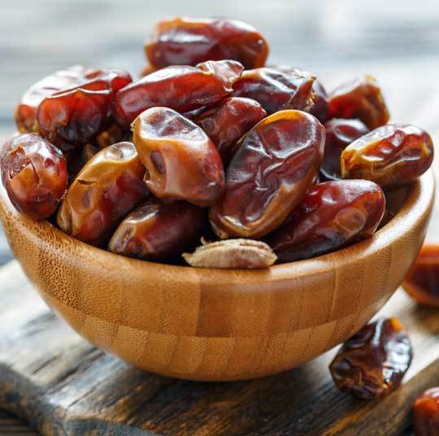
Medjool dates
Notes:
https://www.google.com/url?sa=i&source=images&cd=&ved=2ahUKEwiTur_EpZnkAhUFVK0KHUqFB30QjRx6BAgBEAQ&url=https%3A%2F%2Fwww.challahconnection.com%2Fmedjool-dates%2F&psig=AOvVaw0CTyY3YL33FvlFsttQjTqE&ust=1566659632267521

Slide 6
A Mule Walks Into an Airport…
No, this isn’t the start of a bad joke. A donkey literally walked into Ben Gurion Airport
July 26, 2019 | David Lazarus
Notes:
https://www.israeltoday.co.il/read/a-mule-walks-into-an-airport/

Slide 7
Notes:
the mule must have escaped a village near the airport and decided to go for a walk through the air-conditioned departure hall during the early hours of the morning.

Slide 8
Israeli social media was a-buzz with captions for the story.
Drug Mule Caught at Ben Gurion Airport
The Mule Walked into the Kiosk and Asked for a Straw (Lots of Straw)

Slide 9
A Security Guard Asks, “Why the Long Face?”
He Came to Apply for a Job – Someone Said the P.A. announcer was a Little Hoarse

Slide 11
Early in the morning, all the head cohanim and elders met to plan how to bring about Yeshua's death. Then they put him in chains, led him away and handed him over to Pilate the governor.
Mattityahu (Matthew) 27:1-2
Notes:
Note they didn’t have a plan, at least not finalized.

Slide 12
Mattityahu (Matthew) 27:3
יְהוּדָה שֶׁהִסְגִּירוֹ, כְּשֶׁרָאָה שֶׁהִרְשִׁיעוּ אוֹתוֹ,
When Y’hudah, who had betrayed him, saw that Yeshua had been condemned,

Slide 13
Mattityahu (Matthew) 27:3
הִתְחָרֵט וְהֶחֱזִיר לְרָאשֵׁי הַכֹּהֲנִים וְלַזְּקֵנִים אֶת שְׁלוֹשִׁים שִׁקְלֵי הַכֶּסֶף בְּאָמְרוֹ:
he was seized with remorse and returned the thirty silver coins to the head cohanim and elders,

Slide 14
Mattityahu (Matthew) 27:4
”חָטָאתִי, כִּי דָּם נָקִי הִסְגַּרְתִּי.“ אַךְ הֵם אָמְרוּ: ”מָה אִכְפַּת לָנוּ? זֶה עִנְיָנְךָ שֶׁלְּךָ!“
saying, “I sinned in betraying an innocent man to death.” “What is that to us?” they answered. “That’s your problem.”

Slide 15
Mattityahu (Matthew) 27:5
הִשְׁלִיךְ אֶת הַכֶּסֶף לְתוֹךְ בֵּית אוֹצַר הַמִּקְדָּשׁ, הָלַךְ מִשָּׁם וְתָלָה אֶת עַצְמוֹ.
Hurling the pieces of silver into the sanctuary, he left; then he went off and hanged himself.

Slide 16
What does this portion of the Word say to us?
planning → put away
Remorse
Despair → suicide
Notes:
Three topics in this message. Since this is my second time to preach since June 20, out of pulpit 7 Shabbats…make up for loss
Don’t worry.

Slide 17
What does this portion of the Word say to us?
planning → put away

Slide 18
met to plan how to bring about Yeshua's death
They didn’t yet have a plan. Just a purpose. The Sanhedrin had been up all night, which they had spent in arresting, trying, and examining Yeshua, and the witnesses against him; and had come to a unanimous vote, with judicial difficulties.
Notes:
They didn’t have a plan! Not a complete one. The Ruakh highlighted to me, they just had fury.
“hot button issues”
Why the commitment to kill?
Is there a latent trip wire in Jewish mentality about Yeshua??
Does Shaul/Paul say anything similar?

Slide 19
^{Acts 26.9-11} “I used to think it was my duty to do all I could to combat the name of Yeshua from Natzeret… Often I went from one synagogue to another, punishing them and trying to make them blaspheme; and in my wild fury against them, I even went so far as to persecute them in cities outside the country.
Notes:
What was that about. Why wild fury? Exists still?

Slide 20
greatly, exceedingly, abundantly, vehemently
_____________________________________________________
madly enraged
Notes:
Wesley: make people mad, sad, or glad

Slide 21
Kokeb’s story about the opposition he faced?
How quickly the March of Remembrance was dis-endorsed by the KC rabbinic counsel?
Supreme Ct of Israel allows Jubus, yoga, NOT Messianics?
Notes:
My experience ~age 22 in Tel Aviv synagogue on Shabbat with pens. So easy to get into a spirit of religious harshness. My parents: you’re worse than Hitler. He destroyed our bodies, you are destroying our souls.
I understand that by now, the 21st Century, Jewish people have had a sad and bitter history of Christian persecution 2000 years, and sensitivity to that, but this was before all that.
This was re Yeshua Himself, and very first, very Jewish followers. Why the rage?

Slide 22
I’m a “big tent” guy.
Notes:
I love siddur prayer, went to synagogue with my family a couple of weeks ago, and I can pray with tefillin and feel embrace of the Ruakh.
I can pray in tongues, and feel the Ruakh.
I can pray in tongues, wearing tefillin. Dan Juster complimented me on Tikkun like approach.
Today, I need to speak about toxicity at the end of the big tent. May be offensive, but needs to be said, and it’s in the exposition of this section. Not history or science exposition, but life application.

Slide 23
^{Ro 10.2-4} I can testify to their zeal for God. But it is not based on correct understanding; for, since they are unaware of God’s way of making people righteous and instead seek to set up ¹their own,

Slide 24
^{Ro 10.2-4} they have not submitted themselves to ² God’s way of making people righteous. For the goal at which the Torah aims is the Messiah, who offers righteousness to everyone who trusts.
Notes:
We always have a mixture. Obedience to the Word / Empowerment by the Spirit. Test every spirit by the Word!

Slide 25
Two ways of righteousness:
Our own
Messiahs.
Notes:
Always a mixture: polar opposites
Our own: pride
Messiah’s: joy

Slide 26
^{Gal 3.10-14} For all who rely on the deeds of Torah are under a curse—for the Scriptures say, “Cursed is everyone who does not keep doing everything written in the scroll of the Torah.” It is clear that no one is set right before God by Torah, for “the righteous shall live by emunah.” [faith]
Notes:
That is, Messiah’s righteousness imparted

Slide 27
^{Gal 3.10-14} However, Torah is not based on trust and faithfulness; on the contrary, “the one who does these things shall live by them.” Messiah liberated us from Torah’s curse [not the Torah itself, but our disobedience to it], having become a curse for us (for it is written,
Notes:
That is, our own.

Slide 28
^{Gal 3.10-14} “Cursed is everyone who hangs on a tree”) — in order that through Messiah Yeshua the blessing of Abraham might come to the Gentiles, so we might receive the promise of the Ruakh through trusting faith.

Slide 29
Two ways of righteousness:
Our own
Messiahs
The difference can sometimes be very subtle. For Jews and for the Nations this applies.
Notes:
We walk in His energy to keep righteous.

Slide 30
^{Gal. 4.28} But just as then the one born according to limited human capability persecuted the one born through the Spirit’s supernatural power, so it is now.
Notes:
IF we are focused on the mitzvot and not the Messiah, there is an easy possible negativity, loss of joy, loss of desire to share at the minimum.
This is the source of the rage the Sanhedrin felt, and later Shaul/Paul.

Slide 31
So Shaul and the Sanhedrin and others feel offended by supernatural salvation.
Notes:
Others: KC Rabbinic counsel.
This is the unremovable offense.
That is, we can avoid crosses, and idolatrous seeming pictures of Yeshua and Miriam his mother, and Crusader references, and terminology problems, but this issue, supernatural impartation of salvation through the Atoning death of Messiah, is the bottom line offense. If we offend people over this, we haven’t failed. If we offend people otherwise…we are clumsy, etc.

Slide 32
^{2 Cor 3.6} He also made us competent as servants of a new covenant—not of the letter, but of the Ruakh. For the letter kills, but the Ruakh gives life.
Notes:
We always have a mixture of the letter and the Ruakh, but which is your reliance?
Obedience to the Word, Empowerment by the Spirit. Test every spirit by the Word!
Where is your focus?

Slide 33
^{2 Cor 3.7-12} Now if that which worked death, by means of a written text engraved on stone tablets, came with glory — such glory that the people of Isra’el could not stand to look at Moshe’s face because of its brightness, even though that brightness was already fading away

Slide 34
^{2 Cor 3.7-12} — won’t the working of the Spirit be accompanied by even greater glory? For if there was glory in what worked to declare people guilty, how much more must the glory abound in what works to declare people innocent!

Slide 35
^{2 Cor 3.7-12} In fact, by comparison with this greater glory, what was made glorious before has no glory now. For if there was glory in what faded away, how much more glory must there be in what lasts.
Notes:
This is pretty radical. So much so that many who misunderstand Torah decide to get rid of, devalue, reject Shaul/Paul.
Consider next: What I’m about to say may seem negative and divisive, but it’s still true!
What caused the implacable rage? “Wild fury against the believers?”

Slide 36
Our prototype is not Orthodox Judaism. It has great attraction:
It’s ornate “life choreography,” beautiful.
It’s family centered.
It promotes community.
Lots of scripture.

Slide 37
Our prototype is not Orthodox Judaism. It has great deficits:
It lacks the presence of Yeshua and the sheh-khinah שכינה
It lacks the power of G-d to transform. Minutae. Shulkhan Arukh
It lacks the Atoning Blood and the experience of forgiveness.
Notes:
Yom Kippur experience. Pinchas Gitterman ministry.
Can be stifling. Shulkan Arukh. P 6...

Slide 38
Our prototype is NOT the Messiah believing congregations of the Nations.
They have the Atoning Blood, and the Presence.
They often lack covenantal understanding of Israel.

Slide 39
Our prototype is NOT the Messiah believing congregations of the Nations.
They have the Sabbath and holidays wrong.
They have a lot of non-scriptural practices.

Slide 40
Acts 15 urges patience.
^{Acts 15.20-21} Write to them to abstain from the contamination of idols, and from sexual immorality, and from what is strangled, and from blood. For Moses from ancient generations has had in every city those who proclaim him, since he is read in all the synagogues every Shabbat.”

Slide 41
^{Ro 14.4} Who are you to pass judgment on someone else’s servant? It is before his own master that he will stand or fall; and the fact is that he will stand, because the Lord is able to make him stand.
Notes:
Our vision, my vision, what G-d in Messiah called me to build here at Or HaOlam:

Slide 42
Working to bring Jewish people, and those grafted in, to their covenantal identity in Messiah. Implies:
1) Salvation through the Atonement of the Messiah. Personal faith in the atoning death and resurrection of Yeshua. It’s all about the King;
Notes:
Formerly: Jewish, Yeshua-ish renewal

Slide 43
2) Covenantal identity of Jewish people, not replacement;
3) Restoration to Torah lifestyle;
4) Restoration/survival of the nation of Israel.
Notes:
Do we have a good prototype?
Zeal for G-d without excess, without anger?

Slide 44
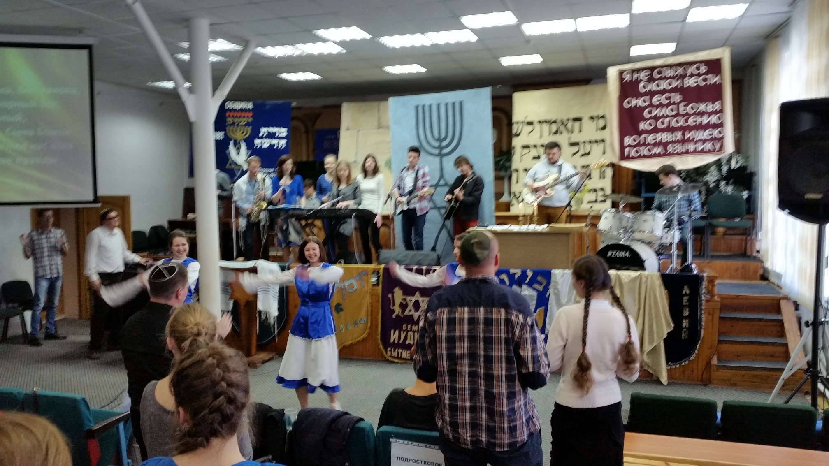
One prototype congregation
Minsk, Belarus
One prototype congregation.

Slide 45
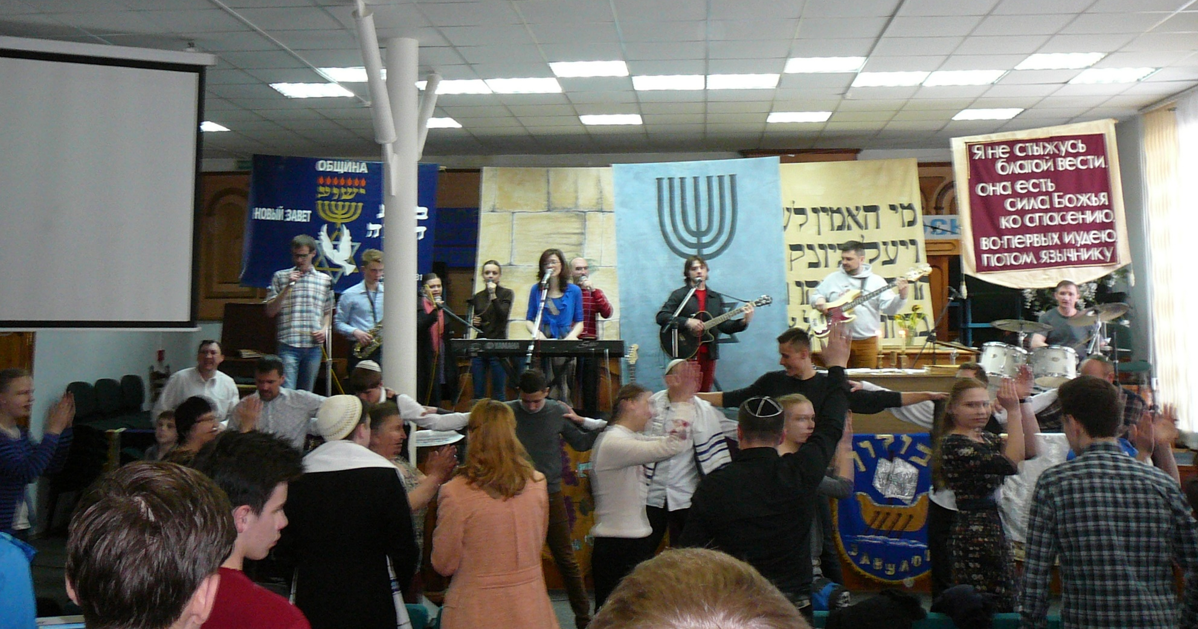
Notes:
Congregation totally made up of new births there. We bless our transfer members, you are a gift, you enable us to survive, but we haven’t brought you to birth. Ie Paul/Shaul:

Slide 46
^{1 Cor. 4.15} For even if you have ten thousand trainers in connection with the Messiah, you do not have many fathers; for in connection with the Messiah Yeshua it was I who became your father by means of the Good News.

Slide 47
^{Gal 4.19} My dear children, I am suffering the pains of giving birth to you all over again — and this will go on until the Messiah takes shape in you.
Notes:
Cong Brit Chadasha means of outreach:

Slide 48
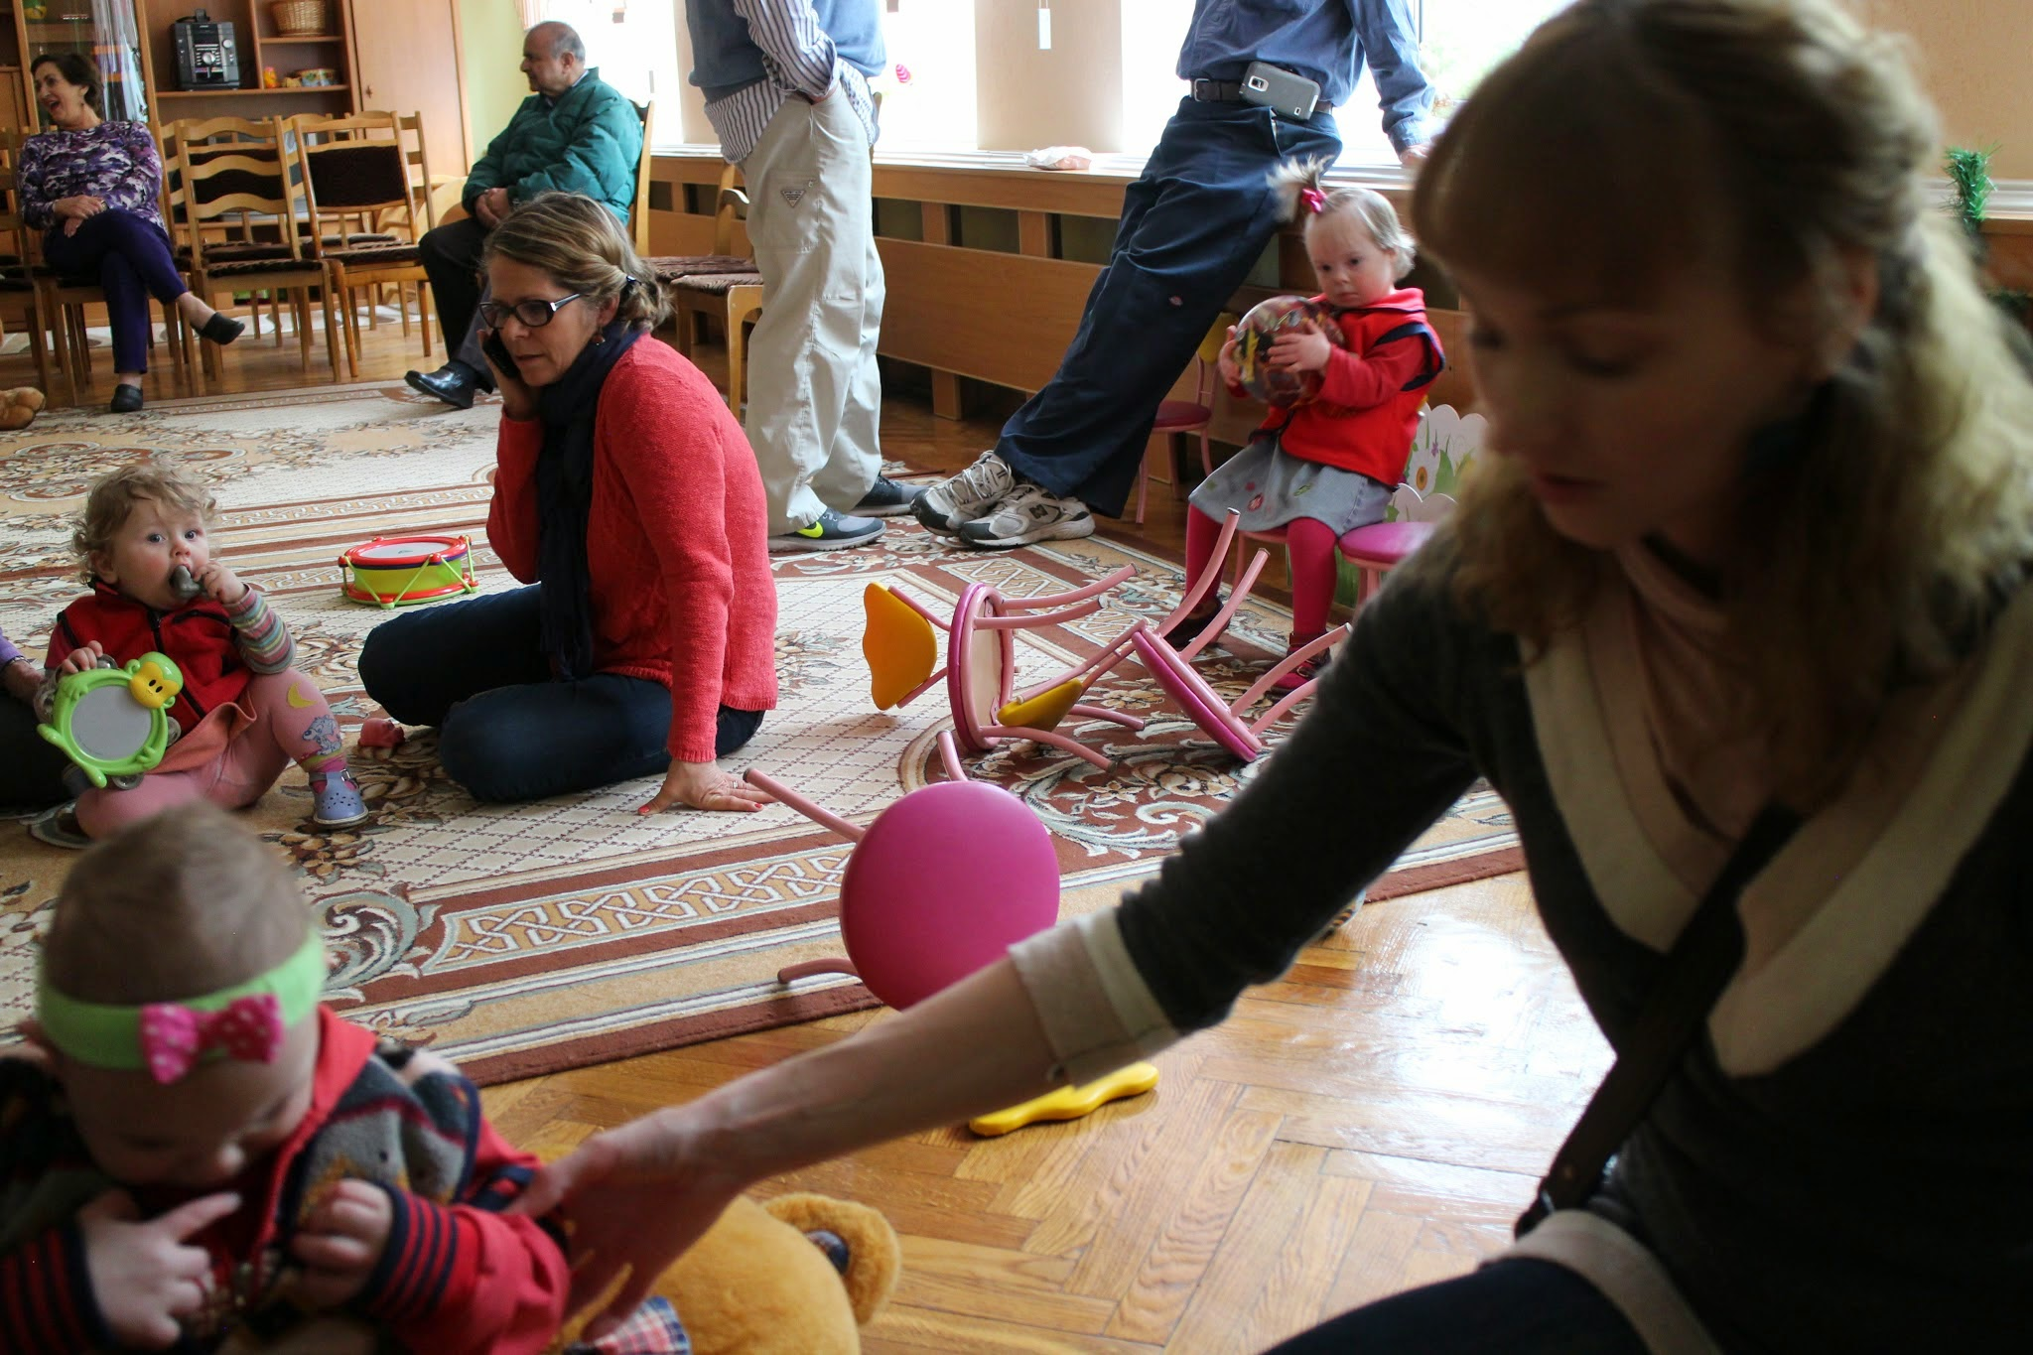
Abandoned children’s institution
Notes:
Soviet culture is if you cannot maintain your kids, especially if health, mental health issues, abandon them to the state. Kids untouched, unloved. Just subsitence.
Neighborhood public school ministry we can enter called “Caring for Kids”

Slide 49
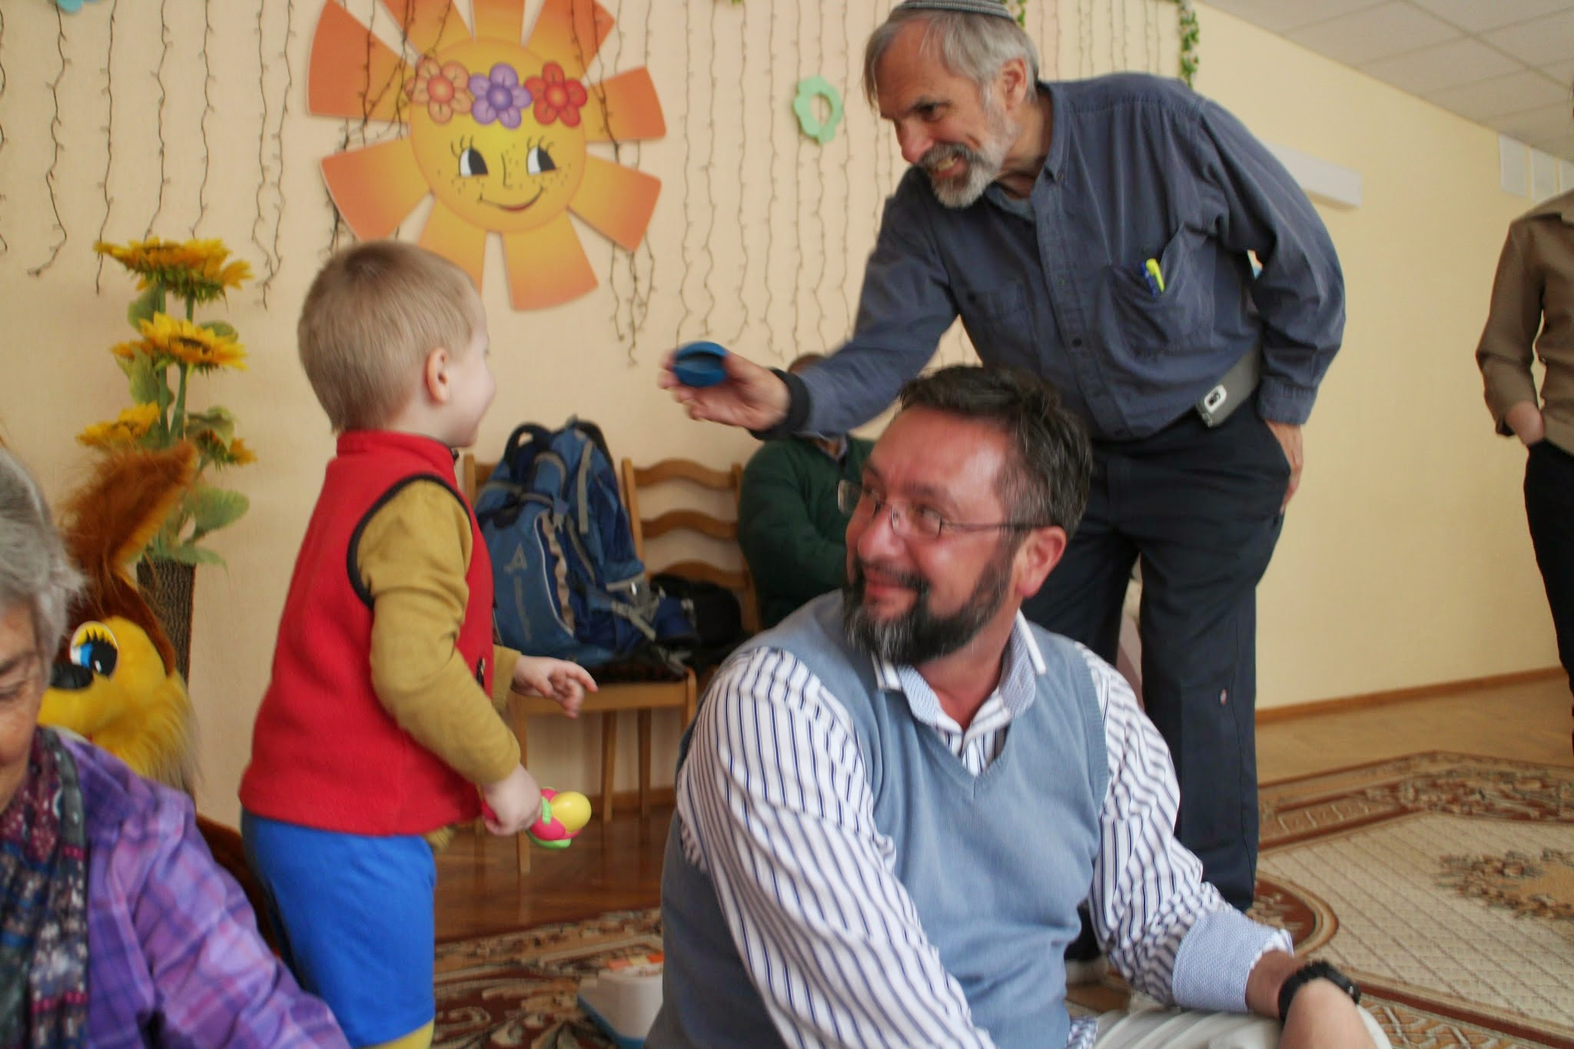

Slide 50
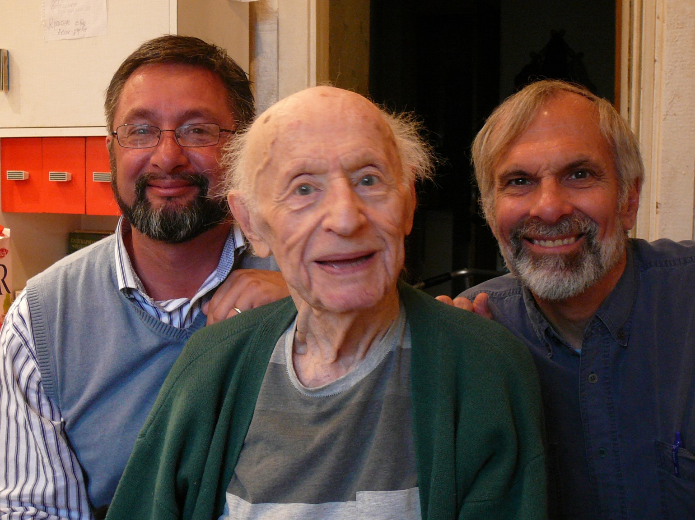
Notes:
Lev Gurevich. 97 almost. In 2015 WW II Almost physics math U Moscow volunteer army tank trenches 1941 whole division captured by Nazis. 1000 to concentration camp. Brest, no food, water, typhus epidemic. Many many died.

Slide 51
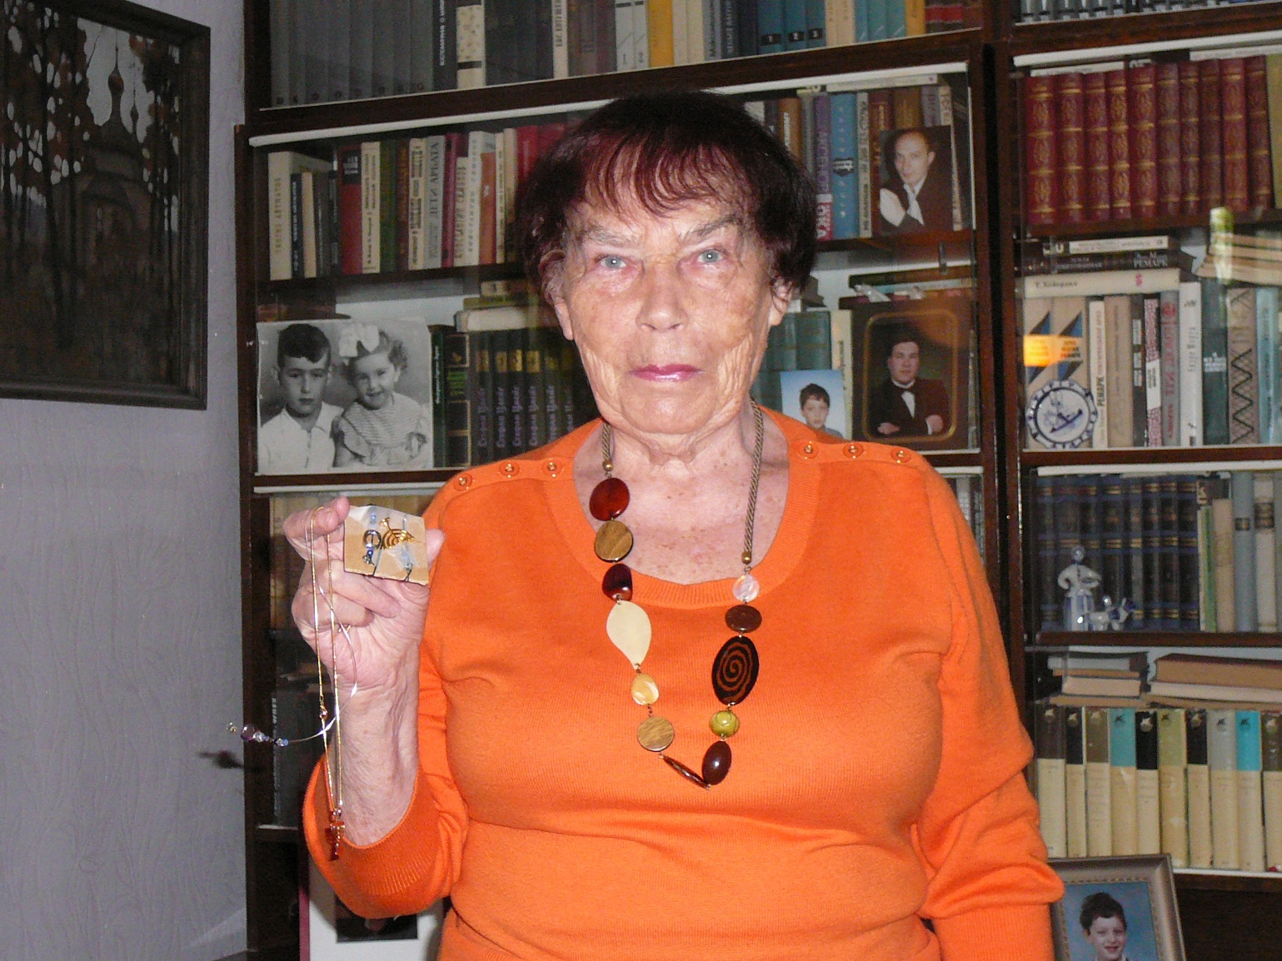
Notes:
Cema margilina. 17 October 1941 pogrom in Uzda near 6 miles from sumachalovichy. Grandparents died but saved grandchildren. Nazis see no one there. Put furniture over basement door. Russian neighbor worked w Nazis. Said only 2 people lived there. Didn't betray. Heard gunshots, stayed all night. Then hard time pushing furniture off. Walked to Minsk ghetto. Only one Jew in Uzda now. She goes to Uzda yearly October. Were 10,000. 40k Jews here 140k

Slide 52
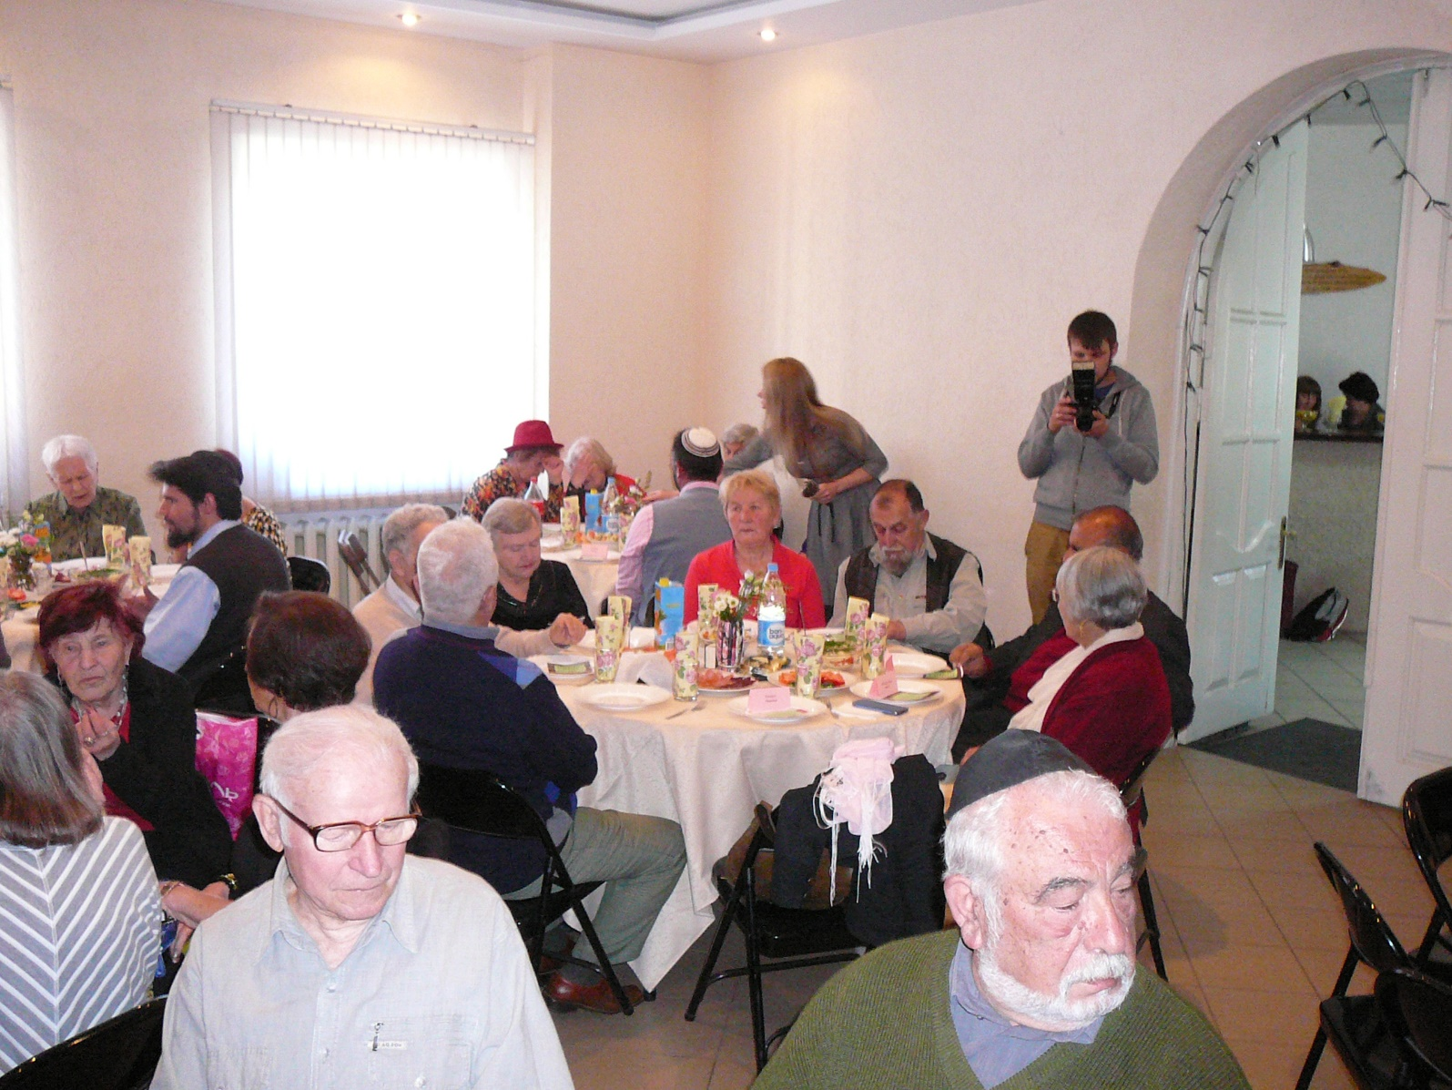
Banquet for Holocaust
survivors

Slide 53
^{Mtt.22.9-10} Go into the highways and byways, and invite everyone you find to the wedding feast.’ And those servants went out into the highways and gathered together all they found, both bad and good; and the wedding was filled with guests.
Notes:
Provided them with wedding garments…we need births!
If you are here to perfect your walk in the Torah, that’s not my vision.
If you are here to walk with Messiah and share Him with Israel and the Nations, we have unity.

Slide 54
^{Mishlei/Prov 24.11-12} Rescue those being dragged off to death, hold back those stumbling to slaughter. If you say, “Look, we didn’t know this.” Won’t He who weighs hearts perceive it? Won’t He who guards your soul know it? Won’t He repay each one according to his deeds?

Slide 55
If we are not sharing Yeshua,
Cookies to our neighbors,
A word when feasible to clerks, etc.
Every department is a department of outreach: dance, teaching kids, mowing the lawn
Notes:
If the heart of your walk is Torah for your own development, it’s self.
If the heart of your walk is righteousness for Yeshua and reproduction, it’s glory.
Jews aren’t really listening to the Orthodox anyway…

Slide 56
Pew study 2013 American Jewry
10% of the Jewish pop. Orthodox
41% Reform [Renewal, Reconstructionist]
31% nones

Slide 57
Israel
9% ultra Orthodox
11% religious
44.3% secular
Notes:
The Non-Torah p 46

Slide 58
^{2 Cor 4.6-7} For it is the God who once said, “Let light shine out of darkness,” who has made his light shine in our hearts, the light of the knowledge of God’s glory shining in the face of the Messiah Yeshua.
Notes:
It’s our joy, compassion, humility, service, and words that will win Jewish people, Israelis. In covenantal Jewish context, so as to avoid frivolous offense, but His smile in us.

Slide 59
^{2 Cor 4.6-7} But we have this treasure in clay jars, so that it will be evident that such overwhelming power comes from God and not from us.

Slide 60
Two ways of righteousness:
Our own
Messiahs
The difference can sometimes be very subtle. For Jews and for the Nations this applies.
Notes:
We walk in His energy to keep righteous.
Our own can sow pride, anger, denunciation.
His righteousness sows humility, joy, love, shalom.

Slide 61
^{Gal. 4.28} But just as then the one born according to limited human capability persecuted the one born through the Spirit’s supernatural power, so it is now.
Notes:
IF we are focused on the mitzvot and not the Messiah, there is an easy negativity.
STOP: Examine your heart and motives. What is your focus?

Slide 62
What does this portion of the Word say to us?
Planning → put away
Remorse

Slide 63
Mattityahu (Matthew) 27:3
יְהוּדָה שֶׁהִסְגִּירוֹ, כְּשֶׁרָאָה שֶׁהִרְשִׁיעוּ אוֹתוֹ,
When Y’hudah, who had betrayed him, saw that Yeshua had been condemned,

Slide 64
Mattityahu (Matthew) 27:3
הִתְחָרֵט וְהֶחֱזִיר לְרָאשֵׁי הַכֹּהֲנִים וְלַזְּקֵנִים אֶת שְׁלוֹשִׁים שִׁקְלֵי הַכֶּסֶף בְּאָמְרוֹ:
he was seized with remorse and returned the thirty silver coins to the head cohanim and elders,

Slide 65
was seized with remorse
change his mind, regret
Remorse is not repentance! metanoia

Slide 66
^{2 Cor. 7.9-11} You were grieved according to God’s will, so that you might in no way suffer loss from us. For the grief that God wills brings a repentance that leads to salvation, leaving no regret. But the world’s grief brings death.

Slide 67
^{2 Cor. 7.9-11} For see what this very thing—this grieving that God wills—has brought you! What diligence, what defense, what indignation, what fear, what longing, what zeal, what rendering of justice!

Slide 68
Yehudah/Judas should have run to Yeshua.
But he abandoned hope, despaired. He could not, on his own, fix this.
Dante’s Inferno:

Slide 69
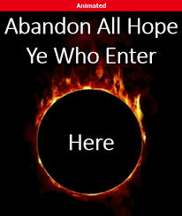
Notes:
https://www.google.com/url?sa=i&source=images&cd=&ved=2ahUKEwjAkauBjZrkAhURlKwKHQKICZwQjRx6BAgBEAQ&url=%2Furl%3Fsa%3Di%26source%3Dimages%26cd%3D%26ved%3D%26url%3Dhttp%253A%252F%252Fslaterpress.com%252F%26psig%3DAOvVaw3PhBkDB5bvCEL_6OkRd089%26ust%3D1566687715014260&psig=AOvVaw3PhBkDB5bvCEL_6OkRd089&ust=1566687715014260

Slide 70
Notes:
STOP:
Have we repented of our past, or just regretted it and trying to fix it?
Are we running to G-d in Yeshua, or for G-d and religion?

Slide 71
What does this portion of the Word say to us?
Motivation → murder
Remorse
Despair → suicide

Slide 72
Causes of suicide:
Guilt, real and toxic
Abandonment
Hopelessness
Notes:
Me as a teen. Fatherlessness. Motherlessness. Jewish mother criticism / performance. Likely would have been a suicide if Yeshua hadn’t found me!

Slide 73
Charisma Magazine:
At this point, however, what is clear is the vast majority of shooters came from broken families without a consistent biological father throughout their rearing and development.
Notes:
https://www.charismanews.com/opinion/in-the-line-of-fire/77655-the-spirit-of-jezebel-fatherless-america-and-mass-shootings?utm_source=In%20the%20Line%20of%20Fire&utm_medium=email&utm_content=subscriber_id:5194514&utm_campaign=Blogger%20-%20Michael%20Brown%20-%202019-08-19

Slide 74
We found maybe four or five of the 27 shooters that we could definitively conclude (without doubt) had been raised in an intact family, or a family that included the biological dad at home, or a biological father who was consistently at home.
Notes:
https://www.charismanews.com/opinion/in-the-line-of-fire/77655-the-spirit-of-jezebel-fatherless-america-and-mass-shootings?utm_source=In%20the%20Line%20of%20Fire&utm_medium=email&utm_content=subscriber_id:5194514&utm_campaign=Blogger%20-%20Michael%20Brown%20-%202019-08-19

Slide 75
Causes of suicide

Slide 76
They're depressed. This is, without question, the most common reason people die by suicide. Severe depression is almost always accompanied by a pervasive sense of suffering as well as the belief that escape from it is hopeless.
Notes:
https://www.psychologytoday.com/us/blog/happiness-in-world/201004/the-six-reasons-people-attempt-suicide

Slide 77
…depression, as we all know, is almost always treatable, we should all seek to recognize its presence in our close friends and loved ones. Often, people suffer with it silently, planning suicide without anyone ever knowing.
Notes:
https://www.psychologytoday.com/us/blog/happiness-in-world/201004/the-six-reasons-people-attempt-suicide

Slide 78
Despite making both parties uncomfortable, inquiring directly about suicidal thoughts, in my experience, almost always yields an honest response. If you suspect someone might be depressed, don't allow your tendency to deny the possibility of suicidal ideation prevent you from asking about it.
Notes:
https://www.psychologytoday.com/us/blog/happiness-in-world/201004/the-six-reasons-people-attempt-suicide

Slide 79
Are we careful when feeling overwhelmed, hopeless, to run to Yeshua AND to friends?
Are we on the lookout for people entering / appearing hopeless?

Slide 81
“The opposite of hope is despair, and when we despair, it is because we feel there are no choices.” Warren G. Bennis, On Becoming a Leader

Slide 82
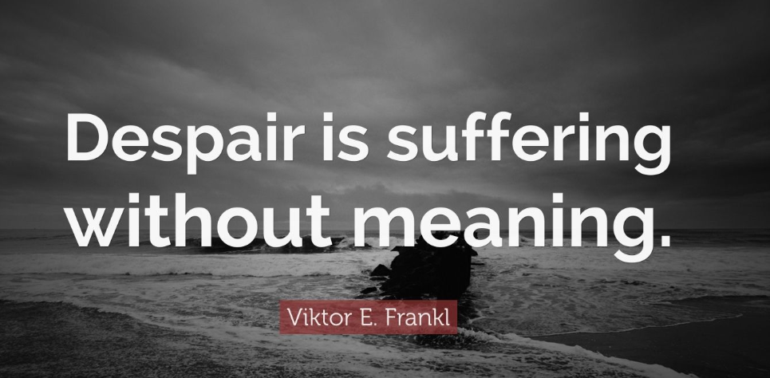
Notes:
https://quotefancy.com/quote/927256/Viktor-E-Frankl-Despair-is-suffering-without-meaning
an Austrian psychologist as well as a Holocaust survivor. Surviving Theresienstadt, Auschwitz, Kaufering and Türkheim.

Slide 83
Here in Southern California we are very fire conscious. We have discovered that many varieties of plants don’t reproduce unless there is a fire that generates enough heat to burn off the outer shells. So, fire is a part of the renewal process.

Slide 84
“When you are in distress and all these things have come upon you, in the latter days You will return to the Lord your God and listen to His voice. For the Lord your God is a compassionate God; He will not fail you nor destroy you nor forget the covenant with your fathers which He swore to them.” ^{(Deuteronomy 4:30-31)}

Slide 85
Mattityahu (Matthew) 27:4
”חָטָאתִי, כִּי דָּם נָקִי הִסְגַּרְתִּי.“ אַךְ הֵם אָמְרוּ: ”מָה אִכְפַּת לָנוּ? זֶה עִנְיָנְךָ שֶׁלְּךָ!“
saying, “I sinned in betraying an innocent man to death.” “What is that to us?” they answered. “That’s your problem.”

Slide 86
^{Dvarim 19.16-19} “If a malicious witness comes forward and gives false testimony against someone, then both the men involved in the controversy are to stand before Adoni, before the cohanim and the judges in office at the time.

Slide 87
^{Dvarim 19.16-19} The judges are to investigate carefully. If they find that the witness is lying and has given false testimony against his brother, you are to do to him what he intended to do to his brother.

Slide 88
Mattityahu (Matthew) 27:5
הִשְׁלִיךְ אֶת הַכֶּסֶף לְתוֹךְ בֵּית אוֹצַר הַמִּקְדָּשׁ, הָלַךְ מִשָּׁם וְתָלָה אֶת עַצְמוֹ.
Hurling the pieces of silver into the sanctuary, he left; then he went off and hanged himself.

Slide 89
What does this portion of the Word say to us?
Plan → putting away: Is our energy from obedience or union?

Slide 90
What does this portion of the Word say to us?
Remorse vs repentance
Despair → suicide
Do you have hope? He is our hope!! Friends can help.
Are you watching for hopelessness in others?

