Slide 1
e-handout
To have these notes
without taking notes
Go to OrHaOlam.com
Click on downloads,
messages, 2020

Slide 2
Surgery report [nothing gory]

Slide 3
Well folks, a journey of 100 miles begins with a single walker.
Notes:
Jeannemarie Stevenson

Slide 4
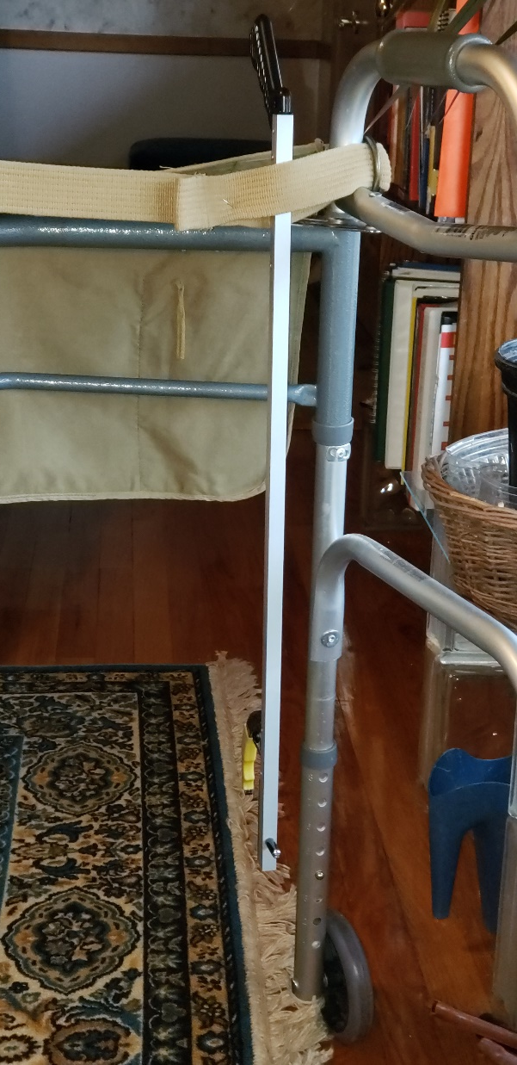
Hip surgery patient’s best friend: grabber stick.

Slide 5
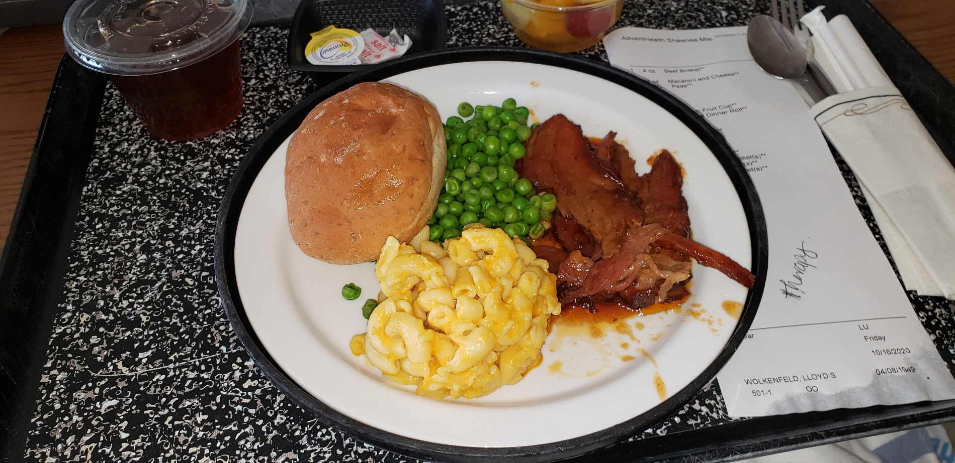
Noon meal after 7 am surgery:
Barbecued beef! I ate it all!

Slide 6
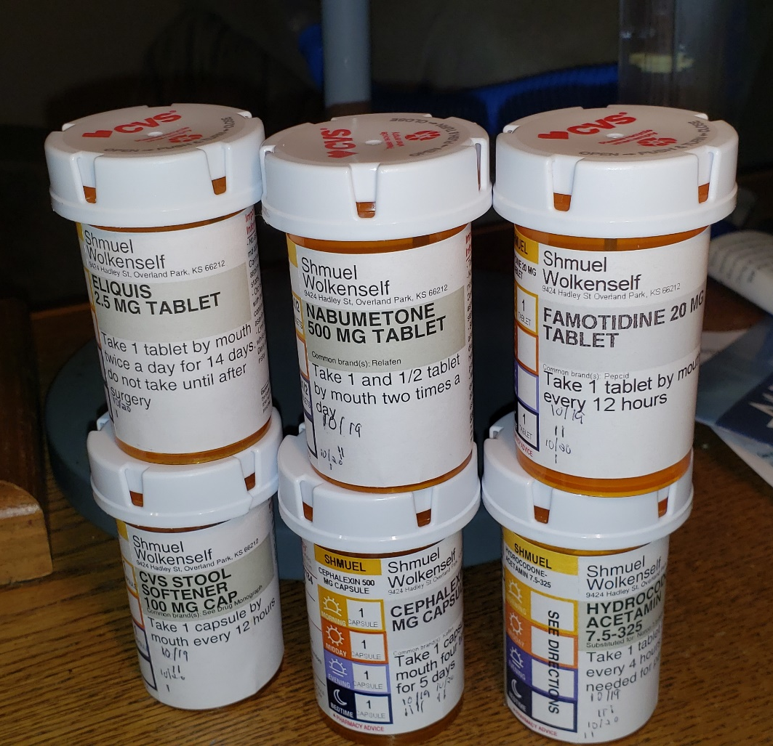
I get by with a little help from my friends!
Dawn and I are
otherwise
blessed to have
zero
prescription
meds.
Notes:
I get by with a little help from my friends.

Slide 7
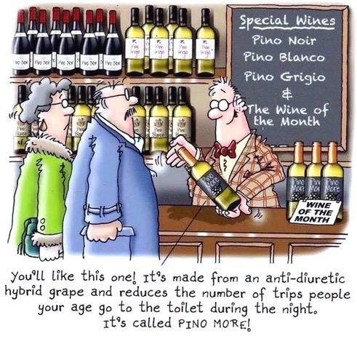
Pino Noir
Pino Blanco
Pino Grigio

Slide 8
Pino Noir
Pino Blanco
Pino Grigio
Pino More

Slide 9
Israel news insight:

Slide 10
In a moving video, StandWithUs educator @HusseinAboubak
congratulates #Israel for achieving peace with several Arab countries over the last few months.
Hussein grew up in Egypt and was taught to hate Jews and Israel. Today, he is an advocate for peace and tolerance.

Slide 11
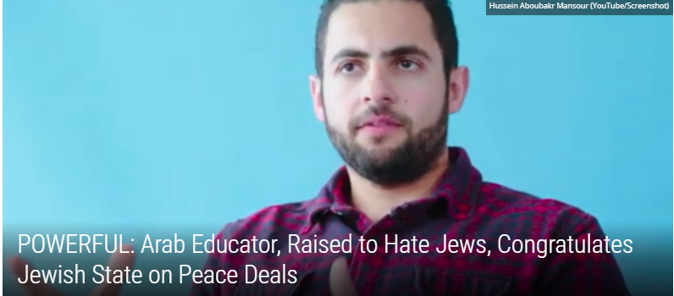
Notes:
https://twitter.com/i/status/1320832575246458880
Hussein grew up in Egypt and was taught to hate Jews and Israel. Today, he recognizes Israel as a “good neighbor” and a “wonderful country,” and he feels certain that the Palestinians will soon join the peace train.

Slide 12
Many Palestinians recognize it as well – those that haven’t been brainwashed or are too afraid to speak out. Take the reaction of the 100,000 Palestinians living in the Emirates. Safe from Ramallah’s retribution, they openly welcomed the deal.
Notes:
https://worldisraelnews.com/uae-israel-deal-may-be-start-of-real-arab-spring/

Slide 13
A Palestinian poet living in the Emirates said, “This important achievement is an answer to many Arab expectations that were lost, and to gambles that were disappointed.” The Palestinian Authority “took much from our lives and our dreams and exhausted budgets in the billions that would have been better spent on investment and development in the coming generations,” he said.
Notes:
https://worldisraelnews.com/uae-israel-deal-may-be-start-of-real-arab-spring/

Slide 14
“When the Palestinians cried about the elimination of Qassem Soleimani, head of Iran’s Revolutionary Guard, the most hated man in Iraq, in Syria and in the Gulf States – this was from our perspective, the end. They called this man the ‘Jerusalem martyr.’ This was the breaking point for Arab support for them.”
Notes:
https://worldisraelnews.com/uae-israel-deal-may-be-start-of-real-arab-spring/

Slide 16
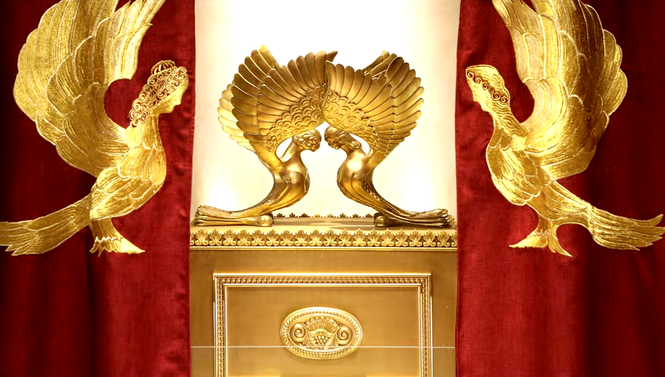
Letter to the Messianic Jews
[Hebrews] MJ 6.1-6.3
First Principles
Notes:
https://www.templeinstitute.org/new-location.htm

Slide 17
^{MJ 6.1-3} Therefore, leaving behind the initial lessons about the Messiah, let us go on to maturity, not laying again the foundation of [Note six foundations]
₁turning from works that lead to death,
₂trusting God, and
Notes:
Six principles

Slide 18
^{MJ 6.1-3} and ₃instruction about washings, ₄s’mikhah, ₅the resurrection of the dead and ₆eternal punishment. And, God willing, this is what we will do.

Slide 19
The first of the first principles is repentance.
Notes:
Do you, do I, have the sense of life without Messiah, whoever noble it may appear, is wrought in the context of death: ego, lust, materialism.

Slide 20
^{MJ 6.1} The foundation of ₁turning from works that lead to death, ₂trusting God
This is MUCH MORE than mental assent to truth.

Slide 21
Faith is also a decision to receive believe trust the revelation
Notes:
Eternal reward and punishment.

Slide 22
Immersion: radical commitment to learn Messiah and His holy ways.
We are a minority but not on the losing side!

Slide 23
₄s’mikhah סְמִיכָה noun

Slide 24
Why such a big deal over one word or phrase?
Equivalent to repentance, faith, immersion?

Slide 25
S’mikhah from
סֶמֶךְsemekh
fulcrum, basis, foundation, reliable source

Slide 26
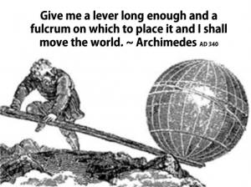
Notes:
https://www.google.com/url?sa=i&url=http%3A%2F%2Fjoescarry.blogspot.com%2F2016%2F11%2Fwhere-to-put-effort-for-world-beyond-war.html&psig=AOvVaw1LHN-Sl3IVm9WZcinaWEaX&ust=1604173756129000&source=images&cd=vfe&ved=0CAIQjRxqFwoTCLj5jYmL3ewCFQAAAAAdAAAAABA-

Slide 27
verbסָמַךְ samakh
to depend on, to rely on, to trust; (literary) to lean on, to rest on; (literary) to strengthen, to support
Notes:
In the Amidah prayer, 18 blessings: somekh nofleem סומך נופלים

Slide 28
₄s’mikhah סְמִיכָה noun
ordination, graduation Authorization, Certification, granting of authority, granting a permit to a person who completes the law of his studies or completes some advanced training to engage in his profession.
“Cleared to launch.”
Greek:

Slide 29
properly to put, lay on (hands); used of the Lord conveying supernatural encouragement and revelation by “the laying on of hands.”
Notes:
Intrinsic force in the Hebrew, acquired in the Greek

Slide 30
Sense of the progression:
We repent
trust Messiah
are immersed/dead to ourselves learn of Him
Receive blessings and authority empowerment
Notes:
You are nobility, then sense of servant leaders. Significant!

Slide 31
Smikhah used in three ways in scripture:
Bestowing blessings
Upon children
Upon disciples
Upon pray-ers
Upon the sick
Ritual substitution
Sacrificial animals
Levites

Slide 32
Ordination
Moshe to Yehoshua/Joshua
Elders and rabbis
Conferring the Spirit

Slide 33
Bestowing Blessings
^{Mark 10.13,16} Now people were bringing little children to Yeshua so He might touch them…And He took them in His arms and began blessing them, laying His hands on them.

Slide 34
^{Ber/Gen 48 14-15} But Isra’el put out his right hand and laid it on the head of the younger one, Efrayim, and put his left hand on the head of M’nasheh — he intentionally crossed his hands, even though M’nasheh was the firstborn. Then he blessed Yosef…
Destiny!!

Slide 35
^{Mark 5.22-23} There came to him a synagogue official, Ya’ir by name, who fell at his feet and pleaded desperately with him, “My little daughter is at the point of death. Please! Come and lay your hands on her, so that she will get well and live!”
Notes:
Touching was important! Communicates warmth, immediate contact, intimacy, life!
Varying ethnic practices. Generalizations risky: Secular Jews very touchy huggy. Other Mediterranean groups, Latins, too.
Nordic, Scandinavian, Asian, not so much. [I could already be on politically incorrect turf.]
Holiness group I came to faith in was highly restrained for the sake of purity. Sometimes clumsy.
Annie Schummacher, taught us Sozo, advised for warmth of touch safely, the shoulder is pretty neutral, side hugs, neck hugs, through spouse.

Slide 36
^{Acts 28.8} Now it so happened that Publius’ father was lying in bed, sick with fever attacks and dysentery. Sha’ul went in to him, prayed, placed his hands on him and healed him.

Slide 37
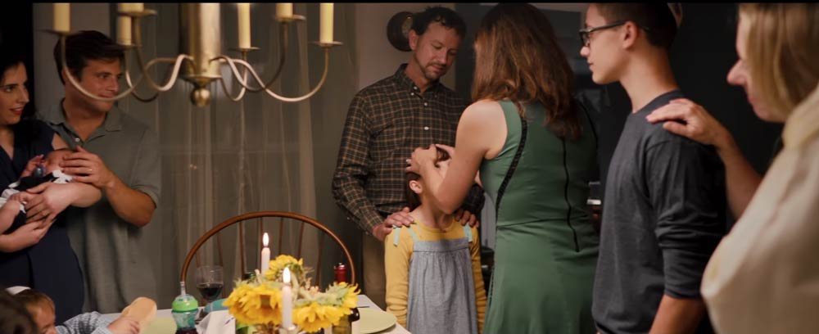
At the family Shabbat table

Slide 38
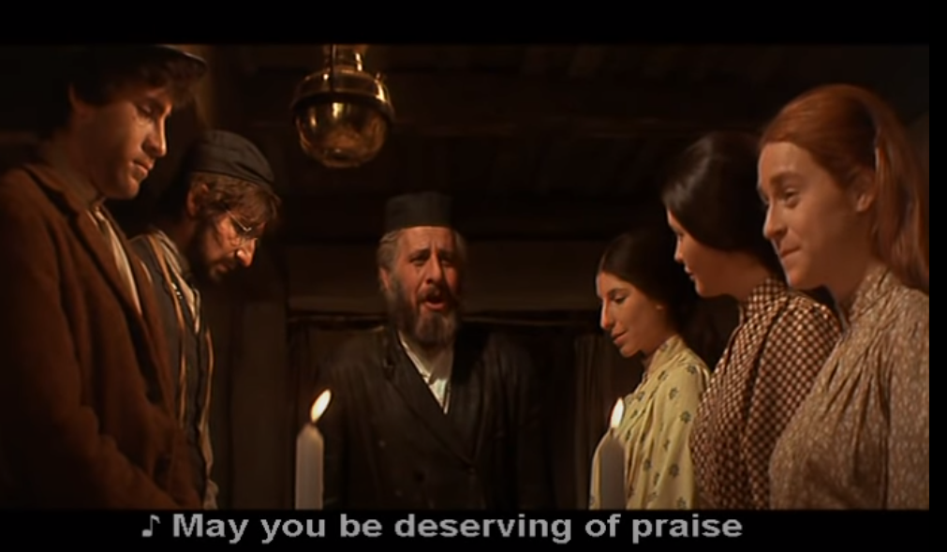
Notes:
https://www.youtube.com/watch?v=LnaZqHy2ZHE&feature=youtu.be

Slide 40
The spirit of joyful blessing should be the main thing people take away from our assembly.
All the Messianic distinctives: holidays, dietary specialties, ancient prayers, geographical reality, should communicate warmth, joy, the covenantal and contextual reality of the Messiah.
Notes:
If communicate anger and those who practice otherwise, or at the sad history of anti-Judaic history in the body of Messiah, we have lost our authority.

Slide 41
From our statement of faith:
Love is the KEY. We have no authority other than to love and bless as we declare truth!
Notes:
Not better, not lesser, just with covenantal responsibilities to serve and lead if they want us to. The main way to lead is to lead in repentance. Command leadership vs demand leadership.

Slide 42
In the early days of the Messianic movement, Asher Intrater said he was trained to capitalize on the verse, when going to churches for fundraising:
^{Ro 15.27} For if the Gentiles have shared with the Jews in spiritual matters, then the Gentiles clearly have a duty to help the Jews in material matters.
Notes:
At lunch with Wes Hall, teacher at IHOPU, who said that he was teaching a class in Romans and his undergraduates took up an offering that he gave to me for our congregation. $900 from undergrads!!
We are called to serve, Jews and Gentiles grafted in!

Slide 43
Smikhah [hands on] used in three ways in scripture:
Bestowing blessings
Upon children
Upon disciples
Upon pray-ers
Upon the sick
Ritual substitution
Sacrificial animals
Levites

Slide 44
^{Vayikra/Lev 1.4} He is to lay his hand upon the head of the burnt offering, and it will be accepted on his behalf to make atonement for him.
Notes:
Courtyard of the Temple bare hands

Slide 45
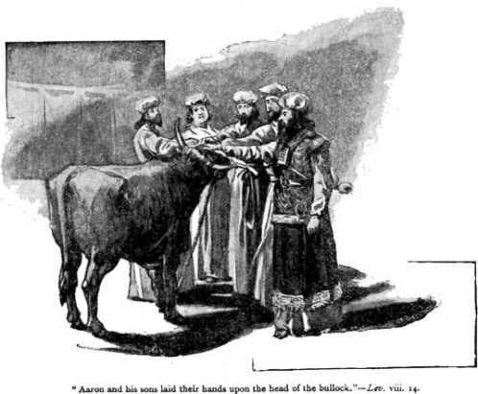
Lev 8.14 Aharon and his sons laid their hands on the head of the bull for the sin offering.
Notes:
https://www.google.com/url?sa=i&url=https%3A%2F%2Fbiblewalk.wordpress.com%2F2011%2F02%2F10%2Fthe-sin-offering-and-the-trespass-offering%2F&psig=AOvVaw0iHGYGygpB_mdIWKqG9jh2&ust=1604181950330000&source=images&cd=vfe&ved=0CAIQjRxqFwoTCJDp69qp3ewCFQAAAAAdAAAAABAS

Slide 46
^{Bamidba/Nu 8.10-14} You will present the L’vi’im before Adoni, the people of Isra’el will lay their hands on the L’vi’im, and Aharon will offer the L’vi’im before Adoni as a wave offering from the people of Isra’el, so that they may do Adoni’s service. The L’vi’im will lay their hands on the heads of the bulls;

Slide 47
^{Bamidba/Nu 8.10-14} the one you will offer as a sin offering and the other as a burnt offering to Adoni to make atonement for the L’vi’im. You are to place the L’vi’im before Aharon and his sons, and offer them as a wave offering to Adoni. In this way you will separate the L’vi’im from the people of Isra’el, and the L’vi’im will belong to me.

Slide 48
^{Yeshayahu/Is 53. 6} We all like sheep have gone astray. Each of us turned to his own way. So Adoni has laid on Him the iniquity of us all.
Notes:
A reference to laying hands. G-d layed hands on Messiah and communicated ALL the sins of ALL of us.

Slide 49
Smikhah [hands on] used in three ways in scripture:
Bestowing blessings
Upon children
Upon disciples
Upon pray-ers
Upon the sick
Ritual substitution
Sacrificial animals
Levites

Slide 50
Ordination
Moshe to Yehoshua/Joshua
Elders and rabbis
Conferring the Spirit

Slide 51
^{Bamidbar/Nu 27.18-20} Adoni said to Moshe, “Take Y’hoshua the son of Nun, a spiritual man, and lay your hand on him. Put him in front of El‘azar the cohen and the whole community, and commission him in their sight. Delegate to him some of your authority, so that the entire community of Isra’el will obey him.

Slide 52
^{Dt 34.9} Y’hoshua [Joshua] the son of Nun was full of the Spirit of wisdom, for Moshe had laid his hands on him, and the people of Isra’el heeded him and did what Adonai had ordered Moshe.

Slide 53
^{Bamidbar/Nu 11.25} Adoni came down in the cloud, spoke to him, took some of the Spirit that was on him and put it on the seventy leaders.

Slide 54
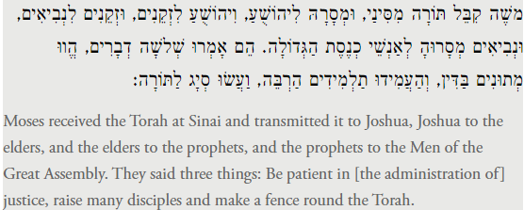
Pirkei Avot, part of the Talmud
Notes:
https://www.sefaria.org/Pirkei_Avot.1.1?lang=bi&with=all&lang2=en

Slide 55
^{Mtt. 23.1-2} Then Yeshua addressed the crowds and his talmidim: “The Torah-teachers and the P’rushim,” he said, “sit in the seat of Moshe

Slide 56
^{Shmot/Ex 18.13} The next day, Moses sat to judge the people, and they stood around Moses from morning till evening.

Slide 57
The seat of Moshe. The Midrash Rabbah says: "They made for him [Moses| a katedra like that of the advocates, in which one sits and yet seems to be standing." ^{(Exodus Rabbah 43:4)}
Pesiktu diRav Kahana ^{1:7} mentions the seat of Moses, and the editors of the English edition comment:
Notes:
^{Stern’s Commentary}

Slide 58
“The particular place in the synagogue where the leaders used to sit was known metaphorically as the seat of Moses or as the throne of Torah, symbolizing the succession of teachers of Torah down through the ages.”
Notes:
^{Stern’s Commentary} (William G. Braude and Israel J. Kapstein, Pesikta diRav Kahana, Philadelphia: Jewish Publication Society of America, 1975, p. 17)

Slide 59
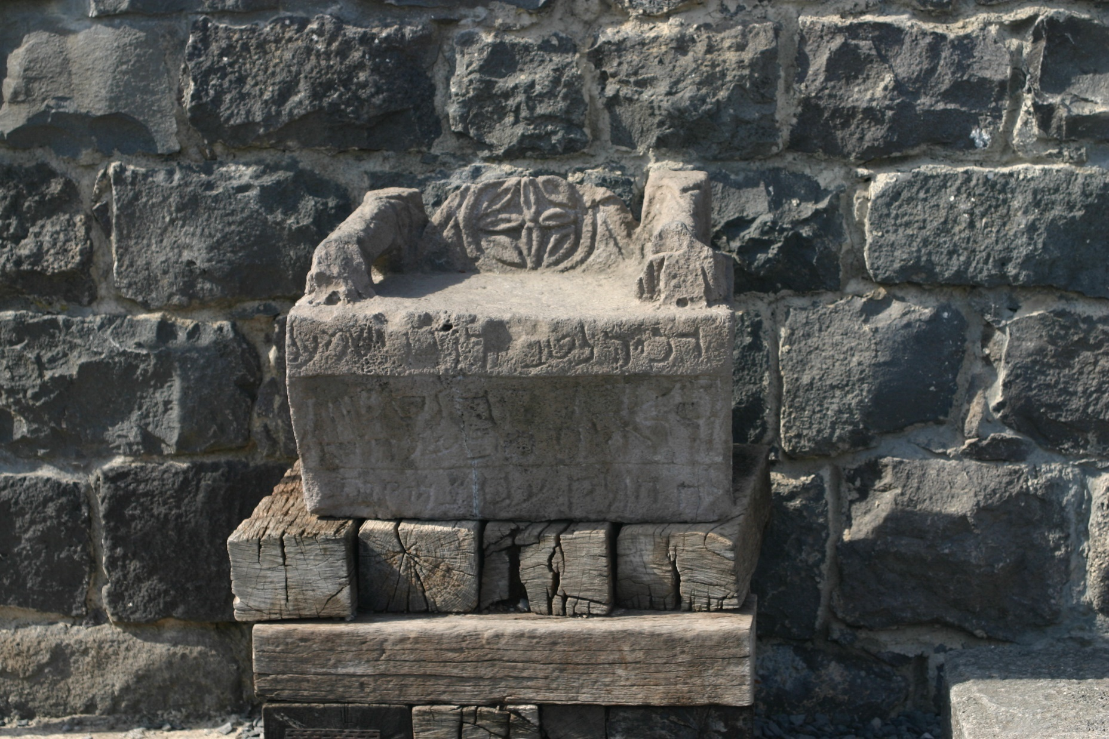
Moses’ Seat from Korazin
Notes:
https://www.google.com/search?safe=active&tbm=isch&q=moses+seat&chips=q:moses+seat+in+synagogue,online_chips:chair&sa=X&ved=0ahUKEwiYnMOPh5rZAhXIwFMKHaYtAysQ4lYILygH&biw=1282&bih=933&dpr=1#imgdii=tzzvVoEFxQgdZM:&imgrc=xPwCVanN2-K1hM:
A talmudic village (perhaps 400 years after Yeshua) the synagogue in the center of the community - not just a place of worship but the community center as well.

Slide 60
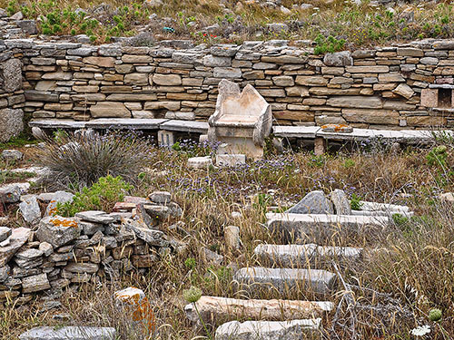
Notes:
https://ferrelljenkins.wordpress.com/tag/bible-atlas/
This large synagogue dates to the mid-second century B.C. Two inscriptions found in 1979-80 indicate that the worshipers here (Israelites) were likely Samaritans who revered Argarizein (Mount Gerizim). (See Kraabel, “New Evidence of the Samaritan Diaspora has been Found on Delos.” BA 47:1; 1984).

Slide 61
Notes:
http://www.bible.ca/synagogues/Moses-Seat-Metaphor-Pride-reader-leader-judge-Architectural-ancient-Synagogue-pre-70AD-standardized-typology-design-incorporated-adopted-similarities-into-church.htm

Slide 62
Messianic scriptures on laying on of hands for ordination:
^{Acts 6.5-6} They chose Stephen, a man full of faith and the Ruach HaKodesh…They presented these men to the emissaries, who prayed and laid their hands on them.
Notes:
Size problems.

Slide 63
^{Acts 13.2-3} One time when they were worshipping the Lord and fasting, the Ruakh HaKodesh said to them, “Set aside for me Bar-Nabba and Sha’ul for the work to which I have called them.” After fasting and praying, they placed their hands on them and sent them off.
Notes:
Ravenhill: we pay the place is taken. They prayed, the place was shaken. [later]
BTW, call for fasting on Nov. 3.

Slide 64
^{Titus 1.5} The reason I left you in Crete was so that you might attend to the matters still not in order and appoint congregation leaders in each city — those were my instructions.

Slide 65
^{1 Tim 5.22} Do not be hasty in granting s’mikhah to anyone, and do not share in other people’s sins — keep yourself pure.
Notes:
Much easier to appoint than to disappoint!

Slide 66
^{Acts 8.17} They began laying their hands on them, and they were receiving the Ruakh ha-Kodesh.

Slide 67
^{Acts 9.17} Hananyah / Ananias left and entered into the house. Laying hands on Saul, he said, “Brother Saul, the Lord—Yeshua, the One who appeared to you on the road by which you were coming—has sent me, so that you might regain your sight and be filled with the Ruach ha-Kodesh.”

Slide 68
From Daniel Pipes http://www.danielpipes.org/
Rather than the person, I advise a focus on a party's overall outlook. Does it take pride in American history or emphasize its faults? Does it favor the original Constitution or a living version of it?
Notes:
Harvard trained, fluent in Arabic, one one of the best Jewish commentators on the Middle East.

Slide 69
From Daniel Pipes http://www.danielpipes.org/
Does it emphasize individualism or equality? Does it focus on the free market or government oversight? Does it see the United States more as a force for good or ill in the world?
Notes:
Harvard trained, fluent in Arabic, one one of the best Jewish commentators on the Middle East.

Slide 70
Is there a pattern of power?
Repentance from dead works.
Faith in G-d thru resurrected Messiah.
Instruction expressed in immersion.
Laying on of hands for service.
Notes:
Similar to Grow Conf: Love G-d, Healing in Discipleships/Home groups, training, engagement.

Slide 71
Lost people reborn | Cup of Sanctifica-tion | Know G-d | Yokhanan/ John Lion | Main service
Reborn people healed | Cup of judgment | Find Freedom Emotionally Jewishly | Luke Man | Home groups
Healed people trained | Cup of Redemption | Discover Develop your calling | Matthew Eagle | Training
Trained people mobilized | Cup of fulfilment | Make a Difference | Mark Ox: plow or sacrifice | Dream team
Notes:
Cups:
out of Egypt,
Egypt out of you / deliverance,
back to original intention/after supper,
Praise
10 other scriptures where this pattern appears.
• Know G-d: the main weekend service
• Find freedom: intimacy and community of the small groups
• Discover purpose: discipleship and training
• Make a difference: Dream team

Slide 72
^{1Tim 4.14-16} Do not neglect your gift, which you were given through a prophecy when the body of elders gave you s’mikhah. Be diligent about this work, throw yourself into it, so that your progress may be clear to everyone. Pay attention to yourself and to the teaching, continue in it, for by so doing you will deliver both yourself and those who hear you.

Slide 73
"It is incumbent on every generation to pay its own debts as it goes. A principle which if acted on, would save one-half the wars of the world."
--
Thomas Jefferson

Slide 74
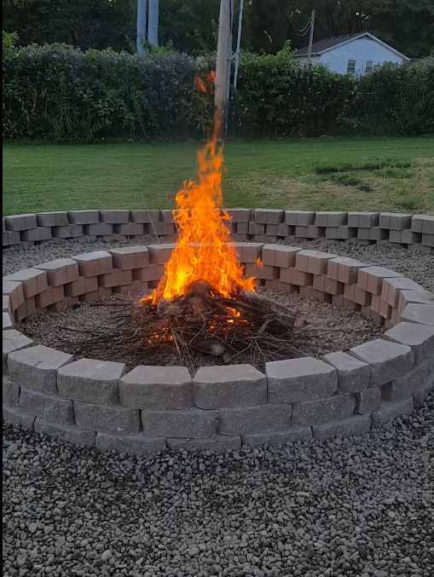
Firepit first burn, Sept 7, 2017

Slide 75
^{2 Tim 1.6-7} For this reason, I am reminding you to fan the flame of God’s gift, which you received through s’mikhah from me. For God gave us a Spirit who produces not timidity, but power, love and self-discipline.

Slide 76
