Slide 1
e-handout
To have these notes
without taking notes
Go to OrHaOlam.com
Click on downloads,
messages, 2020

Slide 2
How do we know that David was in fact older than Goliath?

Slide 3
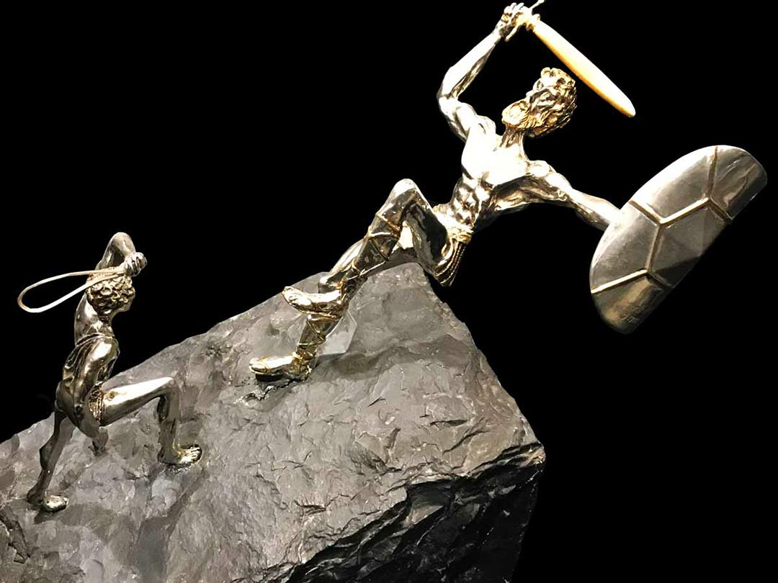
Because David rocked him to sleep
Notes:
Ben Schork

Slide 4
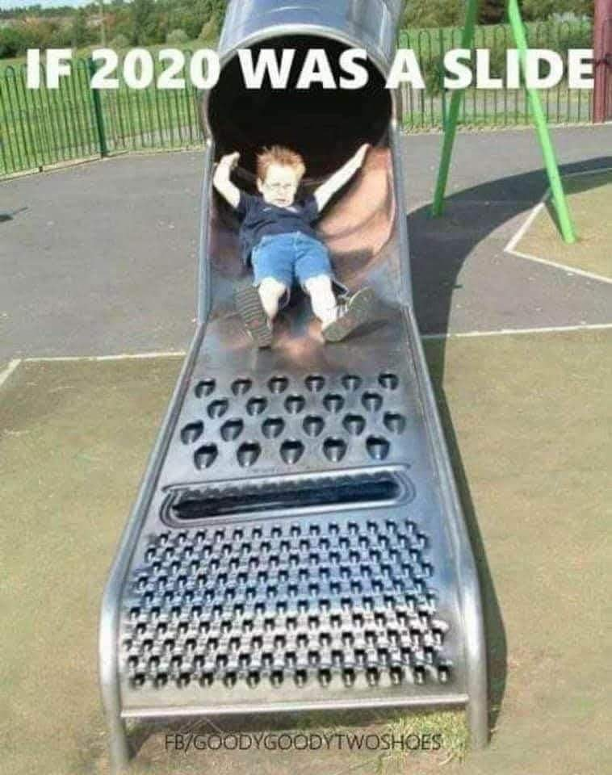
Notes:
From Lori Wilson
COVID, shut down, riots, election

Slide 6
Nevertheless, concerning
the election…

Slide 7
^{Mishlei/Prov 8.14-15} Counsel and sound wisdom are mine. I have understanding and power. By me kings reign and princes decree justice.
^{Dan. 2:21} It is God who raises and puts down kings
Notes:
Election integrity is our prayer.

Slide 9
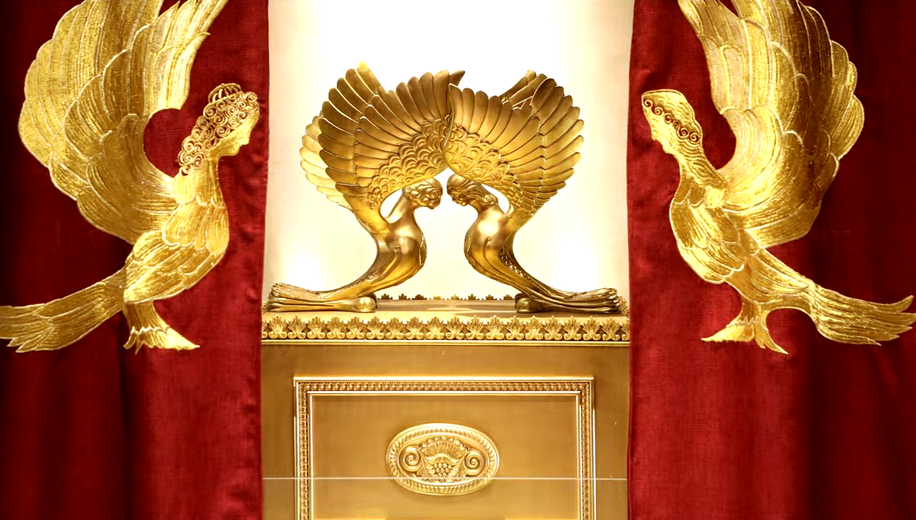
Letter to the Messianic Jews
[Hebrews] MJ 6.1-6.3
First Principles Part 6
Eternity
Notes:
https://www.templeinstitute.org/new-location.htm

Slide 10
^{MJ 6.1-3} Therefore, leaving behind the initial lessons about the Messiah, let us go on to maturity, not laying again the foundation of [Note six foundations]
₁turning from works that lead to death,
₂trusting God, and
Notes:
Six principles

Slide 11
^{MJ 6.1-3} and ₃instruction about washings, ₄s’mikhah, ₅the resurrection of the dead and ₆eternal punishment. And, God willing, this is what we will do.

Slide 12
Last Shabbat we spoke on
what the resurrection is NOT, some false ideas.
Then we compared an unjust universe to a fatherless world. No righteous authority.
Leading to Orphan Shabbat.

Slide 13
Today I feel I should give a complete view of what ₅the resurrection of the dead and ₆eternal punishment is in my understanding, including some controversies.
Answer the ancient cry…

Slide 14
^{Rev. 6.10} “Sovereign Ruler, HaKadosh, the True One, how long will it be before you judge the people living on earth and avenge our blood?”
^{T’hillim /Ps 85.12} Truth will spring up from the earth, and justice will look down from heaven. When?
Notes:
I became a believer in Messiah in 1969, age 20. Went to a Bible College in Cincinnati, met my wife, and we took a prophecy course taught by a retired pastor, TW Commodol.
Big picture…

Slide 15
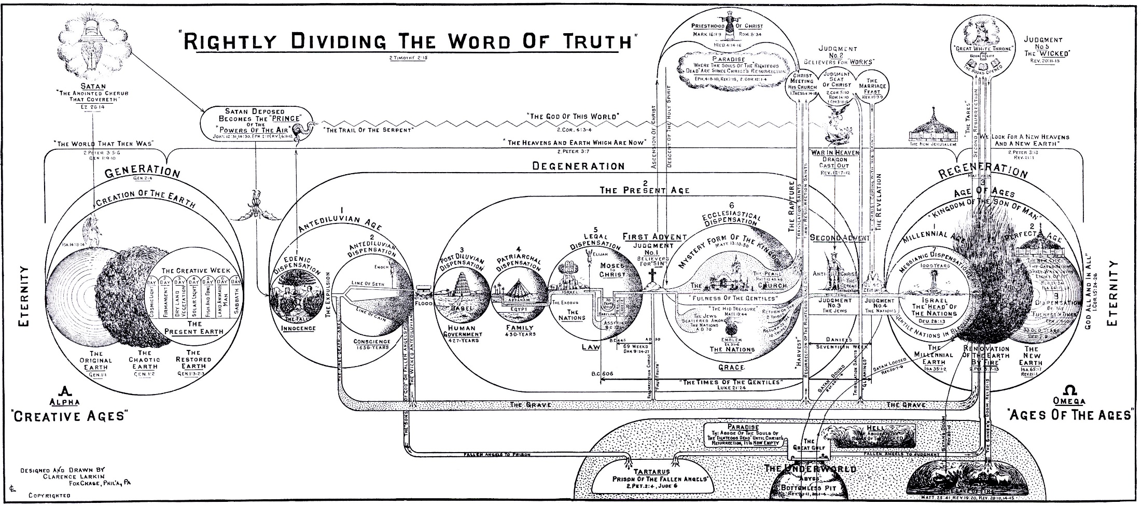
Clarence Larkin 1918
Notes:
Eternity past to eternity future. In 25 years of ministry here, neither I nor anyone else has given the comprehensive picture. P 18-19 of the book, Dispensational Truth.
I am going to note some parts of this diagram in zoomed in mode.

Slide 16
Pretty complex.
Dispensational view. Mostly correct. Some disagreements.
G-d has dealt with humanity in different modes: Garden of Eden, Noah, Patriarchs, Torah, Kingdom of Israel, Messiah. ✔

Slide 17
G-d NEVER broke covenant with Israel: Land, people. G-d will restore Israel to its Land and leadership. ✔
Restoration of Israel will occur after Gentile believers raptured. Until then, Jews join the church. X
Notes:
https://en.wikipedia.org/wiki/Dispensationalism#Messianic_Judaism

Slide 18
Outline of eternal judgments:
Place of the righteous dead before Messiah’s coming.
Place of the righteous dead after Messiah’s coming for atonement.
Place of the righteous dead after Messiah’s coming to reign on earth.
Notes:
No one is righteous, but by faith and repentance.

Slide 19
Outline of eternal judgments:
Place of the unrighteous dead before Messiah’s coming.
Place of the unrighteous dead after Messiah’s coming for atonement.
Place of the unrighteous dead after Messiah’s coming to reign on earth, and Thousand Years ended.

Slide 20
Place of the righteous dead before Messiah’s coming.
Before Yeshua, people were saved by repentance and faith through sacrifices in G-d’s atonement [to come]
At death they went to Avraham’s side [triclinium table]. NOT G-d’s immediate presence.
Notes:
Sacrifices NEVER earned atonement, only emphatic, graphic symbols.

Slide 21
^{Lk 16.19-23} “Once there was a rich man who used to dress in the most expensive clothing and spent his days in magnificent luxury. At his gate had been laid a beggar named El‘azar who was covered with sores…In time the beggar died and was carried away by the angels to Avraham’s side… now he is comforted here.
Notes:
Apparently NOT a parable.

Slide 22
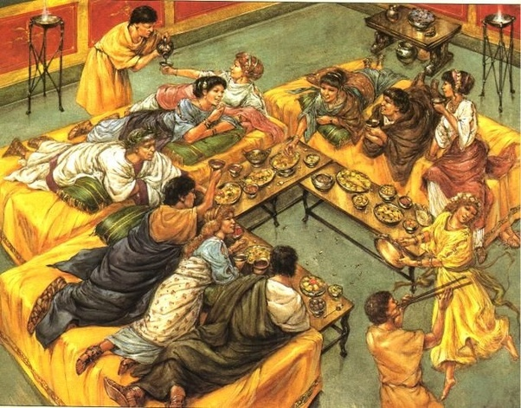
triclinium eating,
entertain-ment
Notes:
https://qph.fs.quoracdn.net/main-qimg-c7f0c7b9c95ecb436dea064a421d69b4
Is that comfortable? Cf upright

Slide 23
^{Lk. 23.38-43} Now there was also an inscription over Him: THIS IS THE KING OF THE JEWS. One of the criminals hanging there…replied… We’re getting what we deserve for our actions, and rightly so—but this One has done nothing wrong.”

Slide 24
^{Lk. 23.38-43} And he said, “Yeshua, remember me when You come into Your kingdom.” Yeshua said to him, “Amen, I tell you, today you shall be with Me in Paradise.”

Slide 25
פַּרְדֵּס pardes, paradise, citrus plantation, orchard, garden of knowledge
Avraham’s side = Paradise

Slide 26
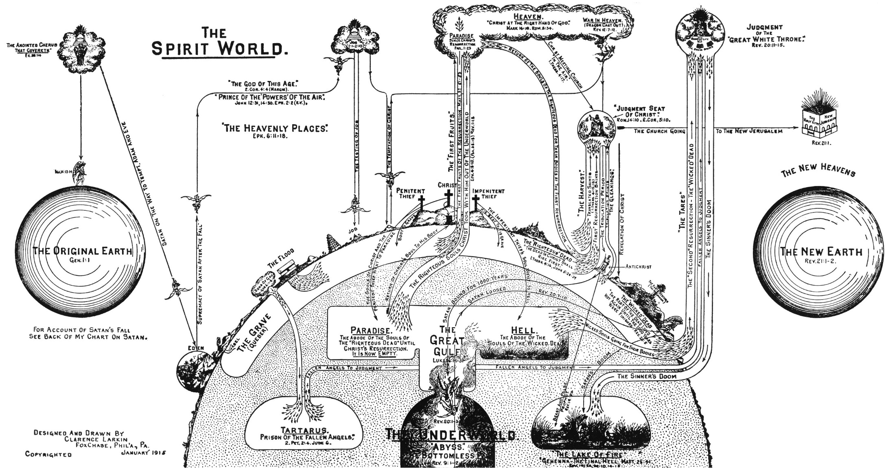
Notes:
Righteous:
Bodies went to the grave,
souls to Avraham’s side, comfort, paradise

Slide 27
Place of the righteous dead after Messiah’s coming for atonement.
After Yeshua, into G-d’s presence / heaven, until His Return
^{Eph 4.7} “After he went up into the heights, he led captivity captive.
^{Ps 68.19} You went up on high. You led captivity captive.
עָלִיתָ לַמָּרוֹם, שָׁבִיתָ שֶּׁבִי alita lmarom, shavita shevi

Slide 28
Notes:
Avraham’s side [bosom] emptied, all carried into G-d’s immediate presence. Heaven.

Slide 29
^{2 Cor 5.6-8} Therefore we are always confident and know that while we are at home in the body, we are absent from the Lord. For we walk by faith, not by sight. We are confident, I say, and prefer rather to be absent from the body and at home with the Lord. [no time delay]
Notes:
What is commonly called heaven. Presence of Messiah at the right hand of the Father.

Slide 30
Place of the unrighteous dead before Messiah’s coming.
Before Yeshua, at death they went immediately into a place of torment.
^{Lk 16.22-23} Then the rich man also died and was buried. And from Sheol…he was in torment.
Notes:
Not because he was rich.

Slide 31
^{T’hillim/Ps 73 18-20} You place them [the wicked] on a slippery slope and make them fall to their ruin. How suddenly they are destroyed, swept away by terrors! They are like a dream when one awakens; Adoni, when you rouse yourself, you will despise their phantoms.

Slide 32
^{Ro 2.7-8} To those who by perseverance in doing good are seeking glory, honor, and immortality—eternal life. But to those who are self-seeking and do not obey the truth, but obey unrighteousness—wrath and fury. [parallel time description]
Notes:
Eternal wrath and fury.

Slide 33
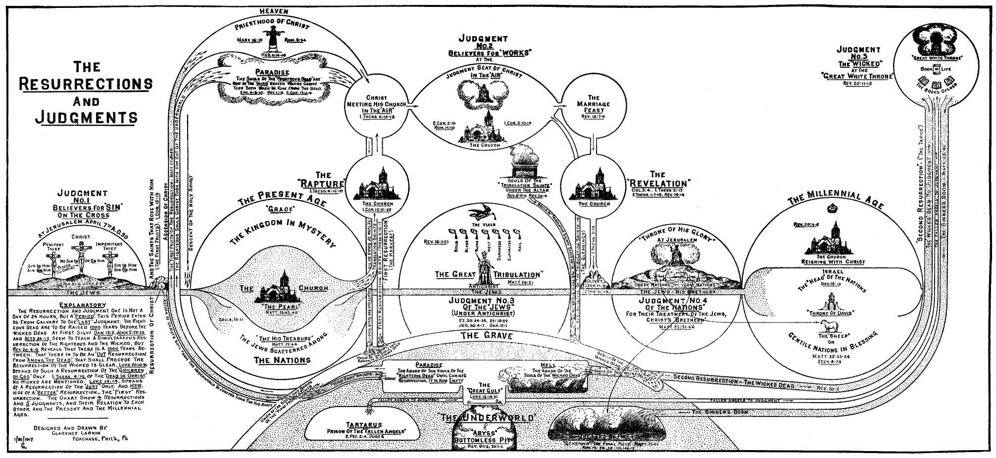
Notes:
Note “hell”

Slide 34
Place of the unrighteous dead after Messiah’s coming for atonement.
After Yeshua, they remain in the place of torment, but not the final place. Like the City Jail, before trial and penitentiary.
Notes:
Not because he was rich.

Slide 35
Place of the unrighteous dead after Messiah’s coming to reign on earth, and Thousand Years ended.
After Yeshua’s return and final judgment and close of the thousand year Kingdom. ^{Rev 20.5} The rest of the [unrighteous] dead did not come to life until the thousand years were completed.

Slide 36
^{Yn 5.28-29} “Do not be amazed at this, for an hour is coming when all who are in their graves will hear His voice and come out! Those who have done good will come to a resurrection of life, and those who have done evil will come to a resurrection of judgment.
Notes:
Two resurrections.

Slide 37
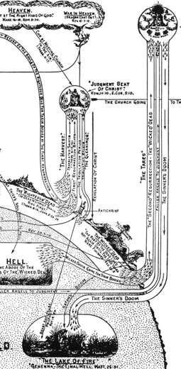
^{Rev. 20.11-15} Then I saw a great white throne, and the One seated on it… And I saw the dead—the great and the small—standing before the throne. The books were opened, and another book was opened—the Book of Life. And the dead were judged according to what was written in the books, according to their deeds.

Slide 38
^{Rev. 20.11-15} The sea gave up the dead that were in it, and death and Sheol gave up the dead in them. Then they were each judged, each one of them, according to their deeds. Then death and Sheol were thrown into the lake of fire. This is the second death—the lake of fire. And if anyone was not found written in the Book of Life, he was thrown into the lake of fire.

Slide 39
Outline:
Place of the righteous dead before Messiah’s coming.
Place of the righteous dead after Messiah’s coming for atonement.
Place of the righteous dead after Messiah’s coming to reign on earth.

Slide 40
^{1 Thes. 4.13-18} Now we do not want you to be uninformed, brothers and sisters, about those who are asleep, so that you may not grieve like the rest who have no hope. For if we believe that Yeshua died and rose again, so with Him God will also bring those who have fallen asleep in Yeshua.

Slide 41
^{1 Thes. 4.13-18} For this we tell you, by the word of the Lord, that we who are alive and remain until the coming of the Lord shall in no way precede those who are asleep. For the Lord Himself shall come down from heaven with a commanding shout, with the voice of the archangel and with the blast of God’s shofar,

Slide 42
^{1 Thes. 4.13-18} and the dead in Messiah shall rise first. Then we who are alive, who are left behind, will be caught up together with them in the clouds, to meet the Lord in the air—and so we shall always be with the Lord. Therefore encourage one another with these words.

Slide 43
1 Thes. 4.17
seize by force; snatch up, suddenly and decisively – like someone seizing bounty (spoil, a prize); to take by an open display of force (i.e. not covertly or secretly).
Notes:
https://biblehub.com/interlinear/1_thessalonians/4-17.htm
Something pretty dramatic!!

Slide 45
Rapture:
Pre-Tribulation
Mid-Tribulation
Post-Tribulation

Slide 46
Here?
Messiah
Messiah’s
Notes:
Questionable issue is when is the rapture?

Slide 47
^{1 Cor 15.51-53} We shall not all sleep,
but we shall all be changed— in a moment, in the twinkling of an eye,
at the last shofar. For the shofar will sound, and the dead will be raised incorruptible, and we will be changed. For this corruptible must put on incorruptibility, and this mortal must put on immortality.

Slide 48
While believers in Messiah, both previously deceased / resurrected and living / raptured, will be
at the Judgment of Rewards,
then the Marriage Supper of the Lamb

Slide 49
on earth the Book of Revelation
seals broken,
shofars sounded,
bowls of G-d’s fury poured out

Slide 50
Here?
Messiah
Messiah’s
Notes:
Questionable issue is when is the rapture?

Slide 51
^{Mtt. 24.21} Then there will be great trouble, such as has not happened since the beginning of the world until now, nor ever will.
^{Dan. 12.1} “At that …there will be a time of distress such as has never occurred since the beginning of the nation until then.

Slide 52
^{Yer. 30.7} Oy! For that day is monumental. There will be none like it— a time of trouble for Jacob! Yet out of it he will be saved.

Slide 53
^{Daniel 12. 9-11} Then he said: “Go your way, Daniel. For the words are closed up and sealed until the time of the end. Many will be purified, made spotless and refined, but the wicked will act wickedly. None of the wicked will understand, but the wise will understand.

Slide 54
^{Daniel 12. 9-11} “From the time that the daily burnt offering is taken away, and abomination of desolation is set up, there will be 1,290 days.
1290 days = 3.5 years
Most view this event as half the tribulation.

Slide 55
^{Mtt 24.30} Then the sign of the Son of Man will appear in heaven, and then all the tribes of the land will mourn, and they will see ^{Dan. 7.13} ‘the Son of Man coming on the clouds of heaven’ with power and great glory.

Slide 56
^{Zekh 14.2} I will gather all the nations against Yerushalayim for war. The city will be taken…Then Adoni will go out and fight against those nations, fighting as on a day of battle. On that day his feet will stand on the Mount of Olives, which lies to the east of Yerushalayim; and the Mount of Olives will be split in half from east to west,

Slide 57
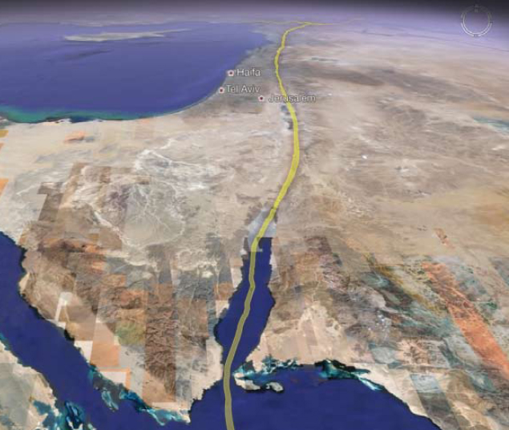
Great Rift Valley
Notes:
Continues all the way to Lake Victoria in Africa and Lake Malawi.

Slide 58
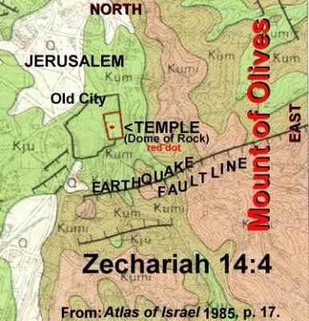

Slide 59
After the revelation of Messiah in the Battle of Jerusalem [Armageddon /Har Megiddo really just a staging ground], Yeshua will set up His Kingdom! Raptured living and righteous resurrected dead rule with Him for the thousand years.

Slide 60
After the thousand year rule, the Millennium, the wicked will be resurrected to the final judgment. The earth will be renewed by fire.

Slide 61
^{Rev. 21.2-7} I also saw the holy city—the New Jerusalem—coming down out of heaven from God, prepared as a bride adorned for her husband. I also heard a loud voice from the throne, saying, “Behold, the dwelling of God is among men, and He shall tabernacle among them. They shall be His people,

Slide 62
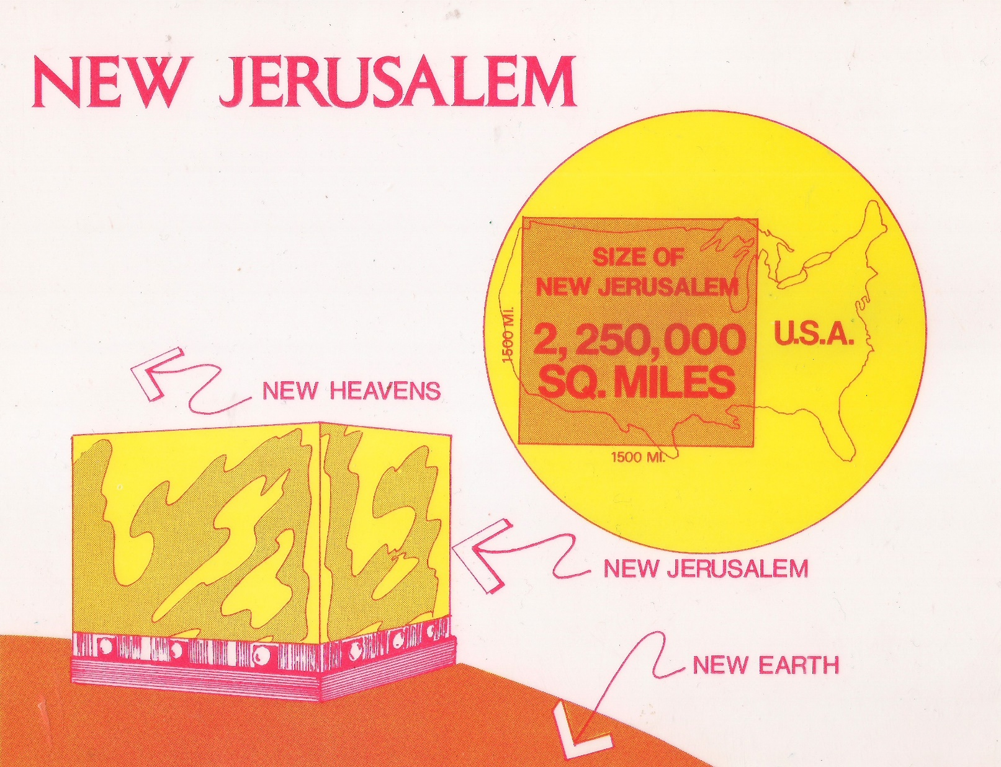

Slide 63
Notes:
https://www.google.com/url?sa=i&url=https%3A%2F%2Fwww.preservedwords.com%2Fcharts.html&psig=AOvVaw0Mp7VzBoyRn7HN-uNMhJU8&ust=1605381302185000&source=images&cd=vfe&ved=0CAIQjRxqFwoTCICP3cOdgO0CFQAAAAAdAAAAABAD
Note: 1000 year Millennial Kingdom → New Heaven and Earth

Slide 64
Outline of eternal judgments:
Place of the righteous dead before Messiah’s coming.
Place of the righteous dead after Messiah’s coming for atonement.
Place of the righteous dead after Messiah’s coming to reign on earth.
Notes:
No one is righteous, but by faith and repentance.

Slide 65
Outline of eternal judgments:
Place of the unrighteous dead before Messiah’s coming.
Place of the unrighteous dead after Messiah’s coming for atonement.
Place of the unrighteous dead after Messiah’s coming to reign on earth, and Thousand Years ended.
Notes:
Now, a practical, immediate application.

Slide 66
^{Rev. 6.10} “Sovereign Ruler, HaKadosh, the True One, how long will it be before you judge the people living on earth and avenge our blood?”
^{T’hillim /Ps 85.12} Truth will spring up from the earth, and justice will look down from heaven. When?
Notes:
Back then, I was a wannbe hippy, flower child, seeking love and truth and peace.
We were looked on by the Christians as the plague of the nation. Didn’t see our hearts, except some. Chuck Smith. Calvary Chapel was a hub of the "Jesus People" phenomenon that existed at that time and was featured in Time Magazine for its success among "hippies" and young people. Calvary Chapel pioneered a less formal and contemporary approach in its worship and public meetings; for example, it did outreaches on the beach, and baptisms in the Pacific Ocean.[9] Much of Contemporary Christian Music (CCM) has its roots in Calvary Chapel worship music. Today, justice, not love

Slide 67
So, is there justice in the universe?
Ultimately, but what about those who cry for justice now?
Even unjustly crying for justice.

Slide 68
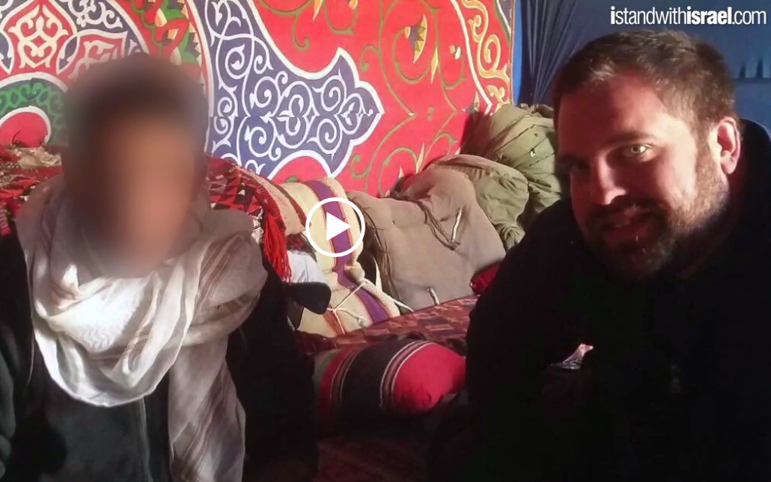
Notes:
http://simeonscry.org/
Up to 3.08

Slide 69
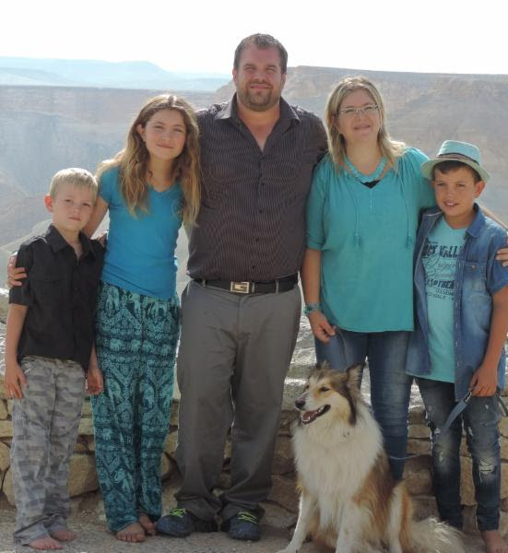
Sean & Ayelet Steckbeck, Maayan and sons.
Notes:
BLM story: a rally was being set up, and Sean’s team got there first to set up sound system. BLM asked if they could speak. Sean said OK if you won’t disrupt or leave. Sean said, “I know you are concerned about justice for George Floyd, Breonna Taylor, Ahmaud Arbery. But what about justice for yourself. What about justice for your selfishness, rage, lust, unfairness. Only Jesus can give you freedom from the justice we all merit.
Sean called for repentance, and BLM, transgender, were kneeling in prayer!
My generation of Flower Children were looking from love and peace, these looking for justice! KEY

Slide 70
Justice is achieved in the Person of the Kingdom of G-d in the King of the Universe.
Yeshua IS justice, and will bring justice.

Slide 71
^{Rev. 1.17-19} When I saw Him, I fell at His feet like a dead man. But He placed His right hand on me, saying, “Do not be afraid! I am the First and the Last, and the One who lives. I was dead, but look—I am alive forever and ever! Moreover, I hold the keys of death and Sheol.

Slide 72
What is it like for the righteous in the Presence?

Slide 73
^{T’hillim 16.10-11} For you will not abandon me to Sh’ol, you will not let your faithful one see the Abyss. You make me know the path of life; in your presence is unbounded joy,
in your right hand eternal delight.
שֹׂבַע שְׂמָחוֹת אֶת-פָּנֶיךָ; נְעִמוֹת בִּימִינְךָ נֶצַח.

Slide 74
^{1 Cor. 2.9} As the Tanakh says, “No eye has seen, no ear has heard and no one’s heart has imagined all the things that God has prepared for those who love him.”

Slide 75
^{Ber/Gen 3.8-9} They heard the voice of Adoni, God, walking in the garden at the time of the evening breeze… Adoni, God, called to the man, “Where are you?”

Slide 76
Let him smother me with kisses from his mouth, for your love is better than wine.
יִשָּׁקֵנִי מִנְּשִׁיקוֹת פִּיהוּ, כִּי-טוֹבִים דֹּדֶיךָ מִיָּיִן.
“Loves” in plural
Notes:
Adjective agrees with noun in number and gender: love and good both in plural. Jon Cahn

Slide 77
אָבוֹא אֶל מִזְבֵּחַ אֱלֹהִים אֶל אֵל שִׂמְחַת גִּילִי
Avo el mizbakh Elohim
el El simkhat gili
אַקְרִיב פְּרִי שְׂפָתַי לְפָנֶיךָ
Akriv pri sfati lefaneikha
[I will come to the altar of God, to G-d my exceeding joy,
I will bring the fruit of my lips]

Slide 78
הִנֵּה מִשְׁכָּן אֱלֹהִים עִם בְּנֵי אָדָם
Hineh mishkan Elohim im b’nei adam
הֵמָּה יִהְיוּ לוֹ לָעָם
Hema yihyu lo le’am
[Behold, the tabernacle of G-d
is with men
They shall be His people.]

Slide 79
הוּא יִמְחֶה כָּל דִּמְעָה מֵעֵינָם
Hu yimkheh kol dimah me’einam
וּמָוֶת, כְּאֵב וּזְעָקָה לֹא יִהְיוּ עוֹד
Umavet, ke’ev veze’akah lo yihu od
He will wipe away every tear
from their eyes
There shall be no more death,
pain, nor crying.

Slide 80
נָגִילָה וְנִשְׂמְּחָה וְנִתַּן לוֹ כָּבוֹד
Nagila v’nis’mekha V’nitan lo kavod
[Come and rejoice and give Him glory]
Notes:
But there are some people…that always hurt.

Slide 81
^{Rev. 21.2-7} and God Himself shall be among them and be their God. He shall wipe away every tear from their eyes, and death shall be no more. Nor shall there be mourning or crying or pain any longer, for the former things have passed away.”

Slide 82
^{Rev. 21.2-7} And the One seated upon the throne said, “Behold, I am making all things new!” Then He said, “Write, for these words are trustworthy and true.” Then He said to me, “It is done! I am the Alpha and the Omega, the Beginning and the End.

Slide 83
Justice is achieved in the Person of the Kingdom of G-d in the King of the Universe.
Yeshua IS justice, and will bring justice.

Slide 84
^{Daniel 12.2-3} Multitudes who sleep in the dust of the earth will awake—some to everlasting life, and others to shame and everlasting contempt. Those who are wise will shine like the brightness of the heavenly expanse. And those who turn many to righteousness will be like the stars forever and ever.
Notes:
The duration of resurrection to life is equivalent to the duration of the resurrection of the punishment of the lost.

Slide 85
^{Rev. 21.2-7} To the thirsty I will freely give from the spring of the water of life. The one who overcomes shall inherit these things, and I will be his God and he shall be My son. But for the cowardly and faithless and detestable and murderers and sexually immoral and sorcerers and idolaters and all liars—their lot is in the lake that burns with fire and brimstone, which is the second death.”

