Slide 1
e-handout
To have these notes
without taking notes
Go to OrHaOlam.com
Click on downloads,
messages, 2020

Slide 2
From Scott Hahn:
I asked the doctor if I could sew up my own wound.

Slide 3
From Scott Hahn:
I asked the doctor if I could sew up my own wound.
He said, “Sure, suture self!”

Slide 4
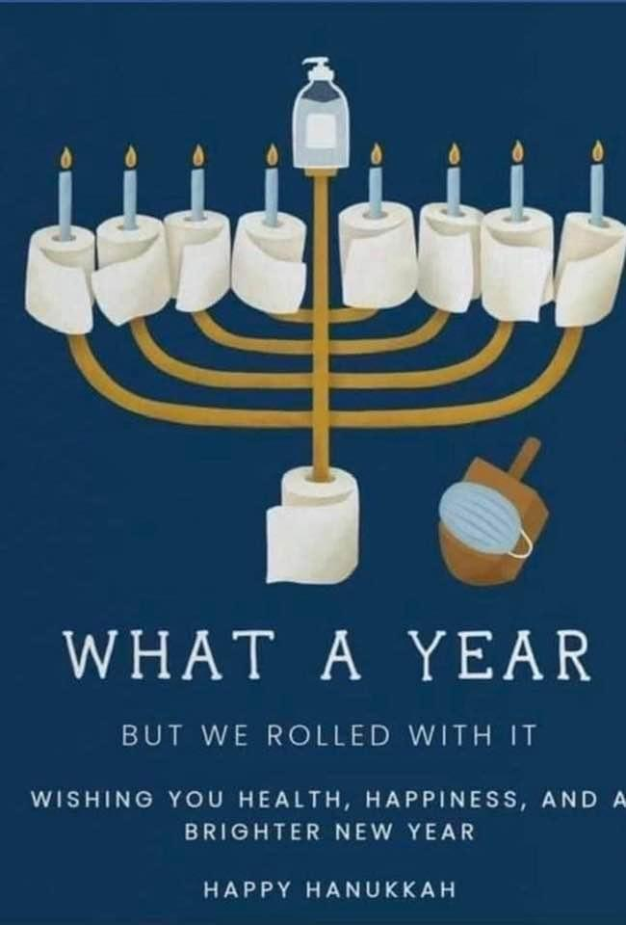
What a year,
But we rolled with it!
Notes:
From Rukhel

Slide 7
Notes:
Talk to you about the roller coaster ride in Ch 6

Slide 8
^{MJ 6.9-12} Now even though we speak this way, dear friends, we are confident that you have the better things that come with being delivered. For God is not so unfair as to forget your work and the love you showed for him in your past service to his people — and in your present service too.
Notes:
What way is he speaking? We’ll come back to that.

Slide 9
^{MJ 6.9-12} However, we want each one of you to keep showing the same diligence right up to the end, when your hope will be realized; so that you will not become sluggish, but will be imitators of those who by their trust and patience are receiving what has been promised.

Slide 10
^{MJ 6.9} Now even though we speak this way,
?
Notes:
What way is he speaking? Why so vital?
Context: chapter review…

Slide 11
MJ 6.1-3 Strong Beginning

Slide 12
MJ 6.1-3 Strong Beginning
MJ 6.4-8 Disastrous Ending
Notes:
Radical jump. But rather than leave us on a downer…

Slide 13
MJ 6.1-3 Strong Beginning
MJ 6.4-8 Disastrous Ending
MJ 6.9-12 Glorious Ending
Notes:
Roller coaster ride

Slide 14
Outline of this message:
MJ/Heb 6: good start, bad end, good end
Good end: 5 crowns to give back to the King Messiah Yeshua.
Notes:
Roller coaster
Top of mountain

Slide 15
^{MJ 6.9-12} we are confident that you have the better things that come with salvation. For God is not so unfair as to forget your work and the love you showed for him in your past service to his people — and in your present service too.
Notes:
Does anyone notice what I’m doing? Does it count? I try to sent appreciation notes, but God remembers your work and love.
Your life is like a saga in scripture: Avraham, Yitskhak, Yaakov, Abraham, Isaac, Jacob.
Iyov/Job one time lamented that his story wasn’t being recorded. But it was. So is yours!
But I’m not in scriptures, so how?

Slide 16
Similar to the thoughts of Shaul/Paul…

Slide 17
^{1 Cor. 3.11-13} For no one can lay any foundation other than the one already laid, which is Yeshua the Messiah. Some will use gold, silver or precious stones in building on this foundation;

Slide 18
^{1 Cor. 3.11-13} while others will use wood, grass or straw. But each one’s work will be shown for what it is; the Day will disclose it, because it will be revealed by fire
Notes:
Our works all based on grace, חן וחסד
He gives us love to love Him and others, then rewards us for using His love.
All about power and presence of יְשוּעַ Yeshua
Our works will be examined.
Pre-Trib? Irrelevant.

Slide 19
^{1 Cor. 3.13-15} —the fire will test the quality of each one’s work. If the work someone has built on the foundation survives, he will receive a reward;

Slide 20
^{1 Cor. 3.13-15} if it is burned up, he will have to bear the loss: he will still escape with his life, but it will be like escaping through a fire.
Notes:
Tried by fire: motives, attitudes,
Mixed? OK partial reward
I’m not doing for Adoni perfectly,
Still do, gain, receive as you are.
Greatest gift of heart: 6x/sec eye exchange
Joel Chernoff re Joseph Project: smell of Holy Spirit on us

Slide 21
And similar to Yokhanan/ John…

Slide 22
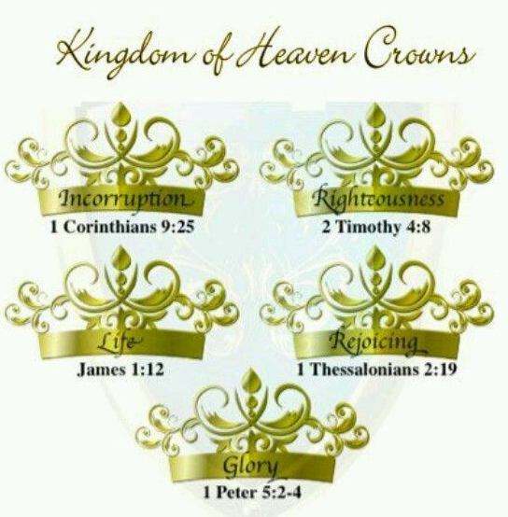
^{1Yn 1.8} Watch yourselves, so that you won’t lose what you have worked for, but will receive your full reward.
Notes:
https://i.pinimg.com/originals/92/1c/61/921c616534cd3d86dd8bde9bf17d52b3.jpg

Slide 23
Why would we want a reward, a crown? Isn’t just being in eternity with G-d and King Messiah Yeshua good enough?
Notes:
Three surprises about being there:
people expected missing.
People not expected there.
You and I are there.
What actually goes on in eternity, in G-d’s immediate Presence…

Slide 24
^{Rev. 4.2-4} Instantly I was in the Spirit, and there before me in heaven stood a throne, and on the throne Someone was sitting. The One sitting there gleamed like diamonds and rubies, and a rainbow shining like emerald encircled the throne.
Notes:
Vision of Adoni ~ chariot, merkavah of Ezk 1

Slide 25
^{Rev. 4.2-4} Surrounding the throne were twenty-four other thrones, and on the thrones sat twenty-four elders dressed in white clothing and wearing gold crowns on their heads.
Notes:
24??
12 tribes of Israel
12 Ones sent to all the Nations of the earth
12 Jews, 12 Gentile Nations
Not “separate but equal” Together and equal, yet identity maintained. Marriage supper of the Lamb? Israeli falafel, Matzoh ball soup only? Hope also egg rolls, lasagna, enchiladas, masala & kabobs!
All Jews? No, all royalty!

Slide 26
This closely resembles the imagery used by Rav in the Talmud to depict saved human beings in the age to come: “In the עולם הבא olam haba , the world to come… the righteous sit with their crowns upon their heads and feast on the Sh’khinah.” (B’rakhot 17a)
Notes:
Rav = Abba Arika (175–247) (Talmudic Aramaic: אבא אריכא) (born Abba bar Aybo) was a Jewish Talmudist who lived in Babylonia,
known as an amora (commentator on the Oral Law) of the 3rd century who established at Sura the systematic study of the rabbinic traditions, which, using the Mishnah as text, led to the compilation of the Talmud. With him began the long period of ascendancy of the great academies of Babylonia (Oesterley & Box 1920), around the year 220. He is commonly known simply as Rav (or Rab, Hebrew: רב

Slide 27
^{Rev 4.10-11} The twenty-four elders fall down before the One sitting on the throne, who lives forever and ever, and worship him. They throw their crowns in front of the throne and say,
Notes:
Seraph worship: “day and night they never stop saying, "Holy, holy, holy is ADONAI, God of heaven's armies””
Seraph abuse?
We follow prostrate and present crowns.
Our love gift to G-d and Messiah.
This is the coinage, the currency of worship.
[How many times present the same crown?]
How get them?
Point of this message.

Slide 28
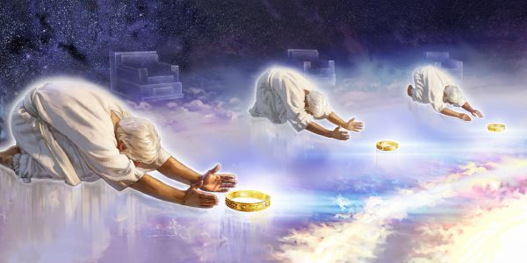

Slide 29
^{Rev 4.10-11} "You are worthy, ADONI Eloheinu, to have glory, honor and power, because you created all things yes, because of your will they were created and came into being!"

Slide 30
Five crowns
heaven’s currency of worship
Notes:
Prep for eternity…

Slide 31
^{2 Cor. 5 6-11} So we are always confident—we know that so long as we are at home in the body, we are away from our home with the Lord; for we live by trust, not by what we see. We are confident, then, and would much prefer

Slide 32
^{2 Cor. 5 6-11} to leave our home in the body and come to our home with the Lord. Therefore, whether at home or away from home, we try our utmost to please

Slide 33
Him; for we must all appear before the Messiah’s court of judgment, where everyone will receive the good or bad consequences of what he did while he was in the body. So it is with the fear of the Lord before us that we try to persuade people.

Slide 34
Five crowns
heaven’s currency of worship

Slide 35
Crown of Rejoicing / Soulwinners
^{1 Thes. 2.17-20} And as for us, brothers, when we were deprived of your company for a short time—in person, but not in thought—we missed you and tried hard to come and see you.
Notes:
Sweetest of the crowns

Slide 36
Crown of Rejoicing / Soulwinners
^{1 Thes. 2.17-20} We wanted so much to come to you—I, Sha’ul, tried more than once —but the Adversary stopped us. For when our Lord Yeshua returns, what will be our hope, our joy, our crown to boast about? Won’t it be you? Yes, you are our glory and our joy!
Notes:
Win people to יְשוּעַ
Feels as good as getting saved all over again, except retain is harder, talmidut/discipleship, home groups
Prayer before service.
How many have you won to Yeshua? How many have you tried to win??
28 people 25 years OH. Each one is a diamond!
Some not totally OH work, but close assist,
Some gone back.
Not all my work. Team.

Slide 37
Crown of Rejoicing / Soulwinners
^{Daniel 12.3} Those who are wise will shine like the brightness of the heavenly expanse. And those who turn many to righteousness will be like the stars forever and ever.

Slide 38
Crown of Rejoicing / Soulwinners
^{Phil. 4.1} Therefore, my brothers and sisters whom I love and long for, my joy and crown—stand firm in the Lord in this way, my loved ones.

Slide 39
Crown of Rejoicing / Soulwinners
^{Mishlei/Prov 11.30} The fruit of the righteous is a tree of life, and whoever wins souls is wise.

Slide 40
Crown of Rejoicing / Soulwinners
^{Mishlei/Prov 24.10-12} If you slack off on a day of distress, your strength is small indeed. Yes, rescue those being dragged off to death — won’t you save those about to be killed?

Slide 41
Crown of Rejoicing / Soulwinners
^{Mishlei/Prov 24.10-12} If you say, “We knew nothing about it,” won’t he who weighs hearts discern it? Yes, he who guards you will know it and repay each one as his deeds deserve.

Slide 42
Crown of Rejoicing / Soulwinners
GREAT Commision:
^{Mt 28.18-19} Yeshua came and talked with them. He said, “All authority in heaven and on earth has been given to me. Therefore, go and make people from all nations into talmidim,

Slide 43
Crown of Rejoicing / Soulwinners
GREAT Commision:
^{Mt 28.18-19} immersing them into the reality of the Father, the Son and the Ruach HaKodesh.
Reproduce! At least try!
Notes:
The idea that you are a prototype to win people will keep you as a great example!!

Slide 44
Notes:
https://i.pinimg.com/originals/92/1c/61/921c616534cd3d86dd8bde9bf17d52b3.jpg

Slide 45
Incorruptible Crown/Victors
^{I Cor 9.23-27} But I do it all because of the rewards promised by the Good News, so that I may share in them along with the others who come to trust.

Slide 46
Incorruptible Crown/Victors
^{I Cor 9.23-27} Don’t you know that in a race all the runners compete, but only one wins the prize? So then, run to win! Now every athlete in training submits himself to strict discipline,

Slide 47
^{I Cor 9.23-27} and he does it just to win a laurel wreath that will soon wither away.

Slide 48
Crown of laurel leaves
Notes:
https://st2.depositphotos.com/2482107/6710/i/950/depositphotos_67105213-stock-photo-laurel-wreath-close-up.jpg

Slide 49
^{I Cor 9.23-27} But we do it to win a crown that will last forever. Accordingly, I don’t run aimlessly but straight for the finish line; I don’t shadow-box but try to make every punch count.

Slide 50
^{I Cor 9.23-27} I treat my body hard and make it my slave so that, after proclaiming the Good News to others, I myself will not be disqualified.
Notes:
Crown of self control: denial, give for others, tithe, give sacrificially
Serve others, deny self, fast, study?
Hours of prayer and study, yet not by drudgery
Yet, do it >> see latest movie.
Essence of discipleship = discipline.
~ learning Hebrew, glory, yet still a lingo

Slide 51
^{2 Tim 2.4-7} No soldier on duty gets involved with civilian affairs, since he has to please his commanding officer. Also an athlete can’t win a contest unless he competes according to the rules. The farmer who has done the hard work

Slide 52
^{2 Tim 2.4-7} should be the first to receive a share of the harvest. Think about what I am saying, for the Lord will enable you to understand everything.

Slide 53
Notes:
https://i.pinimg.com/originals/92/1c/61/921c616534cd3d86dd8bde9bf17d52b3.jpg

Slide 54
Crown of Life / Martyr’s ^{Rev 2.10-11} Don’t be afraid of what you are about to suffer. Look, the Adversary is going to have some of you thrown in prison, in order to put you to the test; and you will face an ordeal for ten days. Remain faithful, even to the point of death; and I will give you life as your crown.
Notes:
In the United States of America, we haven’t suffered for being believers in the Bible and the Messiah. Honored: tax exempt purchases, no property tax on building, you get income tax deduction for contributions.
We don’t know the future. Few weeks ago message on the persecuted believers worldwide. Do we have a persecution exemption? First Amendment?
CA worship shut down, and protests/riots allowed!!

Slide 55
Crown of Life / Martyr’s
^{Lk 6.22-23} "How blessed you are whenever people hate you and ostracize you and insult you and denounce you as a criminal on account of the Son of Man. Be glad when that happens; yes, dance for joy!

Slide 56
^{Lk 6.22-23} "because in heaven your reward is great. For that is just how their fathers treated the prophets.
But you can waste your sorrows.
Notes:
This year: corona → lockdown, unrest, fires, election confusion.
Looking to start 24/7 prayer room in cyberspace.
Political correctness: picnic, brown bag are offensive words.

Slide 57
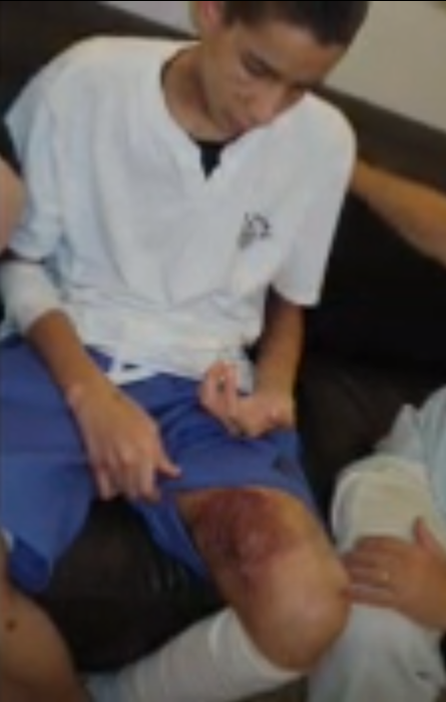
Ami Ortiz, age 15, survivor of Purim “gift” bombing in Ariel, Israel.

Slide 58
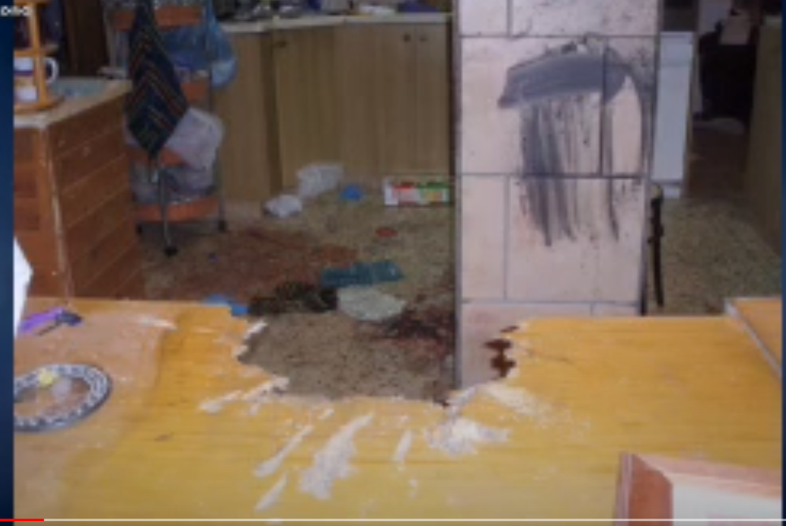
Notes:
https://www.youtube.com/watch?v=_bLc6LqLjd8
If HR-5 is passed, religious charities will NOT be able to use sexual identity as a basis for hiring, or facilities use, bathroom use. If lose Georgia seats…
In our Corporate By-Laws our facility, clergy, staff will only officiate in a wedding of an XX woman and an XY man. HR-5 will override.
Next admin
Fund abortion by charities health plan
Legalize prostitution
Open borders
Military transgendering

Slide 59
Notes:
https://i.pinimg.com/originals/92/1c/61/921c616534cd3d86dd8bde9bf17d52b3.jpg

Slide 60
Crown of Glory/Elder’s ^{1 Kefa/Pet 5.1-4} Therefore, I urge the congregation leaders among you, as a fellow-leader and witness to the Messiah’s sufferings, as well as a sharer in the glory to be revealed: shepherd the flock of God

Slide 61
Crown of Glory/Elder’s ^{1 Kefa 5.1-4} that is in your care, exercising oversight not out of constraint, but willingly,

Slide 62
Crown of Glory/Elder’s
^{1 Kefa 5.2-4} as God wants; and not out of a desire for dishonest gain, but with enthusiasm; also not as machers domineering over those in your care,
Notes:
Examples, leaders, Servants
Clean toilets, Oneg, usher, media booth
Ministry is glorious and not glorious.

Slide 63
^{1 Kefa 5.2-4} but as people who become examples to the flock. Then, when the Chief Shepherd appears, you will receive glory as your unfading crown

Slide 64
^{Mtt 10.41-42} Anyone who receives a prophet because he is a prophet will receive the reward a prophet gets, and anyone who receives a tzaddik because he is a tzaddik will receive the reward a tzaddik gets.
Notes:
Serve and bless

Slide 65
^{Mtt 10.41-42} Indeed, if someone gives just a cup of cold water to one of these little ones because he is my talmid -- yes! -- I tell you, he will certainly not lose his reward!"
Notes:
Serve and bless

Slide 66
Notes:
https://i.pinimg.com/originals/92/1c/61/921c616534cd3d86dd8bde9bf17d52b3.jpg

Slide 67
Crown of Righteousness/ Love His Appearing
^{2 Tim 4 6-8} For as for me, I am already being poured out on the altar; yes, the time for my departure has arrived. I have fought the good fight, I have finished the race, I have kept the faith.
Notes:
Not living for this world
Responsible, yet treasure elsewhere.

Slide 68
Crown of Righteousness/ Love His Appearing ^{2 Tim 4 6-8} All that awaits me now is the crown of righteousness which the Lord, “the Righteous Judge”, will award to me on that Day—and not only to me, but also to all who have longed for him to appear.
Notes:
.

Slide 69
Outline:
MJ 6: good start, bad end, good end
Good end: 5 crowns to give back to the King Messiah Yeshua: soulwinners, victors, sufferers, servant leaders, faithful.

Slide 70
^{MJ 6.9-12} However, we want each one of you to keep showing the same diligence right up to the end, when your hope will be realized; so that you will not become sluggish, but will be imitators of those who by their trust and patience are receiving what has been promised.

Slide 71
^{1Yn 1.8} Watch yourselves, so that you won’t lose what you have worked for, but will receive your full reward.
Notes:
https://i.pinimg.com/originals/92/1c/61/921c616534cd3d86dd8bde9bf17d52b3.jpg
Context:
Love ea other
= according to commandments
Many deceivers: יְשוּעַ not come in flesh
[wrong living, wrong doctrine → lose reward]

