Slide 1
e-handout
To have these notes
without taking notes
Go to OrHaOlam.com
Click on downloads,
messages, 2019

Slide 2
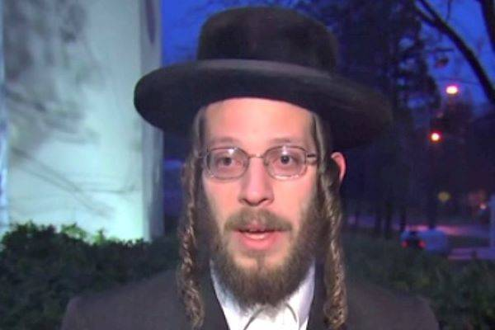
Hanukkah Hero Recalls Face-to-Face Battle
with Machete-wielding Attacker
Notes:
https://unitedwithisrael.org/hanukkah-hero-recalls-face-to-face-battle-with-machete-wielding-attacker/?utm_source=MadMimi&utm_medium=email&utm_content=Hasidic+Hero+Stopped+Machete-wielding+NY+Attacker%3B+Netanyahu+Seeks+Immunity+from+Prosecution%3B+Mystery+Millionaire+Stuns+Israeli+Hospital+with+Massive+Donation&utm_campaign=20200101_m156190385_Hasidic+Hero+Stopped+Machete-wielding+NY+Attacker%3B+Netanyahu+Seeks+Immunity+from+Prosecution%3B+++Mystery+Millionaire+Stuns+Israeli+Hospital+with+Massive+Donation&utm_term=more_btn_light_png

Slide 3
In a TV interview on Monday, Joseph Gluck recalled that the attacker, Grafton E. Thomas, had entered the house of Rabbi Chaim Rottenberg just as the menorah-lighting ceremony was ending in the dining room.
Notes:
https://unitedwithisrael.org/hanukkah-hero-recalls-face-to-face-battle-with-machete-wielding-attacker/?utm_source=MadMimi&utm_medium=email&utm_content=Hasidic+Hero+Stopped+Machete-wielding+NY+Attacker%3B+Netanyahu+Seeks+Immunity+from+Prosecution%3B+Mystery+Millionaire+Stuns+Israeli+Hospital+with+Massive+Donation&utm_campaign=20200101_m156190385_Hasidic+Hero+Stopped+Machete-wielding+NY+Attacker%3B+Netanyahu+Seeks+Immunity+from+Prosecution%3B+++Mystery+Millionaire+Stuns+Israeli+Hospital+with+Massive+Donation&utm_term=more_btn_light_png

Slide 4
“First he stood in the anteroom, hitting people right and left with a big machete knife,” Gluck told CNN. “That’s when I started to run out through a side door with all the people in the dining room. We ran to the back of the house, going out by the back door.”
Notes:
https://unitedwithisrael.org/hanukkah-hero-recalls-face-to-face-battle-with-machete-wielding-attacker/?utm_source=MadMimi&utm_medium=email&utm_content=Hasidic+Hero+Stopped+Machete-wielding+NY+Attacker%3B+Netanyahu+Seeks+Immunity+from+Prosecution%3B+Mystery+Millionaire+Stuns+Israeli+Hospital+with+Massive+Donation&utm_campaign=20200101_m156190385_Hasidic+Hero+Stopped+Machete-wielding+NY+Attacker%3B+Netanyahu+Seeks+Immunity+from+Prosecution%3B+++Mystery+Millionaire+Stuns+Israeli+Hospital+with+Massive+Donation&utm_term=more_btn_light_png

Slide 5
Gluck said that he immediately turned and ran to the front of the house to offer further assistance. Going back inside, he quickly came face to face with Thomas.
Notes:
https://unitedwithisrael.org/hanukkah-hero-recalls-face-to-face-battle-with-machete-wielding-attacker/?utm_source=MadMimi&utm_medium=email&utm_content=Hasidic+Hero+Stopped+Machete-wielding+NY+Attacker%3B+Netanyahu+Seeks+Immunity+from+Prosecution%3B+Mystery+Millionaire+Stuns+Israeli+Hospital+with+Massive+Donation&utm_campaign=20200101_m156190385_Hasidic+Hero+Stopped+Machete-wielding+NY+Attacker%3B+Netanyahu+Seeks+Immunity+from+Prosecution%3B+++Mystery+Millionaire+Stuns+Israeli+Hospital+with+Massive+Donation&utm_term=more_btn_light_png

Slide 6
“I grabbed the coffee table that was on the floor, hit him in his face, and that’s when he came back outside after me,” a visibly-exhausted Gluck continued.
Notes:
https://unitedwithisrael.org/hanukkah-hero-recalls-face-to-face-battle-with-machete-wielding-attacker/?utm_source=MadMimi&utm_medium=email&utm_content=Hasidic+Hero+Stopped+Machete-wielding+NY+Attacker%3B+Netanyahu+Seeks+Immunity+from+Prosecution%3B+Mystery+Millionaire+Stuns+Israeli+Hospital+with+Massive+Donation&utm_campaign=20200101_m156190385_Hasidic+Hero+Stopped+Machete-wielding+NY+Attacker%3B+Netanyahu+Seeks+Immunity+from+Prosecution%3B+++Mystery+Millionaire+Stuns+Israeli+Hospital+with+Massive+Donation&utm_term=more_btn_light_png

Slide 7
“He told me, ‘Hey you, I’ll get you!’ I was a few feet in front of him, I was screaming, ‘He’s coming, he’s coming!’
Notes:
https://unitedwithisrael.org/hanukkah-hero-recalls-face-to-face-battle-with-machete-wielding-attacker/?utm_source=MadMimi&utm_medium=email&utm_content=Hasidic+Hero+Stopped+Machete-wielding+NY+Attacker%3B+Netanyahu+Seeks+Immunity+from+Prosecution%3B+Mystery+Millionaire+Stuns+Israeli+Hospital+with+Massive+Donation&utm_campaign=20200101_m156190385_Hasidic+Hero+Stopped+Machete-wielding+NY+Attacker%3B+Netanyahu+Seeks+Immunity+from+Prosecution%3B+++Mystery+Millionaire+Stuns+Israeli+Hospital+with+Massive+Donation&utm_term=more_btn_light_png

Slide 8
When Thomas returned to his car to drive away from the crime scene, it was Gluck who wrote down his license plate, enabling police in New York City to apprehend the 37-year-old attacker in Harlem a few hours after the attack.
“Get down” “Bajen al piso”
Notes:
https://unitedwithisrael.org/hanukkah-hero-recalls-face-to-face-battle-with-machete-wielding-attacker/?utm_source=MadMimi&utm_medium=email&utm_content=Hasidic+Hero+Stopped+Machete-wielding+NY+Attacker%3B+Netanyahu+Seeks+Immunity+from+Prosecution%3B+Mystery+Millionaire+Stuns+Israeli+Hospital+with+Massive+Donation&utm_campaign=20200101_m156190385_Hasidic+Hero+Stopped+Machete-wielding+NY+Attacker%3B+Netanyahu+Seeks+Immunity+from+Prosecution%3B+++Mystery+Millionaire+Stuns+Israeli+Hospital+with+Massive+Donation&utm_term=more_btn_light_png

Slide 10
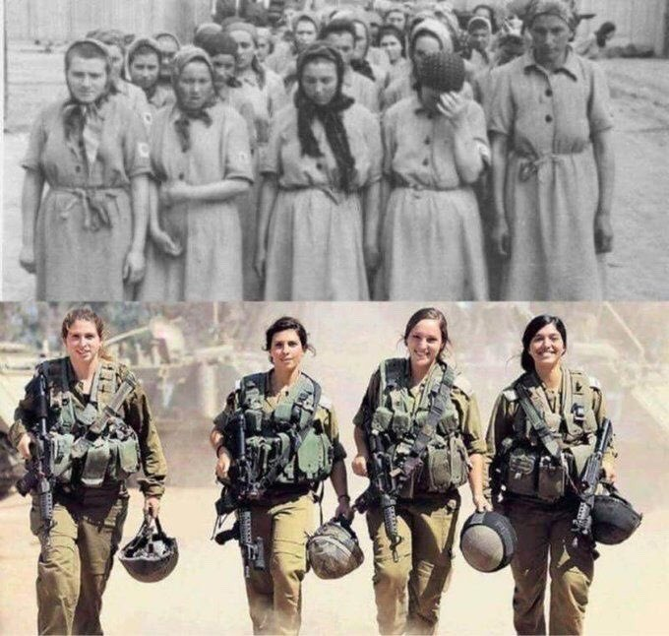
The four Israeli soldiers in the bottom photo are the grand-daughters of the first four women in the top photo at a Nazi concentration camp
Notes:
From Vicki Kline
Fight and SURVIVE!

Slide 12
Blessings of our
building flood problem
Notes:
Pretty much finished. My wife has spent 100 hours here, with others.

Slide 13
Electric heater in the Ladies’ Room, where there was no duct from the HVAC system, and it got chilly in the winter.
A ceiling fan installed in the Ladies’ Room to give a bit of air flow in a room that is otherwise stuffy in the summer.

Slide 14
The lobby ceiling has much better drywall finish, as there was a structural flaw in the framing that held the ceiling and a recurring crack kept forming.
Ladies’ Room, kitchen, Bring n Share Room have a knock down plaster ceiling finish. A better look than previously.

Slide 15
The Ladies’ Room has knock down finish on the walls.
Removed a partial wall in the Bring n Share Room, much better access and pedestrian flow, and reinforced ceiling rafters.
Ladies’ room now almost handicap accessible.

Slide 16
Cost $40,000 to 50,000, almost all covered by insurance!
Notes:
[Pause]

Slide 17
We just entered 2020
Heard many jokes about a year of vision? 2020 vision?
Notes:
First one sent to me from Gerardo.

Slide 18
My friend asked me where I see myself in the new year.
How would I know? I don't have 2020 vision.
Notes:
From Dawn W.

Slide 19
Notes:
https://hips.hearstapps.com/hmg-prod.s3.amazonaws.com/images/gh-new-years-jokes-9-1575386479.png

Slide 20
Notes:
https://www.google.com/url?sa=i&url=https%3A%2F%2Fwww.goodhousekeeping.com%2Fholidays%2Fg30082216%2Fbest-new-years-jokes%2F&psig=AOvVaw3NStoEDm26WD91H6TatxEP&ust=1578782157251000&source=images&cd=vfe&ved=0CAIQjRxqFwoTCNiw6f-L-uYCFQAAAAAdAAAAABBe

Slide 21
An iPhone and a firework were arrested on New Year's Eve.
One was charged and the other was let off.
Notes:
From Dawn

Slide 22
Notes:
https://www.google.com/url?sa=i&url=https%3A%2F%2Fme.me%2Fi%2Finterviewer-where-do-you-see-yourself-2-years-from-now-20754171&psig=AOvVaw3NStoEDm26WD91H6TatxEP&ust=1578782157251000&source=images&cd=vfe&ved=0CAIQjRxqFwoTCNiw6f-L-uYCFQAAAAAdAAAAABBq

Slide 24
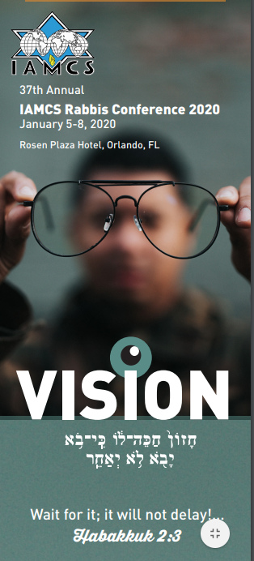
2020 IAMCS Rabbis’ Conference
חָזוֹן...חַכֵּה-לוֹ, כִּי בֹא יָבֹא, לֹא יְאַחֵר.
For the vision …wait for it; it will surely come, it will not delay.
Notes:
Theme of this year’s conference was VISION

Slide 25
What is Yeshua’s VISION for His congregations, His followers.
Last words of anyone are often very significant.
Air hose story.
Last words of Yeshua, post resurrection, on earth.

Slide 26
מַתִּתְיָהוּ Mattityahu
(Matthew) 28:18-20
Notes:
After appearance to 500, some doubted.

Slide 27
Mattityahu (Matthew) 28:18
נִגַּשׁ יֵשׁוּעַ לְדַבֵּר אִתָּם וְאָמַר: ”נִתְּנָה לִי כָּל סַמְכוּת בַּשָּׁמַיִם וּבָאָרֶץ. ‏
Yeshua came and talked with them. He said, “All authority in heaven and on earth has been given to me.
Notes:
סמכות sam-khut specialized power: support. “Somekh noflim” He supports the falling.

Slide 28
Mattityahu (Matthew) 28:19
עַל כֵּן לְכוּ וַעֲשׂוּ אֶת כָּל הַגּוֹיִים לְתַלְמִידִים,
“Therefore, go and make people from all nations into talmidim,
Notes:
Not just believers

Slide 29
Mattityahu (Matthew) 28:19
הַטְבִּילוּ אוֹתָם לְשֵׁם הָאָב וְהַבֵּן וְרוּחַ הַקֹּדֶשׁ
immersing them into the reality of the Father, the Son and the Ruakh HaKodesh,
Notes:
Experiential

Slide 30
Mattityahu (Matthew) 28:20
וְלַמְּדוּ אוֹתָם לִשְׁמֹר אֶת כָּל מַה שֶּׁצִּוִּיתִי אֶתְכֶם. “
“and teaching them to obey everything that I have commanded you.

Slide 31
Mattityahu (Matthew) 28:20
הִנֵּה אִתְּכֶם אֲנִי כָּל הַיָּמִים עַד קֵץ הָעוֹלָם.“
And remember! I will be with you always, yes, even until the end of the age.”

Slide 32
Note four components of this last words commissioning vision:
Power, supportive, undergirding
Not convert but immerse into experiential reality
Obedience based to Tanakh and Messianic Scriptures.
Yeshua with us AS WE DO.
Notes:
Ever feel “I can’t do this. Can’t make it.” Underneath are the everlasting arms!
Not just words, Presence!
Like Sheep Among Wolves movie about Iranian awakening. Thousands in the land of the ayatollahs, discipleship → conversion. Jews are converted sinners.
Immanuel work. Just giving out door hangers, Immanuel for me!!

Slide 33
This is the vision of Yeshua, the last instruction that He left us.
I have supportive power, so go and share this power with others to serve ME. I’ll accompany you!

Slide 34
Vision of Or HaOlam?
Healing place, spiritual hospital, rejuvenation, revitalizing
Every successful full service hospital has a maternity wing.
Notes:
At rabbi’s conference, my presentation.

Slide 35
^{Mishlei/Prov 30.15-16} Three things are never satisfied; four never say, “Enough!” — Sh’ol and a barren womb; the earth, never satisfied with water; and fire, which never says, “Enough!”
Notes:
Childless wife feels need. Can be content in Yeshua, but loss.
Are we childbearing? Do we feel passion about it?

Slide 36
^{Beresheet/Gen 44.33-34} Therefore, I beg you, let your servant stay as a slave to my lord instead of the boy, and let the boy go up with his brothers. For how can I go up to my father if the boy isn’t with me?
Notes:
How can we go to our Father, and no fruit, sons and daughters.

Slide 38
These are the last words of Yeshua, post resurrection, in Matthew.
Similar in Mark, Luke, Acts.

Slide 39
^{Mk 16.15} He told them, “Go into all the world and proclaim the Good News to every creature.
Notes:
Go.

Slide 40
^{Lk. 24.45-49} Then he opened their minds, so that they could understand the Tanakh, telling them, “Here is what it says: the Messiah is to suffer and to rise from the dead on the third day; and in his name repentance leading to forgiveness of sins is to be
Notes:
Obedience based. “This is a good way to live.” “This is G-d’s way to live.”

Slide 41
^{Lk. 24.45-49} proclaimed to people from all nations, starting with Yerushalayim. You are witnesses of these things. Now I am sending forth upon you what my Father promised, so stay here in the city until you have been equipped with power from above.”
Notes:
Starts with seeking the Jewish people. Not just spiritually Jewish. Bagel and lox and humus types.
Supported, Immanuel.

Slide 42
^{Acts 1.8} But you will receive power when the Ruakh HaKodesh comes upon you; you will be my witnesses both in Yerushalayim and in all Y’hudah and Shomron, indeed to the ends of the earth!”
Notes:
Power, Immanuel, starts with the Jews.

Slide 43
Vision of Or HaOlam: Working to bring Jewish people, and those grafted in, to their covenantal identity in Messiah.
Implies:
1.) Salvation through the Atonement of the Messiah; personal faith in the atoning death and resurrection of Yeshua; it's all about the King

Slide 44
2.) Covenantal identity of Jewish people, not replacement
3.) Restoration to Torah lifestyle
4.) Restoration/survival of the nation of Israel.

Slide 45
(Covenantal identity, so Jewish believers don’t assimilate.
^{Ro. 11:15} "For if their casting Yeshua aside means reconciliation for the world, what will their accepting him mean? It will be life from the dead!)

Slide 46
Vision of Or HaOlam
One vision, or division!

Slide 47
Note four components of this last word vision and commissioning:
Power, support, undergirding
Not convert but immerse into experiential reality
Obedience based to Tanakh and Messianic Scriptures.
Yeshua with us AS WE DO.
Notes:
Ever feel “I can’t do this. Can’t make it.” Underneath are the everlasting arms!
Not just words, Presence!
Like Sheep Among Wolves movie about Iranian awakening. Thousands in the land of the ayatollahs, discipleship → conversion. Jews are converted sinners.
Immanuel work. Just giving out door hangers, Immanuel for me!!

Slide 48
This is the vision of Yeshua, the last instruction that He left us.
I have supportive power, so go and share this power with others to serve ME. I’ll accompany you!

Slide 49
The Hebrew word used for VISION in this verse isחזון KHAZON (Khah-ZON), also translated in English as “revelation” or “divine guidance.” Khazon is made up of the Hebrew letters chet, zayin, vav, and nun. These letters give us a fascinating word picture.
Notes:
https://www.jewishjewels.org/news-letters/vision/

Slide 50
Khet ח represents a fence that protects.
Zayin ז is a weapon, like an ax.
Vav ו like a nail, connects.
Nun ן represents life, like a fish darting through water. So—Khazon (Vision) is a WEAPON THAT PROTECTS LIFE!
Notes:
https://www.jewishjewels.org/news-letters/vision/

Slide 51
Proverbs 29:18. Let’s look at this verse in a few versions:
^{TLV} Where there is no divine vision people cast off restraint, but blessed is the one who keeps Torah.
^{CJB} Without a prophetic vision, the people throw off all restraint; but he who keeps Torah is happy.

Slide 52
“Where there is no revelation, people cast off restraint; but blessed is the one who heeds wisdom’s instruction” ^{(NIV).}
“When people do not accept divine guidance, they run wild. But whoever obeys the law is joyful” ^{(NLT)}.
Notes:
https://www.jewishjewels.org/news-letters/vision/

Slide 53
Note four components of this last word vision and commissioning:
Power, support, undergirding
Not convert but immerse into experiential reality
Obedience based to Tanakh and Messianic Scriptures.
Yeshua with us AS WE DO.

Slide 54
^{2 K 20.14-19} Elisha was now ill with the disease from which he would eventually die. Yo’ash the king of Isra’el came down to visit him and wept over him; he said, “My father! My father! The chariots and horsemen of Isra’el!” Elisha said to him, “Bring a bow and arrows”; and he brought him a bow and arrows.

Slide 55
^{2 K 20.14-19} He said to the king of Isra’el, “Put your hand on the bow”; and he put his hand on it. Then Elisha laid his hands on the king’s hands and said, “Open the east window.” He opened it. Elisha said, “Shoot”; and he shot. He said, “Adoni’s arrow of victory, the arrow of victory against Aram!

Slide 56
^{2 K 20.14-19} You will defeat Aram completely at Afek!” He said, “Take the arrows”; and he took them. He told the king of Isra’el, “Strike the ground.” He struck three times, then stopped. The man of God became angry with him; he said, “You should have struck five or six times; then you would have defeated Aram completely. As it is, you will defeat Aram only three times.”
Notes:
Yoash had little passion about victory! Three was enough.

Slide 57
^{Ro 12.11-12} Don’t be lazy when hard work is needed, but serve the Lord with spiritual fervor. Rejoice in your hope, be patient in your troubles, and continue steadfastly in prayer.
Notes:
I’m at Teerosh because I’m the Rabbi. Reverse: I’m the rabbi because I’m passionate.

Slide 58
^{2 Tim 1.6} I remind you to fan into flame the gift of God

Slide 59
^{Phil 3:13-15} Brothers and sisters, I do not consider myself as having taken hold of this. But this one thing I do: forgetting what is behind and straining toward what is ahead, I press on toward the goal for the reward of the upward calling of God in Messiah Yeshua.

Slide 60
^{Phil 3:13-15} Therefore let all who are mature have this attitude; and if you have a different attitude in anything, this also God will reveal to you.

Slide 61
Evidence that we are in the last days, and need to be passionate about Yeshua’s vision.
Rising anti-Semitism
HR-5 and similar. Equality Act.

Slide 62
Five teenagers from Berlin made international news earlier this week when they brutally attacked and sexually assaulted a 68-year-old Jewish man on his way to visit the Putlitzbrücke Holocaust memorial.
Notes:
https://www.frc.org/get.cfm?i=WA20A09&f=WU20A02

Slide 63
This came just a day after a Jewish man was subjected to antisemitic slurs and physically attacked on the Berlin subway.
Notes:
https://www.frc.org/get.cfm?i=WA20A09&f=WU20A02

Slide 64
In 2018, a sweeping CNN survey conducted in Europe found the statistic that one out of five people in France between the ages of 18 and 34 said they'd never even heard of the Holocaust.
Notes:
https://www.frc.org/get.cfm?i=WA20A09&f=WU20A02

Slide 65
A French court released the murderer of a Jewish kindergarten teacher because he claimed to have smoked marijuana before he strangled her in her apartment while shouting about Allah before throwing her over a balcony.
Notes:
https://www.frc.org/get.cfm?i=WA20A09&f=WU20A02

Slide 66
^{Zekh 14.1-2} Behold, a day of Adoni is coming when your plunder will be divided in your midst. I will gather all the nations against Jerusalem to wage war. The city shall be captured, the houses ransacked and the women raped. Half of the city will be exiled but the remainder of the people will not be cut off from the city.

Slide 67
^{Zekh 13.8-9} Then it will happen —it is a declaration of Adoni—that in the entire land two-thirds will be cut off and die, but a third will be left in it. This third I will bring through the fire. I will refine them as silver is refined, and will test them as gold is tested.

Slide 68
^{Zekh 13.8-9} They will call on My Name and I will answer them. I will say, ‘They are My people,’ and they will answer, ‘Adoni is my God.

Slide 69
^{Zekh 14.3-4} Then Adoni will go forth and fight against those nations as He fights in a day of battle. In that day His feet will stand on the Mount of Olives which lies to the east of Jerusalem.

Slide 70
Evidence that we are in the last days, and need to be passionate about Yeshua’s vision.
Rising anti-Semitism
HR-5 and similar. Equality Act.

Slide 71
Note four components of this last word vision and commissioning:
Power, support, undergirding
Not convert but immerse into experiential reality
Obedience based to Tanakh and Messianic Scriptures.
Yeshua with us AS WE DO.
Notes:
Ever feel “I can’t do this. Can’t make it.” Underneath are the everlasting arms!
Not just words, Presence!
Like Sheep Among Wolves movie about Iranian awakening. Thousands in the land of the ayatollahs, discipleship → conversion. Jews are converted sinners.
Immanuel work. Just giving out door hangers, Immanuel for me!!

Slide 72
This is the vision of Yeshua, the last instruction that He left us.
I have supportive power, so go and share this power with others to serve ME. I’ll accompany you!

