Slide 1
e-handout
To have these notes
without taking notes
Go to OrHaOlam.com
Click on downloads,
messages, 2019

Slide 2
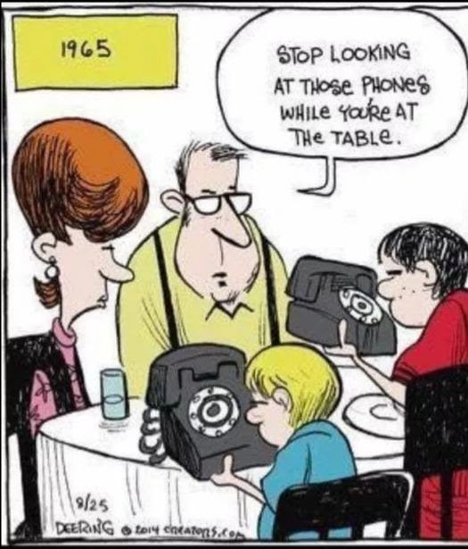
Notes:
Along this line, we are requesting that unless you are following the scriptures, which are on screen anyway, please don’t text, browse, do email, multitask. Come to the meeting. “Don’t fire unless you see the whites of their eyes.”

Slide 3
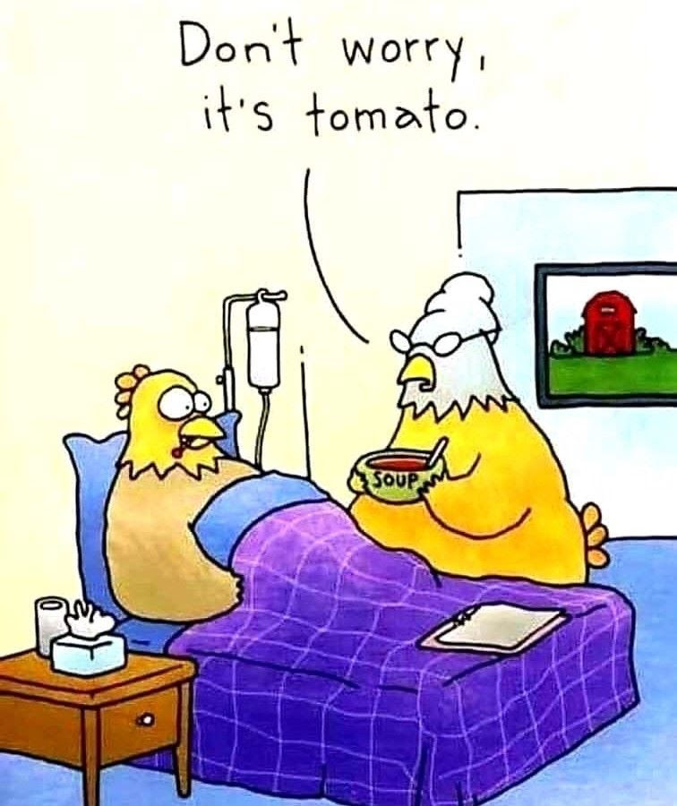
Jewish penicillin…
chicken soup

Slide 4
Rabbi Sheinberg was retiring and saying farewell to his congregation at the shul doors for the last time. Old Mrs. Diamond approached him as she walked out. She said, "Rabbi, your successor won't be as good as you."
Notes:
Rabbi Alan M Levine
Emeritus - Kol Mashiach Messianic Synagogue
Lev Elohim Ministries

Slide 5
"Nonsense," said Rabbi Sheinberg, in a flattered tone.
"No, really," said Mrs. Diamond, "I've been here under five different rabbis, and each one has been worse than the last."
Notes:
Rabbi Alan M Levine Emeritus - Kol Mashiach Messianic Synagogue Lev Elohim Ministries

Slide 6
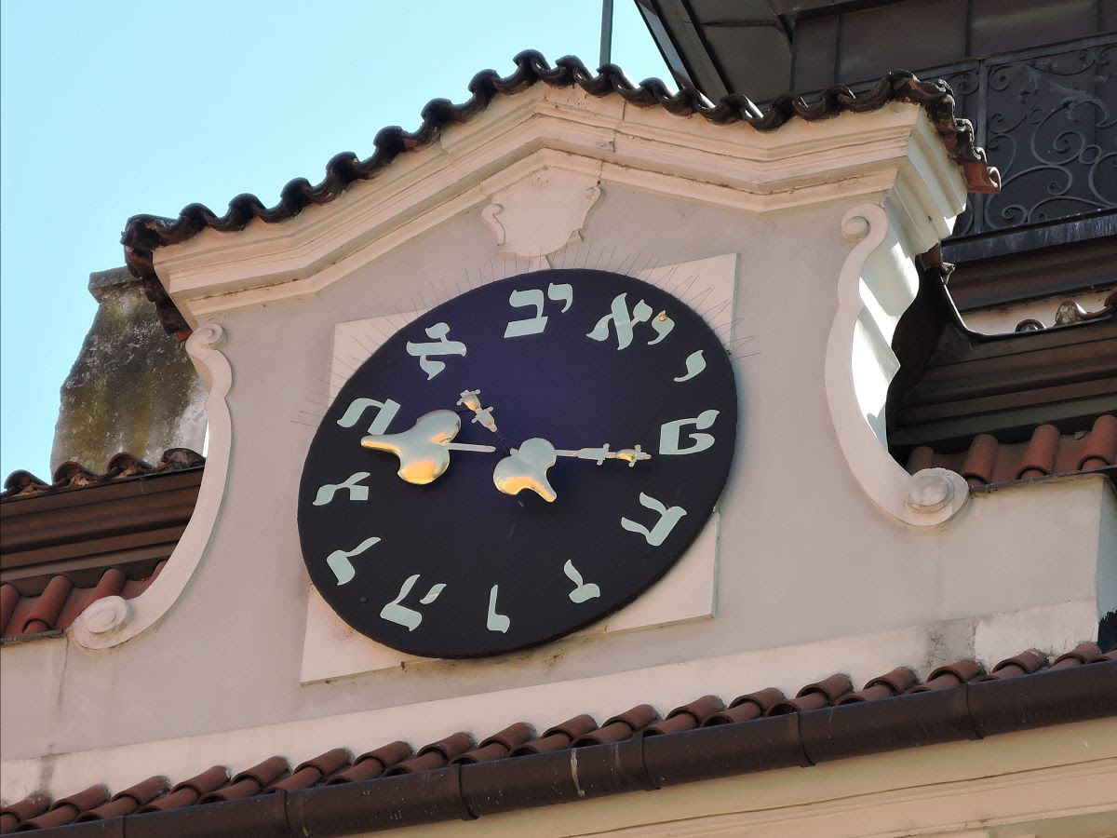
Jewish time Counter clockwiseclock, Prague Jewish Quarter
Notes:
Starting new series...

Slide 7
Letter to the Messianic Jews
Notes:
2009 5769 10 January

Slide 8
This Book / Letter was in danger of rejection from the Bible.
A well known Hebrew roots teacher near Oklahoma City, OK DOES reject it today. Why?
Power and the peril of the priesthood of Yeshua.

Slide 9
^{Mes Jews/Heb 1.1-3} In days gone by, God spoke in many and varied ways to the Fathers through the prophets. But now, in the akharit-hayamim / end of days, he has spoken to us through his Son, to whom he has given ownership of everything and through whom he created the universe

Slide 10
^{Mes Jews/Heb 1.1-3} This Son is the radiance of the Sh’khinah, the very expression of God’s essence, upholding all that exists by his powerful word; and after he had, through himself, made purification for sins, he sat down at the right hand of HaG’dulah BaM’romim / Majesty on High.
Notes:
Effulgence of G-d!

Slide 11
the very expression
of God’s essence
Notes:
Effulgence, outshining of G-d. Solar flare is the sun.
Let’s get the big picture of this letter.

Slide 12
Introduction
Yeshayahu/Isaiah often considered the pre-besorah /gospel: Messiah the servant-ruler #0
Messianic Jews/Hebrew often considered the #5 besorah /gospel: Messiah the Cohen HaGadol / High Priest
Notes:
“priest” sort of problematic word.
Jewish priest ? Sounds Roman Catholic
Cohen is the right term, but
cohen doesn’t sound priestly, sounds like your dentist
Modern Hebrew dictionary put in “priest” first translation כֹּמֶר komer
This is the only Mes Scrip/New testament book where Yeshua is called our cohen/priest

Slide 13
Authorship: according to Clement of Alexandria [150-215 CE]: The epistle was written by Paul in Hebrew (unsigned through modesty), and "translated carefully" into Greek by Luke, a thing demonstrated by its stylistic similarity with Luke's Acts.
Notes:
https://en.wikipedia.org/wiki/Authorship_of_the_Epistle_to_the_Hebrews
But not like Paul, or other emissaries, so questioned.
Why kept?

Slide 14
Original readers?
earliest manuscripts “pros Hebraious”
Readers well versed in Torah and in Temple practices—many complex allusions.
Addressees could have been residents of Jerusalem—detailed description of sacrifices and Mishkan/Tabernacle.
Notes:
So this book is particularly for US, Jews and Gentiles in a Jewish context.

Slide 15
Adressees understood rejection and persecution ^{10:32-34} But remember the earlier days, when, after you had received the light, you endured a hard struggle with sufferings. Sometimes you were publicly disgraced and persecuted
Notes:
Pretty common to Messianic Jewish believers, tho many cultures have reaction. Muslims!!
I was personally called “worse than Hitler. He destroyed our bodies. You are destroying our souls.” Sent to a psychiatrist, although certainly therapy and healing needed.

Slide 16
^{10:32-34} while at other times you stood loyally by those who were treated this way. For you shared the sufferings of those who had been put in prison. Also when your possessions were seized, you accepted it gladly;

Slide 17
^{10:32-34} since you knew that what you possessed was better and would last forever.

Slide 18
Probably before destruction of the Temple — destruction not mentioned, but warnings. 65 to 70 C.E.
Main theme: Messiah as הַגָּדוֹל הַכֹּהֵן HaCohen HaGadol – High Priest
Notes:
Temple destroyed in 70 CE

Slide 19
Purpose: teaching and exhortation / warning
Power and the peril of the priesthood of Yeshua.
What is the peril? Five warnings

Slide 20
Five warnings:
First ^{2.1 to 2.4} Therefore, we must pay much more careful heed to the things we have heard, so that we will not drift away.
Notes:
Jack Frost story about heading and speed but Gulf Stream. Only recourse, I believe, is celestial navigation. Look at the stars, and calculate position!

Slide 21
Second ^{3.12 to 4.13} Watch out, brothers, so that there will not be in any one of you an evil heart lacking trust, [like Israel in the Sinai] which could lead you to apostatize from the living God! Instead, keep exhorting each other every day, as long as it is called Today, so that none of you will become hardened by the deceit of sin.
Notes:
Deceit of sin: great warning for out day of debauched culture.

Slide 22
Alexander Pope
Sin is a monster of such hideous mein,
That to be hated is but to be seen.
But seen too oft, with unveiled face,
We first pity, then endure, then embrace.
Notes:
Deceit of sin? That it’s normal to be flagrantly immoral, dishonest, bad tempered.
Why media, with it’s adultery, promiscuity, sensuality, senseless violence is so debilitating, weakening. See couples sleeping together as if the norm, becomes tolerated. Not that we’re contemptuous, but grieving.
R movies, even PG-13 doubtful.

Slide 23
Third ^{5.11 to 6.20} For although by this time you ought to be teachers, you need someone to teach you the very first principles of God's Word all over again! You need milk, not solid food!
Notes:
Growth expected!

Slide 24
Fourth ^{10.26 to 31} For if we deliberately continue to sin after receiving the knowledge of the truth, there no longer remains a sacrifice for sins,
Notes:
Growth expected!

Slide 25
^{10.26 to 31} but only the terrifying prospect of Judgment, of raging fire that will consume the enemies. Someone who disregards the Torah of Moshe is put to death without mercy on the word of two or three witnesses.

Slide 26
^{10.26 to 31} Think how much worse will be the punishment deserved by someone who has trampled underfoot the Son of God; who has treated as something common the blood of the covenant.
Notes:
Typical thinking that Tanakh is judgmental and severe. Here worse in Y
This phrase is the peril of the priesthood.

Slide 27
Fifth ^{12.25 to 12.29} See that you don't reject the One speaking! For if those did not escape who rejected him when he gave divine warning on earth, think how much less we will escape if we turn away from him when he warns from heaven. Even then, his voice shook the earth… For indeed, "Our God is a consuming fire!"
Notes:
5 dreadful warnings relative to missing the power of this priest. The peril. Really quoted from the Tanakh, Hebrew Scriptures, Old Testament.

Slide 28
^{Dvarim/Dt 4.23-24} Watch yourselves, so that you do not forget the covenant of Adoni your God, which He cut with you, and make for yourselves a graven image in the form of anything that Adoni your God has forbidden you. For Adoni your God is a consuming fire — a jealous God.

Slide 29
^{Yeshayahu/Is 33.14} The sinners in Tziyon are frightened; trembling has seized the ungodly. “Who of us can live with the devouring fire? Who of us can live with eternal burning?”

Slide 30
Power and the peril of the priesthood of Yeshua.

Slide 31
In Tanakh times Israel did NOT obeyed Torah, and so her Strength and Shield departed.
Assyrian conquest of Northern Kingdom, threat to South 721 CE
Babylonian captivity and exile 586 BCE.

Slide 32
Similarly concerning the Messiah. It’s NOT true to say that the Jews rejected Yeshua. Tens of thousands received Him, even of the Jerusalem Cohanim/ priests. But the leaders and the majority of our people did refuse Him.

Slide 33
So our Strength and Shield again departed. Exile 135 CE.
Does that justify our history of persecution?
Below is the spiritual root of Nazism, anti-Semitism, anti-Zionism, BDS, Jew hatred.
Notes:
Peril of the priesthood.

Slide 35
^{Yeshayu/Is 10.5-8} Woe to Assyria, [northern Iraq] the rod of My anger— the club in their hand is My indignation! I am sending it against an ungodly nation [Israel], and against the people of My fury I am commissioning it, to take spoil and plunder, to trample them down like mud in the streets.
Notes:
Assyrian was sent in ~700 BCE to punish Israel for apostasy, leaving G-d, idolatry and perversion
Also to threaten Judah to come to repentance.

Slide 36
^{Yeshayu/Is 10.5-8} Yet that is not what Assyria intends, nor is that what he is thinking about. Rather his heart is to destroy, and to cut down nations — only a few! For he says: “Aren’t all my princes kings?
Notes:
Assyria took G-d’s plan far beyond it’s intended level.

Slide 37
^{Yeshayu/Is 10.12-14} The arrogant heart of the king of Assyria, and the glorying of his haughty eyes.” For he said: “By the strength of my own hand I’ve done it, and my own wisdom, for I am shrewd! I abolished the borders of peoples, and plundered their treasure.

Slide 38
^{Yeshayu/Is 10.12-14} As a mighty one I [Assyria] cast down inhabitants. My hand found the riches of the peoples as a nest— like gathering forsaken eggs, I have gathered the entire earth. Not a wing fluttered, not a beak opened or chirped!”

Slide 39
The Assyrians, and many like them since, have taken the departure of G-d’s blessing and protection from Israel as a carte blanche for vicious, insane, rapacious destruction.
Notes:
But, G-d is NOT done with Israel, ever.
Nevertheless, if there is at least SOME repentance by Israel…

Slide 40
^{Dvarim / Dt 30.3-6} God will reverse your exile and show you mercy; he will return and gather you from all the peoples to which Adoni your God scattered you. If one of yours was scattered to the far end of the sky,

Slide 41
^{Dvarim / Dt 30.3-6} Adoni your God will gather you even from there; he will go there and get you. Adoni your God will bring you back into the land your ancestors possessed, and you will possess it; he will make you prosper there, and you will become even more numerous than your ancestors.
Notes:
Physical salvation of Israel.

Slide 42
^{Dvarim / Dt 30.3-6} Then Adoni your God will circumcise your hearts and the hearts of your children, so that you will love Adoni your God with all your heart and all your being, and thus you will live.
Notes:
Spiritual salvation after arriving in the Land. Also salvation before return.
That’s what the Messianic Jewish movement is. Return of Jews, again leading the Nations.

Slide 43
Assyrian type hatred and destruction, way beyond the scope of divine rebuke, is still happening…

Slide 45
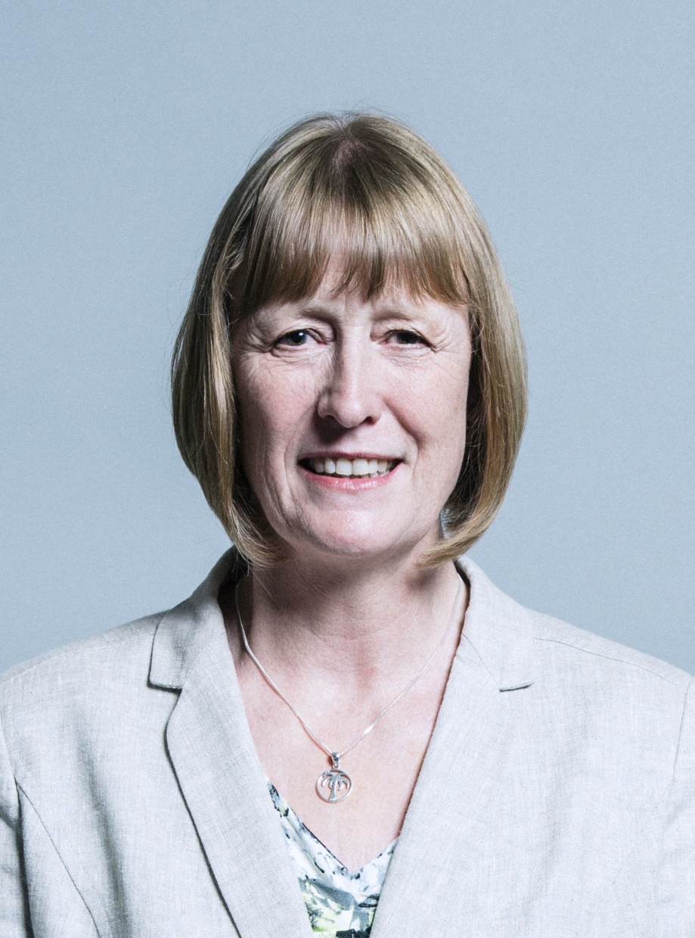
Joan Ryan (born 1955) is a British politician who has served as the Member of Parliament (MP) for Enfield North
Notes:
https://worldisraelnews.com/labour-mp-who-bucked-corbyn-branded-jew-w-target-of-death-threats/?utm_source=MadMimi&utm_medium=email&utm_content=Terrorist+Reveals+Horrific+Details+of+Murder-Rape%3B+Labour+MP+Who+Fought+Corbyn+Told+She+Should+%27Burn+in+Ovens%27%3B+Did+Tlaib+Steal+Funds%3F&utm_campaign=20190303_m150217058_Terrorist+Reveals+Horrific+Details+of+Murder-Rape%3B+Labour+MP+Who+Fought+Corbyn+Told+She+Should+%27Burn+in+Ovens%27%3B+Did+Tlaib+Steal+Funds%3F&utm_term=_0D_0A_09_09_09_09_09_09_09_09_09_09Read+Now_0D_0A_09_09_09_09_09_09_09_09_09

Slide 46
A British Labour party member who split from the party in protest over its “culture of anti-Semitism” she has received two death threats and was branded a “Jew whore” who should burn “in the ovens,” the Daily Mail reported on Sunday.
Notes:
https://worldisraelnews.com/labour-mp-who-bucked-corbyn-branded-jew-w-target-of-death-threats/?utm_source=MadMimi&utm_medium=email&utm_content=Terrorist+Reveals+Horrific+Details+of+Murder-Rape%3B+Labour+MP+Who+Fought+Corbyn+Told+She+Should+%27Burn+in+Ovens%27%3B+Did+Tlaib+Steal+Funds%3F&utm_campaign=20190303_m150217058_Terrorist+Reveals+Horrific+Details+of+Murder-Rape%3B+Labour+MP+Who+Fought+Corbyn+Told+She+Should+%27Burn+in+Ovens%27%3B+Did+Tlaib+Steal+Funds%3F&utm_term=_0D_0A_09_09_09_09_09_09_09_09_09_09Read+Now_0D_0A_09_09_09_09_09_09_09_09_09

Slide 47
March 3, 2019 Joan Ryan, who quit Labour last month, called police, the paper said, after receiving the threats. One was a handwritten note just over a week ago which used grotesque profanities, saying she defected to Israel and should be raped and “set on fire.”
Notes:
https://worldisraelnews.com/labour-mp-who-bucked-corbyn-branded-jew-w-target-of-death-threats/?utm_source=MadMimi&utm_medium=email&utm_content=Terrorist+Reveals+Horrific+Details+of+Murder-Rape%3B+Labour+MP+Who+Fought+Corbyn+Told+She+Should+%27Burn+in+Ovens%27%3B+Did+Tlaib+Steal+Funds%3F&utm_campaign=20190303_m150217058_Terrorist+Reveals+Horrific+Details+of+Murder-Rape%3B+Labour+MP+Who+Fought+Corbyn+Told+She+Should+%27Burn+in+Ovens%27%3B+Did+Tlaib+Steal+Funds%3F&utm_term=_0D_0A_09_09_09_09_09_09_09_09_09_09Read+Now_0D_0A_09_09_09_09_09_09_09_09_09

Slide 48
Notes:
Ted Pearce: Forgotten people video

Slide 49
YET, G-d is faithful.
^{Yekhez/Ezek 37.11-14} Then he said to me, “Human being! These bones are the whole house of Isra’el; and they are saying, ‘Our bones have dried up, our hope is gone, [avdah tikvatenu] and we are completely cut off.’ Therefore prophesy; say to them that Adoni Elohim says,
Notes:
The text of Hatikvah was written in 1878 by Naphtali Herz Imber. Some reports that he was a believer in Messiah.

Slide 50
^{Yekhez/Ezek 37.11-14} ‘My people! I will open your graves and make you get up out of your graves, and I will bring you into the land of Isra’el. Then you will know that I am Adoni — when I have opened your graves and made you get up out of your graves, my people!

Slide 51
^{Yekhez/Ezek 37.11-14} I will put my Spirit in you; and you will be alive. Then I will place you in your own land; and you will know that I, Adoni, have spoken, and that I have done it,’ says Adoni.”

Slide 52
^{Yeshayahu/Is 11.11-12} On that day Adoni will raise his hand again, a second time, to reclaim the remnant of his people who remain from Ashur, Egypt, Patros, Ethiopia, ‘Eilam, Shin‘ar, Hamat and the islands in the sea.

Slide 53
^{Yeshayahu/Is 11.11-12} He will hoist a banner for the Goyim, assemble the dispersed of Isra’el, and gather the scattered of Y’hudah from the four corners of the earth.

Slide 54
^{Yeshayahu/Is 43.5-7} Don’t be afraid, for I am with you. I will bring your descendants from the east, and I will gather you from the west; I will say to the north, ‘Give them up!’and to the south, ‘Don’t hold them back! Bring my sons from far away,

Slide 55
^{Yeshayahu/Is 43.5-7} and my daughters from the ends of the earth, everyone who bears my name [Israel], whom I created for my glory — I formed him, yes, I made him.’”

Slide 57
Israel is restored, and at least some of the Nations are recognizing the “Assyrian” role, either they were such, or passive about it.

Slide 58
^{Aryeh Savir, TPS} On Tuesday, Jan. 21, 2020 Israel began the process of welcoming the 47 delegations of heads of state and royals, including US Vice President Mike Pence, Russian President Vladimir Putin, Spain’s King Felipe VI and the UK’s Prince Charles,
Notes:
https://unitedwithisrael.org/kings-princes-and-presidents-arrive-in-israel-for-holocaust-memorial/?utm_source=MadMimi&utm_medium=email&utm_content=Kings%2C+Princes+and+Presidents+Arrive+in+Israel+for+Holocaust+Memorial%3B+%27Jewish+Temple+Never+Existed%E2%80%99%3F+Israel+Reaches+Out+to+Iranians+in+Persian&utm_campaign=20200122_m156562816_Kings%2C+Princes+and+Presidents+Arrive+in+Israel+for+Holocaust+Memorial%3B+%27Jewish+Temple+Never+Existed%E2%80%99%3F++Israel+Reaches+Out+to+Iranians+in+Persian&utm_term=AP_17310715773495-250x170_jpg

Slide 59
who are convening in Jerusalem this week to commemorate the 75th anniversary of the liberation of Auschwitz and to discuss the war on global anti-Semitism.
In total, 26 presidents, four kings (Holland, Belgium, Spain and Luxembourg)
Notes:
https://unitedwithisrael.org/kings-princes-and-presidents-arrive-in-israel-for-holocaust-memorial/?utm_source=MadMimi&utm_medium=email&utm_content=Kings%2C+Princes+and+Presidents+Arrive+in+Israel+for+Holocaust+Memorial%3B+%27Jewish+Temple+Never+Existed%E2%80%99%3F+Israel+Reaches+Out+to+Iranians+in+Persian&utm_campaign=20200122_m156562816_Kings%2C+Princes+and+Presidents+Arrive+in+Israel+for+Holocaust+Memorial%3B+%27Jewish+Temple+Never+Existed%E2%80%99%3F++Israel+Reaches+Out+to+Iranians+in+Persian&utm_term=AP_17310715773495-250x170_jpg

Slide 60
and four prime ministers will attend the event, Times of Israel reported.
The international event, the largest in Israel’s history, will culminate on Thursday at the Yad Vashem Holocaust memorial with the Fifth World Holocaust Forum, titled “Remembering the Holocaust: Fighting Antisemitism.”
Notes:
https://unitedwithisrael.org/kings-princes-and-presidents-arrive-in-israel-for-holocaust-memorial/?utm_source=MadMimi&utm_medium=email&utm_content=Kings%2C+Princes+and+Presidents+Arrive+in+Israel+for+Holocaust+Memorial%3B+%27Jewish+Temple+Never+Existed%E2%80%99%3F+Israel+Reaches+Out+to+Iranians+in+Persian&utm_campaign=20200122_m156562816_Kings%2C+Princes+and+Presidents+Arrive+in+Israel+for+Holocaust+Memorial%3B+%27Jewish+Temple+Never+Existed%E2%80%99%3F++Israel+Reaches+Out+to+Iranians+in+Persian&utm_term=AP_17310715773495-250x170_jpg

Slide 61
Words of Vice President Mike Pence: The word “remember” appears no fewer than 169 times in the Hebrew Bible — for memory is the constant obligation of all generations. And today we pause to remember…the “dark stain on human history” — the greatest evil ever perpetuated by man against man in the long catalogue of human crime.
Notes:
https://www.whitehouse.gov/briefings-statements/remarks-vice-president-pence-fifth-world-holocaust-forum-jerusalem-israel/

Slide 62
The faces of a million and a half children reduced to smoke under a silent sky for the crime of having a single Jewish grandparent. The night Elie Wiesel called “seven times sealed” consumed the faith of so many then, and challenges the faith of so many still.
Notes:
https://www.whitehouse.gov/briefings-statements/remarks-vice-president-pence-fifth-world-holocaust-forum-jerusalem-israel/

Slide 63
Today we remember what happens when the powerless cry for help and the powerful refuse to answer. The town’s name was Oświęcim. As part of their plan to destroy the very existence of Polish culture, the Nazis gave Polish towns German names. And this one they called Auschwitz.
Notes:
https://www.whitehouse.gov/briefings-statements/remarks-vice-president-pence-fifth-world-holocaust-forum-jerusalem-israel/

Slide 64
When Russian soldiers opened the gates of Auschwitz on January 27, 1945, they found 7,000 half-starved, half-naked prisoners, hundreds of boxes of camp records that documented the greatest mass murder in history. Before the war was over, in its five years of existence, more than 1.1 million men, women, and children would perish at Auschwitz.
Notes:
https://www.whitehouse.gov/briefings-statements/remarks-vice-president-pence-fifth-world-holocaust-forum-jerusalem-israel/

Slide 65
As my wife and I can attest firsthand, from this past year, one cannot walk the grounds of Auschwitz without being overcome with emotion and grief. One cannot see the piles of shoes, the gas chambers, the crematoriums, the lone boxcar facing the gate to the camp, and those grainy photographs of men, women, and children being sent to their deaths without asking: “How could they?”
Notes:
https://www.whitehouse.gov/briefings-statements/remarks-vice-president-pence-fifth-world-holocaust-forum-jerusalem-israel/

Slide 66
Today we mourn with those who mourn and grieve with those who grieve. We remember the names and the faces and the promise of the 6 million Jews who were murdered in the Holocaust. Today we also pay tribute to those who survived, who all these years have borne witness to that evil and have served mankind by their example.
Notes:
https://www.whitehouse.gov/briefings-statements/remarks-vice-president-pence-fifth-world-holocaust-forum-jerusalem-israel/

Slide 67
G-d has not forgotten Israel’s physical survival, and the spiritual revival is in progress, blessing all the Nations with new life as well.

Slide 68
Part of the physical restoration: A unique breakthrough that the Israelis have done for own their survival. All Hebrew, but the graphic are clear enough. The opening screen says “Breakthrough in laser weapons.”

Slide 70
Not quite implemented yet, but far enough along to advertise!
What Israel is doing to bless the world.

Slide 71
Notes:
Israelis saving Koalas
https://unitedwithisrael.org/watch-israelis-among-the-first-rescuers-to-reach-australias-kangaroo-island/?utm_source=MadMimi&utm_medium=email&utm_content=%E2%80%98Mockery+of+Holocaust%E2%80%99%3A+Macron+Slammed+for+Visit+with+Abbas%3B+U+of+Michigan+Must+Cancel+Anti-Semitic+Event%3B+World+Leaders+Pledge+to+Fight+Anti-Semitism&utm_campaign=20200123_m156574269_%5BAC%5D+%E2%80%98Mockery+of+Holocaust%E2%80%99%3A+Macron+Slammed+for+Visit+with+Abbas%3B+U+of+Michigan+Must+Cancel+Anti-Semitic+Event%3B+World+Leaders+Pledge+to+Fight+Anti-Semitism&utm_term=Screenshot_2020-01-23-Australia_25E2_2580_2599s-Kangaroo-Island-gets-a-hand-from-Israel-YouTube-209x

Slide 72
^{Daniel 4.31-32} “For His dominion is an everlasting dominion, and His kingdom endures from generation to generation! All the inhabitants of earth are counted as nothing. He does as He wills with the army of heaven and the inhabitants of the earth. No one can hold back His hand, or say to Him, ‘What have you done?’

Slide 73
^{T’hillim/Ps 2.7-11} “I will proclaim the decree: Adonai said to me, ‘You are my son; today I became your father. Ask of me, and I will make the nations your inheritance; the whole wide world will be your possession.

Slide 74
^{T’hillim/Ps 2.7-11} You will break them with an iron rod, shatter them like a clay pot.’” Therefore, kings, be wise; be warned, you judges of the earth. Serve Adoni with fear; rejoice, but with trembling. Kiss the son, lest he be angry, and you perish along the way.
Notes:
Returning to our theme…

Slide 75
^{Mes Jews/Heb 1.1-3} In days gone by, God spoke in many and varied ways to the Fathers through the prophets. But now, in the akharit-hayamim / end of days, he has spoken to us through his Son, to whom he has given ownership of everything and through whom he created the universe

Slide 76
^{Mes Jews/Heb 1.1-3} This Son is the radiance of the Sh’khinah, the very expression of God’s essence, upholding all that exists by his powerful word; and after he had, through himself, made purification for sins, he sat down at the right hand of HaG’dulah BaM’romim / Majesty on High.

Slide 77
Power and the peril of the priesthood of Yeshua.

Slide 78
Application: Worship the Son, our cohen/priest!
Time in the Word and worship!

Slide 79
^{T’hillim / Ps 27.4-6} Just one thing have I asked of Adoni; only this will I seek: to live in the house of Adoni all the days of my life, to see the beauty of Adoni and inquire in his temple….

Slide 80
^{T’hillim / Ps 27.4-6} For he will set me high on a rock. Then my head will be lifted up above my surrounding foes, and I will offer in his tent sacrifices with shouts of joy; I will sing, sing praises to Adoni.

Slide 81
Effects of Bible reading
Notes:
https://vimeo.com/380063273?ref=fb-share&1&fbclid=IwAR3SnOnt6q5-OfRnllwa7_IGPkoN8m1T2NjqOHxtQrSiWsBVHXyy96_LJkY

Slide 82
Stand and fight for justice and protecting the weakest.

Slide 83
A recent court ruling has cleared the way for Kansas abortion laws to become like those of New York. The Value Them Both Amendment protects women and babies from a limitless abortion industry.

Slide 84
Contact your Kansas Legislators and urge them to support the state constitutional amendment, Value Them Both, with out any changes and to place it on the August 2020 election ballot.

Slide 85
Yeshua the Cohen
The peril, the power

Slide 86
Summary of all:
^{8.1-2} Here is the whole point of what we have been saying: we do have just such a cohen gadol as has been described. And he does sit at the right hand of HaG'dulah in heaven. There he serves in the Holy Place, that is, in the true Tent of Meeting, the one erected not by human beings but by ADONI.

Slide 87
^{7.24-25} because he lives forever, his position as cohen does not pass on to someone else; and consequently, he is totally able to deliver those who approach God through him; since he is alive forever and thus forever able to intercede on their behalf.

