Slide 1
e-handout
To have these notes
without taking notes
Go to OrHaOlam.com
Click on downloads,
messages, 2020

Slide 2
A FLORIDA COURT SETS ATHEIST HOLY DAY In Florida , an atheist created a case against Easter and Passover Holy days. He hired an attorney to bring a discrimination case against Christians and Jews and observances of their holy days.. The argument was that it was unfair that atheists had no such recognized days.
Notes:
Steve Bancroft

Slide 3
The case was brought before a judge. After listening to the passionate presentation by the lawyer, the judge banged his gavel declaring, "Case dismissed!"
Notes:
Steve Bancroft

Slide 4
The lawyer immediately stood and objecting to the ruling saying, "Your honor, How can you possibly dismiss this case? The Christians have Christmas, Easter and others. The Jews have Passover, Yom Kippur and Hanukkah, yet my client and all other atheists have no such holidays...“
Notes:
Steve Bancroft

Slide 5
The judge leaned forward in his chair saying, "But you do. Your client, counselor, is woefully ignorant."
The lawyer said," Your Honor, we are unaware of any special observance or holiday for atheists."
Notes:
Steve Bancroft

Slide 6
The judge said, "The calendar says April 1st is April Fool's Day. Psalm 14:1 states, 'The fool says in his heart, there is no God.' Thus, it is the opinion of this court, that, if your client says there is no God, then he is a fool. Therefore,
April 1st is his day.
Court is adjourned..."
Notes:
Steve Bancroft

Slide 8
Some good news: Sound booth remodeling…

Slide 9
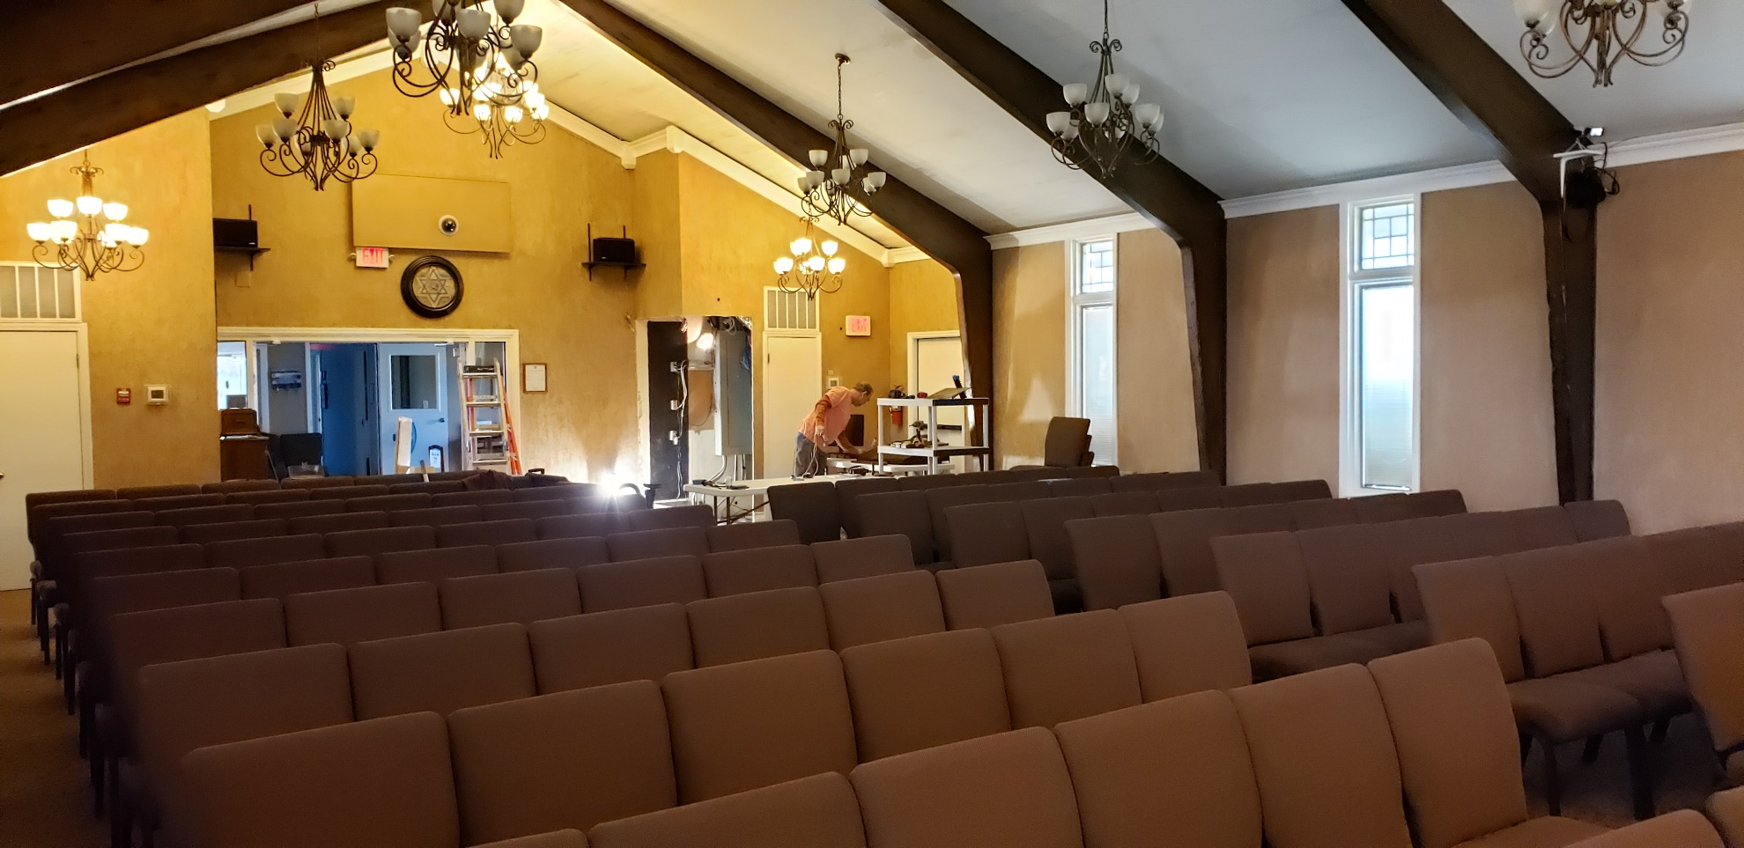

Slide 10
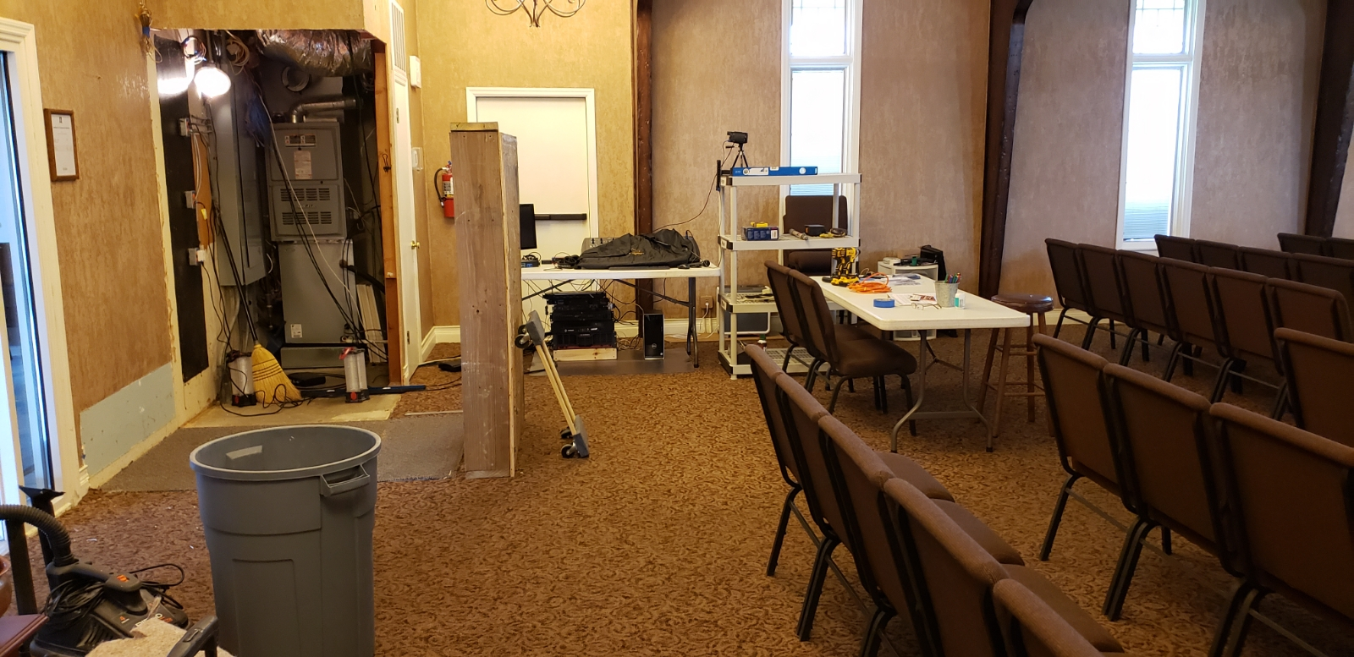

Slide 11
Notes:
https://worldisraelnews.com/watch-daily-israel-news-recap-march-26-2020/?utm_source=MadMimi&utm_medium=email&utm_content=Blue+and+White+Breaks+Apart+as+Gantz+Joins+Netanyahu%3B+Former+Partners+Blast+Gantz+for+%E2%80%98Selling+Out%E2%80%99+to+Netanyahu%3B+IDF+Ready+to+Enforce+Corona+Curfew&utm_campaign=20200326_m157576501_Blue+and+White+Breaks+Apart+as+Gantz+Joins+Netanyahu%3B+Former+Partners+Blast+Gantz+for+%E2%80%98Selling+Out%E2%80%99+to+Netanyahu%3B+IDF+Ready+to+Enforce+Corona+Curfew&utm_term=F200326DCFF37-600x315_jpg

Slide 12
Notes:
https://worldisraelnews.com/watch-daily-israel-news-recap-march-26-2020/?utm_source=MadMimi&utm_medium=email&utm_content=Blue+and+White+Breaks+Apart+as+Gantz+Joins+Netanyahu%3B+Former+Partners+Blast+Gantz+for+%E2%80%98Selling+Out%E2%80%99+to+Netanyahu%3B+IDF+Ready+to+Enforce+Corona+Curfew&utm_campaign=20200326_m157576501_Blue+and+White+Breaks+Apart+as+Gantz+Joins+Netanyahu%3B+Former+Partners+Blast+Gantz+for+%E2%80%98Selling+Out%E2%80%99+to+Netanyahu%3B+IDF+Ready+to+Enforce+Corona+Curfew&utm_term=F200326DCFF37-600x315_jpg

Slide 13
Notes:
https://worldisraelnews.com/watch-daily-israel-news-recap-march-26-2020/?utm_source=MadMimi&utm_medium=email&utm_content=Blue+and+White+Breaks+Apart+as+Gantz+Joins+Netanyahu%3B+Former+Partners+Blast+Gantz+for+%E2%80%98Selling+Out%E2%80%99+to+Netanyahu%3B+IDF+Ready+to+Enforce+Corona+Curfew&utm_campaign=20200326_m157576501_Blue+and+White+Breaks+Apart+as+Gantz+Joins+Netanyahu%3B+Former+Partners+Blast+Gantz+for+%E2%80%98Selling+Out%E2%80%99+to+Netanyahu%3B+IDF+Ready+to+Enforce+Corona+Curfew&utm_term=F200326DCFF37-600x315_jpg

Slide 14
To mark the International Day of Happiness, the UN released its annual World Happiness Report on Friday, with Israel ranked as the 14th happiest country in the world – not as happy as top-ranked Finland, but in a much better mood than the 18th-ranked United States.
Notes:
https://worldisraelnews.com/what-me-worry-un-ranks-israel-among-happiest-countries-on-earth/?utm_source=MadMimi&utm_medium=email&utm_content=Netanyahu%3A+Worst+Epidemic+%E2%80%98Since+Middle+Ages%E2%80%99%3B+Founder+of+Israeli+Medic+Corps+in+Critical+Condition+with+Coronavirus%3B+Assassins+Kill+Friend+of+US+Citizen+Rescued+from+Lebanon&utm_campaign=20200322_m157502133_Netanyahu%3A+Worst+Epidemic+%E2%80%98Since+Middle+Ages%E2%80%99%3B+Founder+of+Israeli+Medic+Corps+in+Critical+Condition+with+Coronavirus%3B+Assassins+Kill+Friend+of+US+Citizen+Rescued+from+Lebanon&utm_term=_0D_0A_09_09_09_09_09_09_09_09_09_09Read+Now_0D_0A_09_09_09_09_09_09_09_09_09

Slide 15
While it may be expensive to live there, Tel Aviv made the top 10 happiest cities coming in 8th place, while Jerusalem was 33rd. In contrast, the only North American cities that hit the top 20 cities of joyous residents were Toronto (13th), Washington (18th) and Dallas (19th).
Notes:
Continuing our series in Messiah the Divine Cohen/Priest
https://worldisraelnews.com/what-me-worry-un-ranks-israel-among-happiest-countries-on-earth/?utm_source=MadMimi&utm_medium=email&utm_content=Netanyahu%3A+Worst+Epidemic+%E2%80%98Since+Middle+Ages%E2%80%99%3B+Founder+of+Israeli+Medic+Corps+in+Critical+Condition+with+Coronavirus%3B+Assassins+Kill+Friend+of+US+Citizen+Rescued+from+Lebanon&utm_campaign=20200322_m157502133_Netanyahu%3A+Worst+Epidemic+%E2%80%98Since+Middle+Ages%E2%80%99%3B+Founder+of+Israeli+Medic+Corps+in+Critical+Condition+with+Coronavirus%3B+Assassins+Kill+Friend+of+US+Citizen+Rescued+from+Lebanon&utm_term=_0D_0A_09_09_09_09_09_09_09_09_09_09Read+Now_0D_0A_09_09_09_09_09_09_09_09_09

Slide 16
Letter to the Messianic Jews [Hebrews] MJ 3.1-6
Notes:
https://www.templeinstitute.org/new-location.htm

Slide 17
Courage in Crisis

Slide 18
^{MJ 3.1-6} Therefore, holy brothers and sisters, who share in the call from heaven, think carefully about Yeshua, whom we acknowledge publicly as God’s emissary and as Kohen Gadol / High Priest.
Notes:
Holy brothers and sisters. Look at someone, and say, “You are a holy person.” Special to G-d, to me, to life.
Call from heaven… as opposed to covenantal call to the Land, the Temple, the Cohanut/priesthood, sacrifices. They were about to loose all of those.

Slide 20
1. to perceive, remark, observe, understand
2. to consider attentively, fix one's eyes or mind upon
behold, 4; consider, 7; discover, 1; perceive, 2; contemplated, 1; detected, 1; look, 1; look more closely, 1; looked, 1; looks, 1; notice, 2; observe, 1; observing, 1;

Slide 21
Kata
1. down from, through out
2.according to, toward, along
noeÑw [noy ye oh]
1.to perceive with the mind, to understand, to have understanding
2. to think upon, heed, ponder, consider

Slide 22
Like an astronomer, with protracted fixed focus on a star.
Find exoplanets by slight dimming: planet in transit.
Find binary stars, slight periodic brightening.
Find temperature, age

Slide 23
Consider Yeshua:
Character
Actions on earth, now. [?]
Responses
Attitude
WWYD

Slide 24
While we are looking at Him, we see Him looking back.
^{Acts 7. 54-56} On hearing these things, they were cut to their hearts and ground their teeth at him. But he, full of the Ruakh HaKodesh, looked up to heaven and saw God’s Sh’khinah, with Yeshua standing at the right hand of God.

Slide 25
^{Acts 7. 54-56} “Look!” he exclaimed, “I see heaven opened and the Son of Man standing at the right hand of God!”
Notes:
What verse quoting?
What anomaly? Standing.

Slide 26
As they were stoning him, Stephen called out to God, “Lord Yeshua! Receive my spirit!” Then he kneeled down and shouted out, “Lord! Don’t hold this sin against them!” With that, he died.
Notes:
This is really the heart of the message, look to Yeshua in stress, He is already looking at you. Eye contact 6x/sec joy. Joy even as I type this.

Slide 27
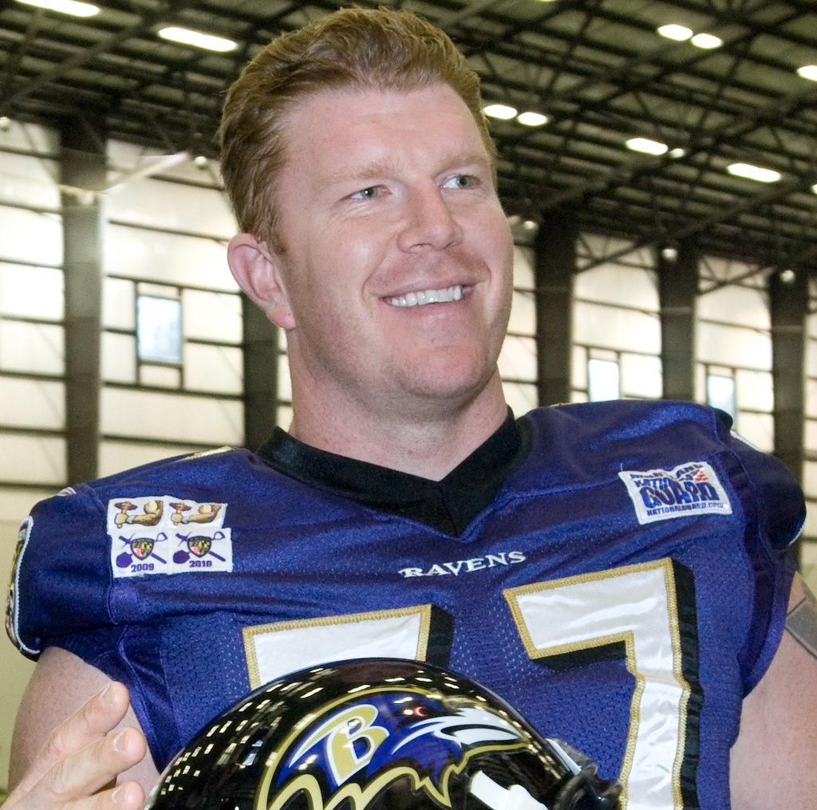
Matt Birk is a former American football center

Slide 28
Matt Birk is a former American football center. He was drafted by the Minnesota Vikings. “My parents made it to every game – literally. It didn’t matter when or where, they would find a way or sacrifice and make sure they were in the stands. Result – It made me proud of them.

Slide 29
I think I played hard because I wanted them to be proud of me. As a parent, I truly understand the importance of ‘being there’ for your kids because I experienced it.”
Notes:
Yeshua is always there for you. Look to Him

Slide 31
^{MJ 3.1-6} He was faithful to God, who appointed him; just as ^{Bamidbar/Nu 12:7} “Moshe was faithful in all God’s house.”

Slide 32
Reminder: When Jewish hearers in Yeshua’s day were told a phrase of scripture, many or most would think of the whole chapter.
We still do that.
That’s one small step…

Slide 33
^{Bamidbar/Nu 12.1-9} Miryam and Aharon began criticizing Moshe…They said, “Is it true that Adoni has spoken only with Moshe? Hasn’t he spoken with us too?” Adoni heard them. Now this man Moshe was very humble, more so than anyone on earth.

Slide 34
^{Bamidbar/Nu 12.1-9} Suddenly Adoni told Moshe, Aharon and Miryam, “Come out, you three, to the tent of meeting.” The three of them went out. Adoni came down in a column of cloud and stood at the entrance to the tent. He summoned Aharon and Miryam, and they both went forward.

Slide 35
^{Bamidbar/Nu 12.1-9} He said, “Listen to what I say: when there is a prophet among you, I, Adoni, make myself known to him in a vision, I speak with him in a dream. But it isn’t that way with my servant Moshe. He is the only one who is faithful in my entire household.

Slide 36
^{Bamidbar/Nu 12.1-9} With him I speak face to face and clearly, not in riddles; he sees the image of Adoni. So why weren’t you afraid to criticize my servant Moshe?” The anger of Adoni flared up against them, and he left.
~Yokhanan/John’s description of Yeshua.

Slide 37
^{Yn 3.34-36} Because the one whom God sent speaks God’s words. For God does not give him the Spirit in limited degree — the Father loves the Son and has put everything in his hands. Whoever trusts in the Son has eternal life.

Slide 38
Similarities of Yeshua and Moshe
direct facetime with G-d
had great opposition.
gave the laws of LIFE.
revelation from a mountain.
a great number of miracles.
described as meek.

Slide 39
^{MJ 3.1-6} But Yeshua deserves more honor than Moshe, just as the builder of the house deserves more honor than the house. For every house is built by someone, but the one who built everything is God. Also, Moshe was faithful in all God’s house,

Slide 40
^{MJ 3.1-6} as a servant giving witness to things God would divulge later. But the Messiah, as Son, was faithful over God’s house. And we are that house of his, provided we hold firmly to the courage and confidence inspired by what we hope for.

Slide 41
In his house, Moshe was a servant, chief servant
over his house Messiah heir, Creator, judge

Slide 42
provided we hold firmly to the courage and confidence.
Hold firmly: prayer, scripture, worship, community
Courage: days needing?? courage?
Confidence: Messiah’s atoning death and RESSURECTION!
Notes:
Preview of the conclusion of the message

Slide 43
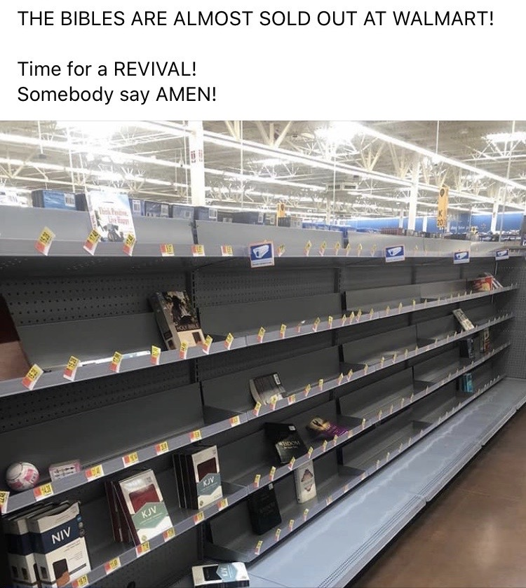

Slide 44
Hillel the elder, who lived in Babylonia and Jerusalem during the first century BCE, writes in Pirkei Avot / Ethics of Our Fathers (2:5)
Al tifrosh min hatzibur
אל‭ ‬תִּפְרוֹשׁ מִן‭ ‬הַצִּבּוּר
Do not separate yourself from the community
Notes:
I’m still busier than ever on email and zoom. Keep in touch by phone, Skype, Zoom, WhatsApp.

Slide 45
So, how do we understand our current crisis?

Slide 46
Messiah Yeshua spoke of the Last Days, the birth pangs prior to His return. These Last Days will be marked by unusual events including plague: “And there will be great earthquakes, and in various places plagues and famines. And there will be terrors and great signs from heaven” (Luke 21:11).

Slide 47
In an alert obtained by ABC News, the FBI’s New York office reports that "members of extremist groups are encouraging one another to spread the virus, if contracted, through bodily fluids and personal interactions."
Notes:
https://abcnews.go.com/US/white-supremacists-encouraging-members-spread-coronavirus-cops-jews/story?id=69737522

Slide 48
Racist extremist groups, including neo-Nazis and other white supremacists, are encouraging members who contract novel coronavirus disease to spread the contagion to cops and Jews, according to intelligence gathered by the FBI.
Notes:
We have instructed our congregational cleaner to wipe down all exterior door handles.
https://abcnews.go.com/US/white-supremacists-encouraging-members-spread-coronavirus-cops-jews/story?id=69737522

Slide 49
Italian artist Giovanni Gasparro’s painting graphically revived the medieval blood libel against the Jews.
Notes:
Giovanni Gasparro, an artist based in the Adriatic port city of Bari, uploaded images of the 7ft X 5ft painting that revives the anti-Semitic blood libel of medieval times onto his Facebook page on Tuesday.
https://unitedwithisrael.org/italian-artist-honored-by-catholic-church-revives-anti-semitic-blood-libel/?utm_source=MadMimi&utm_medium=email&utm_content=Whirlwind+Week+Ends+with+Netanyahu-Gantz+Unity%3B+Demand+NY+Times+Correct+Anti-Israel+Corona+Hit+Piece%3B+Iran%27s+Lies+Exposed+on+Iranian+TV&utm_campaign=20200327_m157582225_Whirlwind+Week+Ends+with+Netanyahu-Gantz+Unity%3B+Demand+NY+Times+Correct+Anti-Israel+Corona+Hit+Piece%3B+Iran%27s+Lies+Exposed+on+Iranian+TV&utm_term=more_btn_dark_jpg

Slide 50
Scriptural, Historical perspective

Slide 51
^{Ezekiel 38:22} With pestilence and with blood I will enter into judgment with him. And I will rain on him and on his troops, and on the many peoples who are with him, a torrential rain, with hailstones, fire and brimstone”

Slide 52
The anti-Jewish armies who try to divide the Jewish capital city of Jerusalem will be melted away by divine plague:
^{(Zechariah 14:12, 15, 18)} Now this will be the plague with which Adoni will strike all the peoples who have gone to war against Jerusalem;

Slide 53
^{(Zechariah 14:12, 15, 18)} their flesh will rot while they stand on their feet, and their eyes will rot in their sockets, and their tongue will rot in their mouth . . . So also like this plague will be the plague on the horse . . . No rain will fall on them. It will be the plague with which Adoni smites the nations who do not go up to celebrate the Feast of Sukkot.

Slide 54
^{(Revelation 6:7-8)} One of the Four Horsemen of the Apocalypse will unleash a plague which will catalyze the slaying of 25% of the earth: “When the Lamb broke the fourth seal, I heard the voice of the fourth living creature saying, ‘Come.’

Slide 55
^{(Revelation 6:7-8)} I looked, and behold, an ashen horse; and he who sat on it had the name Death; and Hades was following with him. Authority was given to them over a fourth of the earth, to kill with sword and with famine and with pestilence and by the wild beasts of the earth”

Slide 56
^{(Revelation 11:6)} The Two Witnesses will strike the earth with plagues as an integral part of their ministry: These have the power to shut up the sky, so that rain will not fall during the days of their prophesying. And they have power over the waters to turn them into blood, and to strike the earth with every plague, as often as they desire.

Slide 57
^{(Revelation 16:9, 21)} Many people will respond to God’s plagues by blaspheming Adoni and refusing to repent: Men were scorched with fierce heat; and they blasphemed the name of God who has the power over these plagues.

Slide 58
^{(Revelation 16:9, 21)} And they did not repent so as to give Him glory... And huge hailstones, about one hundred pounds each, came down from heaven upon men. And men blasphemed God because of the plague of the hail, because its plague was extremely severe.

Slide 59
Recent and historical plagues…

Slide 60
HIV/AIDS pandemic (2005-2012) 36 million
Hong Kong Flu pandemic (1968) 1 million
Asian Flu pandemic (1956-1958) 2 million
Spanish Flu pandemic (1918) 20-50 million
Sixth cholera pandemic (1910-1911) 800,000+
Flu H3N8 pandemic (1889-1890) 1 million
Notes:
(www.weforum.org/agenda/2020/03/a-visual-history-of-pandemics/; https://www.mphonline.org/worst-pandemics-in-history/; www.visualcapitalist.com/history-of-pandemics-deadliest/):

Slide 61
Third cholera pandemic (1852–1860) 1 million
The Black Death (1346-1353) bubonic plague 75-200 million
Plague of Justinian (541-542) bubonic plague 25 million
Antonine plague (165 AD) 5 million
Notes:
(www.weforum.org/agenda/2020/03/a-visual-history-of-pandemics/; https://www.mphonline.org/worst-pandemics-in-history/; www.visualcapitalist.com/history-of-pandemics-deadliest/):

Slide 62
The Spanish Flu of 1918 infected some 500 million people and claimed 20 million lives. More recent research puts that number much higher, betweeen 50-100 million.
Notes:
https://worldisraelnews.com/netanyahu-coronavirus-worst-epidemic-since-middle-ages/?utm_source=MadMimi&utm_medium=email&utm_content=Netanyahu%3A+Worst+Epidemic+%E2%80%98Since+Middle+Ages%E2%80%99%3B+Founder+of+Israeli+Medic+Corps+in+Critical+Condition+with+Coronavirus%3B+Assassins+Kill+Friend+of+US+Citizen+Rescued+from+Lebanon&utm_campaign=20200322_m157502133_Netanyahu%3A+Worst+Epidemic+%E2%80%98Since+Middle+Ages%E2%80%99%3B+Founder+of+Israeli+Medic+Corps+in+Critical+Condition+with+Coronavirus%3B+Assassins+Kill+Friend+of+US+Citizen+Rescued+from+Lebanon&utm_term=_0D_0A_09_09_09_09_09_09_09_09_09_09Read+Now_0D_0A_09_09_09_09_09_09_09_09_09

Slide 63
According to The History Channel, the Justinian Plague starting in 541 C.E. killed about 50 million people, or 26 percent of the world population, over the course of two centuries.

Slide 64
The Black Death (Bubonic Plague) entered Europe through Sicily at the port of Messina in 1347 A.D. and swept across Europe over the next three years, killing an estimated 75 to 200 million people worldwide. Europe lost 30 to 60 percent of its population.
Notes:
https://worldisraelnews.com/netanyahu-coronavirus-worst-epidemic-since-middle-ages/?utm_source=MadMimi&utm_medium=email&utm_content=Netanyahu%3A+Worst+Epidemic+%E2%80%98Since+Middle+Ages%E2%80%99%3B+Founder+of+Israeli+Medic+Corps+in+Critical+Condition+with+Coronavirus%3B+Assassins+Kill+Friend+of+US+Citizen+Rescued+from+Lebanon&utm_campaign=20200322_m157502133_Netanyahu%3A+Worst+Epidemic+%E2%80%98Since+Middle+Ages%E2%80%99%3B+Founder+of+Israeli+Medic+Corps+in+Critical+Condition+with+Coronavirus%3B+Assassins+Kill+Friend+of+US+Citizen+Rescued+from+Lebanon&utm_term=_0D_0A_09_09_09_09_09_09_09_09_09_09Read+Now_0D_0A_09_09_09_09_09_09_09_09_09

Slide 65
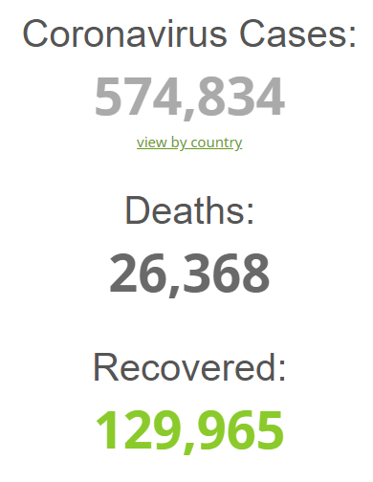
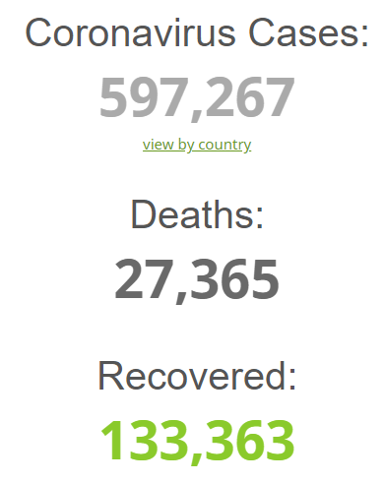
noon, Fri., Mar. 27, 2020 11pm
Notes:
https://www.worldometers.info/coronavirus/

Slide 66
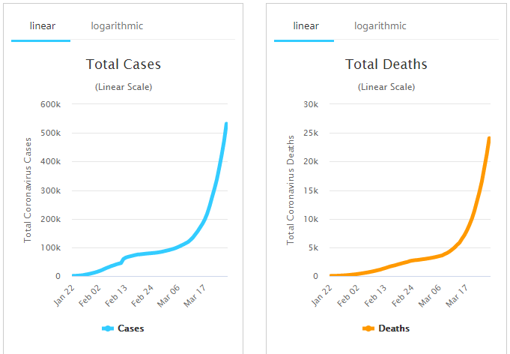
Fri.,
Mar. 27
Noon
Note exponential rise
Notes:
https://www.worldometers.info/coronavirus/

Slide 67
Theories of WHY this is happening.

Slide 68
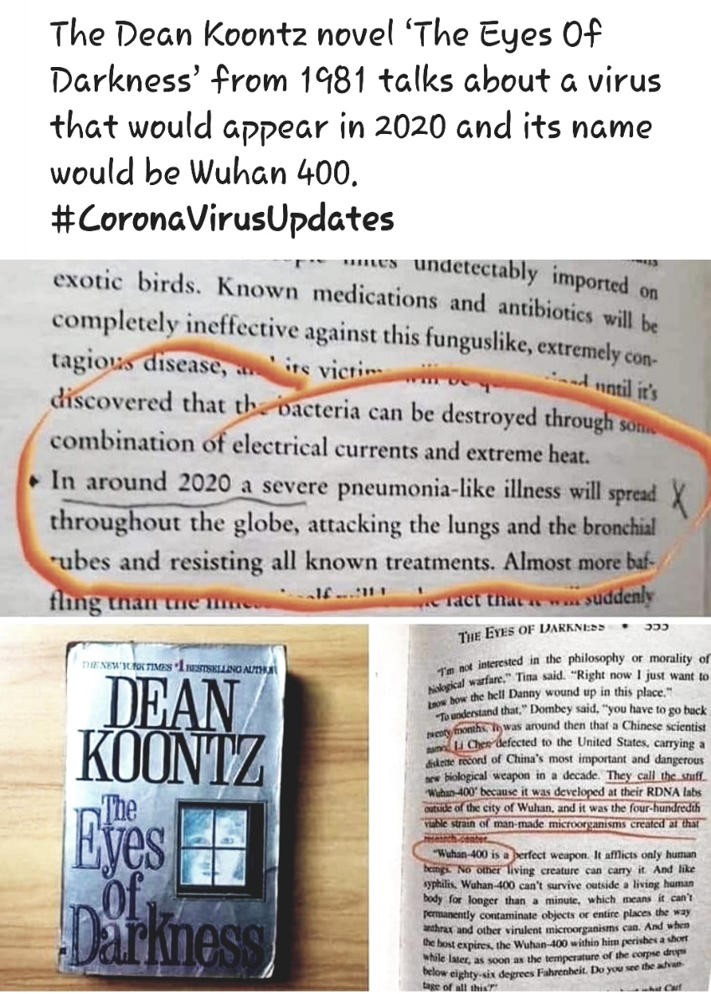

Slide 69
The Jewish Voice [NOT J Bernis] here is our theory; as good as any. It was developed as a weapon by two or our most extreme enemies; China and Iran. Radio Free Asia, last week, rebroadcast a Wuhan television report from 2015 showing China’s most advanced virus research lab, known as the Wuhan Institute of Virology.
Notes:
http://thejewishvoice.com/2020/03/has-china-been-criminally-negligent/

Slide 70
The Jewish Voice [NOT J Bernis]. It is capable of working with deadly viruses. Dany Shoham, a former Israeli military intel officer and an expert in Chinese bio-warfare, said the institute is linked to Beijing’s covert bio-weapons program.
Notes:
http://thejewishvoice.com/2020/03/has-china-been-criminally-negligent/

Slide 71
The Jewish Voice [NOT J Bernis].
China now has a population of 1.5 billion people, many of whom live in abject poverty and are a burden on the nation. China’s reputation for brutality against its own citizens may have led them to test it locally and willingly or not unleashed its power worldwide, aiming, eventually, to cripple its worst enemy…..the U.S. It appears to be a diabolical plan.
Notes:
http://thejewishvoice.com/2020/03/has-china-been-criminally-negligent/

Slide 72
The Jewish Voice [NOT J Bernis].
Let’s bring in the other culprit… its partner, Iran. China is dependent on Iranian oil and in turn, supplies that Islamic nation with a major portion of its military equipment including its nuclear-weapon technology. They share a bond of American hatred. Sadly enough, Iran has suffered over 800 deaths linked to the Corona virus and China, over 3,000. Both nations care little about life but more so about their hatred for both the U.S. and the West.
Notes:
http://thejewishvoice.com/2020/03/has-china-been-criminally-negligent/

Slide 73
Other theories:
Big Pharma, set it up for mandatory vaccinations.
Illuminati / Council on Foreign Relations Rothschilds/ Rockefellers: plan to depopulate the earth to 500 million.

Slide 74
Chinese plan to bankrupt the USA

Slide 75
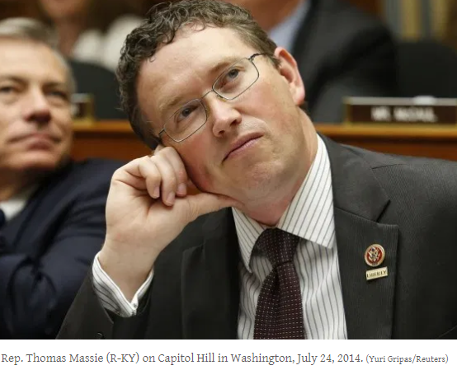
Rep Thomas Massle
Notes:
https://www.nationalreview.com/news/citing-budget-deficit-concerns-kentucky-republican-says-he-could-delay-house-vote-on-coronavirus-bill/

Slide 76
$2 trillion (Congress)
+$4 trillion (Fed & Treasury)
———————————
$6 trillion stimulus
$6 trillion divided by 350 million citizens = $17,000 per citizen times a family of 4 =$68,000 per family of new national debt
Notes:
https://www.nationalreview.com/news/citing-budget-deficit-concerns-kentucky-republican-says-he-could-delay-house-vote-on-coronavirus-bill/

Slide 78
Bill Gates 2015
Ted Talk warning
Notes:
https://www.mercurynews.com/2020/03/25/coronavirus-bill-gates-predicted-pandemic-in-2015/

Slide 79
Bill Gates warned five years ago that it was coming. In a TED talk in 2015, the Microsoft co-founder and billionaire philanthropist cited lessons learned from Western Africa’s 2014 Ebola virus crisis, and said the U.S. and other countries were not prepared for the future pandemic that was going to hit them.
Notes:
https://www.mercurynews.com/2020/03/25/coronavirus-bill-gates-predicted-pandemic-in-2015/

Slide 80
“If anything kills over 10 million people in the next few decades, it’s most likely to be a highly infectious virus rather than a war,” Gates said. “Not missiles, but microbes.”
Notes:
https://www.mercurynews.com/2020/03/25/coronavirus-bill-gates-predicted-pandemic-in-2015/

Slide 81
Individual countries, the World Health Organization, and others need to create medical strike teams that train like military soldiers, run simulated pandemic exercises, and prepare to quickly move into areas
Notes:
https://www.mercurynews.com/2020/03/25/coronavirus-bill-gates-predicted-pandemic-in-2015/

Slide 82
where pandemics are starting to test and treat victims, he said. Governments also need to invest far more in medical equipment, vaccine research and other ways to prepare.
Notes:
https://www.mercurynews.com/2020/03/25/coronavirus-bill-gates-predicted-pandemic-in-2015/

Slide 83
Ebola hemorrhagic fever
2013–2016 West Africa
25–90% mortality
Ebola is not airborne.
Almost zero incubation time.
Heroic workers who isolated patients.

Slide 84
The first known severe illness caused by a coronavirus emerged with the 2003 Severe Acute Respiratory Syndrome (SARS) epidemic in China.

Slide 85
Severe acute respiratory syndrome (SARS) is a viral respiratory disease that surfaced in the early 2000s caused by the first-identified strain of the SARS coronavirus (SARS-CoV or SARS-CoV-1)
Notes:
https://en.wikipedia.org/wiki/Severe_acute_respiratory_syndrome

Slide 86
SARS was a relatively rare disease; at the end of the epidemic in June 2003, the incidence was 8,422 cases with a case fatality rate 11%.
Notes:
https://en.wikipedia.org/wiki/Severe_acute_respiratory_syndrome

Slide 87
A second outbreak of severe illness began in 2012 in Saudi Arabia with the Middle East Respiratory Syndrome (MERS). This is a viral respiratory infection caused by the MERS-coronavirus (MERS-CoV). .
Notes:
https://en.wikipedia.org/wiki/Middle_East_respiratory_syndrome

Slide 88
Symptoms may range from mild to severe. They include fever, cough, diarrhea and shortness of breath. Disease is typically more severe in those with other health problems. Mortality is about one-third of diagnosed cases.
Notes:
https://en.wikipedia.org/wiki/Middle_East_respiratory_syndrome

Slide 89
Just under 2000 cases have been reported of MERS as of 4 April 2017. About 36% of those who are diagnosed with the disease die from it. The first identified case occurred in 2012 in Saudi Arabia and most cases have occurred in the Arabian Peninsula.
Notes:
https://en.wikipedia.org/wiki/Middle_East_respiratory_syndrome

Slide 90
The 2009 flu pandemic or swine flu was an influenza pandemic that lasted from January 2009 to August 2010, and the second of the two pandemics involving H1N influenza virus (the first being the 1918–1920 Spanish flu pandemic), albeit a new strain
Notes:
https://en.wikipedia.org/wiki/2009_flu_pandemic

Slide 91
H1N1 Swine flu 2009-2010
Confirmed cases
700 million – 1.4 billion
Deaths
18,036 (WHO confirmed)
284,000 (CDC estimation)
Notes:
https://en.wikipedia.org/wiki/2009_flu_pandemic

Slide 92
So, how do we respond.
Don’t panic. Look to Messiah. He’s looking at you. Cheering you!
Do the basic five.
Seek to serve.
Notes:
https://en.wikipedia.org/wiki/Ebola_virus_disease#2013%E2%80%932016_West_Africa

Slide 93
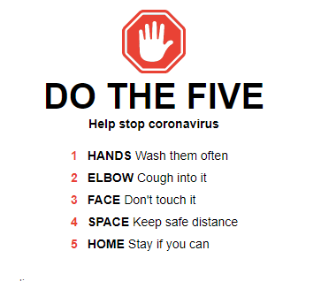
Notes:
https://www.google.com/search?q=coronavirus+tips&fbx=dothefive

Slide 94
NY Times: Our health reporter Donald McNeil writes: “If it were possible to wave a magic wand and make all Americans freeze in place for 14 days while sitting six feet apart, epidemiologists say, the whole epidemic would sputter to a halt.”
Notes:
https://www.nytimes.com/2020/03/22/health/coronavirus-restrictions-us.html?auth=login-email&campaign_id=9&emc=edit_NN_p_20200323&instance_id=16988&login=email&nl=morning-briefing&regi_id=35997600tion%3DtopNews&section=topNews&segment_id=22598&te=1&user_id=0c340ef4a0010f69a562b70ff5e66878

Slide 95
Dave Ramsey Message of Hope
https://youtu.be/z2Bq7gcB35M
Don’t panic: fear is selfish
Don’t sell stocks and funds, time to hold

Slide 96
Arkansas's Cleburne County isn't big -- but it still had the second-highest number of coronavirus cases. Eventually, local health officials started to piece it all together, a puzzle that led them straight to the doors of the Greer's Ferry First Assembly.
Notes:
Tony Perkins
https://www.frc.org/updatearticle/20200324/church-story

Slide 97
Like a lot of churches across the country, the leaders of Greer's Ferry, Arkansas didn't want to cancel its services. The virus seemed like a distant threat in early March, and they still had activities on the calendar.
Notes:
Tony Perkins
https://www.frc.org/updatearticle/20200324/church-story

Slide 98
So instead of heeding the warnings from federal officials, the congregation went ahead and hosted a special children's ministry event. The result was catastrophic.
Notes:
Tony Perkins
https://www.frc.org/updatearticle/20200324/church-story

Slide 99
Today, 34 people linked to the church have tested positive for the coronavirus -- with many more expected to be diagnosed. Pastor Mark Palenske and his wife were infected, posting on Facebook that "the intensity of this virus has been underestimated by so many, and I continue to ask that each of you take it very seriously
Notes:
Tony Perkins
https://www.frc.org/updatearticle/20200324/church-story

Slide 100
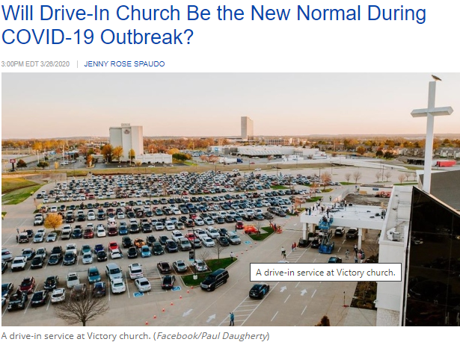
Notes:
https://www.charismanews.com/us/80504-will-drive-in-church-be-the-new-normal-during-covid-19-outbreak?utm_source=Charisma%20News%20Daily&utm_medium=email&utm_content=subscriber_id:5160390&utm_campaign=CNO%20daily%20-%202020-03-27

Slide 101
One UK Pastor had online congregation and created different hang out "rooms" for "coffee time" for people to just connect and chat in small groups. As he dipped in and out of each "room", he observed the people were all really happy. And they had wonderful fellowship. Zoom?

Slide 102
Consider Yeshua:
Character
Actions
Responses
WWYD

Slide 103
provided we hold firmly to the courage and confidence.
Hold firmly: prayer, scripture, worship, community
Courage: days needing?? courage?
Confidence: Messiah’s atoning death and RESSURECTION!

