Slide 1
e-handout
To have these notes
without taking notes
Go to OrHaOlam.com
Click on downloads,
messages, 2020

Slide 2
Good news from Israel

Slide 3
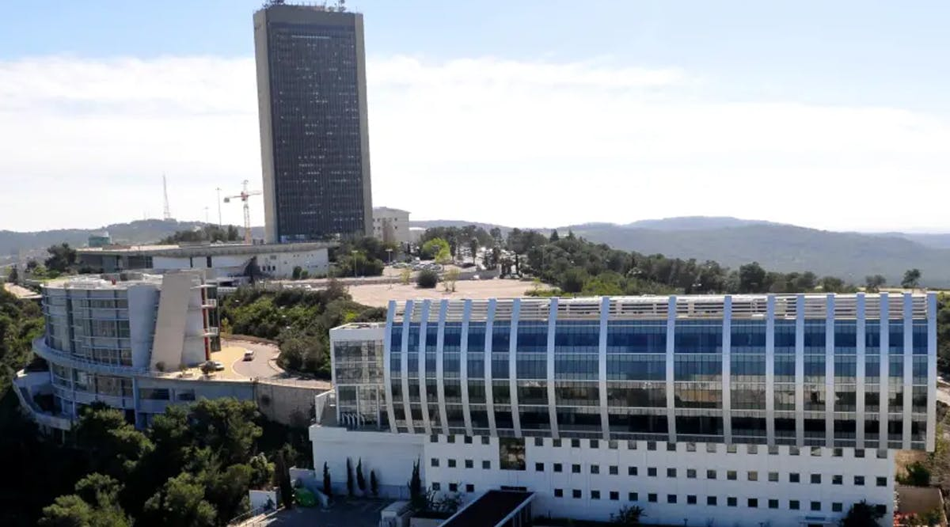
Haifa University Ranks above
Major Universities

Slide 4
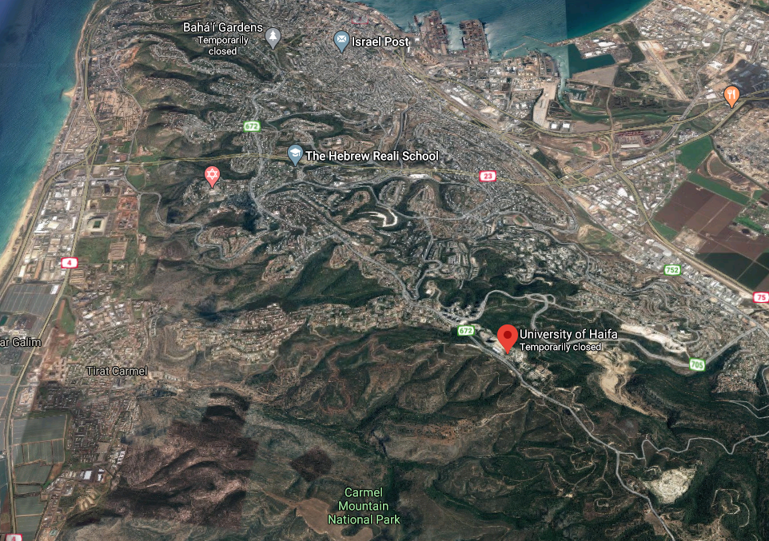

Slide 5
The global university index system Shanghai Ranking ranked Haifa University above not only all other Israeli universities but also renowned higher learning institutes across the world for educational studies.
Notes:
https://vfinews.com/en/news/july-7-2020/haifa-university-ranks-above-major-universities-in?subscribed=true&utm_source=VFI+News+-+English&utm_campaign=3edbe10879-EMAIL_CAMPAIGN_2020_07_07_07_00&utm_medium=email&utm_term=0_c414809724-3edbe10879-148559991&mc_cid=3edbe10879&mc_eid=[UNIQID]

Slide 6
The index grades and prioritizes universities around the globe based on a variety of factors, including Nobel Prize winners, published research, and more.
Notes:
https://vfinews.com/en/news/july-7-2020/haifa-university-ranks-above-major-universities-in?subscribed=true&utm_source=VFI+News+-+English&utm_campaign=3edbe10879-EMAIL_CAMPAIGN_2020_07_07_07_00&utm_medium=email&utm_term=0_c414809724-3edbe10879-148559991&mc_cid=3edbe10879&mc_eid=[UNIQID]

Slide 7
Haifa University ranked in the top 76-100 universities in the world for education studies above schools such as Cambridge University and Oxford University in England, and Yale University and Brown University in the United States.
Notes:
https://vfinews.com/en/news/july-7-2020/haifa-university-ranks-above-major-universities-in?subscribed=true&utm_source=VFI+News+-+English&utm_campaign=3edbe10879-EMAIL_CAMPAIGN_2020_07_07_07_00&utm_medium=email&utm_term=0_c414809724-3edbe10879-148559991&mc_cid=3edbe10879&mc_eid=[UNIQID]
Highly integrated Arab/Jewish student demographic

Slide 9
From Wed., July 8 till Thurs., July 30 there is a special intercessory 3 weeks.

Slide 10
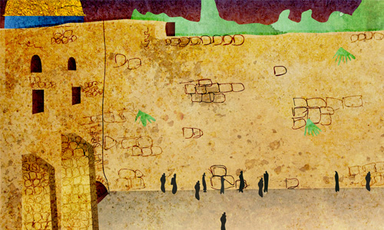
Notes:
https://www.chabad.org/library/article_cdo/aid/144573/jewish/The-Three-Weeks.htm

Slide 11
For eight hundred and thirty years there stood an edifice upon a Jerusalem hilltop which served as the point of contact between heaven and earth. So central was this edifice to the relationship between man and G‑d that nearly two-thirds of the mitzvot are contingent upon its existence.
Notes:
https://www.chabad.org/library/article_cdo/aid/144573/jewish/The-Three-Weeks.htm

Slide 12
Its destruction is regarded as the greatest tragedy of our history, and its rebuilding will mark the ultimate redemption-the restoration of harmony within G‑d's creation and between G‑d and His creation.
Notes:
https://www.chabad.org/library/article_cdo/aid/144573/jewish/The-Three-Weeks.htm

Slide 13
A full three weeks of our year—the three weeks "between the straits" of Tammuz 17 [Wed. July 8/9] and Av 9 [Wed. Thurs. July 29/30]—are designated as a time of mourning over the destruction of the Holy Temple and the resultant galut—physical exile and spiritual displacement—in which we still find ourselves.
Notes:
https://www.chabad.org/library/article_cdo/aid/144573/jewish/The-Three-Weeks.htm

Slide 14
The Rebbe urged that the Three Weeks should be a time of increased Torah study and giving of charity—in keeping with the verse, "Zion shall be redeemed by law, and her returnees by charity."
Notes:
https://www.chabad.org/library/article_cdo/aid/144573/jewish/The-Three-Weeks.htm

Slide 15
^{T’hillim/Ps 137.5-6} If I forget you, Yerushalayim, may my right hand wither away! May my tongue stick to the roof of my mouth if I fail to remember you,
if I fail to count Yerushalayim
the greatest of all my joys.

Slide 16
^{Yeshayahu/Is 61.1-4} The Ruakh /Spirit of Adoni Elohim is on me…to console those who mourn in Zion…They will rebuild the ancient ruins. They will restore former desolations.
Ruin of righteousness
Return of Messiah
Notes:
Ruin of our righteousness, return of Messiah.

Slide 17
From Jim Garlow: In my State of California, our Governor has informed us that we cannot sing and worship in services. In my County of San Diego, our Public Health Officer has informed us that we cannot have gatherings in our homes for the rest of 2020.

Slide 18
In the United States, 49 percent of millennials are unable to name a single extermination camp or ghetto and 41 percent believe substantially less than six million Jews were killed during the Holocaust.
Congresswoman Vicky Hartzler

Slide 19
What is the heritage of Jerusalem that we are wanting to restore?

Slide 20
June 6: Ceased / rested from his own work DIY hazards ^{MJ 4.9}
Carnal works of the flesh
Our own works of righteousness, no need for Messiah.
Our own working for Messiah: lone soldier.
Messiah’s works, but in our own strength.
Notes:
These are the works we can claim.

Slide 21
June 13 Surgical Precision 2 edged
Cause of Repentance ^{MJ 4.12}
See oneself without excuse Ro.1.20
Goodness/Kindness of G-d → see our sin Ro. 2.4
My repentance: My Saga w Racism
Hindrances to Repentance
Diverting guilt → blame
False guilt / accusations
What is G-d doing to bring real repentance
Notes:
^{Ro 1.20} His invisible attributes—His eternal power and His divine nature—have been clearly seen ever since the creation of the world, being understood through the things that have been made. So people are without excuse.
^{Ro. 2.4} God’s kindness leads you to repentance.

Slide 22
June 27 Naked and Open ^{MJ 4.13}
Positive aspects to G-d seeing us
Compassion
Steps for recovery
Camaraderie
Negative aspects to G-d seeing us
No excuses
No blame
No hiding wrongdoing
Notes:
Illustrate with a story from scripture…

Slide 23
How do we get delivered from our own works. [June 6]
How do we get precise spiritual surgery needed? [June 13]
How do we get help with all that secret stuff G-d sees? [June 27]
Notes:
Not a big issue to me. It is to G-d
I don’t need surgery. I’m entirely healthy and holy.
There is nothing G-d sees I wouldn’t mind being up on screen. Entire thought life.
I really spent those three weeks speaking about spiritual problems. Not the solution

Slide 24
What is the heritage of Jerusalem that we are wanting to restore?

Slide 25
Notes:
https://www.templeinstitute.org/new-location.htm

Slide 26
^{MJ 4.14} Therefore, since we have a _{1.}great cohen gadol who has passed through to the highest heaven, Yeshua, the Son of God, let us hold firmly to what we acknowledge as true.

Slide 27
^{MJ 4.15} For we do not have a _{2.}cohen gadol unable to empathize with our weaknesses; since in every respect he was tempted just as we are, the only difference being that he did not sin.

Slide 28
^{MJ 4.16} Therefore, let us confidently approach the throne from which God gives grace, so that we may receive mercy and find grace in our time of need.

Slide 29
^{MJ 5.1} For every _{3.}cohen gadol taken from among men is appointed to act on behalf of people in matters relating to God, so that he may offer gifts and sacrifices for sins.

Slide 30
^{MJ 5.2-3} He _{4.}[the cohen gadol] can deal gently with the ignorant and deluded, since he himself also is subject to weakness. Also, because of this weakness, he has to offer sacrifices for his own sins, as well as those of the people.
Notes:
https://biblehub.com/greek/50.htm

Slide 31
Four references to the cohen gadol.
He
delivers us from our own works,
does the precise surgery to transform,
gets to all the secret stuff!
How?

Slide 32
When I say “cohen” what comes to mind?
Did a Google search on cohen.
In 0.9 sec found 242,000,000 hits
Michael Cohen lawyer
Dr. Mark Cohen
Leonard Cohen
Sasha Baron Cohen
Notes:
Priest? No, dentist, lawyer, musician!

Slide 33
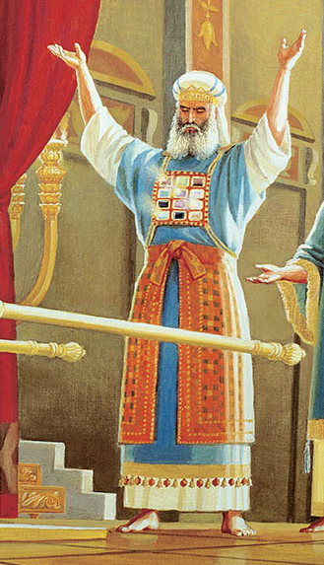
The Cohen Gadol wore eight holy garments (bigdei kodeshבגדי קודש ). Of these, four were of the same type worn by all Cohanim/priests and four were unique to the Cohen Gadol.
Notes:
https://templeinstitute.org/priestly-garments-3
Didn’t start so elaborate…

Slide 34
^{Shmot/Ex 19.5-6} Now if you will pay careful attention to what I say and keep my covenant, then you will be my own treasure from among all the peoples, for all the earth is mine; and you will be a kingdom of cohanim for me, a holy nationגוֹי קָדוֹשׁ [goy kadosh].’

Slide 35
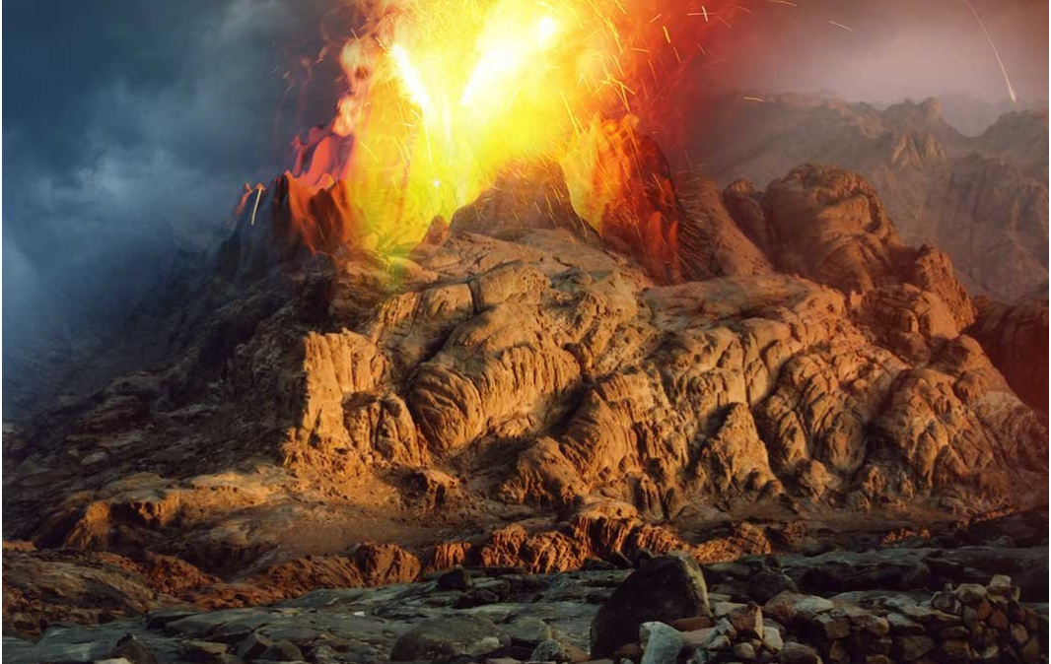
Notes:
https://ffoz.org/discover/shavuot/fire-on-the-mountain.html
On that day at Mount Sinai, there was wind; there was lighting; there was thunder; there was smoke; and there was fire. (Image © Bigstock/FFOZ)

Slide 36
^{Shmot/Ex 20.18-21} All the people witnessed the thundering and the lightning, and the sound of the shofar, and the mountain smoking. When the people saw it, they trembled and stood far off. So they said to Moses, “You, speak to us, and we will listen, but do not let God speak to us, or we will die.”

Slide 37
^{Shmot/Ex 20.18-21} So Moses said to the people, “Do not be afraid, for God has come to test you, so that His fear may be in you, so that you do not sin.” The people stood far off, while Moses drew near to the thick darkness where God was.

Slide 38
^{Shmot/Ex 28.1-2} “You are to summon your brother Aharon and his sons to come from among the people of Isra’el to you, so that they can serve me as Cohanim... You are to make for your brother Aharon garments set apart for serving God, expressing dignity and splendor.

Slide 39
So, what was the work
of the Cohanim כוהנים
[pl of cohen] כוהן
Notes:
What is the heart of our redemption from our own works, our precise surgery, our deep inner cleansing?

Slide 40
^{MJ 5.1} For every _{3.}cohen gadol taken from among men is appointed to act on behalf of people in matters relating to God, so that he may offer gifts and sacrifices for sins.

Slide 41
δῶρα (dōra) gift (focusing on "the free nature of the gift. That is, something "uncaused" (not coerced, spontaneous) מְנָחוֹת gift, present, tribute
θυσίας (thysias) an offering (sacrifice); an official sacrifice prescribed by God; hence an offering the Lord accepts because offered on His terms. זְבָחִים
Notes:
https://biblehub.com/greek/1435.htm
freewill offerings, peace offerings, burnt offerings, sin and trespass offerings, all kind of sacrifice.

Slide 42
He alone could offer the sacrifices for the sins of the priests, or of the people, or of himself

Slide 43
^{Vayikra/Lev 4.13-14} ‘“‘If the entire community of Isra’el inadvertently makes a mistake, with the assembly being unaware of the matter, and they do something against any of the mitzvot of Adonai concerning things which should not be done, they are guilty. When the sin they have committed becomes known, then

Slide 44
^{Vayikra/Lev 4.16-18} The anointed cohen is to bring some of the bull’s blood to the tent of meeting. The cohen is to dip his finger in the blood and sprinkle it seven times in the presence of Adonai in front of the curtain.
Notes:
That is, the high priest, as the Targums of Onkelos and Jonathan, and the Septuagint version, render it;

Slide 45
^{Vayikra/Lev 4.16-18} He is to put some of the blood on the horns of the altar before Adoni, there in the tent of meeting. All the remaining blood he is to pour out at the base of the altar for burnt offerings, which is at the entrance to the tent of meeting…Thus the cohen will make atonement for them, and they will be forgiven.

Slide 46
^{MJ 7.25} Therefore He is also able to save completely those who draw near to God through Him, always living to make intercession for them.

Slide 48
^{Vayikra/Lev 4.2-3} If anyone sins unintentionally in any of Adoni’s mitzvot that are not to be done, and commits any one of them —or if the anointed cohen sins so as to bring guilt on the people—then let him offer for his sin which he has committed, a young bull without blemish to Adoni for a sin offering.
Notes:
That is, the high priest, as the Targums of Onkelos and Jonathan, and the Septuagint version, render it;
So if the Cohen Gadol sins, the whole nation is tainted.
Leader sins, it taints the whole society.
Evangelical pastor Ted Haggard ranted against the evils of premarital sex, adultery, and gay marriage. That is, until he was caught in a gay sex scandal in 2006. A male escort named Mike Jones publicly claimed that Haggard had been a client for years. Not only that, Haggard had allegedly used crystal meth in front of his male lover. https://www.ranker.com/list/pastors-that-fell-from-grace/genevieve-carlton

Slide 49
Jim Baker, Tony Alamo, Bob Coy, Dave Reynolds, Jimmy Swaggart, Pres. Clinton.
The first asset we have in our inventory as leaders is integrity, humility, character. If the cohen Gadol sins, the whole nation is tainted. Fathers, Mothers…
Notes:
Jim Bakker was perhaps the most popular televangelist in the 1980s, though his wife Tammy Faye gave him a run for his money. That all ended when Bakker was brought down by an enormous scandal that included sexual abuse and fraud. In 1987, Bakker's secretary publicly accused the televangelist of raping and drugging her. After Bakker resigned from his ministry, he was charged with accounting fraud and sentenced to 45 years in prison. https://www.ranker.com/list/pastors-that-fell-from-grace/genevieve-carlton
Bob Coy was the most famous evangelical pastor in Florida. His Fort Lauderdale megachurch had 25,000 members, and George W. Bush even visited Coy. in 2014 he admitted to multiple affairs and a pornography addiction.In 2017, Coy was publicly accused of molesting a four-year-old child.

Slide 50
Only Yeshua could say, “^{Yn 8.46} Which one of you convicts Me of sinning? If I am telling the truth, why don’t you believe Me?”
^{Yeshayahu/Is 53.9} And they made His grave with the wicked—
But with the rich at His death,
Because He had done no violence,
Nor was any deceit in His mouth.
Notes:
I heard Tovia Singer comment that that was unique.

Slide 51
The cohen gadol is to carry the urim
^{Bamidbar /Nu 27.20} El‘azar the cohen, who is to find out by means of the urim what Adoni’s will is for Y’hoshua’s decisions.

Slide 52
^{Shmot/Ex 28.30} You are to put the urim and the tumim in the breastplate for judging; they will be over Aharon’s heart when he goes into the presence of Adoni. Thus Aharon will always have the means for making decisions for the people of Isra’el over his heart when he is in the presence of Adoni.

Slide 53
The Cohen Gadol wore eight holy garments (bigdei kodeshבגדי קודש ). Of these, four were of the same type worn by all Cohanim/priests and four were unique to the Cohen Gadol.
Notes:
https://templeinstitute.org/priestly-garments-3
Note some of the 12 stones of the khoshen/ breastplate, illuminated? One theory about the Urim and Thumim

Slide 54
^{Malakhi 2.7} A cohen’s lips should safeguard knowledge, and people should seek Torah from his mouth, because he is the messenger of Adoni-Tzva’ot.
Notes:
Edersheim Temple p 93

Slide 55
^{Col. 2.2-3} May they have all the riches of the full assurance of understanding, leading to a true knowledge of the mystery of God—that is, Messiah. In Him all the treasures of wisdom and knowledge are hidden.

Slide 56
^{Phil 3.8-11} I consider everything a disadvantage in comparison with the supreme value of knowing the Messiah Yeshua as my Lord. It was because of him that I gave up everything and regard it all as garbage, in order to gain the Messiah and be found in union with him,

Slide 57
^{Phil 3.8-11} not having any righteousness of my own based on legalism, but having that righteousness which comes through the Messiah’s faithfulness, the righteousness from God based on trust. Yes, I gave it all up in order to know him,

Slide 58
^{Phil 3.8-11} that is, to know the power of his resurrection and the fellowship of his sufferings as I am being conformed to his death, so that somehow I might arrive at being resurrected from the dead.

Slide 60
^{Vayikra/Lev 6.7-9} ‘This is the law for the grain offering: the sons of Aharon are to offer it before Adonai in front of the altar. He is to take from the grain offering a handful of its fine flour, some of its olive oil and all of the frankincense which is on the grain offering;

Slide 61
^{Vayikra/Lev 6.7-9} and he is to make this reminder portion of it go up in smoke on the altar as a fragrant aroma for Adonai. The rest of it Aharon and his sons are to eat; it is to be eaten without leaven in a holy place — they are to eat it in the courtyard of the tent of meeting.

Slide 62
^{Eph 5.20} Always give thanks for everything to God the Father in the name of our Lord Yeshua the Messiah.

Slide 63
Though other priests would serve only when it was their week on rotation and on feast days (and even then their function was decided by lot), the cohen gadol was privileged to take part at his own pleasure in any of the priestly rites at any time.
Notes:
https://en.wikipedia.org/wiki/High_Priest_of_Israel

Slide 64
Josephus contends that the high priest almost invariably participated in the ceremonies on Shabbat, the New Moon, and the festivals.
Notes:
https://en.wikipedia.org/wiki/High_Priest_of_Israel

Slide 65
On Yom Kippur he alone entered the Holy of Holies, to make atonement for his house and for the people
^{Vayikra/Lev 16.17} No one is to be present in the tent of meeting from the time he enters the Holy Place to make atonement until the time he comes out, having made atonement for himself, for his household and for the entire community of Isra’el.

Slide 67
^{MJ 5.2} He can deal gently with the ignorant and deluded, since he himself also is subject to weakness.
ignorant ἀγνοοῦσιν (agnoousin) not to know (through lack of information or intelligence)
deluded πλανωμένοις (planōmenois) to go astray, wander, roam about, to be led into error
Notes:
https://biblehub.com/greek/50.htm

Slide 68
He can deal gently with the ignorant and deluded,
^{2 Cor 3.14-16} What is more, their minds were made stonelike; for to this day the same veil remains over them when they read the Tanakh; it has not been unveiled, because only by the Messiah is the veil taken away.
Notes:
We often don’t see our own sins.
Isaiah, “Woe is me” revelation of the HOLY ONE. Yeshua prays Yn 16

Slide 69
Deluded
Much sin is in delusion.
1. From the tempter. ^{Ber/Gen 3.1} But the serpent was shrewder than any animal of the field that Adoni Elohim made. So it said to the woman, “Did God really say, ‘You must not eat from all the trees of the garden’?”

Slide 70
“You most assuredly won’t die! For God knows that when you eat of it, your eyes will be opened and you will be like God, knowing good and evil.” Now the woman saw that the tree was good for food, and that it was a thing of lust for the eyes, and that the tree was desirable for imparting wisdom.

Slide 71
He can deal gently with the ignorant
We don’t see our own sins.
^{Ro 11:25} For, brothers, I want you to understand this truth … It is that stoniness, to a degree, has come upon Isra'el, until the Gentile world enters in its fullness
Notes:
We often don’t see our own sins. Usually see self as VICTIM. Woman attacked → belittling her husband. Man sensitive → cruel.
Stoniness??
Pharaoh hardened his heart, and G-d further hardened it

Slide 72
^{Yn 16.8-10} "When he [the Ruakh רוח] comes, he will show that the world is wrong about sin, about righteousness and about judgment --about sin, in that people don't put their trust in me; about righteousness,
Notes:
We often don’t see our own sins. Isaiah, “Woe is me” revelation of the HOLY ONE. Yeshua prays Yn 16

Slide 73
^{Yn 16.8-10} in that I am going to the Father and you will no longer see me; about judgment, in that the ruler of this world has been judged.
Notes:
We often don’t see our own sins. Isaiah, “Woe is me” revelation of the HOLY ONE. Yeshua prays Yn 16

Slide 74
^{MJ 5.2-3} since he too is subject to weakness. Also, because of this weakness, he has to offer sacrifices for his own sins, as well as those of the people.
Notes:
Yom Kippur: Cohen offered first for himself. My sense of sin.

Slide 75
^{Viyikra/Lev 16.6} Aharon is to present the bull for the sin offering which is for himself and make atonement for himself and his household.
Notes:
Yom Kippur: Cohen offered first for himself. My sense of sin.

Slide 76
^{Mt. 23.37-39} “O Jerusalem, Jerusalem who kills the prophets and stones those sent to her! How often I longed to gather your children together, as a hen gathers her chicks under her wings, but you were not willing!
Notes:
T’hillim/Ps

Slide 77
^{Mt. 23.37-39} Look, your house is left to you desolate! For I tell you, you will never see Me again until you say, ‘Barukh ha-ba b’Shem Adoni. Blessed is He who comes in the name of the Lord!’
Notes:
T’hillim/Ps 118.26

Slide 78
Summary of all:
^{8.1-2} Here is the whole point of what we have been saying: we do have just such a cohen gadol as has been described. And he does sit at the right hand of HaG'dulah in heaven. There he serves in the Holy Place, that is, in the true Tent of Meeting, the one erected not by human beings but by ADONI.

