Slide 1
e-handout
To have these notes
without taking notes
Go to OrHaOlam.com
Click on downloads,
messages, 2020
Notes:
Last Sunday, I attended the Day of Discovery at the J, and one session was . The Cosmic Joke: Judaism, Mysticism and Comedy
Sarah Aptilon Grew up KC. Teaches now at JCCC. Interested in meditation, advised to go to the source; went to Japan to learn meditation 7 years. Monastery. Midlife crisis age 21 Altered world view. 10 years later grad Yale Middle Eastern Studies. World view of laughter in tragedy, Jewish way.

Slide 2
George Burns: secret of good sermon: good beginning, good ending,

Slide 3
George Burns: secret of good sermon: good beginning, good ending, two as close together as possible.

Slide 4
Notes:
Jai Cohen

Slide 5
Notes:
Jai Cohen

Slide 6
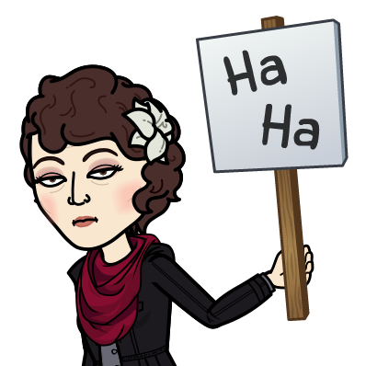

Slide 7
Correction:
Last week I said that most congregations don’t teach discipleship. Overstated.
They do teach prayer, fasting, sharing.
They fail to teach covenants, role Israel, meaning of the festivals.

Slide 8
I want to play a clip form the 1960’s that captures something pivotal in my youth.
I DO NOT agree with some of the visuals, but the theme is gripping.

Slide 9
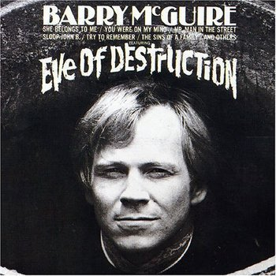
Barry McGuire was part of the folk-rock scene in Southern California in the 60’s.
Notes:
https://youtu.be/qfZVu0alU0I
https://genius.com/Barry-mcguire-eve-of-destruction-lyrics

Slide 10
Don't you understand, what I'm trying to say?
Can't you see the fears that I'm feeling today?
Take a look around you, boy, it's bound to scare you, boy
And you tell me over and over and over again my friend
Ah, you don't believe we're on the eve of destruction
Notes:
https://genius.com/Barry-mcguire-eve-of-destruction-lyrics

Slide 11
I can't twist the truth, it knows no regulation
Handful of Senators don't pass legislation,
And marches alone can't bring integration
When human respect is disintegratin'
This whole crazy world is just too frustratin'
Notes:
https://genius.com/Barry-mcguire-eve-of-destruction-lyrics

Slide 12
And you tell me over and over and over again my friend
Ah, you don't believe we're on the eve of destruction
2020 version of fearsome sights, eve of destruction ~ “beginning of sorrows”
Notes:
https://genius.com/Barry-mcguire-eve-of-destruction-lyrics

Slide 13
Pandemic killing many, and draconian response of shutting down the economy and education.
Innocent till proven guilty, but alleged rogue police murder triggering centuries of pent-up rage.
Riots and vandalism unchecked, including Bible burning.

Slide 14
Police defunding implemented in 13 cities so far.
Socialism accepted by many as the solution for America.
Trillions of dollars of debt incurred to prevent mass starvation.

Slide 15
Michael Brown: Once again, it feels as if we’re on the eve of destruction. But this time, it’s not because of the threat of nuclear war (although that is always possible). Nor is it because of global warming (despite the apocalyptic warnings of some). It’s not even because of the pandemic (although COVID-19 certainly has turned the world upside down).
Notes:
https://blackchristiannews.com/2020/08/michael-brown-on-were-on-the-eve-of-destruction-again/

Slide 16
Instead, it is because, once again, we are destroying ourselves, especially here in America. We are on the verge of tearing apart at the seams.
Notes:
https://blackchristiannews.com/2020/08/michael-brown-on-were-on-the-eve-of-destruction-again/

Slide 17
What was extreme and fringe in that generation became mainstream in the next generation. Put another way, radicals like Bill Ayers of the Weathermen (who bombed buildings in their anti-war protests) became university professors and even mentors of a president.
Notes:
https://stream.org/we-stand-on-the-precipice-of-a-very-dangerous-cultural-shift/

Slide 18
This 244-year-old American Republic may not survive from this as the place of “life, [spiritual] liberty, and the pursuit of [prosperity and] happiness.”
But the prophet also offers hope!
Notes:
Jim Garlow, James Dobson

Slide 19
From Sept. 8 to Yom Kippur, Sept 28, we will have nightly services. We are looking for leaders to take one night in the three weeks.
May G-d have pity on His people as we seek Him!

Slide 20
Why is our culture apparently on the Eve of Destruction.
Where is “Where is Adoni, the God of Eliyahu?”
First Principles of LIFE.

Slide 21
Notes:
https://www.templeinstitute.org/new-location.htm
Essence of G-d’s branding, visual arts communication.

Slide 22
^{MJ 6.1-3} Therefore, leaving behind the initial lessons about the Messiah, let us go on to maturity, not laying again the foundation of [Note six foundations]
₁turning from works that lead to death,
₂trusting God, and
Notes:
Six principles

Slide 23
^{MJ 6.1-3} and ₃instruction about washings, ₄s’mikhah, ₅the resurrection of the dead and ₆eternal punishment. And, God willing, this is what we will do.

Slide 24
Review

Slide 25
₁turning from works that lead to death
Does NOT mean turning from the Torah, the mitzvot. Common reading. Get rid of the Law. Khok olam חָק-עוֹלָם
Dead works = sin
Notes:
Common misinterp in the believing world.

Slide 26
₁turning from works that lead to death
We don’t just turn from bad to good, we turn from death to LIFE. Impossible to see without the Ruakh/Spirit.

Slide 27
Impossible to see fully at first.
We are not sinners because we’ve sinned.
We sin because we’re sinners.
Shaul/Paul’s summary…

Slide 28
^{Eph. 2.1-3} You [addressing his Greek readers] used to be dead because of your sins and acts of disobedience. You walked in the ways of the עולם הזה olam hazeh [this present world spirit] and obeyed the Ruler of the Powers of the Air, who is still at work among the disobedient.

Slide 29
^{Eph. 2.1-3} Indeed, we all once lived this way — we followed the passions of our old nature and obeyed the wishes of our old nature and our own thoughts. In our natural condition we were headed for God’s wrath, just like everyone else.
Notes:
Even Shaul/Paul in his strong religious devotion, didn’t’ have LIFE

Slide 30
^{Yeshayahu / Is 64.6} All of us are like someone unclean, all our righteous deeds like menstrual rags; we wither, all of us, like leaves; and our misdeeds blow us away like the wind.

Slide 31
We have just started the month of Elul, a forty-day period of repentance, judgment, and forgiveness in preparation for the High Holidays of Rosh Hashanah and Yom Kippur.
Notes:
Dr. Helene Lotman, President & CEO of Jewish Federation of Greater Kansas City

Slide 32
This time recalls the weeks Moses spent on Mount Sinai to receive the second set of tablets and pray for God’s forgiveness on behalf of the Israelites who had sinned by building the golden calf.
Notes:
Dr. Helene Lotman, President & CEO of Jewish Federation of Greater Kansas City

Slide 33
Rabbi Yitz Greenberg, author of The Jewish Way, explains that Elul is a time for “accounting for the soul” or חשבון הנפשkhesbon hanefesh, an accounting with oneself. This is the time for the individual to concentrate on mortality and the meaning of life.
Notes:
Dr. Helene Lotman, President & CEO of Jewish Federation of Greater Kansas City

Slide 34
The first of the first principles is repentance.
Notes:
Do you, do I, have the sense of life without Messiah, whoever noble it may appear, is wrought in the context of death: ego, lust, materialism.
I know that “Some people are nicer by nature than others are by grace.” Seems to belie this, so we can’t compare ourselves to other. Only to our past, and to Messiah, and to how G-d shows us this.

Slide 35
Across Africa and Asia, millions of people in historically unengaged people groups are now in rapidly growing Disciple Making Movements. In 2000 there were 6 such movements, today there are now 1,035!
Notes:
https://www.christianpost.com/voices/christianity-is-growing-faster-than-any-time-in-history-why-is-the-church-in-europe-america-declining.html

Slide 36
Across Africa and Asia many thousands of former Muslim clerics have left Islam to become fearless disciples of Messiah.
Notes:
https://www.christianpost.com/voices/christianity-is-growing-faster-than-any-time-in-history-why-is-the-church-in-europe-america-declining.html

Slide 37
What is it that the churches of the Global South are doing that makes so much difference?
1. Abundant, and Bold Prayer
2. Discipling to Conversion
3. Obedience-Based Discipleship
4. Empowering Ordinary People for Ministry
Notes:
https://www.christianpost.com/voices/christianity-is-growing-faster-than-any-time-in-history-why-is-the-church-in-europe-america-declining.html

Slide 38
5. Make Replicating Disciples, not Converts
6. Never Ending Leadership Training for All
Notes:
https://www.christianpost.com/voices/christianity-is-growing-faster-than-any-time-in-history-why-is-the-church-in-europe-america-declining.html

Slide 39
Repeat: The first of the first principles is total repentance: deny our self and following the Messiah.
The second is faith…

Slide 40
^{MJ 6.1} The foundation of ₁turning from works that lead to death, ₂trusting God
This is MUCH MORE than mental assent to truth.

Slide 41
^{Mark 1.14-15} Yeshua came into the Galilee, proclaiming the Good News of God. “Now is the fullness of time,” He said, “and the kingdom of God is near! Turn away from your sins, and believe in the Good News!”

Slide 42
^{Yaakov /James 2.19} You believe that “God is one”? [Dvarim/Dt 6.4 Shma: Here Oh Israel, Adoni our G-d…is One] Good for you! The demons believe it too — the thought makes them shudder with fear!
And they are still demons!
Notes:
This is MUCH MORE than mental assent to truth.
All Jewish people of his time believed this.

Slide 43
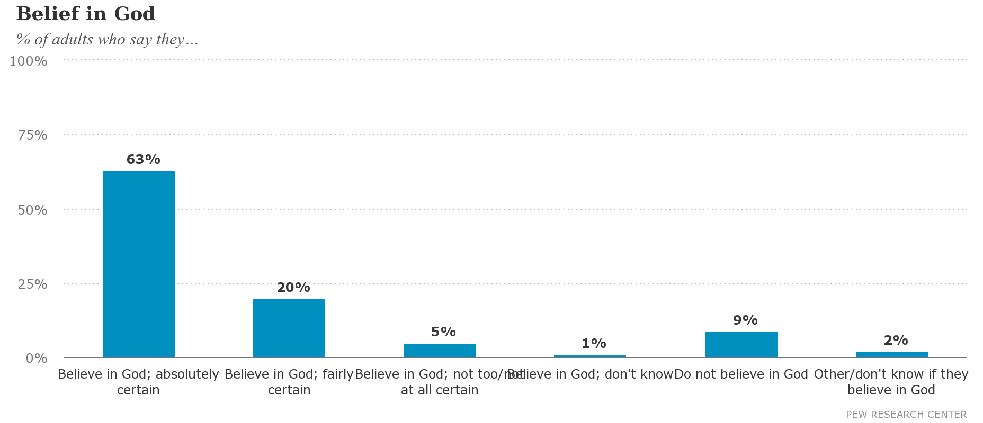
Pew Research Center 2014
Notes:
83% believers
?

Slide 45
There are no atheists in foxholes.
Supported and refuted.
In any case, that type of crisis faith is NOT what G-d wants in us. Not a first principle
Can be a starter.

Slide 46
Rather: ^{MJ 11.6} Now without faith it is impossible to please God. For the one who comes to God must believe that He exists and that He is a rewarder of those who seek Him.

Slide 47
So we seek Him, trusting that He is there to respond.

Slide 48
Jewish view of the Ten Commandments / Ten Words
^{Shmot/ Ex 20.2 א} I am Adoni your God, who brought you out of the land of Egypt, out of the abode of slavery.
3^{ב} You are to have no other gods before me. CJB
Notes:
Maimonides, the 1100’s Spain and N Africa doctor to the Sultan, Rabbi, commentator, astronomer, said faith in G-d is the First Commandment.

Slide 49
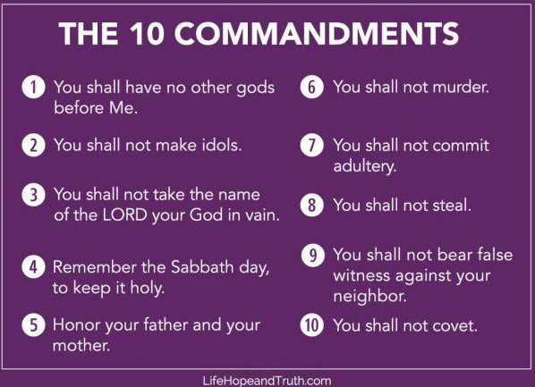
Notes:
Typical Christian construct, skips #1, and #2 divided into two.
Entirely possible to be a synagogue attender or church attender without believing in G-d. Niece Shira’s Bat Mitzvah during opening singing of the Psalms, Psukei d’zimra.
So, how are we different from the P’rushim?

Slide 50
Consider the subgroups of Judaism in Messiah’s day.
Tskukim / Sadducees: Believed in G-d, not in the soul afterlife, resurrection, final judgment.
P’rushim / Pharisees: repentance, resurrection, final judgment.
Notes:
Are we like the P’rushim? In some ways.

Slide 51
^{MJ 6.1} The foundation of ₁turning from works that lead to death, ₂trusting God

Slide 52
epi: on, upon
Orig Word: ἐπί (ep-ee’)
Usage: on, to, against, on the basis of, at
Faith on G-d

Slide 53
Faith on G-d >> Faith in G-d
Relying on, building on, confidence, depending on
^{MJ 11.8} By trusting, Avraham obeyed, after being called to go out to a place which God would give him as a possession; indeed, he went out without knowing where he was going.

Slide 54
Confident belief that G-d exists and that He interacts with us in blessings for obedience, and curses/withdrawal for disobedience.
Theism vs Deism
Illustration from Day of Discovery:

Slide 55
Guy late for business meeting. Looking for parking place. Panicking. Promises G-d if he finds parking place, he’ll go to shul every Friday. Parking place immediately opened.

Slide 56
“Never mind G-d, I found one”

Slide 57
Faith on Messiah is a whole new level from the rest of Israel.
Greater than mental assertion that G-d exists as One. Sadducces.
Greater than Kingdom expectation of the Essenes.
Greater than eternal judgment of the P’rushim

Slide 58
^{Ro 8.15-17} For you did not receive a spirit of slavery to bring you back again into fear; on the contrary, you received the Spirit, who makes us sons and by whose power we cry out, “Abba!” (that is, “Dear Father!”).

Slide 59
^{Ro 8.15-17} The Spirit himself bears witness with our own spirits that we are children of God; and if we are children, then we are also heirs, heirs of God and joint-heirs with the Messiah — provided we are suffering with him in order also to be glorified with him.
Notes:
Do you have a 100% inner assurance that if you died now, and stood before G-d, you would be accepted?
On what basis?
Suffering is not extraneous, surprising to the faith. Intrinsic. Love suffers long.

Slide 60
^{1 Kefa/P 1.8-9} Though you have not seen Him, you love Him. And even though you don’t see Him now, you trust Him and are filled with a joy that is glorious beyond words, receiving the outcome of your faith—the salvation of your souls.

Slide 61
^{Mtt 17.20-21} I tell you that if you have trust as tiny as a mustard seed, you will be able to say to this mountain, ‘Move from here to there!’ and it will move; indeed, nothing will be impossible for you! But this kind does not go out except through prayer and fasting.””

Slide 62
^{Mtt.6.28-30} Why do you worry about clothing? Consider the lilies of the field, how they grow. They neither toil nor spin. Yet I tell you that not even Solomon in all his glory clothed himself like one of these.

Slide 63
^{Mtt.6.28-30} Now if in this way God clothes the grass—which is here today and thrown into the furnace tomorrow — will He not much more clothe you, O you of little faith?

Slide 64
So faith in the Jewish Messiah brings joy, confidence over adversaries, rest, even “in the valley of the shadow of death.”

Slide 65
Messianic faith relative to normative Judaism is faith on fire. Experiential. Still faith.

Slide 66
Kabbala is to Judaism as
Zen is to Buddhism
Zen is a shortcut to nirvana ~kabbala is a personal experience of the transcendent, without atonement.
The Spirit of Yeshua is the bona fide, the real [Jewish] way to experience G-d.

Slide 67
Even with strong revelation, faith is required to walk it out.

Slide 68
^{Acts 27.23-26} For this very night, there stood next to me an angel of the God to whom I belong and whom I serve. He said, ‘Don’t be afraid, Sha’ul! you have to stand before the Emperor. Look! God has granted you all those who are sailing with you
Notes:
14 days fasting, 276 people on the ship

Slide 69
^{Acts 27.23-26} So, men, take heart! For I trust God and believe that what I have been told will come true. Nevertheless, we have to run aground on some island.”
Shaul/Paul made a choice.
14 days fasting, 276 people on the ship

Slide 70
Faith affects money issues too.
Or HaOlam rejected the CARES Act $ so as not to participate in the $23 trillion national dept, no $26 trillion.
We TRUSTED that G-d would keep our people, and they would keep supporting.

Slide 71
^{Malakhi 3. 10-12} Bring the whole tenth into the storehouse, so that there will be food in my house, and put me to the test,” says Adonai-Tzva’ot. “See if I won’t open for you the floodgates of heaven and pour out for you a blessing far beyond your needs.

Slide 72
^{Malakhi 3. 10-12} For your sakes I will forbid the devourer to destroy the yield from your soil; and your vine will not lose its fruit before harvest-time,” says Adonai-Tzva’ot. “All nations will call you happy, for you will be a land of delights,” says Adonai-Tzva’ot.

Slide 73
^{1 Cor.9.13-14} Don’t you know that those who serve in the temple get their food from the temple, and that those who serve at the altar share in what is offered on the altar? In the same way, the Lord has commanded that those who preach the gospel should receive their living from the gospel.

Slide 74
Why is our culture apparently on the Eve of Destruction.
Where is “Where is Adoni, the God of Eliyahu?”
First Principles of LIFE.
Repentance and faith in the sustaining love of G-d. Lambert’s wonderful message.

Slide 75
אמונהEmunah, Active Faith, that everything that happens has a divine, ultimately wonderful purpose.
Notes:
Every stress, anxiety, difficulty, hindrance, disease, distress, dysfunction, antagonism

Slide 76
Levels of living faith.
אֱמוּנָה Emunah
faith, trust, confidence
Active faith.

Slide 77
Basic level Emuna: firm belief that EVERYTHING comes from Adoni by way of perfect Divine providence. No secondary causes.
Intermediate level: belief that everything that comes from Adoni is for the very best. All troubles have their purpose. Therefore PRAISE. Without understanding the purpose.
Notes:
Like holiness. We accept G-d goodness, and praise. We fall before His Holiness. We praise ALL His works. ALL.
We talk about Sozo ministry, which involves finding the lies about life and G-d that we’ve received, renouncing, and asking G-d for revelation of truth.
This is group generalized Sozo, כי the basic lie is that life/G-d is mean, against us.
We commit to praise in everything. Even the consequences of our and others failures. Still in His hands.

Slide 78
Upper level: Belief that our joyful task is to discern the message to us in EVERY trouble. Then repent as needed, and pray for the change.
Notes:
Message NOT = punishment. Iyov/Job was not punished, but called to go higher. Tho He slay me, yet will I trust Him.
Ester had some level of this and determined to use her position in the court for G-d.

Slide 79
^{Yoel 1.2, 2.12-16} “Hear this, you leaders! Listen, all who live in the land! Has anything like this ever happened in your days, or in your ancestors’ days? “Yet even now,” says Adoni , “turn to me with all your heart, with fasting, weeping and lamenting.” Tear your heart, not your garments; and turn to Adoni your God.

Slide 80
^{Yoel 1.2, 2.12-16}
“Blow the shofar in Tziyon! Proclaim a holy fast, call for a solemn assembly.” Gather the people; consecrate the congregation.

Slide 81
From Sept. 8 to Yom Kippur, Sept 28, we will have nightly services. We are looking for leaders to take one night in the three weeks.
May G-d have pity on His people as we seek Him!

Slide 83
