Slide 1
e-handout
To have these notes
without taking notes
Go to OrHaOlam.com
Click on downloads,
messages, 2021

Slide 2
For sagging spirits and uncertainties:

Slide 3
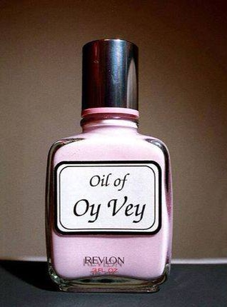
For sagging spirits and uncertainties:

Slide 4
40 days of life report: Nationwide, at least 394 babies have been saved from abortion so far in this fall campaign!

Slide 5
Annie Fowler, OP Director
40 Days of Life

Slide 6
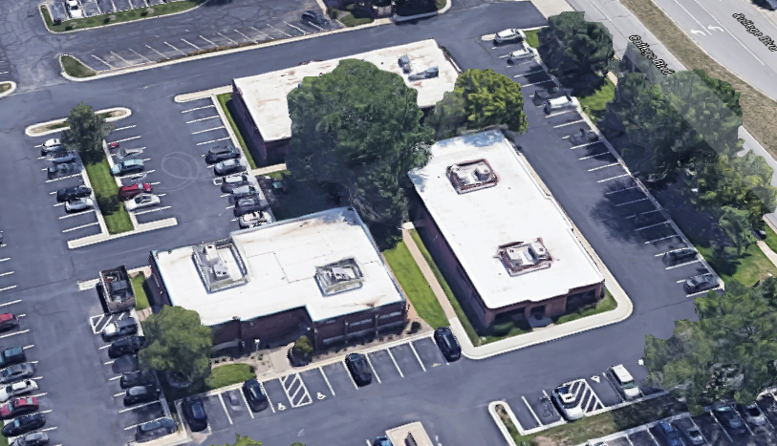
Center for Women’s Health

Slide 7
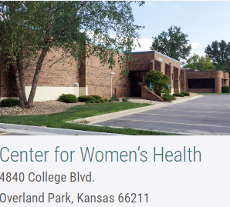

Slide 8
Annie in Overland Park, Kansas noticed a woman outside the abortion facility.
The mom appeared conflicted about going through with her abortion appointment, so Annie beckoned her over.
Notes:
Using several of our protest signs in sequence, she told me

Slide 9
"I invited her to have breakfast with me," Annie said. The mother accepted the invitation, and near the end of their meal together, Annie issued another invitation: would the expectant mother like to get a free ultrasound at the local pregnancy resource center?

Slide 10
"I called ahead...and then took her in for a sonogram while I waited in the waiting room," Annie shared. "I was blessed to see the beautiful sonogram images. Her amazing baby is 14 weeks and 3 days old. She CHOSE LIFE!"

Slide 11
The Book of the Prophet Isaiah/ Yeshayahu
Notes:
The whole thing? Just some verses from ch 60, but context
Within the series on Messianic Jews/Hebrews…

Slide 12
The Book of the Prophet Isaiah/ Yeshayahu
Ch 1-35 Conditions and Events in the time of Isaiah
Ch 39-39 Historical Record
Ch 40-66 Israel’s end time exaltation

Slide 13
The Book of the Prophet Isaiah/ Yeshayahu
Ch 1-35 Conditions and Events in the time of Isaiah
Ch 39-39 Historical Record
Ch 40-66 Israel’s end time exaltation
Notes:
Last week, Tommy Waller presented HaYovel, within that third section, Isaiah 61.5:

Slide 14
^{Yeshayahu/Is 61.5} Children of foreigners will be your plowmen and vinedressers.

Slide 16
Chapter 60 takes it to an even higher level.
Five verses of ch 60 set to music by Messianic Jewish Alliance of Israel
young adults
Notes:
https://www.mjai.co.il/about/
https://www.youtube.com/channel/UCmAoGcWAVvMR6iUIdUg-R2g

Slide 17
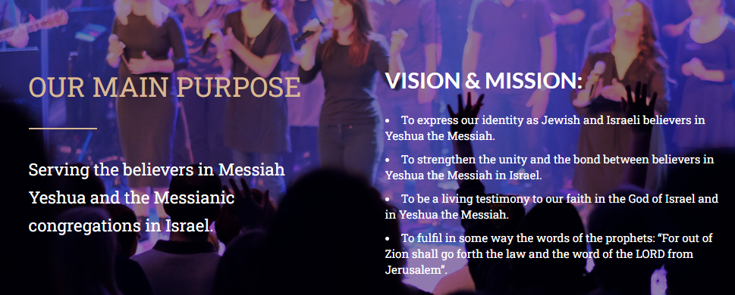
Notes:
Bergita Vexler, Irena, Sarah Liberman, Sheli Myers
https://www.mjai.co.il/about/
https://www.facebook.com/mjai.co.il/

Slide 19
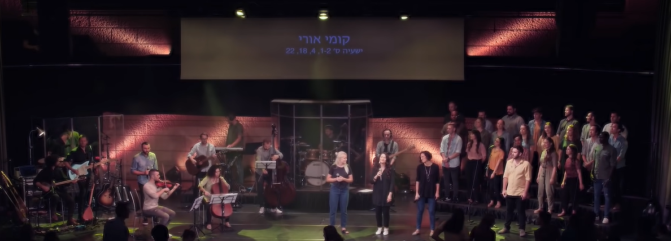
Kumi Ori Sheli Myers ק֥וּמִי א֖וֹרִי
Yeshayahu / Is 60.1-2, 4, 18, 22
https://youtu.be/SuDmwjT3q9w
https://lyricstranslate.com

Slide 20
^{Yeshayahu/Is 60.1} Rise up, shine forth,
For, your Light has come.
Shekhinah of Messiah in splendor has dawned.

Slide 21
^{Yeshayahu/Is 60.2} See how darkness covers the earth
And the nations in depth of night
But Adoni in splendor will dawn on you.
And His glory, and His glory on you will appear.

Slide 22
^{Yeshayahu/Is 60.18} No more will violence sound in your land
Blasts nor looting on your grounds
You will call your walls salvation
And your gates,
Praise will declare.

Slide 23
^{Yeshayahu/Is 60.22} The smallest one will become like a thousand
And the least like a nation of might.
I’m Adoni, in its time I’ll accelerate.
In its time, in its time
I’ll accelerate.

Slide 24
^{Yeshayahu/Is 60.4} Lift your eyes round about, and see them all
Gathered to you your sons come from very far away.

Slide 26
Outline of this message on Is 60:
[1-2] Glory in spite of darkness
[v 18, 22] Safety and security
[v 4] Children restored.

Slide 27
Outline of this message on Is 60:
[1-2] Glory in spite of darkness
[v 18, 22] Safety and security
[v 4] Children restored.

Slide 29
קוּמִי אוֹרִי כִּי בָא אוֹרֵךְ
Kumi ori, ki va orekh
Rise up, shine forth,
For, your Light has come.
Notes:
The light has come! We didn’t cause it. We didn’t make it, we didn’t earn it. But the light has come.

Slide 30
וּכְבוֹד יְיָ עָלַיִךְ זָרָח׃
Ukh-vod Adoni aliyikh zarakh
Shekhinah of Messiah in splendor has dawned.
Notes:
Zarakh ~ sunrise
Revelation of His redemption, His resurrection.
My “liquid love” experience in Schenectady NY April 1969

Slide 31
^{2 Cor 4.6} For it is the God who once said, “Let light shine out of darkness,” who has made his light shine in our hearts, the light of the knowledge of God’s glory shining in the face of the Messiah Yeshua.

Slide 32
^{Mtt. 4.13-13} Leaving Natzeret, He came and settled in Capernaum…This was to fulfill what was spoken through Isaiah the prophet, saying … the people sitting in darkness have seen a great light, and those sitting in the region and shadow of death, on them a light has dawned.”

Slide 33
^{Acts 22.6-7} [Paul/Shaul] “As I was traveling and approaching Dammesek, around noon, suddenly a brilliant light from heaven flashed all around me! I fell to the ground…
Notes:
The light has come! We didn’t cause it. We didn’t make it, we didn’t earn it. But the light has come.

Slide 34
Is it conditional at all?

Slide 35
קוּמִי אוֹרִי כִּי בָא אוֹרֵךְ
Kumi ori, ki va orekh
Rise up, shine forth,
For, your Light has come.
Notes:
How to we arise?
Action of faith and repentance:
Rise up: out of despair, worry, fear, evil habits, irritation, self dependence. “Take up your bed [mat] and walk.” Love, joy, peace, gratefulness for irritations, dishonor, forgiveness, re anger, bitterness at family, friends.
^{1 Kefa/P 5.6-7} Therefore, humble yourselves under the mighty hand of God, so that at the right time he may lift you up. Throw all your anxieties upon him, because he cares about you.

Slide 36
^{Mtt 17.20} He said to them, “Because you have such little trust! Yes! I tell you that if you have trust as tiny as a mustard seed, you will be able to say to this mountain, ‘Move from here to there!’ and it will move; indeed, nothing will be impossible for you!

Slide 37
קוּמִי אוֹרִי כִּי בָא אוֹרֵךְ
Kumi ori, ki va orekh
Rise up, shine forth,
For, your Light has come.
Notes:
How to we arise?
faith and repentance
Pause for mid-message invitation

Slide 38
הִנֵּה הַחֹשֶׁךְ יְכַסֶּה־אֶרֶץ
Henay hakhoshekh y’khaseh erets
See how darkness covers the earth

Slide 39
וַֽעֲרָפֶ֖ל לְאֻמִּ֑ים
V’arafel l’umim
And the nations in depth of night
Notes:
Darkness of grief. Easy to be obsessed with grief, or anger.
The world culture is in DEEP darkness…

Slide 40
A boy in a skirt entered a girl’s bathroom and raped a girl in Loudoun County, Virginia.
The father was charged with disturbing the peace in the school board meeting.
Notes:
https://nypost.com/2021/10/22/loudoun-county-school-boss-scott-ziegler-knew-of-alleged-sex-assault-report/

Slide 41
Dr. Deborah Nucatola has been senior director of medical services at Planned Parenthood since February 2009, where she oversees medical practices at all Planned Parenthood affiliates nationwide. She has been employed by Planned Parenthood for more than a decade. She also performs abortions up to 24 weeks in Los Angeles.
Notes:
Tue Jul 14, 2015
https://www.lifesitenews.com/news/undercover-video-planned-parenthood-uses-illegal-partial-birth-abortions-to/

Slide 42
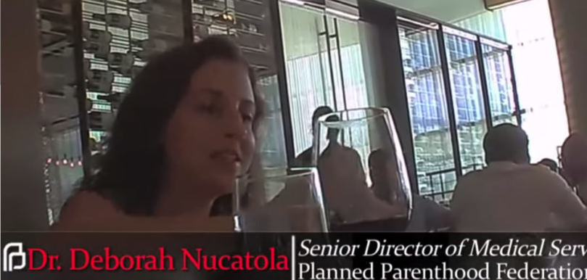

Slide 43
In the video, she met with investigators posing as buyers from a human biologics company on July 25, 2014.
Notes:
https://www.lifesitenews.com/news/undercover-video-planned-parenthood-uses-illegal-partial-birth-abortions-to/

Slide 44
While casually sipping wine and eating salad, Dr. Nucatola revealed that she charges $30 to $100 per specimen, and that fetal livers are especially in demand – although “a lot of people want intact hearts these days,” and she has had requests for lungs and “lower extremities.”
Notes:
https://www.lifesitenews.com/news/undercover-video-planned-parenthood-uses-illegal-partial-birth-abortions-to/

Slide 45
Notes:
https://www.youtube.com/watch?v=DH_gU50LD6o
Till 3.02

Slide 46
הִנֵּה הַחֹשֶׁךְ יְכַסֶּה־אֶרֶץ
Henay hakhoshekh y’khaseh erets
See how darkness covers the earth
Notes:
State Dept issues an International Day of Pronouns.

Slide 47
וַֽעֲרָפֶ֖ל לְאֻמִּ֑ים
V’arafel l’umim
And the nations in depth of night
Notes:
.

Slide 48
וְעָלַיִךְ יִזְרַח יְיָ
V’alayikh yizrakh Adoni
But Adoni in splendor will dawn on you.
Notes:
Word “zarakh” again.

Slide 49
וּכְבוֹדוֹ וּכְבוֹדוֹ עָלַיִךְ יֵֽרָאֶֽה
Ukhvodo ukhvodo alayikh yaraeh
And His glory, and His glory on you will appear.
Notes:
The world culture may be dark, but on you and me…His light!
His glory changes every perspective. Relativism in morality, a little lying, cheating, lust, becomes NOT little.

Slide 50
קוּמִי אוֹרִי כִּי בָא אוֹרֵךְ
Kumi ori, ki va orekh
Rise up, shine forth,
For, your Light has come.
Notes:
^{1 Kefa/Pet 5.6-77} Therefore humble yourselves under the mighty hand of God, so that He may lift you up at the appropriate time. Cast all your worries on Him,^{[c]} for He cares for you.

Slide 51
וּכְבוֹד יְיָ וּכְבוֹד יְיָ עָלַיִךְ זָרָח׃
Ukh-vod Adoni Ukh-vod Adoni aliyikh zarakh
Shekhinah of Messiah in splendor has dawned.

Slide 53
Outline of this message on Is 60:
[1-2] Glory in spite of darkness
[v 18, 22] Safety and security
[v 4] Children restored.

Slide 54
לֹֽא־יִשָּׁמַע עוֹד חָמָס בְּאַרְצֵךְ
Lo yishama od khamas b’artekh
No more will violence sound in your land
Notes:
Jews have tooooo much history with violence in our land…

Slide 55
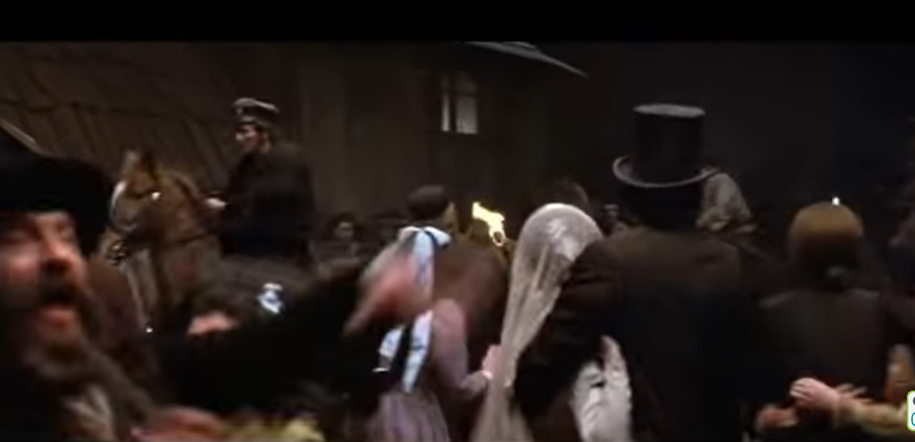
Fiddler on the Roof pogrom
Notes:
https://www.youtube.com/watch?v=YgrLO7Mr1xA

Slide 56
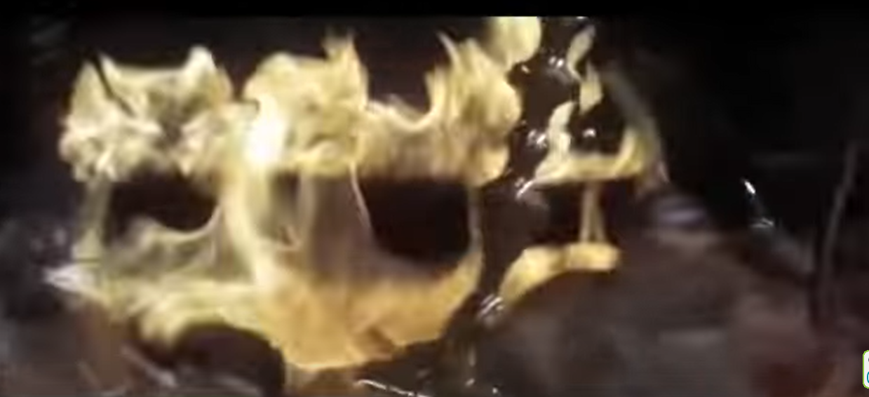
Notes:
https://www.youtube.com/watch?v=YgrLO7Mr1xA

Slide 57
שֹׁד וָשֶׁבֶר בִּגְבוּלָיִךְ
Shod vashehver big’vulayikh
Blasts nor looting on your grounds
Notes:
Bus bombing or broken estranged families.

Slide 58
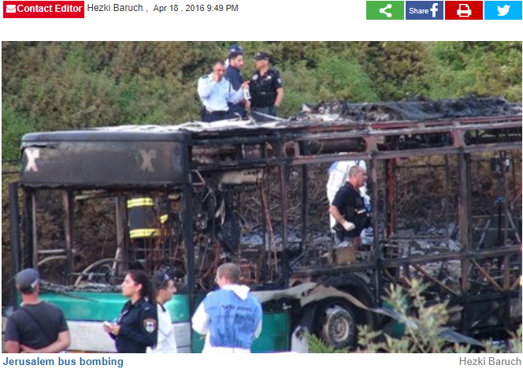
2016 Jeru-salem
Notes:
Also family disruption: estranged children, spouses

Slide 59
וְקָרָאת יְשׁוּעָה חֽוֹמֹתַיִךְ
V’karat y’shuah khomotayikh
You will call your walls salvation
Notes:
Walls are not barriers to pleasure, they are guardrails to JOY. Torah is joy! No more shrimp and lobster sauce ki joy. Holidays: 10 in Sept + outreach.
Purity, celibacy increases marital joy. Save your kisses for your Mrs, then they will be most delicious.
Greatest loss is when condemnation kicks in.
All rabbinics fit in the Messianic world in THIS context. Ways of joy.

Slide 60
וּשְׁעָרַיִךְ שְׁעָרַיִךְ תְּהִלָּֽה
U-sh’arayikh sh’arayikh t’hilah
And your gates
And your gates
Praise will declare.
Notes:
Gates will be praiseful, NOT condemning. Joyful entrance into Kingdom.

Slide 61
קוּמִי אוֹרִי כִּי בָא אוֹרֵךְ
Kumi ori, ki va orekh
Rise up, shine forth,
For, your Light has come.

Slide 62
וּכְבוֹד יְיָ וּכְבוֹד יְיָ עָלַיִךְ זָרָח׃
Ukh-vod Adoni Ukh-vod Adoni aliyikh zarakh
Shekhinah of Messiah in splendor has dawned.

Slide 63
הַקָּטֹן יִֽהְיֶה לָאֶלֶף
Hakaton yhiyeh la-elef
The smallest one like a thousand
Notes:
We are small. Maybe smallest of the synagogues in the KC Metro. Buildings, resources, liturgical skill best of us limited. Yet, when Messianics sing the beautiful Kedusha, we have a special sense of the brightness.

Slide 64
וְהַצָּעִיר לְגוֹי עָצוּם
V’hatsa-ir l’goy atsum
And the least like a nation of might.

Slide 65
אֲנִי יְיָ בְּעִתָּהּ אֲחִישֶֽׁנָּה
Ani Adoni b’itah akhishenah
I am Adoni, in its time I’ll accelerate.
Notes:
^{Lk 18.7-8} Won’t God do justice for His chosen ones, who cry out to Him day and night? Will He be slow to help them? I tell you, He will quickly give them justice.
Cry day and night. Some don’t like the IHOPKC 24/7 prayer room. I admire it.
We don’t have that stellar of a turn out for Teerosh Tuesday prayer, but the Spirit is there and there are faithful warriors. But, this verse says that G-d will accelerate His redemption in response to our prayer. I urge you to join us for Teerosh.

Slide 66
בְּעִתָּהּ בְּעִתָּהּ אֲחִישֶֽׁנָּה
B’itah b’itah akhishenah
In its time I’ll accelerate.

Slide 67
קוּמִי אוֹרִי כִּי בָא אוֹרֵךְ
Kumi ori, ki va orekh
Rise up, shine forth,
For, your Light has come.
Notes:
3.09

Slide 68
וּכְבוֹד יְיָ וּכְבוֹד יְיָ עָלַיִךְ זָרָח׃
Ukh-vod Adoni Ukh-vod Adoni aliyikh zarakh
Shekhinah of Messiah in splendor has dawned.

Slide 69
וּכְבוֹד יְיָ וּכְבוֹד יְיָ עָלַיִךְ זָרָח׃
Ukh-vod Adoni Ukh-vod Adoni aliyikh zarakh
Shekhinah of Messiah in splendor has dawned.

Slide 72
Outline of this message on Is 60:
[1-2] Glory in spite of darkness
[v 18, 22] Safety and security
[v 4] Children restored.

Slide 73
שְׂאִֽי־סָבִיב עֵינַיִךְ וּרְאִי כֻּלָּם
S’ee saviv e-ni-ikh ur’ee kulam
Lift your eyes round about, and see them all

Slide 74
נִקְבְּצוּ בָֽאוּ־לָךְ בָּנַיִךְ מֵֽרָחוֹק
Nikbitsu va-u lakh banayikh merakhok
Gathered to you, your sons come, from very far away.
Notes:
Gathered, same root as kibbutz, the communal farms. Some of our children may be in a reflection of this verb. Communal economy = socialism.
Verb in passive, nifal form. When we can’t reach our children…they WILL be reached.
From very far away: some of our kids Bible deniers, BLM, humanism, so many ways of diverging from the faith. In the 70’s similar, unexpected revival. Bold.

Slide 75
שְׂאִֽי־סָבִיב עֵינַיִךְ וּרְאִי כֻּלָּם
S’ee saviv e-ni-ikh ur’ee kulam
Lift your eyes round about, and see them all
Notes:
Lift your eyes…so easy to be distressed. Trouble, opposition.

Slide 76
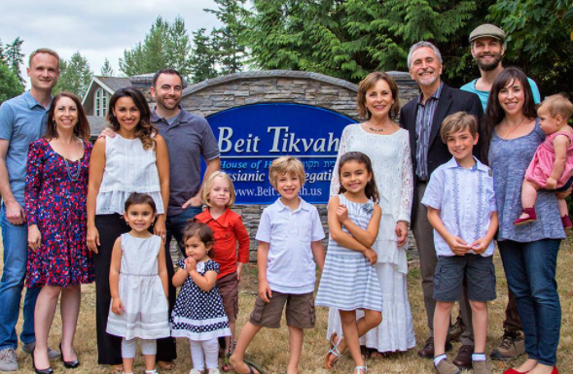
Rabbi Hylan & Rita Slobodkin
Notes:
Hylan Slobodkin and family, all believers.
Hylan says he’s experiencing renewal like the 1970’s. Immersing/baptizing new believers!
Shared with me a report…

Slide 77
Mario Murillo, Oct 7, 2021,
Batavia, NY
Over 3,500 people engulfed the tent. There were as many outside as inside. 500 came to Messiah. The congregations vow to carry the fire.
Notes:
https://mariomurillo.org/2021/10/07/the-dawn-of-a-movement/

Slide 78
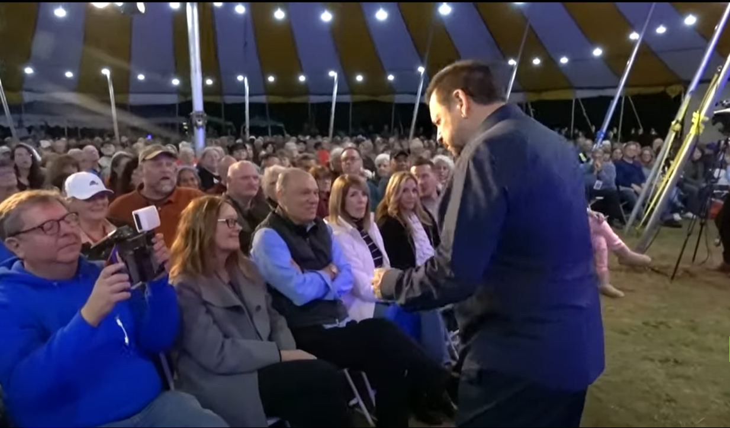

Slide 79
If you ask anyone who was there, “Will the flames and fire of God die down after this week?”
They will give you a strange stare. Then suggest to them that what has happened over these past four nights is not real, and they will burst out laughing.
Notes:
https://mariomurillo.org/2021/10/07/the-dawn-of-a-movement/

Slide 80
Go ahead and ask them to define these past four days. You will not hear them call this just a ‘good crusade.’ They will not tell you these were ‘wonderful services.’ No, they will tell you with firm conviction, “THIS IS THE DAWN OF A MOVEMENT!”
Notes:
https://mariomurillo.org/2021/10/07/the-dawn-of-a-movement/

Slide 83
Rise up, shine forth,
For, your Light has come.
Shekhinah of Messiah in splendor has dawned.

Slide 84
See how darkness covers the earth
And the nations in depth of night
But Adoni in splendor will dawn on you.
And His glory, and His glory on you will appear.

Slide 85
No more will violence sound in your land
Blasts nor looting on your grounds
You will call your walls salvation
And your gates, and your gates
Praise will declare.

Slide 86
The smallest one will become like a thousand
And the least like a nation of might.
I’m Adoni, in its time I’ll accelerate.
In its time, in its time
I’ll accelerate.

Slide 87
Lift your eyes round about, and see them all
Gathered to you your sons come from very far away.

Slide 88
Do you KNOW Yeshua and the assurance of sins forgiven?
Are you hearing daily from His Word?
How are you applying what you heard?
Are you asking this of another?
Notes:
Who are you discipling, building up?4

