Slide 1
e-handout
To have these notes
without taking notes
Go to OrHaOlam.com
Click on downloads,
messages, 2021

Slide 2
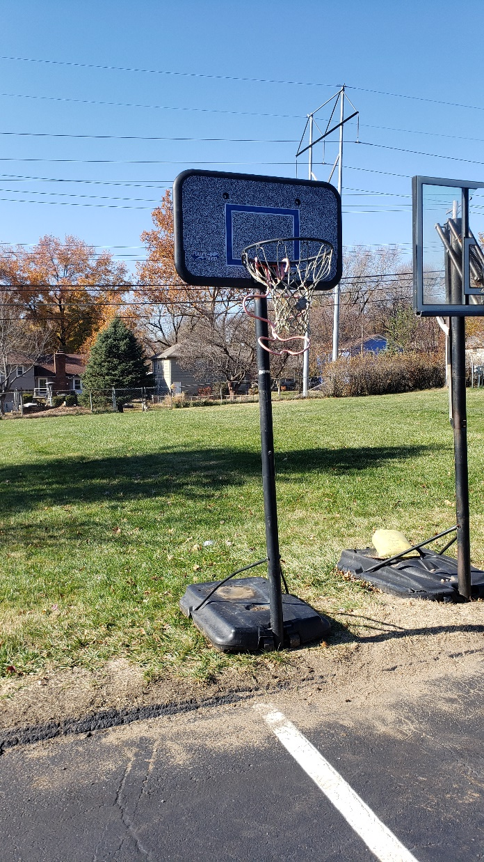
Basketball backboard donated to us by the homeschool network facilitated by our backyard neighbors to the north: Ryan and Rachel Schmidt.

Slide 3
There are many things in life that can only happen once.
Birth.

Slide 4
There are many things in life that can only happen once.
Birth.
First solo bike ride.

Slide 5
There are many things in life that can only happen once.
Birth.
First solo bike ride.
First kiss.

Slide 6
There are many things in life that can only happen once.
Birth.
First solo bike ride.
First kiss.
First marriage.

Slide 7
There are many things in life that can only happen once.
Birth.
First solo bike ride.
First kiss.
First marriage.
Death.

Slide 8
There are some things in history that only happen once.
Creation
Notes:
Important because there is are other views in Jewish and worldly thought.
Creation: evolution, long day short day

Slide 9
There are some things in history that only happen once.
Creation
Atonement
Notes:
Important because there is are other views in Jewish and worldly thought.
Creation: evolution, long day short day
Atonement: every year on YK, or once?

Slide 10
There are some things in history that only happen once.
Creation
Atonement
Judgment
Notes:
Important because there is are other views in Jewish and worldly thought.
Creation: evolution, long day short day
Atonement: every year on YK, or once?
Judgment: every year on RH to YK, or once?

Slide 11
There are some things in history that only happen once.
Creation
Atonement
Judgment
Opportunity
Notes:
Important because there is are other views in Jewish and worldly thought.
Creation: evolution, long day short day
Atonement: every year on YK, or once?
Judgment: every year on RH to YK, or once?
Opportunity: application

Slide 13
Hebrew/Messianic Jews MJ 9.26-28 But as it is, he has appeared once at the end of the ages in order to do away with sin through the sacrifice of himself. Just as human beings have to die once, but after this comes judgment,
Notes:
“As” implies logical connection.

Slide 14
Hebrew/Messianic Jews MJ 9.26-28 so also the Messiah, having been offered once to bear the sins of many, will appear a second time, not to deal with sin, but to deliver those who are eagerly waiting for him.
Notes:
There is as ONCE connection

Slide 15
Once, what? Outline
Rabbinic rule of exposition “heavy and light” kal vakhomer
Application in these vss to life, death & judgment, atonement.
Application to opportunity, Hanukkah like opportunity!
Notes:
Yes, this is a Hanukkah message, I didn’t forget.

Slide 16
Once, what? Outline
Rabbinic rule of exposition “heavy and light” kal vakhomer
Application in theses vss to life, death & judgment, atonement.
Application to opportunity, Hanukkah like opportunity!

Slide 17
The first rule of Hillel and of Rabbi Ishmael of Bible exposition is קַל וָחֹומֶר"kal va-khomer" heavy and light, known in Latin as an argument a fortiori, meaning “from the stronger case.”
Notes:
https://en.wikipedia.org/wiki/Talmudical_hermeneutics#Kal_va-chomer_(%D7%A7%D7%9C_%D7%95%D7%97%D7%95%D7%9E%D7%A8)

Slide 18
An example of an argument kal va-khomer, a fortiori, is “Arnold is known to be stronger than Barack. If Barack can lift 100 lbs., a fortiori Arnold can lift 100 lbs.”
Notes:
https://en.wikipedia.org/wiki/Talmudical_hermeneutics#Kal_va-chomer_(%D7%A7%D7%9C_%D7%95%D7%97%D7%95%D7%9E%D7%A8)
https://outorah.org/p/6495

Slide 19
The Torah itself gives us a perfect example of a kal vakhomer. In Numbers 22:14, after reprimanding Miriam, God sent her out of the camp for a week. Moshe asked for clemency for his sister but God replied, “If her father had spit in her face,
Notes:
https://outorah.org/p/6495

Slide 20
wouldn’t she hide her face in shame for seven days?” If she would hide for a week after being chastised by her father, kal v’chomer she should leave the camp for a week after being chastised by God. [Light and heavy.]
Notes:
https://outorah.org/p/6495

Slide 22
Once what?
Rabbinic rule of exposition “heavy and light” kal vakhomer
Apply this to our text in MJ/Hebrews.

Slide 23
Hebrew/Messianic Jews MJ 9.26-28 But as it is, he has appeared once at the end of the ages in order to do away with sin through the sacrifice of himself. Just as human beings have to die once, but after this comes judgment,
Notes:
Light, only in the sense of easy to prove.
Messiah appeared just at the right time to fulfill ALL the prophecies about Him.
Messiah had the unique character purity to be our sin-free sacrifice.
Messiah rose from the dead to guarantee our redemption.

Slide 24
Hebrew/Messianic Jews MJ 9.26-28 so also the Messiah, having been offered once to bear the sins of many, will appear a second time, not to deal with sin, but to deliver those who are eagerly waiting for him.
Notes:
There is as ONCE connection

Slide 25
Yeshua lived and atoned ONCE.
Humans die ONCE, then judgment.
Therefore, Messiah’s atonement is ONCE and final, and His return is ONCE and final.
Notes:
Once that we know of. Not being repeated.

Slide 26
This is the also Bible's refutation of the concept of reincarnation which is based on the notion that although the body is obviously mortal, the soul is not; so that after one's body dies, the soul that was in it migrates, perhaps after an interval of time, to another body
Notes:
https://kifakz.github.io/eng/bible/stern/stern_evreyam_09.html

Slide 27
for purification, gaining experience or working out "karma." In Hinduism and Buddhism, karma is the spiritual force which attaches to a person's soul as a result of the ethical consequences of his actions.
Notes:
https://kifakz.github.io/eng/bible/stern/stern_evreyam_09.html

Slide 28
This is the also Bible's refutation of the concept of multiple judgements. For example, in Talmudic tractate [subdivision] Rosh HaShanah 1.2 “on Rosh HaShana, all creatures pass before Him like sheep, as it is stated: ^{Psalms 33:15} ‘He Who fashions their hearts alike, Who considers all their deeds.’” Yearly judgement?
Notes:
https://www.sefaria.org/Mishnah_Rosh_Hashanah.1.2?lang=bi&with=About&lang2=en

Slide 29
^{T’hillim/Ps 33.13-15} Adoni looks down from heaven. He observes all humanity. From His dwelling place He gazes on all the inhabitants of the earth — He who fashions the hearts of all,
who discerns all their deeds.

Slide 30
So, therefore, kal vakhomer,
Yeshua lived and atoned ONCE.
Humans die ONCE, then judgment.
Therefore, Messiah’s atonement is ONCE and final, and His return is ONCE and final.
Notes:
Once that we know of. Not being repeated.
This is a pause point, to celebrate and receive!
Two thousand years ago, 6590 miles away, 14 hours flight time, our redemption, salvation, deliverance from sin, guilt, death was procured. Have we received His salvation?
Are we walking in the power of His resurrection?
Pause for self examination.
We have a one time, unique for our day, Hanukkah opportunity.

Slide 32
Once what?
Rabbinic rule of exposition “heavy and light” kal vakhomer
Application to life, death & judgment, atonement.
Application to opportunity, Hanukkah like opportunity!

Slide 33
Is there a once in history opportunity? [Once/generation]
^{Shmot /Ex 17.16} Then he said, “By the hand upon the throne of Adonai, Adonai will have war with Amalek in every to generation.”
But it appears there is THE opportunity for this generation.
Notes:
In a sense, there is a continual opportunity, but what about us, now??

Slide 34
^{Ester 4.14} For if you fail to speak up now, relief and deliverance will come to the Jews from a different direction; but you and your father’s family will perish. Who knows whether you didn’t come into your royal position precisely for such a time as this.”

Slide 35
^{Mishlei/Prov 24. 10-12} If you falter in a day of adversity, your strength is small. Rescue those being dragged off to death, hold back those stumbling to slaughter. If you say, “Look, we didn’t know this.”

Slide 36
^{Mishlei/Prov 24. 10-12} Won’t He who weighs hearts perceive it? Won’t He who guards your soul know it? Won’t He repay each one according to his deeds?

Slide 37
What is Hanukkah about?
Dedication
in the face of adversity!
In the face of genocidal adversity.
The unique opportune time in each generation.

Slide 38
This is OUR opportunity to stand, as the Maccabees.
You may only get ONE opportunity to face your adversity.

Slide 39
George Washington became acquainted with the spirit of the Maccabees, upon settling, in December (Hanukkah) 1777, at his new headquarters at Valley Forge, Penn., with ill-equipped, weary troops. Faced with a superpower, George III of Britain,
Notes:
https://www.chabad.org/kabbalah/article_cdo/aid/3874565/jewish/Judah-Maccabee-at-West-Point.htm

Slide 40
Washington concluded that only a dramatic change could avoid a defeat. According to the diary entries of Louisa Hart, Washington told the Harts about a Jewish solider at Valley Forge who lit a Chanukah candle and explained its significance.
Notes:
https://www.chabad.org/kabbalah/article_cdo/aid/3874565/jewish/Judah-Maccabee-at-West-Point.htm

Slide 41
Washington's reaction was: "Perhaps we are not as lost as our enemies would have us believe. I rejoice in the Maccabees' success, though it is long past ... It pleases me to think that miracles still happen."
Notes:
https://www.chabad.org/kabbalah/article_cdo/aid/3874565/jewish/Judah-Maccabee-at-West-Point.htm

Slide 42
Six months later, on June 19, 1778, the Continental Army implemented the battle tactics of Judah the Maccabee, leaving Valley Forge in pursuit of the British, who were moving toward New York. Although the war would linger for five more years, Washington won a decisive victory.

Slide 43
The statue of Judah the Maccabee, the hero of the Jewish rebellion against the Syrian-Seleucid Empire, is displayed at the West Point Military Academy, the most prestigious U.S. military academy, founded in 1802. The statue of Judah the Maccabee,
Notes:
https://www.chabad.org/kabbalah/article_cdo/aid/3874565/jewish/Judah-Maccabee-at-West-Point.htm

Slide 44
known for his principle-driven leadership and daring battle tactics, is displayed along with the statues of Joshua, David, Alexander the Great, Julius Caesar, Hector, King Arthur, Charlemagne and Godfrey of Bouillon — "the Nine Worthies."
Notes:
https://www.chabad.org/kabbalah/article_cdo/aid/3874565/jewish/Judah-Maccabee-at-West-Point.htm

Slide 45
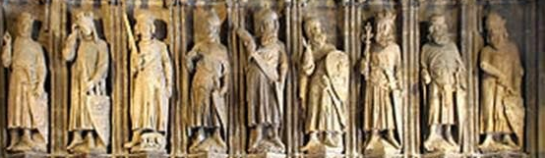
Nine “worthies” of West Point:
Joshua, David, Alexander the Great, Judah Maccabee, Julius Caesar, Hector, King Arthur, Charlemagne, and Godfrey of Bouillon
Notes:
https://external-content.duckduckgo.com/iu/?u=https%3A%2F%2Fhighfrontier.org%2Fwp-content%2Fuploads%2F2019%2F12%2FDecember-24-2019.jpg&f=1&nofb=1

Slide 46
Benjamin Franklin, John Adams and Thomas Jefferson were inspired by the Maccabees, proposing "Rebellion against tyrants is obedience to God" as the American official seal.
Notes:
https://www.chabad.org/kabbalah/article_cdo/aid/3874565/jewish/Judah-Maccabee-at-West-Point.htm

Slide 47
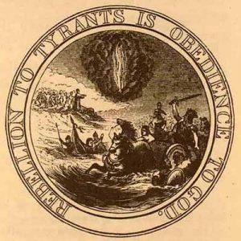
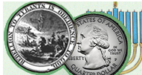
Notes:
https://thefederalistpapers.org/founders/franklin/rebellion-to-tyrants-is-obedience-to-god-benjamin-franklin
Rebellion to tyrants is obedience to G-d. Jefferson and others liked this Maccabee themed saying.
Franklin’s design was recommended by the first committee for the reverse side of the Great Seal. No sketch was made of their design. The above drawing was made by Benson J. Lossing for Harper’s New Monthly Magazine in July 1856.

Slide 48
"In God We Trust" was inspired also by the Maccabees' battle cry. A literal translation of the battle cry is "Whoever trusts God; join me!" The Maccabees' sacrifice and lack of political correctness also inspired Patrick Henry's "Give me liberty or give me death!"
Notes:
https://www.chabad.org/kabbalah/article_cdo/aid/3874565/jewish/Judah-Maccabee-at-West-Point.htm

Slide 49
Shimon the Maccabee - who succeeded Judah and Yonatan the Maccabees — articulated the Jewish territorial case when responding to an ultimatum by Antiochus,
Notes:
https://www.chabad.org/kabbalah/article_cdo/aid/3874565/jewish/Judah-Maccabee-at-West-Point.htm

Slide 50
who demanded an end to the Jewish "occupation" of Jerusalem, Jaffa, Gaza, Gezer and Ekron: "We have not occupied a foreign land; we have not ruled a foreign land; we have liberated the land of our forefathers from foreign occupation," Shimon said.
Notes:
https://www.chabad.org/kabbalah/article_cdo/aid/3874565/jewish/Judah-Maccabee-at-West-Point.htm

Slide 51
So, what are our current unique challenges?
1. Division within. I’m a firm believer in Mt. 18 reconciliation.

Slide 52
^{Mtt 24.10-12} At that time many will be trapped into betraying and hating each other, many false prophets will appear and fool many people; and many people’s love will grow cold.
G-d has blessed me with the gift of mediation. Mostly successful.

Slide 53
But that is treatment. Consider preventative.
a. ^{Eph. 4.15, 32} Speaking the truth in love, we will in every respect grow up into him who is the head, the Messiah…Be kind to each other, tenderhearted; and forgive each other, just as in the Messiah God has also forgiven you.
Notes:
Too many fires to put out. Preventative speaking.

Slide 54
^{Gal. 5.13-15} Through love serve one another. For the whole Torah can be summed up in a single saying: “Love your neighbor as yourself.” But if you bite and devour one another, watch out that you are not destroyed by one another.
Notes:
Also, preventative hearing…

Slide 55
^{T’hillim/Ps 141.3-5} Set a guard, Adoni, over my mouth. Keep watch over the door of my lips…Let the righteous strike me—it is kindness. Let him correct me—it is oil on my head —my head will not refuse it. Yet still my prayer is against their wickedness.
^{1 Cor 13.4} Love…suffers long.

Slide 56
So, what are our unique challenges?
2. A culture given to falsehood.

Slide 57
Be Brave Nikki Haley
Notes:
Nimrata Nikki Haley (née Randhawa; born January 20, 1972^{[1]}) is an American diplomat and politician who served as the 116th and first female governor of South Carolina from 2011 to 2017, and as the 29th United States ambassador to the United Nations for two years, from January 2017 to January 2019.^{[2]}
Haley was born in Bamberg, South Carolina, and studied accounting at Clemson University.
As a young woman, she tried out to be Miss S. Carolina. Since she was neither white nor black, she was disqualified.
https://www.prageru.com/video/be-brave till 5.29

Slide 58
So, what are our unique challenges?
3. Hatred of Jewish people.

Slide 59
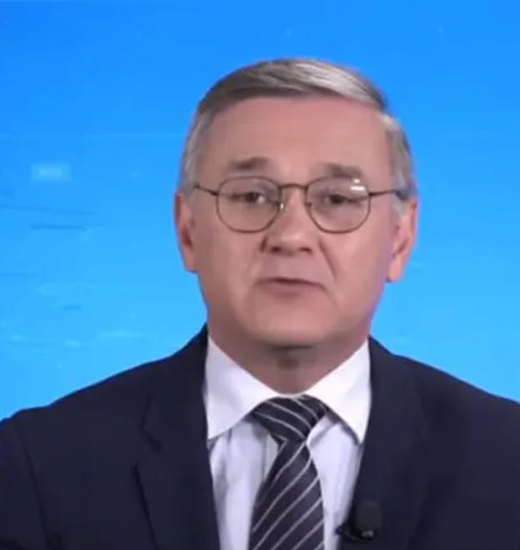
Jose Carlos Bernardi, a pundit for Jovem Pan, a Brazilian right-leaning radio and television station, made the comments
Notes:
https://vfinews.com/news/november-23-2021/brazilian-journalist-says-brazil-would-need-to-kill

Slide 60
in a discussion Tuesday, Nov. 23, 2021 about how Brazil could attain the economic development enjoyed by Germany . “Only by attacking Jews will we get there. If we kill a gazillion Jews and appropriate their economic power, then Brazil will get rich.
Later a lame apology.
Notes:
https://vfinews.com/news/november-23-2021/brazilian-journalist-says-brazil-would-need-to-kill

Slide 61
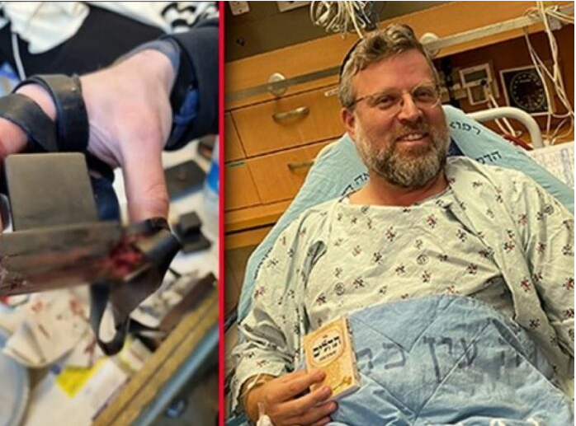
Life saved by tefillin!
Notes:
https://www.theyeshivaworld.com/news/headlines-breaking-stories/2031302/nissim-at-terror-attack-bullet-strikes-tefillin-shel-yad-saving-victims-life.html

Slide 62
Rabbi Ze’ev Katzenellenbogen was saved due to a bullet striking the exact place of his arm Tefillinשל יד shel yad, saving his life. Age 46, a father of 8 and a resident of the Jewish Quarter of the Old City, was on the way back from Shacharis at the Kosel, when he heard the sound of shooting.
Notes:
https://www.theyeshivaworld.com/news/headlines-breaking-stories/2031302/nissim-at-terror-attack-bullet-strikes-tefillin-shel-yad-saving-victims-life.html

Slide 63
“I was going home from Shacharis, still wrapped in my tallis and tefillin. I heard gunshots and chaos. Suddenly, I felt a sharp pain in my arm right at the place of my tefillin.
Notes:
https://www.theyeshivaworld.com/news/headlines-breaking-stories/2031302/nissim-at-terror-attack-bullet-strikes-tefillin-shel-yad-saving-victims-life.html

Slide 64
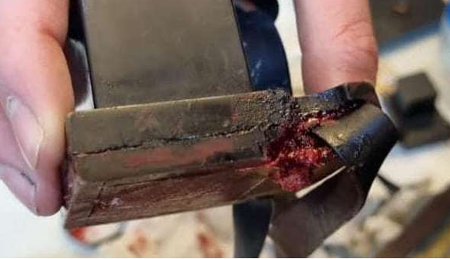
Notes:
https://www.charismanews.com/opinion/standing-with-israel/87532-hamas-terror-attack-in-jerusalem-kills-one-shows-christian-friends-depth-of-hamas-hatred

Slide 65
So, what are our unique challenges?
4. Run up to the Tribulation. Birthpangs of sorrows.

Slide 66
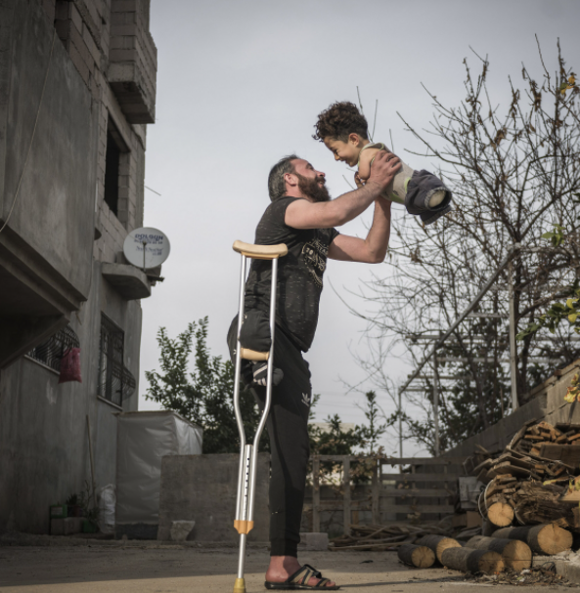
“Hardship of Life” by Turkish photog Mehmet Aslan took the place of overall winner in SIPA 2021. The emotionally-charged shot was taken in the district of Reyhanli, in the Turkish province of Hatay, at the border with Syria.
Notes:
https://www.theepochtimes.com/hardship-of-life-touching-photos-from-far-corners-of-the-world-win-international-photo-competition_4073536.html?utm_source=newsnoe&utm_medium=email&utm_campaign=breaking-2021-11-22-1&est=kx9M6xD%2FN6qKNK4cc6tLGMnMitNNW%2FAyv8jt0DawHoDCT0QqORDTsA4Xh60RfcQAFQ%3D%3D

Slide 67
A father, Munzir, who lost one leg when a bomb was dropped as he walked through a bazaar in Idlib, holds his son, Mustafa, who was born without lower or upper limbs due to a congenital disorder caused by medications during his mother’s treatment in the war in Syria.
Notes:
The photo was selected from tens of thousands of images submitted by photographers from 163 countries.

Slide 68
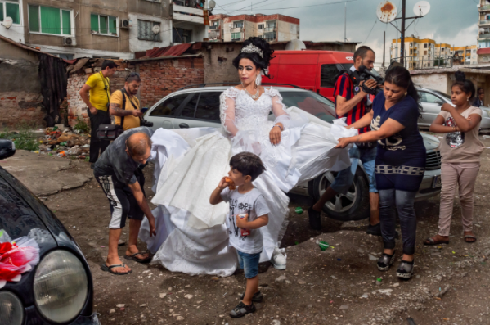
Notes:
A young bride is shown preparing for her wedding on a slum-like street in the crowded Roma ghetto of Stolipinovo.
https://www.theepochtimes.com/hardship-of-life-touching-photos-from-far-corners-of-the-world-win-international-photo-competition_4073536.html?utm_source=newsnoe&utm_medium=email&utm_campaign=breaking-2021-11-22-1&est=kx9M6xD%2FN6qKNK4cc6tLGMnMitNNW%2FAyv8jt0DawHoDCT0QqORDTsA4Xh60RfcQAFQ%3D%3D

Slide 69
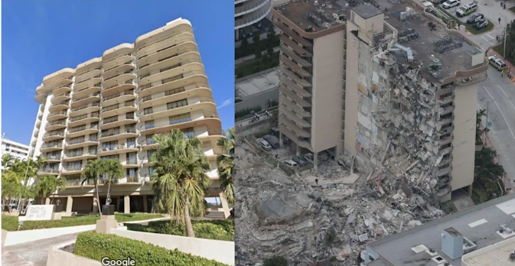
Before-and-after images of the Florida
condo collapse show the severity of
the disaster
Notes:
https://www.yahoo.com/entertainment/images-florida-condo-collapse-show-154448626.html

Slide 70
When the building collapsed in Surfside, Florida, the Israel Defense Forces deployed a rapid response elite squad to help with search and rescue. This team was credited with recovering 81 of the 97 bodies of victims due to its superior methods of mapping out potential locations.
Notes:
https://www.charismanews.com/world/86600-another-nation-makes-bold-move-to-stand-with-israel?utm_source=Charisma%20News%20Daily&utm_medium=email&utm_content=subscriber_id:5160390&utm_campaign=CNO%20daily%20-%202021-09-02

Slide 71
A Jonathan Cahn insight into the urgency of the hour.

Slide 72
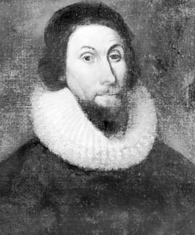
John Winthrop, 1588, England —died 1649, Boston, Massachusetts Bay Colony

Slide 73
First governor of the Massachusetts Bay Colony, the chief figure among the Puritan founders of New England.
Notes:
https://frankspeech.com/tv/video/pastor-jonathan-cahn-joins-frankspeech-thanks-thon-special-message-america-and-americans

Slide 74
Gov. Winthrop's prophecy from Dt 28, which was the parasha reading just before Sept 11, 2001.
^{Dt. 28.15} “But if you refuse to pay attention to what Adoni your God says, and do not observe and obey all his mitzvot and regulations which I am giving you today, then all the following curses will be yours in abundance:
Notes:
https://frankspeech.com/tv/video/pastor-jonathan-cahn-joins-frankspeech-thanks-thon-special-message-america-and-americans

Slide 75
^{Dt. 28.49-50} Adoni will bring against you a nation from far away that will swoop down on you from the end of the earth like a vulture, יִדְאֶה הַנָּשֶׁר a nation whose language you don’t understand, a nation grim in appearance, whose people neither respect the old nor pity the young.

Slide 77
On September 11, 2001, at 8:45 a.m. on a clear Tuesday morning, an American Airlines Boeing 767 loaded with 20,000 gallons of jet fuel crashed into the north tower of the World Trade Center in New York City.
Notes:
https://frankspeech.com/tv/video/pastor-jonathan-cahn-joins-frankspeech-thanks-thon-special-message-america-and-americans

Slide 78
Notes:
sky

Slide 79
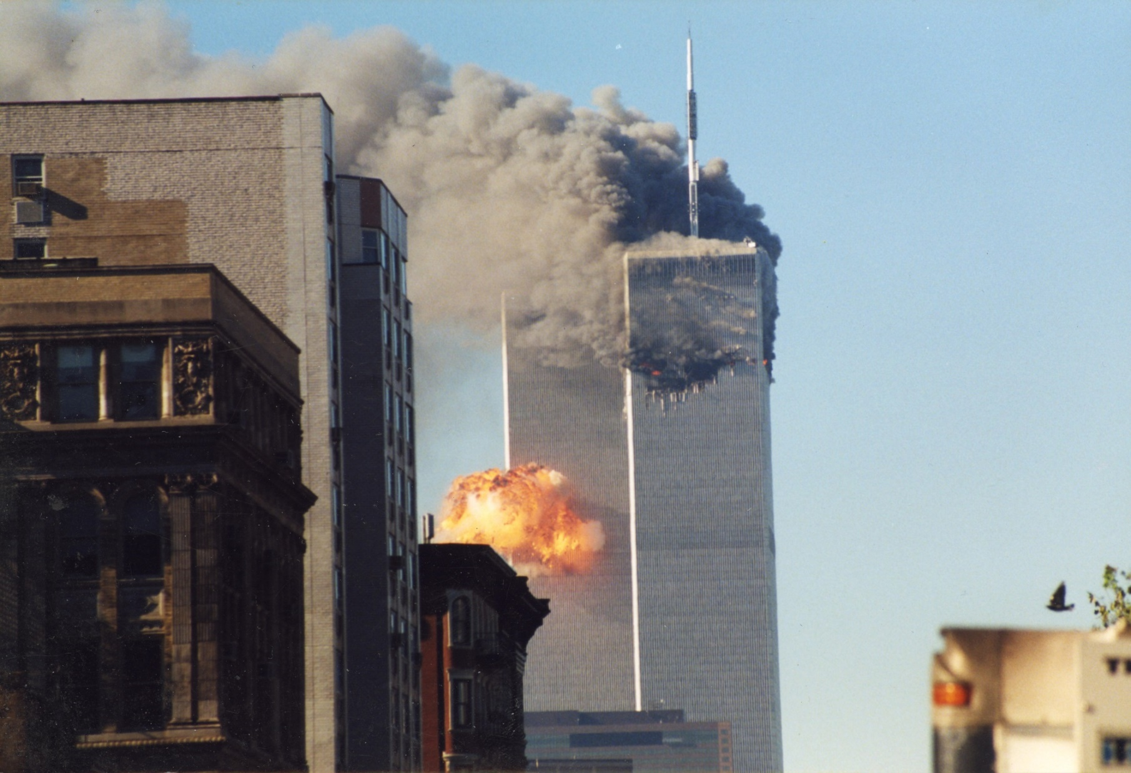

Slide 80
^{Dt 28.23} “The sky over your head will be brass and the earth under you iron.
^{Dt 28.29} You will grope about at noon like a blind person groping in the dark, unable to find your way.

Slide 81
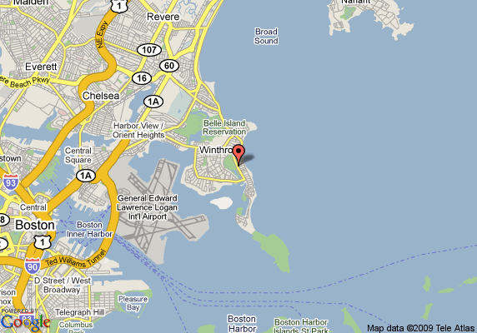
Notes:
https://frankspeech.com/tv/video/pastor-jonathan-cahn-joins-frankspeech-thanks-thon-special-message-america-and-americans

Slide 83
Once what?
We have the reality of the Once and final atonement.
We live in expectation of the Once and Final Return
We have opportunity to be vessels of His atonement in our unique time.

Slide 84
Do you KNOW Yeshua and the assurance of sins forgiven?
Are you hearing daily from His Word?
How are you applying what you heard?
Are you asking this of another?
Notes:
Who are you discipling, building up?4

Slide 86
