Slide 1
e-handout
To have these notes
without taking notes
Go to OrHaOlam.com
Click on Messages tab,
2021 Messages
Notes:
Used to be called “Downloads” tab. We now have a paid web tech who apparently can fix anything.

Slide 3
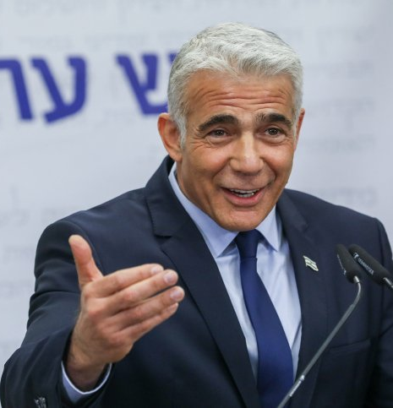
Israel Foreign Minister Yair Lapid
Notes:
https://www.israeltoday.co.il/read/israeli-foreign-minister-claims-hes-from-the-line-of-jesus/?utm_source=acfs&utm_medium=email&utm_term=all&utm_campaign=newsletter-en-2021-11-29
foreign policy, and promote economic, cultural, and scientific relations with other countries. NOT immigration.

Slide 4
When Israel Foreign Minister Yair Lapid recently appointed his Messianic Jewish sister-in-law Ilil Keren to the board of the Jewish National Fund (JNF), religious news outlets created a fire storm across the Israeli media resulting in Keren resigning the post.
Notes:
https://www.israeltoday.co.il/read/israeli-foreign-minister-claims-hes-from-the-line-of-jesus/?utm_source=acfs&utm_medium=email&utm_term=all&utm_campaign=newsletter-en-2021-11-29

Slide 5
Keren, it was discovered, had been a member of a Messianic Jewish congregation in Tel Aviv together with her husband who held the role of “prayer leader” in the community.
Notes:
https://www.israeltoday.co.il/read/israeli-foreign-minister-claims-hes-from-the-line-of-jesus/?utm_source=acfs&utm_medium=email&utm_term=all&utm_campaign=newsletter-en-2021-11-29
Continuing the series on the Letter to the Messianic Jews/ Book of Hebrews

Slide 7
Messianic Jews/Hebrews/MJ 10.1-4 For the Torah has in it a shadow of the good things to come, but not the actual manifestation of the originals. Therefore, it can never, by means of the same sacrifices repeated endlessly year after year, bring to the goal those who

Slide 8
Messianic Jews/Hebrews/MJ 10.1-4 approach the Holy Place to offer them. Otherwise, wouldn’t the offering of those sacrifices have ceased? For if the people performing the service had been cleansed once and for all, they would no longer have sins on their conscience.
Notes:
I attended in my youth yearly, YK services. Of course no sacrifice, but the prayers and liturgy. There was afterward a sense of having done what we were supposed to do, but no great sense in our conscience of forgiveness and release.
One believing friend asked his Rabbi during a service, “Is G-d here?” Got back a look of incredulity. “What does that mean?”

Slide 9
Messianic Jews/Hebrews/MJ 10.1-4 No, it is quite the contrary — in these sacrifices is a reminder of sins, year after year. For it is impossible that the blood of bulls and goats should take away sins.

Slide 10
Conscience:
What is it?
How does it operate?
How can we keep it at peace?

Slide 11
Conscience:
What is it?
How does it operate?
How can we keep it at peace?

Slide 12
Definition of conscience
the sense or consciousness of the moral goodness or blameworthiness of one's own conduct, intentions, or character together with a feeling of obligation to do right or be good
Notes:
https://www.merriam-webster.com/dictionary/conscience

Slide 13
^{1 Thes 5.23} Now may the God of shalom Himself make you completely holy; and may your whole spirit and soul and body be kept complete, blameless at the coming of our Lord Yeshua the Messiah.
Notes:
One construct of this spirit, soul, body…

Slide 14
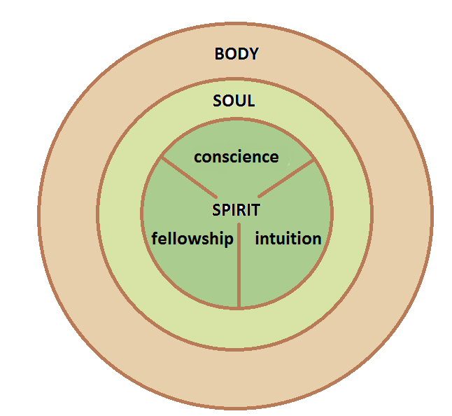
your whole spirit and soul and body
Notes:
http://holdingtotruth.com/wp-content/uploads/2013/07/spirit-soul-body-w-parts-of-spirit-rev2.png
Spirit is the innermost sense
Of self
Of G-d
Of other people
Of right and wrong: conscience

Slide 15
Soul:
intellect,
will, emotions
Notes:
http://holdingtotruth.com/wp-content/uploads/2013/07/spirit-soul-body-w-parts-of-spirit-rev2.png
Soul is logical and emotional;
spirit is intuitive.
Sometime argue.
^{Ps 42.6} Why are you downcast, O my soul? Why are you murmuring within me? Hope in God, for I will yet praise Him, for the salvation of His presence.
It’s OK to lie to the IRS, the government is corrupt. Logical? Still not RIGHT!

Slide 16
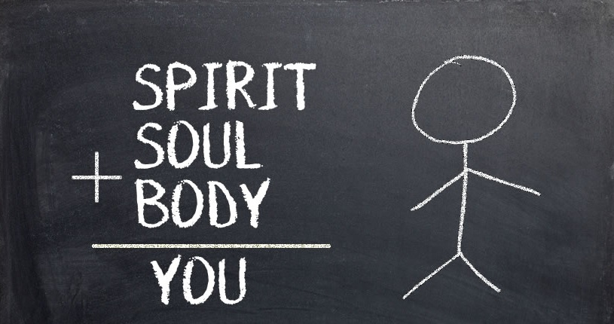
Notes:
https://external-content.duckduckgo.com/iu/?u=http%3A%2F%2Fwordoffaithstthomas.com%2Fwp-content%2Fuploads%2F2016%2F07%2FSpirit-Soul-and-Body.jpg&f=1&nofb=1

Slide 17
Notes:
We have choices to make that can defile or satisfy our conscience.

Slide 18
Conscience:
What is it?
How does it operate?
How can we keep it at peace?

Slide 19
^{T’hillim/Ps 139.13} For You have created my conscience. You knit me together in my mother’s womb.

Slide 20
^{Ro 2.15b-16} Their consciences also bear witness to this, for their conflicting thoughts sometimes accuse them and sometimes defend them on a day when God passes judgment on people’s inmost secrets. (According to the Good News as I proclaim it, he does this through the Messiah Yeshua.)

Slide 21
^{1 K 8.38-39} Regardless of what prayer or plea anyone among all your people Isra’el makes — for each individual will know what is plaguing his own conscience — and the person spreads out his hands toward this house; hear in heaven where you live, and forgive, and act.

Slide 22
^{Acts 24.15-16} In God I have a hope—which these men also wait for—that there will surely be a resurrection of both the righteous and the unrighteous. “Therefore I do my best always to have a clear conscience before both God and men.

Slide 23
^{1 Tim 1:5} Now the goal of this command is love from of a pure heart and a clear conscience and a genuine faith.

Slide 24
^{2 Cor. 4.2} Indeed, we refuse to make use of shameful underhanded methods, employing deception or distorting God’s message. On the contrary, by making very clear what the truth is, we commend ourselves to everyone’s conscience in the sight of God.
Notes:
Our only inventory in ministry is integrity

Slide 25
^{1 Timothy 4:2} Such teachings come from the hypocrisy of liars whose own consciences have been burned, as if with a red-hot branding iron.

Slide 28
Conscience:
What is it?
How does it operate?
How can we keep it at peace?

Slide 29
Messianic Jews/Hebrews/MJ 10.1-4 For the Torah has in it a shadow of the good things to come, but not the actual manifestation of the originals. Therefore, it can never, by means of the same sacrifices repeated endlessly year after year, bring to the goal those who

Slide 30
Messianic Jews/Hebrews/MJ 10.1-4 approach the Holy Place to offer them. Otherwise, wouldn’t the offering of those sacrifices have ceased? For if the people performing the service had been cleansed once and for all, they would no longer have sins on their conscience.

Slide 31
Messianic Jews/Hebrews/MJ 10.1-4 No, it is quite the contrary — in these sacrifices is a reminder of sins, year after year. For it is impossible that the blood of bulls and goats should take away sins.

Slide 32
Here is the miracle and the uniqueness of faith in the Messiah Yeshua

Slide 33
^{Ro. 8.15-17} For you did not receive a spirit of slavery to bring you back again into fear; on the contrary, you received the Spirit, who makes us sons and by whose power we cry out, “Abba!” (that is, “Dear Father!”).

Slide 34
^{Ro. 8.15-17} The Spirit himself bears witness with our own spirits that we are children of God; and if we are children, then we are also heirs, heirs of God and joint-heirs with the Messiah — provided we are suffering with him in order also to be glorified with him.

Slide 35
Myself, Sunday evening, April 13, 1969: “Your name is now in the Book of Life.”

Slide 36
Pilgrim Holiness Church, Schenectady NY, April 13, 1969, after 10 days of fasting, I experienced
Notes:
Golden glow up in the laminated rafters. “Cloud of liquid love.” April 13, 1969 I experienced New Birth. Many young people similarly seeking.
Went home few weeks later. “Mom, Dad, I’ve found the answer to life’s problems. It’s not in drugs, or revolution, but in the love of Jesus Christ.”
Sent me to psychiatrist. “You’re worse than Hitler. He destroyed our bodies. You are destroying our souls.”
Not everyone may have the dramatic story I did. But the inner Ruakh/Spirit assurance of salvation all must have.
But, what about Jewishness? “Put on altar” I’ll figure out the Jewish piece later. Need to get the salvation piece. …

Slide 37
In Judaism, the Book of Life
ספר החיים sefer ha-khaim; is the book in which God records the names of every person who is destined for Heaven and the World to Come. Particularly considered on High Holidays.

Slide 38
Wesley:
“Your sins are forgiven, accepted thou art,
I listened and heaven sprung up in my heart.”

Slide 39
Do you have the witness of the Spirit that your name is in the Book of Life?

Slide 40
Do you have the witness of the Spirit that your name is in the Book of Life?
I think so

Slide 41
Do you have the witness of the Spirit that your name is in the Book of Life?
I think so
I hope so

Slide 42
Do you have the witness of the Spirit that your name is in the Book of Life?
I think so
I hope so
It should be: a do all this…

Slide 43
^{Ro. 8.15-17} You received the Spirit, who makes us sons and by whose power we cry out, “Abba!” (that is, “Dear Father!”).
Notes:
Pause for reflection

Slide 44
Scriptures on the Book of Life

Slide 45
^{T’hillim/Ps 69.29} Erase them from the book of life, let them not be written with the righteous.

Slide 46
^{Yeshayahu/Is 4.3} Those left in Tziyon and remaining in Yerushalayim will be called holy, and everyone in Yerushalayim written down for life.

Slide 47
^{Phil 4.3} I ask you, true companion, to help these women—they labored side by side with me in spreading the Good News, together with Clement also and the rest of my fellow workers, whose names are in the Book of Life.

Slide 48
^{Rev. 3.5} The one who overcomes thus will be dressed in white clothes; I will never blot his name out of the Book of Life, and will confess his name before My Father and His angels.

Slide 49
^{Rev. 13.8} All who dwell on the earth shall worship him [the satanic anti-Messiah]—everyone whose name has not been written from the foundation of the world in the Book of Life of the Lamb.

Slide 50
^{Rev. 17.8} The beast that you saw was, and is not, and yet is about to rise up from the abyss and head for destruction, those who dwell on the earth—whose names have not been written in the Book of Life.

Slide 51
^{Rev. 21.12} And I saw the dead—the great and the small—standing before the throne. The books were opened, and another book was opened—the Book of Life. And the dead were judged according to what was written in the books, according to their deeds.
Notes:
Books…apparently record of all our deeds, words, thoughts.

Slide 52
^{Rev. 20.5} And if anyone was not found written in the Book of Life, he was thrown into the lake of fire.

Slide 53
^{Rev. 21:27} And nothing unholy shall ever enter it, nor anyone doing what is detestable or false, but only those written in the Book of Life.

Slide 54
Hanukkah connection
to the witness of the Spirit
that our conscience is clear.

Slide 56
^{Yn 10.22-30} Then came Hanukkah; it was winter in Jerusalem. Yeshua was walking in the Temple around Solomon’s Colonnade. Then the Judean leaders surrounded Him, saying, “How long will You hold us in suspense? If You are the Messiah, tell us outright!”

Slide 57
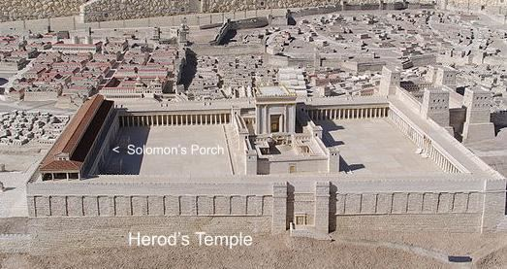

Slide 58
^{Yn 10.22-30} Yeshua answered them, “I told you, but you don’t believe!...My sheep hear My voice. I know them, and they follow Me. I give them eternal life! They will never perish, and no one will snatch them out of My hand.
Notes:
Do YOU hear His voice? In the Ruakh, in the Word?
Never perish, as long as you hear…Shma.
This is the message the Messiah of Israel had for our people on Hanukkah. “Hear my voice.”
[From Israel Pochtar.]

Slide 59
^{Yn 10.22-30} My Father, who has given them to Me, is greater than all. And no one is able to snatch them out of the Father’s hand. I and the Father are one.”

Slide 61
Conscience:
What is it?
How does it operate?
How can we keep it at peace?

Slide 62
FIRSTLY: internal
^{Mishlei/Prov 4.23} Guard your heart diligently, for from it flow the springs of life.

Slide 63
^{Col.3.15} Let the shalom of Messiah rule “to act as umpire,
lit: to act as arbiter in the games)”
in your hearts—to this shalom you were surely called in one body. Also be thankful.

Slide 64
SECONDLY: relational
^{Mtt 5.23-24} So if you are offering your gift at the Temple altar and you remember there that your brother has something against you, leave your gift where it is by the altar, and go, make peace with your brother. Then come back and offer your gift.
Notes:
In conflict, the winner is the first one to unconditionally humble themselves.
Not I was wrong because you make me sooooo mad.
Just: I was wrong. I apologize.
Not even “Forgive me” at first.
G-d in Messiah will NOT give us the Ruakh sense of peace in our conscience if we have offended or been offended. Forgive. Seek forgiveness.
Not all offenses can be resolved…

Slide 65
^{Gal. 5.13-15} Through love serve one another. For the whole Torah can be summed up in a single saying: “Love your neighbor as yourself.” But if you bite and devour one another, watch out that you are not destroyed by one another.

Slide 66
^{Eph. 4.15, 32} Speaking the truth in love, we will in every respect grow up into him who is the head, the Messiah…Be kind to each other, tenderhearted; and forgive each other, just as in the Messiah God has also forgiven you.
Notes:
Too many fires to put out.

Slide 67
^{T’hillim/Ps 141.3-5} Set a guard, Adoni, over my mouth. Keep watch over the door of my lips…Let the righteous strike me—it is kindness. Let him correct me—it is oil on my head —my head will not refuse it. Yet still my prayer is against their wickedness.
^{1 Cor 13.4} Love…suffers long.

Slide 68
THIRDLY: sacrificial [Hanukkah connection]
According to the rabbis, these three cardinal sins require martyrdom because of their intrinsic severity, and not because of the punishment prescribed for them. One must therefore be martyred for any Biblical law associated with them,
Notes:
https://www.aish.com/jl/m/pm/48936542.html

Slide 69
no matter how minor it may seem. However, one need not be martyred for a rabbinical prohibition.
Notes:
https://www.aish.com/jl/m/pm/48936542.html

Slide 70
We are commanded, "Love Adoni your God ... with all your soul" (Deut. 6:5), and this is interpreted to mean that one must continue to love God even at the expense of one’s earthly existence and soul.

Slide 71
^{Vayikra/Lev. 22.32} You must not profane My holy Name, for I will be made holy among the Sons- of-Yisrael. I am Adoni who makes you holy.
וְנִקְדַּשְׁתִּי בְּתוֹךְ בְּנֵי יִשְׂרָאֵל
“Making the Name holy,” “kiddush Hashem” has been a theme in Judaism

Slide 72
Therefore, if any government passes an edict forbidding the practice of any religious law, one must be willing to be martyred.
Notes:
https://www.aish.com/jl/m/pm/48936542.html

Slide 73
There are three cardinal sins which one may not transgress under any circumstances, even at the expense of one's life. They are: idolatry, murder and sexual crimes. These sins outweigh life because of their intrinsic severity.
Notes:
https://www.aish.com/jl/m/pm/48936542.html

Slide 74
One must be martyred for idolatry since absolute love of God implies that one not even appear to forsake Him under any conditions.
Notes:
https://www.aish.com/jl/m/pm/48936542.html

Slide 75
One must be martyred for sexual crimes, since they are equated with murder, as the Torah states in the case of rape, "The [rapist] is no different from a man who rises up against his neighbor and murders him."
Notes:
https://www.aish.com/jl/m/pm/48936542.html

Slide 76
^{Dt. 22.26} But if the man finds the engaged woman in the field, and the man forces her and lies with her, then only the man who lay with her is to die.
Notes:
https://www.aish.com/jl/m/pm/48936542.html

Slide 77
These three cardinal sins require martyrdom because of their intrinsic severity, and not because of the punishment prescribed for them. One must therefore be martyred for any Biblical law associated with them, no matter how minor it may seem. However, one need not be martyred for a rabbinical prohibition.
Notes:
https://www.aish.com/jl/m/pm/48936542.html

Slide 78
Hanukkah connection to the witness of the Spirit that our conscience is clear.

Slide 79
Antiochus IV destroyed the Temple, the central place of Jewish worship, and outlawed the practice of Shabbat, Jewish festivals and circumcision. Antiochus IV forced the Jews to choose between worshiping the Greek gods or death.
Notes:
https://tulanehullabaloo.com/58300/intersections/two-jews-guide-to-hanukkah/

Slide 80
At the heart of the Hanukkah story is the heroism of the Maccabees. While the Greeks had sophisticated weapons of war, along with lightning-fast chariots, the Jews operated almost entirely on foot. The Greeks were an empire, a world power; the Jews were a band of upstarts.
Notes:
https://www.chabad.org/holidays/chanukah/article_cdo/aid/5320184/jewish/Were-the-Maccabees-Wrong-to-Fight.htm#utm_medium=email&utm_source=1_chabad.org_magazine_en&utm_campaign=en&utm_content=content

Slide 81
The Greeks were led by experienced generals, and the Maccabees by a family of priests. The gulf in numbers, training and equipment was immense. That is why the eventual victory against the Greeks is a central part of the miracle of Hanukkah. No one observing this mismatched struggle would have given the Jews even the slightest chance.
Notes:
https://www.chabad.org/holidays/chanukah/article_cdo/aid/5320184/jewish/Were-the-Maccabees-Wrong-to-Fight.htm#utm_medium=email&utm_source=1_chabad.org_magazine_en&utm_campaign=en&utm_content=content

Slide 82
Was It Allowed by Torah Law?
By any reasonable estimation, their vastly unequal footing would have made the instigation of war a straightforward suicide mission! There was simply no natural way for the Jews to have succeeded in their endeavor. We may then ask: Is it even permitted according to Jewish law to put oneself in such certain danger? certain danger?
Notes:
https://www.chabad.org/holidays/chanukah/article_cdo/aid/5320184/jewish/Were-the-Maccabees-Wrong-to-Fight.htm#utm_medium=email&utm_source=1_chabad.org_magazine_en&utm_campaign=en&utm_content=content

Slide 83
There is a fourth element necessary to maintain a clear conscience: FAITH

Slide 84
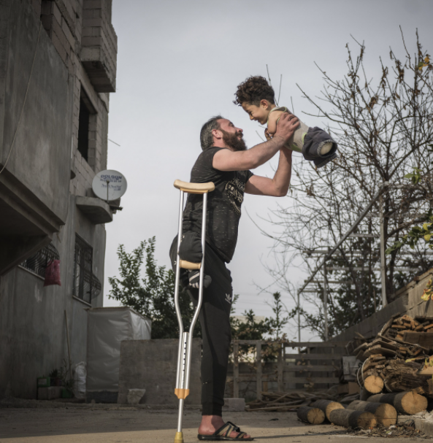
“Hardship of Life” by Turkish photog Mehmet Aslan took the place of overall winner in SIPA 2021. The emotionally-charged shot was taken in the district of Reyhanli, in the Turkish province of Hatay, at the border with Syria.
Notes:
https://www.theepochtimes.com/hardship-of-life-touching-photos-from-far-corners-of-the-world-win-international-photo-competition_4073536.html?utm_source=newsnoe&utm_medium=email&utm_campaign=breaking-2021-11-22-1&est=kx9M6xD%2FN6qKNK4cc6tLGMnMitNNW%2FAyv8jt0DawHoDCT0QqORDTsA4Xh60RfcQAFQ%3D%3D

Slide 85
A father, Munzir, who lost one leg when a bomb was dropped as he walked through a bazaar in Idlib, holds his son, Mustafa, who was born without lower or upper limbs due to a congenital disorder caused by medications during his mother’s treatment in the war in Syria.
Notes:
The photo was selected from tens of thousands of images submitted by photographers from 163 countries.

Slide 86
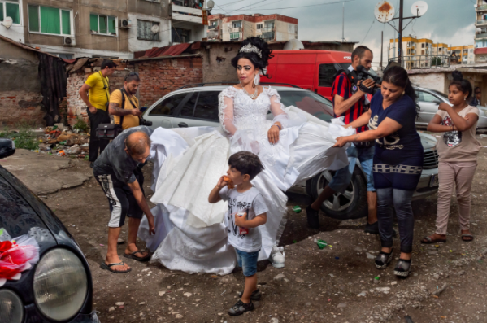
Notes:
A young bride is shown preparing for her wedding on a slum-like street in the crowded Roma ghetto of Stolipinovo. Stolipinovo is a district of the Bulgarian city of Plovdiv and the most populous predominantly Romani-inhabited district on the Balkans with a population of about 80,000
https://www.theepochtimes.com/hardship-of-life-touching-photos-from-far-corners-of-the-world-win-international-photo-competition_4073536.html?utm_source=newsnoe&utm_medium=email&utm_campaign=breaking-2021-11-22-1&est=kx9M6xD%2FN6qKNK4cc6tLGMnMitNNW%2FAyv8jt0DawHoDCT0QqORDTsA4Xh60RfcQAFQ%3D%3D

Slide 87
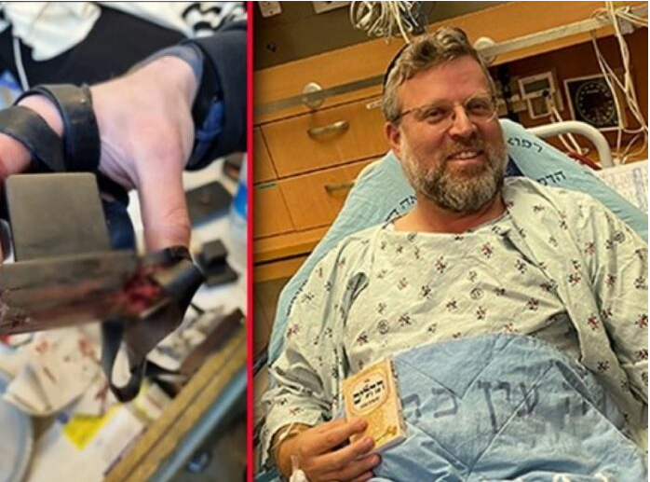
Life saved by tefillin!
Notes:
https://www.theyeshivaworld.com/news/headlines-breaking-stories/2031302/nissim-at-terror-attack-bullet-strikes-tefillin-shel-yad-saving-victims-life.html

Slide 88
Rabbi Ze’ev Katzenellenbogen was saved due to a bullet striking the exact place of his arm Tefillinשל יד shel yad, saving his life. Age 46, a father of 8 and a resident of the Jewish Quarter of the Old City, was on the way back from Shacharis at the Kosel, when he heard the sound of shooting.
Notes:
https://www.theyeshivaworld.com/news/headlines-breaking-stories/2031302/nissim-at-terror-attack-bullet-strikes-tefillin-shel-yad-saving-victims-life.html

Slide 89
“I was going home from Shacharis, still wrapped in my tallis and tefillin. I heard gunshots and chaos. Suddenly, I felt a sharp pain in my arm right at the place of my tefillin.
Notes:
https://www.theyeshivaworld.com/news/headlines-breaking-stories/2031302/nissim-at-terror-attack-bullet-strikes-tefillin-shel-yad-saving-victims-life.html

Slide 90
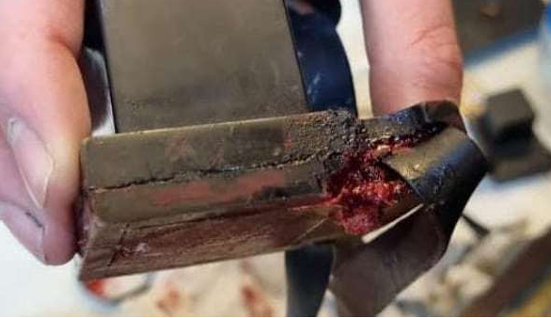
Notes:
https://www.charismanews.com/opinion/standing-with-israel/87532-hamas-terror-attack-in-jerusalem-kills-one-shows-christian-friends-depth-of-hamas-hatred

Slide 92
Summary on the Conscience:
How can we keep it at peace?
Be sensitive to the Ruakh!
Humble yourself, forgive, over hurtful speech.
Be willing to sacrifice yourself
TRUST Yeshua!

Slide 93
Do you KNOW Yeshua and the assurance of sins forgiven?
Are you hearing daily from His Word?
How are you applying what you heard?
Are you asking this of another?
Notes:
Who are you discipling, building up?4

Slide 95
