Slide 1
e-handout
To have these notes
without taking notes
Go to OrHaOlam.com
Click on downloads,
messages, 2020
Notes:
This time starting with something very serious. No jokes.

Slide 2
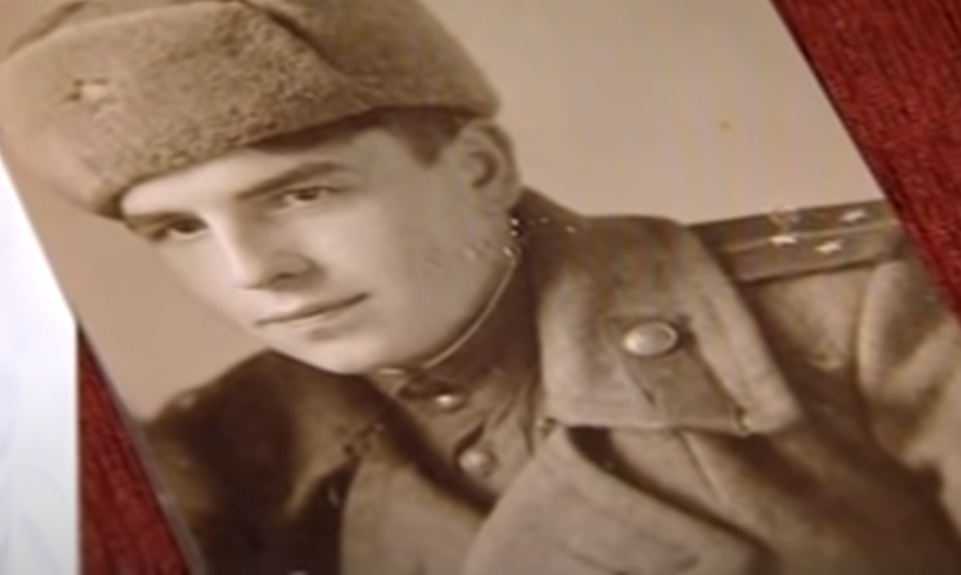
Yvon
Mashkinovin
Russian
Auschwitz
liberator
Notes:
https://youtu.be/-aSHpwmzMxc

Slide 3
A few months after Auschwitz was liberated, American soldiers advancing through Germany began to discover and liberate smaller concentration camps. The commander of the American forces,
Notes:
From Stewart Winograd

Slide 4
General Dwight Eisenhower (who went on to be the 34th President of the United States) wrote a letter describing the experience of the Buchenwald Concentration Camp network.

Slide 5
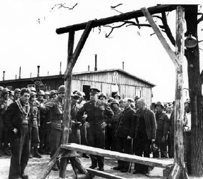
Gen. Eisenhower [Ike] at Buchenwald

Slide 7
Notes:
Eisenhower engaged a photographer named Alfred Hitchcock to document the horrors lest there be denial in future years!
General George Patton, who General Eisenhower mentions here, was one of the most fearless and tough American generals. His rough disposition had earned him the nickname “Old Blood and Guts” Yet there was a room in Buchenwald that was so horrible he could not enter.

Slide 8
Resolution adopted by the General Assembly on 1 November 2005:
The Holocaust, which resulted in the murder of one third of the Jewish people, along with countless members of other minorities, will forever be a warning to all people of the dangers of hatred, bigotry, racism and prejudice.
Notes:
https://undocs.org/en/A/RES/60/7

Slide 9
Resolved that the United Nations will designate 27 January as an annual International Day of Commemoration in memory of the victims of the Holocaust.
Notes:
https://undocs.org/en/A/RES/60/7

Slide 10
However, why should International Holocaust Remembrance Day be a preaching theme?

Slide 12
Outline: Pray for the Shalom of Jerusalem – Why?
Enters G-d’s promises to Israel
Current anti-Semitism
How to bless Israel
Outward expression
Inward expression

Slide 13
^{T’hillim/Ps 122.6-9} Pray for the shalom of Jerusalem— “May those who love you be at peace! May there be shalom within your walls— quietness within your palaces.” For the sake of my brothers and friends, I now say: “Shalom be within you.” For the sake of the House of Adoni our God, I will seek your good.
Notes:
None of the commentators thought this was anything but a prayer for the local assembly, congregation. G. Campbell Morgan, Spurgeon, John Gill. None thought Jerusalem meant… Jerusalem.
Art Scroll commented on the holiness of the city.
Let’s do a word study…
the name of Jerusalem, which signifies "they shall see peace“ sort of pun here.
Spurgeon, G. Campbell Morgan, interpret praying for Jerusalem as praying for the local congregation.

Slide 14
^{T’hillim/Ps 122.6} Seek the shalom of Jerusalem, they shall have shalom that love you.
שַׁאֲלוּ שְׁלוֹם יְרוּשָׁלִָם; יִשְׁלָיוּ אֹהֲבָיִךְ.
Sha’alu shalom Yerusaliyim, yishlav ohavayikh
Notes:
Two words to analyze…

Slide 15
שָׁלוֹם Shalom
peace; quiet, tranquility, safety, well-being, Hello! Goodbye; welfare, health, contentment, good condition, success, comfort.
בשלום - safely; peacefully, at peace
To pay a bill: l’shalem לשלם
Notes:
Song about Shalom in the Broadway play, Milk and Honey.

Slide 16
To complete: הִשְׁלִים heshleem
Perfection: שְׁלֵמוּת, מֻשְׁלָמוּת shlaymut, mushlamut

Slide 17
יִשְׁלָיוּ from שלו
Calm, quiet, tranquil, at ease, restful, carefree, secure

Slide 18
^{T’hillim/Ps 122.6} Seek the shalom of Jerusalem, they shall have shalom that love you.
שַׁאֲלוּ שְׁלוֹם יְרוּשָׁלִָם; יִשְׁלָיוּ אֹהֲבָיִךְ.
Sha’alu shalom Yerusaliyim, yishlav ohavayikh
Notes:
Of that particular city, with it’s politics and weaknesses…

Slide 19
^{T’hillim/Ps 87.2-3} Adoni loves the gates of Zion more than all the dwellings of Yaakov. Glorious things are spoken of you, city of God. Selah.
Notes:
You sound soooo ethnocentric and racist. I’m probably going to lose my Twitter account.

Slide 20
Why is this?
Coveantal love and purpose.

Slide 21
^{Zekh 2.12} For Adoni-Tzva’ot has sent me on a glorious mission to the nations that plundered you, and this is what he says: “Anyone who injures you injures the very pupil of my eye.

Slide 22
^{Zekh 2.14-15} “Sing, daughter of Tziyon; rejoice! For, here, I am coming; and I will live among you,” says Adoni. When that time comes, many nations will join themselves to Adoni. “They will be my people, and I will live among you.”
Notes:
Don’t only love the Torah of Israel, love Israel.
Why? G-d’s vessel.

Slide 23
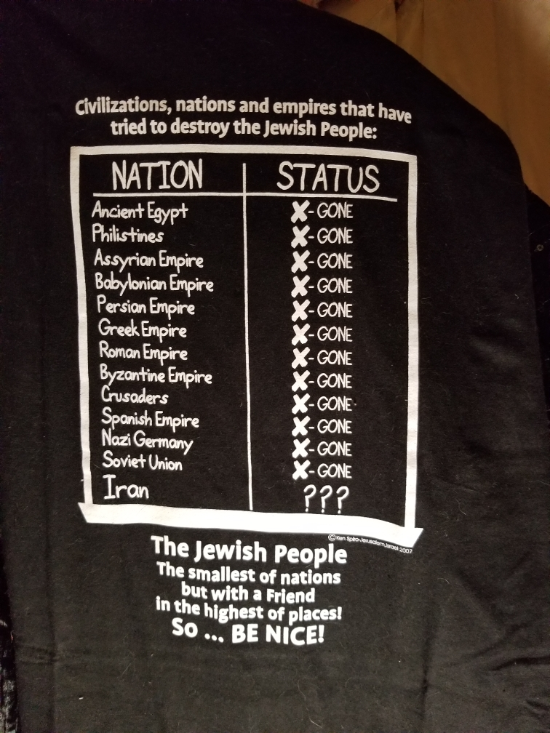
Notes:
From a T-shirt

Slide 24
Notes:
From a T-shirt

Slide 25
There are Hebrew roots congregations that teach Torah.
The difference between them and us, a Messianic Congregation, is that we teach that G-d still has a unique calling on Israel, and the Nations are grafted in.

Slide 26
Has a wonderful theme: studying the
"The Land, the People, and the Scriptures of Israel."
Notes:
Basic difference between Jewish people and those of the Nations, Gentiles.

Slide 27
^{Ro 11.12} Now if their transgression leads to riches for the world, and their loss riches for the Gentiles, then how much more their fullness!
^{Ro 11.15} For if their rejection leads to the reconciliation of the world, what will their acceptance be but life from the dead?
Notes:
So it’s great for all Nations to keep the holidays and the dietary laws. But for Jews there is a covenantal identity expression that is “fullness…life from the dead.”
Another apocalyptic difference…

Slide 28
^{Mtt. 23.39} For I tell you, you will never see Me again until you say,
בָּרוּךְ הַבָּא, בְּשֵׁם יְיָ
‘Barukh ha-ba b’shem Adoni. Blessed is He who comes in the name of the Lord!’”
Notes:
The Jews in Jerusalem, speaking a Hebrew idiom of ‘welcome.’
How many Jewish Jerusalemites have to welcome Messiah for Him to return…tipping point accord to Marty Waldman, Mes. Rabbi in Dallas. Maybe Knesset!

Slide 29
^{Ro. 11.26-28} For I do not want you, brothers and sisters, to be ignorant of this mystery — lest you be wise in your own eyes — that a partial hardening has come upon Israel until the fullness of the Gentiles has come in; and in this way all Israel will be saved, as it is written,

Slide 30
^{Ro. 11.26-28} “The Deliverer shall come out of Zion. He shall turn away ungodliness from Jacob. And this is My covenant with them, when I take away their sins.” Concerning the Good News, they are hostile for your sake; but concerning chosenness, they are loved on account of the fathers.

Slide 31
When Jews or people of the Nations, Gentiles, land in Israel, it feels like home. Spiritually it is for all, but covenantally it is homeland for Jewish people.

Slide 32
^{Zekh8.23} Thus says Adoni-Tzva’ot, “In those days it will come to pass that ten men from every language of the nations will grasp the corner of the garment of a Jew saying, ‘Let us go with you, for we have heard that God is with you.’
Notes:
All nations celebrate with us, without being us.
So, this is the positive reason why we honor Israel by making Intl Holocaust Remembrance day a preaching theme.
But there is also a darker reason.

Slide 33
Outline: Pray for the Shalom of Jerusalem – Why?
Enters G-d’s promises to Israel
Current anti-Semitism
How to bless Israel
Outward expression
Inward expression

Slide 34
Today, Holocaust denial is a growing phenomenon, as people claim the events never happened, or suggest that they have been exaggerated. It is another dangerous manifestation of modern –day anti-semitism!
Notes:
So the enemy never lets Jews forget who they are, or trivializes suffering, but also, we are commanded.

Slide 35
^{Dvarim/ Dt. 25.17-18} “Remember what Amalek did to you along the way as you came out from Egypt— how he happened upon you along the way and attacked those among you in the rear, all the stragglers behind you, when you were tired and weary—he did not fear God.

Slide 36
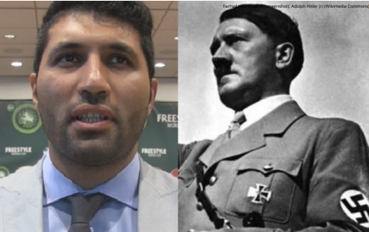
1. California lawyer called for genocide of Jews: “Hitler was right. We need a new Hitler.” An Iranian-American international lawyer in California has it out for the Jews and
Notes:
By Yakir Benzion, United With Israel
https://unitedwithisrael.org/we-need-a-new-hitler-california-refuses-to-disbar-hatemongering-lawyer/?utm_source=newsletters_unitedwithisrael_org&utm_medium=email&utm_content=California+Lawyer+Wants+%27A+New+Hitler%E2%80%99%2C+but+Won%27t+be+Disbarred%3B+Biden+Blasted+for+%27West+Bank%27+Embassy+Gaffe%3B+%E2%80%98We+will+Not+Stop+Striving+for+1+Million+Israelis+in+Judea%2C+Samaria%E2%80%99&utm_campaign=20210121_m161706122_California+Lawyer+Wants+%27A+New+Hitler%E2%80%99%2C+Won%27t+be+Disbarred%3B+Biden+Blasted+for+%27West+Bank%27+Embassy+Gaffe%3B+%E2%80%98We+will+Not+Stop+Striving+for+1+Million+Israelis+in+Judea%2C+Samaria%E2%80%99&utm_term=more_btn_light_png

Slide 37
says the world needs a new Hitler to help him, the blogging website Israellycool reported this week. Farhad Khorasani is something of an Iranian sports celebrity in Los Angeles, and his sport is wrestling – one of the the most popular sports in Iran.

Slide 38
He is also the founder and chair of the Iranian American Sport Association (IASA), which supposedly promoted sports and “bridges the sports gap between the two nations and support USA-Iran Sports Diplomacy.”

Slide 39
2. Nine out of 10 American Jews who were surveyed in a report said they are concerned by current antisemitic trends in their country. According to one popular conspiracy, “the Jews spread the pandemic for financial gain.”
Notes:
https://www.israeltoday.co.il/read/israel-expect-sharp-rise-in-antisemitism-in-2021/?utm_source=acfs&utm_medium=email&utm_term=all&utm_campaign=newsletter-2021-01-24
Most of you are likely familiar with the iconic Auschwitz gate…

Slide 40
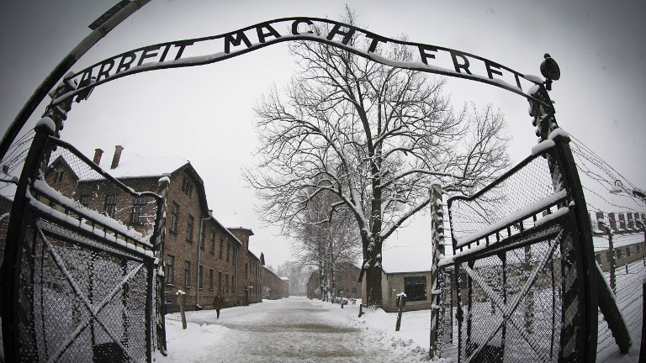
Notes:
Arbeit macht frei is a German phrase meaning "Work sets you free”
Auschwitz II Birkenau Slogan to deceive the inmates.
https://www.google.com/url?sa=i&url=https%3A%2F%2Fwww.timesofisrael.com%2Fholocaust-survivors-rush-to-beat-deadline-on-poland-property-claims%2F&psig=AOvVaw2YQFeEgZ_aPA-yZSEiGzYG&ust=1612068565694000&source=images&cd=vfe&ved=0CAIQjRxqFwoTCOCaltbtwu4CFQAAAAAdAAAAABAa

Slide 41
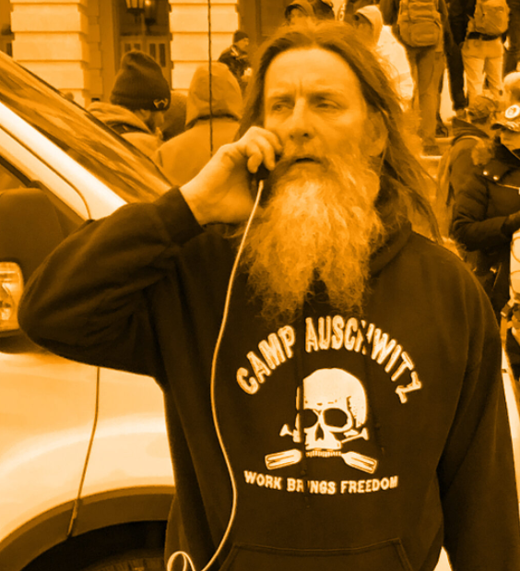
3. Robert Keith Packer, the man wearing a "Camp Auschwitz" sweatshirt, was arrested in Newport News, Virginia Wed. morning, Jan. 13, 2021.

Slide 43
Earlier this week, the online retailers Etsy and Teespring apologized after the Auschwitz-Birkenau Memorial and Museum found that vendors on their respective platforms were selling "Camp Auschwitz" T-shirts.

Slide 44
Etsy was not the only company to remove shirts with the phrase from its site — Teespring and TeeChip also took them down, according to Newsweek. Teespring added that it will make a donation to the Auschwitz museum.
Notes:
https://www.timesofisrael.com/etsy-removes-camp-auschwitz-shirt-from-its-online-store/

Slide 45
4. Abbas Ghassemi, a chemical engineering professor at the University of California Merced, will not be teaching in the spring semester at the school, after outrage last month over his anti-Semitic social media posts, the Merced Sun-Star reported Friday. One post, on Dec. 13, read,
Notes:
https://worldisraelnews.com/anti-semitic-professor-in-california-suspended-from-spring-semester/?utm_source=newsletters_worldisraelnews_com&utm_medium=email&utm_content=Israeli+Jets+Over+Syria+Endure+Barrage+of+Missiles%3B+Heroic+Female+Soldier+Helps+IDF+Shoot+Terrorist+Lunging+with+Knife%3B+Israel+Warns+%E2%80%98Disease+Has+Changed%E2%80%99&utm_campaign=20210126_m161761612_Israeli+Jets+Over+Syria+Endure+Barrage+of+Missiles%3B+Heroic+Female+Soldier+Helps+IDF+Shoot+Terrorist+Lunging+with+Knife%3B+Israel+Warns+%E2%80%98Disease+Has+Changed%E2%80%99&utm_term=_0D_0A_09_09_09_09_09_09_09_09_09_09Read+Now_0D_0A_09_09_09_09_09_09_09_09_09

Slide 46
“the Zionists and IsraHell interest have embedded themselves in every component of the American system, media, banking, policy, commerce … just a veneer of serving US interest and population — everyone pretends that is the case.”
Notes:
https://worldisraelnews.com/anti-semitic-professor-in-california-suspended-from-spring-semester/?utm_source=newsletters_worldisraelnews_com&utm_medium=email&utm_content=Israeli+Jets+Over+Syria+Endure+Barrage+of+Missiles%3B+Heroic+Female+Soldier+Helps+IDF+Shoot+Terrorist+Lunging+with+Knife%3B+Israel+Warns+%E2%80%98Disease+Has+Changed%E2%80%99&utm_campaign=20210126_m161761612_Israeli+Jets+Over+Syria+Endure+Barrage+of+Missiles%3B+Heroic+Female+Soldier+Helps+IDF+Shoot+Terrorist+Lunging+with+Knife%3B+Israel+Warns+%E2%80%98Disease+Has+Changed%E2%80%99&utm_term=_0D_0A_09_09_09_09_09_09_09_09_09_09Read+Now_0D_0A_09_09_09_09_09_09_09_09_09

Slide 47
Another included an image of a “Zionist brain” with labels such as “frontal money lobe,” “Holocaust memory centre,” “self-pity gland” and “world domination lobe.”
Notes:
https://worldisraelnews.com/anti-semitic-professor-in-california-suspended-from-spring-semester/?utm_source=newsletters_worldisraelnews_com&utm_medium=email&utm_content=Israeli+Jets+Over+Syria+Endure+Barrage+of+Missiles%3B+Heroic+Female+Soldier+Helps+IDF+Shoot+Terrorist+Lunging+with+Knife%3B+Israel+Warns+%E2%80%98Disease+Has+Changed%E2%80%99&utm_campaign=20210126_m161761612_Israeli+Jets+Over+Syria+Endure+Barrage+of+Missiles%3B+Heroic+Female+Soldier+Helps+IDF+Shoot+Terrorist+Lunging+with+Knife%3B+Israel+Warns+%E2%80%98Disease+Has+Changed%E2%80%99&utm_term=_0D_0A_09_09_09_09_09_09_09_09_09_09Read+Now_0D_0A_09_09_09_09_09_09_09_09_09

Slide 48
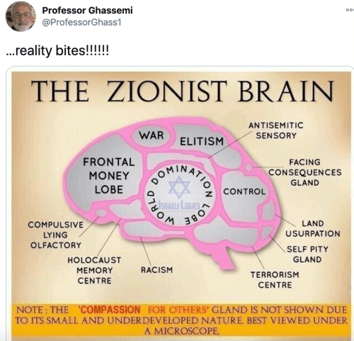
Notes:
https://www.google.com/url?sa=i&url=https%3A%2F%2Fwww.jweekly.com%2F2020%2F12%2F21%2Fuc-merced-professor-deletes-antisemitism-laden-twitter-account%2F&psig=AOvVaw1Dkoe6FAmiXqU-el48yKtV&ust=1612058165853000&source=images&cd=vfe&ved=0CAIQjRxqFwoTCNDZmefGwu4CFQAAAAAdAAAAABAD

Slide 49
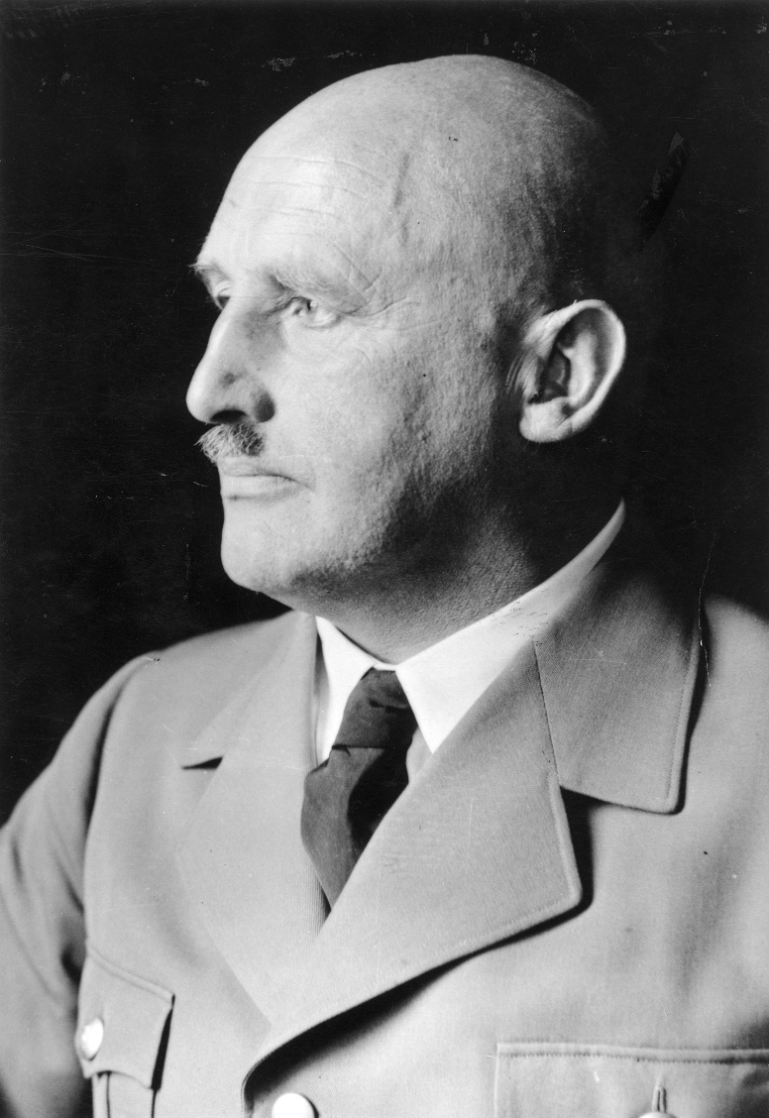
Julius Streicher 1885 –1946) was a member of the Nazi Party. He was the founder and publisher of the virulently antisemitic newspaper Der Stürmer, which became a central element of the Nazi propaganda machine.
Notes:
https://upload.wikimedia.org/wikipedia/commons/3/31/Bundesarchiv_Bild_146-1997-011-24%2C_Julius_Streicher.jpg

Slide 50
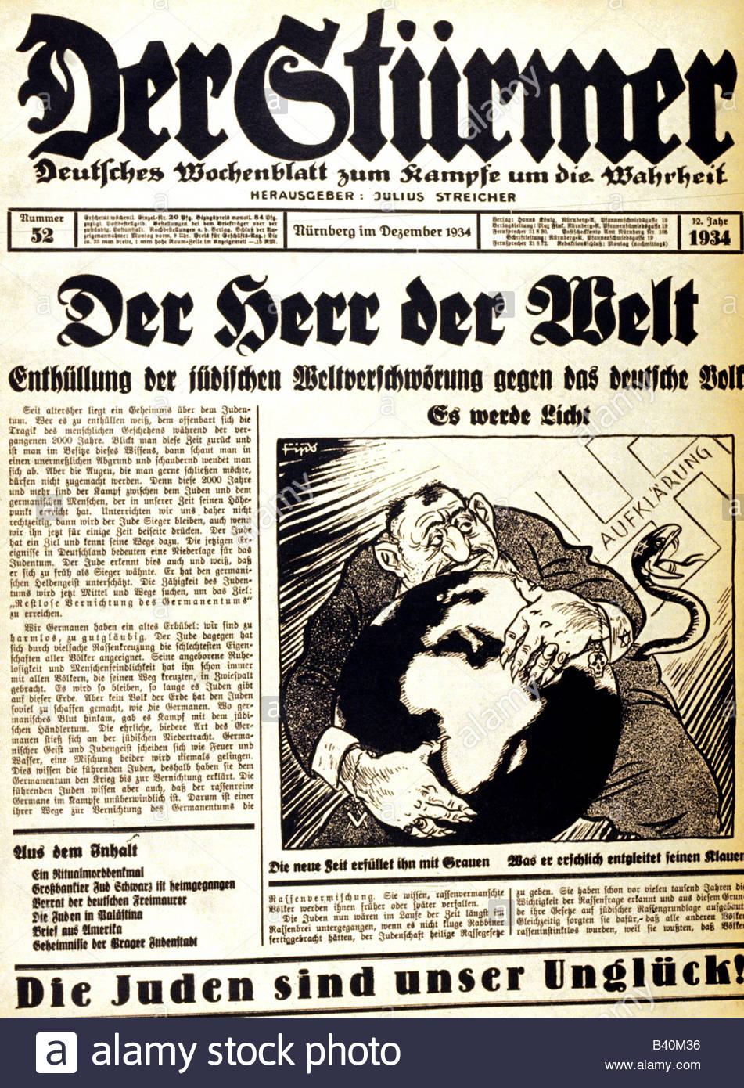
Der Sturmer accusation of Jewish ambition and plots to take over the world.
Protocols of the Elder of Zion, Rothschilds…

Slide 51
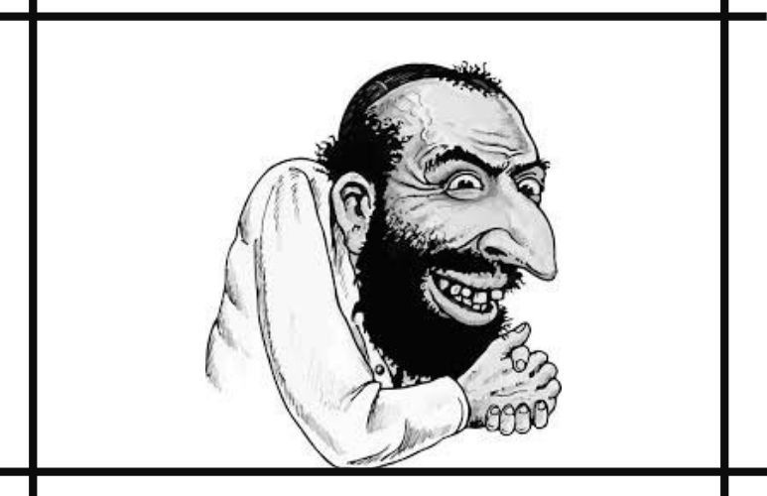
Notes:
https://www.media-diversity.org/wp-content/uploads/2020/09/Untitled-design-5-1.jpg

Slide 52
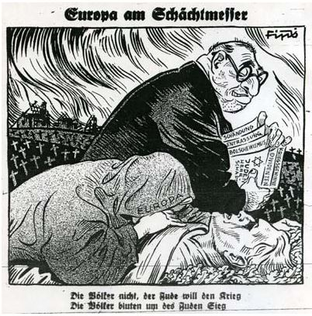
Jewish financial gain in war
Notes:
https://www.google.com/url?sa=i&url=http%3A%2F%2Fquadrant.org.au%2Fwp-content%2Fuploads%2F2014%2F07%2F%3FSD&psig=AOvVaw18i6JI9aSrqtJ5090GMDQN&ust=1612058514861000&source=images&cd=vfe&ved=0CAIQjRxqFwoTCIC7nY7Iwu4CFQAAAAAdAAAAABBY

Slide 53
Convicted of crimes against humanity in the Nuremberg trials, at the bottom of the scaffold he cried out "Heil Hitler!". When he mounted the platform, he delivered his last sneering reference to Jewish scripture, snapping "Purimfest!“ [Haman’s 10 sons.]
Notes:
Streicher's body, along with those of the other nine executed men and the corpse of Hermann Göring, was cremated at Ostfriedhof (Munich) and the ashes were scattered
https://en.wikipedia.org/wiki/Julius_Streicher

Slide 54
Notes:
https://www.google.com/url?sa=i&url=https%3A%2F%2Fwww.jweekly.com%2F2020%2F12%2F21%2Fuc-merced-professor-deletes-antisemitism-laden-twitter-account%2F&psig=AOvVaw1Dkoe6FAmiXqU-el48yKtV&ust=1612058165853000&source=images&cd=vfe&ved=0CAIQjRxqFwoTCNDZmefGwu4CFQAAAAAdAAAAABAD

Slide 55
Notes:
https://www.google.com/url?sa=i&url=https%3A%2F%2Fwww.jweekly.com%2F2020%2F12%2F21%2Fuc-merced-professor-deletes-antisemitism-laden-twitter-account%2F&psig=AOvVaw1Dkoe6FAmiXqU-el48yKtV&ust=1612058165853000&source=images&cd=vfe&ved=0CAIQjRxqFwoTCNDZmefGwu4CFQAAAAAdAAAAABAD

Slide 56
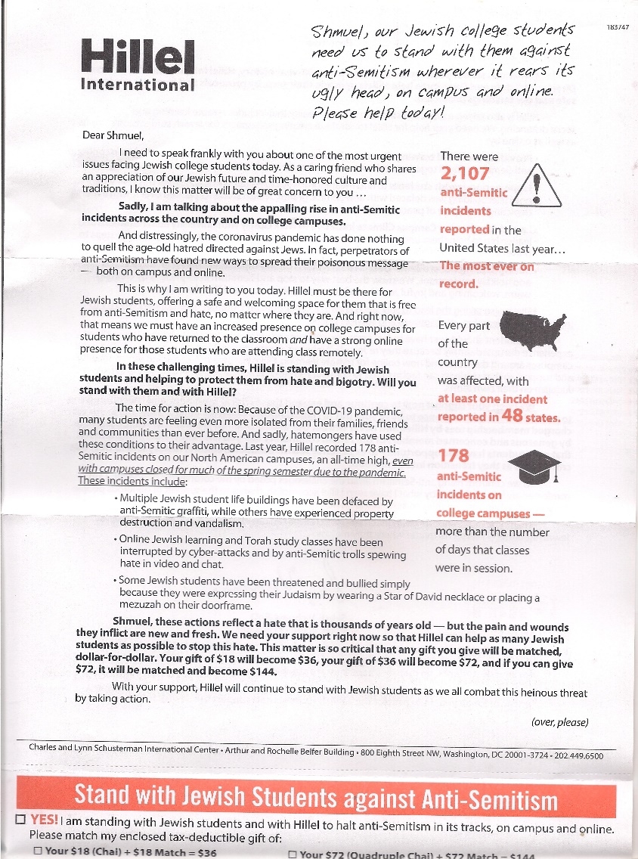
5.

Slide 57
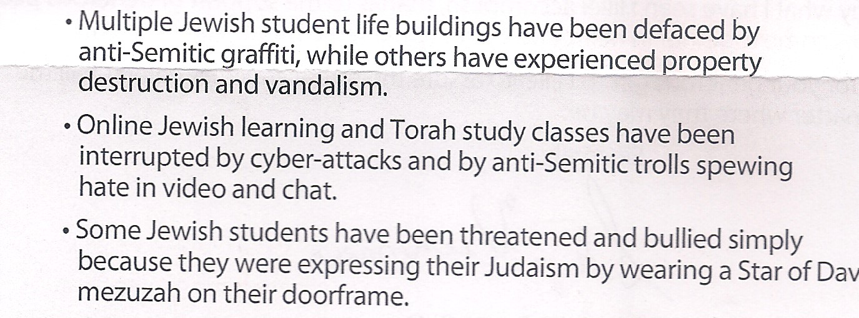

Slide 58
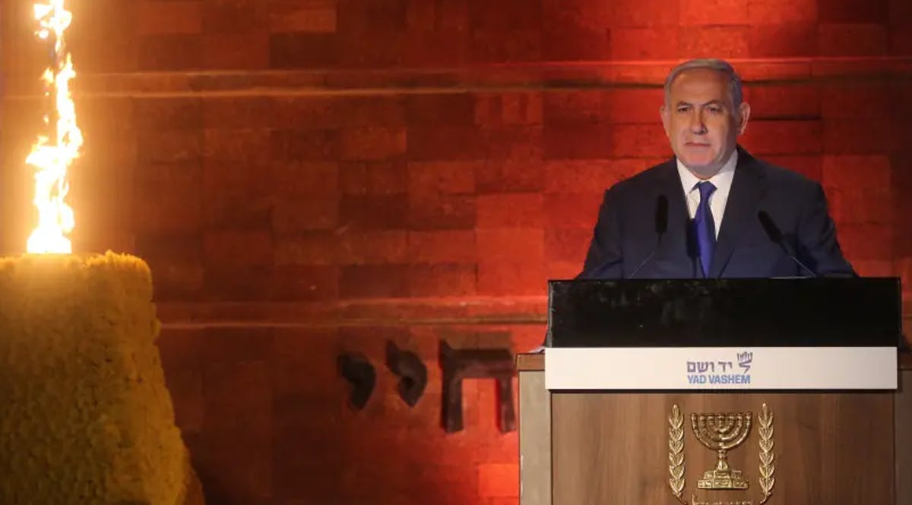
Notes:
https://vfinews.com/en/news/january-29-2021/netanyahu-never-again-is-israels-mission?subscribed=true&mc_cid=d668ed0bc5&mc_eid=UNIQID

Slide 59
Netanyahu: ‘Never Again’ is Israel’s Mission
Israel’s mission is to ensure the Jewish people will never be defenseless against those who seek to destroy it, Prime Minister Benjamin Netanyahu said in honor of International Holocaust Remembrance Day.
Notes:
https://vfinews.com/en/news/january-29-2021/netanyahu-never-again-is-israels-mission?subscribed=true&mc_cid=d668ed0bc5&mc_eid=UNIQID

Slide 60
We remember this darkest chapter in human history when a European country decided to adopt a policy and a program to exterminate every last Jew, mobilizing the full power of a modern developed industrial state to implement this incredible nightmare,” Netanyahu said.
Notes:
https://vfinews.com/en/news/january-29-2021/netanyahu-never-again-is-israels-mission?subscribed=true&mc_cid=d668ed0bc5&mc_eid=UNIQID

Slide 61
The world has not learned the lessons of the Holocaust and eradicated antisemitism, the prime minister lamented.
Notes:
https://vfinews.com/en/news/january-29-2021/netanyahu-never-again-is-israels-mission?subscribed=true&mc_cid=d668ed0bc5&mc_eid=UNIQID

Slide 62
“The disease of antisemitism continues to contaminate and spread,” Netanyahu added. “A vaccine to safeguard against the antisemitism virus has yet to be found.” (JPost / VFI News)
Notes:
https://vfinews.com/en/news/january-29-2021/netanyahu-never-again-is-israels-mission?subscribed=true&mc_cid=d668ed0bc5&mc_eid=UNIQID

Slide 63
Outline: Pray for the Shalom of Jerusalem – Why?
Enters G-d’s promises to Israel
Current anti-Semitism
How to bless Israel
Outward expression
Inward expression

Slide 64
Application:

Slide 65
1. ^{T’hillim/Ps 122.6} Seek the shalom of Jerusalem, they shall have shalom that love you.
שַׁאֲלוּ שְׁלוֹם יְרוּשָׁלִָם; יִשְׁלָיוּ אֹהֲבָיִךְ.
Sha’alu shalom Yerusaliyim, yishlav ohavayikh
Notes:
Both in prayer, in finance, in voting, in speaking up, and in evangelism. Invite Jewish neighbors with joy. Purim, Passover, SuperBowl

Slide 66
19 / 168 filled | Midnight | 1 a.m. | 2 a.m. | 3 a.m.
Sunday | Louise Warfare children | Kathi Joy, music | Shmuel Sweet reality | Greg
Monday | Cathy A | Ramona | Amy Stewart | Amy Richardson
Notes:
- Password protected Joomla page with short registration form
- Staff can change the password at any time. Notify users of the new password.
- Staff can edit notes, instructions, messages shown to the users.
- Calendar of the week shown with the ability for any user to sign up for a 1/2 - 1 hour block
- Users can edit / delete their entry at any time
- Users may also optionally indicate that they are "attending" the event
- After the time has passed, the user can submit a short report
- Users can look backwards or forward through the calendar, either to review past signups, or to volunteer for times in the future

Slide 67
That’s why we did March of
Remem-brance.

Slide 68
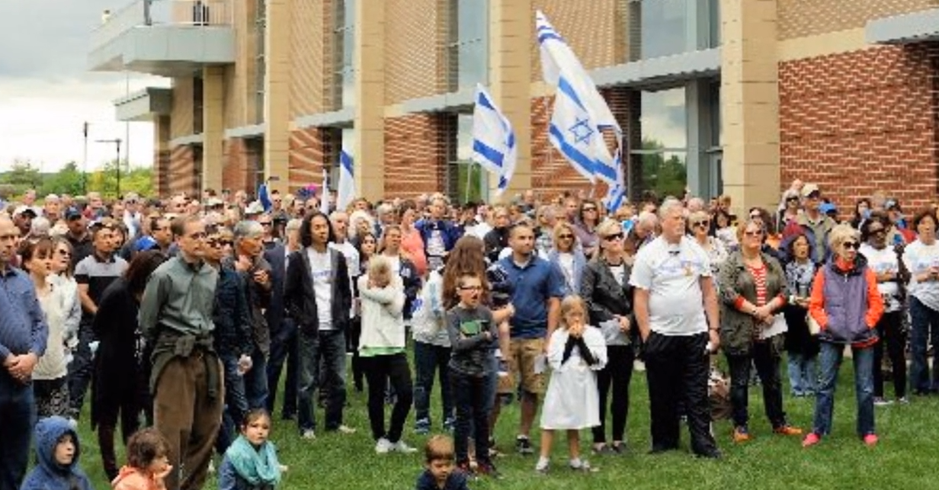
March of Remembrance around
Bartle Hall

Slide 69
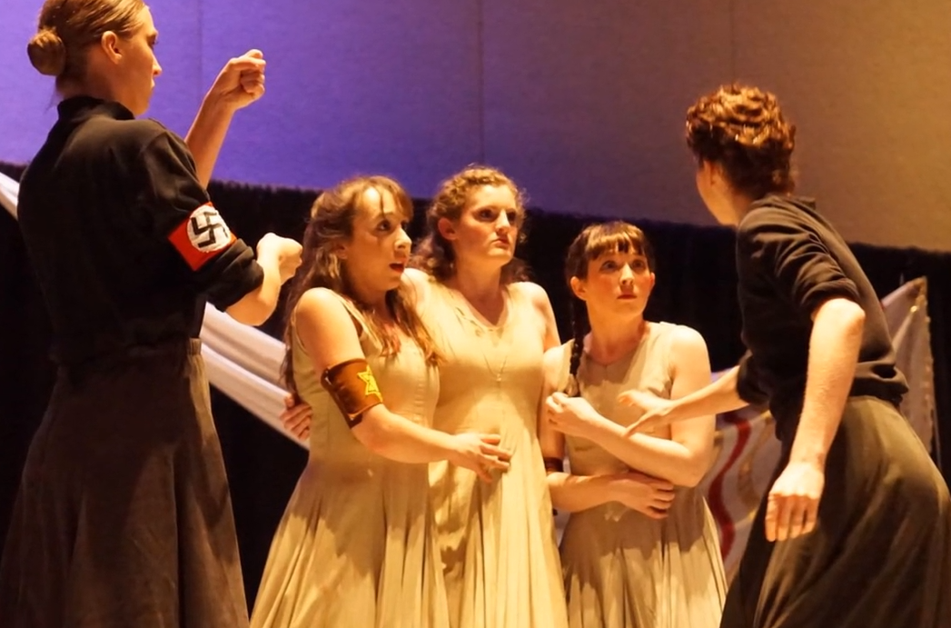
choreography

Slide 70
2. Walk in the blessing of Avraham.
^{Ber/Gen 12.3} My desire is to bless those who bless you.

Slide 71
^{Lk 7.1-5} When Yeshua finished all His drash in the hearing of the people, He entered Capernaum. Now a certain centurion had a valued slave, who was ill and about to die. When he heard about Yeshua, he sent Jewish elders to Him,

Slide 72
^{Lk 7.1-5} asking Him to come and save his slave. When they came to Yeshua, they begged Him earnestly, saying, “He is worthy for You to grant this, for he loves our people and even built our synagogue.”
Notes:
Share Salvation with Jewish people as you are given opportunity!

Slide 73
3. Learn about past and rising Jewish persecution. Prep for ^{Zekh 14} “For I will gather all the nations
against Yerushalayim for war.
The city will be taken,
the houses will be rifled,
the women will be raped,
and half the city will go into exile;

Slide 76
4. ^{Ro 11.11} Salvation has come to the Gentiles, to provoke Israel to jealousy.
Express gratefulness to Jewish people for giving you all you value most: scripture, G-d, Messiah
Be the best and most Messiah like.
Notes:
Big transition from Jewish outreach and compassion to our own inreach…

Slide 77
Rare. Beautiful.
Stolen. Crashed. Vandalized.
Set on fire.
Dumped into the river.
Bent and broken.
(answers today)
Notes:
https://www.dropbox.com/sh/jh56ict687pq6fi/AAAV3RieS7jl0EsLF_Qm2PVra/Ellel%20Ministries%20Introduction%20Videos?dl=0&preview=RESTORED+TO+RUN+002.mp4&subfolder_nav_tracking=1

Slide 78
Notes:
3:40 to the end.
https://www.dropbox.com/sh/jh56ict687pq6fi/AAAV3RieS7jl0EsLF_Qm2PVra/Ellel%20Ministries%20Introduction%20Videos?dl=0&preview=RESTORED+TO+RUN+002.mp4&subfolder_nav_tracking=1

Slide 79
Session 1 Foundations for Freedom, the need for the healing ministry and what it is, the key of making Yeshua Lord of every area of our lives.
Session 2 1:30 to 2:30 - Freedom from Bad Roots
Session 3 3:00 to 4:00 - Freedom through Forgiveness and from Ungodly Soul Ties (relationship ties)

Slide 80
Sunday Worship and welcome 10:00 to 10:30
Session 4 10:30 to 11:30 - Freedom From the effects of Hurt Pain and Rejection
Session 5 12:00 to 1:00 - Freedom from Generational Iniquity
Lunch from 1:00 to 2:00

Slide 81
Session 6 2:00 to 3:00 - Freedom from the Enemy (teaching on deliverance)
Session 7 Prayer Ministry time from 3:00 to 4:00
Session 8 4:00 to 4:30- Moving On In the Lord

Slide 82
Actions
Preliminary Interest signup
Housing the team

Slide 83
Outline: Pray for the Shalom of Jerusalem – Why?
Enters G-d’s promises to Israel
Current anti-Semitism
How to bless Israel
Outward expression
Inward expression

