Slide 1
e-handout
To have these notes
without taking notes
Go to OrHaOlam.com
Click on downloads,
messages, 2021

Slide 2
Notes:
Brian Kaufman, I think

Slide 4
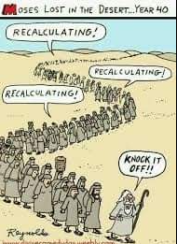
Notes:
Next: scholarly debate between Lucy and Linus

Slide 5
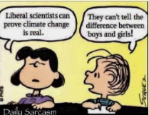
Notes:
Lucy and Linus

Slide 7
Notes:
https://www.frc.org/get.cfm?i=WA21C56&f=WU21C18
Tony Perkins

Slide 8
Whatever the Oral Roberts men's basketball team manages to do on the court can't obscure the dangerous and hateful ideology of its core institution."
Notes:
https://www.frc.org/get.cfm?i=WA21C56&f=WU21C18
Tony Perkins

Slide 9
“It is the school's discriminatory and hateful anti-LGBTQ+ policy that fans should protest as the Golden Eagles advance in the tournament... [A]s part of their honor code, the university requires students to abide
Notes:
https://www.frc.org/get.cfm?i=WA21C56&f=WU21C18

Slide 10
by a pledge saying that they will not engage in 'homosexual activity,' and that they will not be united in marriage other 'than the marriage between one man and one woman.’”
Note: “discriminatory and hateful”
Notes:
https://www.frc.org/get.cfm?i=WA21C56&f=WU21C18

Slide 11
It seems that the culture is against our Biblical lifestyle, and we are labelled as hateful, with consequences.
How can we be optimistic, have hope?

Slide 13
The focus of the service is the resurrection of the Messiah to eternal life. He is the firstfruits from the dead, symbolized by the barley harvest.

Slide 14
Eternal life implied in existence
Logic of Eden
Eternity in our hearts
Transhumanism
Eternal life in Festivals: Firstfruits
Evidence of Messiah’s Resurrection to Eternal Life
Notes:
Eternal life is built into the warp and woof of our being.

Slide 15
Therefore we have hope even if losing all
Losing: CNN on Gov Noem, Lil Nas X
Winning: small groups, healing, Shavuot Carole Ward
CNN on gender ID, military

Slide 16
A.Eternal Life in the Logic of Eden
^{Ber./Gen 2.15-17} Then Adoni Elohim took the man and gave him rest in the Garden of Eden in order to cultivate and watch over it. Then Adoni Elohim commanded the man saying,

Slide 17
^{Ber./Gen 2.15-17} “From all the trees of the garden you are most welcome to eat. But of the Tree of the Knowledge of Good and Evil you must not eat. For when you eat from it, you most assuredly will die!
Notes:
Gave him rest ~ Yeshua take my yoke…rest to your souls.
Implication is that if they avoid the Tree of KoGaE, they would live…forever.
Physical death is really a mercy. If we lived forever in this depraved state, we would do anything. No consequence. Eternal consequence plus or minus.

Slide 18
B. Eternity in our hearts
^{Kohelet/Ecc 3.11}He has made everything suited to its time;
also, he has given human beings an awareness of eternity;
אֶת-הַכֹּל עָשָׂה יָפֶה בְעִתּוֹ;
גַּם אֶת-הָעֹלָם נָתַן בְּלִבָּם

Slide 19
^{Kohelet/Ecc 3.11} but in such a way that they can’t fully comprehend, from beginning to end, the things God does.
מִבְּלִי אֲשֶׁר לֹא-יִמְצָא הָאָדָם אֶת-הַמַּעֲשֶׂה אֲשֶׁר-עָשָׂה הָאֱלֹהִים, מֵרֹאשׁ וְעַד-סוֹף

Slide 20
^{1 Cor. 15.16-19} For if the dead are not raised, not even Messiah has been raised. And if Messiah has not been raised, your faith is futile—you are still in your sins. Then those also who have fallen asleep in Messiah have perished. If we have hoped in Messiah in this life alone, we are to be pitied more than all people.

Slide 21
C. Eternal life embedded in Transhumanism
Notes:
New word? Transvestite, transgender, transitioning

Slide 22
transhumanism
A belief that humans should strive to transcend the physical limitations of the mind and body by technological means.
Notes:
https://www.wordnik.com/words/transhumanism
Sent to me by Vicki Kline

Slide 23
transhumanism
a philosophy favouring the use of science and technology, especially neurotechnology, biotechnology, and nanotechnology, to overcome human limitations and improve the human condition
Notes:
Https://www.wordnik.com/words/transhumanism
Sent to me by Vicki Kline

Slide 24
IIlustrative: the concept of transhumanism as it evolves over time
Notes:
(Photo: transhumanity.net)
https://www.israel365news.com/90921/transhuman-tendency-man-machines-trumping-god/

Slide 25
Russian transhumanists and life extensionists Alexey Turchin and Maxim Chernyakov suggests combatting aging by replacing diseased organs with bioengineered ones or staying alive in a nanotech body, when that technology develops. If those methods are unavailable or unsuccessful, Turchin recommends cryonics, or freezing the body
Notes:
https://www.israel365news.com/188609/scientists-propose-surrounding-the-sun-with-supercomputer-to-resurrect-the-dead/

Slide 26
Another method they explore is referred to as ”indirect mind uploading”, or “digital immortality”. This involves the preservation of data about a person to allow for future reconstruction by a powerful computer artificial intelligence (AI). Turchin is already doing this in his own life by recording every detail of his life as it happens.
Notes:
https://www.israel365news.com/188609/scientists-propose-surrounding-the-sun-with-supercomputer-to-resurrect-the-dead/

Slide 27
One possible scenario would involve downloading the digitalized version of the individual into a host body reconstructed from the original via cloning. Cells for the cloning process could be obtained by digging up the graves of the deceased. “If we want to do it with a good probability of success, then count on [the year] 2600, to be sure.”
Notes:
https://www.israel365news.com/188609/scientists-propose-surrounding-the-sun-with-supercomputer-to-resurrect-the-dead/

Slide 28
The major obstacle the two researchers foresaw to the technologies required to manifest immortality and resurrection for billions of people would be a sophisticated AI and the energy required to power the systems. Their vision included power being provided by a Dyson Sphere,
Notes:
https://www.israel365news.com/188609/scientists-propose-surrounding-the-sun-with-supercomputer-to-resurrect-the-dead/

Slide 29
a hypothetical megastructure that completely encompasses a star, in this case, the sun, and captures a large percentage of its power output. In this case, a Dyson Sphere around the sun would produce roughly 400 septillion watts per second.
Notes:
https://www.israel365news.com/188609/scientists-propose-surrounding-the-sun-with-supercomputer-to-resurrect-the-dead/

Slide 30
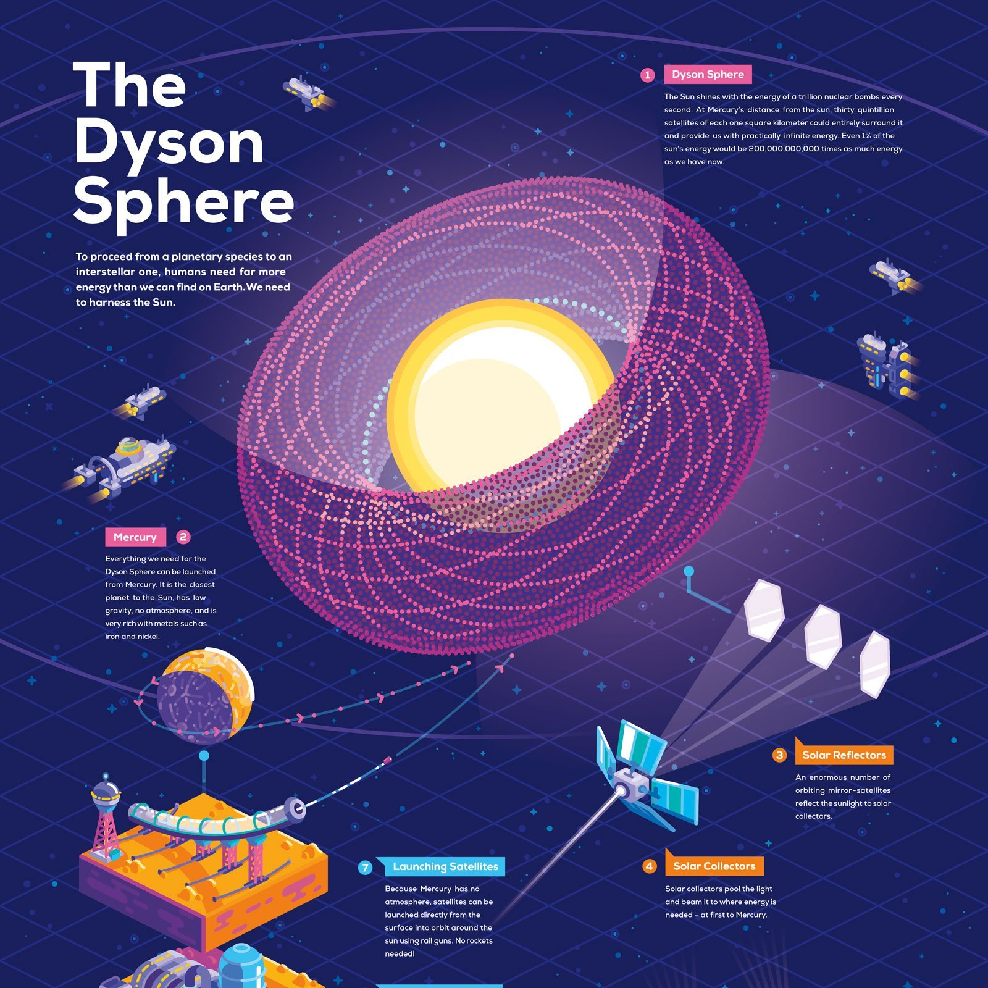
Notes:
https://cdn.shopify.com/s/files/1/0254/0516/1520/products/Dyson-Sphere_2048x2048_75793541-bb25-4b3d-b14c-805f84010bf2_2048x.jpg?v=1577013347

Slide 31
Notes:
https://uncrate.com/p/2018/12/building-a-dyson-sphere.jpg

Slide 32
Raymond Kurzweil, born 1948, is an American inventor and futurist.
Notes:
https://www.israel365news.com/188609/scientists-propose-surrounding-the-sun-with-supercomputer-to-resurrect-the-dead/

Slide 33
Kurzweil has joined the Alcor Life Extension Foundation, a cryonics company. In the event of his declared death, Kurzweil plans to be perfused with cryoprotectants, vitrified in liquid nitrogen, and stored at an Alcor facility in the hope that future medical technology will be able to repair his tissues and revive him.
Notes:
https://en.wikipedia.org/wiki/Ray_Kurzweil

Slide 34
Conclusion #1: Eternal life is an expectation planted deep in the human spirit. But how can we obtain it?

Slide 36
Eternal life implied in existence
Logic of Eden
Eternity in our hearts
Transhumanism
Eternal life in Festivals: Firstfruits
Evidence of Messiah’s Resurrection to Eternal Life

Slide 37
Therefore hope even if losing all
Losing: CNN on Gov Noem,
Winning: small groups, healing, Shavuot Carole Ward
CNN on gender ID, military

Slide 38
The focus of the service is the resurrection of the Messiah to eternal life. He is the firstfruits from the dead, symbolized by the barley harvest.

Slide 39
^{Vayikra/Lev 23.5-8} During the first month, on the fourteenth day of the month in the evening, is Adoni’s Passover. On the fifteenth day of the same month is the Feast of Matzot to Adoni. For seven days you are to eat matzah.
Notes:
Hag Festival Matzot = Pesakh

Slide 40
^{Vayikra/Lev 23.5-8} On the first day you are to have a holy convocation and you should do no regular work...On the seventh day is a holy convocation, when you are to do no regular work.”

Slide 41
1st day = work cessation Mar. 27 Exodus from Egypt…Seder meal
7th day = work cessation Apr. 3 Reed Sea crossing…
Notes:
The Baal Shem Tov [founder of Hassidism] remarked that on the last day of Passover, the rays of the messianic redemption are already shining bright.
He instituted that a special meal be held during the waning hours of the day.
Known as "Moshiakh's Meal," this rich and multifaceted custom was vigorously encouraged by the Rebbe, Rabbi Menachem M. Schneerson.
Mandatory for Jews or Gentiles? NO, but celebratory

Slide 42
^{Lev 23.9-11} Adoni spoke to Moses saying: “Speak to people of Israel and tell them: When you have come into the land which I give to you, and reap its harvest, then you are to bring the omer of the firstfruits of your harvest to the kohen.

Slide 43
^{Lev 23.9-11} He is to wave the omer before Adoni, to be accepted for you. On the morrow after the Shabbat, the kohen is to wave it.
Notes:
There is NOTHING in Jewish liturgy, the Siddur, the Makhzor, to celebrate this holiday in post-Biblical times. To Messianics, it is the BIG event. The biggest holiday. Not enough Messianic songs about the Resurrection.

Slide 44
There are two interpretations as to the "morrow after the Shabbat" phrase, for firstfruit waving.
Monday, Mar 29 or
Sunday Apr 4.
We are doing barley / firstfruits / resurrection today on Sat Apr 3.

Slide 45
In 325 A.D., the Council of Nicaea, established a formula for the date of Resurrection celebration as the Sunday following the full moon that falls on or after the spring equinox = Mar. 21. Separated from Heb cal
Notes:
https://www.learnreligions.com/how-date-of-easter-is-calculated-542413
Gruber Church and the Jews p. 28-29 But sometimes Passover and the Church’s Resurrection Day are in sync.

Slide 46
^{1 Cor. 15.20-23} The Messiah has been raised from the dead, the firstfruits of those who have died. For since death came through a man, also the resurrection of the dead has come through a man… But each in his own order: the Messiah is the firstfruits.

Slide 47
^{Ro 8.15-16} For you did not receive the spirit of slavery to fall again into fear; rather, you received the Spirit of adoption, by whom we cry, “Abba! Father!” The Ruakh Himself bears witness with our spirit that we are children of God.

Slide 48
^{Lev 23.15-16} From the day after the day of rest — that is, from the day you bring the sheaf for waving — you are to count seven full weeks, until the day after the seventh week; you are to count fifty days; and then you are to present a new grain offering to Adonai .' "
Notes:
The count connects Resurrection with Ruakh receiving

Slide 50
Eternal life implied in existence
Logic of Eden
Eternity in our hearts
Transhumanism
Eternal life in Festivals: Firstfruits
Evidence of Messiah’s Resurrection to Eternal Life

Slide 51
Therefore hope even if losing all
Losing: CNN on Gov Noem,
Winning: small groups, healing, Shavuot Carole Ward
CNN on gender ID, military

Slide 52
Evidence for the Resurrection that Even Traditional Jewish Historians Accept
Jonathan Mann
Messiah Conference 2019

Slide 53
Notes:
Jonathan Mann: I look forward to Messiah conference every year - the worship, ....Joshua Aaron and Aaron Shust, teachings, catching up with friends . . . I have to admit that I am weird because what I look forward to the most is going down to the Jews for Judaism to Dialogue and debate on whether the resurrection of Yeshua was actually an event that occurred in history.
I have been involved in studying this evidence for the past 5-6 years. Throughout college I have been in numerous conversations with atheists, agnostics, Muslims and other skeptics debating this evidence for the resurrection. I have gotten to know some of the top scholars in this area including Dr. Gary Habermas, Dr. William Lane Craig, Dr. Mike Licona, and have been able to debate this evidence with a couple of leading Orthodox Jewish counter missionaries.

Slide 54
Notes:
Here is a picture of Erik and I from Tuesday, I was have actually spent time on Monday, Tuesday, and Wednesday at the tent – about 7 hours total at the tent --- You are here because you care about your Jews – you believe I am wrong about Yeshua, I have left Judaism and you want to bring me into traditional Judaism. – I am a Messianic Jew because Yeshua rose from the dead. It’s possible I am wrong about this, this is the conclusion I have come to after my examination of the evidence. I want to know if I am wrong, truth is what is most important, if you could show me that Yeshua did not rise from the dead I will leave Messianic Judaism

Slide 55
If Yeshua did not rise from the dead, Messianic Judaism is false.
Notes:
In 1 Cor 15 Paul says that if Yeshua did not rise from the dead our faith is meaningless and we have no hope He started – there is no evidence for this event happening in history

Slide 56
Notes:
These counter missionaries brought in a scholar who use to teach at Ben Gurion University in Israel to debunk my argument for the resurrection and a younger Jewish guy to watch this happen (both guys are not in this picture . . . Result After, their scholar had not objections to the reliability of the facts – he respected scholarship
I asked the same question – which has superior evidence? The central argument that the former head of Jews for Judaism – Akiva – when I showed him why his central argument against the resurrection – that Yeshua did not exist – he said “I have no evidence for my position.”

Slide 57
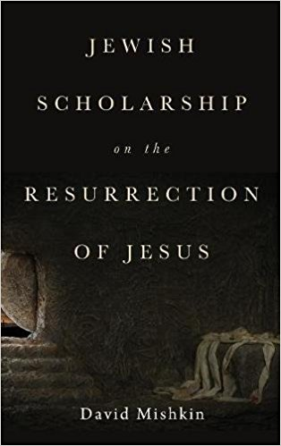
Summary
Yeshua died by crucifixion.
Yeshua was buried in a nearby tomb.
Yeshua’s tomb was found empty.
The disciples had experiences they believed were appearances of the risen Yeshua.
Paul had an experience he believed was an appearance of the risen Yeshua.
Notes:
What is the best explanation of the facts?

Slide 58
What I am not arguing:
“Yeshua rose from the dead because most traditional Jewish historians accept these five facts.”

Slide 59
What I am arguing:
“The best historical explanation of these five facts that are well evidenced and accepted by most traditional Jewish historians is that Yeshua rose from the dead.”

Slide 60
What historical explanation do traditional Jewish historians provide?

Slide 61
Dr. Paula Fredriksen
“I know in their own terms what they saw was the raised Jesus. That’s what they say and then all the historical evidence we have afterwards attest to their conviction that that’s what they saw. I’m not saying that they really did see the raised Jesus. I wasn’t there. I don’t know what they saw. But I do know that as a historian that they must have seen something.”
- Interview by Peter Jennings in The Search for Jesus (ABC), July 2000, qtd. in The Case for the Resurrection of Jesus, pg. 60.

Slide 62
Dr. Joseph Klausner
“There can be no question but that some of the ardent Galilaeans saw their lord and Messiah in a vision.”
- Jesus of Nazareth: His Life, Times, and Teaching, pg. 359

Slide 63
Were these experiences subjective visions or physical appearances?

Slide 64
Dr. Naomi M. Simon’s study
4% of grieving adults experience visual hallucinations
Notes:
MD – Harvard Medical School, Professor at NYU in the Department of Psychiatry
Director, Anxiety and Complicated Grief Disorders

Slide 65
Dr. Gary Sibcy
“I have surveyed the professional literature (peer-reviewed journal articles and books) written by psychologists, psychiatrists, and other relevant healthcare professionals during the past two decades and have yet to find a single documented case of a group hallucination, that it, an event for which more person purportedly shared in a visual or other sensory perception where there was clearly no external referent.”
- Email to Gary Habermas, March 10, 2009, qtd. in Michael Licona, The Resurrection of Jesus: A New Historiographical Approach, pg. 484.
Notes:
Licensed Clinical Psychologist, Piedmont Psychiatric Center, Centra Health Hospitals, Virginia

Slide 66
Dr. Gary Habermas and Dr. Joseph Bergeron
“simultaneous identical collective hallucinations are not found in peer-reviewed medical literature . . . the concept of collective hallucination is not part of current psychiatric understanding . . .”
- “The Resurrection of Jesus: A Clinical Review of Psychiatric Hypotheses for the Biblical Story of Easter,” Irish Theological Quarterly, 80 (2), 162

Slide 67
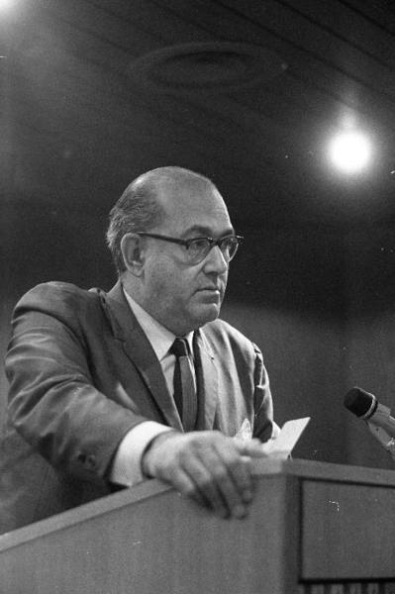
Dr. Pinchas Lapide
“Already at the beginning of the first century, the chief Pharisaic schools of Hillel and Shammai believed in the bodily resurrection.”
- The Resurrection of Jesus: A Jewish Perspective, pg. 57

Slide 68
Paul’s trial before the Sanhedrin (Acts 23:6-7, 9)
“When Paul noticed that some were Sadducees and others were Pharisees, he called out in the council, ‘Brothers, I am a Pharisee, a son of Pharisees. I am on trial concerning the hope of the resurrection of the dead.’ When he said this, a dissension began between the Pharisees and the Sadducees, and the assembly was divided. . . certain scribes of the Pharisees’ group stood up and contended, ‘We find nothing wrong with this man. What if a spirit or an angel has spoken to him?’”

Slide 69
1 Corinthians 15:20
“But now Messiah has been raised from the dead, the firstfruits of those who have fallen asleep.”

Slide 70
1 Corinthians 15:11
“Whether then it is I or they, so we proclaim, and so you believed.”

Slide 71
Dr. Jon D. Levenson
“In both the Pauline and rabbinic texts at hand, the beneficiaries of the new way of being are not disembodied spirits.”
- Resurrection and the Restoration of Israel: The Ultimate Victory of the God of Life, pg. 189

Slide 72
Acts 13:36-37
“For after David had served God’s purpose in his own generation, he went to sleep and was laid with his fathers and saw decay. But the One whom God raised up did not see decay.”

Slide 73
Dr. Yehezel Kaufmann
“There are scholars who opine that the belief in Jesus’ resurrection derived wholly from his appearance before his disciples (that is, in a vision unconnected with bodily resurrection), which opinion is, however, in error. . . . The appearance . . . Of the ‘spirit’ or ghost of the departed in a vision would not have been a miracle.”
- Christianity and Judaism: Two Covenants, pg. 133

Slide 74
Dr. Gary Habermas and Dr. Joseph Bergeron
“the bereavement experiences actually convince those grieving that the individual is dead.”
- “The Resurrection of Jesus: A Clinical Review of Psychiatric Hypotheses for the Biblical Story of Easter,” Irish Theological Quarterly, 80 (2), 171

Slide 75
Dr. Pinchas Lapide
“no vision or hallucination is sufficient to explain such a revolutionary transformation [of the disciples].”
- The Resurrection of Jesus: A Jewish Perspective, pgs. 125-26

Slide 76
Notes:
If the disciples hallucinated, Rome or the Sanhedrin could have disproven the resurrection by pointing people to the occupied tomb, just outside Jerusalem.

Slide 77
Rabbi Yisroel Blumenthal

Slide 78
Rabbi Yisroel Blumenthal
“There are many scenarios that would have the disciples believe that their leader is resurrected which are more plausible than an actual resurrection . . . [it is] possible that some of the disciples removed the body from the grave . . . If this were the case it is obvious that the disciples who actually removed the body would not believe the resurrection story, but the rest of the following would have no problem believing it.”
- jewsforjudaism.org/knowledge/articles/resurrection/

Slide 79
It is possible that . . .
Daniel ate pork and lied that he ate only vegetables.
Maimonides secretly believed Yeshua was the Messiah.
Neil Armstrong landing on the moon was fake.

Slide 80
DOES THE THEORY EXPLAIN THE FACTS?
Yeshua died by crucifixion.
Yeshua was buried in a nearby tomb.
Yeshua’s tomb was found empty.
The disciples had experiences they believed that were appearances of the risen Yeshua.
Paul had an experience he believed was an appearance of the risen Yeshua.

Slide 81
Dr. Joseph Klausner
“Here again, it is impossible to suppose that there was any conscious deception.”
- Jesus of Nazareth: His Life, Times, and Teaching, pg. 359.

Slide 82
Dr. Pinchas Lapide
“Any kind of deception is excluded in any case, be it the theft of the body, trance, or the invention of a miracle.”
- The Resurrection of Jesus: A Jewish Perspective, pg. 97
Notes:
The Jews for Judaism scholar –– Taught at Ben Gurion University – story – the facts

Slide 83
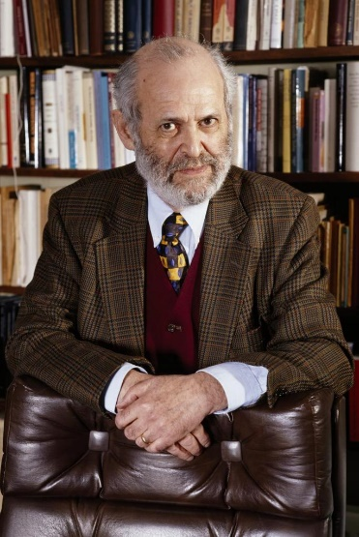
Dr. Geza Vermes
“All in all, none of the six suggest theories stands up to stringent scrutiny.”
- The Resurrection: History and Myth, pg. 148

Slide 84
The Historical Facts
Yeshua died by crucifixion.
Yeshua was buried in a nearby tomb.
Yeshua’s tomb was found empty.
The disciples had experiences they believed were appearances of the risen Yeshua.
Paul had an experience he believed was an appearance of the risen Yeshua.
Notes:
The Jews for Judaism scholar –– Taught at Ben Gurion University – story – the facts Stolen body

Slide 85
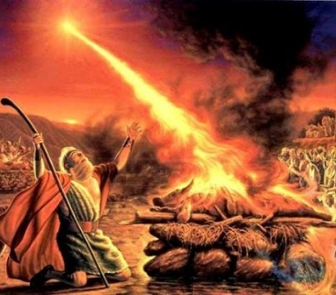
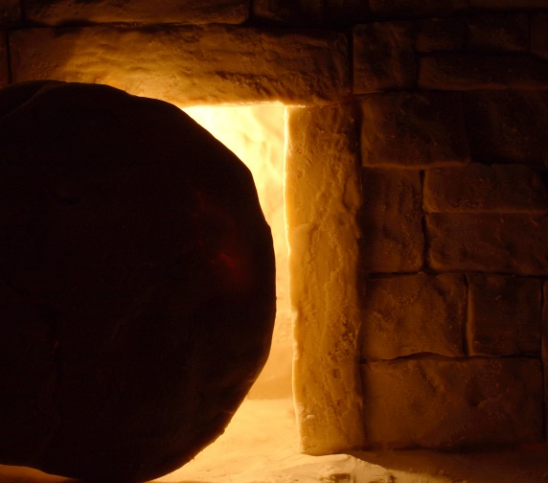
Comparison of Historical Evidence

Slide 86
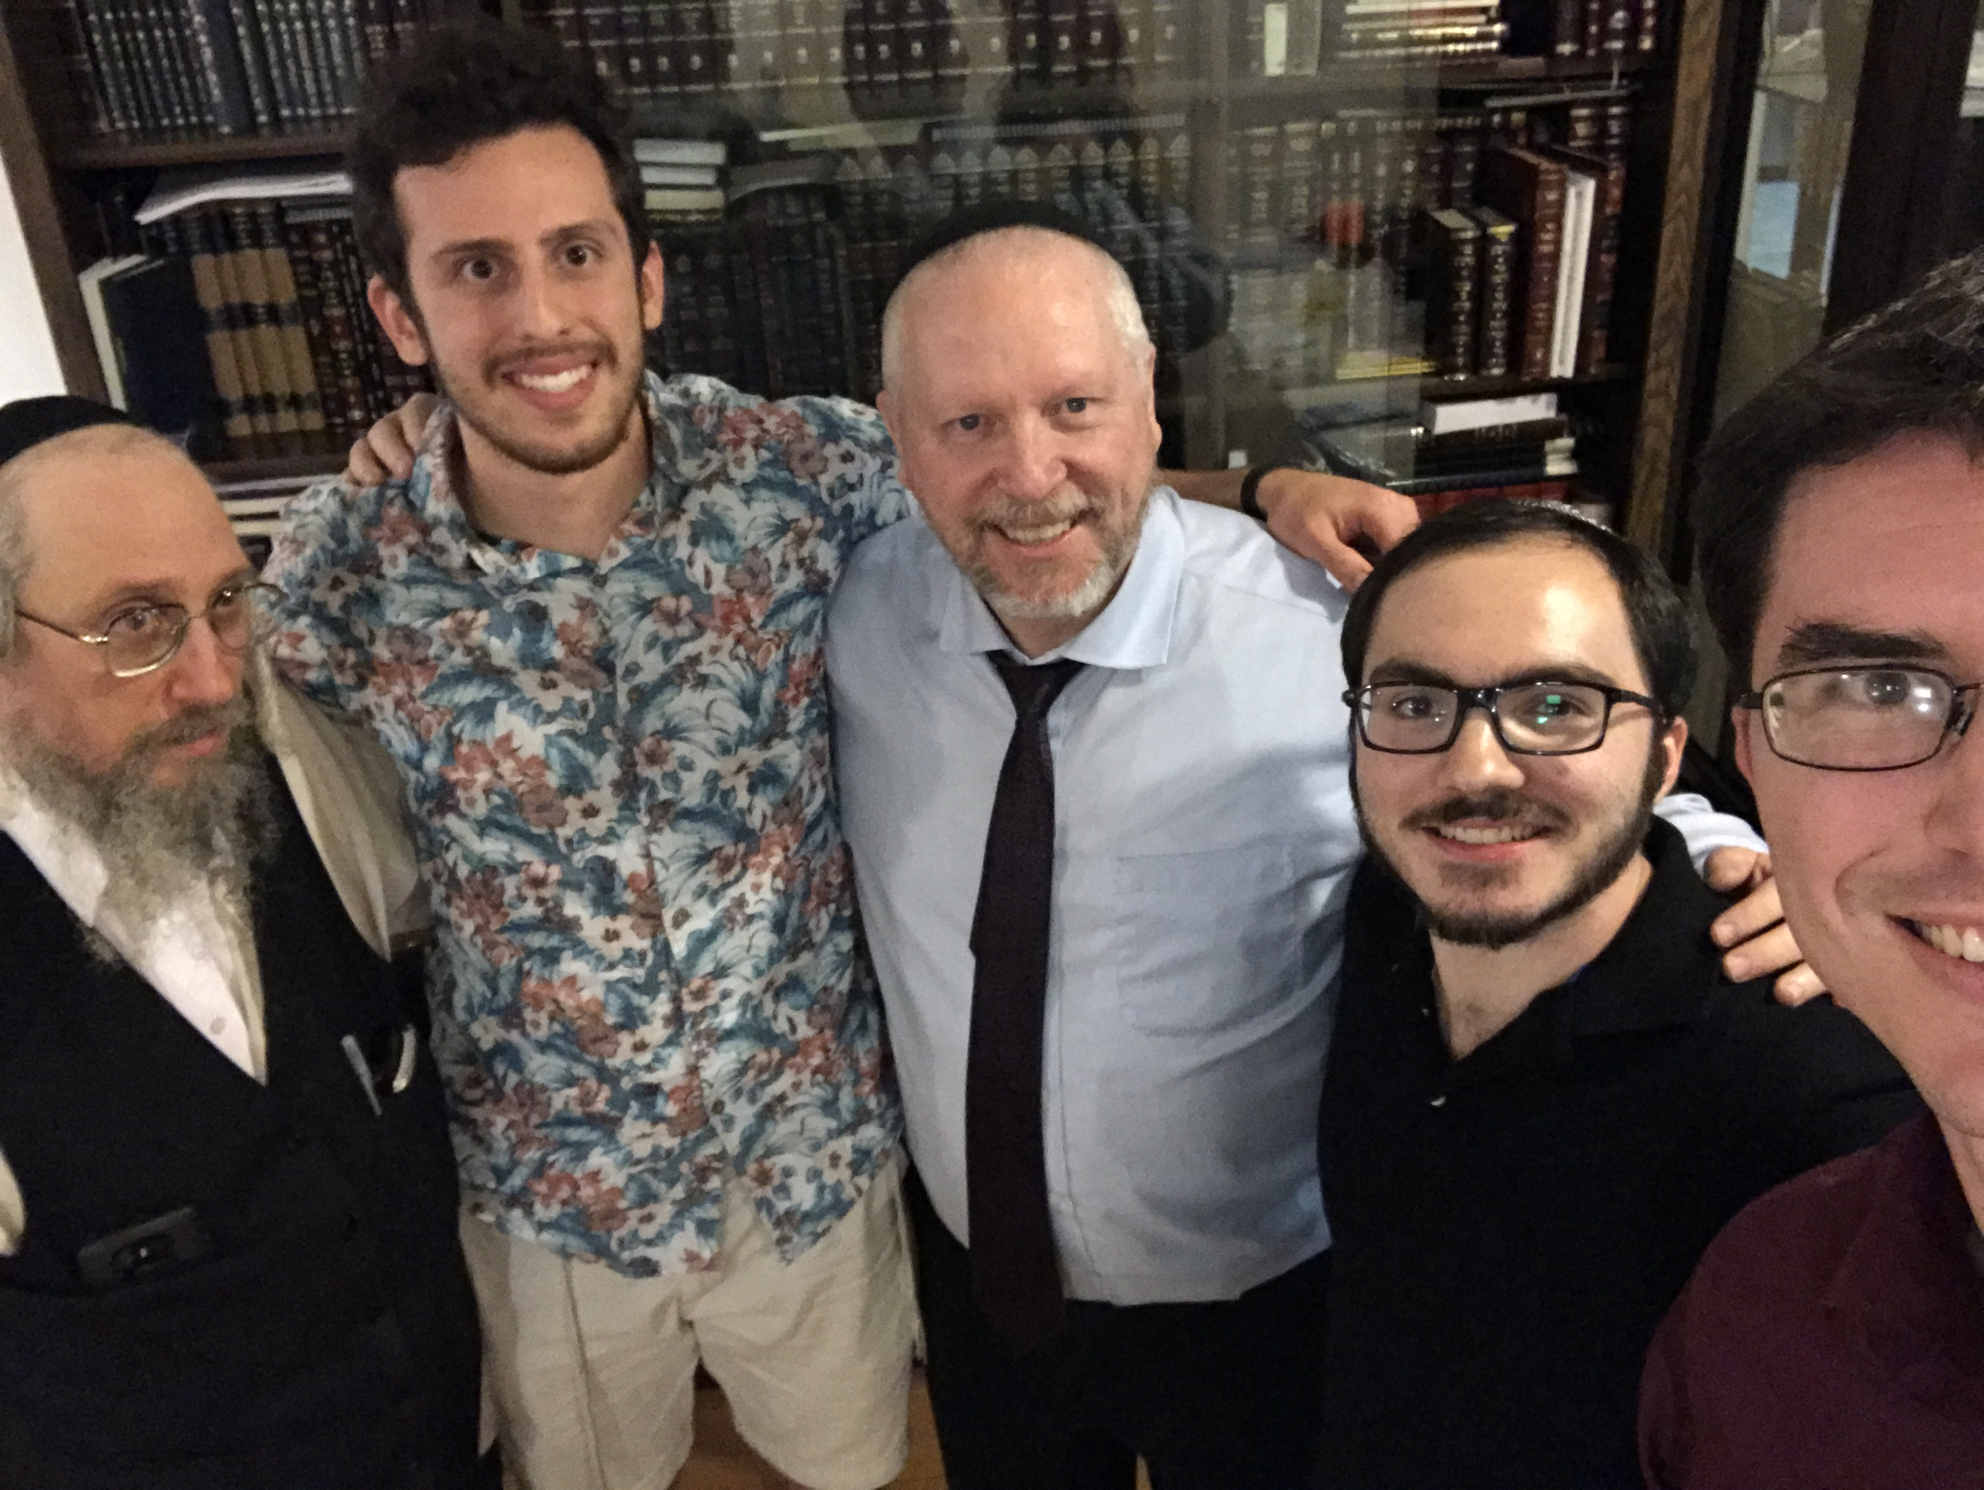

Slide 87
Another issue of the Bible’s historicity and evidence…

Slide 88
Notes:
https://youtu.be/5GnEdLaU6yo
Rabbi Ken Spiro, a licensed Israeli tour guide with a Master’s degree in history.

Slide 89
Notes:
https://youtu.be/5GnEdLaU6yo
Rabbi Ken Spiro, a licensed Israeli tour guide with a Master’s degree in history.

Slide 91
Eternal life implied in existence
Logic of Eden
Eternity in our hearts
Transhumanism
Eternal life in Festivals: Firstfruits
Evidence of Messiah’s Resurrection to Eternal Life

Slide 92
Therefore hope even if losing all the cultural / political battles
Losing: CNN on Gov Noem,
Winning: small groups, healing, Shavuot Carole Ward
CNN on gender ID, military

Slide 94
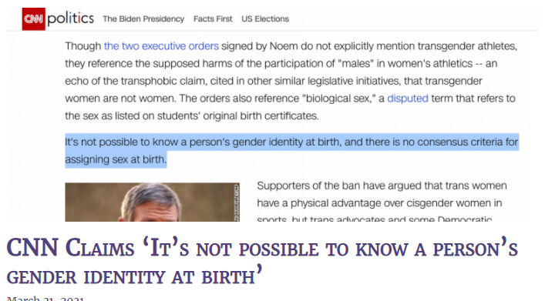
Notes:
CNN
We are losing our sanity.

Slide 95
Lil Nas "Old Town Road" spent 19 weeks atop the US Billboard Hot 100 chart, becoming the longest-running number-one song since the chart debuted in 1958
Notes:
https://www.charismanews.com/opinion/in-the-line-of-fire/84912-5-takeaways-from-the-new-satan-sneakers?utm_source=Charisma%20News%20Daily&utm_medium=email&utm_content=subscriber_id:5160390&utm_campaign=CNO%20daily%20-%202021-03-31

Slide 96
His Grammy-winning song, “Old Town Road,” has been a massive hit with “the elementary school set.” Yet, as he boasted in a tweet, “i literally sing about lean & adultery in old town road.
Notes:
https://askdrbrown.org/library/5-takeaways-new-satan-sneakers

Slide 97
u decided to let your child listen. blame yourself.” (“Lean” refers to “an illicit substance made with codeine cough syrup, soda, and hard candy.” It is “highly addictive and potentially damaging to the body.”)
Notes:
https://askdrbrown.org/library/5-takeaways-new-satan-sneakers

Slide 98
According to Vox.com, “Lil Nas X put human blood into 666 Nikes because being queer means embracing your villainy.”

Slide 99
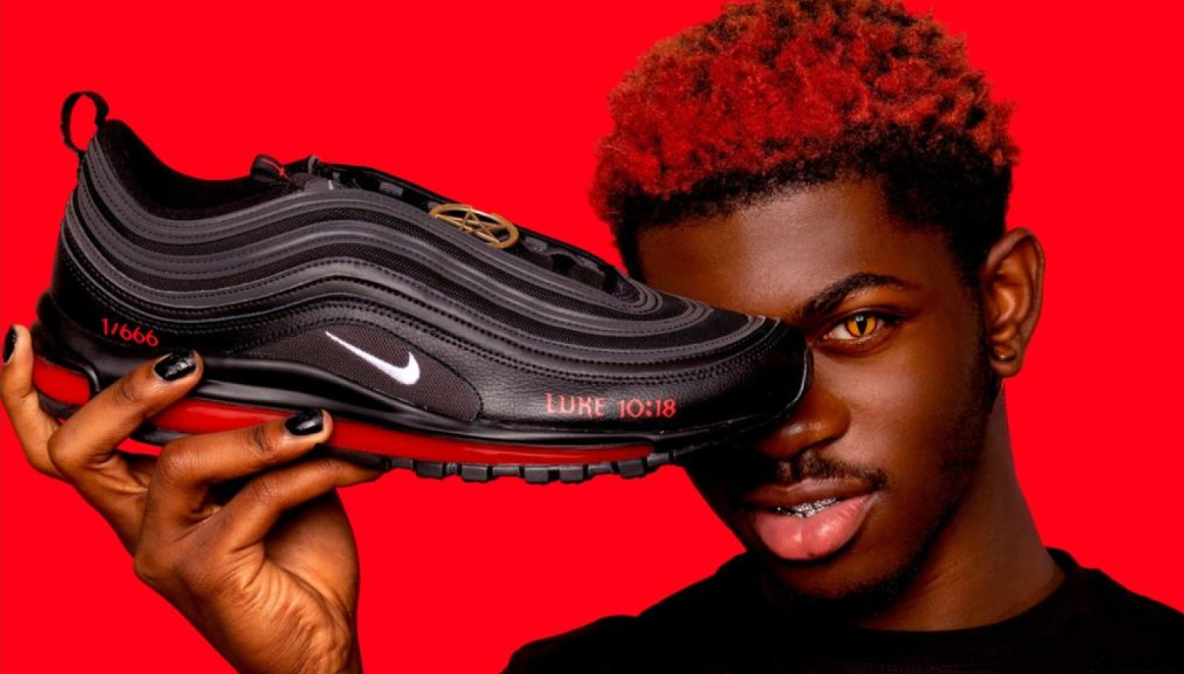
Notes:
https://askdrbrown.org/library/5-takeaways-new-satan-sneakers

Slide 100
^{Lk 10.18-19} Yeshua said to them, “I saw Satan fall like lightning from heaven. Remember, I have given you authority; so you can trample down snakes and scorpions, indeed, all the Enemy’s forces; and you will remain completely unharmed.

Slide 101
He has been open about feeling spiritually rejected and hated because of his gayness, pushing back aggressively with his new, satanic association.
Notes:
https://askdrbrown.org/library/5-takeaways-new-satan-sneakers

Slide 102
But, just as Paul could say about his previous life as a blasphemer of God and a persecutor and even murderer of Jewish followers of Jesus, perhaps this rapper is also operating in ignorance and unbelief ^{1 Timothy 1:13}. Perhaps he, too, does not fully realize the depth of his own depravity.
Notes:
https://askdrbrown.org/library/5-takeaways-new-satan-sneakers

Slide 104
Eternal life implied in existence
Logic of Eden
Eternity in our hearts
Transhumanism
Eternal life in Festivals: Firstfruits
Evidence of Messiah’s Resurrection to Eternal Life

Slide 105
Therefore hope even if losing all the political battles
Losing: CNN on Gov Noem,
Winning: small groups, healing, Shavuot Carole Ward
CNN on gender ID, military

Slide 106
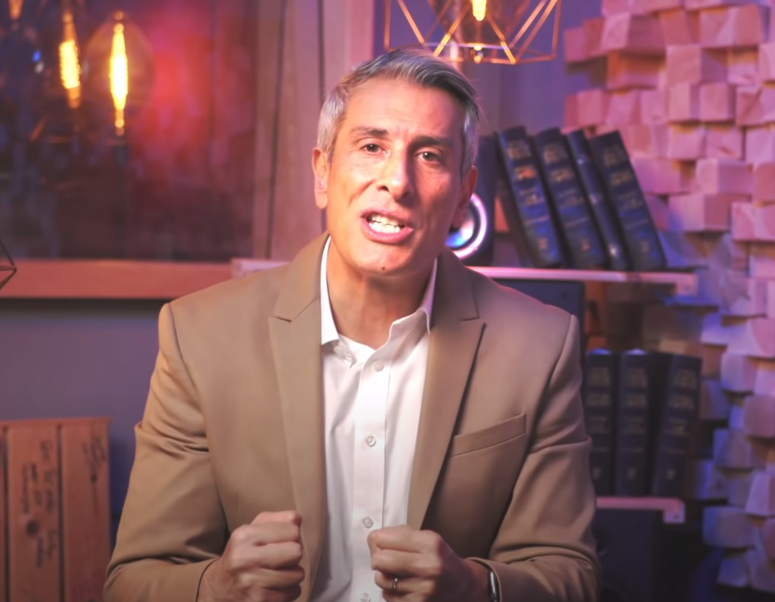
Notes:
https://www.youtube.com/watch?v=YgHLm27ZVIk

Slide 107
^{Yermiyahu/Jer 23}: ’Behold, days are coming’, says Adoni, ‘when they will no longer say, ‘As God lives, who brought the Jews out of the Egypt,’ but, ‘as God lives, who raised and returned the Jews from the northern lands and from every country into which I had driven them, and they will dwell on their own Land.’

Slide 108
The first Israeli Chief Rabbi Abraham Isaac Kook (1865-1935) explained that this is precisely why the miracle of our future/current redemption is even greater than the miraculous Exodus. It would have been easier for God to break the laws of nature like He did with the Ten Plagues and the Splitting of the Sea, than to orchestrate our return to Israel through natural means
Notes:
https://unitedwithisrael.org/passover-miracles/?utm_source=newsletters_unitedwithisrael_org&utm_medium=email&utm_content=Israeli+Cancer+Breakthrough%3B+US+Human+Rights+Report+Based+on+Anti-Israel+Bias%3B+Majority+of+US+Jews+Experienced+Anti-Semitism%3B+Israeli+High-Tech+%E2%80%98Passover+Breakdance%E2%80%99&utm_campaign=20210402_m162684169_Israeli+Cancer+Breakthrough%3B+US+Human+Rights+Report+Based+on+Anti-Israel+Bias%3B+Majority+of+US+Jews+Experienced+Anti-Semitism%3B+Israeli+High-Tech+%E2%80%98Passover+Breakdance%E2%80%99&utm_term=more_btn_dark_jpg

Slide 109
Yet, He has begun to do just that with the miraculous restoration of the Hebrew language, the in-gathering of Jews from Arab and African countries, the upheaval of the Holocaust and the rebirth of the Jewish State after 2,000 long years of exile.
Notes:
https://unitedwithisrael.org/passover-miracles/?utm_source=newsletters_unitedwithisrael_org&utm_medium=email&utm_content=Israeli+Cancer+Breakthrough%3B+US+Human+Rights+Report+Based+on+Anti-Israel+Bias%3B+Majority+of+US+Jews+Experienced+Anti-Semitism%3B+Israeli+High-Tech+%E2%80%98Passover+Breakdance%E2%80%99&utm_campaign=20210402_m162684169_Israeli+Cancer+Breakthrough%3B+US+Human+Rights+Report+Based+on+Anti-Israel+Bias%3B+Majority+of+US+Jews+Experienced+Anti-Semitism%3B+Israeli+High-Tech+%E2%80%98Passover+Breakdance%E2%80%99&utm_term=more_btn_dark_jpg

Slide 110
On the basis of the Resurrection of Messiah, we HAVE hope.
We may lose the cultural norms.
We may lose our facility for “hate speech.”
We have each other: small groups, prepare mentally.
Notes:
City Wide Prayer: Village Fire group. Redeemer fellowship guy: prepare

Slide 111
Omer count…to Shavuot. Time for fasting, intercession. Not “Lent.”
24/7 prayer admin@OrhaOlam.com
Shavuot: All night prayer?
Rivka Whitten, Carole Ward
Notes:
My daughter’s sister in law attends Bellicose Church. http://bellicosechurch.org/

Slide 112
In order to fight for the togetherness of seeking first the kingdom of God in all of life, we organize our congregation into what we call missional communities.
Notes:
http://bellicosechurch.org/

Slide 113
A missional community is a small family of believers committed to living out God’s mission together in everyday life, to particular people and places.
Notes:
http://bellicosechurch.org/

Slide 114
They are called missional communities because we believe that both concepts of mission and community are essential for maximum impact. Community without mission becomes selfish, codependent, and complacent. Mission without community forfeits one of the greatest apologetics for the gospel.
Notes:
http://bellicosechurch.org/

Slide 115
Do you KNOW Him and the assurance of sins forgiven?
Are you surrendered to Him, body, soul, spirit? Walking in relational love, confessing?
Are you filled with His Spirit, transforming your life?
Notes:
Who are you discipling, building up?4

