Slide 1
e-handout
To have these notes
without taking notes
Go to OrHaOlam.com
Click on downloads,
messages, 2021

Slide 2
What is the Ancient Superfood?
In order to live a long, healthy life, many people in Israel consume this Biblical food daily.
Notes:
https://www.israeltoday.co.il/read/what-is-the-ancient-superfood/?utm_source=acfs&utm_medium=email&utm_term=all&utm_campaign=newsletter-en-2021-07-08

Slide 3
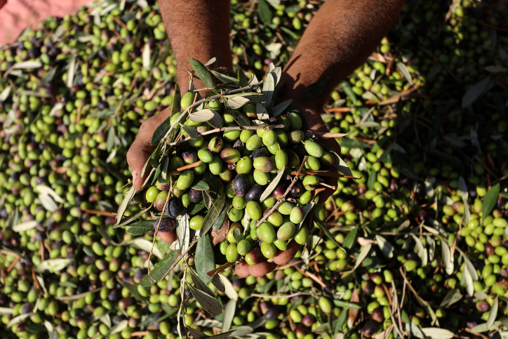
Notes:
https://www.israeltoday.co.il/read/what-is-the-ancient-superfood/?utm_source=acfs&utm_medium=email&utm_term=all&utm_campaign=newsletter-en-2021-07-08

Slide 4
Israel produces 18,000 tons of fresh olive oil annually. It is a popular ingredient in the kitchen and the per capita consumption in the country is just under four liters (over a gallon) a year. Olive oil has been a valued superfood for thousands of years.
Notes:
https://www.israeltoday.co.il/read/what-is-the-ancient-superfood/?utm_source=acfs&utm_medium=email&utm_term=all&utm_campaign=newsletter-en-2021-07-08

Slide 5
Olive oil protects against heart disease and lowers the risk of breast cancer. Olive oil supports the digestive system. The oil of the olive is also well known for its skin and hair health and beauty care.
Notes:
https://www.israeltoday.co.il/read/what-is-the-ancient-superfood/?utm_source=acfs&utm_medium=email&utm_term=all&utm_campaign=newsletter-en-2021-07-08

Slide 6
It is rich in antioxidants, has a full-bodied taste, and the acidity is a maximum of 0.8 percent. Good olive oil has a delightfully spicy, peppery and bitter tang.
Notes:
https://www.israeltoday.co.il/read/what-is-the-ancient-superfood/?utm_source=acfs&utm_medium=email&utm_term=all&utm_campaign=newsletter-en-2021-07-08

Slide 7
Notes:
https://www.israeltoday.co.il/read/what-is-the-ancient-superfood/?utm_source=acfs&utm_medium=email&utm_term=all&utm_campaign=newsletter-en-2021-07-08

Slide 8
“Olive oil not only tastes good, it is good for you. In order to live a long, healthy life, many people in the country drink a glass of cold-pressed olive oil every day,”
Notes:
https://www.israeltoday.co.il/read/what-is-the-ancient-superfood/?utm_source=acfs&utm_medium=email&utm_term=all&utm_campaign=newsletter-en-2021-07-08

Slide 10
Song of Songs 8:5
Notes:
Story of this minor holiday [never preached on in the 26 years of Or HaOlam] has a sad start…

Slide 11
Low point in Israeli history. Shoftim/Judges ch 19-21
Levite / Levi from Ephraim, northern hills, whose concubine ran away to her father and home in Beit Lekhem [Bethlehem].
The Levi went “to persuade her to return.” ^{Shoftim/Ju 19.3}
Notes:
Ephraim north of Jerusalem, Beit Lekhem south.
None of the commentators LXX, Vulgate, Targum, nor Josephus see this as sexual infidelity, but rather a disagreement. Argument.

Slide 12
She was restored, but on the return trip north they were attacked in Givah /Gibeah, of the tribe of Benyamin, like Sdom.
The Levi was not protective, and the woman was molested and murdered.
Notes:
Like Lot.

Slide 13
All the tribes sought to bring the rapists to justice, but instead there was great war between Benyamin and the other tribes.
Benyamin was reduced to 600 men, 100 men without wives.
Notes:
Low point: bigamy, community desire for homosexual attack, non protection of the woman, molestation till death.

Slide 14
^{Shoftim/Ju. 21.19-21} “Behold, there is the feast of Adoni from year to year at Shiloh” (which is to the north of Bethel, on the east side of the highway that goes up from Bethel to Shechem, and to the south of Lebonah).
Notes:
Not known what feast this is

Slide 15
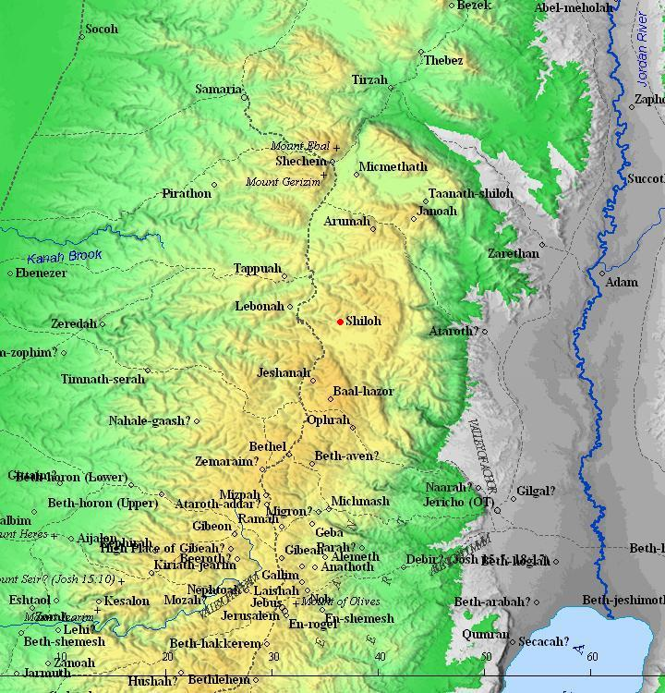
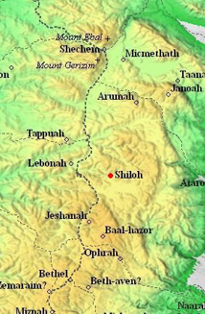
Notes:
We will go to Shiloh next year tour, 2022, if we can have one. Breathtaking.

Slide 16
^{Shoftim/Ju. 21.19-21} So they commanded the children of Benjamin saying “Go and hide in the vineyards, and watch, and behold, if the daughters of Shiloh should come out to join in the dances, then come out of the vineyards, and let each of you catch his wife from among the daughters of Shiloh.
Notes:
Clarke: vines were in full leaf

Slide 17
Talmudic tradition ^{Taanit 30b} places this mysterious feast and dance and abduction of wives on 15 of Av. Tu B’Av ט״ו באב‎ [9+6]
This has morphed into a minor holiday of love.

Slide 18
According to the Mishna, Tu B'Av was a joyous holiday in the days of the Temple in Jerusalem, marking the beginning of the grape harvest. Yom Kippur marked the end of the grape harvest.
Notes:
https://en.wikipedia.org/wiki/Tu_B%27Av#cite_note-9

Slide 19
On both dates the unmarried young women and girls of Jerusalem dressed in white garments, and went out to dance in the vineyards.
Notes:
https://en.wikipedia.org/wiki/Tu_B%27Av#cite_note-9

Slide 20
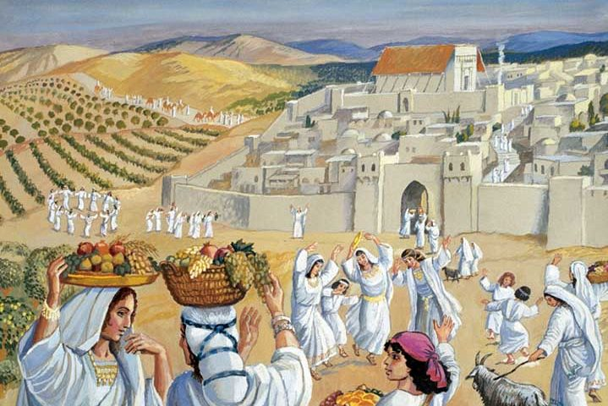
Notes:
https://external-content.duckduckgo.com/iu/?u=https%3A%2F%2Fwww.ou.org%2Fholidays%2Ffiles%2FTu-BAv-e1470913449272.jpg&f=1&nofb=1

Slide 21
In modern times, it has become a romantic Jewish holiday, and has been said to be a "great day for weddings, commitment ceremonies, renewal of vows, or proposing". Celebrated as a holiday of love
(חַג הָאַהֲבָה‎ Ḥag HaAhava).

Slide 22
It is a regular workday, music and dance festivals are typically held to celebrate the day. Israelis give cards and flowers to their loved ones on Tu b’Av.

Slide 23
These customs are observed by all segments of Israeli society, whether they consider themselves religious or non-religious.

Slide 24
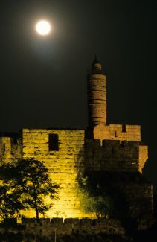
As the Hebrew calendar is lunar, 15/ Tu b’Av occurs in the middle of the lunar month on a full moon.
Notes:
Linking the full moon, Tu b’Av is characterized by love, fertility, and romance.

Slide 25
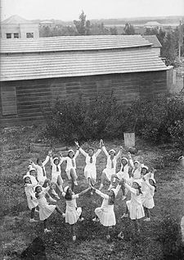
It is a day for romance, explored through singing, dancing, giving flowers, and studying. The rabbis teach that on Tu B’Av one begins to set more time for studying as the High Holidays approach.
Notes:
To Jewish people, study is romantic.
https://israelforever.org/interact/blog/Israel_forever_Dancing_Girls_Tu_BAv.jpg
https://www.myjewishlearning.com/article/celebrating-romantic-love/

Slide 26
2021: Sunset, 23 July –
nightfall, 24 July
Notes:
So, we missed it this year, except…

Slide 27
Two applications
All you married, dating men get your wives/girlfriends flowers, or a gift, or take care of her in some special way.
A day of love: I want to examine our MOST important love relationship, to the Heavenly Bridegroom.
Notes:
Singles NOT excluded!!

Slide 28
Song of Songs 8:5

Slide 29
Song of Songs 8:5 Tu B'Av Divine Lover
Who is this coming up from the wilderness leaning on her lover?
מִי זֹאת, עֹלָה מִן-הַמִּדְבָּר, מִתְרַפֶּקֶת עַל-דּוֹדָהּ to hug, to cling to; ?
Notes:
I usually have an outline to help you follow the flow, but today I have only one point: Divine Lover!

Slide 30
Hudson Taylor Union and Communion
Song of Songs
§1 1.2-2.7 Longing & Surrender
§2 2.8-3.5 Failure, back to the world
§3 3.6-5.1 Unbroken intimacy
§4 5.2-6.10 Failure, spiritual pride
§5 6.11-8.4 Mutual delight
§6 8.5-14 Leaning on her Beloved
Notes:
This is LIFE in Messiah. He walks with us, in us. We walk with Him through all. His Blood covers our failures.
Next verses after our theme, SS 8.5…

Slide 31
^{Song 8.6-7} Set me like a seal on your heart, like a seal on your arm; for love is as strong as death, jealousy as cruel as Sh’ol; its flashes are flashes of fire, [as fierce as the] flame of Yah. No amount of water can quench love, torrents cannot drown it..
Notes:
These verses set to music, famous Misty Edwards song.

Slide 32
How do we get there?

Slide 33
^{3.21-32} Adoni is good to those who wait for Him, to the soul that seeks Him. It is good to wait quietly for the salvation of Adoni. It is good for a man to bear the yoke in his youth. Let him sit alone and be silent, since He has laid it upon him.
Notes:
Time: love is spelled time.
Bear the yoke…learn of me. Casting care upon Him. He shares the yoke.

Slide 34
^{Col 1.25-28} I became [His] servant according to God’s commission, given to me for you, in order to declare His message in full— the mystery that was hidden for ages and generations, but now has been revealed to His kedoshim, Holy People.

Slide 35
^{Col 1.25-28} God chose to make known to them this glorious mystery regarding the Gentiles—which is Messiah in you, the hope of glory! We proclaim Him, warning and teaching everyone in all wisdom, so that we may present every person complete in Messiah.
Notes:
I’ve done Basic Youth Conflicts, Ancient Paths, Life Model, RTF, Ellel, learning about healing my inner needs and weaknesses.
This, what I’m about to share with you, is the biggest quantum leap!
As I was praying and thinking about how to deal with a certain difficult issue, it seemed that Yeshua in the Ruakh said, “That is a good idea. But you can’t live up to it. Let ME live up to it in you. Let Me do the work of loving…”

Slide 36
^{1 Kefa/P 5.7} Throw all your anxieties upon him, because he cares about you.
Notes:
Every insecurity, anxiety, irritation, outrage, defilement, violation, disrespect, out of control internal dynamic, stress, give to Yeshua to walk with you, in You, give you His wisdom and love.

Slide 37
^{Mark 1.14-15} After Yokhanan had been arrested, Yeshua came into the Galil proclaiming the Good News from God: “The time has come,
God’s Kingdom is near!
Turn to God from your sins
and believe the Good News!”
Notes:
At least three levels of believing
Cerebral: convinced
Believe and receive
Believe and intimacy

Slide 38
^{Mtt 11.28-30} Come to Me, all who are weary and burdened, and I will give you rest. Take My yoke upon you and learn from Me, for I am gentle and humble in heart, and ‘you will find rest for your souls.’ For My yoke is easy and My burden is light.”
Notes:
The first verse that I could enter, in April 1969 when I was new to the Bible.

Slide 39
^{Mtt 11.28-30} Come to Me, all who are weary and burdened,
בּוֹאוּ אֵלַי

Slide 40
^{Yn 6.35} Yeshua said to them, “I am the bread of life. Whoever comes to Me will never be hungry, and whoever believes in Me will never be thirsty.
Notes:
We haven’t really come to Him, unless we are feeding on His LIFE!!

Slide 41
^{Yn 6.53-54} Then Yeshua said to them, “Yes, indeed! I tell you that unless you eat the flesh of the Son of Man and drink his blood, you do not have life in yourselves. Whoever eats my flesh and drinks my blood has eternal life.
Notes:
Horrific words to Jews trained in dietary laws!
Joyner Call p 39-40

Slide 42
^{Mtt 11.28-30} Come to Me, all who are weary

Slide 43
kopiaó: to grow weary, toil grow weary, toil, work with effort (of bodily and mental labor alike).
Notes:
Trying to live in joy, in forgiveness, in purity of thought, peace, overcoming fear, insecurity

Slide 44
^{Mtt 11.28-30} Come to Me, all who are weary
בּוֹאוּ אֵלַי כָּל הָעֲמֵלִים
laboring , toiling, effort, travail, suffering, trouble, misery, mischief, oppression
Whatever overwhelms you!
Notes:
Joyner Call p 48

Slide 45
^{Mtt 11.28-30} Come to Me, all who are weary and burdened,

Slide 46
phortízō – overload (pack up), causing someone to be (literally) “weighted-down.”
Notes:
Stewart Winograd, in Toronto, ~2008:
If we serve G-d because we see a need, we will be overwhelmed and burn out ourselves and our families.
If we serve G-d because we are called by Yeshua, we will have joy and power.

Slide 47
^{T’hillim 38.5} My iniquities loom high over my head as a heavy burden, too heavy for me.
Notes:
Joyner 114 -115

Slide 48
^{Mtt 11.28-30} Come to Me, all who are weary and burdened,
בּוֹאוּ אֵלַי כָּל הָעֲמֵלִים וְהָעֲמוּסִים
עֲמוּס
loaded, laden; busy, crowded (street, intersection)
Notes:
Some frustrated by traffic. NYC driver. I love traffic, to dodge and weave and avoid.

Slide 49
and I will give you rest.
anapauó: to give rest, give intermission from labor, by impl. refresh
Notes:
Hebrew modern translation uses a surprising word…

Slide 50
and I will give you rest.
וַאֲנִי אַמְצִיא לָכֶם מְנוּחָה.
אַמְצִיא
to invent; to fabricate, to make up; to deliver; to proffer, to offer, to present
Notes:
Causative form of verb. Like Hashivenu last week.
Shelley Duvall's Faerie Tale Theatre: Cinderella Prince is admiring her dress. I poofed it together. Er… I put it together.
He will poof you rest…find it from no where.

Slide 51
and I will give you rest.
ַאֲנִי אַמְצִיא לָכֶם מְנוּחָה.
מְנוּחָה m’nukhah
rest, respite; quiet, calm, serenity;
Notes:
Same root as Noah.

Slide 52
Take My yoke upon you

Slide 53
Take My yoke upon you
zygós – properly, a yoke; a wooden bar placed over the neck of a pair of animals so they can pull together; (figuratively) what unites (joins) two people to move (work) together as one.
Notes:
Joyner p 198

Slide 54
^{Mtt 11.28-30} and learn from Me, for I am gentle and humble in heart,

Slide 55
^{Zekh 9.9} Rejoice greatly, daughter of Zion! Shout, daughter of Jerusalem! Behold, your king is coming to you, a righteous one bringing salvation. He is lowly, riding on a donkey—on a colt, the foal of a donkey

Slide 56
and ‘you will find rest for your souls.’
the vital breath, breath of life, (b) the human soul, (c) the soul as the seat of affections and will, (d) the self, (e) a human person, an individual.

Slide 57
and ‘you will find rest for your souls.’
תִּמְצְאוּ מַרְגּוֹעַ לְנַפְשׁוֹתֵיכֶם
rest, peace, relaxation, serenity
Notes:
Rega rega: wait, pause, slow down

Slide 58
For My yoke is easy and My burden is light.”
Chréstos useful, gentle, pleasant, kind

Slide 59
For My yoke is easy and My burden is light.”
כִּי עֻלִּי נָעִים וְקַל מַשָּׂאִי.
naim ~ Naomi: pleasant, lovely, sweet, agreeable, fitting, musical

Slide 60
^{Mtt 11.28-30} Come to Me, all who are weary and burdened, and I will give you rest. Take My yoke upon you and learn from Me, for I am gentle and humble in heart, and ‘you will find rest for your souls.’ For My yoke is easy and My burden is light.”
Notes:
But, that doesn’t eliminate community help when we just can’t get it.

Slide 61
^{Yaakov 5.15-16} The prayer of faith will save the one who is sick, and the Lord will raise him up. If he has committed sins, he will be forgiven. So confess your offenses to one another and pray for one another so that you may be healed. The effective prayer of a righteous person is very powerful.

Slide 62
What about fasting?

Slide 63
^{Luke 2.36-38} There was also a prophet named Hannah Bat-P’nu’el, of the tribe of Asher. She was a very old woman — she had lived with her husband seven years after her marriage and had remained a widow ever since; now she was eighty-four.

Slide 64
^{Luke 2.36-38} She never left the Temple grounds but worshipped there night and day, fasting and praying. She came by at that moment and began thanking God and speaking about the child to everyone who was waiting for Yerushalayim to be liberated.
Notes:
Fasting is intimacy, if done right. Next Hebrew month…

Slide 65
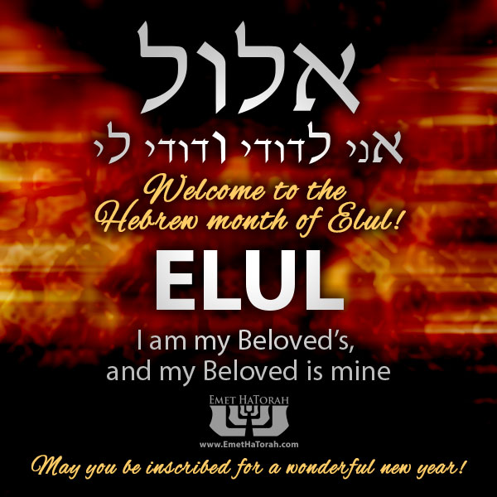
Aug. 9, 2021 begins the month of Elul.
Fasting?
Between Rosh HaShanna and Yom Kippur!
Notes:
https://external-content.duckduckgo.com/iu/?u=https%3A%2F%2Fwww.emethatorah.com%2Fsites%2Fdefault%2Ffiles%2FElul.jpg&f=1&nofb=1

Slide 67
Song of Songs 8:5
Notes:
Story of this minor holiday [never preached on in the 26 years of Or HaOlam] has a sad start…

Slide 68
Song of Songs 8:5 Tu B'Av Divine Lover
Who is this coming up from the wilderness leaning on her lover?
מִי זֹאת, עֹלָה מִן-הַמִּדְבָּר, מִתְרַפֶּקֶת עַל-דּוֹדָהּ to hug, to cling to; ?

Slide 69
Do you KNOW Yeshua as your intimate Lover and have the assurance of sins forgiven?
Are you hearing daily from His Word?
How are you applying what you heard?
Are you asking this of another?
Notes:
Who are you discipling, building up?4

