Slide 1
e-handout
To have these notes
without taking notes
Go to OrHaOlam.com
Click on downloads,
messages, 2021
Notes:
I don’t have the sense of color coordination that some have. My wife, and my daughter when she was home, would question what I was about to wear, especially to shul. So…

Slide 2
Men in black

Slide 3
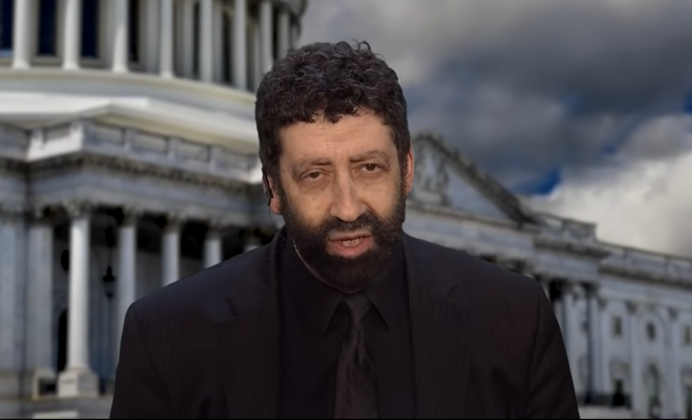
Notes:
https://www.youtube.com/watch?v=hrCtoQUXnmc
First 1 second “This is Jonathan Cahn”
Great gravitas!

Slide 4
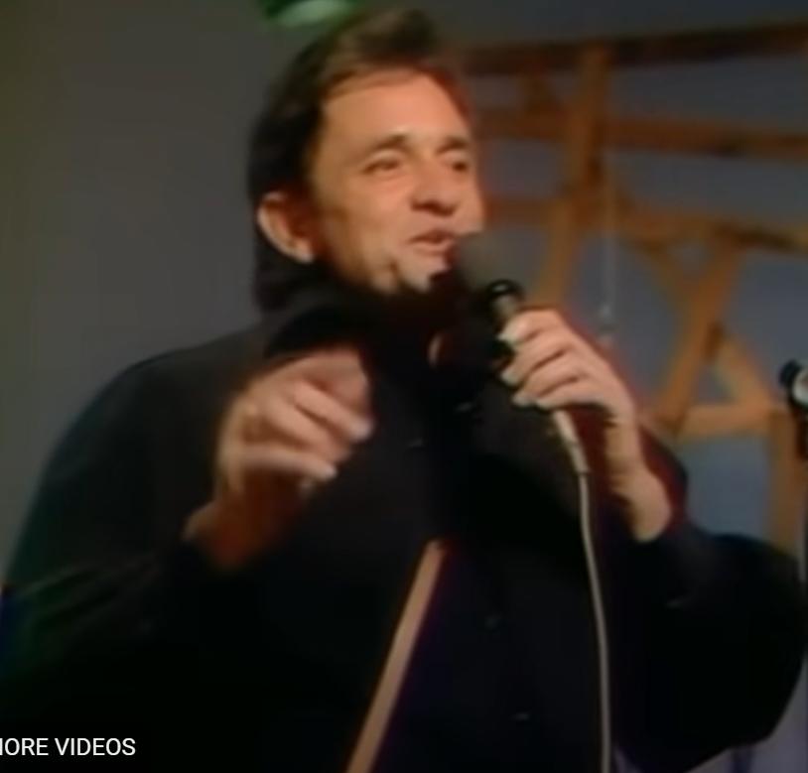
NOT endorsing him or his music
Notes:
Another
0 to 14 sec
https://www.youtube.com/watch?v=1Okt0-Y38Pc
I will mostly dress in black. Not always, but pretty fool proof!

Slide 5
Jewish research…
Notes:
Sometimes people call me with a question that they could solve by googling. But, I understand that it’s easier and more cheerful maybe, to Shmoogle, than to google. However, pure Jewish research…

Slide 6
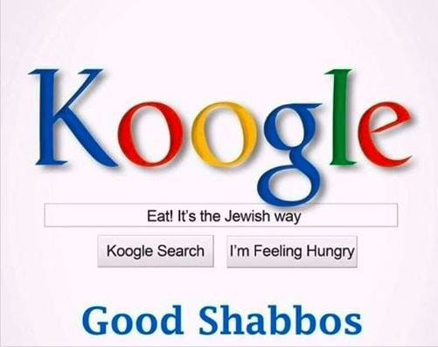
Notes:
From Lori

Slide 8
^{MJ 9.5} Above it [the kaporet] were the k’ruvim representing the Sh’khinah, casting their shadow on the lid of the Aron / Ark.
Notes:
Point out on pic of Aaron / Ark
When I read to find out message, this word lit up to me in my sense of the Ruakh. Stern’s translation. So, I feel I should discuss..

Slide 9
The Sh’khinah Mes. Jews 9.5
Validity and definition of the term
History: importance
Requirements to view it.
Consequences of viewing it.

Slide 10
Sh’khinah שְׁכִינָה
The word sh’khinah is not present in the Bible, and is first encountered in the rabbinic literature.
from שָׁכַן shakhan "to settle, inhabit, or dwell“
שְׁכוּנָה Sh’khunah neighborhood
Notes:
https://en.wikipedia.org/wiki/Shekhinah
Make me a Mishkan/Tabernacle that I may dwell ושכנתי among you. Ayelet Steckbeck story.

Slide 11
Sh’khinah שְׁכִינָה
Divine Presence, Godhead, holy inspiration
Notes:
The Greek

Slide 12
Doxes: opinion (always good in NT), praise, honor, glory, renown; an especially divine quality, the unspoken manifestation of God, splendor.
Notes:
https://biblehub.com/greek/2435.htm
splendor…implying the Sh’khinah

Slide 13
Hilastérion: the place of propitiation; the lid of the golden ark (the mercy-seat) where the blood of a vicarious animal appeased God's wrath on sin.
Notes:
https://biblehub.com/greek/2435.htm
hilasmós – properly, propitiation; an offering to appease (satisfy) an angry, offended party.
https://biblehub.com/greek/2434.htm

Slide 14
So the Greek text would be clarified as “the manifestation of G-d above the place of atonement.”
Stern uses the term “Sh’khinah”
Notes:
From the rabbinic world, in Babylon 900’s CE

Slide 15
“According to Saadiah Gaon [882–942 c.e. Babylon], the שְׁכִינָה, Sh'khinah is identical with Kavod Adoni כָּבוֹד יְיָ (‘the glory of God’), which served as an intermediary between God and man during the prophetic experience.
Notes:
(see Saadiah’s interpretation of Ezekiel 1:26, 1 Kings 22:19, and Daniel 7:9 in Book of Beliefs and Opinions 2:10).”1

Slide 16
Saadia suggests that the
‘glory of God’ Kavod Adoni כָּבוֹד יְיָ
is the biblical term, and
שְׁכִינָה, Sh'khinah the Talmudic term for the created splendor of light. [or uncreated in Messianic thinking]
Notes:
(see Saadiah’s interpretation of Ezekiel 1:26, 1 Kings 22:19, and Daniel 7:9 in Book of Beliefs and Opinions 2:10).”1

Slide 17
which acts as an intermediary between God and man, and which sometimes takes on human form. Thus when Moshe asked to see the glory of God, he was shown the שְׁכִינָה Sh'khinah.
Yeshua was the uncreated Sh’khinah that Moshe saw!!
Notes:
(see Saadiah’s interpretation of Ezekiel 1:26, 1 Kings 22:19, and Daniel 7:9 in Book of Beliefs and Opinions 2:10).”1

Slide 18
That theשְׁכִינָה Sh’khinah could be incarnated among us is not foreign to Jewish thought. This was well expressed by one of our greatest scholars, Saadiah Gaon of Babylon/Iraq.
Notes:
David Stern JNTC p 663

Slide 19
Sh’khinah = Kavod Adoni
כָּבוֹד יְיָ = שְׁכִינָה
Divine dwelling = Glory of G-d
Metaphorically the cherubs / keruvim represent this.
Notes:
Practice pronunciation? Altogether now.
Re-read our verse with this in mind: Divine dwelling about the place of atonement.

Slide 20
David Stern: God spoke to Moses "from between the k'ruvim" and because the Tanakh speaks often of God's presence there, the author regards the k'ruvim as representing the Sh'khinah
Notes:
David Stern Commentary, https://kifakz.github.io/eng/bible/stern/stern_evreyam_09.html

Slide 21
^{MJ 9.5} Above it [the kaporet] were the k’ruvim representing the Sh’khinah, casting their shadow on the lid of the Aron / Ark.

Slide 23
The Sh’khinah Mes. Jews 9.5
Validity and definition of the term
History: importance
Requirements
Consequences
Notes:
Experiencing the G-d of Israel was the biggest thing in their agenda!

Slide 24
^{Shmot/Ex 16.9-10} Moshe said to Aharon, “Say to the whole community of Isra’el, ‘Come close, into the presence of Adoni, for he has heard your grumblings.’” As Aharon spoke to the whole community of the people of Isra’el,

Slide 25
^{Shmot/Ex 16.9-10} they looked toward the desert; and there before them the glory of Adoni appeared in the cloud; Kavod Adoni
Notes:
Beginning of quails and manna

Slide 26
^{Shmot /Ex 24.9-11} Moshe, Aharon, Nadav, Avihu and seventy of the leaders went up; and they saw the God of Isra’el. Under his feet was something like a sapphire stone pavement as clear as the sky itself.
Notes:
Hertz: fell into a trance in which this mystic vision was seen by therm.

Slide 27
^{Shmot /Ex 24.9-11} He did not reach out his hand against these notables of Isra’el; on the contrary, they saw God, even as they were eating and drinking.
Notes:
Hertz: fell into a trance in which this mystic vision was seen by them.
Maybe this is why eating, meals together is SUCH a big deal in Jewish community.

Slide 28
^{Shmot/Ex 25.20-21} The k’ruvim will have their wings spread out above, so that their wings cover the ark, and their faces are toward each other and toward the ark-cover. You are to put the ark-cover on top of the ark.

Slide 29
^{Shmot/Ex 25.22} There I will meet with you. I will speak with you from above the ark-cover, from between the two k’ruvim which are on the ark for the testimony, about all the orders I am giving you for the people of Isra’el.

Slide 30
^{Bamidbar/Nu 7.89} When Moshe entered the Mishkan, the Tent of Meeting, to speak with Adoni, he heard the voice speaking to him from above the atonement cover [הַכַּפֹּרֶת hakaporet ] atop the Ark of Testimony between the k’eruvim.

Slide 31
^{Yeshayahu/Is 37.16} “Adoni-Tzva’ot, God of Israel, who is enthroned upon the k’ruvim, You alone are God of all the kingdoms of the earth. You have made heaven and earth.

Slide 32
^{1 Shmuel 4.4} So the people sent to Shiloh and brought from there the ark for the covenant of Adonai-Tzva’ot, who is present above the k’ruvim.

Slide 33
^{MJ 9.5} Above it were the k’ruvim representing the Sh’khinah, casting their shadow on the lid of the Aron / Ark.
Notes:
When I read to find out message, this word lit up to me in my sense of the Ruakh. Stern’s translation. Here’s the original…

Slide 34
History of Israel and the Sh’khinah שְׁכִינָה

Slide 35
Completion of the Mishkan/ Tabernacle
^{Shmot/Ex 40.34-35} Then the cloud covered the Tent of Meeting, and the glory of Adoni filled the Tabernacle. Moshe was unable to enter into the Tent of Meeting,

Slide 36
Completion of the Mishkan/ Tabernacle
^{Shmot/Ex 40.34-35} because the cloud resided there and the glory of Adoni filled the Tabernacle.

Slide 37
Inauguration of the cohanut/ priesthood
^{Vayikra/Lev 9.22-24} Aharon raised his hands toward the people, blessed them and came down from offering the sin offering, the burnt offering and the peace offerings.
Notes:
After spending 8 days in the Mishkan courtyard.

Slide 38
Inauguration of the cohanut/ priesthood
^{Vayikra/Lev 9.22-24} Moshe and Aharon entered the tent of meeting, came out and blessed the people. Then the glory of Adoni appeared to all the people! Fire came forth from the presence of Adoni.

Slide 40
Completion of the Jerusalem Temple
^{1 K 8.10-13} When the cohanim came out of the Holy Place, the cloud filled the house of Adoni, so that, because of the cloud, the cohanim could not stand up to perform their service;

Slide 41
Completion of the Jerusalem Temple
^{1 K 8.10-13} The glory of Adoni filled the house of Adoni. Shlomo said, “Adoni said he would live in thick darkness. But I have built you a magnificent house, a place where you can live forever.”

Slide 42
Departure of the Sh’khinah, step 1
^{Y’khezkael/Ezek 9.3-4} Then the glory of the God of Isra’el was made to go up from over the keruv, where it had been, to the threshold of the house. He called to the man clothed in linen, who had the scribe’s writing equipment at his waist.

Slide 43
Departure of the Sh’khinah, step 1
^{Y’khezkael/Ezek 9.3-4} Adoni said to him, “Go throughout the city, through all Yerushalayim, and put a mark on the foreheads of the men who are sighing and crying over all the disgusting practices that are being committed in it.”

Slide 44
Departure of the Sh’khinah, step 2
^{Y’khezkael/Ezek10.4} Then the glory of Adoni rose up from above the keruv to the threshold of the House. The House was filled with the cloud and the court was full of the brilliance of Adoni’s glory.

Slide 45
Departure of the Sh’khinah, step 3
^{Y’khezkael/Ezek10.18-19} Now the glory of Adoni left the threshold of the house and halted above the k’ruvim. The k’ruvim lifted their wings and rose off the earth — I was watching as they went off.

Slide 46
Departure of the Sh’khinah, step 3
^{Y’khezkael/Ezek10.18-19} with the wheels next to them. They paused at the entrance to the east gate of Adoni’s house, with the glory of the God of Isra’el over them, from above.

Slide 47
Departure of the Sh’khinah, step 4
^{Y’khezkael/Ezek11.22-23} The k’ruvim lifted their wings, and the wheels were next to them, with the glory of the God of Isra’el over them, above. Next, the glory of Adoni rose from within the city and stood over the mountain which is on the east side of the city.
Notes:
But there is hope. The same prophet, Y’khezkael/Ezek predicts a future Temple.

Slide 48
Return of the Glory Steps 1 and 2
^{Y’khezkael/Ezek 43.1-4}After this, he brought me to the gate facing east. There I saw the glory of the God of Isra’el approaching from the east. His voice was like the sound of rushing water, and the earth shone with his glory.

Slide 49
Return of the Glory Steps 1 and 2
^{Y’khezkael/Ezek 43.1-4} The vision seemed like the vision I had seen when I came to destroy the city; also the visions were like the vision I had seen by the K’var River; and I fell on my face. Adoni’s glory entered the house through the gate facing east.
Notes:
This is the gate the Muslims have sealed to keep G-d from returning.

Slide 50
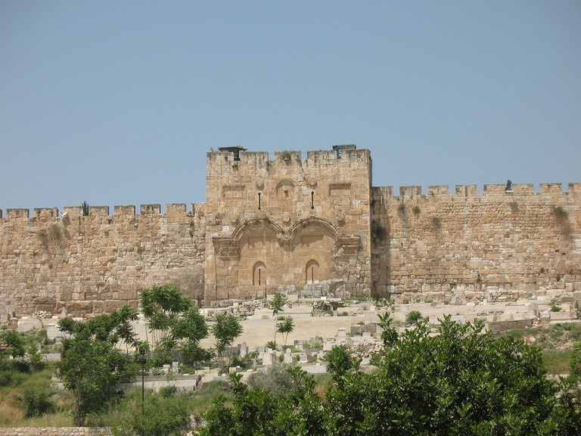
Eastern gate of the Old City of Jerusalem

Slide 51
Return of the Glory Step3
^{Y’khezkael/Ezek 43.5-} Next, a spirit took me up and brought me into the inner courtyard, and I saw Adoni’s glory fill the house.

Slide 52
Return of the Glory Step 4
^{Zekharyah 6. 12-13} “Thus says Adoni-Tzva’ot: Behold, a man whose Name is the Branch will branch out from his place and build the Temple of Adoni. He will build the Temple of Adoni.

Slide 53
Return of the Glory Step 4
^{Zekharyah 6. 12-13} He will bear the splendor and sit and rule on His throne. Thus He will be a kohen on His throne. So a counsel of shalom will be between them both.
Notes:
יִשָּׂא הוֹד Yisa Hod

Slide 55
The Sh’khinah Mes. Jews 9.5
Validity and definition of the term
History: importance
Requirements to view
Consequences

Slide 56
^{T’hillim / Ps 27.4} Just one thing have I asked of Adoni; only this will I seek: to live in the house of Adoni all the days of my life, to see the beauty of Adoni and visit in his temple.
Notes:
Other glories: essence of idolatry. Other feel goods: mindfulness, nirvana. Maybe and application of the Shma!

Slide 57
^{T’hillim / Ps 24.3-4} Who may go up to the mountain of Adoni? Who can stand in his holy place? Those with clean hands and pure hearts, who don’t make vanities the purpose of their lives or swear oaths just to deceive.
Notes:
Yet by grace

Slide 58
And in any case, we do are not clean enough. Glory is light.
^{1 Yn 1.7} If we walk in the light as He Himself is in the light, we have fellowship with one another and the blood of His Son Yeshua purifies us from all sin.

Slide 59
The Sh’khinah Mes. Jews 9.5
Definition
History: importance
Requirements
Consequences

Slide 60
^{2 Cor 3.18} So all of us, with faces unveiled, see as in a mirror the glory of the Lord; and we are being changed into his very image, from one degree of glory to the next, by Adoni the Spirit.
Notes:
Cf: I’m praying and seeking G-d, so don’t bother me.

Slide 61
^{T’hillim / Ps 90.16-17} Show your deeds to your servants and your glory to their children. May the favorנֹעַם] pleasantness, beauty] of Adoni our God be on us, prosper for us all the work that we do — yes, prosper the work that we do.

Slide 62
^{Yn 17.21-24} I pray that they may be united with us, so that the world may believe that you sent me. The glory which you have given to me, I have given to them; so that they may be one, just as we are one — I united with them and you with me,

Slide 63
^{Yn 17.21-24} so that they may be completely one, and the world thus realize that you sent me, and that you have loved them just as you have loved me. Father, I want those you have given me to be with me where I am;

Slide 64
^{Yn 17.21-24} so that they may see my glory, which you have given me because you loved me before the creation of the world [Κόσμου kosmos the world, universe].
Notes:
The Shilo ben Hod song that our wonderful young people sung last Shabbat has a great them of unity and glory…

Slide 65
הִנֵּה מַה טוֹב וּמַה נָעִים
Hineh ma tov uma naim,
How good and pleasant it is

Slide 66
כְּשֶׁכֻּלָּנוּ מְהַלְּלִים
Kshe'kulanu mehalelim
When all of us worship

Slide 67
שַׁרִים בְּיַחַד לָאֱלוֹהִים
Sharim beyakhad le’Elohim,
Singing together to God

Slide 68
כָּל אֶחָד הוּא חֵלֶק, כּוּלָּם בִּפְנִים
Kol ekhad hu khelek, kulam bifnim
Everyone takes part,
everybody is in

Slide 69
^{Matt 17.1-2} Six days later, Yeshua took Kefa, Ya‘akov and his brother Yochanan and led them up a high mountain privately. As they watched, he began to change form — his face shone like the sun, and his clothing became as white as light
Notes:
Confirms doctrine. Me and April 13, 1969, name written in the Book of Life!!

Slide 71
Nosh: Although spoken words of love are important, love comes alive through the things we do for others and therefore is best expressed in actions. In the same way, God knows we love Him when we seek to act obediently to his commands and direction.

Slide 72
Obedience is much more than a performed duty. It is an act of love that deepens fellowship and intimacy with God.

Slide 73
Helps pray political issues.

Slide 74
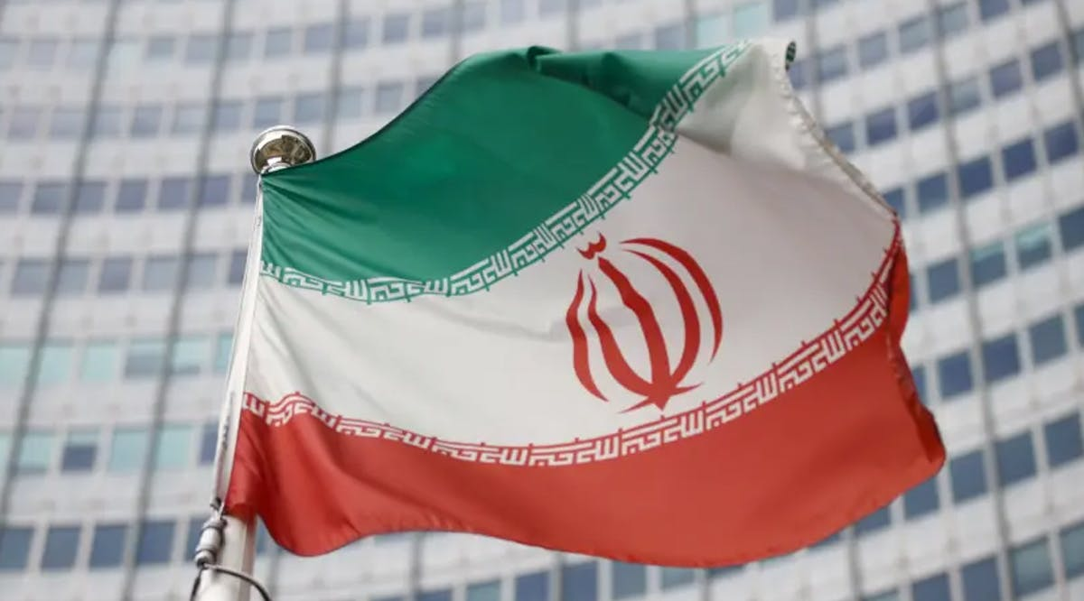
Flag of Iran
Notes:
the national emblem ("Allah") in red centred on the white band and the takbir ( is the Arabic phrase ʾAllāhu ʾakbar) written 11 times each in the Kufic script in white, at the bottom of the green and the top of the red band.^{[1]}

Slide 75
Gantz: Iran is 10 Weeks from Breakout to a Nuclear Weapon
Tehran will be able to break out to a nuclear weapon within 10 weeks, Defense Minister Benny Gantz told diplomats from UN Security Council member states on Wednesday.
Notes:
https://vfinews.com/news/aug-6-2021/gantz-iran-is-10-weeks-from-breakout-to-a-nuclear?subscribed=true&mc_cid=1a1a237c52&mc_eid=UNIQID

Slide 76
“Iran has violated all of the guidelines set in the JCPOA [nuclear agreement] and is only around 10 weeks away from acquiring weapons-grade materials necessary for a nuclear weapon,” Gantz warned.
“Therefore,” he added, “it is time to act.”
Notes:
https://vfinews.com/news/aug-6-2021/gantz-iran-is-10-weeks-from-breakout-to-a-nuclear?subscribed=true&mc_cid=1a1a237c52&mc_eid=UNIQID

Slide 77
^{T’hillim/Ps 83.17-19} Fill their faces with shame, so that they will seek your name, Adoni. Let them be ashamed and fearful forever; yes, let them perish in disgrace. Let them know that you alone, whose name is Adoni, are the Most High over all the earth.

Slide 78
“Seeing” the glory, enables one to stand strong for speaking the truth with love.

Slide 79
A professor at an elite medical school abjectly apologizes to his students for using the term "pregnant women," implying that only women can get pregnant: "I don't want you to think that I am in any way trying to imply anything, and if you can summon some generosity to forgive me, I would really appreciate it. It was certainly not my intention to offend anyone."
Notes:
https://www.charismanews.com/opinion/renewing-america/86277-the-parallels-of-early-1930s-germany-and-current-america-can-no-longer-be-ignored?utm_source=Charisma%20News%20Daily&utm_medium=email&utm_content=subscriber_id:5160390&utm_campaign=CNO%20daily%20-%202021-08-04

Slide 80
Seeing the glory changes opinion, character. Yeshua is the glory bearer.
Notes:
On another line…

Slide 81
Nothing in scripture is proved by numerology = gematria
We will never say here that Christianity is false, or anti-Messiah.

Slide 82
“Seeing” the glory makes one what to share it.
^{Matt 28.18-20} Yeshua came and talked with them. He said, “All authority in heaven and on earth has been given to me. Therefore, go and make people from all nations into talmidim, immersing them into the reality

Slide 83
“Seeing” the glory makes one what to share it.
^{Matt 28.18-20} of the Father, the Son and the Ruakh HaKodesh, and teaching them to obey everything that I have commanded you. And remember! I will be with you always, yes, even until the end of the age.”

