Slide 1
e-handout
To have these notes
without taking notes
Go to OrHaOlam.com
Click on downloads,
messages, 2021

Slide 2
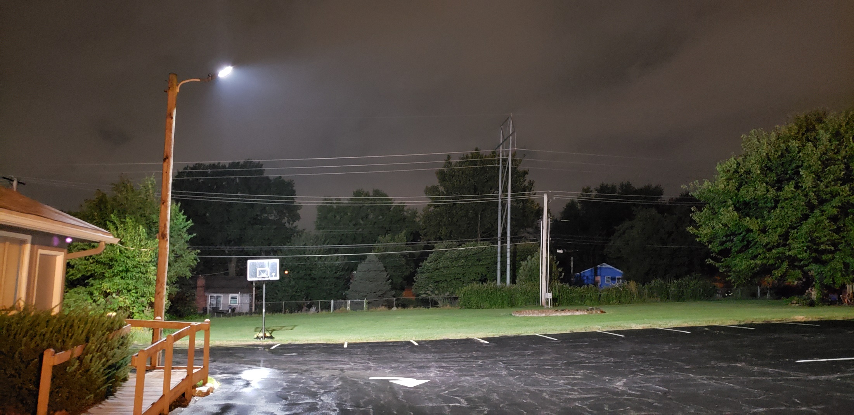
New parking lot lights, looking west
Notes:
We bless and thank Frank Schork for the installation!

Slide 3
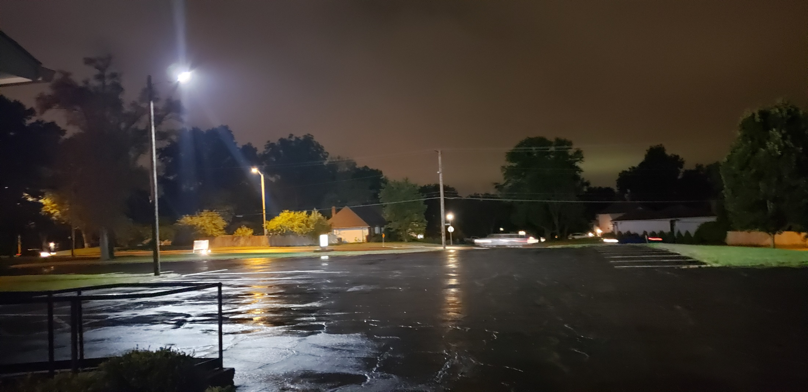
New parking lot lights, looking south
Notes:
New year, very different circumstances…

Slide 4
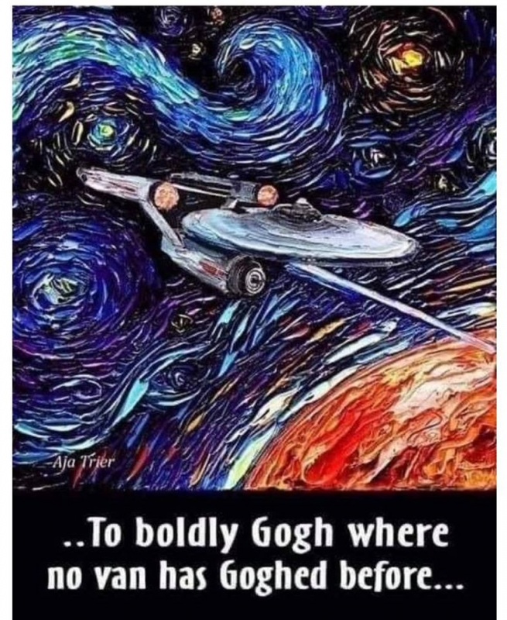
Notes:
Rukhel

Slide 6
We are at the last Shabbat of the Hebrew calendar month of Elul.
The new month and new year start Monday at sunset.
Happy New Year = Shannah Tova

Slide 7
Prep: Rosh Hashanna greetings
Shana Tovah שָׁנָה טוֹבָה
[Have a] Good Year
לשָׁנָה טוֹבָה וּמְתוּקָה
L’Shana Tova oo-m’tukah
[Have a] Good and sweet year
Notes:
In traditional Jewry, Rosh HaShannah is celebrated two days. Uncertainty when new moon was.
Also L’shana tovah t’katevu. לשָׁנָה טוֹבָה תכתבו May a good year be written to you. Based on Rabbinic legend that your fate for the next year is determined and sealed from now to YK. A cute idea, to really repent now to YK, but not TRUE. Some Messianics in KC teach as if it is true.
Practice…

Slide 8
Month of Elul as acronym
אֲנִי לְדוֹדִי וְדוֹדִי לִי אלול אֱלוּלElul
Anee l’dodi, v’dodi li
I am my beloved’s and he is mine.
A surprising example of loving faithfulness…

Slide 9
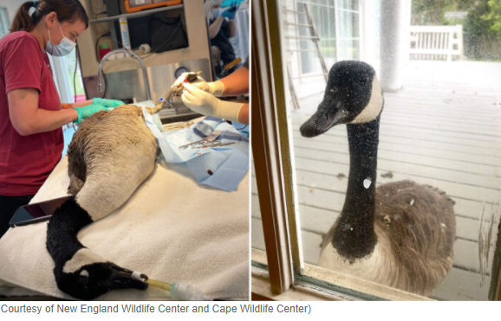
Injured goose having surgery, New England Wildlife Center.
Notes:
https://www.theepochtimes.com/mkt_breakingnews/loyal-goose-woefully-watches-injured-mate-undergo-surgery-through-window-of-wildlife-hospital_3923656.html?utm_source=newsnoe&utm_medium=email&utm_campaign=breaking-2021-09-03-2&mktids=6cfb785c94e727d9d062b675b36ff0ee&est=t75FjKhUhKS%2BLAZgx9Z54D1sWBcRlMH0z4MIyBhOuLZf3LQVK4P9bhX71%2F2pKI5k5w%3D%3D

Slide 10
Watching mate’s
surgery
Notes:
Loyal Goose Woefully Watches Injured Mate Undergo Surgery Through Window of Wildlife Hospital
Last Elul message…
https://www.theepochtimes.com/mkt_breakingnews/loyal-goose-woefully-watches-injured-mate-undergo-surgery-through-window-of-wildlife-hospital_3923656.html?utm_source=newsnoe&utm_medium=email&utm_campaign=breaking-2021-09-03-2&mktids=6cfb785c94e727d9d062b675b36ff0ee&est=t75FjKhUhKS%2BLAZgx9Z54D1sWBcRlMH0z4MIyBhOuLZf3LQVK4P9bhX71%2F2pKI5k5w%3D%3D

Slide 11
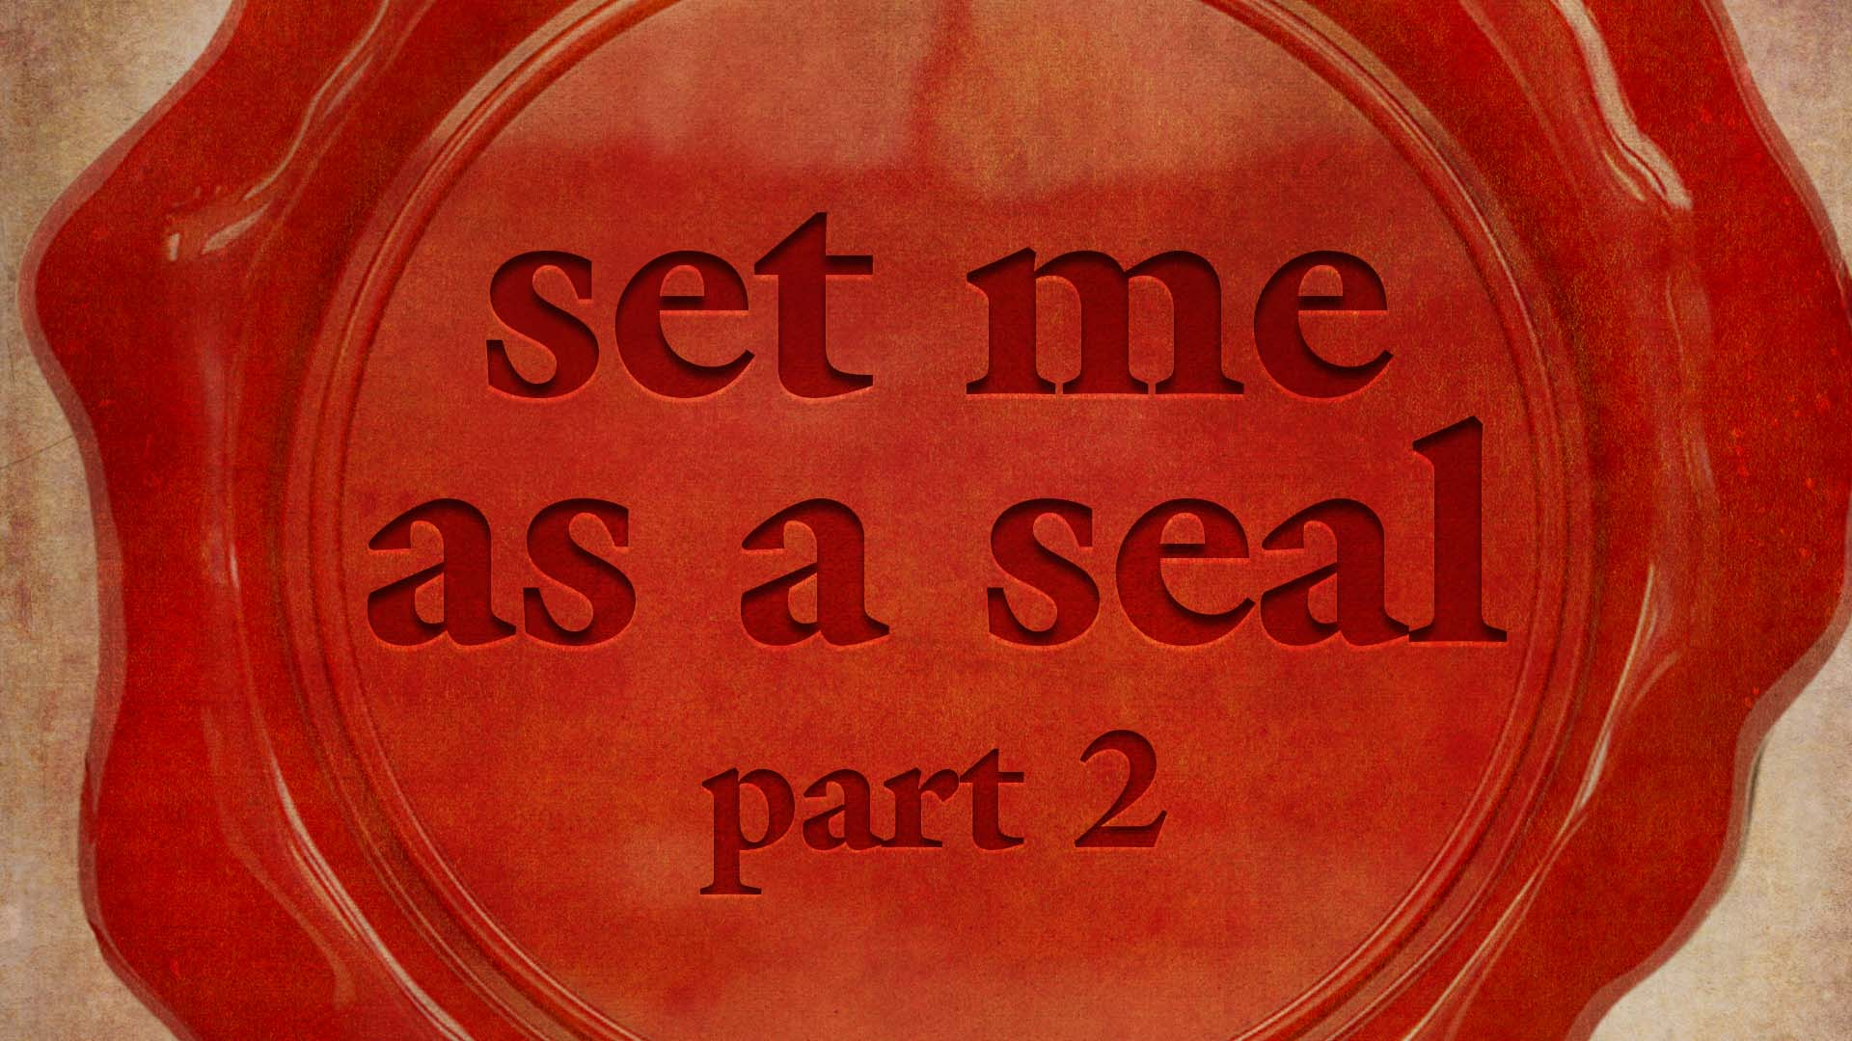
Notes:
Song of Songs, superlative song, is an ecstatic word poem of undulating rising to bliss of submission then sinking to selfish failure.

Slide 12
Set Me As a Seal
Song of [love] Songs
§3. Unbroken intimacy 3.6-5.1
§4. Intimacy again broken, restoration 5.2-6.10
§5. Fruits of recognized union 6.11-8.4
§6 Unrestrained intimacy 8.5-14
Notes:
The book Song of Songs, the superlative song, is an undulation, a variation from ecstatic submission to selfish defiance, and back again.
Where we left off

Slide 13
^{Song 4.16 [She]} Awake, north wind! Come, south wind! Blow on my garden to spread its fragrance. Let my darling enter his garden and eat its finest fruit.
Notes:
She is ready for any experience that will draw her to Him. Love Adoni with all…m’odekha. Easier to say than to live out. We talked about three.

Slide 14
North winds before us, last week:
Personal contentions
Iranian nuclear countdown
Culturally taught lies [Candace Owens on slavery, also gender, anti-Semitism, much else.]
Notes:
Family, relational, health, financial issues
Genocide: Zoom call with some Israelis and Benjamin Gantz Sar HaBitakhon, שר הבטחון Minister of Defense gives a weekly countdown to Iranian nuclear capacity!

Slide 15
Jews in America are the target of 58% of all religiously motivated hate crimes in the US despite constituting a mere 2% of the population, newly released FBI statistics for 2020 have shown.
Notes:
https://vfinews.com/news/september-3-2021/jews-target-of-58-of-all-religiously-motivated-hate?subscribed=true&mc_cid=043ce5873d&mc_eid=UNIQID

Slide 16
Nevertheless, CNN writers Christina Carrega and Priya Krishnakumar produced an exhaustive breakdown of the FBI [statistics] that omitted the…Jews.
Notes:
https://unitedwithisrael.org/cnn-omits-any-reference-to-huge-number-of-hate-crimes-against-us-jews-in-article-about-fbi-report/?utm_source=newsletters_unitedwithisrael_org&utm_medium=email&utm_content=CNN+Ignores+Hate+Crimes+Against+Jews%3B+70+US+State+Dept_+Officials+Demand+Firing+%27Anti-Semite%E2%80%99%3B+Ancient+Hebrew+Inscription+Reveals+if+Jews+Kept+Sabbatical+Year&utm_campaign=20210903_m164606961_CNN+Ignores+Hate+Crimes+Against+Jews%3B+70+US+State+Dept_+Officials+Demand+Firing+%27Anti-Semite%E2%80%99%3B+Ancient+Hebrew+Inscription+Reveals+if+Jews+Kept+Sabbatical+Year&utm_term=CNN+Ignores+Huge+Number+of+Hate+Crimes+Against+Jews

Slide 17
^{Song 4.16 [She]} Awake, north wind! Come, south wind! Blow on my garden to spread its fragrance. Let my darling enter his garden and eat its finest fruit.
Notes:
Do we REALLY enter this?

Slide 18
Can we really say this? “Love suffers loooooooooooong.”
What north winds do you and I face?
Notes:
Pause for prayer…

Slide 19
Can we really say this? “Love suffers loooooooooooong.”
North winds in our community:
Doctrinal differences
Notes:
People feel welcomed?? Big tent. Families bitterly divided.
PreTrip, Post Trib, speaking in tongues is glorious or Satanic, eternal security or lose salvation

Slide 20
Can we really say this? “Love suffers loooooooooooong.”
North winds in our community:
Doctrinal differences
Science differences: severity of COVID-19, masks, vaccination?
Notes:
People feel welcomed. Big tent. Families bitterly divided.
PreTrip, Post Trib, speaking in tongues is glorious or Satanic, eternal security or lose salvation
Can you bless someone unvaccinated? Can you bless the vaccinated. Many Messianic leaders, almost all in Israel, are vaccinated. Deeply dividing families.

Slide 21
Can we really say this? “Love suffers loooooooooooong.”
North winds in our community:
Doctrinal differences
Science differences: mask, vax, severity of COVID-19?
Political differences?
Notes:
People feel welcomed. Big tent. Families bitterly divided.
PreTrip, Post Trib, speaking in tongues is glorious or Satanic, eternal security or lose salvation
Can you bless someone unvaxed? Many Messianic leaders, almost all in Israel, are vaxed.
Election steal? I’m NOT so concerned about the Nov., 2020 election. I’m concerned about the eternal 2020 vision election. It’s more important that we are not overcome, even if overrun. More important is our relationship with G-d and people than our candidate.

Slide 22
Big tent ⛺
In non-salvation issues.
I could lose money! Lose safety!
Lose unity in the Spirit!?
Notes:
I was recently told about a ministry among Muslims…

Slide 23
REACHING UNREACHED NATIONS
Sun

Slide 24
Notes:
Eric Watts https://www.runministries.org/ministries

Slide 25
For years, RUN Ministries has talked about boys being kidnapped or given by their devout Muslim families for jihad. They’re put in terrorist training camps to become Islamic teachers, soldiers, and even suicide bombers. They are the next generation for jihad.
Notes:
Eric Watts https://www.runministries.org/ministries

Slide 26
Our prayers can change the world! A small village of nearly 10,000 innocent Afghans is now safe from evil men after an attack of death and destruction was averted. Why? Because God’s people are praying!
Notes:
Eric Watts https://www.runministries.org/ministries

Slide 27
Since the U.S. announced its departure from Afghanistan, the Taliban has accelerated this strategy. They’re now training hundreds of boys to be suicide bombers with plans to send them to kill innocents and destroy villages across Afghanistan.
Notes:
Eric Watts https://www.runministries.org/ministries

Slide 28
Yesterday, our teams encountered two suicide attackers in a remote part of the country. Their intentions were to blow up “infidels” — no matter who or where. BUT GOD HAD A DIFFERENT PLAN!
Notes:
Eric Watts https://www.runministries.org/ministries

Slide 29
“If you see someone on their way to death or in danger of being killed, you must do something to save them.” ^{Proverbs 24:11}
Thanks to the supernatural leading of the Holy Spirit, a RUN rescue team met the boys before they could carry out their plan.
Notes:
Eric Watts https://www.runministries.org/ministries

Slide 30
Our leaders successfully disarmed the two bombers and began feeding them, treating them with kindness, and sharing with them the Good News of the Gospel. Today, they left their suicide vests behind and are now following the love and mercy of Yeshua as baptized believers!
Notes:
Eric Watts https://www.runministries.org/ministries

Slide 31
Together, we can be an army of prayer warriors asking the Lord to protect RUN rescue teams and those who Our prayers can change the world! A small village of nearly 10,000 innocent Afghans is now safe from evil men after an attack of death and destruction was averted. Why? Because God’s people are praying!

Slide 32
Notes:
https://www.runministries.org/ministries
My dear friend Peter van der Steur telling me about outreach among Jihadists.
From Morocco to Indonesia
60 million won, most Jihadis
3 million house congregations!
One country 91,000 without passports former Jihadists ready to die, going in, 127 already have
Many believe last days outpouring. Practice. Outreach is practice.
Like firemen practice for real fire.

Slide 33
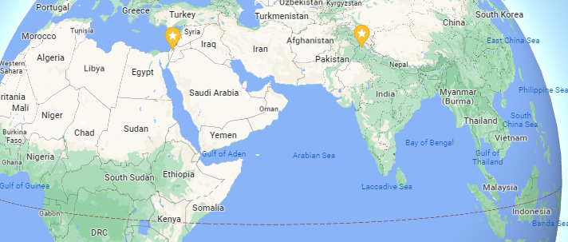
from Morocco to Indonesia
Notes:
Two starred locations were picked out by Google maps, the Beit Midrash in Jerusalem that I committed to pray for each week, and the other is Dharmshala, where Rivka Hare worked for with Winograd’s Reach Initiative.

Slide 34
^{Song 4.16 [She]} Awake, north wind! Come, south wind! Blow on my garden to spread its fragrance. Let my darling enter his garden and eat its finest fruit.
Notes:
Do we REALLY enter this?

Slide 35
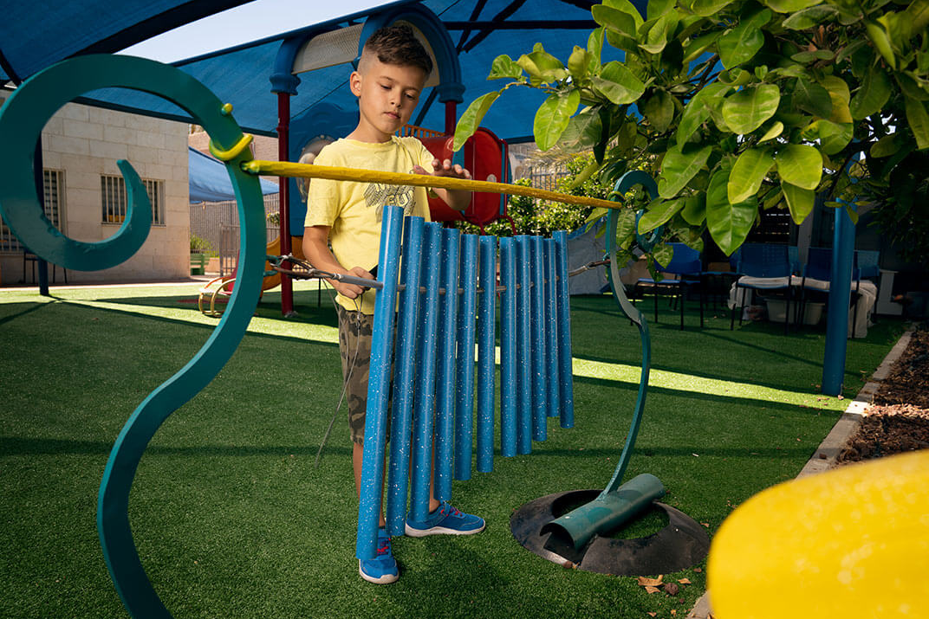
Notes:
https://maozisrael.org/report/2021/07/taste-and-see/

Slide 36
The constant threat of an explosion being just 15 seconds from any given moment has taken its toll on the inhabitants of towns of Southern Israel. Today most of the population, especially the children, suffer from some level of PTSD.
Notes:
https://maozisrael.org/report/2021/07/taste-and-see/

Slide 37
It was one such Hamas rocket that landed over a decade ago near an Israeli named Yaron. A blacksmith by hobby, he began his journey by melting down the rockets into a variety of symbols of peace as sculptures and jewelry.
Notes:
https://maozisrael.org/report/2021/07/taste-and-see/

Slide 38
Yaron was designing musical instruments made from rockets. He wanted to place these instruments in play areas so children (and adults) who were being fired on could experience the victory that comes with playing music with those rockets the day after.
Notes:
https://maozisrael.org/report/2021/07/taste-and-see/

Slide 39
Notes:
https://maozisrael.org/report/2021/07/taste-and-see/

Slide 40
When the instruments arrived, the kids would stand in line to play them. The counselor told of moments where the children played the instruments while in the distance the sound of explosions from the Iron Dome intercepting rockets could be heard.
Notes:
https://maozisrael.org/report/2021/07/taste-and-see/

Slide 41
The Sounds of Peace are a divine demonstration of the confidence of the Jewish people that because of their God, there will always be the day after.
Notes:
What about us? How well do we sing in pain, adversity, disaster? Do we see Yeshua?
https://maozisrael.org/report/2021/07/taste-and-see/

Slide 42
Notes:
Song of Songs, superlative song, is an ecstatic word poem of undulating rising to bliss of submission then sinking to selfish failure

Slide 43
Set Me As a Seal
Song of [love] Songs
§3. Unbroken intimacy 3.6-5.1
§4. Intimacy again broken, restoration 5.2-6.10
§5. Fruits of recognized union 6.11-8.4
§6 Unrestrained intimacy 8.5-14

Slide 44
^{Song 5.2-6} [She] I am asleep, but my heart is awake. Listen! I hear my darling knocking!
[He] Open for me, my sister, my love, my dove, my flawless one! For my head is wet with dew, my hair with the moisture of the night.

Slide 45
^{Rev 3.20-22} Here, I’m standing at the door, knocking. If someone hears my voice and opens the door, I will come in to him and eat with him, and he will eat with me. I will let him who wins the victory sit with me on my throne,

Slide 46
^{Rev 3.20-22} just as I myself also won the victory and sat down with my Father on his throne. Those who have ears, let them hear what the Spirit is saying to the Messianic communities.”’”

Slide 47
^{Song 5.2-6 [She]} I’ve removed my coat; must I put it back on? I’ve washed my feet; must I dirty them again? The man I love put his hand through the hole by the door-latch, and my heart began pounding at the thought of him.
Notes:
Enough of G-d. Prayer missed. Time devotionally in the word, in worship, missed. Little foxes that spoil the vines.

Slide 48
^{Song 5.2-6 [She]} I got up to open for the man I love. My hands were dripping with myrrh — pure myrrh ran off my fingers onto the handle of the bolt. I opened for my darling, but my darling had turned and gone.

Slide 49
Charles Finney, the father of modern revivalism, made this piercing statement:
"There is a certain type of believer that although being constructively involved in the congregation and passes off as being a very good believer,
Notes:
https://www.charismanews.com/opinion/the-flaming-herald/86531-can-you-be-a-christian-without-believing-in-jesus?utm_source=Charisma%20News%20Daily&utm_medium=email&utm_content=subscriber_id:5160390&utm_campaign=CNO%20daily%20-%202021-08-27

Slide 50
is useless in revival. I do not mean that they are wicked, but they have a form of piety which has no fire or efficiency and actually repels new believers, and wards off the truth."
Notes:
https://www.charismanews.com/opinion/the-flaming-herald/86531-can-you-be-a-christian-without-believing-in-jesus?utm_source=Charisma%20News%20Daily&utm_medium=email&utm_content=subscriber_id:5160390&utm_campaign=CNO%20daily%20-%202021-08-27

Slide 51
You must ask yourself why you are serving God. Is it for the blessings and what He can give you out of life, or what you can give back to Him for giving you His life? That's the basic difference between a true and a false conversion.
True repentance leads to obedience and the pursuit of holiness.
Notes:
https://www.charismanews.com/opinion/the-flaming-herald/86531-can-you-be-a-christian-without-believing-in-jesus?utm_source=Charisma%20News%20Daily&utm_medium=email&utm_content=subscriber_id:5160390&utm_campaign=CNO%20daily%20-%202021-08-27

Slide 52
"Pursue peace with all people, and holiness, without which no one will see the Lord" ^{(Heb. 12:14)}
Without holiness you won't see the Lord. Without purity of heart you can't see God.
"Blessed are the pure in heart, for they shall see God" ^{(Matt. 5:8).}
Notes:
https://www.charismanews.com/opinion/the-flaming-herald/86531-can-you-be-a-christian-without-believing-in-jesus?utm_source=Charisma%20News%20Daily&utm_medium=email&utm_content=subscriber_id:5160390&utm_campaign=CNO%20daily%20-%202021-08-27

Slide 53
^{Song 5.6b-7 [She]} My heart had failed me when he spoke — I sought him, but I couldn’t find him; I called him, but he didn’t answer. The watchmen roaming the city found me; they beat me, they wounded me; they took away my cloak, those guardians of the walls!

Slide 54
^{Song 5.9 [Chorus]} How does the man you love differ from any other, you most beautiful of women? How does the man you love differ from any other?

Slide 55
^{Song 5.10-11 [She]} The man I love is radiant and ruddy; he stands out among ten thousand. His head is like the finest gold; his locks are wavy and black as a raven.

Slide 56
^{Song 5.15-16 [She]} His appearance is like the L’vanon, as imposing as the cedars. His words are sweetness itself; he is altogether desirable. This is my darling, and this is my friend, daughters of Yerushalayim.

Slide 57
^{Daniel 7.9-14} “While I was watching, thrones were set up, and the Ancient of Days took his seat. His garment was as white as snow, and the hair of His head like pure wool. His throne was ablaze with flames, its wheels a burning fire.

Slide 58
^{Daniel 7.9-14} A river of fire was flowing and coming out from before Him. Thousands of thousands attended Him and ten thousand times ten thousand stood before Him…

Slide 59
^{Daniel 7.9-14} “I was watching in the night visions. Behold, One like a Son of Man, coming with the clouds of heaven. He approached the Ancient of Days, and was brought into His presence.

Slide 60
^{Daniel 7.9-14} Dominion, glory and sovereignty were given to Him that all peoples, nations, and languages should serve Him. His dominion is an everlasting dominion that will never pass away, and His kingdom is one that will not be destroyed.

Slide 61
^{Rev 1.13-16} In the midst of the menorot, I saw One like a Son of Man, clothed in a robe down to His feet, with a golden belt wrapped around His chest. His head and His hair were white like wool, white like snow, and His eyes like a flame of fire.

Slide 62
^{Rev 1.13-16} His feet were like polished bronze refined in a furnace, and His voice was like the roar of rushing waters. In His right hand He held seven stars, and out of His mouth came forth a sharp, two-edged sword. His face was like the sun shining at full strength.
Notes:
But He is not dangerously glorious, rather engagingly glorious. Glory to share.

Slide 63
^{Yeshayahu/Is 57.15} For thus says the High, Exalted One who lives forever, whose name is Holy: “I live in the high and holy place but also with the broken and humble, in order to revive the spirit of the humble and revive the hearts of the broken ones.
Notes:
Lion of the tribe of Judah is to her the king of love.

Slide 64
William Wilberforce led a campaign against the British Parliament to abolish slavery in the late 1700's and early 1800's. During the course of his intense efforts, Wilberforce came to a desperate place of discouragement, feeling he had absolutely no more strength to continue. In this condition,
Notes:
George Whitten

Slide 65
In this condition, he was about to give up, when his elderly friend, John Wesley, lying on his deathbed, was informed of his friend William's distress. Wesley requested pen and paper, and with a quivering hand, wrote these words, "Unless God has raised you up for this very thing, you will be worn out by the opposition of men and devils.
Notes:
George Whitten

Slide 66
But if God be for you, who can be against you? Are all of them stronger than God? Oh be not weary of well-doing! Go on, in the name of God and in the power of his might, till even American slavery shall vanish away before it.“
Notes:
George Whitten
So, look to Yeshua, not the circumstances of the battle.

Slide 67
John Wesley died six days later, but William Wilberforce fought for forty-five more years, and in 1833, three days before his own death, witnessed the abolition of slavery in Britain.
Notes:
George Whitten

Slide 68
^{Song 6.2-3 [She]} My lover went down to his garden, to the beds of balsam
to graze his flocks in the gardens and to gather lilies. I am my beloved’s and my beloved is mine. He browses among the lilies.
Notes:
Slightly different than previous. She mentions his claim first, cf
My beloved is mine, and I am His
of a previous chapter. Her testimony, despite difficulties. He responds…

Slide 69
^{Song 6.4-5 [He]} You are as beautiful as Tirtzah, my love, as lovely as Yerushalayim, but formidable as an army marching under banners. Turn your eyes away from me, because they overwhelm me!
Notes:
His response

Slide 72
Set Me As a Seal
Song of [love] Songs
§3. Unbroken intimacy 3.6-5.1
§4. Intimacy again broken, restoration 5.2-6.10
§5. Fruits of recognized union 6.11-8.4
§6 Unrestrained intimacy 8.5-14

Slide 73
^{Song 8.6-7 [She]} Set me like a seal on your heart, like a seal on your arm; for love is as strong as death, passion as cruel as Sh’ol; its flashes are flashes of fire, [as fierce as the] flame of Yah.

Slide 74
^{Song 8.6-7 [She]} No amount of water can quench love, torrents cannot drown it. If someone gave all the wealth in his house for love, he would gain only utter contempt.
Notes:
This is imagery from the Temple service.

Slide 75
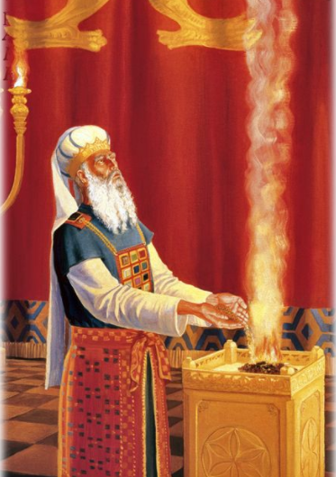
^{Shmot/Ex 28.10-12} Take two onyx stones and engrave on them the names of the sons of Isra’el — six of their names on one stone and the six remaining names on the other, in the order of their birth.
Notes:
http://2.bp.blogspot.com/_nbNVAcrsK3A/SjZiTpe_vUI/AAAAAAAAAbY/32a_E_zzQ-s/s400/templeinst.jpg

Slide 76
^{Shmot/Ex 28.10-12} An engraver should engrave the names of the sons of Isra’el on the two stones as he would engrave a seal. Mount the stones in gold settings, and put the two stones on the shoulder-pieces of the vest as stones calling to mind the sons of Isra’el.

Slide 77
^{Shmot/Ex 28.10-12} Aharon is to carry their names before Adoni on his two shoulders as a reminder.
Notes:
Messiah is our Kohen HaGadol, כוהן הגדול great High Priest
Surely He has borne our griefs and carried our pains. ^{Yesh/Is 53.4}
^{1 Kefa/Pet 5.7} Throw all your anxieties upon him, because he cares about you.
What burden in the Ruakh do you carry. You are a Kohen, a priest.
Fasting: from till Rosh Hashanna till Yom Kippur

Slide 78
^{Song 8.6-7 [She]} Set me like a seal on your heart, like a seal on your arm; for love is as strong as death, passion as cruel as Sh’ol; its flashes are flashes of fire, [as fierce as the] flame of Yah.

Slide 79
^{MJ/Heb. 9.28} Messiah was offered once to bear the sins of many. He will appear a second time, apart from sin, to those eagerly awaiting Him for salvation.

Slide 80
Do you KNOW Yeshua and the assurance of sins forgiven?
Are you hearing daily from His Word?
How are you applying what you heard?
Are you asking this of another?
Notes:
Who are you discipling, building up?4

