Slide 1
e-handout
To have these notes
without taking notes
Go to OrHaOlam.com
Click on Messages tab,
2022 Messages
Notes:
You may notice that I’m slowing down in my rate of speech. This is because we may be getting language translation equipment for simultaneous translation.

Slide 2
Correction:
תָּבוֹא מַלְכוּתְךָ Tavo mal-khut’kha
Sound the shofar of liberation!
Notes:
I mispronounced the Hebrew, and taught you wrong.

Slide 3
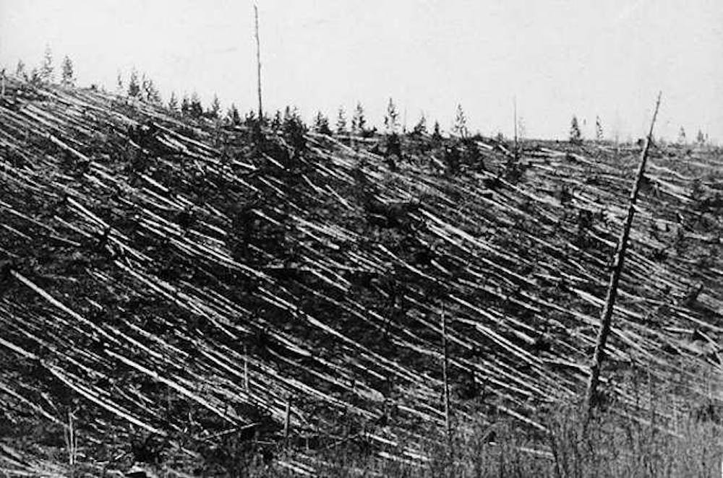
Tunguska event 80 million trees
Notes:
https://images.theconversation.com/files/26234/original/xkh376v7-1372241498.jpg?ixlib=rb-1.1.0&q=45&auto=format&w=1000&fit=clip

Slide 4
The Tunguska event was a ~12 megaton explosion [1000x Hiroshima 15 kilotons] in Siberia, Russia, 1908. The explosion flattened an estimated 80 million trees over an area of 830 sq mi of forest.

Slide 5
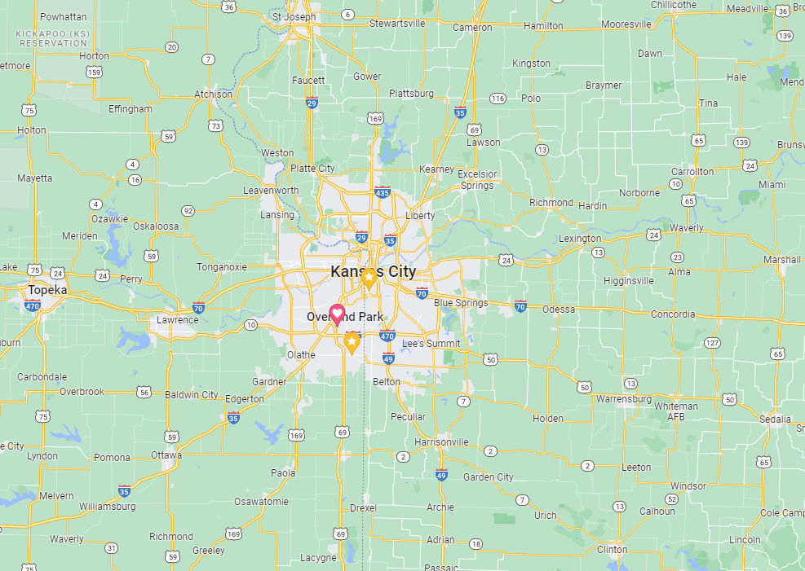
Flattened trees
~20 mi x 40 mi

Slide 6
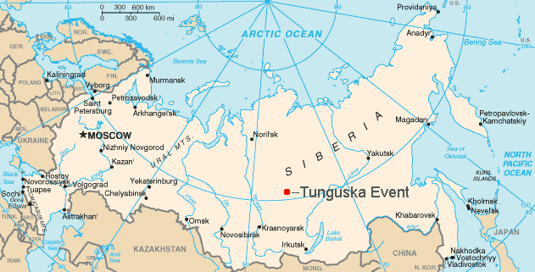

Slide 7
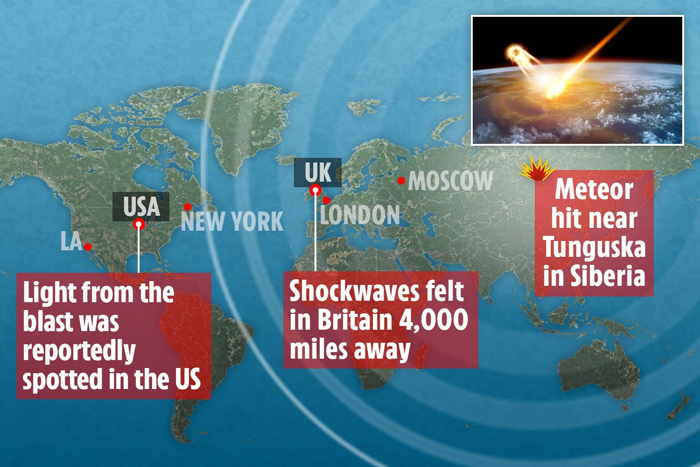

Slide 8
Notes:
https://i.ytimg.com/vi/PVF1NDrHPeo/maxresdefault.jpg

Slide 9
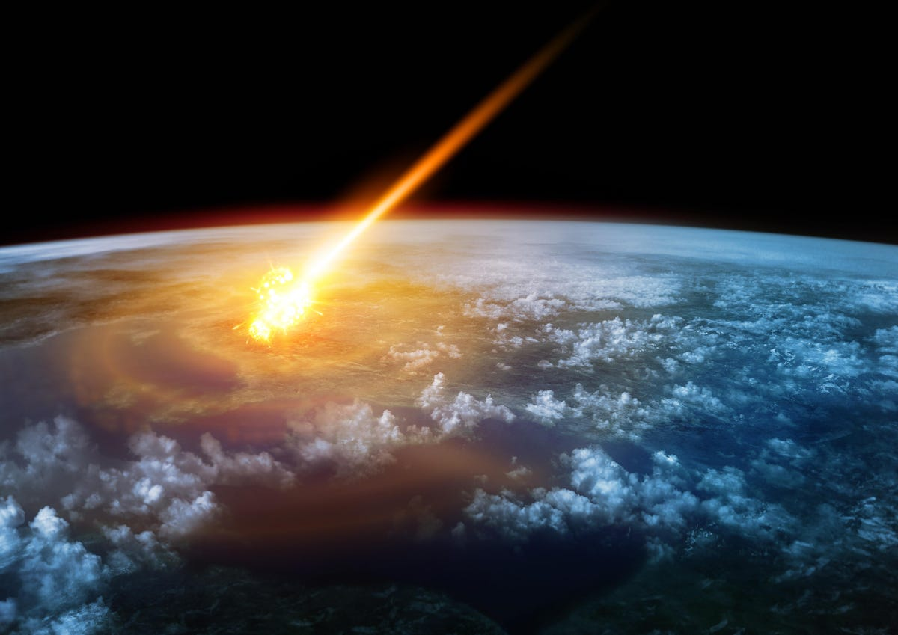
Notes:
https://imageio.forbes.com/specials-images/imageserve/5efb85ed222b100007dd18b6/0x0.jpg?format=jpg&width=1200
Because of this 1908 event, people have been worried about an asteroid collision with earth.

Slide 10
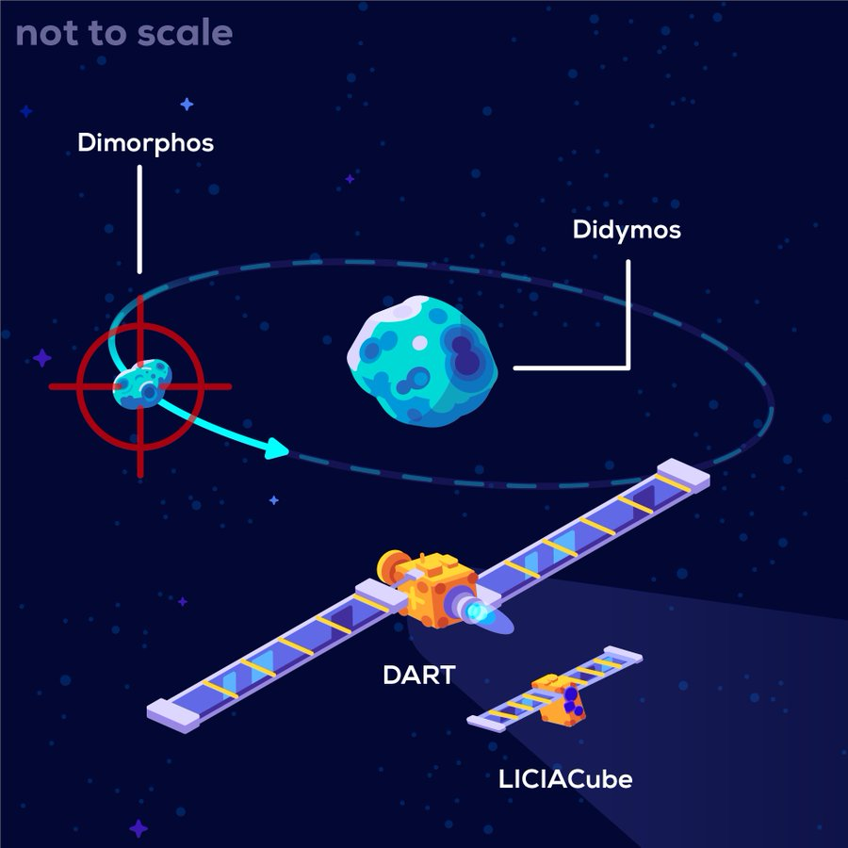
The 1,260-pound DART spacecraft was launched in November 2021 and hit Dimorphos [which does not pose a threat to Earth] at ~14,000 mph while seven million miles away from Earth 6 pm Monday, Sept 26, 2022.
Notes:
https://www.google.com/url?sa=i&url=https%3A%2F%2Fen.as.com%2Flatest_news%2Fhow-much-has-the-dart-robotic-suicide-mission-cost-n%2F&psig=AOvVaw3a09VIecYyFyKhQX9s31ey&ust=1664637601312000&source=images&cd=vfe&ved=0CAwQjRxqFwoTCPiu49DovPoCFQAAAAAdAAAAABA1
Dimorphos — a 530-foot diameter asteroid, or just about as tall as the Washington Monument, that orbits larger asteroid Didymos.
Hopefully the collision will change the orbital velocity of Dimorphos around Didymos 1%, but won’t be known for months.
Italian space probe observed the event:

Slide 11
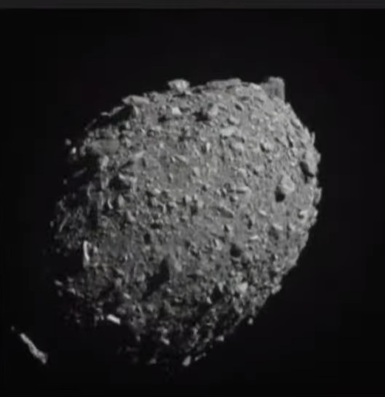
Notes:
1.44.37 on https://www.youtube.com/watch?v=-6Z1E0mW2ag
This may seem like “far out” space science, but there is a scriptural corollary…

Slide 12
^{2 Peter 3.10-12} On that day the heavens will pass away with a roar, and the elements will melt and disintegrate, and the earth and everything done on it shall be exposed. Since all these things are to be destroyed in this way, what kind of people should you be?

Slide 13
^{2 Peter 3.10-12} Live your lives in holiness and godliness, looking for and hastening the coming of the day of God. In that day the heavens will be dissolved by fire, and the elements will melt in the intense heat.

Slide 14
Nora נוֹרָא
terrible, terrifying, awful; awe-inspiring, awesome (God)

Slide 15
עֲשֶׂרֶת יָמִים נוֹרָאִים
Aseret Yamim Noraim
Ten Days of Awe:
The Fear of the L-rd
Rosh HaShanah to Yom Kippur
Sept 25 to Oct 5

Slide 17
What is the “fear of Adoni?”

Slide 18
The Hebrew words יִרְאַ֣ת yir’aṯ and פחד p̄aḥaḏ are most commonly used to describe fear of God.
Bahya ibn Paquda characterized two types of fear as a lower "fear of punishment" and a higher "fear of [divine awe] glory.
Notes:
https://en.wikipedia.org/wiki/Fear_of_God
יִרְאָה fear, terror, dread; awe, reverence; piety,
פחד fear, anxiety

Slide 19
Fear of God may refer to fear itself, but more often to a sense of awe, and submission to Deity.
Maimonides categorized the fear of God as a positive commandment, as the feeling of human insignificance deriving from contemplation of God's "great and wonderful actions and creations."
Notes:
Pause and meditate on majesty.
https://en.wikipedia.org/wiki/Fear_of_God

Slide 20
עֲשֶׂרֶת יָמִים נוֹרָאִים
Aseret Yamim Noraim
Ten Days of Awe:
The Fear of the L-rd
Rosh HaShanah to Yom Kippur
Sept 25 to Oct 5

Slide 22
Yamim Noraim ימים נוראים
DAYS OF AWE AND RECONCILIATION
Notes:
https://www.umjc.org/commentary/2022/9/28/days-of-awe-and-reconciliation?utm_source=UMJC+News&utm_campaign=d6f2747465-EMAIL_CAMPAIGN_2020_12_10_08_42_COPY_01&utm_medium=email&utm_term=0_cd802052fa-d6f2747465-203688328

Slide 23
These ten days are set aside for serious introspection
^{Mishnah Yoma 8:9} For transgressions between a person and God, Yom Kippur atones; however, for transgressions between a person and another, Yom Kippur does not atone until he appeases the other person.
Notes:
https://www.umjc.org/commentary/2022/9/28/days-of-awe-and-reconciliation?utm_source=UMJC+News&utm_campaign=d6f2747465-EMAIL_CAMPAIGN_2020_12_10_08_42_COPY_01&utm_medium=email&utm_term=0_cd802052fa-d6f2747465-203688328

Slide 24
^{Matthew 5:23–24} Therefore, if you are presenting your offering upon the altar, and there remember that your brother has something against you, leave your offering there before the altar and go. First, be reconciled to your brother, and then come and present your offering.

Slide 25
^{Yn 17.20-22} [Yeshua says:] I pray not only for these, but also for those who will trust in me because of their word, that they may all be one.
Just as you, Father, are united with me and I with you,

Slide 26
^{Yn 17.20-22} I pray that they may be united with us, so that the world may believe that you sent me. The glory which you have given to me, I have given to them; so that they may be one, just as we are one

Slide 27
During these Days of Awe, we have the opportunity to reach out to those we have offended, and even to those who have offended us. This reaching out is not an opportunity to correct or change the other’s mind. Rather, it is an opportunity to offer an attitude of shalom.
Notes:
https://www.umjc.org/commentary/2022/9/28/days-of-awe-and-reconciliation?utm_source=UMJC+News&utm_campaign=d6f2747465-EMAIL_CAMPAIGN_2020_12_10_08_42_COPY_01&utm_medium=email&utm_term=0_cd802052fa-d6f2747465-203688328
[Pause]
Think about anyone you have offended, or they have offended you. Sometimes unfixable, and you can only forgive in your heart. Give blessing. Thank G-d for difficulty.
Much better than stewing and seething in your heart. And pray for opportunity of real reconciliation.

Slide 29
Today, the Shabbat between Rosh Hashanah and Yom Kippur is therefore called Shabbat Shuvah, “Shabbat of Return.”
The Haftorah selection is
Hoshea 14:
Notes:
https://www.umjc.org/commentary/2022/9/28/days-of-awe-and-reconciliation?utm_source=UMJC+News&utm_campaign=d6f2747465-EMAIL_CAMPAIGN_2020_12_10_08_42_COPY_01&utm_medium=email&utm_term=0_cd802052fa-d6f2747465-203688328

Slide 30
^{Hos 14:2} “Return שׁוּבָה O Israel, to Adoni your God, for you have stumbled in your iniquity”
Notes:
https://www.umjc.org/commentary/2022/9/28/days-of-awe-and-reconciliation?utm_source=UMJC+News&utm_campaign=d6f2747465-EMAIL_CAMPAIGN_2020_12_10_08_42_COPY_01&utm_medium=email&utm_term=0_cd802052fa-d6f2747465-203688328

Slide 31
The Jewish community stresses human forgiveness far more than personal salvation, and is not as apt to think about a secured future beyond the grave.
Notes:
https://www.umjc.org/commentary/2022/9/28/days-of-awe-and-reconciliation?utm_source=UMJC+News&utm_campaign=d6f2747465-EMAIL_CAMPAIGN_2020_12_10_08_42_COPY_01&utm_medium=email&utm_term=0_cd802052fa-d6f2747465-203688328

Slide 32
Adoni cares both for our here-and-now and for our eternity. During these Days of Awe, we should look for ways to be reconciled with those whom we’ve drifted away from.
Notes:
https://www.umjc.org/commentary/2022/9/28/days-of-awe-and-reconciliation?utm_source=UMJC+News&utm_campaign=d6f2747465-EMAIL_CAMPAIGN_2020_12_10_08_42_COPY_01&utm_medium=email&utm_term=0_cd802052fa-d6f2747465-203688328

Slide 33
Adoni is not only concerned with our eternal dwelling place but with each and every day of our lives on this planet as well.
Notes:
https://www.umjc.org/commentary/2022/9/28/days-of-awe-and-reconciliation?utm_source=UMJC+News&utm_campaign=d6f2747465-EMAIL_CAMPAIGN_2020_12_10_08_42_COPY_01&utm_medium=email&utm_term=0_cd802052fa-d6f2747465-203688328

Slide 34
עֲשֶׂרֶת יָמִים נוֹרָאִים
Aseret Yamim Noraim
Ten Days of Awe:
The Fear of the L-rd
Rosh HaShanah to Yom Kippur
Sept 25 to Oct 5

Slide 36
^{Mislei/Prov 1.7} The fear of Adoni is the beginning of knowledge, but fools despise wisdom and discipline.
Fourteen times in Proverbs.
Notes:
Fourteen times in Proverbs.
Note parallelism in structure. Hebrew poetry basic.

Slide 37
Contrasted with the fear of man
^{Mislei/Prov 29.25} Fearing human beings is a snare;
but he who trusts in Adoni will be raised high [above danger].

Slide 38
Oswald Chambers: The remarkable thing about fearing G-d is that when you fear G-d, you fear nothing else. Whereas if you do not fear G-d, you fear everything else.
Notes:
.

Slide 39
Benefits of the Fear of Adoni

Slide 40
^{Mislei/Prov 9.10} The fear of Adoni is the beginning of wisdom
and knowledge of the Holy One is understanding.
^{Mislei/Prov 15.33} The fear of Adoni is the discipline of wisdom,
and humility comes before honor.
Notes:
Ie applying to our lives

Slide 41
^{Mislei/Prov 14.26} In the fear of Adoni one has strong confidence.
It will be a refuge for His children.

Slide 42
^{Mislei/Prov 22.4} The reward for humility is fear of Adoni,
along with wealth, honor and life.

Slide 43
^{Mislei/Prov 10.24} The fear of Adoni prolongs life,
but the years of the wicked are cut short.

Slide 44
^{Mislei/Prov 14.27} The fear of Adoni is a fountain of life
enabling one to avoid deadly traps.

Slide 45
^{Mislei/Prov 8.13} The fear of Adoni is hatred of evil.
I hate pride and arrogance,
evil ways and duplicitous speech.
Notes:
Rte 22 in PA, used to pass Adult bookstores. Made me mad.

Slide 46
^{Mislei/Prov 31.30}Charm is deceitful and beauty is vain,
but a woman who fears Adoni will be praised.

Slide 47
^{Mislei/Prov 16.6} Grace and truth atone for iniquity,
And people turn from evil through fear of Adoni.
Notes:
“I thought only the Blood Atonement atoned.”
This leads to that.

Slide 48
^{Mislei/Prov 23.17} Don’t envy sinners, but follow the example of those who always fear God;

Slide 49
^{Mislei/Prov 2.3-5} Yes, if you will call for insight and raise your voice for discernment, if you seek it as you would silver and search for it as for hidden treasure — then you will understand the fear of Adoni and find knowledge of God.

Slide 50
^{Mislei/Prov 1.28-29} Then they will call me, but I won’t answer; they will seek me earnestly, but they won’t find me.
Because they hated knowledge
and did not choose the fear of Adoni.

Slide 51
^{Mislei/Prov 15.16} Better is little with the fear of Adoni
than great wealth with turmoil.

Slide 52
^{Mtt. 10.28-31} Do not fear those who kill the body but are powerless to kill the soul. Rather, fear him who can destroy both soul and body in Gei-Hinnom. Aren’t sparrows sold for next to nothing, two for an assarion?

Slide 53
^{Mtt. 10.28-31} Yet not one of them will fall to the ground without your Father’s consent. As for you, every hair on your head has been counted. So do not be afraid, you are worth more than many sparrows.

Slide 54
^{Acts 10.34-35} Then Peter opened his mouth and said, “I truly understand that God is not one to show favoritism, but in every nation the one who fears Him and does what is right is acceptable to Him.
Notes:
Message of salvation available to all nations.

Slide 55
^{Rev 14.6-7} And then I saw another angel flying high in the sky, having a timeless message of good news to proclaim to those who dwell on the earth—to every nation and tribe and tongue and people.

Slide 56
^{Rev 14.6-7} He said in a loud voice, “Fear God and give Him glory, because the hour of His judgment has come. Worship the One who made heaven and earth and sea and springs of water.”

Slide 57
עֲשֶׂרֶת יָמִים נוֹרָאִים
Aseret Yamim Noraim
Ten Days of Awe:
The Fear of the L-rd
Rosh HaShanah to Yom Kippur
Sept 25 to Oct 5

Slide 59
Losing the Fear of Adoni

Slide 60
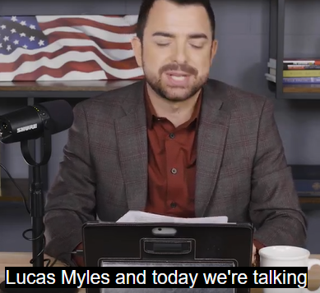
Notes:
Each week brings reports of formerly mainstream and well-known evangelical figures deconstructing or even “deconverting” from their faith. This rising group, which is known by the moniker “Exvangelical,” spread doubt through their faithless recanting of previously held religious beliefs.
https://www.theepochtimes.com/premiering-at-8-pm-et-enemies-within-christianity-the-deconstruction-movement-and-exvangelicals_4761067.html?utm_source=enewsnoe&utm_campaign=etv-2022-09-29&utm_medium=email&est=BLdbIUMPVInC8dH5q%2B4bv5CArCnryOUXu9VP1Ap1p7H7M9rNOIn0GsDhnVjwSU4Kmg%3D%3D

Slide 61
Notes:
https://www.theepochtimes.com/premiering-at-8-pm-et-enemies-within-christianity-the-deconstruction-movement-and-exvangelicals_4761067.html?utm_source=enewsnoe&utm_campaign=etv-2022-09-29&utm_medium=email&est=BLdbIUMPVInC8dH5q%2B4bv5CArCnryOUXu9VP1Ap1p7H7M9rNOIn0GsDhnVjwSU4Kmg%3D%3D

Slide 62
Notes:
https://www.theepochtimes.com/premiering-at-8-pm-et-enemies-within-christianity-the-deconstruction-movement-and-exvangelicals_4761067.html?utm_source=enewsnoe&utm_campaign=etv-2022-09-29&utm_medium=email&est=BLdbIUMPVInC8dH5q%2B4bv5CArCnryOUXu9VP1Ap1p7H7M9rNOIn0GsDhnVjwSU4Kmg%3D%3D

Slide 63
Notes:
https://www.theepochtimes.com/premiering-at-8-pm-et-enemies-within-christianity-the-deconstruction-movement-and-exvangelicals_4761067.html?utm_source=enewsnoe&utm_campaign=etv-2022-09-29&utm_medium=email&est=BLdbIUMPVInC8dH5q%2B4bv5CArCnryOUXu9VP1Ap1p7H7M9rNOIn0GsDhnVjwSU4Kmg%3D%3D

Slide 64
Notes:
https://www.theepochtimes.com/premiering-at-8-pm-et-enemies-within-christianity-the-deconstruction-movement-and-exvangelicals_4761067.html?utm_source=enewsnoe&utm_campaign=etv-2022-09-29&utm_medium=email&est=BLdbIUMPVInC8dH5q%2B4bv5CArCnryOUXu9VP1Ap1p7H7M9rNOIn0GsDhnVjwSU4Kmg%3D%3D

Slide 65
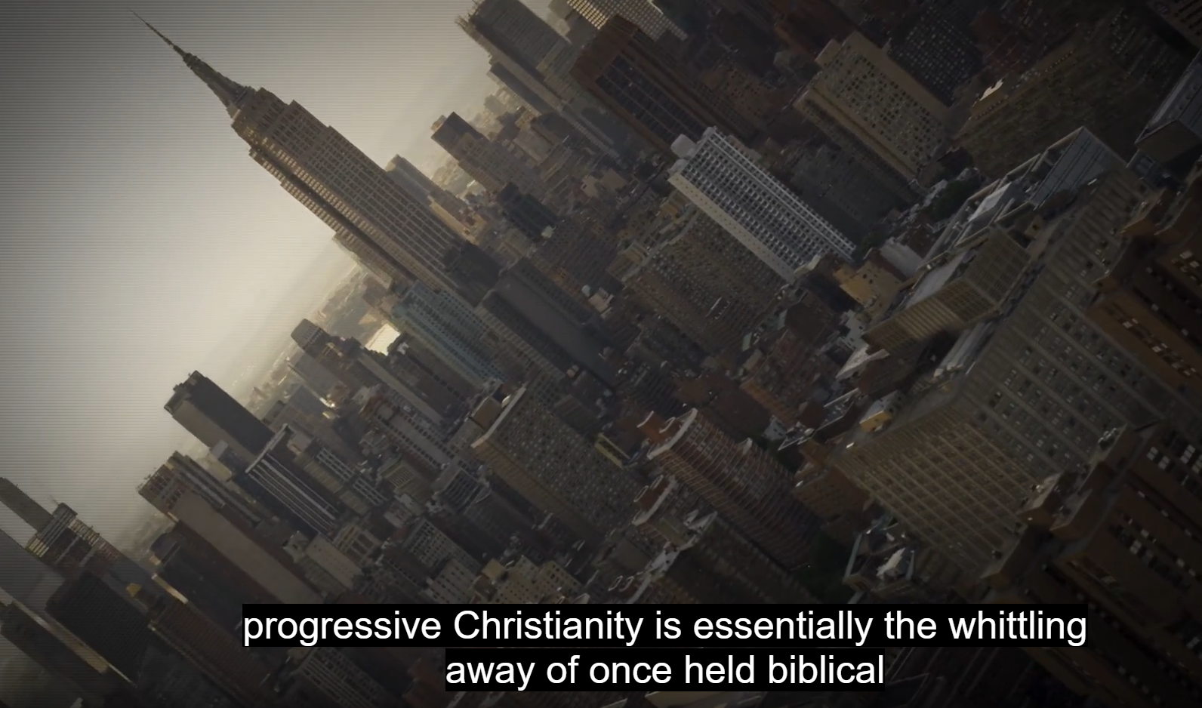
doctrines.
Notes:
Going WOKE.
https://www.theepochtimes.com/premiering-at-8-pm-et-enemies-within-christianity-the-deconstruction-movement-and-exvangelicals_4761067.html?utm_source=enewsnoe&utm_campaign=etv-2022-09-29&utm_medium=email&est=BLdbIUMPVInC8dH5q%2B4bv5CArCnryOUXu9VP1Ap1p7H7M9rNOIn0GsDhnVjwSU4Kmg%3D%3D

Slide 66
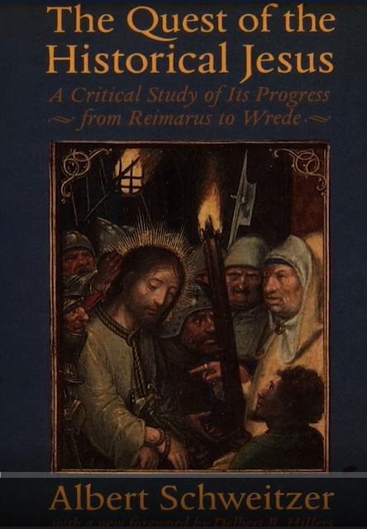
Stripping out the supernatural: miracles, resurrection
Focusing on Enlightenment rationalism
Critical theology
Notes:
Nobel prize winner Missionary doctor.
Leaving inerrancy. “Did G-d really say…?”

Slide 67
For example, story of murderous, adulterous David and Bathsheva revised to say that King David raped Bathsheva.
Not in the text.
Notes:
https://www.theepochtimes.com/premiering-at-8-pm-et-enemies-within-christianity-the-deconstruction-movement-and-exvangelicals_4761067.html?utm_source=enewsnoe&utm_campaign=etv-2022-09-29&utm_medium=email&est=BLdbIUMPVInC8dH5q%2B4bv5CArCnryOUXu9VP1Ap1p7H7M9rNOIn0GsDhnVjwSU4Kmg%3D%3D

Slide 68
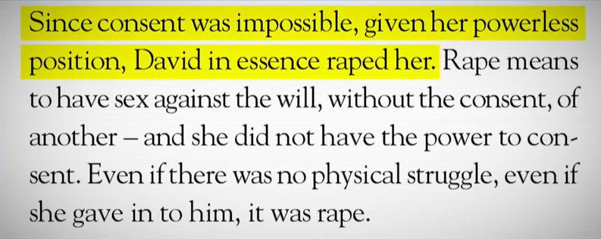
Notes:
Male, king, upper class economically. So endemically rape.
https://www.theepochtimes.com/premiering-at-8-pm-et-enemies-within-christianity-the-deconstruction-movement-and-exvangelicals_4761067.html?utm_source=enewsnoe&utm_campaign=etv-2022-09-29&utm_medium=email&est=BLdbIUMPVInC8dH5q%2B4bv5CArCnryOUXu9VP1Ap1p7H7M9rNOIn0GsDhnVjwSU4Kmg%3D%3D

Slide 69
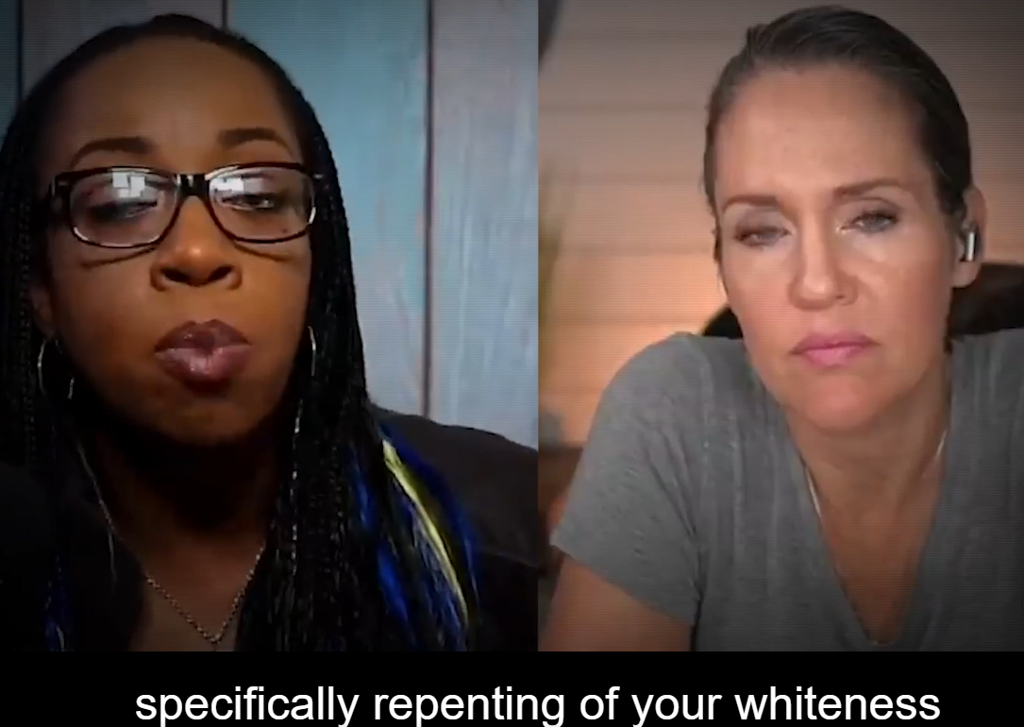
You’ve repented of your sins, but
There is more work to be done…
Notes:
https://www.theepochtimes.com/premiering-at-8-pm-et-enemies-within-christianity-the-deconstruction-movement-and-exvangelicals_4761067.html?utm_source=enewsnoe&utm_campaign=etv-2022-09-29&utm_medium=email&est=BLdbIUMPVInC8dH5q%2B4bv5CArCnryOUXu9VP1Ap1p7H7M9rNOIn0GsDhnVjwSU4Kmg%3D%3D

Slide 70
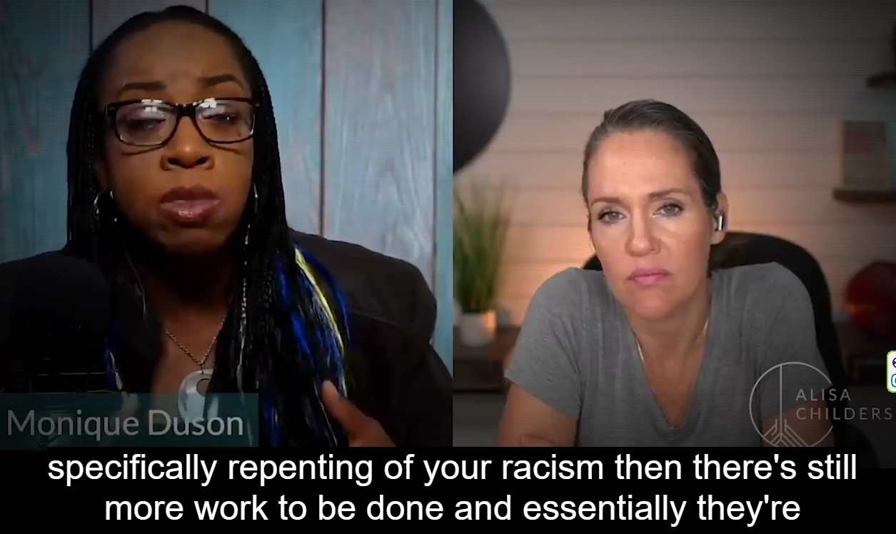
Notes:
https://www.theepochtimes.com/premiering-at-8-pm-et-enemies-within-christianity-the-deconstruction-movement-and-exvangelicals_4761067.html?utm_source=enewsnoe&utm_campaign=etv-2022-09-29&utm_medium=email&est=BLdbIUMPVInC8dH5q%2B4bv5CArCnryOUXu9VP1Ap1p7H7M9rNOIn0GsDhnVjwSU4Kmg%3D%3D

Slide 71
Notes:
https://www.theepochtimes.com/premiering-at-8-pm-et-enemies-within-christianity-the-deconstruction-movement-and-exvangelicals_4761067.html?utm_source=enewsnoe&utm_campaign=etv-2022-09-29&utm_medium=email&est=BLdbIUMPVInC8dH5q%2B4bv5CArCnryOUXu9VP1Ap1p7H7M9rNOIn0GsDhnVjwSU4Kmg%3D%3D

Slide 72
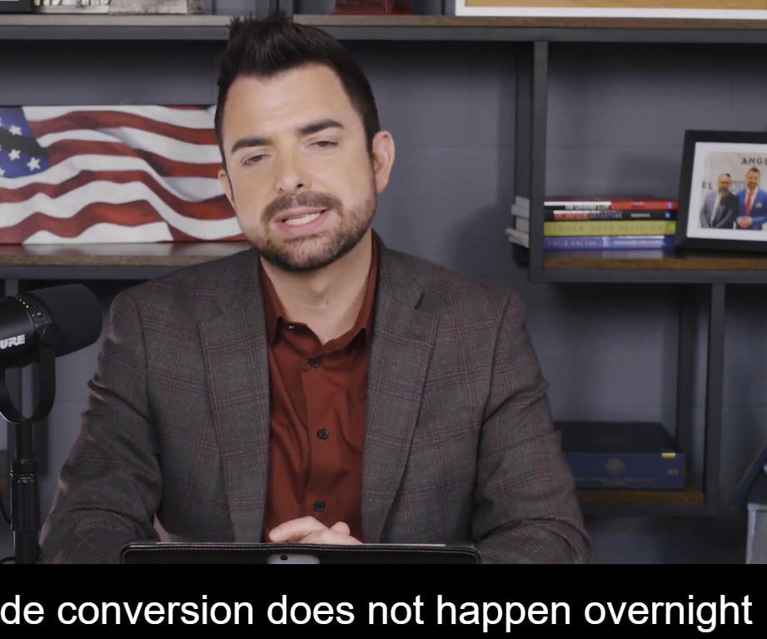
Losing relationship
Making ministry a business
Unforgiveness
Bowing to the approval of the culture.
Notes:
https://www.theepochtimes.com/premiering-at-8-pm-et-enemies-within-christianity-the-deconstruction-movement-and-exvangelicals_4761067.html?utm_source=enewsnoe&utm_campaign=etv-2022-09-29&utm_medium=email&est=BLdbIUMPVInC8dH5q%2B4bv5CArCnryOUXu9VP1Ap1p7H7M9rNOIn0GsDhnVjwSU4Kmg%3D%3D

Slide 73
^{2 Tim 4.3} For the time is coming when people will not have patience for sound teaching, but will cater to their passions and gather around themselves teachers who say whatever their ears itch to hear.

Slide 74
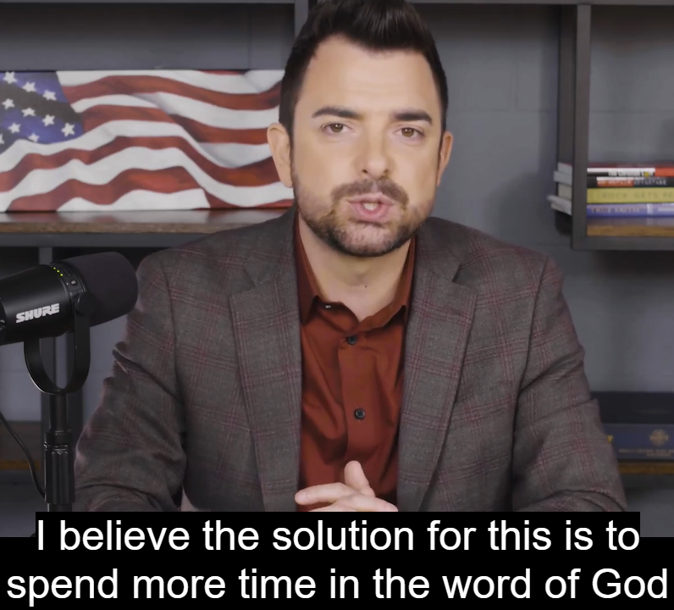
Notes:
https://www.theepochtimes.com/premiering-at-8-pm-et-enemies-within-christianity-the-deconstruction-movement-and-exvangelicals_4761067.html?utm_source=enewsnoe&utm_campaign=etv-2022-09-29&utm_medium=email&est=BLdbIUMPVInC8dH5q%2B4bv5CArCnryOUXu9VP1Ap1p7H7M9rNOIn0GsDhnVjwSU4Kmg%3D%3D

Slide 75
Notes:
https://www.theepochtimes.com/premiering-at-8-pm-et-enemies-within-christianity-the-deconstruction-movement-and-exvangelicals_4761067.html?utm_source=enewsnoe&utm_campaign=etv-2022-09-29&utm_medium=email&est=BLdbIUMPVInC8dH5q%2B4bv5CArCnryOUXu9VP1Ap1p7H7M9rNOIn0GsDhnVjwSU4Kmg%3D%3D

Slide 76
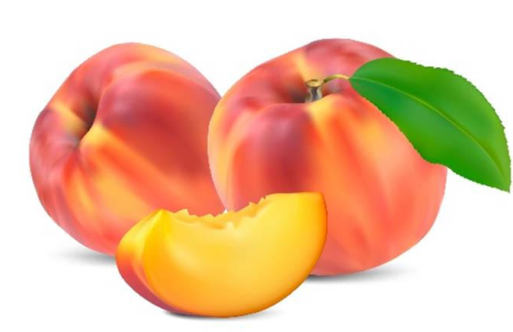

Slide 77
About Fruit
Yes, I am the vine; you are the branches. Those who remain in me, and I in them, will produce much fruit. John 15:5
A few days ago I was eating a peach and I suddenly understood why Yeshua and Paul told us to bear fruit.
The peach was beautiful, tasty, and nutritious, a product of the nectar that flowed through the hidden part of the tree.

Slide 78
In our lives, our fruit isn’t so much what we do or how much we accumulate, but what comes out of us from deep within our being.
I'm often afraid to face what’s inside me. It’s too dark, scary, bitter, perverted. The reality is that all of us are a mess inside. We try to cover it by what shows on the outside.

Slide 79
Yeshua told Nicodemus that our condemnation comes from choosing to live in darkness rather than light. When we invite Yeshua’s light in, he cleans out the bad nectar and replaces it with his sweet nectar.

Slide 80
A practical expression
of the fear of Adoni

Slide 81
Oneg Help
We are told to ““Remember Yom Shabbat, to keep it holy.”
Yeshayahu/Is.58.13 source of our term Oneg = Delight
Notes:
Not do any work—not you, nor your son, your daughter, your male servant, your female servant, your cattle, nor the outsider that is within your gates.
Traditional, non-Messianic synagogues will hire “Shabbes goyim.” Doesn’t work for us since we are all “one new man.”

Slide 82
So, what makes Shabbat a holy delight?
The Presence, in the fear of Adoni in Messiah.
Rest, from stress and labor
Contact with people we love
Food
Notes:
Song, dance, teaching
Commerce, anxiety, tension, labor
Joy Smiles, affirmation
Doesn’t food require work?

Slide 83
^{Shmot/Ex 12.16-17} The first day is to be a holy assembly for you as well as the seventh day. No manner of work is to be done on those days, except what is to be eaten by every person—that alone may be prepared by you…Therefore you are to observe this day throughout your generations as an eternal ordinance.
Above is Pesakh → other holy days
Notes:
NOT Talmudic, rabbinic halakhah. General practice in Messianic Congs.
So we can have a restful meal…

Slide 84
We have rotating Oneg teams for cleanup only. Not for food provision or preparation.
So, all food that congregants “Bring and Share” needs to be fully prepped.
Por favor, B’vakasha, please!

Slide 85
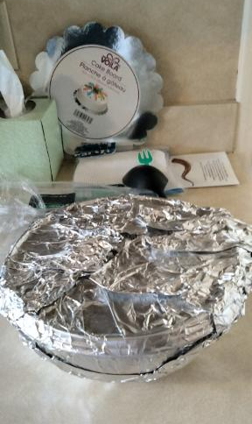
Not left on kitchen counter, but
If ready to eat, on serving table.
If cold food → fridge
If hot food → warming oven or crock pot
Notes:
On dessert rack, should be in serving dish or basket

Slide 86
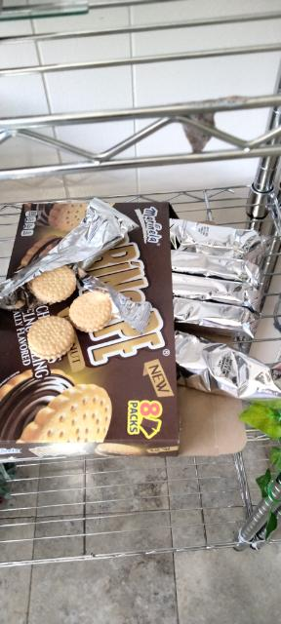
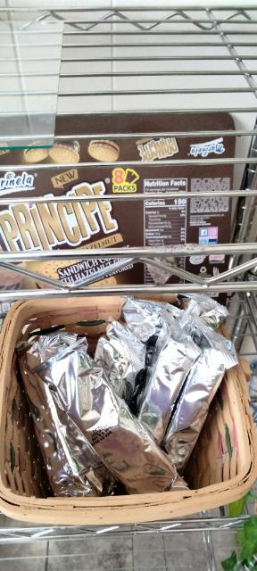
Not this,
But this

Slide 87
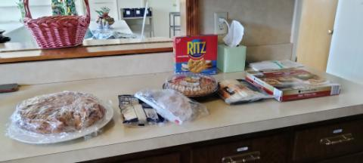
3 options: fridge, warming oven or crock pot, if ready to eat →serving table
Notes:
Don’t leave food on kitchen counter. Three options: Put in warming oven or refrigerator, or on platter on serving table. Please slice pies and cakes, and put on dessert rack.

Slide 88
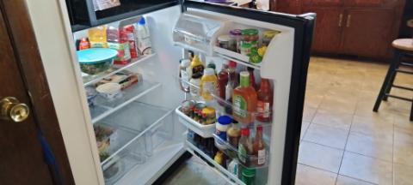
Someone left refrigerator door open.

Slide 89
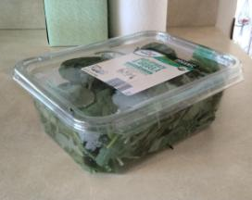
Unprepared salad ingredient.
Please put in serving dish, in fridge.

Slide 90
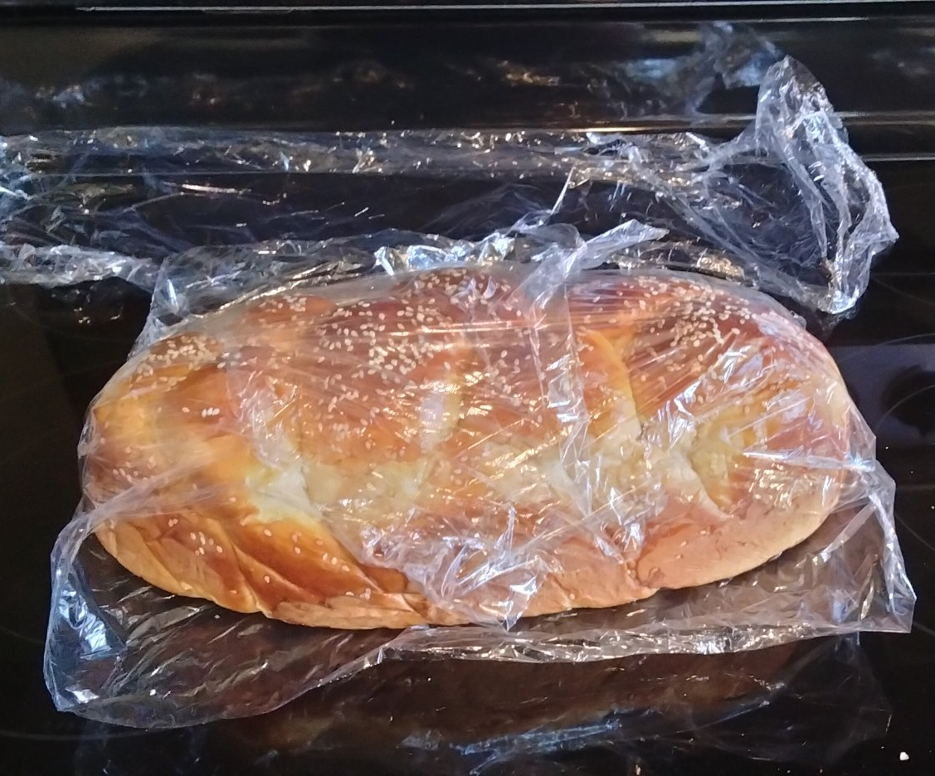
Bread not sliced.
Please slice, cover and set on bread rack.

Slide 91
Dessert not on dessert rack.

Slide 92
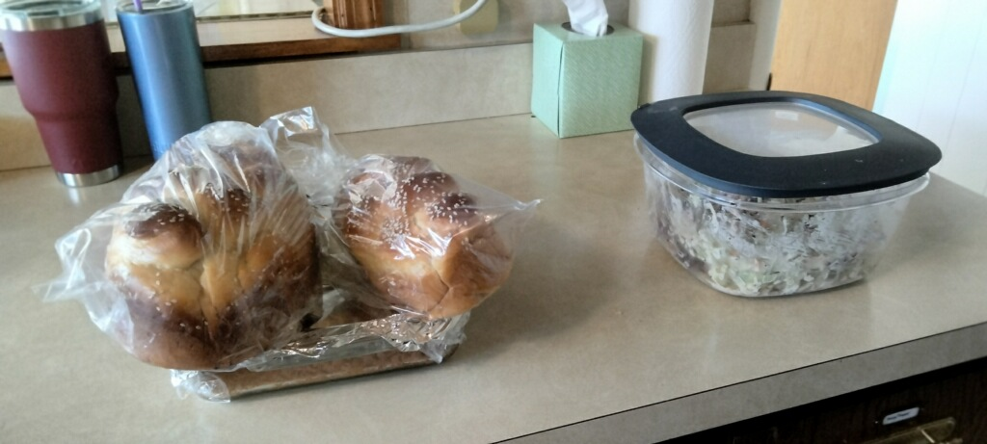
Unsliced bread, prepared food not on serving table.

Slide 93
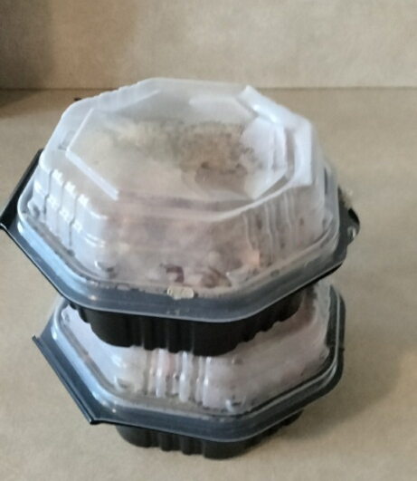
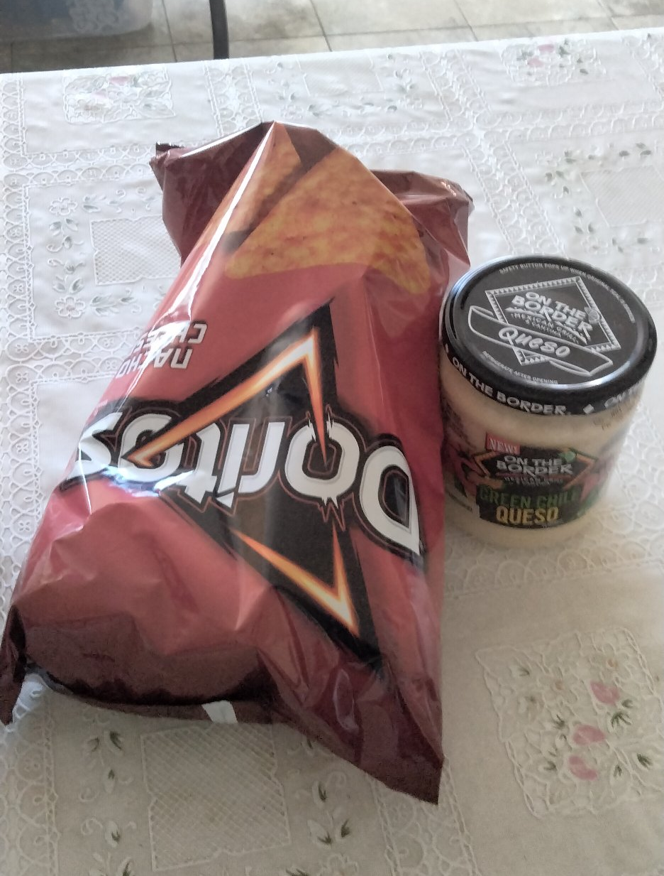
Ready to eat,
but not put out
on the serving
tables.
Chips in the
bag not ready
to serve

Slide 94
Conclusion:
בְּתֵאָבוֹן B’teavon!
Bon appetit!
Party hearty!
And…I get to have eye contact with my beautiful queen during the message.

Slide 95
An expression in the culture of increasing distance from the fear of Adoni

Slide 97
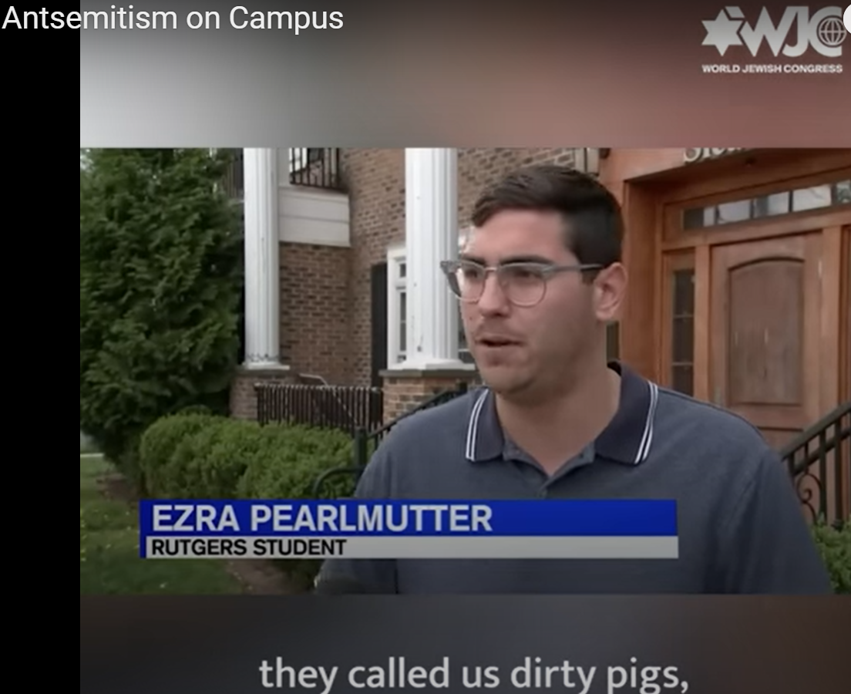
Notes:
https://www.youtube.com/watch?v=1fUv0BXZY70

Slide 98
^{Mes Jews 4.7-9} “Today, if you hear God’s voice, don’t harden your hearts.” For if Y’hoshua had given them rest, God would not have spoken later of another “day.” So there remains a Shabbat-keeping for God’s people.

Slide 99
^{Mes Jews 4.7-9} For the one who has entered God’s rest has also rested from his own works, as God did from his. Therefore, let us do our best to enter that rest; so that no one will fall short because of the same kind of disobedience.

Slide 100
עֲשֶׂרֶת יָמִים נוֹרָאִים
Aseret Yamim Noraim
Ten Days of Awe:
The Fear of the L-rd
Rosh HaShanah to Yom Kippur
Sept 25 to Oct 5

Slide 102
Do you KNOW Yeshua and the assurance of sins forgiven?
Are you hearing daily from His Word, and walking in His fear?
How are you applying what you heard?
Are you asking this of another?
Notes:
Who are you discipling, building up?4

