Slide 1
e-handout
To have these notes
without taking notes
Go to OrHaOlam.com
Click on Messages tab,
2022 Messages
Notes:
You may notice that I’m slowing down in my rate of speech. This is because we may be getting language translation equipment for simultaneous translation.

Slide 2
Israeli Archaeologists Discover Oldest Known Written Prayer – What Does It Say?
Notes:
https://unitedwithisrael.org/israeli-archaeologists-discover-oldest-known-written-sentence/

Slide 3
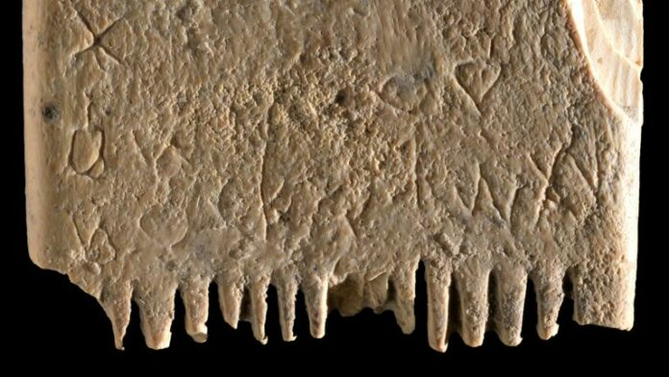
Notes:
https://external-content.duckduckgo.com/iu/?u=https%3A%2F%2Fvinnews.com%2Fwp-content%2Fuploads%2F2022%2F11%2FCanaanite-lice-comb-with-inscription-dates-from-1700-BC-696x392.jpg&f=1&nofb=1&ipt=4e7f4f7bc3ca29c7cd11401e3e1874119293a321d46d858f64b23a9710b34c4c&ipo=images

Slide 4
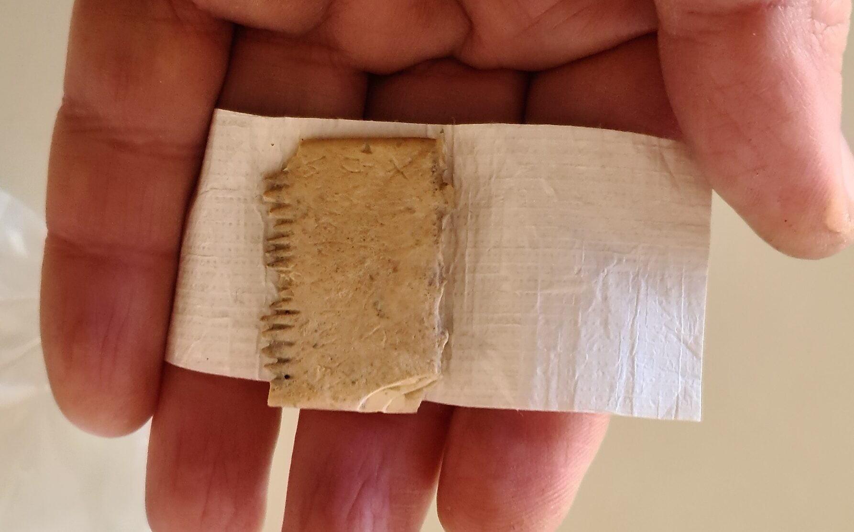
Notes:
https://external-content.duckduckgo.com/iu/?u=https%3A%2F%2Fstatic.timesofisrael.com%2Fwww%2Fuploads%2F2022%2F11%2F20220125_110237-e1667939695460.jpg&f=1&nofb=1&ipt=1bc9c81a34541150c834732af5d63a922fe7f35f57c349ebddf6b81912a35e65&ipo=images

Slide 5
“May this tusk root out the lice of the hair and the beard”
etched on a Canaanite comb that dates back to around 1700 BCE in Lachish.
Notes:
https://unitedwithisrael.org/israeli-archaeologists-discover-oldest-known-written-sentence/

Slide 6
The inscription was deciphered by semitic epigraphist Dr. Daniel Vainstub at Ben Gurion University (BGU), who confirmed the 17 characters were of Canaanite script. The ivory was tested by Professors Rivka Rabinovich of HU and Yuval Goren of BGU who found the comb was made of elephant tusk.
Notes:
https://unitedwithisrael.org/israeli-archaeologists-discover-oldest-known-written-sentence/

Slide 7
The ivory comb is small, measuring roughly 1.4 in x 1 in. [3.5 by 2.5 cm] and has teeth on both sides. The side of the comb with six thick teeth was used to untangle knots in the hair, while the other side, with 14 fine teeth, was used to remove lice and their eggs, much like the current-day two-sided lice combs sold in stores.
Notes:
https://unitedwithisrael.org/israeli-archaeologists-discover-oldest-known-written-sentence/

Slide 8
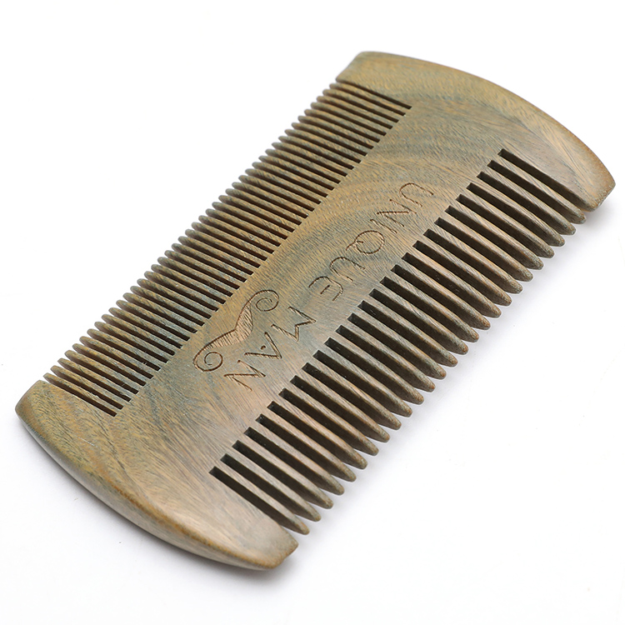
Notes:
https://external-content.duckduckgo.com/iu/?u=https%3A%2F%2Fsc02.alicdn.com%2Fkf%2FHTB1ejMMaifrK1RjSspbq6A4pFXaO%2F223254418%2FHTB1ejMMaifrK1RjSspbq6A4pFXaO.jpg&f=1&nofb=1&ipt=22153b427b0297cb6ed5c42939780e77ac956c5b93d926a9e6155ebcea1fb4fa&ipo=images

Slide 9
The researchers also found the remains of head lice between two of the teeth, ¹/₃₂ in =
~ 0.5–0.6 mm in size.

Slide 10
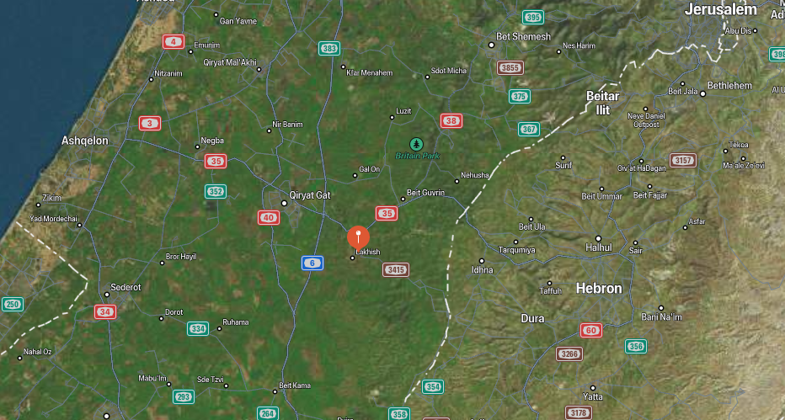

Slide 11
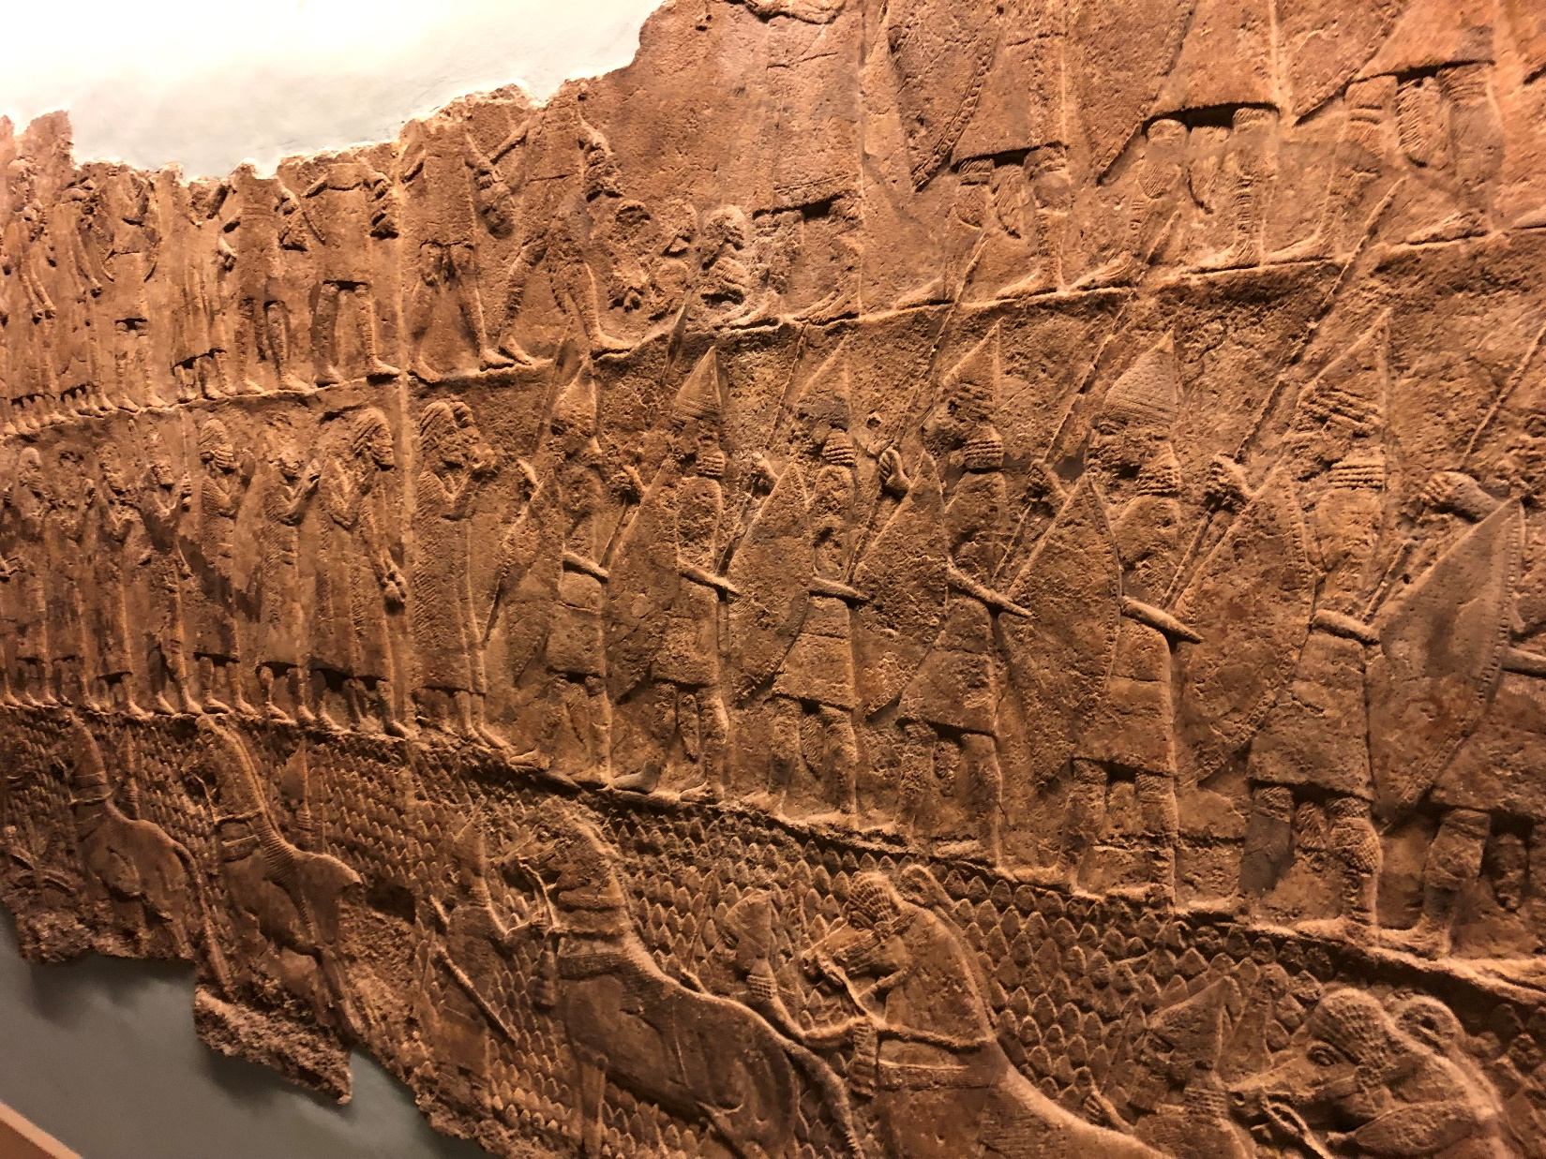
Assyrian siege
of לָכִישׁ Lakhish in 701 BCE
Notes:
1000 years later. Maybe lice problem solved? Warfare. Sennacherib
https://external-content.duckduckgo.com/iu/?u=http%3A%2F%2Fgenerationword.com%2Fimages%2Fbible-museum%2F4-1Kings-Nehemiah%2F30-lachish-0.JPG&f=1&nofb=1&ipt=33d742767d00c0e61e4fc89b71973e4f3902c1fbe6fbb8a6531a558d2a559413&ipo=images

Slide 12
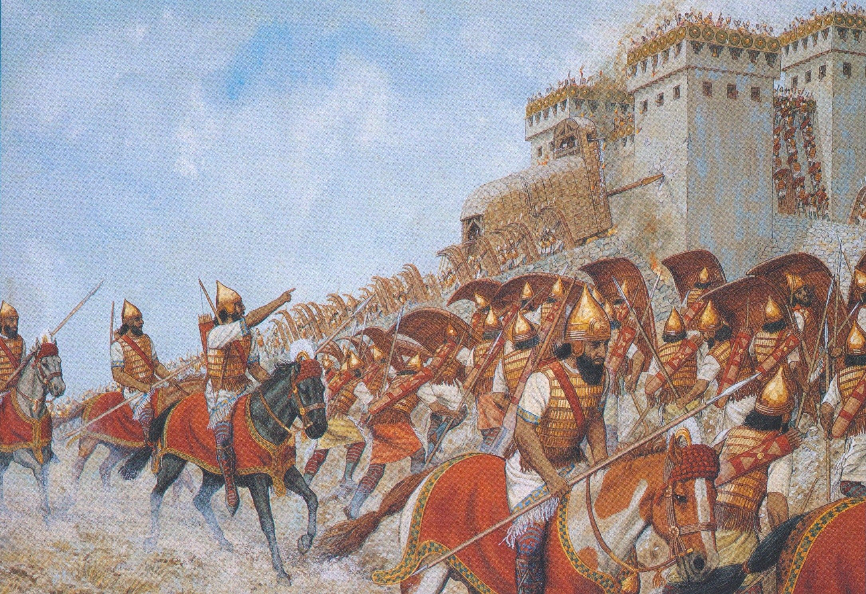
Assyrian siege and conquest
ofלָכִישׁ Lakhish in 701 BCE
Notes:
https://external-content.duckduckgo.com/iu/?u=https%3A%2F%2Fi.pinimg.com%2Foriginals%2F7d%2F06%2F0b%2F7d060b3110f343da46610a105e6f2120.jpg&f=1&nofb=1&ipt=5a539463261d842b2759e9737ef28c753a26a123bd55b23ac254b67159f2f876&ipo=images

Slide 14
and the Spirit of Adoption

Slide 15
Adoption
Spiritual adoption
Needed for Israeli children
Hatikva Families
Needed for American children
Our response?

Slide 16
Adoption
Spiritual adoption
Needed for Israeli children
Hatikva Families
Needed for American children
Our response?

Slide 18
^{Eph. 3. 1-7} You were dead in your trespasses and sins. At that time, you walked in the way of this world, in conformity to the ruler of the domain of the air—the ruler of the spirit who is now operating in the sons of disobedience.
Notes:
“You” writing to Ephesians, Greeks, Gentiles
Walking in depraved perverted spirit of this age

Slide 19
^{Eph. 3. 1-7} We too all lived among them in the cravings of our flesh, indulging the desires of the flesh and the mind. By nature we were children of wrath, just like the others.
Notes:
“We all” Jews, despite outward lack of orgies, had corrupt cravings.
Children of wrath, not children of G-d. Here’s where adoption is implied.

Slide 20
הִנֵּה הַחֹשֶׁךְ יְכַסֶּה־אֶרֶץ
Henay hakhoshekh y’khaseh erets
See how darkness covers the earth
Notes:
State Dept issues an International Day of Pronouns.

Slide 21
וַֽעֲרָפֶ֖ל לְאֻמִּ֑ים
V’arafel l’umim
And the nations in depth of night
Notes:
.

Slide 22
^{Eph. 3. 1-7} But God was rich in mercy, because of His great love with which He loved us.

Slide 23
^{Eph. 3. 1-7} Even when we were dead in our trespasses, He made us alive together with Messiah. (By grace you have been saved!) And He raised us up with Him and seated us with Him in the heavenly places in Messiah

Slide 24
^{Eph. 3. 1-7} Yeshua to show in the olam ha-ba the measureless richness of His grace in kindness toward us in Messiah Yeshua.
Adoption for Jews and Gentiles, from children of wrath and darkness to next of kin to Messiah!

Slide 25
^{Ro. 8.15-17} For you did not receive the spirit of slavery to fall again into fear; rather, you received the Spirit of adoption, by whom we cry, “Abba! Father!”

Slide 26
^{Ro. 8.15-17} The Ruakh Himself bears witness with our spirit that we are children of God. And if children, also heirs—heirs of God and joint-heirs with Messiah—if indeed we suffer with Him so that we may also be glorified with Him.

Slide 27
וְעָלַיִךְ יִזְרַח יְיָ
V’alayikh yizrakh Adoni
But Adoni in splendor will dawn on you.

Slide 28
וּכְבוֹדוֹ וּכְבוֹדוֹ עָלַיִךְ יֵֽרָאֶֽה
Ukhvodo ukhvodo alayikh yaraeh
And His glory, and His glory on you will appear.
Notes:
The world culture may be dark, but on you and me…His light!
His glory changes every perspective. Relativism in morality, a little lying, cheating, lust, becomes NOT little.

Slide 29
Pilgrim Holiness Church,
Schenectady, NY
Notes:
Golden glow up in the laminated rafters. “Cloud of liquid love.” April 13, 1969 I experienced New Birth. I knew that I was born into the Kingdom of Messiah, not into the church, or out of my Jewishness. Many young people similarly seeking.
Went home few weeks later. “Mom, Dad, I’ve found the answer to life’s problems. It’s not in drugs, or revolution, but in the love of Jesus Christ.”
Sent me to psychiatrist.
“You’re worse than Hitler. He destroyed our bodies. You are destroying our souls.”
But, what about Jewishness? “Put on altar” I’ll figure out the Jewish piece later. Need to get the salvation piece. Later, I learned…

Slide 30
^{Gal.7.4-7} But when the fullness of time came, God sent out His Son, born of a woman and born under law— to free those under law, so we might receive adoption as sons. Now because you are sons, God sent the Ruakh of His Son into our hearts,

Slide 31
^{Gal.7.4-7} who cries out, “Abba! Father!” So you are no longer a slave but a son—and if a son, also an heir through God

Slide 32
^{2 Cor. 6.17-18} Therefore, come out from among them, and be separate, says Adoni. Touch no unclean thing. Then I will take you in. I will be a father to you, and you shall be My sons and daughters, says Adoni-Tzva’ot.”

Slide 33
^{Dvarim/Dt 14.2} For you are a holy people to Adoni your God—from all the peoples on the face of the earth, Adoni has chosen you to be His treasured people.

Slide 34
^{Yeshayahu/Is 63.16} For You are our Father— even if Abraham would not know us or Israel not recognize us. You, Adoni, are our Father, our Redeemer— from everlasting is Your Name.
Notes:
Context Israel rebelled scattered and estranged from G.
^{Yeshayahu/Is 63.9-11} In all their troubles he was troubled; then the Angel of His Presence saved them; in his love and pity he redeemed them. He had lifted them up and carried them throughout the days of old. However, they rebelled, they grieved his Holy Spirit; so he became their enemy and himself fought against them. But then his people remembered the days of old, the days of Moshe: “Where is he who brought them up from the sea with the shepherds of his flock?

Slide 35
^{Yn 1.10-14} He was in the world — the world came to be through him — yet the world did not know him. He came to his own homeland, yet his own people did not receive him. But to as many as did receive him, to those who put their trust in his person and power,

Slide 36
^{Yn 1.10-14} he gave the right to become children of God, not because of bloodline, physical impulse or human intention, but because of God. The Word became a human being and lived with us, and we saw his Sh’khinah, the Sh’khinah of the Father’s only Son, full of grace and truth.

Slide 37
Therefore, the most foundational message of the Kingdom of Messiah is that we can be transformed so as to say with a whole heart,
Our Father Who is in Heaven
אָבִינוּ שֶׁבַּשָּׁמַיִם Avinua shebashamiyim
Notes:
Adopted AND born into the Kingdom

Slide 38
There are children who cannot say that, either spiritually or humanly / relationally…

Slide 39
Adoption
Spiritual adoption
Needed for Israeli children
Hatikva Families
Needed for American children
Our response?

Slide 40
The Spirit of Adoption

Slide 41
Orphan Shabbat
שַׁבָּת יָתוֹם
Shabbat Yatom
and
The Spirit of Adoption
Notes:
https://images.prismic.io/orphanshabbat/f66f7bcb-eb87-489c-af88-07c5b20b759d_My+project-1+%2814%29.png?auto=compress,format

Slide 42
There are over 365,000 at-risk children in Israel.
Notes:
https://orphanshabbat.org/en

Slide 43
More than 10,000 children have been removed from their homes by the Ministry of Welfare, only 25% of those children are in foster care.
Notes:
https://orphanshabbat.org/en

Slide 44
Couples wait an average of 5 years to adopt a child and only 120 successful adoptions occur each year.
Notes:
https://orphanshabbat.org/en
Compared to 40k abortions. In both Jewish and Muslim cultures, it’s more shameful to give away your baby in adoption than to kill it.

Slide 45
The OVC (orphan and vulnerable child) crisis in Israel is particularly complex. Due to political, social, and cultural factors, the vast majority of orphans and at-risk children reside in institutions, left without a permanent family.
Notes:
https://orphanshabbat.org/en

Slide 46
Pro-lifers are often accused of caring for the pre-born children, but ignoring the breathing children.
Being pro-life is caring for all of the living!

Slide 47
^{Shmot/Ex 22.21-23} “You must not mistreat any widow or orphan. If you mistreat them in any way, and they cry out to Me, I will surely hear their cry. My wrath will burn hot, and I will kill you with the sword. So your wives will become widows and your children will become orphans.
Notes:
By neglect or ignoring the problems.

Slide 48
^{Yeshayahu/Is 1.16-17} “Wash and make yourselves clean. Put away the evil of your deeds from before My eyes. Cease to do evil. Learn to do good, seek justice, relieve the oppressed, defend the orphan, plead for the widow.”

Slide 49
^{Zekh 7.9-10} “Thus says Adoni-Tzva’ot: ‘Administer true judgment and practice mercy and compassion each to his brother. Do not oppress the widow or the orphan, the outsider or the poor.
Notes:
By neglect or ignoring the problems.

Slide 50
^{T’hillim/Ps 68. 6-7} God in his holy dwelling, is a father to orphans and defender of widows. God gives homes to those who are alone.

Slide 51
^{Yaakov 1.27} Pure and undefiled religion before our God and Father is this: to care for orphans and widows in their distress.

Slide 52
Adoption
Spiritual adoption
Needed for Israeli children
Hatikva Families
Needed for American children
Our response?

Slide 53
The Spirit of Adoption

Slide 54
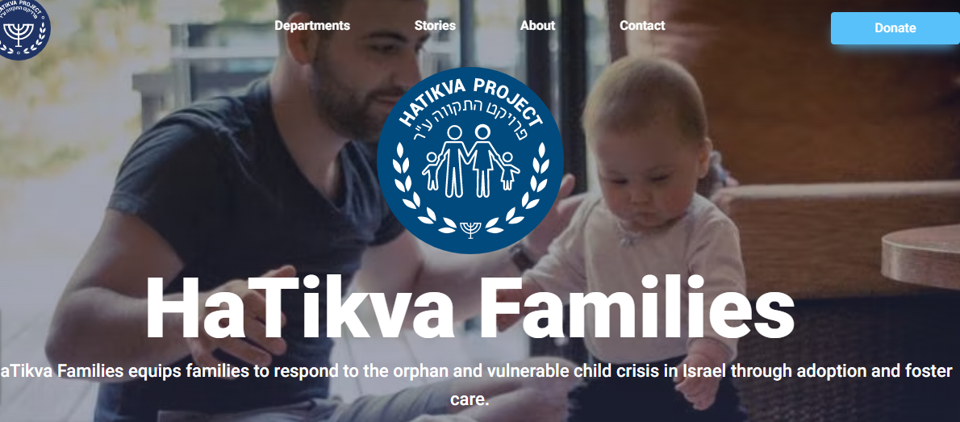
Notes:
https://orphanshabbat.org/en

Slide 55
Affect Change in the Nation of Israel
HaTikva Families recruits and equips families to host, foster, and adopt and provides guidance and support to foster and adoptive families. We train parents and professionals in trauma-informed care. In addition, we own and support an emergency shelter home for young children at risk.
Notes:
https://orphanshabbat.org/en
This beautiful shelter building and staff is a BIG deal in Israel.

Slide 56
HaTikva Families currently serves nine foster and adoptive families and two single mothers with children at-risk, providing practical support, advice & counsel, and training.
Notes:
https://orphanshabbat.org/en

Slide 57
Through HaTikva Families, we equip families to respond to the OVC (orphan and vulnerable child) crisis in Israel through adoption and foster care. We believe that caring for orphans and vulnerable children is a mandate for the global Body of Messiah and one of the purest expressions of the Gospel.

Slide 58
Pray for our families, as they face a lot of behavioral challenges from their children, with a background of trauma or exposure to alcohol in the womb. And pray that we can further support and equip them.
Notes:
https://orphanshabbat.org/en

Slide 59
Pray for more believing families to join the cause to father the fatherless.
Pray that we can reach more professionals in the field with trauma-informed care.
Pray for Israel to move further away from institutional care and towards family-based care.
Notes:
https://orphanshabbat.org/en

Slide 60
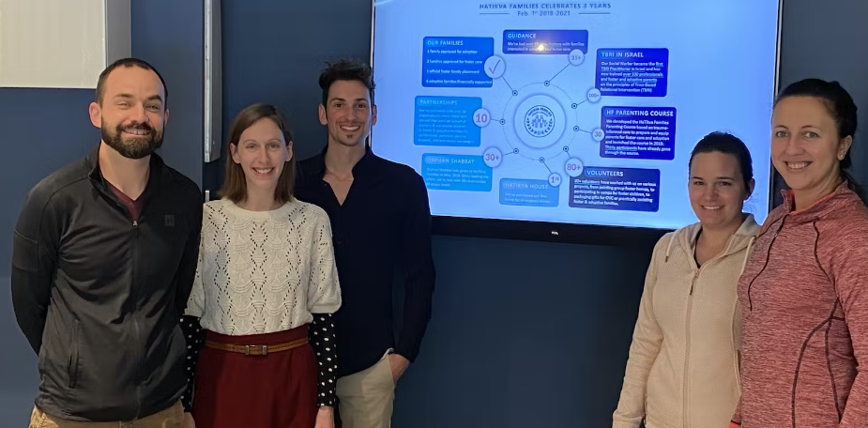

Slide 61
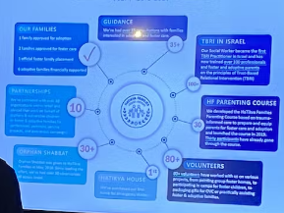
Notes:
https://orphanshabbat.org/en

Slide 62
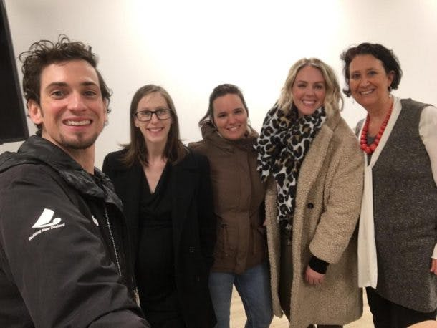
On Fri., January 10,2020, Hatikva Families had the privilege
Notes:
https://hatikvaproject.org/blog/hatikva-families-leads-israels-first-tbri-training

Slide 63
of hosting Israel’s first formal presentation of TBRI, Trust Based Relational Intervention, in partnership with Anchor of Hope Counseling Center and Adoption Wisdom. TBRI is an attachment-based, trauma-informed intervention designed to meet the complex needs of vulnerable children.
Notes:
https://hatikvaproject.org/blog/hatikva-families-leads-israels-first-tbri-training

Slide 64
Call to Israeli believers,
and American visitors!

Slide 65
Orphan care can be intimidating. Many people do not have the time or resources to foster or adopt and believe that, because of their limitations, they can't do anything. However, YOU HAVE A VOICE and that voice has the power to engage others in reaching out to those in need around you.
Notes:
https://orphanshabbat.org/en

Slide 66
Commit to praying for orphaned and vulnerable children. Invite people from your community to join you.
Provide meals for families who are fostering or have adopted children.
Notes:
https://orphanshabbat.org/en

Slide 67
Volunteer your skills to serve in the orphan crisis. Whether you’re a cook, cleaner, financial planner, or graphic designer, connect with people and organizations that would gladly make use of your skills.
Notes:
https://orphanshabbat.org/en

Slide 68
As a congregation:
Provide a respite night each month. Provide childcare for foster and adoptive parents, so that they can have a time to rest and recharge.
Notes:
https://orphanshabbat.org/en

Slide 69
Go to
orphanshabbat.org/en
Offering to be received later.

Slide 70
Notes:
https://images.prismic.io/orphanshabbat/d70ea011-f5a4-481a-bb96-5f2c9737ef21_OS+project+foe+web-1+%281%29.png?auto=compress,format

Slide 71
Adoption
Spiritual adoption
Needed for Israeli children
Hatikva Families
Needed for American children
Our response?

Slide 72
The Spirit of Adoption

Slide 73
The number of American children in foster care was an estimated 407,000 at the end of Fiscal Year (FY) 2020. The number of children waiting to be adopted FY 2020 to was 117,000.
Does represent decreases, but still HUGE.
Notes:
https://www.acf.hhs.gov/media/press/2021/national-data-shows-number-children-foster-care-decreases-third-consecutive-year

Slide 74
Nearly 58,000 children were adopted in 2020.
Black/African American children, who make up 14 percent of the US child population, continue to account for 20 percent of those entering the child welfare system,
Notes:
https://www.acf.hhs.gov/media/press/2021/national-data-shows-number-children-foster-care-decreases-third-consecutive-year

Slide 75
American Indian and Native Alaskan children, who are one percent of the US child population, account for over two percent of those entering care
Notes:
https://www.acf.hhs.gov/media/press/2021/national-data-shows-number-children-foster-care-decreases-third-consecutive-year

Slide 76
Children in father-absent homes are almost four times more likely to be poor. In 2011, 12 percent of children in married-couple families were living in poverty, compared to 44 percent of children in mother-only families
Notes:
https://fathers.com/the-consequences-of-fatherlessness/

Slide 77
There is significantly more drug use among children who do not live with their mother and father.
Children living with their married biological father tested at a significantly higher level than those living with a nonbiological father.
Notes:
https://fathers.com/the-consequences-of-fatherlessness/

Slide 78
Children of single-parent homes are more than twice as likely to commit suicide.
Notes:
https://fathers.com/the-consequences-of-fatherlessness/

Slide 79
Adoption
Spiritual adoption
Needed for Israeli children
Hatikva Families
Needed for American children
Our response?

Slide 80
The Spirit of Adoption

Slide 81
The Send, May 14, 2022
GEHA Field at Arrowhead Stadium

Slide 82
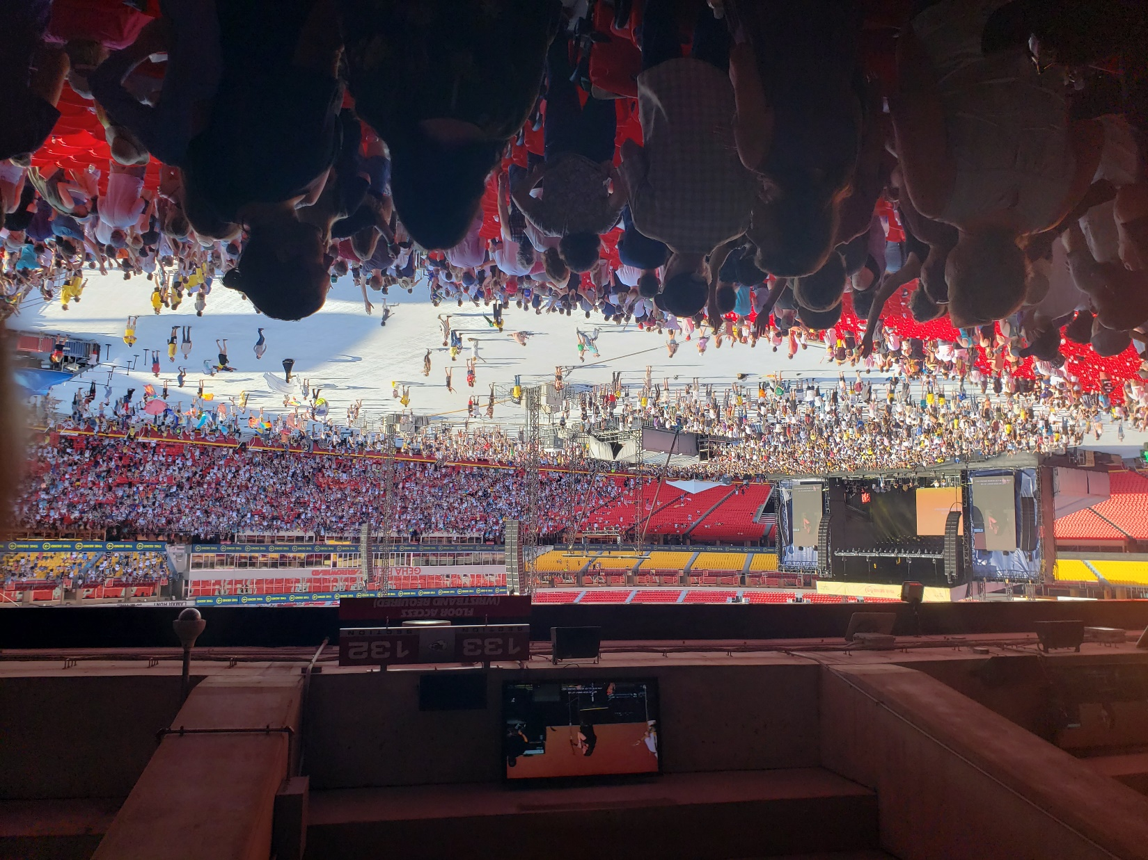

Slide 83
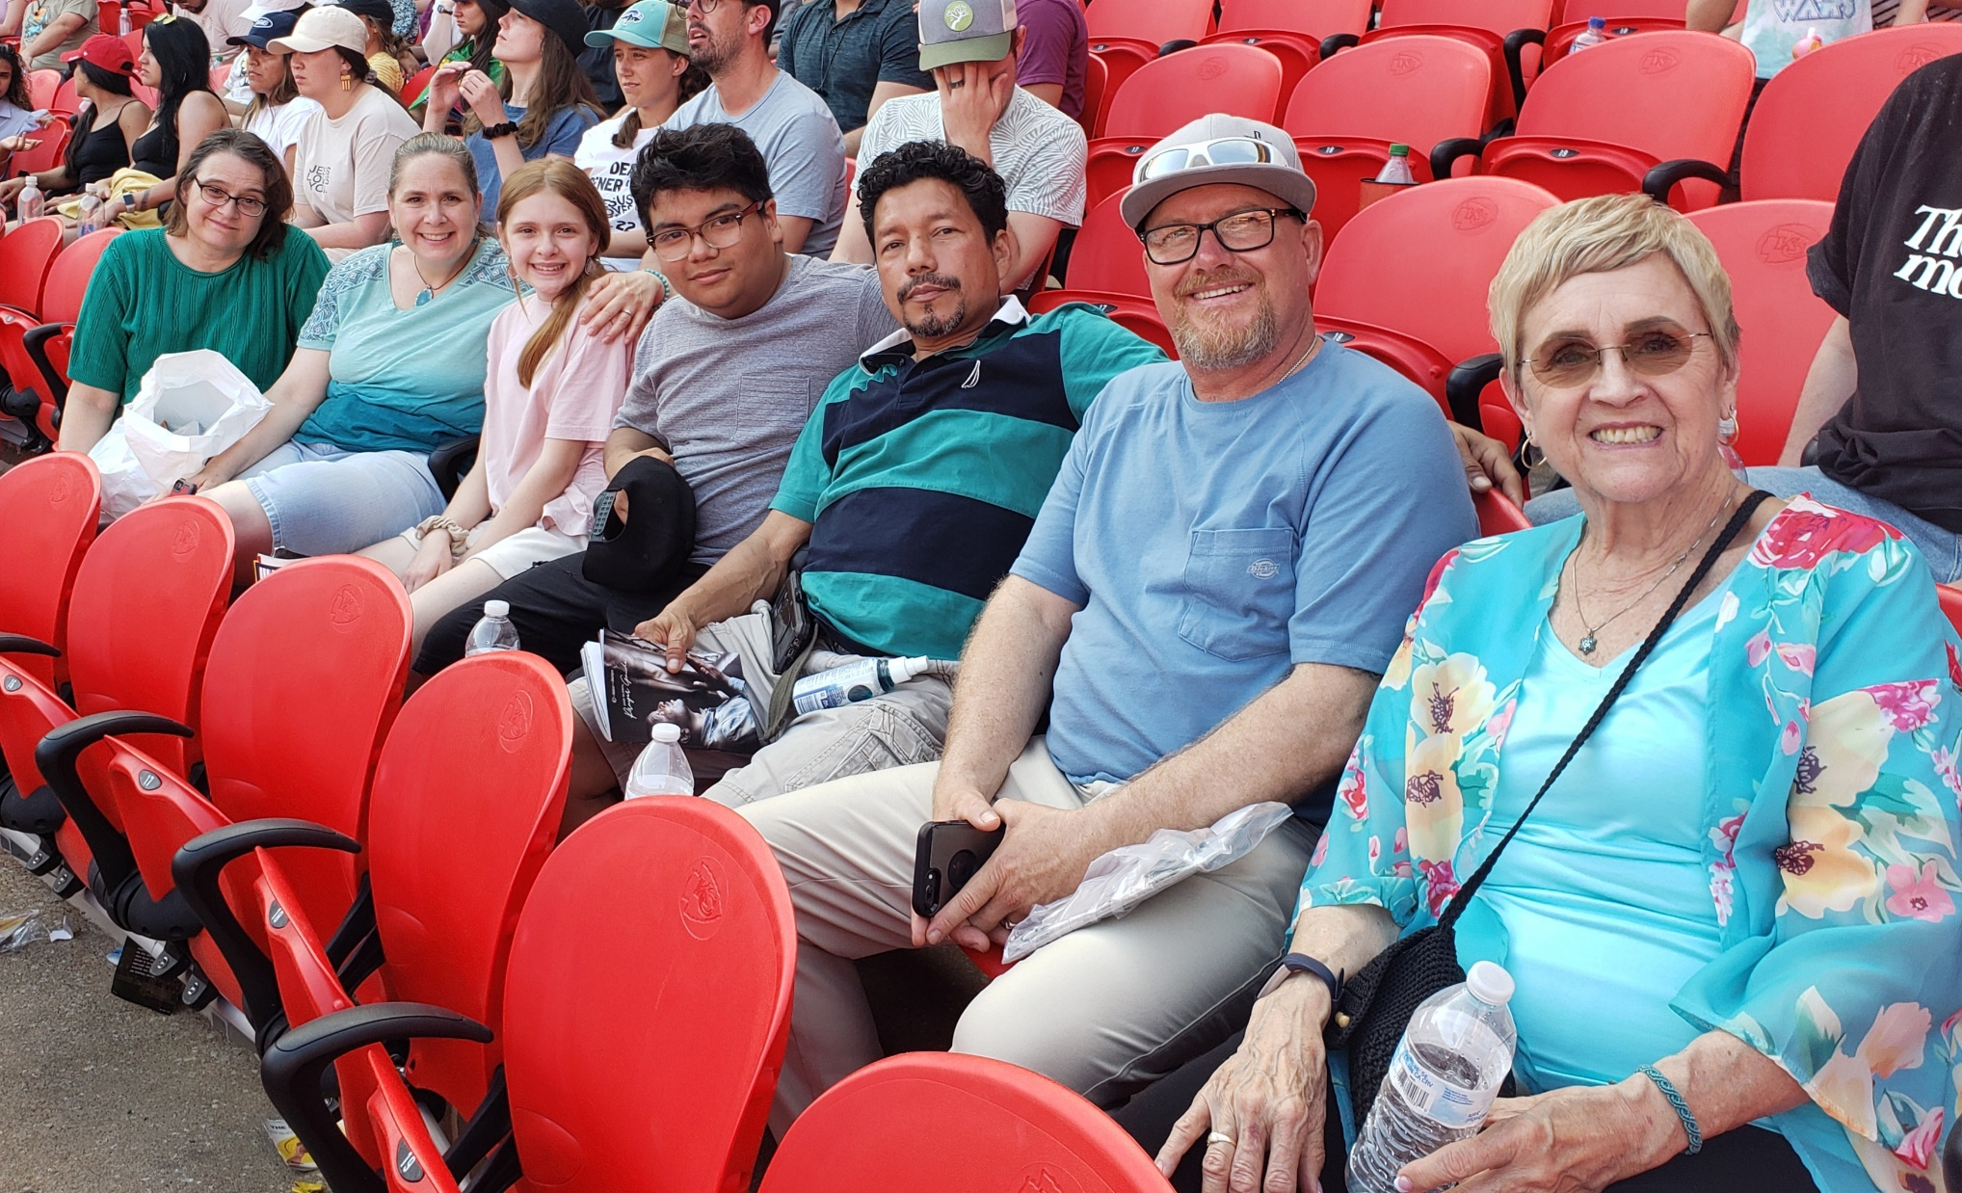

Slide 84
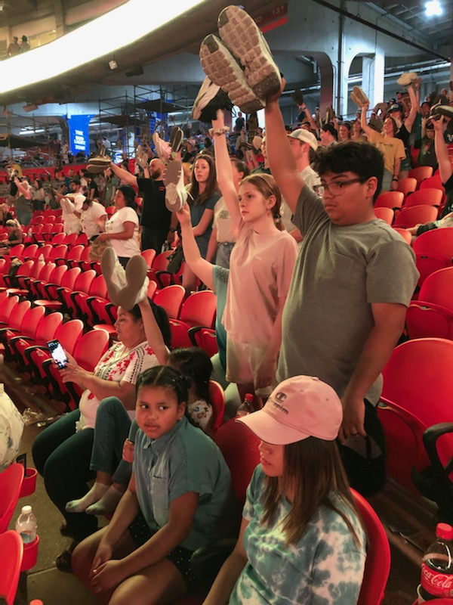
Responding to the challenge to GO wherever G-d SENDS.

Slide 85
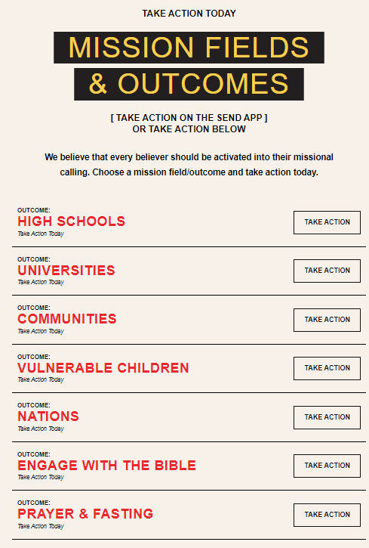
Notes:
https://thesend.org/take-action/#vulnerable-children-desc

Slide 86
We are calling the believers to end the global orphan crisis; standing with Messiah that every child needs and receives a family and a permanent home.
Notes:
https://thesend.org/take-action/#vulnerable-children-desc

Slide 87
1 MILLION HOMES: Giving to fuel orphan care reform and reunify families globally.
CARE PORTAL: Connecting local communities to care for vulnerable children and families.
Notes:
https://thesend.org/take-action/#vulnerable-children-desc

Slide 88
FOSTERING & ADOPTION: Inspiring families and connecting them to foster and adopt within their community.
Notes:
https://thesend.org/take-action/#vulnerable-children-desc

Slide 89
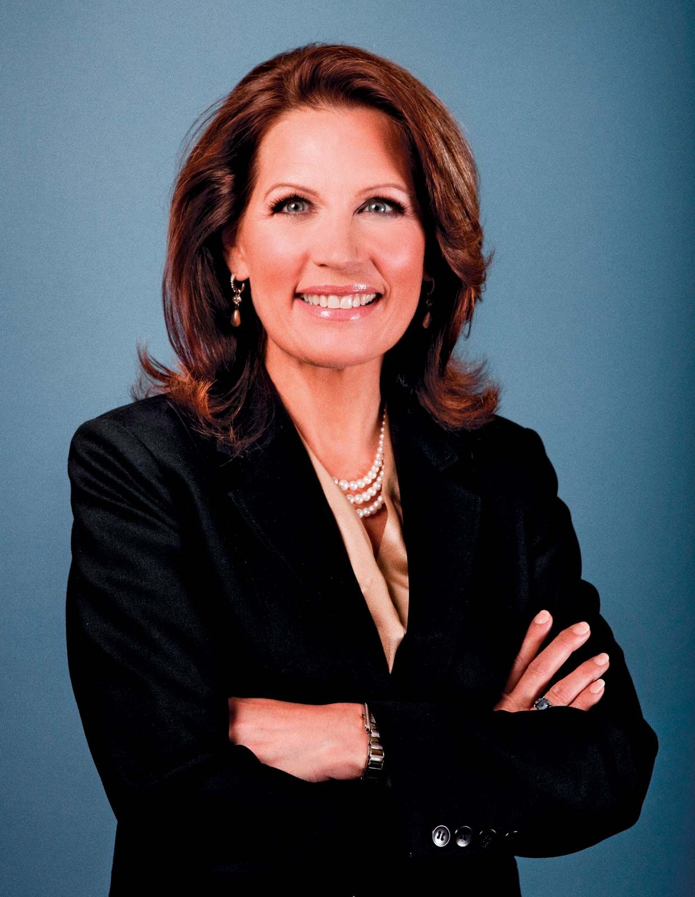
Michele Bachmann, 2011.
Office of U.S. House of Representative
Notes:
https://cdn.britannica.com/24/149824-050-ED786441/Michele-Bachmann-2011.jpg

Slide 90
In 1986 Michele Bachmann received a J.D. from Oral Roberts University in Tulsa, Oklahoma, and two years later she earned a postdoctoral degree in tax law from the College of William and Mary in Williamsburg, Virginia. For five years she worked as a tax

Slide 91
litigation attorney for the U.S. Treasury Department—first in Washington, D.C., and then in St. Paul, Minnesota—before leaving in 1993 to focus on her family. (In addition to raising their five biological children, the Bachmanns took in more than 20 foster children.)
Notes:
Dawn and I raised 4 biological children, no foster children, but 9 boarders, many of whom we had a mentoring relationship. Stephanie Miller among them!

Slide 92
שְׂאִֽי־סָבִיב עֵינַיִךְ וּרְאִי כֻּלָּם
S’ee saviv e-ni-ikh ur’ee kulam
Lift your eyes round about,
and see them all

Slide 93
נִקְבְּצוּ בָֽאוּ־לָךְ בָּנַיִךְ מֵֽרָחוֹק
Nikbitsu va-u lakh banayikh merakhok
Gathered to you,
your sons come,
from very far away.
Notes:
Gathered, same root as kibbutz, the communal farms. Some of our children may be in a reflection of this verb. Communal economy = socialism.
Verb in passive, nifal form. When we can’t reach our children…they WILL be reached.
From very far away: some of our kids Bible deniers, BLM, humanism, so many ways of diverging from the faith. In the 70’s similar, unexpected revival. Bold.

Slide 94
Adoption
Spiritual adoption
Needed for Israeli children
Hatikva Families
Needed for American children
Our response?

Slide 95
The Spirit of Adoption

Slide 96
We will support Evan Levine’s ministry to orphans in Israel.
Consider, pray about hosting, fostering, or adopting a child in need, Big Brother or similar, Caring for Kids, campout, scout.

Slide 97
Do you KNOW Yeshua and and have the Spirit of Adoption?
Are you hearing daily from His Word?
How are you applying what you heard?
Are you open to serving orphans?

