Slide 1
e-handout
To have these notes
without taking notes
Go to OrHaOlam.com
Click on Messages tab,
2022 Messages
Notes:
You may notice that I’m slowing down in my rate of speech. This is because we may be getting language translation equipment for simultaneous translation.

Slide 2
Notes:
https://youtube.com/shorts/UCXU06kRH6s?feature=share
https://www.youtube.com/shorts/UCXU06kRH6s

Slide 3
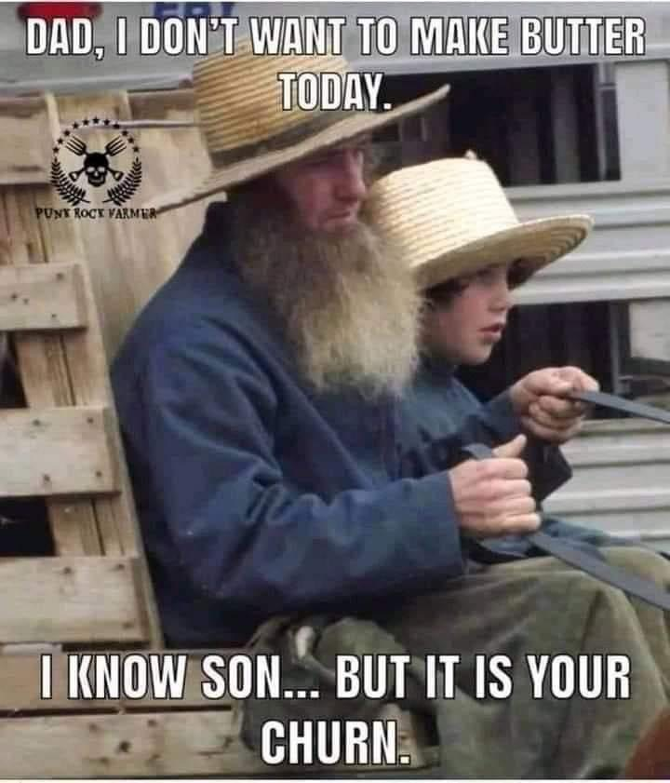
Notes:
Leslie Lindholm

Slide 4
Notes:
Leslie Lindholm.

Slide 6
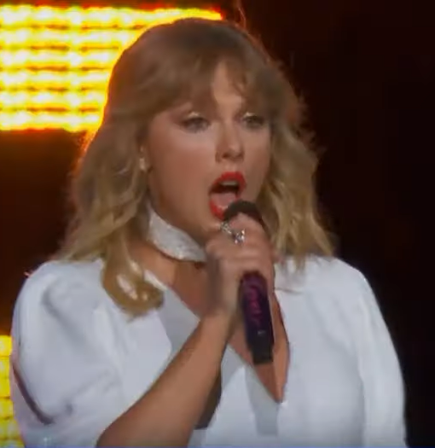
Recently she took home six trophies at the American Music Awards. She is now the most decorated artist in history, while at the same time holding all 10 songs on the Billboard Top 10.
Notes:
Note: I am culturally disconnected. I cannot sing any of her songs. Nor Justin Bieber. Ask me Beatles songs, I’m in. Anyhow she is where our youth majority, Gen z is living.
https://www.charismanews.com/us/90778-what-can-churches-learn-from-taylor-swift

Slide 7
A pastor wrote [Charisma Mag]:
I remember being amazed how this songwriter had somehow climbed into every teenage girl's journal and written their heartache and deepest desires. From the beginning, her transparency and openness created a place for young girls
Notes:
https://www.azlyrics.com/lyrics/anthemlights/shakeitoff.html
https://www.charismanews.com/us/90778-what-can-churches-learn-from-taylor-swift

Slide 8
and those who felt isolated and alone to find the words they couldn't quite express.
Notes:
https://www.azlyrics.com/lyrics/anthemlights/shakeitoff.html
https://www.charismanews.com/us/90778-what-can-churches-learn-from-taylor-swift
She engaged hearts.

Slide 9
'Cause the players gonna play, play, play, play
And the haters gonna hate, hate, hate, hate
Baby, I'm just gonna shake, shake, shake, shake
Notes:
https://www.azlyrics.com/lyrics/anthemlights/shakeitoff.html

Slide 10
I'm dancing on my own
I make the moves up as I go
And that's what they don't know, mmm-mmm
Notes:
https://www.azlyrics.com/lyrics/anthemlights/shakeitoff.html
https://www.charismanews.com/us/90778-what-can-churches-learn-from-taylor-swift
Evidently instilled confidence to make it in spite of rejection, opposition.

Slide 11
My constant question has been, "What can they take from my message on Shabbat that gives them hope and tools in the face of an angry boss, crying kids or no money to pay bills on Wednesday?“
Notes:
https://www.azlyrics.com/lyrics/anthemlights/shakeitoff.html
https://www.charismanews.com/us/90778-what-can-churches-learn-from-taylor-swift

Slide 12
Is it possible this musician reminds us of how Yeshua spoke in parables to meet the people where they were as fishermen, farmers, children, the marginalized and the religious? He always spoke their language in a way that included them into His story.

Slide 13
I'm dancing on my own
I make the moves up as I go
And that's what they don't know, mmm-mmm
Notes:
https://www.azlyrics.com/lyrics/anthemlights/shakeitoff.html
https://www.charismanews.com/us/90778-what-can-churches-learn-from-taylor-swift
Apparently giving teens and Gen Z hope to dance on their own. But is that the hope they really need?
Boomers: Born 1946-64 (58-76)
Generation X: Born 1965-1980 (41-56 years old)
Millennials: Born 1981-1996 (25-40 years old)
Generation Z: Born 1997-2012 (9-24 years old)
Generation Alpha: Born 2010-2025 (0-11 years old)

Slide 15
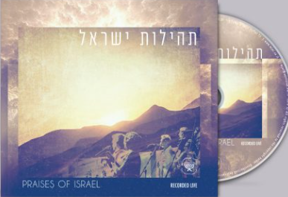
Notes:
https://www.mjai.co.il/product/praises-of-israel/

Slide 16
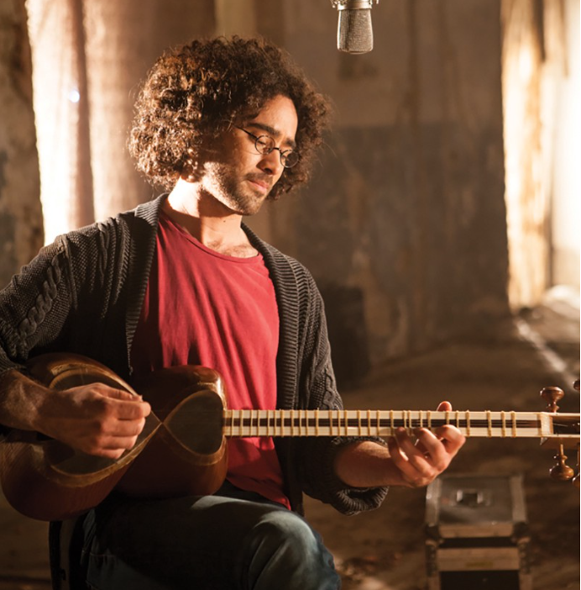
Yaron Cherniak - ירון צ'רניאק
Notes:
Apparently a Millennial

Slide 17
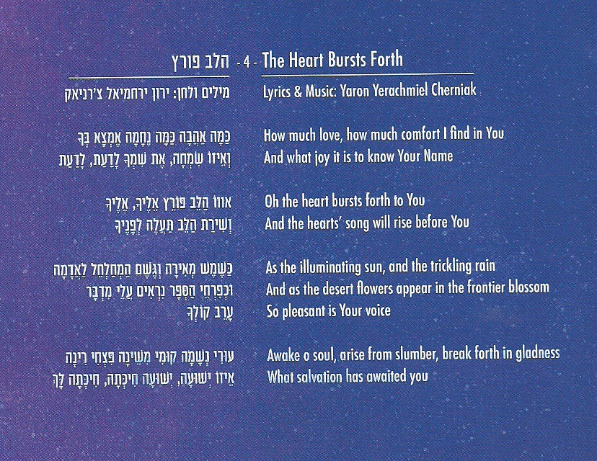
Notes:
I feel we should explore this passionate statement. I’ve never really made a whole message, in 27 years ministry here, on the experience of G-d. I won’t touch it all, but follow Yaron’s song.
Can this be the comfort we all long for, Boomers, Gen X, Millennials, Gen Z

Slide 18
Notes:
My “liquid love” statement.

Slide 19
^{Eph.3.17-21} I pray that you will be rooted and founded in love, so that you, with all God’s people, will be given strength to grasp the breadth, length, height and depth of the Messiah’s love, yes, to know it, even though it is beyond all knowing, so that you will be filled with all the fullness of God.
Notes:
Are we experiencing Messiah’s love??

Slide 20
^{Eph.3.17-21} Now to him who by his power working in us is able to do far beyond anything we can ask or imagine, to him be glory in the Messianic Community and in the Messiah Yeshua from generation to generation forever. Amen.

Slide 21
^{T’hillim/Ps. 5.8} But because of your great lovingkindness, I will enter Your House. I will bow toward Your holy Temple, in awe of You.

Slide 22
^{Ro. 5.7-8} Possibly for a truly good person one might have the courage to die. But God demonstrates his own love for us in that the Messiah died on our behalf while we were still sinners.

Slide 23
^{Ro.8.31-35} If God is for us, who can be against us? He who did not spare even his own Son, but gave him up on behalf of us all — is it possible that, having given us his Son, he would not give us everything else too? So who will bring a charge against God’s chosen people?

Slide 24
^{Ro.8.31-35} Certainly not God — he is the one who causes them to be considered righteous! Who punishes them? Certainly not the Messiah Yeshua, who died and — more than that — has been raised, is at the right hand of God and is actually pleading on our behalf! Who will separate us from the love of the Messiah?

Slide 25
^{Ro.8.35-36} Trouble? Hardship? Persecution? Hunger? Poverty? Danger? War? As the Tanakh puts it, “For your sake we are being put to death all day long, we are considered sheep to be slaughtered.” No, in all these things we are superconquerors, through the one who has loved us.

Slide 26
^{Rev 1.5-6} From Yeshua the Messiah, the faithful witness, the firstborn from the dead and the ruler of the earth’s kings. To him, the one who loves us, who has freed us from our sins at the cost of his blood… to him be the glory and the rulership forever and ever. Amen.

Slide 29
^{Yeshayahu/Is 12.1} “I will give You thanks, Adoni, for though You were angry with me, Your anger is turned away, and You comfort me.

Slide 30
^{Yeshayau /Isaiah 40.1} “Comfort and keep comforting my people,” says your God. “Tell Yerushalayim to take heart; proclaim to her that she has completed her time of service, that her guilt has been paid off.

Slide 31
^{Yeshayahu/Is 51.12} “I, I am the One who comforts you. Who are you that you should fear man, who dies, or a son of man, who is given up like grass?”

Slide 32
^{Yeshayahu/Is 61.1-2} The Ruakh of Adoni Elohim is on me, because Adoni has anointed me to proclaim Good News to the poor. He has sent me to bind up the brokenhearted, to proclaim liberty to the captives, and the opening of the prison to those who are bound, to proclaim the year of Adoni’s favor…to comfort all who mourn

Slide 33
The first verses I ever understood in scripture.
Most of you have heard me tell that in my secular Jewish youth, the world seemed on the brink of cataclysm. [Nuclear war, racial injustice, riots, etc.] [N war went away with fall USSR, now back with Putin, N. Korea and Iran.]

Slide 34
My own life seemed on the brink of cataclysm. Broken family. Everywhere there was anger and doom and darkness.
Then I met some people who were living in different zone, different atmosphere. I got a sense of it. They said it was Bible based.

Slide 35
When I read the Bible, it was incomprehensible. Absolutely opaque. G-d said… ??? Who, how, what??
This first verse I could ever see into.

Slide 36
Mattityahu (Matthew) 11:28
בּוֹאוּ אֵלַי כָּל הָעֲמֵלִים וְהָעֲמוּסִים
Come to me, all of you who are struggling and burdened
עֲמֵל labor, hard work ; travail, trouble, suffering, misery, oppression, sports training
עֲמוּס loaded, laden ; busy, crowded (street, intersection)
Notes:
Come to ME??? What an invitation!! Made sense. I got that.
I was struggling and burdened. Oppressed with darkness of life, of my life, emotions, relationships: parents, guys, girls. Anger, fear, lust → perversion.
I didn’t really understand Bible’s view of sin.
I had a lot of blame and bitterness: parents, Nixon, corporate greed.
I did get that I was in darkness: unbridled lusts tho ‘natural’, raging anger tho justified.
Applies to you?: guilt, regret, anger, defilement/outrage, reversals, betrayals by others, or of others by yourself, or a mixture guilt and anger.

Slide 37
Mattityahu (Matthew) 11:28
וַאֲנִי אַמְצִיא לָכֶם מְנוּחָה.
and I will give you rest.
מְנוּחָה rest, respite ; quiet, calm, serenity
Notes:
I will give??
I did get it that Yeshua and Ruakh was light. Life of Messiah >> logic of Messiah. Life and light. I will give, Come to me. Perfect guru.
REST. SHALOM, M’nukhah. Not ideas, way of rest. Very preliminary grasp. Actually very total pix of holiness. Root of Noah, Noakh of the flood story
Could stop now. Do we walk in His rest???
Resolution to anger: you are a treasure, NOT defiled, abused, no need to assert with violence.
Resolution to lust: you are NOT alone/lonely. Don’t have to consume other to be John Eldgredge.
REST. SHALOM, M’nukhah. Not ideas, way of rest. Yesterday heard first person story...

Slide 38
Mattityahu (Matthew) 11:29
קְחוּ עֲלֵיכֶם אֶת עֻלִּי וְלִמְדוּ מִמֶּנִּי, כִּי עָנָו אֲנִי וּנְמוּךְ רוּחַ; תִּמְצְאוּ מַרְגּוֹעַ לְנַפְשׁוֹתֵיכֶם,
Take my yoke upon you and learn from me, because I am gentle and humble in heart, and you will find rest for your souls.
Notes:
Rest, but not passive. Take the yoke. Means?
Yoke in hearers understanding...

Slide 39
Notes:
http://joshpelton.com/blag/?p=92
Augmented burden bearing

Slide 40
Notes:
http://joshpelton.com/blag/?p=92

Slide 41
Notes:
http://joshpelton.com/blag/?p=92

Slide 42
The yoke was a symbol of servitude in the Bible. sometimes described as of iron (Deut. 28:48).
also a symbol of the burden of slavery or taxes upon the people (I Kings 12:11),
freedom from oppression was the breaking of the yoke (Jer. 5:5, Yeshayahu/Is 58.6).
Notes:
http://www.jewishvirtuallibrary.org/jsource/judaica/ejud_0002_0021_0_21286.html

Slide 43
Yermiyahu/Jeremiah went about Jerusalem wearing a yoke on his neck
Yermiyahu sent yokes to the kings of the neighboring countries, to indicate that they, together with Judah, should submit themselves to Babylonian rule.
Notes:
http://www.jewishvirtuallibrary.org/jsource/judaica/ejud_0002_0021_0_21286.html

Slide 44
At the dramatic public disputation in the Temple with Hananiah , the son of Azzur, the prophet of Gibeon, the latter broke the yoke which Jeremiah was wearing as a sign that
Notes:
http://www.jewishvirtuallibrary.org/jsource/judaica/ejud_0002_0021_0_21286.html

Slide 45
"I will break the yoke of the King of Babylon," while Jeremiah prophesied that in place of the yoke of wood there would come a yoke of iron (Jer. 28).
Notes:
http://www.jewishvirtuallibrary.org/jsource/judaica/ejud_0002_0021_0_21286.html

Slide 46
Yoke of the Kingdom of Heaven:
Ol Malkhut HaShamyim
עול מלכות השמים
in the statement of Neḥunya b. ha-Kanah : "Whoever takes upon himself the yoke of the Torah, they remove from him the yoke of government

Slide 47
and the yoke of worldly concerns, and whoever breaks off the yoke of the Torah, they place on him the yoke of government and the yoke of worldly concerns" (Avot 3:5)

Slide 48
The proclamation of the unity of God by reading the Shema שמע is called "accepting upon oneself the yoke of the kingdom of heaven"
Notes:
Book at Amazon.com

Slide 49
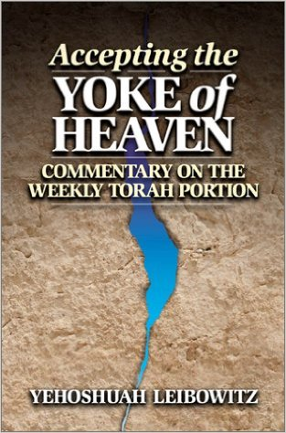

Slide 50
Mattityahu (Matthew) 11:30
כִּי עֻלִּי נָעִים וְקַל מַשָּׂאִי.
For my yoke is easy, and my burden is light.
Notes:
Task driven, vs Yeshua driven.
Stewart Winograd: if we labor because there is a need, we will burn out and antagonize our family.
If we labor for Yeshua’s call, we will have joy and deep success.

Slide 51
What is HIS yoke?
NOT deleting Torah.
^{Mtt. 5.20} For I tell you that unless your righteousness is far greater than that of the Torah -teachers and P’rushim, you will certainly not enter the Kingdom of Heaven!
Moral example.
Social justice.
Notes:
Contemporary terms.
What would be moral example? Things like:

Slide 52
The boss at work knowing that you will not steal money or time.
Your friends knowing that you will not lie.
Your neighbor’s wife knowing that you will not try to commit adultery, in action or word or attitude.
Your fellow congregants knowing that you bear your responsibility in ministry: serving and giving.

Slide 55
^{Song 1.3} Your name is like perfume poured out.

Slide 56
^{Yeshayahu/Is 9.5-6} For a child is born to us, a son is given to us; dominion will rest on his shoulders, and he will be given the name

Slide 57
^{Yeshayahu/Is 9.5-6}
פֶּלֶא יוֹעֵץ, אֵל גִּבּוֹר, אֲבִי-עַד, שַׂר-שָׁלוֹם.
Pele-Yo‘etz El Gibbor Avi-Ad Sar-Shalom
[Wonder of a Counselor, Mighty God, Father of Eternity, Prince of Peace],

Slide 58
^{Yeshayahu/Is 9.5-6} in order to extend the dominion and perpetuate the peace of the throne and kingdom of David, to secure it and sustain it through justice and righteousness henceforth and forever.

Slide 59
^{Rev 19.12-13} His eyes were like a fiery flame, and on his head were many royal crowns. And he had a name written which no one knew but himself. He was wearing a robe that had been soaked in blood, and the name by which he is called is, “The Word of God.”

Slide 60
^{Rev 19.16} It is he who treads the winepress from which flows the wine of the furious rage of Adoni, God of heaven’s armies. And on his robe and on his thigh He has a name written: King Of Kings and Lord of Lords.

Slide 62
^{Phil 2.9-11} For this reason God highly exalted Him and gave Him the name that is above every name, that at the name of Yeshua every knee should bow, in heaven and on the earth and under the earth, and every tongue profess that Yeshua the Messiah is Lord — to the glory of God the Father.

Slide 64
Notes:
When I came home from Bible School, hard times at school, driving my Dad’s big luxury Buick, “Boy this feels good. But the joy in my heart feels sooooo much better.”

Slide 65
^{T’hillim / Ps 45.2} My heart is stirred with a good word. I speak my verses to the king.

Slide 66
^{Song 5.2} I sleep, but my heart is awake. A voice! My lover is knocking! “Open to me, my sister, my darling, my dove, my perfect one!

Slide 67
^{T’hillim / Ps 4.8-9} You have put joy in my heart — more joy than when their grain and new wine overflow. I will lie down and sleep in shalom. For You alone, Adoni, make me live securely.

Slide 68
^{Song 8.6} Set me like a seal on your heart, like a seal on your arm; for love is as strong as death, passion as cruel as Sh’ol; its flashes are flashes of fire, [as fierce as the] flame of Yah.

Slide 71
^{Yeshayahu/Is 35.1-2} The wilderness and dry land will be glad. The desert will rejoice and blossom like a lily. It will blossom profusely, will rejoice with joy and singing.

Slide 72
^{T’hillim/Ps 84.5-8} How happy are those who live in your house; they never cease to praise you! (Selah) How happy the man whose strength is in you, in whose heart are pilgrim] highways. Passing through the [dry] Baka Valley, they make it a place of springs, and the early

Slide 73
^{T’hillim/Ps 84.5-8} rain clothes it with blessings. They go from strength to strength and appear before God in Tziyon.

Slide 74
^{T’hillim/Ps 37.11} The meek will inherit the land, and delight in abundant shalom.

Slide 75
^{Ro 8.16-17} For you did not receive the spirit of slavery to fall again into fear; rather, you received the Spirit of adoption, by whom we cry, “Abba! Father!” The Ruach Himself bears witness with our spirit that we are children of God.

Slide 76
^{Ro 8.16-17} And if children, also heirs—heirs of God and joint-heirs with Messiah—if indeed we suffer with Him so that we may also be glorified with Him.

Slide 78
^{Gal 4.14-15} You welcomed me as if I had been an angel of God, as if I had been the Messiah Yeshua himself! So what has become of the joy you felt? For I bear you witness that had it been possible, you would have gouged out your eyes and given them to me.

Slide 79
^{Thillim/Ps 29} The voice of Adoni is over the waters; the God of glory thunders, Adoni over rushing waters…The voice of Adoni is powerful…The voice of Adoni is full of majesty... The voice of Adoni breaks the cedars. Yes, Adoni shatters cedars of Lebanon.

Slide 82
Do you KNOW Yeshua and the sweetness of His presence?
Are you hearing daily from His Word?
How are you applying what you heard?
Are you offering that sense of His Presence to anyone?

