Slide 1
e-handout
To have these notes
without taking notes
Go to OrHaOlam.com
Click on Messages tab,
2022 Messages

Slide 2
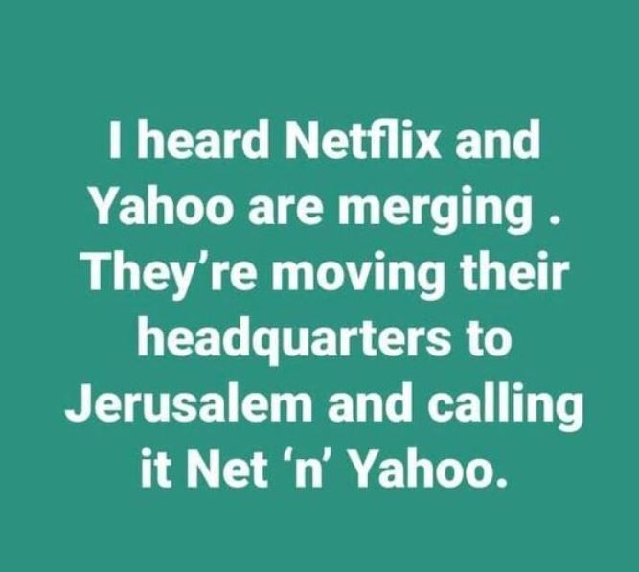

Slide 3
Notes:
From Rukhel

Slide 4
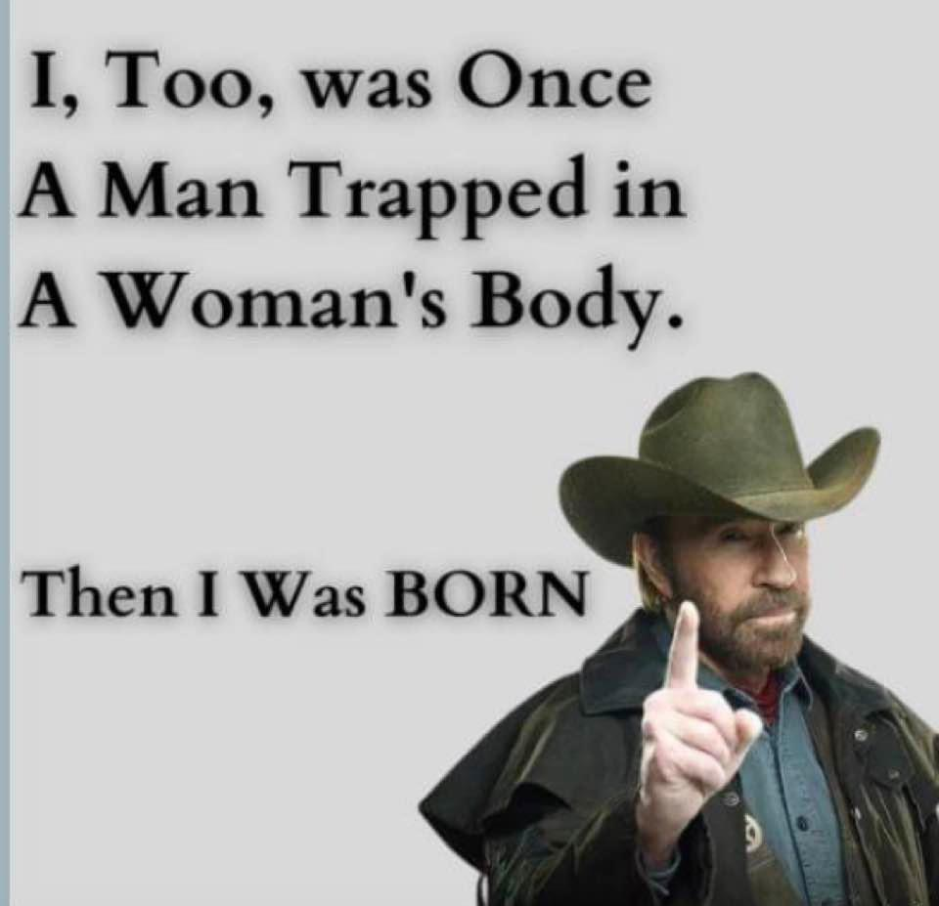
Notes:
Legitimate side to gender issues…

Slide 6
Some Oneg instructions…

Slide 7
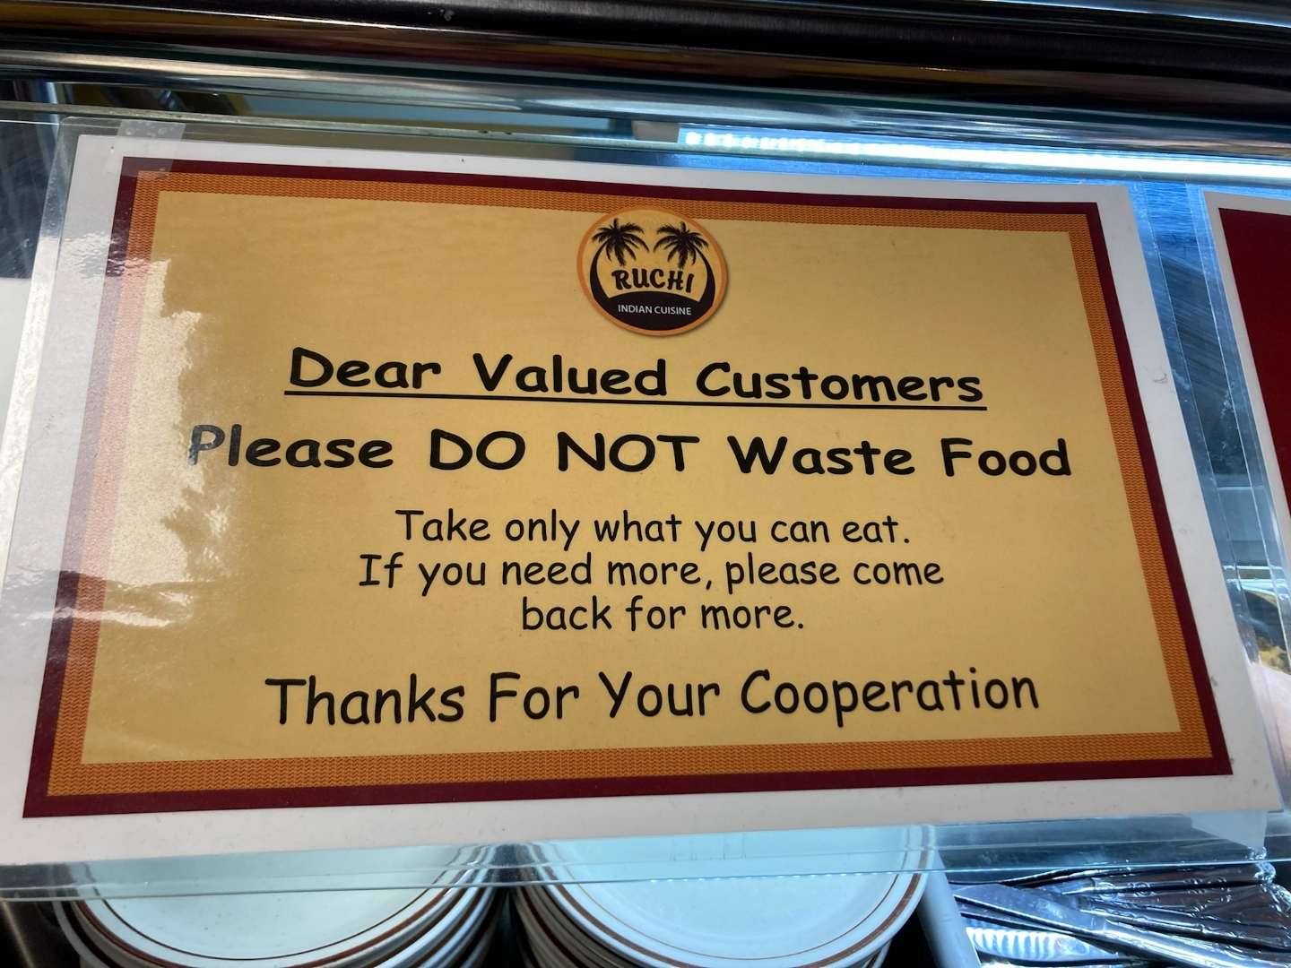
from Rucci’s
Indian cuisine
Notes:
Cathy Adler

Slide 8
Please plug in your crock pot

Slide 9
Slice before setting out for dipping

Slide 10
Election Day is Nov 8.
Revival and Election
Spiritual and political reform

Slide 11
^{Daniel 2.20-21} “Blessed be the name of God from eternity past to eternity future! For wisdom and power are his alone…He removes kings and sets up kings.
מְהַעְדֵּה מַלְכִין, וּמְהָקֵים מַלְכִין
Notes:
Aramaic, not Hebrew.

Slide 12
^{Daniel 4.28 (31)} King Nebuchadnezzar, it has been decreed to you that your kingdom has been removed from you!

Slide 14
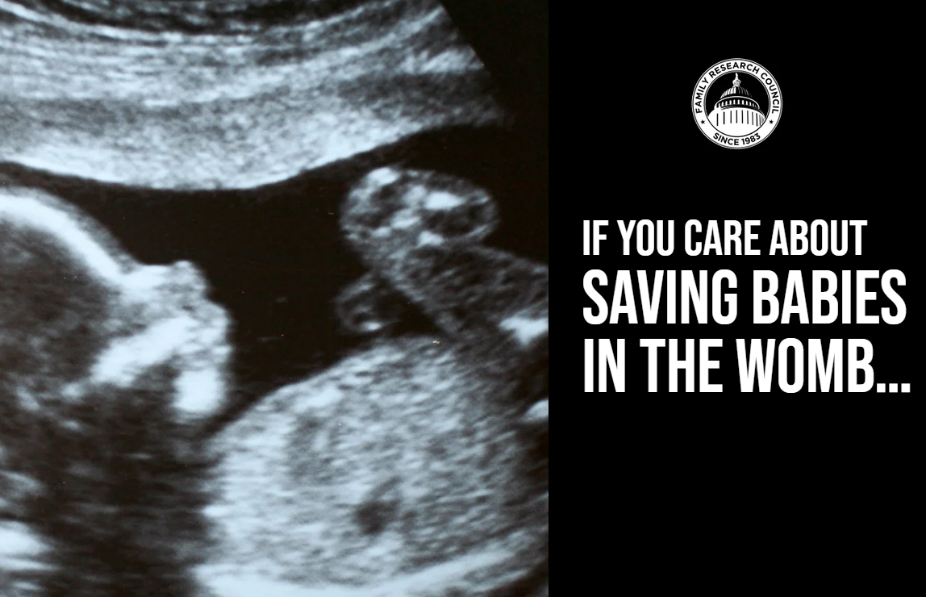
Notes:
https://online.flippingbook.com/link/480822/

Slide 16
Notes:
Prayer first. As men and women come to the revelation of Messiah, through the Spirit, they change their views. Growing up in a secular toxic Jewish home, I was determined NEVER to commit to a marriage.
Till I entered into a relationship with the Holy One of Israel, Messiah Yeshua, and had new understanding of sin, righteousness, and judgement to come.
https://www.frc.org/get.cfm?c=CHECKOUT&dmy=A5CAC2D4-EFDB-7887-DFAF23AFB454E92B&srcItem=PT22I01&fromItem=FN22J16&x=0

Slide 17
Notes:
https://online.flippingbook.com/link/304842/

Slide 18
Notes:
Pray, vote, stand

Slide 19
Notes:
https://online.flippingbook.com/link/283383/

Slide 20
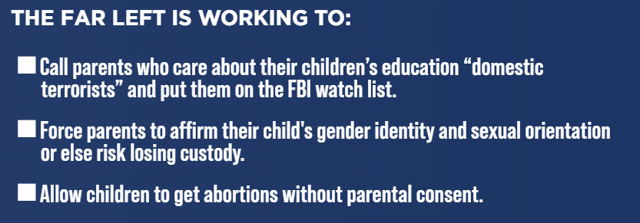
Notes:
Pray, vote, stand

Slide 21
Notes:
https://online.flippingbook.com/link/381591/

Slide 22
Notes:
Pray, vote, stand

Slide 23
Notes:
https://online.flippingbook.com/link/370314/1/

Slide 24
Notes:
https://online.flippingbook.com/link/370314/2/
Pray, vote, stand

Slide 25
Notes:
LGBTQ ACTIVISTS ARE SEEKING TO:
Subject children to experimental gender transition procedures.
Allow biological males to compete in women’s sports and use women’s bathrooms and locker rooms.
Push a radical gender identity ideology in public schools and our military.
https://online.flippingbook.com/link/332455/2/

Slide 26
Notes:
https://www.frc.org/get.cfm?c=CHECKOUT&dmy=A5CAC2D4-EFDB-7887-DFAF23AFB454E92B&srcItem=PT22I01&fromItem=FN22J16&x=0

Slide 27
Marissa Streit, CEO of PragerU, was born in Los Angeles and moved to Israel at a young age, where she completed her primary education and served in military intelligence unit 8200 of the Israeli Defense Force.
Notes:
She returned to Los Angeles to earn her Bachelor’s degree in Business and Economics, and her Master’s degree in Education and Non-Profit Management. Joined Prager U in 2011. Helps PragerU to more than double its audience every year and influence millions of young minds every day. Marissa lives in the Los Angeles area with her husband and three children.

Slide 28
PragerU is the media network that sued Google and YouTube for censoring our patriotic "5-Minute Videos."
When the Big Tech giants realized our videos had been viewed millions of times per day, they censored some of our most popular episodes, even one about "The Ten Commandments." And when our legal team asked why, they said our content was "unsuitable for young people."

Slide 29
Notes:
https://external-content.duckduckgo.com/iu/?u=http%3A%2F%2Fcareforpastors.org%2Fwp-content%2Fuploads%2F2014%2F01%2FMat-Staver-tn1.jpg&f=1&nofb=1&ipt=5b477e831f902f2f193fae4f4ae4a6fa7dfe0101ccc639b22714e97eaca69905&ipo=images

Slide 30
HR 8404 Respect for Marriage Act will establish a federal public policy that gender is irrelevant even in an obvious gender-based human relationship—marriage. Such a public policy will extend far beyond same-sex marriage. If gender is “irrelevant” in marriage, then it will be “irrelevant in sports and private separate gender facilities.
Notes:
Mat Staver, LC Action Chairman alert@lcaction.org via liberty-counsel.ccsend.com

Slide 31
Object to the drag queen indoctrinating your child in school? Too bad. This public policy will make you look like a bigot, much like if someone objected to having a person of color speak to the class. LGBTQ will be placed in the same protected category as race.
Notes:
Mat Staver, LC Action Chairman alert@lcaction.org via liberty-counsel.ccsend.com

Slide 32
Remember the Kentucky Clerk Kim Davis who spent six days in jail for refusing to use her name and authority to endorse same-sex marriage? Even though the Kentucky legislature unanimously passed a religious
Notes:
Mat Staver, LC Action Chairman alert@lcaction.org via liberty-counsel.ccsend.com

Slide 33
accommodation law, HR 8404 would override the law and force every person in public service to violate their sincere religious beliefs.
Notes:
Mat Staver, LC Action Chairman alert@lcaction.org via liberty-counsel.ccsend.com

Slide 34
The (Dis)Respect for Marriage Act, HR 8404, is so close to passing. All Democrats will vote yes, and we count at least four Republican senators who indicated they will support this bill.
Notes:
including Rob Portman (OH), Susan Collins (ME), Lisa Murkowski (AK) and Thom Tillis (NC).
Mat Staver, LC Action Chairman alert@lcaction.org via liberty-counsel.ccsend.com

Slide 35
Thomas Jefferson stated, “We do not have government by the majority. We have government by the majority who participate.”
Notes:
MetroVoice

Slide 36
John F. Kennedy stated, “The ignorance of one voter in a democracy impairs the security of all.”
Notes:
MetroVoice

Slide 37
A billboard sponsored by CA
Notes:
Zoom in…

Slide 39
Notes:
https://www.frc.org/get.cfm?c=CHECKOUT&dmy=A5CAC2D4-EFDB-7887-DFAF23AFB454E92B&srcItem=PT22I01&fromItem=FN22J16&x=0

Slide 40
Election Day is Nov 8.
Revival and Election
Spiritual and political reform

Slide 41
^{Daniel 2.20-21} “Blessed be the name of God from eternity past to eternity future! For wisdom and power are his alone…He removes kings and sets up kings.
מְהַעְדֵּה מַלְכִין, וּמְהָקֵים מַלְכִין
Notes:
Aramaic, not Hebrew.

Slide 43
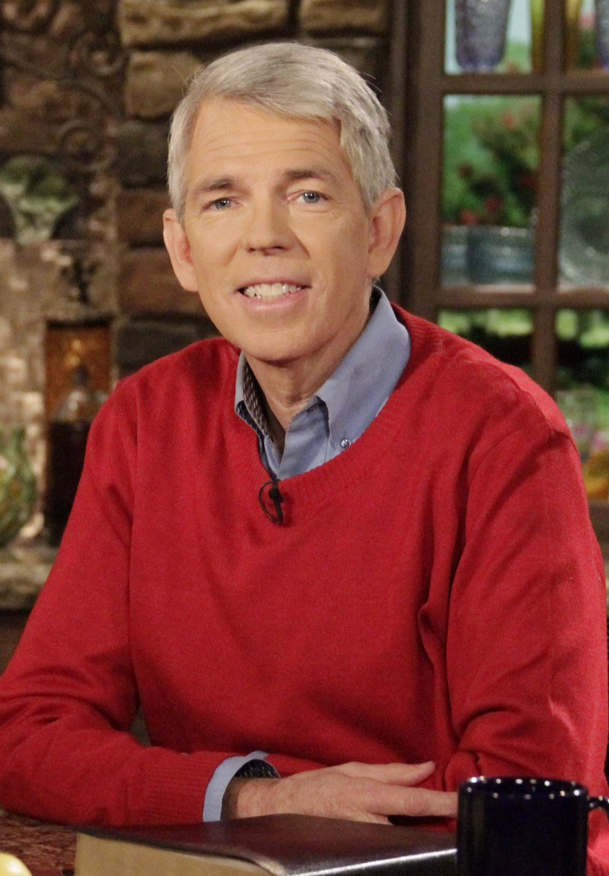
David Barton is the source of the following.
A national news organization has described him as “America’s historian,” and Time Magazine called him “a hero to millions – including some powerful politicians.
Notes:
In fact, Time Magazine named him as one of America’s 25 most influential evangelicals.
https://wallbuilders.com/david-barton/
https://external-content.duckduckgo.com/iu/?u=https%3A%2F%2Fs3.amazonaws.com%2Ftruthandliberty%2Ffiles%2FDB-Promo-pic-052114.jpg&f=1&nofb=1&ipt=18953fcb31296e8b932911942f9d09b0ba3312f724f890ea9846e3061a10d972&ipo=images

Slide 44
A lot of people are saying we really need a revival. We've got to have some kind of revival in America. We're praying for a revival, and that is a terrific, wonderful prayer, but I don’t think it's going to be answered the way we expect it to be answered
Notes:
https://familytalk.widen.net/view/pdf/wy76rgihs1/10312022AMERICASFORGOTTENHISTORYANDHEROES.pdf?u=c3crpv

Slide 45
If I talk to a group and I say, "Okay guys, who's the president of the United States," they can all tell me. If I say, "Who's the president of your local school board," I get blank stares. If I say "Name three federal legislators." Easy. "Name three legislators at the city level. Give me three city council members. Can't do it.
Notes:
https://familytalk.widen.net/view/pdf/wy76rgihs1/10312022AMERICASFORGOTTENHISTORYANDHEROES.pdf?u=c3crpv

Slide 46
We can have a whole lot more impact locally than we can nationally.
Notes:
https://familytalk.widen.net/view/pdf/wy76rgihs1/10312022AMERICASFORGOTTENHISTORYANDHEROES.pdf?u=c3crpv

Slide 47
If we're talking about having revivals, it's an interesting thing about revivals. There are no national revivals.
Notes:
https://familytalk.widen.net/view/pdf/wy76rgihs1/10312022AMERICASFORGOTTENHISTORYANDHEROES.pdf?u=c3crpv

Slide 48
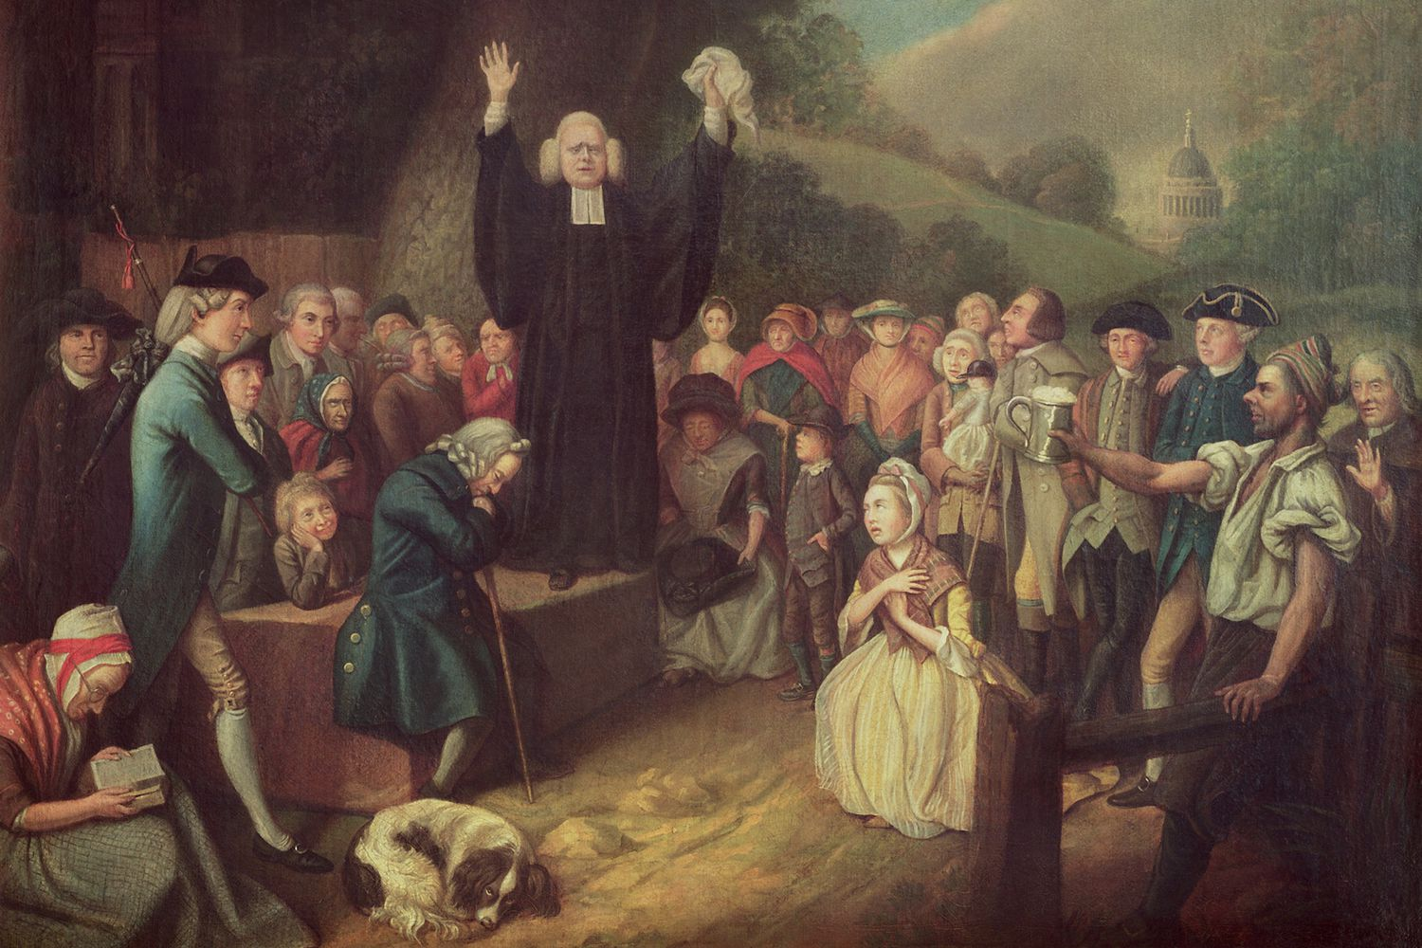
George Whitefield
1714-1770

Slide 49
The Great Awakening, we think it's a national revival, and the reason we think it's a national revival is we see what happened with George Whitefield. What this guy did was he delivered about 34 years of preaching, 18,000 sermons and 80% of all Americans physically heard him preach a sermon.
Notes:
https://familytalk.widen.net/view/pdf/wy76rgihs1/10312022AMERICASFORGOTTENHISTORYANDHEROES.pdf?u=c3crpv

Slide 50
How is that possible? He was a chaplain in Georgia. He got on his horse in Georgia, and he rode to Maine, which was then part of Massachusetts. He rode to Maine as far north as you could go in America, and he preached the gospel in every town he went through.
Notes:
https://familytalk.widen.net/view/pdf/wy76rgihs1/10312022AMERICASFORGOTTENHISTORYANDHEROES.pdf?u=c3crpv

Slide 51
Then he turned around and rode from Maine back to Georgia where he was a chaplain. But he took a different route, preaching every town he went through. Then when he got to Georgia, he turned around and rode back to Maine.
Notes:
https://familytalk.widen.net/view/pdf/wy76rgihs1/10312022AMERICASFORGOTTENHISTORYANDHEROES.pdf?u=c3crpv

Slide 52
He did it seven times, 34 years, 18,000 sermons. The reason 80% of Americans physically heard him preach his sermons, because he’s in 80% of the towns in America. I mean, that's where he went. What happened was when a revival would break out in a local town, it would be the local clergy that would keep it going.
Notes:
Local responsibility. We are responsible for what happens in your heart, home, marriage, family, congregation.
https://familytalk.widen.net/view/pdf/wy76rgihs1/10312022AMERICASFORGOTTENHISTORYANDHEROES.pdf?u=c3crpv

Slide 53
It's the same thing when you look at the American War of Independence. If you try to name the battles, we can come up with three or four usually.
Notes:
https://familytalk.widen.net/view/pdf/wy76rgihs1/10312022AMERICASFORGOTTENHISTORYANDHEROES.pdf?u=c3crpv
Lexington Concord, Trenton, Saratoga Springs, Cornwallis at Yorktown, VA

Slide 54
The British would come town to town, and the people would rise up and say, "No, you're not going to do that here and we’re going to make sure you don't do it here."
The leader of the Battle of Lexington was Pastor Jonas Clark, who took 70 guys from his church out there to face the 700 British.
Notes:
https://familytalk.widen.net/view/pdf/wy76rgihs1/10312022AMERICASFORGOTTENHISTORYANDHEROES.pdf?u=c3crpv

Slide 55
The leader of the Battle of North Concord is Reverend William Emerson, who took 400 guys to stop the British coming over the bridge.
Notes:
https://familytalk.widen.net/view/pdf/wy76rgihs1/10312022AMERICASFORGOTTENHISTORYANDHEROES.pdf?u=c3crpv

Slide 56
The leader of the Road to Boston, there were 4,500 people that showed up and they were led by pastors like Benjamin Boss and Payson Phillips.
Notes:
https://familytalk.widen.net/view/pdf/wy76rgihs1/10312022AMERICASFORGOTTENHISTORYANDHEROES.pdf?u=c3crpv

Slide 57
When you get to Battle of Bunker Hill, it was Joseph Willard who said, "Well I got two companies here in the congregation. Let's go get with the others. We'll defend Boston.“
It was all local, and that's where we win the American War for Independence.
Notes:
https://familytalk.widen.net/view/pdf/wy76rgihs1/10312022AMERICASFORGOTTENHISTORYANDHEROES.pdf?u=c3crpv

Slide 58
There's three requirements to be a voter in the United States.
Notes:
https://familytalk.widen.net/view/pdf/wy76rgihs1/10312022AMERICASFORGOTTENHISTORYANDHEROES.pdf?u=c3crpv

Slide 59
There's three requirements to be a voter in the United States.
Eighteen years old
Legal citizen
Registered.
Notes:
https://familytalk.widen.net/view/pdf/wy76rgihs1/10312022AMERICASFORGOTTENHISTORYANDHEROES.pdf?u=c3crpv
Constitutional
Constitutional
Statutory: set by law, make sure you don't vote seven times or somebody didn't vote seven times for you.

Slide 60
65.3% of American adults are registered to vote. We have more than 100 million American adults who have said, "I don't care what happens to the country.
Notes:
https://familytalk.widen.net/view/pdf/wy76rgihs1/10312022AMERICASFORGOTTENHISTORYANDHEROES.pdf?u=c3crpv

Slide 61
About 40 million professing evangelical believers are not register to vote. So, they can't even be salt and light even if they wanted to.
Notes:
https://familytalk.widen.net/view/pdf/wy76rgihs1/10312022AMERICASFORGOTTENHISTORYANDHEROES.pdf?u=c3crpv
The culture would be very different if they were to get engaged

Slide 62
The last 11 presidential elections, the average voter turnout is 54%, but that's 54% of registered voters. That's 54% of 65.3%, which means only 36% of adults vote for president and takes half of that to win, 18%.
One fifth of the country!
Notes:
https://familytalk.widen.net/view/pdf/wy76rgihs1/10312022AMERICASFORGOTTENHISTORYANDHEROES.pdf?u=c3crpv

Slide 63
In the last 11 presidential elections, one out of five Americans has chosen the president. Four out of five did not choose the president.
Notes:
https://familytalk.widen.net/view/pdf/wy76rgihs1/10312022AMERICASFORGOTTENHISTORYANDHEROES.pdf?u=c3crpv

Slide 64
In the last 21 off-year elections, the voter turnout has been 38%, but that's 38% of 65%, which means 26% actually vote for governor and senator. So 13% determine the governor.
Notes:
https://familytalk.widen.net/view/pdf/wy76rgihs1/10312022AMERICASFORGOTTENHISTORYANDHEROES.pdf?u=c3crpv

Slide 65
On the local level, the average voter turnout at the local level is only 6%, but that's 6% of 65%, which is the registered voters, which means your actual voter turned out is only 4% of adults, and it takes half of that to win, which is 2%.

Slide 66
Why this is important.
The City of Los Angeles is larger than the population of 23 separate individual states. So Eric Garcetti, mayor of Los Angeles, is like being governor in 23 states. Eric Garcetti brags about the fact that he was elected with 2.9% of the vote.
Notes:
https://familytalk.widen.net/view/pdf/wy76rgihs1/10312022AMERICASFORGOTTENHISTORYANDHEROES.pdf?u=c3crpv

Slide 67
He was extremely faith hostile. Everything else is essential, but congregations are not. Pot shops are essential. Liquor shops essential. Big box stores essential. Worship centers, definitely not.
Notes:
https://familytalk.widen.net/view/pdf/wy76rgihs1/10312022AMERICASFORGOTTENHISTORYANDHEROES.pdf?u=c3crpv

Slide 68
Houston, is larger than 20 separate states. It's the fourth largest city in the nation. They elected Annise Parker mayor with 3.3% of the vote.
Notes:
https://familytalk.widen.net/view/pdf/wy76rgihs1/10312022AMERICASFORGOTTENHISTORYANDHEROES.pdf?u=c3crpv

Slide 69
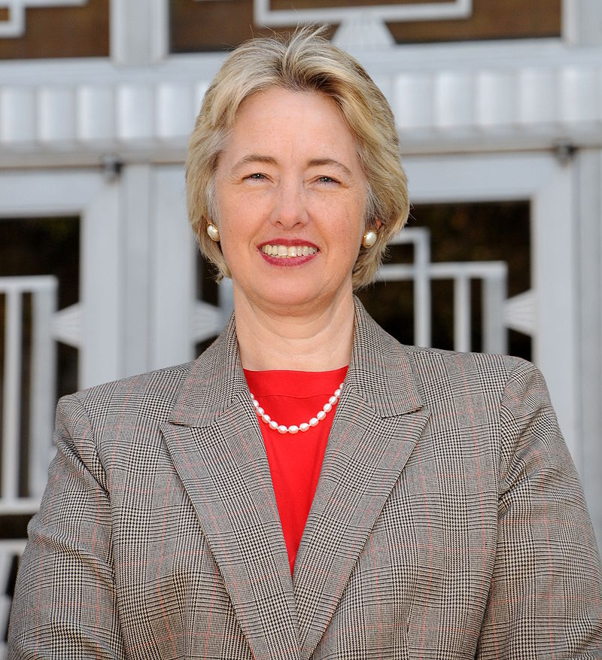
Annise Parker was the first openly lesbian mayor of Houston and she passed a city law that says, “If you say marriage is between a man and woman that is now a hate crime,
Notes:
https://familytalk.widen.net/view/pdf/wy76rgihs1/10312022AMERICASFORGOTTENHISTORYANDHEROES.pdf?u=c3crpv

Slide 70
and I'm going after you," and she did. She went after a bunch of Houston pastors, subpoenaed 17 different forms of communication. I want to see all your text messages, all your emails, everything.
Notes:
https://familytalk.widen.net/view/pdf/wy76rgihs1/10312022AMERICASFORGOTTENHISTORYANDHEROES.pdf?u=c3crpv

Slide 71
Fort Worth is the thirteenth's largest city in the United States. Six years ago, the school board in Fort Worth said, “We're going to let kids choose whatever bathroom they want, whatever locker room they want, and whatever shower they want. We're just not going to do genders in Fort Worth schools anymore.”
Notes:
https://familytalk.widen.net/view/pdf/wy76rgihs1/10312022AMERICASFORGOTTENHISTORYANDHEROES.pdf?u=c3crpv

Slide 72
The Secretary of Education for President Obama, Arnie Duncan said, "What a brilliant idea." So, they came out with a plan that says, any school that gets federal funding can't do gender. That's 97% of the public schools in America.
Notes:
https://familytalk.widen.net/view/pdf/wy76rgihs1/10312022AMERICASFORGOTTENHISTORYANDHEROES.pdf?u=c3crpv

Slide 73
The president of the school board who came up with this was elected with 1,182 votes. So, I looked in the district where he ran I found one congregation, a Bible- believing evangelical congregation that had more than 3000 registered adult voters.
Notes:
https://familytalk.widen.net/view/pdf/wy76rgihs1/10312022AMERICASFORGOTTENHISTORYANDHEROES.pdf?u=c3crpv

Slide 74
Bentonville, Arkansas. This is a hometown of Walmart. It's a town of 40,000 people. There's a Christian lady there that said, "You're not going to do this in our town. I'm running for school board." She ran and she got elected. In that town of 40,000 people there were a total of 35 votes cast for the school board.
Notes:
https://familytalk.widen.net/view/pdf/wy76rgihs1/10312022AMERICASFORGOTTENHISTORYANDHEROES.pdf?u=c3crpv

Slide 75
There are three institutions biblically that God gave us. Family first, easy. God made Adam, made Eve. They had children. God said, "This is good.”
Notes:
https://familytalk.widen.net/view/pdf/wy76rgihs1/10312022AMERICASFORGOTTENHISTORYANDHEROES.pdf?u=c3crpv

Slide 76
The second institution God created was that of civil government. When Noah got off the flood in Genesis 9, God gave him seven civil laws. They're called the Noahide Laws. This is the first recorded instance of civil government being organized into human history.
Notes:
https://familytalk.widen.net/view/pdf/wy76rgihs1/10312022AMERICASFORGOTTENHISTORYANDHEROES.pdf?u=c3crpv

Slide 77
In those laws, God says, "Here's what you do with murderers. Here's what you do with thieves," and it's civil law. So, government came from God in Genesis 9.
Notes:
https://familytalk.widen.net/view/pdf/wy76rgihs1/10312022AMERICASFORGOTTENHISTORYANDHEROES.pdf?u=c3crpv

Slide 78
A political scientist at the University of Houston documented that the single most cited source by the founding fathers in the Declaration declaring independence, was a book by John Locke. It was called the Two Treatises Government, printed first in 1690.
Notes:
https://familytalk.widen.net/view/pdf/wy76rgihs1/10312022AMERICASFORGOTTENHISTORYANDHEROES.pdf?u=c3crpv

Slide 79
Locke's Two Treatises of Government references the Bible more than 1500 times.
Notes:
https://familytalk.widen.net/view/pdf/wy76rgihs1/10312022AMERICASFORGOTTENHISTORYANDHEROES.pdf?u=c3crpv
Usually 5 or 8 reference to govt from leaders.

Slide 80
Dr. Benjamin Rush, was called the Father of Public Schools under the Constitution, because of this piece that he did in 1790.
He said, "The purpose of public schools are threefold. He said, The number one purpose of public schools is to teach students to love and serve God."
Notes:
https://familytalk.widen.net/view/pdf/wy76rgihs1/10312022AMERICASFORGOTTENHISTORYANDHEROES.pdf?u=c3crpv

Slide 81
"The number two purpose of public schools is to teach students to love and serve their country." He said, "The number three purpose of public schools is to teach students to love and serve their family."
Notes:
https://familytalk.widen.net/view/pdf/wy76rgihs1/10312022AMERICASFORGOTTENHISTORYANDHEROES.pdf?u=c3crpv
If you ever lose control of your country, it will become the great enemy of your family, and that's what we're seeing right now.

Slide 82
The previous Virginia Governor Northam, had a problem: they had kids that were surviving abortions. They passed a law that says if a child survives an abortion, were going to go ahead and let that child “die comfortably.”
Notes:
https://familytalk.widen.net/view/pdf/wy76rgihs1/10312022AMERICASFORGOTTENHISTORYANDHEROES.pdf?u=c3crpv

Slide 83
The governor of Maryland said, “We're going to have abortions up to 28 days after a child is born”
Notes:
https://familytalk.widen.net/view/pdf/wy76rgihs1/10312022AMERICASFORGOTTENHISTORYANDHEROES.pdf?u=c3crpv

Slide 84
In Virginia 312 congregations got engaged. Leadership said, 'You find every single person in your congregation, and make sure they're registered to vote, and make sure they go vote biblical values. You don’t have to tell them who to vote for."
Notes:
https://familytalk.widen.net/view/pdf/wy76rgihs1/10312022AMERICASFORGOTTENHISTORYANDHEROES.pdf?u=c3crpv

Slide 85
So, they got 77,000 people registered who had never before participated in elections, and it's an interesting thing. Youngkin got elected with a margin of
65,000.
Notes:
https://familytalk.widen.net/view/pdf/wy76rgihs1/10312022AMERICASFORGOTTENHISTORYANDHEROES.pdf?u=c3crpv

Slide 86
In Michigan last week they just found a guy who voted twice in 2020, which is not good. But the dude was born in 1850. He went through the Civil War, and he voted twice in 2020.
Notes:
https://familytalk.widen.net/view/pdf/wy76rgihs1/10312022AMERICASFORGOTTENHISTORYANDHEROES.pdf?u=c3crpv

Slide 87
The Virginia list of voters they got, of 200 names on the voter's roll, the top 67 names on the voter's roll, they found an obituary for.
Notes:
https://familytalk.widen.net/view/pdf/wy76rgihs1/10312022AMERICASFORGOTTENHISTORYANDHEROES.pdf?u=c3crpv

Slide 88
There's actually 35,000 names on Michigan's voter roll that are dead, that have been voting in recent elections.
Notes:
https://familytalk.widen.net/view/pdf/wy76rgihs1/10312022AMERICASFORGOTTENHISTORYANDHEROES.pdf?u=c3crpv

Slide 89
In Denver, Colorado Springs 1500 congregations got organized in Colorado, and they took 78 school boards including four school boards in Colorado Springs, including Denver.
Notes:
https://familytalk.widen.net/view/pdf/wy76rgihs1/10312022AMERICASFORGOTTENHISTORYANDHEROES.pdf?u=c3crpv

Slide 90
In Fort Worth, they won 20 out of 21. Five weeks ago in Miami-Dade County they won 25 out of 30 in Miami-Dade County. This is going on all over the nation. So, changes has happened, but it's going to get healthy from the bottom up.
Notes:
https://familytalk.widen.net/view/pdf/wy76rgihs1/10312022AMERICASFORGOTTENHISTORYANDHEROES.pdf?u=c3crpv

Slide 91
In the fight for control of the Senate, the three closest contests are the races in Georgia, Nevada and Pennsylvania. The party that can win 2 of these 3 races is virtually certain to gain the majority.
Notes:
Republican Jewish Coalition PAC · 50 F Street, NW, Suite 100, Washington, DC. 20001

Slide 92
Here’s where things stand with five days to go:
In Georgia, Republican challenger Herschel Walker leads Democrat incumbent Raphael Warnock by 1.6% in the RealClearPolitics polling average.
Republican challenger Adam Laxalt leads Democrat incumbent Catherine Cortez Masto by 1.9% in Nevada
And Democrat John Fetterman leads Republican Dr. Mehmet Oz by 1.2% in Pennsylvania
Notes:
Republican Jewish Coalition PAC · 50 F Street, NW, Suite 100, Washington, DC. 20001

Slide 93
Notes:
https://www.frc.org/get.cfm?c=CHECKOUT&dmy=A5CAC2D4-EFDB-7887-DFAF23AFB454E92B&srcItem=PT22I01&fromItem=FN22J16&x=0

Slide 94
Election Day is Nov 8.
Revival and Election
Spiritual and political reform

Slide 96
^{Daniel 2.20-21} “Blessed be the name of God from eternity past to eternity future! For wisdom and power are his alone…He removes kings and sets up kings.
מְהַעְדֵּה מַלְכִין, וּמְהָקֵים מַלְכִין
Notes:
Aramaic, not Hebrew.

Slide 97
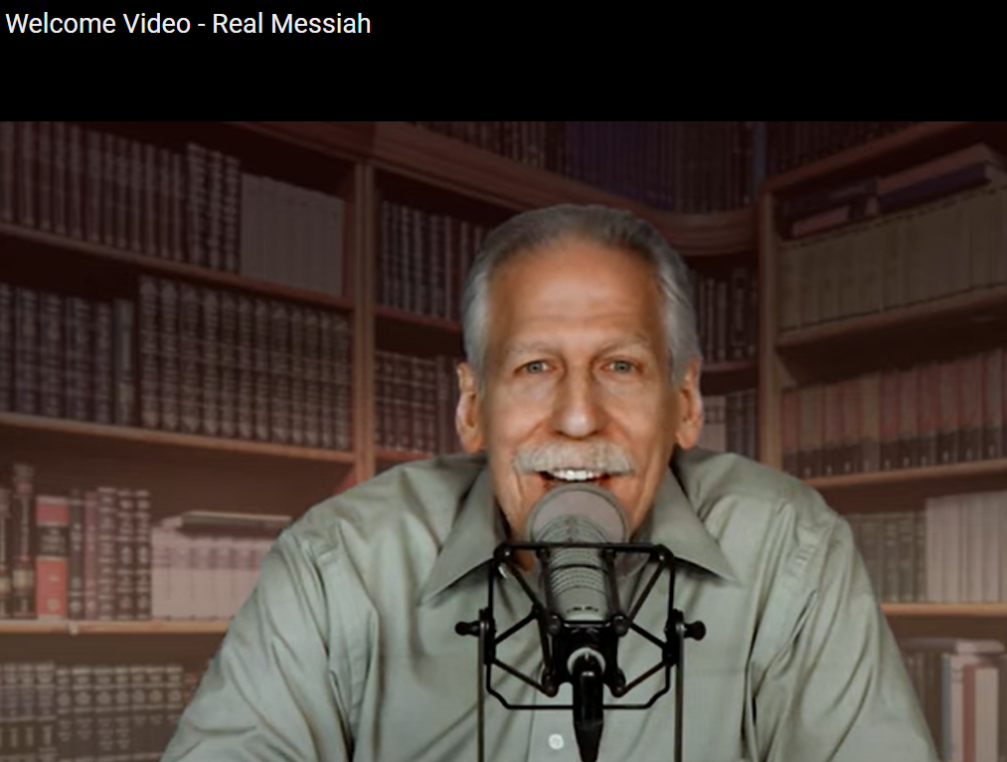
Notes:
https://realmessiah.com/

Slide 98
There have been revival movements in America in the past that had one particular hotspot to which people made pilgrimage. A prominent example would be the Azusa Street Revival in Los Angeles (which began in 1906), helping to birth the modern Pentecostal-Charismatic movement, which now numbers more than 600,000 to a million adherents worldwide.
Notes:
https://askdrbrown.org/article/i-see-thousands-of-holy-fires-across-america?vcrmeid=a7khokltyUuUNkDmaeK8YQ&vcrmiid=n8-9Ls_siEGdG64--fUPAw

Slide 99
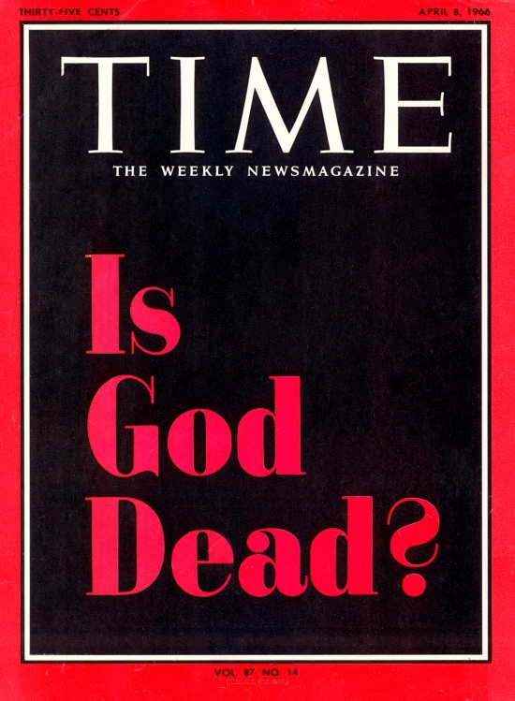
April 8, 1966
Notes:
https://time.com/isgoddead/
The article was far more nuanced than the cover might suggest, but Hamilton and Altizer were not hedging in their views. It’s tempting to take them metaphorically, to say “death” and mean “irrelevance,” but they were speaking literally. The idea was not the same as disbelief: God was real and had existed, they said, but had become dead.

Slide 100
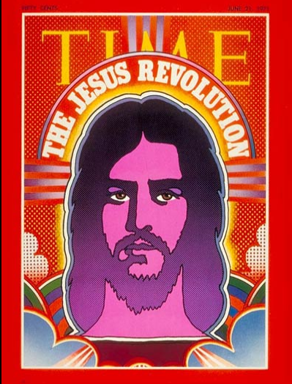
June 21, 1971

Slide 101
More recently, from 1995-2000, believers from more than 130 nations traveled to the Brownsville Revival in Pensacola, Florida, and missionaries were sent out from there (through the ministry school that was raised up) to many nations.
Notes:
https://askdrbrown.org/article/i-see-thousands-of-holy-fires-across-america?vcrmeid=a7khokltyUuUNkDmaeK8YQ&vcrmiid=n8-9Ls_siEGdG64--fUPAw

Slide 102
In 1801 during the Second Great Awakening in America, in what was called the Cane Ridge Revival, an onlooker described what he saw as 20,000 people from the sparsely populated frontier region came together for a 6-day camp meeting.
Hebrides Revival 1949-1953
Notes:
https://askdrbrown.org/article/i-see-thousands-of-holy-fires-across-america?vcrmeid=a7khokltyUuUNkDmaeK8YQ&vcrmiid=n8-9Ls_siEGdG64--fUPAw
https://www.revival-library.org/revival_histories/evangelical/twentieth_century/hebrides_revival.shtml

Slide 103
I do not see an exact repeat of this coming. Instead, I see thousands of hubs across the country. I see thousands of watering holes where people come to repent and get right with God, to be refreshed and renewed, to be saved and filled and delivered.

Slide 104
Notes:
https://www.frc.org/get.cfm?c=CHECKOUT&dmy=A5CAC2D4-EFDB-7887-DFAF23AFB454E92B&srcItem=PT22I01&fromItem=FN22J16&x=0

Slide 105
Election Day is Nov 8.
Revival and Election
Spiritual and political reform

Slide 106
^{Daniel 2.20-21} “Blessed be the name of God from eternity past to eternity future! For wisdom and power are his alone…He removes kings and sets up kings.
מְהַעְדֵּה מַלְכִין, וּמְהָקֵים מַלְכִין
Notes:
Aramaic, not Hebrew.

Slide 108
Do you KNOW Yeshua and drinking the water of LIFE?
Are you hearing daily from His Word?
How are you applying what you heard?
Are you offering that water of life to anyone?

