Slide 1
e-handout
To have these notes
without taking notes
Go to OrHaOlam.com
Click on Messages tab,
2022 Messages
Notes:
You may notice that I’m slowing down in my rate of speech. This is because we may be getting language translation equipment for simultaneous translation.

Slide 2
Notes:
From Vicki Kline

Slide 3
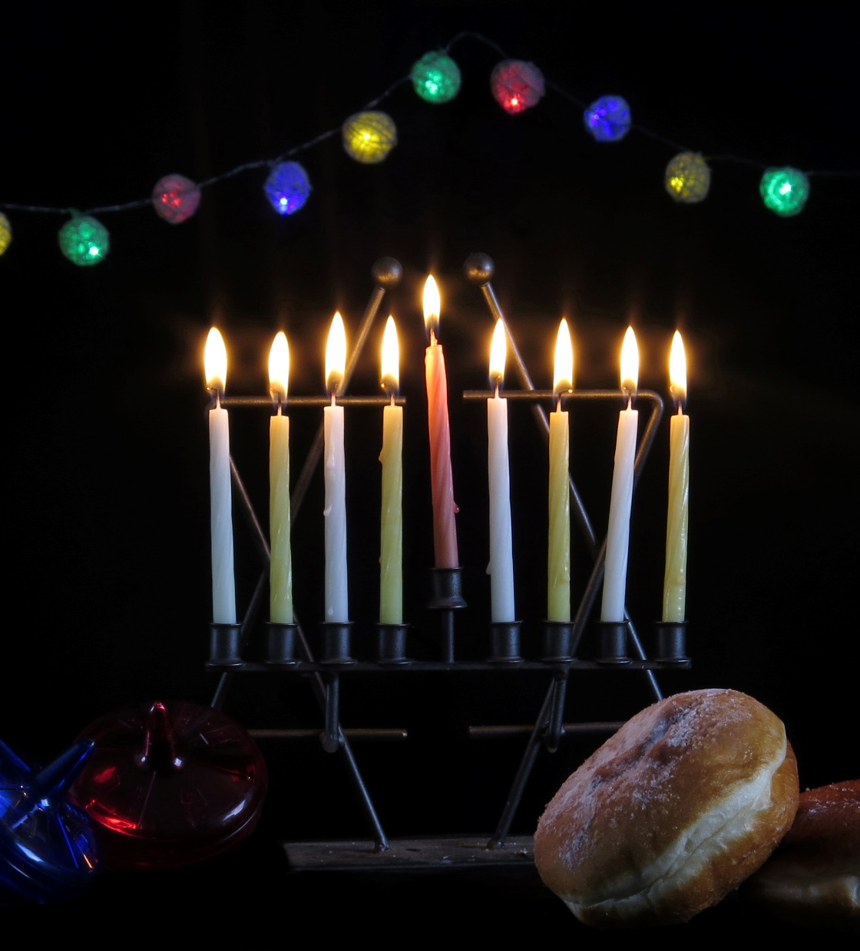
If you look up Hanukkah on Wikipedia,
19 images are candles, donuts, latkes
5 images are war

Slide 4
UMJC EXECUTIVE DIRECTOR
Monique Brumbach is a granddaughter of German Jewish Holocaust survivors, a human rights lawyer. She has been involved in the UMJC since her Bat Mitzvah in 1994, when her parents founded Adat Yeshua, the first Messianic Jewish congregation in New Orleans.
Notes:
A rabbi’s wife married to Rabbi Josh Brumbach

Slide 5
“When our Gentile friends or co-workers ask us ‘what’s Hanukkah about, anyway?’ we tend to give them sugar-coated references to light, miracles, and funny games with spinning tops. But this is only half of the story. [or less!]
Notes:
https://www.umjc.org/commentary/2022/12/16/what-would-the-maccabees-do

Slide 6
“The full story of Hanukkah must include the catalyst: a tyrant invaded our ancestral land and made our way of life illegal.”
Notes:
https://www.umjc.org/commentary/2022/12/16/what-would-the-maccabees-do

Slide 8
“Under Antiochus’ regime, many of our people accommodated the new reality for the sake of survival. They pretended to be good pagans in public, and held on to the scraps of Judaism they could still practice in private.
Notes:
https://www.umjc.org/commentary/2022/12/16/what-would-the-maccabees-do

Slide 9
“But a band of religious zealots planned a rebellion in the caves of Judea, and waged a prolonged campaign of guerilla warfare that finally drove out the occupiers.”
Notes:
https://www.umjc.org/commentary/2022/12/16/what-would-the-maccabees-do

Slide 10
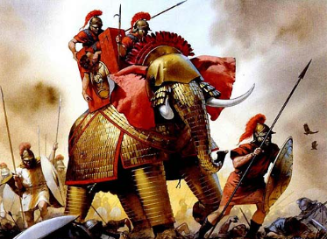

Slide 11
Elazar 162 BCE
Notes:
166 to 164 to liberate Jerusalem
Liberation Jerusalem, cleansed the Temple. Enacted Holiday ~Sukkot
Ever other situations like that?

Slide 12
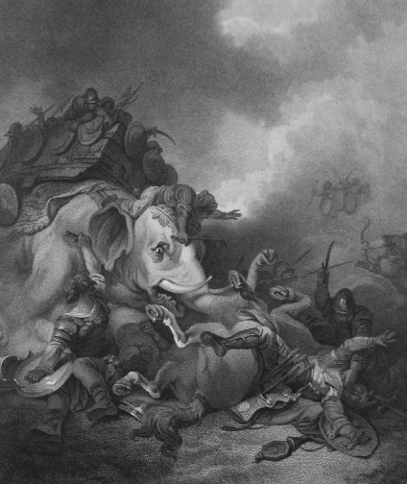
Eleazer (the younger brother of
Judah) died when he single-handedly
attacked a large elephant believed
to be carrying the enemy king I Mac 6:42-46)

Slide 13
“For over two thousand years we have dared to light miniature menorahs and display them outside our homes, not as an act of nostalgia, or an attempt to compete with Santa, but as an act of defiance.
Notes:
https://www.umjc.org/commentary/2022/12/16/what-would-the-maccabees-do

Slide 14
“On the subways and streets of New York City, Jewish people are attacked once every 16 hours. In the last few weeks, those attacks have increased in ferocity and in frequency, inspired by Kanye West and Kyrie Irving’s endorsements of
Notes:
https://www.umjc.org/commentary/2022/12/16/what-would-the-maccabees-do

Slide 15
“Black Hebrew Israelite ideology—which preaches that the “real” Jews are black Africans, and that we are the fakers.”
Notes:
https://www.umjc.org/commentary/2022/12/16/what-would-the-maccabees-do

Slide 16
from Chaim Malespin
Notes:
https://youtu.be/2drFrDZC2i8

Slide 17
^{Dan. 11.35} the people who know their God will stand firm and prevail. Those among the people who have discernment will cause the rest of the people to understand.
Notes:
Know their G-d. Discernment.
Wisdom. Likely first guerilla warfare in history.
What opposition do you face? What will be the price for us to maintain worship. How are we dedicated to the living God?

Slide 18
We are a people in Hanukkah mode. Jews and Gentiles, under threat…
Warfare…in danger of assimilation, extermination.

Slide 19
^{Dan. 11.35} The people who know their God will stand firm and prevail. Those among the people who have discernment will cause the rest of the people to understand.

Slide 21
^{2 Tim 3.1-5 NIV} Mark this: There will be terrible times in the last days. People will be…
[Seventeen characteristics …]
having a form of godliness but denying its power.

Slide 22
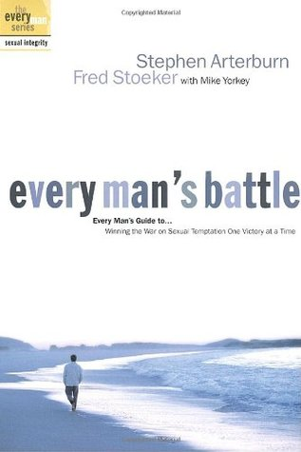
The infiltrator in our battle for survival as Jews and friends.
Everyman’s Battle
Notes:
https://www.goodreads.com/book/show/49064.Every_Man_s_Battle

Slide 23
Failed warfare…
#1

Slide 24
^{Shoftim Ju 16.20-21} She said, “Shimshon! The P’lishtim have come for you!” He awoke from his sleep and said, “I’ll get out this time, just as I shook myself loose before.” But he didn’t know that Adoni had left him.
Notes:
Why: loved a prostitute. Loved a woman in the valley of Sorek.

Slide 25
^{Shoftim Ju 16.20-21} So the P’lishtim seized him, gouged out his eyes and took him down to ‘Azah. There they bound him with two bronze chains and put him to work grinding grain at the mill in the prison.
Notes:
Great hero…lost dreaded locks wild pursuit of illicit sex gratification.

Slide 26
Failed warfare…
#2

Slide 27
^{Ber/Gen 35.22,25} It was while Isra’el was living in that land that Re’uven went and slept with Bilhah his father’s concubine, and Isra’el heard about it...The sons of Bilhah Rachel’s slave-girl were Dan and Naftali.
Notes:
Scripture makes no comment. But try to envision the upheaval. Two grown sons. Rape? Affair triggered by Yaakov/Israel’s neglect?
1738 BCE Adam Clarke
John Gill: though the crime was committed secretly, and was thought it would have been concealed, but by some means or other Jacob heard of it, and no doubt severely reproved his son for it; and though nothing is here related, as said by him on this occasion, it is certain it gave him great offence, grief and trouble, and he remembered it to his dying day, and took away the birthright from Reuben on account of it. Sifre infers Reuven repented.

Slide 28
^{Beresheet/Gen 37.21-22} But when Re’uven heard this [about Yosef], he saved him from being destroyed by them. He said, “We shouldn’t take his life. Don’t shed blood,” Re’uven added.
Notes:
1728 Clarke

Slide 29
^{Beresheet/Gen 37.21-22} “Throw him into this cistern here in the wilds, but don’t lay hands on him yourselves.” He intended to rescue him from them later and restore him to his father.

Slide 30
^{Beresheet/Gen 37.29-30} Re’uven returned to the cistern, and, upon seeing that Yosef wasn’t in it, tore his clothes in mourning. He returned to his brothers and said, “The boy isn’t there! Where can I go now?”
Notes:
Failed rescue. Why? Defiled by sexual sin.

Slide 31
Shimshon/ Samson was defeated because of sexual immorality. “Once Samson went to Gaza and eyed a prostitute there, so he went to her.” “After this, he fell in love with a woman who lived in the Sorek Valley, whose name was D’lilah.”
Rueven failed because of sexual immorality.
Notes:
Judges 16

Slide 32
We are in a war environment

Slide 33
Notes:
Scandals in the evangelical world harm us more than our enemies.

Slide 34
^{Mishlei/Prov 2.6, 16-19} For Adoni gives wisdom; from his mouth comes knowledge and understanding... They will save you from a woman who is a stranger, from a loose woman with smooth talk,

Slide 35
^{Mishlei/Prov 2.6, 16-19} who abandons the ruler she had in her youth and forgets the covenant of her God. Her house is sinking toward death, her paths lead to the dead. None who go to her return; they never regain the path to life.
Notes:
P 68 Proverbs by John Kitchen

Slide 36
^{Lynchburg, VA. Jan. 18, 2016} - A new study is revealing startling statistics concerning pornography use among both men and women, including those who identify as believers.
Notes:
https://www.churchmilitant.com/news/article/new-survey-of-porn-use-shows-startling-stats-for-men-and-women

Slide 37
64 percent, or two thirds, of U.S. men admit to viewing porn at least monthly
the number of believing men nearly equaling the national average.
Notes:
hthttps://www.churchmilitant.com/news/article/new-survey-of-porn-use-shows-startling-stats-for-men-and-women
tps://www.churchmilitant.com/news/article/new-survey-of-porn-use-shows-startling-stats-for-men-and-women

Slide 38
When divided by age "eight out of ten (79%) men between the ages of 18 and 30 view pornography at least monthly,
two thirds (67%) of men between the ages of 31 and 49 view pornography at least monthly.
One half of men between 50 and 68 looks at porn monthly."
Notes:
https://whttps://www.churchmilitant.com/news/article/new-survey-of-porn-use-shows-startling-stats-for-men-and-women
ww.churchmilitant.com/news/article/new-survey-of-porn-use-shows-startling-stats-for-men-and-women

Slide 39
The study claims three out of every 10 men between the ages of 18 and 30 are daily viewers of porn;
three percent of women in the same age group purportedly access pornography daily.
Notes:
httphttps://www.churchmilitant.com/news/article/new-survey-of-porn-use-shows-startling-stats-for-men-and-women
s://www.churchmilitant.com/news/article/new-survey-of-porn-use-shows-startling-stats-for-men-and-women

Slide 40
Among men and women who claim to be believers in Messiah, a stunning seven percent of males admit to viewing porn several times a day, compared to one percent among Christian females.
The number of married individuals who admit to viewing porn several times a day range from five percent of men to two percent of women.
Notes:
hthttps://www.churchmilitant.com/news/article/new-survey-of-porn-use-shows-startling-stats-for-men-and-women
tps://www.churchmilitant.com/news/article/new-survey-of-porn-use-shows-startling-stats-for-men-and-women

Slide 41
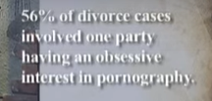
Notes:
https://www.churchmilitant.com/news/article/new-survey-of-porn-use-shows-startling-stats-for-men-and-women

Slide 42
The most recent study, looking at French men aged 18 and older, examines usage patterns, motivations for use, and possible effects of online sexual activity, and reaches important conclusions:
Notes:
https://www.psychologytoday.com/us/blog/love-and-sex-in-the-digital-age/201607/the-reasons-someone-looks-porn-matters-is-why

Slide 43
Porn use is by far the most common online sexual activity for adult males, engaged in by 99% of the study’s 434 participants.
Why so prevalent??
Notes:
https://www.psychologytoday.com/us/blog/love-and-sex-in-the-digital-age/201607/the-reasons-someone-looks-porn-matters-is-why

Slide 44
A study found that 73.8 percent of men who view porn do so hoping to alleviate stress.
One illustrative incident:
Notes:
https://www.psychologytoday.com/us/blog/love-and-sex-in-the-digital-age/201607/the-reasons-someone-looks-porn-matters-is-why

Slide 45
Roberto admitted that he was watching porn for two to three hours per day. “I go online after classes to unwind.”
Notes:
https://www.psychologytoday.com/us/blog/love-and-sex-in-the-digital-age/201607/the-reasons-someone-looks-porn-matters-is-why

Slide 46
He stated that his porn use started when he was 14. “My dad got out of prison right around them, and he was really angry. He was drunk all the time and yelling at my mom, so I would go in my room and lock the door and lose myself in porn for a few hours as a way to not hear or feel what was happening.”
Notes:
https://www.psychologytoday.com/us/blog/love-and-sex-in-the-digital-age/201607/the-reasons-someone-looks-porn-matters-is-why

Slide 47
Traditionally, men are associated with porn use, but the numbers show more women are consuming pornography than ever before. In the United States, 23 percent of this particular site's users are women, with 28 percent in Australia and 22 in the United Kingdom.
Notes:
https://www.churchmilitant.com/news/article/2015-porn-stats-show-alarming-trends1

Slide 48
People frequently view pornography NOT because they are aggressive abusers, rather they are wounded and seeking comfort.
Notes:
Safe, beautiful, pleasure giving people.

Slide 50
What is the remedy?
^{Mishlei/Prov 2.6, 16-19} Her house is sinking toward death, her paths lead to the dead. None who go to her return; they never regain the path to life.

Slide 51
Prayer
Praise
Scripture reading memorizing.
Address your emotional brokenness: shame, rejection, abandonment with counsel
Accountability partner [tech]
Notes:
Prayer: confession, repentance Yet Mission leader abused girls, and repented regularly.
Praise: key to mental, emotional health re abuse and trauma.
Scripture: fill mind with truth
Healing: ministries, community
Accountability: MOST IMPORTANT

Slide 52
^{Messianic Jews 13.4} Marriage is honorable in every respect; and, in particular, sex within marriage is pure. But God will indeed punish fornicators and adulterers.
Notes:
Marriage will not solve your problems. It’s a relationship where you go to GIVE blessing.

Slide 53
Reject the prevailing culture

Slide 54
The Cambridge Dictionary now defines a man as, “an adult who lives and identifies as male though they may have been said to have a different sex at birth.”
Notes:
https://www.charismanews.com/culture/90944-dictionary-stealthily-edits-definition-of-man-and-woman

Slide 55
The definition of a woman [now] reads, “an adult who lives and identifies as female though they may have been said to have a different sex at birth.”
A bit of biological truth…
Notes:
https://www.charismanews.com/culture/90944-dictionary-stealthily-edits-definition-of-man-and-woman

Slide 56
Here is the real definition:
We all have 46 chromosomes.
Twenty two are matched pairs.
One pair is either XY male or XX female.

Slide 57
Notes:
https://external-content.duckduckgo.com/iu/?u=https%3A%2F%2Fimage1.slideserve.com%2F1834532%2Fchromosomes-l.jpg&f=1&nofb=1&ipt=839bc8a4e95032dd3e10b34ff40e6d35b7bd5b789d3e2e53be7900b7cbf56654&ipo=images

Slide 58
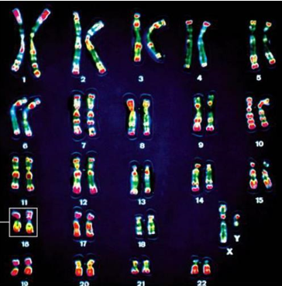
An XY male
Notes:
https://external-content.duckduckgo.com/iu/?u=https%3A%2F%2Fimage1.slideserve.com%2F1834532%2Fchromosomes-l.jpg&f=1&nofb=1&ipt=839bc8a4e95032dd3e10b34ff40e6d35b7bd5b789d3e2e53be7900b7cbf56654&ipo=images

Slide 59
Some aberrations:

Slide 60
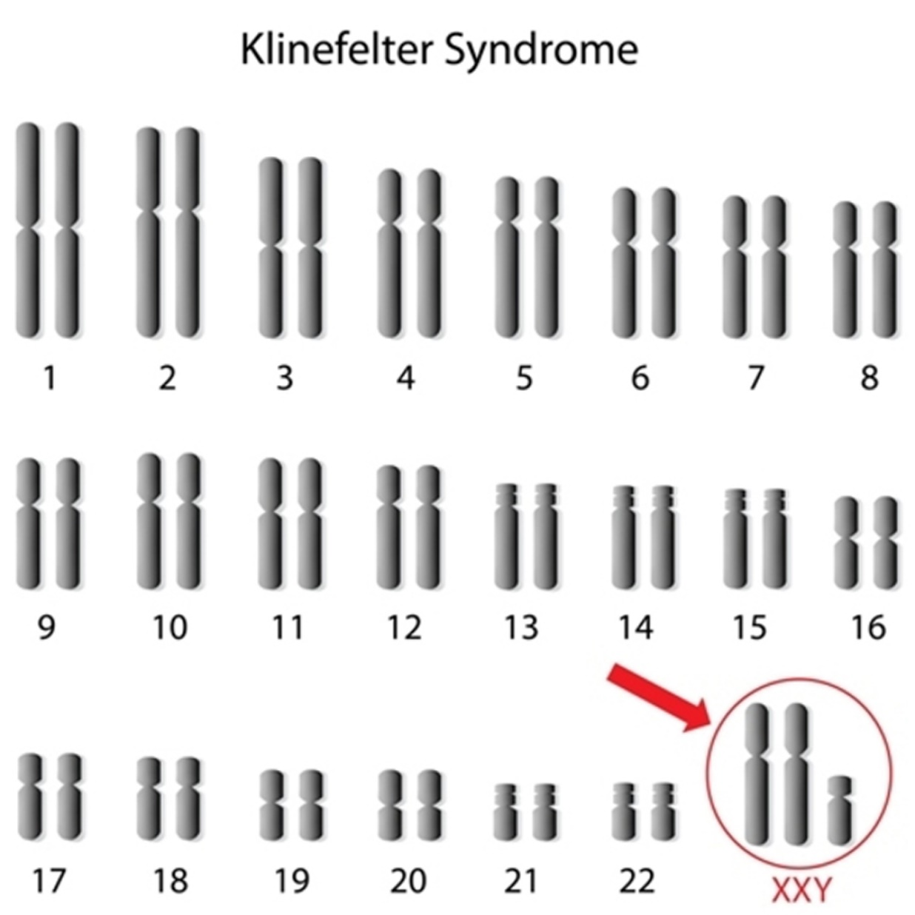
Klinefelter syndrome occurs if boys are born with an extra X chromosome.
Notes:
https://healthjade.com/klinefelter-syndrome/

Slide 61
Klinefelter syndrome is a genetic condition that affects males physical, behavioral, and cognitive development and functioning. Boys and men with Klinefelter syndrome are still genetically male and often will not realize they have this extra X chromosome.
Notes:
https://healthjade.com/klinefelter-syndrome/

Slide 62
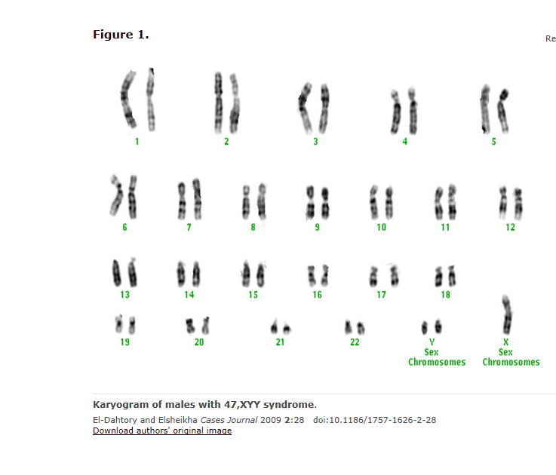
XYY
Notes:
https://external-content.duckduckgo.com/iu/?u=http%3A%2F%2Fembryology.med.unsw.edu.au%2Fembryology%2Fimages%2Fa%2Fa2%2FKaryogram_of_male_with_47%252C_XYY_Syndrome.png&f=1&nofb=1&ipt=dff7e968900457355da973e6cceeefad4867b6cc45d07806cb3c7aa897e4a077&ipo=images

Slide 63
It was sometimes called the super-male disease because men with this syndrome were thought to be overly-aggressive and lacking in empathy. Recent studies have shown that this is not the case. Although individuals with XYY syndrome have an increased risk for learning disabilities and behavioral problems, they are not overly aggressive
Notes:
https://rarediseases.org/rare-diseases/xyy-syndrome/

Slide 64
There are 30 trillion cells in the human body. In normal development, they ALL have the same chromosomes containing the same DNA.
You are male or female 30 trillion times. CANNOT be transitioned!

Slide 65
There is abuse, rejection [A & B],
Deprivation, pain. But, there is redemption.
Close on a positive aspect…

Slide 66
I came into the kingdom in chaotic times: rejection norms of marriage, business, culture.
Transformed by radical new births of unlikely candidates.
I’m stuck there.
radical new birth.

Slide 67
Radical new birth with talmidut/ discipleship will ultimately address the ills of society with Messiah’s love.
Prayer
Bible study
Community praise, learning, confession, serving others.
Notes:
Memorization, commentaries, Hebrew, Greek, history, science

Slide 69
We have a Zoom meeting at 9 p.m. Thursday weekly. The group has been brainstorming possible events, and the following are in the works.
1. Mishloakh Manot - Saturday, March 4 (prep day February 25)

Slide 70
​2. ​Tuesday, May 9: Lag B'Omer bonfire - clarify that it's not occult (in lieu of Teerosh, but add prayer as a component) A Different Lag B'Omer
3. Sunday, May 28: Shavu'ot/Memorial Day Music Festival on our property with band stand back facing the street.

Slide 71
​4. Sunday, October 1, 2023: Sukkot Music Festival on our property

Slide 72
^{Mtt. 28.18-21}Yeshua came and talked with them. He said, “All authority in heaven and on earth has been given to me. Therefore, go and make people from all nations into talmidim, immersing them into the reality of the Father,

Slide 73
^{Mtt. 28.18-21} the Son and the Ruach HaKodesh, and teaching them to obey everything that I have commanded you. And remember! I will be with you always, yes, even until the end of the age.”

Slide 74
Do you KNOW Yeshua and drinking the water of LIFE?
Are you hearing daily from His Word?
How are you applying what you heard?
Are you offering that water of life to anyone?

