Slide 1
e-handout
To have these notes
without taking notes
Go to OrHaOlam.com
Click on Messages tab,
2022 Messages
Notes:
You may notice that I’m slowing down in my rate of speech. This is because we may be getting language translation equipment for simultaneous translation.

Slide 2
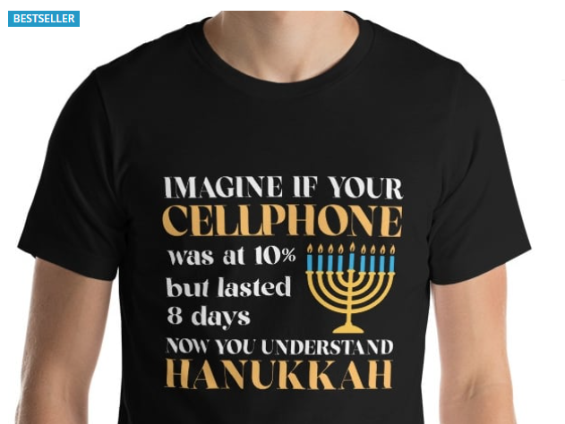
Notes:
https://www.judaicawebstore.com/hanukkah-miracle-t-shirt
Understand the candle part, not the real story, but the most public one

Slide 3
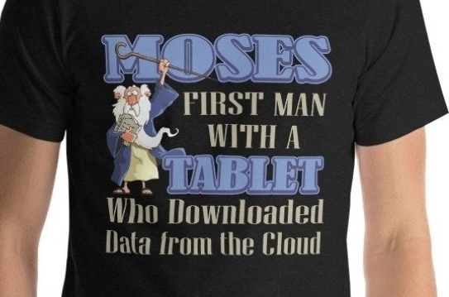
Notes:
https://www.judaicawebstore.com/moses-first-man-to-download-from-the-cloud-fun-jewish-t-shirt

Slide 4
Last Shabbat the message was on our experience of G-d, as the title said “Tasting the Presence.”

Slide 5
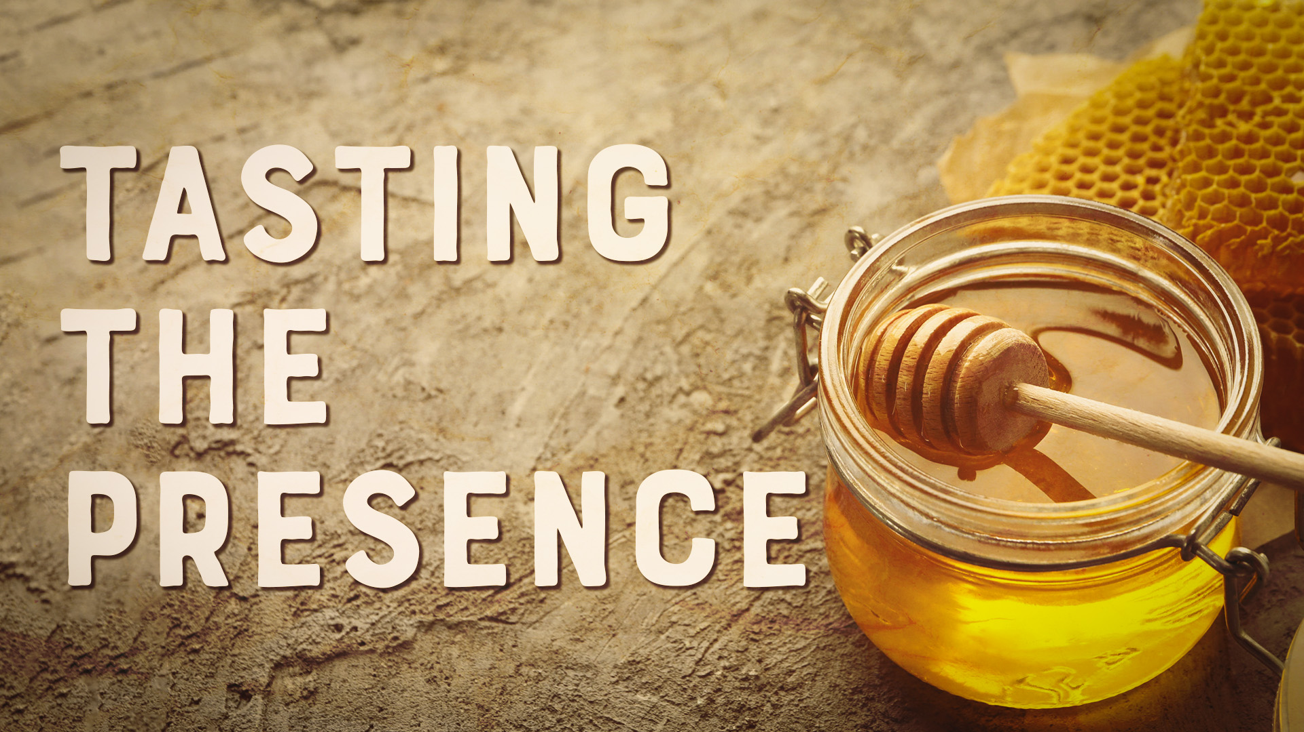

Slide 6
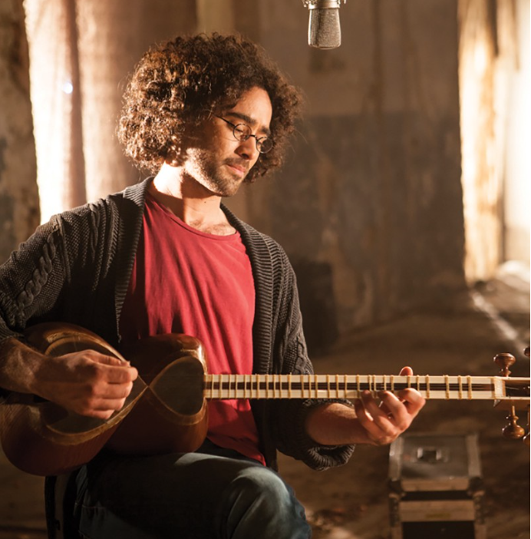
Yaron Cherniak - ירון צ'רניאק
Notes:
Apparently a Millennial

Slide 7
Notes:
My “liquid love” statement.

Slide 9
This Shabbat I feel I need to present the opposite side: the actions and intentions of G-d to us, of the three in one acting toward us. G-d’s heart, as much as we can enter His realm.

Slide 10
^{T’hillim/Ps 67. 7} The earth has yielded its harvest; may God, our God, bless us.
יְבָרְכֵנוּ אֱלֹהִים אֱלֹהֵינוּ.
Notes:
Parallelism is normal Hebrew poetry, but any implications?
Why doubled? Apparently to emphasize that he is OURS!

Slide 11
The earth has yielded its harvest;
may God, our God, bless us.
יְבָרְכֵנוּ אֱלֹהִים אֱלֹהֵינוּ.

Slide 12
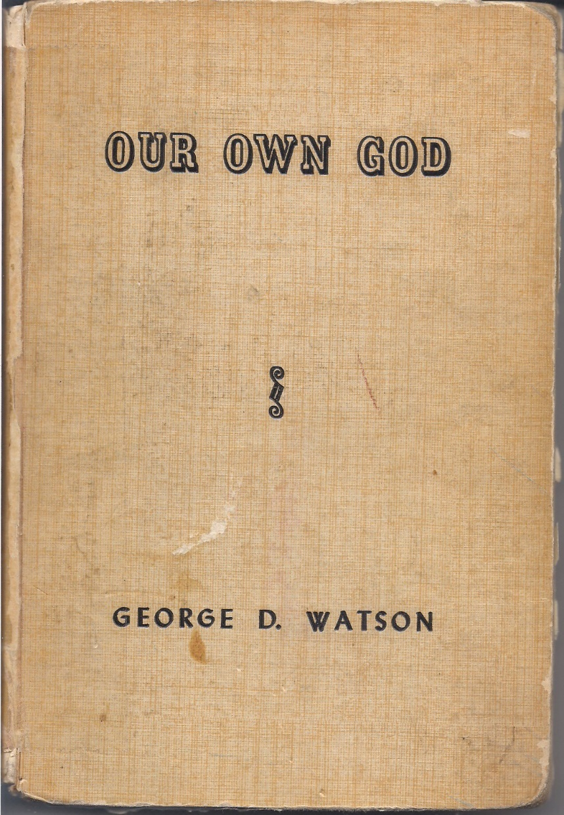
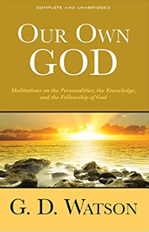
https://www.amazon.com/Our-Own-God-
G-Watson/dp/1937428710
Notes:
Jan. 15,1904 date on author’s preface. G.D.Watson 1845-1924 Wesleyan Methodist
https://www.amazon.com/Our-Own-God-G-Watson/dp/1937428710

Slide 13
G-d is our nearest relative.
^{Yn.17.22-23} The glory which you have given to me, I have given to them; so that they may be one, just as we are one — I united with them and you with me, so that they may be completely one,

Slide 14
G-d is our nearest relative.
^{Yn.17.22-23} and the world thus realize that you sent me, and that you have loved them just as you have loved me.

Slide 15
God is our nearest relative.
Created us
He is upholding all that exists by his powerful word ^{MJ 1.3}
Knows us thoroughly
We can know Him >> any person.
Notes:
Cf cousins, know our story.
2. A perpetual act of creative love sustaining us from falling back into the dark gulf of non-existence.
^{Acts 17.28} ‘In Him we live and move and have our being.’

Slide 16
A. We know G-d through our love nature.
^{1 Cor 8.2-3} The person who thinks he “knows” something doesn’t yet know in the way he ought to know. However, if someone loves God, God knows him.

Slide 17
^{1 Yn 4.15} God is love. Now whoever abides, dwells in love abides in God, and God abides in Him.
The earth has yielded its harvest; may God, our God, bless us.
יְבָרְכֵנוּ אֱלֹהִים אֱלֹהֵינוּ.
Notes:
When love comes into action, it seizes upon the object, says “It’s my own.” He is our own by our love relationship.

Slide 18
The earth has yielded its harvest;
may God, our God, bless us.
יְבָרְכֵנוּ אֱלֹהִים אֱלֹהֵינוּ.

Slide 19
B. G-d is our own in a peculiarly individual way.
We have a private soul, walled off from all other creatures.
No one thinks like you.
G-d is our only total traveling companion. Knows all, loves.
We are at the horizon’s center.
Notes:
P 4 Our Own G-d
Except for Elon Musk’s proposed neural link!
We always minors, no sending off
P 6a&b Our Own G-d

Slide 20
C. We can only know G-d in conformity to His infallible Word.
^{Yeshayahu/Is 8.20} To Torah and to the document! לְתוֹרָה וְלִתְעוּדָה If they do not speak according to this word, it is because they have no light.
Notes:
I’ve been to some meeting of groups that have extra holy books, or deny some books of the Bible, and there is a glow, but it’s different.
When people say, “G-d told me” I hesitate.
Leslie Wilcox at Bible School said danger of violating 3rd Commandment. Everything needs to be confirmed. “Try the spirits, prove all things.” Better to say, “I feel G-d said” “I really thing G-d said.”

Slide 21
^{Yn 14.23} Yeshua answered him, “If someone loves me, he will keep my word; and my Father will love him, and we will come to him and make our home with him.
Notes:
Of course this is conditional. You can’t be viewing or imagining porn, or living in sin, but if our heart is toward G-d, consider this promise!!

Slide 22
D. Serving G-d out of duty or serving out of love is a continuum.
^{Song of Songs 2. 3-4} In his shadow I delighted to sit, and his fruit was sweet to my taste. He has brought me to the banquet house and his banner over me is love.
Notes:
G-d loves to be loved. P 10

Slide 23
E. When people are yielded to G-d there is communication of great joy.

Slide 24
^{Lk 10.17-18} The seventy came back jubilant. “Lord,” they said, “with your power, even the demons submit to us!” …Yeshua said to them, “Nevertheless, don’t be glad that the spirits submit to you; be glad that your names have been recorded in heaven.”

Slide 25
^{Lk 10.21} At that moment he was filled with joy by the Ruakh HaKodesh and said, “Father, Lord of heaven and earth, I thank you because you concealed these things from the sophisticated and educated, yet revealed them to ordinary people. Yes, Father, I thank you that it pleased you to do this.”
Notes:
Only place Yeshua is described as joyful.

Slide 26
F. G-d’s love is expressed in persons.
^{Yn 3.16-18} For God so loved the world that he gave his only and unique Son, so that everyone who trusts in him may have eternal life, instead of being utterly destroyed.
Notes:
Our Own G-d p.15a

Slide 27
everyone who trusts
pás ("each, every") means "all" in the sense of "each (every) part that applies." The emphasis of the total picture then is on "one piece at a time."
Notes:
Group covenant, but not group salvation
Our Own G-d p.15b

Slide 28
F. G-d’s love is expressed in persons.
^{Yn 3.16-18} For God did not send the Son into the world to judge the world, but rather so that through him, the world might be saved. Those who trust in him are not judged;

Slide 29
F. G-d’s love is expressed in persons.
^{Yn 3.16-18} those who do not trust have been judged already, in that they have not trusted in the one who is God’s only and unique Son.
Notes:
This is how I came to understand hell and eternal punishment. We know we are corrupt. “Condemned already.”

Slide 30
G. G-d’s love is unimaginable, since we are filled with unbelief.
^{Eph.3.19-20} The love of Messiah which surpasses knowledge...far beyond all that we ask or imagine, by means of His power that works in us.
Notes:
I love astronomy, and to read about quasars, pulsars, black holes. I read one scientists saying that the universe is not just stranger than we imagine, it’s stranger than we can imagine.
So G-d love in Messiah is not only stronger than we imagine, but we are such creatures of selfishness and easy wounds. Messiah’s love is stronger than we can imagine

Slide 31
^{1 Cor 2.9} As the Tanakh says, “No eye has seen, no ear has heard and no one’s heart has imagined all the things that God has prepared for those who love him.”
Notes:
P 20

Slide 32
When the first atomic bomb was tested, it was a realm unimaginable. Los Alamos scientists had even discussed the possibility that the atmosphere itself might be ignited and the entire earth annihilated but dismissed this as an unlikely possibility.
Notes:
https://www.osti.gov/opennet/manhattan-project-history/Events/1945/trinity_safety.htm

Slide 33
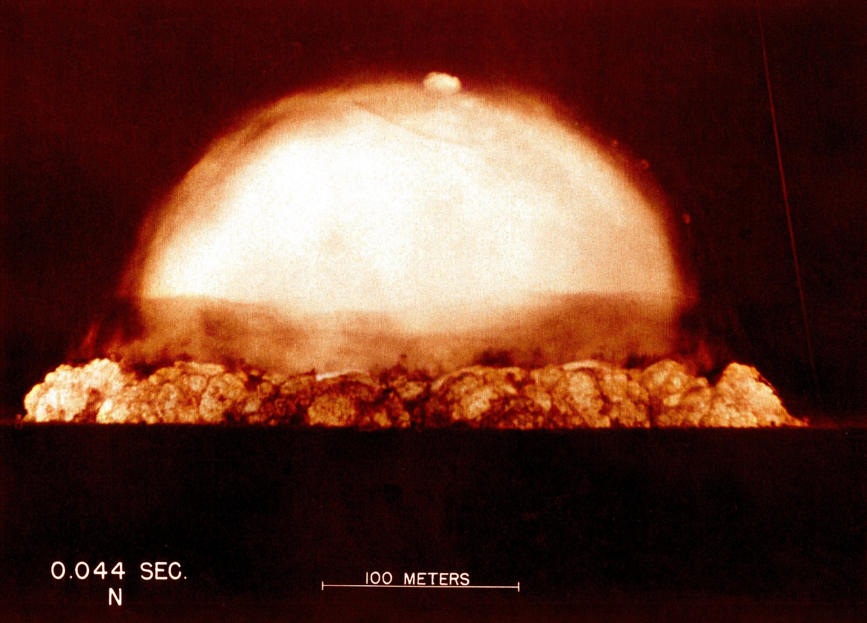
The world enters the nuclear age.
Trinity test fireball, 0.044 seconds
after detonation. July 16, 1945
Notes:
https://external-content.duckduckgo.com/iu/?u=https%3A%2F%2Fexternal-preview.redd.it%2F8gIEDeYZ72DhacVblYGVgcUbbDMxsaY0CfHoNY7w2U0.jpg%3Fauto%3Dwebp%26s%3D338e885e3bd7cee587bc88ef3d8dc60e75f7b919&f=1&nofb=1&ipt=eca38c8840befa091f4d651eb7474f9be4eea4892b6345409160cf038a832dfe&ipo=images
But they did it anyway and all the O₂ was not sucked out of the earth.
G-d’s love is beyond knowing.

Slide 34
How G-d loves us

Slide 35
1. G-d loves us with a creative love. We cannot imagine the feelings of creation ex nihilo
Notes:
We create art, inventions, but really adaptations. Steve Jobs: Macintosh, mouse, iPod, iPhone.

Slide 36
דוּכִיפַת dukheefat
Hoopoes (hu-pu) are colorful birds found across Africa, Asia, and Europe, notable for their distinctive "crown" of feathers.
Notes:
https://en.wikipedia.org/wiki/Hoopoe

Slide 37
דוּכִיפַת
In Jewish tradition, a Hoopoe led King Solomon to meet the Queen of Sheba, which may help explain why in 2008, the Hoopoe won a popular vote to become the national bird of Israel.
Notes:
https://www.meltingpointathens.com/what-is-israel-national-bird/

Slide 38
The hoopoe has two basic requirements of its habitat: bare or lightly vegetated ground on which to forage and vertical surfaces with cavities (such as trees, cliffs or even walls, nestboxes, haystacks, and abandoned burrows
Notes:
https://en.wikipedia.org/wiki/Hoopoe

Slide 39
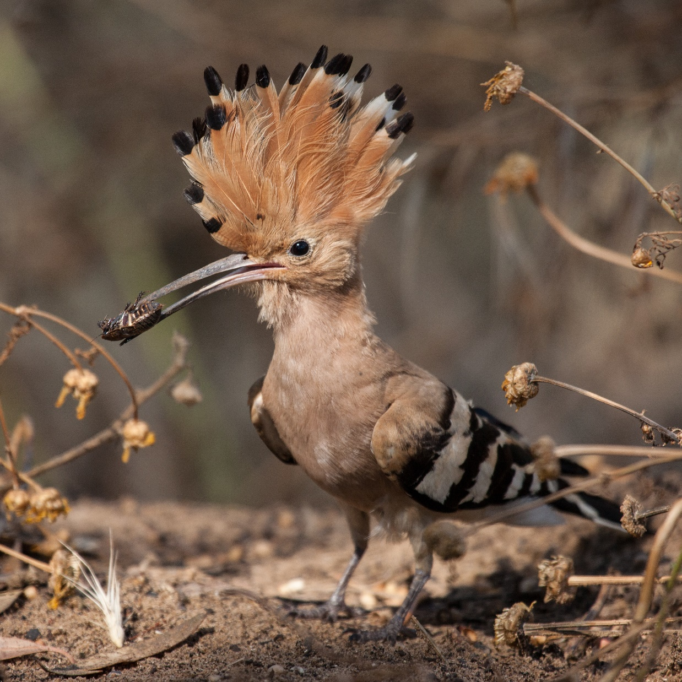
The diet of the hoopoe includes many species considered by humans to be pests, such as the pupae of the processionary moth, a damaging forest pest. For this reason the species is afforded protection under the law in many countries
Notes:
https://upload.wikimedia.org/wikipedia/commons/4/4f/Hoopoe_with_insect.jpg

Slide 40
1. G-d loves us with a creative love. We cannot imagine the feelings of creation ex nihilo and continual sustainment.
^{Col. 1.17} He exists before everything, and in Him all holds together.
Notes:
We don’t continually will the continued existence of our children. Strong nuclear force, holding protons together, not explained.
21

Slide 43
2. G-d loves us with an eternal love.
^{Yer 31.2-4} “The people escaping the sword found favor in the desert — I have brought Isra’el to its rest.” From a distance Adonai appeared to me,

Slide 44
[saying,] “I love you with an everlasting love;

Slide 45
^{Yer 31.2-4} this is why in my grace I draw you to me. Once again, I will build you; you will be rebuilt, virgin of Isra’el. Once again, equipped with your tambourines, you will go out and dance with the merrymakers.
Notes:
^{Eternal love}

Slide 46
^{Yer 31.2-4} Once again, you will plant vineyards on the hills of Shomron, and those doing the planting will have the use of its fruit.

Slide 47
3. G-d loves us with all His heart.
The Shma is our reciprocating what G-d already does.
^{Ro 5.6-9} For while we were still helpless, at the right time Messiah died for the ungodly. For rarely will anyone die for a righteous man—though perhaps for a good man someone might even dare to die.

Slide 48
3. G-d loves us with all His heart.
^{Ro 5.6-9} But God demonstrates His own love toward us, in that while we were yet sinners, Messiah died for us. How much more then, having now been set right by His blood, shall we be saved from God’s wrath through Him.
Notes:
OOG 23a&b

Slide 49
4. G-d loves us personally, individually.
^{Yeshayahu/Is 43.1-3} But now, thus says Adoni— the One who created you, O Jacob, the One who formed you, O Israel: “Fear not, for I have redeemed you, I have called you by name, you are Mine.
Notes:
So many marks of individuality: fingerprint, retina, voice print, palm wrinkles, facial recognition, way walk, 26
Plus inner world thoughts, loves, yearnings. G-d only one knows all that.

Slide 50
^{Yeshayahu/Is 43.1-3} When you pass through the waters, I will be with you, or through the rivers, they will not overflow you. When you walk through the fire, you will not be burned, nor will the flame burn you. For I am Adoni your God, the Holy One of Israel, your Savior.

Slide 51
5. G-d loves us constantly.
6. G-d loves us with a rewarding, crowning love.
Creation, sustainment, redemption, reward
Notes:
28

Slide 52
1 – The incorruptible crown: “And everyone who competes for the prize is temperate in all things. Now they do it to obtain a perishable crown, but we for an imperishable crown.” – ^{1 Cor 9:25.}

Slide 53
2 – The crown of rejoicing: “For what is our hope, or joy, or crown of rejoicing? Is it not even you in the presence of HaAdon our Lord Yeshua the Messiah at His coming? For you are our glory and joy.” – ^{1 Thes 2:19, 20.}

Slide 54
3 – The crown of righteousness: “Finally, there is laid up for me the crown of righteousness, which the Lord, the righteous Judge, will give to me on that Day, and not to me only but also to all who have loved His appearing.” – ^{2 Timothy 4:8}

Slide 55
4 – The crown of life: ^{Yaakov 1:12} “Blessed is the man who endures temptation; for when he has been approved, he will receive the crown of life which the Lord has promised to those who love Him.”

Slide 56
5 – The crown of glory: “And when the Chief Shepherd appears, you will receive the crown of glory that does not fade away.” – ^{1 Kefa/Peter 5:4}

Slide 57
The earth has yielded its harvest;
may God, our God, bless us.
יְבָרְכֵנוּ אֱלֹהִים אֱלֹהֵינוּ.

Slide 58
Do you KNOW Yeshua and the Father as our own G-d?
Are you hearing daily from His Word?
How are you applying what you heard?
Are you offering that water of life to anyone?

