Slide 1
e-handout
To have these notes
without taking notes
Go to OrHaOlam.com
Click on Messages tab,
2022 Messages

Slide 2
Lesson from a horse stable

Slide 3
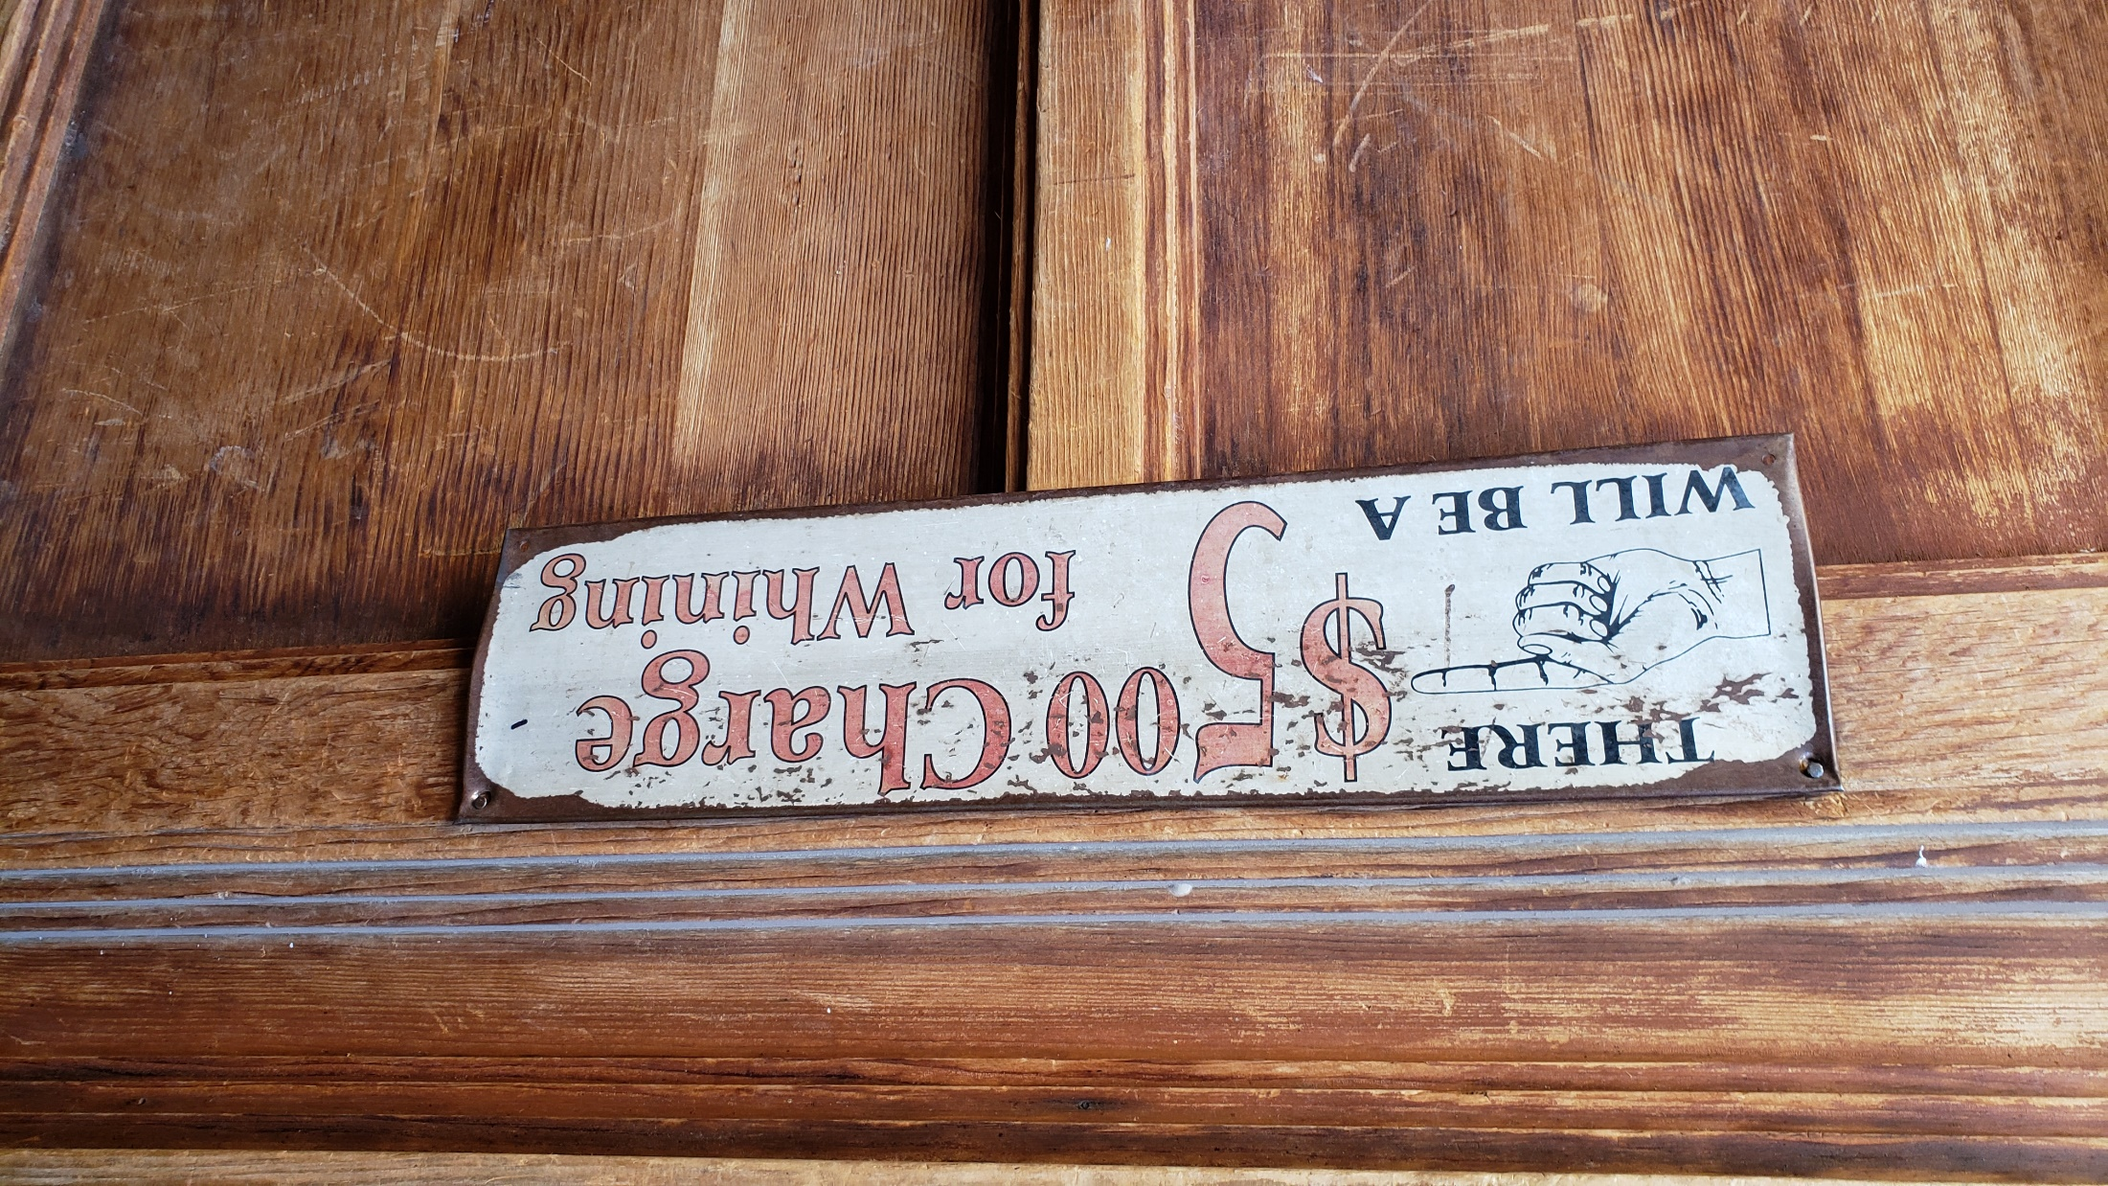

Slide 5
New recognition for the
Messianic Community

Slide 6
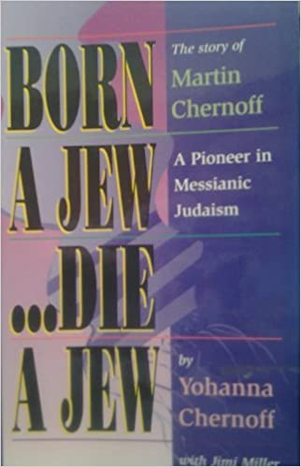
Born a Jew...Die a Jew,
the story of Martin Chernoff- A Pioneer in Messianic Judaism
Notes:
Partially now true in the military culture…

Slide 7
Notes:
From Gavriel Rennels, retired military, dear Or HaOlamnik.

Slide 9
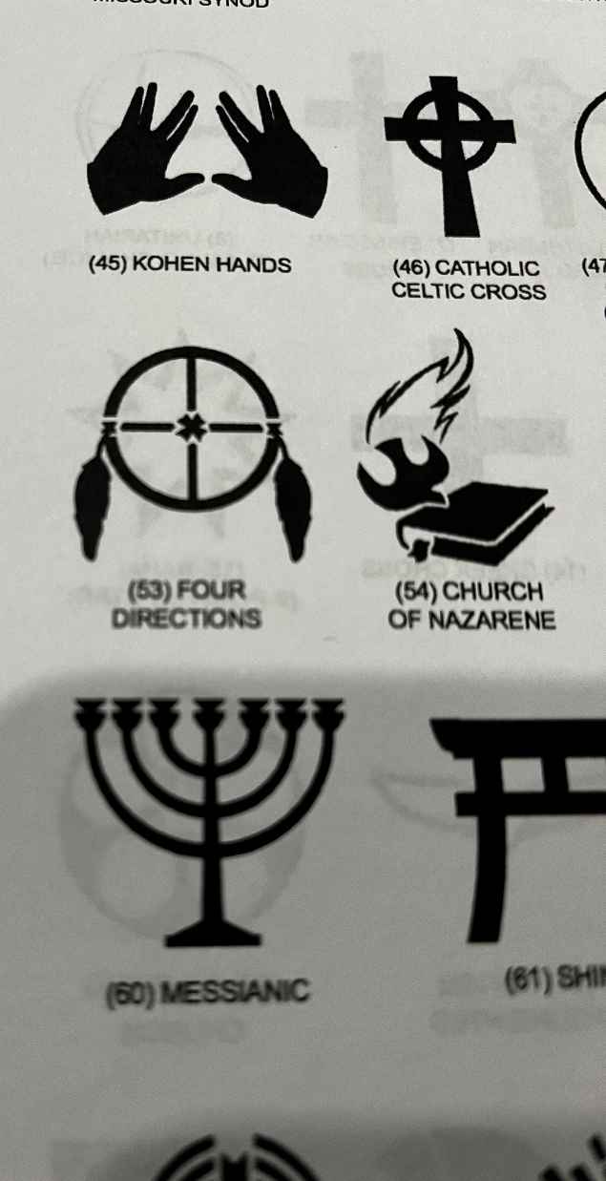
Notes:
So, if you were born a Jew, you can now die as a recognized Messianic Jew, with headstone, at least in a military cemetery.

Slide 10
I have found my true passion…
[other than the Kingdom of Messiah]

Slide 11
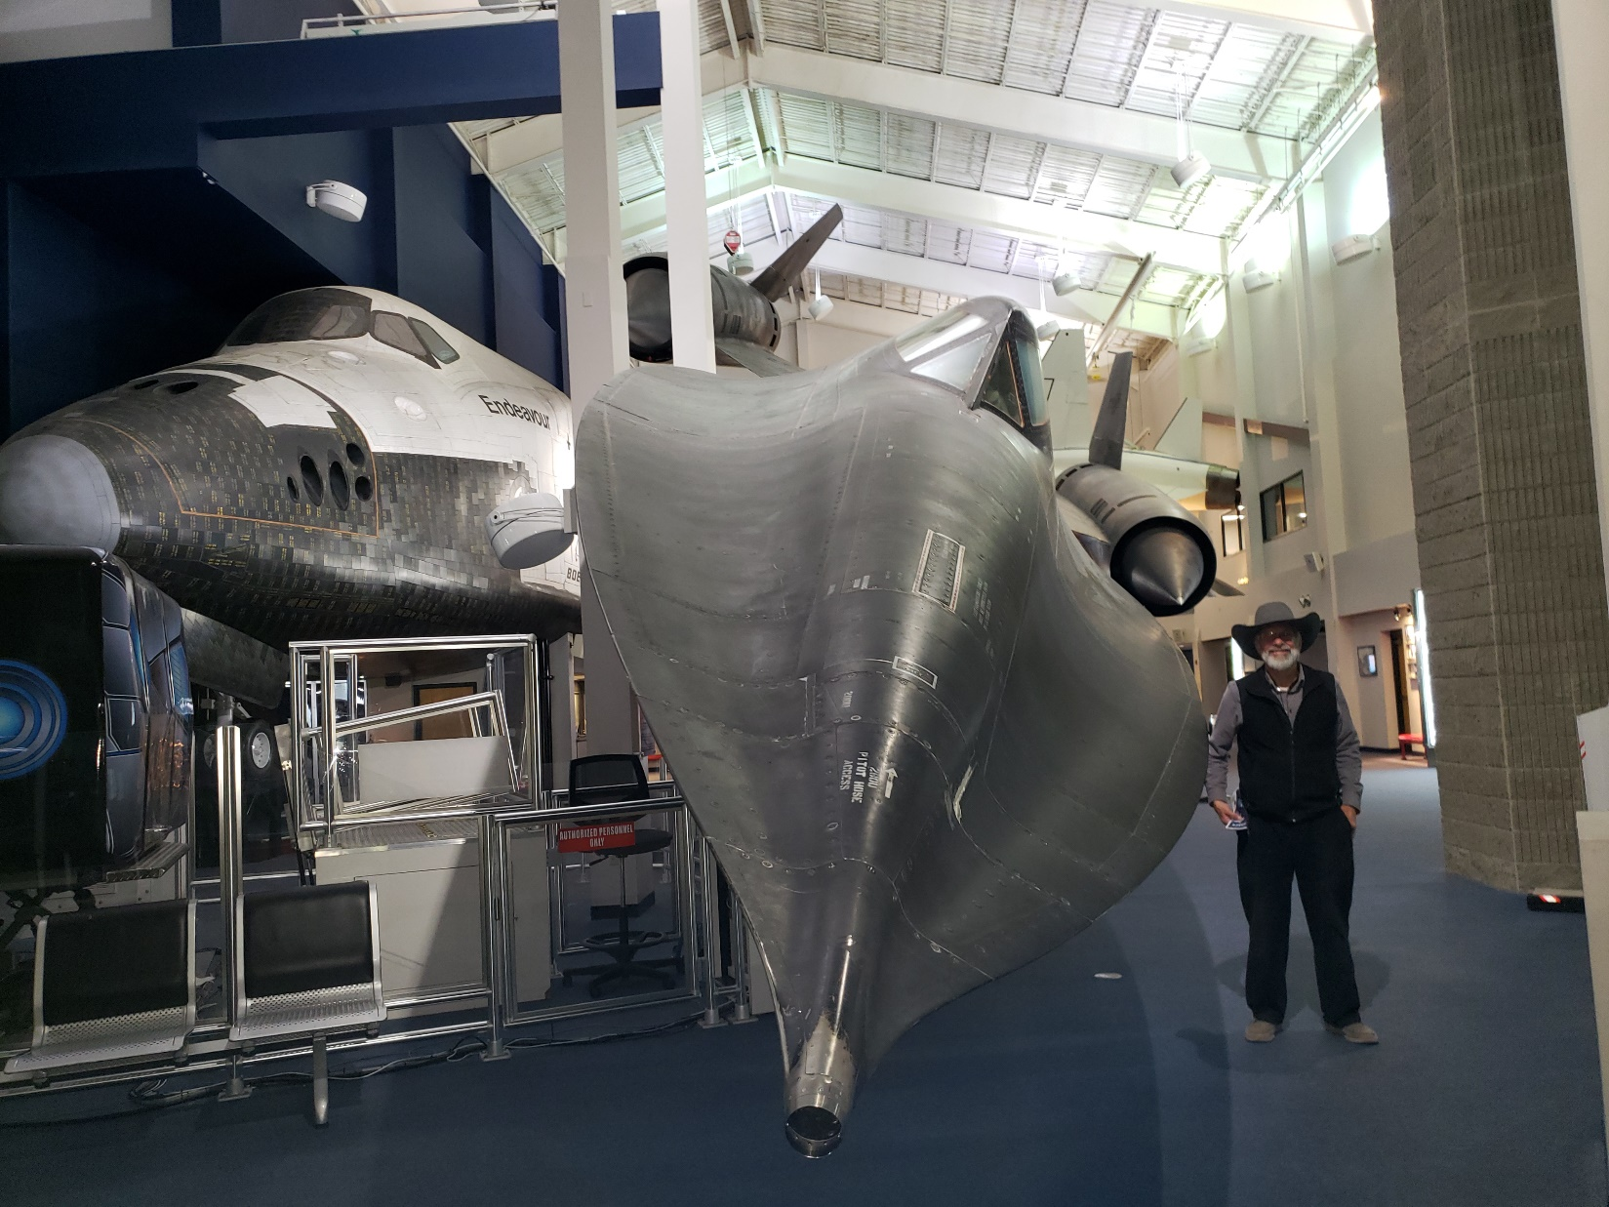
A real
SR-71
Blackbird
85,000 feet ceiling.
Mach 3 = 2,300 mph.
Notes:
85,000 ft = 17 miles up. Cf commercial aircraft at 7 miles. At the Hutchinson Kansas Cosmosphere.
It could outrun anti-aircraft missiles. Height of the Cold War, Pres Reagan had them buzz a Communist leadership conference. No Soviet plane could touch them.
Isn’t that a breathtaking beauty?
Most of you have heard that I’m a frustrated astronaut!
Plus a mock up space shuttle.

Slide 12
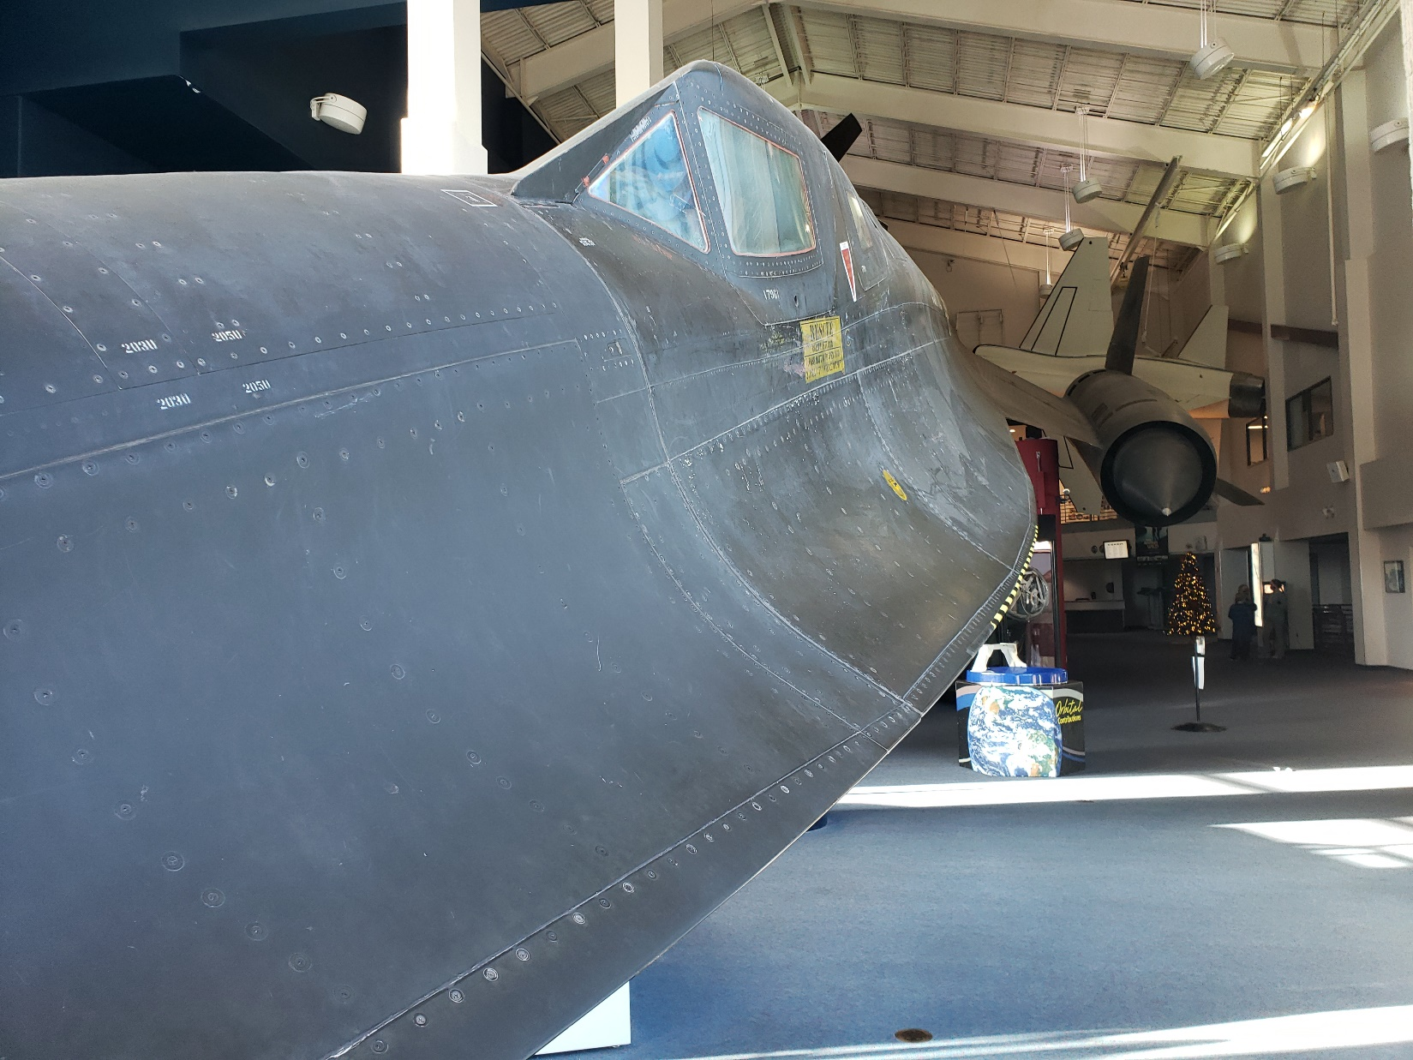

Slide 13
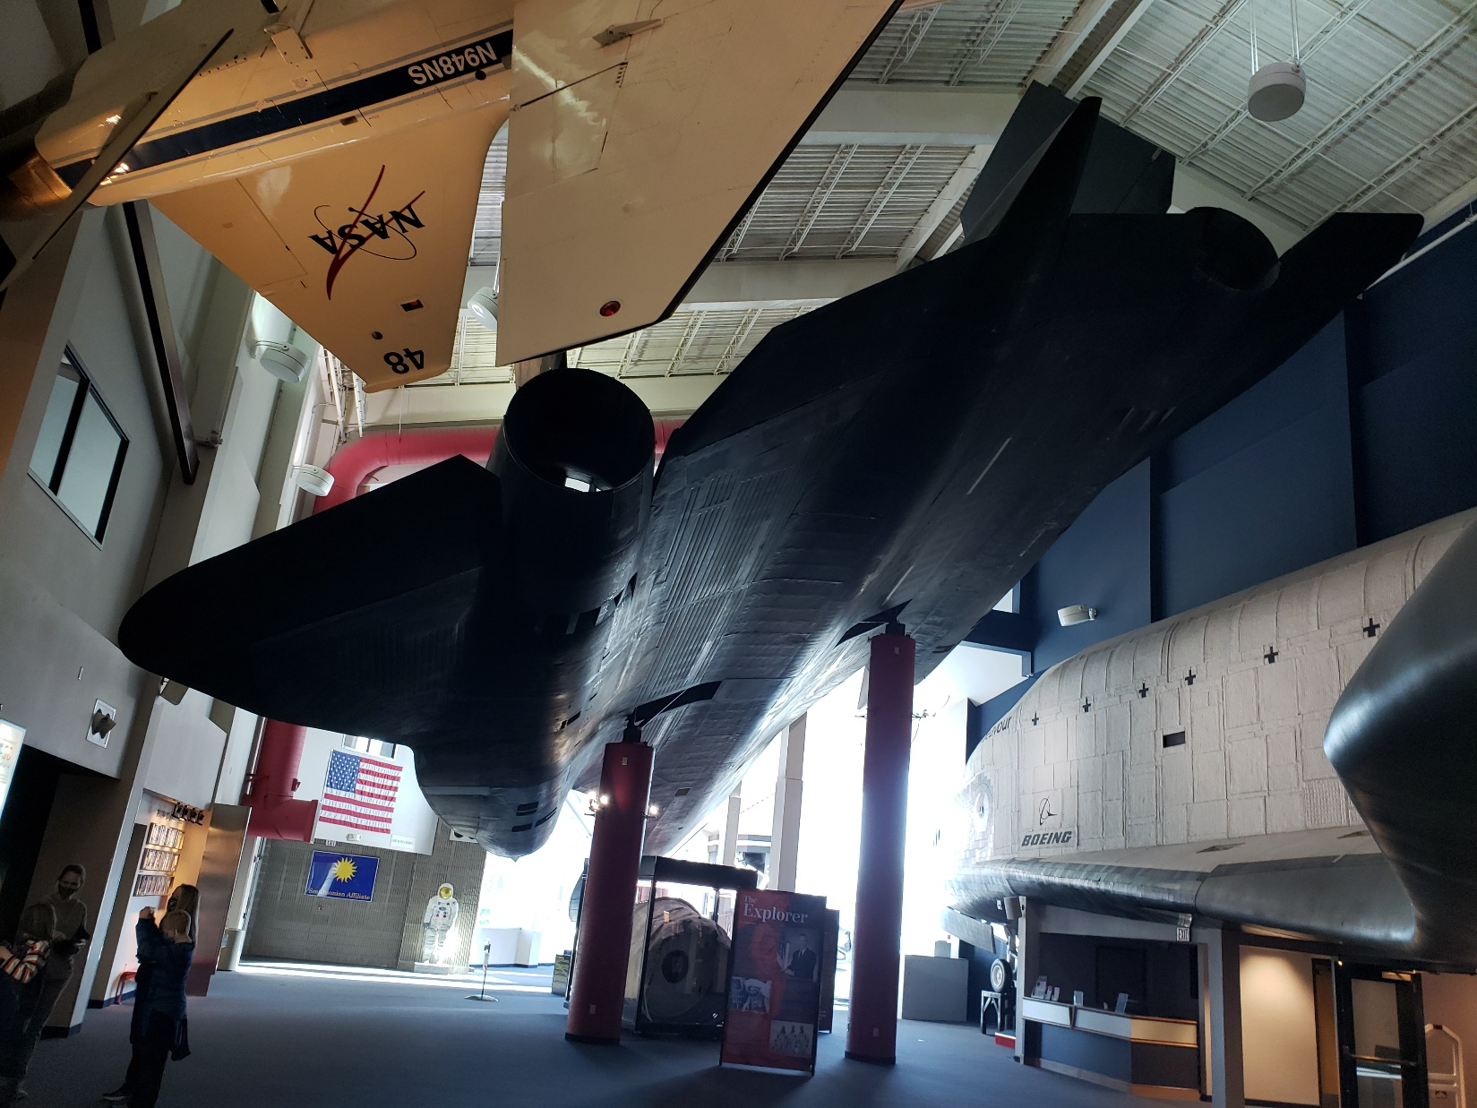
Notes:
Show you something HIGHER, more Powerful.

Slide 15
^{MJ/ Heb 10.11-14} Indeed, every kohen/priest stands day by day serving and offering the same sacrifices again and again, which can never take away sins. But on the other hand, when this One offered for all time a single sacrifice for sins,

Slide 16
^{MJ/ Heb 10.11-14} He sat down at the right hand of God— waiting from then on, until His enemies are made a footstool for His feet. For by one offering He has perfected forever those being made holy.
Notes:
This verse, in whole or part, is quoted ~7 times in the Messianic scriptures/New Testament. It describes the MOST extensive, longest enduring, activity Yeshua did and does. There are GREAT lessons for us. Higher, more powerful!!
Accessed by His one offering. Higher and faster than my SR-71 jet. Halleluyah!
[Pray!]
At the right hand, place of the Queen, co-regent.
Footstool~ feet on necks of enemies.

Slide 17
Yeshua has been there
for ~2000 years!
Notes:
We talk about dying with Messiah, being resurrected with Him.
Consider being ascended with Yeshua!

Slide 18
^{Col 3.1-4} Therefore, if you have been raised up with Messiah, keep seeking the things above—where Messiah is, sitting at the right hand of God. Focus your mind on things above, not on things on the earth.

Slide 19
^{Col 3.1-4} For you have died, and your life is hidden with Messiah in God. When Messiah, who is your life, is revealed, then you also will be revealed with Him, in glory!
Notes:
We are NOT promised to get glory in this life! We ARE promised a hidden life of joy, and future glory.
Often messages on dead with Messiah, risen with Messiah. This about ascended with Messiah!

Slide 20
What is up there, objects and activities, for us to focus our attention on, enter into?

Slide 22
Right hand of G-d [flying higher!]
Intercession for us and by us!
Notes:
Like Kefa/Peter: “I have prayed for you, that you faith doesn’t fail.” Morning watch, or later if needed. I found all the coffee spots when in a certain sales job.

Slide 23
^{Ro 8.34-35} Messiah Yeshua who died, and moreover was raised, and is now at the right hand of God and who also intercedes for us. Who shall separate us from the love of Messiah? Shall tribulation, or distress, or persecution, or famine, or nakedness, or danger, or sword?
Notes:
You are with him a co-regent. “if we are children, then we are also heirs, heirs of God and joint-heirs with the Messiah — provided we are suffering with him in order also to be glorified with him.”
Teerosh, other prayer, is more exhilarating than a SR 71!

Slide 24
^{Acts 2.32-36} “This Yeshua God raised up—we all are witnesses! Therefore, being exalted to the right hand of God and receiving from the Father the promise of the Ruakh ha-Kodesh, He poured out this—what you now see and hear. For David did not ascend into the heavens;

Slide 25
^{Acts 2.32-36} yet he himself says, ‘Adoni said to my Lord, “Sit at my right hand, until I make Your enemies a footstool for Your feet.”’ “Therefore let the whole house of Israel know for certain that God has made Him—this Yeshua whom you had executed —both Lord and Messiah!”
Notes:
Us being filled with the Spirit makes His enemies His footstool.
Verse that is the source of this concept...

Slide 26
^{T’hillim/Ps 110 1.3} A psalm of David. Adoni declares to my Lord: “Sit at My right hand until I make your enemies a footstool for Your feet.” Adoni will extend your mighty rod from Zion: “Rule in the midst of your enemies.” Your people will be a freewill offering in a day of your power.
Notes:
Rule in the midst of your enemies: Ester in the midst Persian power. Freewill offering. Greg’s wonderful message on love and sacrifice. Supplemented from Asher Intrater.
This is quoted in 1 Cor 15…

Slide 27
^{1 Cor 15.25-27} For he has to rule
Notes:
to be king, reign
He is ruling NOW, as we intercede! Doesn’t look like it, but it is!

Slide 28
^{1 Cor 15.25-27} until he puts all his enemies under his feet. The last enemy to be done away with will be death, for “He put everything in subjection under his feet.
Notes:
This Ps 110 verse quoted lots.
Application to Teerosh modality…

Slide 29
^{T’hillim/Ps 149.2-8} Let the children of Zion be glad in their King. Let them praise His Name with dancing. Let them sing praises to Him with tambourine and harp… Let God’s high praises be in their mouth
Notes:
Dance and praise and song lyrics and melody is warfare! Higher and more powerful!

Slide 30
^{T’hillim/Ps 149.2-8} and a two-edged sword in their hand— to execute vengeance upon the nations and rebukes on the peoples, to bind their kings with chains and their nobles with fetters of iron.
Notes:
A sortie. A mission into enemy territory. We bind Satan’s power with dance and praise.

Slide 31
^{Ro 16.20} Now the God of shalom will soon crush satan under your feet. May the grace of our Lord Yeshua be with you.

Slide 32
^{Rev 19.15} From His mouth comes a sharp sword—so that with it He may strike down the nations—and He shall rule them with an iron rod, and He treads the winepress of the furious wrath of Elohei-Tzva’ot.

Slide 33
^{MJ/Heb 1.13-14} But to which of the angels has He ever said, “Sit at My right hand, until I make Your enemies a footstool for Your feet”? Are they not all ministering spirits, sent out for service to those about to inherit salvation?

Slide 35
Right hand of G-d [flying higher!]
Intercession for us and by us!
Accurate truth about Messiah.

Slide 36
Affirmation and assertion of His Deity:
^{Mtt 22.41-45} Then, turning to the assembled P’rushim, Yeshua put a question / sh’eilah to them: “Tell me your view concerning the Messiah: whose son is he?”
Notes:
Sh’eilah is a form of rabbinic literature. Q&A → Responsa.

Slide 37
Affirmation and assertion of His Deity:
^{Mtt 22.41-45} They said to him, “David’s.” “Then how is it,” he asked them, “that David, inspired by the Spirit, calls him ‘Lord,’ when he says,

Slide 38
^{Mtt 22.41-45} ‘Adoni said to my Lord, “Sit here at my right hand until I put your enemies under your feet”’? If David thus calls him ‘Lord,’ how is he his son?” No one could think of anything to say in reply; and from that day on, no one dared put to him another sh’eilah.
Notes:
So Psalm 110 “sit on my right hand” is deity talking to deity.

Slide 39
^{T’hillim/Ps 110 1.1} Adoni declares to my Lord: “Sit at My right hand until I make your enemies a footstool for Your feet.”
Notes:
When Yeshua on His final trial…

Slide 40
^{Mt 26.63-64} The kohen gadol said to Him, “I charge You under oath by the living God, tell us if You are Mashiach Ben-Elohim!” “As you have said,” replied Yeshua. “Besides that, I tell you, soon after you will see the Son of Man sitting at the right hand of power and coming on the clouds of heaven.”
Notes:
Two Hebrew scripture, Tanakh verses combined…

Slide 41
^{T’hillim/Ps 110.1} Adoni declares to my Lord: “Sit at My right hand
^{Daniel 7:13} “I was watching in the night visions. Behold, One like a Son of Man, coming with the clouds of heaven. He approached the Ancient of Days, and was brought into His presence.

Slide 42
Note that Messiah Yeshua does NOT quote the verse speaking out the YHVH, Sacred Name.
^{Mt 26.63-64} “Besides that, I tell you, soon after you will see the Son of Man sitting at the right hand of power and coming on the clouds of heaven.”
Notes:
Two Hebrew scripture, Tanakh verses combined…

Slide 43
^{Yn 17.5} Now, Father, glorify Me together with Yourself, with the glory which I had with You before the world came to be.”
Notes:
He’s accustomed to the glorious presence from eternity past…but the right hand apparently a new position.

Slide 45
Right hand of G-d [flying higher!]
Intercession for us and by us!
Accurate truth about Messiah.
Truth about His conquest of sin.

Slide 46
^{MJ/Heb 2. 6-9} What is man, that You are mindful of him, or the son of man, that You care for him? For a little while, You made him lower than the angels. You crowned him with glory and honor.

Slide 47
^{MJ/Heb 2. 6-9} You put all things in subjection underneath his feet.” For when He put all things in subjection to him, He left nothing outside his control.

Slide 48
Rabbi Jason Sobel on Dobson’s Family Talk: He has His feet pierced. Why? Because what's the first messianic prophecy that we read about in the creation account, Genesis 3:15? It says, "The feet of the woman would crush the head of the serpent." And the serpent is the devil.
Notes:
https://familytalk.widen.net/view/pdf/vq4r6pnbpf/12292021MYSTERIESOFTHEMESSIAH1.pdf?t.download=true

Slide 49
He's like, "You think you're going to crush my head? I'm going to nail your feet to a tree and let's see how you're going to accomplish that now." But he was actually fulfilling the prophecy, even though he thought he was foiling it.
Notes:
https://familytalk.widen.net/view/pdf/vq4r6pnbpf/12292021MYSTERIESOFTHEMESSIAH1.pdf?t.download=true

Slide 50
^{MJ/Heb 2. 6-9} But for now we do not yet see all things subjected to him. But we see One who was made for a little while lower than the angels—namely, Yeshua. He is now crowned with glory and honor, because of the death He suffered so that, by the grace of God, He might taste death for everyone.

Slide 51
MJ/Heb 2.6 quotes T’hillim / Ps 8.4-7 When I consider Your heavens, the work of Your fingers, the moon and the stars, which You established— what is man, that You are mindful of him? And the son of man, that You care for him?

Slide 52
^{T’hillim / Ps 8.4-7} Yet You made him a little lower than the angels,and crowned him with glory and majesty! You gave him dominion over the works of Your hands. You put all things under their feet.

Slide 53
^{Rev 12.4-5} Now the dragon stood before the woman who was about to give birth, so that whenever she gave birth he might devour her child. And she gave birth to a son, a male child, who is to rule all the nations with an iron rod.

Slide 55
Right hand of G-d [flying higher!]
Intercession for us and by us!
Accurate truth about Messiah.
Truth about His conquest of sin.
Practical applications

Slide 56
^{Col 3.1-4} Therefore, if you have been raised up with Messiah, keep seeking the things above—where Messiah is, sitting at the right hand of God. Focus your mind on things above, not on things on the earth.

Slide 57
^{Col 3.1-4} For you have died, and your life is hidden with Messiah in God. When Messiah, who is your life, is revealed, then you also will be revealed with Him, in glory!
Notes:
We are NOT promised to get glory in this life!

Slide 58
^{Acts 7.53-56} You! — who receive the Torah as having been delivered by angels — but do not keep it!” On hearing these things, they were cut to their hearts and ground their teeth at him. But he, full of the Ruakh HaKodesh,

Slide 59
^{Acts 7.53-56} looked up to heaven and saw God’s Sh’khinah, with Yeshua standing at the right hand of God. “Look!” he exclaimed, “I see heaven opened and the Son of Man standing at the right hand of God!”
Notes:
Face martyrdom…

Slide 60
^{Gal 2.20} When the Messiah was executed on the stake as a criminal, I was too; so that my proud ego no longer lives. But the Messiah lives in me, and the life I now live in my body I live by the same trusting faithfulness that the Son of God had, who loved me and gave himself up for me.
Notes:
Reality >> terminology. Are you seeking above? Can’t live the crucified life unless sense that the Son, Supreme at the right hand, LOVES ME. Can take irritations, disrespect, annoyances IF we are living above! Glory NOT in this life.

Slide 61
^{1 Cor 6.7-9} Actually, if you are bringing lawsuits against each other, it is already a defeat for you. Why not rather be wronged? Why not rather be cheated? Instead, you yourselves wrong and cheat; and you do it to your own brothers! Don’t you know that unrighteous people will have no share in the Kingdom of God?
Notes:
Unless heavenly values, being cheated is loss of essential worth. If heavenly values, losses are gain. We don’t trade in dollars or bitcoins, but in character growth, ultimately. SR 71 flies above the enemies. Seated in Messiah, we fly above.

Slide 62
^{Gal.5.15} But if you bite and devour one another, watch out that you are not destroyed by one another.

Slide 63
^{Yaakov 3.5-6} The tongue is a small member—yet it boasts of great things.[a] See how so small a fire sets a blaze so great a forest! 6 And the tongue is a fire.[b] The tongue is a world of evil placed among our body parts. It pollutes the whole body and sets on fire the course of life—and is set on fire by Gehenna.

Slide 65
Right hand of G-d [flying higher!]
Intercession for us and by us!
Accurate truth about Messiah.
Truth about His conquest of sin.
Practical applications
Hope despite the culture going deeply astray.

Slide 66
Most American adults believe that the only two genders are male and female, according to a Rasmussen Reports survey released this week. Three out of four respondents said only two genders exist, and 63% strongly agreed with the statement. The Rasmussen Reports survey was conducted Dec. 21-22, 2021
Notes:
https://justthenews.com/politics-policy/polling/75-americans-polled-said-there-are-only-two-genders?utm_source=justthenews.com&utm_medium=feed&utm_campaign=external-news-aggregators

Slide 67
as controversies involving transgender issues are being felt across college athletics, religious institutions and prisons. Even popular Harry Potter author J.K. Rowling is not immune to criticism from the transgender activist community. [NOT saying Rowling is a paradigm of true spirituality]
Notes:
https://justthenews.com/politics-policy/polling/75-americans-polled-said-there-are-only-two-genders?utm_source=justthenews.com&utm_medium=feed&utm_campaign=external-news-aggregators

Slide 68
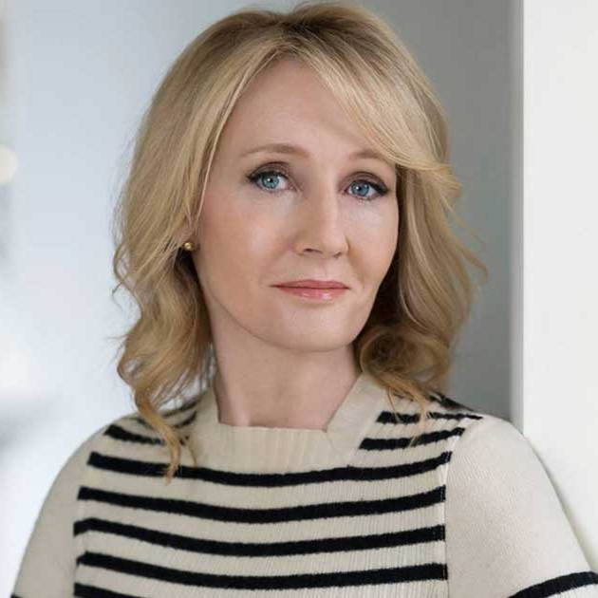
The poll also asked 1,000 American adults if they agreed with J.K. Rowling's statement that men and women are biologically different

Slide 69
or if they thought it was "'hate speech' to say there are only two genders. Most Americans, 58%, agreed with Rowling, while 17% said her words were "hate speech" and 25% were unsure, The Washington Examiner stated.
Notes:
https://justthenews.com/politics-policy/polling/75-americans-polled-said-there-are-only-two-genders?utm_source=justthenews.com&utm_medium=feed&utm_campaign=external-news-aggregators

Slide 70
Stewart Winograd reported
the leader of the Israeli Holocaust Survivors Association in Israel declares himself a Messianic Jew.
In Bible study with 30 other survivors!
PM Naphtali Bennets sister in law is a Messianic worship leader.

Slide 71
https://www.oneforisrael.org/

Slide 72
40 million views in Israel in Hebrew
200 million views worldwide!

Slide 73
As we fix our minds on what is good, what is lovely, what is praiseworthy (Philippians 4:8), and as we orient our spirits toward the true source of joy, our bodies respond. Isn’t that a bit like a miracle?
Notes:
https://www.patheos.com/blogs/askshaunti/2021/04/why-your-attitude-affects-others-and-your-health/?mc_cid=64aebafff2&mc_eid=fec1a78175

Slide 74
An ancient story is told of the Queen of Sheba. She sent two wreaths of roses to Solomon, one real and one artificial, to test his reputed wisdom. She defied him to detect the genuine from the artificial.
Notes:
George Whitten

Slide 75
Solomon at once directed that some bees be brought into the room and of course, they immediately flew to the real flowers and thought nothing of the counterfeit.
Notes:
George Whitten

Slide 76
So it is with us as believers. When we find ourselves overwhelmed, surrounded, being attacked from every side with the bees of revile and persecution, it simply means they recognize that we are the real deal! Our beautiful aroma attracts those scary bees but the Lord, in the end, "Where,[oh bees], is your sting?"
Notes:
George Whitten

Slide 78
Right hand of G-d [flying higher!]
Intercession for us and by us!
Accurate truth about Messiah.
Truth about His conquest of sin.
Practical applications
Hope despite the culture going deeply astray.

Slide 79
Do you KNOW Yeshua and the assurance of sins forgiven?
Are you hearing daily from His Word?
How are you applying what you heard?
Are you asking this of another?
Notes:
Who are you discipling, building up?4

