Slide 1
e-handout
To have these notes
without taking notes
Go to OrHaOlam.com
Click on Messages tab,
2022 Messages

Slide 3
Notes:
From Peter van der Steur, for circumcision.

Slide 4
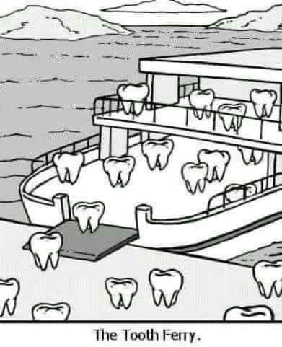
The tooth ferry.
Notes:
From Lori Wilson

Slide 5
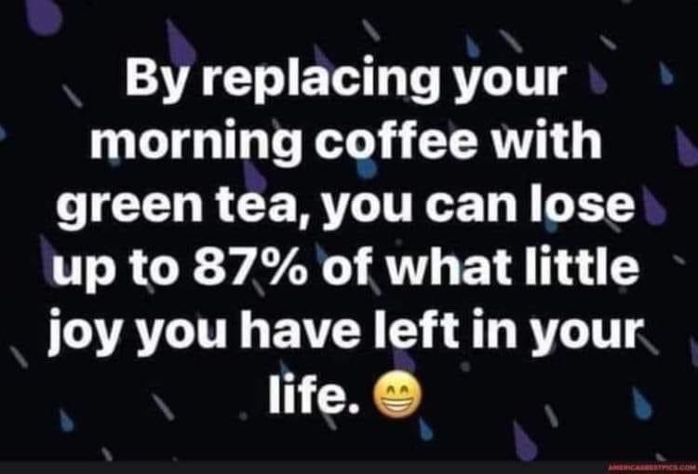
Notes:
Mike Boatright

Slide 7
Monday, Jan 17, is Tu BeShvat
ט״ו שְׁבָט , a Jewish holiday occurring on the 15th day of the Hebrew month of Shevat.
Notes:
Holiday I’ve never spoken about in 26 years. This week got a download.

Slide 8
Tu BeShvat begins at sunset on Sunday, Jan. 16, 2022, and ends in the evening of Jan. 17.
It is also called
Rosh HaShanah La'Ilanot
רֹאשׁ הַשָּׁנָה לְאִילָנוֹת
literally 'New Year of the Trees'.

Slide 9
It may seem quite odd that we are celebrating the New Year for trees in…. January! January is the month in which trees look dead! No blossoms, no leaves, no fruit. We should be celebrating snow and ice!
Notes:
https://unitedwithisrael.org/tu-bshvat-a-celebration-of-lifes-potential/?utm_source=newsletters_unitedwithisrael_org&utm_medium=email&utm_content=Professor%E2%80%99s+Nazi+Salute+Causes+Uproar+at+US+College%3B+Satellites+Built+by+Israeli+Children+Launch+into+Space%21+New+Video+Mocks+Israel%E2%80%99s+National+Anthem&utm_campaign=20220114_m166239844_Professor%E2%80%99s+Nazi+Salute+Causes+Uproar+at+US+College%3B+Satellites+Built+by+Israeli+Children+Launch+into+Space%21+New+Video+Mocks+Israel%E2%80%99s+National+Anthem&utm_term=more_btn_dark_jpg

Slide 10
Yet, on Tu Beshvat we plant trees, talk about trees, and eat lots of fruit at the many “fruit parties” that are held in Jewish communities worldwide.
Notes:
Tu b’Shvat Seders been innovated. We’ve never done one yet.
Collection for forests replanting in Israel. We’ve done in the past. Not this year.
https://unitedwithisrael.org/tu-bshvat-a-celebration-of-lifes-potential/?utm_source=newsletters_unitedwithisrael_org&utm_medium=email&utm_content=Professor%E2%80%99s+Nazi+Salute+Causes+Uproar+at+US+College%3B+Satellites+Built+by+Israeli+Children+Launch+into+Space%21+New+Video+Mocks+Israel%E2%80%99s+National+Anthem&utm_campaign=20220114_m166239844_Professor%E2%80%99s+Nazi+Salute+Causes+Uproar+at+US+College%3B+Satellites+Built+by+Israeli+Children+Launch+into+Space%21+New+Video+Mocks+Israel%E2%80%99s+National+Anthem&utm_term=more_btn_dark_jpg

Slide 11
Although the trees look dead, it is now, in January that their “potential” and “preparations” for blessing are strongest.
A Canadian writer takes maple syrup very seriously. When do the Canadian maple syrup companies begin harvesting their syrup? Now, in January!
Notes:
https://unitedwithisrael.org/tu-bshvat-a-celebration-of-lifes-potential/?utm_source=newsletters_unitedwithisrael_org&utm_medium=email&utm_content=Professor%E2%80%99s+Nazi+Salute+Causes+Uproar+at+US+College%3B+Satellites+Built+by+Israeli+Children+Launch+into+Space%21+New+Video+Mocks+Israel%E2%80%99s+National+Anthem&utm_campaign=20220114_m166239844_Professor%E2%80%99s+Nazi+Salute+Causes+Uproar+at+US+College%3B+Satellites+Built+by+Israeli+Children+Launch+into+Space%21+New+Video+Mocks+Israel%E2%80%99s+National+Anthem&utm_term=more_btn_dark_jpg

Slide 12
Although there are no leaves, buds, or fruits, the trees are very much alive. The sap is running strong through the tree trunks and the trees are getting ready for another season of fruit production.
Notes:
https://unitedwithisrael.org/tu-bshvat-a-celebration-of-lifes-potential/?utm_source=newsletters_unitedwithisrael_org&utm_medium=email&utm_content=Professor%E2%80%99s+Nazi+Salute+Causes+Uproar+at+US+College%3B+Satellites+Built+by+Israeli+Children+Launch+into+Space%21+New+Video+Mocks+Israel%E2%80%99s+National+Anthem&utm_campaign=20220114_m166239844_Professor%E2%80%99s+Nazi+Salute+Causes+Uproar+at+US+College%3B+Satellites+Built+by+Israeli+Children+Launch+into+Space%21+New+Video+Mocks+Israel%E2%80%99s+National+Anthem&utm_term=more_btn_dark_jpg

Slide 13
People love boring holes in the maple trees in the cold of January to suck up some of the natural sap. The trees are far from their “final product” and completing their mission in January, but all the preparations and potential are underway!
Notes:
https://unitedwithisrael.org/tu-bshvat-a-celebration-of-lifes-potential/?utm_source=newsletters_unitedwithisrael_org&utm_medium=email&utm_content=Professor%E2%80%99s+Nazi+Salute+Causes+Uproar+at+US+College%3B+Satellites+Built+by+Israeli+Children+Launch+into+Space%21+New+Video+Mocks+Israel%E2%80%99s+National+Anthem&utm_campaign=20220114_m166239844_Professor%E2%80%99s+Nazi+Salute+Causes+Uproar+at+US+College%3B+Satellites+Built+by+Israeli+Children+Launch+into+Space%21+New+Video+Mocks+Israel%E2%80%99s+National+Anthem&utm_term=more_btn_dark_jpg

Slide 14
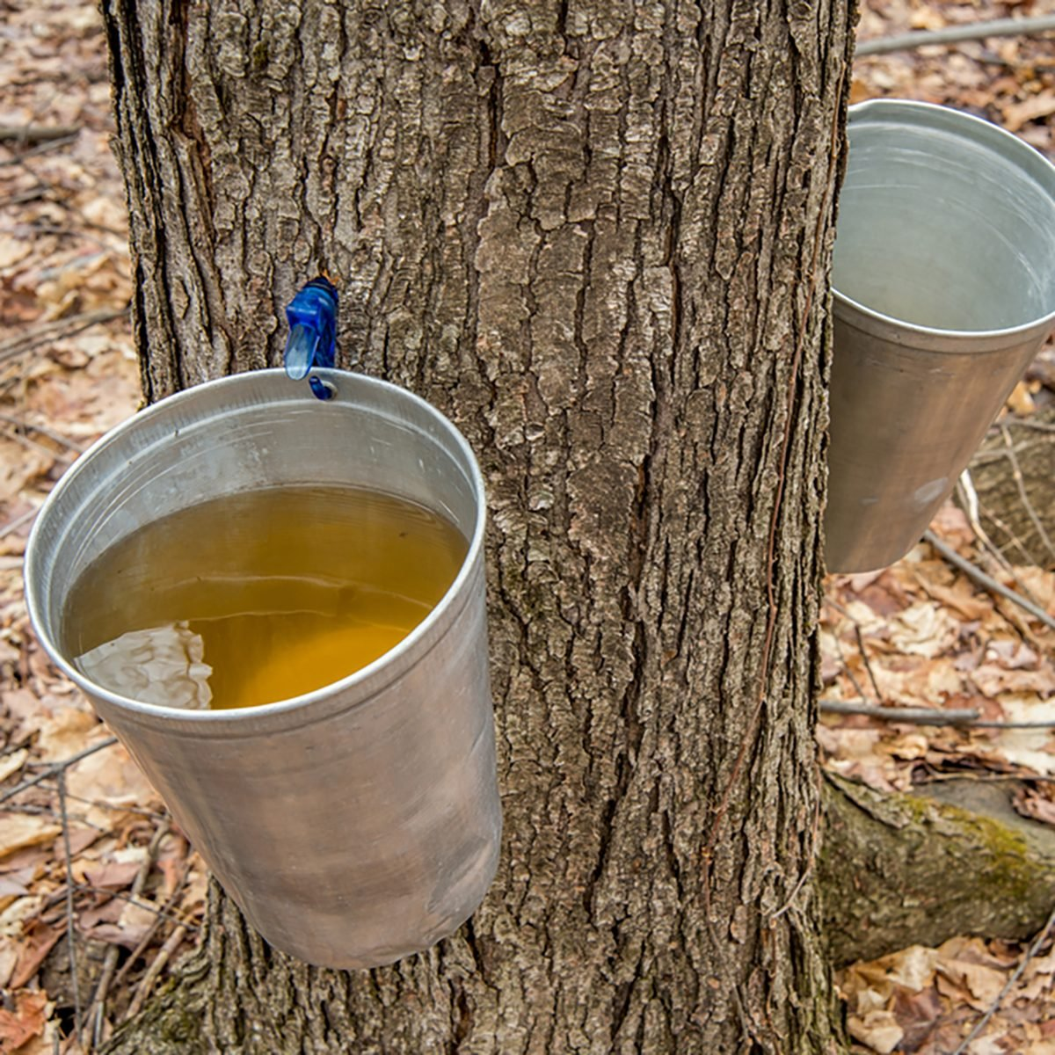
Maple trees tapped for syrup.
Notes:
https://www.israeltoday.co.il/read/tu-bishvat-celebrating-the-trees-of-life/

Slide 15
Notes:
https://www.israeltoday.co.il/read/tu-bishvat-celebrating-the-trees-of-life/

Slide 16
Also, at this time of year, one of the most beautiful sites in Israel takes place: the budding of the almond trees up and down the country beginning around Tu BeShevat.

Slide 17
The rainy season is coming to an end, cold winds are warming, scents of springtime are in the air and the almond tree is displaying her blossoms.
Notes:
https://www.israeltoday.co.il/read/tu-bishvat-celebrating-the-trees-of-life/

Slide 18
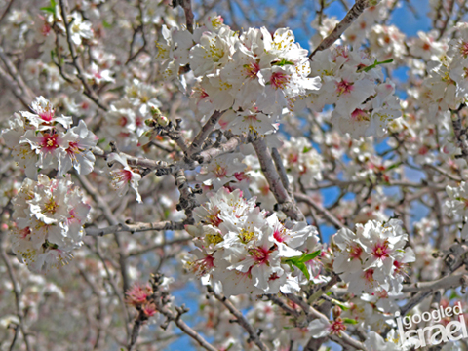
Almond
Blossom in Israel
Notes:
https://igoogledisrael.com/tis-the-season-for-almond-blossoms-in-israel/

Slide 19
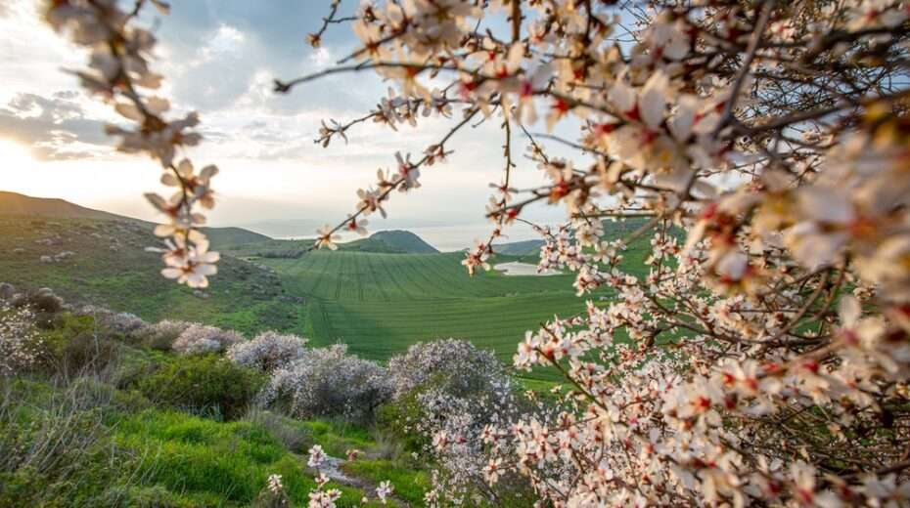
Notes:
At this time of the year, the winter rains have usually dumped a fair amount of much-needed refreshment to the parched and rather brown hills and valleys of Israel. And within just a few weeks, that brown landscape transforms itself into a stunning bed of blooming wild flowers and grasses.
https://www.israeltoday.co.il/read/the-festival-of-the-trees/

Slide 20
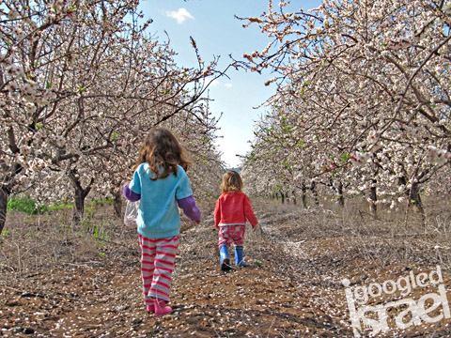
Notes:
Perhaps the most stunning bloomers are the orchards of almonds, found throughout Israel, from the hills around Jerusalem to the hills of the Galilee. They are instant pull-your-camera-out moments, that first time you see a beautiful orchard in full bloom…
https://igoogledisrael.com/wp-content/uploads/2012/02/kids_almonds3small.jpg
https://igoogledisrael.com/tis-the-season-for-almond-blossoms-in-israel/

Slide 21
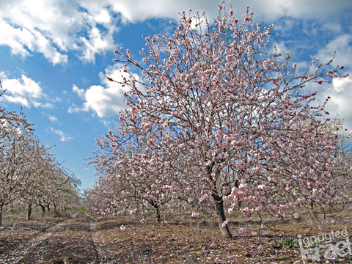

Slide 22
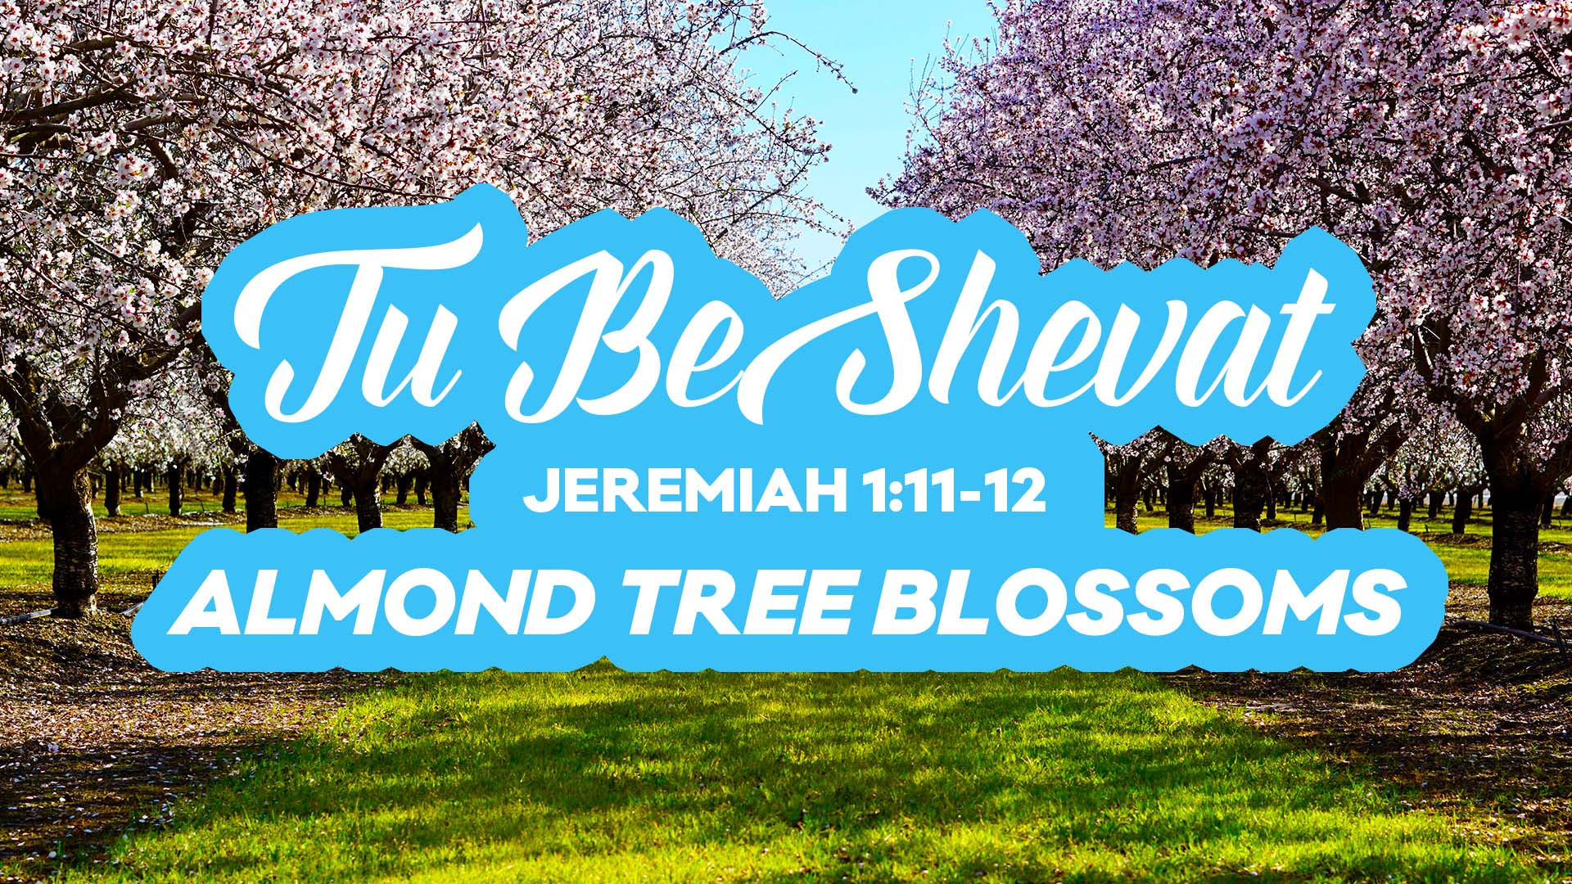

Slide 23
Tu BeShvat טוּ בִּשְׁבָט
15th of Shevat
Yer. 1.11-12 Almond Tree Blossoms
[Based on a Hebrew Bible pun]
Notes:
Is 53 by His wounds or His fellowship, double meanings in Hebrew have great implications.

Slide 24
^{Yer. 1.11-12} The word of Adoni came to me, asking, “Yirmeyahu, what do you see?” I answered, “I see a branch from an almond שָׁקֵד shaked tree. Then Adoni said to me, “You have seen well, because I am watching שֹׁקֵד shoked to fulfill my word.”

Slide 25
וַיְהִי דְבַר-יְיָ אֵלַי לֵאמֹר, מָה-אַתָּה רֹאֶה יִרְמְיָהוּ; וָאֹמַר, מַקֵּל שָׁקֵד אֲנִי רֹאֶה. וַיֹּאמֶר יְיָ אֵלַי, הֵיטַבְתָּ לִרְאוֹת: כִּי-שֹׁקֵד אֲנִי עַל-דְּבָרִי, לַעֲשֹׂתוֹ.

Slide 26
almond tree שָׁקֵד shaked
I am watching שֹׁקֵד shoked

Slide 27
almond tree שָׁקֵד shaked
I am watching שֹׁקֵד shoked
What is G-d watching for?
Next verses in Yermiyahu ch 1…

Slide 28
^{Yer. 1.14-16} Then Adoni said to me: “From the north, disaster will be poured out on all the inhabitants of the land…I will pronounce My judgments on them for all their wickedness— they have forsaken Me, offering incense to other gods, worshipping the works of their hands.
Notes:
Judgement is coming. Hell is real.

Slide 30
Tu BeShvat טוּ בִּשְׁבָט
15th of Shevat
Yer. 1.11-12 Almond Tree Blossoms
Abundant harvest
Opposing apostasy
Notes:
This is our dual, sort of opposite, task today.
[Pray]

Slide 31
Tu B’shvat teaches us that even when something [trees] look lifeless, bleak, and without hope, one should not give up or pass judgement so easily. The potential and blessing of trees at this time of year is hidden.
Notes:
https://unitedwithisrael.org/tu-bshvat-a-celebration-of-lifes-potential/?utm_source=newsletters_unitedwithisrael_org&utm_medium=email&utm_content=Professor%E2%80%99s+Nazi+Salute+Causes+Uproar+at+US+College%3B+Satellites+Built+by+Israeli+Children+Launch+into+Space%21+New+Video+Mocks+Israel%E2%80%99s+National+Anthem&utm_campaign=20220114_m166239844_Professor%E2%80%99s+Nazi+Salute+Causes+Uproar+at+US+College%3B+Satellites+Built+by+Israeli+Children+Launch+into+Space%21+New+Video+Mocks+Israel%E2%80%99s+National+Anthem&utm_term=more_btn_dark_jpg

Slide 32
^{2 Cor. 1.8-9} We were under great pressure—so far beyond our strength that we despaired even of living. In fact, we had within ourselves the death sentence—so that we might not rely on ourselves, but on God who raises the dead.

Slide 33
So too, when we feel that things are at a “dead end,” that things look bleak, we too must not give up. We have to remember that blessing and potential is often hidden but eventually the blessing, the true “fruits”, will emerge.
Notes:
https://unitedwithisrael.org/tu-bshvat-a-celebration-of-lifes-potential/?utm_source=newsletters_unitedwithisrael_org&utm_medium=email&utm_content=Professor%E2%80%99s+Nazi+Salute+Causes+Uproar+at+US+College%3B+Satellites+Built+by+Israeli+Children+Launch+into+Space%21+New+Video+Mocks+Israel%E2%80%99s+National+Anthem&utm_campaign=20220114_m166239844_Professor%E2%80%99s+Nazi+Salute+Causes+Uproar+at+US+College%3B+Satellites+Built+by+Israeli+Children+Launch+into+Space%21+New+Video+Mocks+Israel%E2%80%99s+National+Anthem&utm_term=more_btn_dark_jpg

Slide 34
When the Jewish people complained that the water in Marah was bitter, God told Moses to throw a certain small tree into the water which would make the water sweet. Why did God specifically use a tree as the emissary to sweeten the water?
Notes:
https://unitedwithisrael.org/tu-bshvat-a-celebration-of-lifes-potential/?utm_source=newsletters_unitedwithisrael_org&utm_medium=email&utm_content=Professor%E2%80%99s+Nazi+Salute+Causes+Uproar+at+US+College%3B+Satellites+Built+by+Israeli+Children+Launch+into+Space%21+New+Video+Mocks+Israel%E2%80%99s+National+Anthem&utm_campaign=20220114_m166239844_Professor%E2%80%99s+Nazi+Salute+Causes+Uproar+at+US+College%3B+Satellites+Built+by+Israeli+Children+Launch+into+Space%21+New+Video+Mocks+Israel%E2%80%99s+National+Anthem&utm_term=more_btn_dark_jpg

Slide 35
It is explained that God was trying to tell us that when things look bleak and hopeless –like a desert without fresh water –there is always potential for re-birth, like the lifecycle of the tree. The tree represents hope and potential! The TREE of Messiah’s SACRIFICE.
Notes:
https://unitedwithisrael.org/tu-bshvat-a-celebration-of-lifes-potential/?utm_source=newsletters_unitedwithisrael_org&utm_medium=email&utm_content=Professor%E2%80%99s+Nazi+Salute+Causes+Uproar+at+US+College%3B+Satellites+Built+by+Israeli+Children+Launch+into+Space%21+New+Video+Mocks+Israel%E2%80%99s+National+Anthem&utm_campaign=20220114_m166239844_Professor%E2%80%99s+Nazi+Salute+Causes+Uproar+at+US+College%3B+Satellites+Built+by+Israeli+Children+Launch+into+Space%21+New+Video+Mocks+Israel%E2%80%99s+National+Anthem&utm_term=more_btn_dark_jpg

Slide 36
During the times when the Temple was still standing in Jerusalem, Tu BeShvat was the day when famers brought up their yearly tithes for the service of the priests. By this time of year, trees have soaked up all the winter rains and sap is flowing up through the branches
Notes:
https://www.israeltoday.co.il/read/tu-bishvat-celebrating-the-trees-of-life/

Slide 37
This was also the day of the First harvest of the fruits for trees that had turned four years old and produced their first harvest (Lev 19:23-25).
Notes:
https://www.israeltoday.co.il/read/tu-bishvat-celebrating-the-trees-of-life/

Slide 38
^{Vayikra/Lev 19.23-25} “When you come into the land and have planted all kinds of trees for food, you are to consider their fruit as forbidden. Three years it will be forbidden to you. It is not to be eaten. Then in the fourth year all its fruit will be holy,

Slide 39
^{Vayikra/Lev 19.23-25} for giving praise to Adoni. In the fifth year you may eat its fruit. So it will yield its increase to you. I am Adoni your God.

Slide 40
Tu b’Shvat themes:
Hidden life of trees [sap running]
^{Col 3.1-3}Seek the things above, where the Messiah is sitting at the right hand of God…For…your life is hidden with the Messiah in God.
Flowering of almonds: abundance
Judgment despite apparent beauty and prosperity.

Slide 41
^{1 Thes. 1.6} You, indeed, became imitators of us and of the Lord; so that even though you were going through severe troubles, you received the Word with joy from the Ruakh HaKodesh.

Slide 42
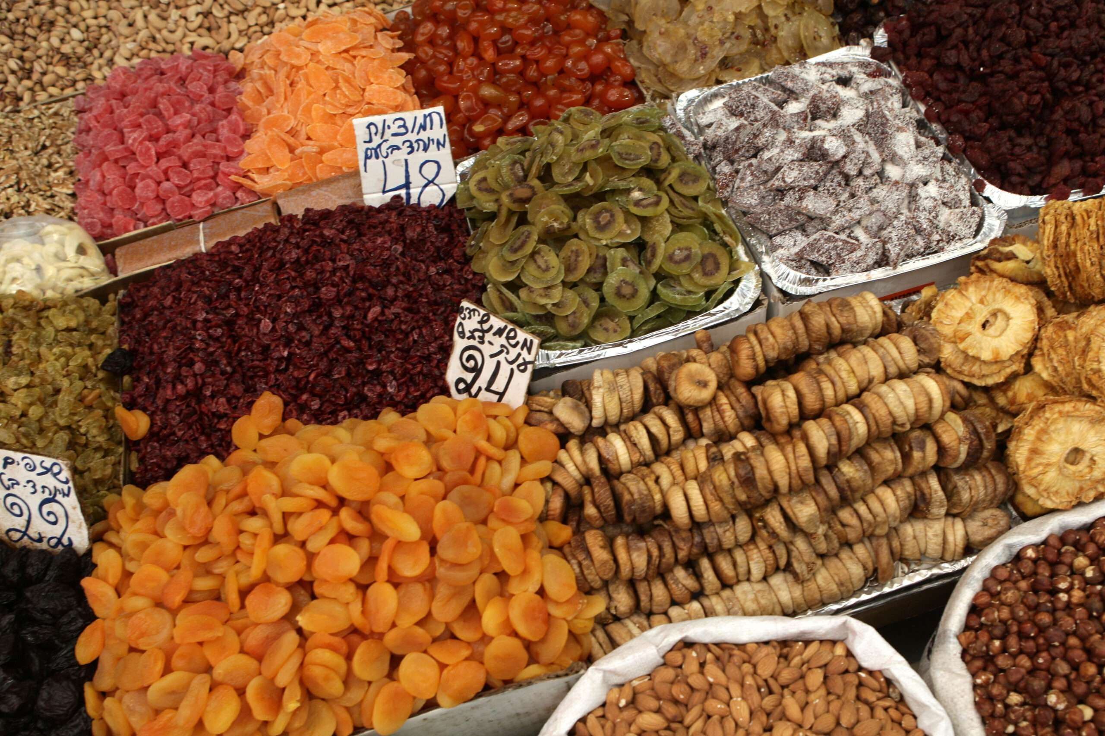
Dried fruits are popular with
Tu B’shvat
Notes:
https://www.israeltoday.co.il/read/the-festival-of-the-trees/

Slide 43
Fruitfulness amidst fight.
One speaker at the Rabbis Conference was Harry Mihet of Liberty Counsel, Romanian, VP of Legal Counsel
Notes:
We can’t get so battle hardened and adversarial and loose our joy and purpose to share the Salvation of the Messiah Yeshua!

Slide 44
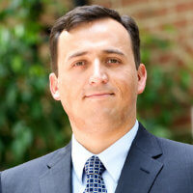
Harry Mihet

Slide 45
In Romania
hot water rationed there from central heater: two nights per week
hospital care free but risky
his father pastor underground church. Often arrested after sermon by secret police. Microphones planted in their home. German shepherds trained to sniff out Bibles.

Slide 46
Sometimes missionaries came to cheer and visit. Tell him of land of free.
45 years communist oppression Romania. 1989 secret police arrested a pastor. People gathered outside home. Rally eventually whole city 400,000. Tanks rolled in, people killed. 1989 December 25 spread whole country. Government overthrown.

Slide 47
They had been processing immigration 4 years. Permitted February 1990. Astonished to see Winn-Dixie supermarket piles of oranges! Compared Romania one orange per year divided brother and sister.
Law degree Duke

Slide 48
Tu beShvat summary:
fruitfulness amidst fight
almond tree שָׁקֵד shaked
I am watching [in judgment] שֹׁקֵד shoked

Slide 49
March 2020 lawsuits about shutting down churches when liquor stores still open. Laughed out court till Supreme Court. Gov Newsome received permanent injunction, banned ever shutting down churches.

Slide 50
No criminal charges, but can collect from bad guys
$I,350,000 paid by Gov. Gavin Newsome.
Liberty Counsel cannot initiate action, must stand with courageous refusers.

Slide 52
Tu BeShvat טוּ בִּשְׁבָט
15th of Shevat
Yer. 1.11-12 Almond Tree Blossoms
Abundant harvest
Opposing apostasy
Notes:
Fruitfulness amidst fight.

Slide 53
Rabbi Eric Tokajer: can government ask about your faith? A: Only ask sincerity, not validity of your faith. Light touch inquiry.
Ro 13 favorite chapter of Communists. Only in things “what is God’s.”
50% believers vote

Slide 54
Abortion protestor on public sidewalk, Susan Pye would talk to mothers. Eric Holder DOJ sent 7 agents to observe. She crossed street in crosswalk. DOJ painted it as Tiananmen Square protester. DOJ paid LC $120K. Susan Pye continued every Saturday.

Slide 55
A Rabbi in W Palm Beach 10 year case. J4J led lesbian to Yeshua. Published her story, but she later renounced her faith, and viewed as defamation. $145k paid by suing rabbi.

Slide 56
Jeff Forman. 2022
great challenges great opportunities
Alert, watch sober battleship vs cruise ship.
most productive ages 60 to 70
2nd age 70 to 80
3rd age 50 to 60
keep axe sharp. watchful

Slide 57
Tu b’Shvat themes:
Hidden life of trees [sap running]
^{Col 3.1-3}Seek the things above, where the Messiah is sitting at the right hand of God…For…your life is hidden with the Messiah in God.
Flowering of almonds: abundance
Judgment despite apparent beauty and prosperity.

Slide 60
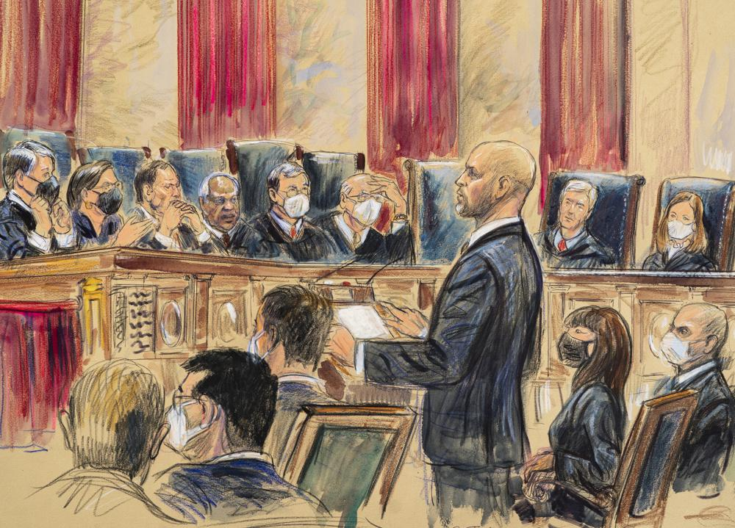

Slide 61
In a massive blow to the Biden administration’s vaccine agenda, the Supreme Court ruled 6-3 on Thursday against the OSHA mandate for private employers. The mandate, which would impact 85 million Americans, has been stayed, blocking the federal government from enforcing it. [OH policy]
Notes:
https://www.dailywire.com/news/supreme-court-rules-against-bidens-private-employer-mandate

Slide 62
Similarly we celebrate Dr. Martin Luther King Jr.. Day on the third Monday of January—this year, Jan. 17. Fruitfulness and fight.
Notes:
https://www.theepochtimes.com/dusting-off-dr-kings-great-message_4208661.html?utm_source=opinionnoe&utm_campaign=opinion-2022-01-13&utm_medium=email&est=VAlBmydmX53MVaWmRq1qqZK6Qkl9Y3IGvHhH73Y4TcBtewgASMOSt2eMmdhdlMiWBg%3D%3D

Slide 63
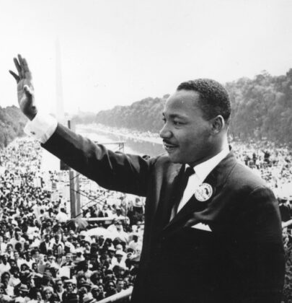
Civil rights leader Martin Luther King (1929–1968) addresses crowds during the "March on Washington" at the Lincoln Memorial in D.C., where he gave his "I have a dream" speech on Aug. 28, 1963. (Central Press/Getty Images)
Notes:
https://www.theepochtimes.com/dusting-off-dr-kings-great-message_4208661.html?utm_source=opinionnoe&utm_campaign=opinion-2022-01-13&utm_medium=email&est=VAlBmydmX53MVaWmRq1qqZK6Qkl9Y3IGvHhH73Y4TcBtewgASMOSt2eMmdhdlMiWBg%3D%3D

Slide 64
The most memorable and oft-quoted line of the speech, “I have a dream that my four little children will one day live in a nation where they will not be judged by the color of their skin but by the content of their character” now is opposed by Critical Race Theory.
Notes:
https://www.theepochtimes.com/dusting-off-dr-kings-great-message_4208661.html?utm_source=opinionnoe&utm_campaign=opinion-2022-01-13&utm_medium=email&est=VAlBmydmX53MVaWmRq1qqZK6Qkl9Y3IGvHhH73Y4TcBtewgASMOSt2eMmdhdlMiWBg%3D%3D

Slide 66
Tu BeShvat טוּ בִּשְׁבָט
15th of Shevat
Yer. 1.11-12 Almond Tree Blossoms
Abundant harvest
Opposing apostasy

Slide 67
Other tree allusions:

Slide 68
^{Yer 17.7-10} Blessed is the man who trusts in Adoni; Adoni will be his security. He will be like a tree planted near water; it spreads out its roots by the river; it does not notice when heat comes; and its foliage is luxuriant; it is not anxious in a year of drought but keeps on yielding fruit.

Slide 69
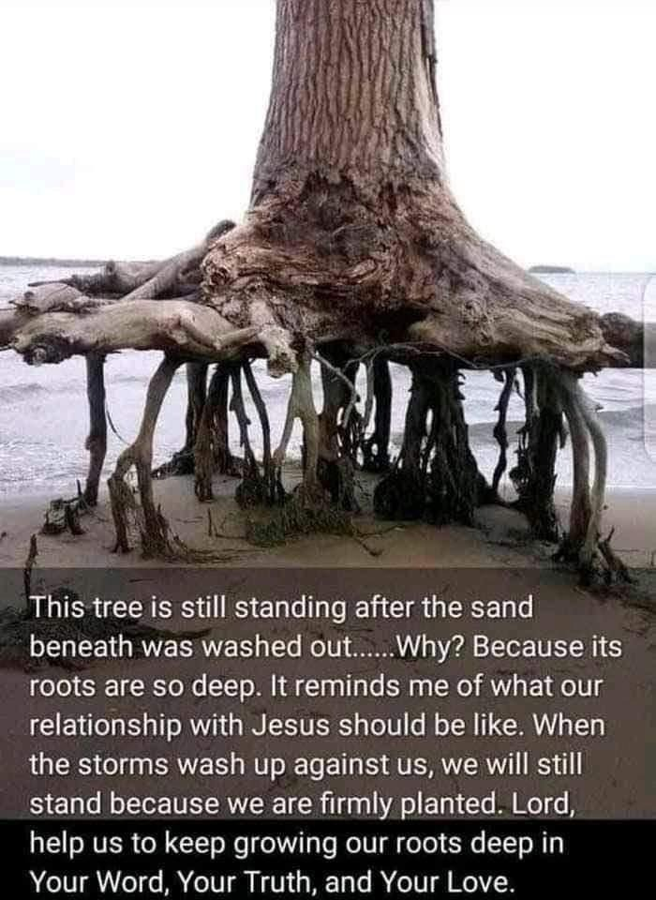

Slide 70
^{Jer 17.9-10} “The heart is more deceitful than anything else and mortally sick. Who can fathom it? I, Adoni, search the heart; I test inner motivations; in order to give to everyone what his actions and conduct deserve.”

Slide 71
In his 1869 travel book, Innocents Abroad, Mark Twain describes the Holy Land as “a desolate country whose soil is rich enough, but is given over wholly to weeds—a silent mournful expanse …
Notes:
https://unitedwithisrael.org/tu-bshvat-annual-reminder-to-appreciate-the-beauty-of-the-land-of-israel/?utm_source=newsletters_unitedwithisrael_org&utm_medium=email&utm_content=Professor%E2%80%99s+Nazi+Salute+Causes+Uproar+at+US+College%3B+Satellites+Built+by+Israeli+Children+Launch+into+Space%21+New+Video+Mocks+Israel%E2%80%99s+National+Anthem&utm_campaign=20220114_m166239844_Professor%E2%80%99s+Nazi+Salute+Causes+Uproar+at+US+College%3B+Satellites+Built+by+Israeli+Children+Launch+into+Space%21+New+Video+Mocks+Israel%E2%80%99s+National+Anthem&utm_term=more_btn_dark_jpg

Slide 72
There was hardly a tree or a shrub anywhere. Even the olive and the cactus, those fast friends of the worthless soil, had almost deserted the country.”
Notes:
https://unitedwithisrael.org/tu-bshvat-annual-reminder-to-appreciate-the-beauty-of-the-land-of-israel/?utm_source=newsletters_unitedwithisrael_org&utm_medium=email&utm_content=Professor%E2%80%99s+Nazi+Salute+Causes+Uproar+at+US+College%3B+Satellites+Built+by+Israeli+Children+Launch+into+Space%21+New+Video+Mocks+Israel%E2%80%99s+National+Anthem&utm_campaign=20220114_m166239844_Professor%E2%80%99s+Nazi+Salute+Causes+Uproar+at+US+College%3B+Satellites+Built+by+Israeli+Children+Launch+into+Space%21+New+Video+Mocks+Israel%E2%80%99s+National+Anthem&utm_term=more_btn_dark_jpg

Slide 73
In 1901, קֶרֶן קַיֶּמֶת לְיִשְׂרָאֵל
Keren Kayemet L’Israel —
Jewish National Fund (KKL-JNF) was founded. KKL-JNF looked for native Mediterranean pine species to help reestablish forests.

Slide 74
While people all over the world complain that there are fewer and fewer trees, Israel is one of the few countries, if not the only one, that entered the 21st century with a net gain in trees. The Jewish National Fund (Keren Kayemet L’Israel or KKL)

Slide 75
set itself the task of planting many trees and forests in Israel at the beginning of the 20th century. Thanks to donations from all over the world, this organization has planted more than 240 million trees in Israel since 1901!

Slide 76
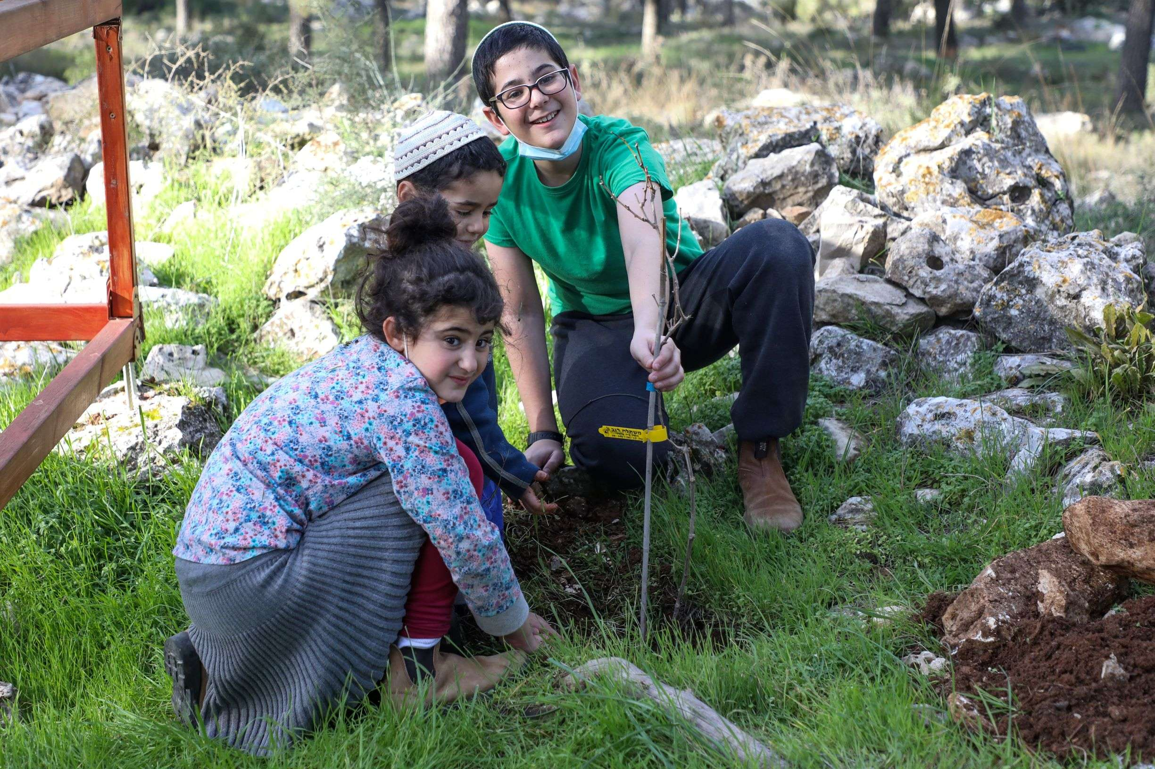
Children plant trees near Gush
Etzion south of Jerusalem

Slide 77
2021 was a year of global fires which consumed 10.1 million acres around the world. In Israel, homes, businesses and hundreds of acres of forests burned to the ground.

Slide 78
The saddest part of it all? Most of these trees had been planted by hand by pioneers; as prophecy foretold: (Isaiah 32:15, Isaiah 41:19). Since the early 1900 Israel has planted over 250 million trees.

Slide 79
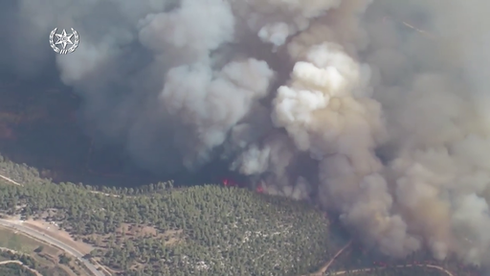
Notes:
https://info.aliyahreturncenter.com/optin1634122157218?mc_cid=ba28336641&mc_eid=0abd2ecb2c

Slide 80
When the Jewish people complained that the water in Marah was bitter, God told Moshe to throw a certain small tree into the water which would make the water sweet. Why did God specifically use a tree as the emissary to sweeten the water? It is explained that God was trying to tell us that when things look bleak and hopeless
Notes:
https://unitedwithisrael.org/tu-bshvat-a-celebration-of-lifes-potential/?utm_source=newsletters_unitedwithisrael_org&utm_medium=email&utm_content=Professor%E2%80%99s+Nazi+Salute+Causes+Uproar+at+US+College%3B+Satellites+Built+by+Israeli+Children+Launch+into+Space%21+New+Video+Mocks+Israel%E2%80%99s+National+Anthem&utm_campaign=20220114_m166239844_Professor%E2%80%99s+Nazi+Salute+Causes+Uproar+at+US+College%3B+Satellites+Built+by+Israeli+Children+Launch+into+Space%21+New+Video+Mocks+Israel%E2%80%99s+National+Anthem&utm_term=more_btn_dark_jpg

Slide 81
–like a desert without fresh water –there is always potential for re-birth, like the lifecycle of the tree. The tree represents hope and potential! The tree represent the execution stake of Yeshua the Messiah, King of Israel!
Notes:
https://unitedwithisrael.org/tu-bshvat-a-celebration-of-lifes-potential/?utm_source=newsletters_unitedwithisrael_org&utm_medium=email&utm_content=Professor%E2%80%99s+Nazi+Salute+Causes+Uproar+at+US+College%3B+Satellites+Built+by+Israeli+Children+Launch+into+Space%21+New+Video+Mocks+Israel%E2%80%99s+National+Anthem&utm_campaign=20220114_m166239844_Professor%E2%80%99s+Nazi+Salute+Causes+Uproar+at+US+College%3B+Satellites+Built+by+Israeli+Children+Launch+into+Space%21+New+Video+Mocks+Israel%E2%80%99s+National+Anthem&utm_term=more_btn_dark_jpg

Slide 82
^{Yeshayahu/Is 55. 6-12} Seek Adoni while He may be found, call on Him while He is near. Let the wicked forsake his way, and the unrighteous one his thoughts, let him return to Adoni, so He may have compassion on him, and to our God, for He will abundantly pardon.

Slide 83
^{Yeshayahu/Is 55. 6-12} “For My thoughts are not your thoughts, nor are your ways My ways.” It is a declaration of Adoni. “For as the heavens are higher than earth, so are My ways higher than your ways, and My thoughts than your thoughts.

Slide 84
^{Yeshayahu/Is 55. 6-12} For as the rain and snow come down from heaven, and do not return there without having watered the earth, making it bring forth and sprout, giving seed to sow and bread to eat, so My word will be that goes out from My mouth.

Slide 85
^{Yeshayahu/Is 55. 6-12} It will not return to Me in vain, but will accomplish what I intend, and will succeed in what I sent it for. “Yes, you will go out with joy and be led forth with peace. The mountains and the hills will break forth before you singing, and all the trees of the field will clap their hands!

Slide 87
Tu BeShvat טוּ בִּשְׁבָט
15th of Shevat
Yer. 1.11-12 Almond Tree Blossoms
Abundant harvest
Opposing apostasy

Slide 88
Do you KNOW Yeshua and the assurance of sins forgiven?
Are you hearing daily from His Word?
How are you applying what you heard?
Are you asking this of another?
Notes:
By repentance and faith in the atoning death and resurrection of Yeshua
Discipleship
Discipleship
Who are you discipling, building up?

