Slide 1
e-handout
To have these notes
without taking notes
Go to OrHaOlam.com
Click on Messages tab,
2022 Messages
Notes:
You may notice that I’m slowing down in my rate of speech. This is because we may be getting language translation equipment for simultaneous translation.

Slide 2
Eytan Stibbes
Mission Rakia is to perform a series of some 34 experiments in zero G conditions
Notes:
https://www.reddit.com/r/SpacePharma/comments/tpggc6/mission_rakia_preps_for_takeoff/
Right now in the ISS. Shabbat: candles spherical flame.

Slide 3
Notes:
Charles Bayer

Slide 4
Facebook comments:
While there is health benefit in a good chicken soup, I thought part of the benefit was the steam and vapors from it as it is sipped. SW: And the globules of schmaltz [chicken fat] floating on the surface.

Slide 5
Facebook comments:
It’s called kholodets and it’s a popular dish Ukrainian Jews make all the time, and it is quite good! Really liking the kholodets on a stick idea, just needs a slice of egg.
Notes:
Charles Bayer

Slide 6
Passover is the Jewish holiday most famous across the entire Jewish world.
93 percent among Israeli Jews participate
70 percent in the United States.
[cp: Easter is celebrated by 79% of Gentiles.]
Notes:
https://www.chicagojewishnews.com/what-is-the-percentage-of-jews-that-celebrate-passover/ Copyright © 2022 by Chicagojewishnews. All rights reserved.
My parents used to fly me home for Passover when undergrad. Then me and Dawn.
The number of Jewish Israelis planning to fast on Yom Kippur is 5%. While 5% plan to only consume liquids!!

Slide 8
^{Lk. 22.14-16} When the hour came, Yeshua reclined at table, and the emissaries with Him. And He said to them, “I have eagerly desired to eat this Passover with you before I suffer. For I tell you, I will never eat it again until it is fulfilled in the kingdom of God.”

Slide 9
What did it look like
in Yeshua’s day?

Slide 10
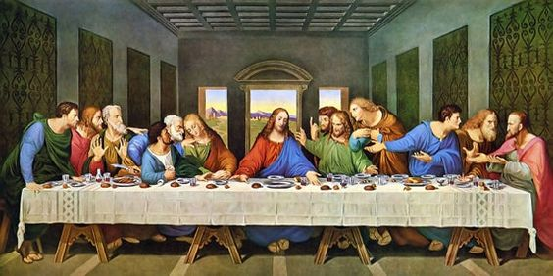
Notes:
Leonardo’s
Still daylight
Bread cf matzah
No families “When your son shall ask.”
Fish cf lamb
Only one person stereotypically Jewish looking, Yehuda/Judas
Straight table
This is one of the objects of Christian culture that precipitated the Messianic movement.

Slide 11
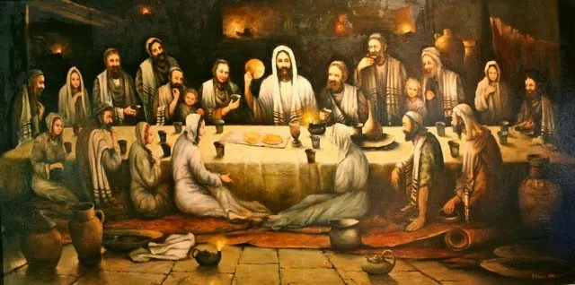
Notes:
Bohdan Piasecki’s painting of the Last Supper added six women and two children. Dark outside. Appears to be matzah.
Intimate family atmosphere.

Slide 12
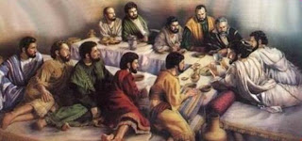
Notes:
Triclinium table. Note reclining. Left out women and children.

Slide 13
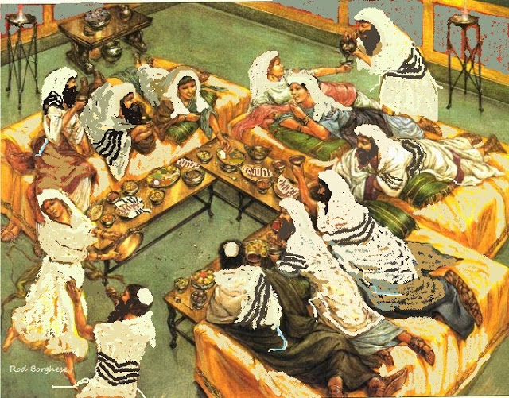
Notes:
https://www.artranked.com/images/cb/cbf2d222268f695163fcc913d363493f.jpg
Triclinium, dancing, women there, music. No Yeshua.

Slide 14
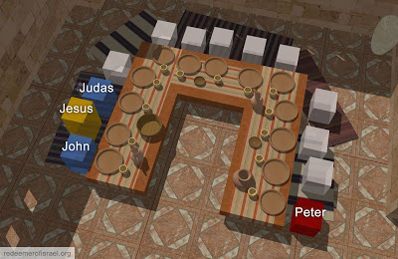
Notes:
https://blogs.bible.org/wp-content/uploads/2020/08/Last-Supper-Triclinium-2.jpg
Probable seating. John-Yokhanan at Yeshua’s right [bosom], Yehuda-Judas next to him for dipping. Kefa-Peter opposite Yokhanan so could ask him questions.
Key issue is the intimacy and warmth. Seder

Slide 15
^{Lk. 22.14-16} When the hour came, Yeshua reclined at table, and the emissaries with Him. And He said to them, “I have eagerly desired to eat this Passover with you before I suffer. For I tell you, I will never eat it again until it is fulfilled in the kingdom of God.”

Slide 16
^{Shmot/Ex 12.3} On the tenth day of this month, each man is to take a lamb or kid for his family, one per household.
Lamb per household.
Family is a unit of worship.
70% of American Jews observe
Notes:
Original mentality.
70% USA today.
Seder relational. Family was a worship unit!
First date I had with Dawn was to take her to a Passover Seder. Shocked everyone…halfway hippie →3 piece suit.
My parents would fly me in from Cincinnati for Seder. After married, flew Dawn and me to NYC.
[Last item to drop off radar when Jews assimilating. In FSU, Jewish practice prohib, but one woman only knew of “holiday crackers.” Till HS age then FSU passport, Yevrai. First time she found out she was Jewish. She came to faith in our Aleph outreach.]

Slide 17
All the liturgy and Torah that we do has an underlying purpose.
All relational. “with you”
Love G-d.
Love your neighbor.
Yeshua’s last instructions at His last supper Passover Seder…

Slide 18
^{Yn. 17.21-23} That they may all be one. Just as you, Father, are united with me and I with you, I pray that they may be united with us, so that the world may believe that you sent me. The glory which you have given to me, I have given to them;

Slide 19
^{Yn. 17.21-23} so that they may be one, just as we are one — I united with them and you with me, so that they may be completely one, and the world thus realize that you sent me, and that you have loved them just as you have loved me.

Slide 20
End times, last days warning to His followers…

Slide 21
^{Matt.24.9-13} “Then they will hand you over to persecution and will kill you. You will be hated by all the nations because of My name. And then many will fall away and will betray one another and hate one other.

Slide 22
Term in Hebrew:
שִׂנאָת חִנָּם sinat khinam
Baseless hatred
Notes:
Literally: Free hatred. I.e., unjustified. Cause of loss to Romans of 2nd Temple. Zealots burned the grain stores.

Slide 23
^{Matt.24.9-13} Many false prophets will arise and lead many astray. Because lawlessness will multiply, the love of many will grow cold. But the one who endures to the end will be saved.
Notes:
So much antagonism to our lifestyle and message, easy to be defensive.

Slide 24
There are two recipients of this wrath:

Slide 25
There are two recipients of this wrath:
Jewish people genealogically, and the Ruths. [ID with Jews]

Slide 26
There are two recipients of this wrath:
Jewish people genealogically, and the Ruths. [ID with Jews]
People of any nation who love and obey Messiah and scripture.

Slide 27
There are two recipients of this wrath:
Jewish people genealogically, and the Ruths. [ID with Jews]
People of any nation who love and obey scripture.
Messianic believers are both.
Notes:
Welcome to the most hated group on the planet!

Slide 29
^{Rev 12.10-17} “Now have come the salvation and the power and the kingdom of our God and the authority of His Anointed One, for the accuser of our brothers and sisters—the one who accuses them before our God day and night—has been thrown out.

Slide 30
Main function of Satan is accusations.
Guilt before G-d. You did this wrong. G-d is mad at you.

Slide 31
Main function of Satan is accusations.
Guilt before G-d. You did this wrong. G-d is mad at you.
Accusations at G-d: He let you down here and here.

Slide 32
Accusations of people: they are wrong in such and such. You need to be against them.

Slide 33
Accusations of people: they are wrong in such and such. You need to be against them.
Accusations of people: They are against you. They don’t like you.
Accusations four ways → rage.

Slide 34
^{Rev 12.10-17} They overcame him by the blood of the Lamb and by the word of their testimony, and they did not love their lives even in the face of death. Therefore rejoice, O heavens, and you who dwell in them! Woe to the earth and the sea, for the devil has come down to you with great rage, knowing that his time is short.

Slide 35
^{Rev 12.10-17} Now when the dragon saw that he had been thrown to the earth, he stalked the woman who had given birth to the male child.
Notes:
Satan is out to destroy the genealogical Jews, the birth family of the Messiah.

Slide 36
^{Rev 12.10-17} But the woman was given two wings of the great eagle, so that she might fly away from the presence of the serpent into the wilderness, to the place where she is taken care of — for a time, times, and half a time…
Notes:
G-d protects the Jewish people

Slide 37
^{Rev 12.10-17} So the dragon became enraged at the woman and went off to make war with the rest of her offspring — those who keep the commandments of God and hold to the testimony of Yeshua.
Notes:
Rest of her offspring: Jews and all nations who ally with Israel and keep Torah.

Slide 38
There are two recipients of this wrath:
Jewish people genealogically, and the Ruths. [ID with Jews]
People of any nation who love and obey scripture.
Messianic believers are both.

Slide 39
This last days intense spirit of accusations and wrath is both external and internal:
The Jewish people
Believers in Messiah
Fellow congregants
Family members.

Slide 40
Notes:
https://www.drjamesdobson.org/marriage-parenting/error-or-opportunity-beelers-episode-9

Slide 41
A whole series of ~2 minute clips like this at https://www.drjamesdobson.org/marriage-parenting

Slide 42
Marriage
de-stress
Setting out to repair a marriage may mean listening more deeply to your partner and understanding their fears, needs, hopes, and priorities. (Joanna Nix-Walkup/Unsplash
Notes:
https://www.theepochtimes.com/de-stressing-your-marriage_4381651.html?utm_source=brightnoe&utm_campaign=bright-2022-04-14&utm_medium=email&est=S1k8%2FarwXxme6XE1orsoDX3iGmCsoiXFwFLkSegK978PS5RdogEcBFPbyoW8Nc0F6Q%3D%3D&est=[EMAIL_SECURE_LINK]

Slide 43
Each day, approximately 2,000 marriages in the United States end in divorce. The top reasons for marital splits include constant fighting and infidelity. But these problems don’t appear out of nowhere. They often start with a breakdown in communication.
Notes:
https://www.theepochtimes.com/de-stressing-your-marriage_4381651.html?utm_source=brightnoe&utm_campaign=bright-2022-04-14&utm_medium=email&est=S1k8%2FarwXxme6XE1orsoDX3iGmCsoiXFwFLkSegK978PS5RdogEcBFPbyoW8Nc0F6Q%3D%3D&est=[EMAIL_SECURE_LINK]

Slide 44
^{Gal. 5.14-15} For the whole of the Torah is summed up in this one sentence: “Love your neighbor as yourself”; but if you go on snapping at each other and tearing each other to pieces, watch out, or you will be destroyed by each other!

Slide 45
This last days intense spirit of accusations and wrath is both external and internal:
The Jewish people
Believers in Messiah
Fellow congregants
Family members.

Slide 46
For the second time in recent weeks, residents of Sarasota, Florida found antisemitic flyers blaming Jews for Russia’s invasion of Ukraine and the COVID pandemic on Saturday.
Notes:
https://unitedwithisrael.org/florida-hatemongers-blame-jews-for-russian-invasion-covid-19/?utm_source=newsletters_unitedwithisrael_org&utm_medium=email&utm_content=Israeli+Hero+%E2%80%98Took+Bullets%E2%80%99+to+Save+Infant%E2%80%99s+Life+During+Attack%3B+Secret+Israel-Arab+Military+Alliance+Ready+to+Fight+Iran%3B+%E2%80%98Get+Out%21%27+Israeli+Politician+Accuses+Blinken+of+%E2%80%98Provocation%E2%80%99&utm_campaign=20220330_m167210520_Israeli+Hero+%E2%80%98Took+Bullets%E2%80%99+to+Save+Infant%E2%80%99s+Life+During+Attack%3B+Secret+Israel-Arab+Military+Alliance+Ready+to+Fight+Iran%3B+%E2%80%98Get+Out%21%27+Israeli+Politician+Accuses+Blinken+of+%E2%80%98Provocation%E2%80%99&utm_term=more_btn_dark_jpg

Slide 47
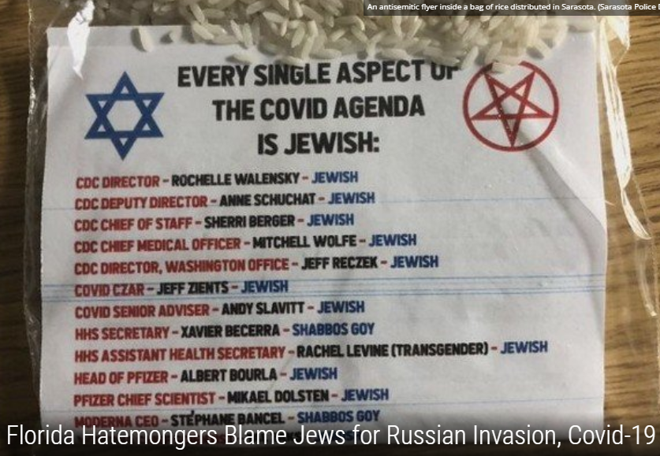
Notes:
https://unitedwithisrael.org/florida-hatemongers-blame-jews-for-russian-invasion-covid-19/?utm_source=newsletters_unitedwithisrael_org&utm_medium=email&utm_content=Israeli+Hero+%E2%80%98Took+Bullets%E2%80%99+to+Save+Infant%E2%80%99s+Life+During+Attack%3B+Secret+Israel-Arab+Military+Alliance+Ready+to+Fight+Iran%3B+%E2%80%98Get+Out%21%27+Israeli+Politician+Accuses+Blinken+of+%E2%80%98Provocation%E2%80%99&utm_campaign=20220330_m167210520_Israeli+Hero+%E2%80%98Took+Bullets%E2%80%99+to+Save+Infant%E2%80%99s+Life+During+Attack%3B+Secret+Israel-Arab+Military+Alliance+Ready+to+Fight+Iran%3B+%E2%80%98Get+Out%21%27+Israeli+Politician+Accuses+Blinken+of+%E2%80%98Provocation%E2%80%99&utm_term=more_btn_dark_jpg

Slide 48
Many of the flyers were titled “Every single aspect of the Ukraine-Russia War is Jewish,” and featured images of Ukrainian and Russian Presidents Volodymyr Zelensky and Vladimir Putin wearing kippot at the Western Wall.
Notes:
https://unitedwithisrael.org/florida-hatemongers-blame-jews-for-russian-invasion-covid-19/?utm_source=newsletters_unitedwithisrael_org&utm_medium=email&utm_content=Israeli+Hero+%E2%80%98Took+Bullets%E2%80%99+to+Save+Infant%E2%80%99s+Life+During+Attack%3B+Secret+Israel-Arab+Military+Alliance+Ready+to+Fight+Iran%3B+%E2%80%98Get+Out%21%27+Israeli+Politician+Accuses+Blinken+of+%E2%80%98Provocation%E2%80%99&utm_campaign=20220330_m167210520_Israeli+Hero+%E2%80%98Took+Bullets%E2%80%99+to+Save+Infant%E2%80%99s+Life+During+Attack%3B+Secret+Israel-Arab+Military+Alliance+Ready+to+Fight+Iran%3B+%E2%80%98Get+Out%21%27+Israeli+Politician+Accuses+Blinken+of+%E2%80%98Provocation%E2%80%99&utm_term=more_btn_dark_jpg

Slide 49
One fear that Jews have, both within and without Ukraine, is that of being blamed for the very war itself. One of the oldest anti-Semitic tropes in history is that Jews, regardless of how much influence they may actually have in a state’s affairs, are somehow responsible for leading their countries into war.
Notes:
https://voegelinview.com/for-jews-russias-invasion-of-ukraine-is-especially-traumatic/

Slide 50
Charles Lindbergh and the America First party accused Jews of trying to persuade the Roosevelt administration to take the United States into war in 1941;
Notes:
https://voegelinview.com/for-jews-russias-invasion-of-ukraine-is-especially-traumatic/

Slide 51
In the early 2000s the Jewish Bush administration officials Paul Wolfowitz and Douglas J. Feith were accused of taking the United States to war with Iraq.
Notes:
https://voegelinview.com/for-jews-russias-invasion-of-ukraine-is-especially-traumatic/

Slide 52
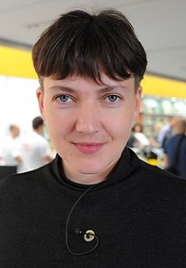
Nadiya Savchenko writes about “The disgusting Jewish takeover of Ukraine.”
Notes:
https://englishnews.org/2020/04/10/the-jewish-takeover-of-ukraine-zelenskys-political-prisoners/

Slide 53
The process of the Jewish president of Ukraine Zelensky coming to power started back in 2014 with what at the time I described as the ‘2nd Jewish War against Ukraine’. The civil war that overthrew the non-EU compliant prior leadership of Ukraine. This was the Jewish Takeover of Ukraine.
Notes:
https://englishnews.org/2020/04/10/the-jewish-takeover-of-ukraine-zelenskys-political-prisoners/

Slide 54
The 1st war against Ukraine was of course was the Holodomor, the genocide of upwards of 7 million Ukrainians died during the artificial famine introduced deliberately under the USSR by the Jewish coordinators and Jewish economic theories that controlled Ukraine.
Notes:
https://englishnews.org/2020/04/10/the-jewish-takeover-of-ukraine-zelenskys-political-prisoners/

Slide 55
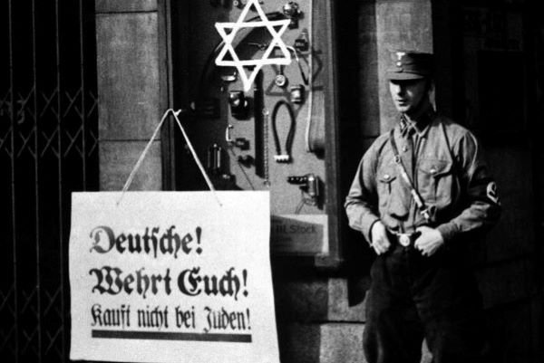
Notes:
Antisemitic boycott sign in Nazi Germany. (illustrative) (shutterstock)

Slide 56
The umbrella organization of Belgium’s Jewish community is taking legal action against a car repair shop owner who refuses to serve Jewish customers.
Notes:
https://unitedwithisrael.org/no-jews-european-business-owner-protests-israel-with-antisemitic-discrimination/?utm_source=newsletters_unitedwithisrael_org&utm_medium=email&utm_content=Arabs+Attack+Worshipers+at+Western+Wall%3B+European+Business+Bans+Jews%3B+Amazing+6-Minute+Crash+Course+on+Passover%3B+Do+it+Right+on+Passover+Night%21&utm_campaign=20220415_m167452437_Arabs+Attack+Worshipers+at+Western+Wall%3B+European+Business+Bans+Jews%3B+Amazing+6-Minute+Crash+Course+on+Passover%3B+Doing+it+Right+on+Passover+Night%21&utm_term=more_btn_light_png

Slide 57
Ludo Eyckmans, who owns a garage in the Antwerp suburb of Stabroek, emailed the media announcing his refusal to serve Jews in protest of Israel’s policies towards Ukraine, according to the Belgian Jewish newspaper, Joods Actueel.
Notes:
https://unitedwithisrael.org/no-jews-european-business-owner-protests-israel-with-antisemitic-discrimination/?utm_source=newsletters_unitedwithisrael_org&utm_medium=email&utm_content=Arabs+Attack+Worshipers+at+Western+Wall%3B+European+Business+Bans+Jews%3B+Amazing+6-Minute+Crash+Course+on+Passover%3B+Do+it+Right+on+Passover+Night%21&utm_campaign=20220415_m167452437_Arabs+Attack+Worshipers+at+Western+Wall%3B+European+Business+Bans+Jews%3B+Amazing+6-Minute+Crash+Course+on+Passover%3B+Doing+it+Right+on+Passover+Night%21&utm_term=more_btn_light_png

Slide 58
“As of today, our Jewish clients are no longer welcome for maintenance of their cars or solving electronic problems,” Eyckmans wrote. He went on to refer to Israel’s “failure to recognize war crimes” by the Russian army in Ukraine.
Notes:
https://unitedwithisrael.org/no-jews-european-business-owner-protests-israel-with-antisemitic-discrimination/?utm_source=newsletters_unitedwithisrael_org&utm_medium=email&utm_content=Arabs+Attack+Worshipers+at+Western+Wall%3B+European+Business+Bans+Jews%3B+Amazing+6-Minute+Crash+Course+on+Passover%3B+Do+it+Right+on+Passover+Night%21&utm_campaign=20220415_m167452437_Arabs+Attack+Worshipers+at+Western+Wall%3B+European+Business+Bans+Jews%3B+Amazing+6-Minute+Crash+Course+on+Passover%3B+Doing+it+Right+on+Passover+Night%21&utm_term=more_btn_light_png

Slide 59
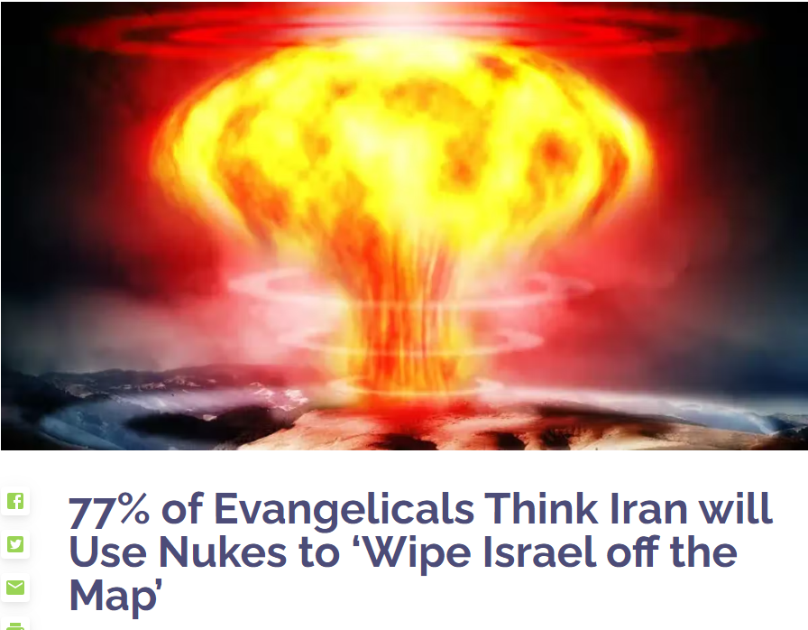
if the Iranian regime were able to build a nuclear weapon, its leaders would use it.
Notes:
https://vfinews.com/news/77-of-evangelicals-think-iran-will-use-nukes-to-wipe/77-of-evangelicals-think-iran-will-use-nukes-to-wipe?subscribed=true&mc_cid=8eca7113da&mc_eid=UNIQID

Slide 60
Cancel culture is an example of this rage. If you disagree, no honor, just expulsion. Division of families over
Vaccine [no official OH policy]
Critical Race Theory [official OH rejection of this!]

Slide 61
LBGTQI…
Abortion: pro-life / pro-choice
Global warming
Israel: apartheid state?
What is a woman? [XX chromosomes]

Slide 62
So with all this rage in the culture, do we catch it?
Selective shut down of worship
Volatile family strife
Congregational fractures.
Notes:
We’ve never had a split in the 26 years of Or HaOlam.

Slide 63
^{Gal. 2.19-20} I have been crucified with Messiah; and it is no longer I who live, but Messiah lives in me. And the life I now live in the body, I live by trusting in Ben-Elohim —who loved me and gave Himself up for me.
Notes:
This is a real spiritual transaction, not just a theory. Pray, repent, seek G-d, confess to those you have wronged. We just burned the khametz of the cong in a bonfire, but as a symbol of the Ruakh flame on our lives.
Put the Blood of Messiah on our door posts and lintels.

Slide 64
It's been a while since we crossed the Red Sea to freedom. But God told us to celebrate each year as if it had just happened because He wants us to remember He is still our deliverer today. So, may His deliverance in your life leave you in awe just like it did the Israelites on that day.
Notes:
Maoz greeting

Slide 65
^{Phil 2.3-7} Do nothing out of rivalry or vanity; but, in humility, regard each other as better than yourselves — look out for each other’s interests and not just for your own.
[our Sunday Seder guests]
Notes:
We will have 214 people in this building tomorrow. Many are us. Many are strangers. They are royalty. Consider giving the newcomers the best…seats, parking space. I didn’t request that Rabbi’s spot. Great honor.

Slide 66
^{Phil 2.3-7} Let your attitude toward one another be governed by your being in union with the Messiah Yeshua: Though he was in the form of God, he did not regard equality with God something to be possessed by force.

Slide 67
^{Phil 2.3-7} On the contrary, he emptied himself, in that he took the form of a slave by becoming like human beings are.
Notes:
How do we live that?

Slide 68
Half of Americans believe the Bible includes “everything a person needs to know to live a meaningful life.” Nevertheless, many of them don’t bother reading it.
Notes:
https://metrovoicenews.com/bible-reading-among-americans-hits-all-time-low/

Slide 69
Bible reading and usage are at an all-time low in the United States, according to new data from the American Bible Society’s State of the Bible Survey. The survey reveals a 10 percent decline among American adults, from 49 percent in 2021 to 39 percent in 2022. It was the lowest percentage ever recorded in the survey, which began in 2011.
Notes:
https://metrovoicenews.com/bible-reading-among-americans-hits-all-time-low/

Slide 70
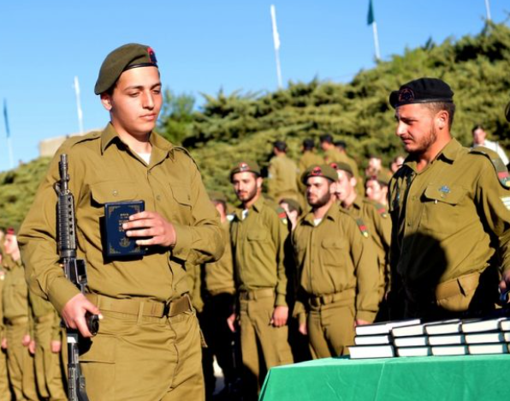
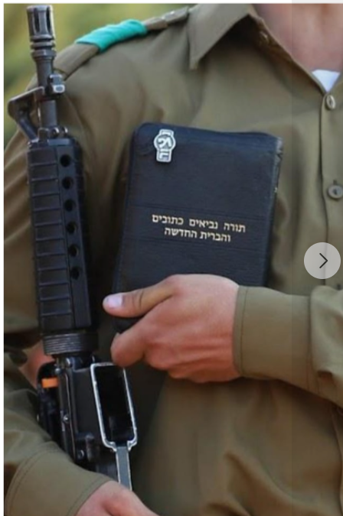
Notes:
Messianic Jews made waves on Hebrew-language social media after a photo was circulated showing a new IDF recruit being sworn-in on a Hebrew Bible containing the New Testament.
https://www.israeltoday.co.il/read/soldier-sworn-in-on-new-testament-sparks-social-media-storm-in-israel/?utm_source=acfs&utm_medium=email&utm_term=all&utm_campaign=newsletter-en-2022-04-05
Israeli social media abuzz after photo circulates showing new IDF recruit being sworn-in on Bible containing the New Testament
By David Lazarus | October 11, 2021 | Topics: MESSIANIC JEWS, New Testament
https://www.israeltoday.co.il/read/is-the-israeli-army-passing-out-new-testament-to-new-recruits/

Slide 72
^{Lk. 22.14-16} When the hour came, Yeshua reclined at table, and the emissaries with Him. And He said to them, “I have eagerly desired to eat this Passover with you before I suffer. For I tell you, I will never eat it again until it is fulfilled in the kingdom of God.”
Notes:
Rage in the culture around us. Within…joy!

Slide 73
Do you KNOW Yeshua and the assurance of sins forgiven?
Are you hearing daily from His Word?
How are you applying what you heard?
Are you asking this of another?
Notes:
Confess sins, repent, believe
Spend time daily, LISTENING to the Ruakh while reading
Walk out what you hear.
Who are you discipling, building up?4

Slide 74
[open Zoom]
Pesakh Overcoming spirit of RAGE
Our homes
Our synagogue
Our outreach

Slide 75
Notes:
https://www.theepochtimes.com/de-stressing-your-marriage_4381651.html?utm_source=brightnoe&utm_campaign=bright-2022-04-14&utm_medium=email&est=S1k8%2FarwXxme6XE1orsoDX3iGmCsoiXFwFLkSegK978PS5RdogEcBFPbyoW8Nc0F6Q%3D%3D&est=[EMAIL_SECURE_LINK]

