Slide 1
e-handout
To have these notes
without taking notes
Go to OrHaOlam.com
Click on Messages tab,
2022 Messages
Notes:
You may notice that I’m slowing down in my rate of speech. This is because we may be getting language translation equipment for simultaneous translation.

Slide 2
What is the name of a bullet proof Irishman?
What is the name of a bullet proof Irishman? Rick O’Shey.
What is the name of a bullet proof Irishman? Rick O’Shey.
Notes:
Gavriel Rennels

Slide 3
What is the name of a bullet proof Irishman? Rick O’Shey.
What is the name of a bullet proof Irishman? Rick O’Shey.
What is the name of a bullet proof Irishman? Rick O’Shey.
Notes:
Gavriel Rennels

Slide 4
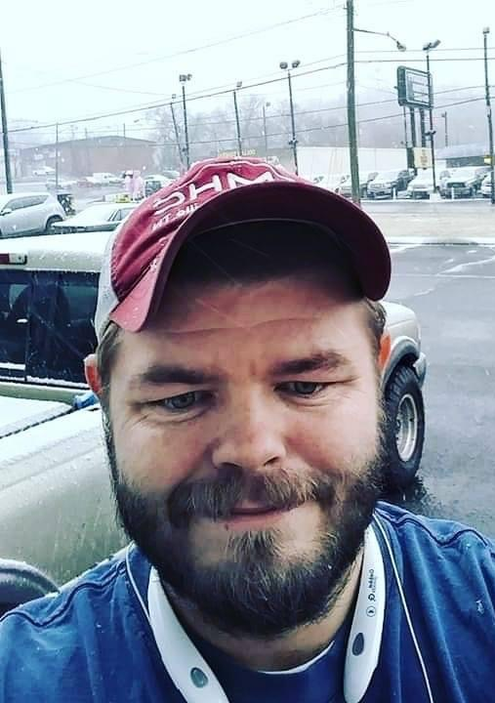
Eric Streeval recognized woman’s hand signal in a gas station, to alert an alleged kidnapping in Hickman County, Tennessee, April 10.
Notes:
https://www.theepochtimes.com/mkt_app/tennessee-man-recognizes-womans-hand-signals-in-gas-station-to-alert-alleged-kidnapping_4405307.html?utm_source=Morningbrief&utm_campaign=mb-2022-04-22&utm_medium=email&est=Y4dbHvBDriXpdUN7Mb%2FBXbTvY2he9KMTA3AyyMNjYo3z2YKehtrPgYRKWCmrl%2BZwMw%3D%3D
The hand signaling technique has been advocated for by many anti-human trafficking organizations such as North Carolina’s Awake and Bold, which initiated a video and billboard campaign.

Slide 5
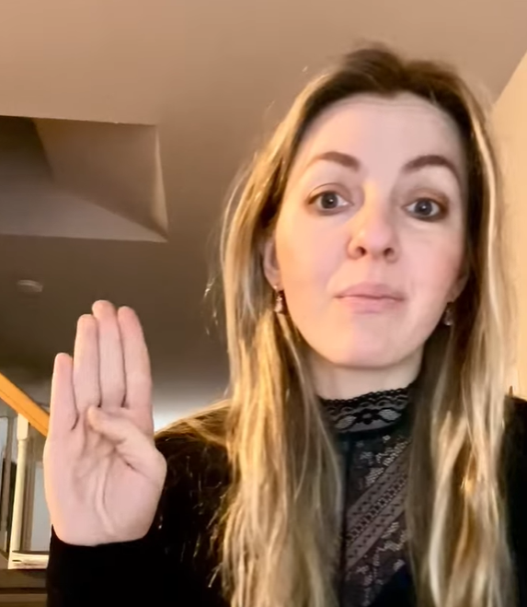
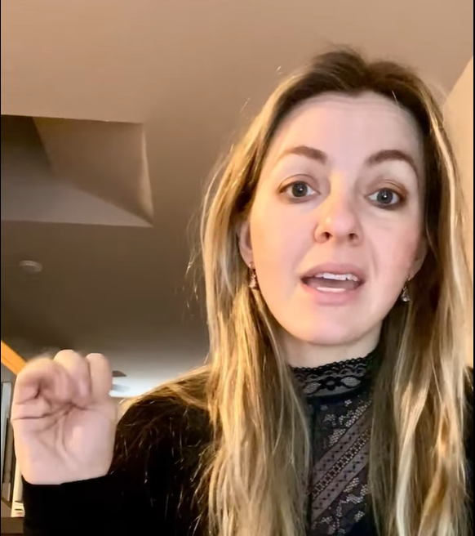
“I need help, I need to be rescued.”
Notes:
https://www.theepochtimes.com/mkt_app/tennessee-man-recognizes-womans-hand-signals-in-gas-station-to-alert-alleged-kidnapping_4405307.html?utm_source=Morningbrief&utm_campaign=mb-2022-04-22&utm_medium=email&est=Y4dbHvBDriXpdUN7Mb%2FBXbTvY2he9KMTA3AyyMNjYo3z2YKehtrPgYRKWCmrl%2BZwMw%3D%3D
Can do it behind your back. Stealthily.

Slide 7
Notes:
Actually two festivals called First Fruits.

Slide 8
First Fruits Times Two:
Resurrection and Ruakh [Spirit]
Notes:
That is, there are two Biblical festivals that are called First Fruits. One is very prominent in Jewish holidays. One is ignored. Can be confusing.

Slide 9
First Fruits
#One
Barley:
Resurrection

Slide 10
Barley is the grain ripening around Passover time
in the Middle East.

Slide 11
Plague #7 Thunderstorm of hail and fire
^{Shmot/Ex 9.31-33} The flax and the barley were destroyed, because the barley was in the ear, and the flax was in bloom. But the wheat and the spelt were not destroyed, because they ripen later.)

Slide 12
^{Shmot/Ex 9.31-33} Moshe went out of the city, away from Pharaoh, and stretched out his hands to Adoni. Then the thunder and hail ceased, and rain no longer poured down on the earth.

Slide 13
^{Vayikra/Lev 23.9-14} “Tell the people of Isra’el, ‘After you enter the land I am giving you and harvest its ripe crops, you are to bring a sheaf of the firstfruits of your harvest to the cohen. He is to wave the sheaf before Adoni, so that you will be accepted; the cohen is to wave it on the day after the Shabbat. [Pesakh]
Notes:
First fruits of the barley harvest. Wheat is not up yet.
Debate if the “day after the Shabbat” is the day after Pesakh/Passover, ie Nisan 16, or if it’s the day after the Shabbat after Passover. Since Pesakh was Saturday, April 16, firstfruits would have been April 17, 2022 = Nisan 16. The Omer count of 50 days would start Sunday [Sat night] April 17

Slide 14
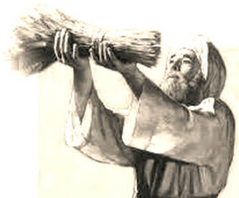
An ancient cohen /priest waving the barley
Notes:
https://3.bp.blogspot.com/-qC9g8Y0pklE/WBKABmcwakI/AAAAAAAAEPw/4f5ucuJdVzslJAsWF4-Sv7QqgFMk_EkQQCLcB/s320/Wave-offering1.jpg

Slide 15
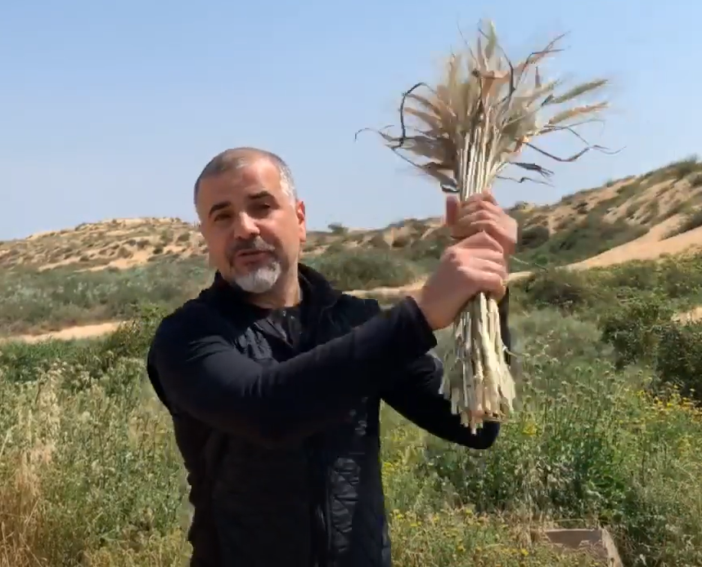
Israel Pochtar Beit Hallel, Ashdod, Israel
Waving to the north
Notes:
https://youtu.be/IyECcOO-SfY

Slide 16
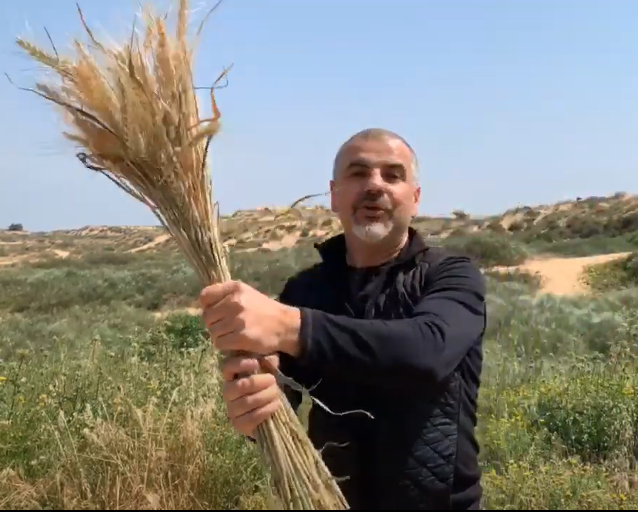
Waving to the east
“Word of G-d from Israel to all nations.”
Notes:
https://youtu.be/IyECcOO-SfY

Slide 17
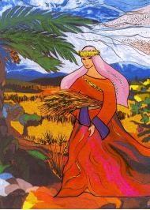
^{Vayikra/Lev 23.9-14} You are not to eat bread, dried grain or fresh grain until the day you bring the offering for your God; this is a permanent regulation through all your generations, no matter where you live…

Slide 18
A historical illustration of this being observed.

Slide 19
^{Y’hoshua 5.10-12} The people of Isra’el camped at Gilgal, and they observed Pesakh on the fourteenth day of the month, there on the plains of Yericho. The day after Pesakh they ate what the land produced, matzah and roasted ears of grain that day.

Slide 20
^{Y’hoshua 5.10-12} The following day, after they had eaten food produced in the land, the man [manna] ended. From then on the people of Isra’el no longer had man; instead, that year, they ate the produce of the land of Kena‘an.

Slide 21
Application to Messiah

Slide 22
^{1 Cor. 15.20-24} But the fact is that the Messiah has been raised from the dead, the first fruits of those who have died. For since death came through a man, also the resurrection of the dead has come through a man. For just as in connection with Adam all die, so in connection with the Messiah all will be made alive

Slide 23
^{Rev 1.17-18} He placed his right hand upon me and said, “Don’t be afraid! I am the First and the Last, the Living One. I was dead, but look! — I am alive forever and ever! And I hold the keys to Death and Sh’ol.
Notes:
Yeshua and barley: He is the one to conquer death. No one before, or after.
Barley is a simple grain, poor man’s food. Globally 70% of barley production is used as animal fodder, while 30% as a source of fermentable material for beer and certain distilled beverages, and as a component of various foods. It is used in soups and stews, and in barley bread of various cultures. Barley grains are commonly made into malt in a traditional and ancient method of preparation.
In 2017, barley was ranked fourth among grains in quantity produced (149 million tonnes or 330 billion pounds) behind maize, rice and wheat.
John Barleycorn personification of a grain.

Slide 24
^{1 Cor. 15.20-24} But each in his own order: the Messiah is the first fruits; then those who belong to the Messiah, at the time of his coming; then the culmination, when he hands over the Kingdom to God the Father, after having put an end to every rulership, yes, to every authority and power.

Slide 25
His resurrection
is the meaning of the barley celebration.
Is the foundation of LIFE for us!

Slide 26
After the days of waving, the count…

Slide 27
^{Vayikra/Lev 23.15-16} “‘From the day after the day of rest — that is, from the day you bring the sheaf for waving — you are to count seven full weeks, until the day after the seventh week; you are to count fifty days; and then you are to present a new grain offering to Adoni.

Slide 28
Apart from the counting of the days [the omer/sheafs] there is no modern celebration of First fruits in any Siddur.
Notes:
We, as believers in the Jewish Messiah, need to count this as a major day. Compose more songs, poems, Siddur type prayers. FFOZ doing?
There is one clear blessing over the resurrection in the Jewish prayer book…

Slide 29
אַתָּה גִּבּוֹר לְעוֹלָם אֲדנָי
A-tah gee-bor l'olam Ah-doni
מְחַיֵּה מֵתִים אַֽתָּה רַב לְהוֹשִׁיעַ
M'khi-yay may-teem a-tah [X2]
Rav l'ho-shee-ah
[You are the mighty One forever, O L-rd
You raise the dead sleeping in their graves
You are mighty to save ]

Slide 30
מְכַלְכֵּל חַיִּים בְּחֶסֶד
M'khal-kayl khi-yeem b'khesed
מְחַיֵּה מֵתִים בְּרַחֲמִים רַבִּים
M'khi-ay may-teem
B'ra-kha-meem ra-beem
[He sustains life in love
He revives the dead
With great mercies]

Slide 31
סוֹמֵךְ נוֹפְלִים וְרוֹפֵא חוֹלִים
So-maykh no-fleem
V'ro-fay kho-leem
וּמַתִּיר אֲסוּרִים
[He supports the falling
And heals the sick
And frees the prisoners]

Slide 32
וּמְקַיֵּם אֱמוּנָתוֹ לִישֵׁנֵי עָפָר
U-m'ka-yeem e-mu-na-to
Lee-shay-nay a-far
[And establishes his faithfulness
With those that sleep in the dust]
Notes:
Death does not stop the covenant faithfulness to Israel, to YOU, Dads and Moms!

Slide 33
מִי כָמֽוֹךָ בַּעַל גְּבוּרוֹת
Mee kha-mokha ba-al g'vu-rot
וּמִי דּֽוֹמֶה לָּךְ מֶלֶךְ מֵמִית
U-mee do-meh lakh Melekh ma-meet
[Who is like you The Master of Power
And who resembles You
O King who controls death]

Slide 34
וּמְחַיֶּה וּמַצְמִֽיחַ יְשׁוּעָה
U-m'kha-yeh u-mats-mee-akh
Y'shu-ah
And gives life
And causes salvation
to spring forth

Slide 35
וְנֶאֱמָן אַתָּה לְהַחֲיוֹת מֵתִים
V’neh-eh-mahn a-tah
L’ha-khay-oht meh-teem
[And you are faithful to
Resurrect the dead]

Slide 36
בָּרוּךְ אַתָּה יְיָ
[בָּרוּךְ הוּא וּבָּרוּךְ שְּׁמוֹ]
Ba-rukh a-tah Ah-do-ni
[Ba-rukh hu u-ba-rukh sh'mo]
מְחַיֶּה הַמֵּתִים
M’kha-yeh ha-meh-teem
Blessed are You, ADONI Who resurrects the dead

Slide 37
He sustains life in love
He revives the dead
With great mercies
He supports the falling
And heals the sick
And frees the prisoners
And establishes his faithfulness
With those that sleep in the dust

Slide 38
Who is like you
The Master of Power
And who resembles You
O King who controls death
And gives life
And causes salvation
to spring forth

Slide 39
And you are faithful to
Resurrect the dead
Blessed are You, ADONI
Who resurrects the dead

Slide 40
^{Vayikra/Lev 23.15-16} “‘From the day after the day of rest — that is, from the day you bring the sheaf for waving — you are to count seven full weeks, until the day after the seventh week; you are to count fifty days; and then you are to present a new grain offering to Adoni.

Slide 41
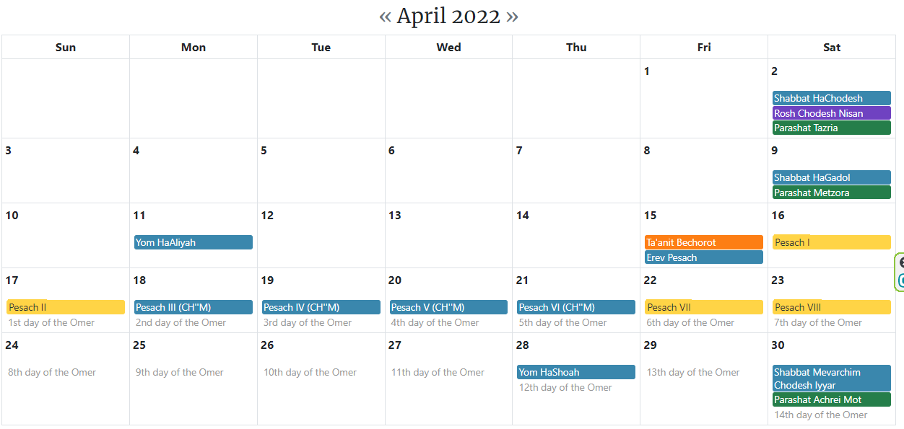
Pesakh/ Passover
Notes:
We delayed our community Passover to keep Shabbat. A LOT of work.
Traditional synagogues employ “Sabbes goys” To us all the nations/goyim art part of the chosen people in spirit. Not all Jews, but not anyone subservient!!

Slide 42
We are a week late. Did the Pesakh Seder on the third night, so as to avoid massive Shabbat work. Previously, our congregational Seder was on the first or the second night.
Next year, back to policy of second night Seder. Thursday evening, April 6.
Notes:
So today is really commemorative of Biblical date last Sunday.

Slide 43
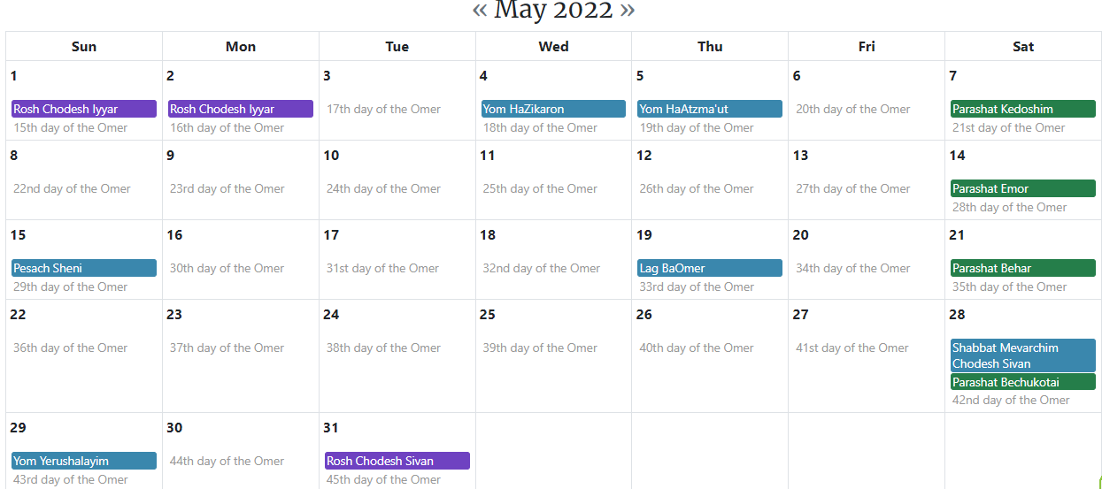

Slide 44
From George Whitten: A remarkable fact is that for nearly 2000 years the Jewish people had no homeland, and no harvest to count – yet they continued to count the Omer, counting a harvest that did not exist.
Notes:
George Whitten

Slide 45
Then, about 130 years ago a historical miracle began as the Lord drew the Jewish people back to their ancient homeland, the land of Israel. The land was revived from being a dusty desert, and the barley harvest was restored, so that now, the Omer is counted as it was in ancient times, with an actual harvest!
Notes:
George Whitten

Slide 46
Now, if the Jews in diaspora (dispersion) could count the days of a non-existent harvest, in expectation of a divine blessing which they earnestly hoped for, then they set an excellent example for us who trust in the Messiah they gave to the world.
Notes:
George Whitten

Slide 47
Since faith is the conviction of things NOT seen, we, also, can begin to give thanks for blessings we're praying for but have yet to receive. Our unsaved loved-one, chronic illness, broken relationship, financial disaster, loss of vision.....all these are trials which are testing and maturing our faith.
Notes:
George Whitten

Slide 48
^{Vayikra/Lev 23.16-18} You are to count fifty days, and then present a new grain offering to Adoni.

Slide 49
Shavuot/Pentecost

Slide 50
First Fruits Times Two:
Resurrection and Ruakh [Spirit]

Slide 51
First Fruits
#Two
Wheat:
Torah and the giving of the Ruakh!

Slide 52
^{Vayikra/Lev 23.16-18} You must bring bread from your homes for waving — two loaves made with one gallon of fine flour, baked with leaven — as firstfruits for Adoni. Along with the bread, present seven lambs without defect one year old.

Slide 53
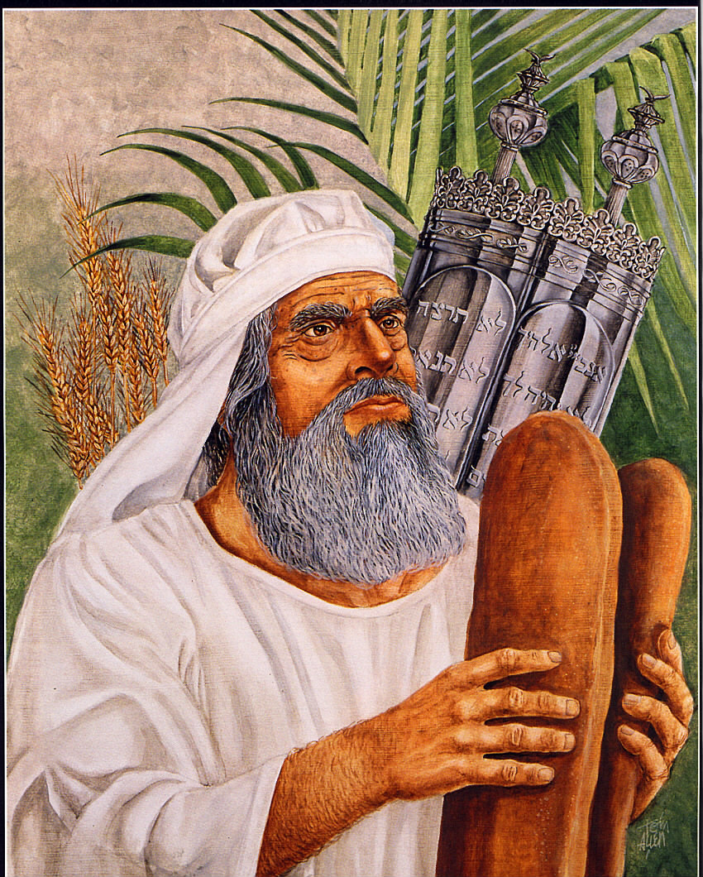
Two loaves made with one gallon of fine flour!
Notes:
Kevin Howard Feasts of the Lord p 88

Slide 54
^{Vayikra/Lev 23.20} The cohen will wave them with the bread of the firstfruits as a wave offering before Adoni, with the two lambs; these will be holy for Adoni for the cohen.

Slide 55
^{Acts 2.1-4} The festival of Shavu‘ot arrived, and the believers all gathered together in one place.
Notes:
[Pentecost]

Slide 56
sumpléroó: to fill up completely, hence to fulfill
Implies a long counting.

Slide 57
^{Acts 2.1-4} Suddenly there came a sound from the sky like the roar of a violent wind, and it filled the whole house where they were sitting.

Slide 58
^{Acts 2.1-4} Then they saw what looked like tongues of fire, which separated and came to rest on each one of them. They were all filled with the Ruakh HaKodesh and began to talk in different languages, as the Spirit enabled them to speak.

Slide 59
First Fruits
#Two
Wheat:
Torah and the giving of the Ruakh!

Slide 60
^{Yaakov/Jas. 1.18} By His will, He brought us forth by the word of truth, so that we might be a kind of first fruits of all He created.

Slide 61
^{Yer/Jer 2.2-3} “The word of Adoni came to me: “Go and shout in the ears of Yerushalayim that this is what Adoni says: ‘I remember your devotion when you were young; how, as a bride, you loved me;

Slide 62
^{Yer/Jer 2.2-3} “through a land not sown. “‘Isra’el is kadosh/holy for Adoni, the first fruits of his harvest; all who devour him will incur guilt; evil will befall them,” says Adoni.

Slide 63
^{Ro. 8.22-23} We know that the whole creation groans together and suffers birth pains until now— and not only creation, but even ourselves. We ourselves, who have the first fruits of the Ruakh, groan inwardly as we eagerly wait for adoption—the redemption of our body.

Slide 64
^{Ro. 16.5} Greet also the community that meets in their house. Greet Epaenetus whom I dearly love, who is the first fruit in Asia for Messiah.

Slide 65
^{1 Cor 16.15-16} Now I urge you, brothers and sisters (you know the household of Stephanas, that it is the first fruits of Achaia [Greece], and that they have devoted themselves in service to the kedoshim), also to submit to people such as these

Slide 66
^{Rev. 14.4-5} These are the ones who follow the Lamb wherever He goes. These have been redeemed from among mankind as first fruits for God and the Lamb. And in their mouth was found no lie—they are blameless.

Slide 67
^{Yn 3.5-8} Yeshua answered, “Yes, indeed, I tell you that unless a person is born from water and the Spirit, he cannot enter the Kingdom of God. What is born from the flesh is flesh, and what is born from the Spirit is spirit.

Slide 68
^{Yn 3.5-8} Stop being amazed at my telling you that you must be born again from above! The wind blows where it wants to, and you hear its sound, but you don’t know where it comes from or where it’s going. That’s how it is with everyone who has been born from the Spirit.”

Slide 69
^{2 Cor. 5.17-18} Therefore if anyone is in Messiah, he is a new creation. The old things have passed away; behold, all things have become new. Now all these things are from God, who reconciled us to Himself through Messiah and gave us the ministry of reconciliation.
Notes:
We receive in order to give and serve.

Slide 70
^{Acts 3.15-16} You killed the author of life! “But God has raised him from the dead! Of this we are witnesses.

Slide 71
archégos: founder, leader
the first in a long procession; a file-leader who pioneers the way for many others to follow; does not strictly mean "author," but rather "a person who is originator or founder of a movement and continues as the leader – i.e. 'pioneer leader, founding leader' "

Slide 72
properly, the first in a long procession; a file-leader who pioneers the way for many others to follow.
Notes:
https://biblehub.com/greek/747.htm

Slide 73
^{Acts 3.15-16} And it is through putting trust in his name that his name has given strength to this man whom you see and know. Yes, it is the trust that comes through Yeshua which has given him this perfect healing in the presence of you all.
Notes:
Apply this to marital dynamics…

Slide 74
A different take on a renewed humanity.

Slide 75
Notes:
https://www.brighteon.com/eab1838b-260d-45dd-b57a-a39063545d07 play till 1.04
Ray Kurzweil also https://www.ted.com/speakers/ray_kurzweil

Slide 76
^{Gal.5.22-23} The fruit of the Spirit is love, joy, peace, patience, kindness, goodness, faithfulness, humility, self control. Nothing in the Torah stands against such things.
Notes:
Application to marriage

Slide 77
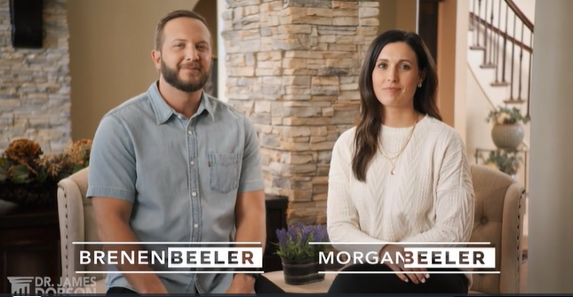
Notes:
https://www.drjamesdobson.org/marriage-parenting/error-or-opportunity-beelers-episode-9

Slide 78
The California state legislature is currently debating a bill—AB 2223—that will effectively legalize infanticide by legalizing abortion until as many as 28 days after a baby is born.
Notes:
https://www.charismanews.com/us/88953-spirit-filled-pastors-rail-against-immoral-california-bill-that-would-legalize-infanticide?utm_source=Charisma%20News%20Daily&utm_medium=email&utm_content=subscriber_id:5160390&utm_campaign=CNO%20daily%20-%202022-04-21

Slide 79
First Fruits Times Two:
Resurrection and Ruakh [Spirit]

Slide 80
First Fruits
#One
Barley:
Resurrection

Slide 81
First Fruits
#Two
Wheat:
Torah and the giving of the Ruakh!

Slide 82
Do you KNOW Yeshua and the assurance of sins forgiven?
Are you hearing daily from His Word?
How are you applying what you heard?
Are you asking this of another?
Notes:
Receiving the Spirit in the power of the resurrection. Being filled with the Spirit.
Backbone of who we are, Shma.
Hearing and doing.
Who are you discipling, building up?4

