Slide 1
e-handout
To have these notes
without taking notes
Go to OrHaOlam.com
Click on Messages tab,
2022 Messages

Slide 2
Student loan $1.7 trillion
debt crisis
Notes:
Vicki and Steve Kline
Our president talks of cancelling the loans!

Slide 3
Student loan $1.7 trillion
debt crisis solved
Notes:
Vicki and Steve Kline
https://www.theepochtimes.com/will-student-debt-forgiveness-bankrupt-the-country_4439834.html?utm_source=uschinanoe&utm_campaign=uschina-2022-05-07&utm_medium=email&est=GSMpRxuqzGjyMbD6oLDD3MpR4rZbZP%2FjnScvyEr59OfmbazWd0ZVyfVsTsNilzMN5Q%3D%3D

Slide 4
One of the most signature customs in a Jewish home is the lighting of Shabbat candles.
Notes:
There are three families this community in which the Grandmother lit Friday evening candles in a closet, then shut the door, and no idea why.
Crypto Jews hiding from the Inquisition!! They found out they were Jewish.

Slide 5
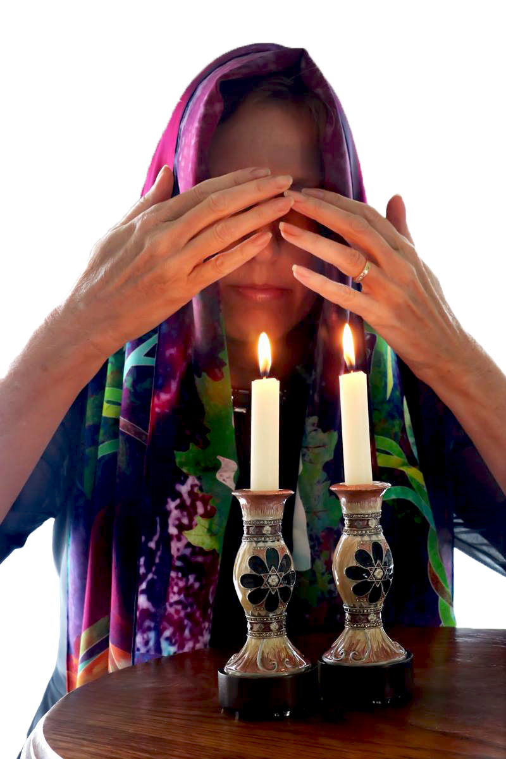
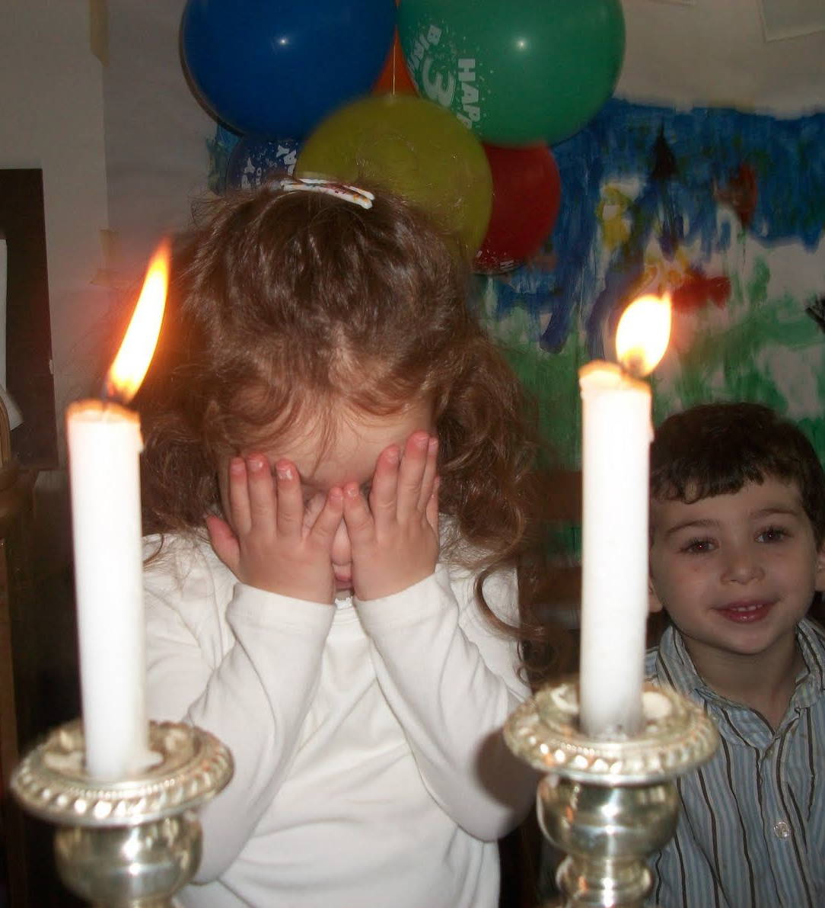
Notes:
https://external-content.duckduckgo.com/iu/?u=https%3A%2F%2Fi2.wp.com%2Fkiebortzjewishgifts.com%2Fwp-content%2Fuploads%2F2016%2F07%2FKarinEtzChaimPurplePrayingWhite.jpg%3Ffit%3D800%252C1200%26ssl%3D1&f=1&nofb=1
https://i.pinimg.com/originals/b7/63/7a/b7637ae1e77dc9fc7448067ee88f04f3.jpg
Single woman can be one candle, married two, increase candles with children
Why the woman? It is the woman who determines the spirituality in the home. By encouraging the study of scripture and the mitzvot and prayer, and through her nurturing presence, the woman transforms her home into a place of holiness, peace and tranquility. It is thus fitting that she be the one to bring the extra measure of light and holiness with the Shabbat candles.

Slide 6
^{Yeshayahu/Is 58.13} Call Shabbat a delight, the holy day of Adoni, honorable…
Notes:
Cover the eyes…the delight, beauty of a candle we want to be totally ascribed to G-d.
The Midrash tells us that G‑d says, “If you kindle the Shabbat lights, I will show you the marvelous radiance that will shine upon Jerusalem at the final redemption.” In other words, the lighting of the Shabbat candles hastens the final redemption, when there will be peace in the entire world.
May we merit this speedily in our days! https://www.chabad.org/library/article_cdo/aid/484176/jewish/Why-Light-Two-or-More-Shabbat-Candles.htm

Slide 7
The practice of lighting an oil lamp before Shabbat is first recorded in the second chapter of m. Shabbat. The purpose of lighting of Shabbat candles is to dignify the Sabbath. Before the advent of electric lighting, when the alternative was to eat in the dark, it was necessary to light lamps to create an appropriate environment.
Notes:
So, about 600 CE. Even the finest cuisine becomes a drab affair when you can’t see the colors, textures and forms of those delicious morsels.
So the women bring in the beauty of Shabbat.

Slide 8
Valiant women have been the instruments in G-d’s hands of bringing the Kingdom…
Prov 31 Eshet Khayil, אשת חילas was elegantly sung…
Notes:
Woman of war

Slide 11
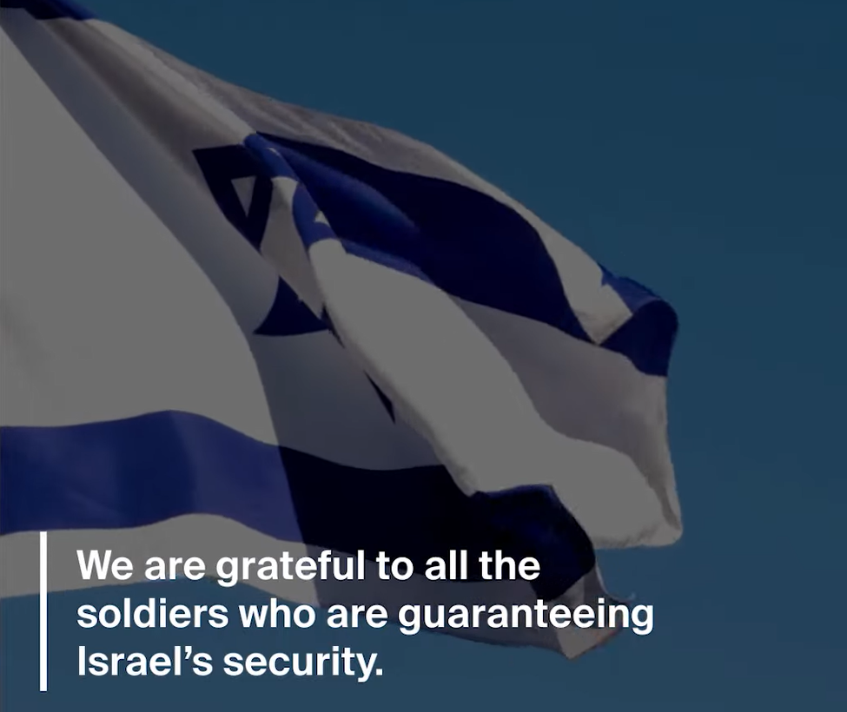
Notes:
https://youtu.be/2jBsY1Lg6m4

Slide 13
Birthing of salvation: praying heroines
^{Yeshayahu/Is 66.8} Who has heard such a thing? Who has seen such things?
Can a land be born in one day?
Can a nation be brought forth at once? For as soon as Zion was in labor, she gave birth to her children.
Notes:
Epochal LIFE giving is in female terms.

Slide 14
Example #1: Yokheved
Hearing from G-d
Notes:
14
Jochebed
Gal 3.27 in the Messiah there is neither Jew nor Gentile, neither slave nor freeman, neither male nor female; for in union with the Messiah Yeshua, you are all one. Here is where it is true

Slide 15
^{Shmot/Ex 2.1-3} A man from the family of Levi took a woman also descended from Levi as his wife. When she conceived and had a son, upon seeing what a fine child he was, she hid him for three months. וַתֵּרֶא אֹתוֹ כִּי-טוֹב הוּא
Notes:
15
Remem backstory death.
Probably the mother of Moses was full of anxiety in the expectation of his birth, now that this edict was in force, and was ready to say, Blessed are the barren that never bore, Lu. 23:29. Better so than bring forth children to the murderer, Hos. 9:13. Yet this child proves the glory of his father’s house. Thus that which is most our fear often proves, in the issue, most our joy. Note, When men are projecting the Israel’s ruin [or yours or mine] God is preparing for salvation.
Bit of a strange, intense expr, all babies in Mes Scrip quote, Pirke Eliezer

Slide 16
“He was beautiful in God's sight,”
as Stephen expresses it, ^{( Acts 7:20 )}
[Pirke Eliezer, c. 48. fol. 57. 2] His form was like an angel of God
Notes:
16

Slide 17
She heard from G-d. Main command of Tanakhic and Messianic Judaism?
Shma, שמע Hear
Notes:
17
His parents observed him to be a goodly child, more than ordinarily beautiful; he was fair to God, Acts 7:20. They fancied he had a lustre in his countenance that was something more than human, and was a specimen of the shining of his face afterwards, Ex. 34:29.
Trogus, a heathen writer, says his beautiful form recommended him: this engaged the affections of his parents to him, and who, from hence, might promise themselves that he would be a very eminent and useful person, could his life be preserved:

Slide 18
Midrash [traditional interpretation]:
Each generation forgets a bit of the Sinaitic revelation because Israel feared the voice of G-d, and asked Moshe to relay the message. If Israel had listened to the Voice, [at Sinai] no generation would have forgotten.
Notes:
18
Yokheved heard
Question to all of us, particularly from Moms, do you hear from G?
NOT so you can tell your fam “Thus says…” ALWAYS CONFIRM
So, you can be uplifted, strengthened, encouraged, counsel

Slide 19
Message of the New Covenant:
“All will know me.”
How much, how well, how often?
Notes:
19
Essence of discipleship
What is G-d showing you in the Bible?
What are you doing with what He has shown you?
Are you asking this of someone else?

Slide 20
When she could no longer hide him, she took a papyrus basket, coated it with clay and tar, put the child in it and placed it among the reeds on the riverbank.
Notes:
20
A mother who hears from G-d! Then hiding was successful beyond imagination. Salvation of Israel!!
Be a great mother??
Hear from G!
Applies to all
Breakthrough!?? Hear from G!
Power of the death and resurrection of Messiah, only if we avail ourselves.

Slide 22
Birthing of salvation: praying heroines
^{Yeshayahu/Is 66.8} Who has heard such a thing? Who has seen such things?
Can a land be born in one day?
Can a nation be brought forth at once? For as soon as Zion was in labor, she gave birth to her children.

Slide 23
Example #2: Hannah:
Cried out and sought G-d
in depression
Notes:
23

Slide 24
^{Shmuel א 1.6-7} Her rival taunted her and made her feel bad, because ADONI had kept her from having children. He [Eli her husband] did the same every year; and each time she went up to the house of ADONI , she taunted her so much that she would cry and not eat.
Notes:
24
Back story:
Responded like most of us do in situations of difficulty and adversity
Felt depressed and angry
Response: Prayed
Women stereotypically more emotional, subject to mood swings, depression???
Anyhow, she was an not w/o reason.
What are you/I depressed, angry, frustrated about?
SHE PRAYED in her anger & depression.

Slide 25
^{Shmuel א 1.10-12} In deep depression she prayed to Adoni and cried. Then she took a vow; she said, “Adoni-Tzva'ot, if you will notice how humiliated your servant is, if you will remember me and not forget your servant but will give your servant a male child, then I
Notes:
25

Slide 26
^{Shmuel א 1.10-12} will give him to Adoni for as long as he lives; and no razor will ever come on his head.” She prayed for a long time before Adoni.
Notes:
26
Later describes mood “the depth of my distress and anger.” Pray then??
Depressed→ prayer always good
Better live in faith & pray, but OK
Angry and depressed → pray
I can relate to this. Love Psalms
Depressed → [Naz] vow not always good, this case perfect
Response from community?

Slide 27
^{Shmuel א 1.13-14} Her lips moved, but her voice could not be heard –so 'Eli עֵלִי thought she was drunk. 'Eli said to her, "How long are you going to stay drunk? Stop drinking your wine!"
Notes:
27
[why apostrophe before Eli’s name in CJB
Ki it’s an ayin, different sound to purists ~D Stern]
Misunderstanding and rejection and scorn for this intensity of prayer
Rather get more depressed ki rejection, explains calmly, respectfully
"The splendor of a human heart that trusts that he is loved gives God more pleasure than Westminster Cathedral, The Sistine Chapel, Beethoven's Ninth Symphony, Van Gogh's Sunflowers, the sight of ten thousand butterflies in flight, or the scent of a million orchids in bloom." It takes heroic courage to trust in the love of God in face of abandonment, betrayal, loss, failure, unemployment or sickness. Trust is often found at the moment we are on our far side of despair. "When all human resources are exhausted, when the craving for reassurances is stifled, when we forgo control, when we cease trying to manipulate God and demystify Mystery, then - at our wits' end - trust happens within us and the untainted cry, 'Abba, into your hands I commend my spirit,' surges from the heart."
Ruthless Trust by Brennan Manning as quoted by Patty Juster May 14, 2010

Slide 28
Then 'Eli replied, "Go in peace. May the God of Isra'el grant what you have asked of him.“
לְכִי לְשָׁלוֹם; וֵאלֹהֵי יִשְׂרָאֵל יִתֵּן אֶת-שֵׁלָתֵךְ אֲשֶׁר שָׁאַלְתְּ מֵעִמּוֹ.
Notes:
28
[no commentary on שֵׁלָתֵךְ why aleph missing]
GREAT WORDS! Prayed and persevered to reassurance. ~witness of Spirit
Then, chapt 2, 3 years later, she fulfills vow and gives toddler Shmuel to Eli to serve. Heartbreak departure?
One of richest praise songs in Bible, but sang it alone, w/o Elkanah husband. Lonely?
Musical in Hebrew. My second memory assignment > Ps 23 also music in Heb

Slide 29
Summary: woman in distress & anger, for years
→prayer
→suspicion of motives
→blessing
→inspired praise & music
→conceived prophet →Messiah’s dynasty
Notes:
29
Are you a woman [men too] takes distresses to prayer and ends in song, or yell about it.
“Sing of Barren one” re abandoned wives.
1 pray → hear 2 pray →sing
I attend City Wide Prayer movement. Petite lady ~70, 5’ 2” told us when her kids little, no time to pray. G said what doing 5 am.? You can pray then. Has for ~50 years. Swan Bates. Quoted scripture 1 Tim 2.2 takes a while.
Woman of faith

Slide 31
Birthing of salvation: praying heroines
^{Yeshayahu/Is 66.8} Who has heard such a thing? Who has seen such things?
Can a land be born in one day?
Can a nation be brought forth at once? For as soon as Zion was in labor, she gave birth to her children.

Slide 32
Example #3: Hannah Bat-P'nu'el
Scriptural / Prophetic Insight
Notes:
32
Is it conceivable there would have been no Messiah, at that time, without her prayers??

Slide 33
^{Luke 2:36-38} There was also a prophet named Hannah Bat-P'nu'el, of the tribe of Asher. She was a very old woman -- she had lived with her husband seven years after her marriage and had remained a widow ever since; now
Notes:
33
Anna in KJV

Slide 34
^{Luke 2:36-38} now she was eighty-four. She never left the Temple grounds but worshipped there night and day, fasting and praying.
Notes:
34
she attended to the usual fasts of twice a week, and to the several set times of prayer, and to every act of devotion, private or public, by night or day???
In Exodus 38:8 “He made the basin of bronze with its base of bronze from the mirrors of the women serving at the entrance to the tent of meeting.”
Targums of Onkelos and Ben Uzziel render it, "who came to pray"; and the
Septuagint version, "that fasted":
Hannah/Anna did both.

Slide 35
^{Luke 2:36-38} She came by at that moment and began thanking God and speaking about the child to everyone who was waiting for Yerushalayim to be liberated.
Notes:
35
Or Came in, must have been out
Here is a praying woman in widowhood.
Doesn’t say if she was a mother, not pre-occupied w children or grandchildren, probably not. Yet legacy of prayer and praise
Apparently, her prayers are what brought on the first coming of Messiah at that time in history…breakthrough!!

Slide 36
A bit of spiritual history…

Slide 38
^{Yeshayahu/Is 66.8} Who has heard such a thing? Who has seen such things?
Can a land be born in one day?
Can a nation be brought forth at once? For as soon as Zion was in labor, she gave birth to her children.

Slide 39
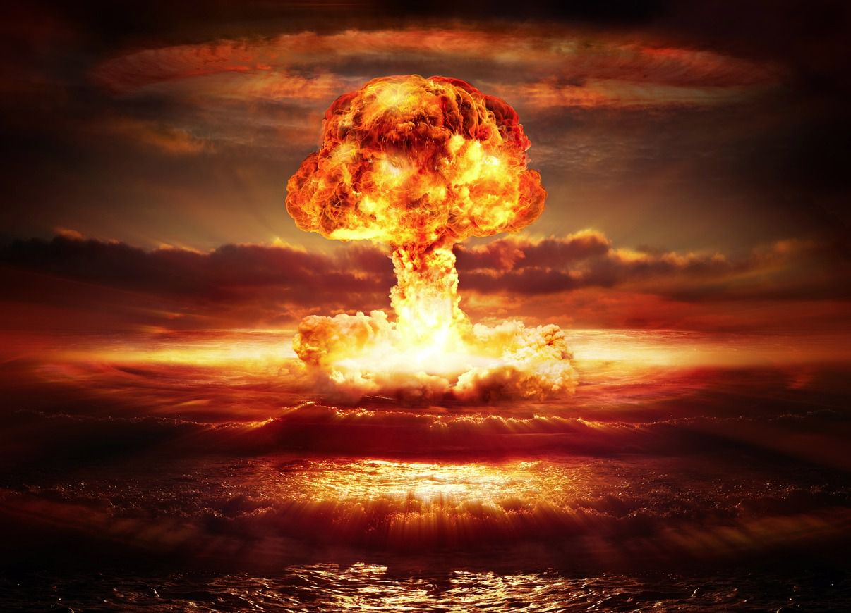
Atomic bomb detonation
Notes:
https://www.google.com/search?q=atomic+bomb&safe=active&source=lnms&tbm=isch&sa=X&ved=0ahUKEwj374-nq5zcAhUIR6wKHQWpAK4Q_AUICigB&biw=1151&bih=848#imgrc=XNjflTrnCTGxmM:
July 16, 1945, in the desert north of Alamogordo, New Mexico, the first nuclear test took place, released energy equivalent to 19,000 tons of TNT, far more powerful than any weapon ever used before.
2 lbs of TNT can obliterate a small car.
https://en.wikipedia.org/wiki/TNT_equivalent
This was 19 million x a car’s worth of TNT.

Slide 40
On August 6, 1945, a uranium-based weapon, Little Boy, was detonated above the Japanese city of Hiroshima, and three days later, another weapon, Fat Man, was detonated above the Japanese city of Nagasaki. On August 15,1945, Japanese Emperor Hirohito announced Japan's surrender.

Slide 41
Power, a whole new form
and level of power
for outreach before the end..

Slide 42
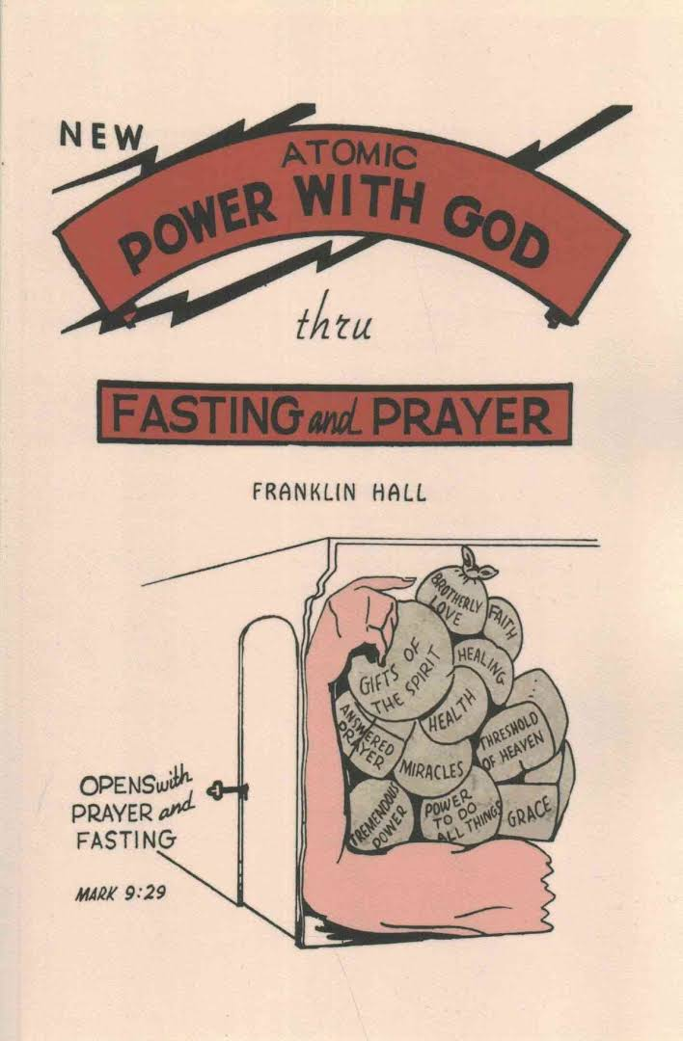
published
1946
Atomic Power
with God
Fasting
movement
in response
Notes:
2016 Reprint of 1950 Edition. Along with many others of the depression era Franklin Hall grew up in rural poverty and was deeply religious. During the depression and World War II he travelled as an independent evangelist. In 1946, he published a brief book entitled "Atomic Power with God through Prayer and Fasting." The book, which provided detailed information on the methods and benefits of fasting, was an immediate success and brought Hall considerable fame. According to Hall, all of the major evangelists began following his fasting regime and miracles erupted everywhere. Many observers of the early revival years agreed, as one said, "Every one of these men down through the years followed Franklin Hall's method of fasting."

Slide 43
Then in 1947-1952 the great healing revival broke out with men like William Branham, Oral Roberts, and T.L. Osborne
Big Tent
Notes:
https://www.christianity.ca/page.aspx?pid=10891
https://www.youtube.com/watch?v=fL85daR2nBI
Do I endorse all these? Not wholly. However, birth is messy. [Been there?] Revival is messy. The Messianic movement is messy: Orthodox Rabbinical Messianics, anti-Orthodox Messianics, charismatic Messianics, anti-charismatic Messianics. Hyper charismatics. Hyper anti charismatics. Big tent guy, to see LIFE in Yeshua where there is life. Big heart, big filter. Sift, keep baby; throw out bathwater. Secret:
I can pray in tongues. Don’t do it much. Sweet.
I can pray in T’fillin. Don’t do it much either. T’fillin and tongues. Dan Juster told me that there was a message on that at the UMJC Conference one year.

Slide 44
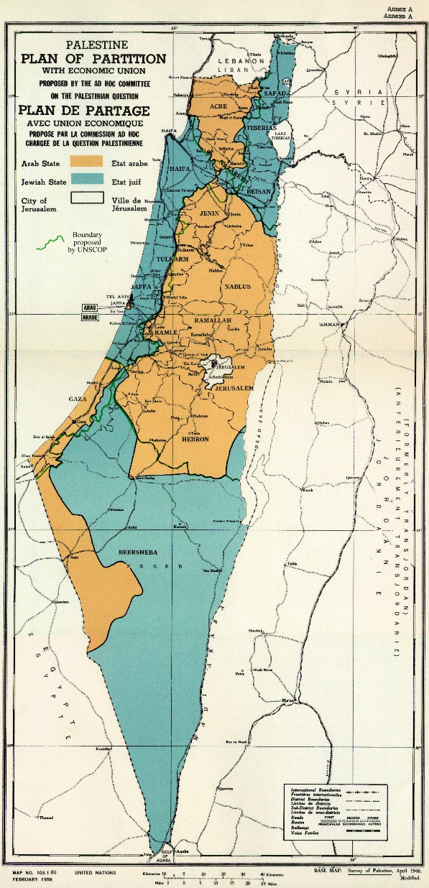
1947 Partition plan
Jewish state blue
Arab state orange
Jerusalem white
internationalized
Needed 2/3 majority
in UN Gen’l Assembly
Notes:
https://en.wikipedia.org/wiki/United_Nations_Partition_Plan_for_Palestine
Context, breakthrough practice of fasting for the Kingdom before the end! The end: outreach and abomination.

Slide 45
On 29 November 1947, the United Nations General Assembly voted 33 to 13, with 10 abstentions and 1 absent, in favor of the modified Partition Plan. All Soviet republics voted FOR. [To antagonize the British.]
Diplomatic miracle.
Notes:
https://en.wikipedia.org/wiki/United_Nations_Partition_Plan_for_Palestine
Very difficult to get the votes. Lots of Arab states opposed.

Slide 46
In 1948 the "Latter Rain" outpouring hit North Battleford, Canada, and swept into the United States.
Notes:
https://www.christianity.ca/page.aspx?pid=10891
https://www.youtube.com/watch?v=fL85daR2nBI

Slide 47
In 1948 Bill Bright saw a vision of college campus awakenings,
Billy Graham's ministry was released in 1949
The Asbury College revival, along with many others, commenced in 1950.
Notes:
https://www.christianity.ca/page.aspx?pid=10891
https://www.youtube.com/watch?v=fL85daR2nBI
These are some leaders most of us would agree was great, good, powerful.

Slide 48
Atomic Power
with God
published
1946
Fasting
movement in
response→ revival
Notes:
Context, breakthrough practice of fasting for the Kingdom before the end! The end: outreach and abomination.
One more, currently ongoing, as big as the above?

Slide 50
Birthing of salvation: praying heroines
^{Yeshayahu/Is 66.8} Who has heard such a thing? Who has seen such things?
Can a land be born in one day?
Can a nation be brought forth at once? For as soon as Zion was in labor, she gave birth to her children.

Slide 51
Are we about to pray down the end of the age and the return of the Messiah Yeshua?

Slide 52
^{Mat. 23.39} For I tell you, you will never see Me again until you say,
ברוך הבא בשם יי
‘Barukh ha-ba b’shem Adoni. Blessed is He who comes in the name of the Adoni!’”
Notes:
I believe in Heaven, hell, holiness, repentance, eternal judgment including the judgment seat of Messiah
Sinner’s prayer for individual salvation, repentance and faith.
Jewish/worldwide prayer for global salvation.

Slide 53
^{Rev. 22.20} “The one who is testifying to these things says, ‘Yes, I am coming soon!’” Amen! Come, Lord Yeshua!

Slide 54
Notes:
Will You Be 1 of 100 Million Intercessors for Israel? www.i49wall.com
https://youtu.be/57A43lmeeCY
BUT only beginning to 1.12 then 2.11 to the end.

Slide 55
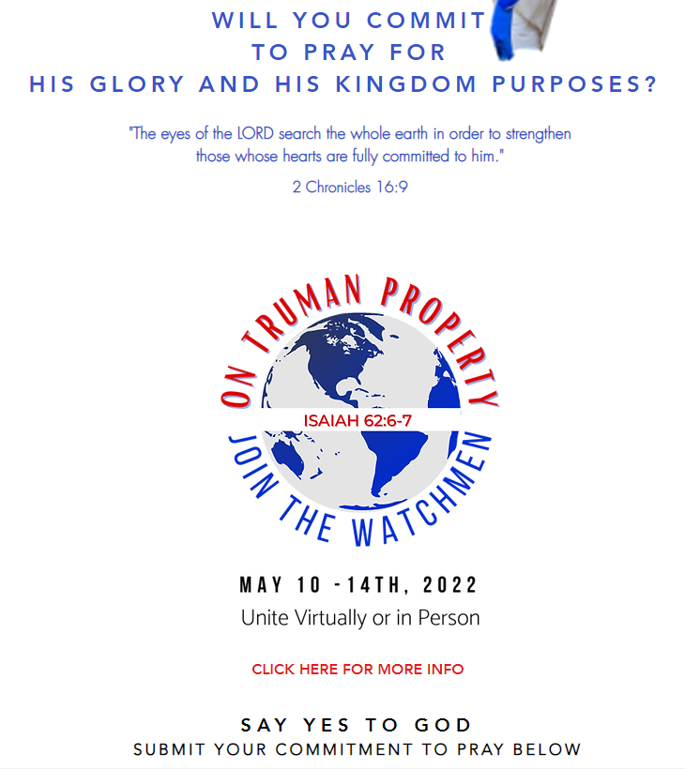
at
https://www.i49wall.com/
Notes:
Main application Moms, and all of us: Join this prayer movement on line or attending. Or HaOlam two sets, Wednesday 5-7pm and Thursday 4-5pm for the pattern of 40 minute worship, 20 minute teaching.

Slide 56
^{T’hillim/Ps 102.13-14} You will arise and take pity on Tziyon, for the set time has come to have mercy on her; the set time has come. For your servants love her very stones; they take pity even on her dust.

Slide 57
The set time to seek G-d for our own salvation.
The set time to seek G-d for the spiritual AND physical salvation of Israel…His Return!

