Slide 1
e-handout
To have these notes
without taking notes
Go to OrHaOlam.com
Click on Messages tab,
2023 Messages

Slide 2
A new kind of Pumpkin Pie
Notes:
Eric and Joy Poling

Slide 3
Why is Cinderella
unfit to play soccer?
Notes:
Jude Mahoney

Slide 4
Why is Cinderella
unfit to play soccer?
Because she keeps
running away from the ball.
Notes:
Jude Mahoney

Slide 6
^{Eph. 2.5-7} Even when we were dead because of our acts of disobedience, he brought us to life along with the Messiah — it is by grace that you have been delivered. That is, God raised us up with the Messiah Yeshua and seated us with him in heaven,

Slide 7
^{Eph. 2.5-7} in order to exhibit in the ages to come how infinitely rich is his grace, how great is his kindness toward us who are united with the Messiah Yeshua.

Slide 8
Eph. 2. 5 He brought us to life.
Eph. 2. 5 Done by grace
Eph. 2. 6 Seated with Him
in heaven.
Eph. 2. 7 Makes us a Showpiece

Slide 9
Eph. 2. 5 He brought us to life.
Eph. 2. 5 Done by grace
Eph. 2. 6 Seated with Him
in heaven.
Eph. 2. 7 Makes us a Showpiece

Slide 10
From 1982 to 1988 we served as a Native Canadian Missionaries in Winnipeg, Manitoba, Canada
North on I 29 till it ends at the Canadian border, then another hour north.

Slide 11
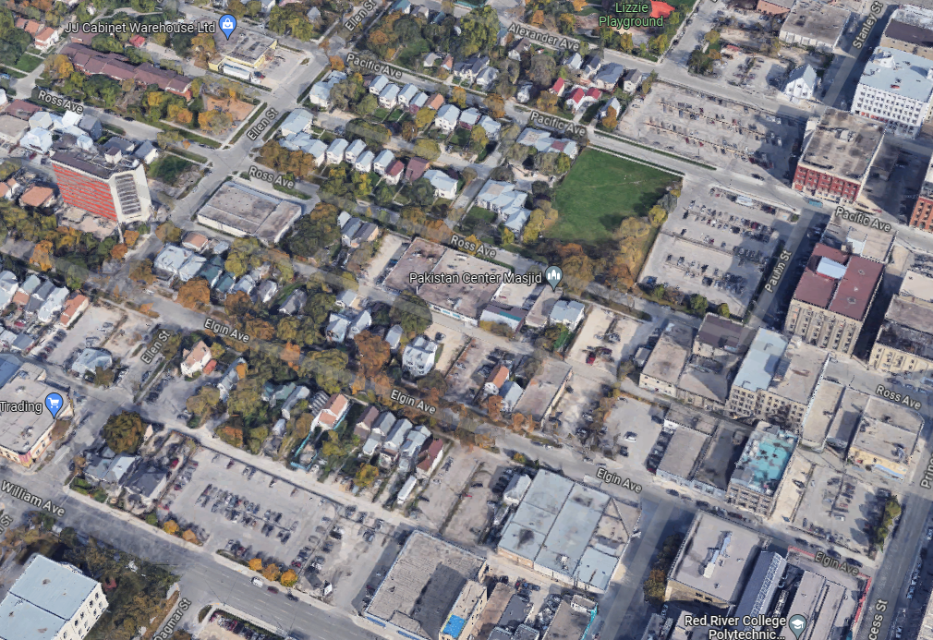
Notes:
Urban Indian ministry. Inner city. I’m not a reservation rural type guy.

Slide 12
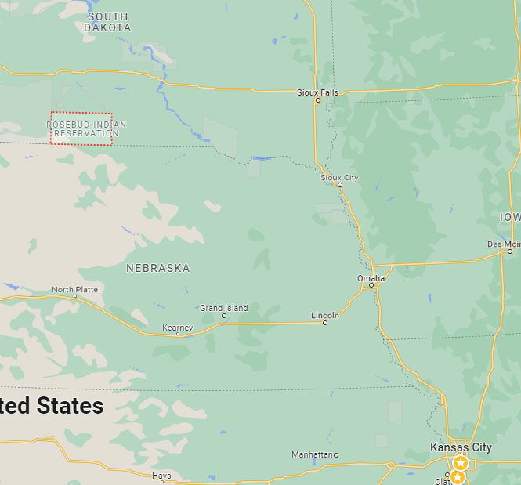
Once per year to Rosebud, SD for staff retreat
Notes:
Urban missionaries, large Native population. Org called the Society of Indian Missions. Yearly staff camp was on the Rosebud Reservation in South Dakota

Slide 13
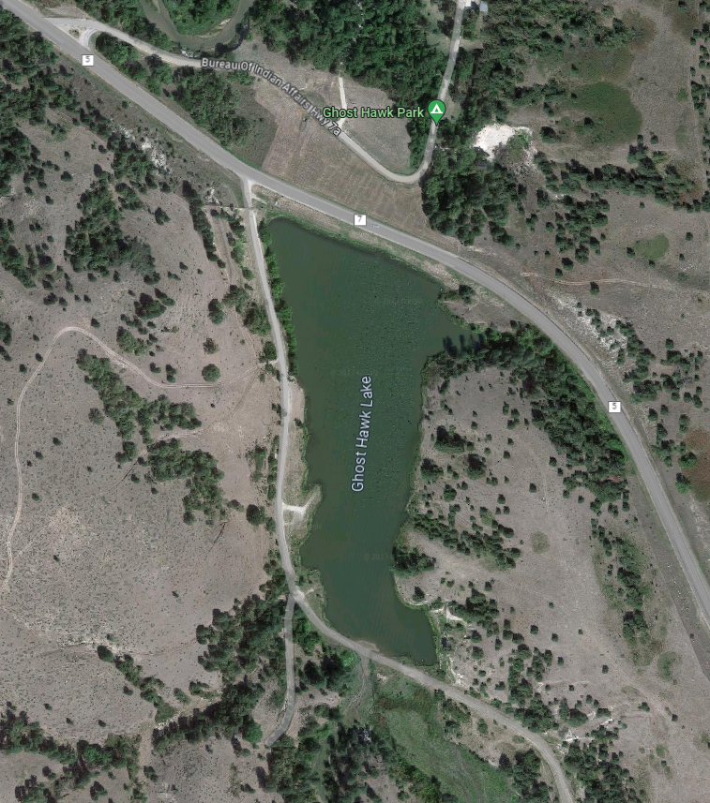
Rosebud Indian Reservation, South Dakota
Notes:
Young man, volunteer from a Bible College, serving the Society of Indian Missions. Big strapping guy, could carry a small car engine. Some guys went for a swim, and one commented, “Look at X blowing bubbles.” He didn’t come up. I am a certified WSI with the Red Cross, and went out to find him. Several attempts. Knew training one drowning → two. Found him, fetal position, murky lake bottom. Grabbed his belt. We did CPR for about an hour before ambulance arrived. [In the movies, the person coughs and spits and wakes up] Didn’t recover. Aspirated on food. He was gone.

Slide 14
^{Eph. 2.5-7} Even when we were dead because of our acts of disobedience, he brought us to life along with the Messiah.
^{Ro.6.4} Just as Messiah was raised from the dead by the glory of the Father, so we too might walk in newness of life.
Notes:
Do you remember glory?
Messiah’s resurrection that gives us authority, power, to rise to LIFE.
Believers are lifted, with Him, to a new life.
We share in Messiah’s Resurrection NOW.
Not in a mystical, Gnostic way, proto Kabbalastic sphere, but of fact to overcome.

Slide 15
^{Col 2.12} You were buried along with Him in immersion, through which you also were raised with Him by trusting in the working of God, who raised Him from the dead.
Impossible transformation
Notes:
G-d, Yeshua [it’s OK to pray to Messiah, I do] how can I overcome this…
Lustful desires [just a click, who will know?] Need an accountability partner. Language, substance abuse.
Bitterness and hurt → sulking
Bitterness and hurt → seething Anger
Prideful attitude
Tshuvah = repentance, then trusting.

Slide 17
Eph. 2. 5 He brought us to life.
Eph. 2. 5 Done by grace
Eph. 2. 6 Seated with Him
in heaven.
Eph. 2. 7 Makes us a Showpiece

Slide 18
^{Eph. 2.5-7} Even when we were dead because of our acts of disobedience, he brought us to life along with the Messiah — it is by grace that you have been delivered. That is, God raised us up with the Messiah Yeshua and seated us with him in heaven,

Slide 19
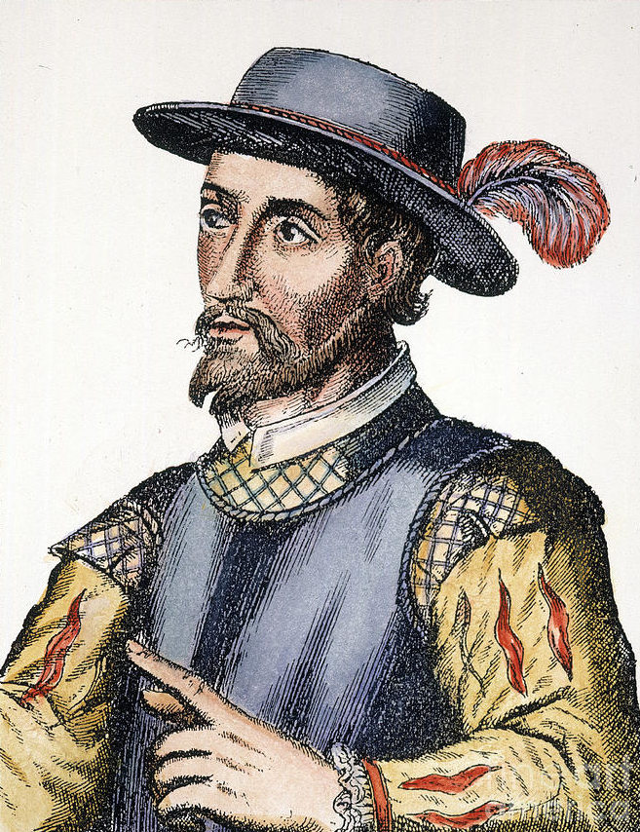
17th century Spanish engraving of Juan Ponce de León,
1474 – 1521
Died age 47

Slide 20
The Spanish explorer Juan Ponce de León, the first Governor of Puerto Rico, was supposedly searching for the Fountain of Youth when he traveled to Florida in 1513. Legend has it that Native Americans told Ponce de León that the Fountain of Youth was on the island of Bimini.
Notes:
You don’t have to hunt for the fountain of youth, or the holy grail, or any rigid standard of religious achievement to receive LIFE. By grace…

Slide 21
charis: grace, kindness; xáris (another feminine noun from xar-, "favor, disposed to, inclined, favorable towards, leaning towards to share benefit")
(xáris) is preeminently used of the Lord's favor – freely extended to give Himself away to people (because He is "always leaning toward them").
Notes:
https://biblehub.com/greek/5485.htm
G-d just likes you, and likes to benefit you! You can trust Him, Messiah, because He loves and cares for you, as you are.

Slide 23
Eph. 2. 5 He brought us to life.
Eph. 2. 5 Done by grace
Eph. 2. 6 Seated with Him
in heaven.
Eph. 2. 7 Makes us a Showpiece

Slide 24
^{Eph. 2.5-7} Even when we were dead because of our acts of disobedience, he brought us to life along with the Messiah — it is by grace that you have been delivered. That is, God raised us up with the Messiah Yeshua and seated us with him in heaven,

Slide 25
Military scouts: Prior to the 20th century, machines for powered and controllable flight were not available to military forces, but some attempts were made to use lighter than air craft. During the Napoleonic Wars and Franco-Prussian War, balloons were used for aerial reconnaissance by the French.

Slide 26
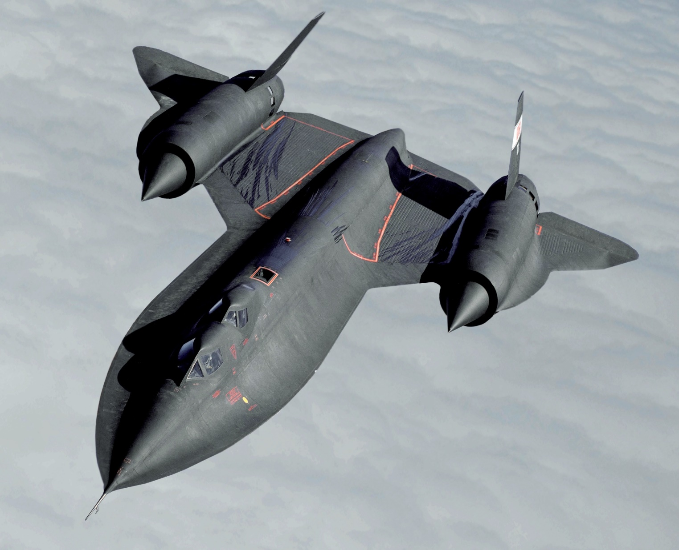
A USAF SR-71 high-altitude reconnaissance aircraft

Slide 27
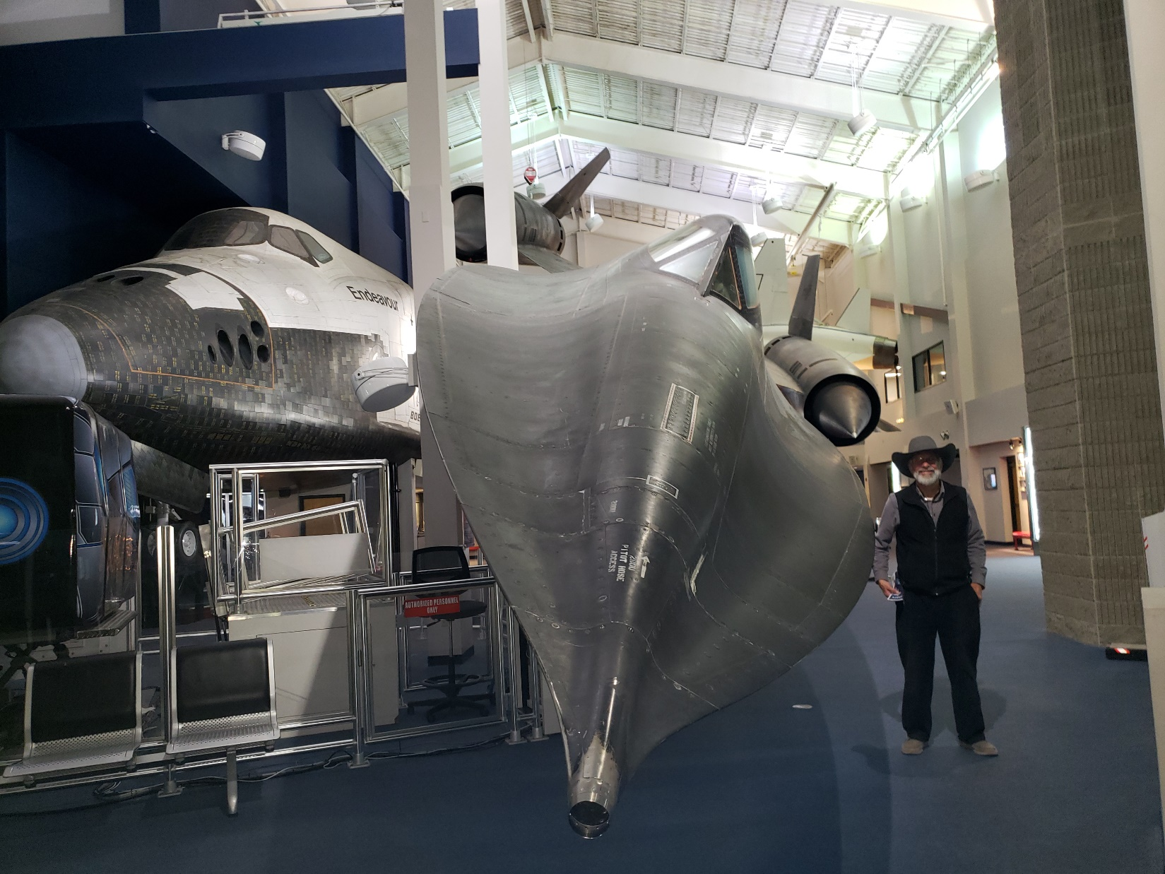
Notes:
Me with my SR-71 at the Hutchinson, KS museum

Slide 28
^{Col. 3.1-4} So if you were raised along with the Messiah, then seek the things above, where the Messiah is sitting at the right hand of God. Focus your minds on the things above, not on things here on earth.

Slide 29
^{Col. 3.1-4} For you have died, and your life is hidden with the Messiah in God. When the Messiah, who is our life, appears, then you too will appear with him in glory!
Notes:
There are things you can see, know, and do from high altitude. Physically and spiritually!

Slide 30
^{Yeshayahu/Is 57.15} For thus says the High and Exalted One who inhabits eternity, whose Name is Holy: “I dwell in a high and holy place, yet also with a contrite and humble spirit, to revive the spirit of the humble, and revive the heart of the contrite.
Notes:
Is there anything more that you want?
Way there is humble. Can’t be right all the time. Can’t have people admiring you. You admire them. Build them up.

Slide 31
^{T’hillim 27.4} Just one thing have I asked of Adoni; only this will I seek: to live in the house of Adoni all the days of my life, to see the beauty of Adoni and visit in his temple.

Slide 32
You can do things from your perch above, that you can’t do when earthbound in vision.

Slide 33
^{Yeshayahu/Is 60.4-5} Lift up your eyes and look all around: they all gather—they come to you— your sons will come from far away, your daughters carried on the hip. Then you will see and be radiant, and your heart will throb and swell with joy. For the abundance of the sea will be turned over to you. The wealth of nations will come to you.

Slide 34
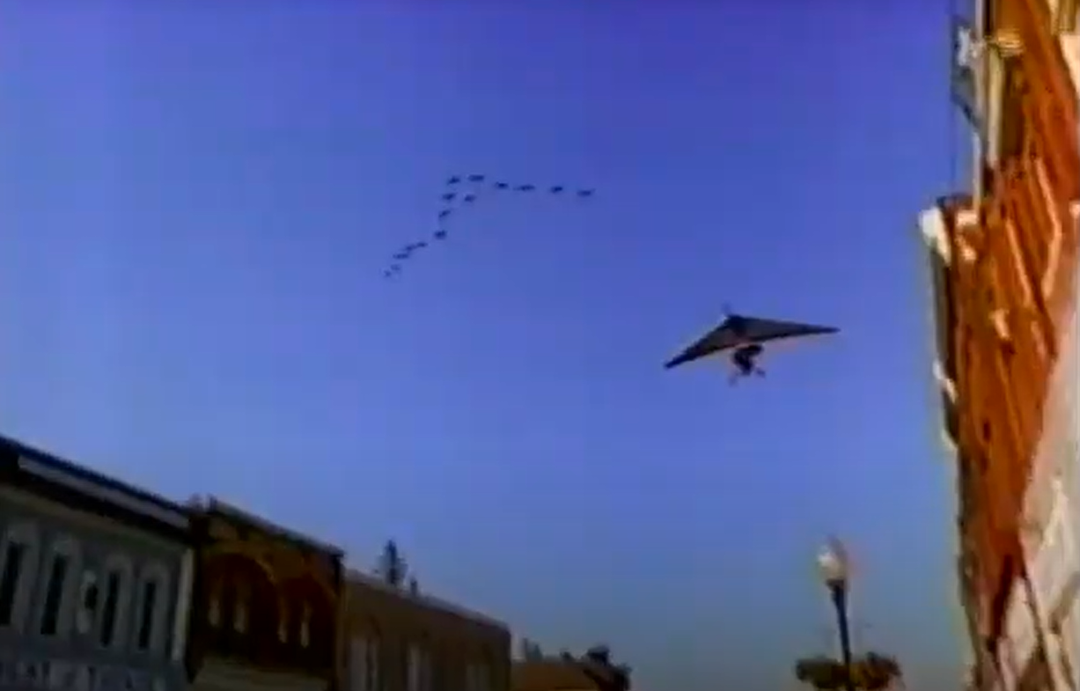
From the movie Fly Away Home

Slide 35
Notes:
https://external-content.duckduckgo.com/iu/?u=http%3A%2F%2Fi.imgur.com%2FQNKwEwh.jpg&f=1&nofb=1&ipt=4a639bf38c806ea91e11a66106537d6486d19e6e22607b93390ffcc62d2da398&ipo=images

Slide 36
This idea of the big picture, 30,000 ft view we’ll apply to the current situation in Israel.
There is a need for fighting and winning from the high place / humble place of prayer!!

Slide 37
Strategic considerations
Ground invasion is necessary to eliminate Hamas. Waiting?
Ground invasion / urban warfare will be extremely costly in deaths.
Israel cannot kill 100,000s Gazan City residents. Not Jewish, Torah, human value.
Costly in Israeli soldiers deaths.

Slide 38
Tunnel warfare more deadly even than urban warfare.
Hostages likely in tunnels.
Mosab Hassan Yousef, the son of Hamas' founder who later became a Christian and one of Israel's top informants.

Slide 39
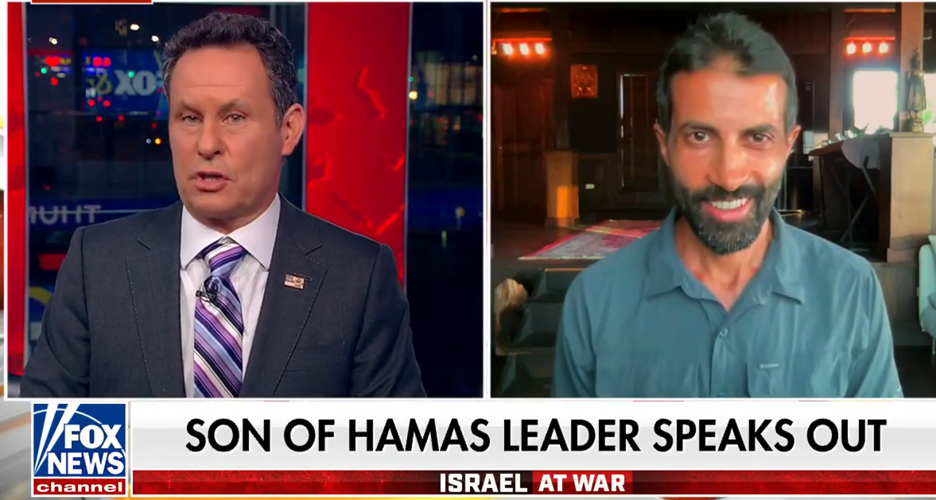
Notes:
https://www.foxnews.com/media/son-hamas-leader-breaks-silence-decision-denounce-terror-group-care-palestinians

Slide 40
Notes:
https://www.foxnews.com/media/son-hamas-leader-breaks-silence-decision-denounce-terror-group-care-palestinians
.02 to 3.10

Slide 41
Gas or napalm the tunnels. Sacrifice hostages.
Then conquer Gaza
Set up reasonable government: Al Sisi / Egypt, Saudis. [America conquered Saddam in Iraq, but didn’t plan well for day 2]

Slide 42
Notes:
https://www.youtube.com/watch?v=Bgc3SUS8zGk

Slide 43
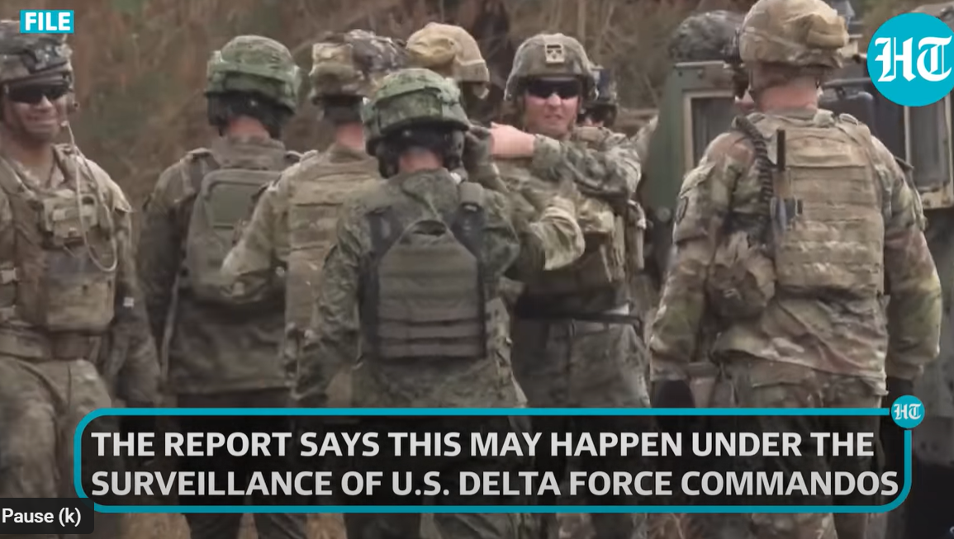
Notes:
https://www.youtube.com/watch?v=Bgc3SUS8zGk

Slide 44
Notes:
https://www.youtube.com/watch?v=Bgc3SUS8zGk

Slide 45
Notes:
https://www.youtube.com/watch?v=Bgc3SUS8zGk

Slide 46
Palestinian groups expect Israel to flood Hamas tunnels with a type of nerve gas or chemical weapon under the surveillance of US Delta Force commandos as part of a surprise attack on the Gaza Strip, a senior Arab source familiar with the Palestinian groups told Middle East Eye.
Notes:
By David Hearst
Published date: 25 October 2023 22:15 BST | Last update: 38 mins 55 secs ago

Slide 47
If hostages are in the tunnels?
Nerve gas may allow rescue.
Likely casualties of war.
If I’m captured, do not negotiate.
Entebbe, Gilad Shalit 2011

Slide 48
In 2011 there was an agreement between Israel and Hamas to release Israeli soldier Gilad Shalit in exchange for 1,027 prisoners — almost all Palestinians and Arab-Israelis, although there were also a Ukrainian, a Jordanian and a Syrian.
Notes:
https://en.wikipedia.org/wiki/Gilad_Shalit_prisoner_exchange

Slide 49
Two hundred and eighty of these had been sentenced to life in prison for planning and perpetrating various attacks against Israeli targets.
Israel will never be safe if it negotiates / surrenders for hostages.
Notes:
https://en.wikipedia.org/wiki/Gilad_Shalit_prisoner_exchange
In the Bible, there are several instances of G-d destroying armies.
180,000 Assyrians one angel
Philistines smitten with hemorrhoids. OK with me if all Hamas smitten with hemorrhoids.

Slide 50
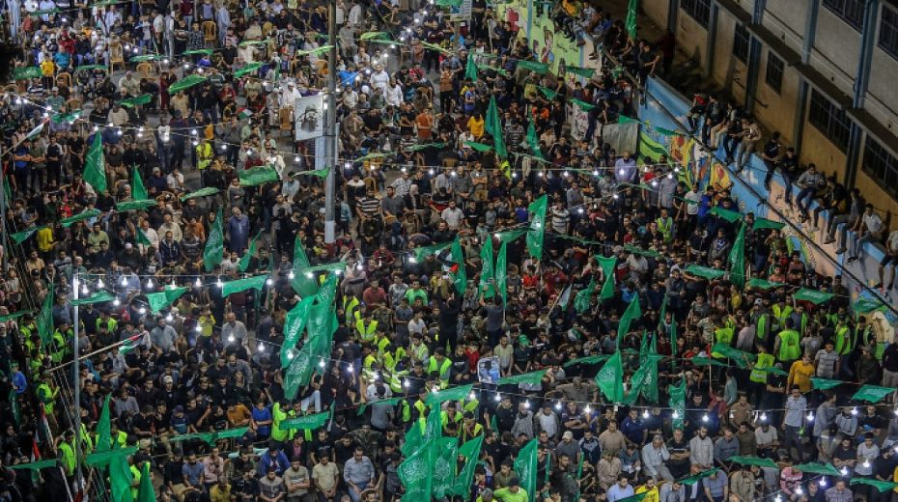
All available evidence indicates that
approximately 60% of the Gaza
Strip’s population supports Hamas
and its armed struggle against Israel.
Notes:
A Hamas rally in Rafah, in the southern Gaza Strip, on Oct. 27, 2022. Photo by Abed Rahim Khatib/Flash90.
https://www.israeltoday.co.il/read/hamas-enjoys-widespread-support-in-gaza/?mc_cid=24a02c8a64&mc_eid=9f06d9f262

Slide 51
Despite claims now being made that the majority of Gaza’s population desires peace and is being held captive by Hamas, data and evidence collected over the past two decades consistently demonstrates the opposite.

Slide 52
Hamas enjoys widespread support among Gaza’s civilian population, which voted Hamas into power and would likely do so again. This support finds expression not only in public opinion polls, but in active participation in Hamas attacks.

Slide 53
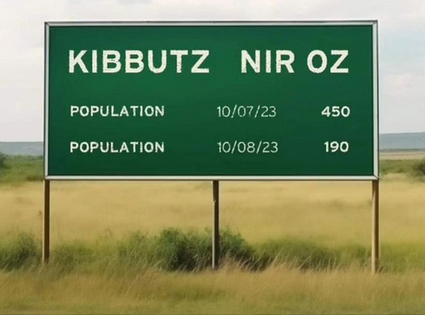
Notes:
Sent to me by my cousin in Tel Aviv.

Slide 54
Until the morning of the attack, Nir Oz was home to about 400 people, many employed growing asparagus and other crops, or in the local paint and sealants factory. Surrounded by the Negev desert, it remains an oasis of greenery, with a botanical garden that is home to more than 900 species of flowers, trees and plants.

Slide 55
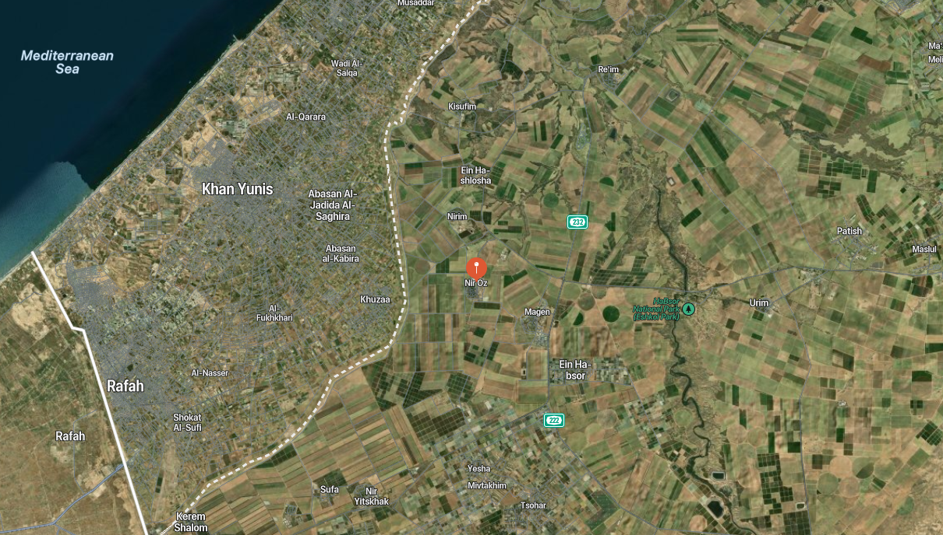

Slide 56
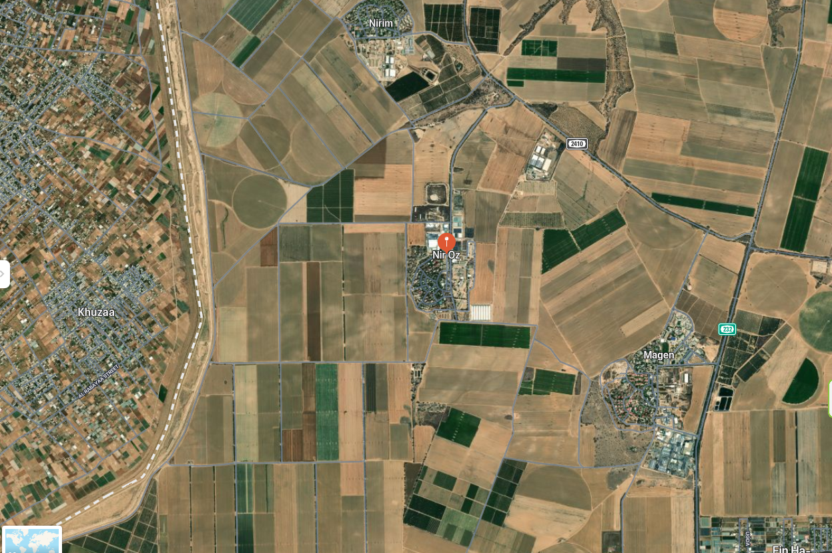

Slide 57
The difficulty of living in Gaza is not new. For years, economic hardship has been the lot of those living in Gaza and the West Bank. Yet this hardship is not shared by their leaders. A Saudi Arabian publication quotes
Notes:
https://washingtonstand.com/commentary/why-are-gazas-arabs-so-poor

Slide 58
“a senior Palestinian Authority official” as saying that roughly “1,700 senior Hamas officials (are) millionaires.” Hamas leader Ismail Haniyeh holds an estimated personal fortune of roughly $4 billion. Another, Khaled Mashal, claims a cool $5 billion.
Notes:
https://washingtonstand.com/commentary/why-are-gazas-arabs-so-poor

Slide 59
Underlying
Mental
Spiritual
Issues

Slide 60
From Daniel Pipes: Core values and narratives in the foundational texts of Islam promote the idea that Muslim victimhood is a very great evil, and this is used to justify killing non-Muslims. From this perspective, non-Muslim deaths are not as bad as Muslim suffering.
Notes:
https://www.meforum.org/65073/a-primer-on-hamas-part-3-who-supports-hamas?goal=0_086cfd423c-64b8a1185c-33765913&mc_cid=64b8a1185c&mc_eid=2515d15785

Slide 61
This asymmetrical instinct underlies the many angry Muslim objections to condolences expressed by Western politicians for the massacre of 1500 Jews on October 7.
It must be emphasized that not all Muslims think like this.
Notes:
https://www.meforum.org/65073/a-primer-on-hamas-part-3-who-supports-hamas?goal=0_086cfd423c-64b8a1185c-33765913&mc_cid=64b8a1185c&mc_eid=2515d15785

Slide 62
Ibn Kathir, a celebrated and influential medieval commentator on the Qur'an, promoted a broader understanding of fitna.
Notes:
https://www.meforum.org/65073/a-primer-on-hamas-part-3-who-supports-hamas?goal=0_086cfd423c-64b8a1185c-33765913&mc_cid=64b8a1185c&mc_eid=2515d15785

Slide 63
Fitna فتنة , فتن: temptation, trial; sedition, civil strife, conflict, is an Arabic word with extensive connotations of trial, affliction, or distress.
Notes:
https://en.wikipedia.org/wiki/Fitna_(word)

Slide 64
For him, even disbelief in Islam, or 'hindering' Muslims from following Islam was fitna, an evil worse than killing. [justifies killing?]
Notes:
https://www.meforum.org/65073/a-primer-on-hamas-part-3-who-supports-hamas?goal=0_086cfd423c-64b8a1185c-33765913&mc_cid=64b8a1185c&mc_eid=2515d15785

Slide 65
"We are the victims!" is projected from Islam's origin story and the rationale it gives for the nascent Muslim community's turn to violence. Islamic tradition relates that Muslims were being persecuted in Mecca until they migrated to Medina,
Notes:
https://www.meforum.org/65073/a-primer-on-hamas-part-3-who-supports-hamas?goal=0_086cfd423c-64b8a1185c-33765913&mc_cid=64b8a1185c&mc_eid=2515d15785

Slide 66
where an Islamic state was founded, which then used force to defend and advance Islam. The turn to violence is justified on the basis of the previous persecution of Muslims.
Fatherless faith. Woundedness.
Notes:
https://www.meforum.org/65073/a-primer-on-hamas-part-3-who-supports-hamas?goal=0_086cfd423c-64b8a1185c-33765913&mc_cid=64b8a1185c&mc_eid=2515d15785

Slide 67
Hana Alyan, a Palestinian-American poet and psychologist, who wrote this week in the NY Times to express her resentment at the lack of empathy for Palestinians, even as the world reacted to a war launched by Palestinian atrocities with a surge of support for them.
Notes:
https://www.israeltoday.co.il/read/palestinians-demand-sympathy-while-spreading-hate/?mc_cid=62de588513&mc_eid=9f06d9f262

Slide 68
She thinks it’s awful that Palestinians are always asked to prove their innocence of terrorism or to disavow those who commit acts of terror on behalf of Palestinian nationalism.
Notes:
https://www.israeltoday.co.il/read/palestinians-demand-sympathy-while-spreading-hate/?mc_cid=62de588513&mc_eid=9f06d9f262

Slide 69
Pause: Prayer for victimhood.
Hurt people hurt people.
Ourselves, victims → defensive, hurtful. Tshuvah, repentance.

Slide 70
Pause: Prayer for victimhood.
Hurt people hurt people.
Ourselves, victims → defensive, hurtful. Tshuvah, repentance.
Reach out our hands eastward, for Muslims to see themselves and repent.

Slide 71
Daniel Pipes: When asked "What should be Israel's primary objective" in the current war, 70 percent of the public answered to "eliminate Hamas." In contrast, only 15 percent answered to "secure the unconditional release of captives held by Hamas" and 13 percent "disarm Hamas completely."

Slide 72
Daniel Pipes: Remarkably, 54 percent of those Israeli Arabs (or, more technically, voters who supported the Joint List, a radical anti-Zionist Arab party), made "eliminate Hamas" their preferred objective.

Slide 73
History of war strategies
Can’t be hunkering down behind walls. Maginot line, Bar lev, Great Wall China.
If war in the north??

Slide 74
As for the Israeli side: in Shtula [on the Lebanese border in the north] last week I spoke with Shlomi, 54, who has headed the emergency response team in his border community for the past 20 years. Like almost all the residents of Shtula, his family came from Iraqi Kurdistan to Israel in the early 1950s.
Notes:
https://www.meforum.org/65088/tehran-makes-its-moves-on-the-border-of-israel?goal=0_086cfd423c-a33fd322be-33765913&mc_cid=a33fd322be&mc_eid=2515d15785

Slide 75
They came to escape the predecessors of the forces that are now launching antitank rockets on their community.
"We're only responding, responding, responding," Shlomi told me as he stood by the entrance to the moshav,
Notes:
https://www.meforum.org/65088/tehran-makes-its-moves-on-the-border-of-israel?goal=0_086cfd423c-a33fd322be-33765913&mc_cid=a33fd322be&mc_eid=2515d15785

Slide 76
an M16 rifle slung across his shoulder. "We aren't initiating anything. I hope that changes. That has to change."
Notes:
https://www.meforum.org/65088/tehran-makes-its-moves-on-the-border-of-israel?goal=0_086cfd423c-a33fd322be-33765913&mc_cid=a33fd322be&mc_eid=2515d15785

Slide 78
A Global, Prophetic Perspective
30,000 ft view

Slide 79
Senate Minority Leader Mitch McConnell, R-KY., on Sunday deemed China, Russia and Iran the new "axis of evil" amid wars in Ukraine and Israel, while addressing U.S. funding of allies' responses to those duel conflicts.

Slide 80
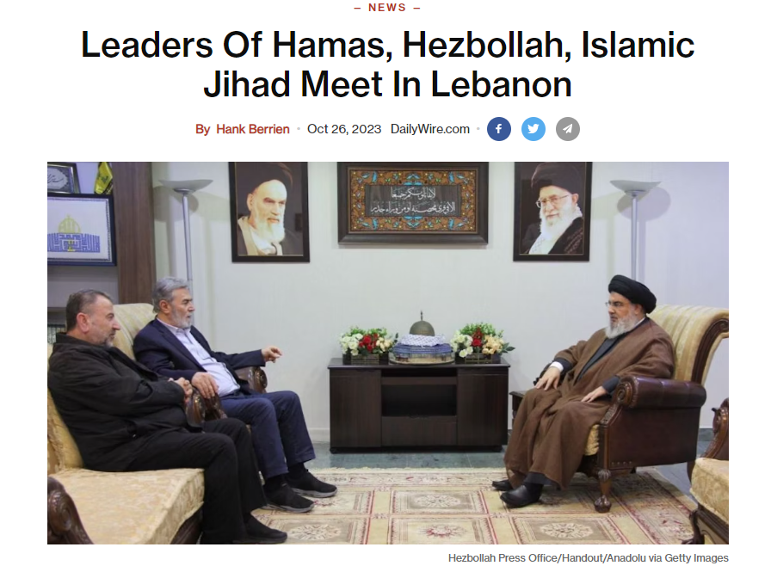
Notes:
https://www.dailywire.com/news/leaders-of-hamas-hezbollah-islamic-jihad-meet-in-lebanon

Slide 81
The experts I spoke to say that Israel must hit Iran and Hezbollah first, hard, and relentlessly, or they believe that every Israeli in the Galilee and the northern tier will soon be slaughtered like Israelis on the Gaza border were on Oct. 7.
Notes:
https://allisrael.com/we-are-facing-end-times-and-end-of-israel-if-we-don-t-vanquish-iranian-hezbollah-hamas-threats-now-veteran-idf-officer-tells-the-rosenberg-report

Slide 82
43% of Israelis (48% of Jews and 15% of Arabs) support a preemptive strike against the Iran-backed terrorist group to prevent an attack similar to the Oct. 7 massacre by Hamas of more than 1,400 Israelis.
Notes:
https://unitedwithisrael.org/israelis-optimistic-despite-the-war-survey-shows/

Slide 83
They readily concede that such a war will be “apocalyptic” and set the region “on fire,” but they fear Israel literally cannot survive a mass invasion by Hezbollah.
Notes:
https://allisrael.com/we-are-facing-end-times-and-end-of-israel-if-we-don-t-vanquish-iranian-hezbollah-hamas-threats-now-veteran-idf-officer-tells-the-rosenberg-report

Slide 84
Nor do they believe Israel can survive Iran – which is already enriching uranium at 84% – quickly breaking out and suddenly building fully operational nuclear weapons.
Notes:
https://allisrael.com/we-are-facing-end-times-and-end-of-israel-if-we-don-t-vanquish-iranian-hezbollah-hamas-threats-now-veteran-idf-officer-tells-the-rosenberg-report

Slide 85
Notes:
Jude Mahoney

Slide 86
Eph. 2. 5 He brought us to life.
Eph. 2. 5 Done by grace
Eph. 2. 6 Seated with Him
in heaven.
Eph. 2. 7 Makes us a Showpiece

Slide 87
^{Eph. 2.5-7} Even when we were dead because of our acts of disobedience, he brought us to life along with the Messiah — it is by grace that you have been delivered. That is, God raised us up with the Messiah Yeshua and seated us with him in heaven,

Slide 88
^{Eph. 2.5-7} in order to exhibit in the ages to come how infinitely rich is his grace, how great is his kindness toward us who are united with the Messiah Yeshua.
Notes:
Each one of us is a Bible story for the future. For eternity. A story of victory amidst battles, hardships, disappointments. YOU are a hero. Gibor.
There is a spirit of that now, of fighting for victory, among Israeli. Seems impossible, but it’s like a revival spirit. If you are not Jewish, this might sound like heresy, but it’s the real heart of the Zionist Return.

Slide 89
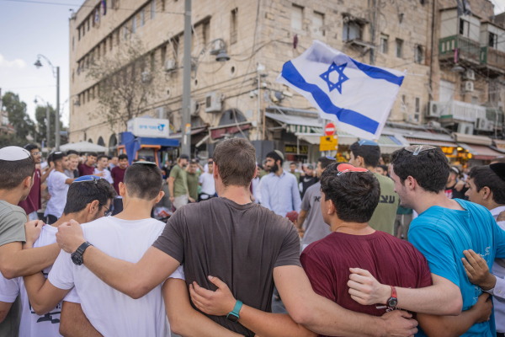
Young religious Jewish men dance and sing as they wave the Israeli flag near Mahane Yehuda market in Jerusalem, during the Israeli war with Gaza, October 20, 2023. Photo by Chaim Goldberg/Flash90
Notes:
https://unitedwithisrael.org/israelis-optimistic-despite-the-war-survey-shows/

Slide 90
Israelis are increasingly optimistic about the future of the country despite being at war with terrorist groups in Gaza and Lebanon, polling demonstrates.
Notes:
https://unitedwithisrael.org/israelis-optimistic-despite-the-war-survey-shows/

Slide 91
The Israel Democracy Institute conducted two flash surveys during the second week of the Hamas-initiated war against the Jewish state, with the results showing a 13.5 percentage point rise in optimism (65.5%) compared to June of this year (52%).
Notes:
https://unitedwithisrael.org/israelis-optimistic-despite-the-war-survey-shows/

Slide 92
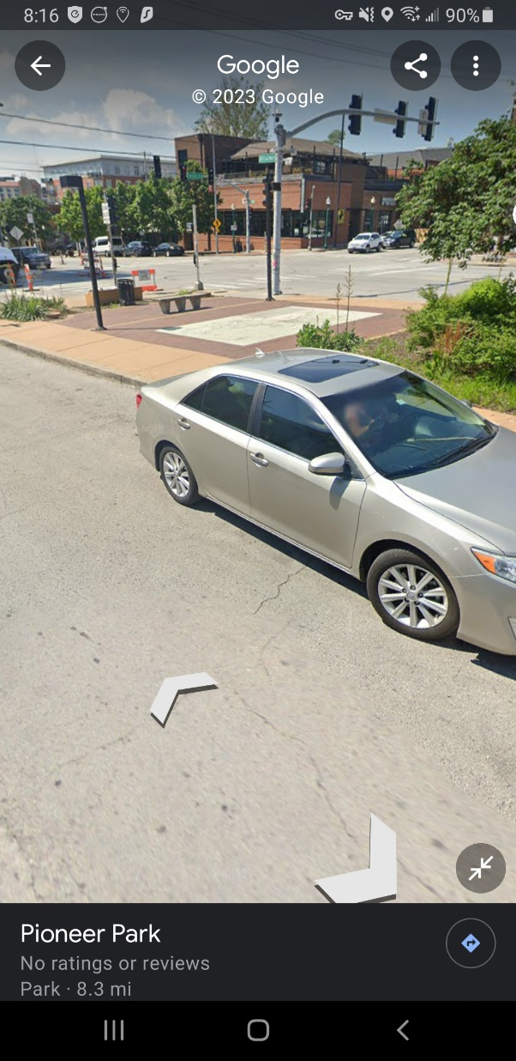
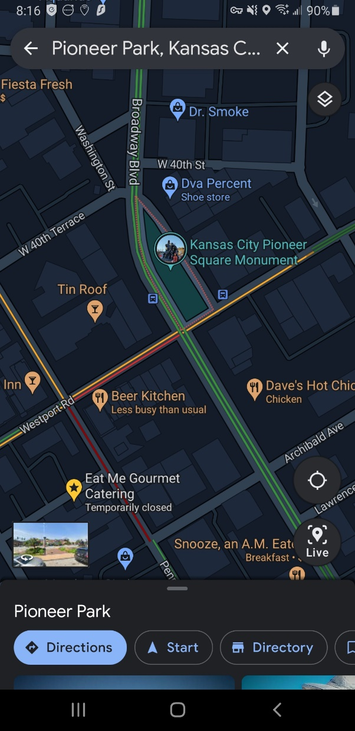
Pioneer Park, Ingathering / Outreach
Shabbat afternoon
Nov. 11, 2023
Heshvan 24, 5784

Slide 93
Why? To share life from the dead with the pedestrians, revelers, bar hoppers, in Westport.
Notes:
We are not just going to spread our beliefs, impose ourselves on them, but we need to view the unsaved as dead in sin…

Slide 94
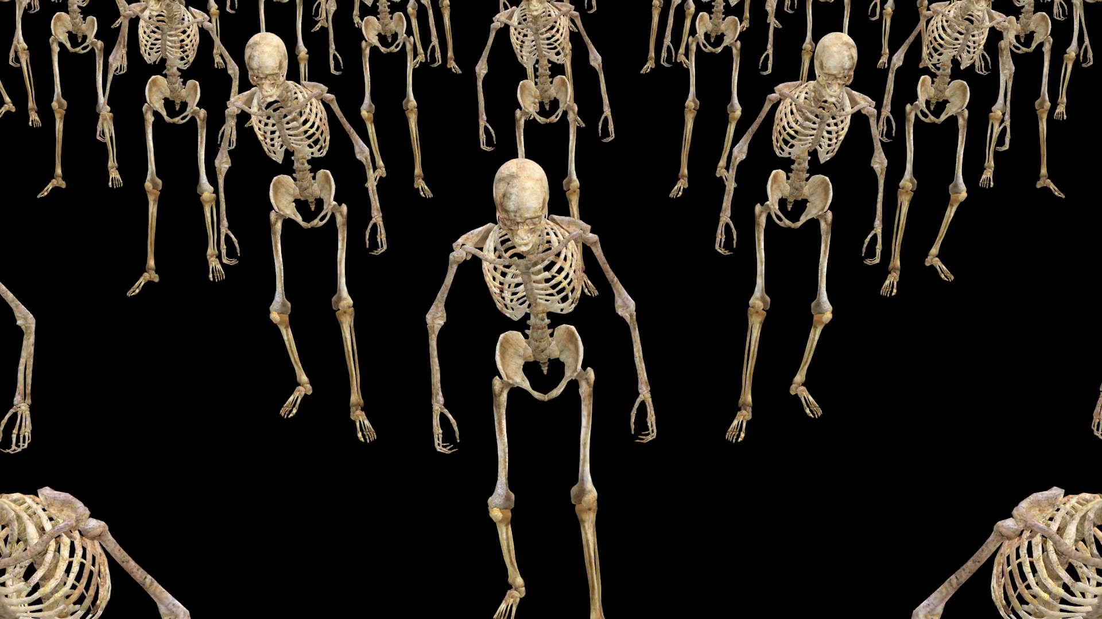
Notes:
https://external-content.duckduckgo.com/iu/?u=https%3A%2F%2Fdm0qx8t0i9gc9.cloudfront.net%2Fthumbnails%2Fvideo%2FCWsBQHy%2Fvideoblocks-a-crowd-of-skeletons-are-walking_scmdoaimz_thumbnail-1080_01.png&f=1&nofb=1&ipt=e06524f2c6bdf93d6ba4c182f8d4a41ea1e9e4fca95f164ae73a332b876ab293&ipo=images

Slide 95
^{Acts 26.17-18} I am sending you, to open their eyes—so they may turn from darkness to light and from the power of satan to God, that they may receive release from sins as well as a place among those who are made holy through trusting in Me.’
Notes:
This song expresses the essence of divine hope in Israel.
Revival without Yeshua? No will lead to Yeshua. ~1967
Note National Anthem and Shma embedded. Recognize a bit of Hebrew.

Slide 96
Notes:
https://youtu.be/H_c2MZkpCag?si=uSfIuWA8VrOYLLP5
From Sally Shiff

