Slide 1
e-handout
To have these notes
without taking notes
Go to OrHaOlam.com
Click on Messages tab,
2023 Messages

Slide 3
Notes:
Mike Boatright

Slide 4
Notes:
https://youtu.be/5krYI8ihxxk
Wednesday prayer here 6 to 8 p.m. I will possibly go to the IHOPKC prayer room tonight.

Slide 5
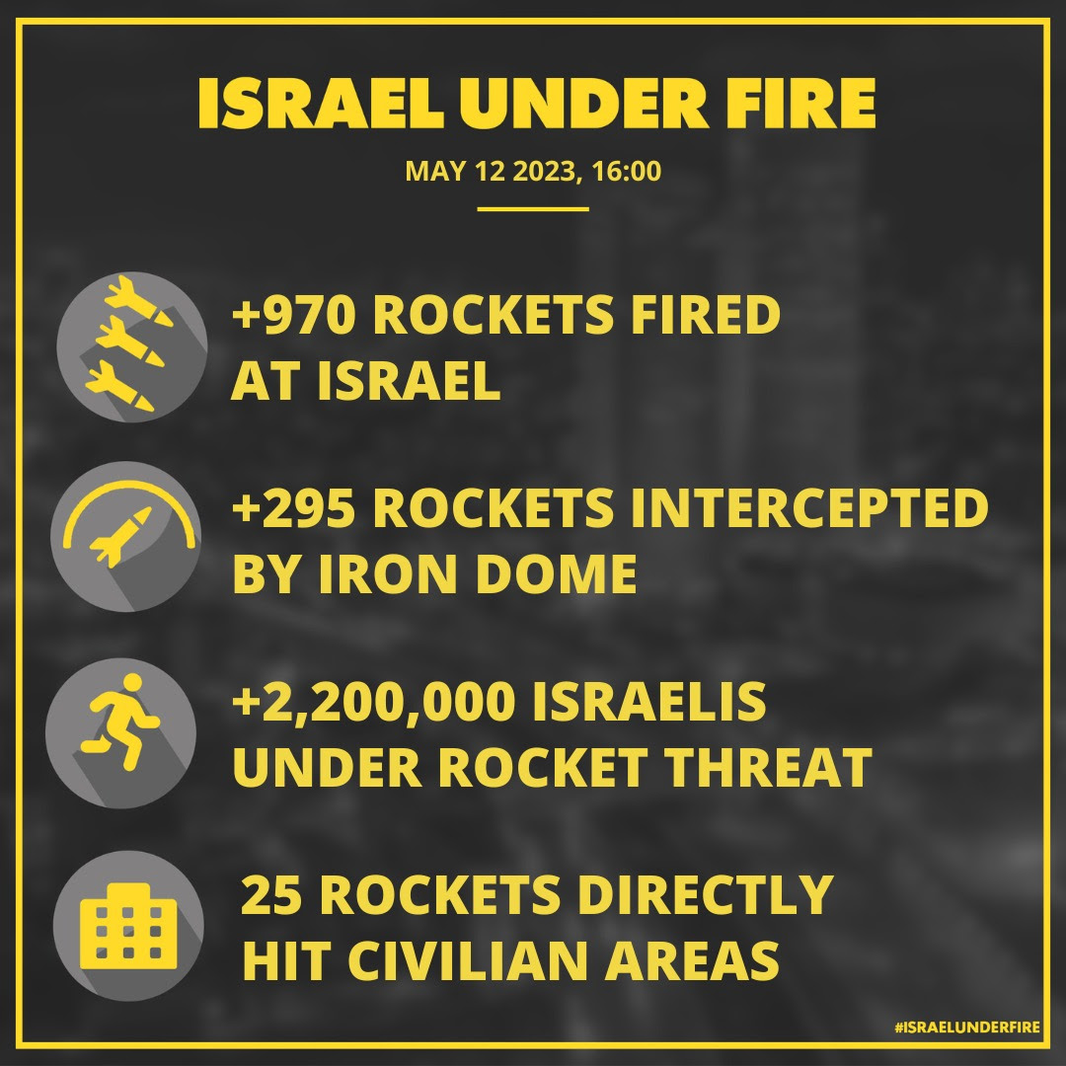

Slide 6
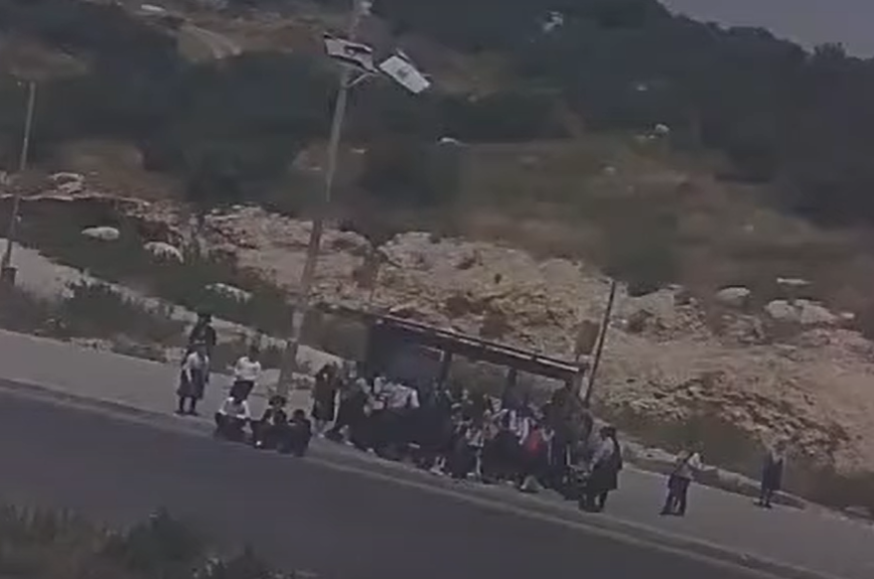

Slide 7
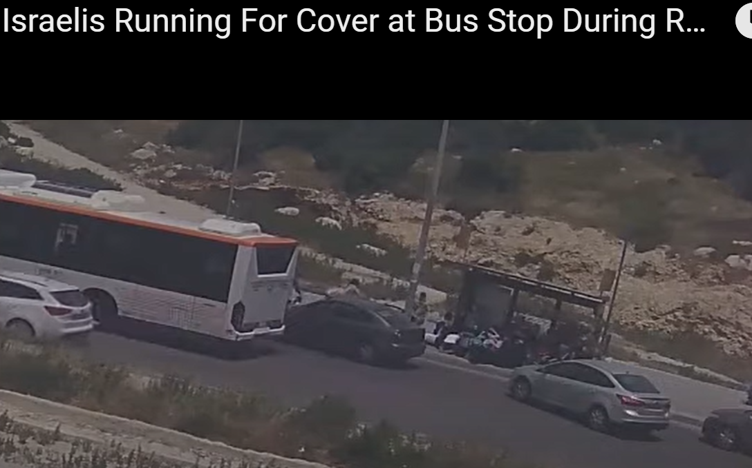

Slide 8
Notes:
https://youtu.be/5krYI8ihxxk
Wednesday prayer here 6 to 8 p.m. I will possibly go to the IHOPKC prayer room tonight.

Slide 9
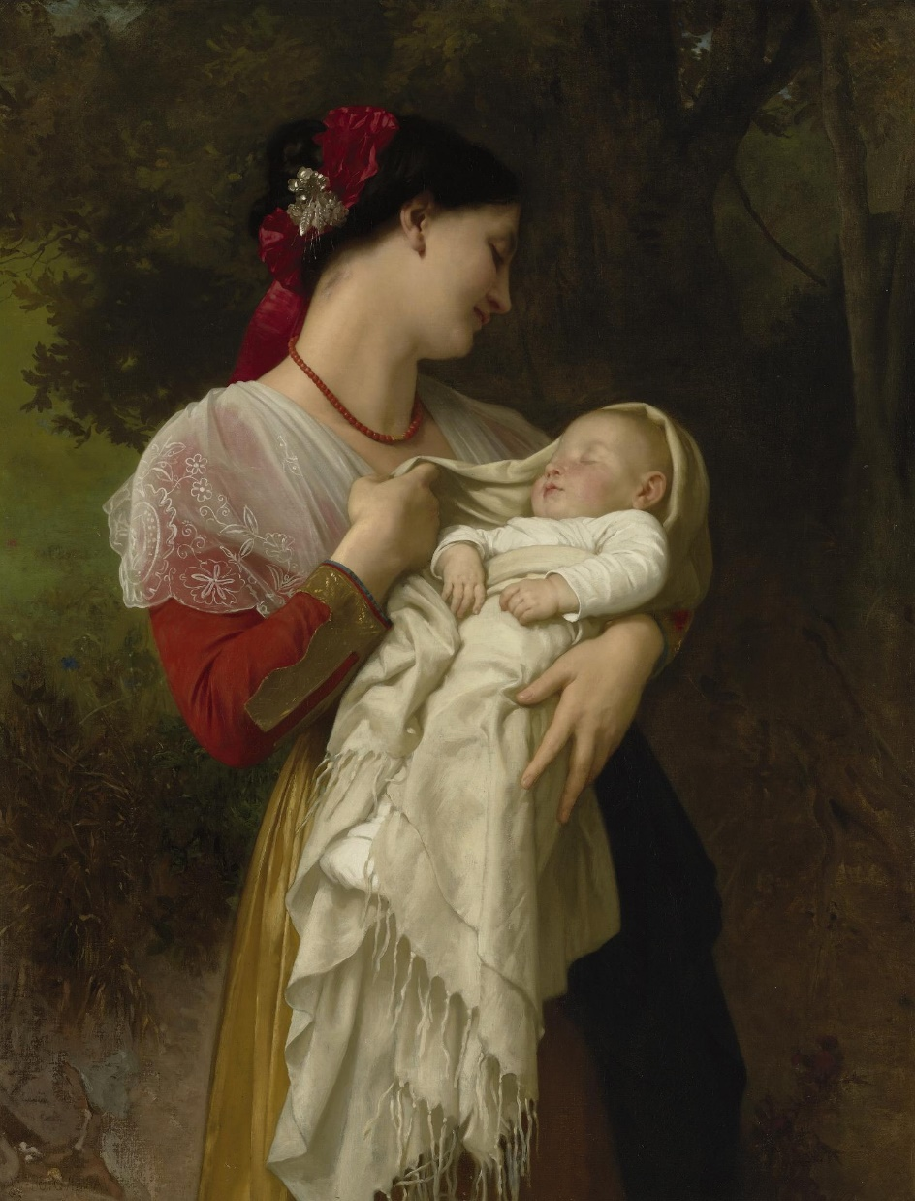
Mother’s Day:
Her Children Praise her.
^{Mishlei / Prov 31.28}
^{Scriptural basis}
Notes:
Maternal Admiration, painted by William-Adolphe Bouguereau
https://upload.wikimedia.org/wikipedia/commons/thumb/1/1e/William-Adolphe_Bouguereau_%281825-1905%29_-_Maternal_Admiration_%281869%29.jpg/240px-William-Adolphe_Bouguereau_%281825-1905%29_-_Maternal_Admiration_%281869%29.jpg

Slide 10
Mother’s Day: Children Praise Her
Scriptural basis
Power to do it.
Surprising reason to do it
If there were problems
Do it

Slide 11
Mother’s Day: Children Praise Her
Scriptural basis
Power to do it.
Surprising reason to do it
If there were problems
Do it

Slide 12
^{Mishlei / Prov 31.28} Her children arise; they make her happy; her husband too, as he praises her.
Notes:
Expository study on this verse.

Slide 13
^{Mishlei / Prov 31.28} Her children arise;
^{Vayikra 19.32} “You are to rise up in the presence of the gray-haired and honor the presence of the elderly. So you will fear your God. I am Adoni.
Notes:
Rise up to honor. Some of the younger men do with me. A woman there, my vintage, but colored hair. Didn’t rise up for her. “Why not?” Expression of honor. Open the door for Mom, for all ladies in fact.

Slide 14
^{Mishlei / Prov 31.28} Her children arise;
Or, Rise up to serve
Notes:
Get up from the TV, the computer, the tablet, the phone.

Slide 15
Notes:
Everyone is on a screen, except the cat.

Slide 16
A nationally representative parent survey found that 98 percent of homes with children now have a mobile device such as a tablet or smartphone.
Nearly half, 49 percent, of children 8 or under "often or sometimes" use screens in the hour before bedtime, which experts say is bad for sleep habits.
Notes:
https://www.npr.org/sections/ed/2017/10/19/558178851/young-children-are-spending-much-more-time-in-front-of-small-screens

Slide 17
When you take every source of screen media together, children 8 and under spend an average of about 2 hours 15 minutes a day in front of small screens.
Mostly passive activity.
Notes:
https://www.npr.org/sections/ed/2017/10/19/558178851/young-children-are-spending-much-more-time-in-front-of-small-screens
Put down the screen and engage in service, in conversation, in communication, in chores, in smiles.

Slide 18
^{Mishlei / Prov 31.28} Her children arise; they make her happy;
Ashruha
Notes:
This is the mitzvah, and commandment, good deed.
Say “Ashruha”
Huge implications to this word. Hebrew generally “highly nuanced.”

Slide 19
אַשֵׁר asher [vb]
to confirm, verify, approve, OK, endorse, acknowledge, certify; to praise; to make happy
אֹשֶׁר osher [noun]
bliss, happiness

Slide 20
^{Mishlei / Prov 31.28} Her children arise; they make her happy;
Passive: recognize her joy! Confirm her blessedness in Yeshua.
Ashruha
Notes:
Recognize she is a joyful Queen [at least most of the time.] ATTITUDE!
Not “Here comes Mom to demand of us!”

Slide 21
T’hillim/Ps 84.4
Notes:
Recognize she is a joyful Queen.

Slide 22
^{Mishlei / Prov 31.28} Her children arise; they make her happy;
Active sense:

Slide 23
אַשֵׁר asher [vb]
to confirm, verify, approve, OK, endorse, acknowledge, certify; to praise; to make happy
אֹשֶׁר osher [noun]
bliss, happiness
Notes:
All of us…think about our mom, living or deceased.
Confirm: house looks great, supper is wonderful, RN: check up appreciated.
Lawyer: great pursuit of justice.
H&R B: helping people with labyrinth IRS
Verify: it gets done every week.
Approve: I like you.
Acknowledge: you are important.
Say nice things!!

Slide 24
^{Mishlei / Prov 31.28} Her children arise; they make her happy; her husband too, as he praises her.
Notes:
Praise, by husband and kids!

Slide 25
The highlight of this service will be the giving of praise of your mothers who are here by the sons and daughters.
We all have a mother, but I’m inviting you to ashruha affirm, bless, acknowledge the moms who are present. Privately…
Notes:
Disclaimer: I have heard that mother’s day can be painful for childless women. This is not meant to exacerbate your loneliness, but to honor the Mothers. Tough job. Dobson program: “Mommy needs a raise, because there is no quitting.” We all have a mother that we should focus on, living or deceased. Honor the mothers.

Slide 26
Mother’s Day:
Her Children Praise her.
^{Mishlei / Prov 31.28}
Power to do it
Notes:
Maternal Admiration, painted by William-Adolphe Bouguereau
https://upload.wikimedia.org/wikipedia/commons/thumb/1/1e/William-Adolphe_Bouguereau_%281825-1905%29_-_Maternal_Admiration_%281869%29.jpg/240px-William-Adolphe_Bouguereau_%281825-1905%29_-_Maternal_Admiration_%281869%29.jpg

Slide 27
To give praise implies to think of the other person: their feelings, their joy.
It implies death to oneself.
Notes:
Last two messages: all Mitzvot in context of the joy/ strength/ power /gratefulness of G-d in Messiah. If brute will, it still counts, but may be in the context of pride, contempt of others. May lose your reward.

Slide 28
^{Gal 2.19-20} For it was through letting the Torah speak for itself that I died to its traditional legalistic misinterpretation, so that I might live in direct relationship with God. When the Messiah was executed on the stake as a criminal, I was too; so that my proud ego no longer lives.

Slide 29
^{Gal 2.19-20} But the Messiah lives in me, and the life I now live in my body I live by the same trusting that the Son of God had, who loved me and gave himself up for me.

Slide 30
^{2 Yn1:8-9} Watch yourselves, so that you won’t lose what you have worked for, but will receive your full reward. Everyone who goes ahead and does not remain true to what the Messiah has taught does not have God. Those who remain true to his teaching have both the Father and the Son.

Slide 31
^{Yohanan 15.5} “I am the vine and you are the branches. Those who stay united with me, and I with them, are the ones who bear much fruit; because apart from me you can do nothing.”
Notes:
If you are NOT now united in Him, this is a great opportunity to enter into a relationship with Messiah of forgiveness and transformation.

Slide 32
The highlight of this service will be the giving of praise of your mothers who are here by the sons and daughters.
We all have a mother, but I’m inviting you to ashruha affirm, bless, acknowledge the moms who are present. Privately…
Notes:
Just prepare in your mind a few words…30 seconds…I love you Mom, thanks for all you do.

Slide 33
Mother’s Day:
Her Children Praise her.
^{Mishlei / Prov 31.28}
Surprising reason to do it
Notes:
Maternal Admiration, painted by William-Adolphe Bouguereau
https://upload.wikimedia.org/wikipedia/commons/thumb/1/1e/William-Adolphe_Bouguereau_%281825-1905%29_-_Maternal_Admiration_%281869%29.jpg/240px-William-Adolphe_Bouguereau_%281825-1905%29_-_Maternal_Admiration_%281869%29.jpg

Slide 34
Pregnancy’s effect on a new mom’s brain Recent research has found compelling evidence that pregnancy can enhance neuroplasticity, or remodeling, in the structures of a woman’s brain.
Notes:
https://metrovoicenews.com/fatherhood-changes-mens-brains-according-to-mri-scans/

Slide 35
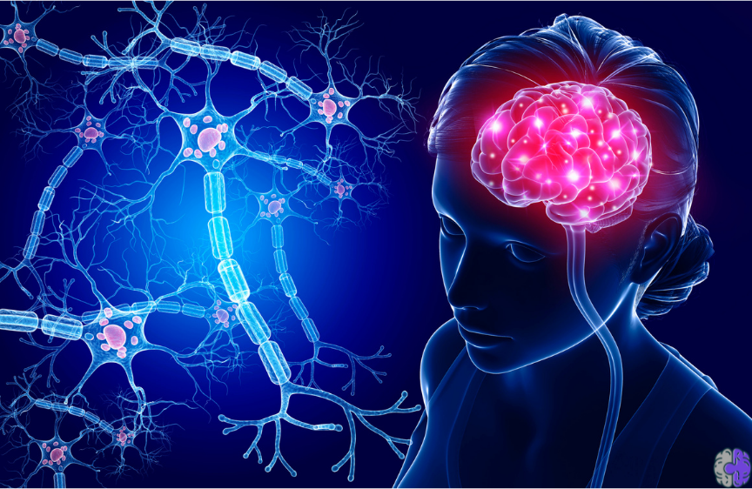
Notes:
https://static.wixstatic.com/media/54f5aa_a7737fa19ac34253b60799f6f6294307~mv2.png/v1/fit/w_864%2Ch_562%2Cal_c/file.png
Nerve cells: axons, dendrites, synapses, cell body

Slide 36
Notes:
https://external-content.duckduckgo.com/iu/?u=https%3A%2F%2Fbiofeedback-neurofeedback-therapy.com%2Fwp-content%2Fuploads%2FNeuroplasticity-and-pathways-1.jpg&f=1&nofb=1&ipt=2b1cba257fb243c38cc8511b5bad225f1c52f59c2d3dc7d8a23c86d11322f1e7&ipo=images

Slide 37
Using magnetic resonance imaging, researchers have identified large-scale changes in the anatomy of women’s brains from before to after pregnancy.
Notes:
https://metrovoicenews.com/fatherhood-changes-mens-brains-according-to-mri-scans/

Slide 38
In one study, researchers in Spain scanned first-time mothers before conceiving, and again at two months after they gave birth. Compared with childless women, the new mothers’ brain volume was smaller, suggesting that key brain structures actually
Notes:
https://metrovoicenews.com/fatherhood-changes-mens-brains-according-to-mri-scans/

Slide 39
shrank in size across pregnancy and the early postpartum period. The brain changes were so pronounced that an algorithm could easily differentiate the brain of a woman who had gone through a pregnancy from that of a woman with no children.
Notes:
https://metrovoicenews.com/fatherhood-changes-mens-brains-according-to-mri-scans/

Slide 40
All across the brain, these changes are visible in gray matter, the layer of tissue in the brain that is rich with neurons. Pregnancy appears to affect structures in the cortex – outer surface of the brain – including regions linked with thinking about others’ minds, a process that researchers call “theory of mind.”
Notes:
https://metrovoicenews.com/fatherhood-changes-mens-brains-according-to-mri-scans/

Slide 41
Mothers also show brain changes in the subcortex – the structures nestled deeper within the brain that are linked with emotion and motivation.
Notes:
https://metrovoicenews.com/fatherhood-changes-mens-brains-according-to-mri-scans/

Slide 42
Why do these structural brain changes happen after pregnancy?
Researchers believe these brain changes may facilitate mothers’ sensitive caregiving of newborns, who demand constant attention and cannot verbalize their needs. Indeed, when mothers see photos or videos of their own infants,
Notes:
https://metrovoicenews.com/fatherhood-changes-mens-brains-according-to-mri-scans/

Slide 43
it activates many of the same brain regions that changed the most across pregnancy. It seems plausible that new mothers’ brains change in ways that help them to respond to and care for their newborns.
Notes:
https://metrovoicenews.com/fatherhood-changes-mens-brains-according-to-mri-scans/
She has given some of her brain function to serve you better!!
Mothers have “eyes in the back of their heads.” Somewhat true…higher sensitivity.

Slide 44
Mother’s Day:
Her Children Praise her.
^{Mishlei / Prov 31.28}
If there were problems
Notes:
Maternal Admiration, painted by William-Adolphe Bouguereau
https://upload.wikimedia.org/wikipedia/commons/thumb/1/1e/William-Adolphe_Bouguereau_%281825-1905%29_-_Maternal_Admiration_%281869%29.jpg/240px-William-Adolphe_Bouguereau_%281825-1905%29_-_Maternal_Admiration_%281869%29.jpg

Slide 45
^{1 Kefa/Peter 3.8-9} Finally, all of you, be one in mind and feeling; love as brothers; and be compassionate and humble-minded, not repaying evil with evil or insult with insult, but, on the contrary, with blessing. For it is to this that you have been called, so that you may receive a blessing.

Slide 46
^{Mtt 5.46-48} For if you love those who love you, what reward do you have? Even the tax collectors do the same, don’t they? And if you greet only your brothers, what more are you doing than anyone else? Even the pagans do that, don’t they? Therefore be perfect, just as your Father in heaven is perfect.”

Slide 47
Mother’s Day:
Her Children Praise her.
^{Mishlei / Prov 31.28}
Benefits of doing it
Notes:
Maternal Admiration, painted by William-Adolphe Bouguereau
https://upload.wikimedia.org/wikipedia/commons/thumb/1/1e/William-Adolphe_Bouguereau_%281825-1905%29_-_Maternal_Admiration_%281869%29.jpg/240px-William-Adolphe_Bouguereau_%281825-1905%29_-_Maternal_Admiration_%281869%29.jpg

Slide 48
Benefits to gratitude practiced.
increased happiness and positive mood
more satisfaction with life
less materialistic
less likely to experience burnout
Notes:
https://positivepsychology.com/benefits-of-gratitude/

Slide 49
better physical health
better sleep
less fatigue
lower levels of cellular inflammation
greater resiliency
encourages the development of patience, humility, and wisdom
Notes:
https://positivepsychology.com/benefits-of-gratitude/

Slide 50
Mother’s Day:
Her Children Praise her.
^{Mishlei / Prov 31.28}
Do it!
Notes:
Maternal Admiration, painted by William-Adolphe Bouguereau
https://upload.wikimedia.org/wikipedia/commons/thumb/1/1e/William-Adolphe_Bouguereau_%281825-1905%29_-_Maternal_Admiration_%281869%29.jpg/240px-William-Adolphe_Bouguereau_%281825-1905%29_-_Maternal_Admiration_%281869%29.jpg

Slide 51
The highlight of this service will be the giving of praise of your mothers by the sons and daughters who are here.
We all have a mother, but I’m inviting you to ashruha affirm, bless, acknowledge the moms who are present. Privately…
Notes:
Just prepare in your mind a few words…30 seconds…I love you Mom, thanks for all you do.
Reminder before we start.

Slide 52
All Oneg clean up by men volunteers. Need six
Notes:
Eric Poling kindly consented to be the Clean up captain.
Me…I take out the trash. I’ve been doing it since age 8 or so. I’m very good at it.

Slide 53
Mother’s Day: Children Praise Her
Scriptural basis
Power to do it.
Surprising reason to do it
If there were problems
Do it

Slide 54
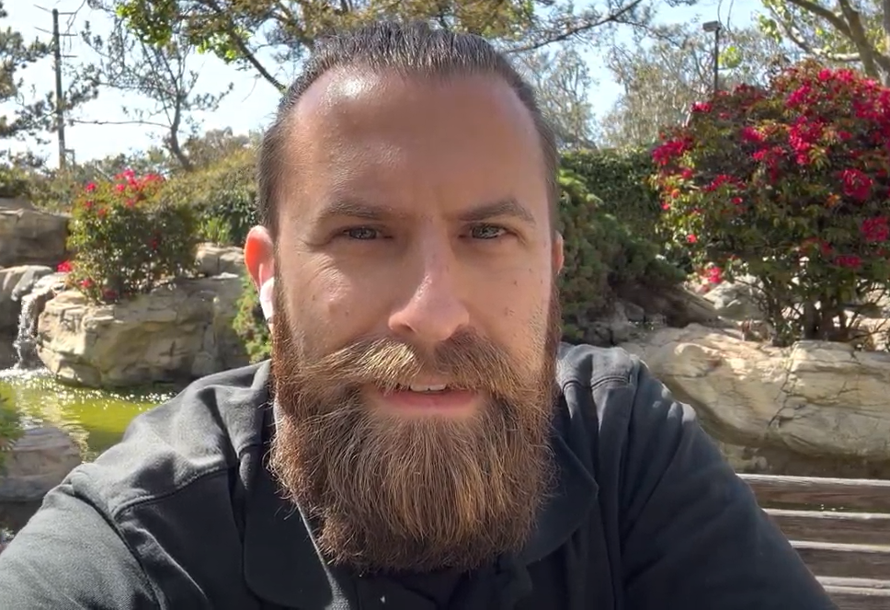
Daniel Wolkenfeld 2023. Happy
Mother’s day to my Mom.

