Slide 1
e-handout
To have these notes
without taking notes
Go to OrHaOlam.com
Click on Messages tab,
2023 Messages

Slide 4
Notes:
`

Slide 5
Notes:
From Mike Boatright

Slide 7
David & Anastasia Bouryi wedding Tbilisi, Georgia
Friday, May 5, 2023

Slide 8
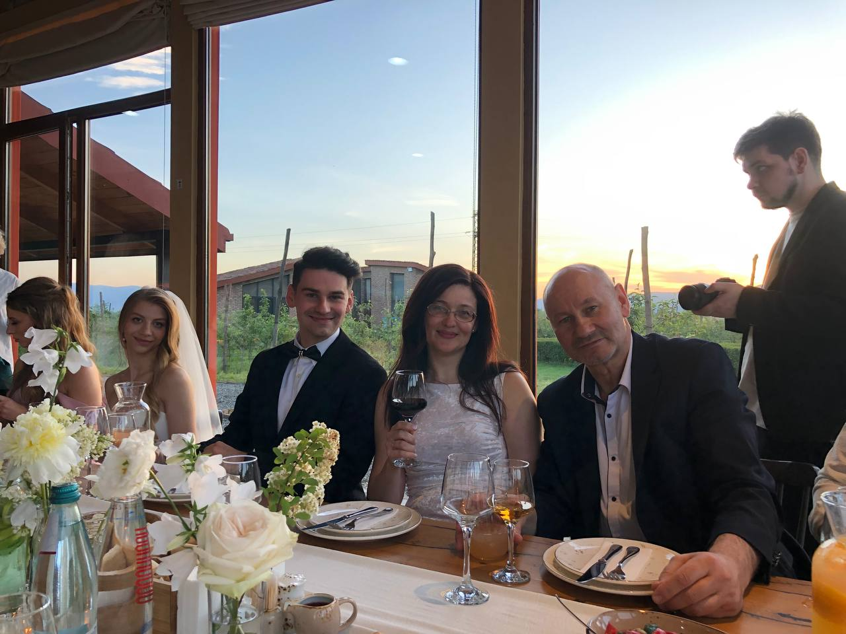

Slide 9
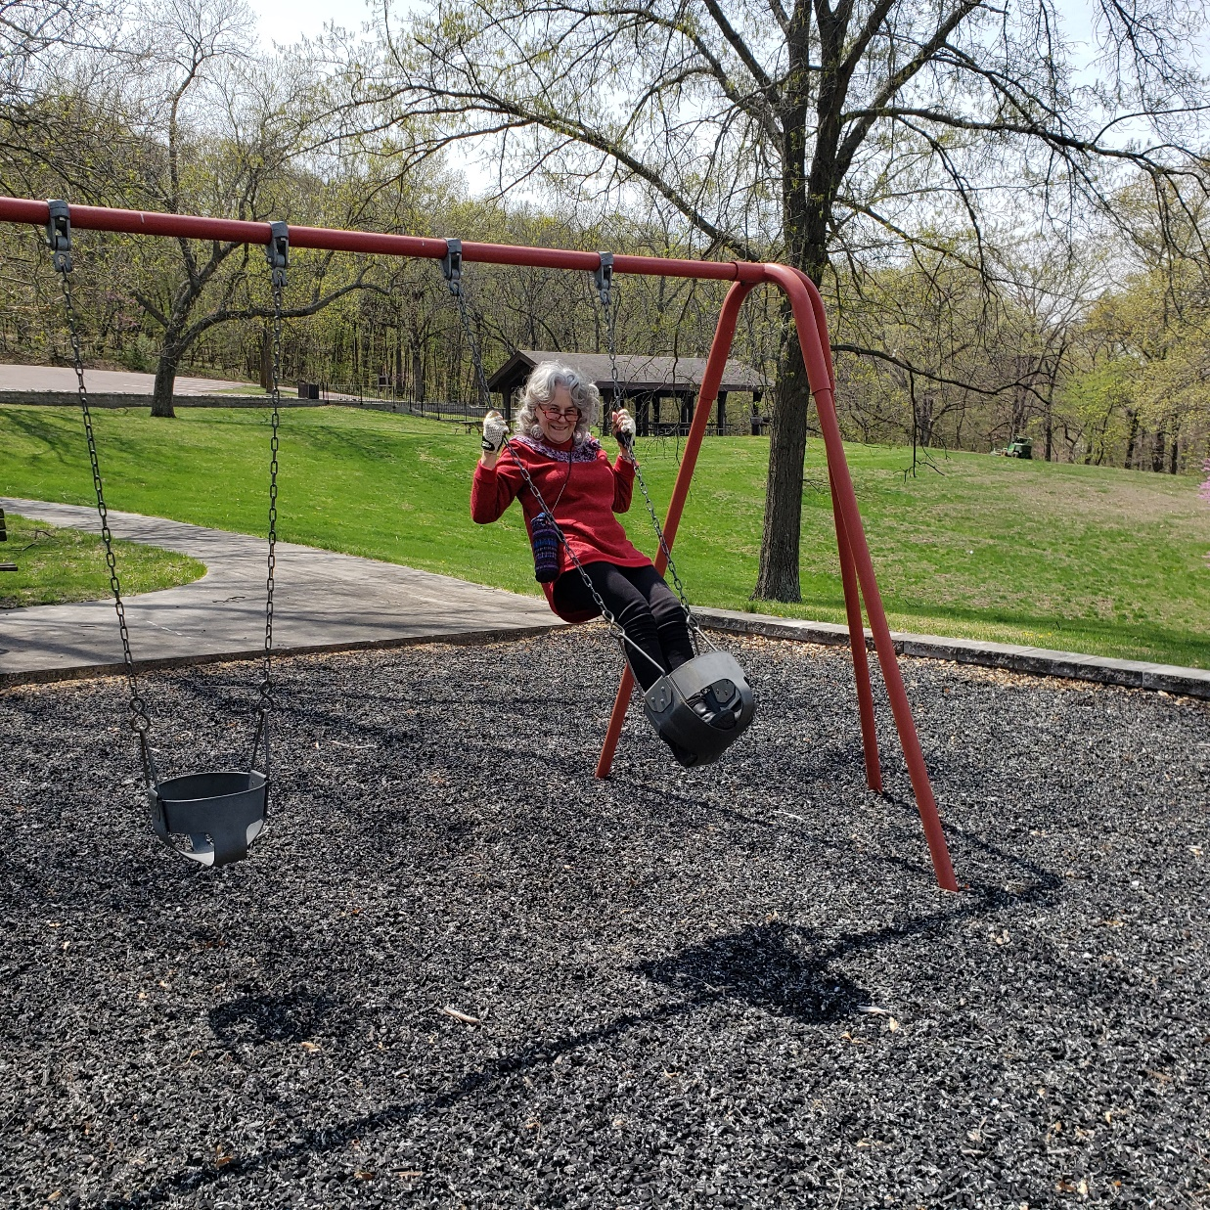
Dawn and Shmuel camping trip last week.

Slide 10
and Coco Puff at full gallop

Slide 11
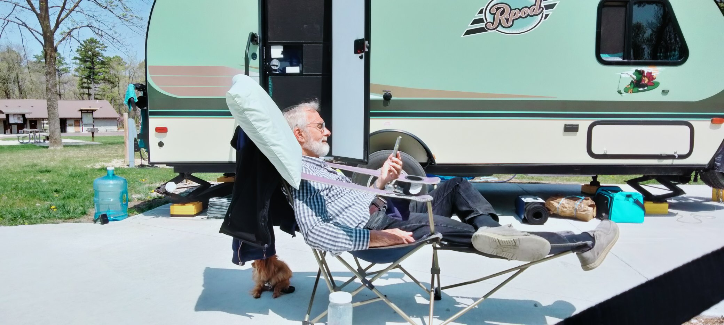

Slide 12
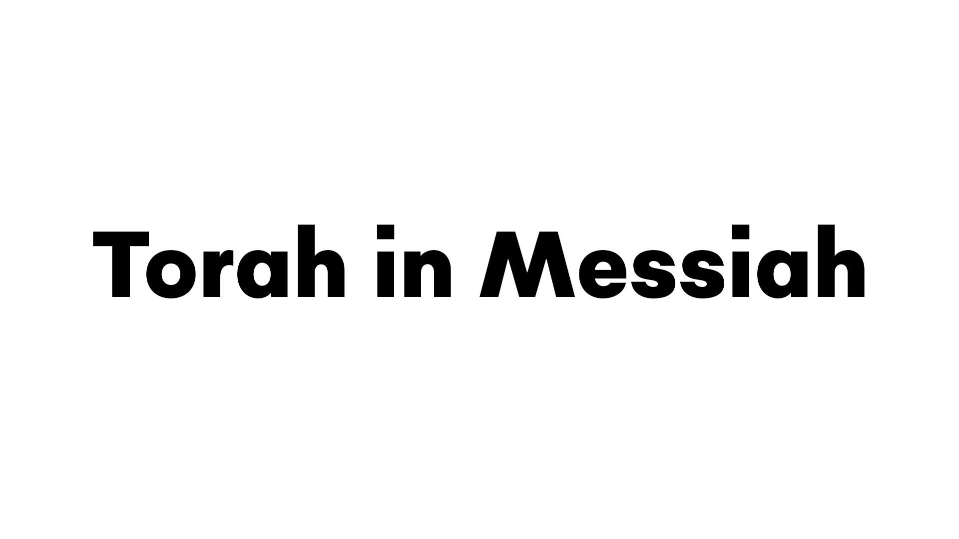
^{Yn 5.39-40} You keep examining the Tanakh because you think that in it you have eternal life. Those very Scriptures bear witness to me. Yet you are unwilling to come to Me so that you may have life!
Part 2
Notes:
Brett taught an important message on observing the mitzvot. I feel I should talk about the power behind doing that!
This may seem like an attack on ancient Rabbinic teaching. It is not that. I would love to get a Ph.D. in rabbinics. However, this is a study in perspective, balance, and a remedy.
NOT equally valid systems!

Slide 13
^{Yn 5.39-40} You keep examining the Tanakh because you think that in it you have eternal life. Those very Scriptures bear witness to me. Yet you are unwilling to come to Me so that you may have life!
Part 2 Review of Part 1
Notes:
NOT equally valid systems!

Slide 14
^{Yn 5.39-40} You keep examining the Tanakh because you think that in it you have eternal life. Those very Scriptures bear witness to me. Yet you are unwilling to come to Me so that you may have life!
Part 2 Review of Part 1
Two systems of righteousness
in Romans10, Galatians 3
Notes:
NOT equally valid systems!

Slide 15
FIRST SYSTEM ^{Ro 10.5} For Moshe writes about the righteousness grounded in the Torah that the person who does these things will attain life through them. [quoting Vayikra/Lev. 18:5.]
Notes:
Does these things → life. Sounds good. Is good. Mostly, but there is a subtle nuance.
No one can do these things.

Slide 16
SECOND SYSTEM ^{Galatians 3.6-8} Just as Abraham “believed God, and it was credited to him as righteousness,” [Genesis 15:6] know then that those who have faith are children of Abraham. The Scriptures, foreseeing that God would justify the Gentiles by faith, proclaimed the Good News

Slide 17
^{Galatians 3.8-9} to Abraham in advance, saying, ^{Genesis 12:3} “All the nations shall be blessed through you.” So then, the faithful are blessed along with Abraham, the faithful one.
Notes:
In Romans 10, it refers to salvation by believing in the Incarnation, Death, Resurrection of Messiah as prophetically picture in Dt. 30.

Slide 18
Summary of the two systems of righteousness
Do right to earn LIFE
Receive LIFE by repentance and believing in G-d’s power, death and resurrection of Messiah. The empowered to do right.

Slide 19
Does this mean all who receive righteousness and salvation can easily, flawlessly live it?

Slide 20
^{Ro 6.12-14} Therefore, do not let sin rule in your mortal bodies, so that it makes you obey its desires; and do not offer any part of yourselves to sin as an instrument for wickedness. On the contrary, offer yourselves to God as people

Slide 21
^{Ro 6.12-14} alive from the dead, and your various parts to God as instruments for righteousness. For sin will not have authority over you; because you are not under legalism but under grace.

Slide 23
^{Yn 5.39-40} You keep examining the Tanakh because you think that in it you have eternal life. Those very Scriptures bear witness to me. Yet you are unwilling to come to Me so that you may have life!
Part 2 Review of Part 1
Two systems the Talmud

Slide 24
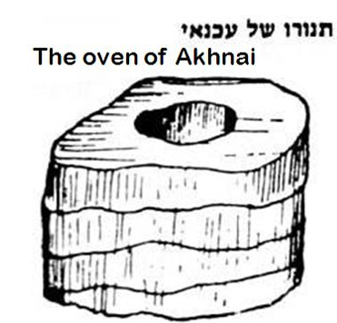
עַכְנַאי
(Talmudic Heb.)
snake
The structure was spiral, coiled ~snake.
Notes:
https://www.chabad.org/library/article_cdo/aid/5455793/jewish/59b.htm

Slide 25
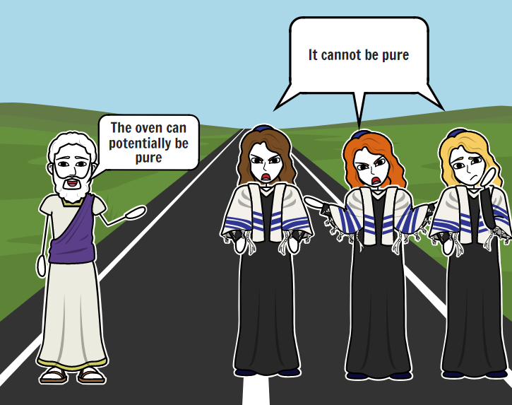
Rabbi Eliezer
Notes:
https://www.storyboardthat.com/storyboards/e1b1a174/ari-and-rachel-oven-of-akhnai-comic2/copy
Bava Metzia 59b
https://www.sefaria.org/Bava_Metzia.59b.1?lang=bi

Slide 26
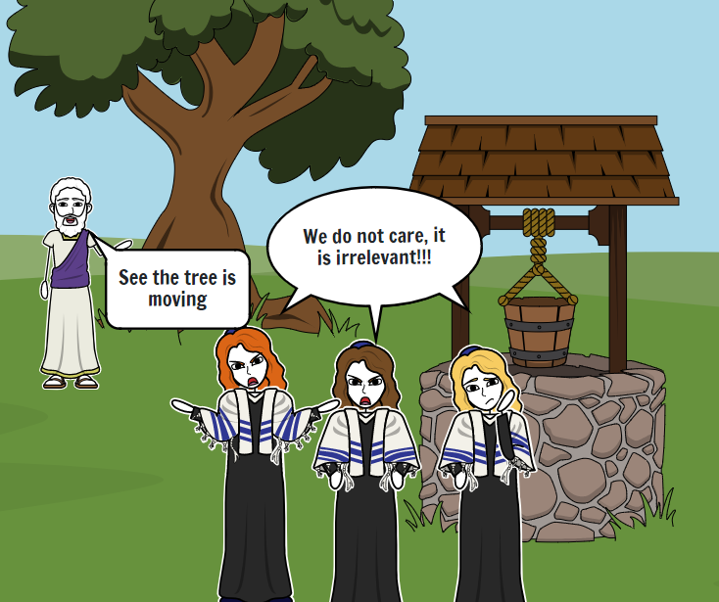
Notes:
https://www.storyboardthat.com/storyboards/e1b1a174/ari-and-rachel-oven-of-akhnai-comic2/copy

Slide 27
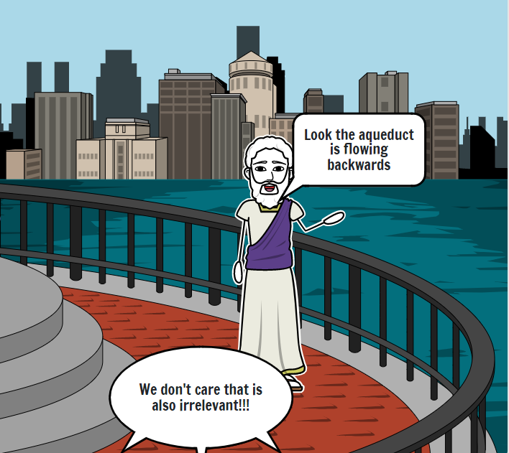
Notes:
https://www.storyboardthat.com/storyboards/e1b1a174/ari-and-rachel-oven-of-akhnai-comic2/copy

Slide 28
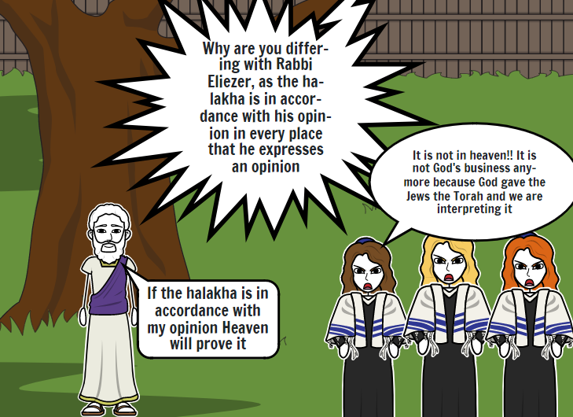
Notes:
https://www.storyboardthat.com/storyboards/e1b1a174/ari-and-rachel-oven-of-akhnai-comic2/copy

Slide 29
Eliezer represents living by the power of G-d.
The Trio [majority] represents group opinion.

Slide 30
Summary of the whole story: R. Eliezer made and got divine approval of his case that the oven was kosher by
• Logic
• Supernatural intervention in moving a tree

Slide 31
Supernatural intervention in reversal of a stream
Supernatural intervention in collapse of walls
G-d spoke from heaven, but genuine Heavenly voice was rejected

Slide 32
Majority opinion of rabbis deemed supreme.
Basis of majority opinion is violation and reversal of Ex 23.2
G-d is construed to like the idea that His will and opinion is overcome.

Slide 33
So is your eternal confidence based in what you do?
Or based on who you ARE in Messiah’s loving power and atonement?
That should motivate what we do!
Human being or human doing.
Work FROM rest, or work TO rest.

Slide 34
^{Yn 5.39-40} You keep examining the Tanakh because you think that in it you have eternal life. Those very Scriptures bear witness to me. Yet you are unwilling to come to Me so that you may have life!
Part 2
Rage in defending works
Notes:
Not just Jewish, many religious groups have a works based lifestyle. It’s generally very lovely.

Slide 35
Yeshua’s challenge to human / rabbinic consensus and knowledge became a source of great rage. Why? Then and why still? Some may say that Jewish anger at Messianics is because of the depredations of Christians, nominal and genuine Christians
Notes:
Crusades, Inquisition, Martin Luther, Pogroms, Holocaust

Slide 36
over the millennia. But that can’t apply to Shaul and first century rabbis. No travesties were yet done. I offer that the rage is a product of the sense of challenge to the human / rabbinical attainment of righteousness. If we really need this level of inner new life, transformation,

Slide 37
and divine righteousness, then pride is deeply broken.

Slide 38
^{Acts 26.11} Often I went from one synagogue to another, punishing them and trying to make them blaspheme; and in my wild fury against them, I even went so far as to persecute them in cities outside the country.
Notes:
Why? Why have I and most Messianics met similar?
I was told by one otherwise compassionate rabbi in this city, I have respect for pastors. I have zero respect for you. You are pretending to be something you are not.
Story of Stephan Acts 7. What did he do? Served widows, presented Yeshua…

Slide 39
^{Acts 7.56-58a} “I see heaven opened and the Son of Man standing at the right hand of God!” At this, they began yelling at the top of their voices, so that they wouldn’t have to hear him; and with one accord, they rushed at him, threw him outside the city and began stoning him.

Slide 40
^{Acts 8.3} But Sha’ul set out to destroy the Messianic Community — entering house after house, he dragged off both men and women and handed them over to be put in prison.

Slide 41
^{Acts 22.1, 21-23} ‘Get going! For I am going to send you far away — to the Goyim!’” They had been listening to him up to this point; but now they shouted at the top of their lungs, “Rid the earth of such a man! He’s not fit to live!” They were screaming, waving their clothes and throwing dust into the air.

Slide 42
Instead of
seeing their own righteousness intensely supplemented and empowered, and worshiping the transformational Source,
they feel threatened that their own righteousness is inadequate. Rage against threat.

Slide 44
^{Yn 5.39-40} You keep examining the Tanakh because you think that in it you have eternal life. Those very Scriptures bear witness to me. Yet you are unwilling to come to Me so that you may have life!
Part 2 Dan Juster’s and
Michael Brown’s Spiritual Analysis
Notes:
Not just Jewish, many religious groups have a works based lifestyle. It’s generally very lovely.

Slide 45
Statement from Dan Juster, with permission to quote:
I read through the Talmud 45 years ago, and read the Mishnah a year ago, the whole thing. No one can believe that this is the heart of God,

Slide 46
the extensive legalism and debates over minutiae us astonishing.
[Consider the laws of carrying in https://www.thetorah.com/article/the-prohibition-to-carry-on-shabbat-historical-and-exegetical-development]
Kitzur Shulchon Oruch p 3, 6
Or on the Shma “lie down and rise up.”
Notes:
Michael Schiffman Hashivenu Institute on Campus of Fuller Seminary, Pasadena, CA

Slide 47
The danger of Rabbinic Judaism is in the soul realm.
It will fascinate, stimulate, complicate and suffocate

Slide 48
Does this suffocation
really happen?

Slide 49
In Israel,
secular Jews make up 41.4%
traditional Jews 38.5%
Orthodox and ultra-Orthodox 20%
Reform and Conservative 7.6%
Notes:
https://en.wikipedia.org/wiki/Secularism_in_Israel

Slide 50
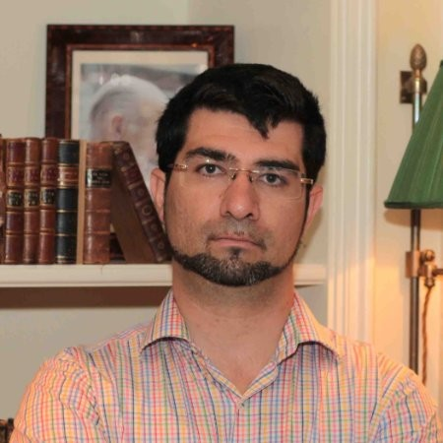
Israeli Eli Nacht, Israeli lawyer Owner of a Law Company, specializing on Government Relations & Business sector. - Founder of Israel Empowerment Lobby

Slide 51
Somewhat of a comedian, but said that the MAIN worry of the vast majority of the Israeli population is
Not Iran
Not Hamas
Not Hezbulloh

Slide 52
Main worry is control by the Orthodox and Netanyahu’s coalition
Notes:
Rejecting Yeshua in the Jewish world
Law of return excluding Messianic Jews
Matrilineal descent determining Jewish ID weddings in Israel
Culture of non-work and non-military service and anti-Zionism among Haredim.
During niddah, among some groups, husband can seek another woman, like concubines. One believing family I know personally the young women was solicited.

Slide 53
^{Yn 5.39-40} You keep examining the Tanakh because you think that in it you have eternal life. Those very Scriptures bear witness to me. Yet you are unwilling to come to Me so that you may have life!
Part 2
The glory source of righteousness
Notes:
Not just Jewish, many religious groups have a works based lifestyle. It’s generally very lovely.

Slide 54
^{1 Yn 4.19} We ourselves love now because he loved us first.

Slide 55
^{Yeshuayahu/Isaiah 60.1-2} “Arise, shine [Yerushalayim], for your light has come, the glory of Adoni has risen over you. For although darkness covers the earth and thick darkness the peoples; on you Adoni will rise; over you will be seen his glory. Nations will go toward your light and kings toward your shining splendor.

Slide 56
^{Mtt 11.28-30} “Come to me, all of you who are struggling and burdened, and I will give you rest. Take my yoke upon you and learn from me, because I am gentle and humble in heart, and you will find rest for your souls.30 For my yoke is easy, and my burden is light.”

Slide 57
Is righteous easy? No, but empowered!
Does it follow that we abolish Torah by this trusting? Heaven forbid! On the contrary, we confirm Torah.

Slide 58
^{Ro. 6.1-4} So then, are we to say, “Let’s keep on sinning, so that there can be more grace”? Heaven forbid! How can we, who have died to sin, still live in it? Don’t you know that those of us who have been immersed into the Messiah Yeshua have been immersed into his death?

Slide 59
^{Ro. 6.1-4} Through immersion into his death we were buried with him; so that just as, through the glory of the Father, the Messiah was raised from the dead, likewise we too might live a new life.

Slide 60
So, how do we face our culture?

Slide 61
Rabbi Jonathan Cahn was guest speaker on James Dobson Family Talk Sept 1–2. The interview was about Rabbi Cahn’s new book, The Return of the gods.

Slide 62
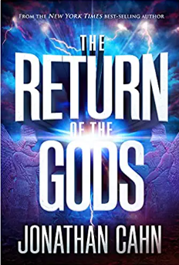
The Bible does speak of the gods. It says,
מי כמוך באלים יי?
Mi khamokיa b’elim Adoni?
Who is like You, Oh L-rd, among the gods?

Slide 63
When Israel turned away from God, they turned to other gods, and as they turned to other gods, there were three main, very iconic gods of all of them, and the first one I call the possessor.

Slide 64
There's one spirit that goes in and then brings the rest. In Hebrew called Baal, which means the possessor. It means the possessor. It means the owner, means the master or Lord. And he was the spirit that Israel turned to at the beginning,

Slide 65
and when you look at the list of the gods, Baal, he's always first, and he was the god of the falling away. He's the alternate god, the substitute god. If you look back, when did America really start turning, start taking those steps? Well, if you look at the early sixties-

Slide 66
we actually have been striking down the 10 Commandments. pagan morality says, "Basically, you can create your own god. You can create your own idol. You're creating reality. You're creating truth." So everybody has their own god, everybody has their own truth. So now you hear a lot of, “Well, that's your own truth.”

Slide 67
When the Bible speaks about Baal, often right after Baal comes the next god or goddess, which is the goddess, the Bible calls Ashtoreth or Ashtora. In ancient Babylonia, Ashtoreth was called Ishtar. When she went to Greece, she became Aphrodite

Slide 68
The focal point of this one was sexuality, the sexual realm. And she was actually known as the prostitute goddess.

Slide 69
The second one is called the enchantress, and the third is called the destroyer. Our culture is unique, this Western civilization, because it’s the only culture that was dispossessed, that was exorcised of the gods. And that's really where we have been, but now we're turning the other way.

Slide 70
Rabbi Cahn explains that America's turn from the one true God has opened the door for the return of the ancient little “g” gods, specifically three spirits that Rabbi Cahn calls the dark trinity made up of Baal, Ishtar, and Molech.

Slide 71
A parable that Yeshua said: Remember He said that if a spirit goes out of a man, He said, “It goes out, looks for a place to rest, finds no place to rest, and if it finds no place, it comes back and says, ‘I will return to my house,’” talking about the man. He comes back, finds it all clean and empty and says,

Slide 72
"I'm going to now bring my seven other friends, my seven other spirits," worse than itself, and now the man is repossessed, and Yeshua says that the latter state is worse than the beginning, but then He says, "So it will be with this generation."

Slide 73
He wasn't just talking about a man being possessed and turning back. He talks about an entire culture or civilization.

Slide 74
The first one, the possessor, Baal, the second Ishtar, or the goddess who changes sexuality, alters gender. And the third, the destroyer is Molech that causes child sacrifice. It's all happening. Everything we're watching, this is what is behind what we are dealing with right now

Slide 75
A revival is the only answer.
A turning back to G-d in fervency and true worship in spirit and in truth. In ancient times, that is when those altars were broken, so we have to deal with it.

Slide 76
We need heroes.
Stand against the new threesome
Baal
Ishtar
Molokh

Slide 77
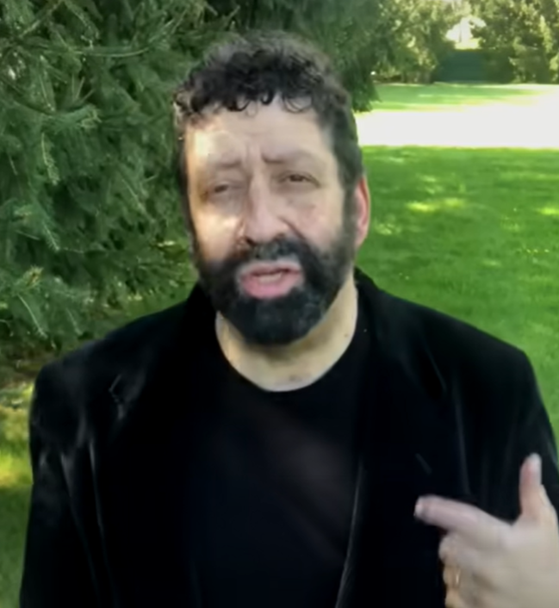
Jonathan Cahn:
Was Tucker Carlson Actually Removed By The Spirits?
Notes:
5.31 to 8.38, 8.58 to 9.53
https://youtu.be/HRK5g1pIx-U

Slide 78
^{Yn 5.39-40} You keep examining the Tanakh because you think that in it you have eternal life. Those very Scriptures bear witness to me. Yet you are unwilling to come to Me so that you may have life!
Part 2
The glory source of righteousness
Notes:
Not just Jewish, many religious groups have a works based lifestyle. It’s generally very lovely.

Slide 79
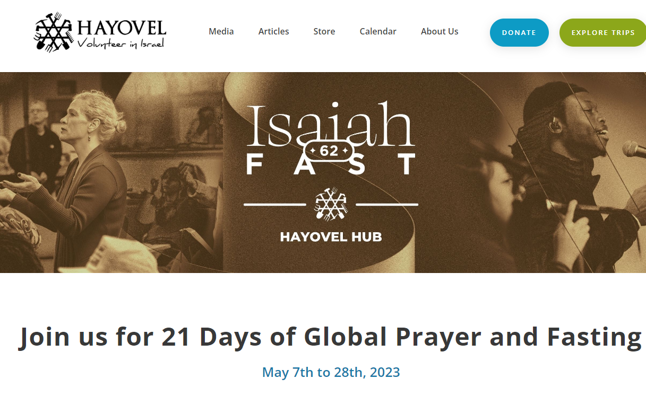
One extra hour per day
Notes:
https://serveisrael.com/isaiah62fast/

Slide 80
^{Yeshayahu 62.1-6} For Tziyon’s sake I will not be silent, for Yerushalayim’s sake I will not rest, until her vindication shines out brightly and her salvation like a blazing torch. ² The nations will see your vindication and all kings your glory. Then you will be called by a new name which Adonai himself will pronounce.

Slide 81
³ You will be a glorious crown in the hand of Adonai, a royal diadem held by your God. ⁴ You will no longer be spoken of as ‘Azuvah [Abandoned] or your land be spoken of as ‘Sh’mamah [Desolate]; rather, you will be called Heftzi-Vah [My-Delight-Is-In-Her] and your land Be‘ulah [Married]. For Adonai delights in you, and your land will be married —

Slide 82
⁵ as a young man marries a young woman, your sons will marry you; as a bridegroom rejoices over the bride, your God will rejoice over you.
⁶ I have posted watchmen on your walls, Yerushalayim;

Slide 83
they will never fall silent, neither by day nor by night. You who call on Adonai, give yourselves no rest; ⁷ and give him no rest till he restores Yerushalayim and makes it a praise on earth.

Slide 84
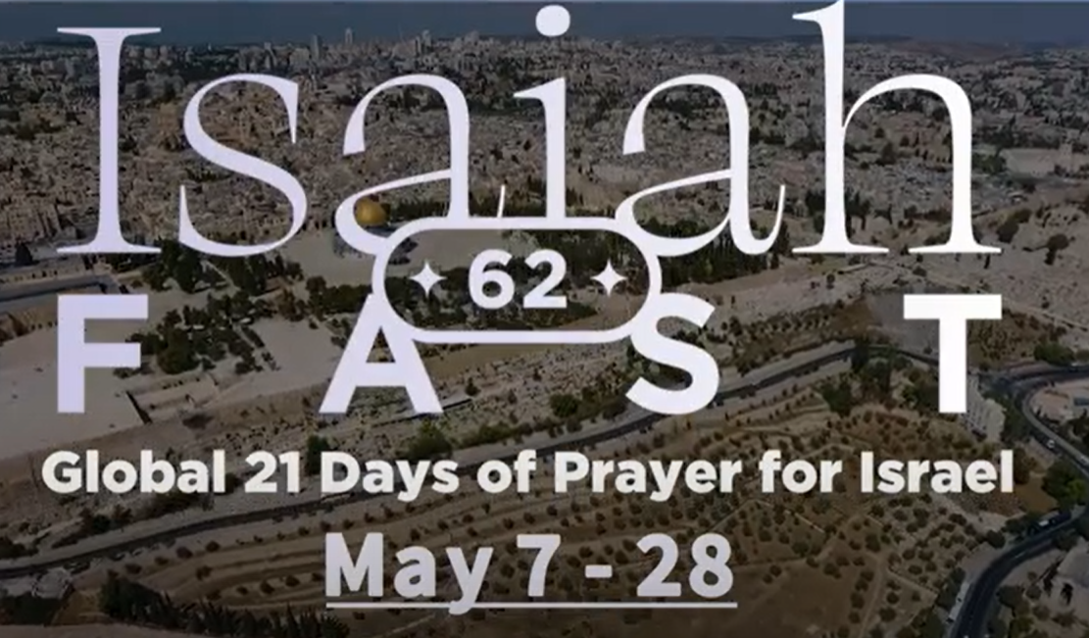
Notes:
https://youtu.be/5krYI8ihxxk

Slide 85
Back in 1983 (40 years ago), Mike Bickle (the founder and director of the house of prayer here) and about 1,000 believers fasted and prayed for revival in Kansas City for 21 days (May 7-28, 1983).

Slide 86
Now the Lord is calling IHOPKC and many others to another 21-day fast, May 7-28, 2023, exactly 40 years later! This fast will be dedicated to specifically praying for Israel and Jerusalem.

Slide 87
Please prayerfully consider joining in some way (Daniel fast, juice fast, water fast, media fast…). It’s a privilege and an honor. There are “hubs” for this fast all around the world that you can either join physically or on zoom. ONE EXTRA HOUR/DAY PRAYER FOR THE JEWISH PEOPLE.

Slide 88
Through various prayer networks, now already more than 5 million believers from all around the world have committed themselves to join this remarkable 21-day fast to pray for Israel, Jerusalem and the Jewish people. People from many languages will be joining.

Slide 89
On the last day of the fast, on Pentecost Sunday (May 28), 100 million Christians (!) will be praying for Israel and the Jewish people! This fast will be historic and momentous and just what Israel desperately needs at this critical time.

Slide 90
Or HaOlam will have an extra prayer meeting, joining the Hispanics on Wednesday at 6 p.m.
Men in the library, women in the sanctuary.
You can pray in English.
Fast as you feel led.

Slide 91
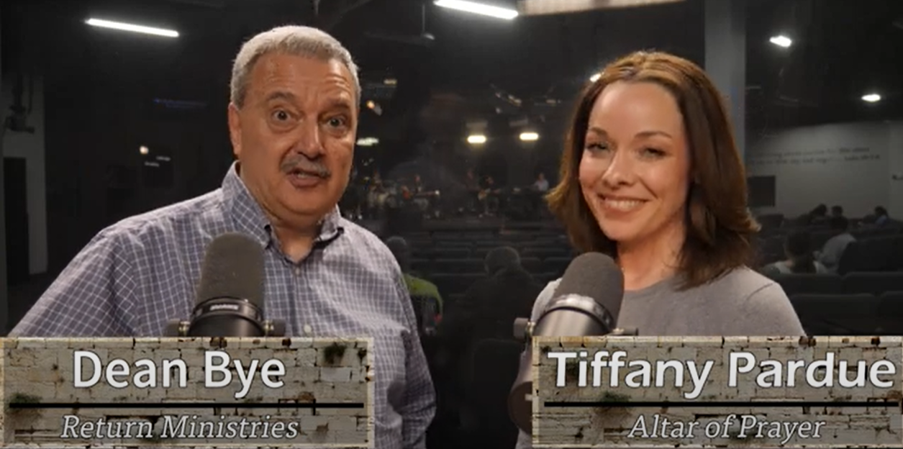
https://www.return.co.il/
Notes:
https://youtu.be/5krYI8ihxxk
Dean Bye, father of Deana Malespin who is the wife of Chaim Malespin, and the agent for Joshua Aaron. And a native Winnipeger, where Dawn and I and our 4 kids spent 6 years in Native Canadian ministry.

Slide 92
https://isaiah62fast.com/
Notes:
https://isaiah62fast.com/

Slide 93
https://isaiah62fast.com/
Notes:
https://isaiah62fast.com/

Slide 94
https://mailchi.mp/altarofprayer/isaiah-62-fast-daily-update
One extra hour per day

Slide 95
This past year, we received a powerful invitation from an unlikely group. A large network of Muslim Background Believers from the Middle East and surrounding areas, had sensed from the Lord that it was important for them to pray together for Israel the nation, and for the salvation of the Jewish people.
Notes:
Copyright (C) 2023 10 Days. All rights reserved. You are receiving this email because you are interested in being a part of the 10 Days of prayer. Our mailing address is:
10 DaysP.O. Box 9659
North Amherst, Ma 01059

Slide 96
You don't have to be an expert in world politics to know that Arabs and people from Muslim majority nations often have a deep animosity towards Israel and the Jewish People. This can affect people even after they become believers.
Notes:
Copyright (C) 2023 10 Days. All rights reserved. You are receiving this email because you are interested in being a part of the 10 Days of prayer. Our mailing address is:
10 DaysP.O. Box 9659
North Amherst, Ma 01059

Slide 97
So, when I received this unlikely invitation, from a large, significant network of underground churches, I was immediately moved to say "Yes". How could this be anything other than the Lord, if we are seeing Arab believers calling the global body of believers to pray for Jewish people? I also sensed that these Muslim Background Believers possessed a unique authority in the Spirit to pray in this way.
Notes:
Copyright (C) 2023 10 Days. All rights reserved. You are receiving this email because you are interested in being a part of the 10 Days of prayer. Our mailing address is:
10 DaysP.O. Box 9659
North Amherst, Ma 01059

Slide 98
^{Yn 5.39-40} You keep examining the Tanakh because you think that in it you have eternal life. Those very Scriptures bear witness to me. Yet you are unwilling to come to Me so that you may have life!
Part 2

