Slide 1
e-handout
To have these notes
without taking notes
Go to OrHaOlam.com
Click on Messages tab,
2023 Messages

Slide 2
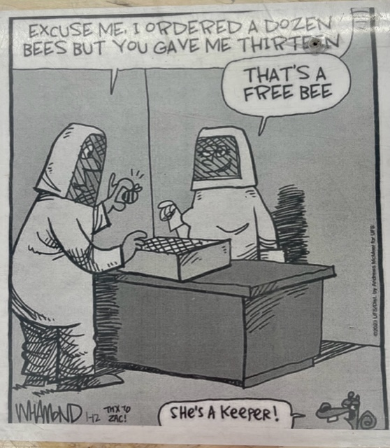

Slide 3
Notes:
Luann Ridgeway
Last week showed pix of riot during May 28 prayer at Southern steps of the Temple Mount, Jerusalem.

Slide 4
פלר חסן נחום Fleur Hassan-Nahoum
Deputy Mayor of Jerusalem
Notes:
| Proud Zionist and Feminist Israel Advocate | London born, grew up Gibraltar. Fluent Sp and Eng. Age 28 Aliyah. Br. Lawyer. Likud.

Slide 5
Jerusalem is a city that sanctifies freedom of religion so when I received complaints about Christians being harassed in the old city we took action. Pleased the Chief Rabbi of Jerusalem has sent out a public letter to clarify that this is against Jewish Law and should stop.
Notes:
https://twitter.com/FleurHassanN/status/1665795396432539651?ref_src=twsrc%5Etfw%7Ctwcamp%5Etweetembed%7Ctwterm%5E1665795396432539651%7Ctwgr%5E623d8890653c43e85852a80197b16eee2c990ff4%7Ctwcon%5Es1_&ref_url=https%3A%2F%2Fwww.charismanews.com%2Fopinion%2Fstanding-with-israel%2F92455-jerusalem-chief-rabbi-condemns-harassment-of-christians-in-jerusalem

Slide 6
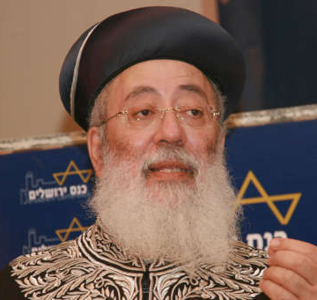
Sephardic Chief Rabbi of Jerusalem Shlomo Amar
Notes:
https://www.charismanews.com/opinion/standing-with-israel/92455-jerusalem-chief-rabbi-condemns-harassment-of-christians-in-jerusalem

Slide 7
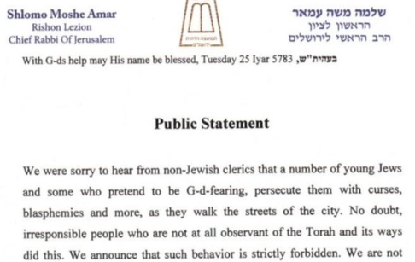
Notes:
This is the good side. On the other hand…

Slide 8
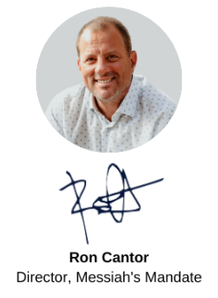
I prayed a lot and talked to Elana before posting this. I don’t want people to think we are sensationalizing this. Elana does not like being in the spotlight. It was not a pleasant experience for her;

Slide 9
and not being there to protect her, plagues me. Oh, how I wish it was me and not her! But after prayer, we felt the Lord wanted us to share it, particularly with those of you who have been praying for her all week.

Slide 10
Notes:
https://youtu.be/fPWSwH0H1cU

Slide 12
I’m starting a new series, on the Letter to the Ephesians.
Previously…
series on Matityahu
October 2015 to Jan. 2020
Series on Messianic Jews / Hebrews
Jan 2020 to Mar 2023
Notes:
With breaks for holidays and special occasions.
Both those Mes Scrip/ New Covenant but commentators say written to Jewish believers.
This one, written to?

Slide 13
He chose us in love, Eph 1.1 - 1.6
Introduction to the Letter
Opening of the letter
Passion of the letter
Notes:
Some introductory insights, before we get into the content.

Slide 14
Written primarily to non-Jews
^{Eph 2.11} Therefore, remember your former state: you Gentiles by birth — called the Uncircumcised by those who, merely because of an operation on their flesh, are called the Circumcised

Slide 15
^{Eph 3.1} It is a consequence of this that I, Sha’ul, am a prisoner of the Messiah Yeshua on behalf of you Gentiles…
^{Eph 4.17} Therefore I say this — indeed, in union with the Lord I insist on it: do not live any longer as the pagans live, with their sterile ways of thinking.
Notes:
Matthew, Mes Jews written to Jewish people, but applies to all.
Ephesians written to non-Jewish, Gentile people, but applies to Jews.

Slide 16
What is the location
of the addressees?

Slide 17
^{Eph 1.1-2} Shaul/Paul, an emissary of Messiah Yeshua by God’s will, To the kedoshim in Ephesus—those trusting in Messiah Yeshua: Grace and shalom to you, from God our Father and the Lord Yeshua the Messiah!
Notes:
In some important ancient manuscripts these words missing.

Slide 18
Introduction
In some important ancient manuscripts these words missing.

Slide 19
Paul seems a little distant from addressees
^{Eph 1.15} For this reason, ever since I heard about your trust in the Lord Yeshua and your love for all God’s people

Slide 20
Paul was in Ephesus
Acts 18.19-21 a week?
Acts 19.1 to 19:41, 52-55 AD, 3 years , Lecture Hall of Tyrannus
About 200,000 to 300,000 population
Commercial center of province of Asia [Turkey]
Notes:
Seems he would have been warmer, not just “I heard”

Slide 21
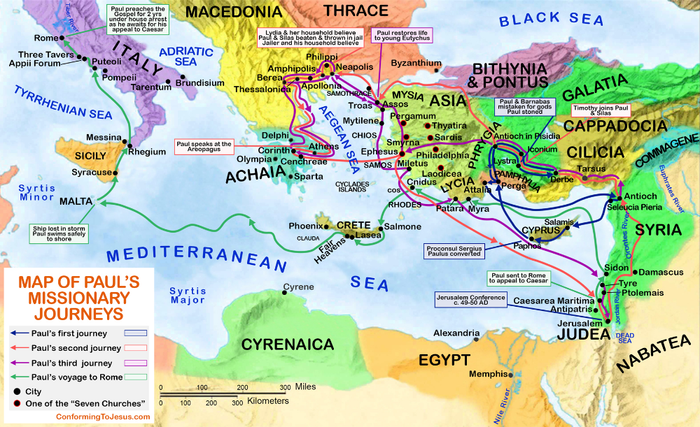
Notes:
https://i.pinimg.com/originals/11/99/35/119935887b6337f9339354333aede716.png

Slide 22
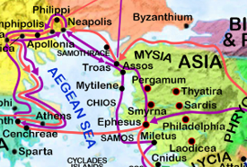
Third mission
Notes:
Acts 19.1 to 19:41, 52-55 AD, 3 years

Slide 23
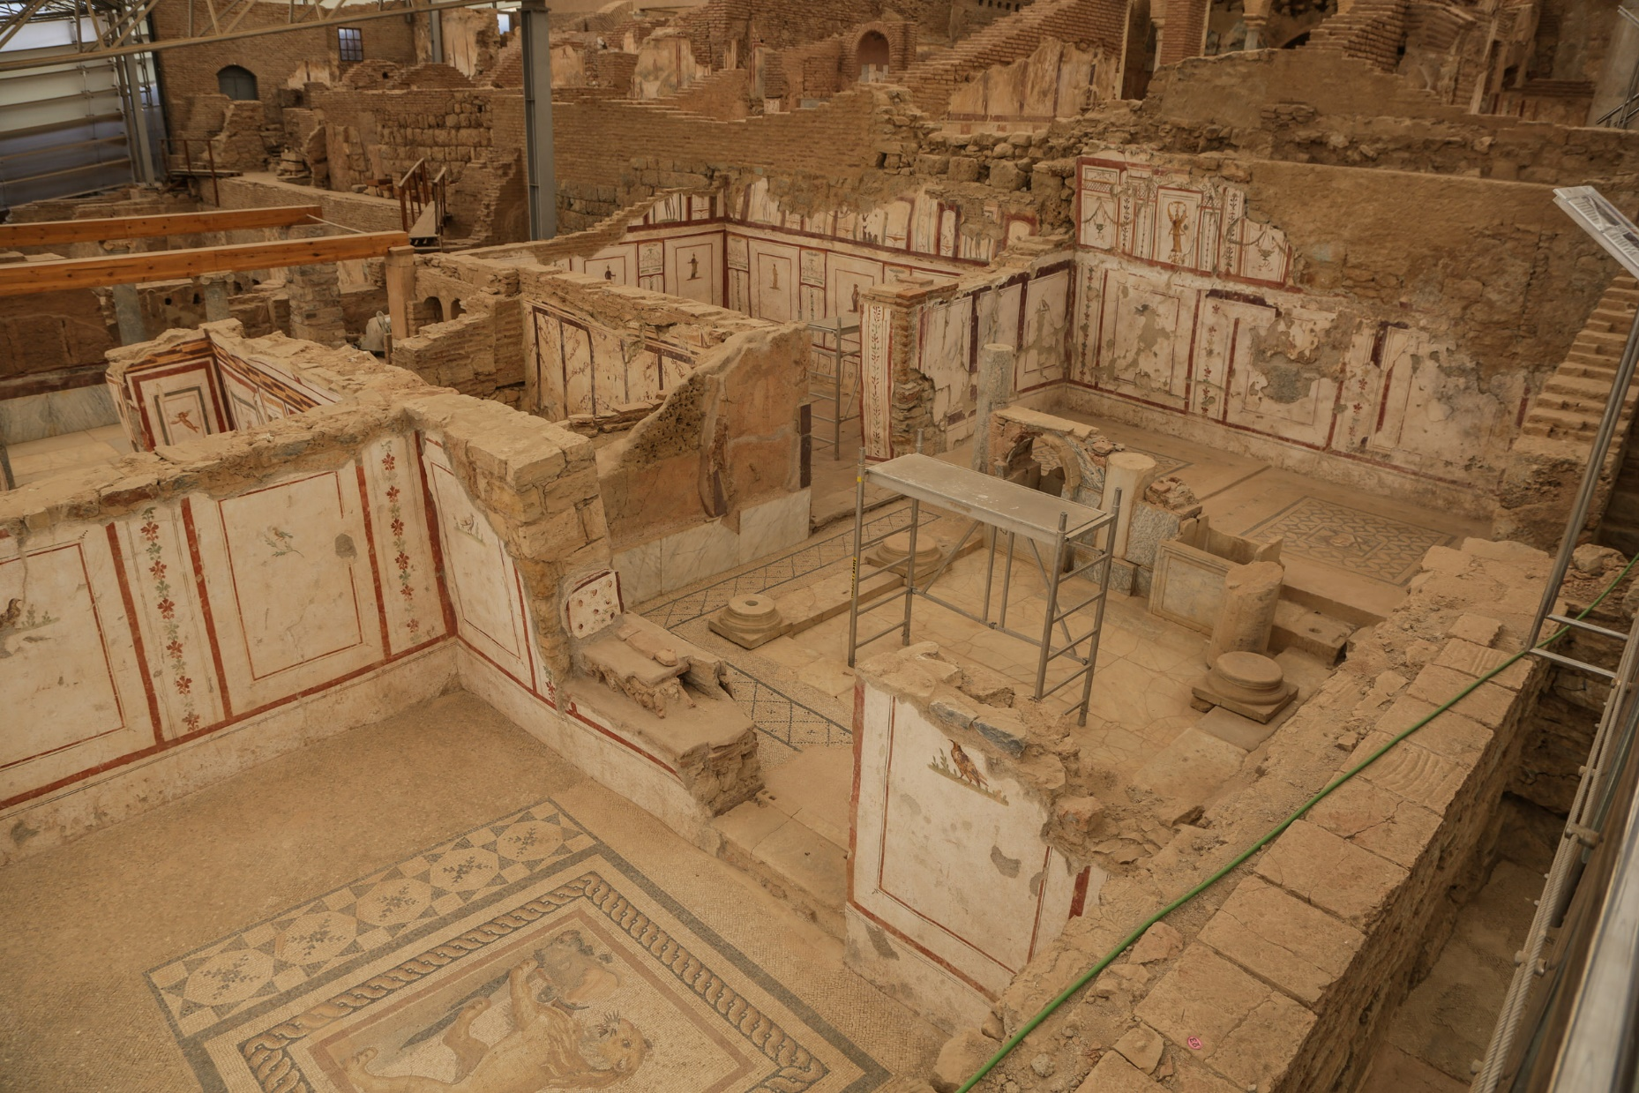
Notes:
https://upload.wikimedia.org/wikipedia/commons/thumb/c/c8/Ephesus_Terrace_Houses.jpg/1280px-Ephesus_Terrace_Houses.jpg
The 'terrace houses' at Ephesus, showing how the wealthy lived during the Roman period.

Slide 24
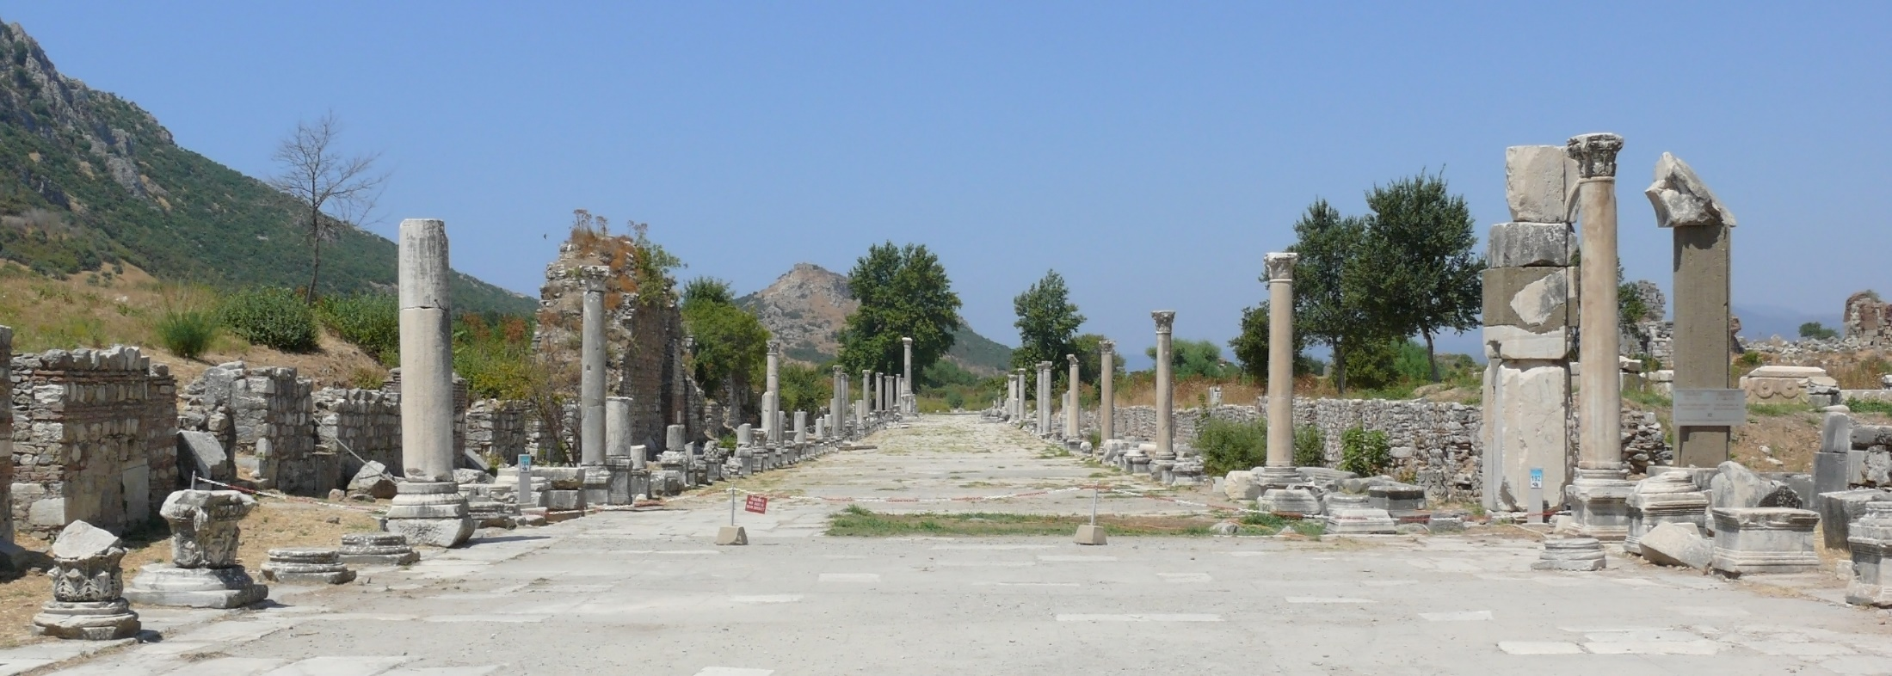
Street scene at the archeological excavations at Ephesus.

Slide 25
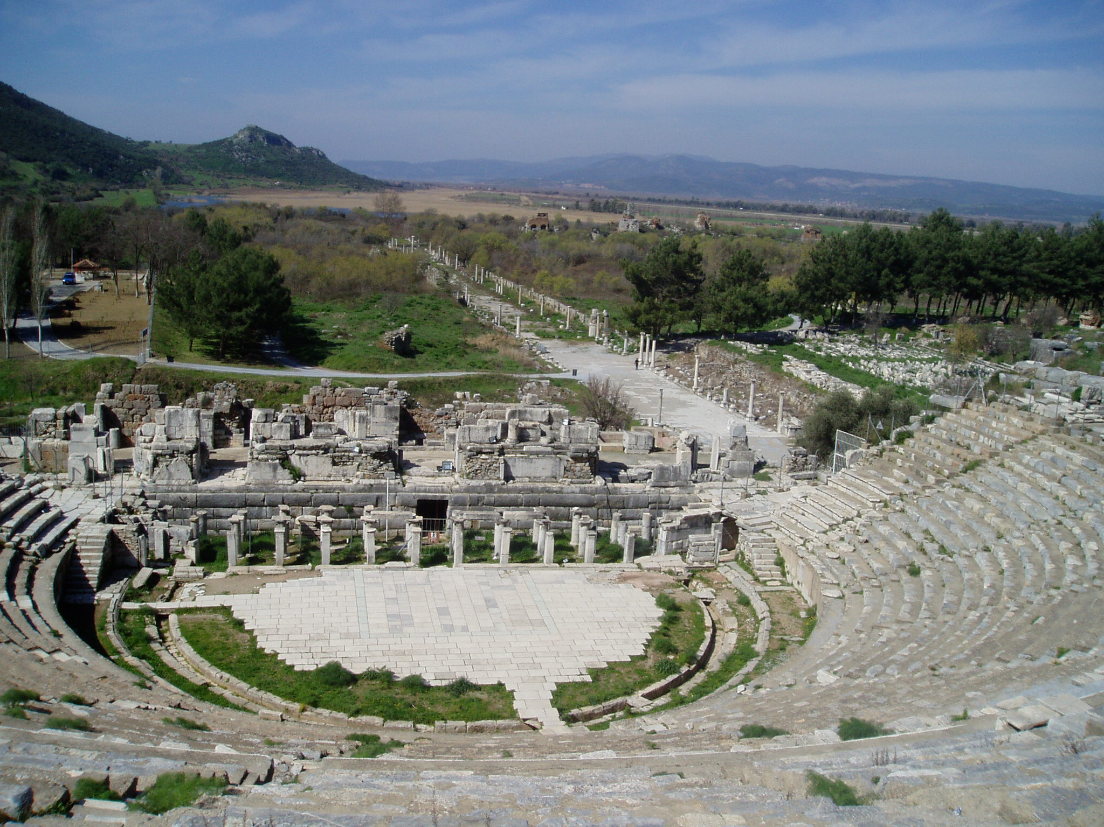
The Theatre of Ephesus with harbor street.
Notes:
https://upload.wikimedia.org/wikipedia/commons/thumb/c/cb/Ephesos_amphitheatre.jpg/1280px-Ephesos_amphitheatre.jpg

Slide 26
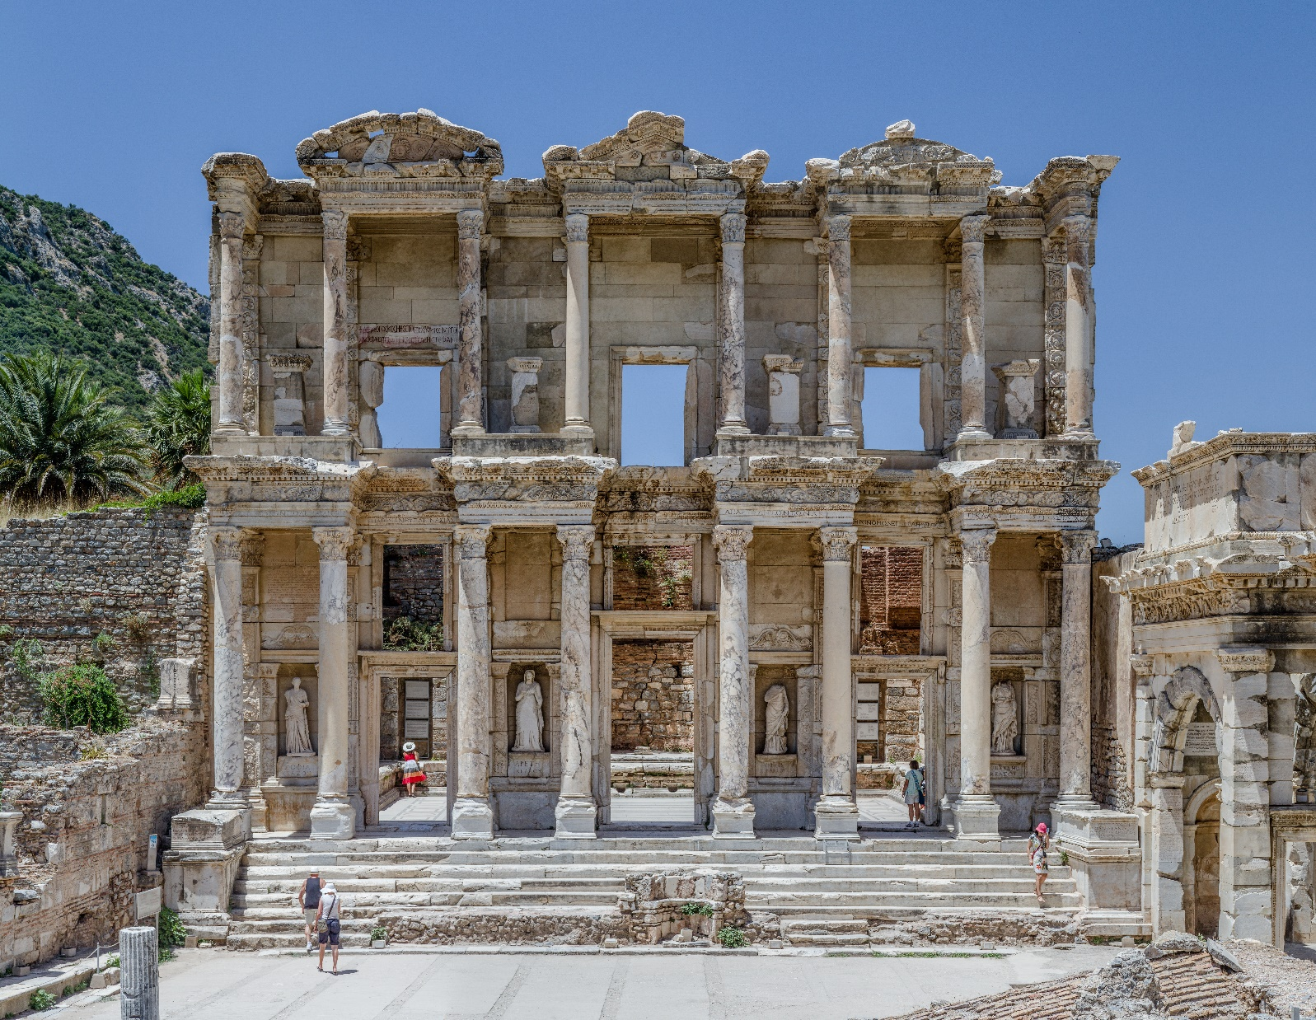
Façade of the Celsus library, in Ephesus

Slide 27
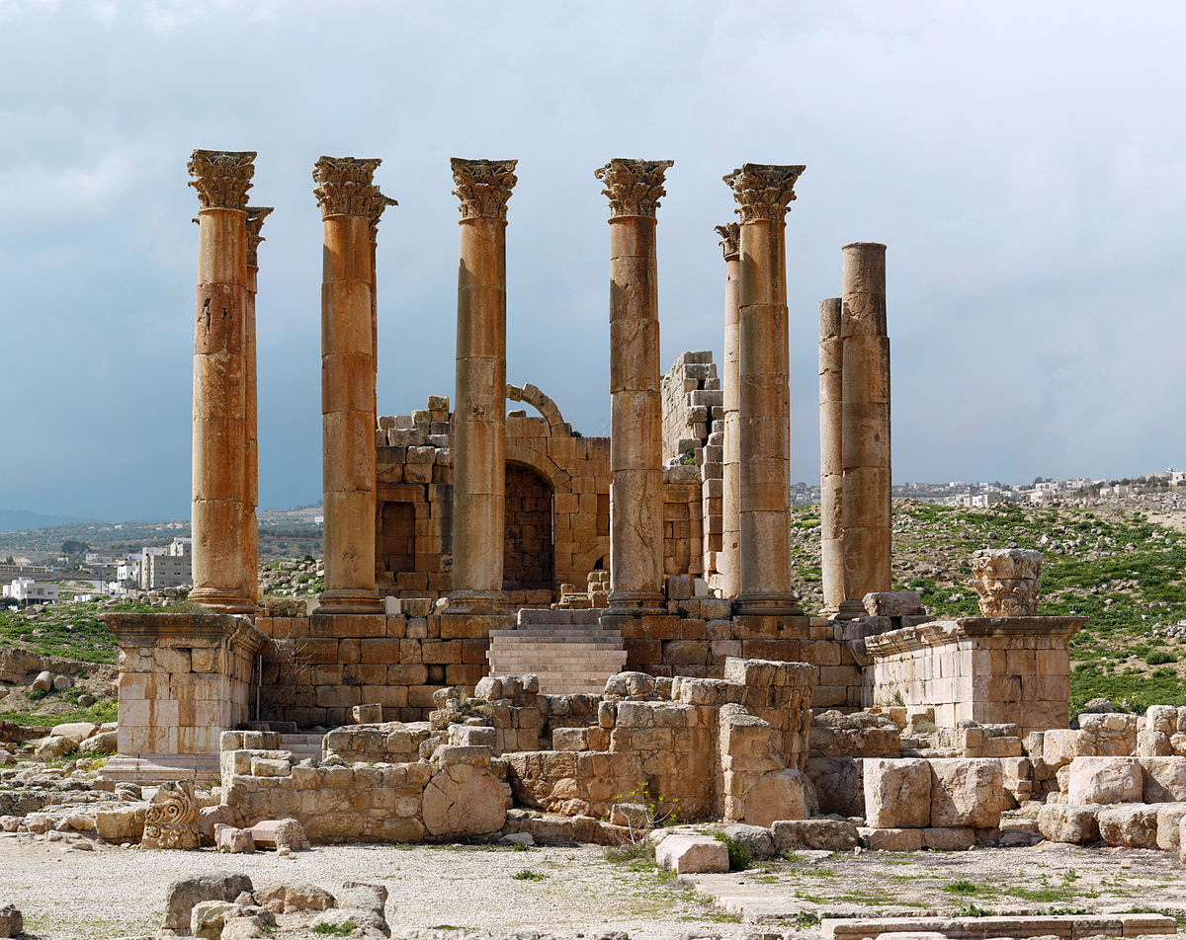
Ruins of the Temple of Artemis
Notes:
https://external-content.duckduckgo.com/iu/?u=https%3A%2F%2Fupload.wikimedia.org%2Fwikipedia%2Fcommons%2Fthumb%2F7%2F79%2FArtemis_Temple_Pan_2_touched.jpg%2F1200px-Artemis_Temple_Pan_2_touched.jpg&f=1&nofb=1&ipt=aed2ea453e1ed066428c788d0d327e5095b42d075be39d05ebc8a98586c062e9&ipo=images

Slide 28
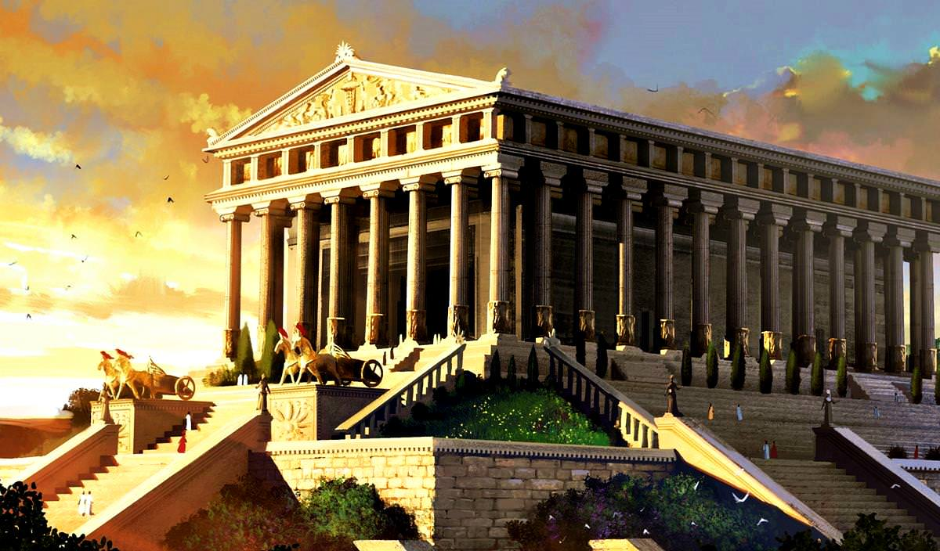
Artists rendition of the Temple of
Artemis
Notes:
343x164 ft more than 100 columns
Built on swampy ground to be earthquake proof
14 steps to platform
Inner shrine image of the goddess Artemis, mummy like figure with many breasts, symbol of fertility.
Behind the shrine the treasury, bank of Asia [Turkey]
https://external-content.duckduckgo.com/iu/?u=https%3A%2F%2Ftse1.mm.bing.net%2Fth%3Fid%3DOIP.vIirqJA5qWcJUwO_eD8S0QHaEW%26pid%3DApi&f=1&ipt=aa862bc201d77600ca1b98b40ddcb37b420778b0574d492fccf720882f395aad&ipo=images

Slide 29
Likely, it was a circular letter, that included Ephesus, but not the exclusive audience.
^{Col 4.16} When this letter has been read among you, make sure that it is also read in Messiah’s community of Laodicea. In turn, you should read my letter coming from Laodicea.
Notes:
We’ll follow standard practice, and call the letter Ephesians, though that city may have not been the main addressee.

Slide 30
No particular heresy or crisis.
Similar to Colossians
Colossian exposition of Messiah in the universe.
Ephesians cosmic significance of believers in fulfilling work of Messiah

Slide 31
Colossians letter has emphasis on reconciliation of men to G-d through the atonement of Yeshua
Ephesians letter has emphasis on reconciliation of men to one another.

Slide 32
Shaul was a prisoner when writing.
^{3.1} For this reason I, Paul, am a prisoner of Messiah Yeshua for the sake of you Gentiles.
^{4.1} Therefore I, a prisoner for the Lord, urge you to walk in a manner worthy of the calling to which you were called—

Slide 33
^{6.19-20} And pray for me when I open my mouth to make known with boldness the mystery of the Good News, for which I am an ambassador in chains.

Slide 34
David Stern summary
Ch 1–3 Who G-d is and how to relate Him as individuals and group
Ch 4-6 Halakhah: practical applications

Slide 35
Key issue according to Stern:
Gentile identity 2.12 “You had no Messiah. You were estranged from the national life of Isra’el. You were foreigners to the covenants embodying God’s promise. You were in this world without hope and without God.

Slide 36
Solution in Messiah 2.13-14 “But now, you who were once far off have been brought near through the shedding of the Messiah’s blood. For he himself is our shalom — he has made us both one and has broken down the m’chitzah which divided us.”
Notes:
But, what does that mean? Are all Gentiles now Jews. Are Jews now Gentiles?

Slide 38
He chose us in love, Eph 1.1 - 1.6
Introduction to the Letter
Opening of the letter
Passion of the letter
Notes:
Ephesians 1.1-1.6 text in blue to distinguish it from many supporting or explanatory scriptures

Slide 39
^{Eph 1.1-2} Shaul/Paul, an emissary of Messiah Yeshua by God’s will,
Notes:
Shaul’s authority by direct encounter with the Messiah. Not any human endeavor. I have ordination from the IAMCS, but that is really of no ultimate consequence.

Slide 40
^{Gal 1.1} From: Sha’ul, an emissary — I received my commission not from human beings or through human mediation but through Yeshua the Messiah and God the Father, who raised him from the dead — also from all the brothers with me.
Notes:
Me too

Slide 41
^{Acts 9.1-6} Now Saul, still breathing out threats and murder against the Lord’s disciples, went to the kohen gadol. He requested letters of introduction from him to the synagogues in Damascus, so that if he found any men or women belonging to the Way, he might bring them as prisoners to Jerusalem.
Notes:
Why so angry??

Slide 42
^{Acts 9.1-6} As he was traveling, approaching Damascus, suddenly a light from heaven flashed around him. Falling to the ground, he heard a voice saying to him, “Saul, Saul, why are you persecuting Me?” “Who are You, Lord?” Saul said.

Slide 43
^{Acts 9.1-6} “I am Yeshua — whom you are persecuting. So he, trembling and astonished, said, “Lord, what do You want me to do?” Then the Lord said to him, ”But get up and go into the city, and you will be told what you must do.”

Slide 44
^{Eph 1.1-2} Shaul/Paul, an emissary of Messiah Yeshua by God’s will,
Notes:
Important to say to non Jewish, pagan audience used to hearing “fate” or the universe [still on movies] or karma
If you are in ministry, need to know that you are CALLED. No other way to survive.

Slide 45
^{Eph 1.1-2} Shaul/Paul, an emissary of Messiah Yeshua by God’s will, To the kedoshim in Ephesus.
Kedoshim קדושים holy ones
Term Shaul frequently uses; Tanakhic designation of G-d’s people:
Notes:
So, YOU and I are G-d’s kedoshim, holy ones. Think of yourself, those around you…holy ones, kedoshim.

Slide 46
^{1 Cor 1.1-2} Paul, called as an emissary of Messiah Yeshua by the will of God, and Sosthenes our brother, to God’s community in Corinth—having been made holy in Messiah Yeshua, called as kedoshim

Slide 47
^{Phil 1.1} Paul and Timothy, slaves of Messiah Yeshua, to all the kedoshim in Messiah Yeshua who are in Philippi with the overseers and servant-leaders:

Slide 48
This is the signature community definition of Israel:
^{Shmot/Ex 19.5-6} Now then, if you listen closely to My voice, and keep My covenant, then you will be My own treasure from among all people, for all the earth is Mine. So as for you, you will be to Me a kingdom of kohanim and a holy nation.’

Slide 49
^{Vayikra/Lev 11.44} “For I am Adoni your God. Therefore, sanctify yourselves, and be holy, for I am holy. You are not to defile yourselves with any kind of creeping thing that moves on the earth. For I am Adoni who brought you up out of the land of Egypt, to be your God. Therefore, you shall be holy, for I am holy.
Notes:
Why is holiness affiliated with food? Build an ambience. Holy means pure, clean, wholesome. Don’t eat creeping things.
Epitome of disgust in movie imagery is Gollum…

Slide 50
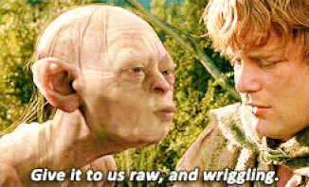
Notes:
https://3.bp.blogspot.com/-FEKfoflYV0o/XABsTQBFS4I/AAAAAAAADqs/RwSOIxJisXgvxQOvKxIZpkU61SSdPnd9ACLcBGAs/s1600/raw%2Bfish%2Bgollum.gif

Slide 51
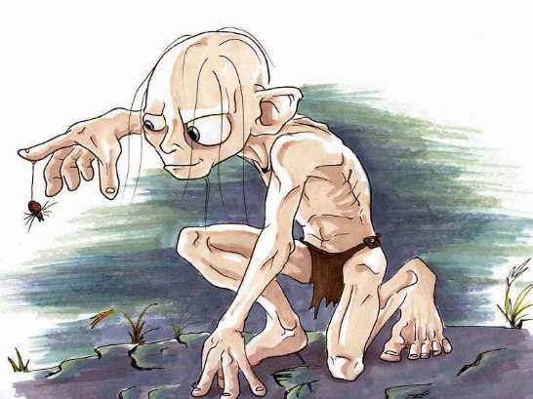
Notes:
Holy is the opposite.

Slide 52
^{Vayikra/Lev 19.2} Adoni said to Moshe, “Speak to the entire community of Isra’el; tell them, ‘You people are to be holy because I, Adoni your God, am holy.
^{Vayikra/Lev 20.26} You are to be holy to Me, for I, Adoni, am holy, and have set you apart from the peoples, so that you would be Mine.
Notes:
First above followed by honoring parents, keeping Shabbat. More elegant holiness associations than just creepy food.
Second associated with food, and witchcraft.
Holiness was the motif of the group I came to faith in. Simplicity, Shabbat [Sunday], modesty, purity. Don’t touch a woman ANYWHERE. Note: I didn’t mean to give a carte blanche last week to shoulder touching. Just IF you do touch, with permission, limit yourself to her shoulder. Or she may limit herself to your cheek.
Do you want to be associated with that holy crowd?
Do you want to be associated with that unholy crowd?

Slide 53
^{1 Thes 5. 23-24} Now may the God of shalom Himself make you completely holy; and may your whole spirit and soul and body be kept complete, blameless at the coming of our Lord Yeshua the Messiah. Faithful is the One who calls you—and He will make it happen!

Slide 54
In the Tanakh, places, things, times, the nation was to be holy.
In Messiah, individuals are called to be holy. Like Yeshua, by trusting in Him, in His power!
Notes:
Invitation now, and at end

Slide 55
^{Eph 1.1-2} Shaul/Paul, an emissary of Messiah Yeshua by God’s will, To the kedoshim in Ephesus—those trusting in Messiah Yeshua: Grace and shalom to you, from God our Father and the Lord Yeshua the Messiah!
Notes:
Extended from normal Greek greeting. Hebrew greeting Shalom שלום standard.
Moreover, greeting in two divine titles. Lord = Kurios is the Greek LXX equiv of the YHVH!

Slide 57
He chose us in love, Eph 1.1 - 1.6
Introduction to the Letter
Opening of the letter
Passion of the letter

Slide 58
^{Eph 1.3-6} Blessed be the God and Father of our Lord Yeshua the Messiah, who in the Messiah has blessed us with every spiritual blessing in heaven.
Blessing is a common Hebraic practice. You’ve heard me rail on 100 blessing as a contrived commandment, but the principle…

Slide 59
^{T’hillim Ps 14.14} Blessed be Adoni the God of Isra’el from eternity past to eternity future.
^{T’hillim Ps 66.20} Blessed be God, who has not rejected my prayer, nor turned His lovingkindness from me.

Slide 60
^{T’hillim Ps 72.18} Blessed be Adoni Elohim, God of Israel, who alone does wonders.

Slide 61
שְׁמוֹנֶה עֶשּׂרֵה Sh'moneh Esray [Eighteen Blessings]
Traditional, Public Domain

Slide 62
בָּרוּךְ אַתָּה יְיָ
[בָּרוּךְ הוּא וּבָּרוּךְ שְּׁמוֹ]
Ba-rukh a-tah Ah-do-ni
[Ba-rukh hu u-ba-rukh sh'mo]

Slide 63
אֱלהֵינוּ וֵאלהֵי אֲבוֹתֵינוּ
E-lo-hay-nu
vay-lo-hay avo-tay-nu
אֱלהֵי אַבְרָהָם אֱלהֵי יִצְחָק
וֵאלהֵי יַעֲקב
Eh-lo-hay Av-rah-am
Eh-lo-hay Yits-khak
Vay-lo-hay Ya-a-kov

Slide 64
Blessed are You ADONI our G-d
the G-d of our forefathers
The G-d of Av-ra-ham
The G-d of Yits-khak
and the G-d of Ya-a-kov]

Slide 65
^{Eph 1.3-6} Blessed be the God and Father of our Lord Yeshua the Messiah, who in the Messiah has blessed us with every spiritual blessing in heaven. In the Messiah he chose us in love before the creation of the universe to be holy and without defect in his presence.

Slide 66
^{Eph 1.3-6} He determined in advance that through Yeshua the Messiah we would be his sons — in keeping with his pleasure and purpose — so that we would bring him praise commensurate with the glory of the grace he gave us through the Beloved One.

Slide 67
Two ways of reading this.
In the Messiah he chose us in love before the creation of the universe to be holy and without defect in his presence.
He chose us individually.
He chose our destiny.

Slide 68
In the Messiah he chose us in love before the creation of the universe to be holy and without defect in his presence.
Notes:
G-d choses individuals for calling, I personally don’t believe He choses individuals for salvation.

Slide 69
^{Ber/Gen 25.23} Adoni said to her: “Two nations are in your womb, and two peoples from your body will be separated. One people will be stronger than the other people, but the older will serve the younger.”
Notes:
Yaakov and Esav, Jacob and Esau. Not chosen for salvation, but destiny. Covenant destiny. One was to be the covenant son, progenitor of the covenant nation.
Proof: the elder Esav never served the younger Yaakov. The Nation of Esav or Edom did serve the nation of Yaakov.

Slide 70
^{1 Chron 18.12-13} Abishai son of Zeruiah struck down 18,000 Edomites in the Valley of Salt. Then he put garrisons in Edom, and all the Edomites became vassals to David. So Adoni gave David victory wherever he went.

Slide 71
A prophecy, the word of Adoni to Isra’el through Mal’akhi: “I love you,” says Adoni. But you ask, “How do you show us your love?” Adoni answers, “‘Esav was Ya‘akov’s brother. Yet I loved Ya‘akov but hated ‘Esav.
Notes:
G-d didn’t hate the individuals, but Yaakov Jacob was the covenant people.

Slide 72
^{Ro 9.14-18} So are we to say, “It is unjust for God to do this”? Heaven forbid! For to Moshe he says, “I will have mercy on whom I have mercy, and I will pity whom I pity.” Thus it doesn’t depend on human desires or efforts, but on God, who has mercy. For the Tanakh says to Pharaoh,

Slide 73
^{Ro 9.14-18} “It is for this very reason that I raised you up, so that in connection with you I might demonstrate my power, so that my name might be known throughout the world.” So then, he has mercy on whom he wants, and he hardens whom he wants.

Slide 74
^{Eph 1.3-6} Blessed be the God and Father of our Lord Yeshua the Messiah, who in the Messiah has blessed us with every spiritual blessing in heaven. In the Messiah he chose us in love before the creation of the universe to be holy and without defect in his presence.
Notes:
Chose us in LOVE in Messiah…

Slide 75
^{Eph 1.3-6} He determined in advance that through Yeshua the Messiah we would be his sons — in keeping with his pleasure and purpose — so that we would bring him praise commensurate with the glory of the grace he gave us through the Beloved One.

Slide 76
^{Yn 1.10-14} He was in the world, and the world was made through Him; but the world did not know Him. He came to His own, but His own did not receive Him. But whoever did receive Him, those trusting in His name, to these He gave the right to become children of God.

Slide 77
^{Yn 1.10-14} They were born not of a bloodline, nor of human desire, nor of man’s will, but of God. And the Word became flesh and tabernacled among us. We looked upon His glory, the glory of the one and only from the Father, full of grace and truth.

Slide 78
^{Eph 1.3-6} Blessed be the God and Father of our Lord Yeshua the Messiah, who in the Messiah has blessed us with every spiritual blessing in heaven. In the Messiah he chose us in love before the creation of the universe to be holy and without defect in his presence.

Slide 79
^{Eph 1.3-6} He determined in advance that through Yeshua the Messiah we would be his sons — in keeping with his pleasure and purpose — so that we would bring him praise commensurate with the glory of the grace he gave us through the Beloved One.

Slide 80
Have you and I chosen to let Him work in our lives to be the holy people He has called us to be?
Received Him as our atonement for salvation.
Received His power into the dark places of our lives? Fear, unforgiveness, lust, greed.

Slide 81
A few days ago, some of us were discussing tandem skydiving. The statistics say that I have a greater chance of winning the lottery than of getting hurt in a tandem skydive. Salvation is like that. I’m strapped to Yeshua. He jumps out of the plane with me. I don’t fight it.

Slide 82
Instead, I enjoy soaring, feeling the wind on my body, and confident the One who holds me isn't foolishly attempting to disobey the very gravity He helped to create.
He knows when to pull the ripcord and land us safely on the earth.

Slide 84
This is because only he sees the Biggest Picture and into the hidden places in you, them, me, and the heart of God. I choose to give up control (which I only thought I had) and let Him fly my plane with me fully present and conscious.

Slide 86
He chose us in love, Eph 1.1 - 1.6
Introduction to the Letter
Opening of the letter
Passion of the letter

Slide 87
^{Eph 1.3-6} Blessed be the God and Father of our Lord Yeshua the Messiah, who in the Messiah has blessed us with every spiritual blessing in heaven. In the Messiah he chose us in love before the creation of the universe to be holy and without defect in his presence.

Slide 88
^{Eph 1.3-6} He determined in advance that through Yeshua the Messiah we would be his sons — in keeping with his pleasure and purpose — so that we would bring him praise commensurate with the glory of the grace he gave us through the Beloved One.

Slide 89
Have you and I chosen to let Him work in our lives to be the holy people He has called us to be?
Received Him as our atonement for salvation.
Received His power into the dark places of our lives? Fear, unforgiveness, lust, greed.

