Slide 1
e-handout
To have these notes
without taking notes
Go to OrHaOlam.com
Click on Messages tab,
2023 Messages

Slide 2
How much did the pirate pay to get his ears pierced?
Notes:
Alongis

Slide 3
How much did the pirate pay to get his ears pierced?
A buccaneer.

Slide 4
I once worked at a cheap pizza shop to get by.

Slide 5
I once worked at a cheap pizza shop to get by.
I kneaded the dough.

Slide 6
I lost my girlfriend’s audiobook,

Slide 7
I lost my girlfriend’s audiobook, and now I’ll never hear the end of it.

Slide 8
Why is ‘dark’ spelled with a k and not c?

Slide 9
Why is ‘dark’ spelled with a k and not c?
Because you can’t see in the dark.

Slide 12
Last time on this series in Ephesians, June 9, 2023…
Introduction to the Letter
Opening of the letter
Passion of the letter
Notes:
City of Ephesus: great metro
Blessing, Shaul’s authority & calling, their calling to holiness = Messiah likeness
He chose us in love. Eternal plan for you and me to be His Kedoshim.

Slide 13
^{Eph 1.3-6} Blessed be the God and Father of our Lord Yeshua the Messiah, who in the Messiah has blessed us with every spiritual blessing in heaven. In the Messiah he chose us in love before the creation of the universe to be holy and without defect in his presence.
Notes:
It’s a big thing to be chosen… for a sports team, a job, and academic honor, a college. I applied to Johns Hopkins, Dartmouth, Union, U Buffalo. Only accepted at the last two.
My wife chose me. She’s been choosing me for 50 years. Amazing.

Slide 14
Eternal plan of love for you and me to be His Holy people, Kedoshim... but, HOW?

Slide 16
God’s Secret Plan
Why secret?

Slide 17
^{Eph 1.7-10} In union with him, through the shedding of his blood, we are set free — our sins are forgiven; this accords with the wealth of the grace he has lavished on us. In all his wisdom and insight he has made known to us his secret plan,

Slide 18
^{Eph 1.7-10} which by his own will he designed beforehand in connection with the Messiah and will put into effect when the time is ripe — his plan to place everything in heaven and on earth under the Messiah’s headship.

Slide 19
Secret love plan for us to be holy in Messiah.
Why secret?
If not kept secret, the enemy would have foiled it.
Notes:
June 6, we commemorated the Normandy invasion to liberate Europe of Hitler.

Slide 20
The Allies put a lot of effort into trying to convince the Germans that the invasion was going to be near Calais, not Normandy.
They invented phantom field armies based in Kent as part of their D-Day deception plan, named Operation Fortitude.
Notes:
https://www.bbc.com/news/uk-48215675

Slide 21
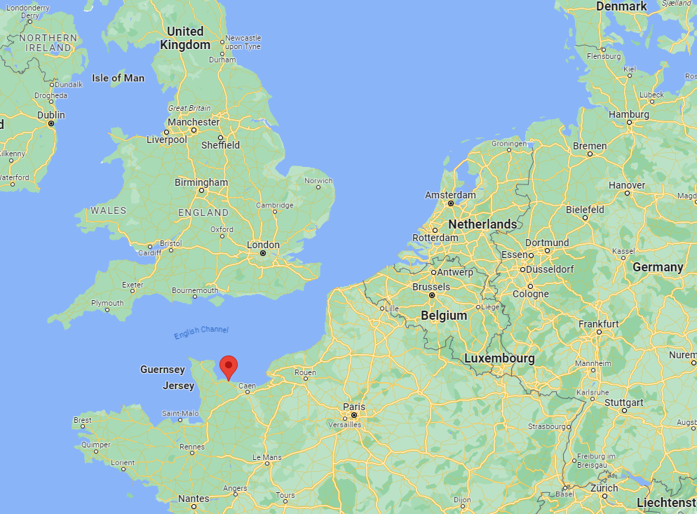
Calais
Omaha Beach
Notes:
240 miles away

Slide 22
They built dummy equipment - including inflatable tanks - parachuted dummies, used double agents and released controlled leaks of misinformation which led the Germans to believe the Allies were going to invade via Calais.
Notes:
https://www.bbc.com/news/uk-48215675

Slide 23
The Germans took the bait so much that even after D-Day they held many of their best troops in the Calais area expecting a second invasion.
Notes:
https://www.bbc.com/news/uk-48215675

Slide 24
^{1 Cor. 2.6-10} We do speak wisdom, however, among those who are mature—but not a wisdom of this age or of the rulers of this age, who are coming to nothing. Rather, we speak God’s wisdom in a mystery—a wisdom that has been hidden, which God destined for our glory before the ages. None of the rulers of this age understood it—

Slide 25
^{1 Cor. 2.6-10} for if they had, they would not have executed the Lord from whom this glory flows.
Notes:
If ha-Satan had known, he wouldn’t have goaded people to Messiah’s death.

Slide 26
Secret plan for us to be holy in Messiah.
But secret?
If not kept secret, the enemy would have foiled it.
If not secret, the Jewish leaders would not have caused it to happen.

Slide 27
^{Yn 11.49-52} But one of them, Kayafa [Caiphas], who was cohen gadol that year, said to them, “You people don’t know anything! You don’t see that it’s better for you if one man dies on behalf of the people, so that the whole nation won’t be destroyed.” Now he didn’t speak this way on his own initiative;

Slide 28
^{Yn 11.49-52} rather, since he was cohen gadol that year, he was prophesying that Yeshua was about to die on behalf of the nation, and not for the nation alone, but so that he might gather into one the scattered children of God.

Slide 29
^{Ro. 11.25} It is that stoniness, to a degree, has come upon Isra’el, until the Gentile world enters in its fullness.
Notes:
G-d allowed, not caused, the hardheartedness of Israel to the Messiah’s message, so that salvation would come to the Nations.

Slide 30
The rabbinic world loved the Jewish method of attaining holiness…
Paul wrote, “I can testify to their zeal for God. But it is not based on correct understanding.” ^{Ro 10.2}
Review of the story of the oven of Aknai
Notes:
The Jewish or Rabbinic method works in part, but not in glory.

Slide 31
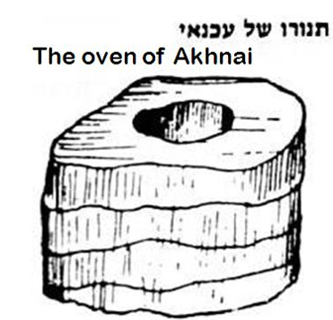
עַכְנַאי
(Talmudic Heb.)
snake
The structure was spiral, coiled ~snake.
Notes:
https://www.chabad.org/library/article_cdo/aid/5455793/jewish/59b.htm

Slide 32
Notes:
https://external-content.duckduckgo.com/iu/?u=http%3A%2F%2Fwww.ruthschreiber.com%2Fwp-content%2Fuploads%2F2019%2F12%2FP1110610-300dpi.jpg&f=1&nofb=1&ipt=dbd0e185b554c5912d07a87c9c0f18fe6de506fa53e8210131c5a49edcc6a189&ipo=images
There was a great debate if this kind of oven could be certified as kosher.

Slide 33
On that day, when they discussed this matter, Rabbi Eliezer answered all possible answers in the world to support his opinion, but the Rabbis did not accept his explanations.
Notes:
Bava Metzia 59b
https://www.sefaria.org/Bava_Metzia.59b.1?lang=bi

Slide 34
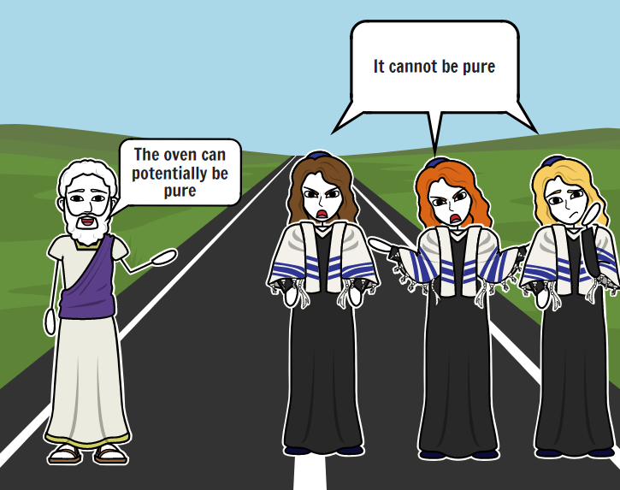
Notes:
https://www.storyboardthat.com/storyboards/e1b1a174/ari-and-rachel-oven-of-akhnai-comic2/copy

Slide 35
The Trio [majority] represents group opinion.
Notes:
Not my idea, but the artist, to represent the Jewish rabbinical majority as three lovely ladies.

Slide 36
After failing to convince the Rabbis logically, Rabbi Eliezer said to them: If the halakha is in accordance with my opinion, this carob tree will prove it. The carob tree was uprooted from its place one hundred cubits, and some say four hundred cubits. The Rabbis said to him: One does not cite halakhic proof from the carob tree.
Notes:
Bava Metzia 59b
https://www.sefaria.org/Bava_Metzia.59b.1?lang=bi

Slide 37
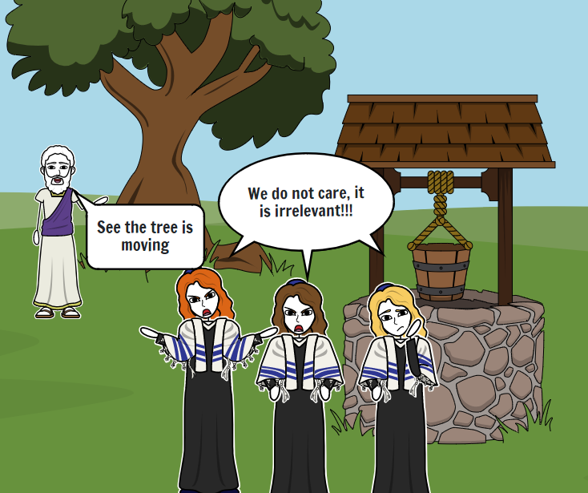
Notes:
https://www.storyboardthat.com/storyboards/e1b1a174/ari-and-rachel-oven-of-akhnai-comic2/copy

Slide 38
Rabbi Eliezer then said to them: If the halakha is in accordance with my opinion, the stream will prove it. The water in the stream turned backward and began flowing in the opposite direction. They said to him: One does not cite halakhic proof from a stream.

Slide 39
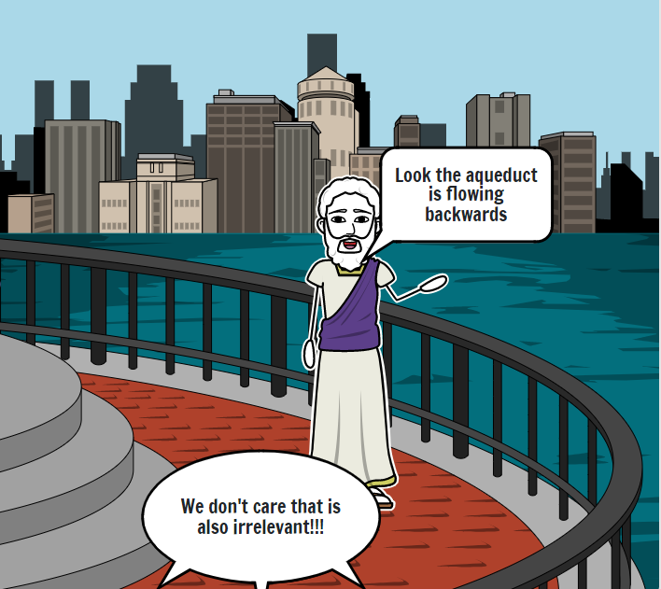
Notes:
https://www.storyboardthat.com/storyboards/e1b1a174/ari-and-rachel-oven-of-akhnai-comic2/copy

Slide 40
Rabbi Eliezer then said to them: If the halakha is in accordance with my opinion, the walls of the study hall will prove it. The walls of the study hall leaned inward and began to fall. Rabbi Yehoshua scolded the walls and said to them: If Torah scholars

Slide 41
are contending with each other in matters of halakha, what is the nature of your involvement in this dispute? The Gemara relates: The walls did not fall because of the deference due Rabbi Yehoshua, but they did not straighten because of the deference due Rabbi Eliezer, and they still remain leaning.
Notes:
Bava Metzia 59b
https://www.sefaria.org/Bava_Metzia.59b.1?lang=bi

Slide 42
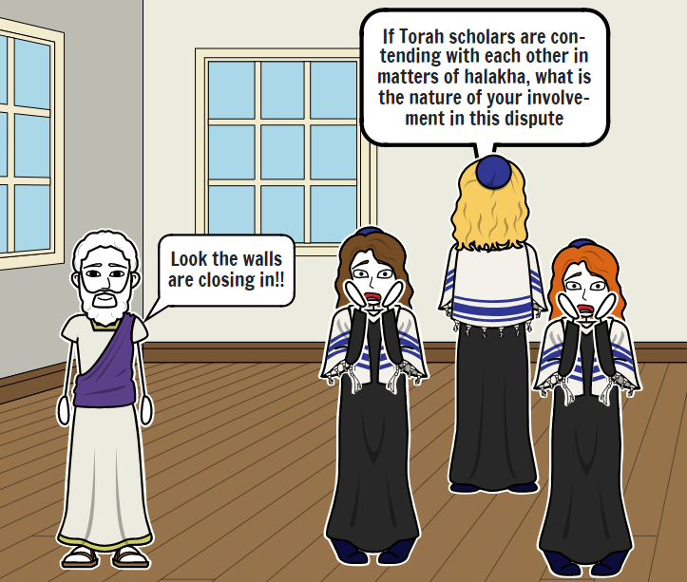
Notes:
https://www.storyboardthat.com/storyboards/e1b1a174/ari-and-rachel-oven-of-akhnai-comic2/copy

Slide 43
Eliezer represents living by the power of G-d.
The Trio [majority] represents group opinion.

Slide 44
Summary of the story thus far: R. Eliezer made and got divine approval of his case by
• Logic
• Supernatural intervention in moving a tree
• Supernatural intervention in reversal of a stream
• Supernatural intervention in collapse of walls
Notes:
None of these were acceptable to the other sages.

Slide 45
Rabbi Eliezer then said to them: If the halakha is in accordance with my opinion, Heaven will prove it. A Divine Voice emerged from Heaven and said: Why are you differing with Rabbi Eliezer, as the halakha is in accordance with his opinion in every place that he expresses an opinion?

Slide 46
Rabbi Yehoshua stood on his feet and said: It is written: “It is not in heaven” (Deuteronomy 30:12). The Gemara asks: What is the relevance of the phrase “It is not in heaven” in this context? Rabbi Yirmeya says: Since the Torah was already given at Mount Sinai,

Slide 47
we do not regard a Divine Voice, as You already wrote at Mount Sinai, in the Torah: “After a majority to incline” (Exodus 23:2). Since the majority of Rabbis disagreed with Rabbi Eliezer’s opinion, the halakha is not ruled in accordance with his opinion.

Slide 48
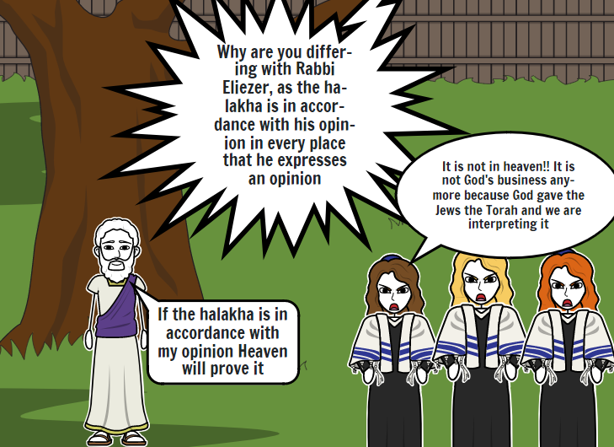
Notes:
https://www.storyboardthat.com/storyboards/e1b1a174/ari-and-rachel-oven-of-akhnai-comic2/copy

Slide 49
R. Yirmiya cited the source of Rabbinic authority, more than heavenly voices and miracles. He says, “It has already been written in the Torah “You shall follow after the Majority.”’
Where does it say that?
Notes:
https://www.jewsforjudaism.org/knowledge/articles/biblical-basis-rabbinic-authority/

Slide 50
Shmot/Ex 23:2. This verse is used as an asmakhtah אַסְמַכְתָּא (Aramaic) written proof, that in Biblical matters we follow the majority, whether in making legal decisions, or with mixtures of kosher and non-kosher food items etc.

Slide 51
[Here is the key] Shmot/Ex 23:2
לֹא-תִהְיֶה אַחֲרֵי-רַבִּים לְרָעֹת; וְלֹא-תַעֲנֶה עַל-רִב ,לִנְטֹת אַחֲרֵי רַבִּים לְהַטֹּת.
Do not follow the majority when it does what is wrong; and don't allow the popular view to sway you into offering testimony for any cause if the effect will be to pervert justice.

Slide 52
The phrase was taken out of context to reverse the meaning!! The word “NOT” was deleted and it reversed the plain sense.

Slide 53
[Here is the key] Shmot/Ex 23:2
לֹא-תִהְיֶה אַחֲרֵי-רַבִּים לְרָעֹת; וְלֹא-תַעֲנֶה עַל-רִב ,לִנְטֹת אַחֲרֵי רַבִּים לְהַטֹּת.
Do not follow the majority when it does what is wrong; and don't allow the popular view to sway you into offering testimony for any cause if the effect will be to pervert justice.

Slide 54
Notes:
https://www.storyboardthat.com/storyboards/e1b1a174/ari-and-rachel-oven-of-akhnai-comic2/copy#

Slide 55
The Gemara relates: Years after, Rabbi Natan encountered Elijah the prophet and said to him: What did the Holy One, Blessed be He, do at that time, when Rabbi Yehoshua issued his declaration? Elijah said to him: The Holy One, Blessed be He, smiled and said:

Slide 56
My children have triumphed over Me; My children have triumphed over Me.
Notes:
This last is a view of G-d that is cringeworthy.

Slide 57
Summary of the whole story: R. Eliezer made and got divine approval of his case by
• Logic
• Supernatural intervention in moving a tree

Slide 58
Supernatural intervention in reversal of a stream
• Supernatural intervention in collapse of walls
• G-d spoke from heaven.
Genuine Heavenly voice was rejected

Slide 59
Majority opinion of rabbis deemed supreme.
• Basis of majority opinion is violation and reversal of Ex 23.2
• G-d is construed to like the idea that His will and opinion is overcome.

Slide 60
G-d’s plan needed to be kept secret, until ready to be revealed, because it was so opposite to the wisdom of man that it could have been undermined by haSatan and by His people.

Slide 62
God’s Secret Plan
Why kept secret?
Meaning of secret wisdom
and understanding.

Slide 63
^{Eph 1.7-10} In union with him, through the shedding of his blood, we are set free — our sins are forgiven; this accords with the wealth of the grace he has lavished on us. In all his wisdom and understanding he has made known to us his secret [mystery] plan,

Slide 64
Three words to explore:
wisdom,
understanding,
secret or mystery

Slide 66
1. Wisdom (sophía) is the root of the English term "philosophy" – “the art of using wisdom,” “affection for wisdom.” wisdom, insight, skill (human or divine), intelligence.
Notes:
General wisdom of life, elder brains are said to have big picture wisdom.

Slide 67
2. understanding [phronesis]: practical wisdom
understanding (which leads to right action), practical wisdom, prudence.
Notes:
Details, application

Slide 68
G-d’s wisdom and understanding is not difficult and complex, but astonishingly simple.
^{Mt 11.25-26} It was at that time that Yeshua said, “I thank you, Father, Lord of heaven and earth, that you concealed these things from the sophisticated and educated and revealed them to infants.
Notes:
Not esoteric.

Slide 69
^{1 Cor 1.19-25} Indeed, the Tanakh says, “I will destroy the wisdom of the wise and frustrate the intelligence of the intelligent.”^{[Is 29.14]} Where does that leave the philosopher, the Torah-teacher, or any of today’s thinkers?

Slide 70
^{1 Cor 1.19-25} Hasn’t God made this world’s wisdom look pretty foolish? For God’s wisdom ordained that the world, using its own wisdom, would not come to know him. Therefore God decided to use the “nonsense” of what we proclaim as his means of saving those who come to trust in it.

Slide 71
^{1 Cor 1.19-25} Precisely because Jews ask for signs and Greeks try to find wisdom, we go on proclaiming a Messiah executed on a stake as a criminal! To Jews this is an obstacle, and to Greeks it is nonsense;

Slide 72
^{1 Cor 1.19-25} but to those who are called, both Jews and Greeks, this same Messiah is God’s power and God’s wisdom! For God’s “nonsense” is wiser than humanity’s “wisdom.”

Slide 73
3. mustérion: a mystery or secret doctrine, the counsels of God, once hidden but now revealed in the good news of Messiah; particular truths or details of the Messiah’s revelation.

Slide 74
In the Bible, a "mystery" (3466 /mystḗrion) is not something unknowable. Rather, it is what can only be known through revelation, i.e. because God reveals it.

Slide 75
In using the word “mystery” Paul used singular, not plural, to distinguish Messiah’s mystery from the Greek mysteries religions.

Slide 76
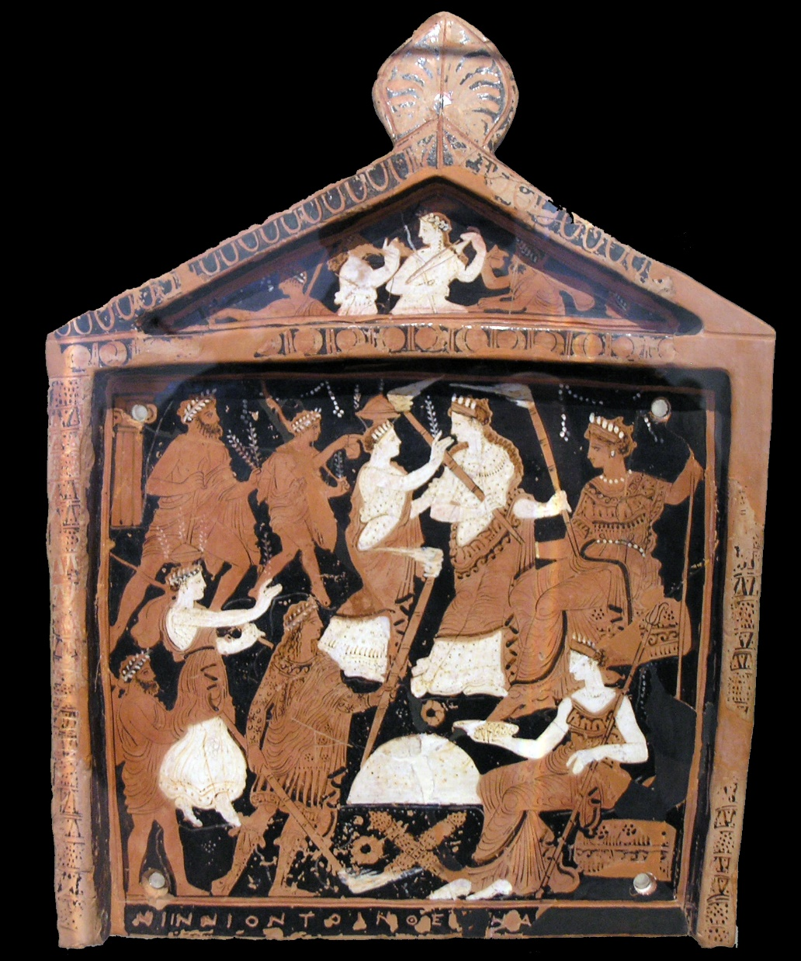
A votive plaque known as the Ninnion Tablet depicting elements of the Eleusinian Mysteries, discovered in the sanctuary at Eleusis (mid-4th century BC)
Notes:
https://en.wikipedia.org/wiki/Eleusinian_Mysteries

Slide 77
References by Herodotus and Euripides attest to the existence of certain Bacchic-Orphic beliefs and practices: itinerant religion specialists and purveyors of secret knowledge, called orpheotelestai, performed the teletai, private rites for the remission of sins.
Notes:
https://www.metmuseum.org/toah/hd/myst/hd_myst.htm

Slide 78
Secret activities, called teletai or orgia, took place in the mountains, where the Bacchoi engaged in ecstatic dancing, singing, revelry, and even eating raw meat. The wine-induced Bacchic frenzy was seen as a temporary madness that transported them from civilization to wilderness, both literally and metaphorically.
Notes:
https://www.metmuseum.org/toah/hd/myst/hd_myst.htm

Slide 79
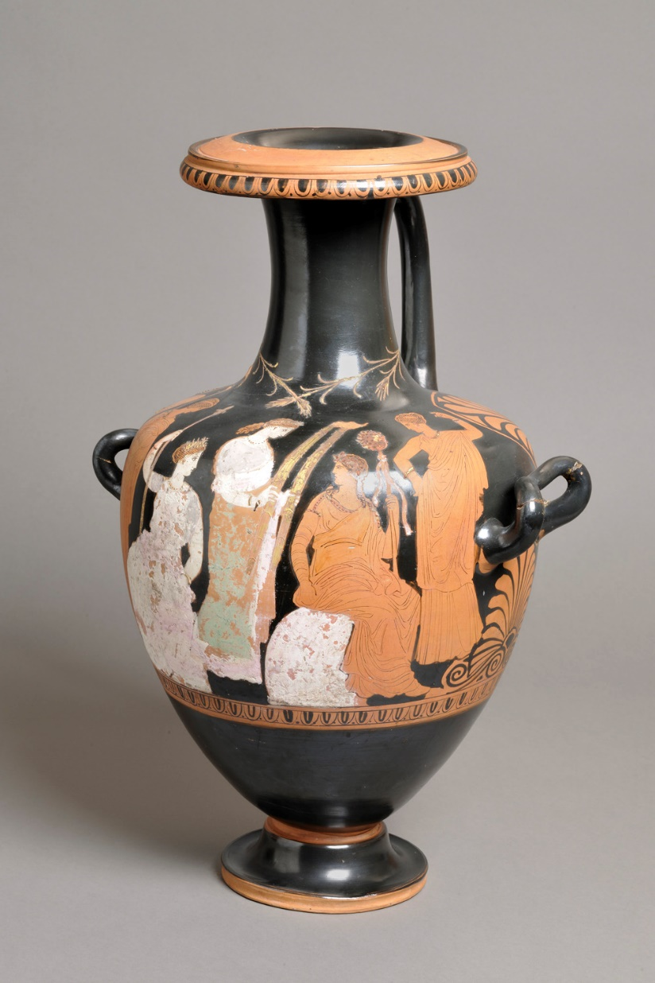
The Eleusinian Mysteries Hydria, showing the reunion of Demeter and Persephone at the start of each spring
Notes:
https://en.wikipedia.org/wiki/Eleusinian_Mysteries
And to distinguish from the secret societies of our day: Masons, Shriners, Knights of Pythias, Knights Templar, Freemasons, Skull and Bones.
Don’t know that I’ve spoken to this in 27 years. Ira Brawer and RTF had a special session.

Slide 80
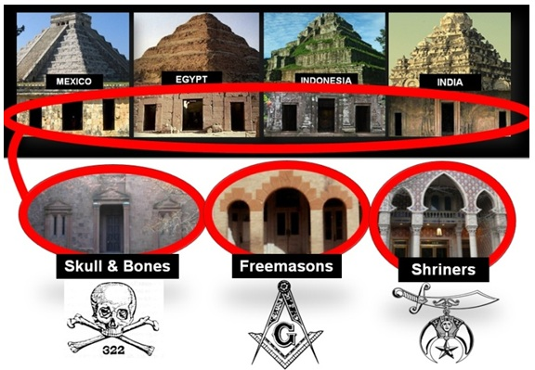
Notes:
https://external-content.duckduckgo.com/iu/?u=https%3A%2F%2Fwww.richardcassaro.com%2Fwp-content%2Fuploads%2F2013%2F03%2FSECRET-SOCIETIES-good-or-evil-Triptych-Ancient-And-Secret-Society.jpg&f=1&nofb=1&ipt=837fe11f57c96c49d861119bc600ad43838063db01fd23749723010fd9c62fb9&ipo=images

Slide 81
In the Bible, a "mystery" is what can only be known through revelation, i.e. because God reveals it.

Slide 83
God’s Secret Plan
Why kept secret?
Meaning of mystery / secret
wisdom…
3. What is the mystery, secret ?
Notes:
It took 82 slides to get here? Like a drumroll.

Slide 84
^{Eph 1.7-10} In union with him, through the shedding of his blood, we are set free — our sins are forgiven; this accords with the wealth of the grace he has lavished on us. In all his wisdom and insight he has made known to us his secret plan,

Slide 85
^{Eph 1.7-10} which by his own will he designed beforehand in connection with the Messiah and will put into effect when the time is ripe — his plan to place everything in heaven and on earth under the Messiah’s headship.

Slide 86
The mystery is
Supernatural FREEDOM from habits, tendencies
Supernatural forgiveness: giving and receiving.
Messiah Yeshua! Present and real. Headship, King, Coach, lover, mentor, friend!

Slide 87
The mystery is
Supernatural comfort in suffering. [Still a choice.]
Supernatural deliverance from trauma [still with processing]
Notes:
Pause and worship and invite!

Slide 88
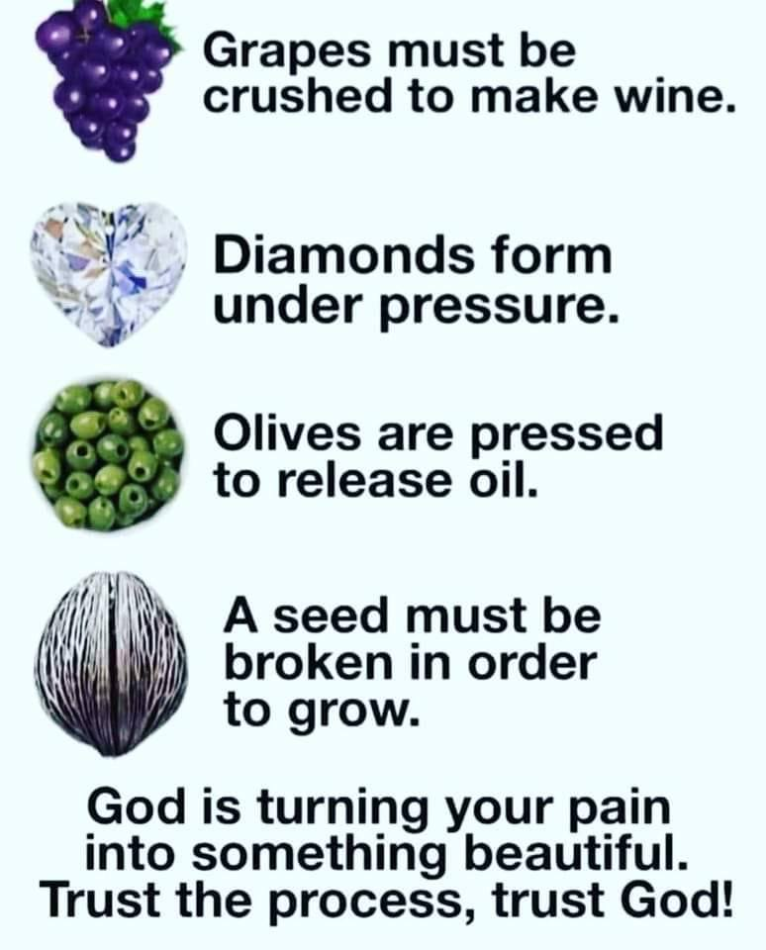
BUT, only if we let our heavenly King, Coach, Lover, Mentor, Friend, work!

Slide 89
^{1 Yn 3. 1-2} See how glorious a love the Father has given us, that we should be called God’s children—and so we are! The reason the world does not know us is that it did not know Him. Loved ones, now we are God’s children;

Slide 90
^{1 Yn 3. 1-2} and it has not yet been revealed what we will be. But we do know that when it’s revealed, we shall be like Him, because we will see Him just as He is.

Slide 91
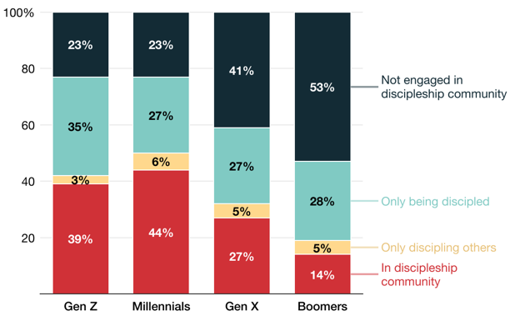
Talmidut
Discipleship
[11-26]
[27-42]
[43-58]
[59-77]
Notes:
Gen Z: Born 1997-2012 (11-26 years old)
Millennials Gen Y: Born 1981-1996 (27-42 years old)
Gen X: Born 1965-1980 (43-58 years old)
Baby Boomers: Born 1946-1964 (59-77 years old)
https://barna.gloo.us/videos/barna-minute-generational-discipleship?vgo_ee=FEA0cY1Lt3mDq6gB0n%2B9q1OEdxVkBBpmUG73NExu5LphLq9UHg%3D%3D%3AhwDuQThN0rEkDH%2Fqx%2F4oaiALev3dvdaR

Slide 92
^{Eph 3.16-19} From the treasures of his glory he will empower you with inner strength by his Spirit, so that the Messiah may live in your hearts through your trusting. Also I pray that you will be rooted and founded in love,

Slide 93
^{Eph 3.16-19} so that you, with all God’s people, will be given strength to grasp the breadth, length, height and depth of the Messiah’s love, yes, to know it, even though it is beyond all knowing, so that you will be filled with all the fullness of God.
Notes:
Beyond all knowing = a mystery, by revelation only

Slide 94
several doctrines of it are called the mysteries of the kingdom of heaven;
The transformation of lives
the uniplurality of persons in the Godhead,
the union of the two natures in Messiah,

Slide 95
his sonship and incarnation,
the kedoshim union and communion with him,
the work of the Spirit of God upon the soul,
the calling of the Gentiles,

Slide 96
the preservation and return of the Jews,
the resurrection of the dead,
and the change of living saints

Slide 97
Jonanthan Cahn books:
The Mystery of the Shemitah (2014)
The Book of Mysteries (2016)
The Oracle: Jubilean Mysteries (2019)

Slide 99
God’s Secret Plan
Why kept secret?
Meaning of secret wisdom…
What is the mystery, secret ?

Slide 100
Are you part of the mystery of “sins forgiven.”
Are you daily reading His word and HEARING from your beloved?
Are you doing what He instructs?
Are you asking someone else this?

