Slide 1
e-handout
To have these notes
without taking notes
Go to OrHaOlam.com
Click on Messages tab,
2024 Messages

Slide 2
How does Big Foot tell time?
Notes:
Luann Ridgeway March 2024

Slide 3
How does Big Foot tell time?
With his Sasquatch

Slide 4
Did you read the review about the restaurant on the moon?

Slide 5
Did you read the review about the restaurant on the moon?
Food was good but it had no atmosphere.
Notes:
Luann Ridgeway March 2024

Slide 6
I changed my i Pod name to Titanic.

Slide 7
I changed my i Pod name to Titanic. It's syncing now.

Slide 8
Progress
New Great House for the play-ground

Slide 9
Marcos was demolition project manager. Good lumber and hardware salvaged. Skilled labor by Jonathan Elizararas, Hedmon, German, Noah, John & Amy Stewart, Eric Poling, others. Wood rot discovered that vindicated the demolition & replacement decision. Stewarts hauled away lots of scrap.

Slide 10
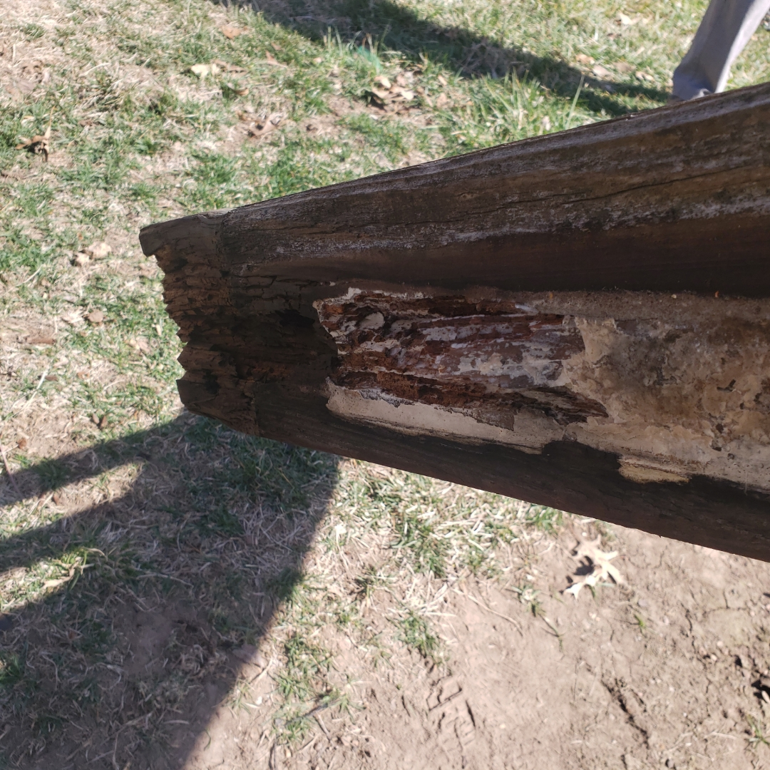

Slide 11
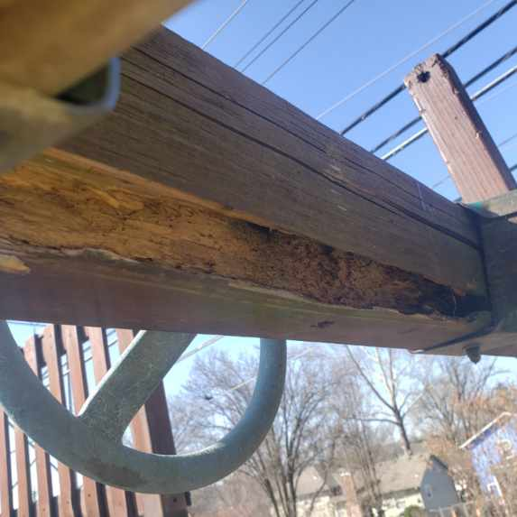

Slide 12
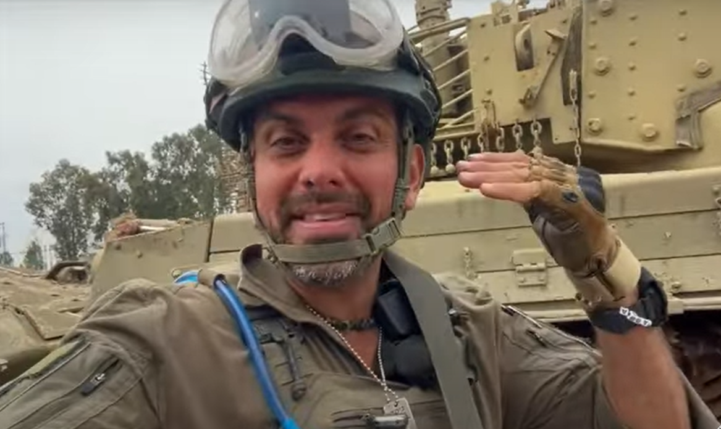
Sgt Major
Chaim
Malespin
Notes:
https://www.youtube.com/watch?v=Lv8GrDGi9vU

Slide 13
Since the war broke out, about 6500 new immigrants made Israel their new home. And there are many reports that there has been a surge of aliyah applications also since the Oct 7th. It may seem ironic, since Israel is in the middle of a war.
Notes:
Chaim Malespin https://youtu.be/Lv8GrDGi9vU

Slide 14
Why would anyone want to move to Israel in a time of insecurity? Well, one of the biggest surprises was the surge of anti-Semitism since the war broke out. And many Jewish families no longer feel as safe as before in Europe
Notes:
Chaim Malespin https://youtu.be/Lv8GrDGi9vU
Tevye, and my grandparents.

Slide 15
and in North America. So despite the situation, for some it is safer to live in Israel than in their communities abroad where they experience anti-Semitism.
Notes:
Chaim Malespin https://youtu.be/Lv8GrDGi9vU
Difference: in Israel they have the Army, the IDF, the Tsvah Haganah l’Yisrael! צבא הגנה לישראל
Jews don’t just die ~in the ghetto, they fight.

Slide 16
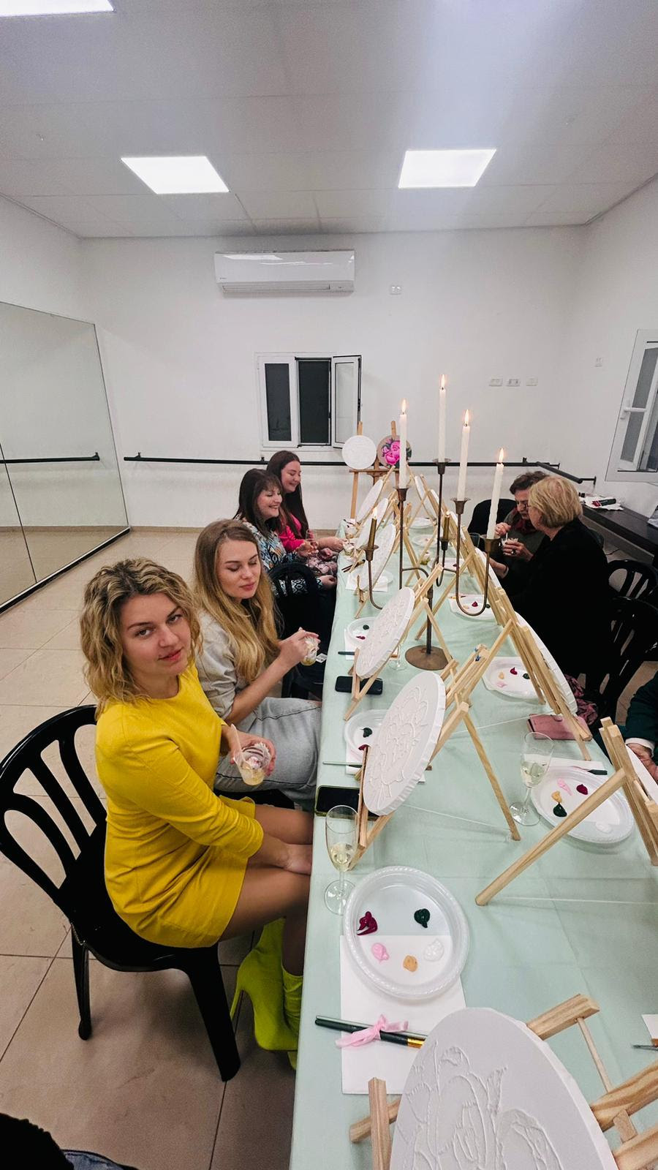
From Chaim Malespin, Aliyah Return Center in the Galil:
We sponsored an art therapy workshop for new immigrant women in Tiberias.

Slide 17
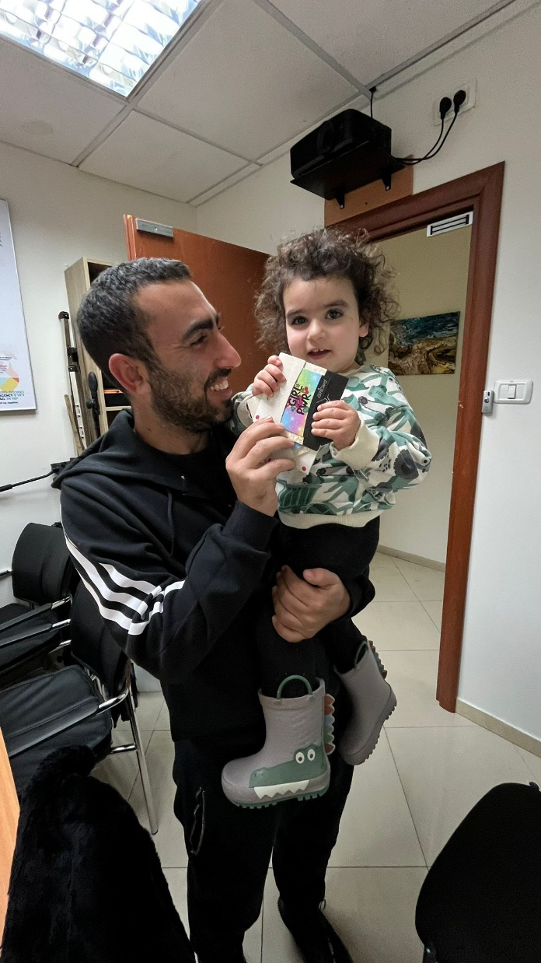
This week we handed out of vouchers for evacuee families. You can see the joy it brings to families!
Notes:
On Purim, we will receive and offering for suffering Israelis.

Slide 18
Notes:
Backtracking a bit to one verse in last week’s message.

Slide 19
^{Eph 4.2-6} Always be humble, gentle and patient, bearing with one another in love, and making every effort to preserve the unity the Spirit gives through the binding power of shalom. There is one body and one Spirit,

Slide 20
^{Eph 4.2-6} just as when you were called you were called to one hope. And there is one Lord, one trust, one immersion, and one God, the Father of all, who rules over all, works through all and is in all.

Slide 22
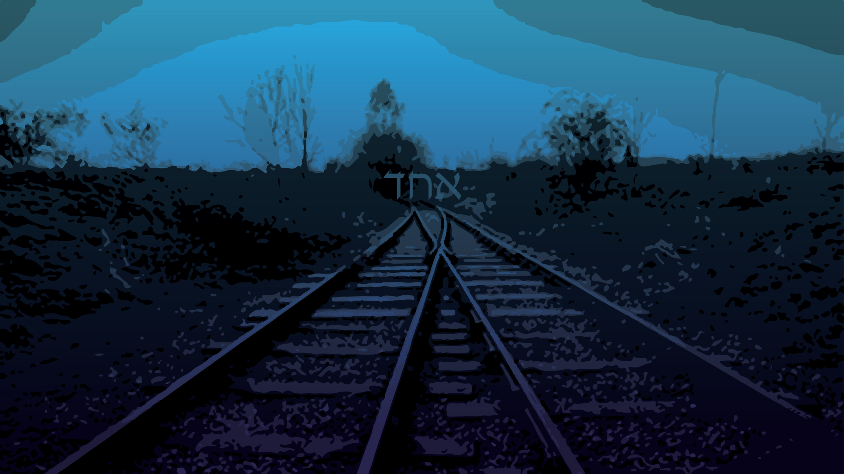
One
Run up to unity
Source of unity
Specifics of unity
Notes:
Backtracking a bit to one verse in last week’s message.

Slide 23
^{Eph 4.2} Always be humble, gentle and patient.
This was a quality scorned by Greco-Roman culture.
Notes:
This is really that heart of that message.

Slide 24
tapeinophrosune: humility
"the having a humble opinion of oneself; a deep sense of one's (moral) littleness; modesty, humility, lowliness of mind“.
Notes:
Thayer’s Greek lexicon
https://biblehub.com/greek/5012.htm
Not that hard to pronounce. Only 6 syllables. Wolkenfeld is 3 syllables.
Ta pei no phro su ne

Slide 25
tapeinophrosune:
derived from
tapeinós, "low, humble" and
phrḗn, "moderation as regulated by inner perspective")
Notes:
https://biblehub.com/greek/5012.htm

Slide 26
with all lowliness and meekness,
with complete lowliness of mind
with all humility and gentleness

Slide 27
tapeinophrosune:
– properly, low; humility, "lowliness" of human pride (self-government); that quality of mindset of "having a humble opinion of oneself, i.e. a deep sense of one's (moral) littleness – i.e. lowliness of mind" (J. Thayer).
Notes:
https://biblehub.com/greek/5012.htm

Slide 28
Benjamin Franklin’s 13 Virtues
Notes:
https://www.wisdominallthings.com/benjamin-franklins-13-virtues-humility/

Slide 29
“My list of virtues contained at first but twelve; but a Quaker friend having kindly informed me that I was generally thought proud, that my pride showed itself frequently in conversation, that I was not content with being in the right when discussing any point,
Notes:
https://www.wisdominallthings.com/benjamin-franklins-13-virtues-humility/

Slide 30
but was overbearing and rather insolent, of which he convinced me by mentioning several instances, I determined endeavoring to cure myself, if I could, of this vice or folly among the rest, and I added Humility to my list, giving an extensive meaning to the word.”
Notes:
https://www.wisdominallthings.com/benjamin-franklins-13-virtues-humility/

Slide 31
“In reality, there is, perhaps, no one of our natural passions so hard to subdue as pride. Disguise it, struggle with it, beat it down, stifle it, mortify it as much as one pleases, it is still alive, and will every now and then peep out and show itself;
Notes:
https://www.wisdominallthings.com/benjamin-franklins-13-virtues-humility/

Slide 32
you will see it, perhaps, often in this history; for, even if I could conceive that I had completely overcome it, I should probably be proud of my humility.”
Notes:
https://www.wisdominallthings.com/benjamin-franklins-13-virtues-humility/
Moshe described himself as the meekest of all men

Slide 33
^{Phil 3.5} Do nothing out of selfishness or conceit, but with humility consider others as more important than yourselves… Have this attitude in yourselves, which also was in Messiah Yeshua,

Slide 34
^{Phil 3.5} Who, though existing in the form of God, did not consider being equal to God a thing to be grasped. But He emptied Himself— taking on the form of a slave…he humbled himself still more by becoming obedient even to death — death on a stake as a criminal! Therefore God raised him to the highest place.

Slide 35
^{Mtt. 11.29} Take my yoke upon you and learn from me, because I am gentle and humble in heart, and you will find rest for your souls.

Slide 36
^{Eph 4.2-6} Always be humble, gentle and patient,

Slide 37
Patience is like good motor oil. It doesn’t remove all the irritants. It just puts them in suspension so they don’t get into your works and seize them up. Patient people have, so to speak, a large crankcase. They can put irritants into suspension.
Notes:
Cornelius Plantinga
Parallel in Colossians.

Slide 38
How can we honor each other?
Who can you honor?
Notes:
Pause to consider.

Slide 39
^{Eph 4.2-6} Always be humble, gentle and patient, bearing with one another in love,
This is the fuel of patience.
Notes:
Women are no longer willing to put up with the difficulties of pregnancy, and so as the sign says, “It’s the woman’s choice – abortion.” They don’t have to put up with pregnancy.
One of our lovely, musical ladies was about 9 months at Purim, about 20 years ago. She said, I’m dressed up as a bowling ball. But still the look of love.

Slide 40
Notes:
Backtracking a bit to one verse in last week’s message.

Slide 41
One
Run up to unity
Source of unity
Specifics of unity

Slide 42
^{Eph 4.3-6} Making every effort to preserve the₁unity the Spirit gives through the binding power of shalom. There is ₂one body and one Spirit, just as when you were called you were called to ₃one hope. And there is ₄one Lord, ₅one trust, ₆one immersion, and ₇one God, the Father of all, who rules over all, works through all and is in all.
Notes:
7 forms of unity

Slide 43
Seven forms of unity
Start with considering the last one, foundational to all.
Amy Jill Levine, Jewish Annotated New Testament, Oxford Press
“this text reframes Dt. 6.4.”

Slide 44
^{Eph 4.3-6} ₇one God, the Father of all, who rules over all, works through all and is in all.
Notes:
Vital, premier concept in a Jewish mindset of scripture

Slide 45
^{Mark 12.28-30} One of the Torah-teachers came up and heard them engaged in this discussion. Seeing that Yeshua answered them well, he asked him, “Which is the most important mitzvah of them all?” Yeshua answered, “The most important is

Slide 46
שְׁמַע יִשְׂרָאֵל
יְיָ אֱלהֵינוּ יְיָ אֶחָד
Sh’ma Yees-ra-ayl
Ah-do-ni E-lo-hay-nu
Ah-do-ni eh-khad
בָּרוּךְ שֵׁם כְּבוֹד מַלְכוּתוֹ לְעוֹלָם וָעֶד
Ba-rukh shaym k’vod Mal-khu-to l’o-lam va-ed

Slide 47
^{Mark 12.28-30} [Hear, O Isra’el, the Lord our God, the Lord is one], and you are to love Adoni your God with all your heart, with all your soul, with all your understanding and with all your strength.’ The second is this: ‘You are to love your neighbor as yourself.’ There is no other mitzvah greater than these.”

Slide 48
One G-d, so we are all created.

Slide 49
One G-d, so we are all created.
One G-d, so are all servants.

Slide 50
One G-d, so we are all created.
One G-d, so are all servants.
One G-d, so we are all equal.

Slide 51
One G-d, so we are all created.
One G-d, so are all servants.
One G-d, so we are all equal.
One G-d, so we will all render account.

Slide 52
One G-d, so we are all created.
One G-d, so are all servants.
One G-d, so we are all equal.
One G-d, so we will all render account.
One G-d, so we will all be judged.

Slide 53
Observant Jews consider the Shema to be the most important part of the prayer service in Judaism, and its twice-daily recitation as a mitzvah (religious commandment). Also, it is traditional for Jews to say the Shema as their last words, and for parents to teach their children to say it before they go to sleep at night
Notes:
https://en.wikipedia.org/wiki/Shema

Slide 54
Literally, reciting the shema was stated as "receiving the kingdom of heaven.
Notes:
https://en.wikipedia.org/wiki/Shema

Slide 55
According to the Talmud, Rabbi Akiva patiently endured while his flesh was being torn with iron combs, and died reciting the Shema. He pronounced the last word of the sentence, Ekhad ("one") with his last breath.
Notes:
https://en.wikipedia.org/wiki/Shema

Slide 56
Since then, it has been traditional for Jews to say the Shema as their last words. In 2006 Roi Klein, a major in the Israel Defense Forces, said the Shema before jumping on a live grenade and dying to save his fellow soldiers.
Notes:
https://en.wikipedia.org/wiki/Shema

Slide 57
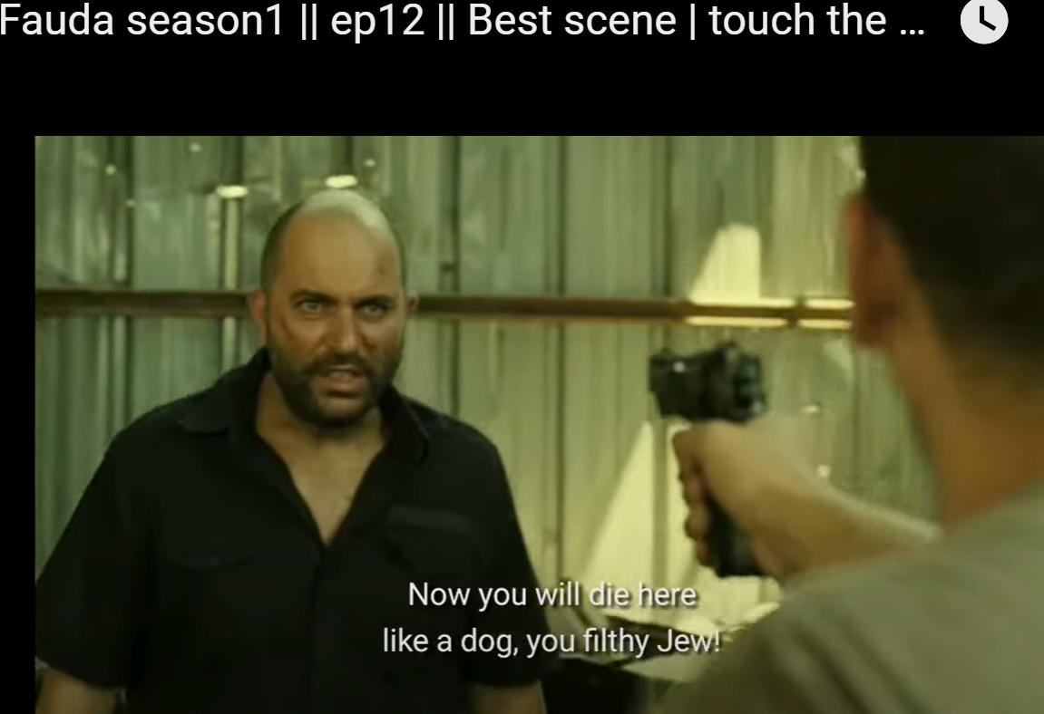
Notes:
https://www.youtube.com/watch?v=Zy6GTQedb9w
Note: the YouTube has more content than I recorded and showed in the synagogue. Violence and taking G-d’s Name in vain. I only showed .03 to .41
It tells the story of Doron, a commander in the Mista'arvim מסתערבים assimilate among the Arabs, in the first season, they pursue a Hamas arch-terrorist known as "The Panther". Doron thought the Panther was eliminated, but found out not. Doron was captured in the undercover operation…

Slide 59
Before going to sleep, the first paragraph of the Shema is recited. This is not only a commandment directly given in the Bible (in Deuteronomy 6:6–7), but is also alluded to from verses such as "Commune with your own heart upon your bed" (Psalms 4:4).
Notes:
https://en.wikipedia.org/wiki/Shema

Slide 60
All flows from the assertion of the oneness of God's kingship. Thus, in the first portion, there is a command to love God with all one's heart, soul, and might, and to remember and teach these very important words to the children throughout the day.
Notes:
https://en.wikipedia.org/wiki/Shema

Slide 61
^{D’varim/Dt 6.4-9} “Sh’ma, Yisra’el! Adoni Eloheinu, Adoni ekhad [Hear, Isra’el! Adoni our God, Adoni is one]; and you are to love Adoni your God with all your heart, all your being and all your resources. These words, which I am ordering you today, are to be on your heart; and you are to teach them carefully to your children.
Notes:
I say this every most night when going to sleep, and most every morning when rising.
I attended a lecture at Kehilath Israel Synagogue about 10 years ago. I think by Rabbi Michael Skobac – one of the world’s foremost authorities on Missionaries and Cults – is the Director of Education and Counselling of Jews for Judaism (Canada) https://www.jewsforjudaism.org/staff/rabbi-michael-skobac/
He was saying how these Messianic Jews twist scripture, and they even find the three fold nature of G-d in the Shema. He quoted “Adoni Eloheinu, Adoni is one Ekhad”

Slide 62
^{D’varim/Dt 6.4-9} You are to talk about them when you sit at home, when you are traveling on the road, when you lie down and when you get up. Tie them on your hand as a sign, put them at the front of a headband around your forehead, and write them on the door-frames of your house and on your gates.
Notes:
I say this every night when going to sleep, and every morning when rising.

Slide 63
בָּרוּךְ שֵׁם כְּבוֹד מַלְכוּתוֹ לְעוֹלָם וָעֶד
Bārūḵh šhēm kəvōd malḵhūtō ləʿōlām vāʾed
"Blessed be the name of His glorious kingdom for ever and ever
Notes:
https://en.wikipedia.org/wiki/Shema

Slide 64
The second line is a rabbinic addition and [in Orthodox liturgy] is recited silently during congregational worship (except on Yom Kippur, when it is recited aloud). In Reform and Conservative Judaism, it is recited aloud, but in a quieter voice than the rest of the prayer
Notes:
https://en.wikipedia.org/wiki/Shema

Slide 65
It was originally a liturgical response in use in the Temple when the name of God was pronounced and took the form of Barukh shem k’vod l’olam, "Blessed be his glorious name forever" (Psalm 72:19).
Notes:
https://en.wikipedia.org/wiki/Shema

Slide 66
However, in time the words malchuto ("His kingdom") and va’ed ("for ever and ever") were added. Malchuto was introduced by the rabbis during Roman rule as a counter to the claim of divine honors by Roman emperors.
Notes:
https://en.wikipedia.org/wiki/Shema

Slide 67
Evidence of the Jewishness of the Jews of India, uncertain origin, maybe Roman expulsion.

Slide 68
שְׁמַע יִשְׂרָאֵל
יְיָ אֱלהֵינוּ יְיָ אֶחָד
Sh’ma Yees-ra-ayl
Ah-do-ni E-lo-hay-nu
Ah-do-ni eh-khad
בָּרוּךְ שֵׁם כְּבוֹד מַלְכוּתוֹ לְעוֹלָם וָעֶד
Ba-rukh shaym k’vod Mal-khu-to l’o-lam va-ed

Slide 69
Notes:
Backtracking a bit to one verse in last week’s message.

Slide 70
One
Run up to unity
Source of unity
Specifics of unity

Slide 71
^{Eph 4.3-6} Making every effort to preserve the₁unity the Spirit gives through the binding power of shalom. There is ₂one body and one Spirit, just as when you were called you were called to ₃one hope. And there is ₄one Lord, ₅one trust, ₆one immersion, and ₇one God, the Father of all, who rules over all, works through all and is in all.
Notes:
7 forms of unity
Preserve implies that it already exists. Doesn’t have to be built.
^{Ro 14.19} So then let us pursue what makes for shalom and for the building up of one another.

Slide 72
^{Eph 4.3-6} Making every effort to preserve the₁unity the Spirit gives through the binding power of shalom.
^{1 Cor 12.12-13} For just as the body is one and has many parts, and all the parts of the body—though many—are one body, so also is Messiah.
Notes:
7 forms of unity

Slide 73
^{1 Cor 12.12-13} For in one Ruakh we were all immersed into one body—whether Jewish or Greek, slave or free—and all were made to drink of one Ruach.
Notes:
To keep this unity we must work to sustain it.
UMJC and MJAA split in about 1977. Infant movement but split. Reconciled about 1997.
“binding power of shalom.” I heard them say, the leaders, “We couldn’t figure out every detail from 20 years ago, but the power of Shalom in the death of Messiah, we surrendered to Him.”

Slide 74
One G-d, so we are all created.
One G-d, so are all servants.
One G-d, so we are all equal.
One G-d, so we will all render account.
One G-d, so we will all be judged.

Slide 75
^{Eph 4.3-6} There is ₂one body and one Spirit, just as when you were called
^{Ro 12.4-5} For just as we have many parts in one body—and all the parts do not have the same function— so we, who are many, are one body in Messiah and everyone parts of one another.
Notes:
Jews and Gentiles, called to bless one another.

Slide 76
G-d blesses Israel
Israel gives blessing
Nations receive
Nations bless Israel
Notes:
Calling to affiliate with Israel, blessings and sufferings. Glory and trauma.

Slide 77
We are trying something new for the Kiddush blessing at the close of the service that may bring more shalom and harmony and order to the dismissal.
1 The crowd will NOT be dismissed from the sanctuary at the close of the message.
2. During the closing invitation song I will get out the Hallah and wine.

Slide 78
3. When there is an appropriate time in the closing song, in addition to the usual invitation and exhortation, we will say the hallah and wine blessings, and give oneg instructions. Part of the instructions is that those who are in the Children's Ed class during oneg are to go to the head of the line.
4. After the blessings, the music can pick up and continue.

Slide 79
^{Eph 4.3-6} you were called to ₃one hope.
We all hope to arrive at the same place in eternity.

Slide 80
And there is ₄one Lord,
Some say therefore to use the original Name.
This is not real unity. Ten reasons NOT to pronounce what we think is the sacred Name.

Slide 81
1 Yeshua never used the Name nor any writer of the whole Mes Scrip/New Testament. If anyone had authority to do so, you would think He would, but He didn't. When He quoted scripture with the Name, He used circumloction, as it's called, substituting attributes.

Slide 82
^{Mattityahu 26.64} Yeshua said to him, "The words are your own. But I tell you that one day you will see the Son of Man sitting at the right hand of HaG'vurah [Heb. for The Powerful One] and coming on the clouds of heaven.“

Slide 83
Yeshua is quoting the concept in T'hillim/Ps 110 of "right hand of ADONI/YHVH," but He doesn't say the Sacred Name. He uses the rabbinic device of circumlocution, says an attribute in place of the Name.
This is the definitive paradigm in this discussion. He didn't use the Name. So, we don't.

Slide 84
2. The scriptures talk about "glorifying the Name of G-d." That doesn't mean by a certain pronunciation. The Hebraic understanding of Name = character, person. So behaving in ways that bring honor to Him.

Slide 85
3. No one knows the right pronunciation of the YHVH, Hebrew yud-heh-vav-heh. Some think Jehovah. Some Yahveh. Some Huway. Or some such. Yeshua certainly knew the correct way, but chose never to say it.

Slide 86
4. There's also an outreach dimension. Unsaved Jewish people if they are used to synagogue prayer, would think we are totally out of touch. Not feel at home.

Slide 87
5. ^{Rev 19:12} His eyes were like a fiery flame, and on his head were many royal crowns. And he had a name written which no one knew but himself.
He is the bearer of the Name in Isaiah 6 according to Yn

Slide 88
6. In the Dead Sea Scrolls, where the Name appears, they resort to the Phoenician script, instead of the Babylonian Hebrew characters that we are used to. This implies something...likely that the name was not to be accessible to the readers, but a bit mysterious, and NOT pronounced.

Slide 89
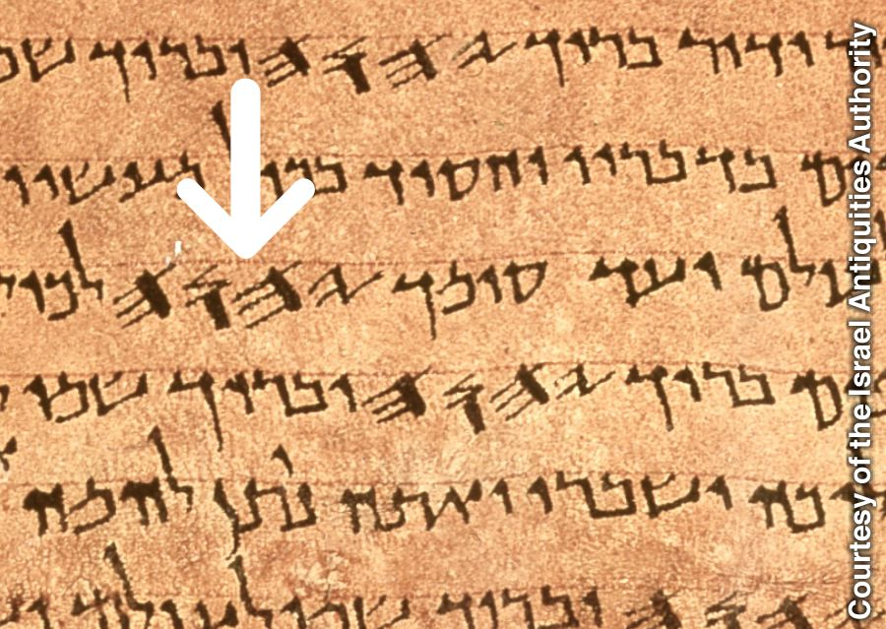
Notes:
https://wol.jw.org/en/wol/mp/r1/lp-e/wp19/2019/19

Slide 90
7. In the prototype prayer in Mt 6, Yeshua explains the meaning of "May your Name be kept holy." He uses the common Hebrew poetic device of parallelism, and says the same thing in different words.

Slide 91
7 "May your Kingdom come, your will be done on earth as in heaven." That, sanctifying the Name has nothing to do with pronunciation, but rather He wants us to pray for transformation of people or of life circumstances.

Slide 92
8. The B'sorah [Gospel] of Matityahu, Matthew uses the phrase "Kingdom of Heaven" as opposed to "Kingdom of G-d.“ Yeshua was following the common practice of reverence for the Name. Particularly in Matityahu/Matthew’s account, many scholars feel was written for Jewish readers, who had the practice of NOT saying the name, but using circumlocutions.

Slide 93
9. When addressing our earthly fathers, we would never call them by their name if we are being respectful. Rather the title "Dad," "Papa", "Father", etc. would be appropriate. Similarly with G-d the Father.

Slide 94
10. from Rabbi Joe Bell:
a. The Tetragrameton is not used in any of the over 500 Greek manuscripts of the N. T. I checked this out with two Professors specializing in N.T. Greek at two Cristian colleges. The words used for YHVH are Abba, Pater and Kurios as in our Adonai ( meaning Lord.

Slide 95
10. Surely God could have inspired those Greek N.T. writers to attempt A Greek form of YHVH. It isn't there.

Slide 96
10b. Nowhere in Jewish writings over 5000 years are we instructed to pronounce the name; not even once!

Slide 97
^{Eph 4.3-6} ₅one trust,
^{Ro 8.14-16} All who are led by God’s Spirit are God’s sons. For you did not receive a spirit of slavery to bring you back again into fear; on the contrary, you received the Spirit,

Slide 98
^{Eph 4.3-6} ₅one trust,
^{Ro 8.14-16} who makes us sons and by whose power we cry out, “Abba!” (that is, “Dear Father!”). The Spirit himself bears witness with our own spirits that we are children of God.
Notes:
Dawn and I visiting Thursday night with a Japanese, Egyptian, Korean believer. Same experience of faith. Amazing and beautiful that the Japanese and the Korean were deeply together.

Slide 99
^{Eph 4.3-6} ₆one immersion, from the Didache
And concerning baptism, baptize this way: Having first said all these things, baptize into the name of the Father, and of the Son, and of the Holy Spirit, in living water. But if you have not living water, baptize into other water;.

Slide 100
^{Eph 4.3-6} ₆one immersion,
and if you can not in cold, in warm. But if you have not either, pour out water thrice upon the head into the name of Father and Son and Holy Spirit. But before the baptism let the baptizer fast, and the baptized, and whatever others can; but you shall order the baptized to fast one or two days before.

Slide 101
Notes:
Backtracking a bit to one verse in last week’s message.

Slide 102
One
Run up to unity
Source of unity
Specifics of unity

Slide 103
^{Eph 4.3-6} Making every effort to preserve the₁unity the Spirit gives through the binding power of shalom. There is ₂one body and one Spirit, just as when you were called you were called to ₃one hope. And there is ₄one Lord, ₅one trust, ₆one immersion, and ₇one God, the Father of all, who rules over all, works through all and is in all.
Notes:
Who can we be more in unity with?

Slide 104
Do you KNOW Yeshua and drinking the water of LIFE?
Are you hearing daily from His Word?
How are you applying what you heard?
Are you offering that water of life to anyone?

Slide 105
1 The crowd will NOT be dismissed from the sanctuary at the close of the message.
2. During the closing invitation song I will get out the Hallah and wine.

Slide 106
3. When there is an appropriate time in the closing song, in addition to the usual invitation and exhortation, we will say the hallah and wine blessings, and give oneg instructions. Part of the instructions is that those who are in the Children's Ed class and choir leader during oneg are to go to the head of the line.
4. After the blessings, the music can pick up and continue.

